Slide 1
Monte-Carlo studies for the ep-elastic scattering
Aleksei Dziuba \ NRC “Kurchatov institute” - PNPI
31st of March 2021

Slide 2
Outline
Simulation software strategy
Goal \ Simulation chain \ Manpower
Current status
What’s new?
ESEPP generator config https://github.com/nuramatov/esepp/
Beam smearing at the exit window (already mentioned by Peter Kravtsov)
Electronic signal https://github.com/aleksha/electronic-signal
Electronic noise https://github.com/aleksha/electronic-noise
Drift velocity experiment
Drift in electric field https://github.com/aleksha/pres-electric-field
Z-position measurement (angular dependence, power of MVA methods)
Recoil ranges for calibration

Slide 3
Run / detector conditions for MC
Beam model
Time distribution for incoming electrons; mean beam frequency – f_{b};
2D beam spatial distribution – Gaus_{x}(μ_{bx},σ_{bx})×Gaus_{x}(μ_{by},σ_{by}) ? Any beam halo?
Beam direction distribution – Gaus_{p}(μ_{pθ},σ_{pθ})×Uniform _{pφ}(-π,π) ?
Geant-4 (detector model) provides ionization
TPC time resolution model
Drift velocities – W_{d1}, W_{d2}; Recombination(r_{hit}, f_{b}); (x,y)-smearing(r_{hit}, f_{b})
Accepting due to not clean gas.
Signal formation (during grid-anode drift)
TDC parameters:
N_{ch}, Δt_{ch}; → t_{i} – TDC channel
Energy to TDC response – C_{TDC};
Noise spectrum
Time-pulse function – δ_{Dirac}(t_{i}) → Some distribution(t,t_{i},T_{j})
These conditions must be included into Monte-Carlo to have is as closer to the data as possible to mimic operation conditions as a function of (beam)time
Goal: MC can be analyzed as DATA

Slide 4
Software status
All important parts were investigated
New studies (done in 2020-03 – 2021-03) will be presented in the main part of the talk
Software chain of isolated tools, but not a one program ☹
Manpower:
Prof. Vorobyev (ideas, coordination, review)
Aleksei Dziuba (with a large input of ideas and settings from PNPI teams)
Arsen Nuramatov (bachelor-year student of SPbSU)

Slide 5
Generators

Slide 6
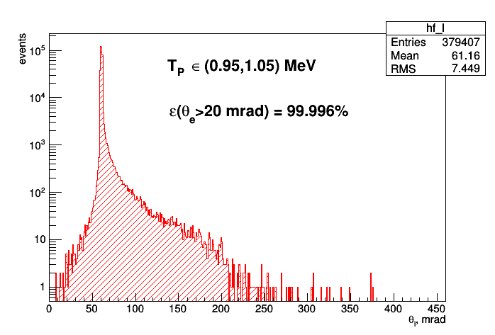
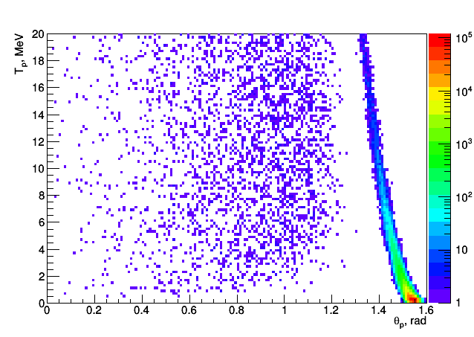
Event generators
There will be no loss in central (not sensitive) part of CSC
ESEPP https://github.com/gramolin/esepp to account radiative corrections
We updated a software stack (conda) and now there is a way not to build it with a dependencies-hell (use pres-mc)
A nice config-file (not interactive)
https://github.com/nuramatov/esepp/
“Handmade” Δ production generation for inelastic (there are more realistic approximation in PRad paper)
NEW
Correlation between T_{p} and electron and proton angle is powerful tool to reject inelastic background

Slide 7
Beam smearing

Slide 8
Beam smearing by main detector
Y
CSC = Cathode Strip Chamber
For scattered electrons
H₂, 20 atm
Ar + CH₄ 20 atm
Mylar, 20 μm
TPC volume
Sci, 10 mm
Count electrons
Anode
Be window
Cathode
Ti
Z
720 MeV electron beam
Grid
CSC
Ionization chamber (for total beam current control)
Sci + W wire?
400 mm
Mylar, 50 μm
Beam position chambers (for feedback to MAMI)
Be (?) windows
720 MeV electron beam
Calibration purposes

Slide 9
Beam smearing at the exit window
5 bars
20 bars

Slide 10
Induced current (during grid-anode drift)

Slide 11
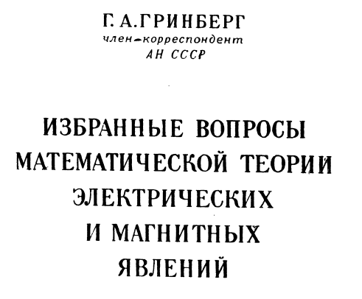
Anode current calculation
Problem: signal is created during grid-anode drift. Additional smearing to a signal shaping
This method is suggested by Alexander Dobrovolsky (PNPI)
Добровольский Александр Владимирович
dobrovolsky_av@pnpi.nrcki.ru
Based on Grinberg’s textbook
Simulation tool uses CERN.ROOT framework
https://root.cern.ch/
Electronic signal tool: https://github.com/aleksha/electronic-signal

Slide 12
Charge between two infinite planes
From potential one can go to the induced charge using Gauss theorem
L – distance between planes
r – radial distance from a charge
h – distance between plane and charge
q – electron charge (q=-1)
pp.113

Slide 13
The method in a nutshell
Create a map of induced charge on rings with fixed width for an electron which is moving perpendicular to anode at r=0.
Calculate induced charge and induced current (as a derivative of the induced charge) with defined anode structure for an electron in point (x,y) using an overlap of the map and anodes.
Find which of anode is fired, using the largest integral of current.
Rescale currents for each of anodes with a common factor, which is evaluated to set the current integral for the fired anode to unity.

Slide 14
Induced charge and current for x=12mm, y=18mm
Electronic signal tool: https://github.com/aleksha/electronic-signal
Central pad (r=10 mm)
1st ring (width 40 mm)
2nd ring (width 40 mm)
Example of a tool result
Agreement with the expected behavior
Need to speed it up
As well as integration into a software chain
Numerical errors (too close r order of h)
Note that it isn’t zero!

Slide 15
Modification of the response functions
Many thanks to Alexander Dobrovolsky, who pointed me on the problem!
Signal appears when electron reach anode
Current is assumed to be constant, while electron drifting between Grid and Anode
Zero time – time, when electron is on the grid
L _{GridAnode} = 10 mm; W₂ = 7,5 mm/μs
Current during Grid-Anode drift

Slide 16
Drift velocity measurements

Slide 17
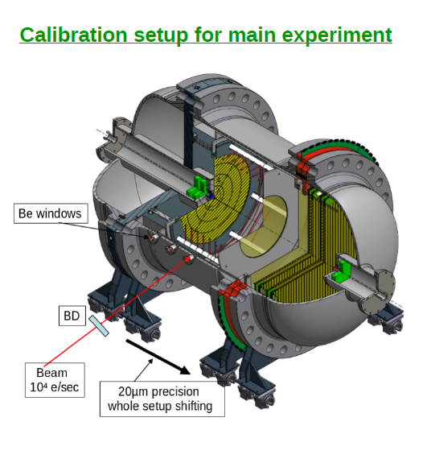
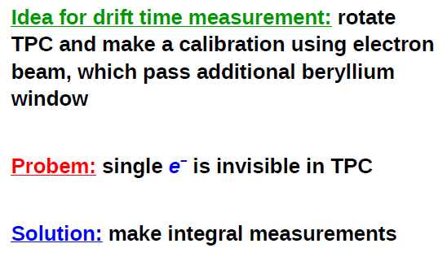
Calibration of drift velocities
titanium
Triggering from incoming beam electron. Time between beam and TPC response is known (with a precision discussed today).
MAMI has excellent beam. The ionization-anode distance is known with 0,1 mm precision.

Slide 18
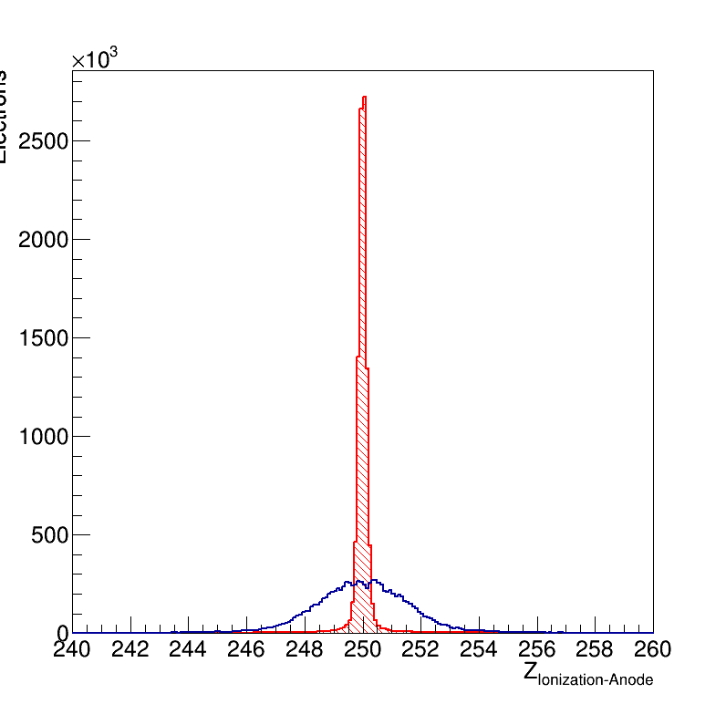
All pads
Central pad is a circle with 1 cm radius
Others are half-rings with 4 cm width
Numbering as on sketch
Beam
14
1
3
5
7
0
16
X
2
4
8
13
9
15
6
10
12
1st anode
11
16th anode

Slide 19
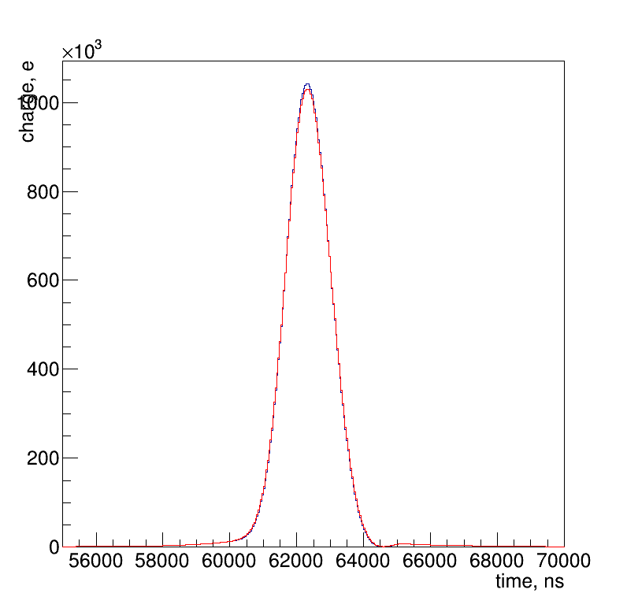
Longitudinal diffusion of electrons
σ_{Z} = 0,008 × √L_{TrackGrid}
[σ_{Z}] = [L_{TrackGrid}] = cm
Parametrization by German Korolev (private communication via Alexey Vorobyev)
Smear Z-position for each ionization electron by a Gaussian function with σ_{Z}.
L_{TrackGrid} = 25 cm
10000 of beam electrons (a part of spectrum around the peak is presented)
Peak maximum as a time-point estimator
Noise OFF
No diffusion
With longitudinal diffusion

Slide 20
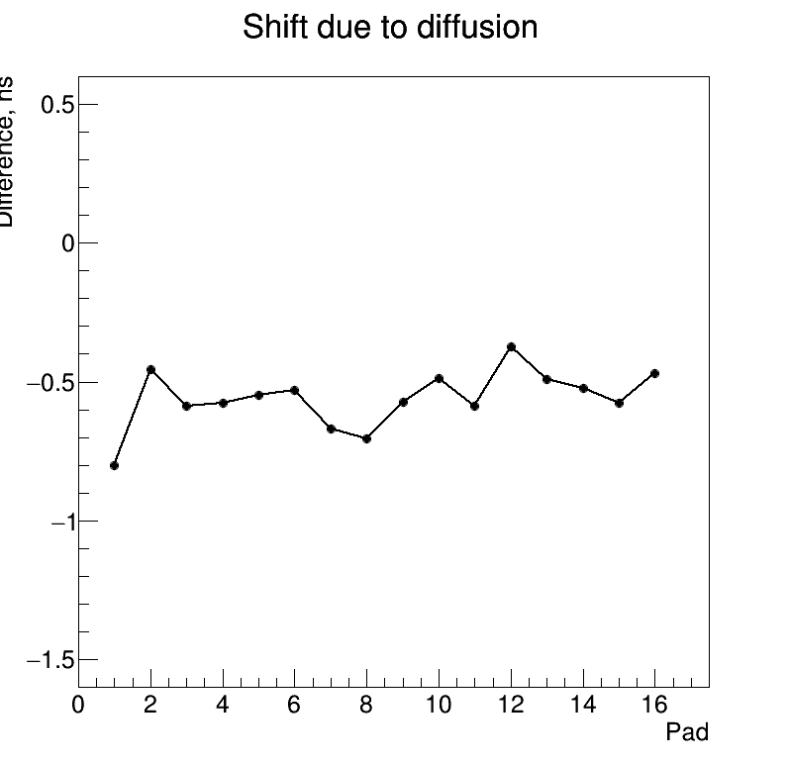
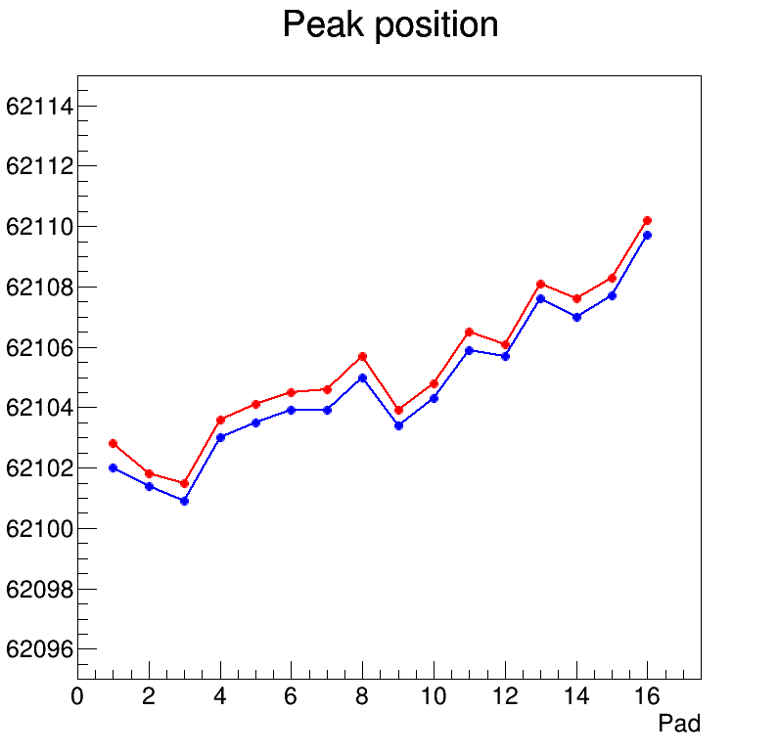
With diffusion
Without diffusion
A scatter around a smooth curve indicates the accuracy of the estimate!
A bias for the maximum position estimator is on nanosecond-scale. Good enough!

Slide 21
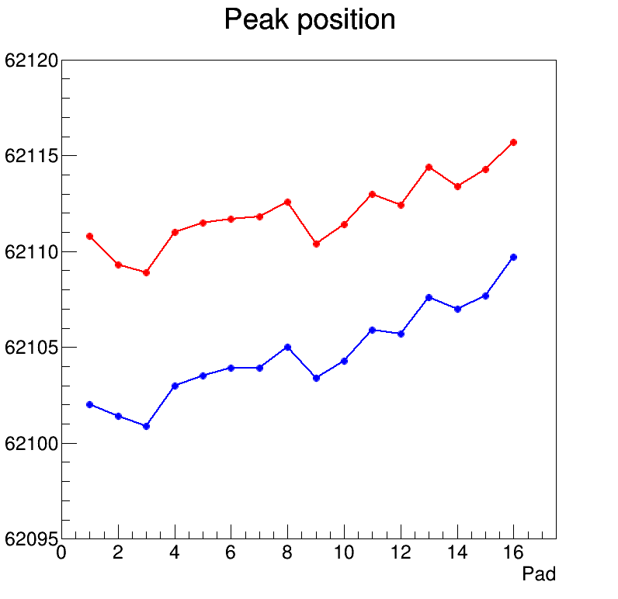
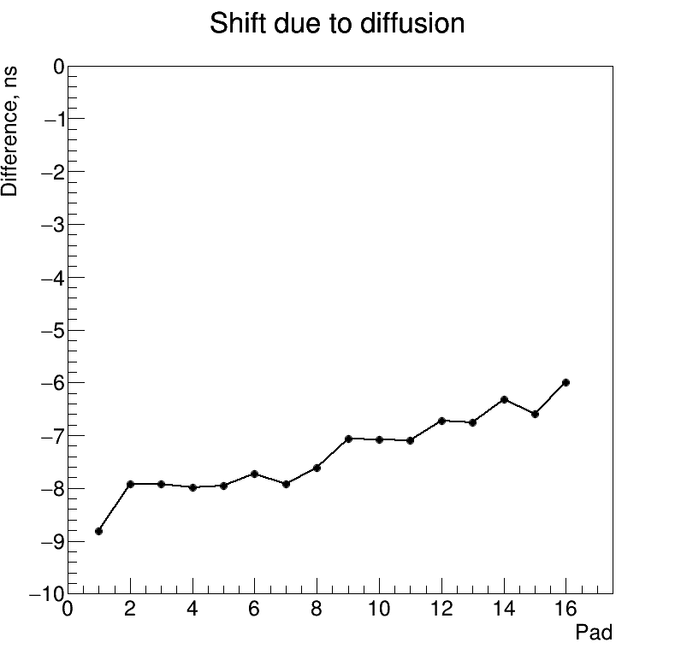
Increase diffusion parameter by factor 4
8-9 ns shift at 250 mm

Slide 22
Electronic noise simulation + influence on a drift velocity measurement

Slide 23
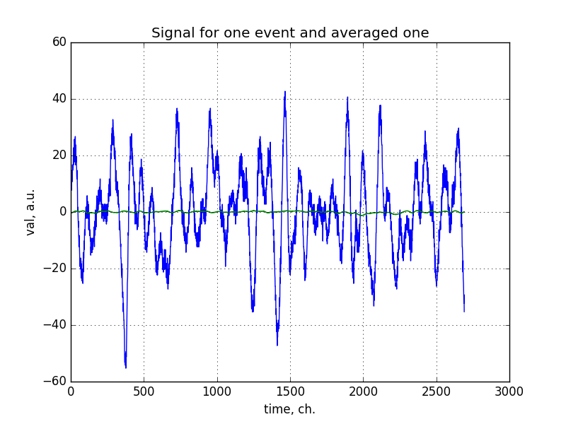
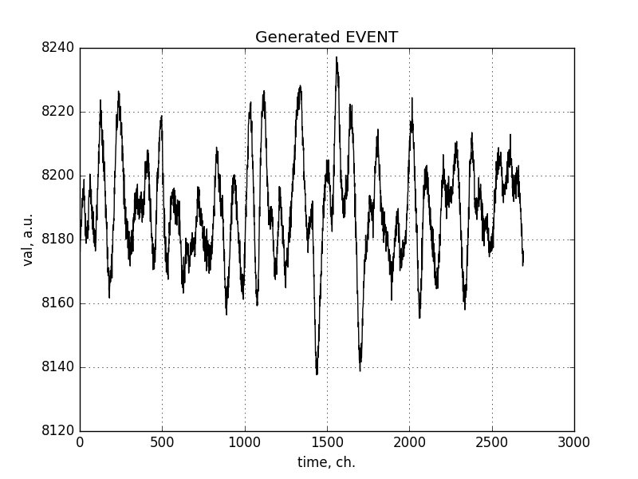
Further studies of noise + simulation
See more details https://github.com/aleksha/G4-Models/tree/master/Data/Noise
Noise in data (baseline corrected)
Now it’s fast! (factor 1000 wrt 1st version)
Thanks to Arsen Nuramatov
Generated noise
Obtain distribution for real and imaginary part of frequency spectra using Fourier transformation;
Fit these distributions using two gaussian hypotheses;
Generate random spectrum out of these distributions;
Use inverse Fourier transformation to obtain spectrum of generated events.

Slide 24
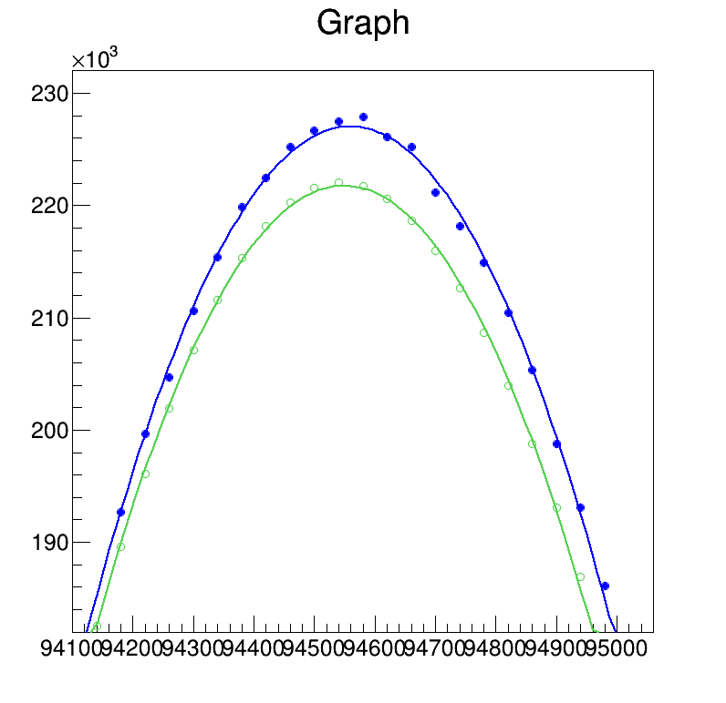
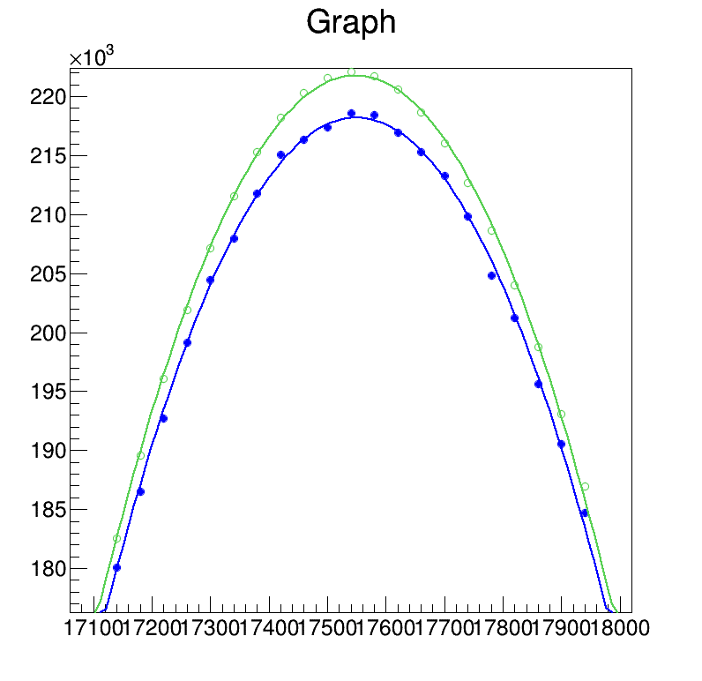
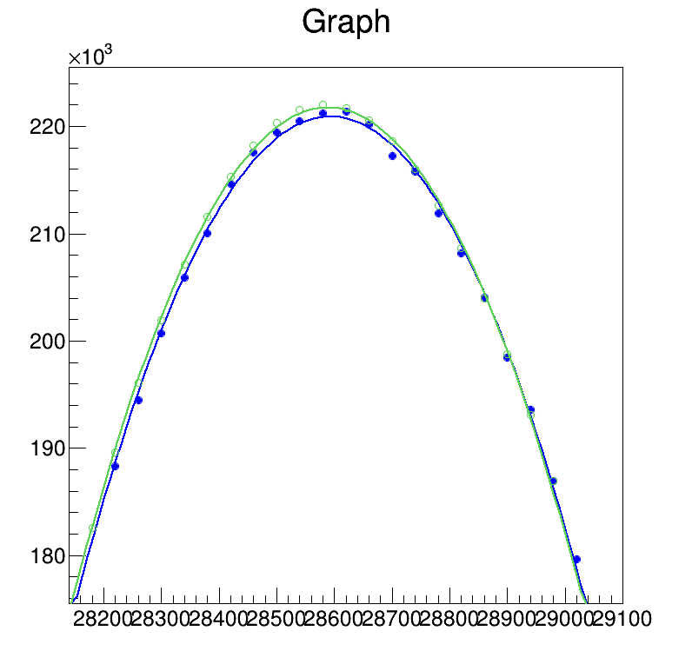
Maximum (peak position) shift due to noise
Peak is placed to the random location of cumulative noise spectrum
Shift of maximum for signal + noise (blue) wrt. pure signal (green)
Some fit examples
Noise ON

Slide 25
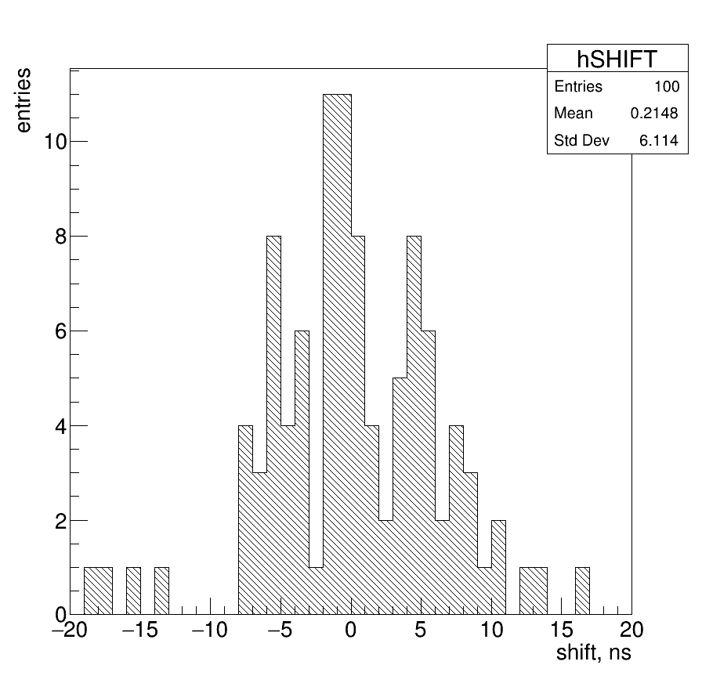
Distribution for shifts for 100k events
100 random places for signal peak at the noise spectrum. Signal shape at the peak region and cumulative noise spectra are same, but position is different!
RMS for maximum with peak position fitting procedure 6,1 ns

Slide 26
Electric field uniformity

Slide 27
Electric field uniformity + drift of electrons
Electric field calculations are done by Kuzma Ivshin using COMSOL package.
Electron is drifted in the electric field. Its track is a series of the steps, defined by a step parameter. A typical step size (of 0.1 mm) is order of magnitude less than a spatial grid size for the electric field (5 mm).
A direction for the step is chosen according to a unit vector parallel to an electric field direction.
Electric field components in a beginning of a step are inferred by an interpolation procedure (tri-linear interpolation).
Tool to calculate shifts https://github.com/aleksha/pres-electric-field

Slide 28
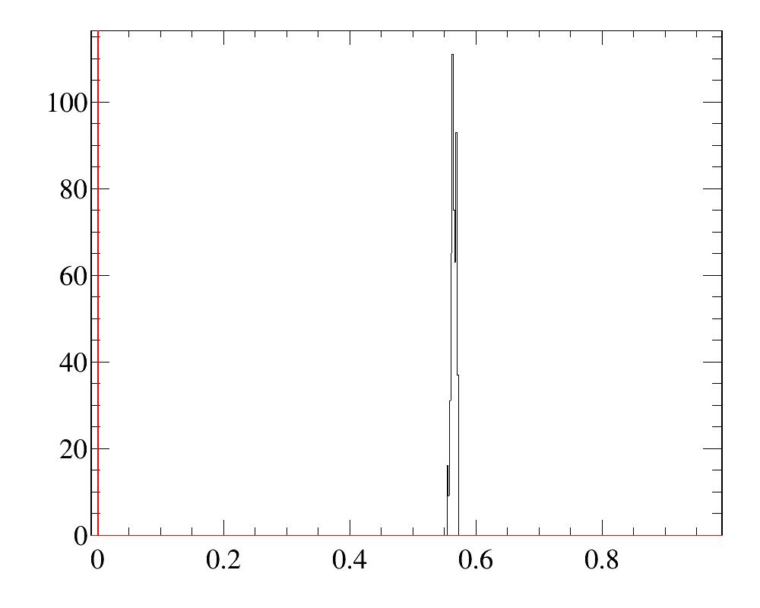
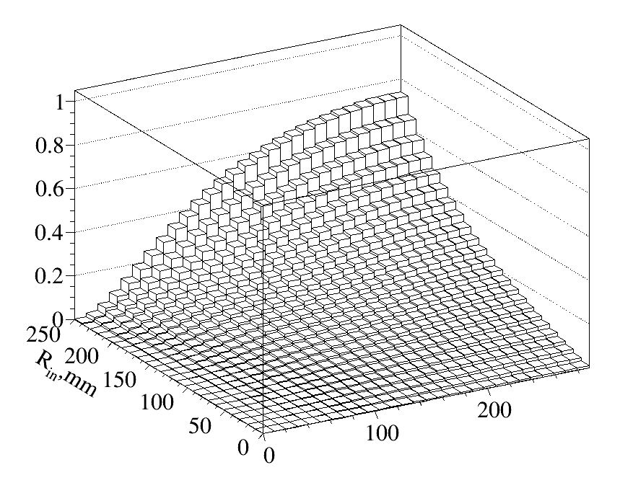
Electric field uniformity + drift of electrons
No radial shift if E_{x} and E_{y} are set to zero
Some radial shift for the full field map
The direction of this is to the center of TPC!
There is strong R_{in} and Z_{in} dependence
Tool https://github.com/aleksha/pres-electric-field
Further development is needed (interpolation-based shift procedure)

Slide 29
Issue with a Z-positioning

Slide 30
A problem of Z-positioning
PRES experiment requires a Q² scale calibration, which will be done using a measurement of an angle of the scattered electron.
Measurement will be done with a first layer of multiwire and Z coordinate of a scattering point measured by a TPC (X and Y assumed to be zero due to the perfect MAMI beam).
Z is measured on the 1st anode ring by finding of a stable timestamp point from the FADC signal. Central pad has twice worser resolution due it’s small size (relatively higher electronic noise) and due to the beam noise.
Signal shapes depends on a scattering angle of the proton (T fixed)

Slide 31
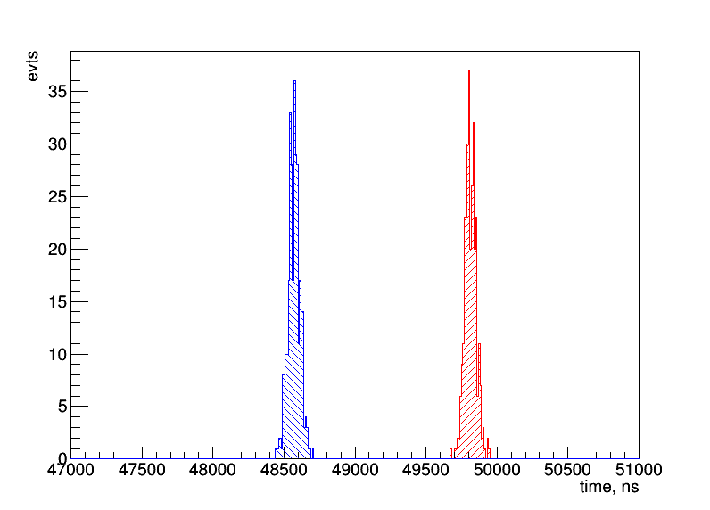
Time point measurement (~40 ns resolution)
T = 5 MeV
Noise ON
1st ring
Start point, measured using front intersection with a baseline
Maximum distribution (pol2-fit)
Time e⁻ reach anode
Time when e⁻ reach grid
1333 ns

Slide 32
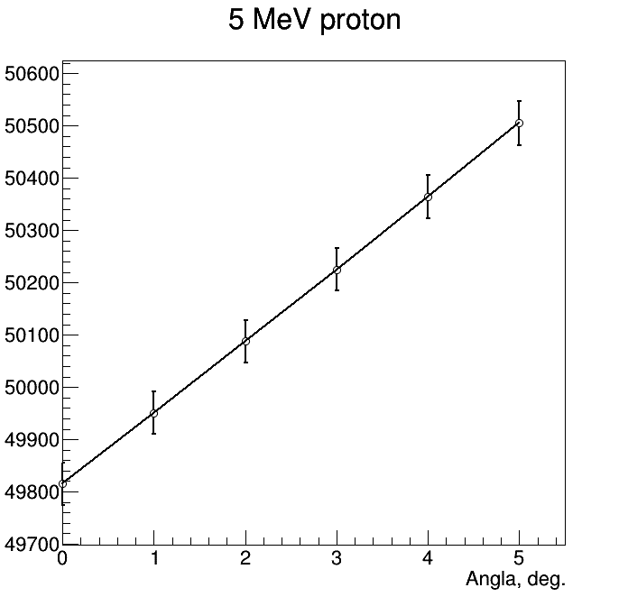
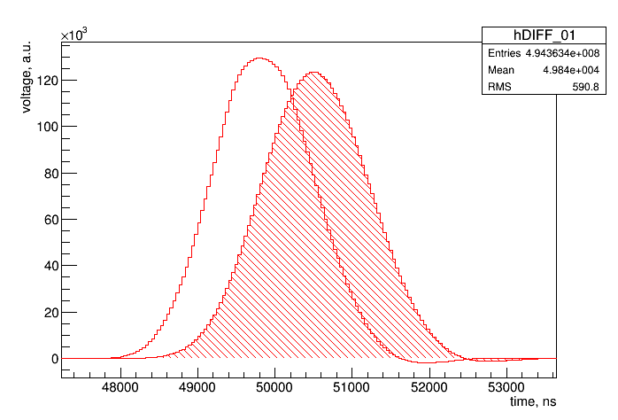
The problem
T = 5 MeV
Angle wrt. Y-axis
Noise OFF
1st ring
Cumulative spectra
RMS = 40 ns
Peak position
Uncertainty for a single event
1st ring
0 deg
wrt. Y
5 deg
600 ns
Strong dependence

Slide 33
Pure electron signal (a cross check)
Idea by Alexander Inglessi
Electrons arrive at grid
Induced current
0 deg.
0 deg.
w/o diffusion
with diffusion
Note, that y-scale are different, but integrals are the same!
2,5 deg.
2,5 deg.
5 deg.
5 deg.
5 deg → Signal projection 0,087*40mm = 3,48 mm → Signal length 870 ns

Slide 34
Pure electron signal (a cross check)
Idea by Alexander Inglessi
Electrons arrive at grid
Drift + Electronic response function
0 deg.
0 deg.
2,5 deg.
2,5 deg.
5 deg.
5 deg.
5 deg → Signal projection 0,087*40mm = 3,48 mm → Signal length 870 ns

Slide 35
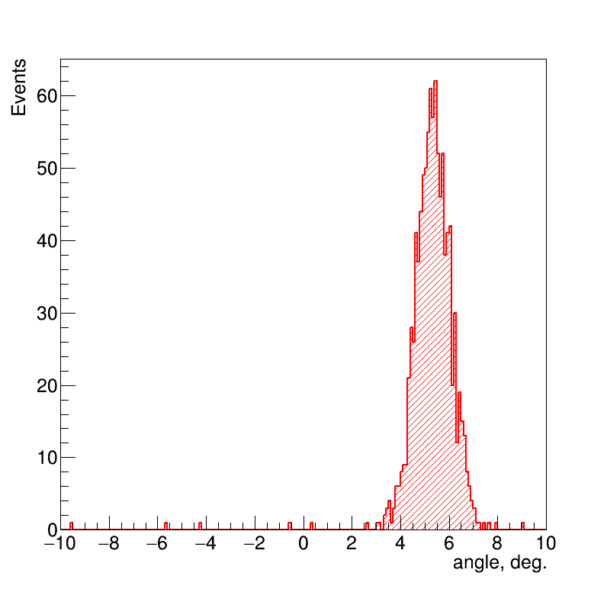
Correction by TPC information
Recoil angle can be measured by TPC
Correction on a measured angle
0,3-0,4 mm resolution of simple algorithm, when offset is estimated from the measured angle
Multivariate analysis (MLP) can make 0,2 mm resolution accessible (next slides)
mean : 5.31285 rms : 0.999505
Angle measiured by 1st and 2nd rings
MC truth 5 deg.

Slide 36
MVA regression as an estimator
Uniform pdf
Z_{TRUE} = (190, 210) mm
Theta_{TRUE} = (0, 6) deg
T_{TRUE} = (4,5, 5,5) MeV
Standard ROOT::TMVA example
Multi Layer Perceptron (MLP)
Boosted decision tree (BDT)
Linear discriminant analysis (LD)
Z or polar angle as target variable
800 events for training / 150 for test
To be compared with 0,3-0,4 mm resolution o simple algorithm, when offset is estimated from the measured angle

Slide 37
First MVA results (Z as a target)
=====================================================
MVA Method: <Bias> <Bias_T> RMS RMS_T
=====================================================
9 variables (start, peak, end) from central anode and first two rings
-----------------------------------------------------
MLP : -0.0246 -0.0299 0.166 0.140
LD : -0.0310 -0.0366 0.174 0.146
BDT : -0.0177 -0.0126 0.229 0.191
Indicated by "_T" are the corresponding "truncated" quantities obtained when removing events deviating more than 2sigma from average.
To be compared with 0,3-0,4 mm resolution of simple algorithm, when offset is estimated from the measured angle
Optimization is required

Slide 38
First MVA results (angle as a target)
=====================================================
MVA Method: <Bias> <Bias_T> RMS RMS_T
=====================================================
9 variables (start, peak, end) from central anode and first two rings
-----------------------------------------------------
MLP : -0.00304 0.0196 0.538 0.435
LD : 0.0274 0.0215 0.539 0.451
To be compared with ~1,0 deg resolution (see slide 4)
Optimization is required
Conclusion: we have to use full power of MVA in our analysis

Slide 39
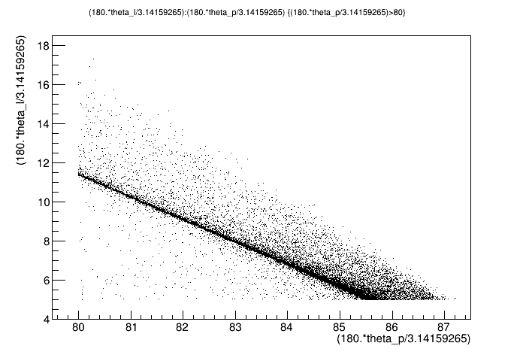
Real life (well it’s ESEPP)
ESEPP configuration:
Photon cut 0,5 MeV
Point-like proton
E=720 MeV
Lepton cut 5 deg.
Maximon & Tjon
Full other rad.calc
Electron angle, deg
10 MeV
Estimates at the previous slide is done for this point
5 MeV
2 MeV
https://github.com/gramolin/esepp
Recoil angle, deg

Slide 40
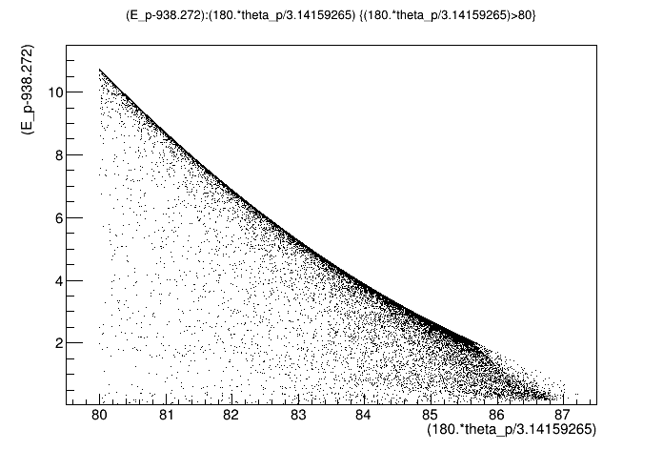
ESEPP
Quite close to linear
One should not expect large quadratic effects in Z-scale calibration
Recoil energy, MeV
Three problems in the middle:
Radiative processes (aka corrections) can create recoils with higher energy which stop between anodes
Same but via in-elastic processes (with pions)
A certain signal detection limit can produce bias
Recoil angle, deg

Slide 41
Range measurement

Slide 42
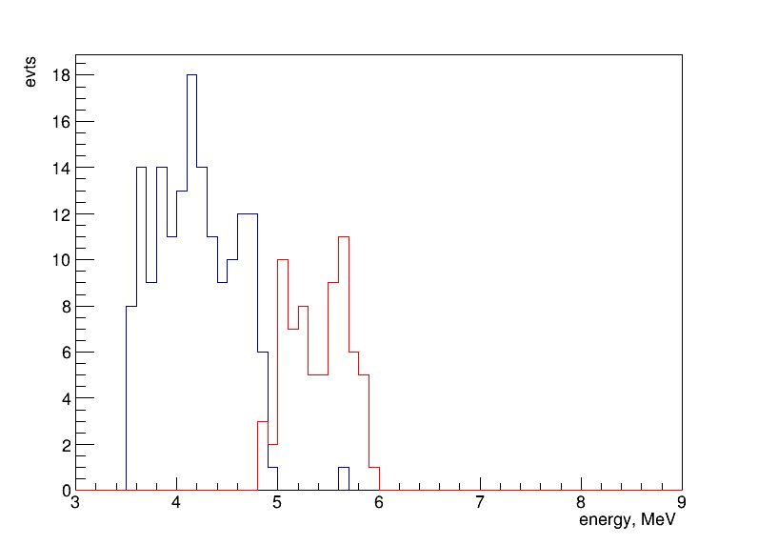
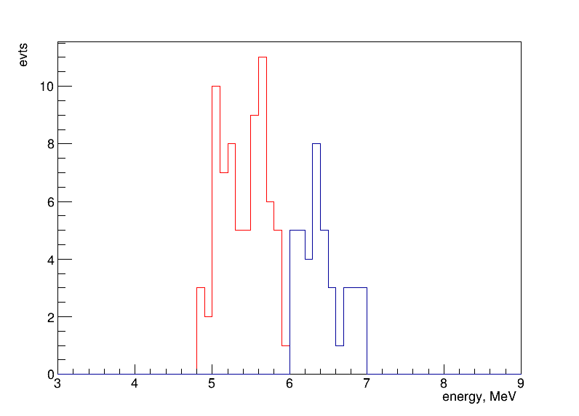
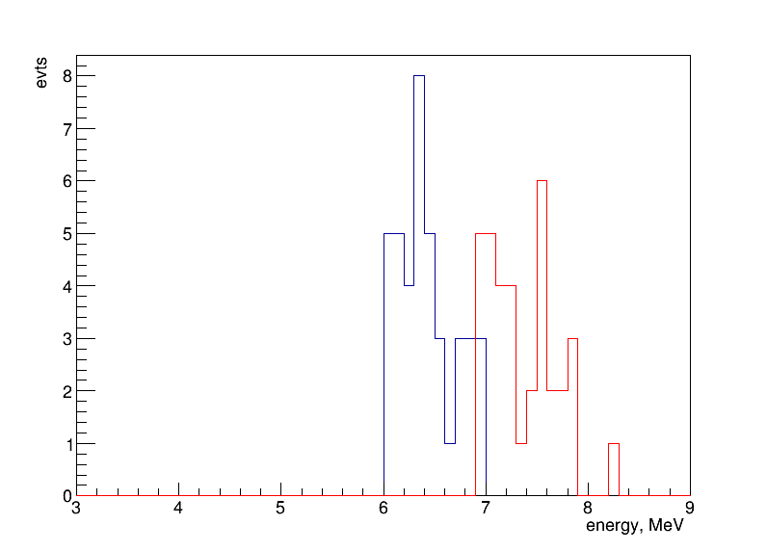
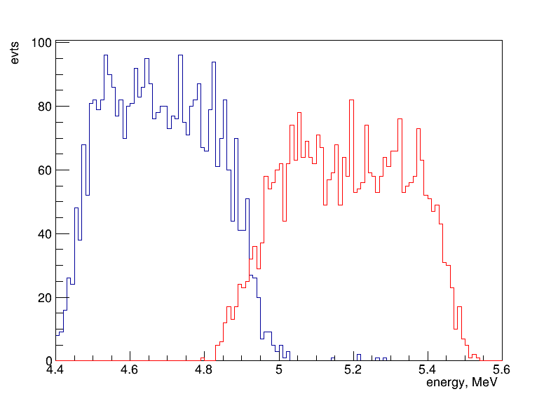
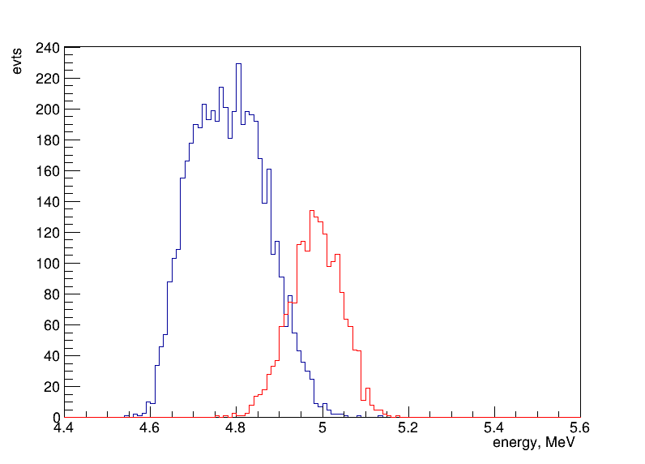
Energy by stop between anodes
Between 2 and 3
Between 3 and 4
Between 4 and 5
Between 2 and 3
Between 2 and 3
7000ev
Gen.Cut on T_{R}
Gen.Cut on T_{R}

Slide 43
+/- 100 keV range, 7000 events
Reconstructed T_{R}
True T_{R}

Slide 44
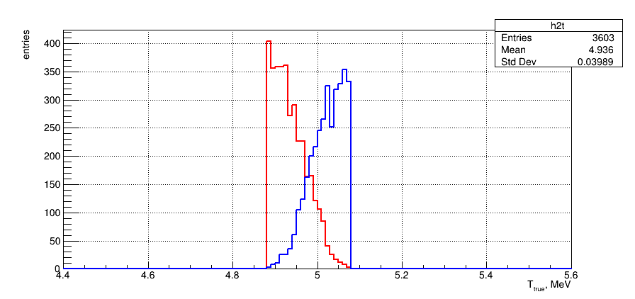
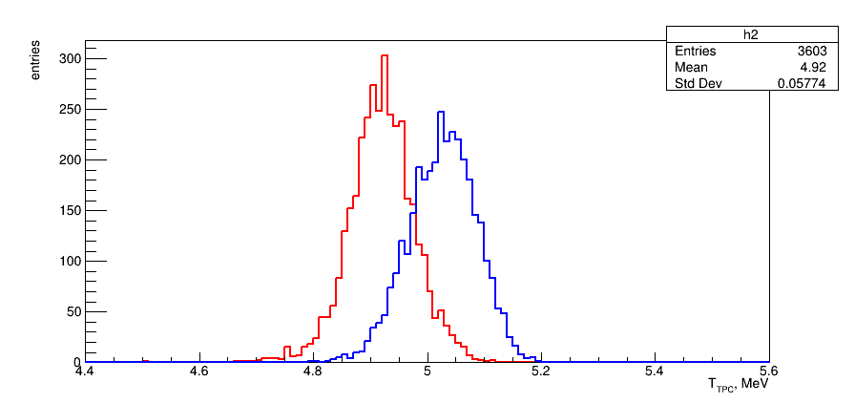
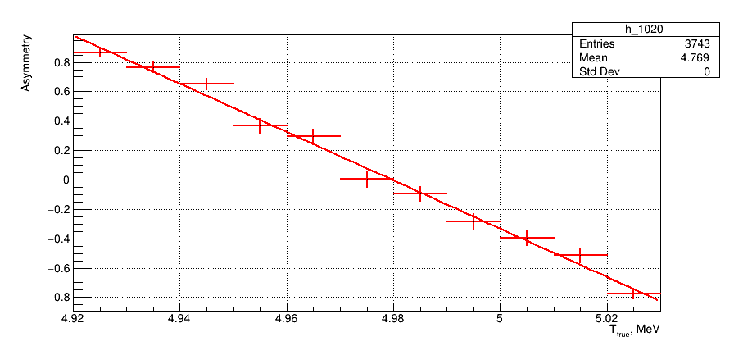
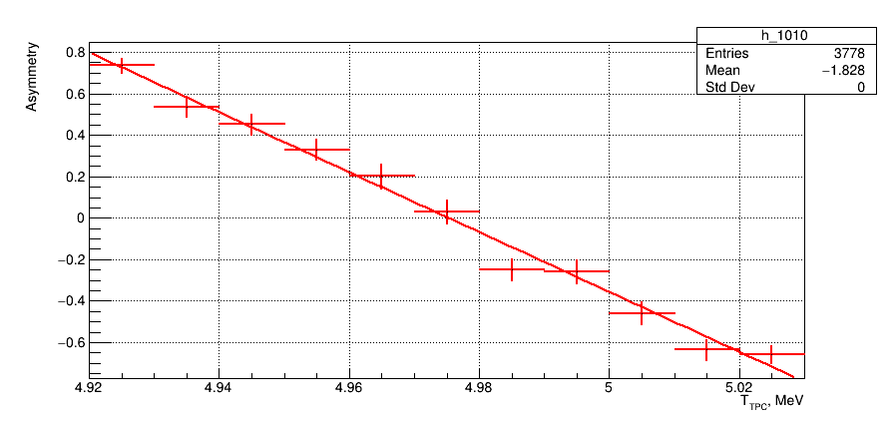
Stopped on edge between 2nd and 3rd rings
True T_{R}
Reconstructed T_{R}
Asymmetry
Find zero crossing
True = 4.9797 +- 0.0008 MeV
Rec. = 4.9753 +- 0.0010 MeV
True – Rec. = -4.4 keV (-4.3σ)

Slide 45
Same energy, same angles, but bias due to Z_{rec}
TPC
MWPC
P (far)
P (close)
0 mm
400 mm
700 mm
Z
e
l
e
Identical events with θ=5 deg. (87 mrad) → Time bias 600 ns
→ +2,4 mm to a true position wrt. anode
Bias in reconstructed θ → Far: 0,3 mrad (resolution 0,04 mrad)
→ Close: 0,7 mrad (resolution 0,10 mrad)
Difference order of 0,4 mrad ← to measure in MC

Slide 46
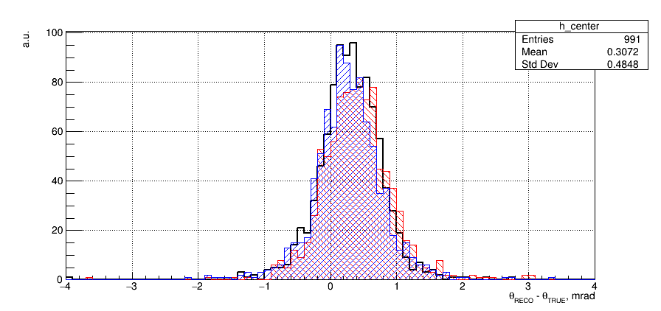
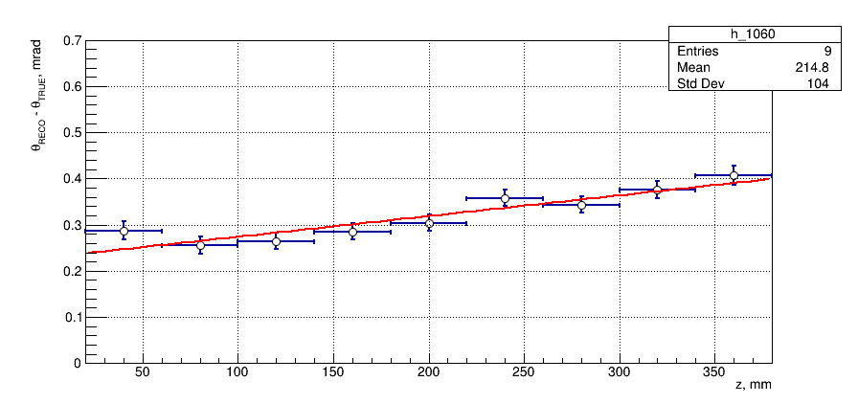
Z-dependent bias in reconstructed angle
Mean value of the bias of reconstructed θ (TPC-MWPC based) with respect to a true one depends on Z
Bias correction → put peak into Z_{TRUE}
Still some bias, which is higher for higher Z, as expected
Why?!! Misalignment?
Center of TPC
Close to anode (Far)
Close to cathode (Close)
Mean +/- Error of Mean

Slide 47
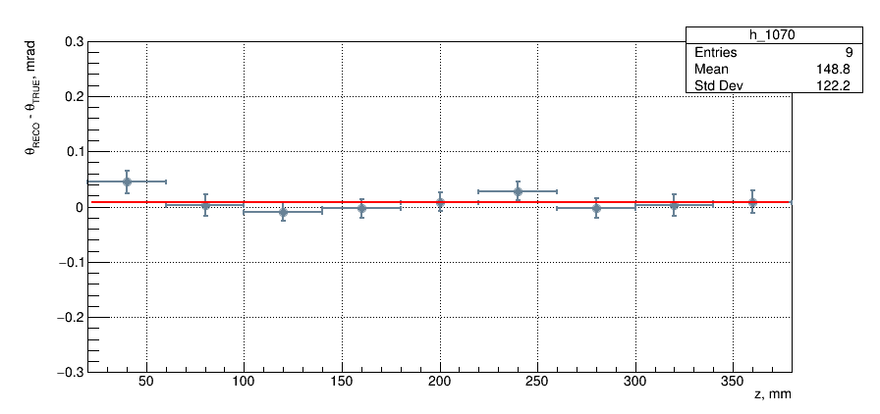
Yes! This was a mistype in code → misalignment
Everything fine but requires MC calibration constant!

Slide 48
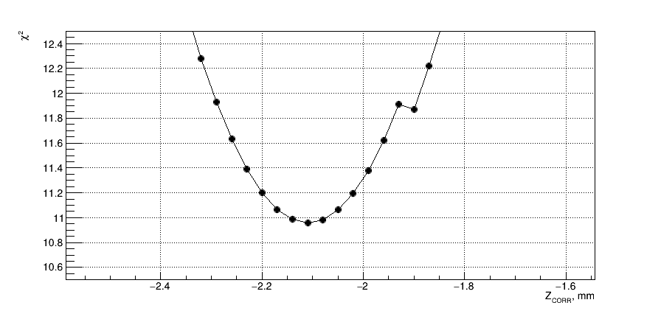
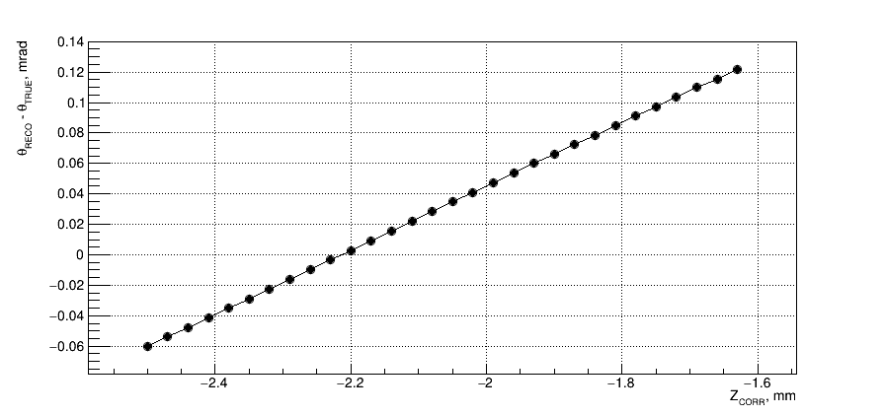
Find tune parameter from best fit by constant
±σ
For each shift calculate χ² with respect to a constant hypothesis
7000 events,
Electron scattering angle is calculated in 18 bins along the Z axis
Δχ²=1 to estimate confidence interval
Uncertainty of 0,04 mrad, which is 1,8*10^{–4} relative precision
Δχ²=1
±σ

Slide 49
Absolute measurement of angle
Identical T_{R} events using range measurement ( T₂₃+/- 50 keV)
Take ΔZ to be some large value (I use 180 mm)
θ = atan( Δl/ ΔZ )
Idea of Nikolay Voropaev: Slice on Z and fit Z-l curve to obtain angle
Radiation tail produce problems
TPC
MWPC
p (far)
p (close)
ΔZ
Z
0 mm
400 mm
e
700 mm
e
Δl
θ = atan( Δl/ ΔZ )

Slide 50
Median as robust estimator for an angle
Median for 2body sample
Mean for ESEPP sample
Mode ESEPP sample
(window dependent)
Median for ESEPP sample
Effect of the E_{photon} cut-off
ESEPP sample
2body sample

Slide 51
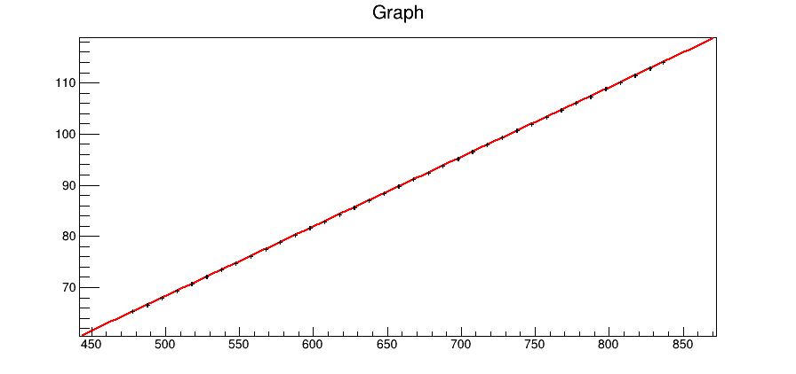
Absolute measurement of angle
An angle obtained from the slope
θ_{med.est} = 135.112 ± 0.021 mrad
was compared with a median true value of scattering angle
θ_{true} = 135.147 mrad.
The relative precision for θ_{med.est} is 1.5×10^{–4}.
A difference between estimated and true value of the median scattering angle of 0.035 mrad is accounted as a bias introduced by the method.
Expressed in the standard deviation of the procedure it states that the reconstructed angle in in 1.5σ agreement with the true one.
σ _{Median} = 3.52 + 0.013×ΔZ
(from pseudoexperiments)
Median of hit position at 1st layer of MWPC, mm
Distance between hit and MWPC position, mm

Slide 52
Conclusions
All the aspects are considered
Many improvements
Signal treatment
Noise tool
Drift velocity studies
Z-position issue
We are trying to create a single project \ applanation for MC
Certain lack of manpower

