Slide 1
PRES gas system

Slide 2
Detector requirements
Parameter | Value
Detector volume (TPC chamber) | ~1000 L
Detector volume (PC chamber) | ~1000 L
Absolute pressure in the detector | 2 – 20 bar
Absolute pressure stability | ±5 mbar
Absolute pressure uncertainty | 0.01% (2.5mbar)
Maximum differential pressure between TPC and PC chambers | 20 mbar
Working differential pressure between TPC and PC chambers | 5-10 mbar
Impurity concentration in hydrogen (TPC chamber) | < 100 ppb
Impurity concentration in Ar+CH₄ mixture (PC chamber) | < 10 ppm
Circulation flowrate for each chamber | 10-15 slpm
Filling / evacuation flowrate for each chamber | 10-15 slpm
Notes:
The crucial points are high absolute pressure measured with good accuracy
And small differential pressure between the chambers

Slide 3
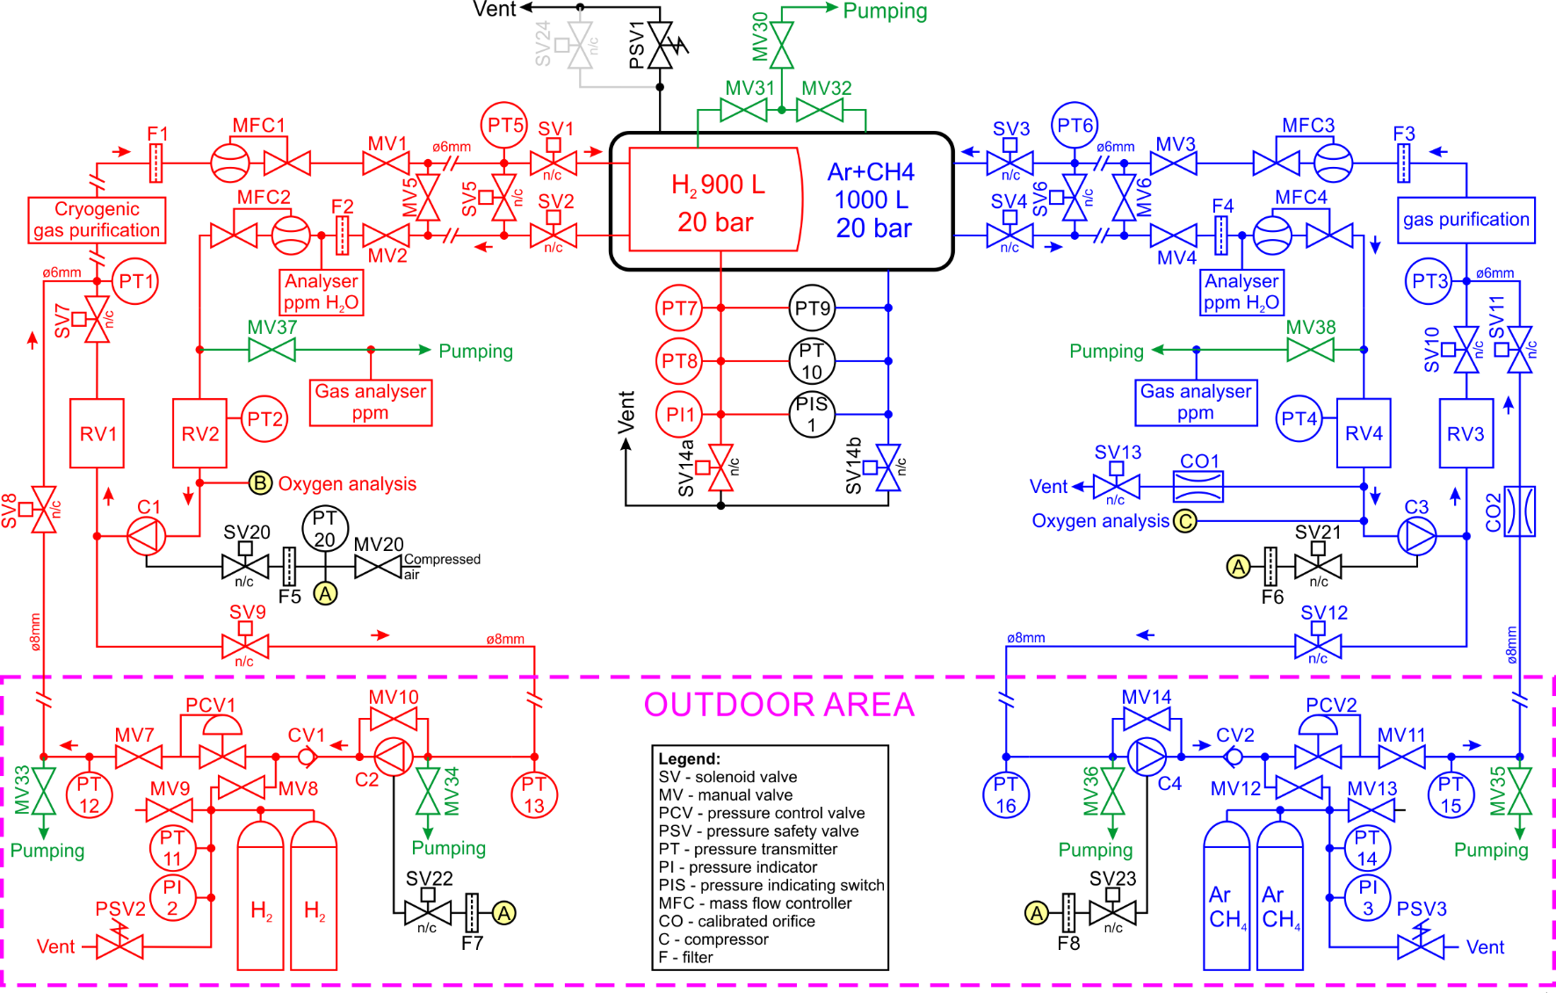
Gas system diagram
Notes:
We have basic part of the system near the detector and storage part in the outdoor area

Slide 4
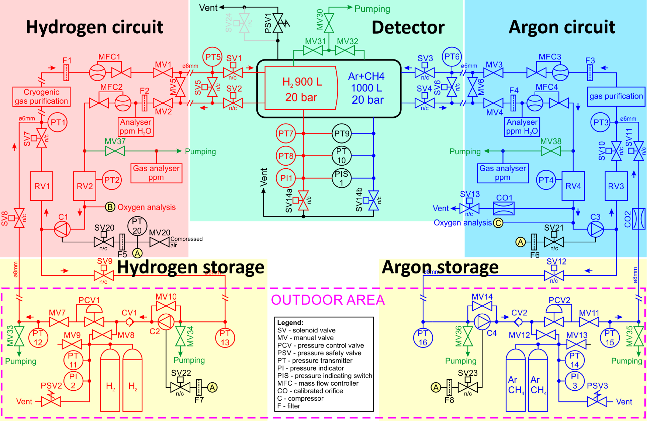
Gas system diagram

Slide 5
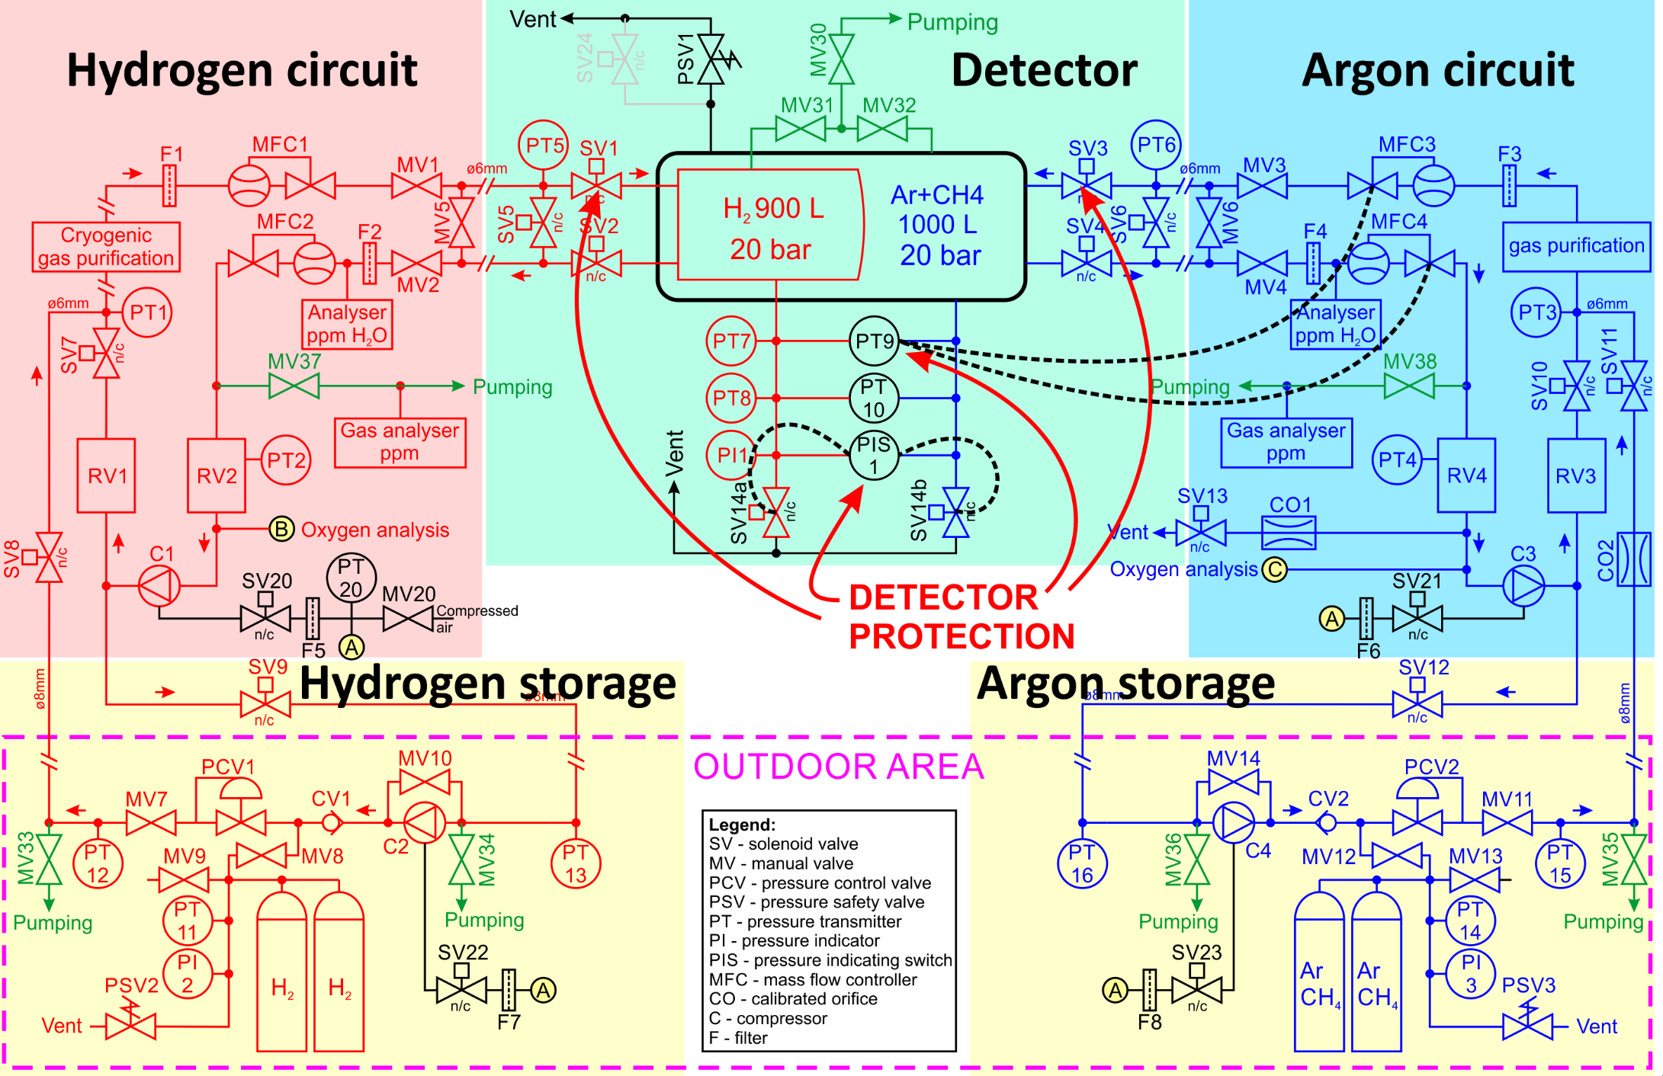
Gas system diagram
Two levels of pressure protection
Control system firmware
  Diff. pressure stabilization using MFCx (~5mbar)
  Integrated interlock operates SV1 – SV4 valves (12mbar)
Pressure sensor with relays
  PIS1 operates SV14a, SV14b (15mbar)
Notes:
Usually we use normally open valves for safe system configuration, but due to high pressure in this detector, we selected special protection.
NC valves managed by control system and PIS control for the exhaust valves, in order to protect internal membrane between the chambers

Slide 6
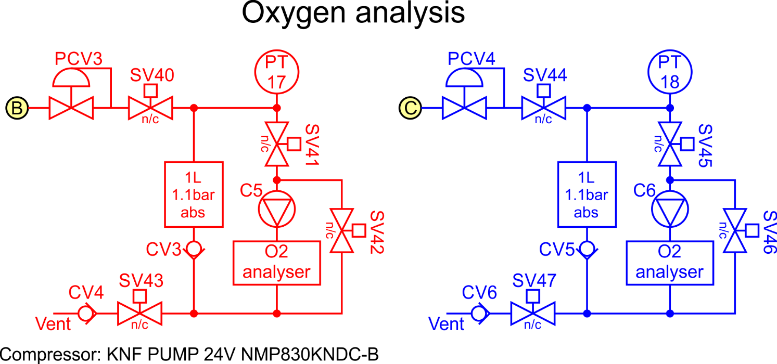
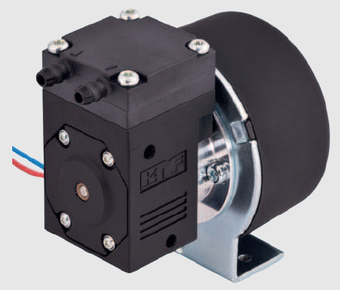
Oxygen analysis
Notes:
Oxygen loops are used for periodic oxygen analysis. It takes about 1-2 standard liters sample and measures oxygen concentration

Slide 7
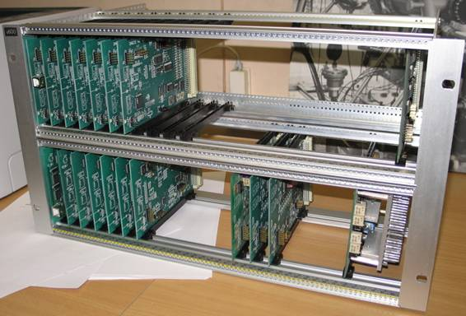
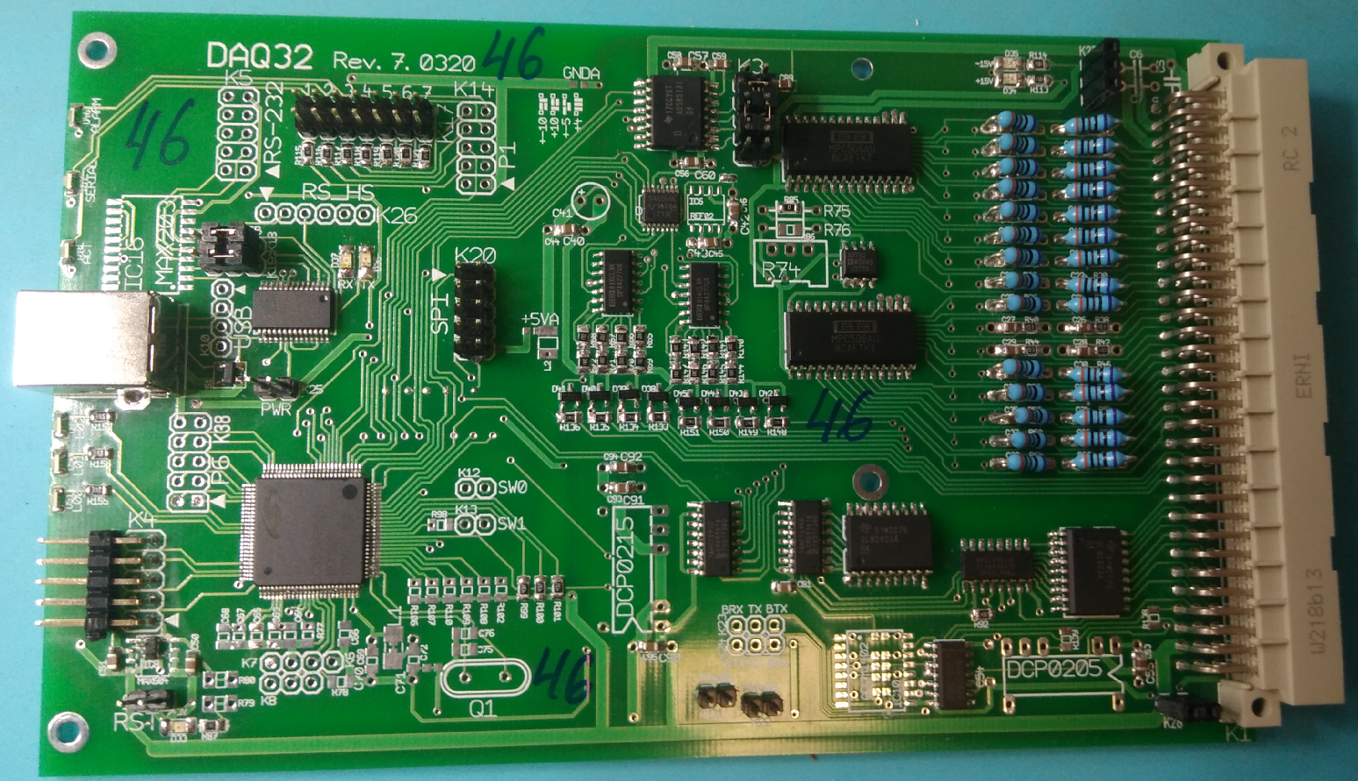
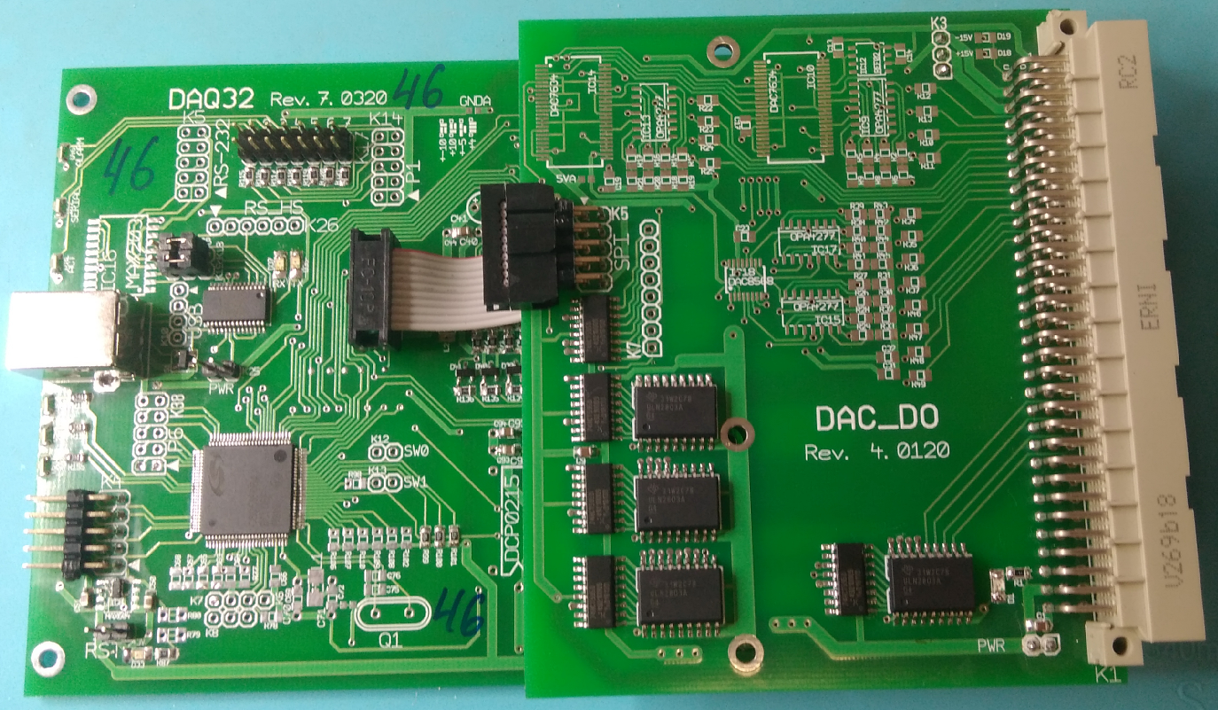
Control system
Slow control modules
compact (high channel density)
integrated controller with interlock
widely used in our systems over 10 years at
BNL, FZ Juelich, PSI, Dubna and AIRBUS test rig
P. Kravtsov and V. Trofimov, Preprint PNPI-2723, Gatchina (2007).
P. Kravtsov et al., CBM Progress report 2010, p. 32.
Notes:
Most of our systems are managed with single control module.

Slide 8
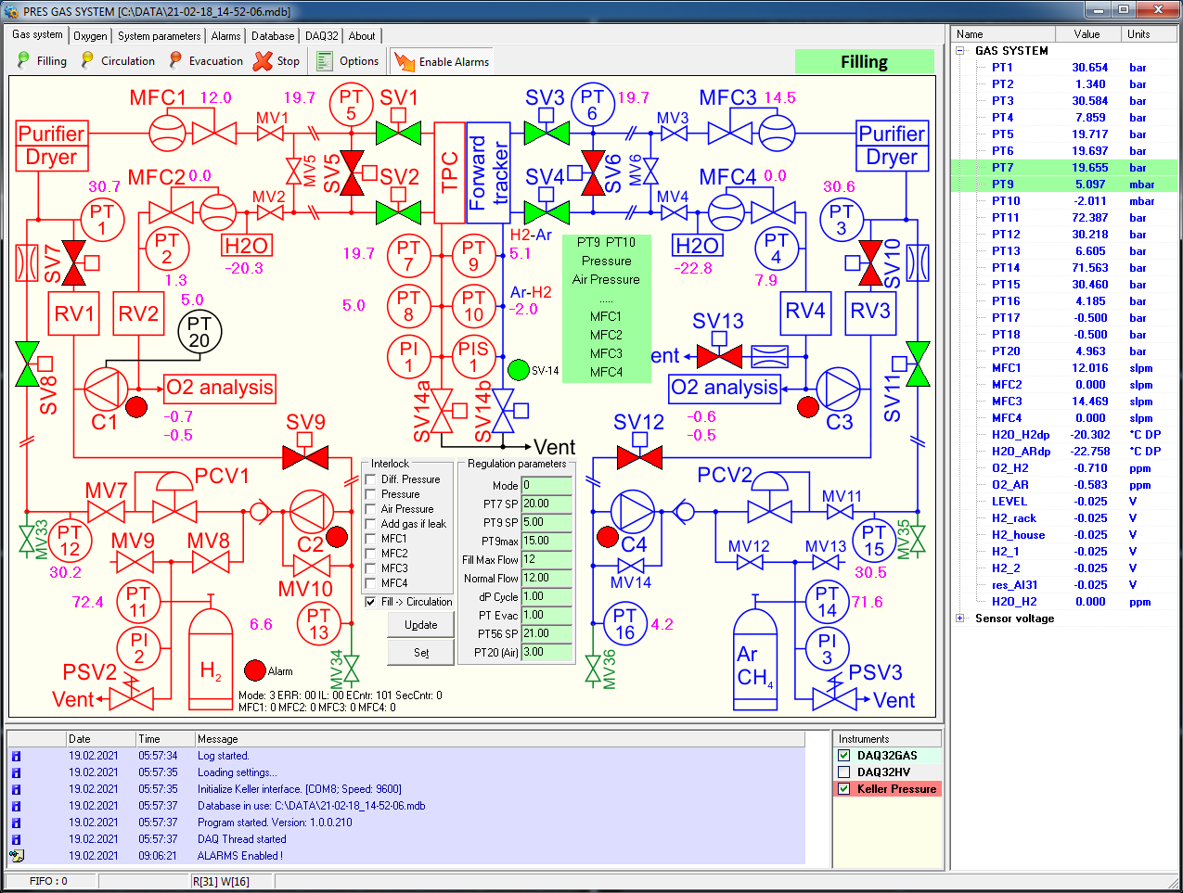
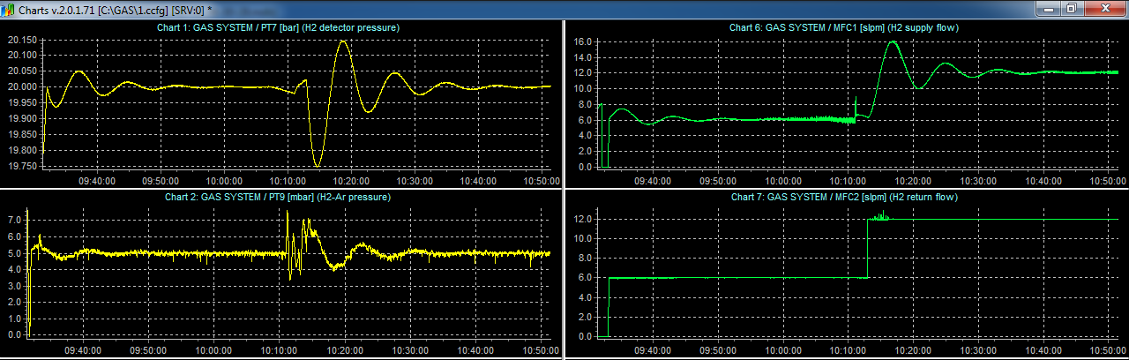
Control software
Notes:
Our standard slow control software.
All parameters are listed at the right and displayed in the gas diagram. All system parameters are written in the DB. We also have online and offline visualization programs.

Slide 9
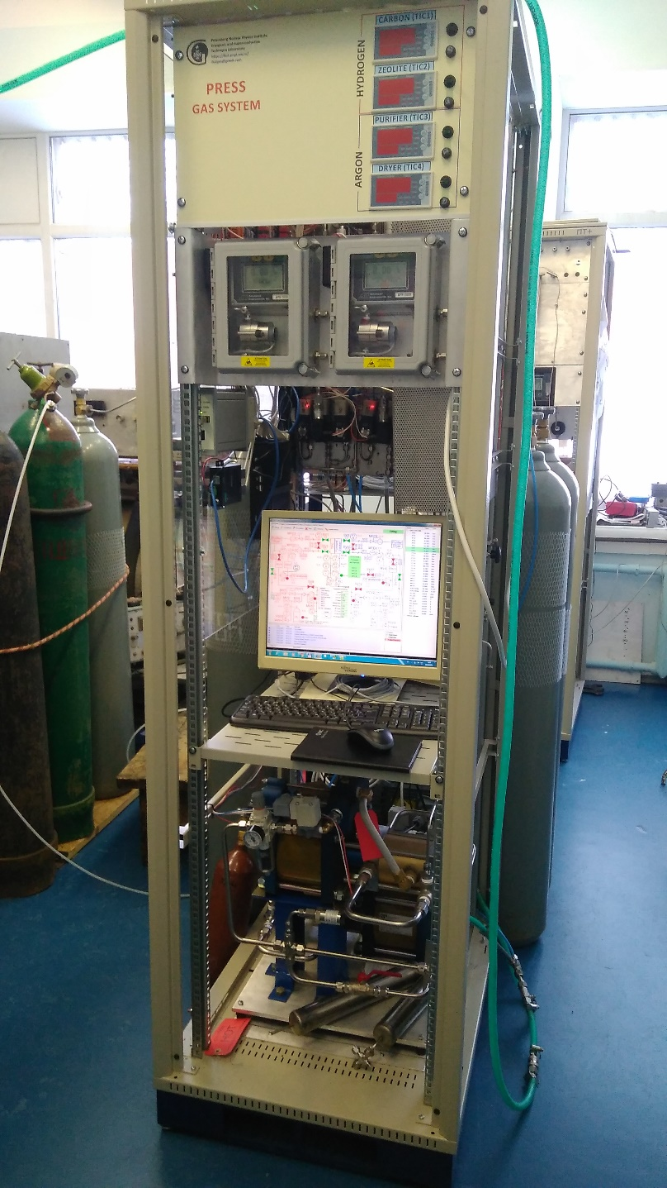
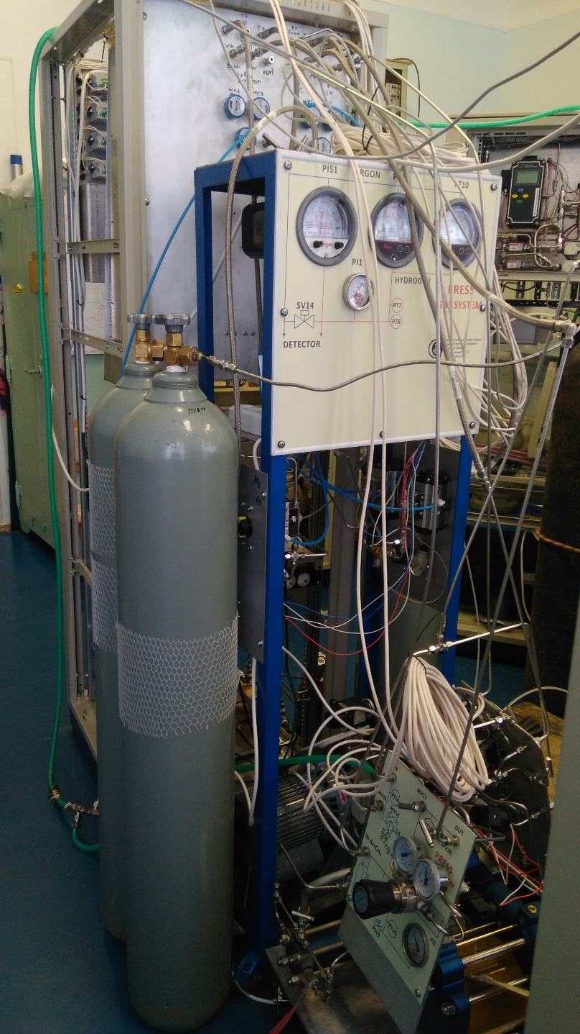
Assembly
Notes:
2 м2 = 6 м2

Slide 10
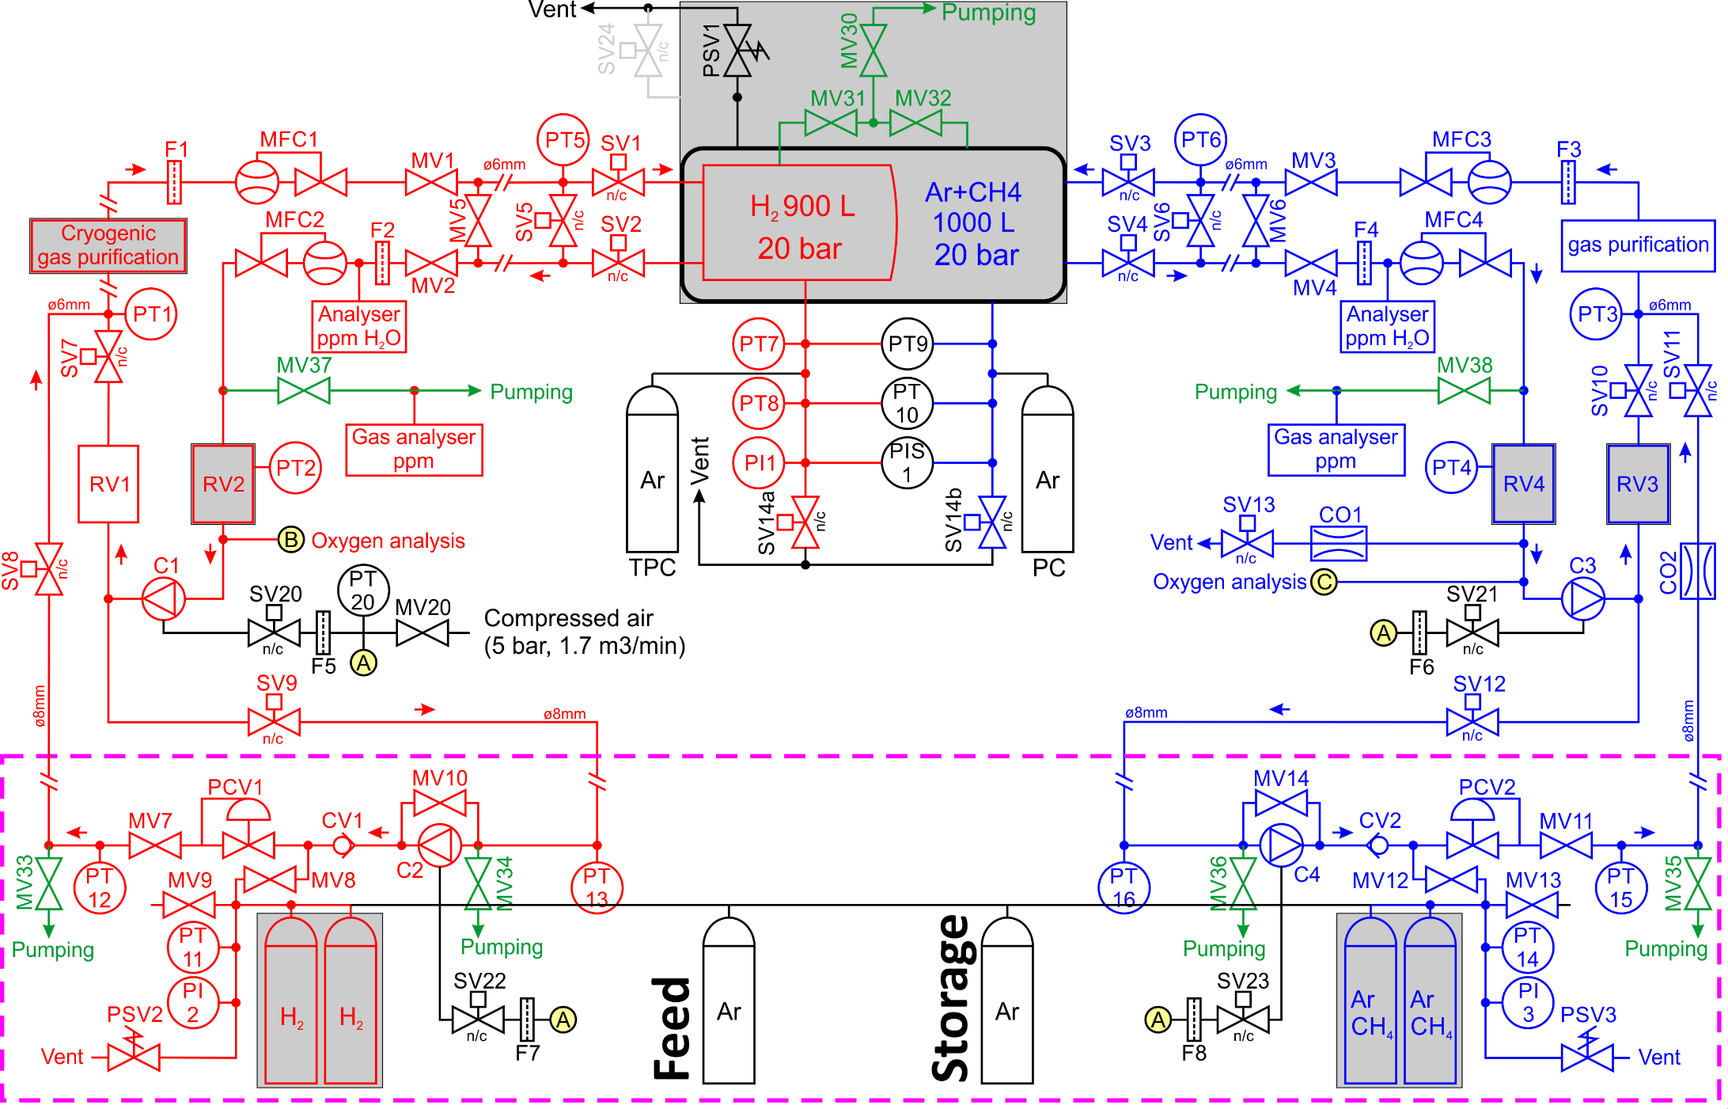
Gas system tests
Notes:
Grayed items do not present in the current setup.
Pure Argon. Two bottles simulate TPC and FT volumes.
One bottle for Feeding the system and one for storage.

Slide 11
Gas system operation modes
Filling mode
  Gas filling from storage through pressure reducer (30bar)
  Hydrogen flow control: MFC1
  Argon flow control and differential pressure stabilization (PT9): MFC3
Circulation mode
  Gas circulation with pneumatic boosters (C1, C3)
  Constant outlet flowrate (MFC2, MFC4)
  Absolute pressure stabilization (PT7): MFC1
  Differential pressure regulation (PT9): MFC3
Evacuation mode
  Gas evacuation from detector to storage cylinders
  Gas compression using circulation boosters (C1, C3) and
  additional evacuation boosters (C2, C4)
  Constant hydrogen flowrate (MFC2)
  Differential pressure regulation (PT9): MFC4
All operation algorithms are implemented in the controller firmware!
Notes:
This was our plans, let’s see the results!

Slide 12
Filling mode. Pressure

Slide 13
Filling mode. Flow
Real flow
Notes:
MFC1 – calibrated for hydrogen
MFC3 real flow about 14slpm

Slide 14
Circulation mode. Booster pressures
RV2=0L
RV2=2L
Leak
Refill algorithm

Slide 15
Circulation mode. Pressure
PT7: 20.000±0.002 bar
PT9: 5.0±0.5 mbar
RV2=0L
Pressure drop due to leak
RV2=2L
Notes:
Главный рез-т – PT7; стабильное диф.давл.; подключение RV2 сильно помогло; течи – падение давления в 12:30; алгоритм добавления свежего газа

Slide 16
Circulation mode. Flowrates
Notes:
MFC3 завышает на 4%

Slide 17
Circulation mode. Compressed air pressure

Slide 18
Evacuation mode 1. Storage pressure
Starting storage pressure: 20 bar
Maximum storage pressure: 54 bar

Slide 19
Evacuation mode 1. Detector pressure
Switch on circulation boosters C1, C3

Slide 20
Evacuation mode 1. Boosters inlet pressure

Slide 21
Evacuation mode 1. Flowrates
Notes:
Flowrates are not stable, but differential pressure is constant

Slide 22
Evacuation mode 1. Compressed air pressure

Slide 23
Evacuation mode 2. Storage pressure
Starting storage pressure: 54 bar
Maximum storage pressure: 78 bar
Notes:
Second independent run of evacuation. Not completely successful.

Slide 24
Results
Filling mode
  Differential pressure: 5.0±0.5 mbar
Circulation mode
  Absolute pressure stabilization: 20.000±0.002 bar (1-2 LSB of ADC)
  Differential pressure: 5.0±0.5 mbar
  Different flowrates for hydrogen and argon are possible
  Reserve volumes (RV1, RV2, RV4) are necessary!
Evacuation mode
  Works fine with storage pressure up to 55 bar
  Differential pressure: 5.0±2 mbar
  Reserve volumes (RV2, RV4) are necessary!
  Storage volume should be properly arranged
  Smaller flowrates for higher pressures (>55bar)
Hardware pressure protection with PIS1 relay and SV14x valves
in all modes works fine (2-3m pipes ø6mm!)
    Plans:
    - Fine tuning of the control algorithms
    - Check transition modes
Notes:
На больших объемах, скорее всего, будет не хуже, но надо настраивать регулирование

Slide 25
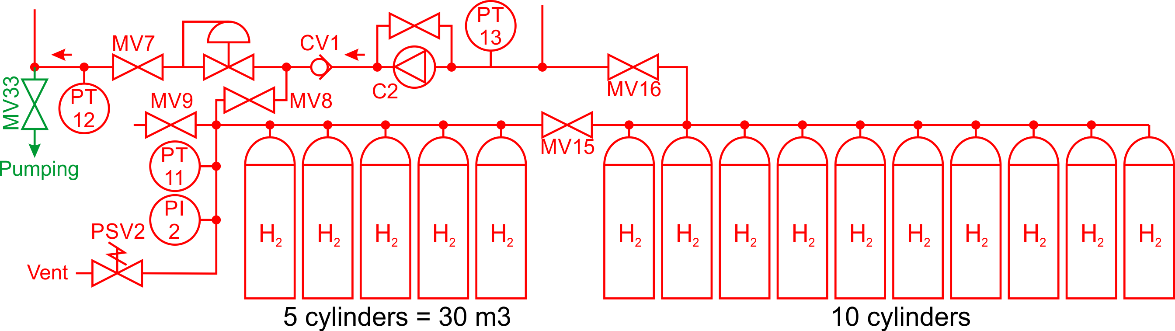
Storage volume
TPC volume: ~1000L
Total amount of hydrogen: 30m³
Storage volume for evacuation: 15 cylinders (600L, 50bar)
Before filling the detector gas could be compressed
in 5 cylinders (200L, 150bar), or feed directly to the
gas system using booster C2.
Gas reserve:
30m³ – 20m³ (TPC) – 6m³ (30bar in 5 cyl.) = 4m³

Slide 26
Storage volume
TPC volume: ~1000L
Total amount of hydrogen: 30m³
Storage volume for evacuation: 15 cylinders (600L, 50bar)
Before filling the detector gas could be compressed
in 5 cylinders (200L, 150bar), or feed directly to the
gas system using booster C2.
Gas reserve:
30m³ – 20m³ (TPC) – 6m³ (30bar in 5 cyl.) = 4m³
Infrastructure requirements
Gas pad with about 30 cylinders
(~15 for hydrogen, ~15 for Ar+CH₄)
Compressed air with capacity of 1.7-2 m³/min at 10 bar
Vent line sized for exhaust air ~0.5-1m³/min
Liquid Nitrogen line for automatic filling the purifier

Slide 27
THANK YOU!

