Slide 1
PRES readout system

Slide 2
DAQ Requirements
Detector system
Time Projection Chamber (TPC)
Forward Tracker (FT)
Beam scintillation counters (S1-S3)
Beam position monitor (BPM)
Beam intensity monitor (BIM)
Beam energy 720 MeV
Time parameters
Beam intensity: 2 MHz
Event rate: <= 50 Hz
Trigger source: TPC
User requirements
Data logging
Online data monitoring

Slide 3
Forward tracker
Cathode strip chambers (MWPC)
8 chambers (4 XY-layers) + ( 8 U-layers ±45°)
240x2.5mm strips in each chamber
Back side strips joined into 12 strips ( 8 U-layers ±45°)
2016 channels in total: (240 x 8) + (12 x 8) = 2016 channels
(40 + 4) = 44 cards ASF48et (48 channels each)

Slide 4
Forward tracker electronics
DAQ card (ASF48et) – 44 cards
48 independent readout channels/card
Digital discriminator in each channel
Option to run adjacent channels
12-bit 25MHz pipeline FADC
Common system clock 100MHz
Memory:
L1 1k words per channel,
L2 32k words per card
Low dead time level
Intermediate Memory
FPGA Logic
Digital
Discriminator
DAQ
interface
Trigger
Multi-Channel FADC
Front-end
2016 channels
Preamplifier
48 channels
Shaping time: 1.2µs
Gain: 40mV/fC
Noise: 800 e⁻
6 boards are ready
Notes:
DAQ cards are produced and ready. With preamplifiers – we have 6 boards ready and plan to produce complete set by autumn

Slide 5
ASF48et diagram

Slide 6
ASF48et signal processing (single channel)
Notes:
By digital discriminator in the FPGA the card keeps the required total number of samples, including specified offset samples in the past, in the L1 memory

Slide 7
ASF48et signal processing (external trigger)
Notes:
By external trigger system looks back in L1 memory for specified time range and reads the selected signal history to L2 memory
Using this technique we can read the FT signals from the past using TPC trigger

Slide 8
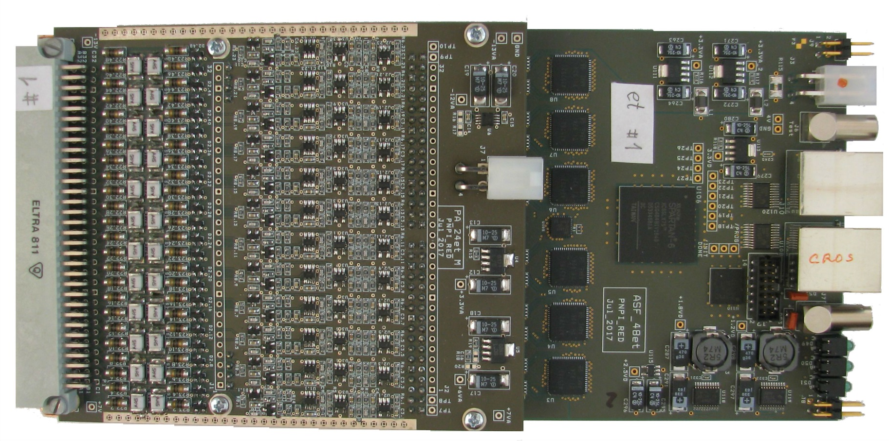
ASF48et with preamplifier

Slide 9
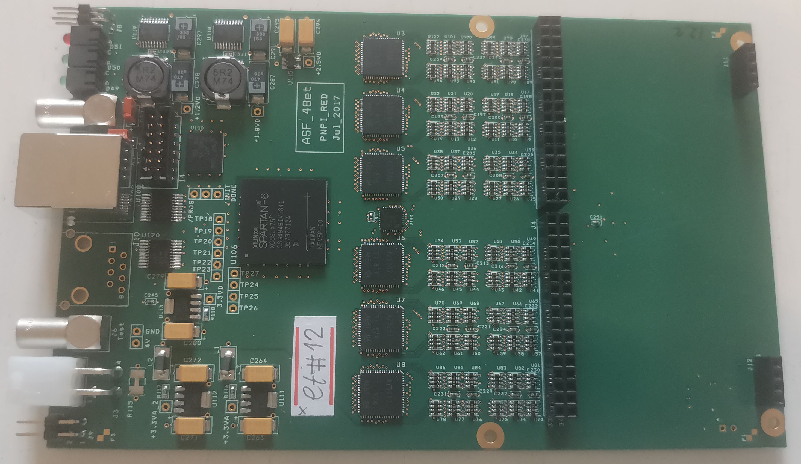
ASF48et no preamplifier (digitizer only)

Slide 10
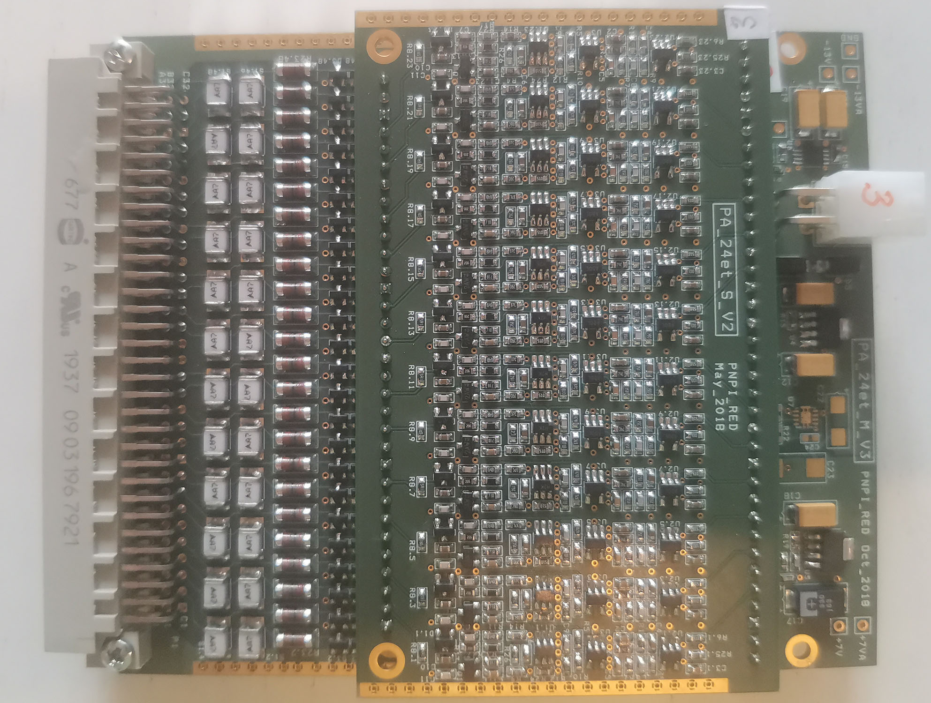
48–channel preamplifier

Slide 11
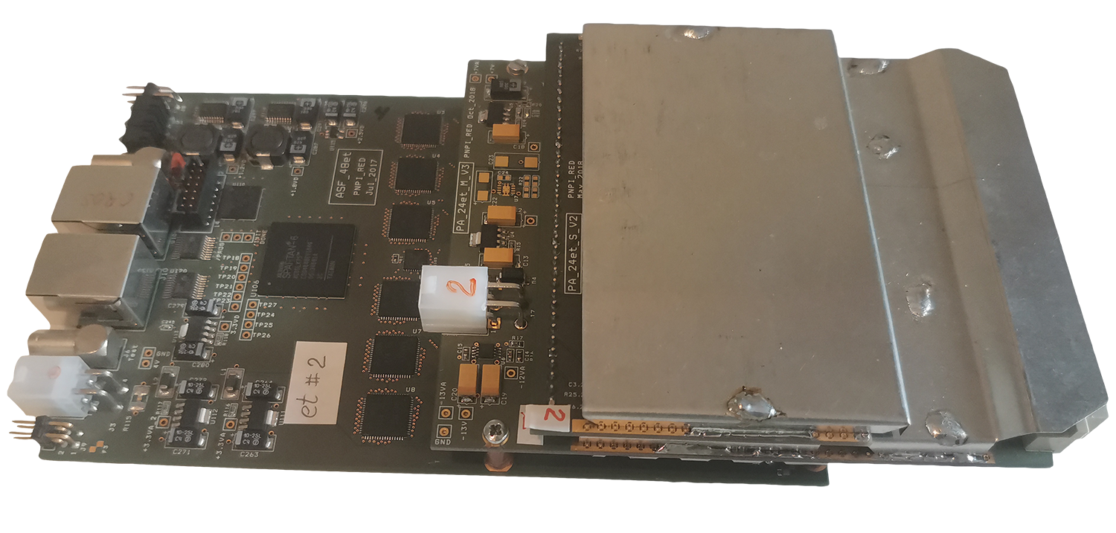
ASF48et with preamplifier

Slide 12
Forward tracker event rate simulation
MC simulation
Beam intensity: 2MHz
200 electrons per event (100μs)
Recoil energy: 1-10MeV
Average 6 strips (hits) per track
Total rate in forward tracker at 50Hz trigger rate:
490h/t x 50Hz = 24500 hit/sec
With 60 ADC samples per signal (hit) data rate:
24500 hit/sec х 64words/hit = 1568000 words/sec (3.14 Mbyte/sec)
Average hits per trigger (100μs)
 | Card/plane
Plane | 1 | 2 | 3 | 4 | 5 | Z | Sum | R/O
FT1 | 2,5h/t | 5,6h/t | 20h/t | 5,6h/t | 2,5h/t | 7,6h/t | 43,8h/t | 90h/t 5760w/t
FT2 | 1,7h/t | 4,6h/t | 26h/t | 4,6h/t | 1,7h/t | 7,6h/t | 46.2h/t
FT3 | 1,4h/t | 4,4h/t | 31,5h/t | 4,4h/t | 1,4h/t | 8,6h/t | 51,7h/t | 108,3h/t 6912w/t
FT4 | 1,2h/t | 4,6h/t | 36h/t | 4,6h/t | 1,2h/t | 9h/t | 56,6h/t
FT5 | 1,1h/t | 4,8h/t | 41h/t | 4,8h/t | 1,1h/t | 10h/t | 62,8h/t | 132,1h/t 8448w/t
FT6 | 1h/t | 5h/t | 46h/t | 5h/t | 1h/t | 11,3h/t | 69,3h/t
FT7 | 1h/t | 5,2h/t | 51h/t | 5,2h/t | 1h/t | 13h/t | 76,4h/t | 158,2h/t 10112w/t
FT8 | 1h/t | 5,4h/t | 55h/t | 5,4h/t | 1h/t | 14h/t | 81,8h/t

Slide 13
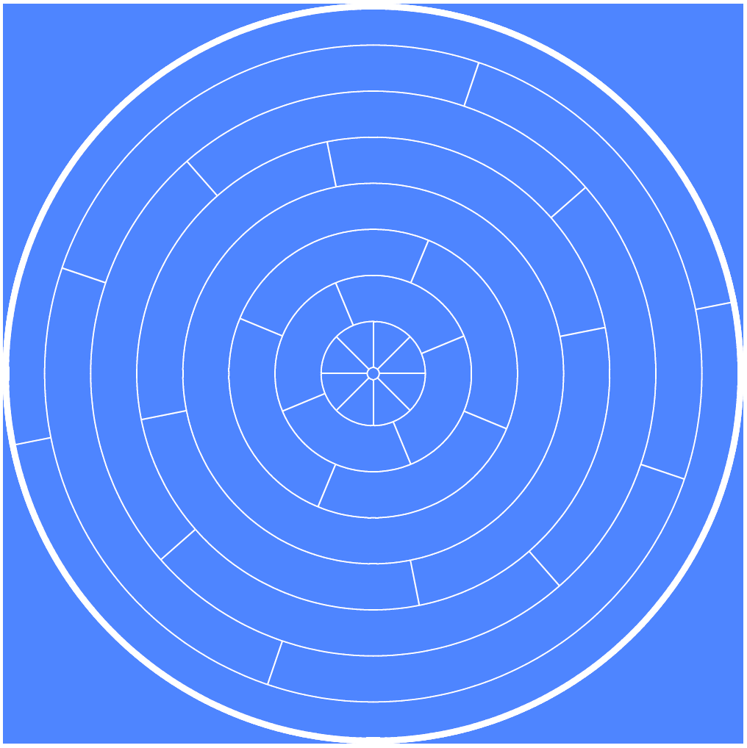
Time Projection Chamber
32 channels (8 rings)
4 Cards ASF12eP (8-9 chann/card)
100μs maximum drift time
Complex trigger logic
System trigger request generation
Recoil energy: 1-10MeV
Beam energy 720 MeV
Anode pad layout
H2
5, 20bar
Notes:
eP card is much more complicated, due to complex trigger logic, long signal processing (up to 100us).
But the structure of the card is the similar, with more powerful FPGA

Slide 14
TPC electronics ASF12eP
DAQ
interface
Trigger RQ
Intermediate Memory
FPGA Logic
Digital
Discriminator
Trigger logic
DAQ card (ASF12eP)
8-12 independent readout channels/card
Dual Digital discriminator in each channel
(Single sample or integrated window)
System trigger request generation logic
12-bit 25MHz pipeline FADC
Common system clock 100MHz
Memory:
L1 8k words per channel,
L2 32k words per card
Trigger TPC
Trigger TPC
Trigger FT
Multi-Channel FADC
Front-end
33
channels
Data rate (50Hz trigger):
10 Mbyte/s (avg)
40 Mbyte/s (peak)
2 preamps are ready
  Energy scale 2MeV, 4.8MeV
  Noise:
  280e- @ C= 0pF
  900e- @ C= 70pF
  1100e- @ C=100pF
H2
4, 20bar
Notes:
We have produced all 4 ADC cards,
We also developed and produced 2 preamplifier cards for the TPC.
The parameters of the preamplifiers are quite promising

Slide 15
ASF48eP diagram
Notes:
The structure is quite similar to forward tracker card, except more powerful FPGA

Slide 16
ASF48eP signal processing (single channel)
System Timer
Notes:
Here we have again self-triggered channel, but with much longer signals (up to 150us)

Slide 17
ASF48eP signal processing (integration window)
System Timer
Notes:
Integration time can be adjusted from 0.1us to 4.8us
Integration window is special feature of the TPC card.
It can be used to reduce noise influence and false triggering

Slide 18
Beam counters electronics
DAQ card (BM-01)
800MHz sampling clock (1.25ns resolution)
8 Independent Channels
Common system clock 100MHz
Memory:
L1 2048 events per channel (8k words/chann)
L2 32k words per card
(1000μs at 2MHz beam intensity)
Data rate (2MHz beam): 0.1Mbyte/s per counter
DAQ
interface
Intermediate Memory
FPGA Logic
Beam Monitor
S1
S2
S3
Notes:
BM card is not finished yet.
Resolution 1.25ns
Beam position and Intensity monitors are read by slow control electronics

Slide 19
The overall DAQ electronics layout
Notes:
DAQ interface means a number of concentrators with dedicated firmware and complex logic.
Trigger source is the TPC digitizers.

Slide 20
DAQ data flow layout
Notes:
Root conc. Is used for synchronization and control of the whole system.
We have 1 second layer conc. For the TPC and 4 second layer conc. for the FT
Total data rate: 15Mb/s average and ~40Mb/s peak

Slide 21
DAQ hardware status
Hardware | Design | Production | Firmware
Forward tracker preamplifier | ✓ | 6/44
Forward tracker digitizer (ASF48et) | ✓ | ✓ | ✓
TPC preamplifier | ✓ | 2/4
TPC digitizer (ASF48eP) | ✓ | ✓ | in progress
Beam monitor | ✓ | in progress | in progress
Beam position monitor preamplifier + digitizer | ✓ | ✓ | ✓
Beam intensity monitor preamplifier + digitizer | ✓ | ✓ | ✓
Readout system (concentrators) | ✓ | ✓ | in progress

Slide 22
Data acquisition software
Readout test software
Full scale DAQ software based on MIDAS
(Maximum Integrated Data Acquisition System)
http://midas.psi.ch
  Flexible distributed DAQ system
  Web interface for run control and monitoring
  Data transfer / logging capability
  Online data monitoring
  Online database
  Message logging
  Alarms

Slide 23
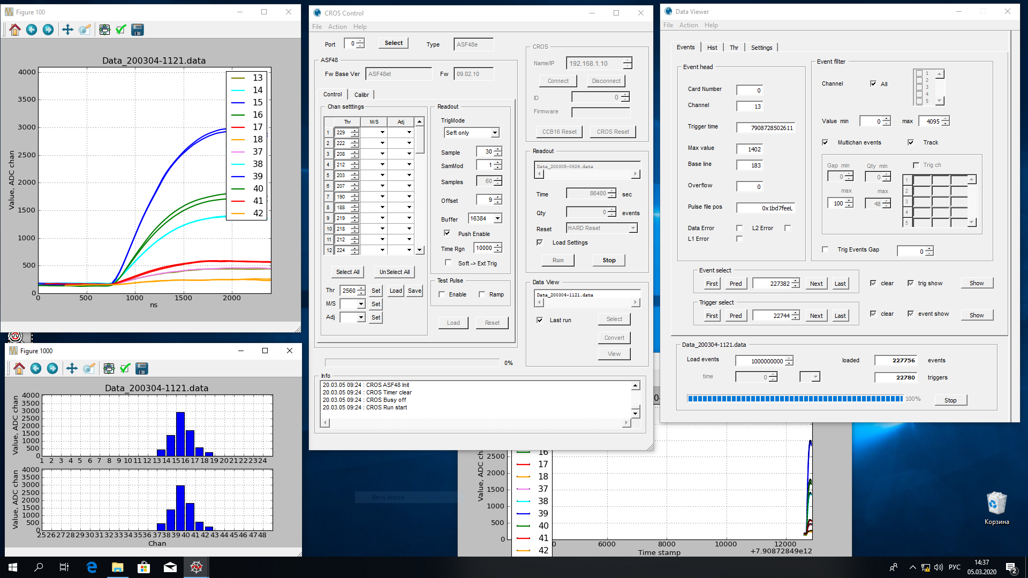
Readout test software
Notes:
Very useful for test measurements and digitizers check

Slide 24
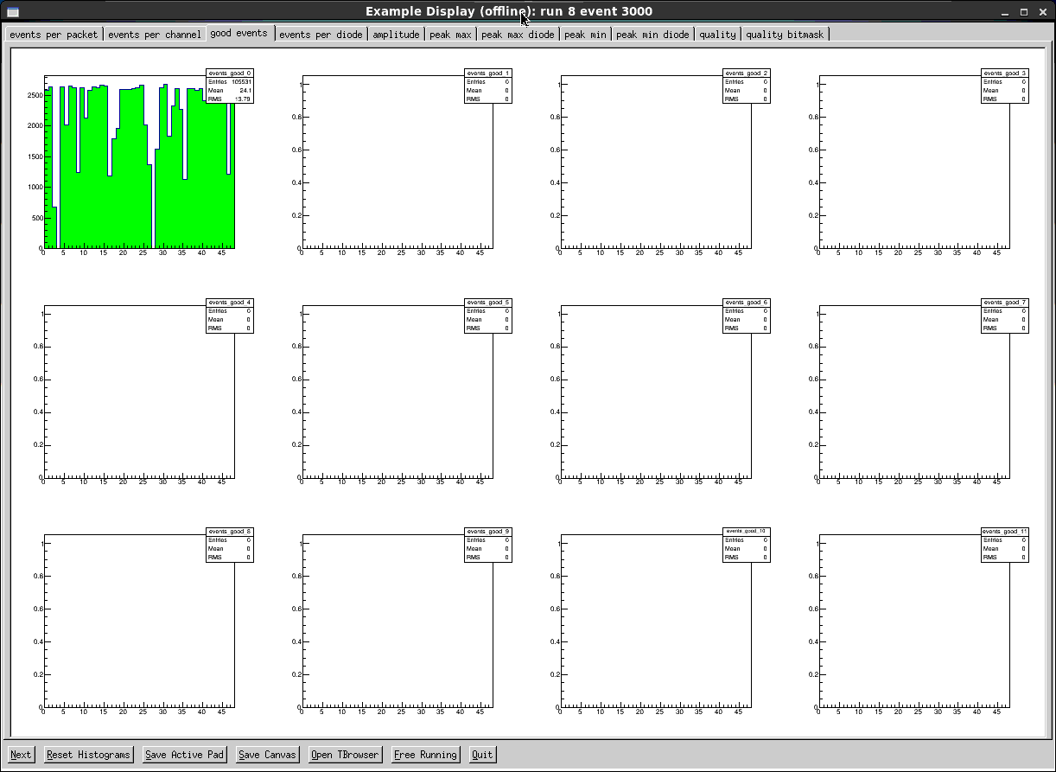
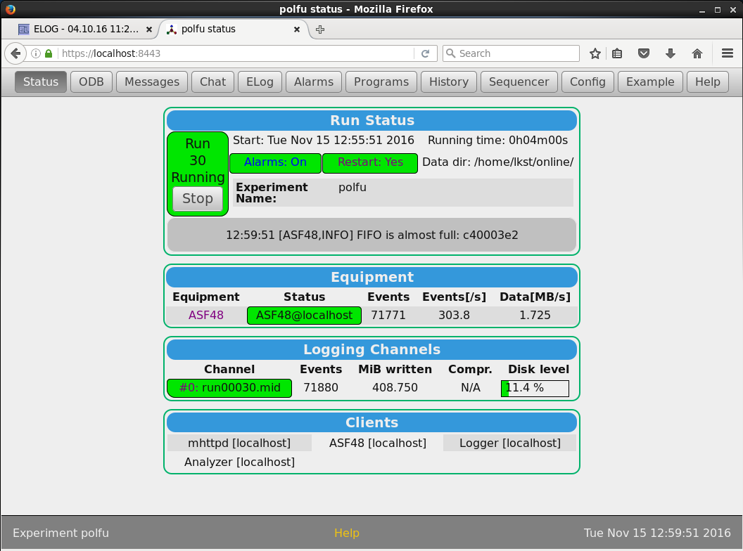
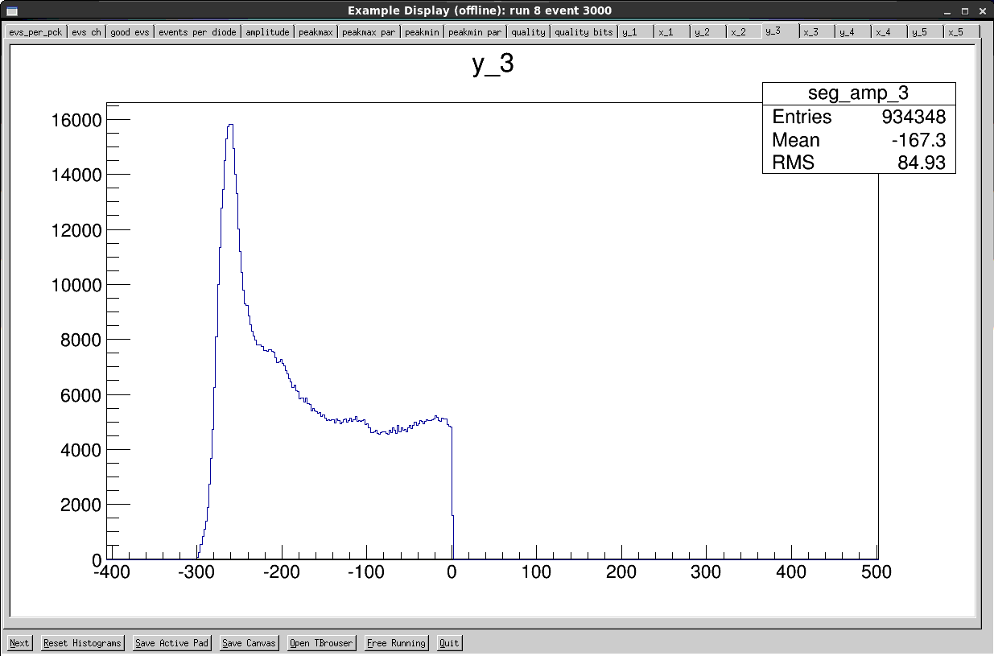
Data acquisition software
Notes:
Long-term data acquisition software.
We used it in PSI experiments and also in our Polarized Fusion experiment at PNPI

Slide 25
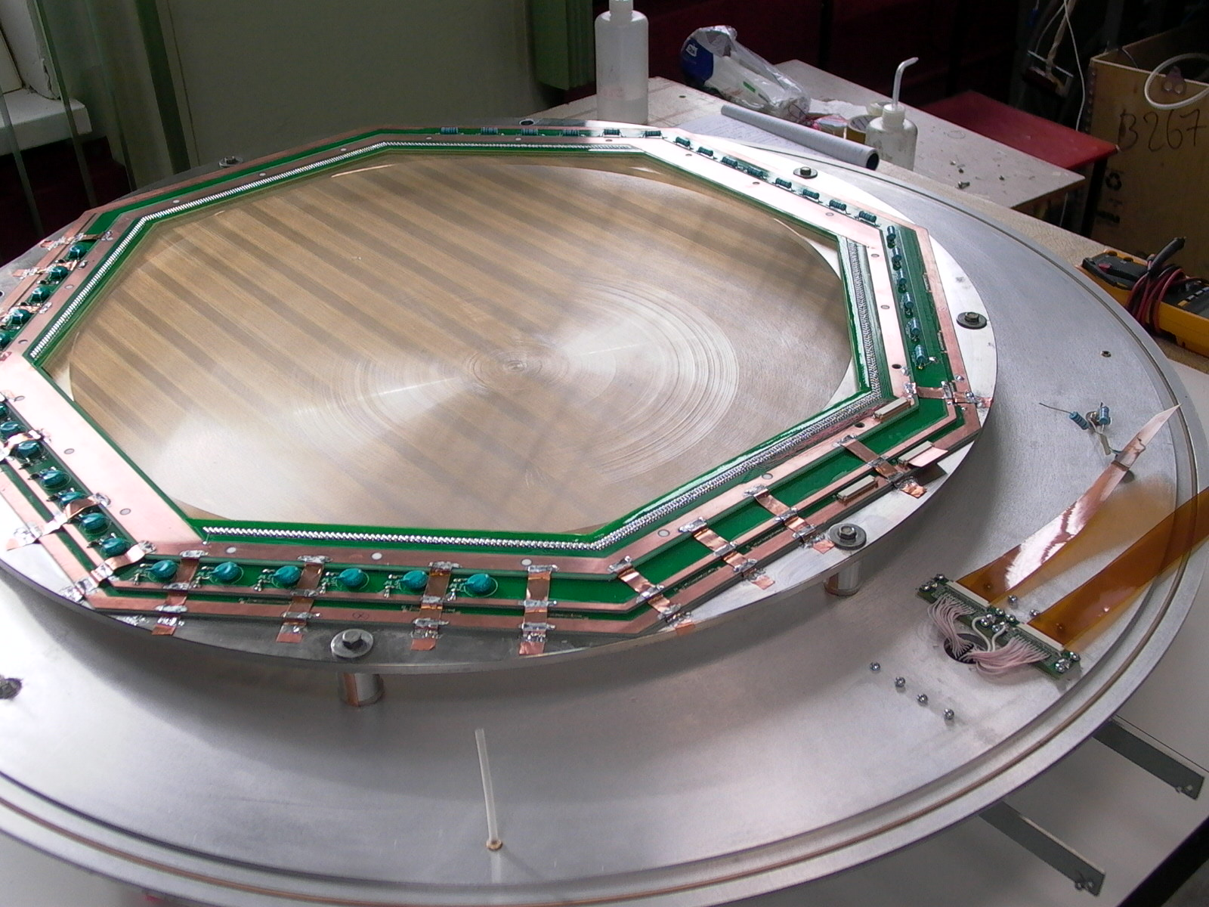
FT CSC prototype
Both parallel cathodes
Cosmic tests
Single ASF48et card:
0..23 channels – top
24..47 channels - bottom
Notes:
We made test measurements with the full sized forward tracked chamber at low pressure, to learn how to analyze signals from the tracker.
It was special chamber with to parallel cathodes to check spatial resolution.
We used single ADC board with 24 channels connected to top cathode and 24 channels at bottom plane.

Slide 26
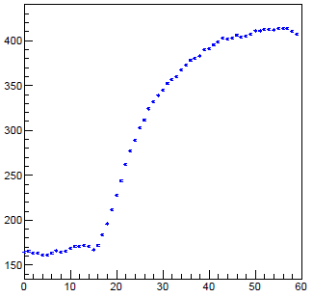
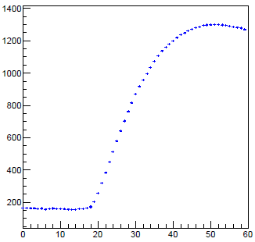
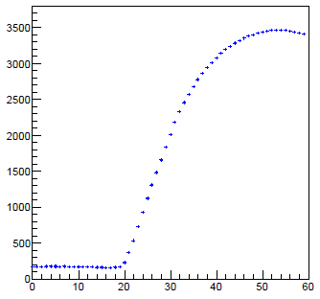
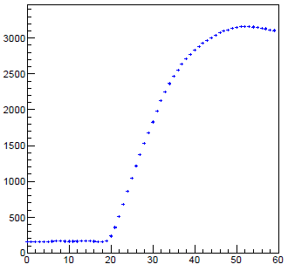
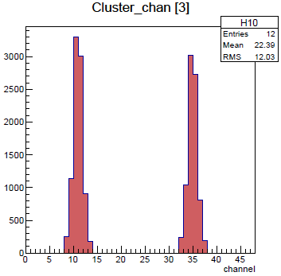
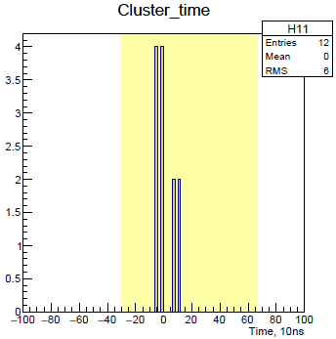
Signal processing
Notes:
We developed signal processing and cluster analysis.

Slide 27
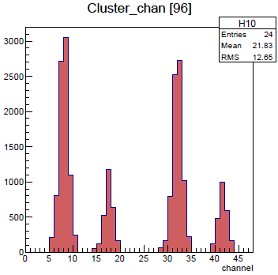
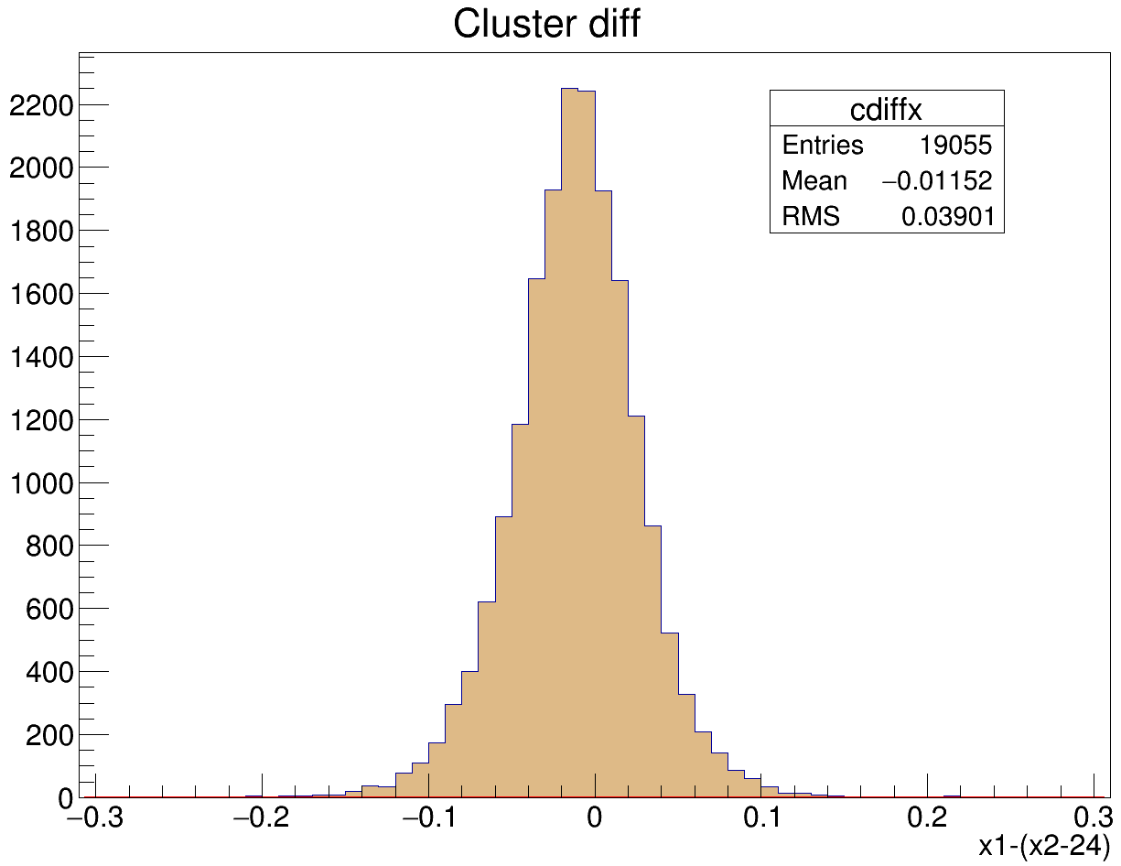
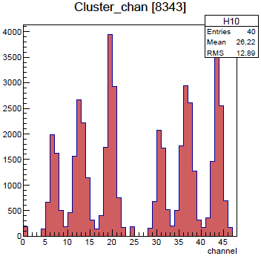
Cosmic data results
Spatial resolution: 70 μm

Slide 28
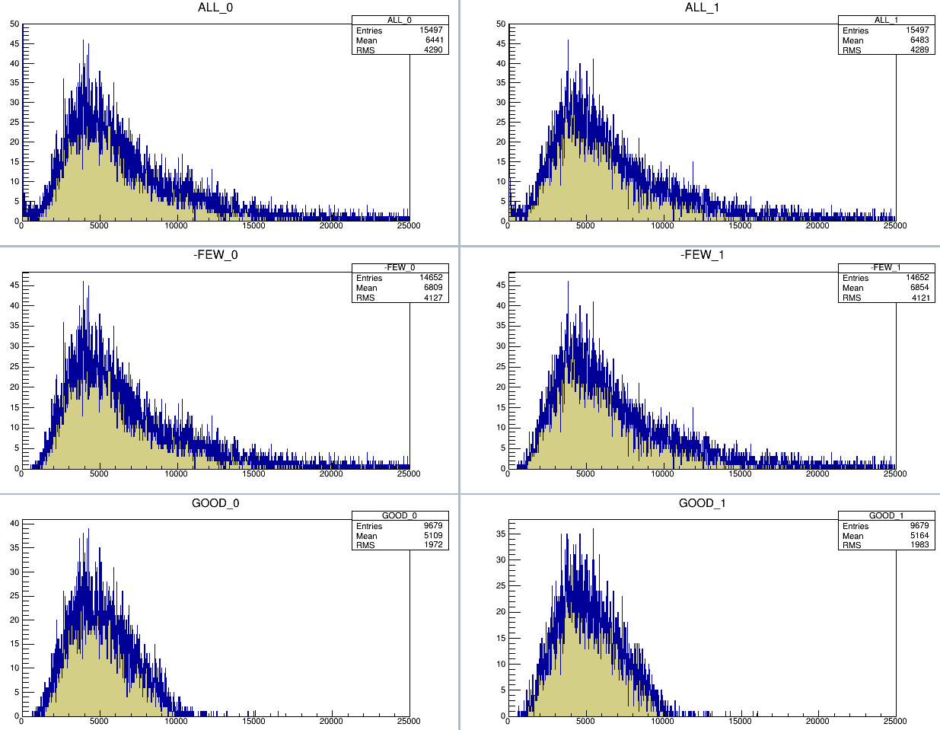
Cosmic data results. Amplitude spectra
Notes:
This is just an example of our analysis:
Amplitude spectra for various type of the clusters

Slide 29
DAQ software status
Software | Status
Readout test software | in progress
MIDAS frontend (FT) | in progress
MIDAS frontend (TPC) | in progress
FT signal processing | ✓
FT clipped signal reconstruction | ✓
MIDAS online analyzer | in progress
MIDAS export analyzer | ✓

Slide 30
THANK YOU!

