Slide 1

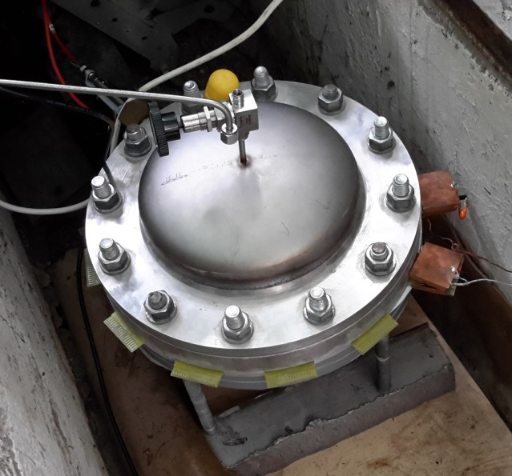
Experimental studies of the MWPCs performance
Two stages of the MWPC tests:
with a small size prototype 10×10 cm (gas mixture from 1 bar up to 20 bar)
with a full-scale MWPC plane (gas mixture from 1 bar up to 20 bar)

Slide 2
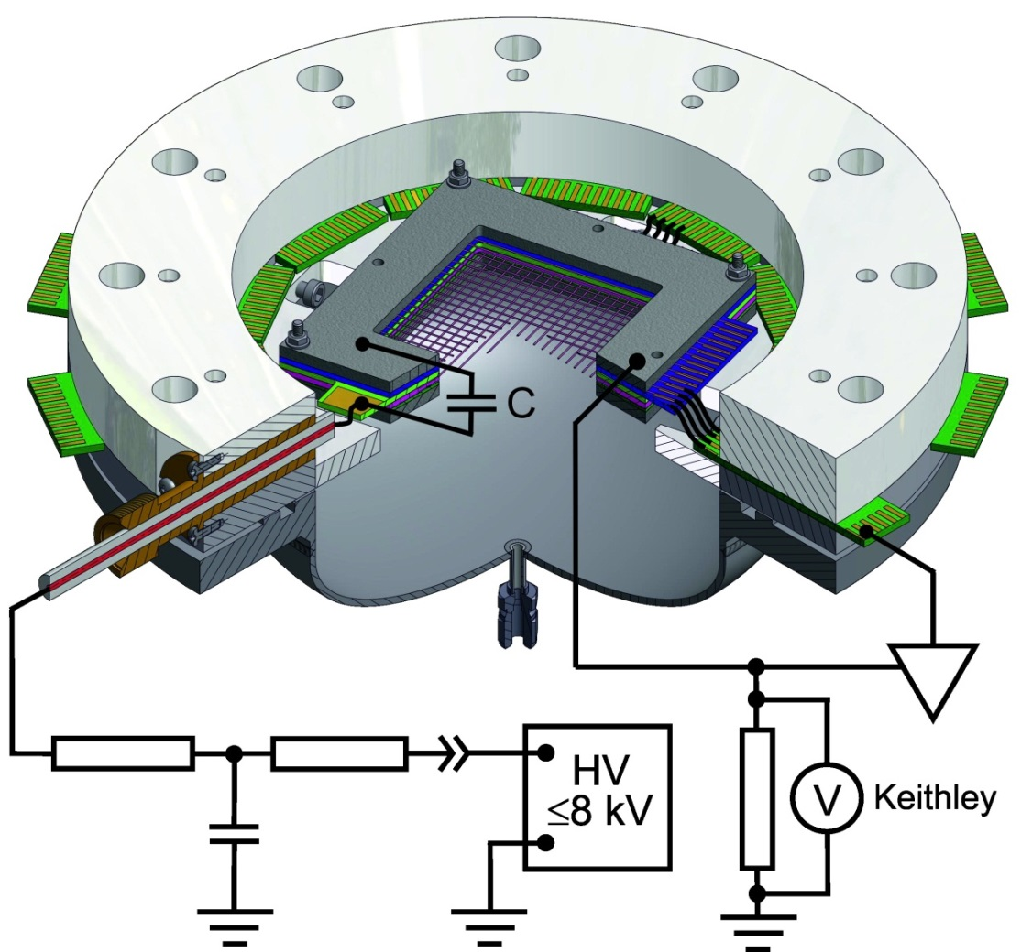
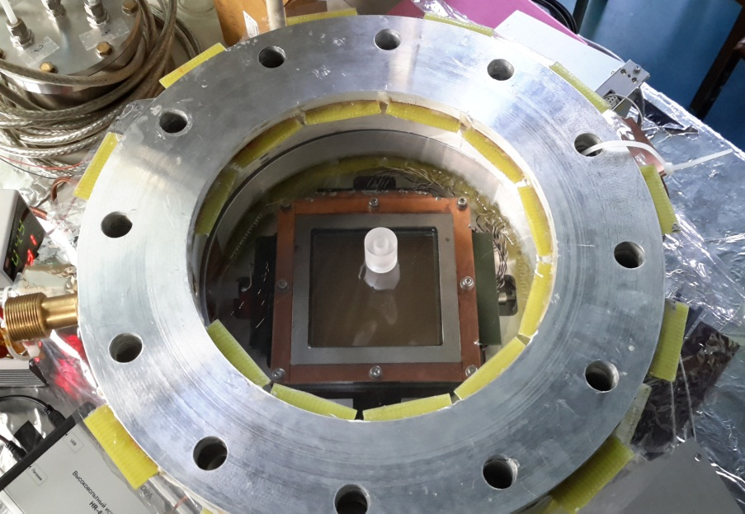
Experimental studies of the MWPCs performance
Scheme of the MWPC Prototype inside of high pressure barrel volume
1 stage
Goals:
Define HV work point at different gas pressures
Determine GG for various gas mixture compositions
Optimize MWPC design
8 kV High Voltage supply source
GG evaluated:
with ionization current (at 1 bar) measurement
with ⁵⁵Fe amplitude calibration (Q _{convertion}- 220e)
with Garfield simulation
Ionization current measurement as a voltage drop on 1 MΩ resistor with Kethley picoampermeter

Slide 3
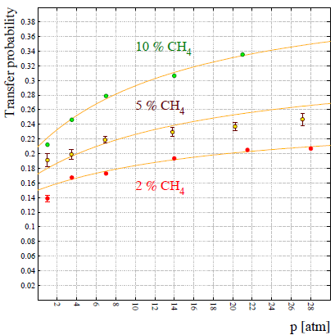

Experimental studies of the MWPCs performance
Gas gain simulation for MWPCs performance and Penning effect
Difficulty of gas gain prediction for Ar/CH₄ is a Penning effect (PE) presence.
PE occurs if the metastable excitation energy level of one gas component (Ar) is energetically higher compared to the ionization energy of the other gas component (CH₄).
$Gtot$ = $\frac{G}{1 − Pγ×G}$
20 bar Ar/CH₄
Penning coefficients have been taken from Ö. Sahin, I. Tapan, E.N. Özmutlu and R. Veenhof “Penning transfer in argon-based gas mixtures” JINST May 4, 2010 . DOI:10.1088/1748-0221/5/05/P05002

Slide 4
Experimental studies of the MWPCs performance
Garfield simulated gas mixture 96%Ar+4%CH₄
Gas work mixture for prototype 96.2%Ar+3.8%CH₄

Slide 5
Experimental studies of the MWPCs performance
The central zone of the electron tracker with a diameter of ~ 2 cm should be ineffective for the electron beam. To suppress gas amplification in the center of the CAS planes, the diameter of the anode wires is electrolytically increased to 70-80 microns.
Dependence of the gas gain on the anode wire diameter evaluated with GARFIELD for two CSC geometries

Slide 6
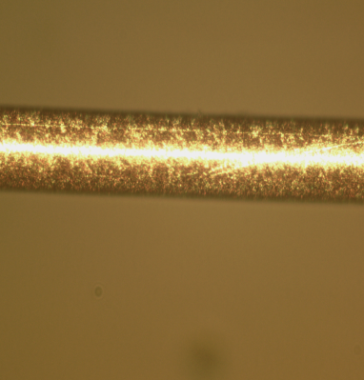
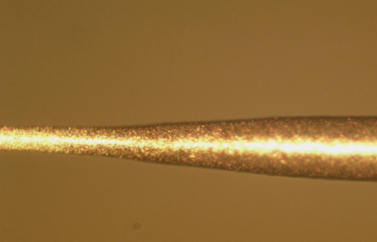
Experimental studies of the MWPCs performance
30 µm
80 µm
The efficiency measurements on the MWPC prototype with modified anode wires have been carried out at the atmospheric pressure with collimated X-ray ⁵⁵Fe source.
Efficiency of 55Fe X-ray source across the central spot versus coordinate X, mm

Slide 7
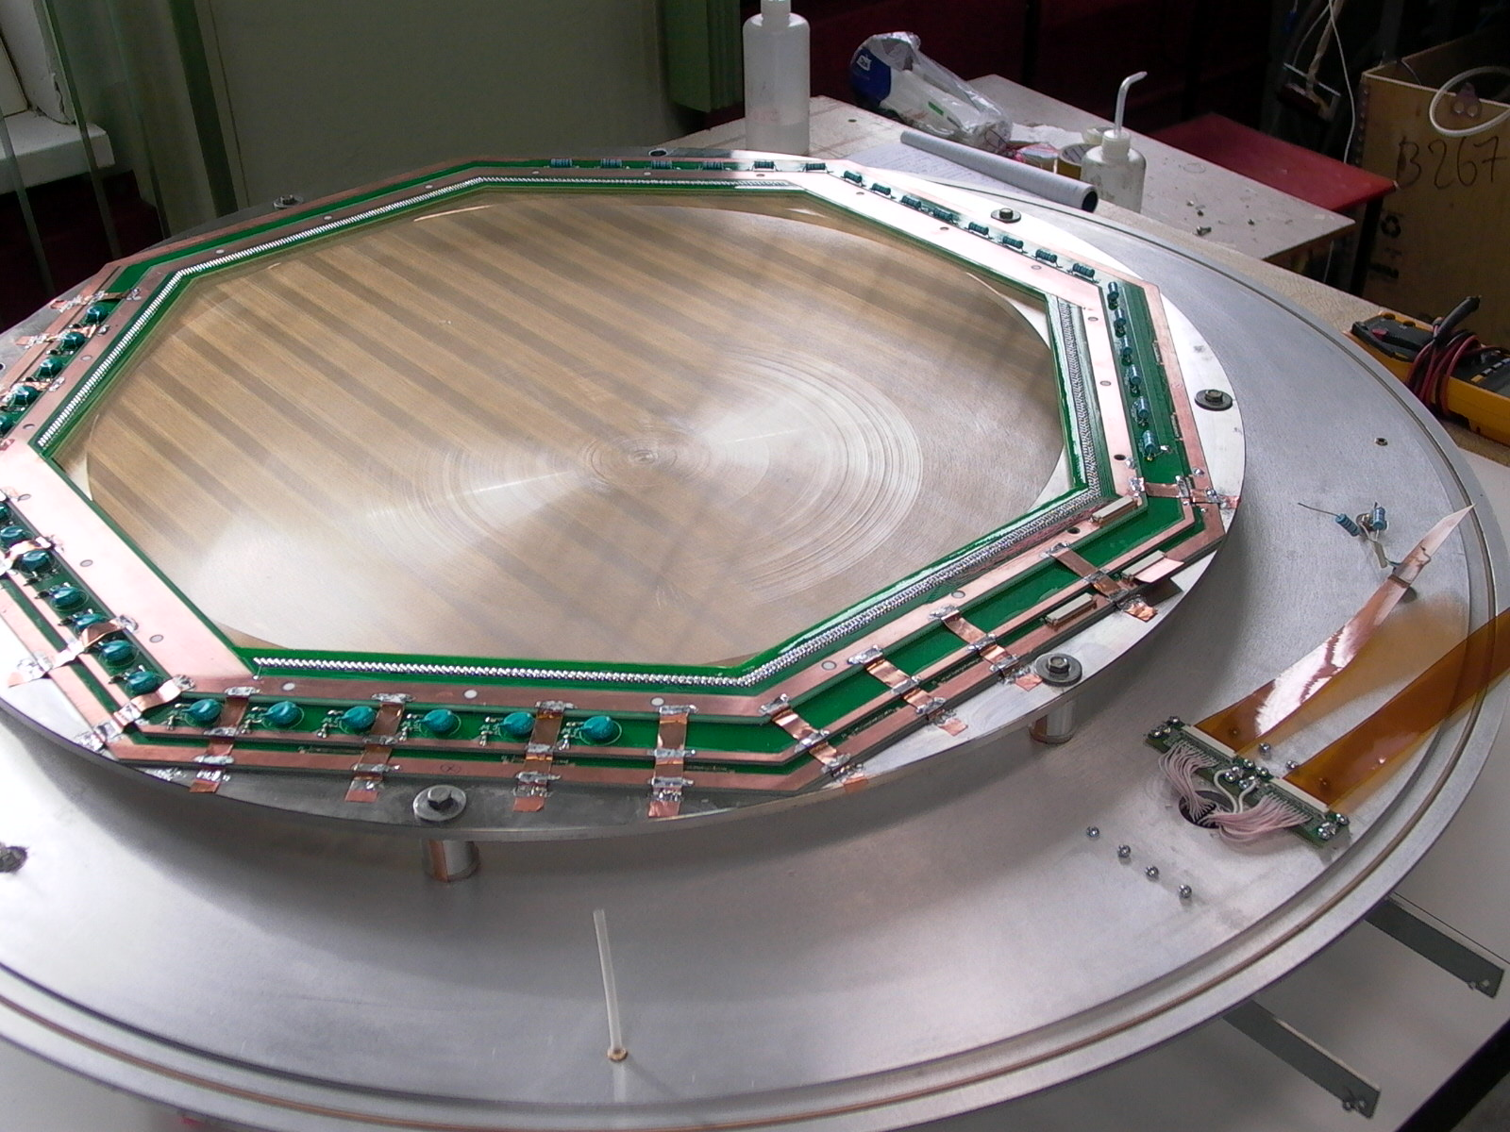
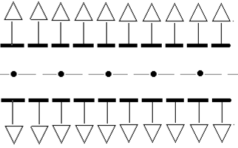
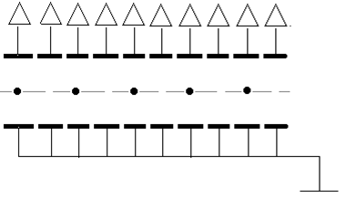
Experimental studies of the MWPCs performance
2-d stage
Full-scale MWPC plane
Anode-cathode gap − L | 3.0 mm
Diameter of the anode wire from gold plated tungsten − 2r | 30 μm
Anode wires spacing − s | 3.0 mm
Anode wire tension, − T_{a} | ∼100 g
Cathode wires spacing − s_{cath} | 0.5 mm
Cathode wires tension − T_{cath} | ∼120 g
Maximum anode and cathode wires length − ℓ | 600 mm
Pressure of the working gas mixture | 20 bar
Working gas mixture | 97%Ar + 3%CH₄
Scheme of the cosmic ray signals registration with 2 x 24ch preamps attached to both cathode planes. Cathode strips (from the top and bottom planes) signals are combined
Scheme of ⁵⁵Fe signal registration with 24ch preamp attached to the cathode plane

Slide 8
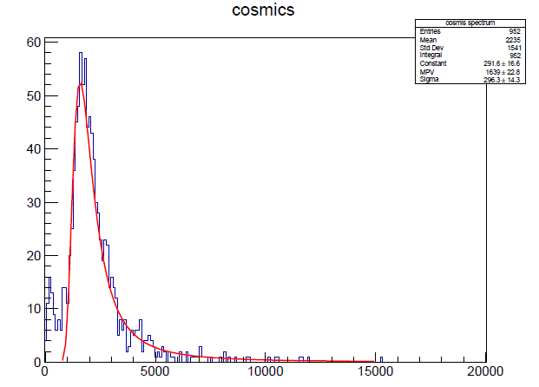
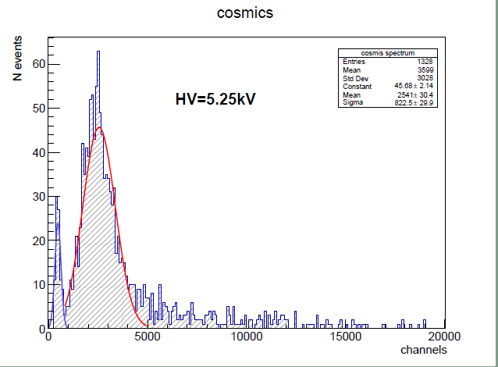
Experimental studies of the MWPCs performance
Cosmic test with 97%Ar+3%CH₄ at 20 bar
But. ⁵⁵Fe peak is at 463 ch, therefore
Q_{GG} = 463 × 76.3 [ē /ch] = 35327 ē
GG = Q_{GG} /(224 × 0.4 ×0.5) = 788 !!
HV=5.20kV
GG = 472
HV=5.25kV
1 channel ←→ 76.3 ē
Shaping time of preamp 1 μm
GG = 536

Slide 9
Experimental studies of the MWPCs performance
~1000 ē of the track are distributed along two 3 mm gaps. The electrons maximum drift time toward the anode wire is ~ 300 ns (at E ~ 10 kV/cm electrons velocity is 11 µm/ns ), thus inducing of the charge on the strips is smeared over this period.
All 224 ē from the photon conversion point drift to the anode wire simultaneously, and charge inducing on the strips starts the right after the avalanche.

Slide 10
Experimental studies of the MWPCs performance
CONCLUSION
MWPC performance is completed as a result of experimental studies:
electric field geometry is optimized
gas mixture: 97%Ar+3%CH4
HV work point: ~5300 V
OUTLOOK
measuring of the coordinate resolution

Slide 11

Thank you for attention

Slide 12
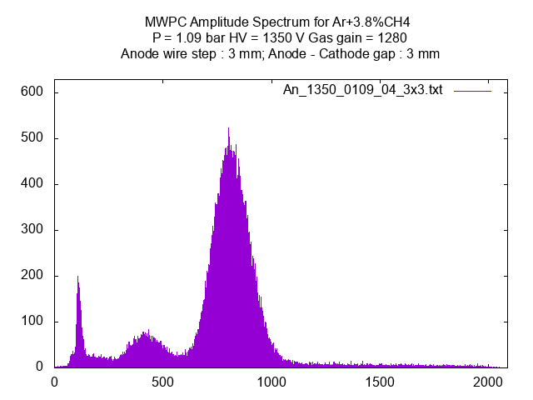
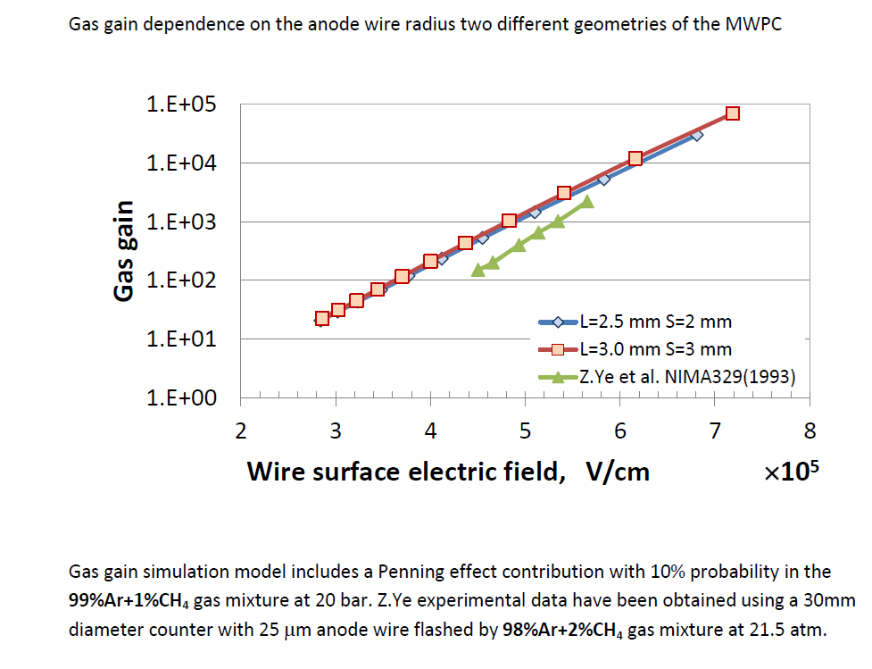

Experimental studies of the MWPCs performance
Peak in P_{pos_I} = 808 ch corresponds to E_{g} = 5.9 keV (FWHM = 200 ch) and a smaller one in P_{pos_II} = 404 ch is escape peak with E_{g} = 2.9 keV. Energy resolution determined from the width of the peak is 25%. Left part of the spectrum associated with noise of environment (can be improved by additional grounding).
Calibration function of PA (in charge unit per histogram channel):
F_{cal} (n_{ch})[fC/ch] = 0.027976 × n_{ch} + 0.039881.
With shaping time ∼ 4 µs and amplitude calibration 132 mV per1 fC gas gain (GG) can be shown as:
$GG=\text{Q}\text{peak} \text{/}\text{(}\text{Q}\text{ioniz}×\text{0.4 ) = }$1280
Another way to evaluate GG is a GARFIELD simulation
R.K. Manchanda, Z. Ye and R.K. Sood
Ultra-high-pressure proportional counter
NIMA 292(1990) 373-385

