Slide 1
TPC construction. Design of the electric field in TPC
Kuzma Ivshin (PNPI)

Slide 2
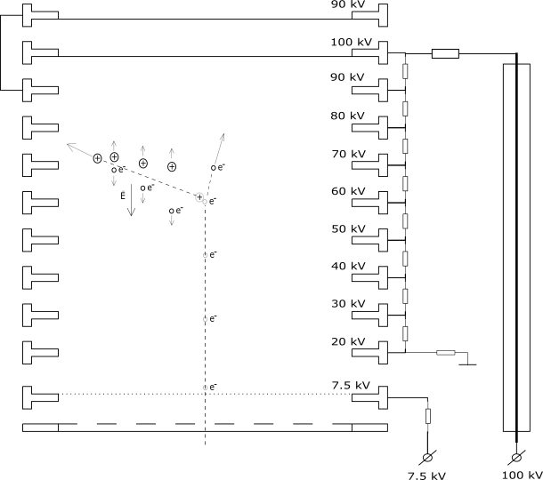
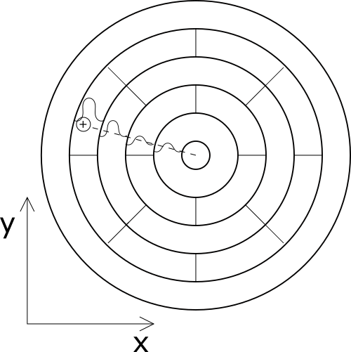
TPC construction

Slide 3
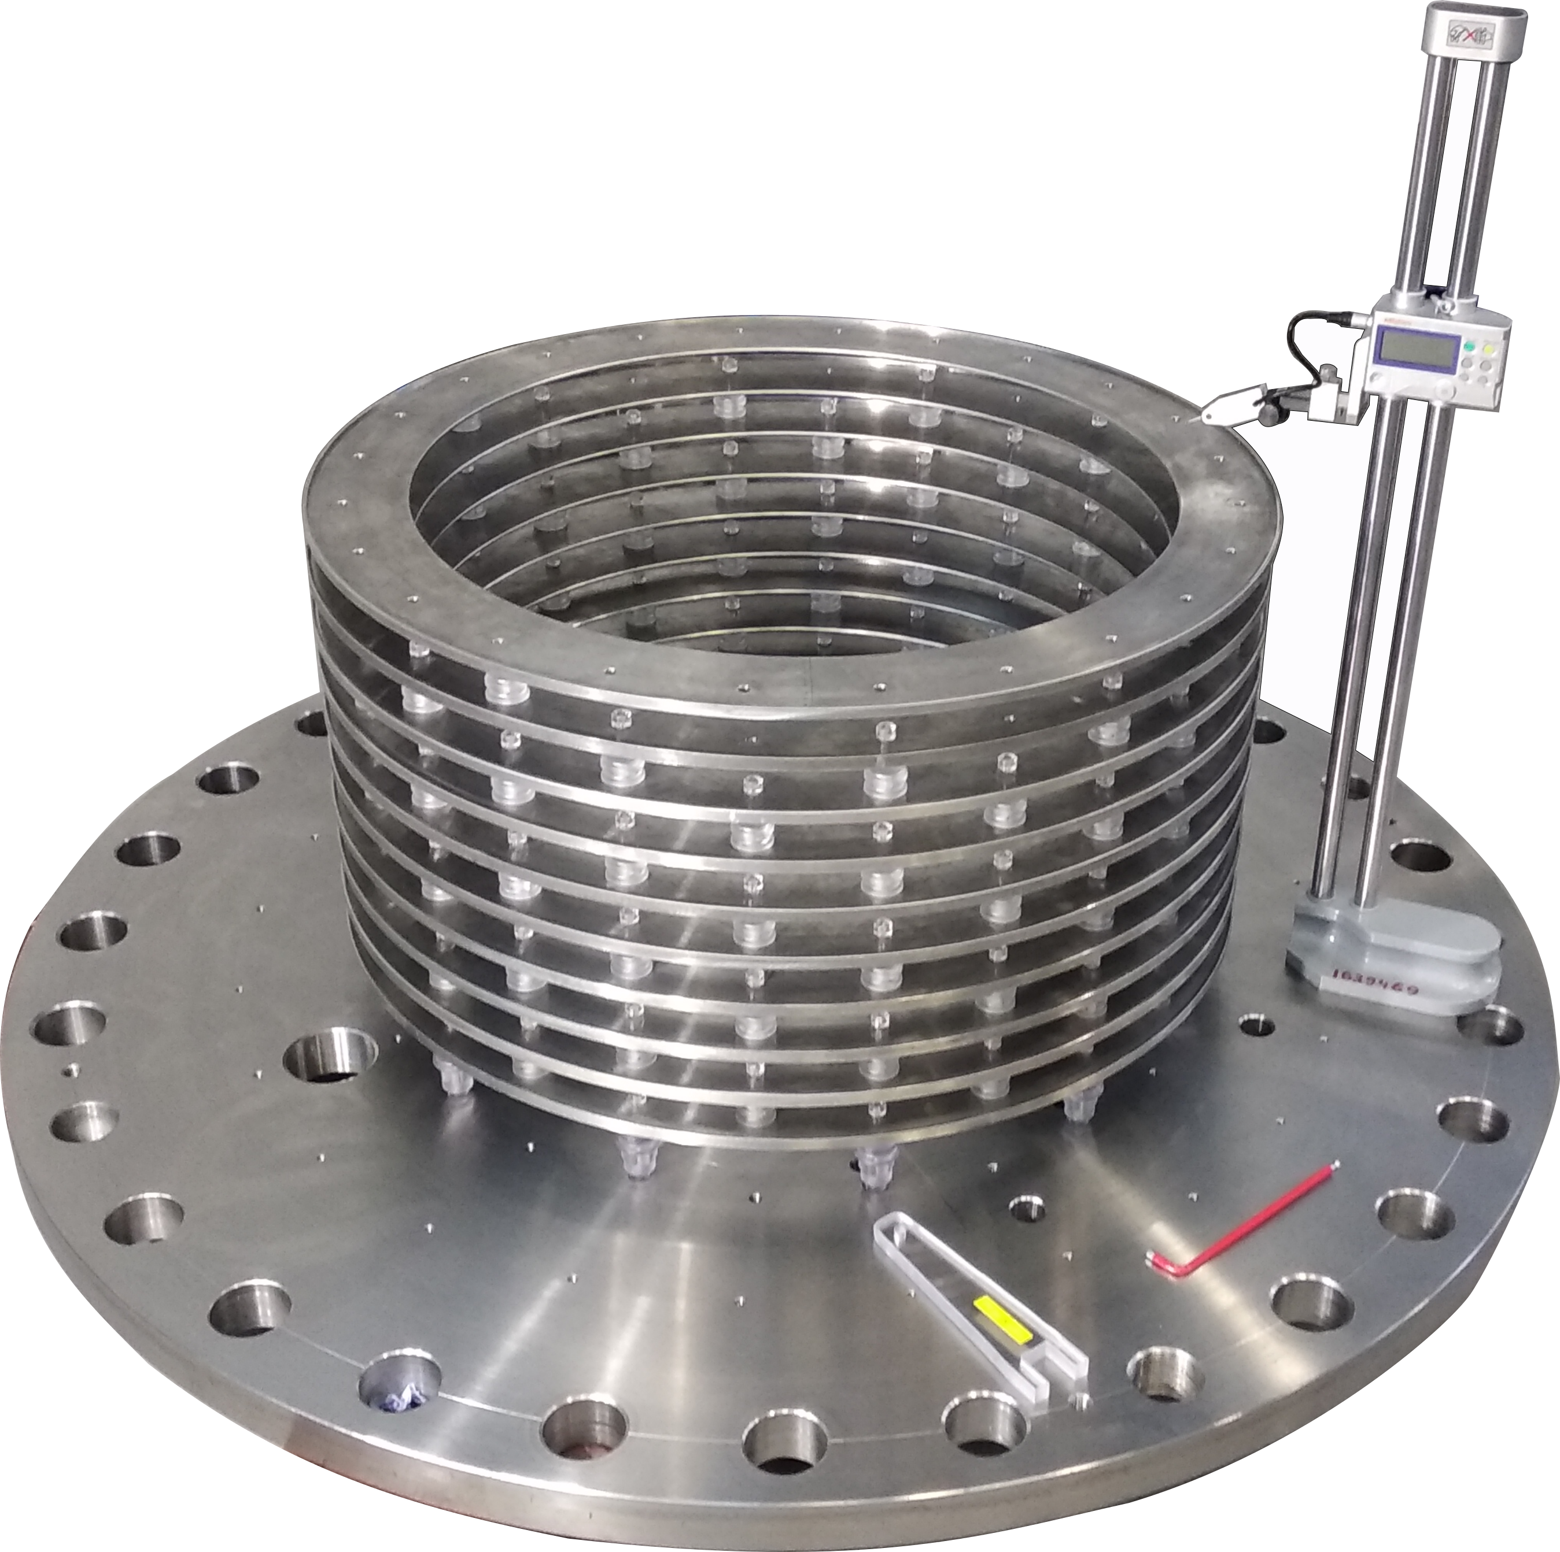
TPC construction

Slide 4
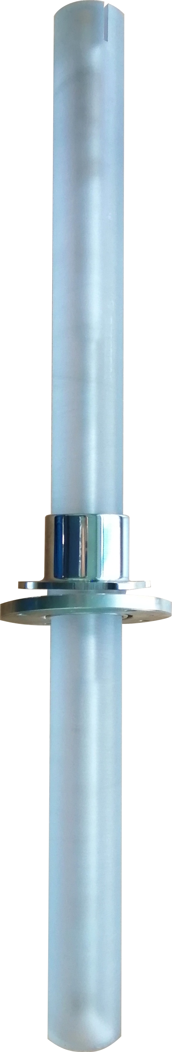
TPC construction

Slide 5
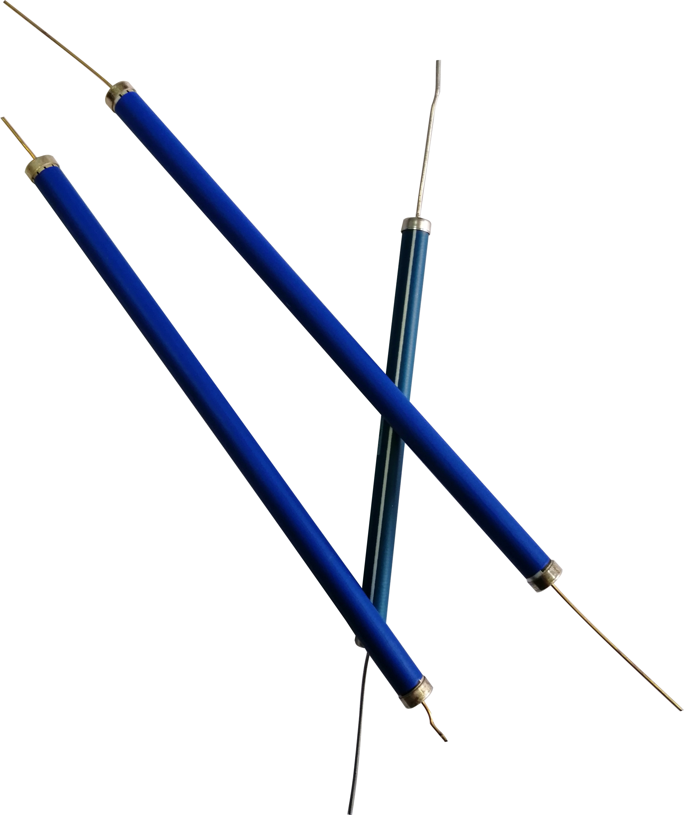
TPC construction
1-2 MOhm
1 GOhm
1.04668 GOhm
1.04668 GOhm
1.04668 GOhm
1.04668 GOhm
1.04668 GOhm
1.04668 GOhm
1.04668 GOhm
2.03627 GOhm

Slide 6
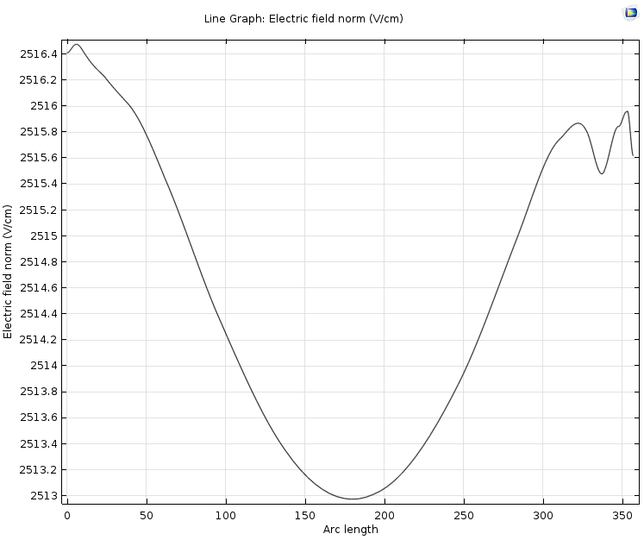
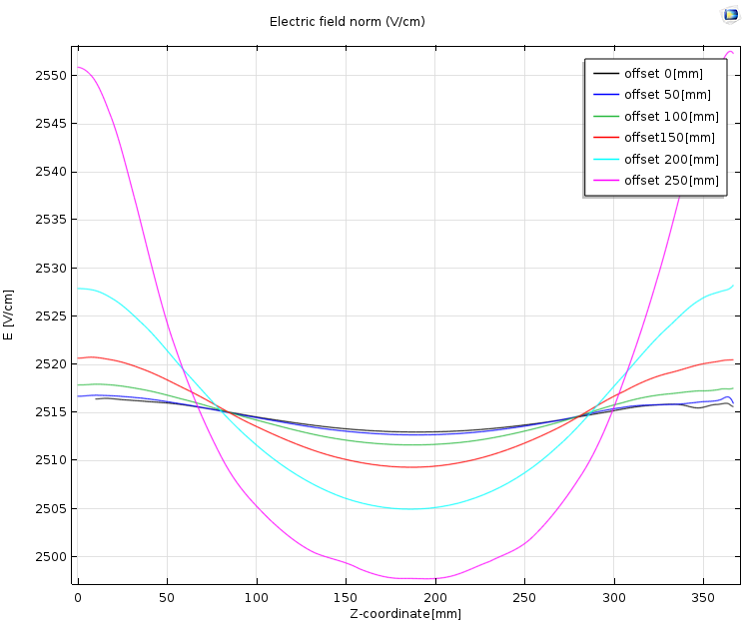
Modeling with fixed step potential
Coordinate of leveling ring (mm) | Potential on the ring (V)
0 | 7500
48.25 | 20000
88.45 | 30000
128.65 | 40000
168.85 | 50000
209.05 | 60000
249.25 | 70000
289.45 | 80000
329.65 | 90000
369.85 | 100000
Offset [mm] | Homoginity [%]
0 | 0.13
50 | 0.15
100 | 0.19
150 | 0.47
200 | 0.87
250 | 2.07

Slide 7
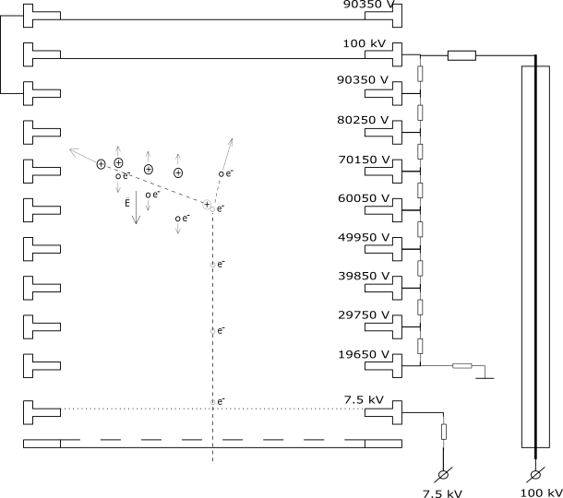
Modeling with calculated ring’s potentials
Coordinate of leveling ring (mm) | Potential on the ring (V)
0 | 7500
48.25 | 19650
88.45 | 29750
128.65 | 39850
168.85 | 49950
209.05 | 60050
249.25 | 70150
289.45 | 80250
329.65 | 90350
369.85 | 100000

Slide 8
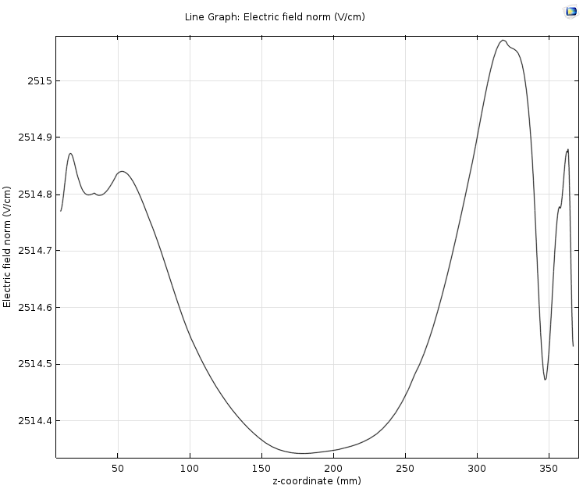
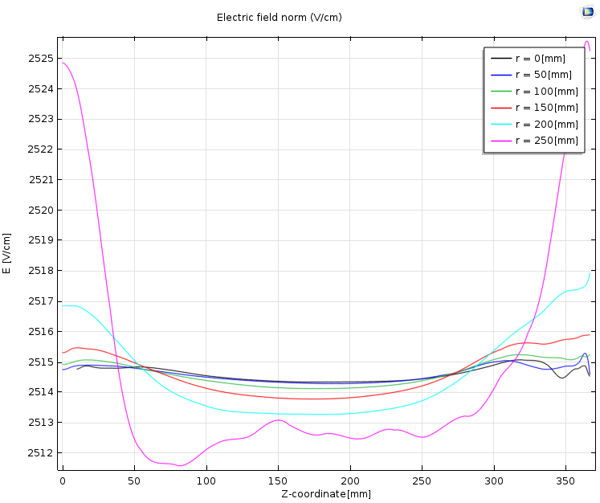
Modeling with leveling rings offsets
Coordinate of leveling ring (mm) | Potential on the ring (V)
0 | 7500
48.25 | 19650
88.45 | 29750
128.65 | 39850
168.85 | 49950
209.05 | 60050
249.25 | 70150
289.45 | 80250
329.65 | 90350
369.85 | 100000
Offset [mm] | Homoginity [%]
0 | 0.028
50 | 0.031
100 | 0.043
150 | 0.087
200 | 0.15
250 | 0.51

Slide 9
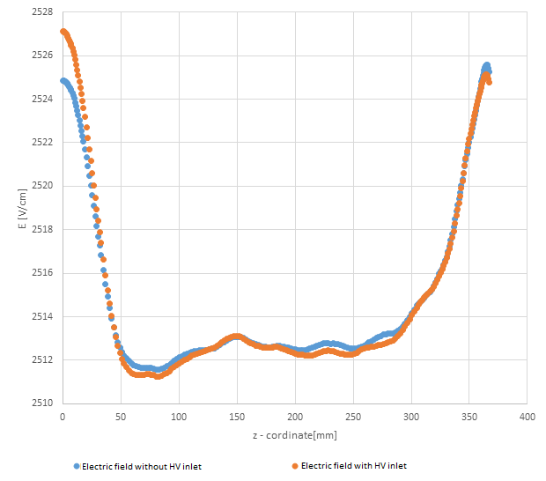
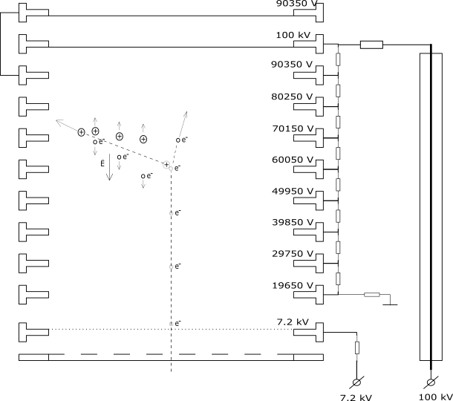
Modeling with HV inlet

