Slide 1
PRES test runs:
2019 results
2021+ preparations

Slide 2
Requirements
Beam monitoring system
Beam counter
  Number of beam electrons with uncertainty of 0.1%
  Beam intensity up to 2MHz
  Minimum beam distortions
Beam position monitor
  Position uncertainty 100um
  Feedback signal to accelerator

Slide 3
Requirements
Beam monitoring system
Beam counter
  Number of beam electrons with uncertainty of 0.1%
  Beam intensity up to 2MHz
  Minimum beam distortions
Beam position monitor
  Position uncertainty 100um
  Feedback signal to accelerator
Scintillation counter
  absolute measurement
  pileup influence
Ionization chamber
  no pileup
  relative measurement

Slide 4
Beam counter setup (2019)
2018 problems:
No counters readout (scope)
IC current background (~10%)
IC leaks (bad measurements)
Required precision: 0.1%
2019 Goals:
IC calibration better than 0.1%
IC background less than 0.1%
SC pair time evaluation

Slide 5
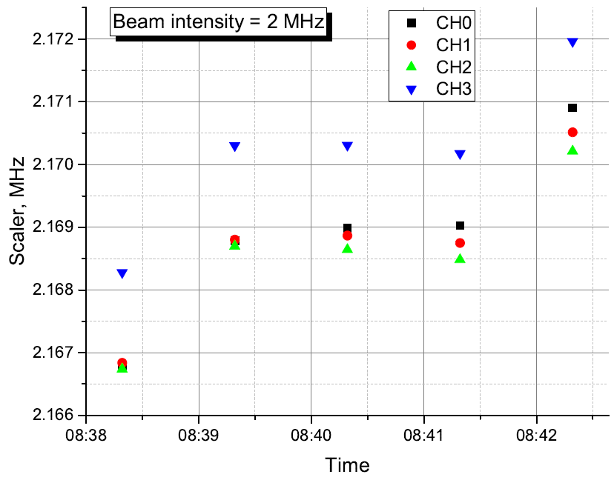
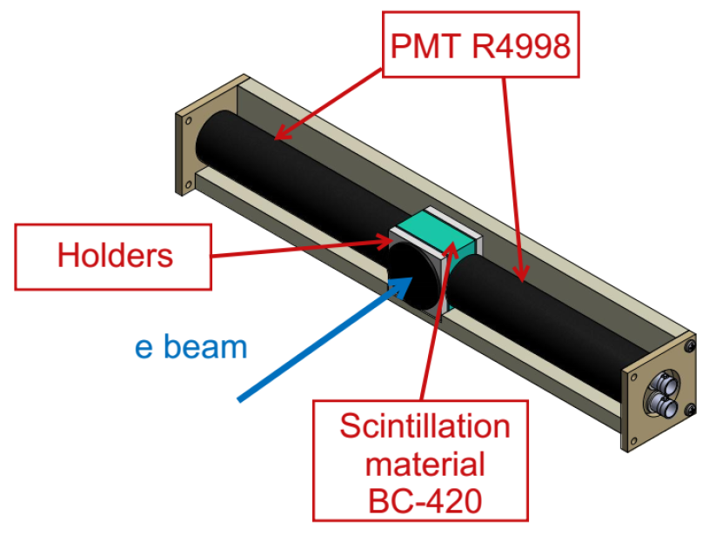
Scintillation counters

Slide 6
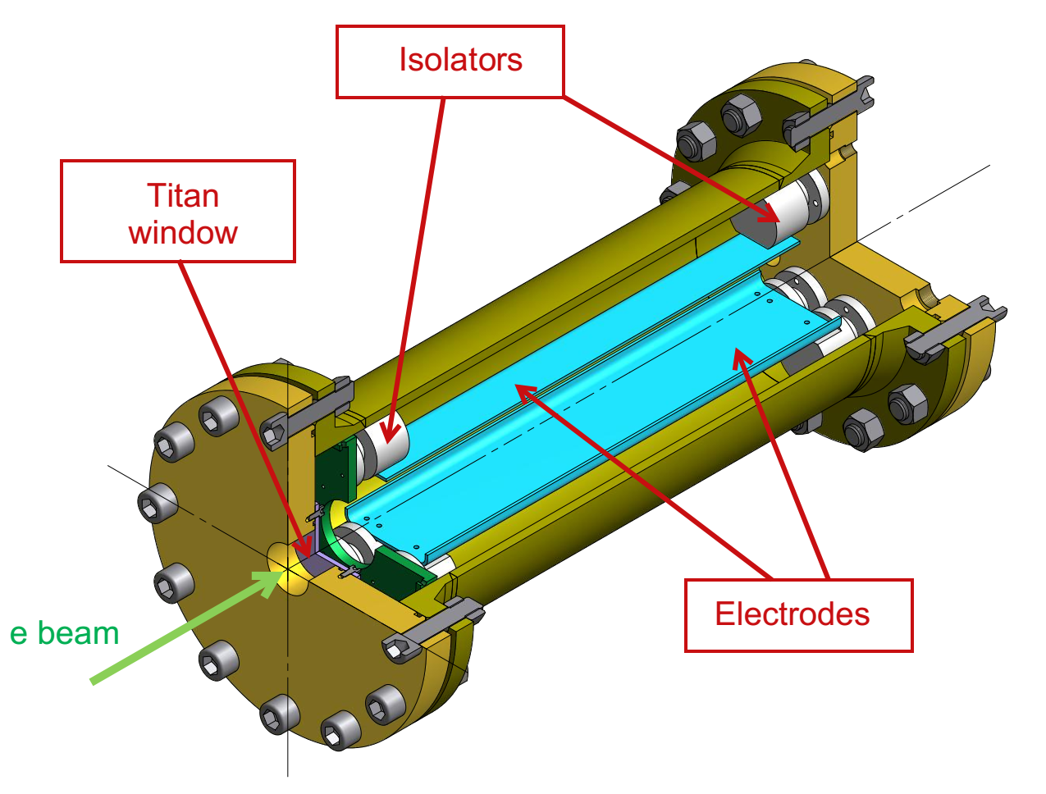
Ionization chamber

Slide 7
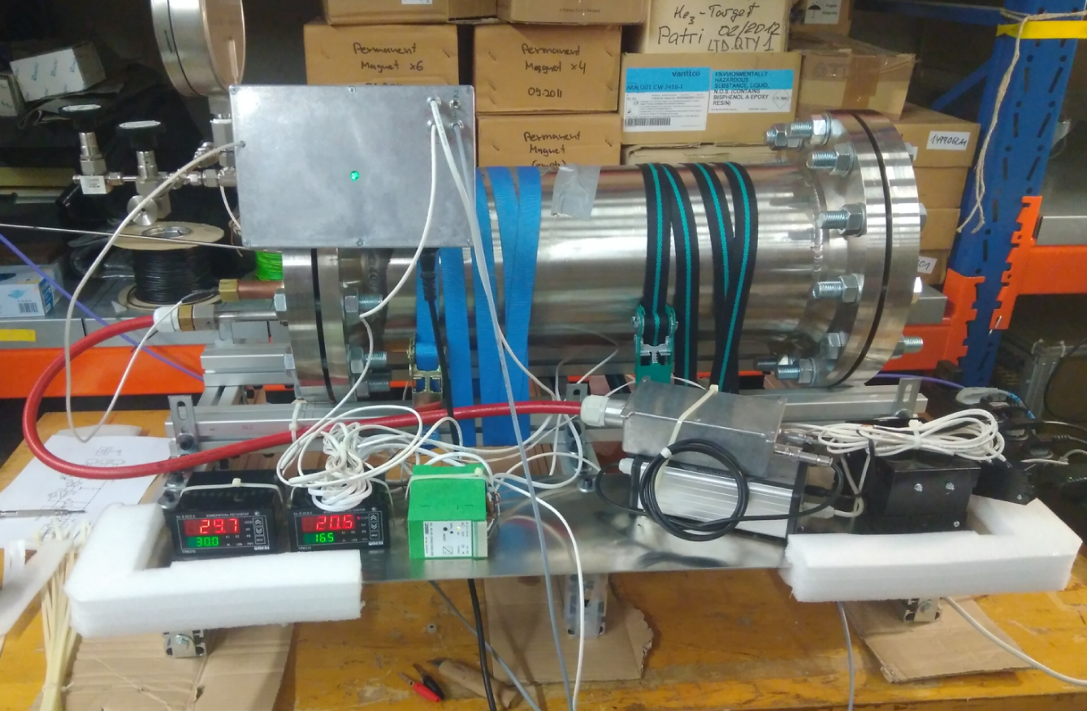
Ionization chamber
IC current amplifier
Keithley 2000
Pressure
AMP Temp.
IC Temp.
High voltage
Keithley 2700

Slide 8
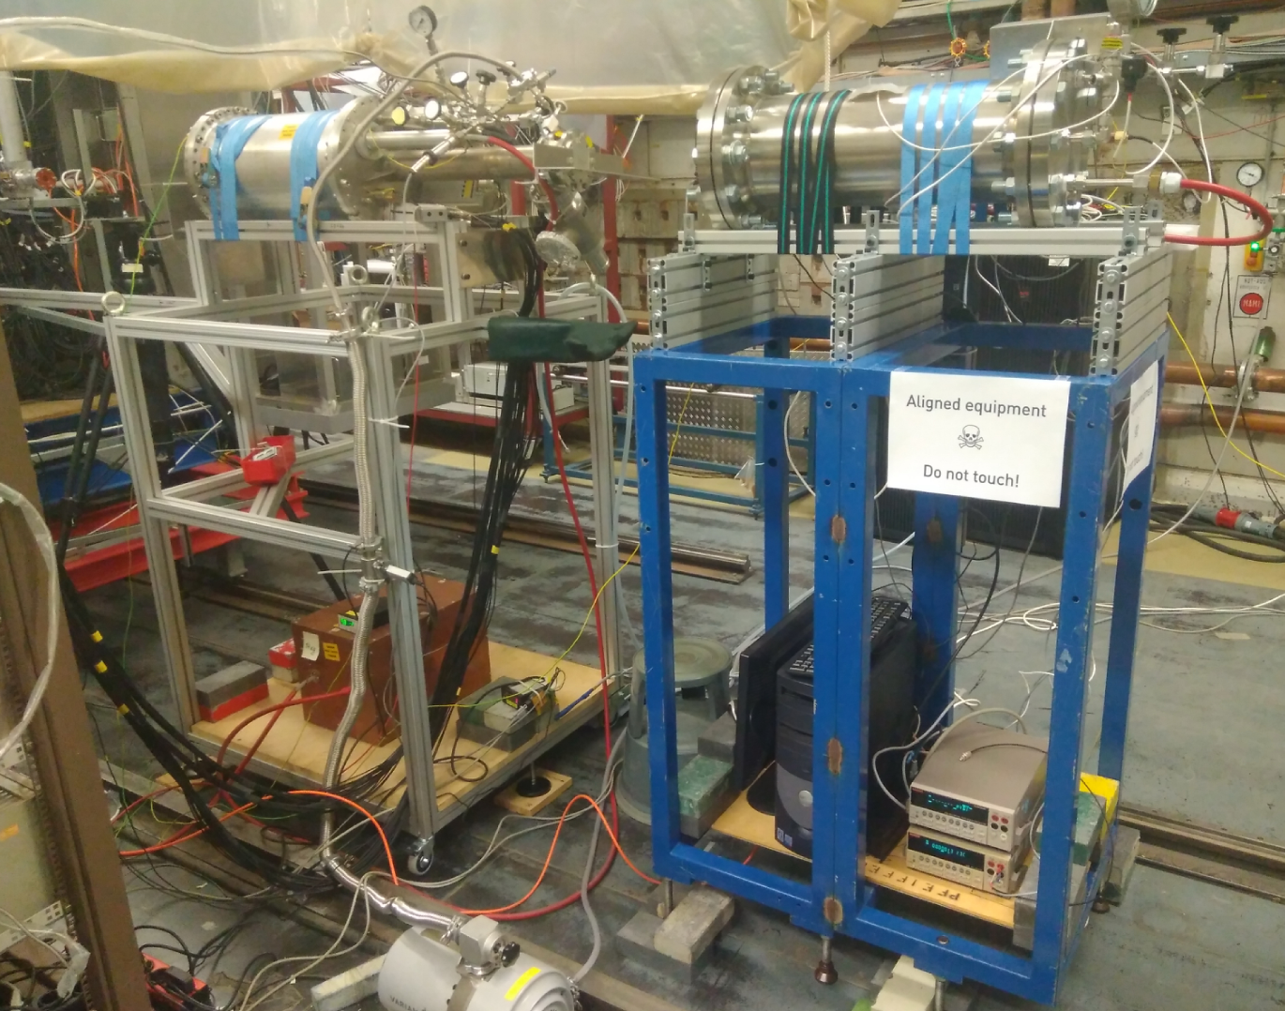
Beam setup
IC
TPC
S2,S3 position
HV control
Slow control

Slide 9
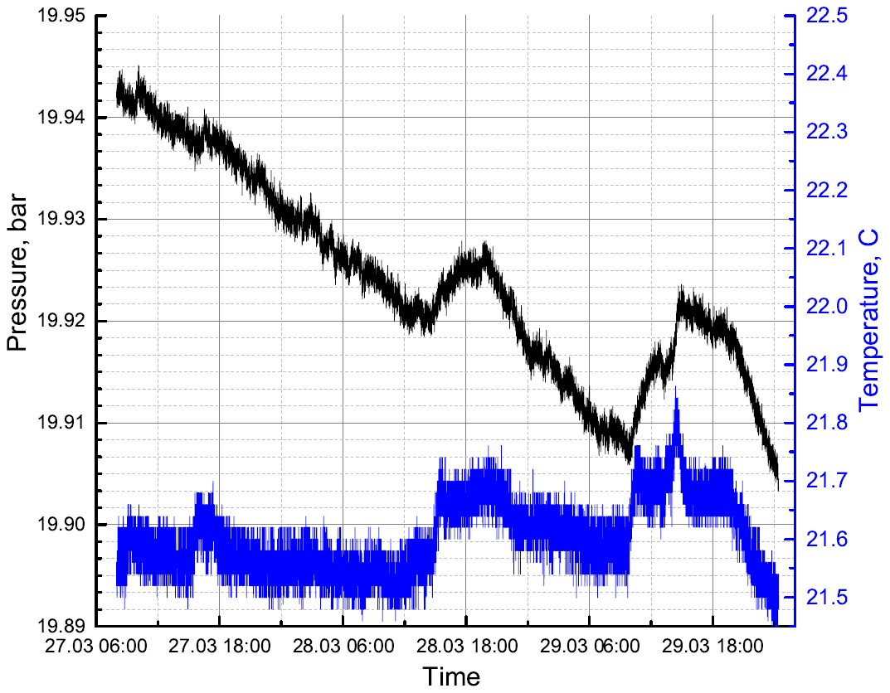
IC. Pressure and temperature
0.1% per day

Slide 10
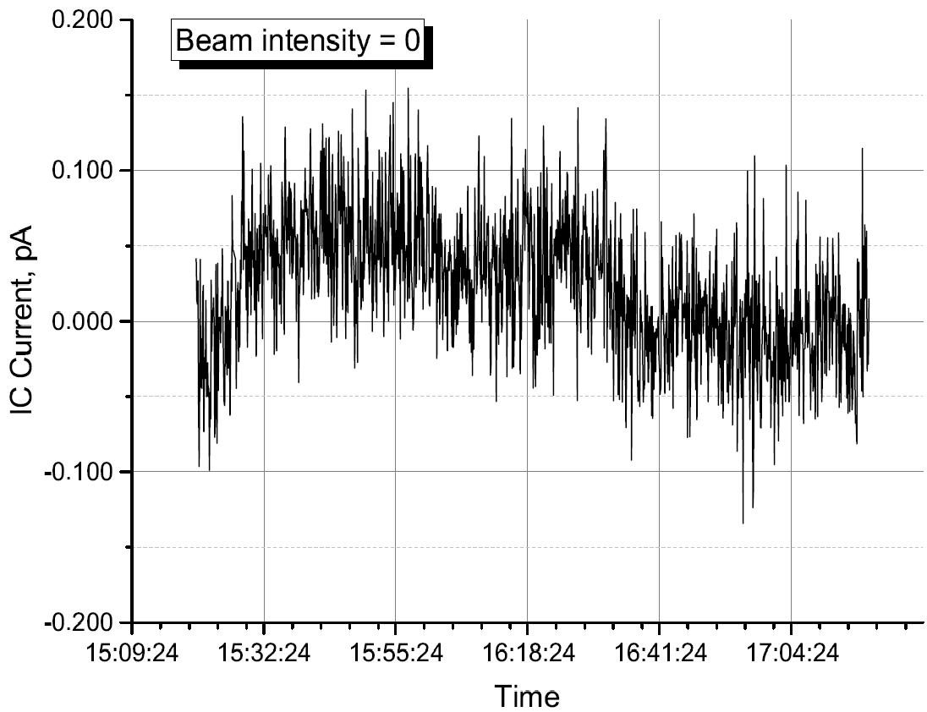
IC. Dark current
Full scale: 40nA
Background noise: 0.1 pA
SNR: 2.5E-6
Notes:
Amplier signal -> Keithley 2000 multimeter, the same as in 2018,
but 200ms measurement period and with averaging by 10 samples.
Thus the sampling time was 2 seconds instead of 20ms in 2018.
Total measurement time - 6 seconds.
All other parameters were measured with Keithley 2700 withing the same 6 seconds during the ionization current acquisition.

Slide 11
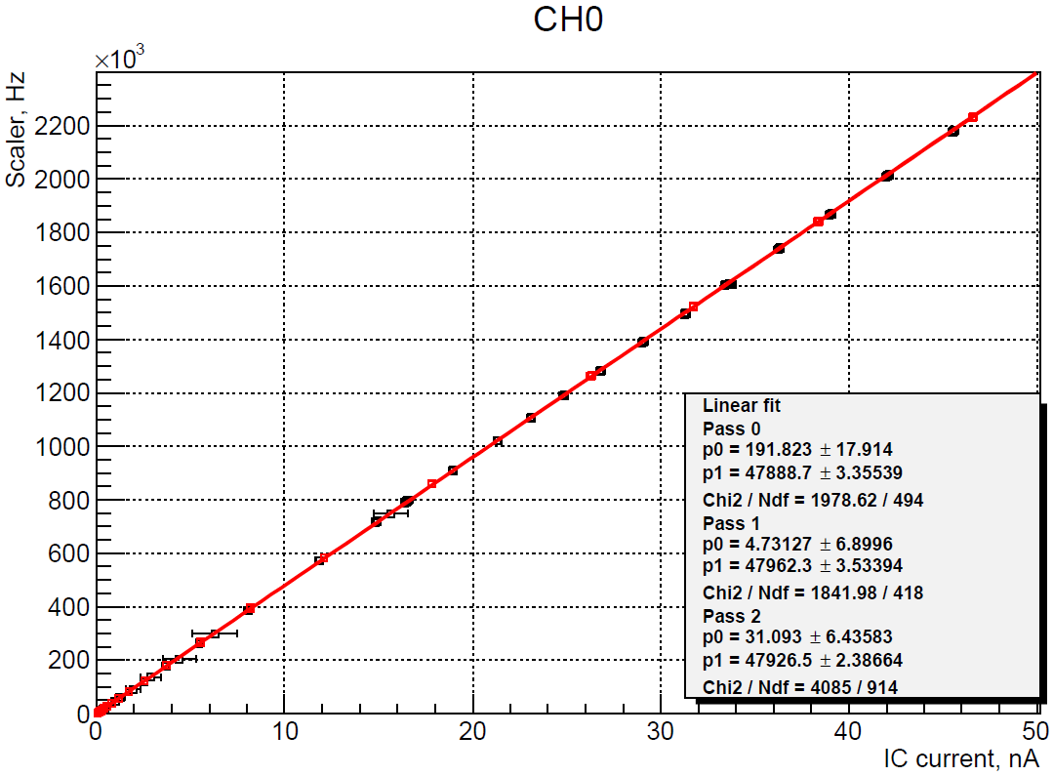
IC calibration
Hi->Lo
Lo->Hi
0.01%
Combined
Notes:
All 4 channels!

Slide 12
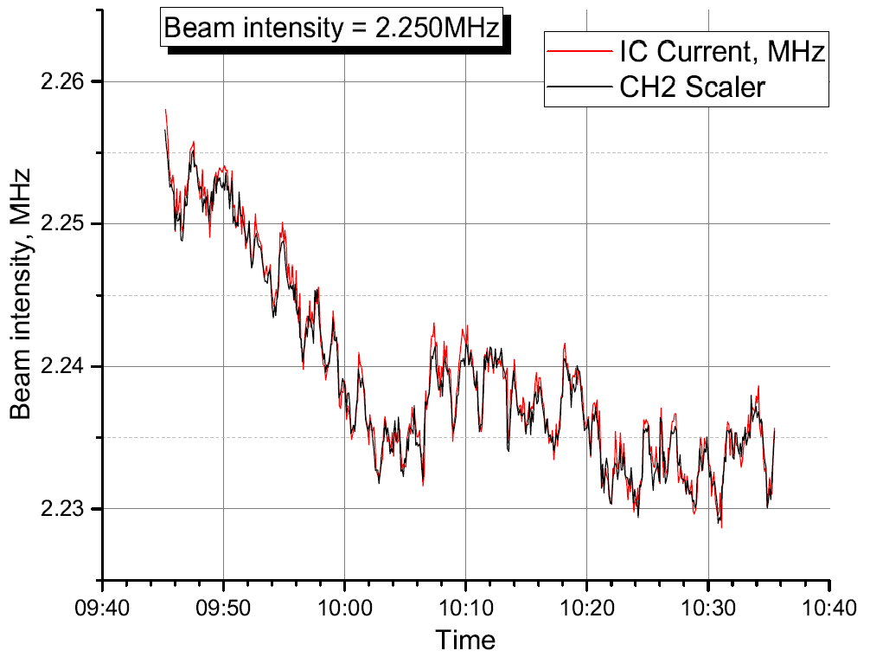
Time structure of the beam (S1 CH2)

Slide 13
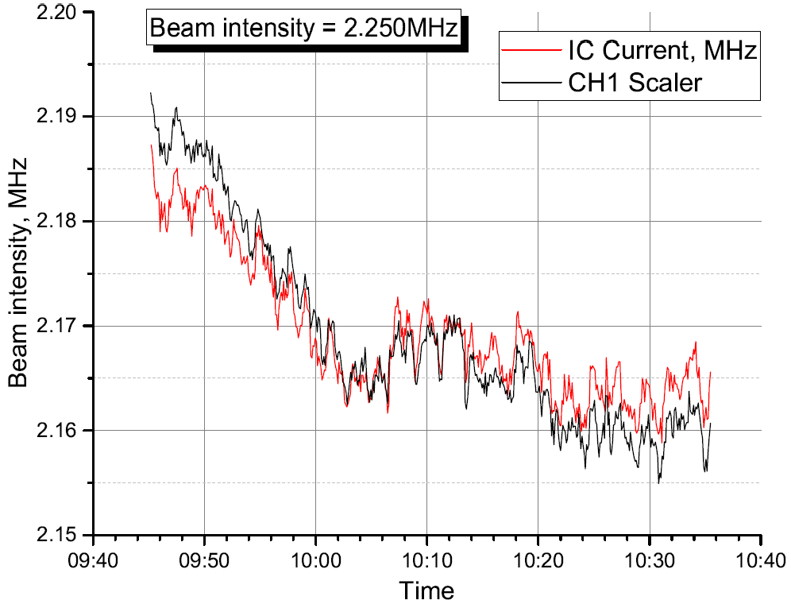
Time structure of the beam (S2 CH1)

Slide 14
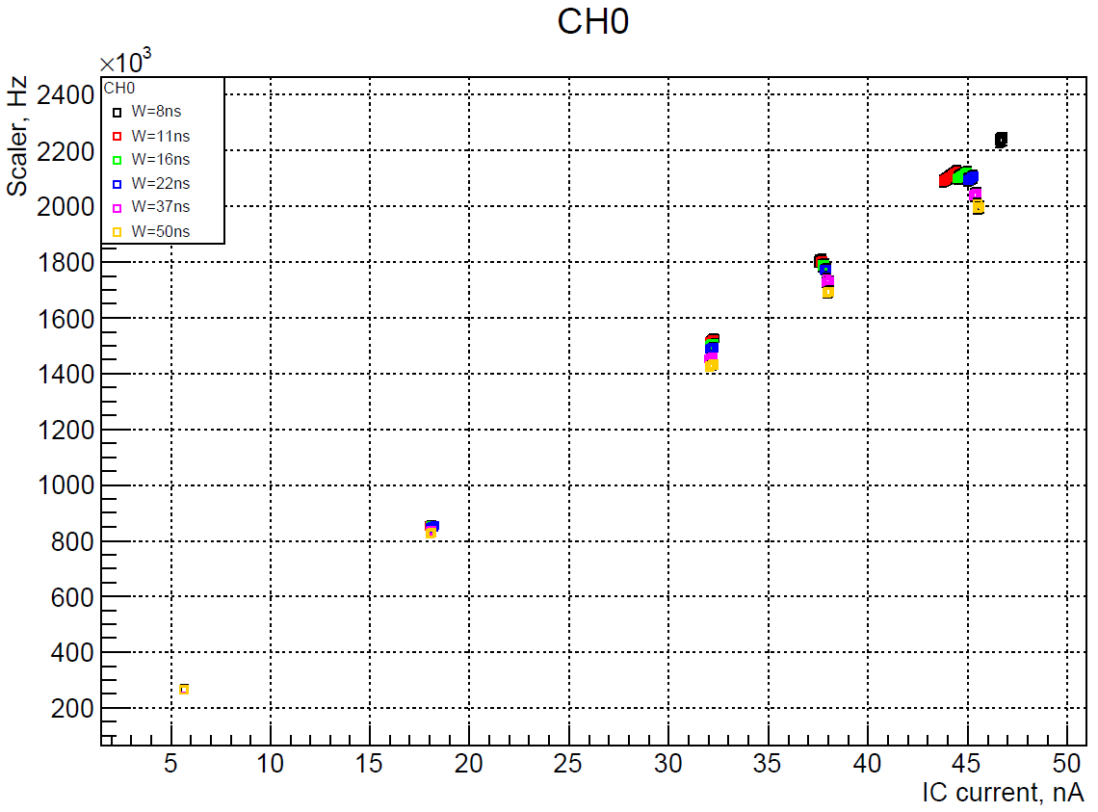
Pair time investigation
Signal width = PMT width + NINO stretching
Notes:
PMT = 5ns
We add to this data calibration measurements at low intensity and evaluate tau from quadratic fit

Slide 15
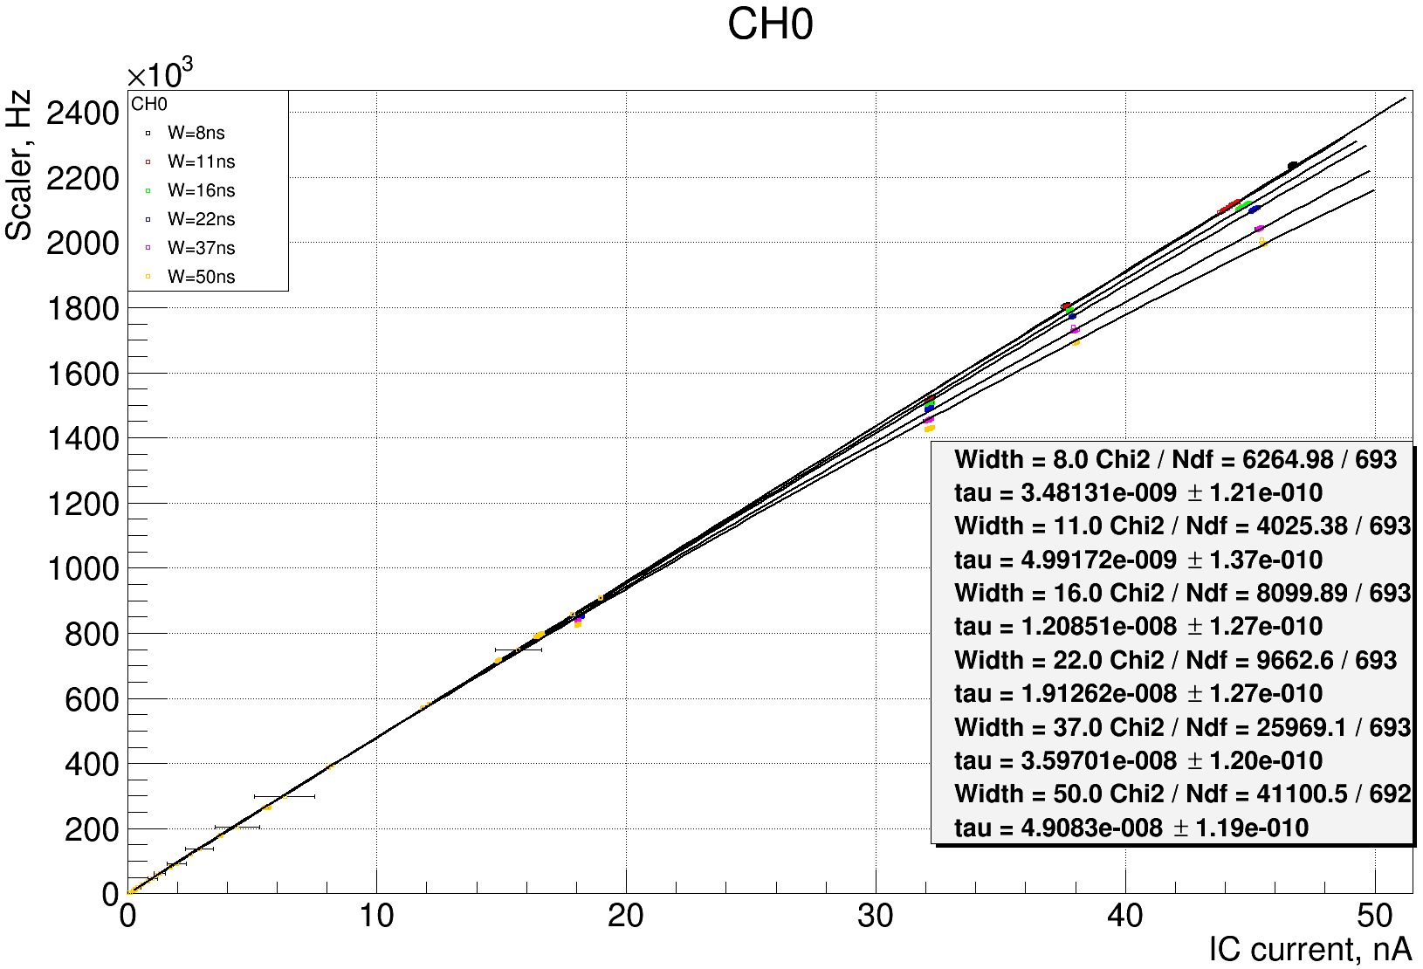
Notes:
I_LIN = 20nA

Slide 16
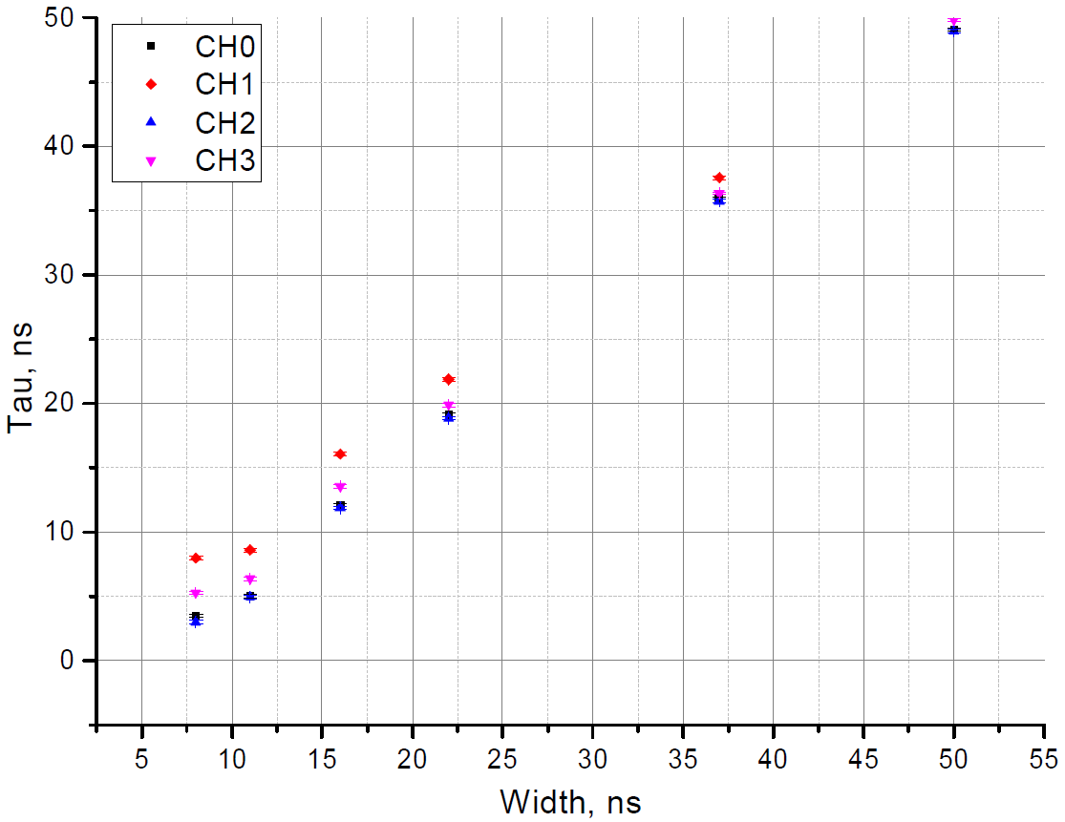
IC measurements
at high intensity needed!

Slide 17
Conclusion
Background of ionization chamber current measurement: 2.5E-6
IC Pressure stability: 0.1% per day.
Ionization chamber calibrated to 0.01%
Pair time evaluation from signal stretching works,
but underestimates the result (IC non-linearity?)
Difference between SC channels?
Off-axis counter can be used for indirect beam
intensity measurements, but with stable beam positioning
2018 problems:
No counters readout (scope)
IC current background (~10%)
IC leaks (bad measurements)
Required precision: 0.1%
2019 Goals:
IC calibration better than 0.1%
IC background less than 0.1%
Sc pair time evaluation

Slide 18
Requirements
Beam monitoring system
Beam counter
  Number of beam electrons with uncertainty of 0.1%
  Beam intensity up to 2MHz
  Minimum beam distortions
Beam position monitor
  Position uncertainty 100um
  Feedback signal to accelerator
Detector type: proportional chamber
Current mode: fA amplifier
Time constant: seconds
Signal processing choice
Accuracy and sensitivity investigation

Slide 19
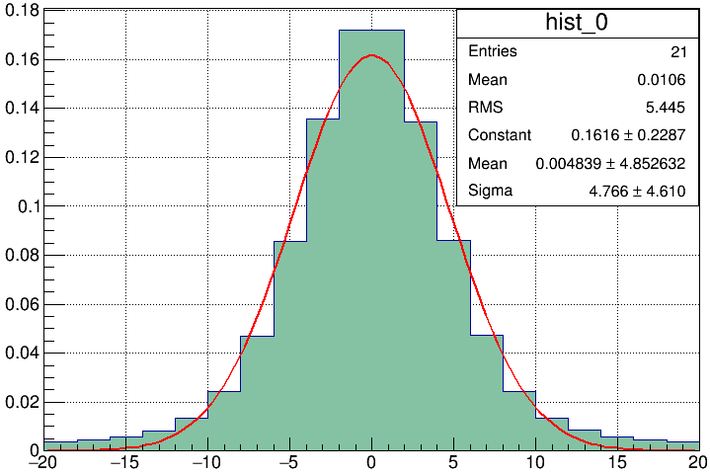
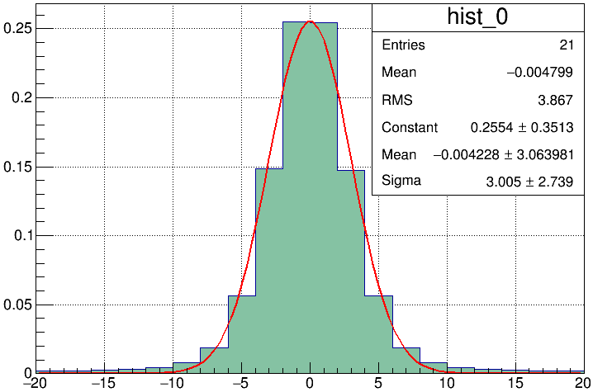
Beam profile MC
20 bar
5 bar

Slide 20
Beam position monitor
1.8kV
Ar+30%CO2
Aperture: 40x40mm
Notes:
40x40mm. Wires: 30um x 2mm, cathode: Cu foil 50um, gap=2.5mm
Ar+30%CO₂. 1.8kV

Slide 21
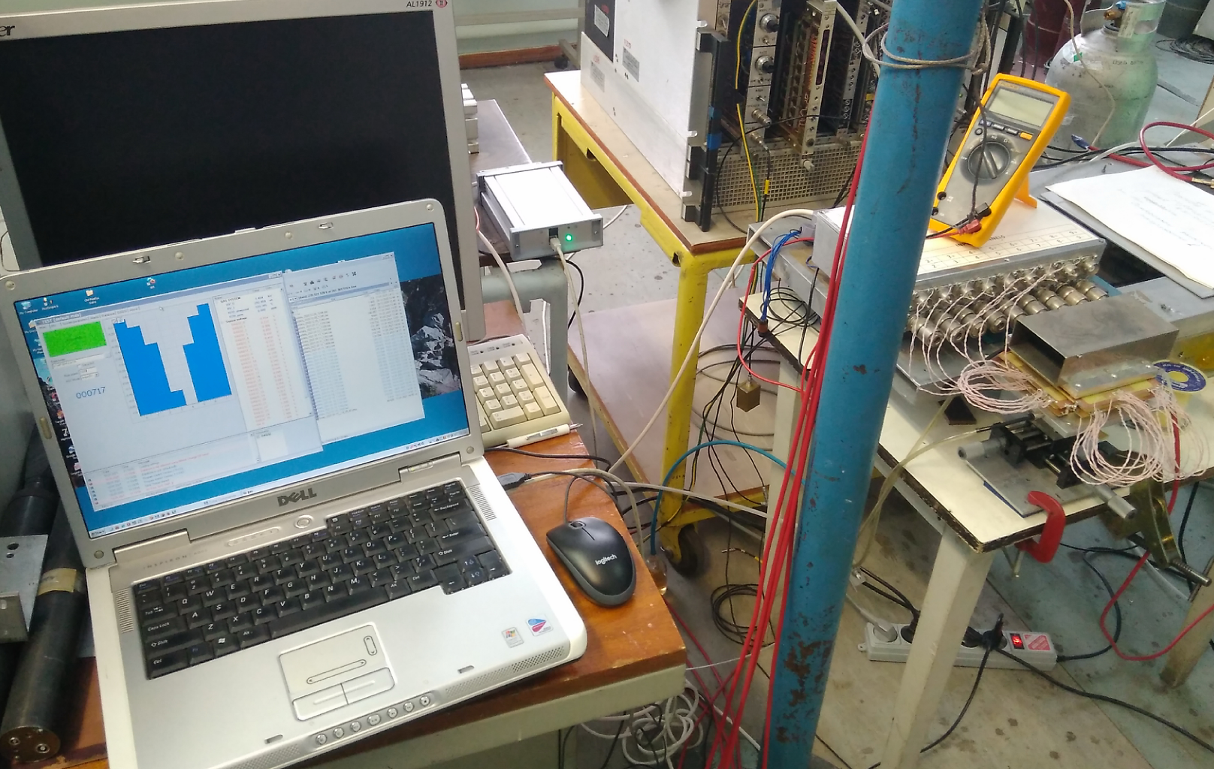
Test rig
Beam profile
ADC (32ch 16 bit)
fA Amplifier
(8 channels)
Chamber
Source,
XY-table

Slide 22
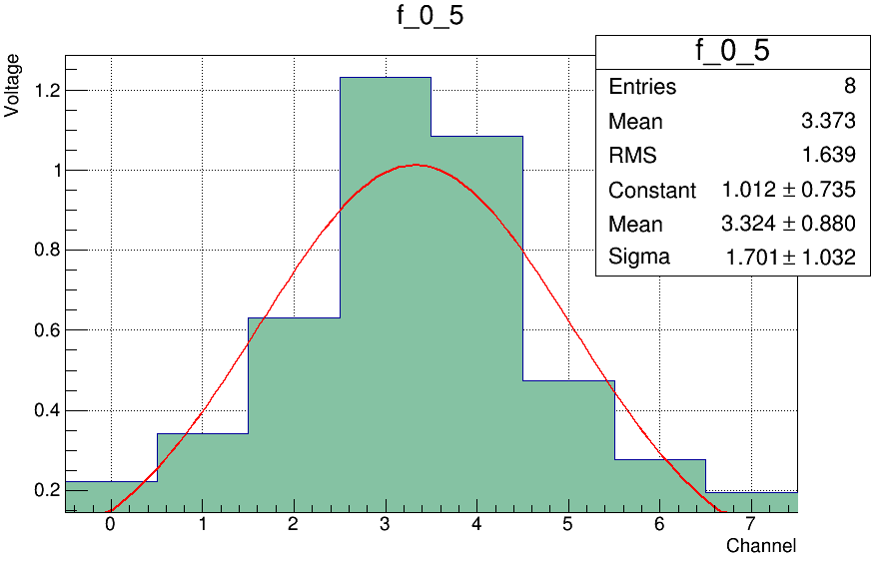
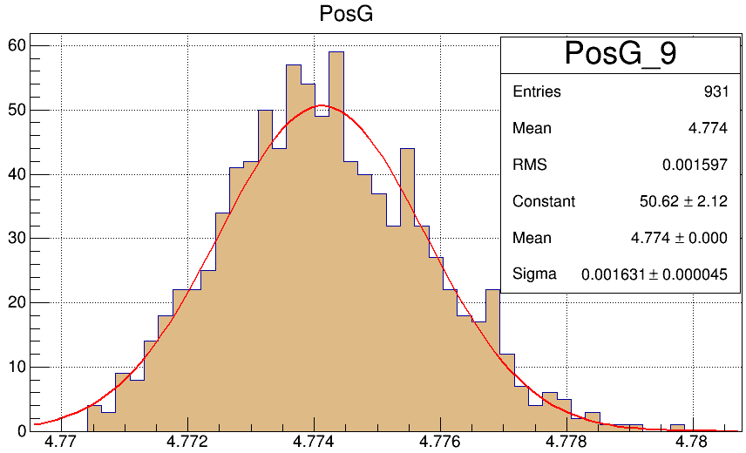
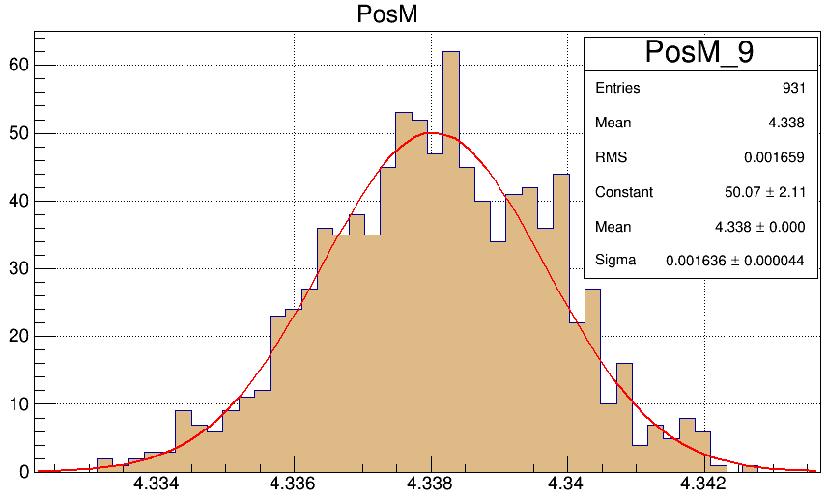
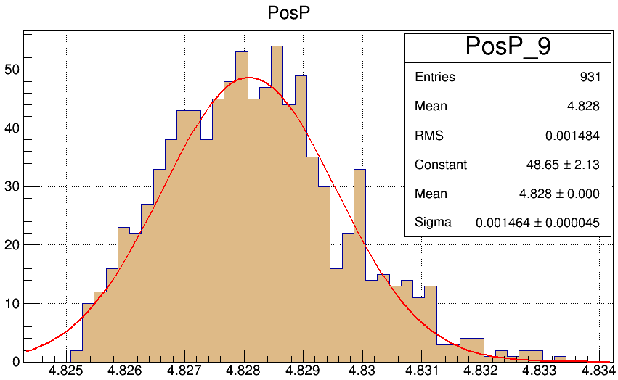
Signal processing
Raw signal
Gauss fit
Mean value
Parabola
Notes:
Gauss, mean: sigma=3.2um
Parabola: sigma=3um (analytic fit in three peak points)
In terms of sensitivity all three methods are fine

Slide 23
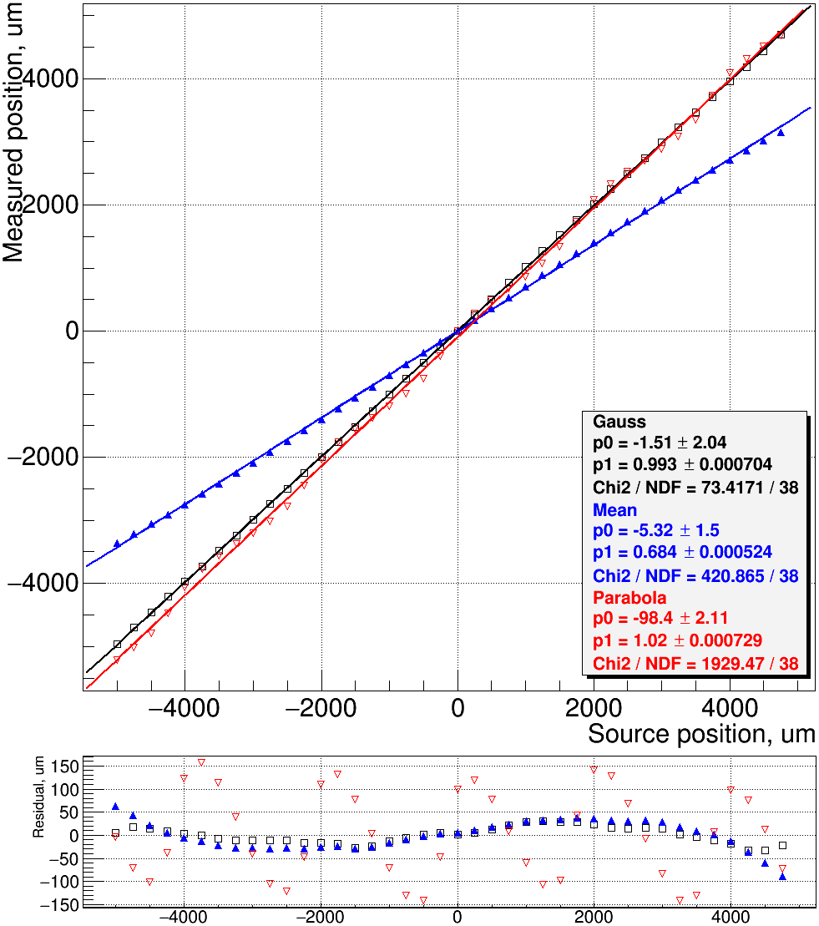
Calibration results [beam RMS=3.3mm]
Notes:
Gauss – best precision
Mean – the same relative accuracy, but different slope
Parabola – sensitive to the chamber structure (wires)

Slide 24
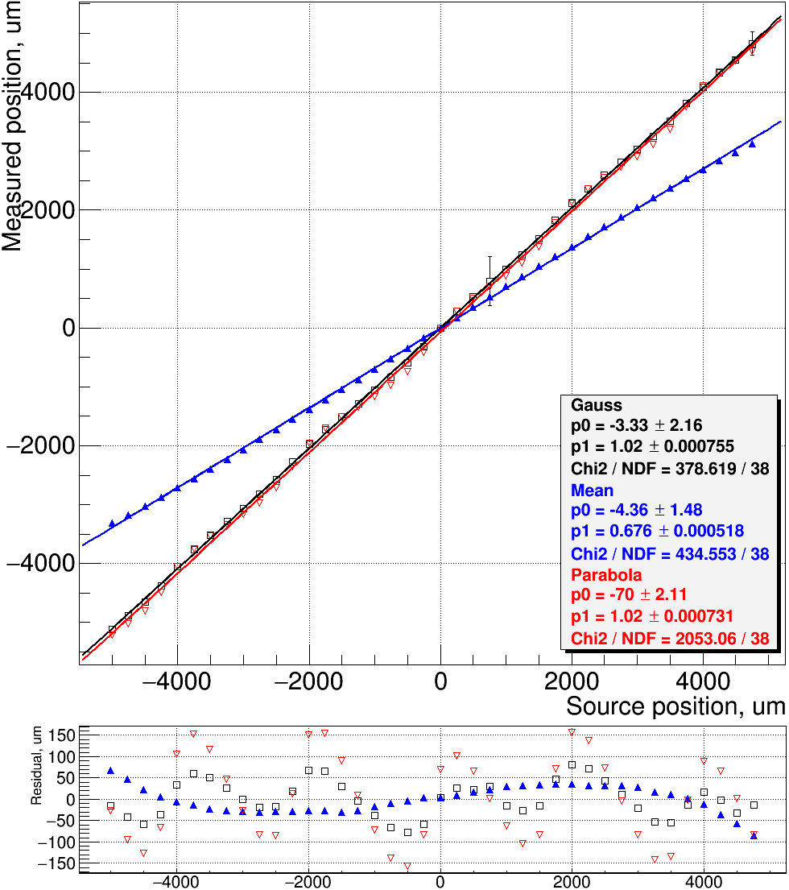
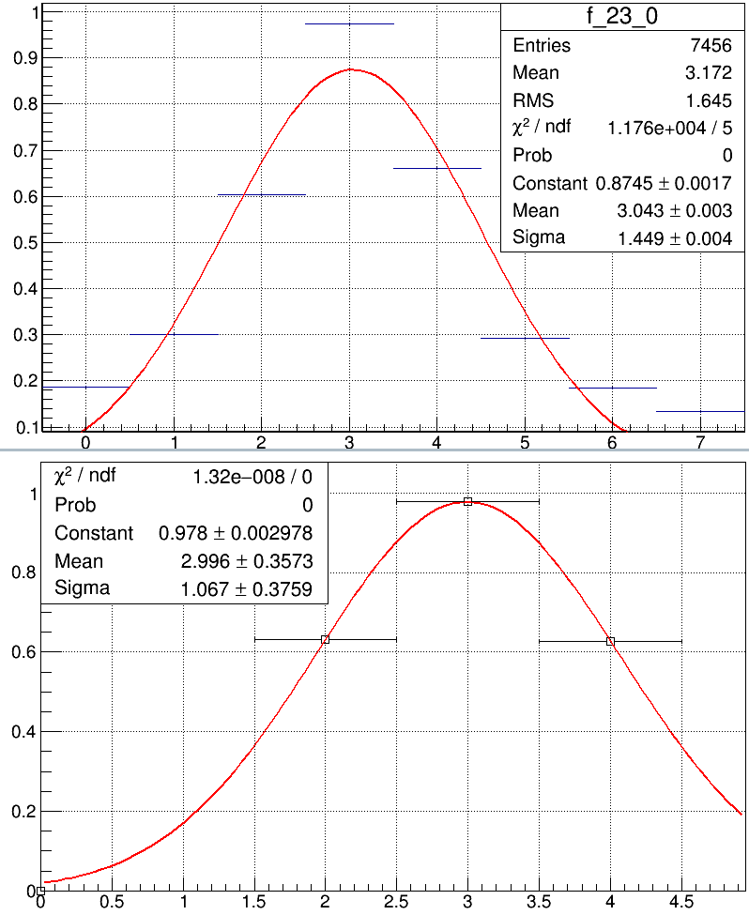
Calibration results [beam RMS=3.3mm]

Slide 25
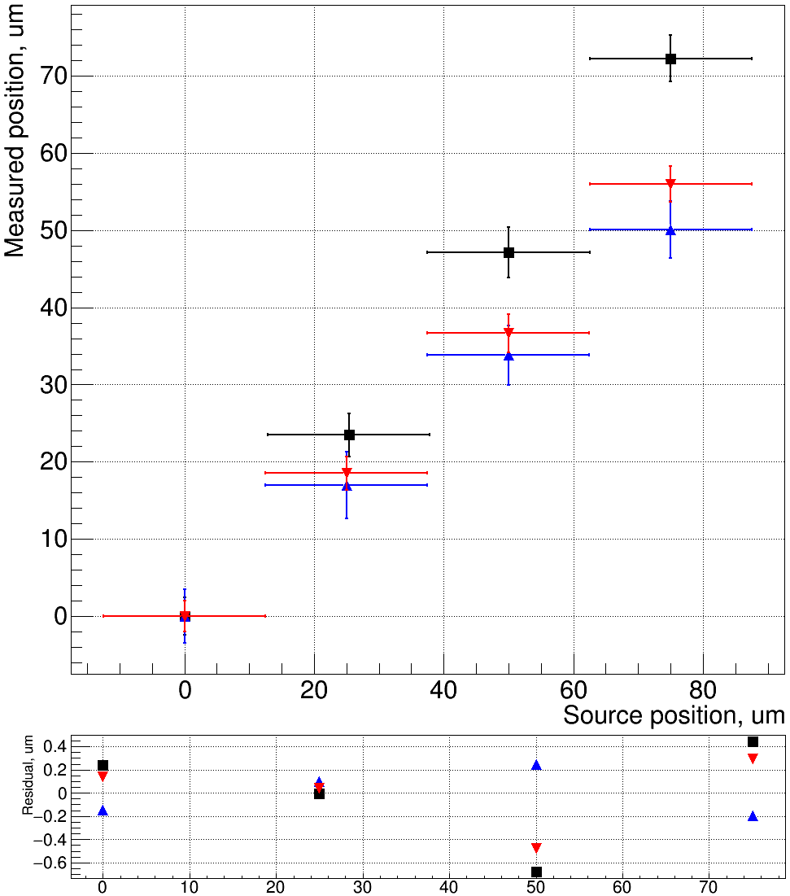
Sensitivity check [beam RMS=3.3mm]
Notes:
All three methods have good sensitivity

Slide 26
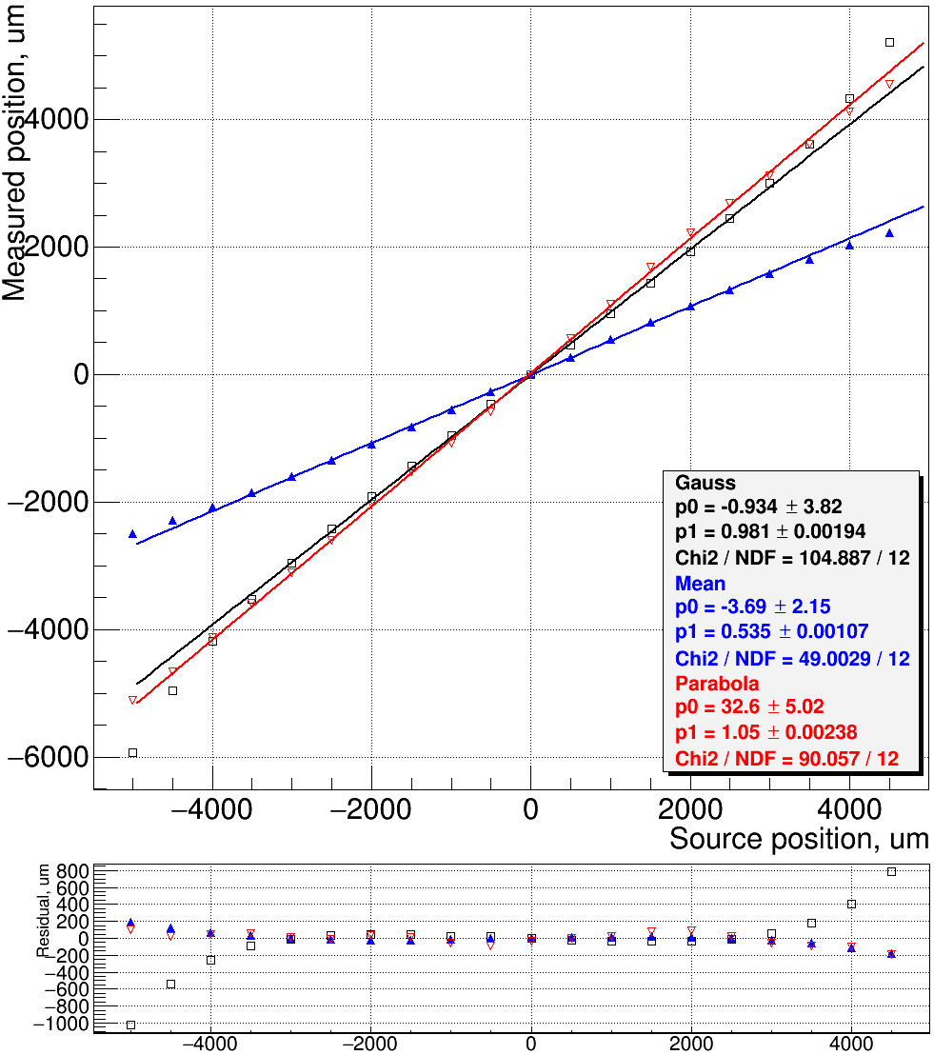
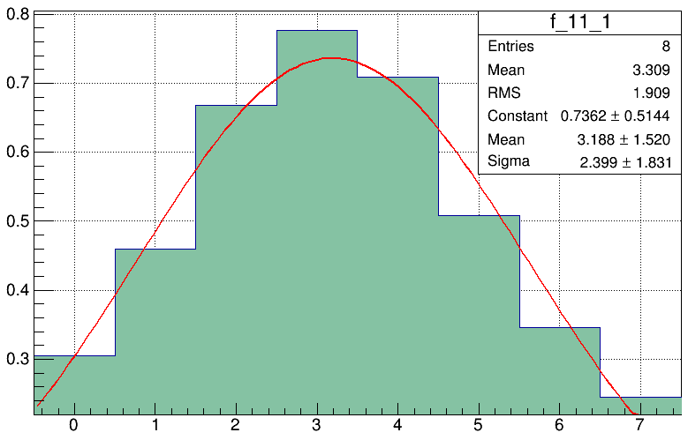
Calibration results [beam RMS=4.8mm]
Notes:
For wide beam profile gauss method becomes worse due to side effects
Mean value: good sensitivity, different slope

Slide 27
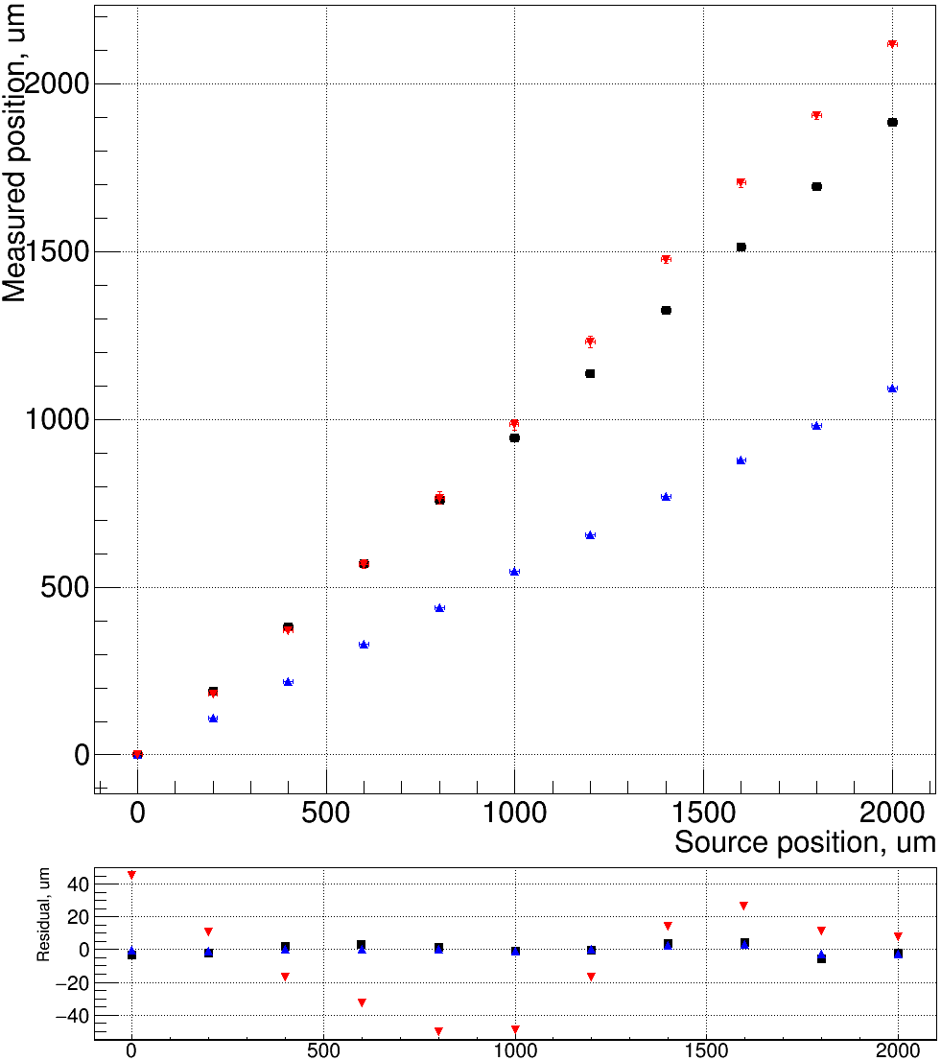
Sensitivity results [beam RMS=4.8mm]

Slide 28
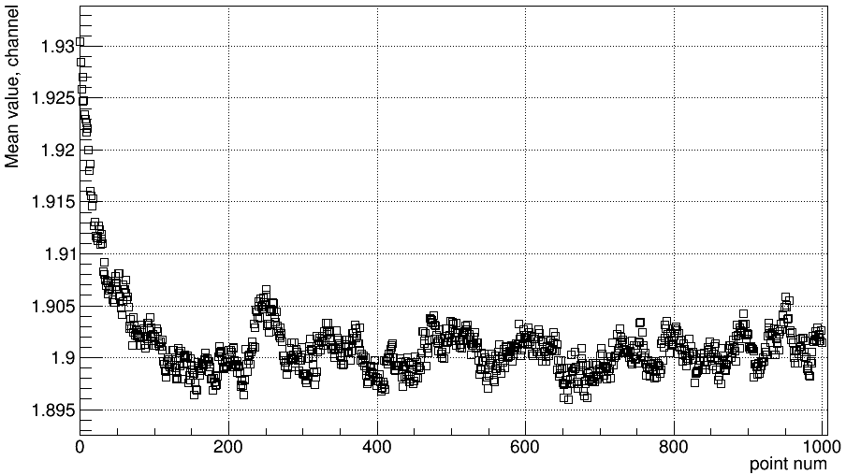
Time dependence
3s integration RC filter

Slide 29
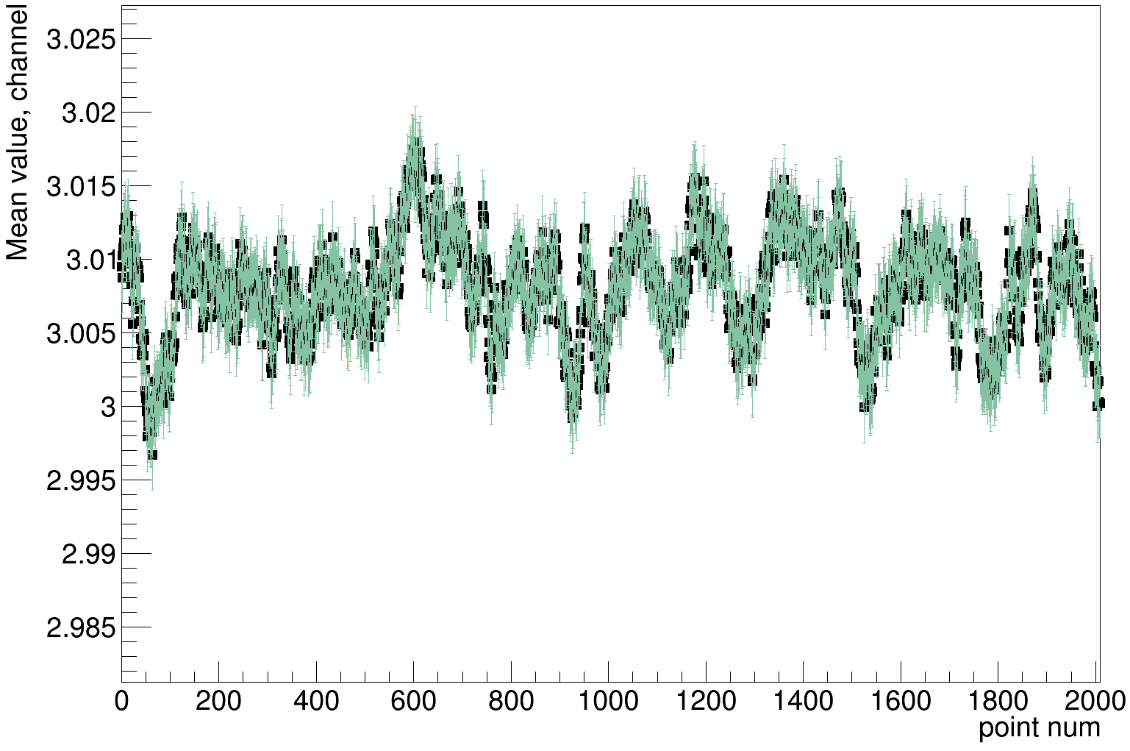
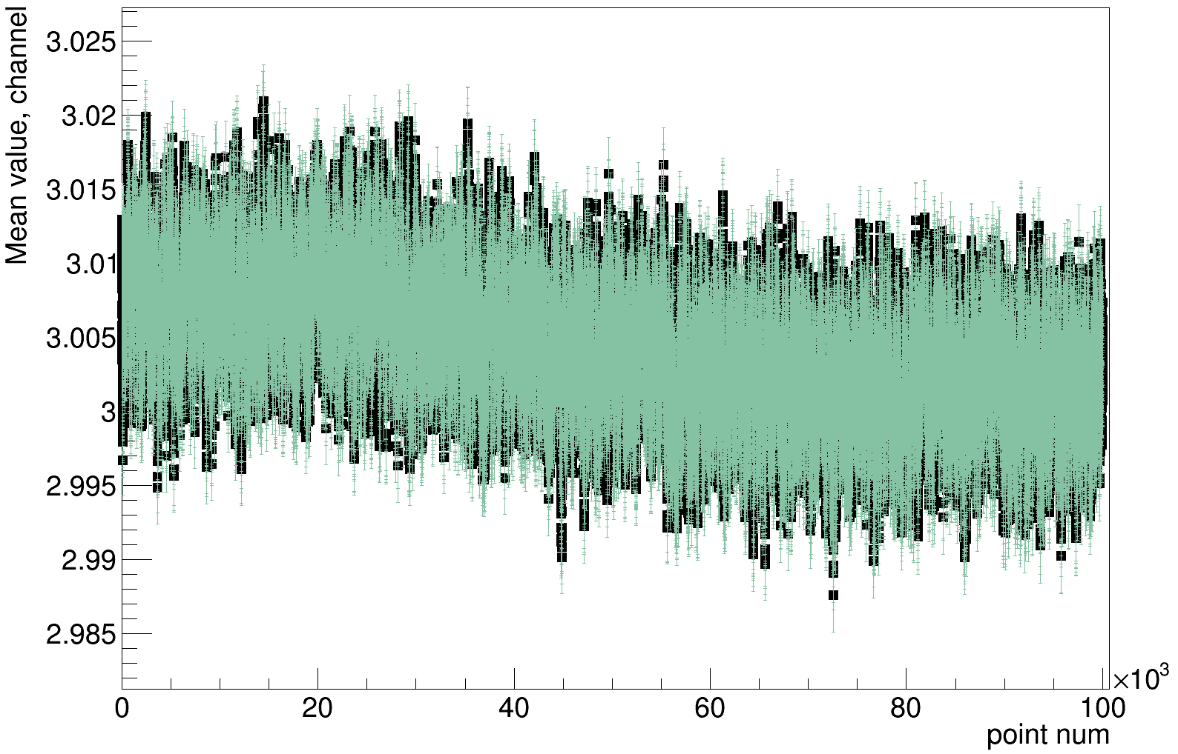
Time dependence
5um drift
20um ripple

Slide 30
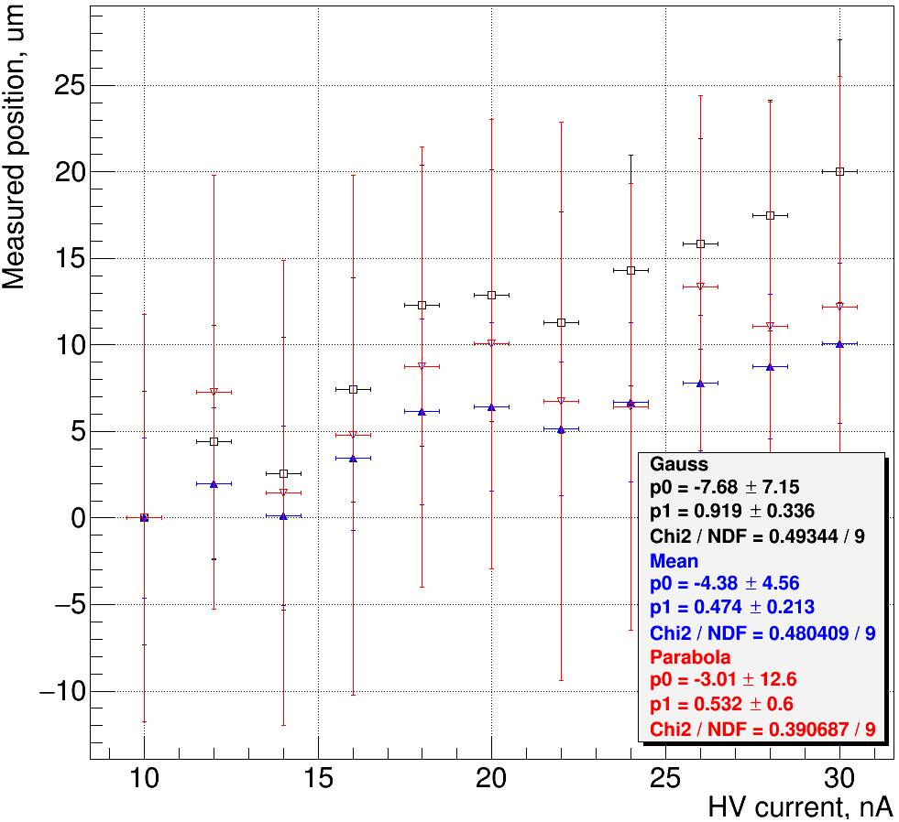
High voltage influence

Slide 31
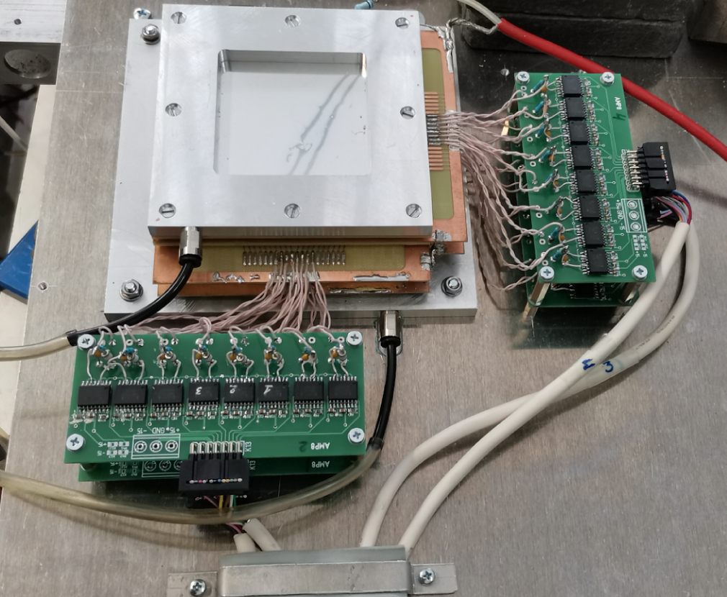
Full scale setup
4 plates x
8 channels

Slide 32
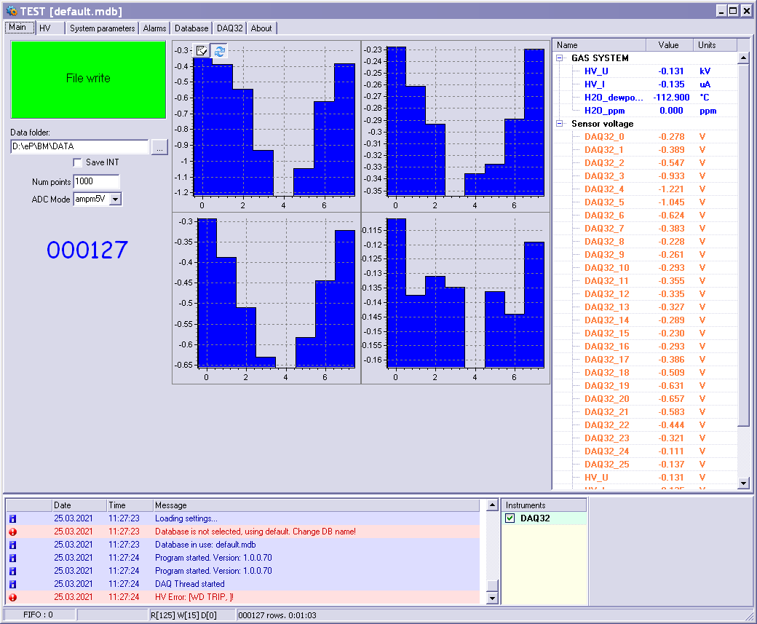
X1
X2
Y1
Y2

Slide 33
Conclusion
Absolute accuracy: ~70um in ±3mm range
Relative sensitivity: <20um
Gauss fit – the best for absolute position calculation
Mean value calculation – the best for feedback signal (easy to program in PLC)
Analog feedback signal: 0..10V 16-bit
Notes:
Parabola – high differential non-linearity due to processing only 3 points out of 8

Slide 34
THANK YOU!

