Slide 1
PROJECT FOR PRECISION MEASUREMENT OF THE PROTON CHARGE RADIUS IN AN ELECTRON-PROTON SCATTERING EXPERIMENT
Status report for PRES collaboration
Vasilyev Alexander
Petersburg Nuclear Physics Institute, Russia

Slide 2
Time Projection Chamber (TPC) detecting recoil protons will be used in
combination with a high precision Forward Tracker (FT) detecting the scattered electrons

Slide 3
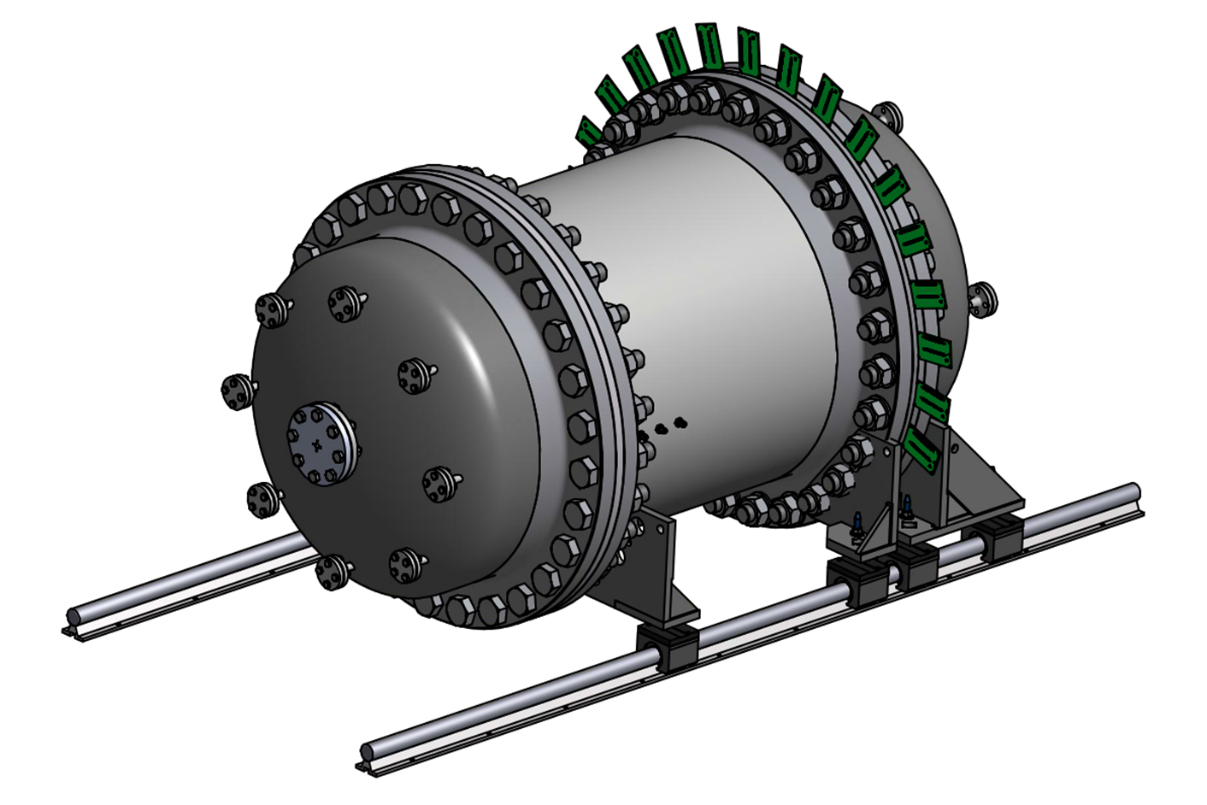
Electron beam
(working
position)
Electron beam
(calibration position)

Slide 6
Forward tracker – the most important and expensive element of the detector
----------- 1st Day, March 30 -----------
14:30 – 15:00 Forward tracker. Design and construction of the MWPCs Sergey Mikirtychyants (PNPI)
----------- 2nd Day, March 31 -----------
9:00 – 9:25 Experimental studies of the MWPCs performance Gennady Gavrilov (PNPI)
Responsible person and producer is Boris Bochin
First proportional chambers working at 20 bar pressure
Space resolution and scale linearity is better than 50 µm
Unclear gas mixture
More than 2000 signals from 20 bar volume

Slide 7
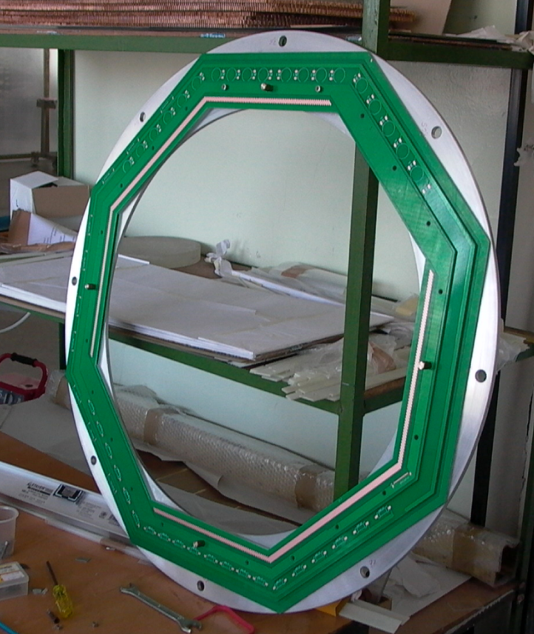
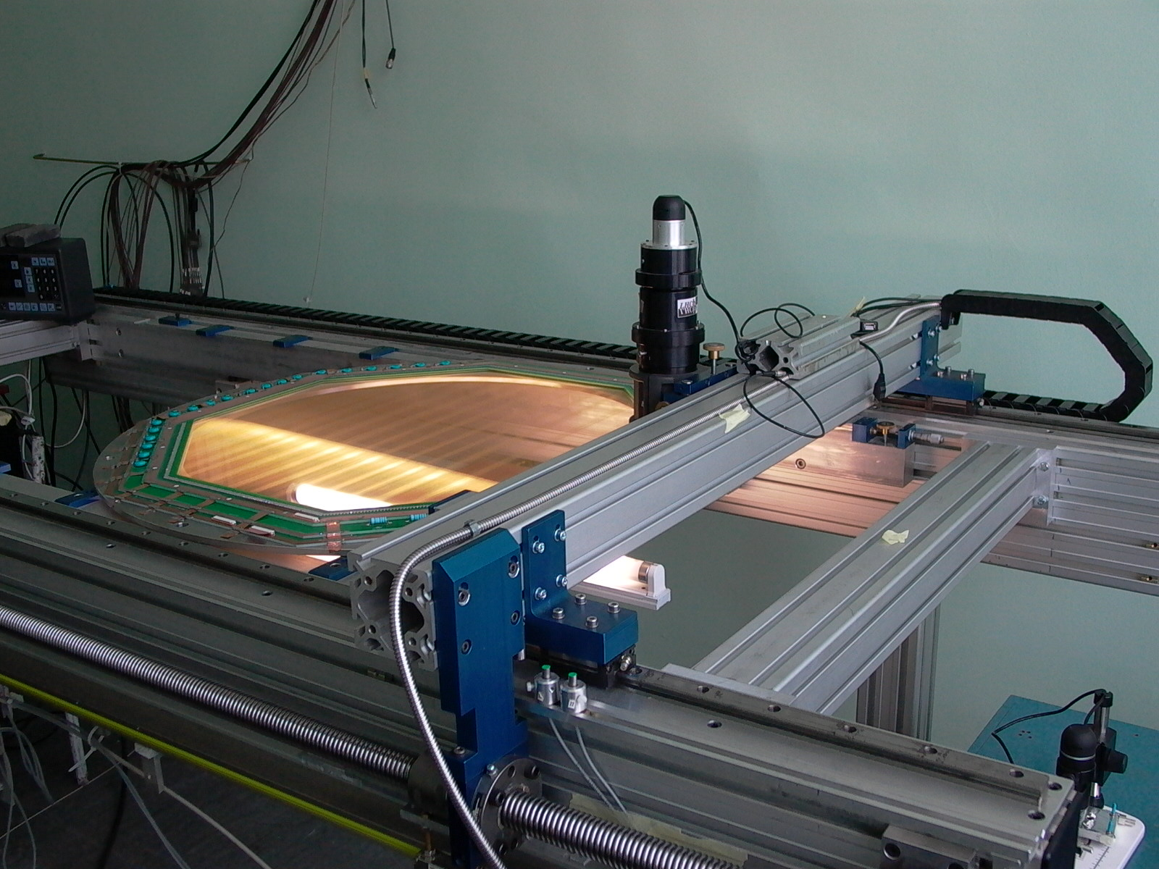
Opening is 800 mm

Slide 8
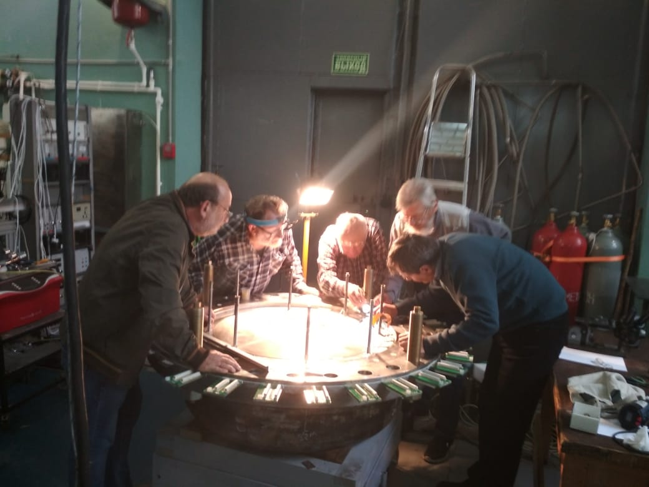
Forward Detector flange
With
Support structure for
Forward Detector
Lord's Supper

Slide 9
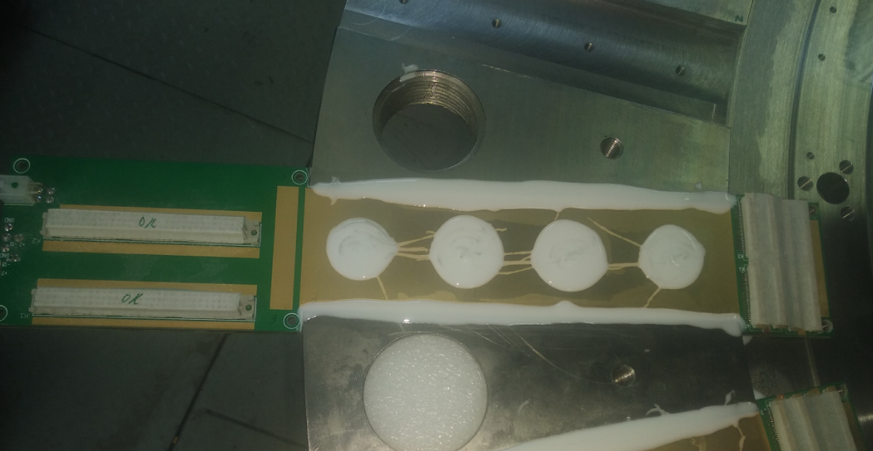
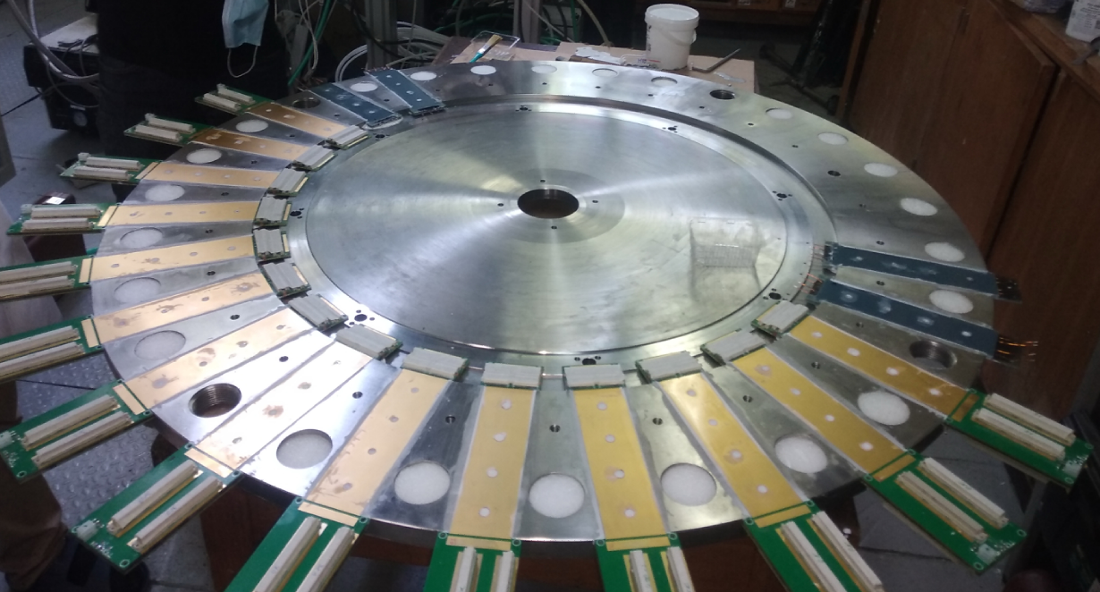
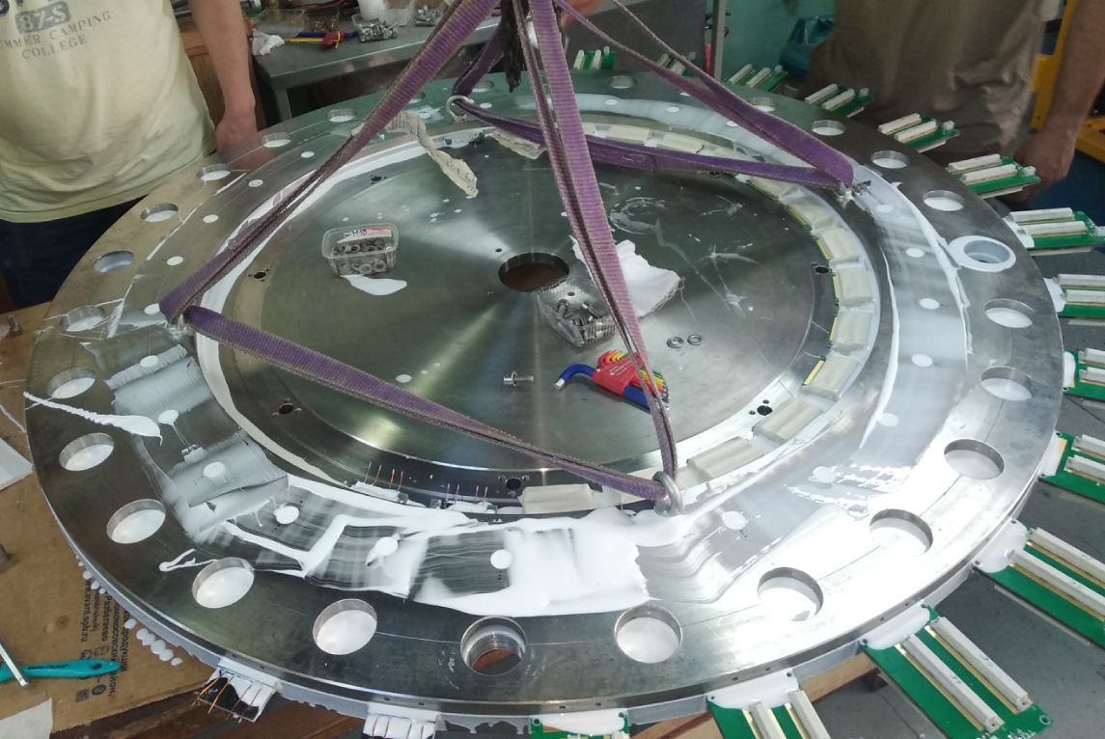
Signals from inside

Slide 10
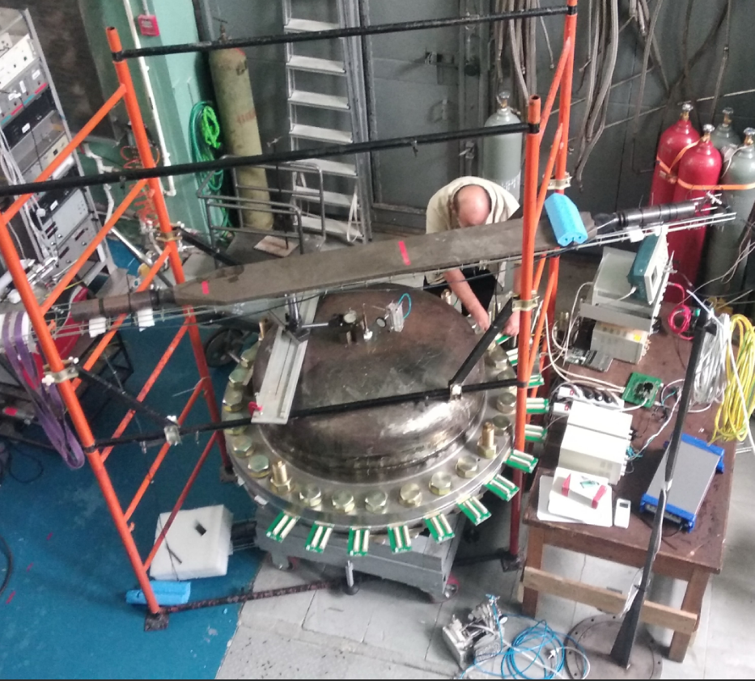
----------- 2nd Day, March 31 -----------
9:25 – 9:50 Readout system
Peter Neustroev (PNPI), confirmed

Slide 11
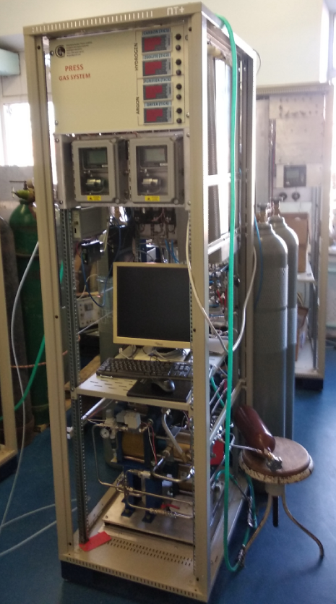
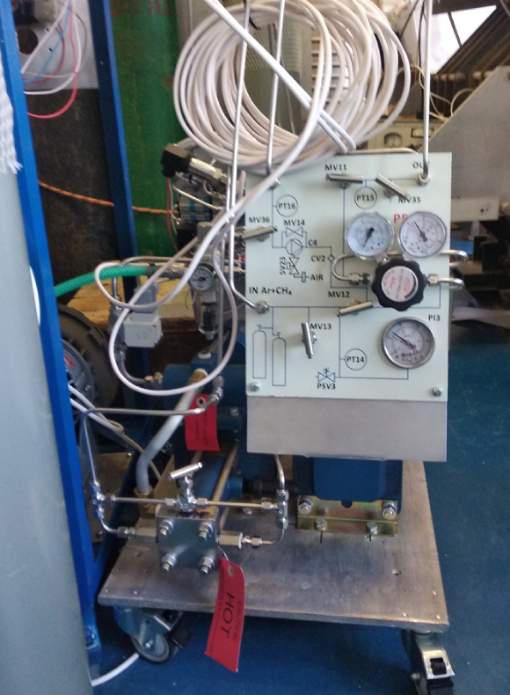
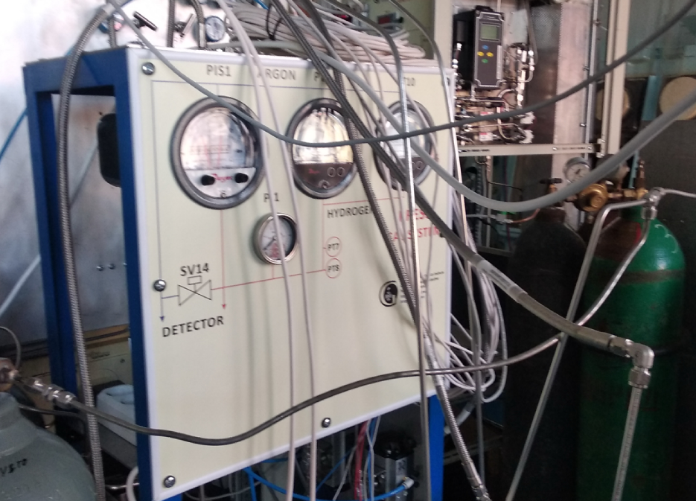
Sophisticated gas system
Two circuits gas system – Hydrogen and Argon-Methane
20 bar at both circuit with a few mbar stability
Differential pressure between circuits is less than 50 mbar at any time
Hydrogen purity is better than 100 ppb (10⁻⁷)
Our team made more than 20 different gas systems.
This is the most complicated one!
----------- 2nd Day, March 31 -----------
9:50 – 10:15 Gas circulation/purification system Peter Kravtsov (PNPI)

Slide 12
Time Projection Chamber (TPC) for PRES
This TPC stands in the long line of PNPI ionization chambers
IKAR, Muon Catalized Fusion, MuCap, MuSun, MuCF d+He3 (now), COMPASS AMBER (Future)
New:
The biggest size
Cathode voltage 100 kV
Unique (for TPCs) homogeneity of electrical field.
----------- 1st Day, March 30 -----------
14:00 – 14:30 TPC construction. Design of the electric field in TPC Kuzma Ivshin (PNPI)

Slide 13
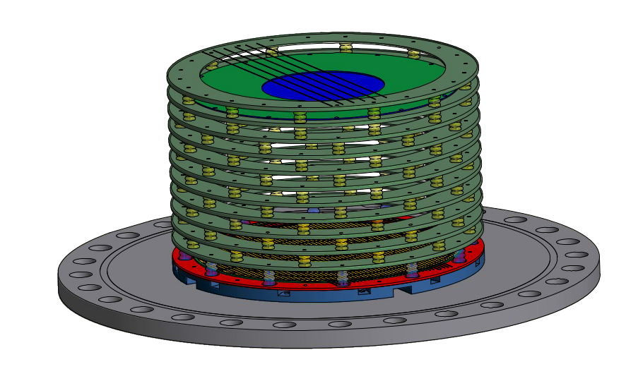
Normalizing ring -90 kV
Cathode -100 kV
Correction ring -90 kV
Grid -7.5 kV
Correction ring -20 kV
Anode
Polycarbonate
Support 30 mm
TPC flange
Correction ring
Polycarbonate insulators

Slide 14
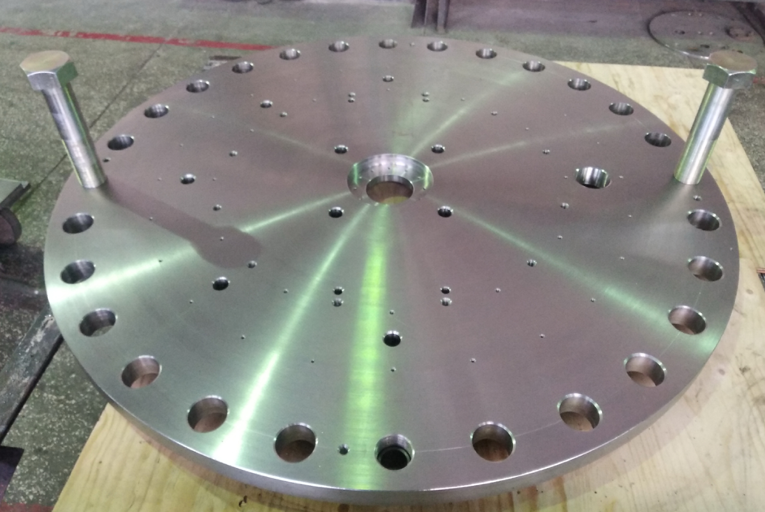
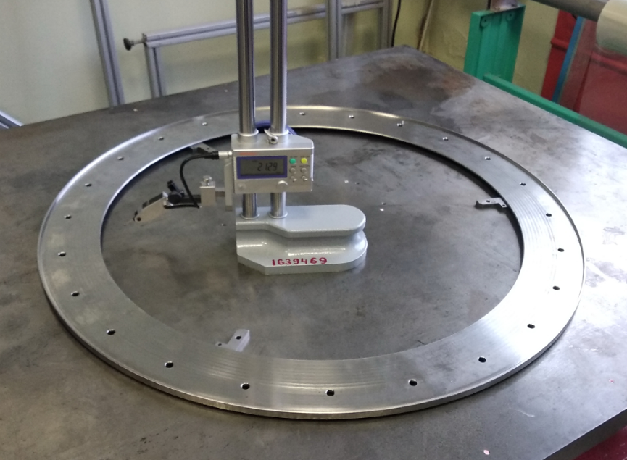
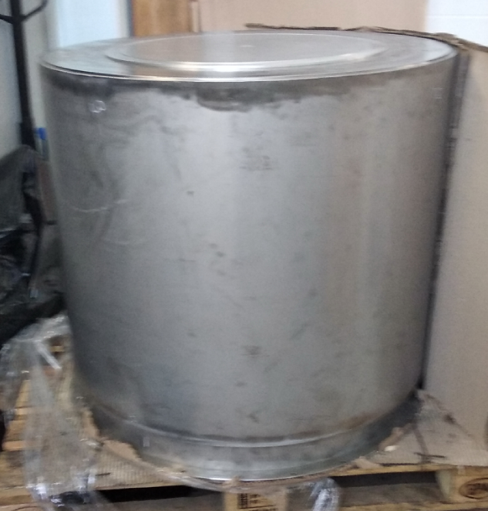
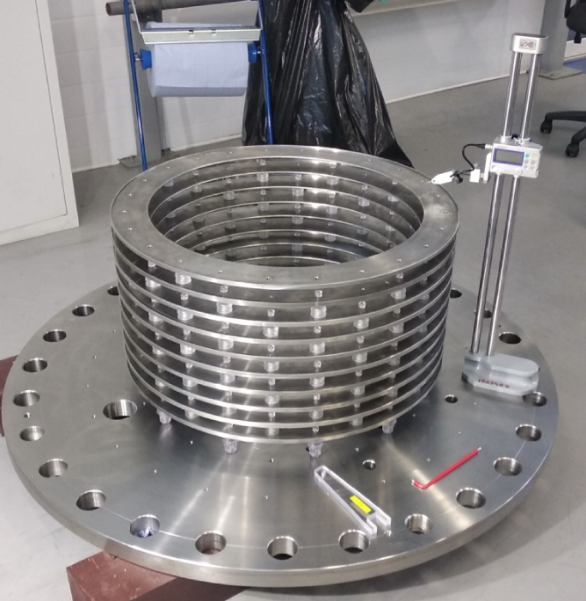
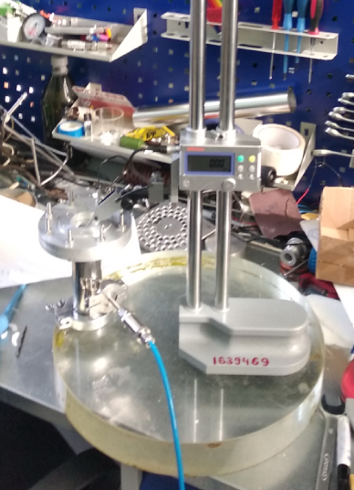
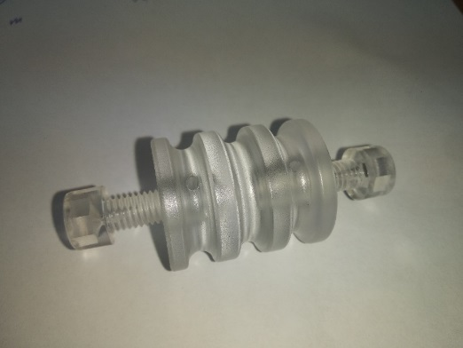
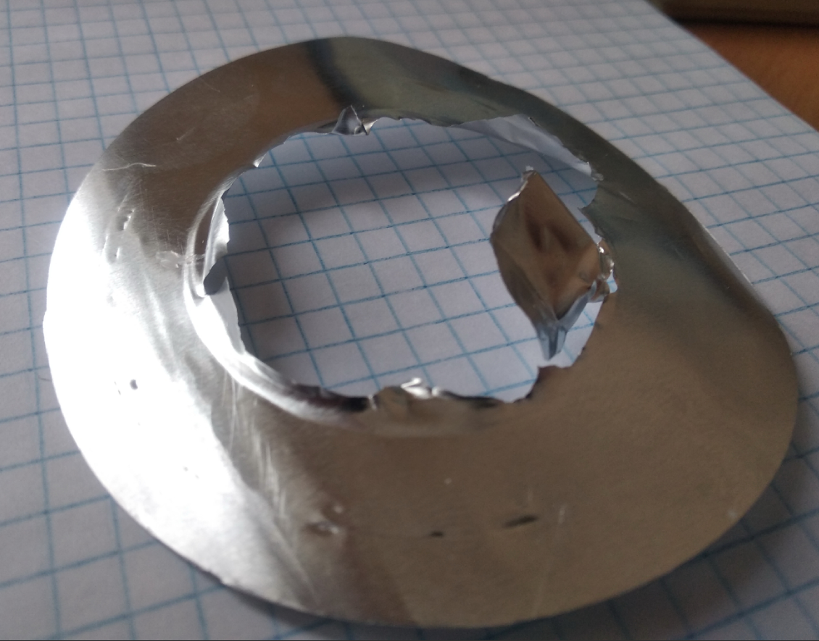
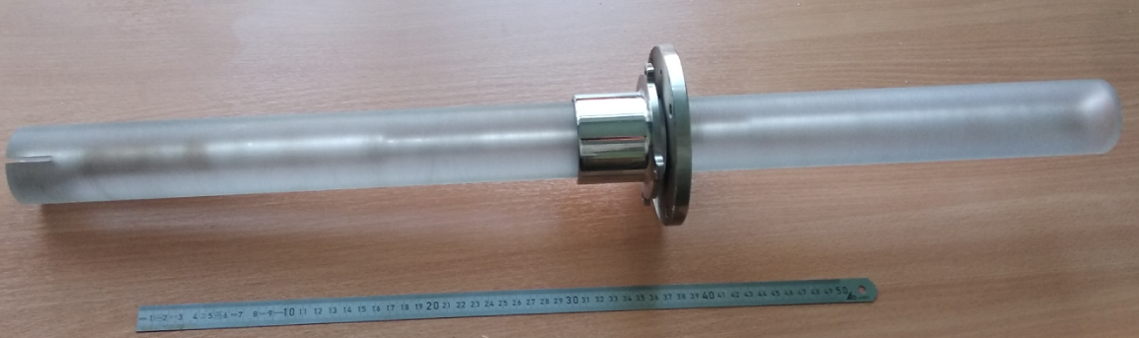

Slide 15
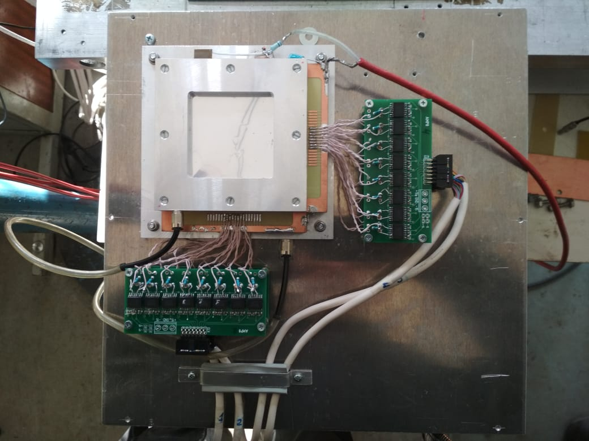
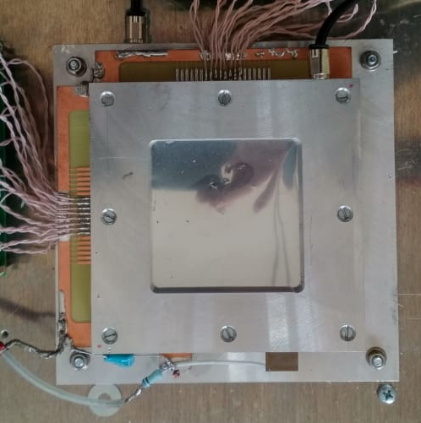
Beam Position Stabilization
---------- 1st Day, Tuesday March 30 -----------
13:00 – 13:30 Results of the previous test runs and preparations for the new test run Peter Kravtsov (PNPI)

Slide 16

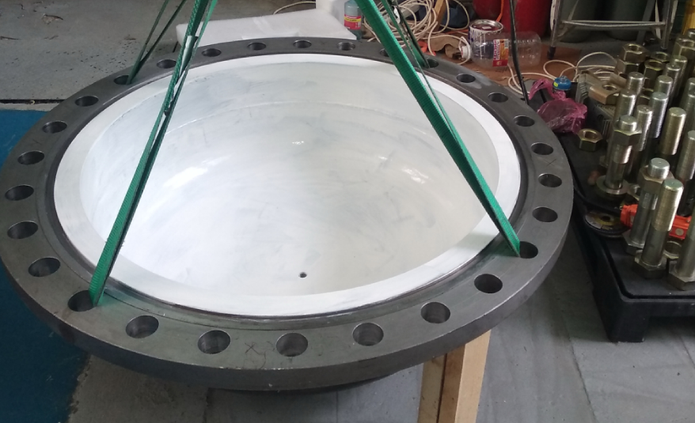
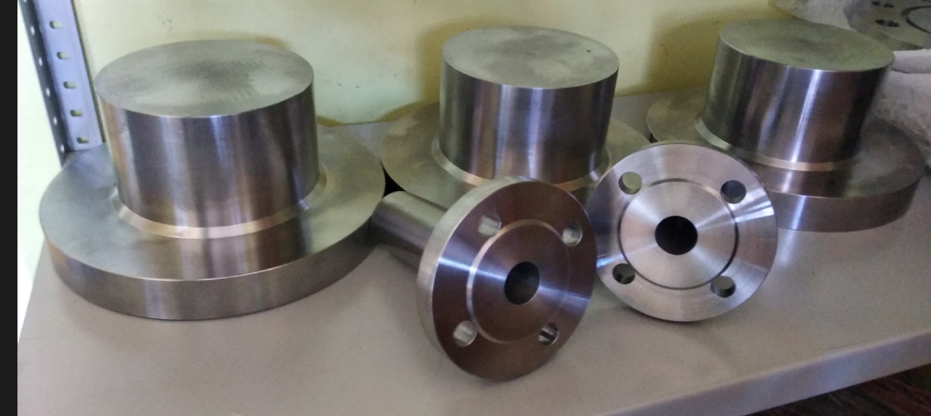
Mechanical elements of the detector (current work)
Elliptical flanges

Slide 17
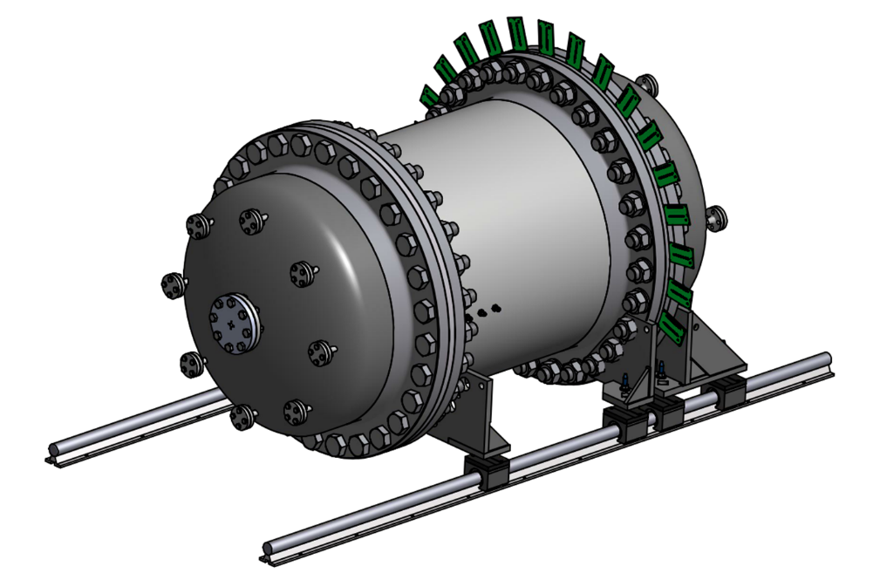
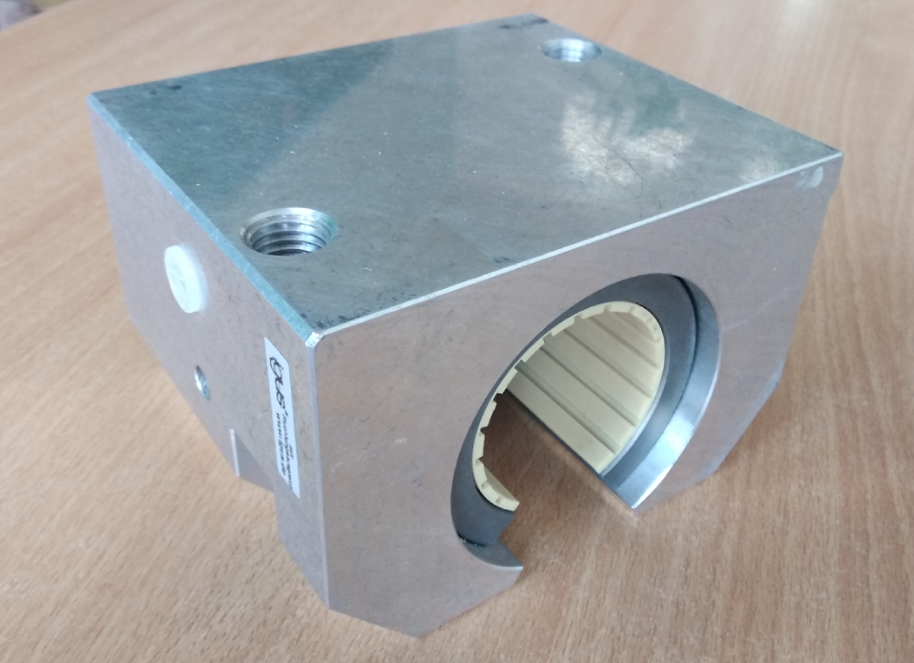
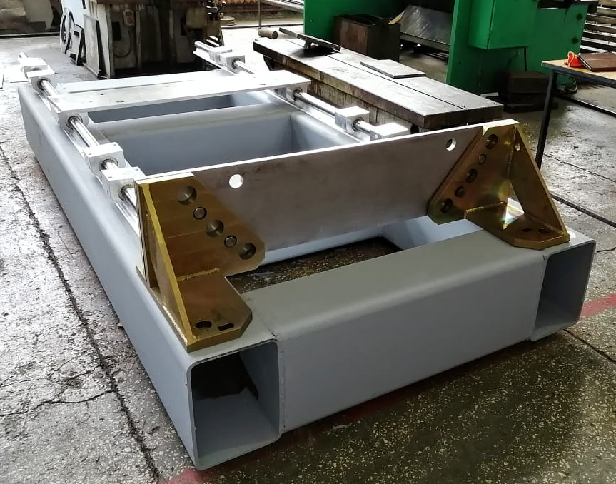
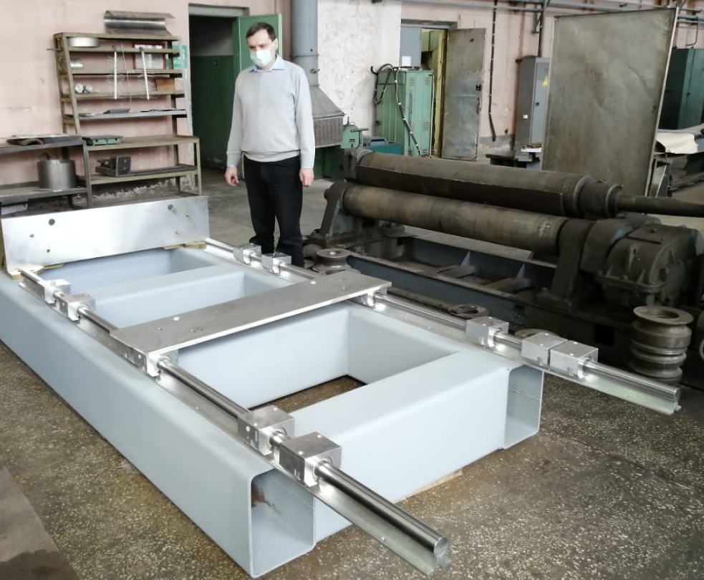
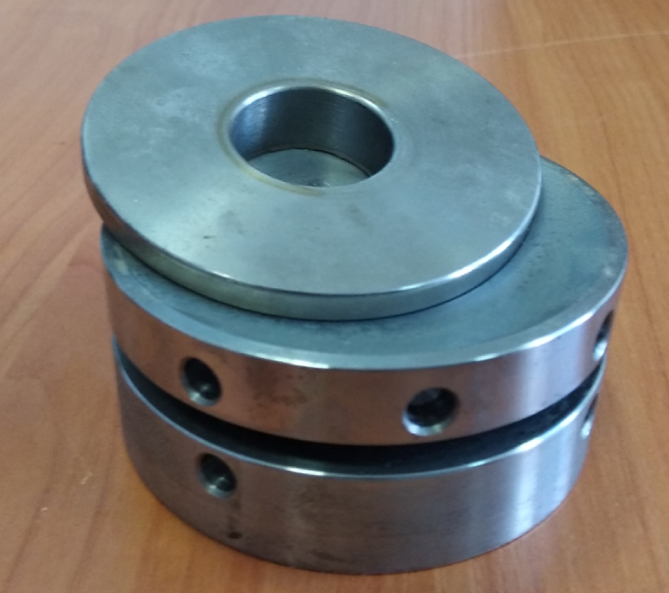
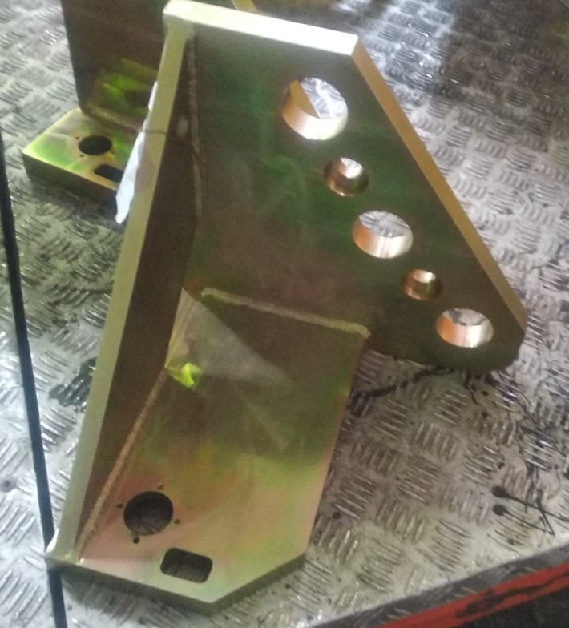
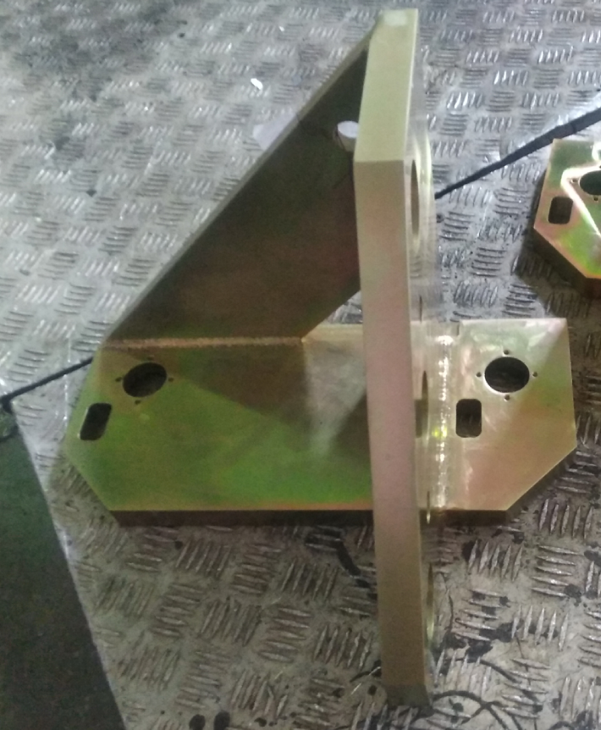
Mechanical elements of the detector (current work)
Support system

Slide 18
Conclusion
In June-July 2021 mechanical part of the detector will be assembled completely
TPC will be assembled and tested before Fall 2021
FD will be ready in June-July 2021
Tests of 3 sections of FD on cosmic rays will be started in May
Our proposal to have test beam run in November 2021 in Mainz with
Electron beam position stabilization
Repeating measurements with beam current monitor and scintillators

