Slide 1
Petersburg Nuclear Physics Institute
DATA ACQUISITION
SYSTEM
PRESS experiment

Slide 2
DAQ Requirements
Detector system
Time Projection Chamber (TPC)
Forward Tracker (FT)
Beam scintillation counters (S1-S3)
Beam position monitor (BPM)
Beam intensity monitor (BIM)
Time parameters
Beam intensity: 2 MHz
Event rate: <= 50 Hz
Trigger source: TPC
User requirements
Data logging
Online data monitoring

Slide 3
Forward tracker
Cathode strip chambers (MWPC)
8 chambers (4 XY-layers)
240x2.5mm strips in each chamber
Back side strips joined into 12 strips
2016 channels in total

Slide 4
Forward tracker electronics
DAQ card (ASF48et)
48 independent readout channels
Digital discriminator in each channel
Option to run adjacent channels
12-bit 25MHz pipeline FADC
Common system clock 100MHz
Memory:
L1 1k words per channel,
L2 16k words per card
No dead time
Intermediate Memory
FPGA Logic
Digital
Discriminator
DAQ
interface
Multi-Channel FADC
Front-end
2016 channels
Preamplifier
Gain: 40mV/fC
Noise: 800 e⁻

Slide 5
ASF48et diagram

Slide 6
ASF48et signal processing (single channel)

Slide 7
ASF48et signal processing (external trigger)

Slide 8
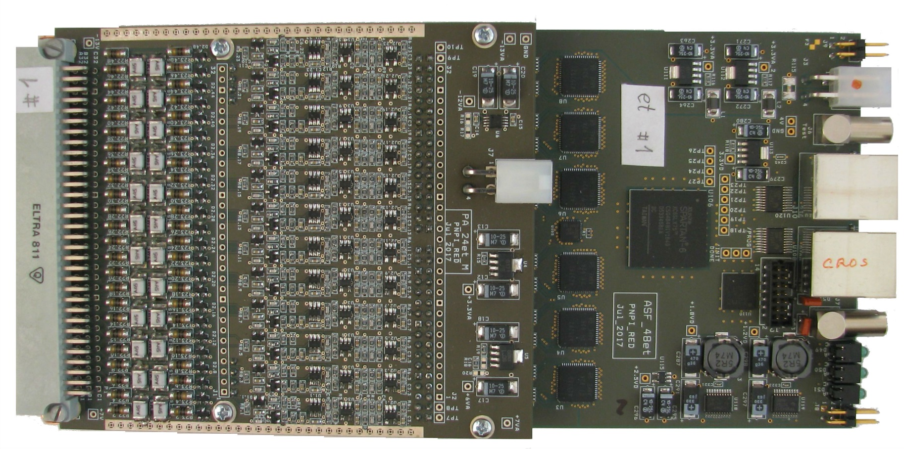
ASF48et with preamplifier

Slide 9
Forward tracker event rate simulation
MC simulation
Beam intensity: 2MHz
200 electrons per event (100μs)
Recoil energy: 1-10MeV
Average 6 strips (hits) per track
Total rate in forward tracker at 50Hz trigger rate:
490h/t x 50Hz = 24500 hit/sec
With 60 ADC samples per signal (hit) data rate:
24500 hit/sec х 64words/hit = 1568000 words/sec (3.14 Mbyte/sec)
Average hits per trigger (100μs)
 | Card/plane
Plane | 1 | 2 | 3 | 4 | 5 | Z | Sum | R/O
FT1 | 2,5h/t | 5,6h/t | 20h/t | 5,6h/t | 2,5h/t | 7,6h/t | 43,8h/t | 90h/t 5760w/t
FT2 | 1,7h/t | 4,6h/t | 26h/t | 4,6h/t | 1,7h/t | 7,6h/t | 46.2h/t
FT3 | 1,4h/t | 4,4h/t | 31,5h/t | 4,4h/t | 1,4h/t | 8,6h/t | 51,7h/t | 108,3h/t 6912w/t
FT4 | 1,2h/t | 4,6h/t | 36h/t | 4,6h/t | 1,2h/t | 9h/t | 56,6h/t
FT5 | 1,1h/t | 4,8h/t | 41h/t | 4,8h/t | 1,1h/t | 10h/t | 62,8h/t | 132,1h/t 8448w/t
FT6 | 1h/t | 5h/t | 46h/t | 5h/t | 1h/t | 11,3h/t | 69,3h/t
FT7 | 1h/t | 5,2h/t | 51h/t | 5,2h/t | 1h/t | 13h/t | 76,4h/t | 158,2h/t 10112w/t
FT8 | 1h/t | 5,4h/t | 55h/t | 5,4h/t | 1h/t | 14h/t | 81,8h/t

Slide 10
Time Projection Chamber
32+1 channels (8 rings)
100μs maximum drift time
Complex trigger logic
System trigger generation
Anode pad layout

Slide 11
TPC electronics
DAQ
interface
Trigger
Intermediate Memory
FPGA Logic
Digital
Discriminator
Trigger logic
DAQ card (ASF48eP)
12 independent readout channels
Digital discriminator in each channel
Single sample or integrated window
System trigger generation logic
12-bit 25MHz pipeline FADC
Common system clock 100MHz
Memory:
L1 8k words per channel,
L2 32k words per card
Multi-Channel FADC
Front-end
33
channels
Data rate (50Hz trigger):
10 Mbyte/s (avg)
40 Mbyte/s (peak)

Slide 12
ASF48eP diagram

Slide 13
ASF48eP signal processing (single channel)

Slide 14
ASF48eP signal processing (integration window)

Slide 15
Beam counters electronics
DAQ card (ASF48eP)
800MHz sampling clock (1.25ns resolution)
Common system clock 100MHz
Memory:
L1 64 words per channel,
L2 8k words per card
(1000μs at 2MHz beam intensity)
Data rate (2MHz beam): 0.1Mbyte/s per counter
DAQ
interface
Intermediate Memory
FPGA Logic
Beam Monitor
S1
S2
S3

Slide 16
The whole DAQ electronics layout

Slide 17
DAQ data flow layout

Slide 18
DAQ hardware status
Hardware | Design | Production | Firmware
Forward tracker preamplifier | ✓ | in progress
Forward tracker digitizer (ASF48et) | ✓ | ✓ | ✓
TPC preamplifier | ? | ?
TPC digitizer (ASF48eP) | ✓ | ✓ | in progress
Beam monitor | ✓ | in progress | in progress
Beam position monitor preamplifier | ✓ | in progress
Beam position monitor digitizer | ✓ | ✓ | in progress
Beam intensity monitor preamplifier | ✓ | ✓
Beam intensity monitor digitizer | ✓ | ✓ | ✓

Slide 19
Data acquisition software
ASF48 test software
Full scale DAQ software based on MIDAS
(Maximum Integrated Data Acquisition System)
http://midas.psi.ch
  Flexible distributed DAQ system
  Web interface for run control and monitoring
  Data transfer / logging capability
  Online data monitoring
  Online database
  Message logging
  Alarms

Slide 20
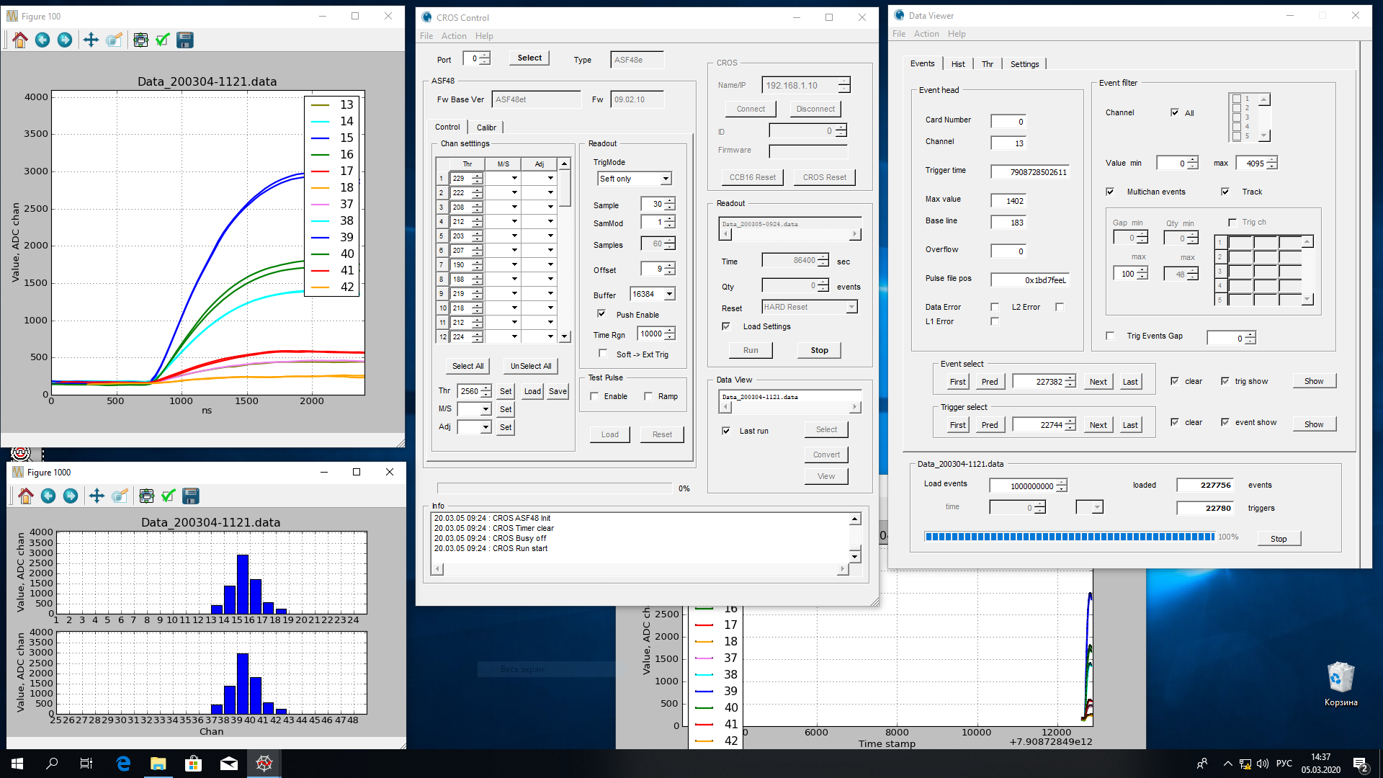
ASF48 test software

Slide 21
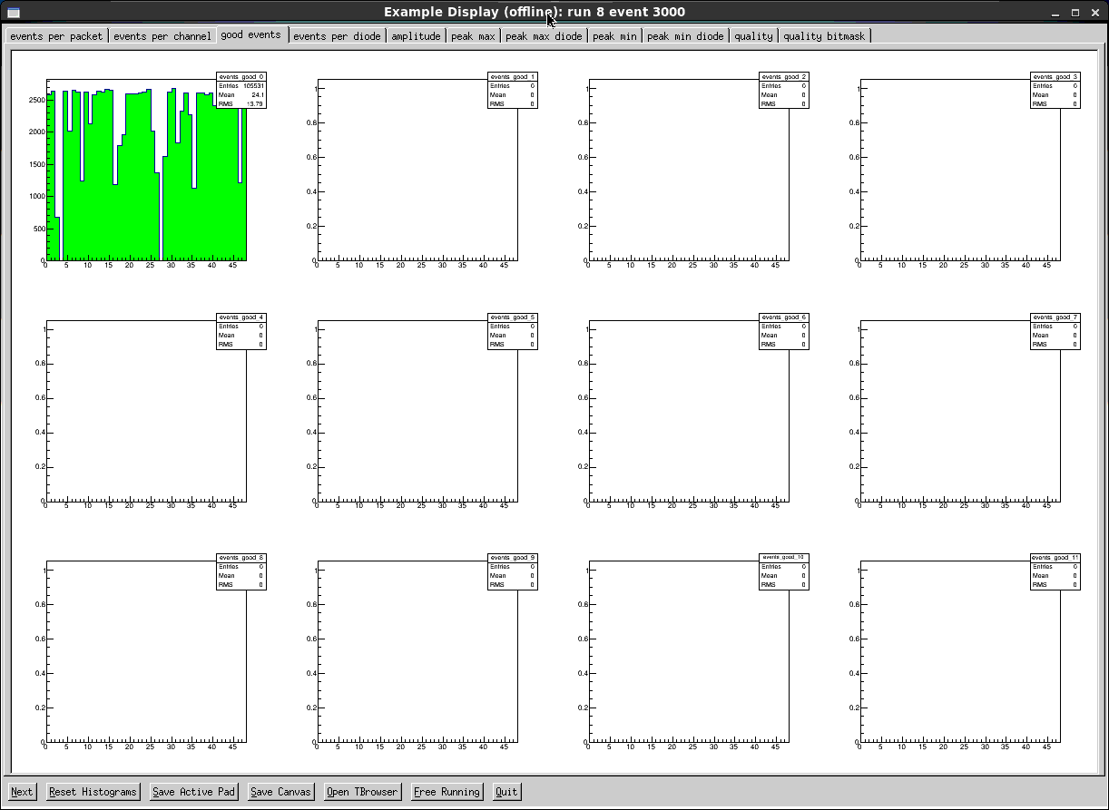
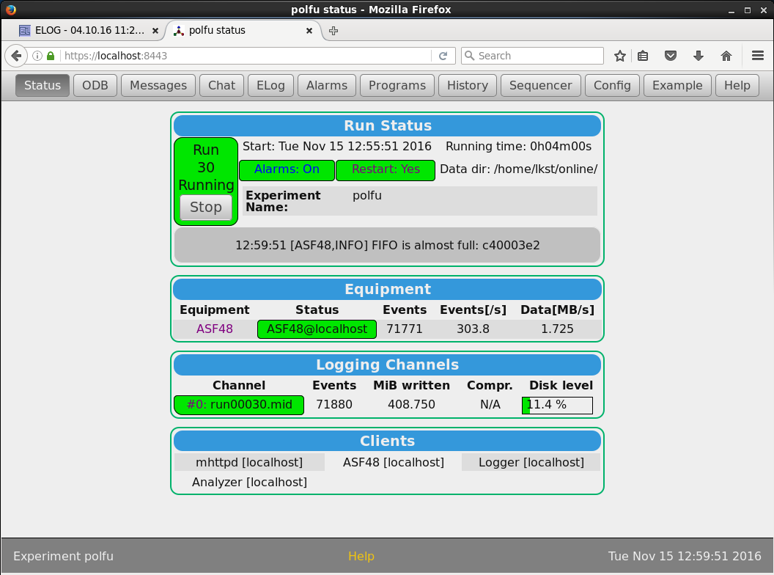
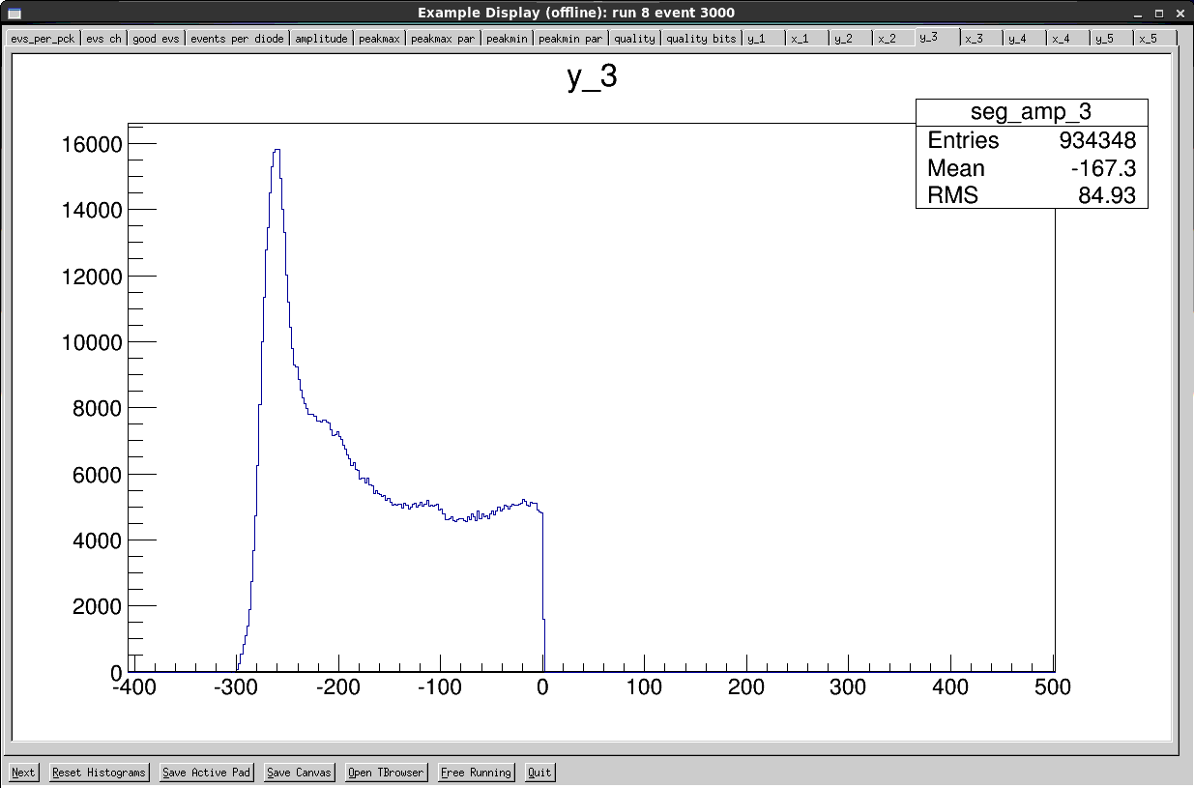
Data acquisition software

Slide 22
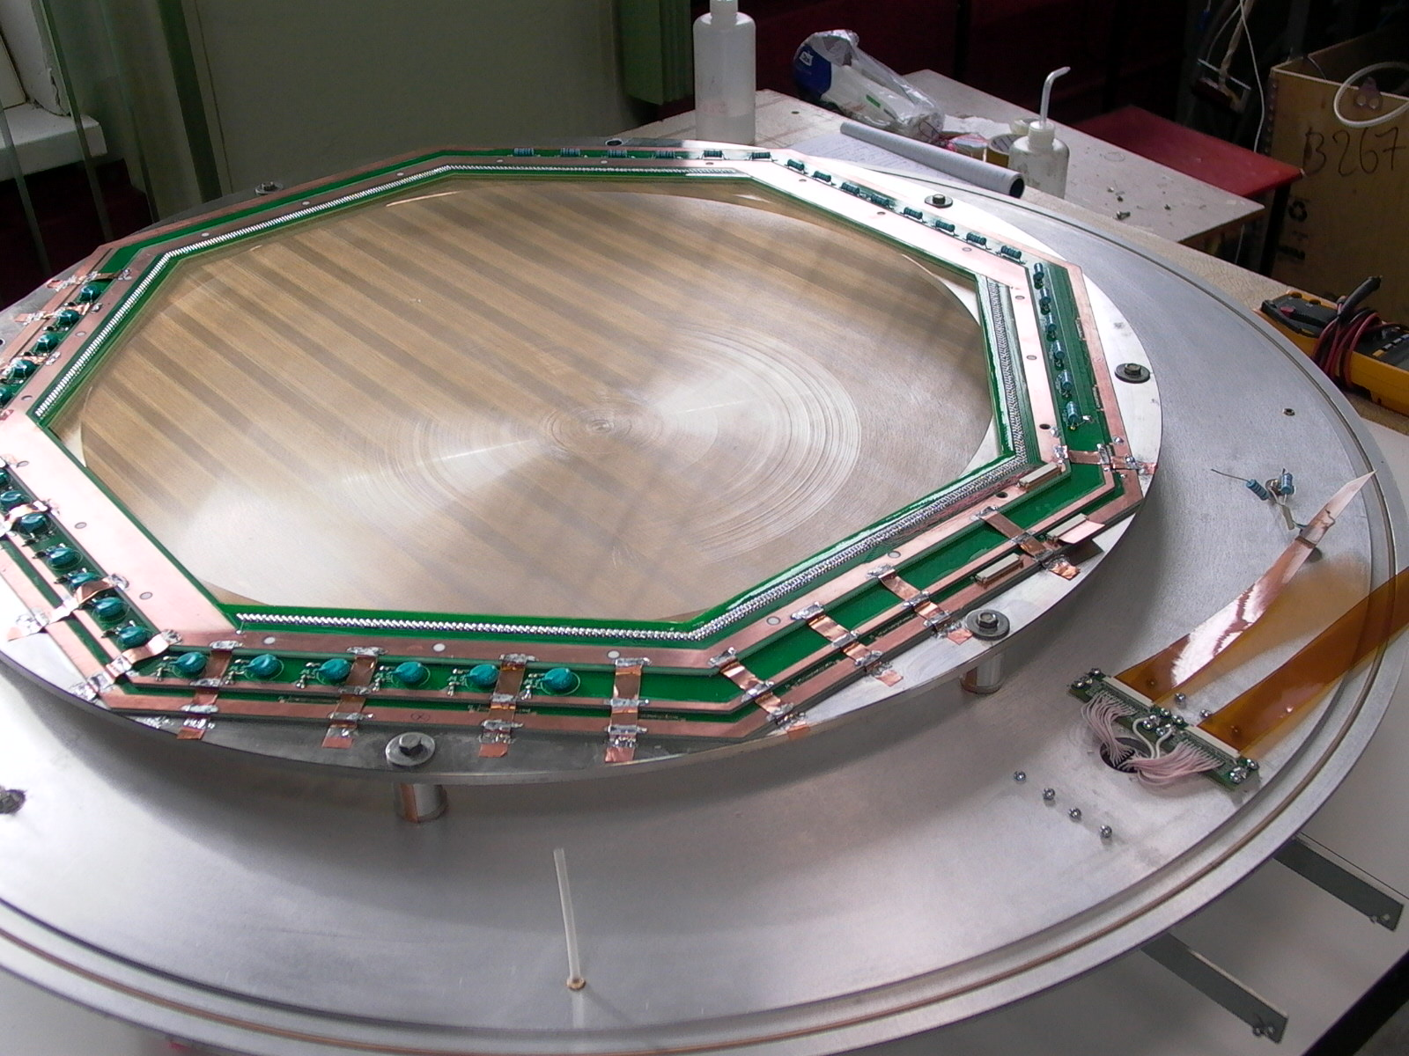
FT CSC prototype
Both parallel cathodes
Cosmic tests
Single ASF48et card:
0..23 channels – top
24..47 channels - bottom

Slide 23
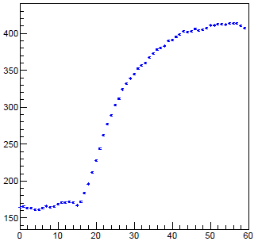
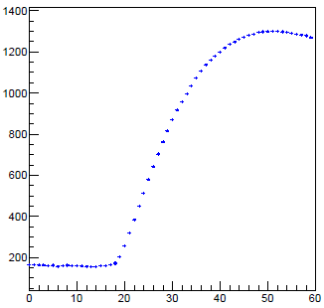
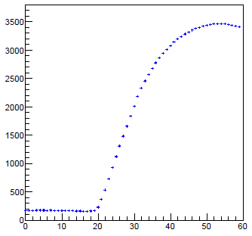
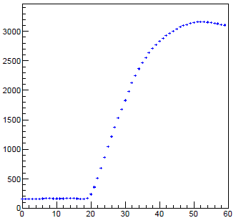
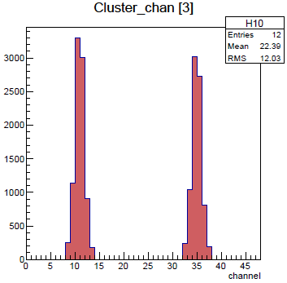
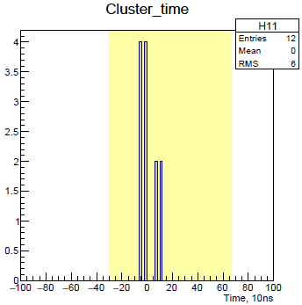
Signal processing

Slide 24
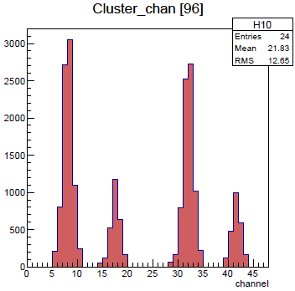
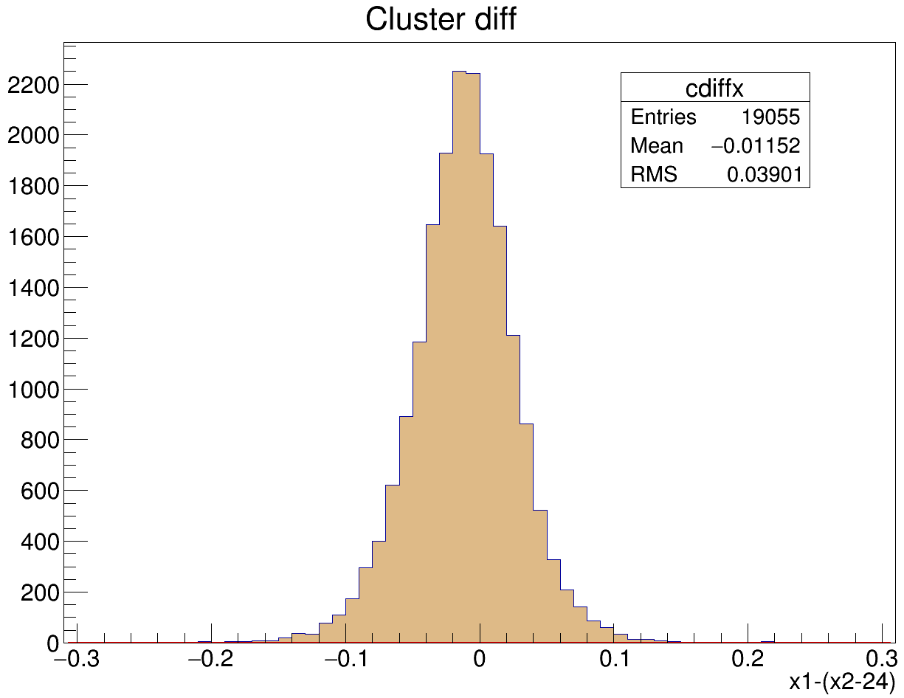
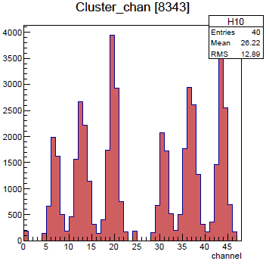
Cosmic data results
Spatial resolution: 70-80um

Slide 25
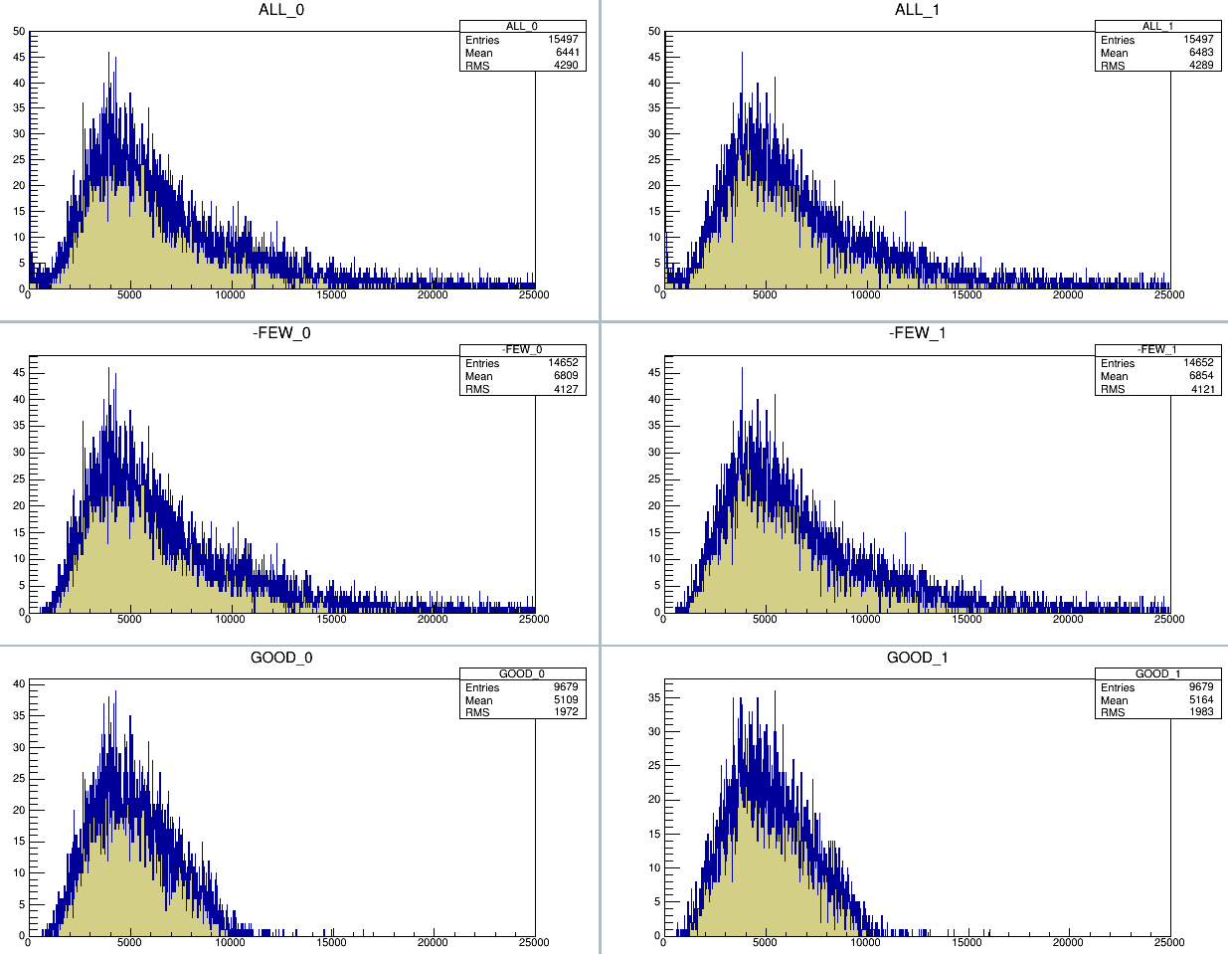
Cosmic data results. Amplitude spectra

Slide 26
DAQ software status
Software | Status
ASF48 test software | ✓
MIDAS frontend (FT) | in progress
MIDAS frontend (TPC) | in progress
FT signal processing | ✓
FT clipped signal reconstruction | in progress
MIDAS online analyzer | in progress
MIDAS export analyzer | ✓

Slide 27
DAQ status
Software | Status
ASF48 test software | ✓
MIDAS frontend (FT) | in progress
MIDAS frontend (TPC) | in progress
FT signal processing | ✓
FT clipped signal reconstruction | in progress
MIDAS online analyzer | in progress
MIDAS export analyzer | ✓
Hardware
Digitizers for the TPC, FT, Beam detectors | ✓
Beam monitor | in progress
Preamplifiers for the FT, Beam detectors | production
Preamplifiers for the TPC | ?

Slide 28
Thank you!

