Slide 1
Hydrogen-Safety TPC Video Conference St. Petersburg - Mainz
Abstract
Hydrogen H₂ is highly explosive, explosion very quick ==> strong forces „brisance“
H₂ bulk dissipates 50 cm in air in ½ h (iso concentration lines, „Fick‘s“ law)
It diffuses through membranes, Kapton, Mylar, „partial pressure“.
Gas concentrations (< 4.6 % H₂ in air) and purities (<5% Oxygen in Hydrogen in TPC) are crucial for safety
Safe explosion-proof construction possible and necessary if unclear situation
Expansion factor 8.3 bar at 1 bar. (5 at 5 bar typ. ). Concentration limit 4,6 and 5 % also at 20 bar. See Schroeder Berlin BAM
Talk, TPC Collab. Foundation Meeting March 9th, 2020 Mainz by E.Schilling, KPH Mainz

Slide 2
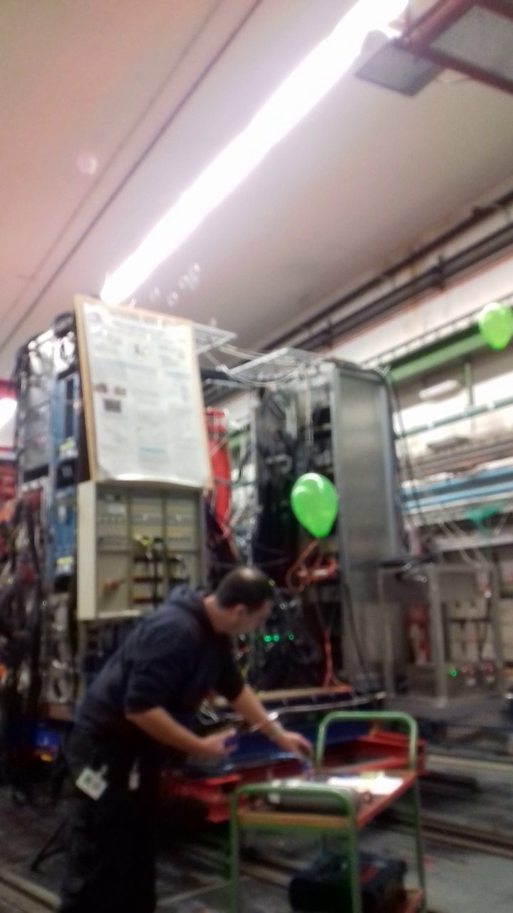
Hydrogen-Safety TPC St. Petersburg at Mainz, „winds are changing“
„99 Luftballons“ peace song by Nena 1983
https://www.youtube.com/watch?v=7aLiT3wXko0
Wind shown with helium-filled bubbles. Bubbles drift 1 m/s horizontally + 1 m/s upward to the ceiling. Bubbles (and tanks and dreams) can burst (turbulence, wall thickness)
Balloons stay, if bonded to a thread, indicating wind direction. Many directions in taggerhall ! Main stream
beam-upward. Counterstream 3 m/s clearly seen. Ventilation off >10 sec !
Talk, TPC Collab. Foundation Meeting March 9th, 2020 Mainz by E.Schilling, KPH Mainz now videoconference

Slide 3
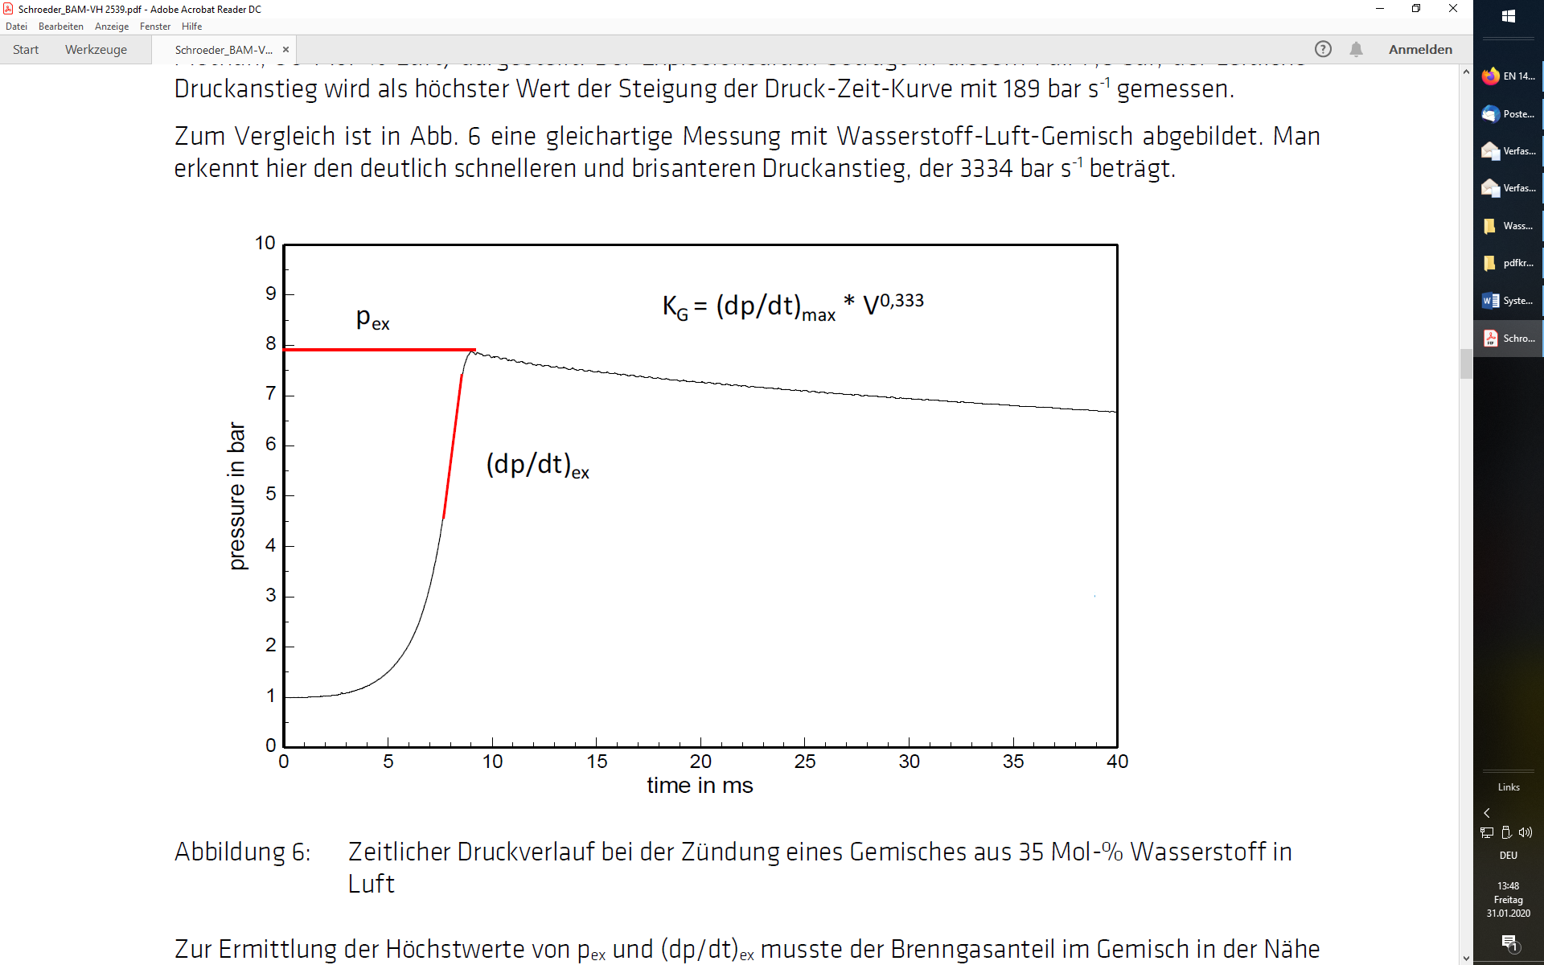
Petersburg: burst disk quick enough ? Mainz: 3 ms available. 15000 Euro.

Slide 4
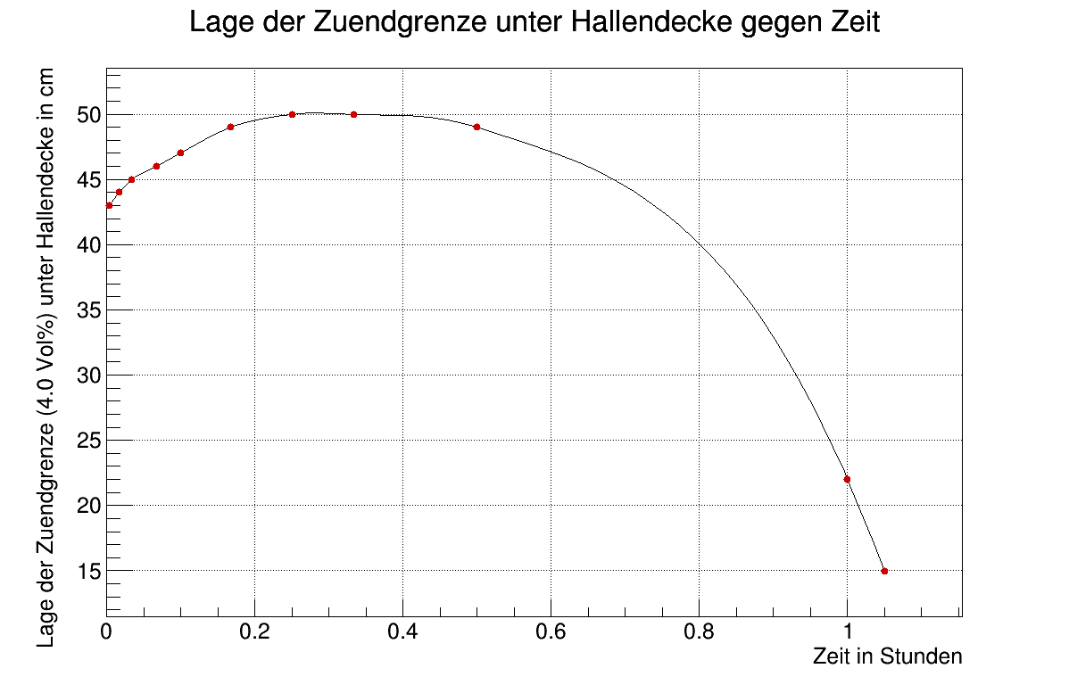
Simulation by J. Diefenbach starting with 4 cm Hydrogen layer complete tagger hall ceiling.

Slide 5
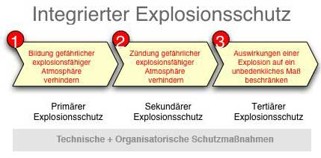
Explosion protection is one of the most safety-relevant areas of responsibility. In the event of an explosion, the life and health of the workers are endangered by uncontrolled flame and pressure effects, as well as by harmful reaction products and consumption of the oxygen needed to breathe from the ambient air. Explosion hazards can occur in all companies handling combustible substances. These substances include numerous inputants, intermediates, end products and residues from the everyday work process. With the aim of preventing explosions and protecting against explosions, the employer shall take the technical and/or organisational measures corresponding to the nature of the operation in accordance with the following ranking of principles:
https://www.youtube.com/watch?v=JTwpmXLY_9A&feature=emb_rel_pause
Do avoid forming dangerous explosive atmosphere
Do avoid ignition of explosive atmosphere
Do restrict consequences of an explosion to a harmless measure
Plant-technical protective measures must be given priority over organisational measures. However, (cost-effective) organisational measures can already make a significant contribution to reducing the risk of explosion. However, organisational measures must be consistently enforced and compliance must be monitored regularly. As a rule, the required safety is only achieved by the sensible combination of protective measures.
System of protective measures, translated google from http://www.druckgeraete-online.de/seiten/atex/atex_produkt/atex_schutzmassnahmen.htm
Only educational, no guarantee in case faults, copyright restricted internal use JGU-PNPI
https://www.youtube.com/watch?v=JTwpmXLY_9A&feature=emb_rel_pause >> see explosion (rembe.com)

Slide 6
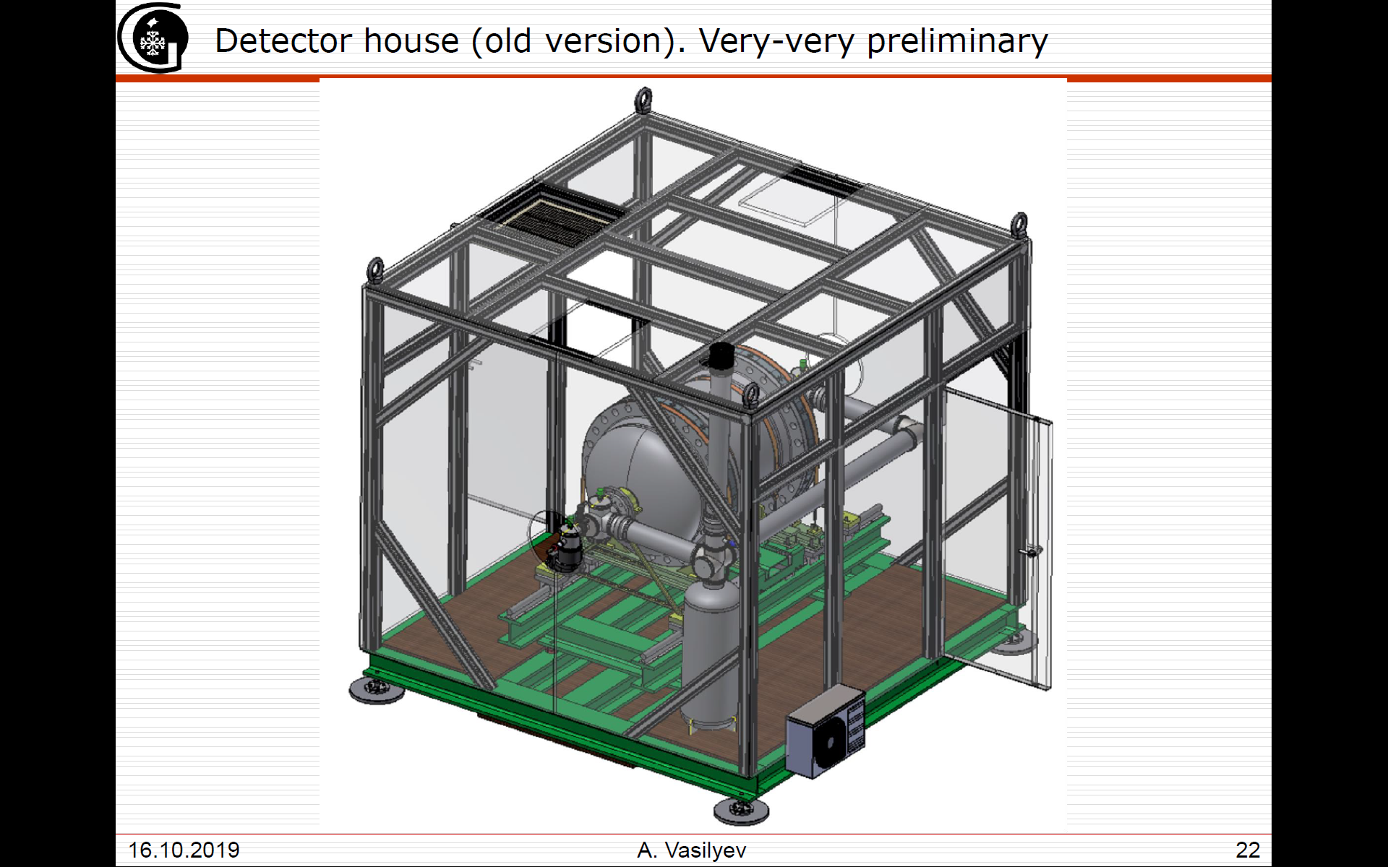
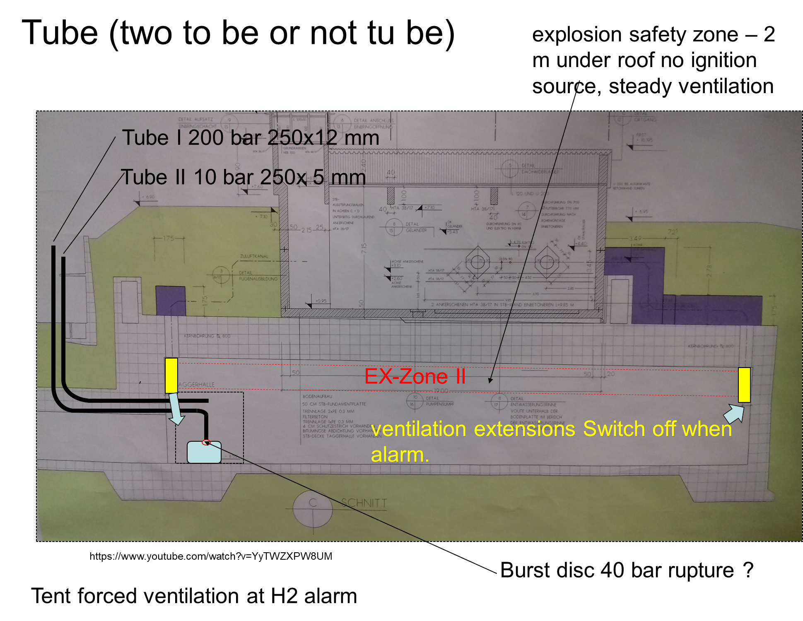
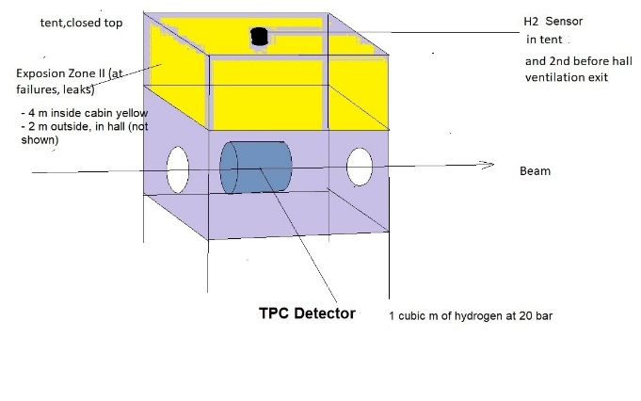
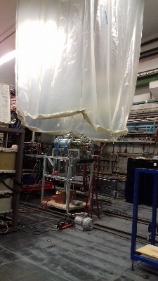
Avoiding explosive atmosphere outside TPC
1. scenario small leaks < 1 m³/h : Ventilation: in A2 hall, 2 m long funnels dive from hall ceiling into hall to prevent from spreading hydrogen into neighborhalls. Normal, e.g. A2 H2 cryo target operational mode
2. TPC scenario 0,5 m³ Hydrogen will drift to ceiling in several seconds (balloon velocity) and would self-dissipate by diffusion law after 30 min.
so wind shield, or open tent, no collection of gas in the vicinity of electronics in run 2019
Non-ignition EX-zone II pragmatic solution „switch off light, crane“ established minus 2 m under roof.
Hydrogen is lighter than air and is explosive if > 4-5 % in air. Consequences
3. TPC scenario 20 m³ Hydrogen in a climatized tent=hut. Intermediate leak forced ventilation 1 m³ /h. In case of rupture, Hydrogen within seconds tent will not withstand. Gravitational flap upward to hall
Forced ventilation explosion safe 1 m³ /s. No underpressure, implosion of hut, sucking flap at the floor.

Slide 7

Tent 40 l H2 10 bar, pressure survey, camera, comitted precautions, test of reliability
40 Liters to 400 Liters

Slide 8

tent for windshield or for containment ? Electricity without ATEX standard is forbidden in Ex zone. And: use antistatic material, grounded.

Slide 9
Source: Talk A. Vasiliev. 1000 -20000 Liters H2

Slide 10
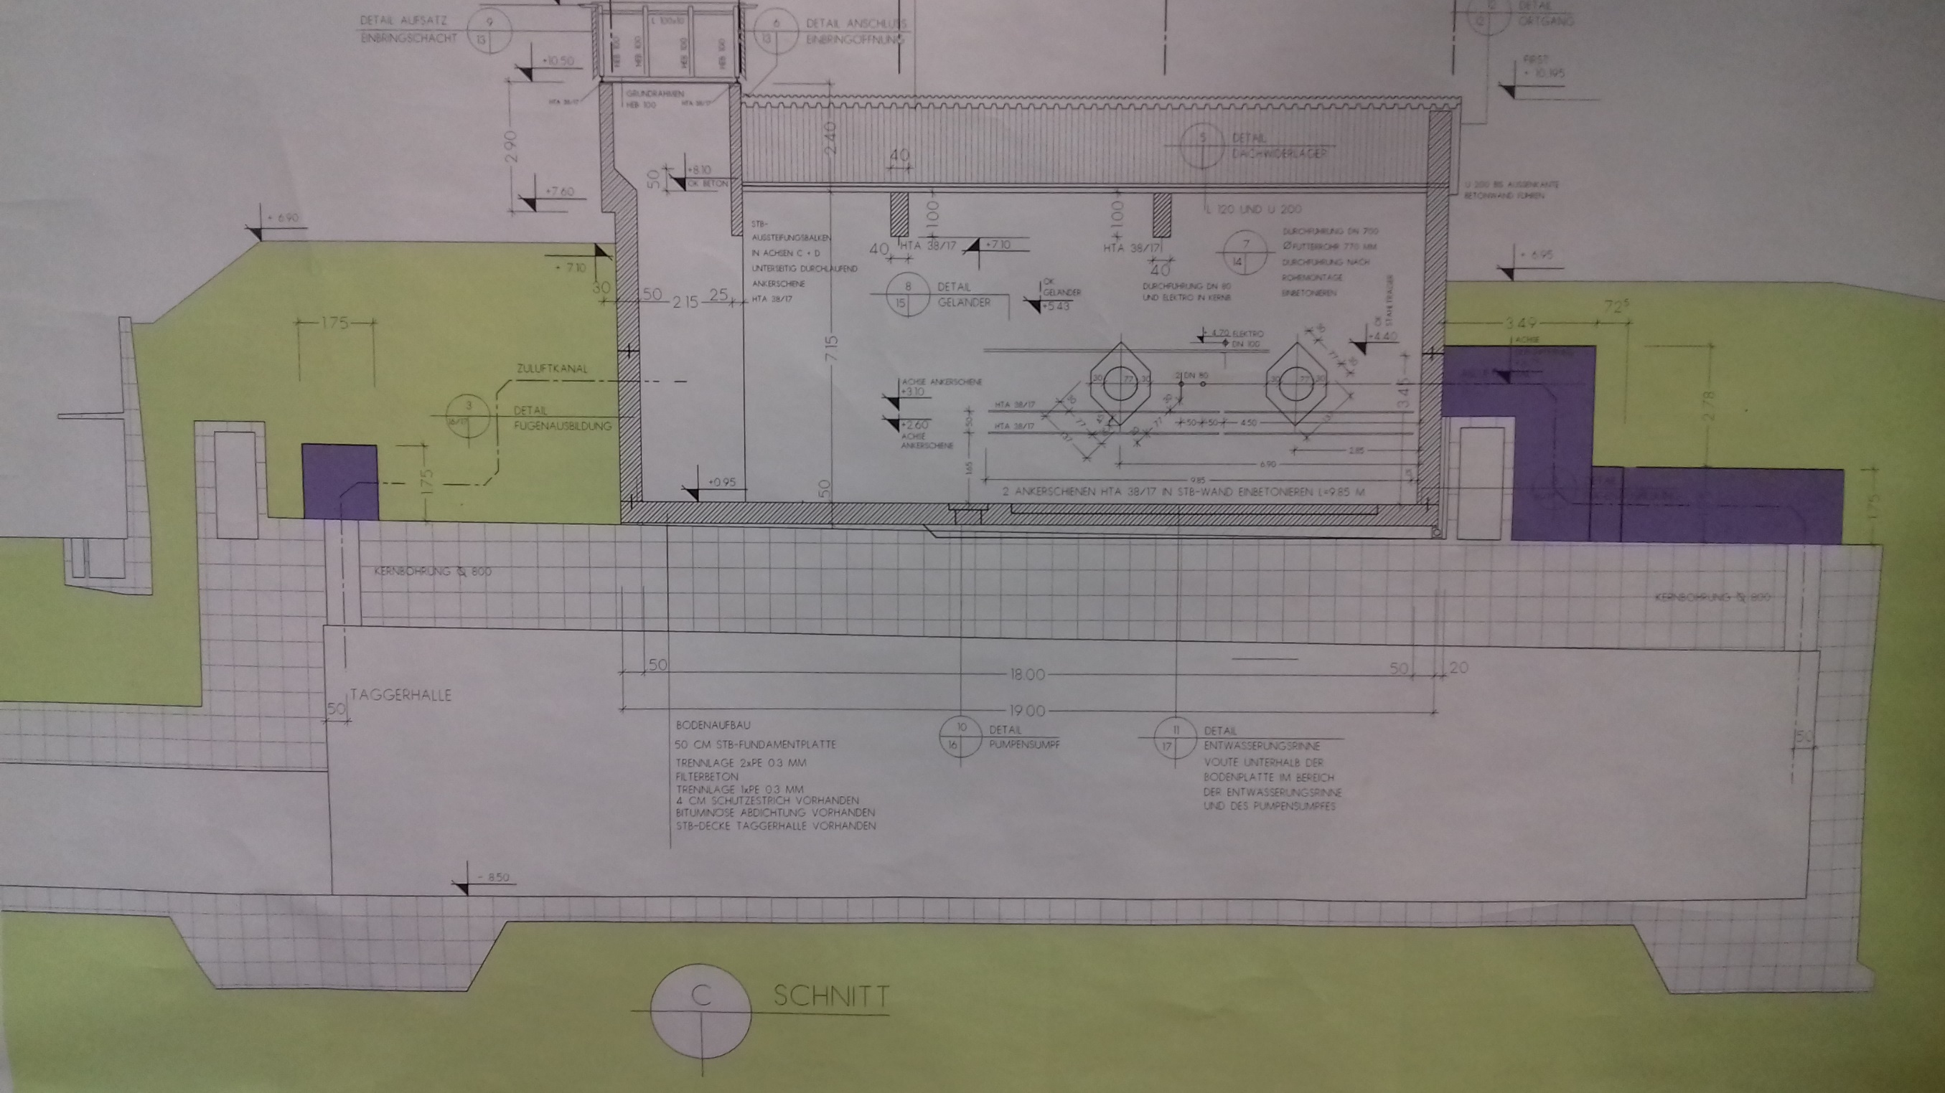
Tube (two to be or not tu be)
No ignition source, H2 sensors
Tube I 200 bar 250x12 mm possibly paid
Tube II 10 bar 250x 5 mm
EX-Zone II
Ventilation extensions, switch off when alarm.
https://www.youtube.com/watch?v=YyTWZXPW8UM
Burst disc 40 bar 15000 Euro
Tent forced ventilation at H2 alarm

Slide 11


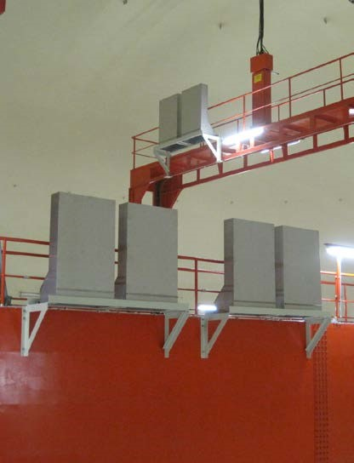
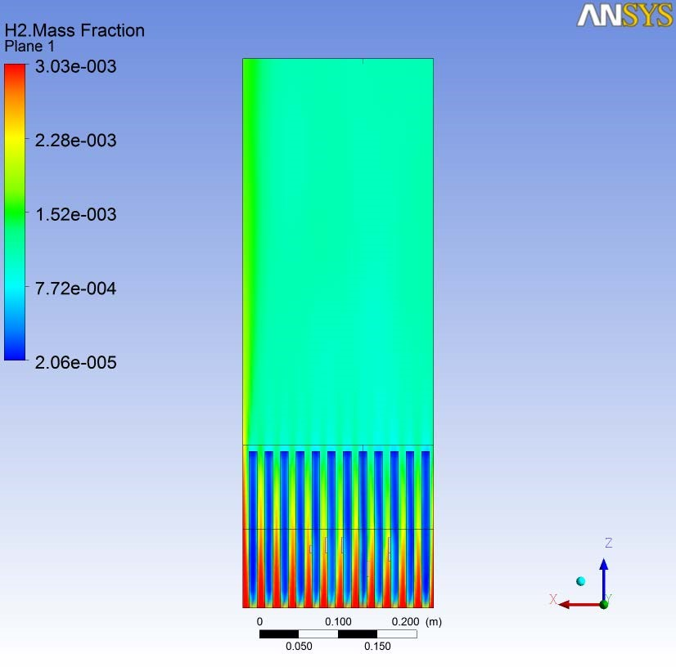
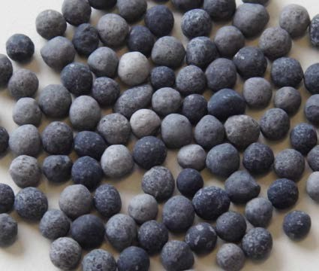
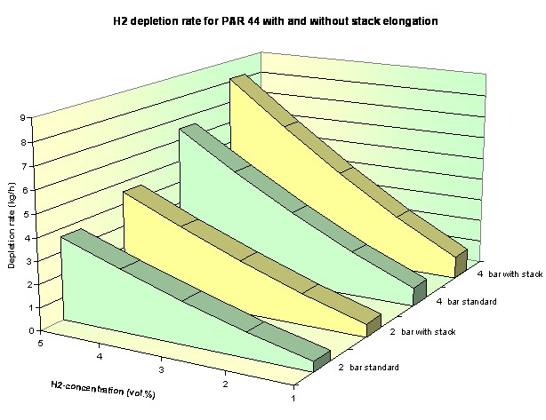
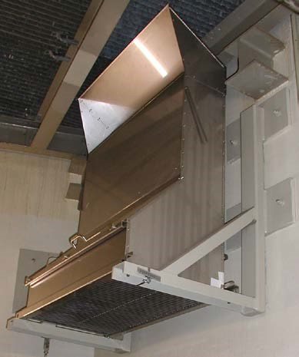
NIS-PAR - Passive Autocatalytic Recombiner for Hydrogen Control
use palladium as catalyst applied on a base material consisting of aluminium oxide pellets (spheres) providing a very large specific reaction surface.
Under the roof (see fukushima) and in non – cryogenic trap

Slide 12
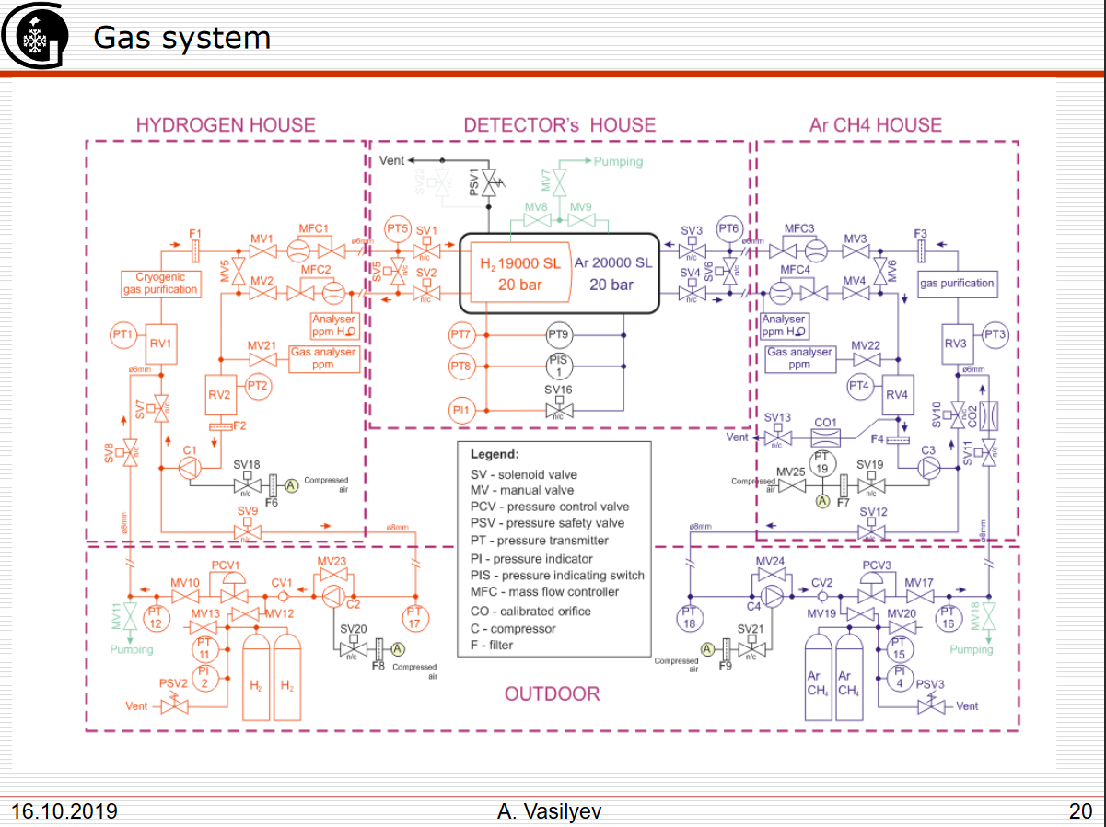
Preventing from Hazards from inside TPC, avoiding dangerous atmosphere is possible, but difficult. H2 Purity. Technical discussion Tuesday. Some changes. 100 % duty online control

Slide 13
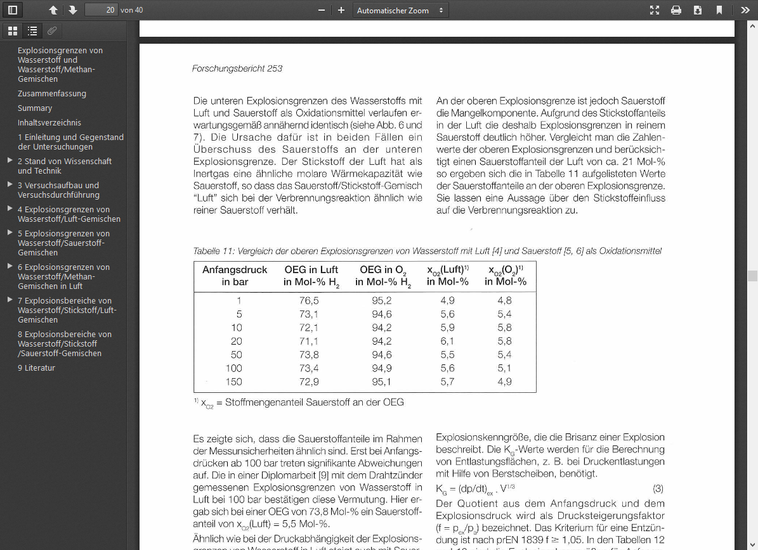

Slide 14
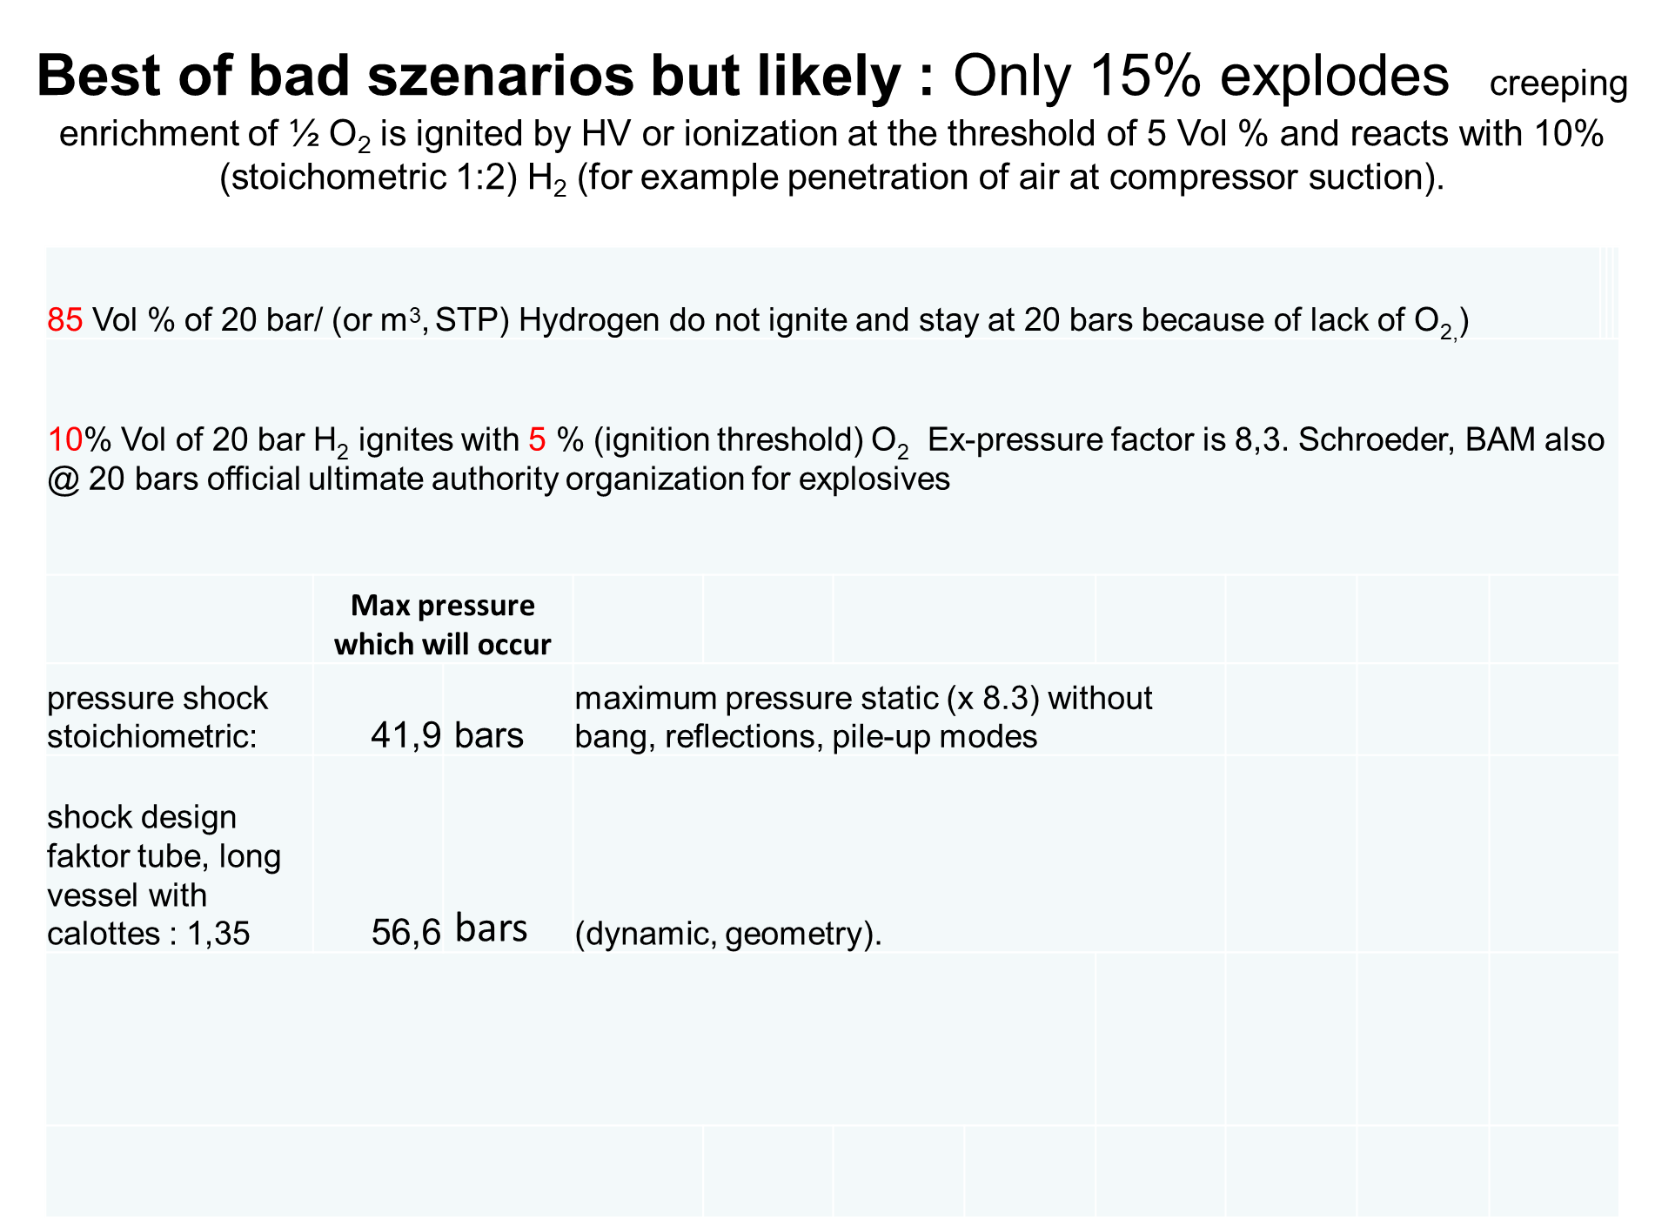
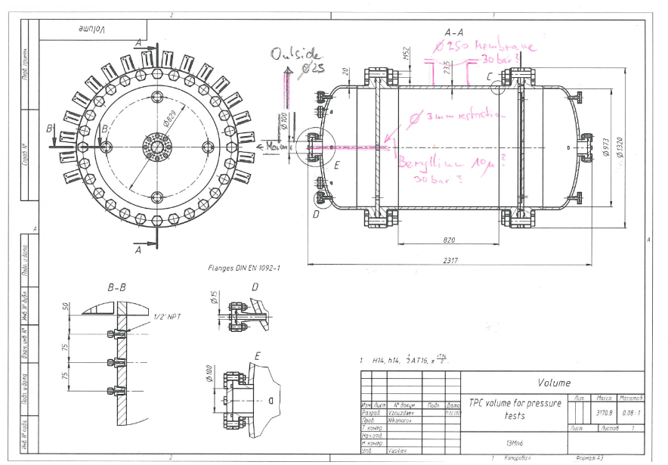
Preventing TPC and/or beryllium window burst, - by wall thickness, - rupture disc - Beryllium catcher

Slide 15
most likely scenario : Only 15% explodes creeping enrichment of ½ O₂ is ignited by HV or ionization at the threshold of 5 Vol % and reacts with 10% (stoichometric 1:2) H₂ (for example penetration of air at compressor suction).
85 Vol % of 20 bar/ (or m³, STP) Hydrogen do not ignite and stay at 20 bars because of lack of O_{2,})
10% Vol of 20 bar H₂ ignites with 5 % (ignition threshold) O₂ Ex-pressure factor is 8,3. Schroeder, BAM also @ 20 bars official ultimate authority organization for explosives
 | Max pressure which will occur
pressure shock stoichiometric: | 41,9 | bars | maximum pressure static (x 8.3) without bang, reflections, pile-up modes
shock design faktor tube, long vessel with calottes : 1,35 | 56,6 | bars | (dynamic, geometry).

Slide 16
For specialists: explosive *8.3 * 1.35 bang factor and w/o argon methane
IIIIIIIIIIIIIIIIIIII 2:1 20 bars/m³ H₂/O₂ „sabotage“ mixture in 1 m³ TPC ⬄ 224 bars
IIIIIIIIIIIIIIIIIIII+IIIIIIIIIIIIIIIIIIII +19 m³ inert argon + 1 m³ Methan in 2 m³⬄ 131 bars
IIIIIIIIIIIIIIIIIIII 2:1 2 bars H2/Air at threshold (5% O₂) contamination in 1 m³ ⬄ 57 bars
IIIIIIIIIIIIIIIIIIII+IIIIIIIIIIIIIIIIIIII + 19 m³ spectator + 1m³ Methan at threshold 2 m³⬄ 46,7 bars

Slide 17
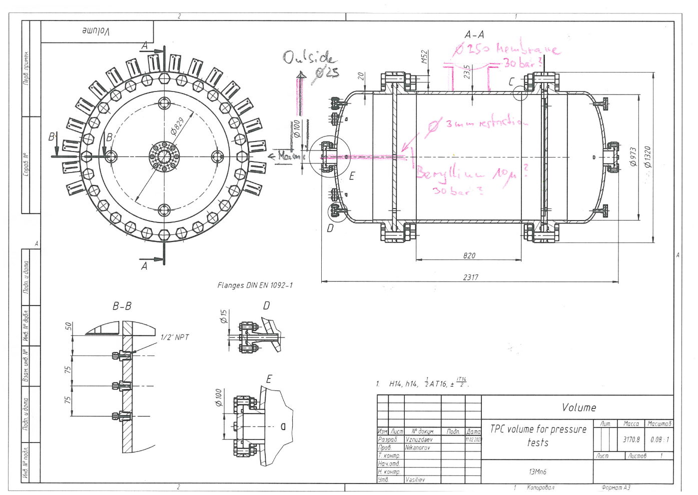
2 weeks ago enlarged 20>>23 mm wall thickness no dome, beryllium solution poss.

Slide 18
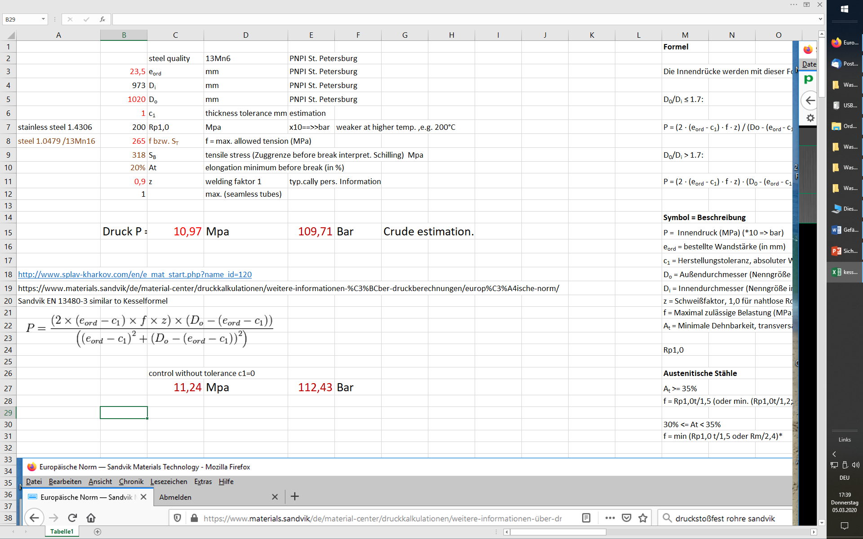

Slide 19
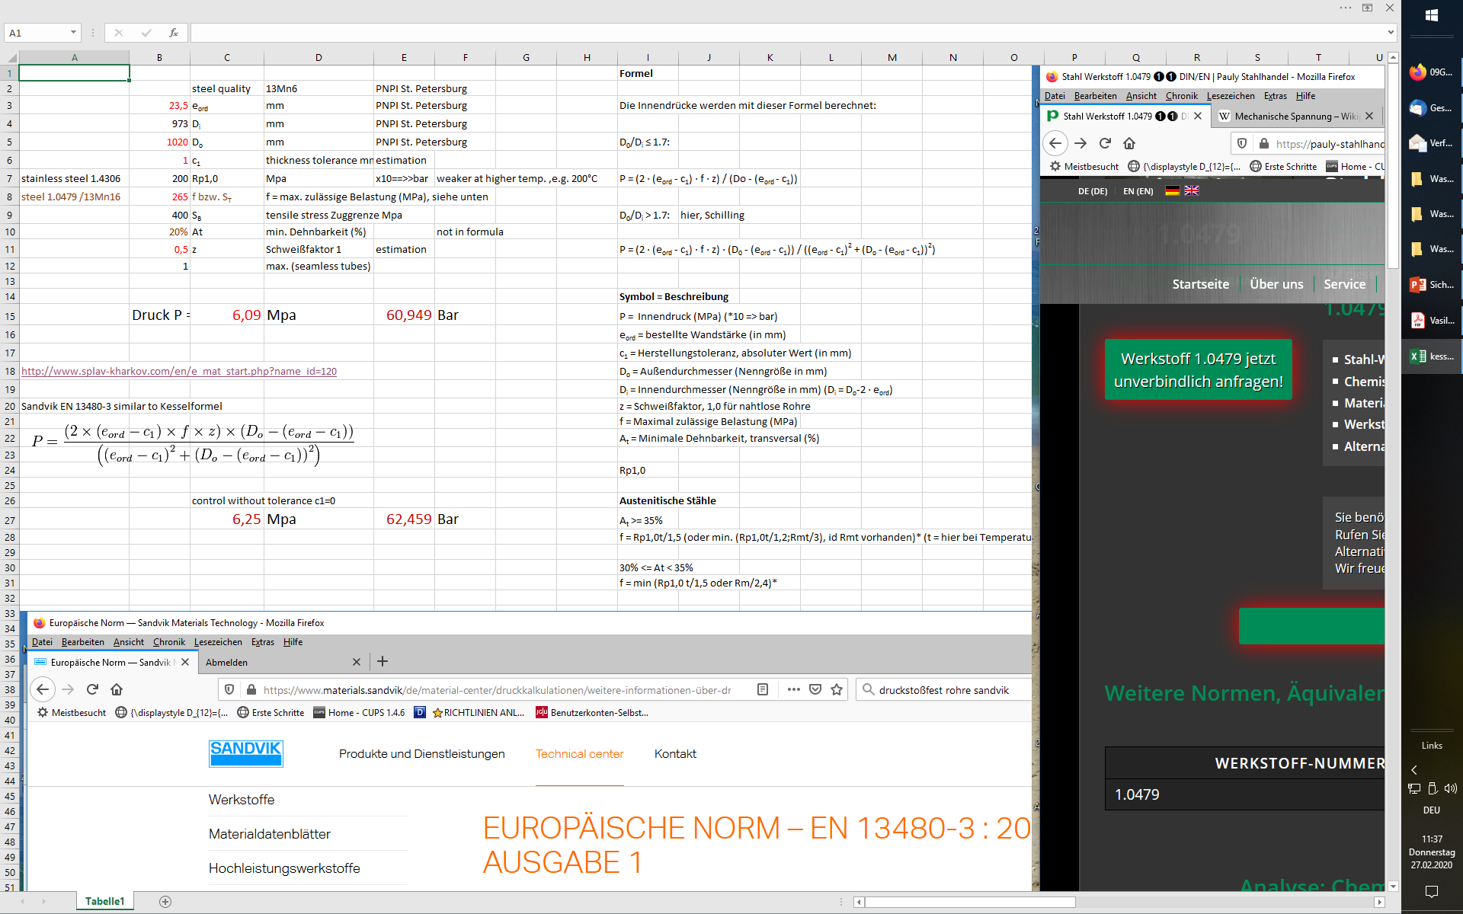
Pressure Calculation

Slide 20
Precautions small 40 Liter /10 bar H2 Active Target Minutes Tuesday, 18. Dezember 2018 18:06 participants: A. Denig, L. Doria, Thomas, J. Diefenbach, E. Schilling, V. Sokhoyan, M. Ostrick, W. Lauth
Absolutely necessary for all hydrogen run times of A2:
• Replace plastic pipes for H2 exhaust air with metal pipes with explosion-proof fan, possibly use existing Cu pipe for targeted drain.
When TPC Test St. Petersburg in March 2019 : exhaust air system to be installed on the ceiling
• Tent over experiment (see sketch)
• Buffer volume with aperture system, flanges to the MAMI beam line, see sketch
• Interlock system in case of accident (Electronic workshop TBE):
• at pressure drop, high voltage off, hydrogen sensors, hall ventilation and circulating air cooler off, exhaust air H2 on, valves to close to MAMI, gas purity sensor
interlock (should be) provided by LBB:
• Lighting off, emergency lighting on, horn off, RAS off, crane off
personal protection:
• any work on the experiment only without hydrogen
• automated emptying (throttled) e.g. via existing copper pipe d = 25mm (green in drawing) filled with N2. Grounding of the Cu tube.
• HV can only be switched on if pressure (1 bar) in the TPC
• Filling process: only by named people
In experiment operation without a beam with hydrogen:
• switch off high voltage (via interlock with entrance door)
• Only named persons (extended group A2)
• Monitor, slow control with all parameters of the accident case, cameras on mechanical gauges and on chamber
Conclusion: The absolutely necessary devices cannot be completed by March 2019. The beam time in March is to be postponed by one year. LBB could have laid the new pipes by this time and our workshop would be relieved. An experiment with He and/or a low hydrogen content could be carried out in March hydrogen.

Slide 21
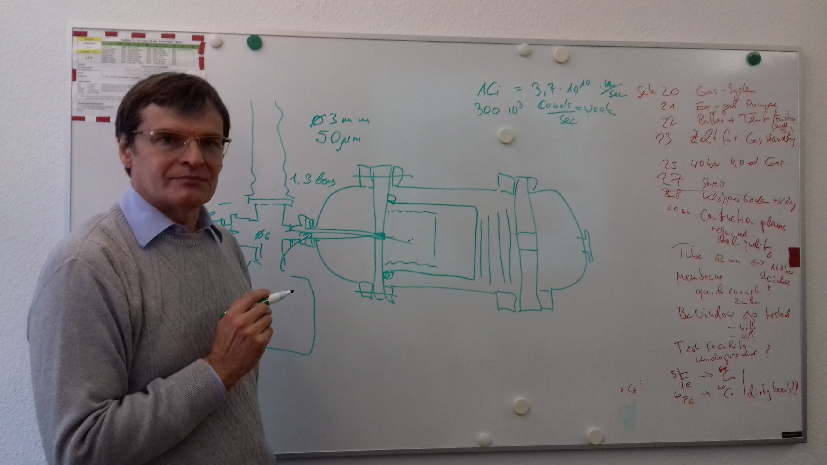
Beryllium window 3 mm diam. in a long channel 3 mm, 50 mu thickness, must be testet 30 bar
Live discussion Oct 2019

Slide 22
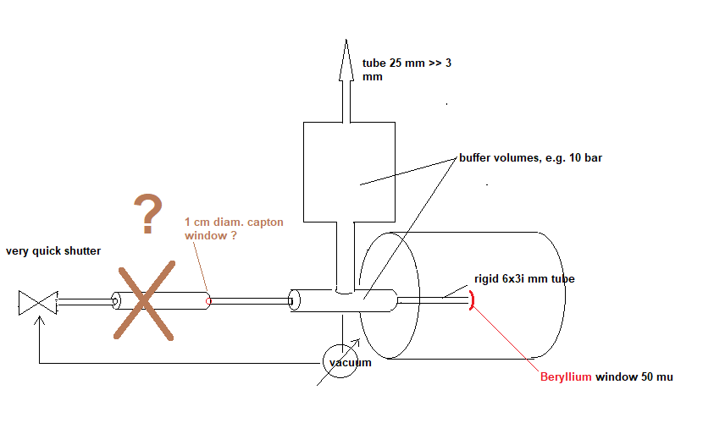
Beryllium catcher. Pipe to the roof has 25 mm, beam pipe 3 mm diameter. Dynamic pressure reduction

Slide 23
I Tube
explosion inside the chamber: exhaust is open for explosions.
second hazard: hydrogen content in tent or hall air > 1 %, safety fan starts running and presses flap to the right
1,01 bar
200 bar
if explosion occurs from inside TPC the taggerhall is always saved by the set back flap „Rückschlagklappe“

Slide 24
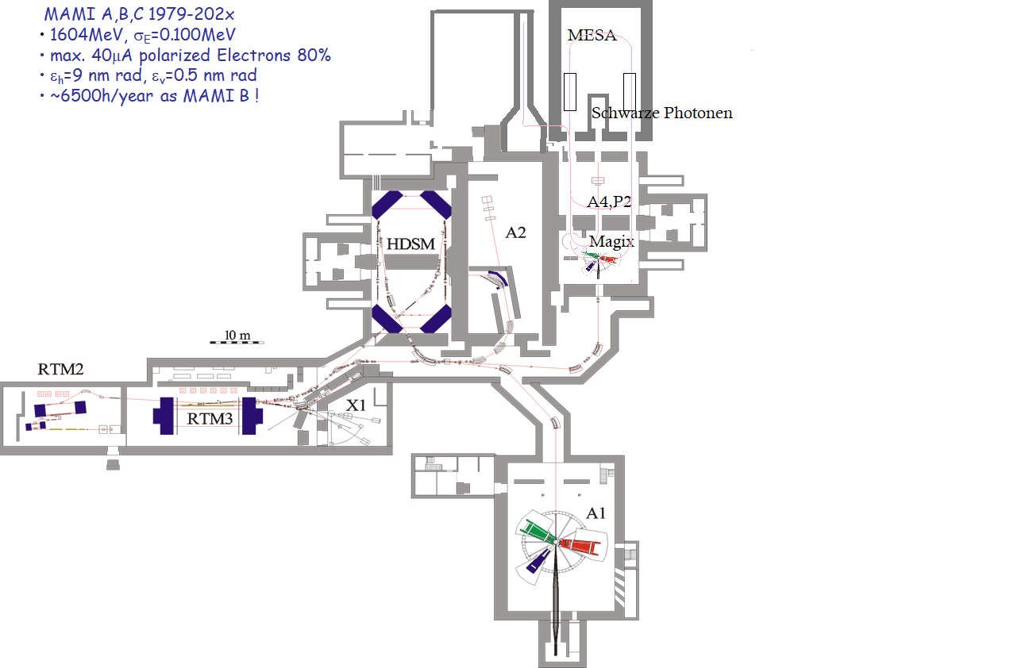
Two of three items together possible
in A2 tagger hall:
1. Persons
2. HV on
3. Hydrogen in
No H2
find TPC !
Floor map courtesy Merkel,Thomas, some adds MESA + MAMI Beam Schilling

Slide 25
Only named operators, specific EX-safety operation instructions

Slide 26
safety costs
2020 | 2021 | Euro without Tax (19%)
7500 |  | 1. Risc assessment "HAZOP" hydrogenhandling 20 bar 1 cubicmeter external Firma = 7500 Euro. E.g. Company CSE Prof. Schmidt (7500 Euro), Prof Schröder, typ. scenario.
7500 |  | 1a The TÜV offer is still pending. I took 7500 euros.
 | 15000 | 2. In 2020 rupture disc DN 250 costs 15000 Euro, conversation with company Rembe
 | 15000 | 3. In 2020 tube für rupture disc 25 cm in addition to tube payed by LBB. estimation.
 | 5000 | 4. In 2020 evtlly costs for exhaust mufflers 5 000 Euro in benefit for Eardrum
5000 |  | 5. tent to hall ceiling 7x7 meters in antistatic meshed foil with aluminium profiles or wood.
5000 |  | 6. H2 sensor EX saved additional, Sensor in Zelt. 5000 Euro
0 |  | 7. Hydrogen bottles shelter, store for 12 hydrogengasbundle outside, weatherp(roof)
10000 |  | 8. duty checks 5000 Euro/years.
 | 70000 | together 70000 Euro in 2 y, depends on number of helpers, volunteers (= young scientists)

Slide 27
Conclusion
TPC in tagger hall (without roof) is possible if
Purity H2 > 99 % survey online: use mass spectrom with channel plate (precise leak) or use heat conductivity sensor >>> technical session or now on demand.
only two of three items (HV, Hydrogen, people) can stay in the hall, evtl. purity proof relaxes this statement
existing ventilation outside for small hydrogen leaks, H2 sensor switches „off“ Ventilation if H2 >1 %
quick ventilation off the tent, ex proof fan „on“ if H2 sensor (in tent) > 1 % in, additional tube
inside TPC: HAZOP with TÜV necessary whether additional rupture disc or not. Legally needed. If yes, 2nd tube, dome or other solution
organisational measures: legal risk assessment forms „Explosionsschutzdokument“ Gefährdungsbeurteilung (existing Draft) have to be accepted by University
regular checks, fixed control intervalls, costs, responsibility are cleared
Beryllium window is O.K. with precautions e.g. 3 mm beam tube and catcher
Evtlly no fixed connection to MAMI beampipe but window with beryllium buffer volume. Tests with 20 bar and 3 mm tube

Slide 28
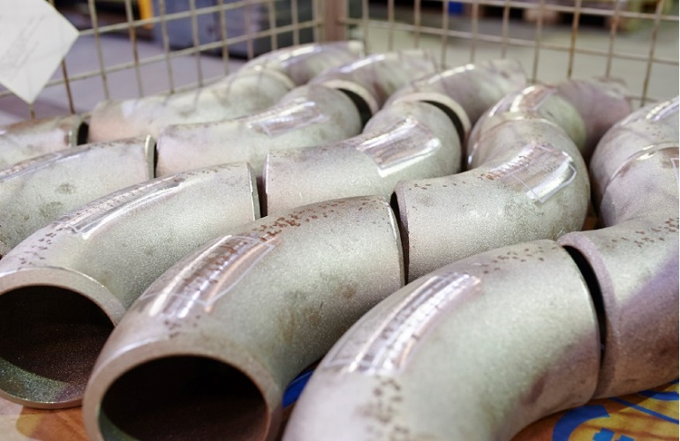
Tube Business for good welders. Wall Thickness 11 mm

Slide 29
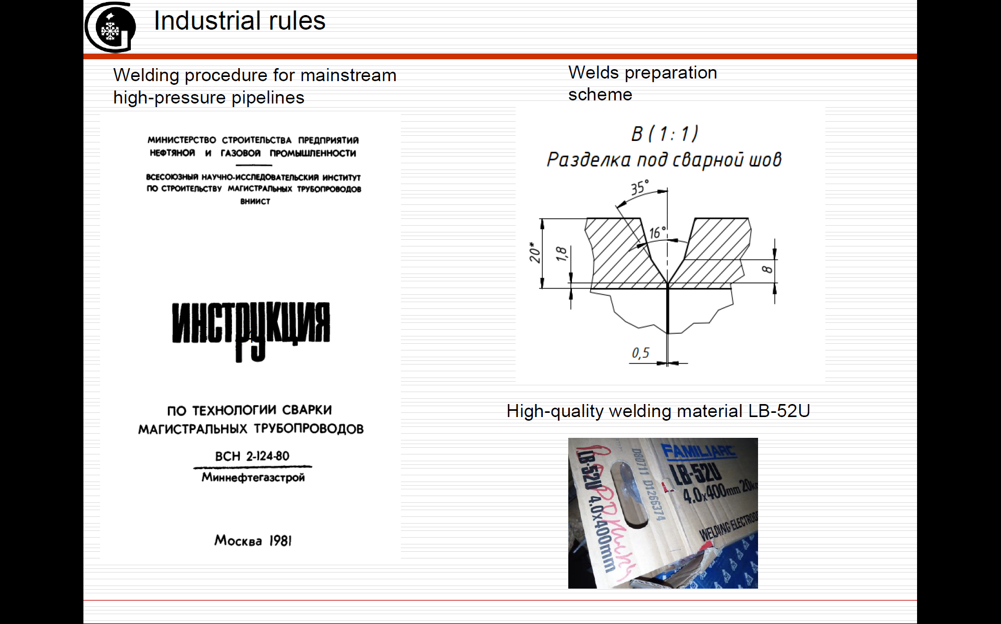
Talk A. Vasiliev

Slide 30
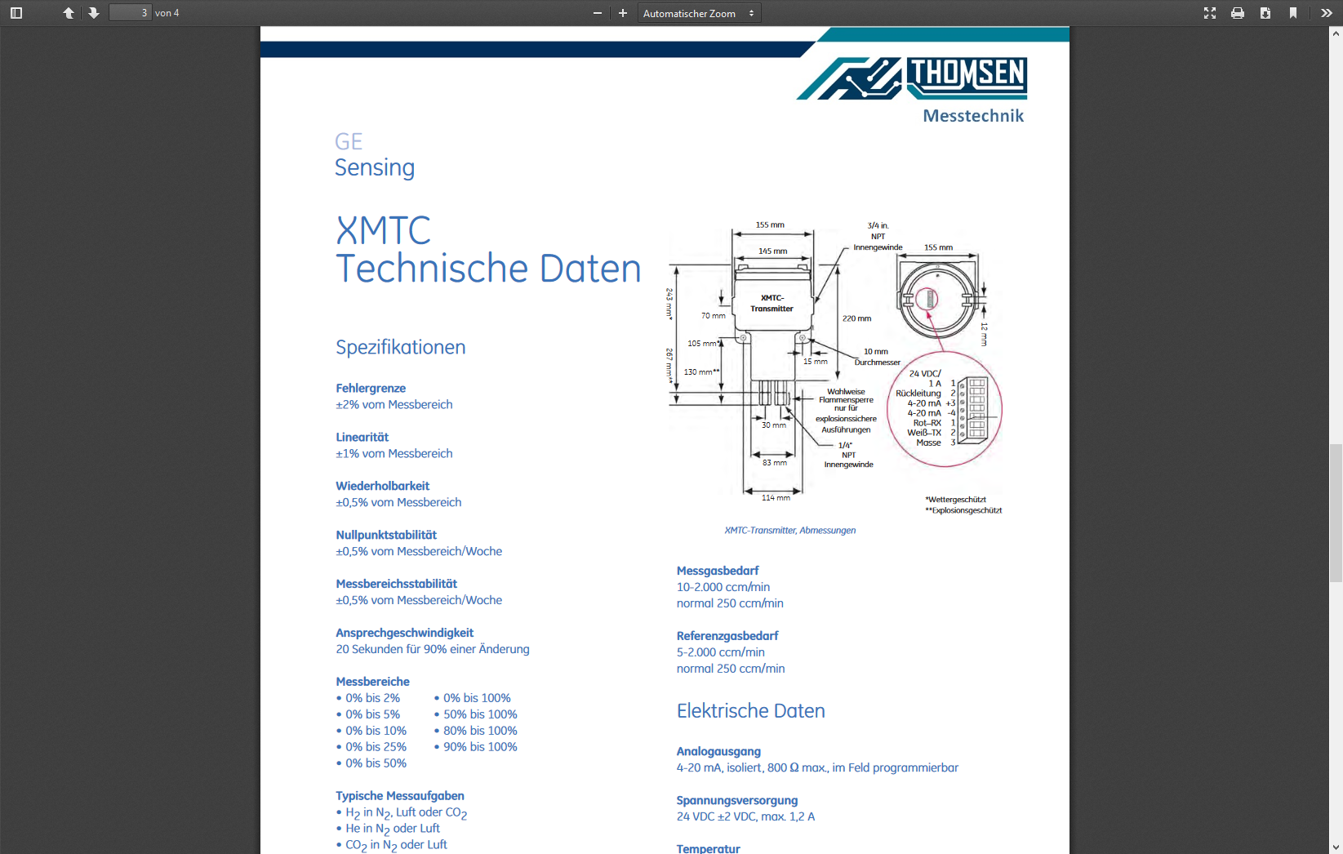

Slide 31
H2 permeation through kapton, partial pressure, no cryogenic purification, catalysts ?
online control
99 % H2
MV21
always open
MV22 open
online control
99 % H2
compressor
piston sealing
air <-→ hydrogen tight

Slide 32
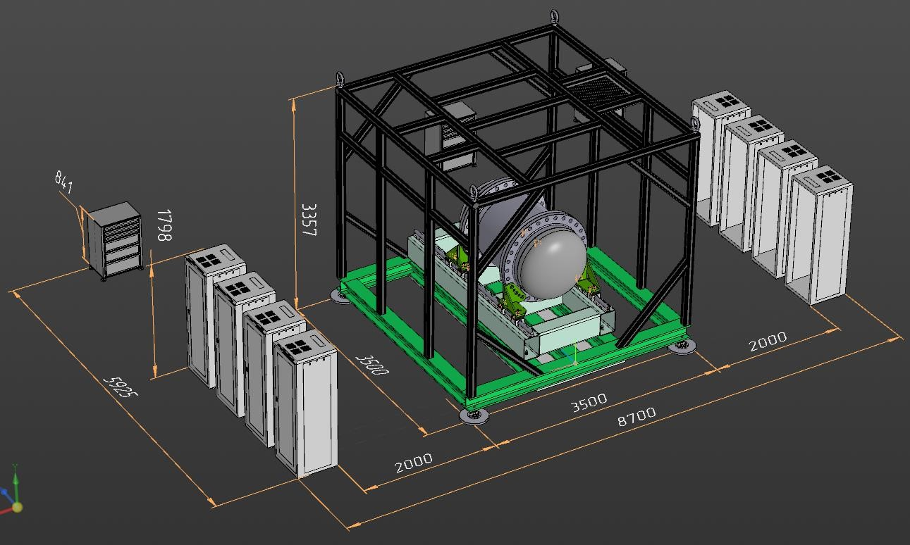
Tent with climatization, but: no electrics allowed

Slide 33
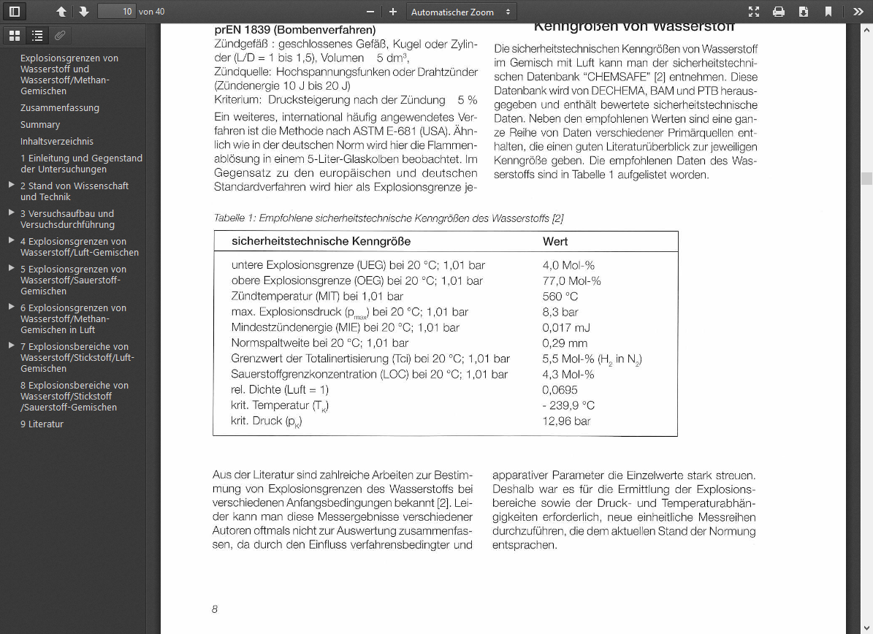

Slide 34
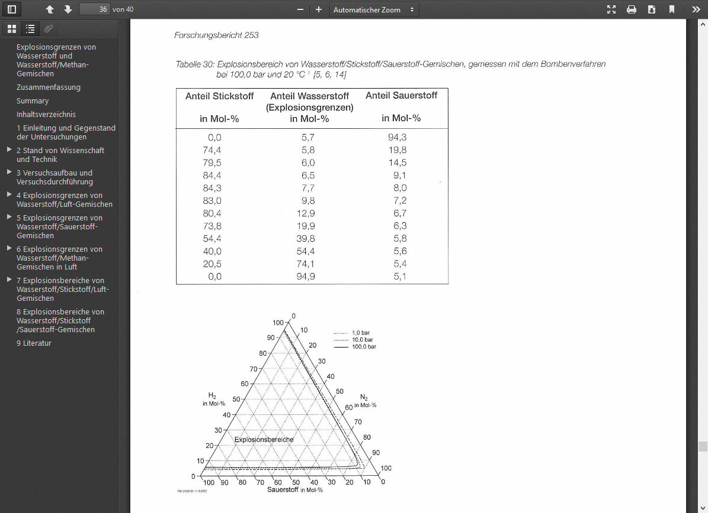
Prof. V. Schroeder et al. BAM Berlin

Slide 35
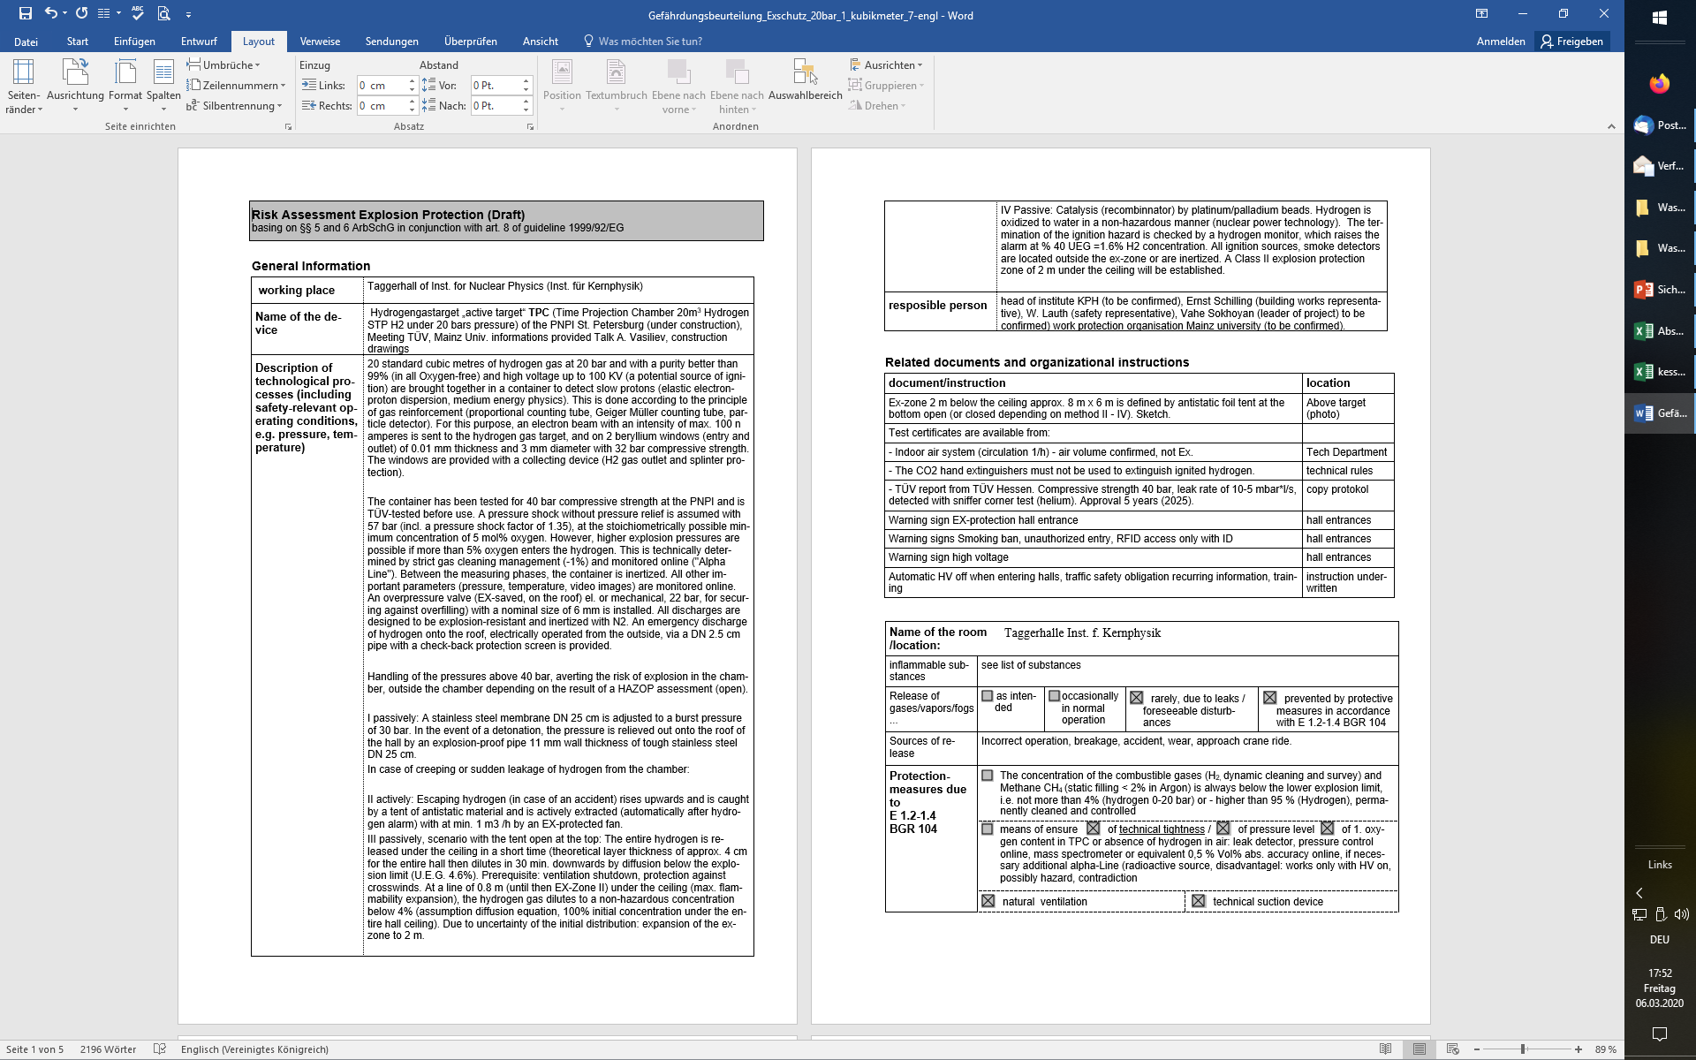

Slide 36
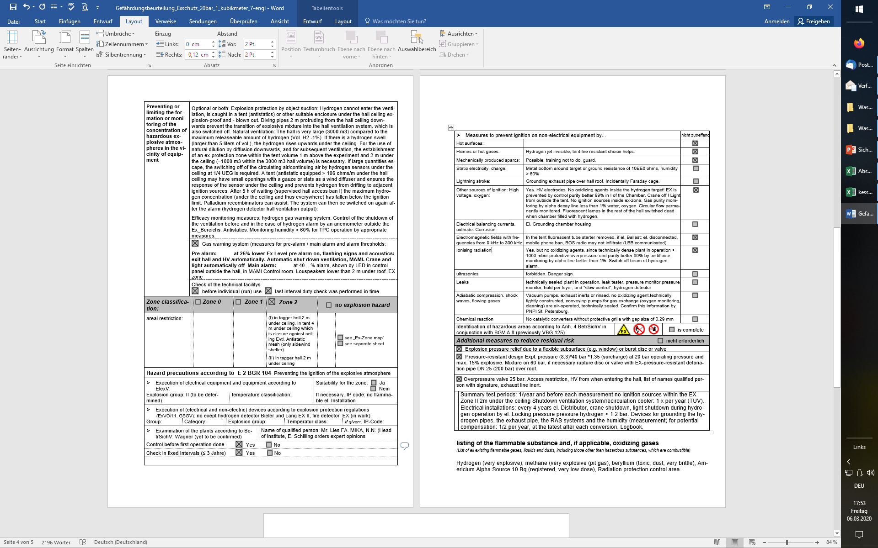

Slide 37
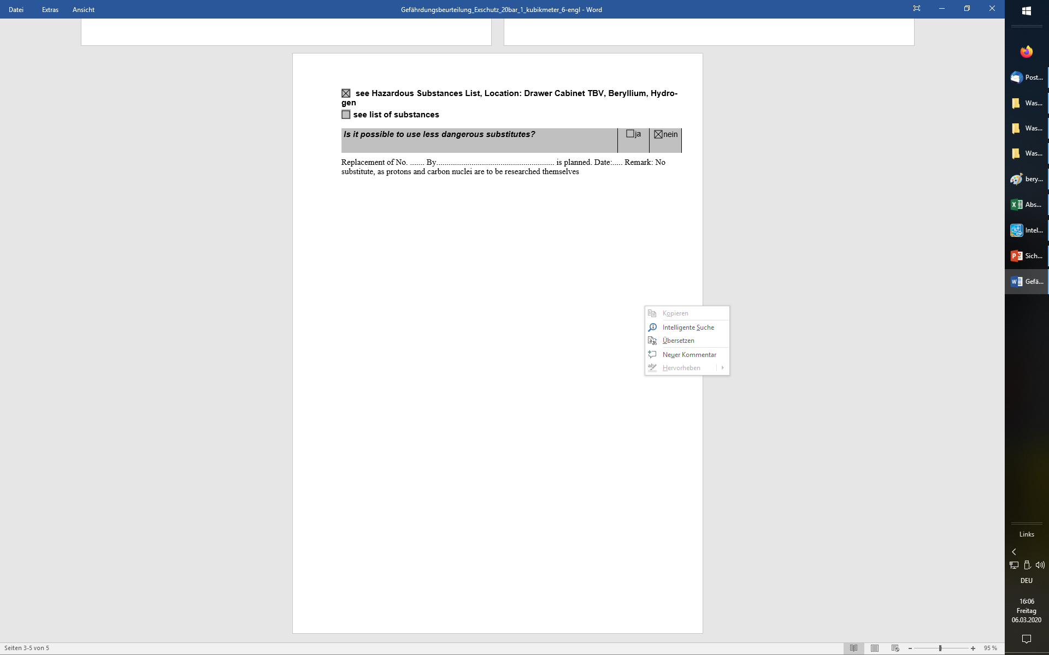

Slide 38
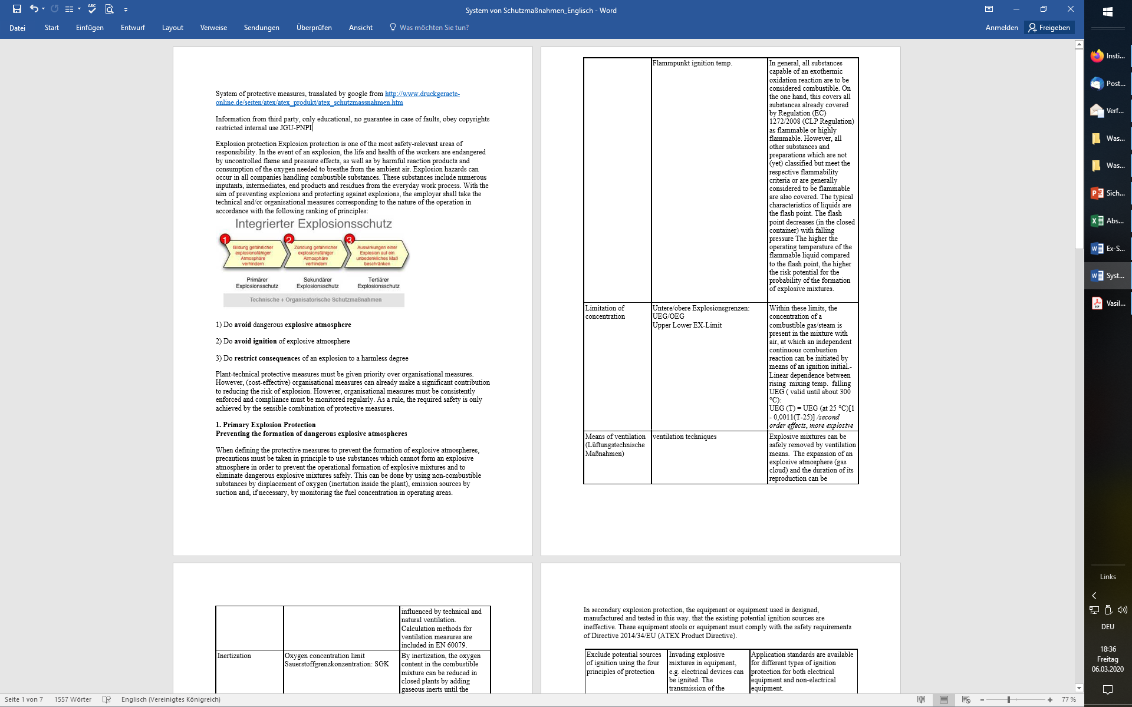

Slide 39
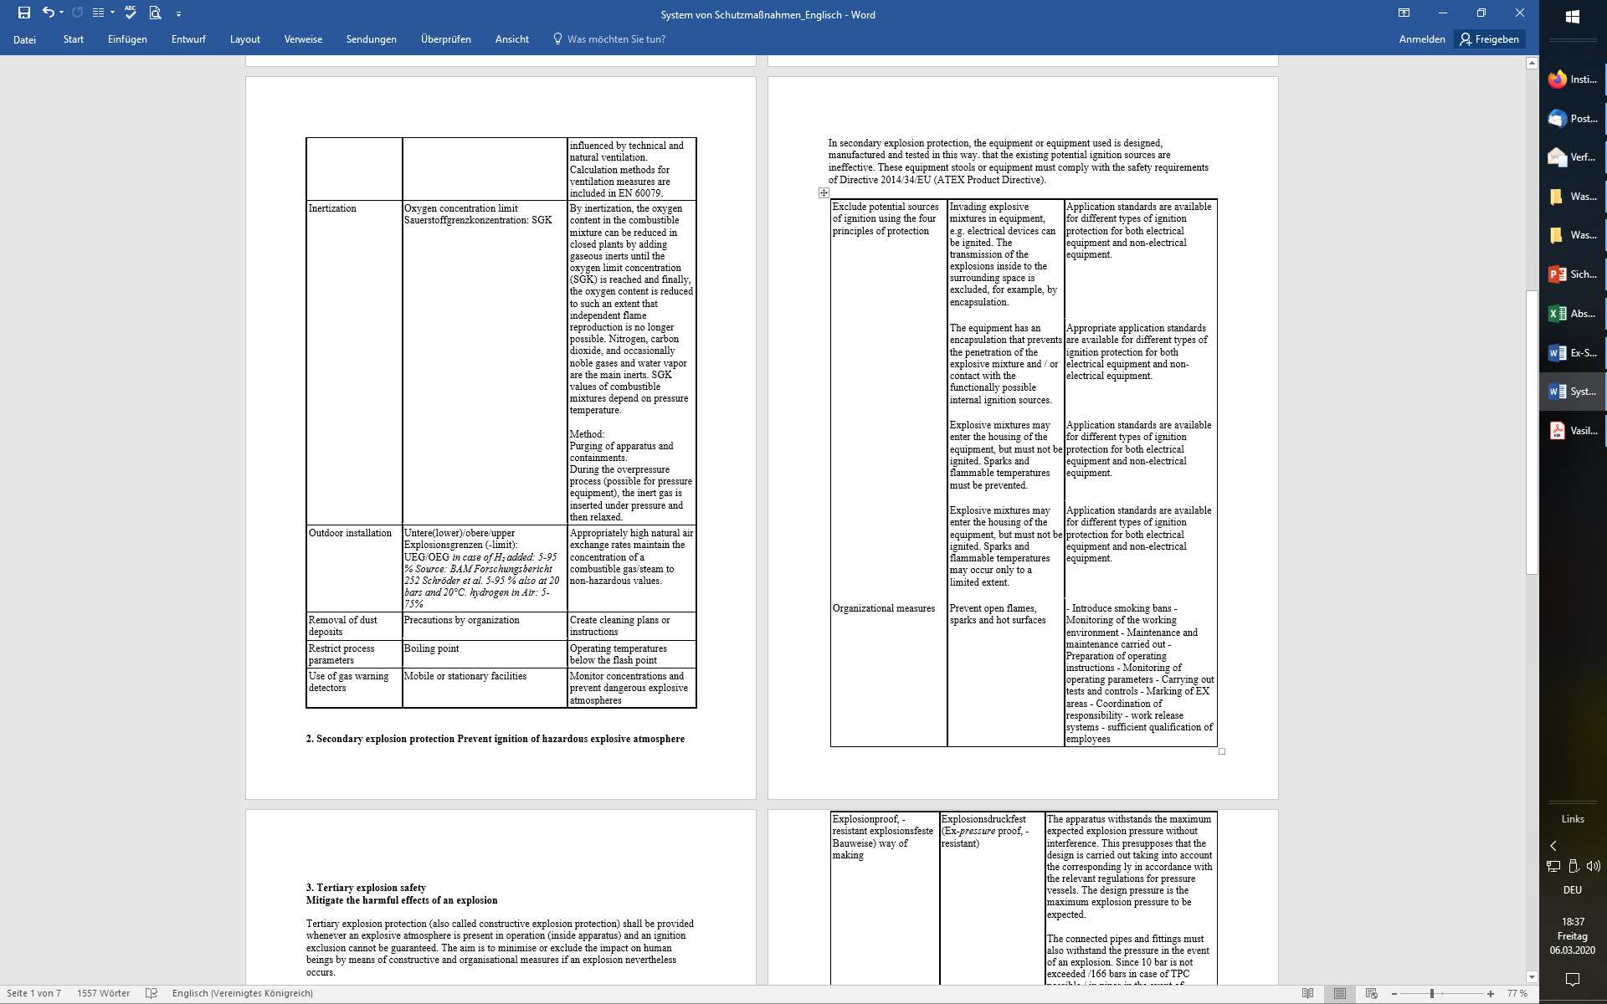

Slide 40
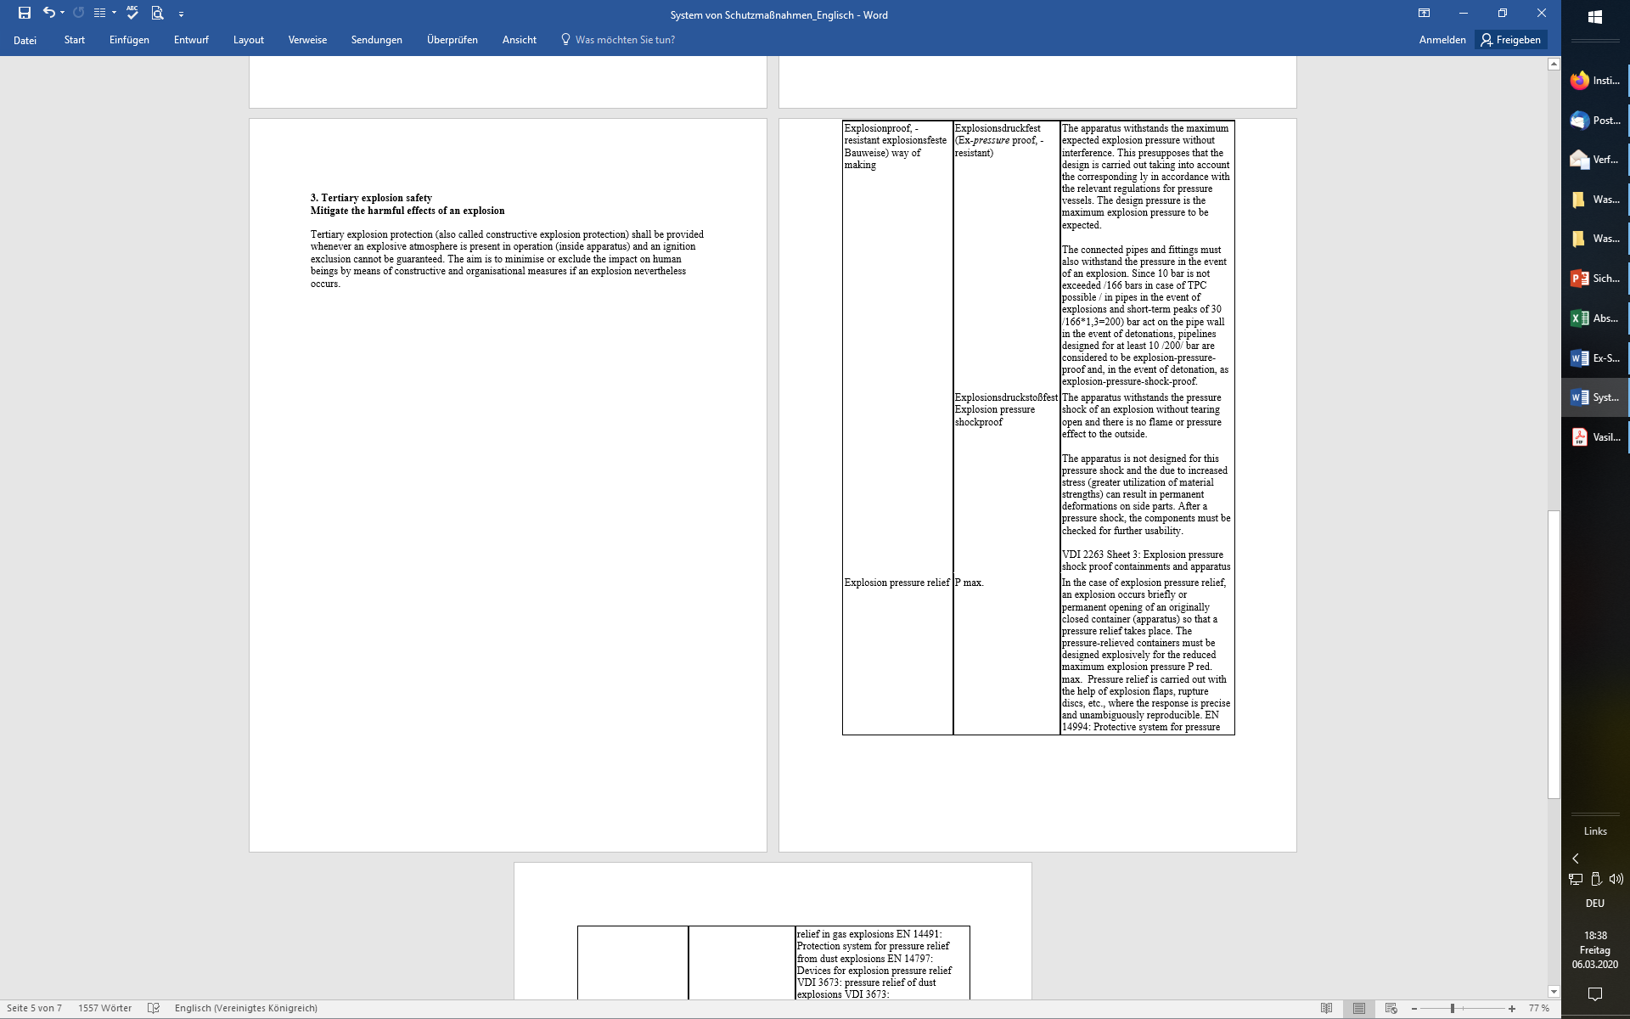

Slide 41
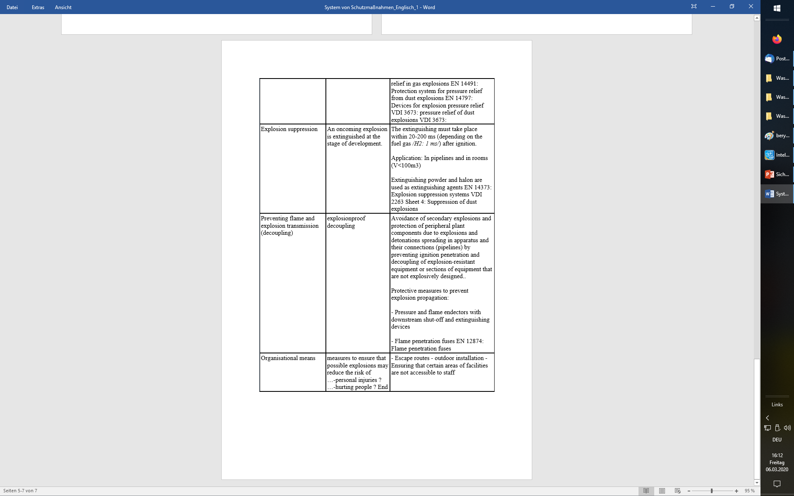

Slide 42
