Slide 1
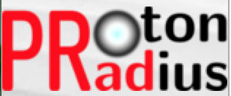
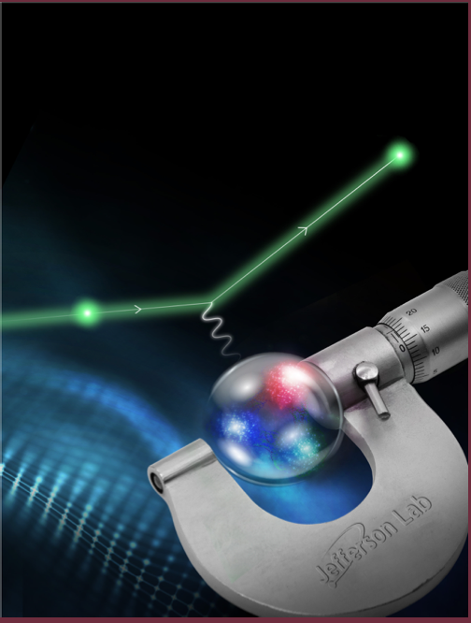


Recent Results from the PRad Experiment
A. Gasparian
NC A&T State University, NC USA
for the PRad collaboration
Outline
  the Proton Radius Puzzle, recent history
  our approach for a new ep-experiment
  the PRad experiment
  PRad results
  plans for new experiments
  summary and outlook
New York Times

Slide 2
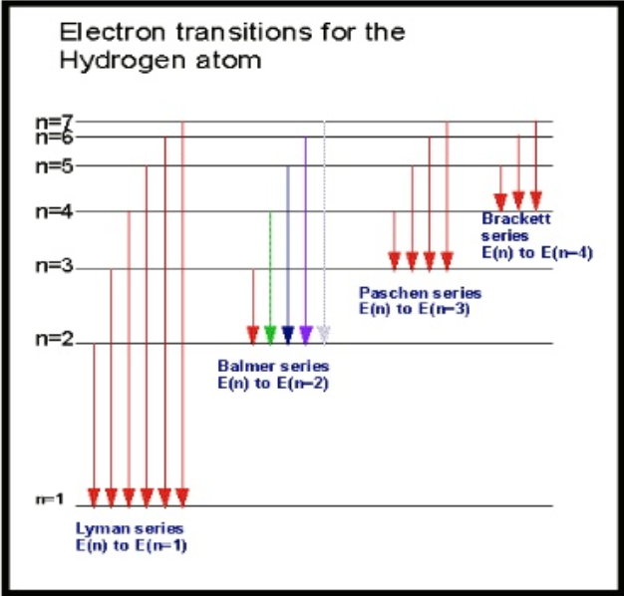
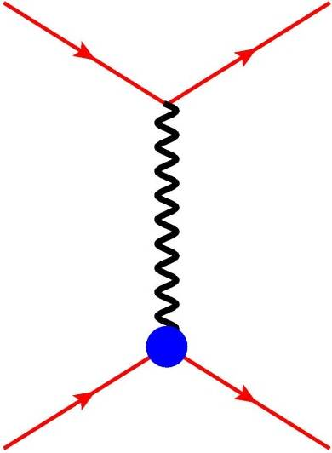

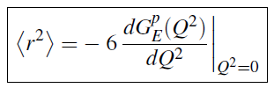




Methods to Measure the Proton Charge Radius
Two different techniques:
Hydrogen spectroscopy (lepton-proton bound states,
Atomic Physics):
  regular hydrogen
  muonic hydrogen
Lepton-proton elastic scattering (Nuclear Physics):
  ep- scattering (like PRad)
  μp- scattering (like MUSE)
  With relativisticly correct definition of the Proton charge radius:
e$,μ$
e$,μ$
$γ∗$
G_{E}$,GM$
p
p

Slide 3
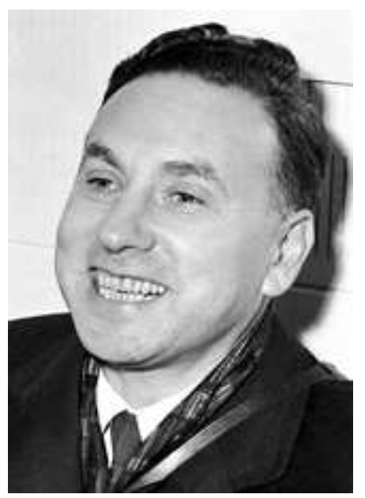
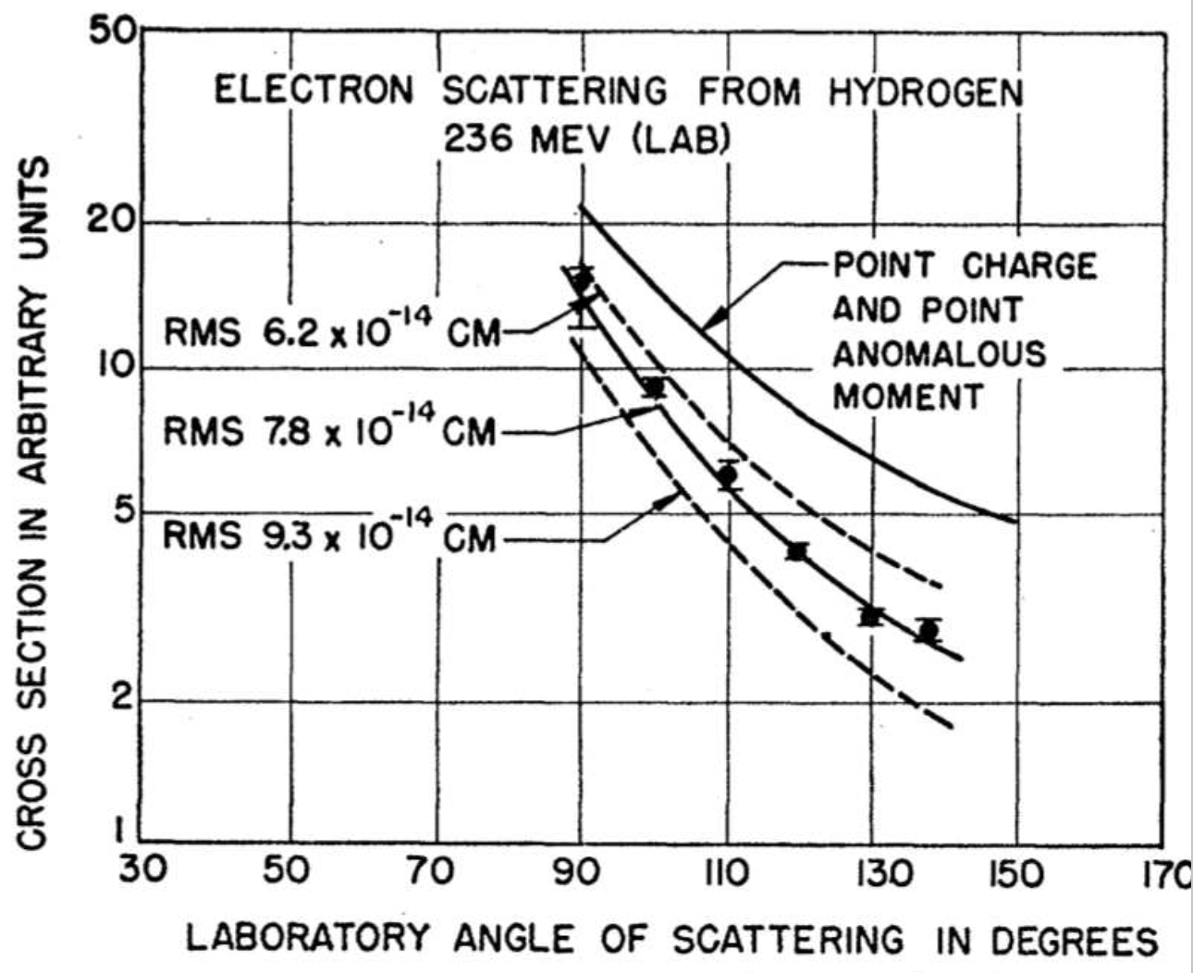
The First Measurement of the Proton Charge Radius (ep-scattering)
started with Robert Hofstadter
  Nobel prize in Physics (1961):
  “… for his pioneering studies of electron
  scattering in atomic nuclei and for his
  consequent discoveries concerning the
  structure of nucleons …”
The Proton rms charge radius in 1956 was measured to be:
  7.8 10⁻¹⁴ cm (0.78 fm)
  Hofstadter, McAllister, Phys. Rev. 102, 851 (1956).
Over 60 years of experimentation!
  started from 0.78 fm
  ended to 0.895 fm by 2010.
  where we are now ???
Hofstadter, McAllister, Phys. Rev. 98, 217 (1955).
Hofstadter, McAllister, Phys. Rev. 102, 851 (1956).

Slide 4
The Puzzle: Proton Radius before 2010
CODATA average: 0.8751 ± 0.0061 fm
ep-scattering average (CODATA): 0.879 ± 0.011 fm
Regular H-spectroscopy average (CODATA): 0.859 ± 0.0077 fm
  Very good agreement between ep-scattering and H-spectroscopy results !

Slide 5
The Puzzle: Proton Radius in 2013
New York Times
Regular hydrogen average (CODATA): 0.8751 ± 0.0061 fm
Muonic hydrogen (CREMA coll. 2013): 0.8409 ± 0.0004 fm
  Muonic hydrogen (CREMA coll. 2010): 0.84184 ± 0.00067 fm

Slide 6
The Puzzle: Proton Radius in 2017
Regular hydrogen average (CODATA): 0.8751 ± 0.0061 fm
Muonic hydrogen (CREMA coll. 2013): 0.8409 ± 0.0004 fm
  Regular H-spectr. (2S ➔ 4P, Garching, PSI): 0.8335 ± 0.0095 fm

Slide 7
The Puzzle: Proton Radius in 2018
Regular hydrogen average (CODATA): 0.8751 ± 0.0061 fm
Muonic hydrogen (CREMA coll. 2013): 0.8409 ± 0.0004 fm
  Regular H-spectr. (2S ➔ 4P, Garching, PSI): 0.8335 ± 0.0095 fm
  Regular H-spectr. (1S ➔ 3S, LKB, Paris): 0.877 ± 0.013 fm

Slide 8
The Puzzle: Proton Radius in 2019
Regular hydrogen average (CODATA): 0.8751 ± 0.0061 fm
Muonic hydrogen (CREMA coll. 2013, PSI): 0.8409 ± 0.0004 fm
  Regular H-spectr. (2S ➔ 4P, Garching, PSI): 0.8335 ± 0.0095 fm
  Regular H-spectr. (1S ➔ 3S, LKB, Paris): 0.877 ± 0.013 fm
  Regular H-spectr. (2S_{1/2} ➔ 2P_{1/2} , York Un. Canada) 0.833 ± 0.010 fm

Slide 9
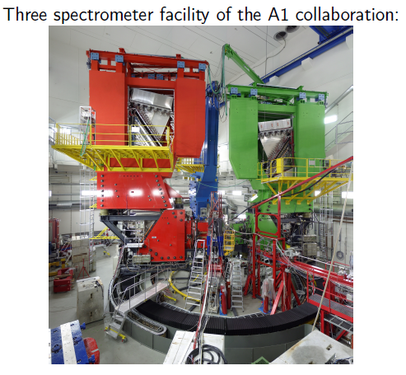
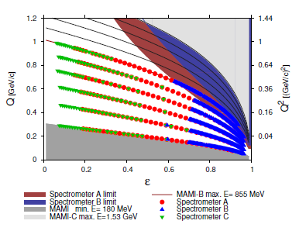
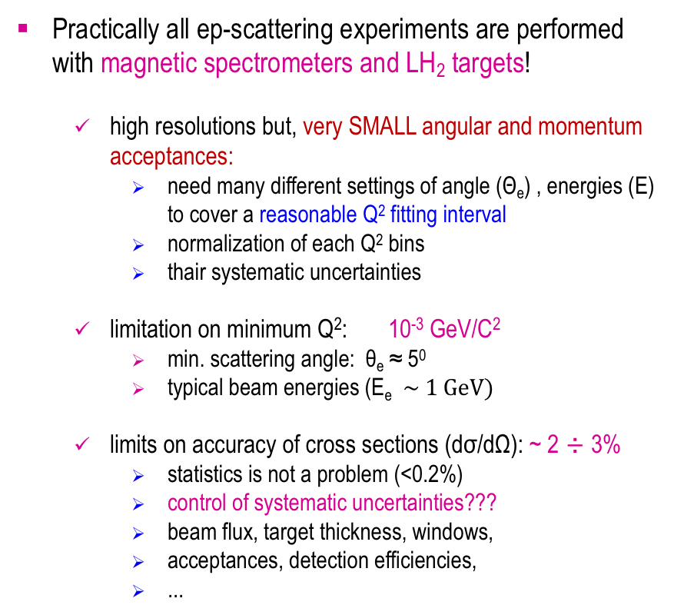
Planning a new ep→ep Experiment: weaknesses of previous magnetic spectrometer experiments
Practically all ep-scattering experiments are performed with magnetic spectrometers and LH₂ targets!
  high resolutions but, very SMALL angular and momentum acceptances:
    need many different settings of angle (Θ_{e}) , energies (E) to cover a reasonable Q² fitting interval
    normalization of each Q² bins
    thair systematic uncertainties
  limitation on minimum Q²: 10⁻³ GeV/C²
    min. scattering angle: θ_{e} ≈ 5⁰
    typical beam energies (E_{e} $\sim 1 GeV)$
  limits on accuracy of cross sections (dσ/dΩ): ~ 2 ÷ 3%
    statistics is not a problem (<0.2%)
    control of systematic uncertainties???
    beam flux, target thickness, windows,
    acceptances, detection efficiencies,
    ...

Slide 10
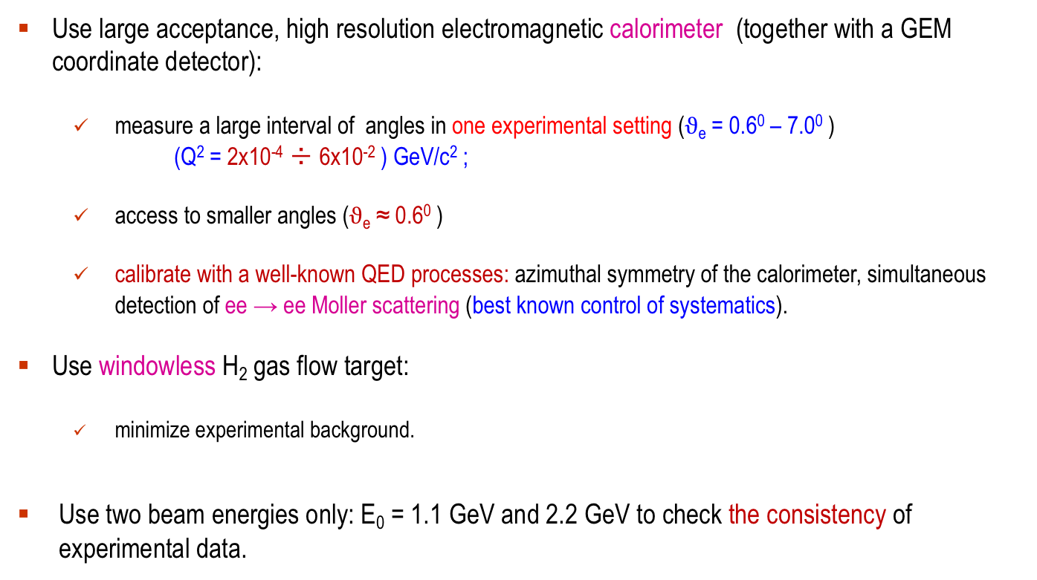
A Possible Solution: PRad Experimental Approach
Use large acceptance, high resolution electromagnetic calorimeter (together with a GEM coordinate detector):
  measure a large interval of angles in one experimental setting ($ϑ$_{e} = 0.6⁰ – 7.0⁰ )
  (Q² = 2x10⁻⁴ ÷ 6x10⁻² ) GeV/c² ;
  access to smaller angles ($ϑ$_{e} ≈ 0.6⁰ )
  calibrate with a well-known QED processes: azimuthal symmetry of the calorimeter, simultaneous detection of ee → ee Moller scattering (best known control of systematics).
Use windowless H₂ gas flow target:
  minimize experimental background.
Use two beam energies only: E₀ = 1.1 GeV and 2.2 GeV to check the consistency of experimental data.

Slide 11
PRad Experiment Timeline
Initial proposal development: 2011-12
Approved by JLab PAC39: 2012
Funding proposal for windowless H₂ gas flow 2012
target (NSF MRI #PHY-1229153)
Development, construction of the target: 2012 – 15
Funding proposals for the GEM detectors: 2013
(DOE awards)
Development, construction of the GEM detectors: 2013-15
Beam line installation, commissioning,
data taking in Hall B at JLab: January /June 2016
Date analysis 2016 – 2019
Publication in Nature journal November, 2019

Slide 12
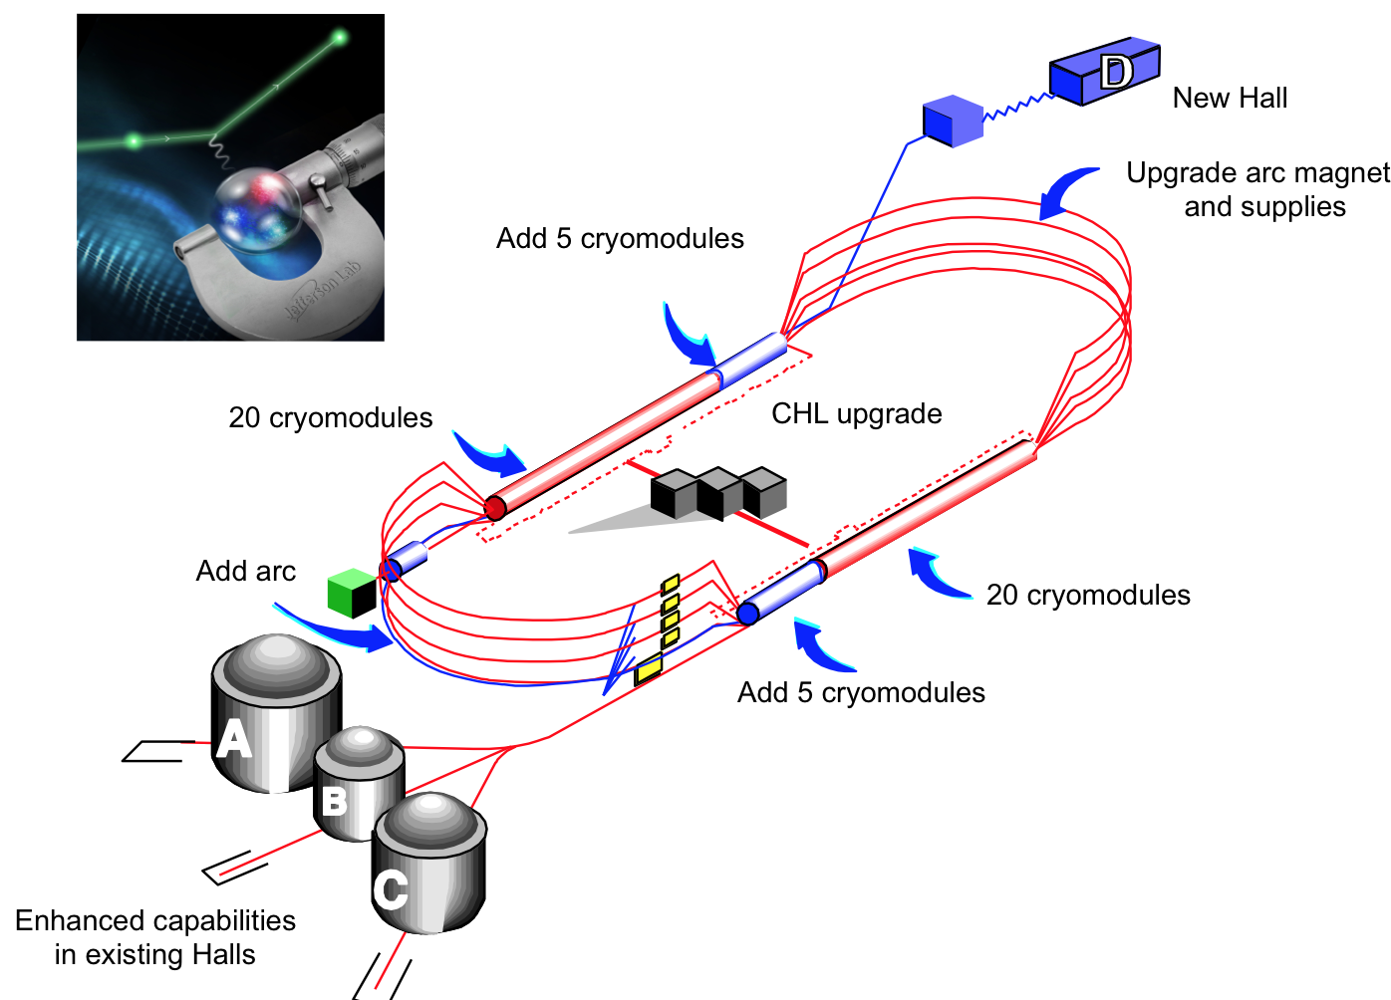
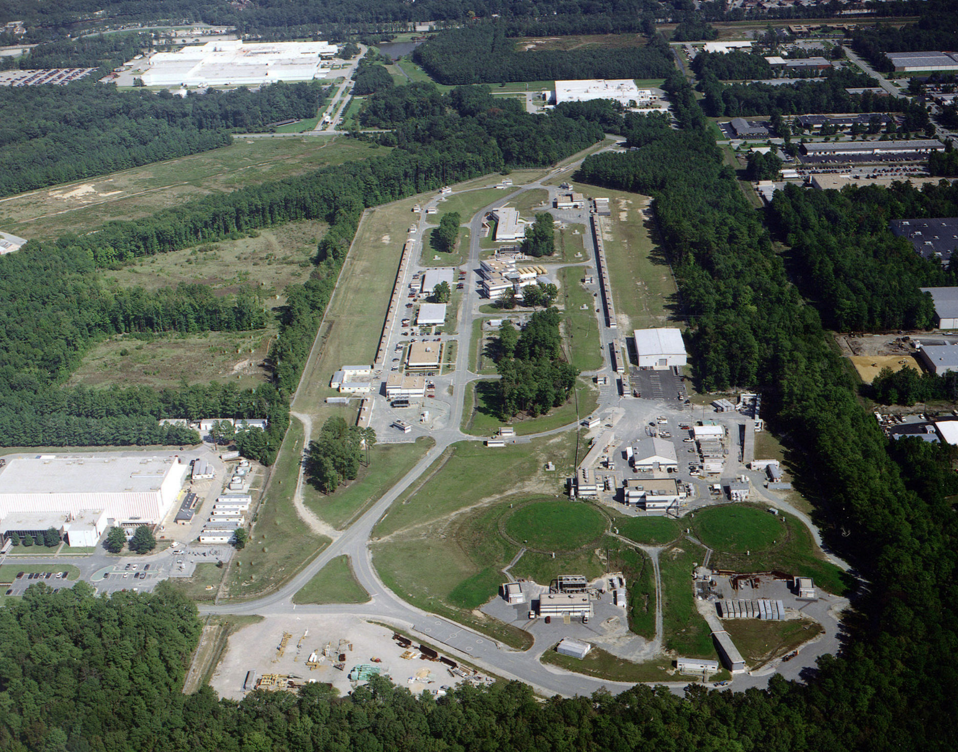
PRad Experiment Performed in Hall B at Jefferson Lab
PRad was performed in Hall B at JLab

Slide 13
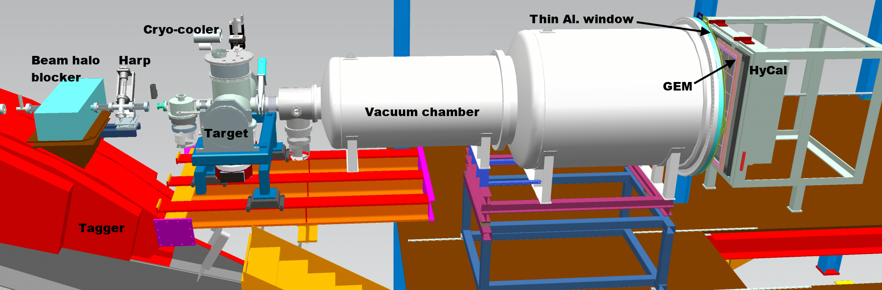
PRad Experimental Setup in Hall B at JLab (schematics)
Main detector elements:
  windowless H₂ gas flow target
  PrimEx HyCal calorimeter
  vacuum box with one thin window at HyCal end
  X,Y – GEM detectors on front of HyCal
Beam line equipment:
  standard beam line elements (0.1 – 50 nA)
  photon tagger for HyCal calibration
  collimator box (6.4 mm collimator for photon beam, 12.7 mm for e⁻ beam halo “cleanup”)
  Harp 2H00 l
e - beam

Slide 14
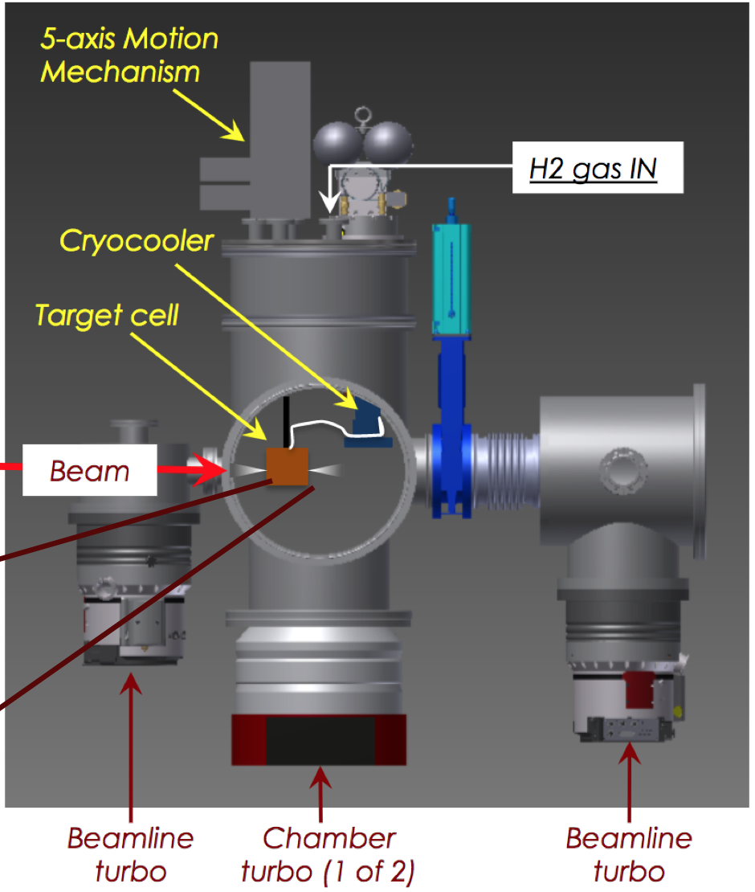
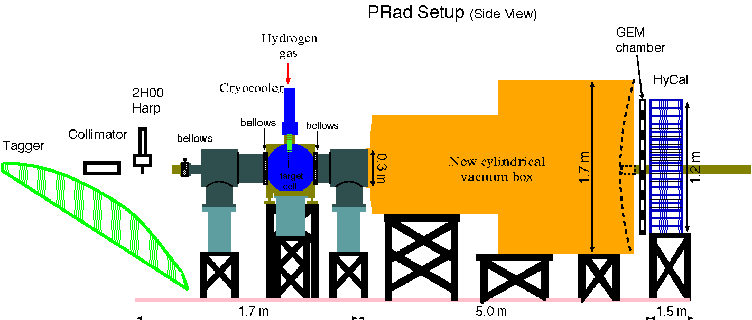
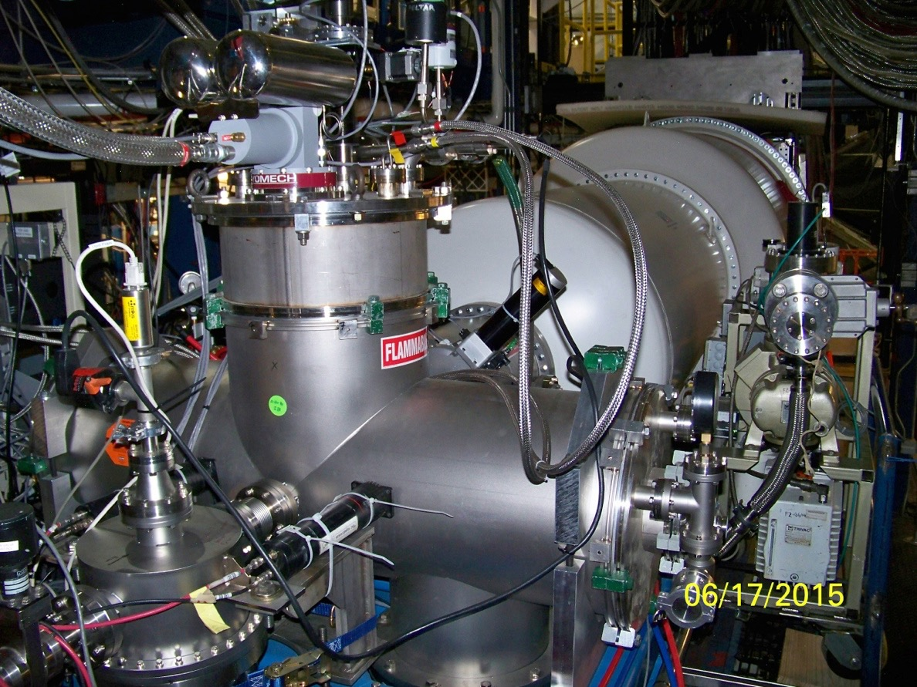
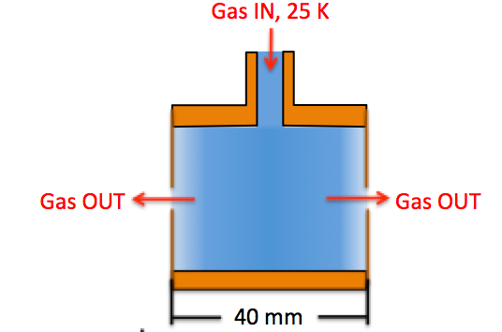
Windowless Gas Flow Target
New Cylindrical Vacuum Chamber
Electron beam
Electron Beam
8 cm diam. X 4 cm long target cell
2 mm holes open at front and back of kapton foils for the beam passage
Areal density: 1.8x10⁺¹⁸ H atoms/cm²
  cell pressure: 471 mTorr
  chamber pressure: 2.34 mTorr: cell vs. chamber pressures: 200:1
  Vacuum tank pressure 0.3 mTorr: cell vs. vacuum tank pressures: 1000:1
  Gas temperature: 19.5 K
e-beam

Slide 15
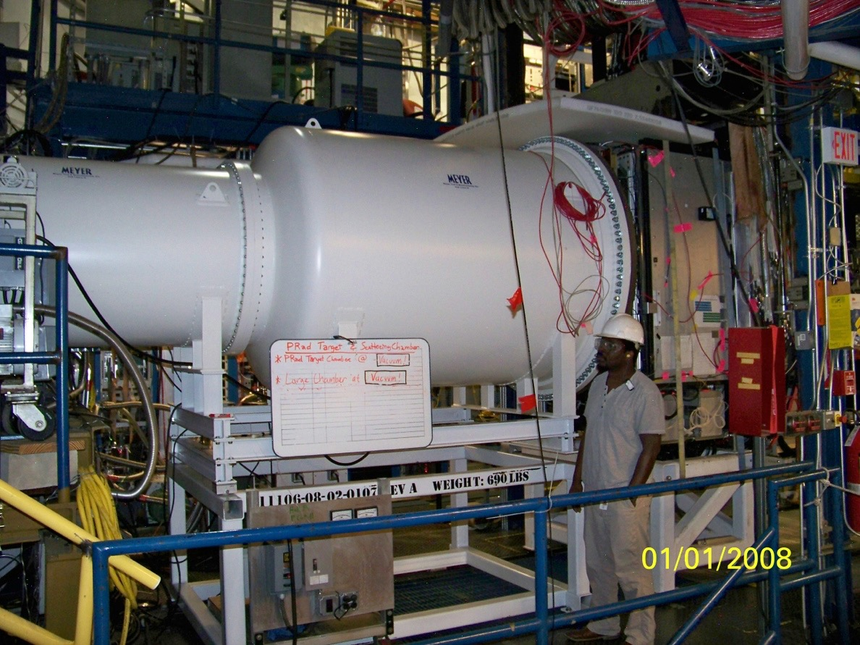
PRad Experimental Apparatus: Vacuum Chamber
New Cylindrical Vacuum Chamber
Electron beam
5 m long two stages vacuum chamber,
1.7 m diameter, 2 mm Al vacuum window
vacuum chamber pressure: 0.3 mTorr

Slide 16
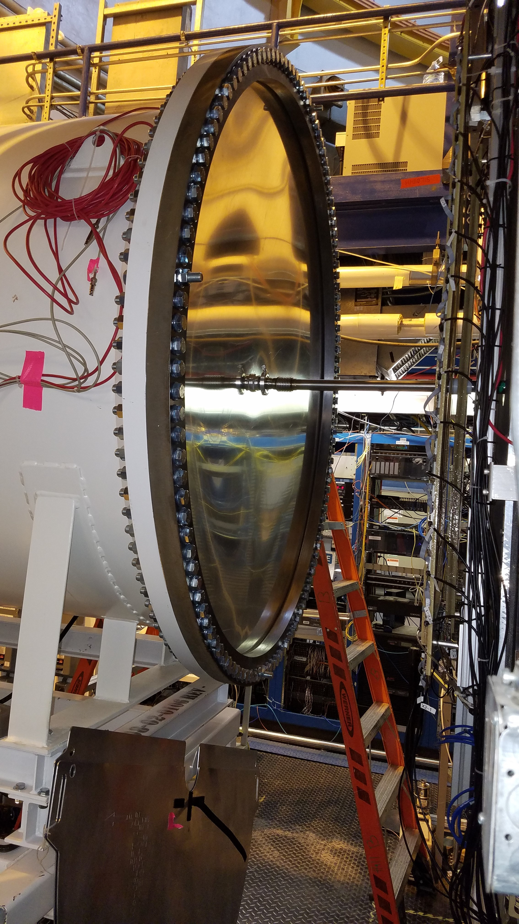
PRad Experimental Apparatus: Vacuum Chamber and Window
2-stage vacuum box in Hall B beam line
1.7 m diameter, 2 mm Al vacuum window

Slide 17
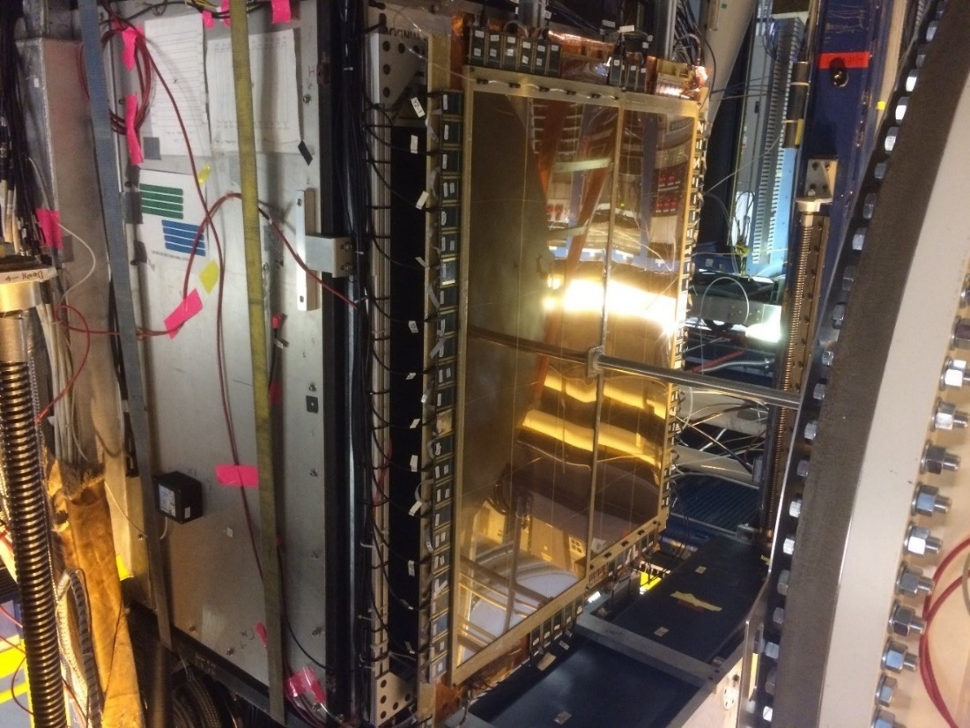
PRad Experimental Apparatus: GEM Coordinate Detectors
Two large area GEM detectors
Small overlap region in the middle
Excellent position resolution (72 µm)
Improve position resolution of the setup by > 20 times
Large improvements in Q² determination
New Cylindrical Vacuum Chamber
Electron beam

Slide 18
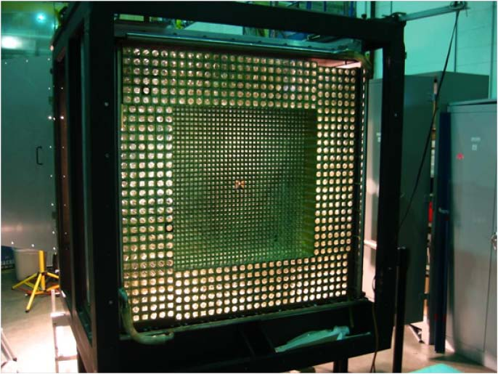
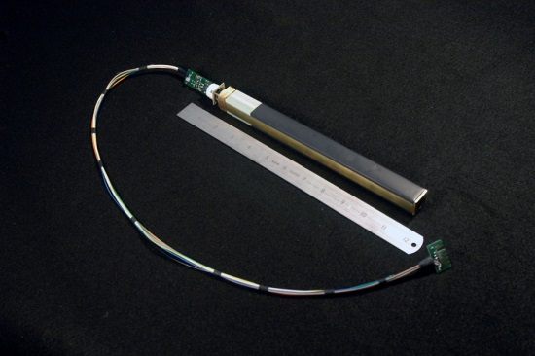
PRad Experimental Apparatus: HyCal El. Mag. Calorimeter
hybrid EM calorimeter (HyCal)
  inner 1156 PbWO₄ modules.
  outer 576 lead glass modules.
5.8 m from the target.
scattering angle coverage: ~ 0.6˚ to 7.5˚
full azimuthal angle coverage
high resolution and efficiency
  2.5% at 1 GeV for crystal part
  6.1% at 1 GeV for lead glass part
energy calibration done with tagged photons
e-beam
New Cylindrical Vacuum Chamber
Electron beam

Slide 19
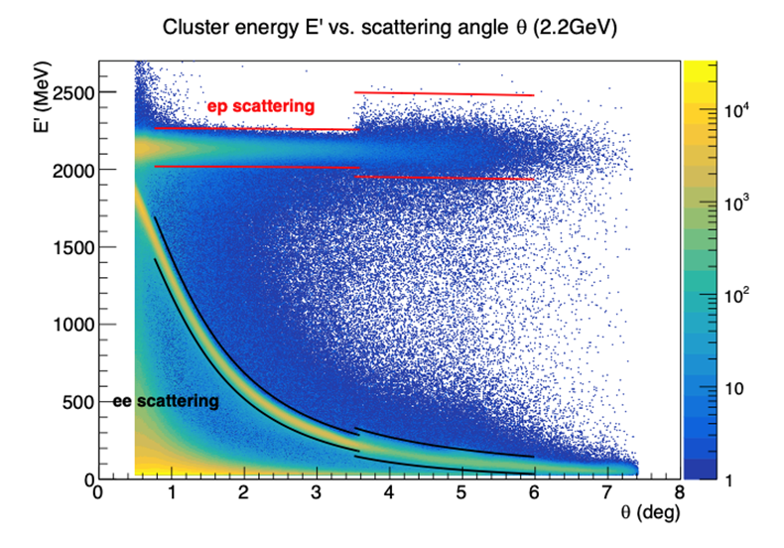
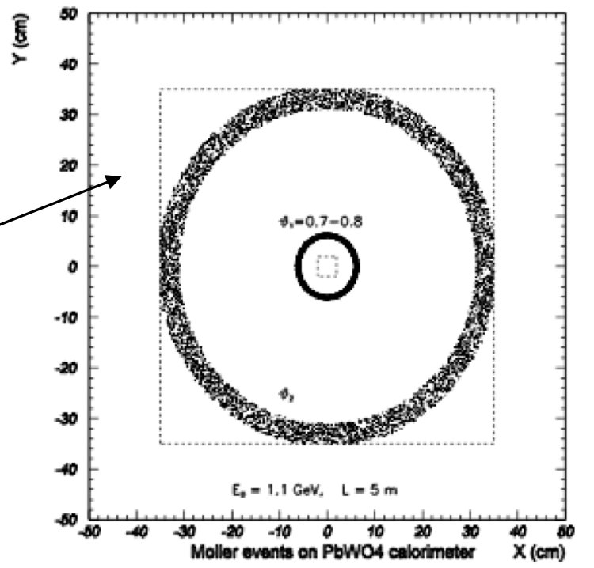
Experimental Data Set: Event Selection
Experiment performed in May/June, 2016
with two beam energy settings:
  1.1 GeV (604 M events)
  2.2 GeV (756 M events)
For all events, require hit matching between GEMs and HyCal
For ep and ee events, apply angle dependent energy cut based on kinematics:
  cut size depend on local detector resolution
For ee, if requiring double-arm events, apply additional cuts:
  elasticity
  co-planarity
  vertex z (kinematics)
2.2 GeV

Slide 20
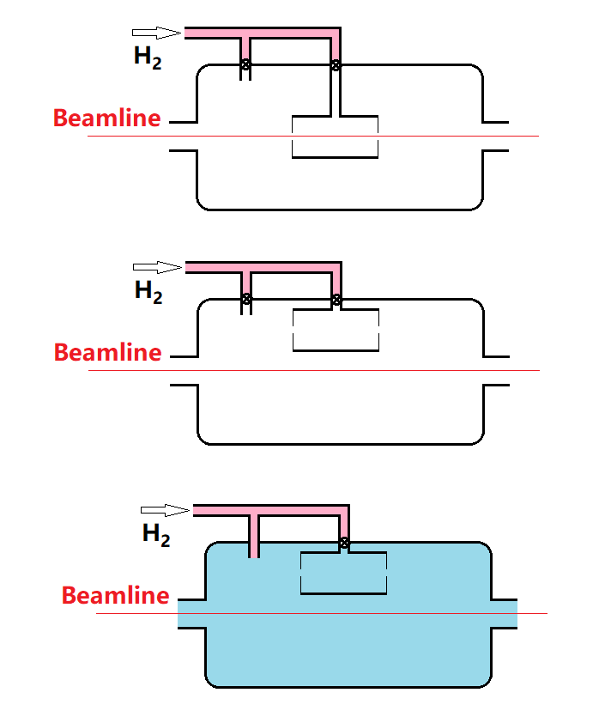
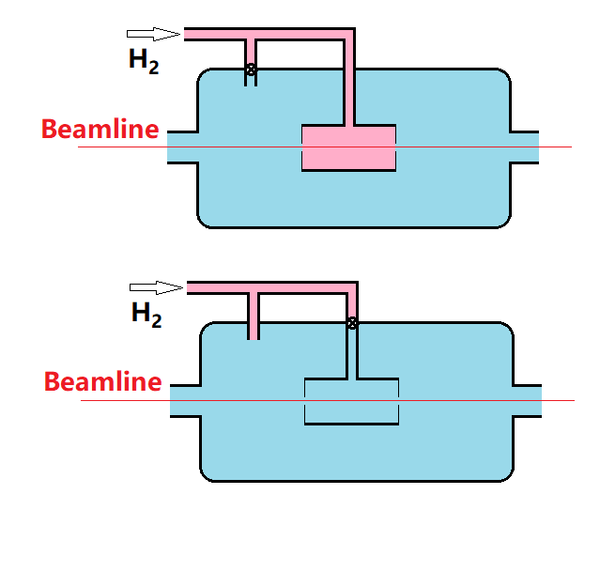
Data Analysis – Background Subtraction
Runs with different target condition taken for background subtraction and studies for the systematic uncertainties.
Developed simulation program for target density distribution (COMSOL finite element analysis).
Pressure:
~470 mTorr
~3 mTorr
< 0.1 mTorr

Slide 21
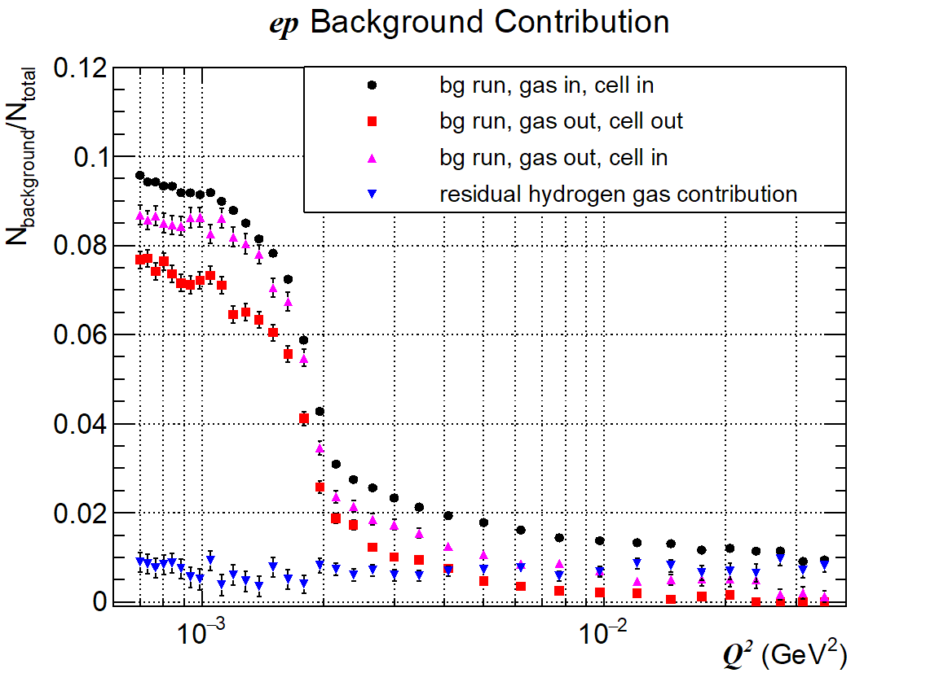
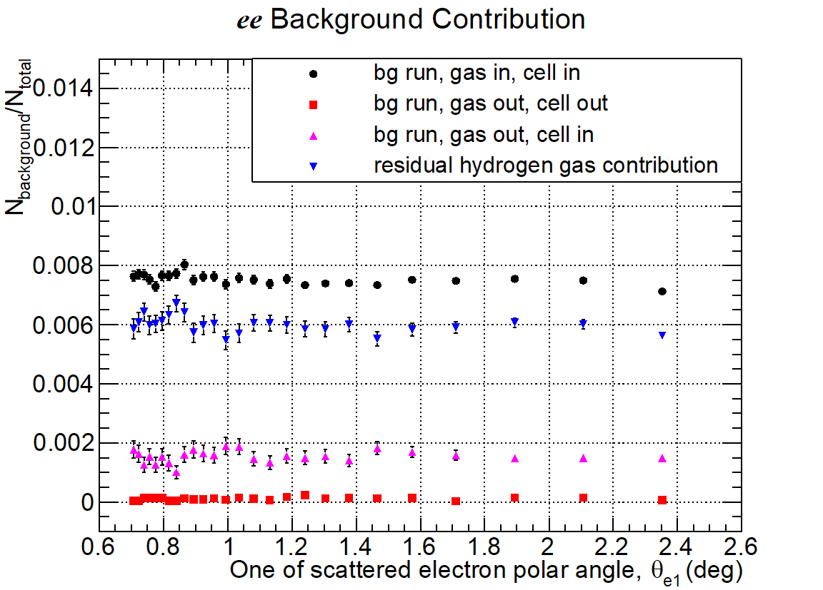
Data Analysis – Background Subtraction
ep background rate ~ 10% at forward angles (<1.3⁰, dominated by upstream “collimator”),
less than 2% otherwise.
ee background rate ~ 0.8% at all angles .
2.2 GeV data
2.2 GeV data

Slide 22
Data Analysis – Inelastic ep Contribution
Using Christy 2018 empirical fit to study inelastic ep contribution
Good agreement between data and simulation
Negligible for the PbWO₄ region (<3.5º)
Less than 0.2%(2.0%) for 1.1GeV(2.2GeV) in the Lead glass region
PbWO₄ region
Lead glass region
M. E. Christy and P. E. Bosted, PRC 81, 055213 (2010)

Slide 23
Data Analysis: Stability vs. Run Number
Normalized ep/ee ratio vs. run number, (background subtracted with neighboring empty target runs).
Sensitive to systematics like time variation of beam line background, …

Slide 24
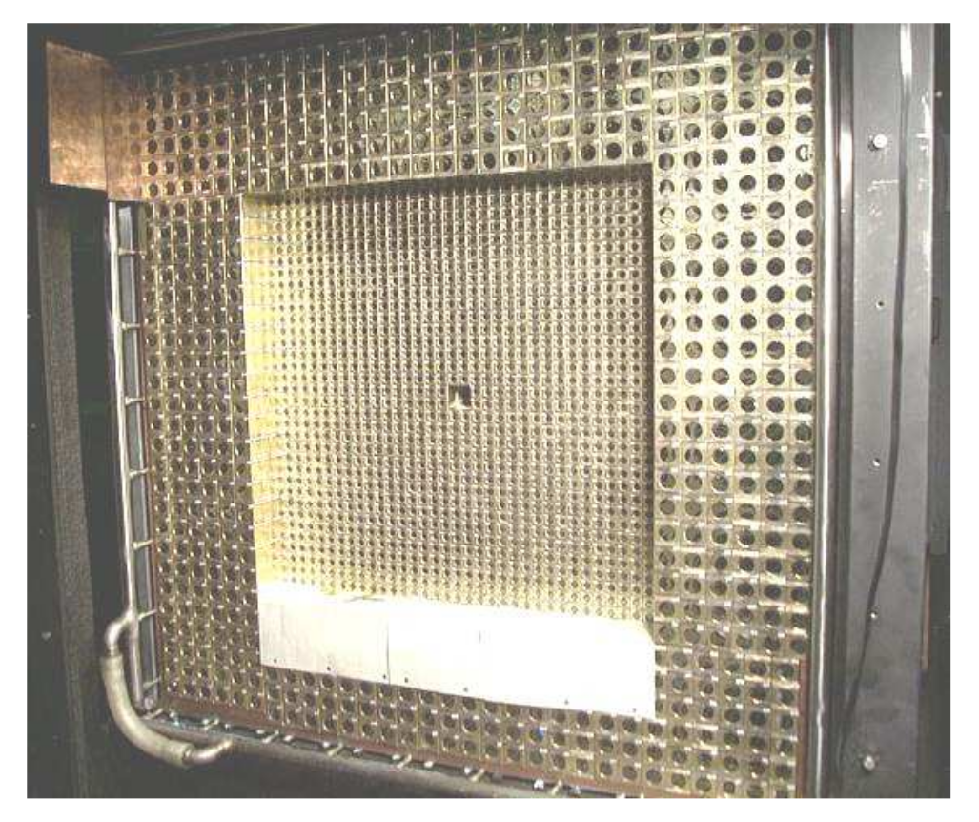
Data Analysis: Azimuthal Uniformity
Ratio (ep/ee)_{dat} / (ep/ee)_{sim} vs. azimuthal quadrants
Sensitive to detector efficiency, beam position, tilting angles, …
2nd
1st
2.2 GeV data
3rd
4th

Slide 25
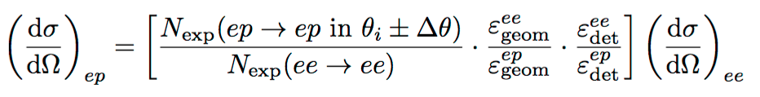
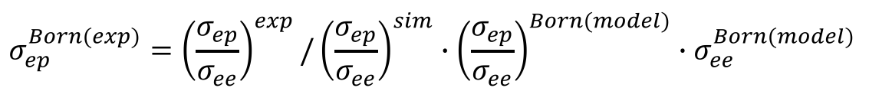
Extraction of the ep → ep Elastic Scattering Cross Section
To reduce the systematic uncertainty, the ep cross section is normalized to the Møller cross section:
Radiative effects corrected by Monte Carlo method:
  GEANT4 based simulation package with full geometry setup
  event generators with complete calculations of radiative corrections^{1),2)}
  iterative procedure applied for radiative corrections
    1) A. V. Gramolin et al., J. Phys. G Nucl. Part. Phys. 41(2014)115001;
    2) I. Akushevich et al., Eur. Phys. J. A 51(2015)1 (fully beyond ultra relativistic approximation).

Slide 26
Elastic ep→ep Differential Cross Sections (Current)
Extracted differential cross sections vs. Q², with 1.1 and 2 GeV data (current).
Statistical uncertainty: ~0.2% for 1.1 GeV and ~0.15% for 2.2 GeV per point.
Systematic uncertainties: 0.3% - 0.5% for 1.1 GeV and 0.3 – 1.1% for 2.2 GeV per point.
33 data points from 1.1 GeV data set
38 data points from 2.2 GeV data set

Slide 27
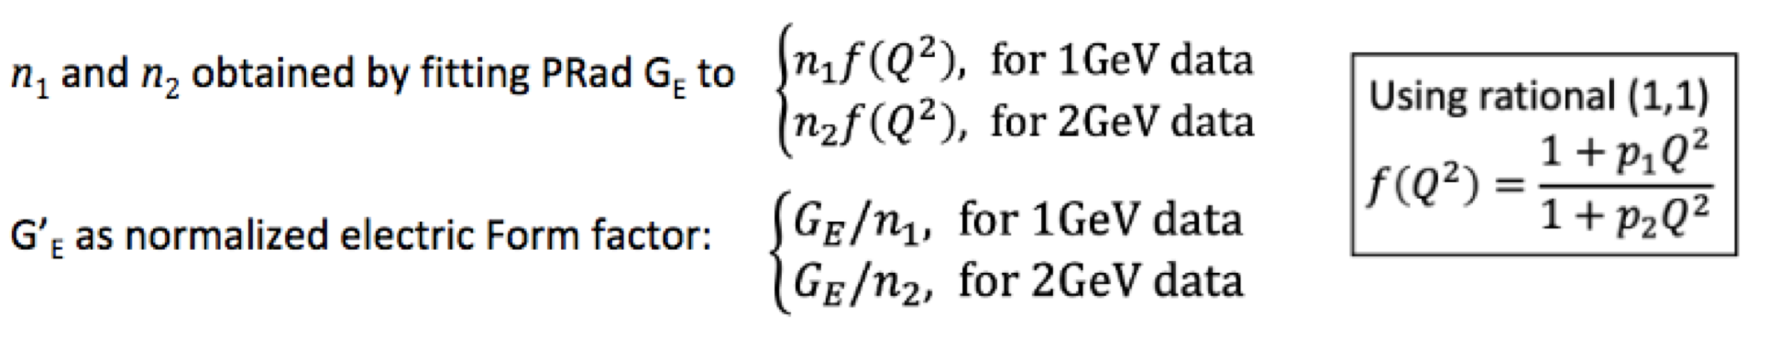
Extracted Proton Electric Form Factor, G_{E} vs. Q²
33 data points from 1.1 GeV data set
38 data points from 2.2 GeV data set
n₁ = 1.0002 +/- 0.0002(stat.) +/- 0.0020 (syst.), n₂ = 0.9983 +/- 0.0002(stat.) +/- 0.0013 (syst.)

Slide 28
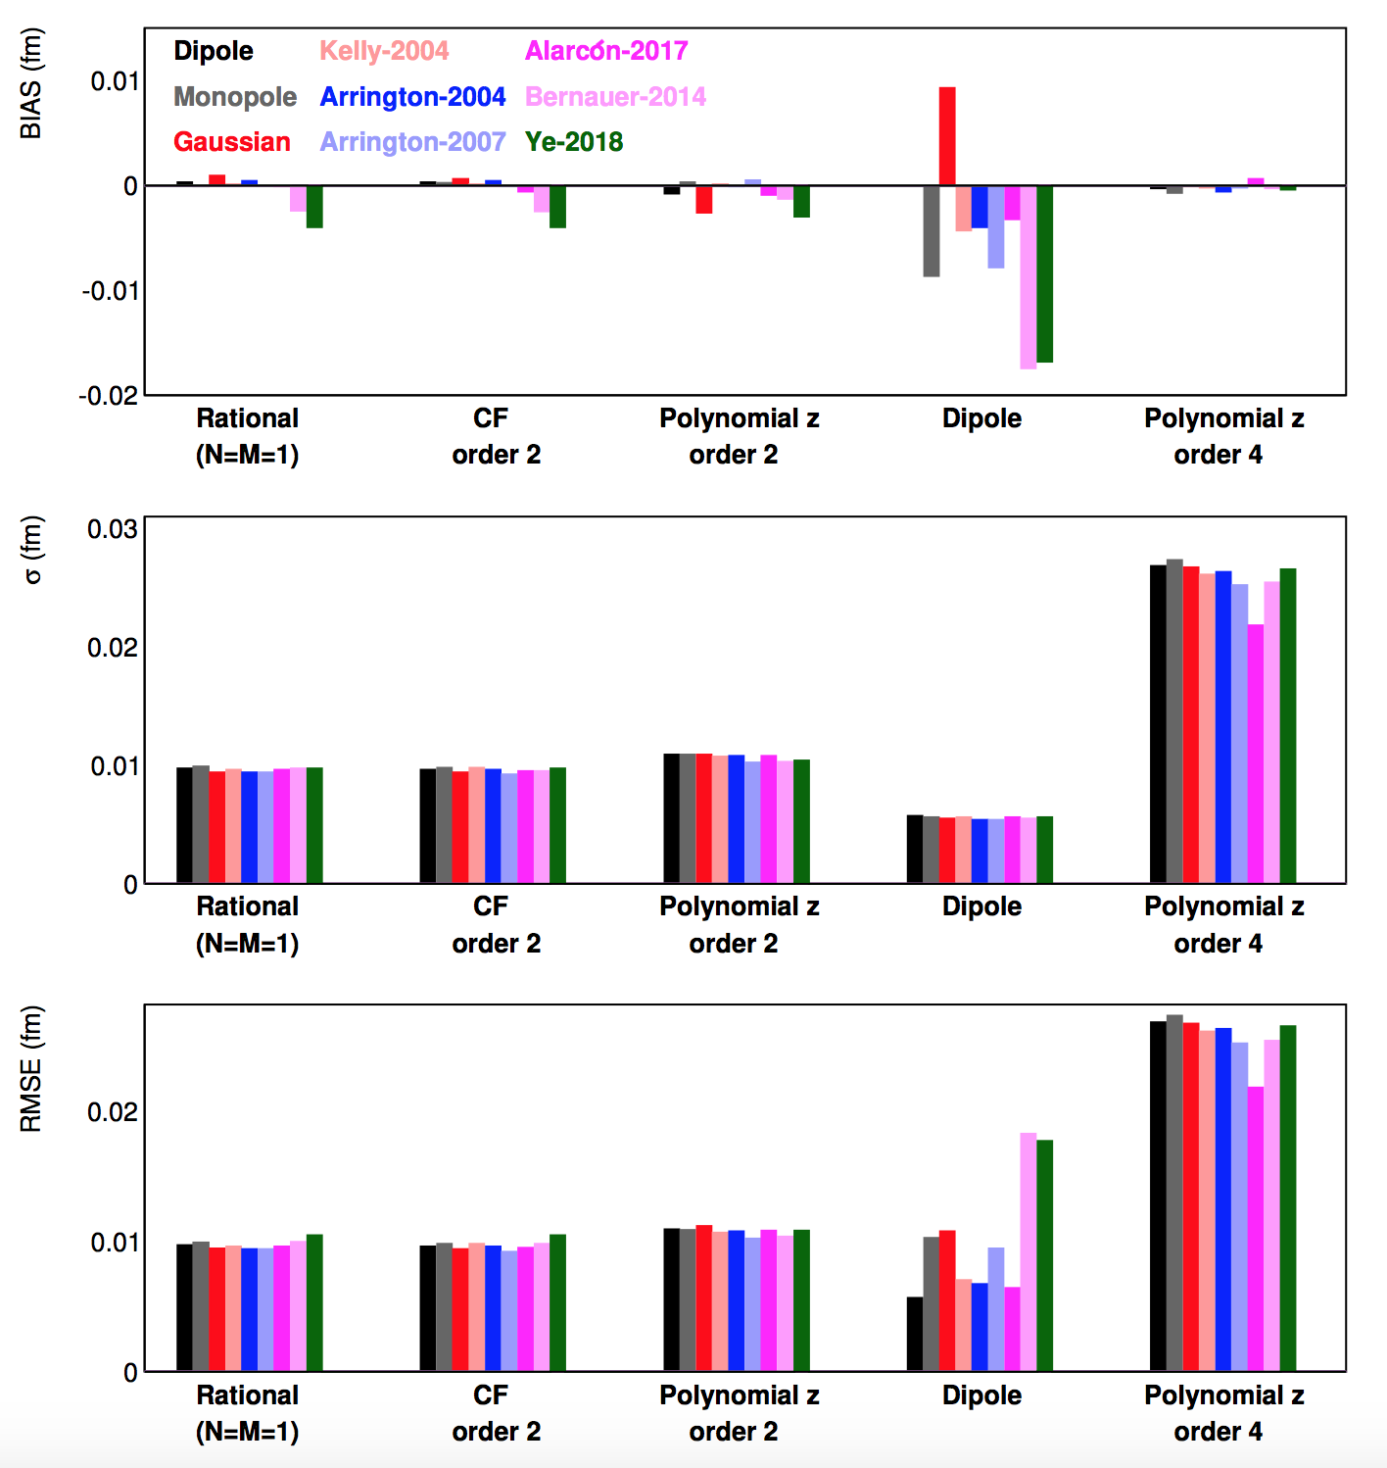
Recent Developments in Fitting Procedures
The input form factors (with known r_{p}) are used to generate pseudo data using PRad kinematic range and uncertainties.
All combinations of input functions and fit functions can then be tested repeatedly against regenerated pseudo data.
Since the input radius is known, this allowed to find fitting functions that are robust for proton radius extractions in an objective fashion.
The following fitters:
  two-parameter rational function
  two-parameter continued fraction
  second-order polynomial expansion of z
are identified as robust fitters with small uncertainties
RMSE = sqrt(bias² + σ²)
X. Yan, et al.
“Robust extraction of the proton charge radius from electron-proton scattering data”, PRC 98, 2, 025204, 2018

Slide 29
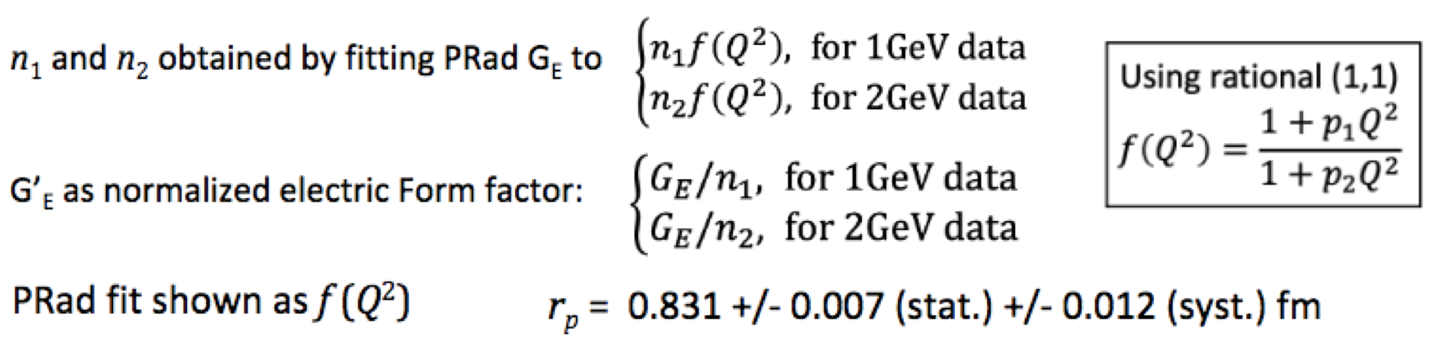
Fit to Extract the Proton Radius
PRad finalresult: R_{p} = 0.831 ± 0.007 (stat.) ± 0.012 (syst.) fm

Slide 30
The PRad Final Result on the Radius with the Mainz ISR
PRad final result: R_{p} = 0.831 ± 0.007 (stat.) ± 0.012 (syst.) fm

Slide 31
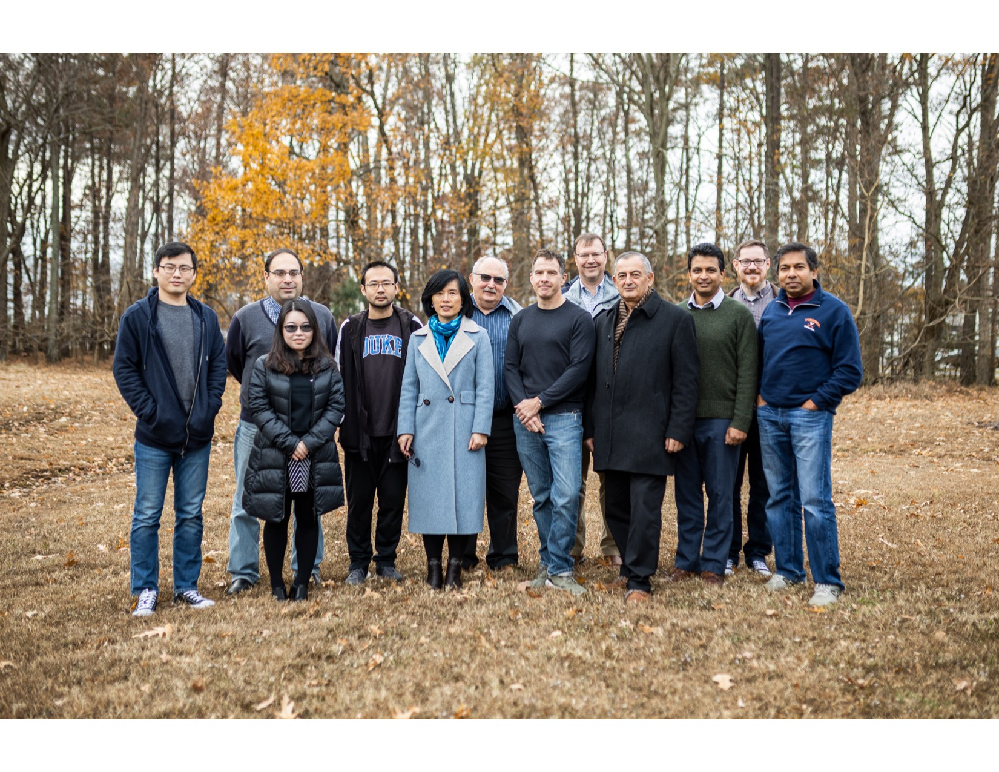
PRad Collaboration
A part of the PRad collaboration
in December, 2019 at JLab
Currently 14 collaborating universities and institutions:
Jefferson Laboratory, NC A&T State University,
Duke University, Idaho State University,
Mississippi State University, Norfolk State University,
University of Virginia, Argonne National Laboratory,
University of North Carolina at Wilmington, Hampton University,
College of William & Mary, Tsinghua University, China,
Old Dominion University, ITEP Moscow, Russia.
Graduate students:
Chao Peng (Duke), Weizhi Xiong (Duke),
Xinzhan Bai (UVa), Li Ye (MSU)
Postdocs:
Chao Gu (Duke), Xuefei Yan (Duke),
Mehdi Meziane (Duke), Zhihong Ye (Duke),
Maxime Lavilain (NC A&T), Krishna Adhikari (MSU),
Latif-ul Kabir (MSU), Chandra Akondi (NC A&T)

Slide 32
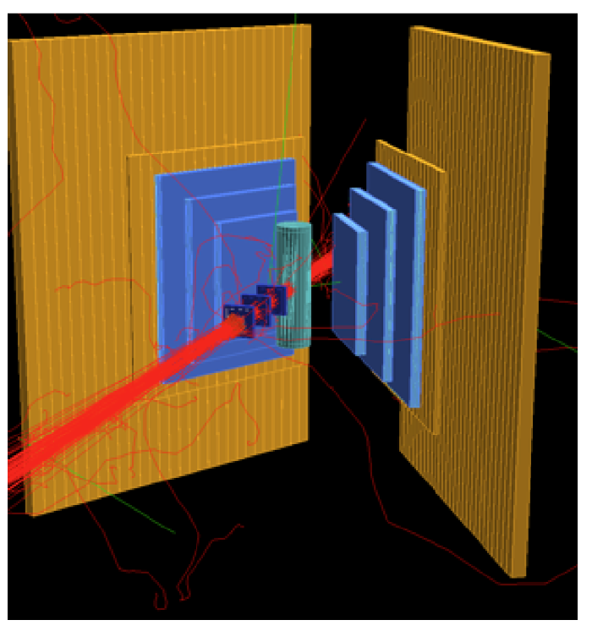
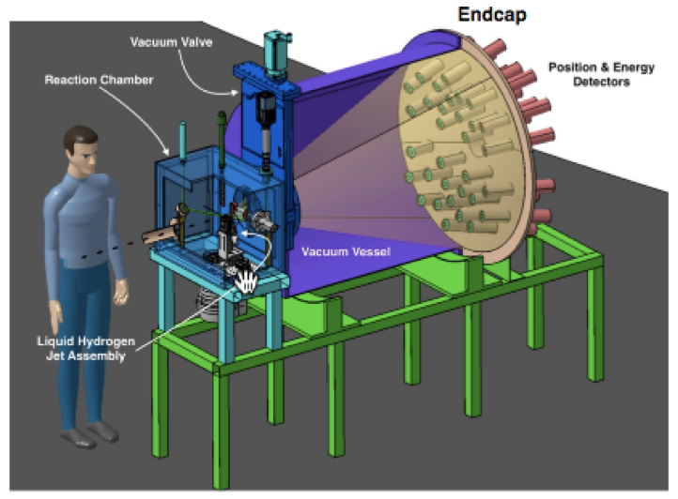
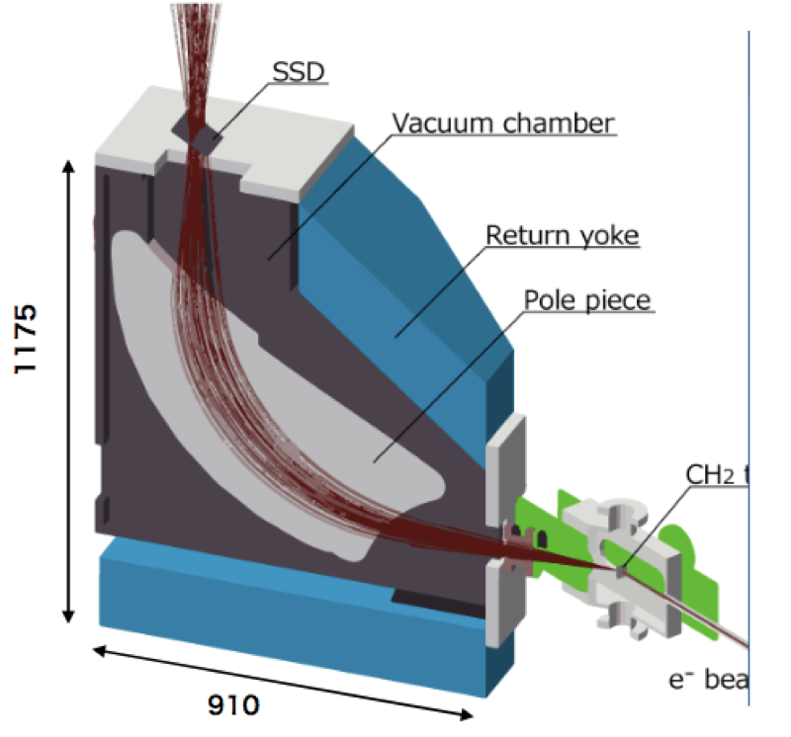
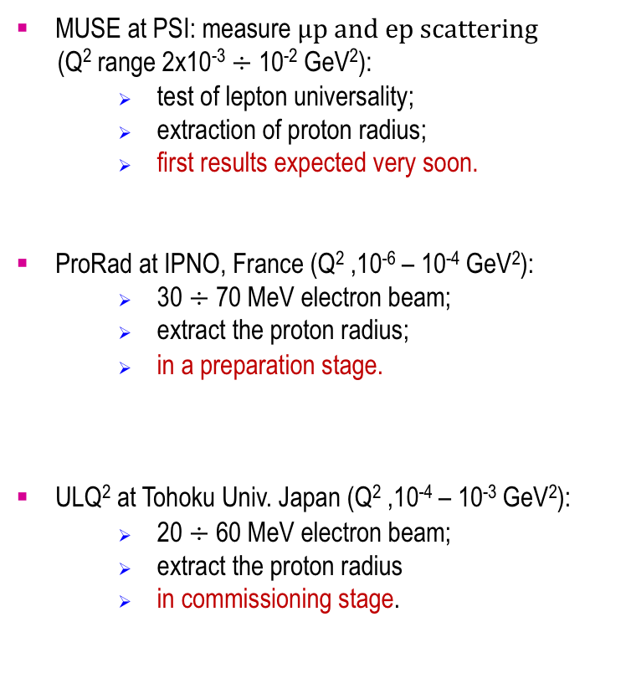
New Experiments in Progress
MUSE at PSI: measure $μp and ep scattering$
($\text{Q}\text{2} \text{range}\text{ 2}\text{x}\text{10}\text{−}\text{3} \text{÷}\text{ 10−2 }\text{GeV}\text{2}\text{):}$
  test of lepton universality;
  extraction of proton radius;
  first results expected very soon.
ProRad at IPNO, France (Q² ,10⁻⁶ – 10⁻⁴ GeV²):
  30 $÷$ 70 MeV electron beam;
  extract the proton radius;
  in a preparation stage.
ULQ² at Tohoku Univ. Japan (Q² ,10⁻⁴ – 10⁻³ GeV²):
  20 $÷$ 60 MeV electron beam;
  extract the proton radius
  in commissioning stage.

Slide 33
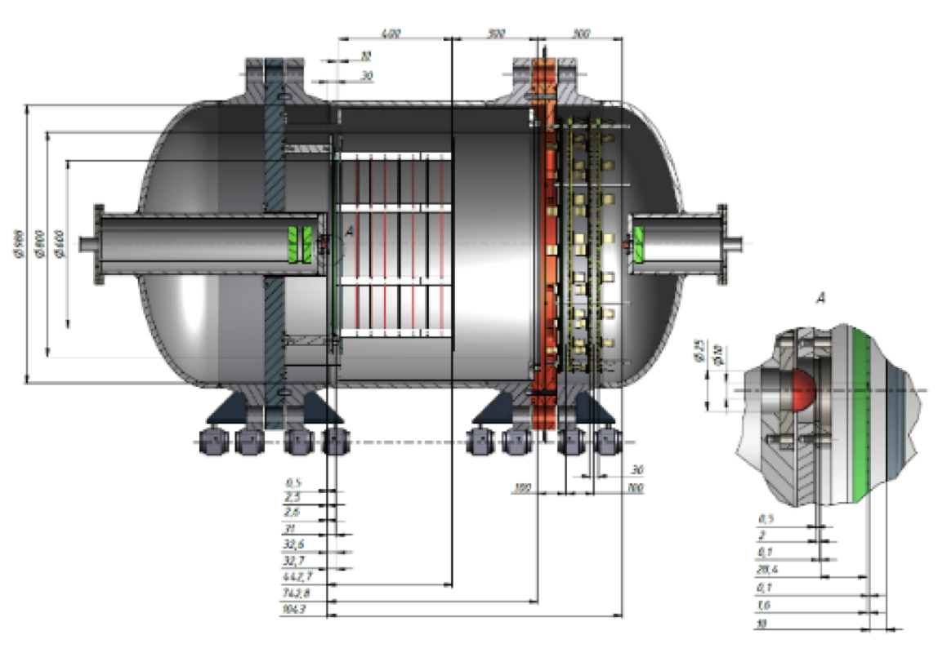
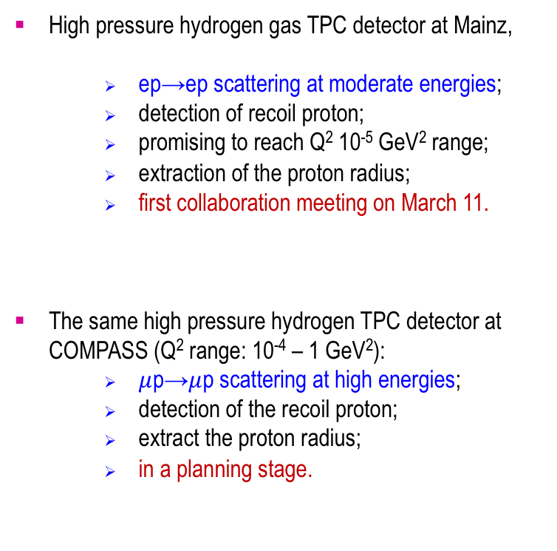
Planning Experiments
High pressure hydrogen gas TPC detector at Mainz,
  ep→ep scattering at moderate energies;
  detection of recoil proton;
  promising to reach Q² 10⁻⁵ GeV² range;
  extraction of the proton radius;
  first collaboration meeting on March 11.
The same high pressure hydrogen TPC detector at COMPASS (Q² range: 10⁻⁴ – 1 GeV²):
  $μ$p→$μ$p scattering at high energies;
  detection of the recoil proton;
  extract the proton radius;
  in a planning stage.

Slide 34

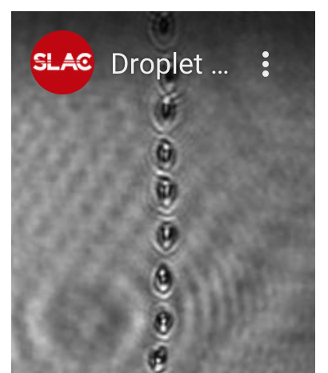
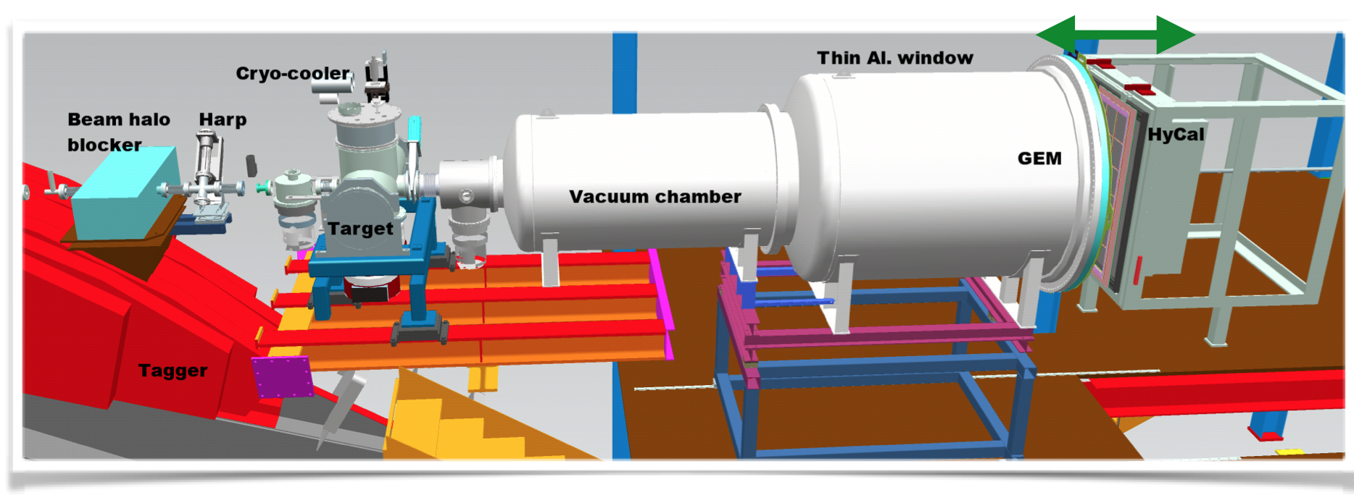
Possible Extension of the PRad Experiment: PRad-II at JLab
We are preparing a proposal to JLab PAC-48 (this summer) to get maximum precision with the PRad method:
  add second GEM detector for tracking;
  modify the hydrogen gas target: looking for a liquid hydrogen droplet target;
  4 times more statistics;
  upgrade HyCal to all PbWO₄ crystals;
  upgrade DAQ based on FADC electronics;
e - beam

Slide 35
Possible Extension of the PRad Experiment: PRad-II at JLab
PRad result: R_{p} = 0.831 ± 0.007 (stat.) ± 0.012 (syst.) fm (±1.67%)
PRad-II projected:
expect 2.5 times improvement in total uncertainty:
R_{p} = 0.8?? ± 0.003 (stat.) ± 0.005 (syst.) fm (±0.67%)

Slide 36
Summary
The “Proton Radius Puzzle” is becoming more “puzzling” recently ” !?:
  two recent experiments performed in the spectroscopy sector: not much agreement !!!
  discrepancy between ep-scattering and muonic hydrogen experiments unchanged (before PRad).
PRad was uniquely designed and performed in 2016 to address the “Puzzle”:
  data in a large Q² range have been recorded with the same experimental settings,
  [2x10⁻⁴ ÷ 6x10⁻²] GeV/C².
  lowest Q² data set (~10⁻⁴ GeV/C²) has been collected for the first time in ep-scattering experiments;
  simultaneous measurement of the Moller and Mott scattering processes has been demonstrated to control systematic uncertainties.
The PRad final result supports small proton charge radius:
    R_{p} = 0.831 ± 0.007 (stat.) ± 0.012 (syst.) fm (±1.67% total)
Is the “Proton Radius Puzzle” solved???
    … wait for few more experiments!
PRad was supported in part by NSF MRI #PHY-1229153 and DOE DE-FG02-03ER41231 awards.
my research work is supported in part by NSF award: PHY-1812421

Slide 37
Thank you!

Slide 38
The PRad Final Result on the Radius
PRad final result: R_{p} = 0.831 ± 0.007 (stat.) ± 0.012 (syst.) fm

Slide 39
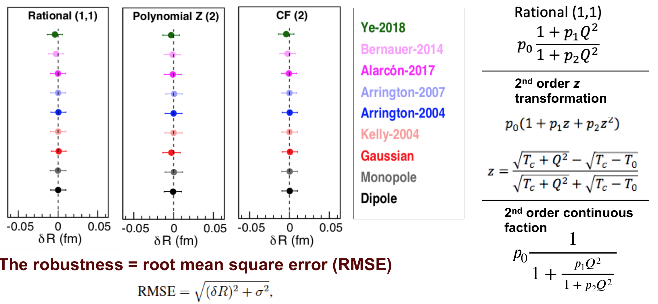
Recent Developments in Fitting Procedures

Slide 40
Systematic Uncertainties
Item | R_{p} uncertainty (fm) | n₁ uncertainty (1.1GeV) | n₂ uncertainty (2.2GeV)
Event selection | 0.0070 | 0.0002 | 0.0006
Radiative correction | 0.0069 | 0.0010 | 0.0011
Detector efficiency | 0.0042 | 0.0000 | 0.0001
Beam background | 0.0039 | 0.0017 | 0.0003
HyCal response | 0.0029 | 0.0000 | 0.0000
Acceptance | 0.0026 | 0.0001 | 0.0001
Beam energy | 0.0022 | 0.0001 | 0.0002
Inelastic ep | 0.0009 | 0.0000 | 0.0000
Total | 0.0116 | 0.0020 | 0.0013

Slide 41
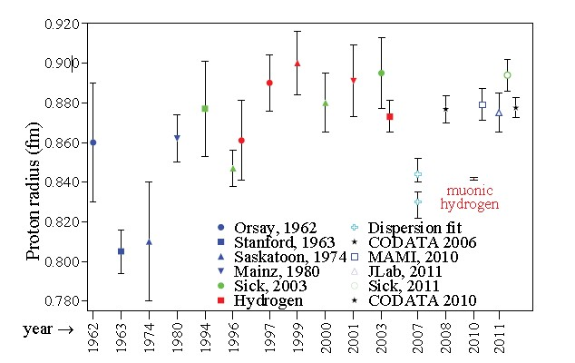
Proton Radius Extracted From e-p Scattering Experiments
More different analysis results than actual experiments
Started with: r_{p} ≈ 0.81 fm in 1963
Reached to: r_{p} ≈ 0.88 fm by 2011

Slide 42
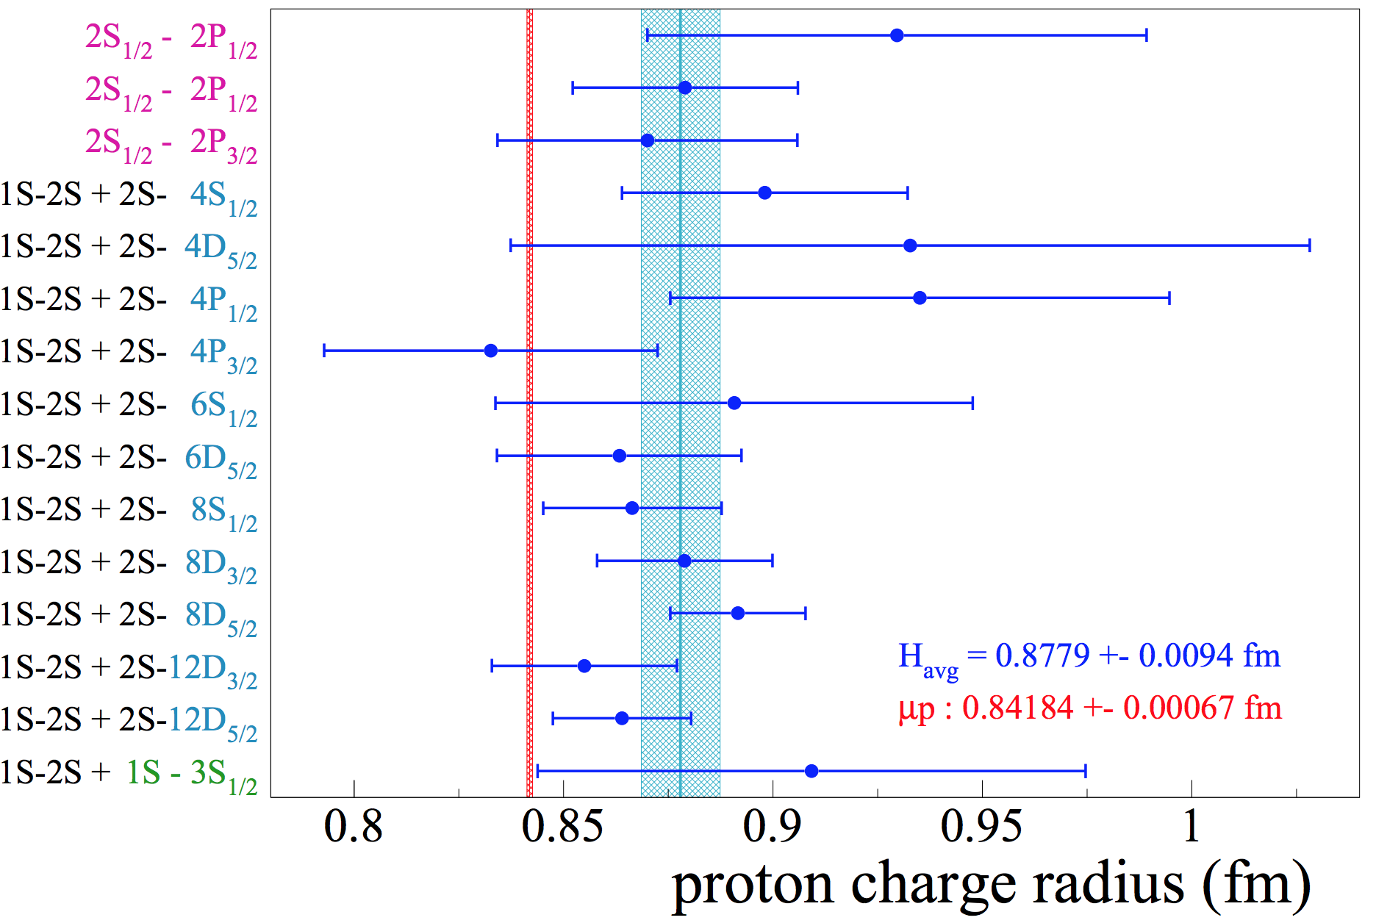
Proton Radius from Regular Hydrogen Spectroscopy

