Slide 1
Cosmic Ray Trigger V4
Svoboda, ANNIE CM February 2026

Slide 2
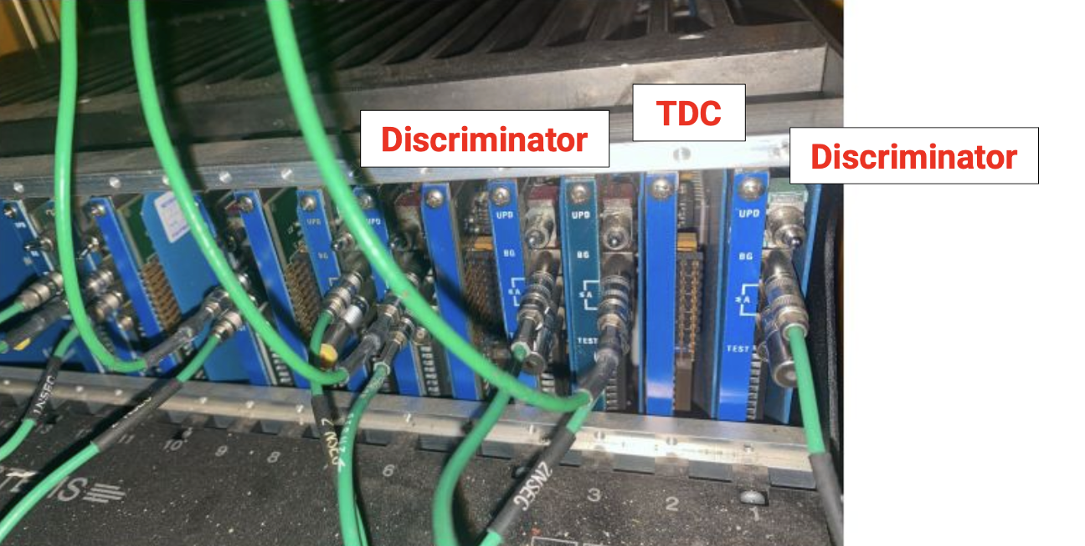
Summed output on the back of each CAMAC discriminator
There are twelve layers in z, with each layer having two discriminators and one TDC
Each discriminator has a 1 mA/hit = 50 mV/hit into 5-0 ohms
Summed output that can be daisy chained

Slide 3
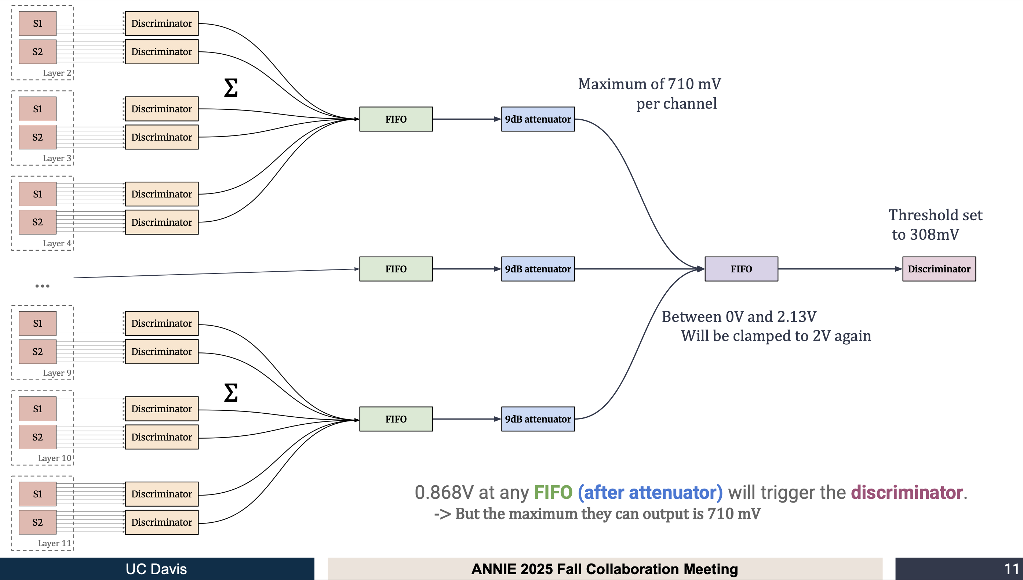
summing
amplifiers
CR Trigger
Version 3

Slide 4
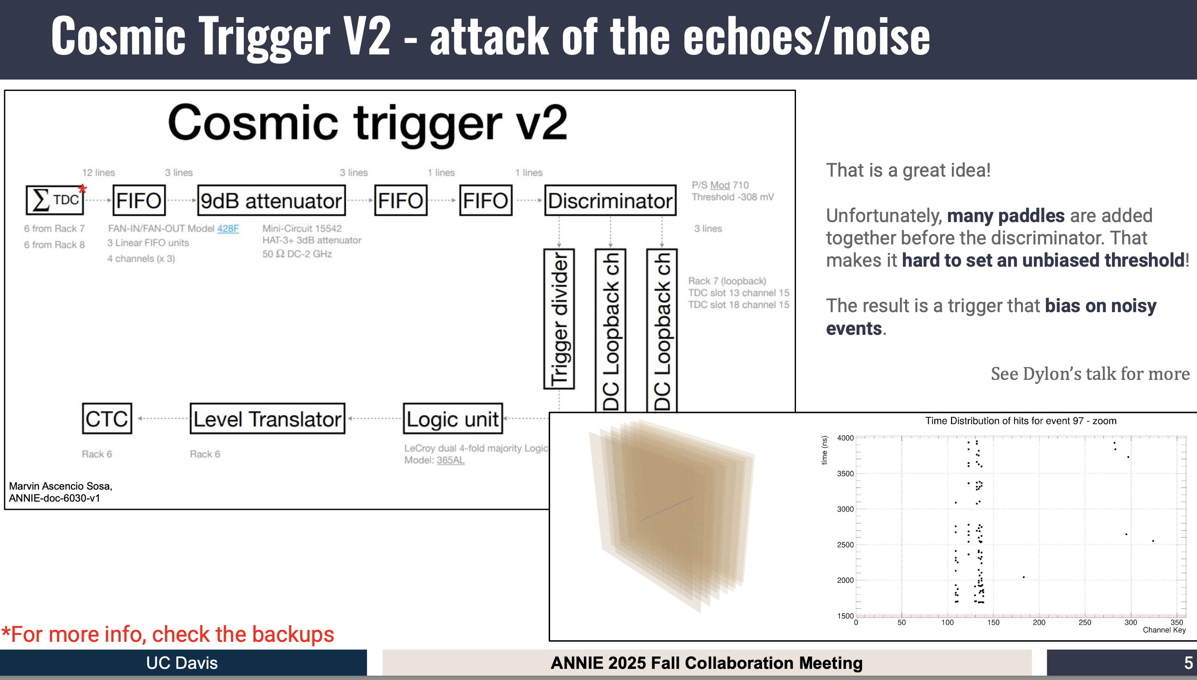

Slide 5
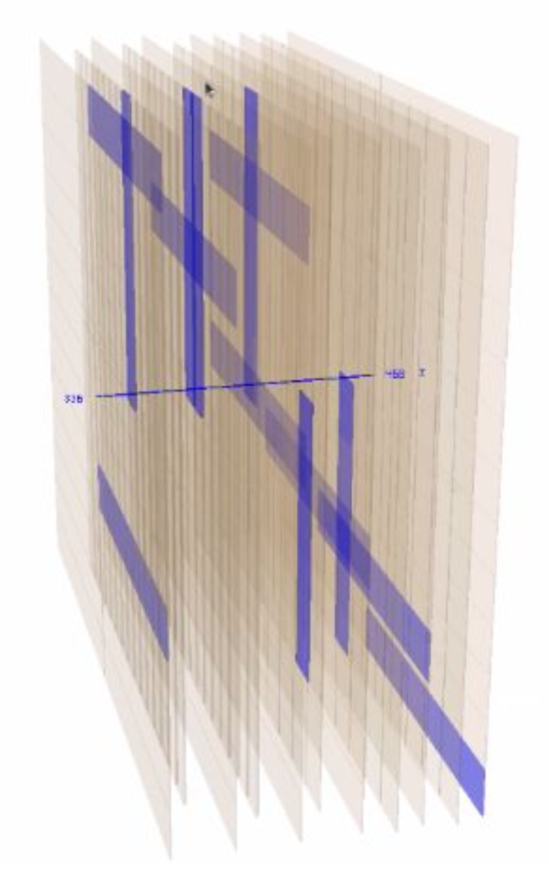
Some paddles have noisy/oscillating
discriminators when registering a large
pulse.
Since every paddle has an equal vote
in the trigger coincidence sum, we are
very sensitive to such noise.
Most the the CR triggers are noise
instead of useful data

Slide 6
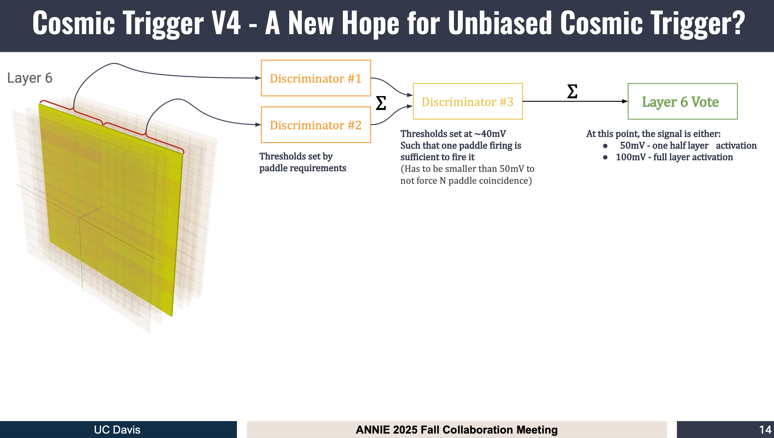
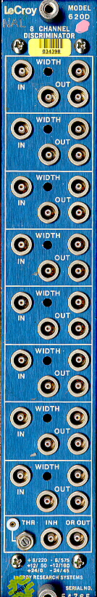
Solution: Move to a trigger where each layer
gets one “vote” no matter how many paddles
in the layer fired.

Slide 7
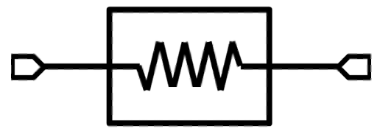
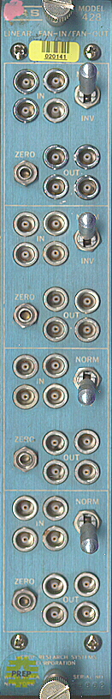
7 dB
Each of the 4 layers are analog
summed such that the max
output is -0.8 V (within spec)
Layer 0
vote
-0.20 V
max
Layer 1
vote
3dB
Layer 2
vote
3dB
-0.4 V max
…
Each vote is a -1 V logic
pulse from the
layer discriminator
…
x12
x12
3dB
Layer 10
vote
-1.2 V max
1 paddle
= 100 mV
Layer 11
vote
to CR trigger
discriminator
LRS Model 428 Quad Linear Fan-In/Fan-Out

Slide 8
What do we need?
twelve 7 dB attenuators + spare
three 3 dB attenuators + spare
12 channels of layer discriminators (2 octal NIM discriminators)
1 channel of CR discriminator
1 NIM Quad Linear FIFO
BNC/lemo adapters

Slide 9
When to do this?
Do not have to stop beam data taking when setting up, but should plan on a day of testing before bringing online
Will need to take scaler rates of layers and CR overall sum to set the thresholds
What CR trigger rate can we handle?
March 31-April 2 time frame?

