Slide 1


MUonE α(t) and a_{μ}^{HLO} space-like
U. Marconi
INFN, Bologna
On behalf of the proponents
Mainz, 2018 November 20

Slide 2
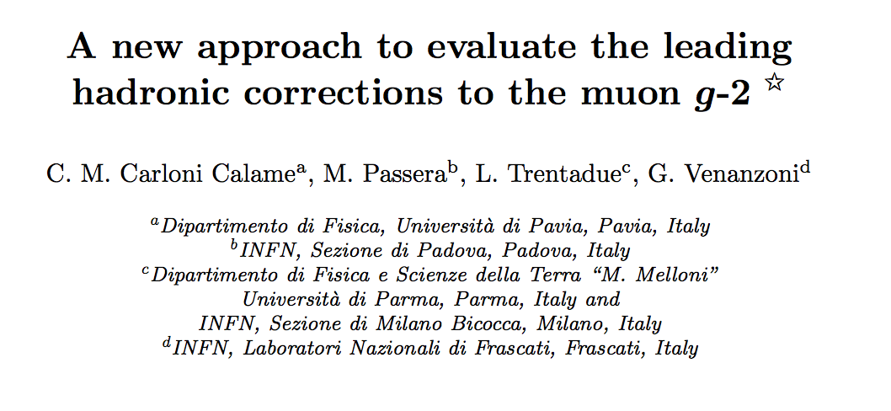
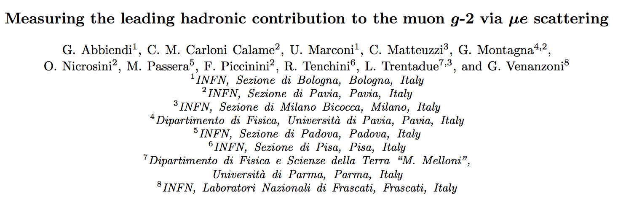
Reference papers
Phys. Lett. B 746 (2015) 325
Eur. Phys. J. C (2017) 77: 139.
Notes:
These are two recent papers that describes the idea and the experimental proposal I’m going to talk about in the next 15 minutes.

Slide 3
Experiment proposed to CERN
Physics Beyond Collider Study Group
The experiment would typically:
  Enrich and diversify the CERN scientific program
  Exploit the unique opportunities offered by CERN’s accelerator complex and scientific infrastructure
  Complement the laboratory’s collider program
  (LHC, HL-LHC and possible future colliders).
  The scientific findings will be collected in a report to be delivered by the end of 2018.
  This document will serve as input to the next update of the European Strategy for Particle Physics.

Slide 4
g-2 anomaly
Summary of the present status
E821 experiment at BNL:
a_{μ}^{E821} = (11659208.9 ± 6.3)×10⁻¹⁰ [0.54 ppm]
The SM prediction:
a_{μ}SM =(11659180.2 ± 4.9)×10⁻¹⁰ [0.42 ppm]
3.5σ discrepancy:
a_{μ}^{E821} - a_{μ}SM = (28 ± 8 )×10⁻¹⁰
Significance is limited by:
  Experimental uncertainty:
  New experiments planned at FNAL E989 and J-PARC, aiming to improve the precision x4.
  Theoretical uncertainty:
  Theoretical precision is limited by low energy hadronic effects.
Notes:
The present experimental precision is of 0.5 ppm.
The theoretical prediction based on the SM reached a comparable precision at the level of 0.4 pm.
We record then the well known 3.5 sigma discrepancy between theory and data.
The significance is limited by the experimental uncertainty.
There are experiments planned in the next 2-4 year which aim to improve the precision by a given factor.
Theory is mainly limited by the hadronic contribution to the anomaly.
The largest hadron contribution to the anomaly is shown here in this diagram.
The error is 0.6%.
We aim to improve this error by a factor 2.

Slide 5
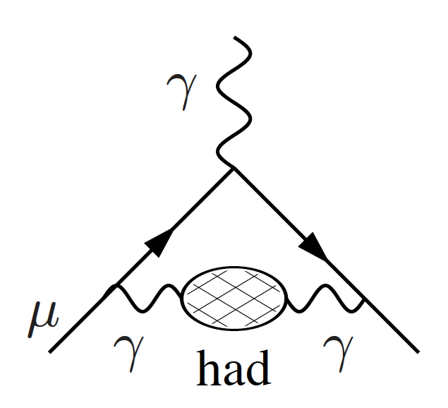
Hadronic Leading Order Contribution
Main contribution to the muon g-2 anomaly
due to non perturbative hadronic effects
With time-like data
a_{μ}^{HLO} = (692.3±4.2)×10⁻¹⁰
δa_{μ}^{HLO}/a_{μ}^{HLO} ~ 0.6%
With the new approach
we aim to
δa_{μ}^{HLO}/a_{μ}^{HLO} ~ 0.3%
hadronic vacuum polarization

Slide 6
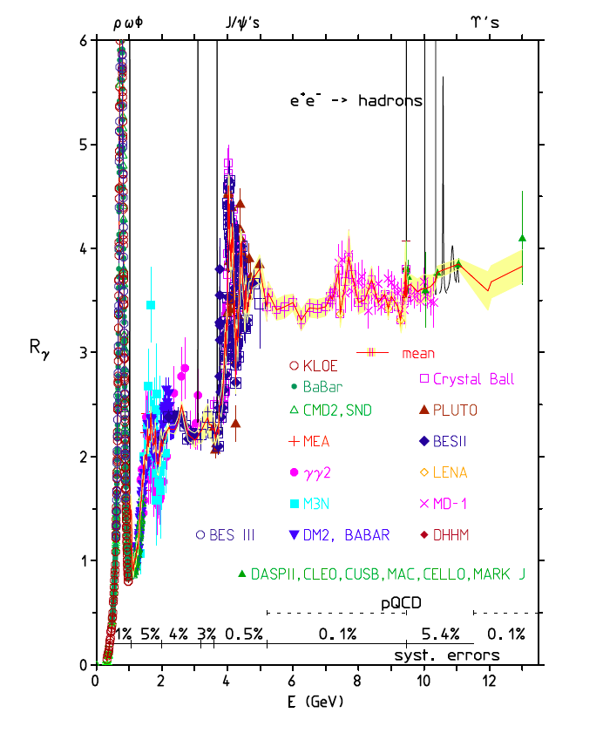
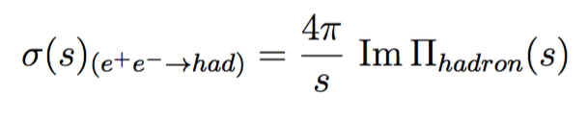
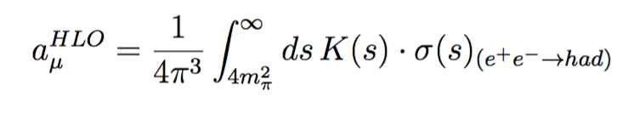
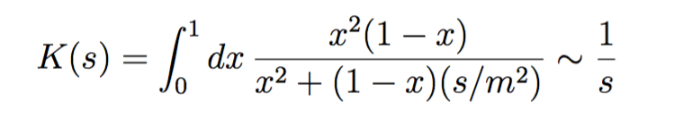
a_{μ}^{HLO} calculation with time-like data
Collection of many experimental results
Optical theorem and analyticity:
The main contribution is in the highly fluctuating low energy region.
The high-energy tail of the integral is calculated using pQCD
Notes:
At low energy this cross-section is highly fluctuating due to resonances and particle production threshold effects.

Slide 7

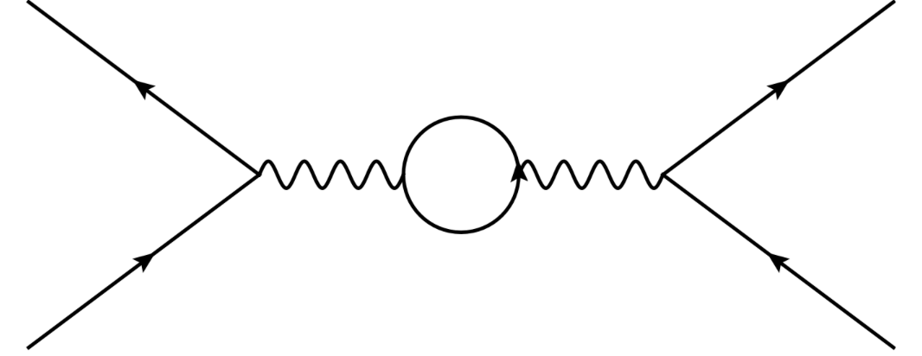
α(t) through: μ + e → μ + e
t-channel: space-like four-momentum transfer
α(t) through:
Simulation of the LO differential
cross-section μ + e → μ + e
elastic scattering
Effect of the hadronic shift Δα_{had}
μ
μ
t = q² < 0
e
e

Slide 8


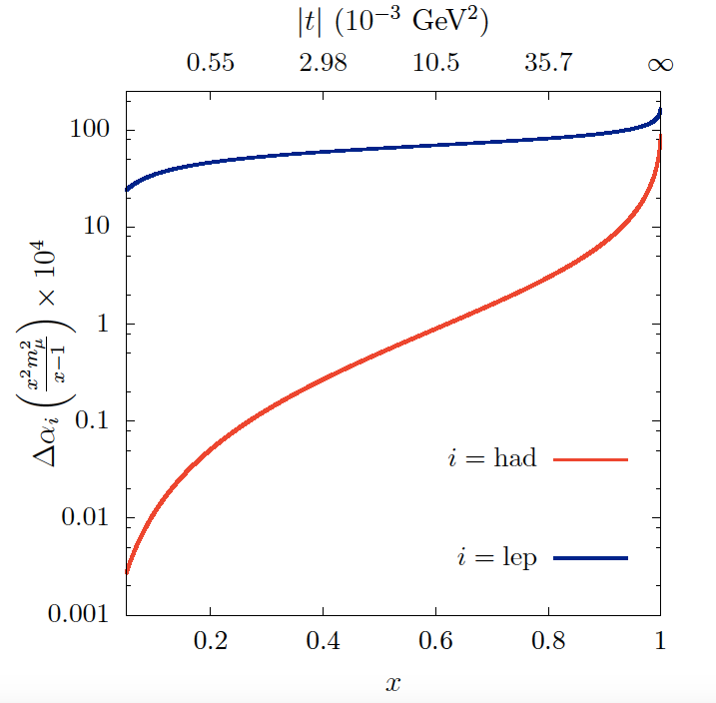
Running of α(t) and Δα_{had}(t)
Expected shifts Δα(t)
Δα_{had}(t) through:
Δα_{lep}(t)
Δα(t) =Δα_{lep}(t) + Δα_{had}(t)
Δα_{had}(t)
Δα_{lep}(t) can be
calculated precisely
Δα_{had}(t)=Δα(t) - Δα_{lep}(t)

Slide 9
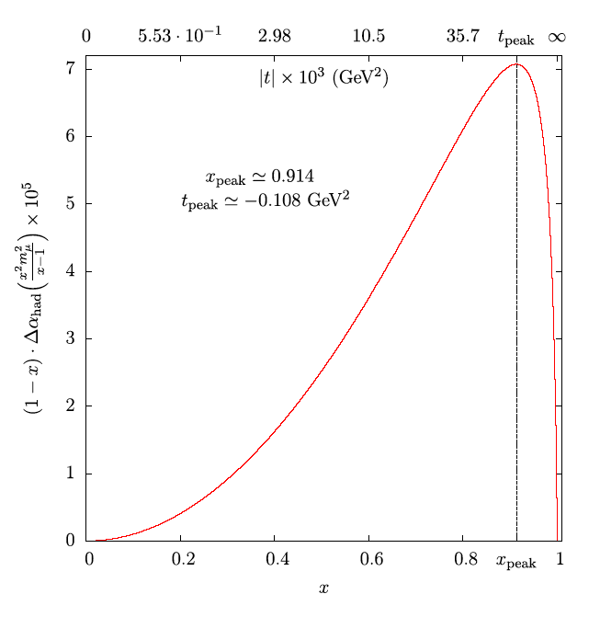
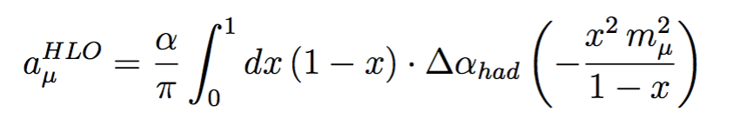
a_{μ}^{HLO} space-like
The expected shape of integral function
Use high-intensity CERN’s muon beam of E_{μ} ~ 150 GeV colliding on atomic electrons at rest to measure Δα_{h}(t) with t = q² < 0.
Highly boosted final state:
0 < - t < 0.161 GeV²
0 < x < 0.93
87% of the integral.
Remaining 13% using pQCD & time-like data, and/or lattice QCD results.
x
Notes:
Using the CERN muon beam M2 of 150 GeV colliding on electron at rest we can produce an highly boosted final state, covering the x region between 0 and 0.93.
In order to get the value of the HLO one has to integrate Delta alpha hadronic as a function of x with simple kermel 1-x.
The expected shape of the integral function is shown in the plot on the right.
You can see in this case it is a smooth function because the transferred momentum in the scattering is time-like.
Note that we can cover a range of x corresponding to 87% of the integral, peak included. The remain part of the integral can be calculated using pQCD and time-like data, and/or lattice QCD.

Slide 10
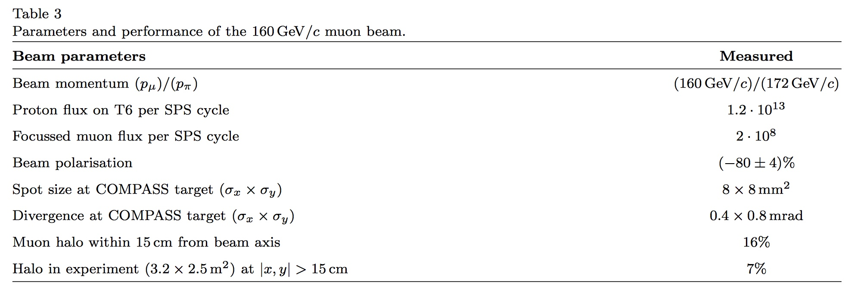
Muon beam M2 at CERN
70 MHz
https://arxiv.org/pdf/hep-ex/0703049.pdf

Slide 11
Optimal Muon Beam Momentum
Fraction of the a_{μ}^{HLO} integral as a function of the muon beam momentum: p_{μ} = 150 GeV → 87% of the integral (0 < x < 93).
E_{peak}= 106 GeV

Slide 12
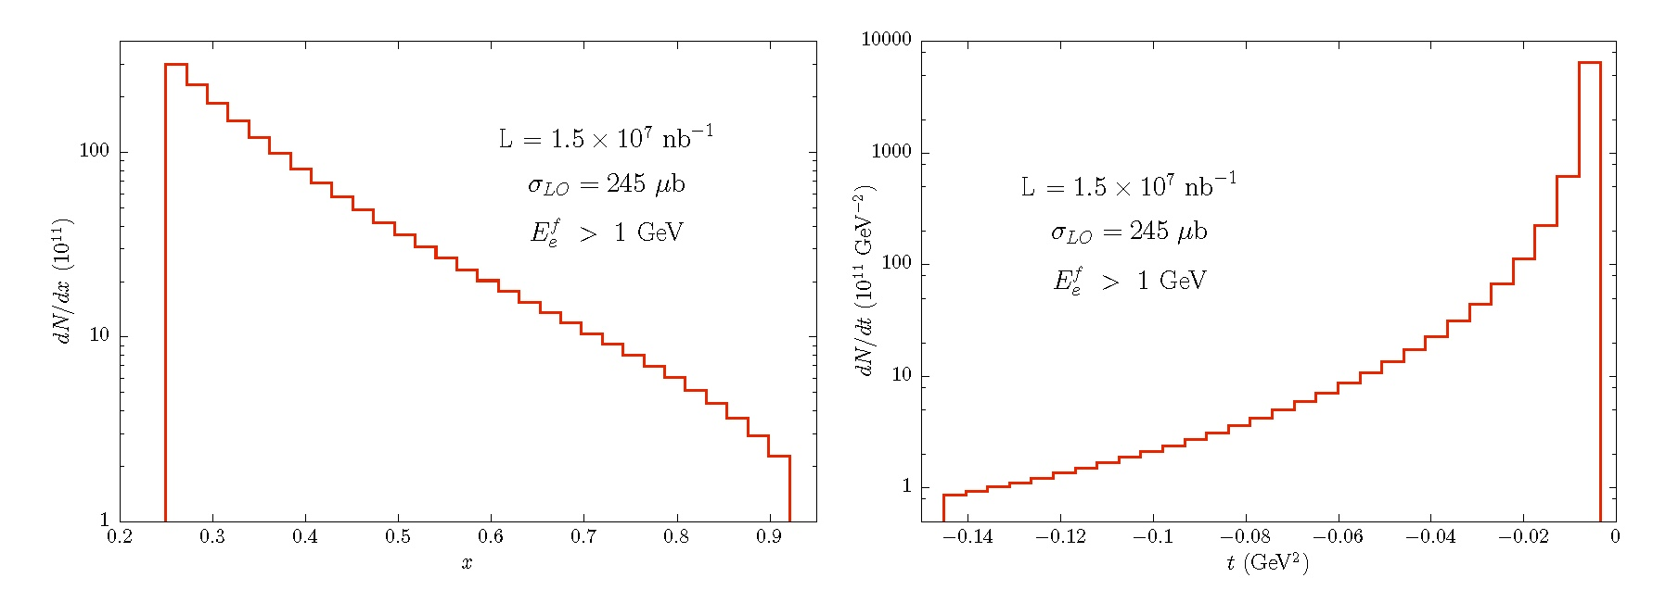
Luminosity
LO cross-section: σ_{LO}(E_{e} > 1 GeV) = 245 μb
Low Z material, Beryllium or Carbon, ρ ≈ 2 g/cm³, Z/A≈2, n_{e}≈ 6×10²³ cm⁻³
Rate = 𝓛 × σ = ( I_{μ} n_{e} d ) σ
With the CERN 150 GeV muon beam, which has an average intensity of
~ 1.3×10⁷ μ/s, incident on d = 60 cm of Be, and 2 years of data taking with a running time of 2 ×10⁷ s/yr, one can reach an integrated luminosity of
𝓛_{int} ~ 1.5 × 10⁷ nb⁻¹

Slide 13
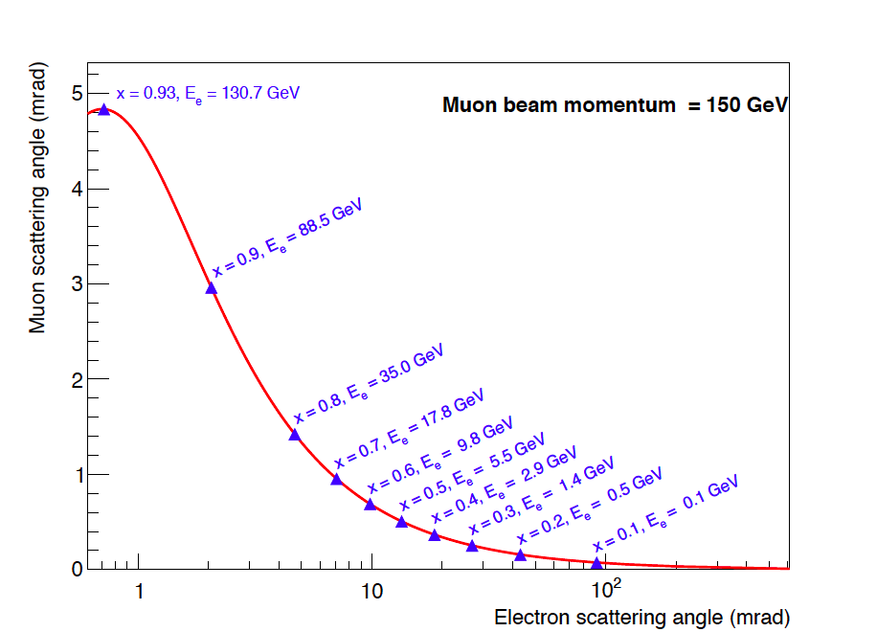
Signature: elastic scattering in the (θ_{e} , θ_{μ}) plane
e-out
θ_{e}
μ-in
θ_{μ}
μ-out
θ_{e} → E_{e} → t = q² = 2m_{e}² - 2m_{e}E_{e}

Slide 14
Detection technique
Modular apparatus covering the full angular acceptance with high uniformity.
60 layers of low Z material (Be or C) paired to Si strip planes
~ 1 m
e
μ
Transverse dimension
~10x10 cm²
module n
target n
target n +1
Measuring angles with high angular resolution
μ
e
GEANT4

Slide 15
The detector
Use state of the art silicon detectors developed for the
HL-LHC or Belle2, possibly already funded by INFN.
A module must be transparent to non interacting muons.
Each module tracks muons passing through: to measure the incoming direction right before the next stage.
The module, where the interaction will take place, in order to measure the scattering angles acts as a standalone detector.
L = I D ρ
D= n×d
Module n
Module n+1
μ
e
μ
Target
Target
Target

Slide 16
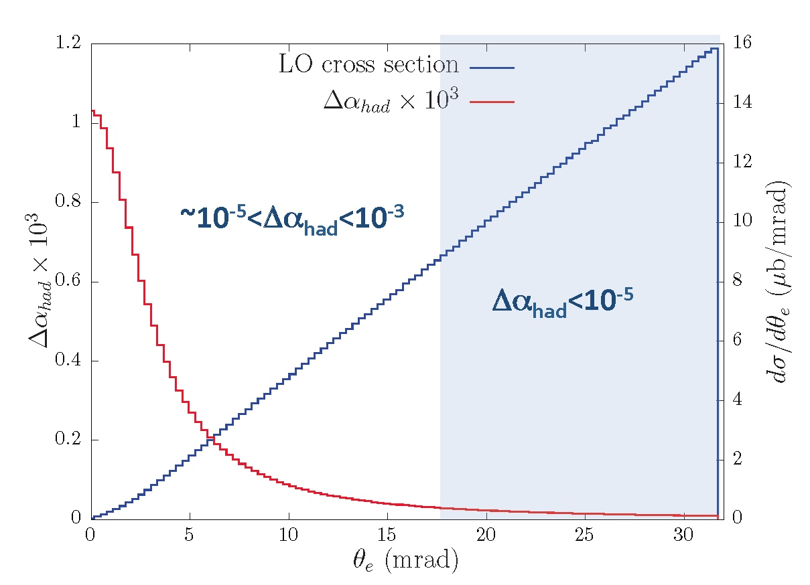
Cross section and the signal
To reach a precision on a_{μ}^{HLO} as with time-like data (4 × 10⁻¹⁰):
2 years of data taking, with a muon beam of intensity of 1.3 × 10⁷ s⁻¹
60 cm of low Z material segmented in thin layers, each of 10mm

Slide 17
2017 Test Beam Goals
Measure the effect of low Z materials on high energy electrons and check GEANT4 simulations.
Carbon targets of various thickness: 4 to 20 mm
Electron beams of 12 GeV and 20 GeV
Detector response measured directly
by taking data without the targets
Detector alignment performed with high-energy pions and muons
Run with muon beam: to possibly detect elastic scattering events.

Slide 18
Test Beam 2017: the setup
We used the UA9 tracking system to record scattering data
Alignment, tracking, pattern recognition done by ourselves starting from scratch as well as for the Geant4 simulations.
The goal: reach ~1% in the core of the MSC distributions and few per cent on the tales
upstream
C targets
downstream
ECAL
beam
UA9 detector

Slide 19
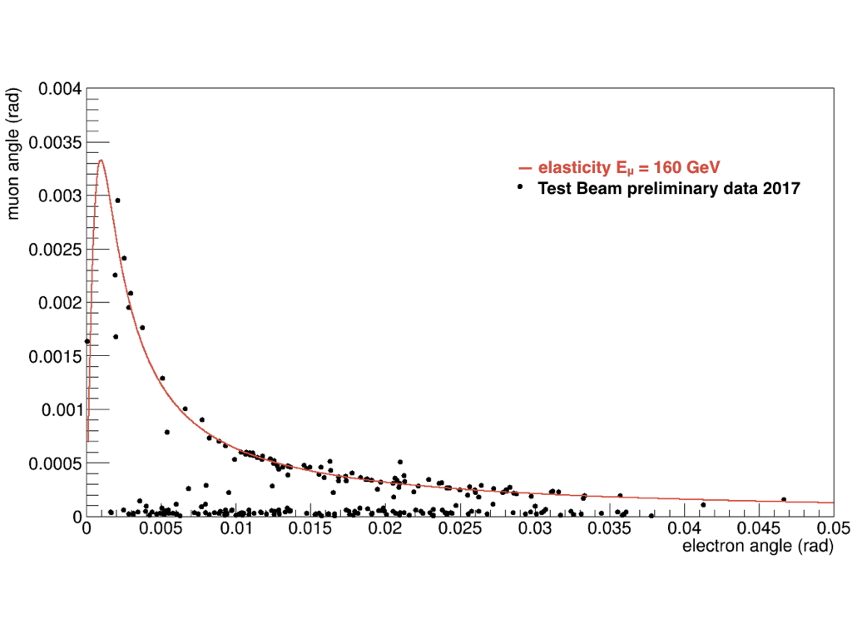
2017 Test Beam Result
Evidence of the elastic scattering
160 GeV muon beam, 8 mm C target
Golden selection: single track in, and two tracks out

Slide 20
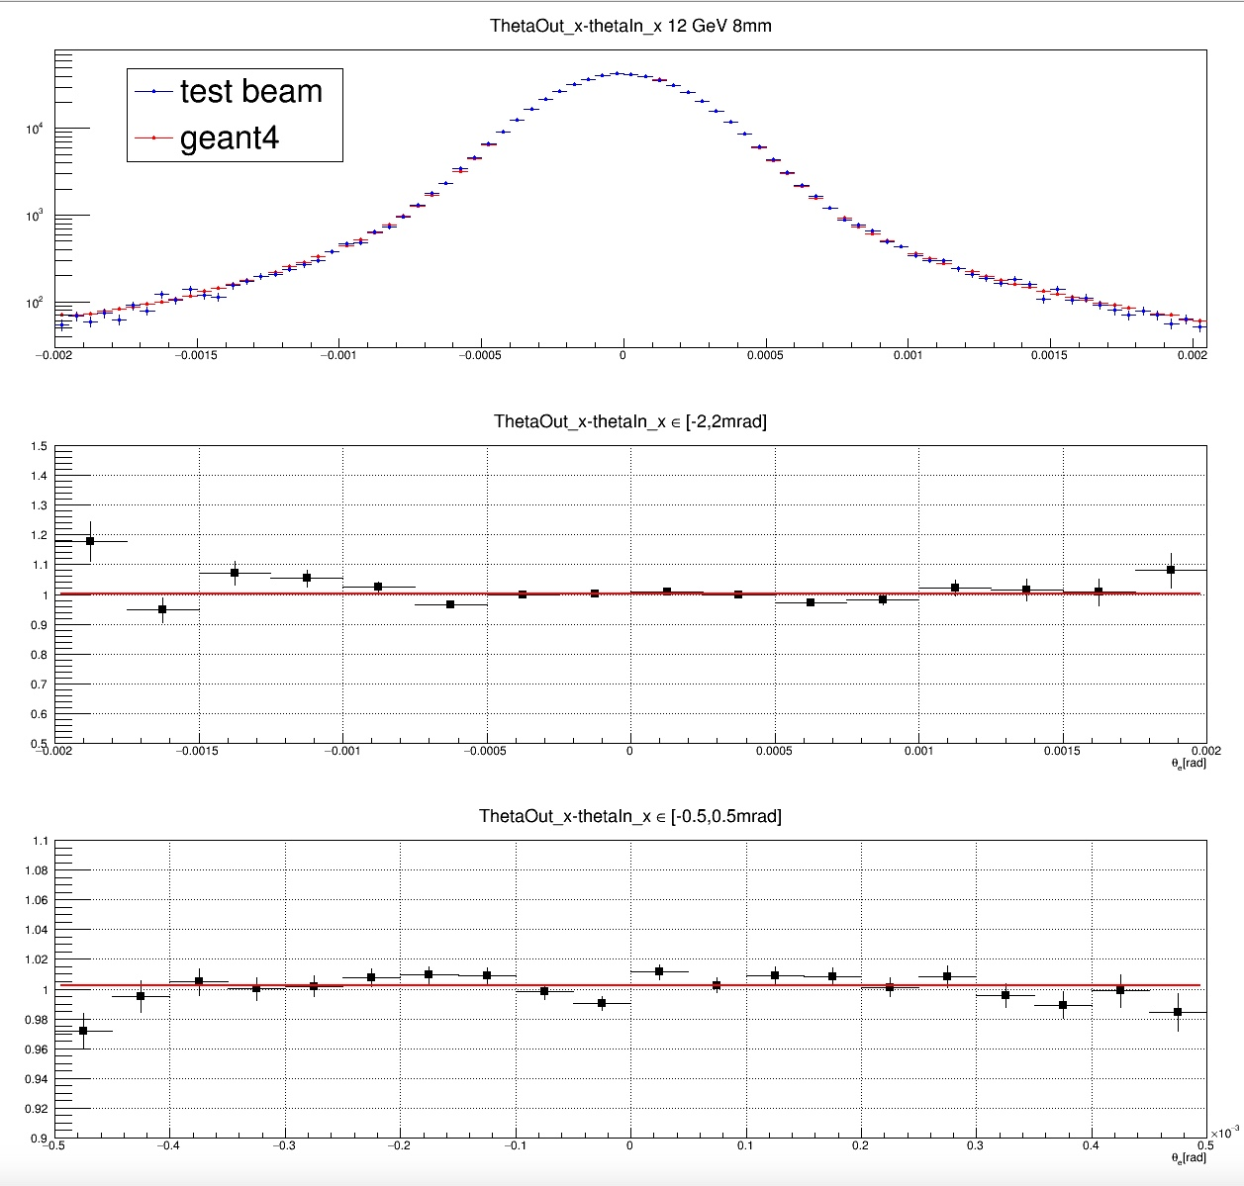
8mm, 12 GeV
Diffusion angle [-2,2] mrad
Diffusion angle [-2,2] mrad
𝝌²/NDF = 60/15
p₀ = 1.002 ± 0.001
Diffusion angle [-0.5,0.5] mrad
𝝌²/NDF = 29/19
p₀ = 1.001 ± 0.001

Slide 21
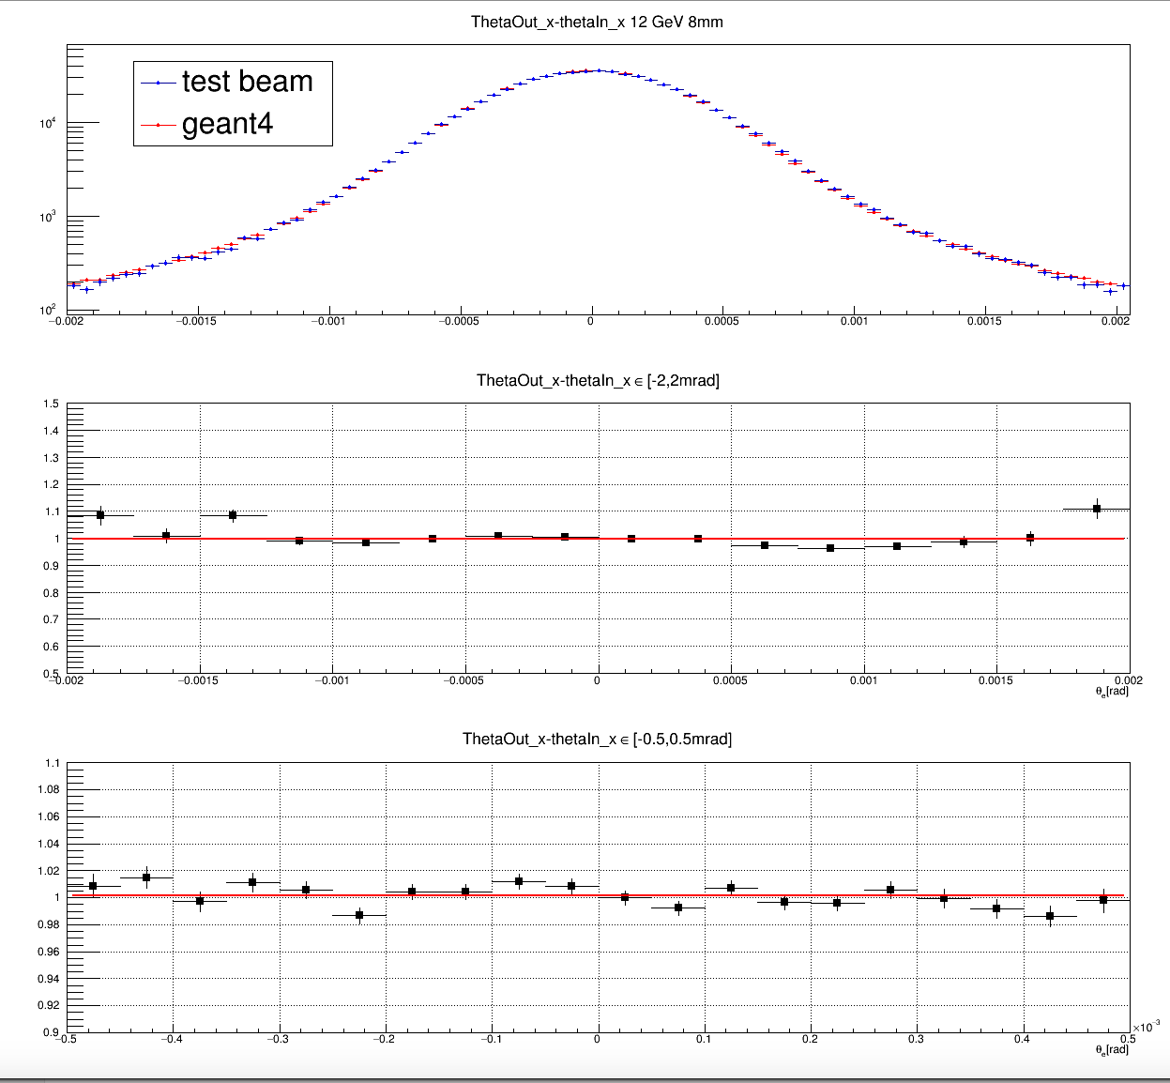
20mm, 12 GeV
Diffusion angle [-2,2] mrad
Diffusion angle [-2,2] mrad
𝝌²/NDF = 94/15
p₀ = 0.998 ± 0.001
Diffusion angle [-0.5,0.5] mrad
𝝌²/NDF = 30/19
p₀ = 1.001 ± 0.001

Slide 22
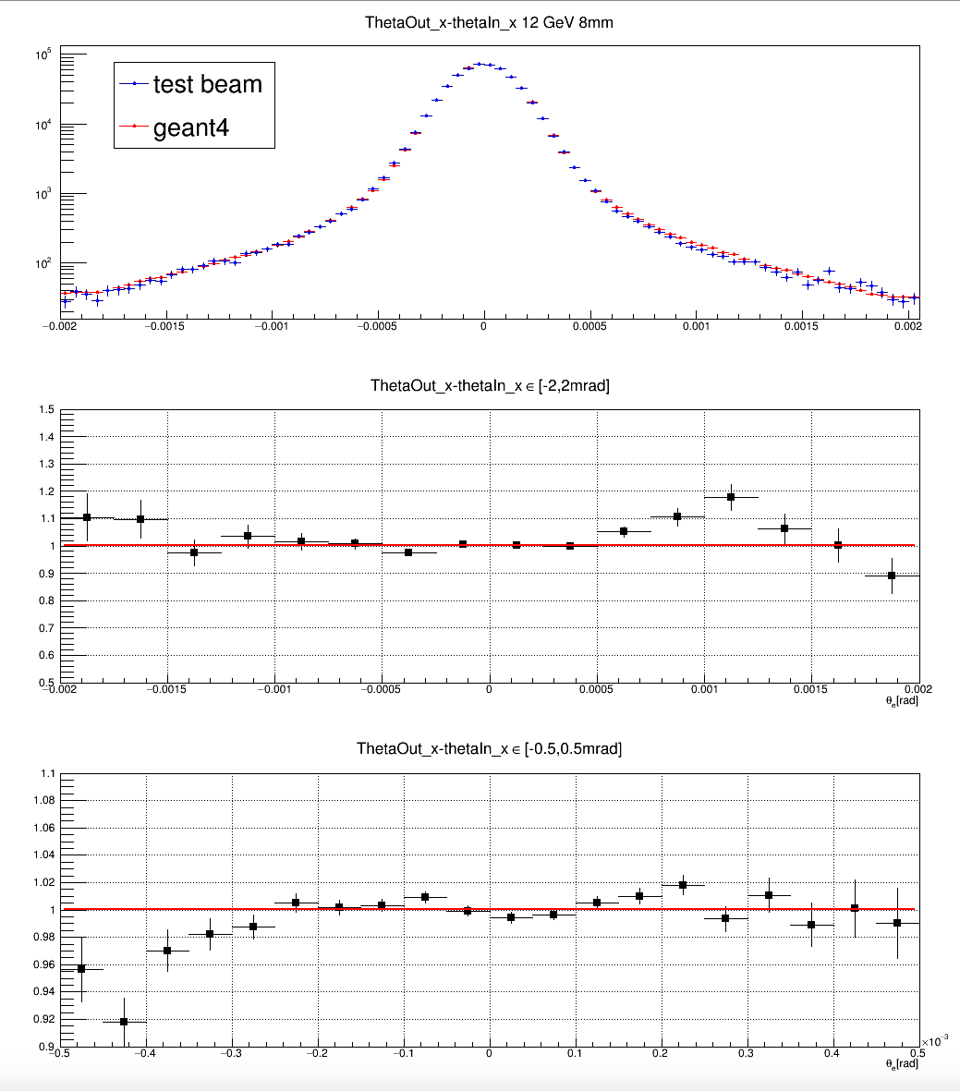
8mm, 20 GeV
Diffusion angle [-2,2] mrad
Diffusion angle [-2,2] mrad
𝝌²/NDF = 62/15
p₀ = 1.001 ± 0.001
Diffusion angle [-0.5,0.5] mrad
𝝌²/NDF = 55/19
p₀ = 1.001 ± 0.001

Slide 23
Test beam 2018
The setup has been located downstream COMPASS, behind the Tungsten hadrons filter.
  Aim of the measurement campaign: muon – electron elastic scattering with high statistics
    Using muons from pions decays (hadron beam) with an estimated beam momentum p = (187±7) GeV
    To measure the correlation between the scattering angles:
    muon angle vs the electron angle;
    Electron energy vs the electron angle correlation and PID.
The detector consists of:
  Tracking system: stations equipped with the AGILE silicon strip sensors: 400 micron thick, single sided,
  about 40 micron intrinsic hit resolution.
  Electromagnetic calorimeter: 3x3 cell matrix.

Slide 24
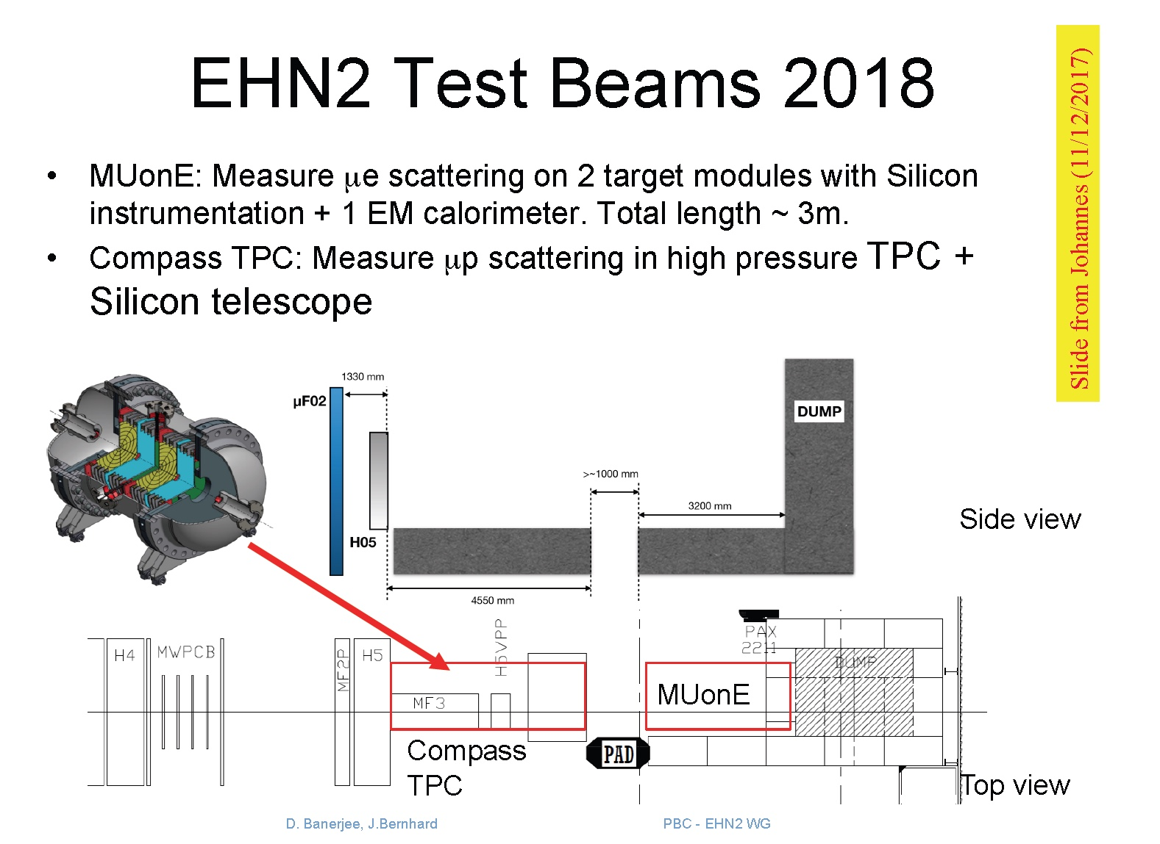
Test Beam 2018
ECAL
Module 1
Module 2
μ
μ
e
μ
Target
Target
~ 70 cm

Slide 25
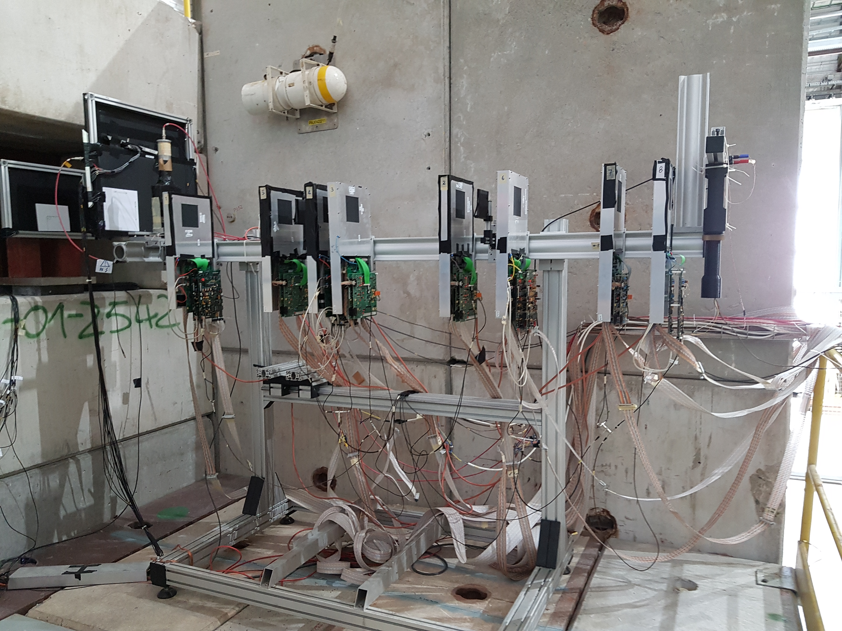
Test beam 2018
With remote control
beam

Slide 26
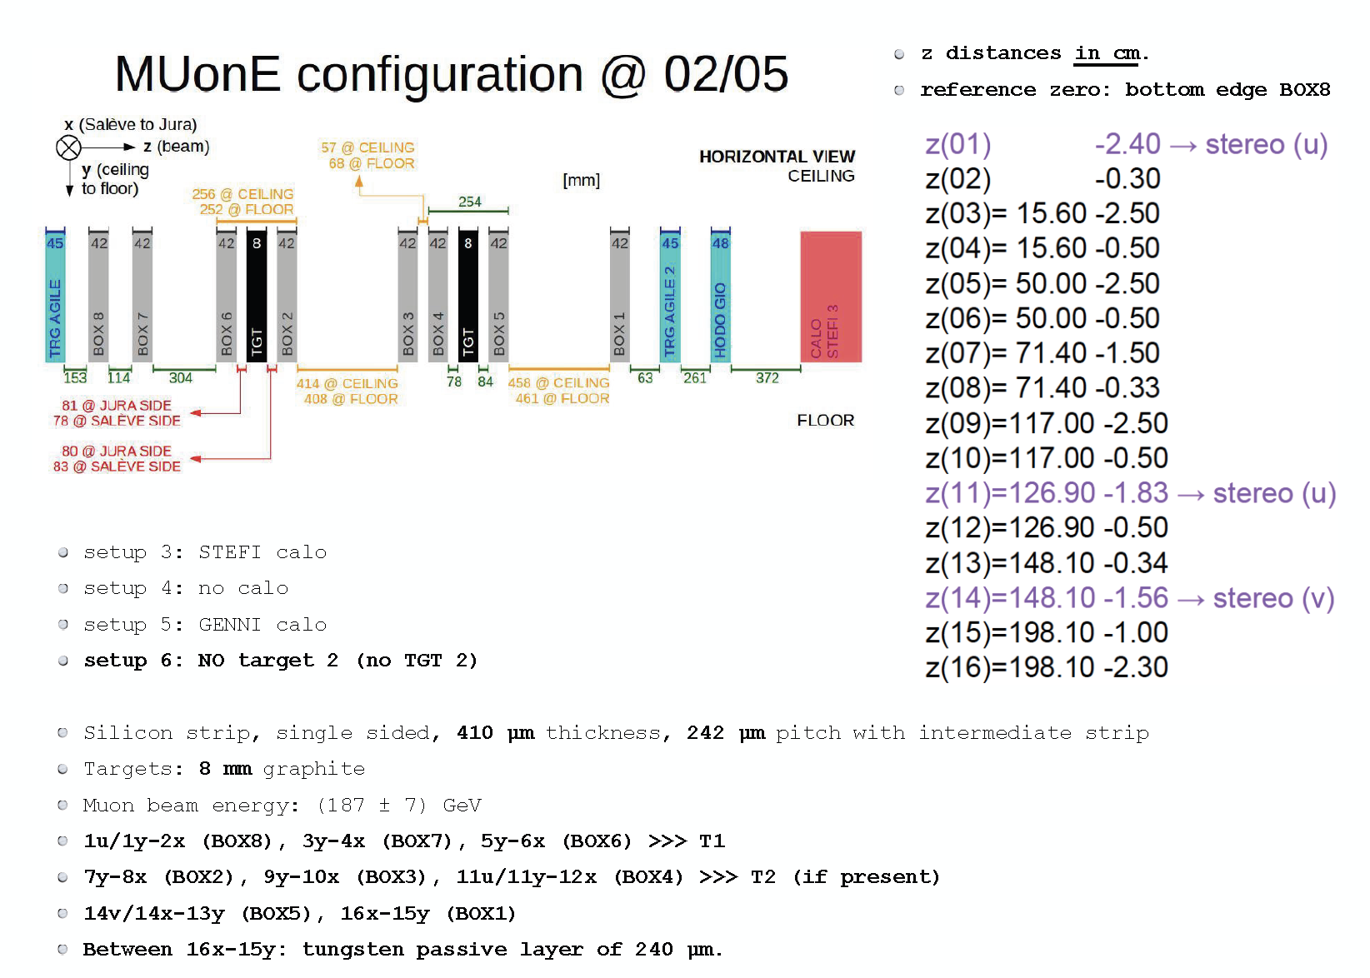
Test beam 2018: arrangements
beam
Tracking station positioning
Δz ~ 1mm

Slide 27
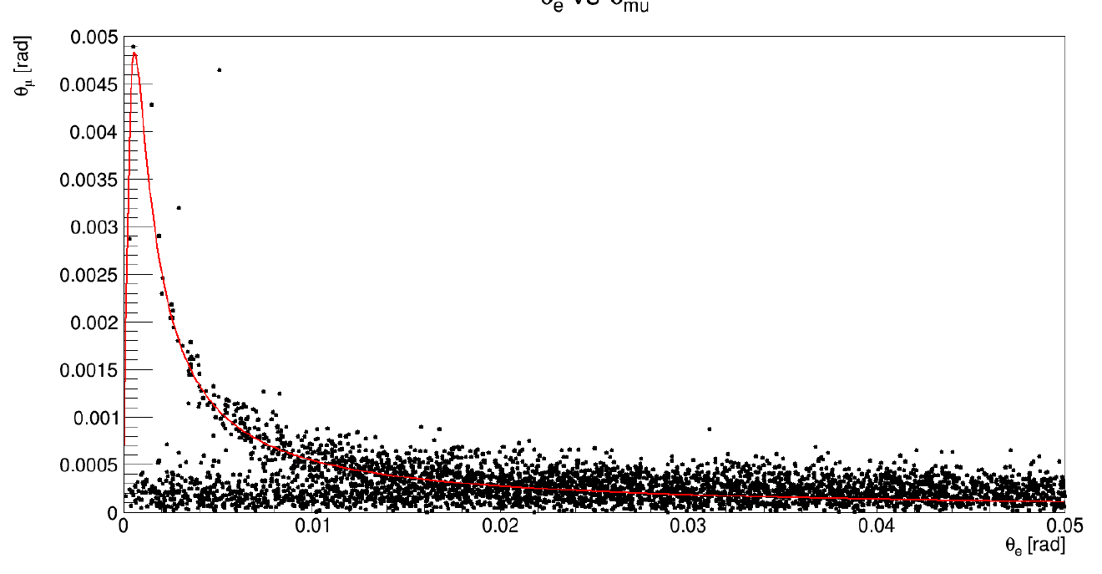
Simulation: Test beam 2018, GEANT4
Tracking algorithm applied.
Configuration: without T2, using the downstream boxes 2, 4 and 5
Box 3 removed since it was not working properly
150 million incoming muons → 5742 reconstructed events
angle_µ vs angle_e
40µm hit resolution
angular ~ 0.1 mrad
5 mrad
Elasticity curve: beam momentum at 187 GeV
50 mrad

Slide 28
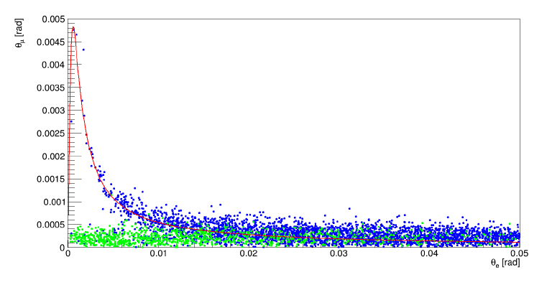
Simulation: Test beam 2018, GEANT4
angle_µ vs angle_e
Signal
Background
Pair production

Slide 29
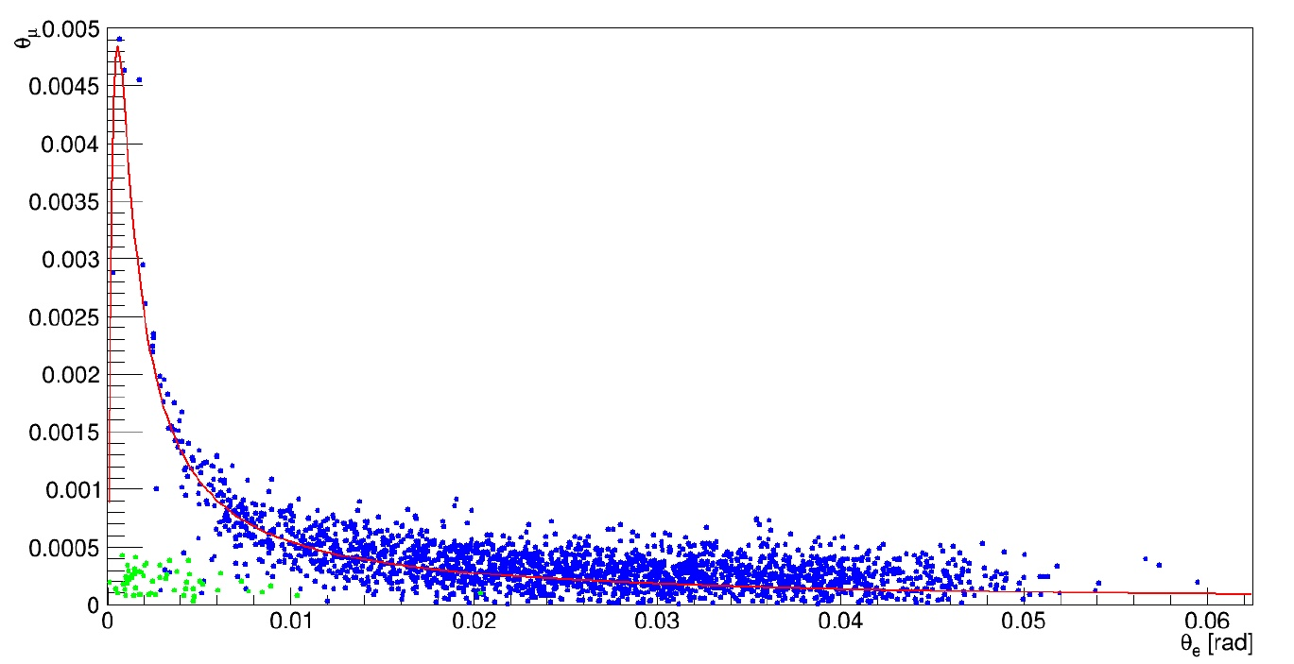
Simulation: Test beam 2018, GEANT4
Electron candidate: E_{e} > 1 GeV
Signal
Background
Pair production

Slide 30
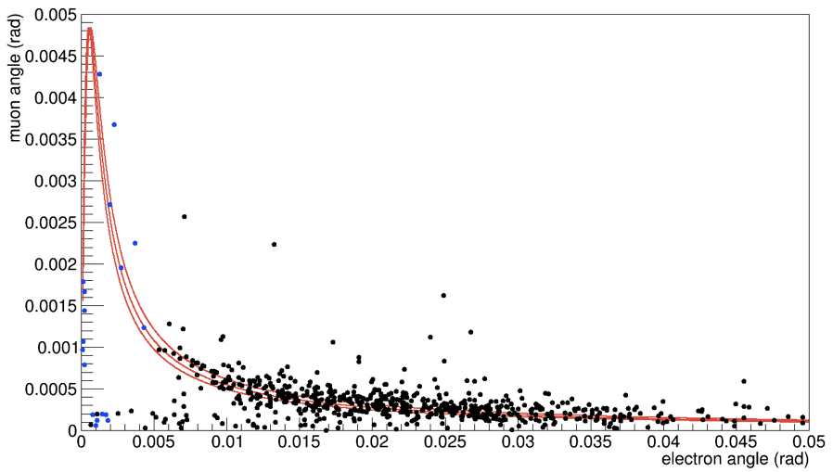
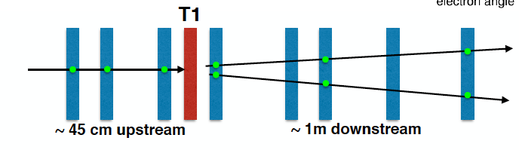
Data: using the Calorimeter
Elasticity curve: beam momentum (187 ± 7) GeV
Data with E > 1 GeV
ECAL

Slide 31
Ongoing studies
Efficiency of the selection
  χ² of the tracks
  Coplanarity of the three direction vectors.
  Elasticity: d= d(P,γ) of the angles from the elasticit curve. Not used yet.
  Common vertex constraint at the target of the tracks (muon in, muon out, electron candidate)
  Energy

Slide 32
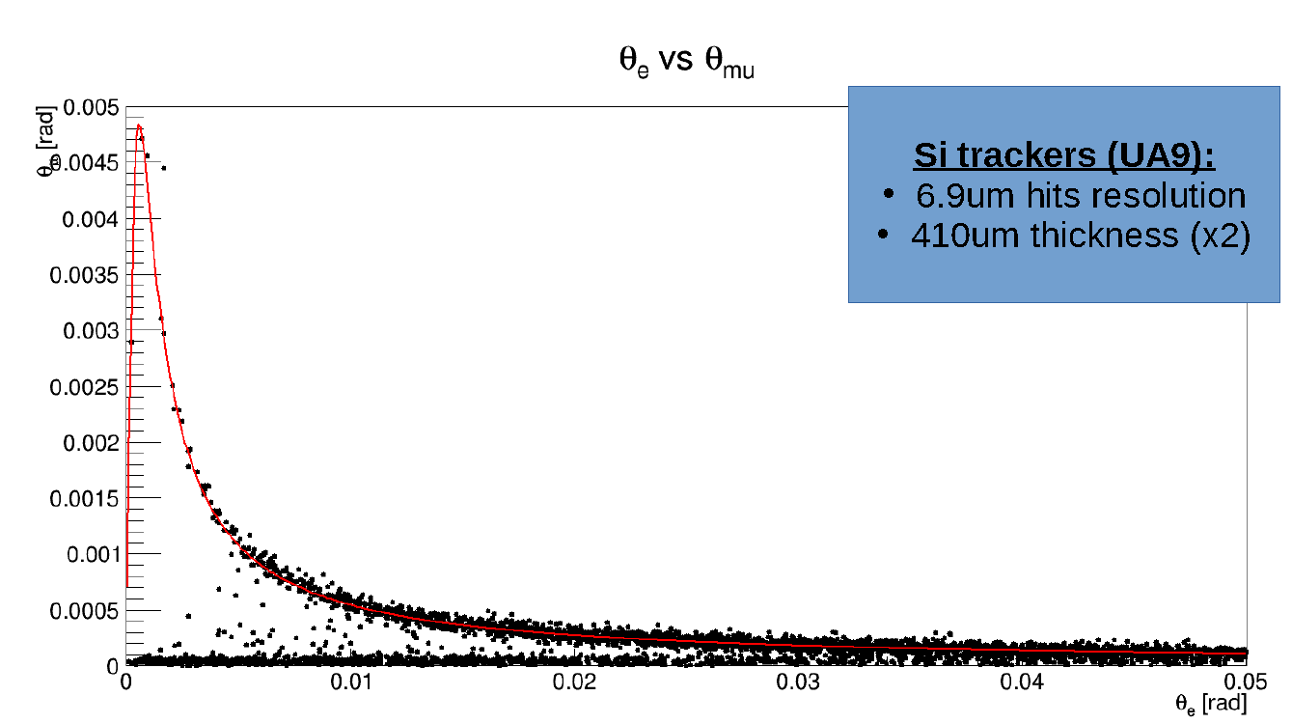
Effect of the resolution: GEANT4
UA9 resolution 7μm
angle_µ vs angle_e
angle_µ vs angle_e

Slide 33
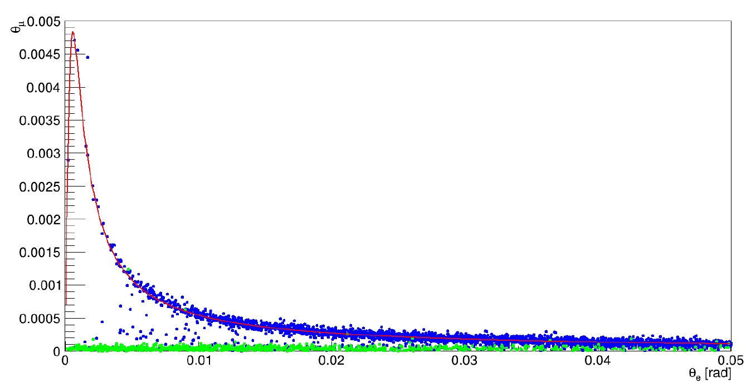
Effect of the resolution: GEANT4
UA9 resolution 7μm
Signal
Background

Slide 34
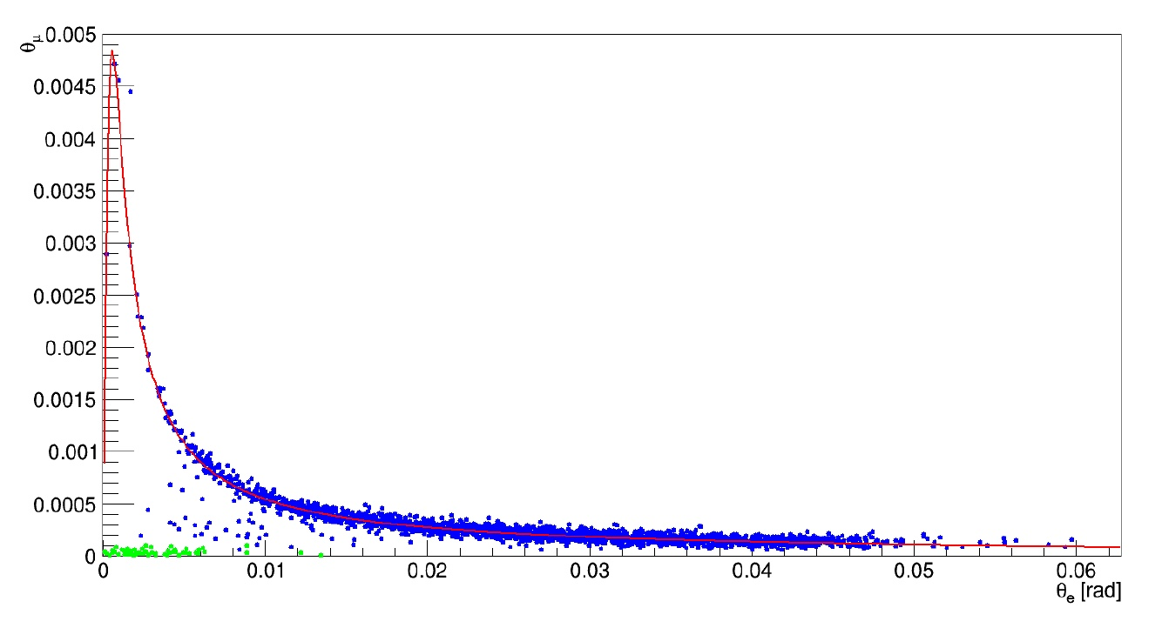
Effect of the resolution: GEANT4
UA9 resolution 7μm
E_{e} > 1 GeV
Signal
Background
Notes:
Che cosa sono I punti blue sotto la curva di elasticità?
Dunque, cosa sono quelli verdi?

Slide 35
Suitable sensors and ASICs
Requirements:
  Dimensions: 10 cm × 10 cm
  Single hit resolution: r ≤ 10 μm
  Fast timing (25 ns).
  Minimal thickness: d ≤ 300 μm
Possible implementation:
  strip pitch p ≤ 50μm and floating electrodes charge sharing to get a resolution better than the geometrical σ=p/sqrt(12), depending on S/N
  1028 channel hybrid per sensor single sided

Slide 36
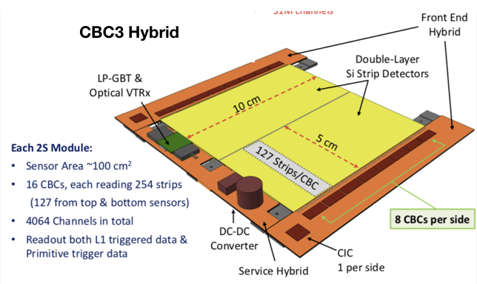
CBC3 based CMS detector

Slide 37
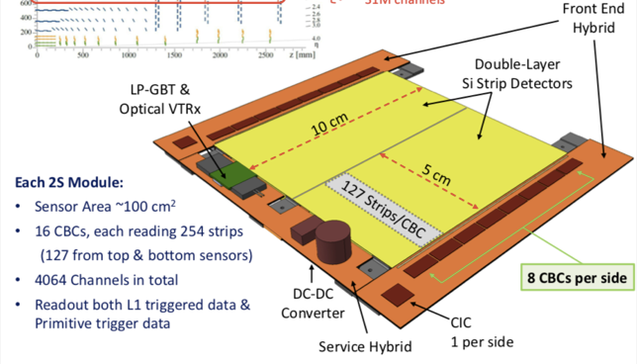
CMS CBC

Slide 38
CMS CBC ASIC

Slide 39
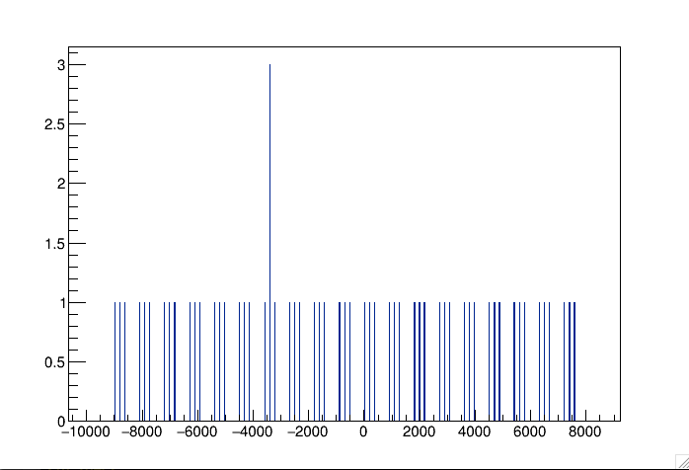
Trigger
Hits
Trigger: at least two hits per each detector in a module
For a detector of 30 modules the number of triggers generated by 2.e+5 muons going through are are 39180.
The estimated trigger rate is: 39180/2e+5*70 = 13.7 MHz
The CBC3 sustainable trigger rate is 750 kHz.
Unlikely we can determine event signatures to trigger the whole detector at 750 kHz.
z (mm)

Slide 40
NLO studies

Slide 41
Plans for 2019
Evaluate the effectiveness of the CMS solution
Evaluate alternative matching sensors and ASIC
Design the readout electronics and DAQ
Define the mechanics support to get ~10 μm longitudinal precision
Study how to measure the energy, or the momentum, of the electron candidates.

Slide 42
Plans for 2019 (2)
Develop a detailed MC description of the detector:
  Needed to perform detailed feasibility studies.
  Correct for MSC effects, account for detector’s efficiency and selection cuts.
Measuring the running of α = α (q²) with simulated data:
  LO based feasibility studies are ongoing
  NLO simulations and related studies just started

Slide 43
Plans
2019
  Detector optimization
  Work to the LoI
2020
  Detector construction and installation
2012
  Data taking for feasibility studies
2022 – 2023
  Reach a relative precision a_{μ}^{HLO} of 1%

Slide 45
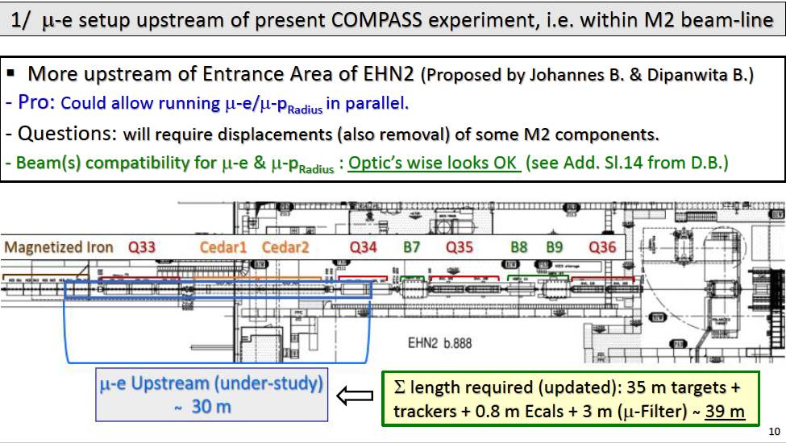
Possible location at CERN M2
Between BSM and COMPASS
A. Magnon & C. Valle document

Slide 46
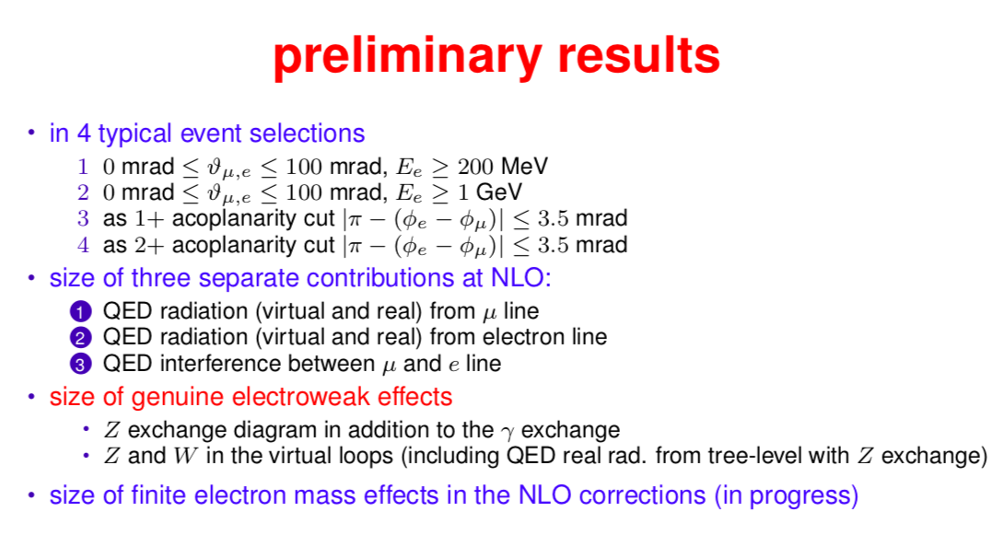
Progresses in the theory
NLO

Slide 47
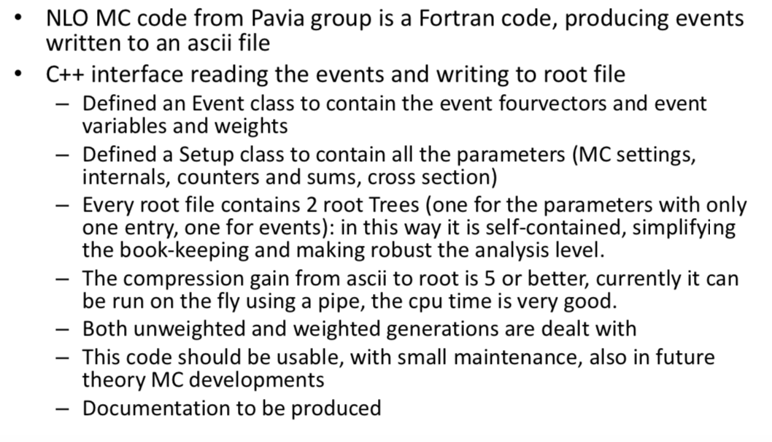
Analysis Workflow

Slide 48
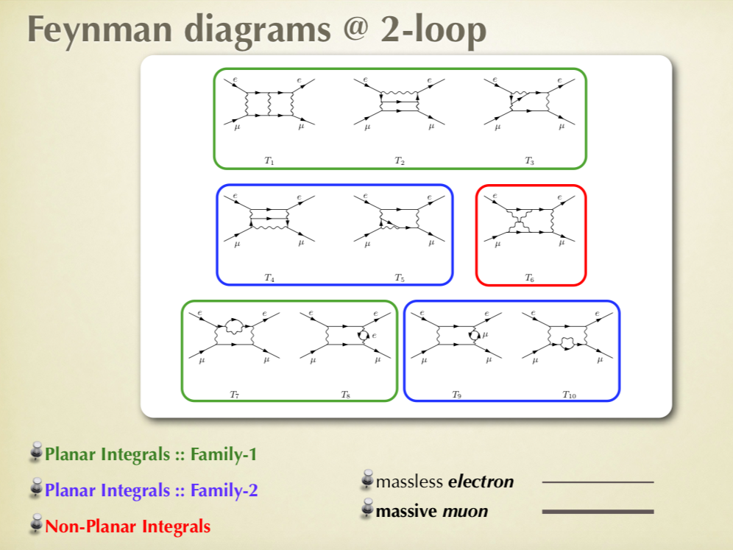
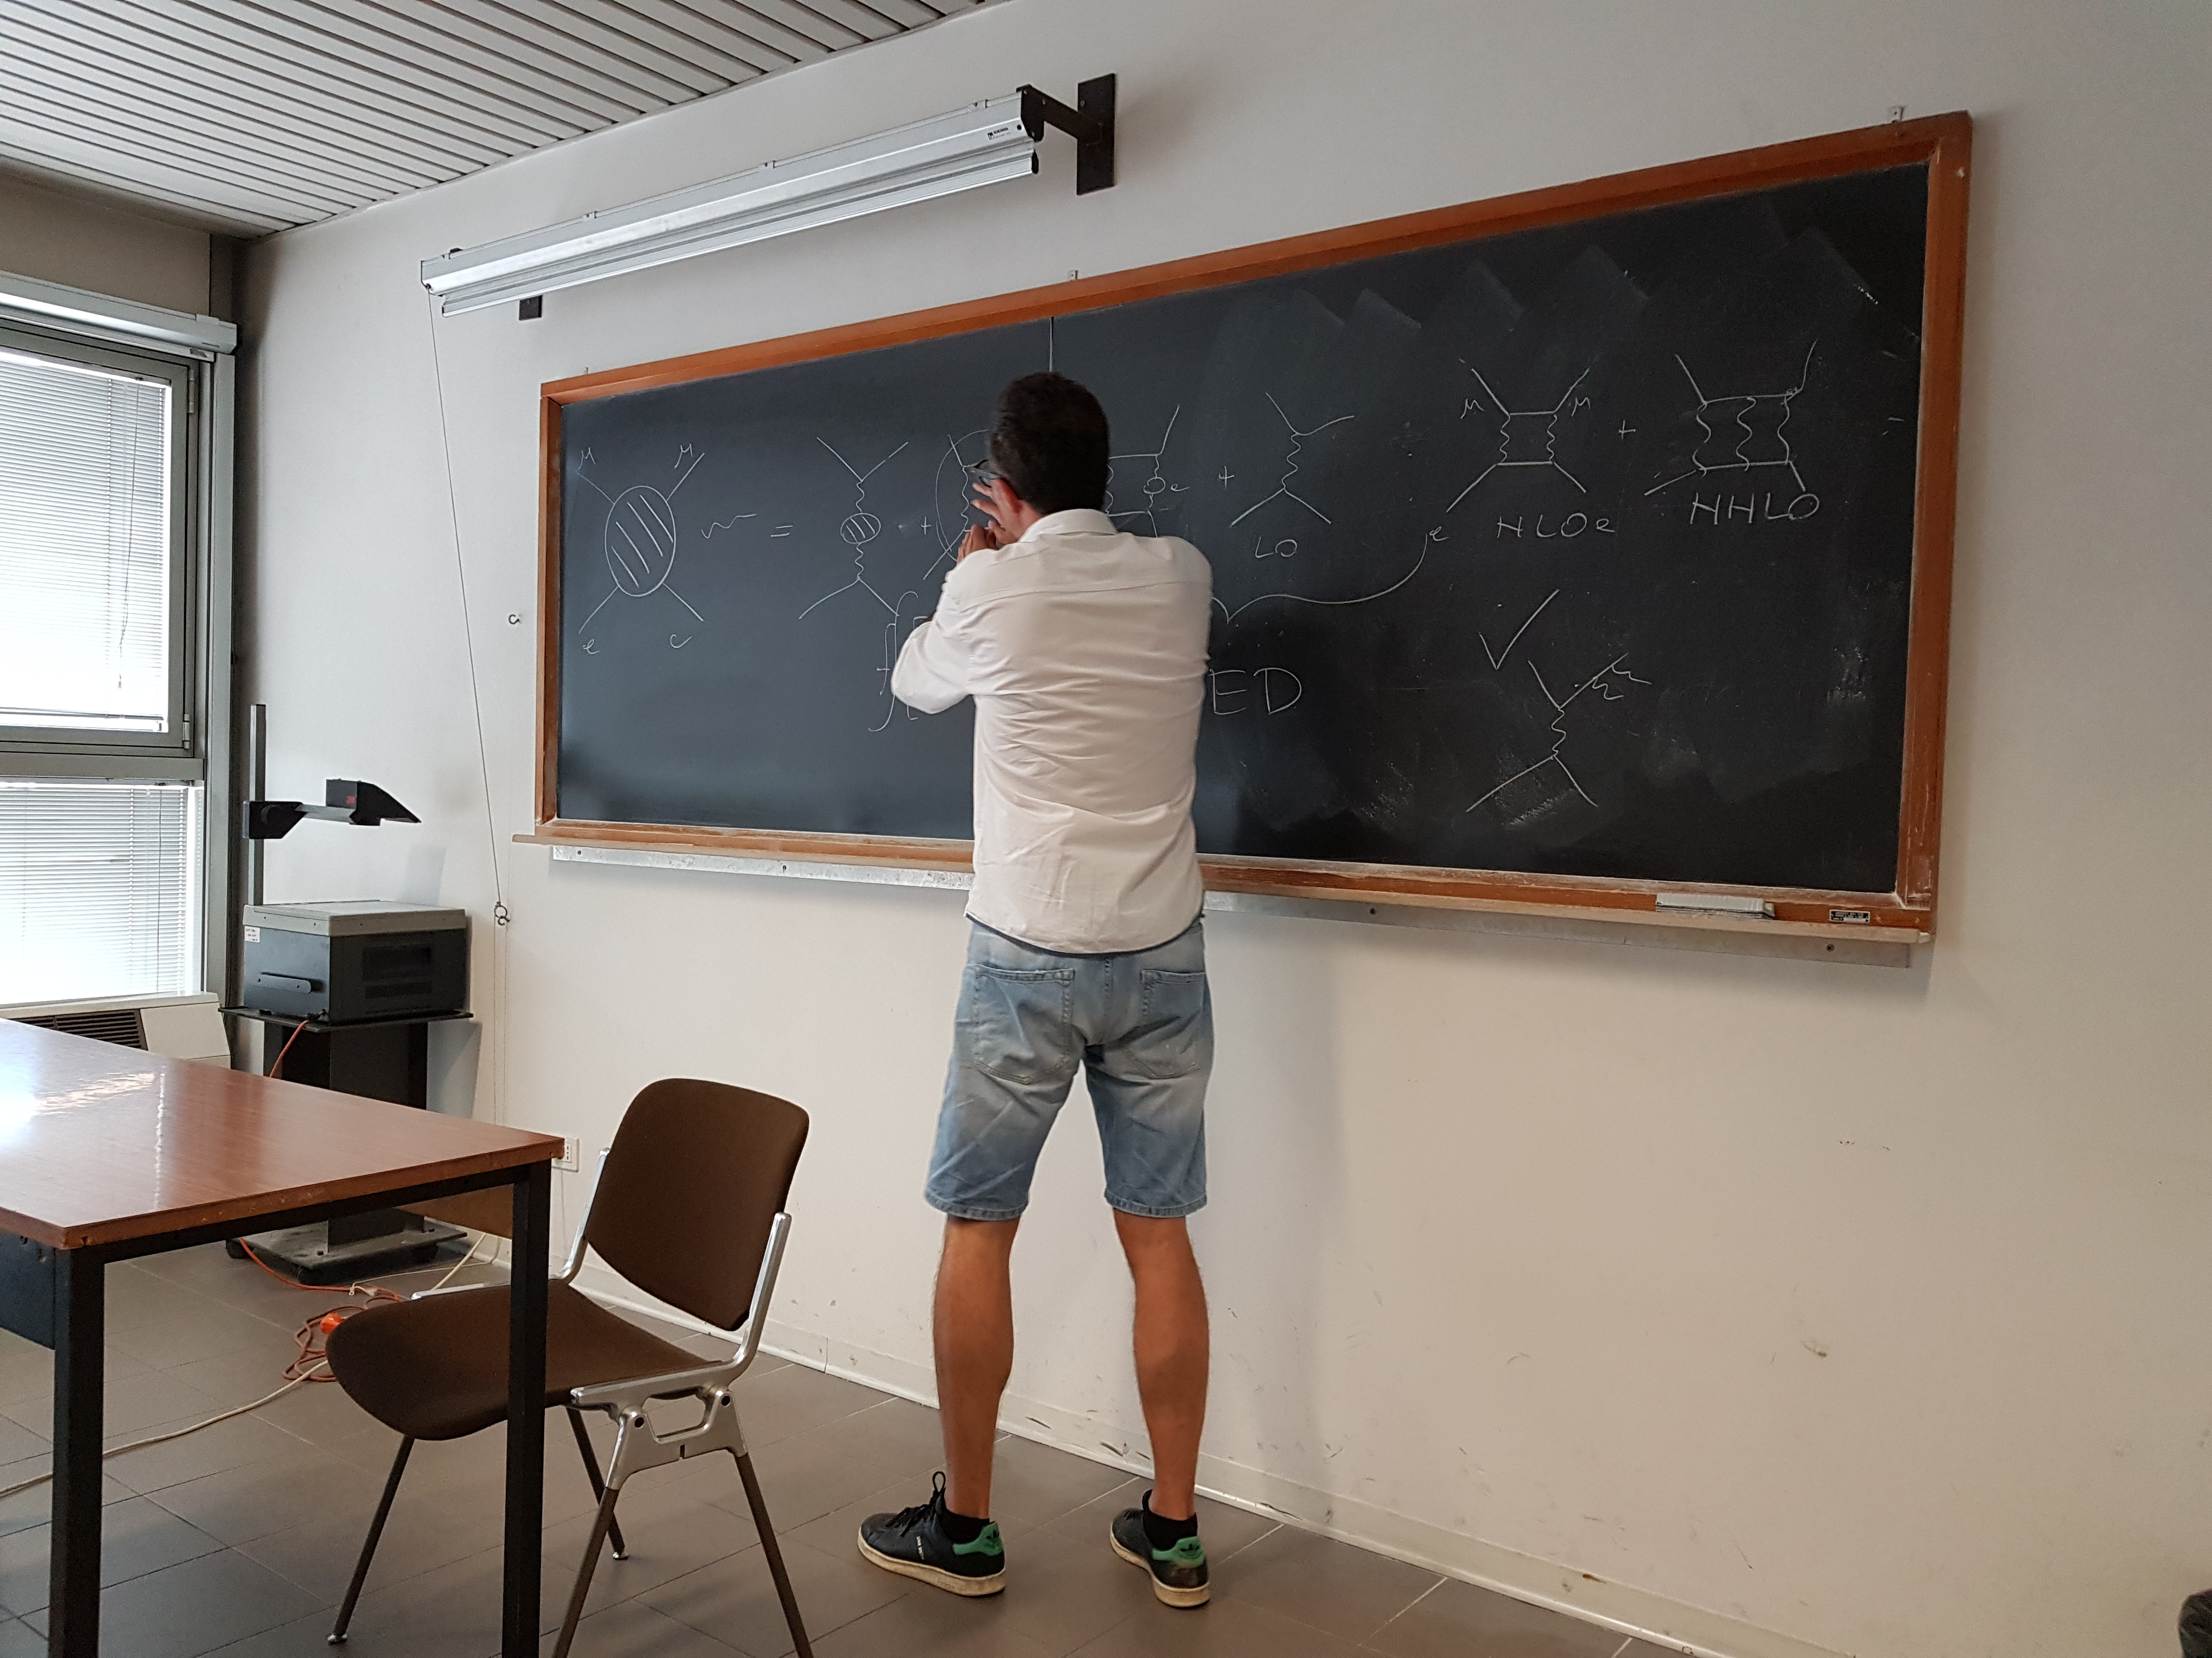
Progresses in the theory (2)
New classes of high-order NNLO diagrams recently calculated for the first time.
“No show stopper”.

Slide 49
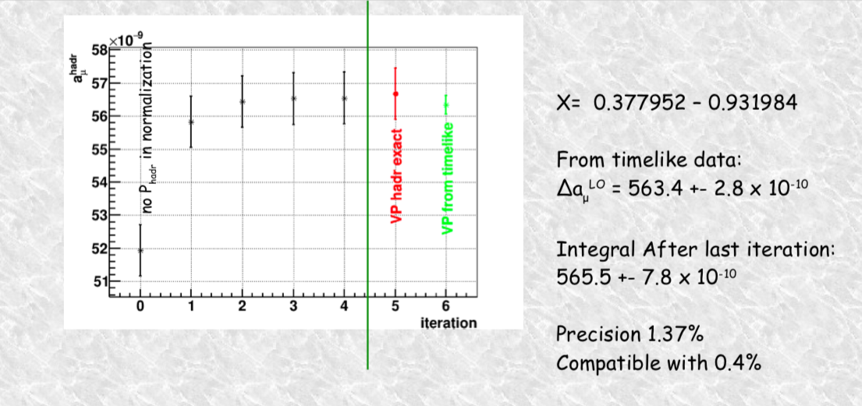
Fitting for α = α(t) cross-section LO

Slide 50
The End

Slide 51
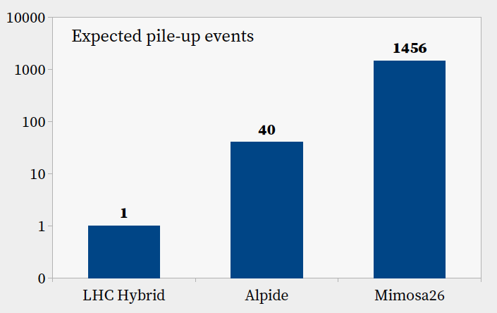
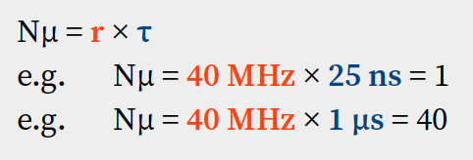
Detector integration time
Hybrid pixels & strips for (HL-)LHC: 25 ns
ALPIDE: 1 µs
Mimosa26: 112 µs
Expected pile-up events
Nµ
Notes:
number of events you expects to record the signal from that particle, plus Nμ other from

Slide 52
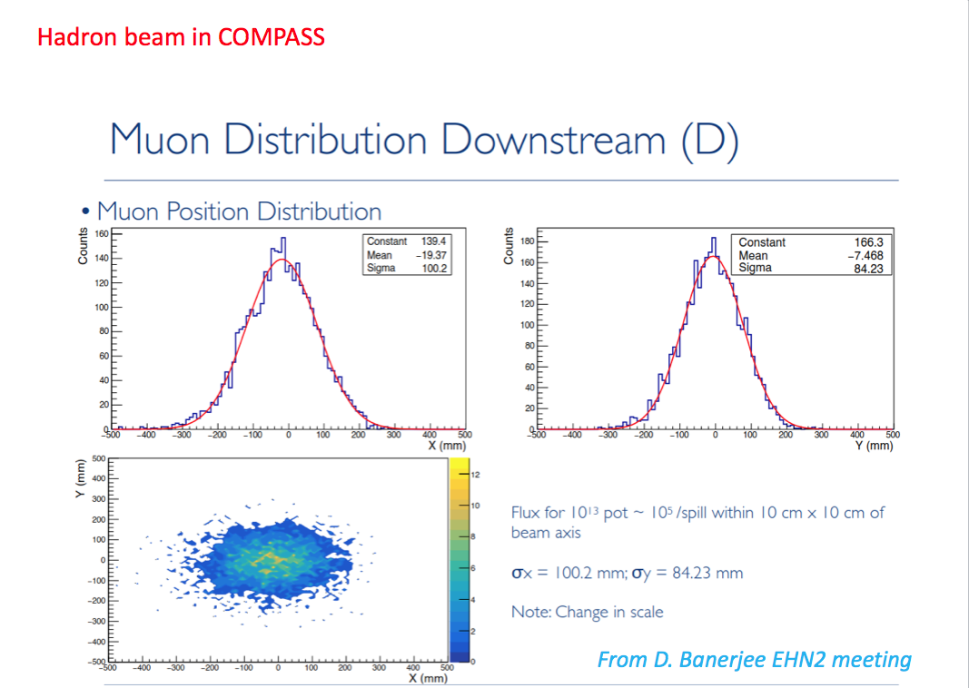
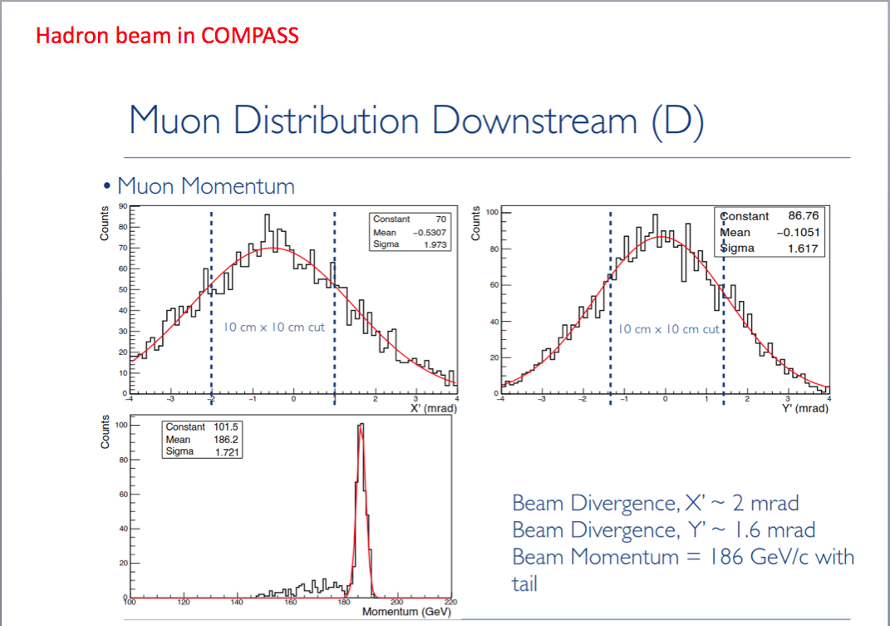
Test Beam 2018
Beam momentum 186 GeV/c

Slide 53
Theory
Our final TH goal: a running MC for the ratio of the SM cross sections in the signal and normalization regions below, at the level, of 10ppm

Slide 54
Theory (2)
Next theory workshop in Zurich - Feb 2019

Slide 55
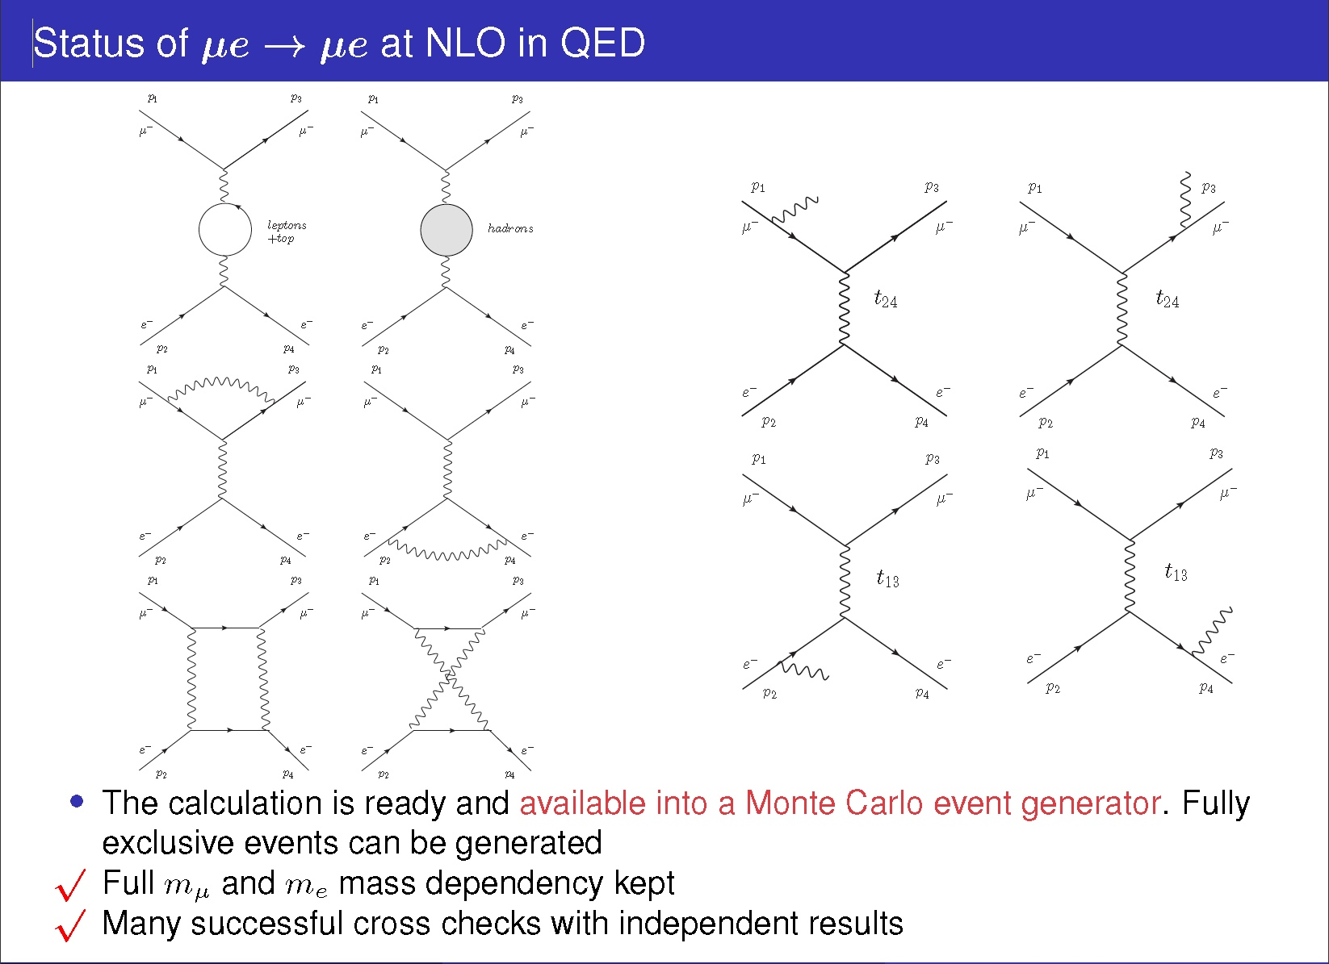

Slide 56
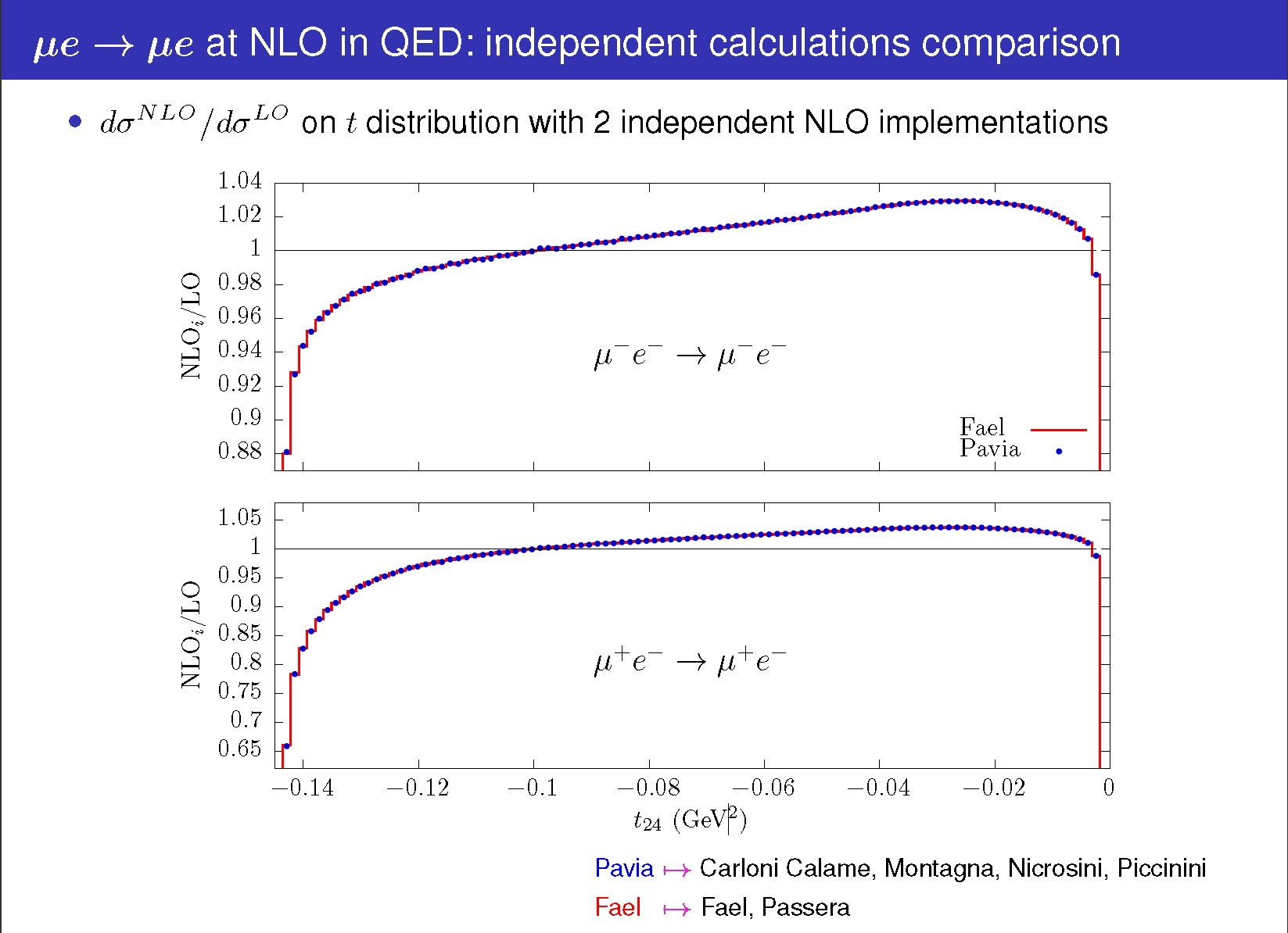

Slide 57
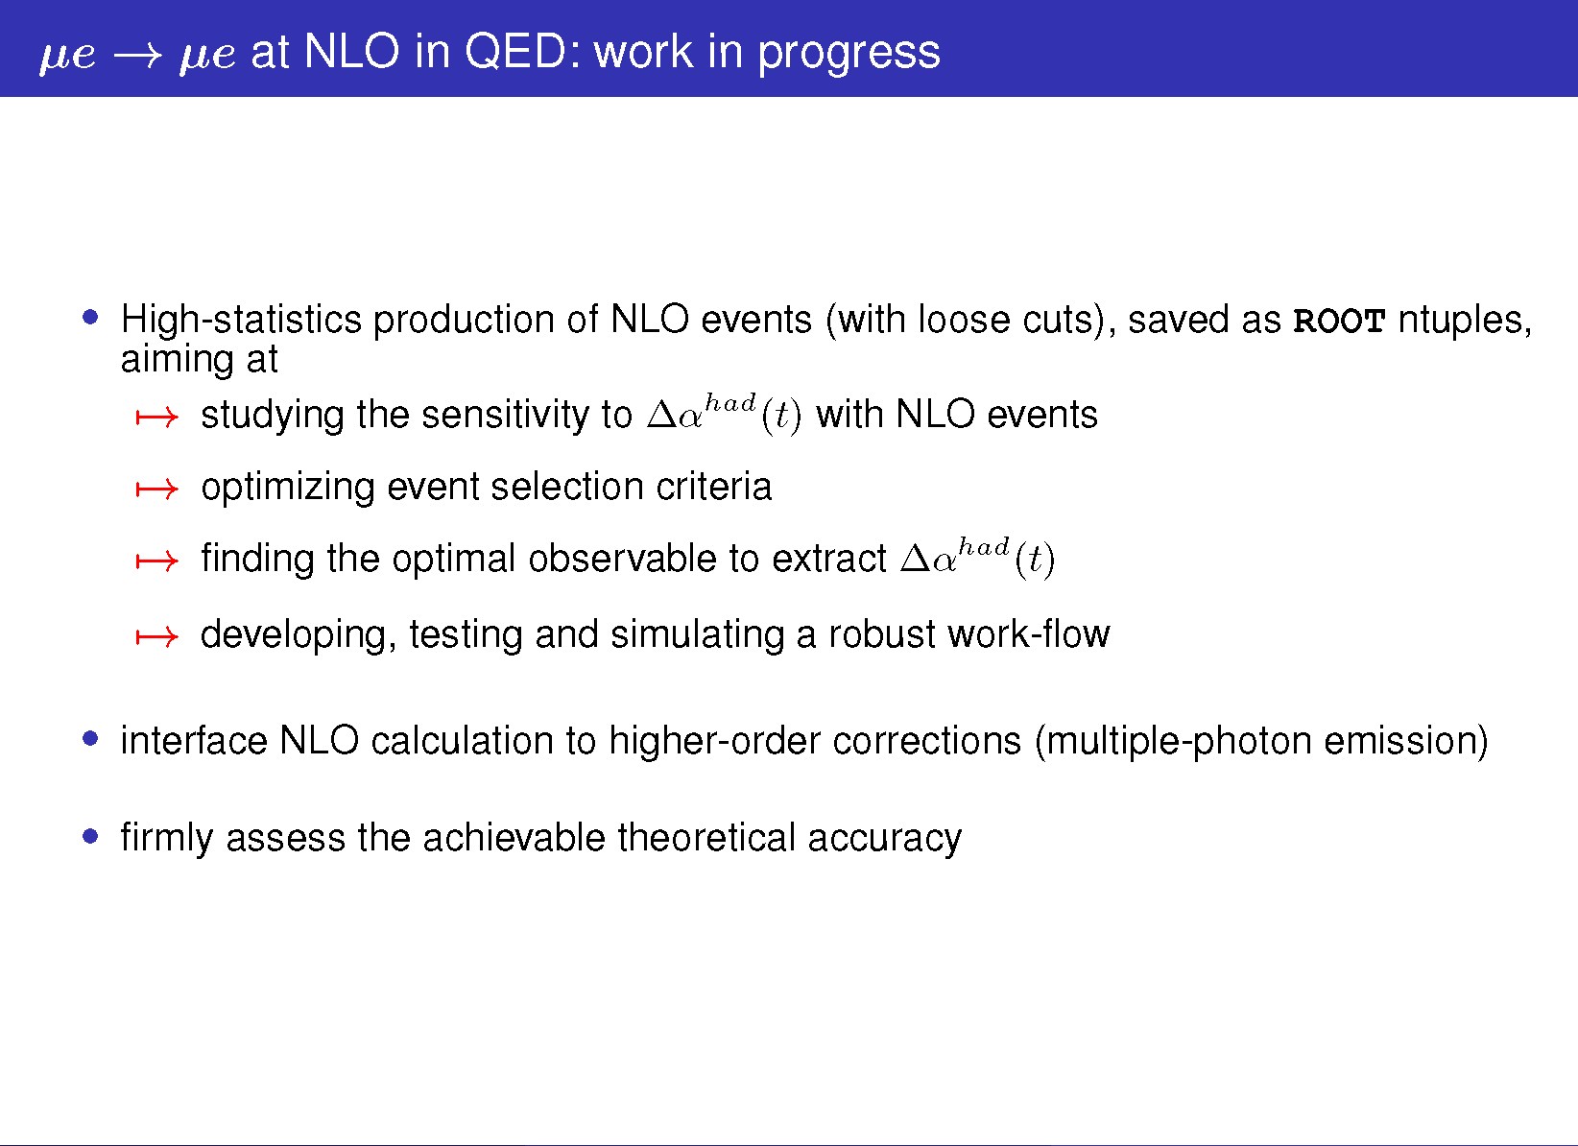

Slide 58
Detector Optimization
50 cm
e
10 cm
μ
d
μ
Target
State of the art silicon detectors
hit resolution ~10 μm
intrinsic angular resolution ~ 10 μm / 0.5 m = 0.02 mrad

Slide 59
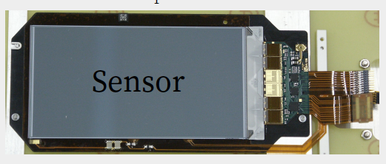
Silicon detectors survey
 | ALICE Upg Inner | ALICE Upg Outer | CMS Upg 2S | 2×CMS Upg 2S | CMS Upg PS | CMS Upg Pixel | 2×CMS Current | Mimosa26 | LHCb VELO-pix
Technology | MAPS | MAPS | Hybrid strip | Hybrid strip | Hybrid strip/px | Hybrid pixel | Hybrid strip | MAPS | Hybrid pixel
active x [cm] | 27 | 21 | 10 | 10 | 10 | 33 | 10 | 1.06 | 4.246
active y [cm] | 1.5 | 3 | 10 | 10 | 5 | 44.2 | 10 | 2.12 | 1.408
pixel size x [µm] | 30 | 30 | 90 | 90 | 100 | 50 | 90 | 18.4 | 55
pixel size y [µm] | 30 | 30 | 50000 | 90 | 1400 | 50 | 50000 | 18.4 | 55
σx [µm] | 2 | 2 | 26 | 26 | 29 | 7 | 18 | 3.2 | 12
σy [µm] | 2 | 2 | 14434 | 26 | 404 | 7 | 18 | 3.2 | 12
Material [x/X₀] | 0.3% | 0.8% | 2.3% | 4.5% | 3.8% | 2.0% | 4.5% | 0.10% | 0.94%
Sensor mat. [x/X₀] | 0.3% | 0.8% | 0.3% | 0.6% | 3.8% | 2.0% | 0.6% | 0.10% | 0.94%
Notes:
Material amount, response time, Single-hit resolution, efficiency, readout rate, size
Strip and pixel hybrid detector in which Sensor and ASIC are separate objects. (fast)
Monolithic Active Pixel (MAPS) with volume integrated into the ASIC (slow)

Slide 60
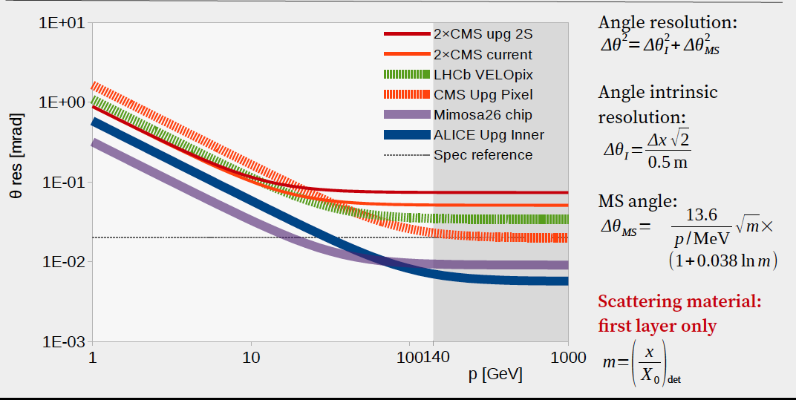
Resolution dominated by MS up to 100 GeV/c
Resolution on scattering angle assumptions:
2 measurement plane 0.5 m apart
Scattering on:
  No plane (ideal resolution)
  First detector plane (pure tracker resolution)
  First plane + ½ Be target (includes “average” MS in target)
Core of MS only considered (no tails)

Slide 61
Plans
2019.
  Select optimal sensors and front end electronics among the existing ones
  Define the trigger (sampling) rate
  Define the event filter strategy and DAQ model.
  Measure the MSC around 1 GeV, in controlled conditions.
  Define the entire analysis strategy on NLO simulated events.
  Perform a detailed study of the systematic errors.
  Collaboration, involvement and roles of the foreign laboratories interested in the project.
  Write down the Letter of Intent.
  Possible test beam at Fermilab with 60 GeV muons
2020-21. Build up the detector
GOAL: Be ready to run at the LHC start up in 2021.

Slide 62
Collaboration and other matters
Krackov
Novosibirsk
UK
US
Sezioni INFN
  Bologna
  Ferrara
  MI-B
  Padova
  Pisa, SNS
  Trieste
Funding
  PRIN-2017

Slide 63
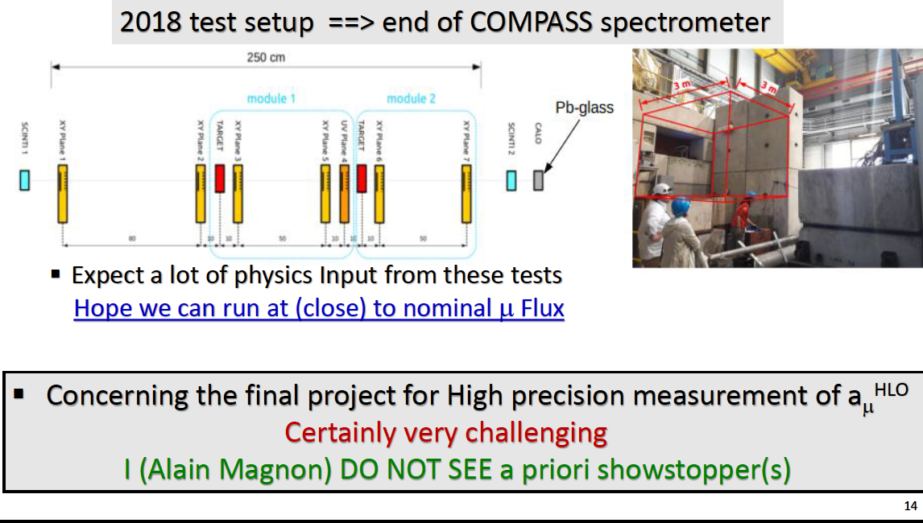
Report of the MUonE PBC CERN referee
(A. Magnon) 2 March 2018

Slide 64
The End
F. Jegelrlehner, April 2018:
https://arxiv.org/pdf/1804.07409.pdf
"Therefore, the very different Euclidean approaches, lattice QCD and the
proposed alternative direct measurements of the hadronic shift ∆α (q²)[79],
in the long term will be indispensable as complementary cross-checks"

Slide 65
Systematics
Effects of Multiple Scattering
Tracking efficiency: uniformity
Tracking positions: angular systematic
Elasticity selection cuts
PID
Signal/Background: dedicated event generator.
Uncertainty in the muon beam momentum:
Scattering kinematics to determine the beam momentum
Theoretical uncertainty on the mu-e cross section
All the systematic effects must be known to ensure an error on the cross section < 10ppm

Slide 66
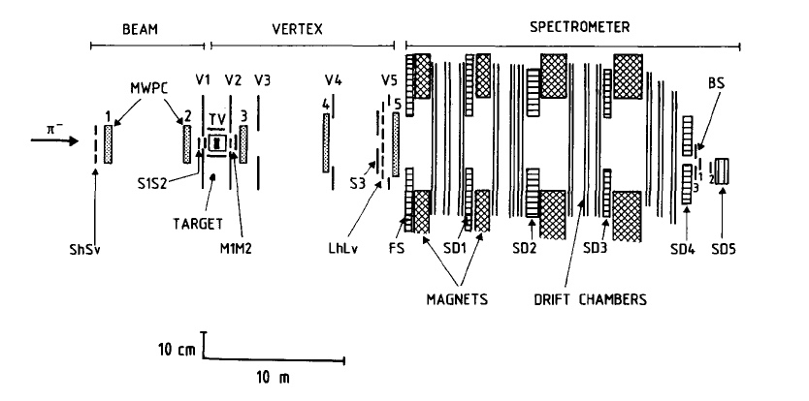

NA7 experiment
A MEASUREMENT OF THE SPACE-LIKE PION ELECTROMAGNETIC FORM FACTOR,
“The pion form factor has been measured in the space-like q² region
0.014 to 0.26 (GeV/c)² by scattering 300 GeV pions from the electrons of a liquid hydrogen target”.
Target: 28 cm liquid Hydrogen
X₀ (liquid H₂) = 890.5 cm
Nuclear Physics B277 (1986) 168-196
“The q² variable for the final sample was determined from the angles alone, up to the kinematic ambiguity which was resolved using the shower detectors. In this procedure the only rejection criterion involving the momenta was a cut against electrons of less than 1 GeV/c”.

Slide 67

LO electrons angular distribution
Beryllium d = 30 mm
10⁸ events
μ + e (rest) → μ + e
LO cross-section
E_{e} > 500 MeV
at the
generator level
electron angle (mrad)

Slide 68

Beryllium d = 10 mm
E0 > 1 GeV
electron angle (mrad)

Slide 69

Modeling the target
Geant4 vs simple model
Bremsstrahlung and following MSC of lower momentum electrons perfectly describe the tails

Slide 70

Effect of the target (Geant)
1 GeV, d = 30 mm
Gaussian core, σ = 3.6 mrad
GEANT4 events
Highland formula (PDG) = 3.593 mrad
Notes:
This plot shows in blue what MSC is according to the PDG compared to GEANT4 for 1GeV electrons and a Beryllium target thickness of 3 cm.
Differences are remarkable.
But he question is how good is Geant in describing MSC?
Unfortunately there are not data to test Geant.
We will have to calibrate Geant.

Slide 71
Work in collaboration with:
G. Abbiendi, C. M. Carloni Calame, R. Calabrese,
D. Galli, F. V. Ignatov, M. Incagli, V. Ivantchenko,
E. Luppi, U. Marconi, C. Matteuzzi, G. Montagna,
O. Nicrosini, M. Passera, C. Patrignani, F. Piccinini,
M. Prest, L. Trentadue, R. Tenchini, E. Vallazza ,
G. Venanzoni
Other people declared their interest.
Students, PhD student, Post Doc
C.Brizzolari, M. Soldani, G.Ballerini,V. Mascagna
L. Pagani, F. Pisani, A. Principe
M. Bonanomi

