Slide 1
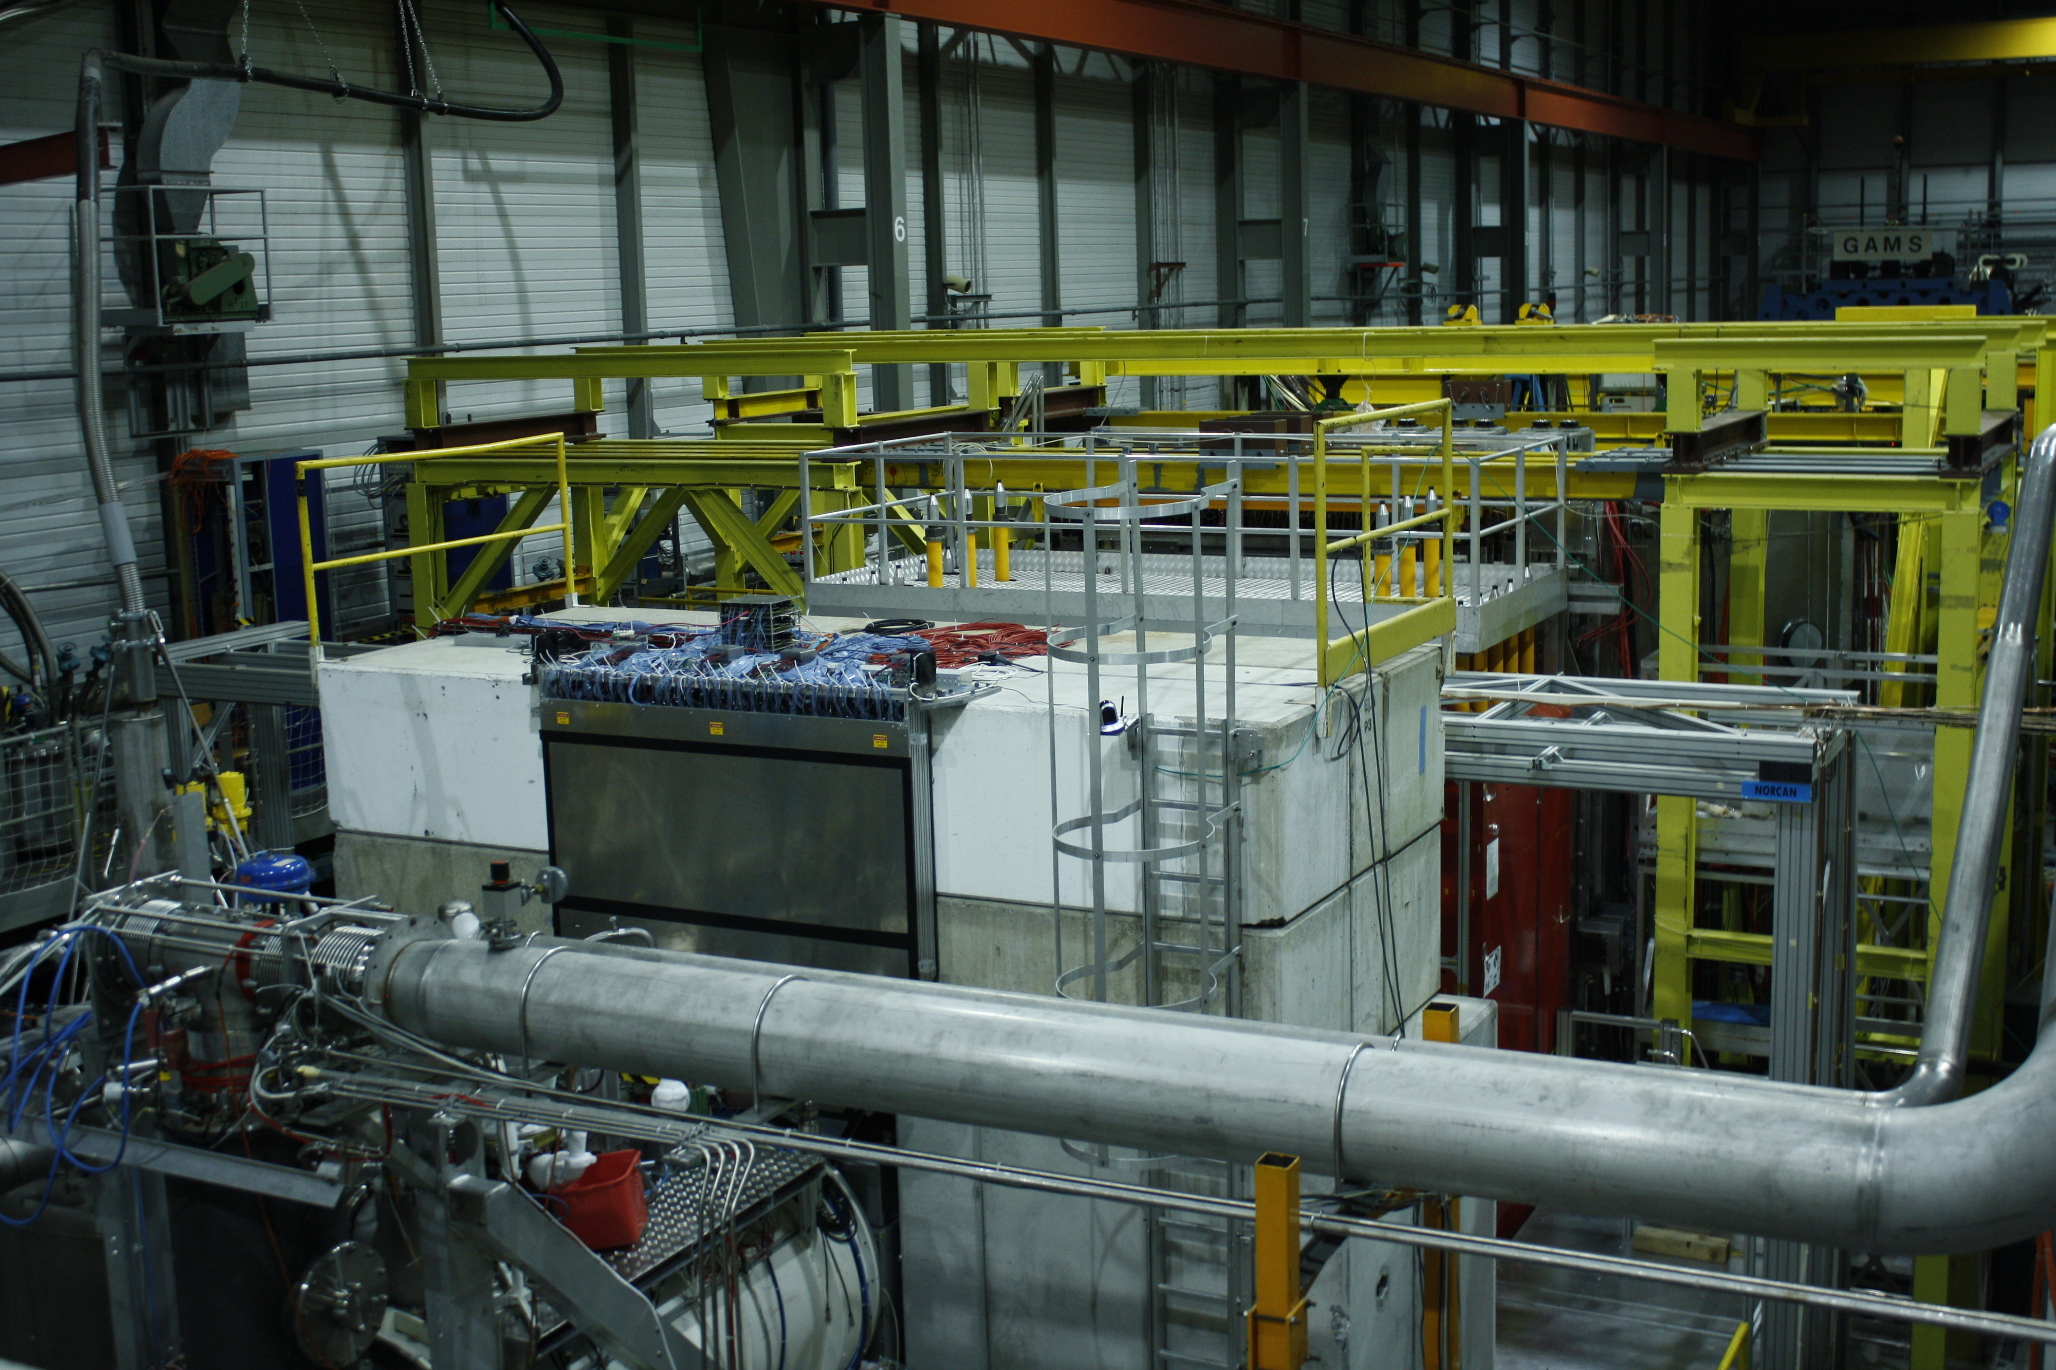
Future Hadron Opportunities
20. November 2018
“COMPASS++”
A New QCD Facility
at the CERN SPS M2 beam line
Proton radius measurement with
high-energy muons
Drell-Yan processes
Antiproton production and annihiliation cross sections
Kaon spectroscopy
Kaon-induced Primakoff processes
…
Jan Friedrich, TU Munich

Slide 2

arXiv:1808.00848
Proton radius measurement using muon-proton elastic scattering
Hard exclusive reactions using a muon beam and a transversely polarised target
Drell-Yan and charmonium production
Measurement of antiproton production cross sections for Dark Matter Search
Spectroscopy with low-energy antiprotons
Spectroscopy of kaons
Study of the gluon distribution in the kaon via prompt-photon production
Low-energy tests of QCD using Primakoff reactions
Production of vector mesons and excited kaons off nuclei

Slide 3
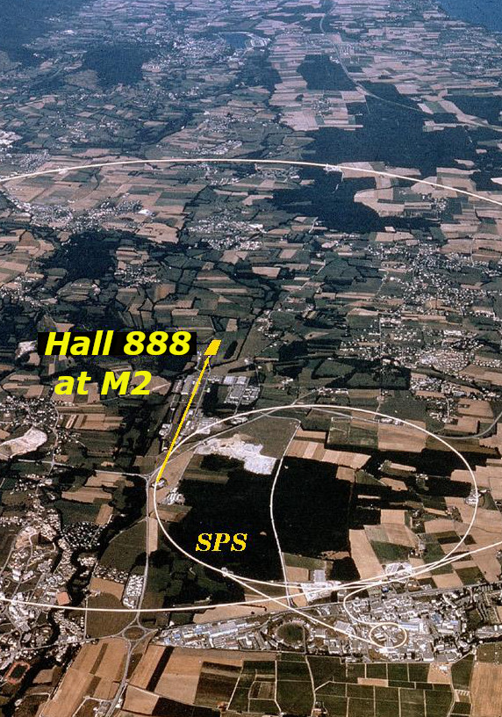
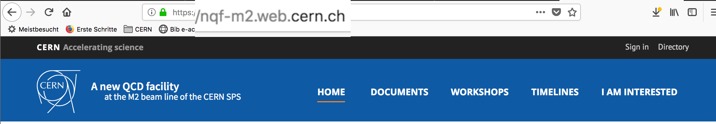
Letter of Intent for a
New QCD Facility at CERN
The M2 beam line of the CERN SPS
has been built to deliver high-intensity
muon beams to experiments in hall 888:
EMC (1973), NMC, SMC, COMPASS
(also „conventional“ hadron beams)
Idea for a follow-up apparatus: Letter of Intent
not a single experiment but a
facility that bundles the needs of several campaigns into a common effort

Slide 4
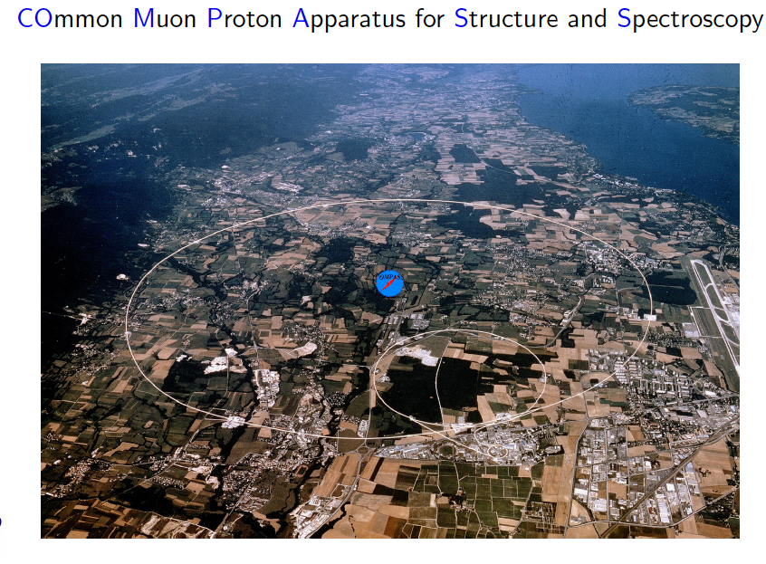
COMPASS QCD facility at CERN (SPS)
~210 physicists, 12 countries + CERN, 24 institutions
approved in 1997, running since 2002
huge scientific output
approved beam time 2021 (completion of program)
affected by ageing

Slide 5
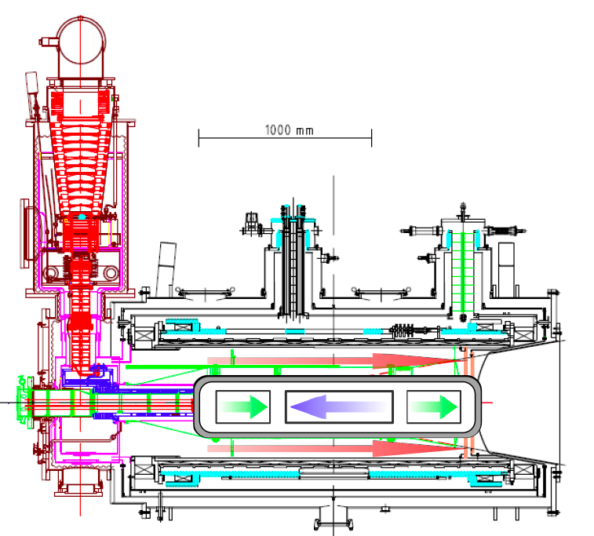
Reminder
Versatile apparatus to investigate QCD:
Two-stage COMPASS Spectrometer
Muon, electron and hadron beams with
momenta 20-250 GeV and intensities
up to 10⁸ particles per second
Solid-state polarised (NH₃ or ⁶LiD), liquid hydrogen and nuclear targets
Powerful tracking (350 planes) and PID systems (Muon Walls, Calorimeters, RICH)

Slide 6
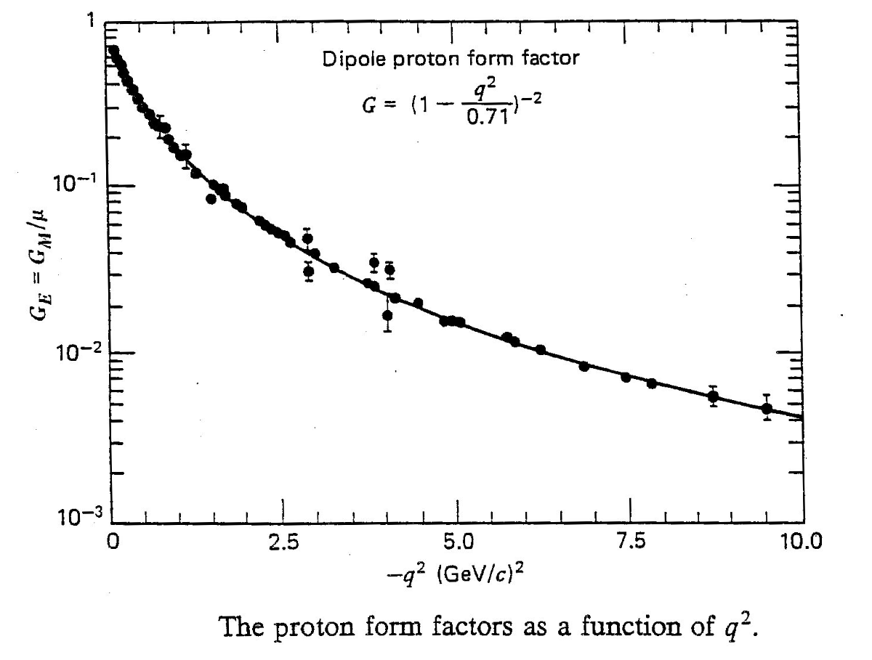
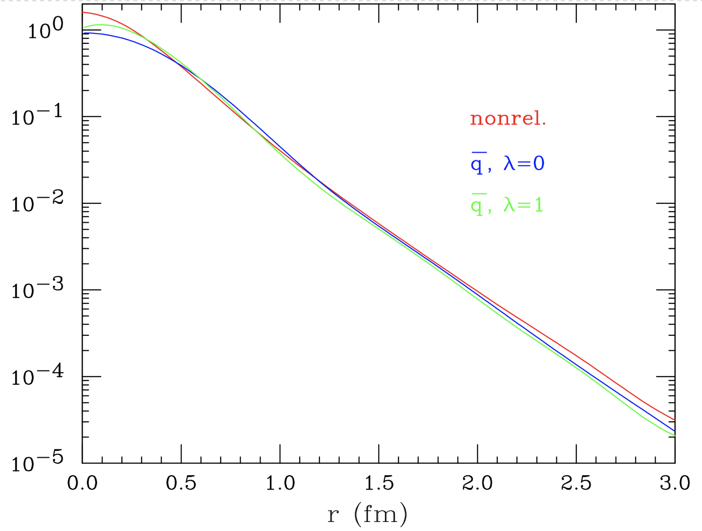
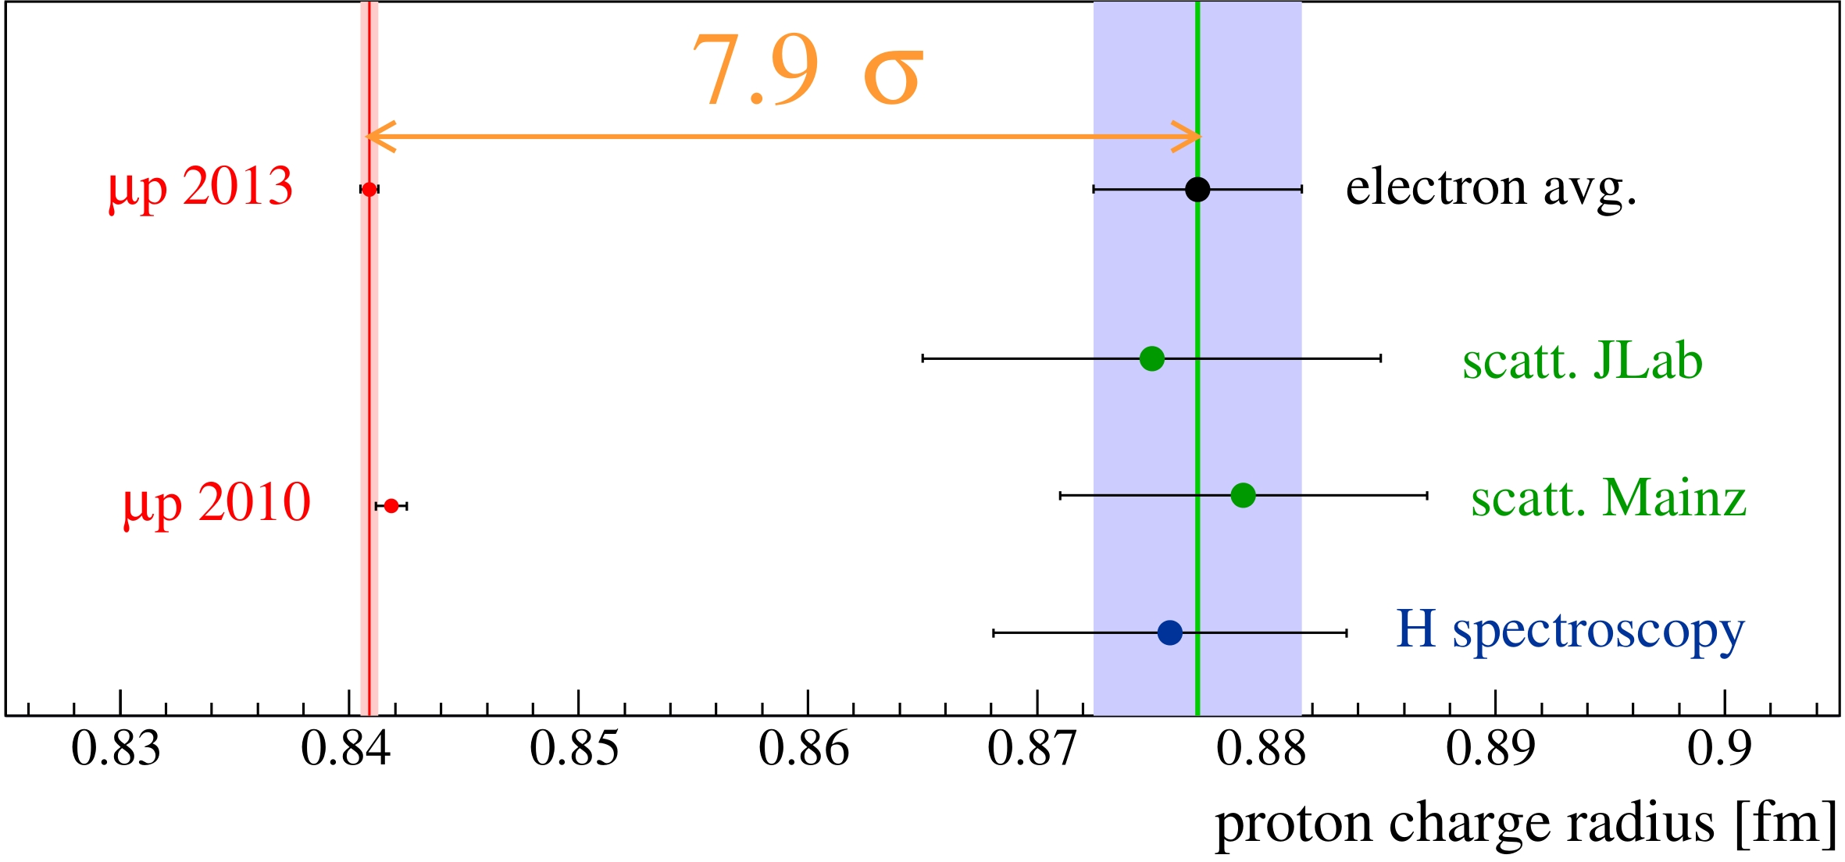
Proton radius and form factors
← Fourier → transform
I. Sick 2006
The proton form factors are measured in elastic lepton-proton scattering.
The finite-size effect also enters in the splitting of (exotic) atom levels measured in laser spectroscopy
Proton radius puzzle:
without H spectroscopy ~5σ

Slide 7
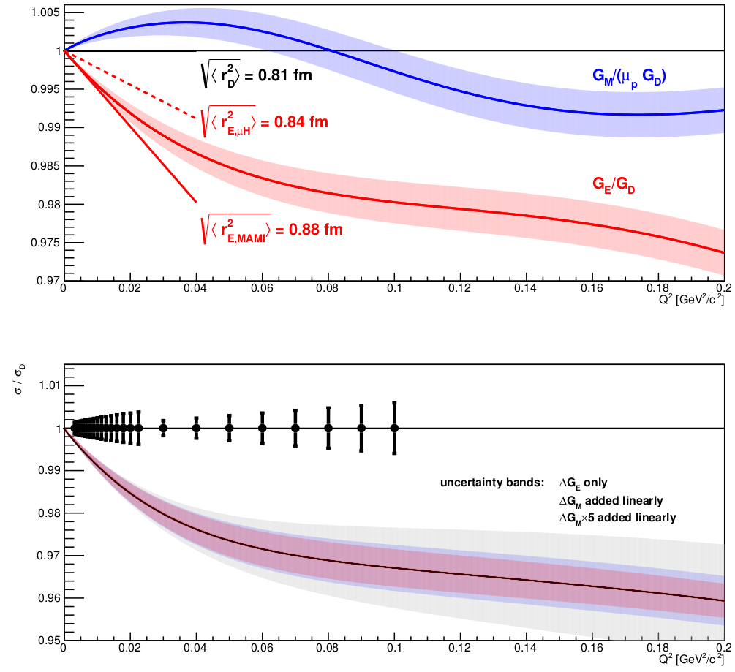
Proton radius:
Discrepancy in terms of form factor slope

Slide 8
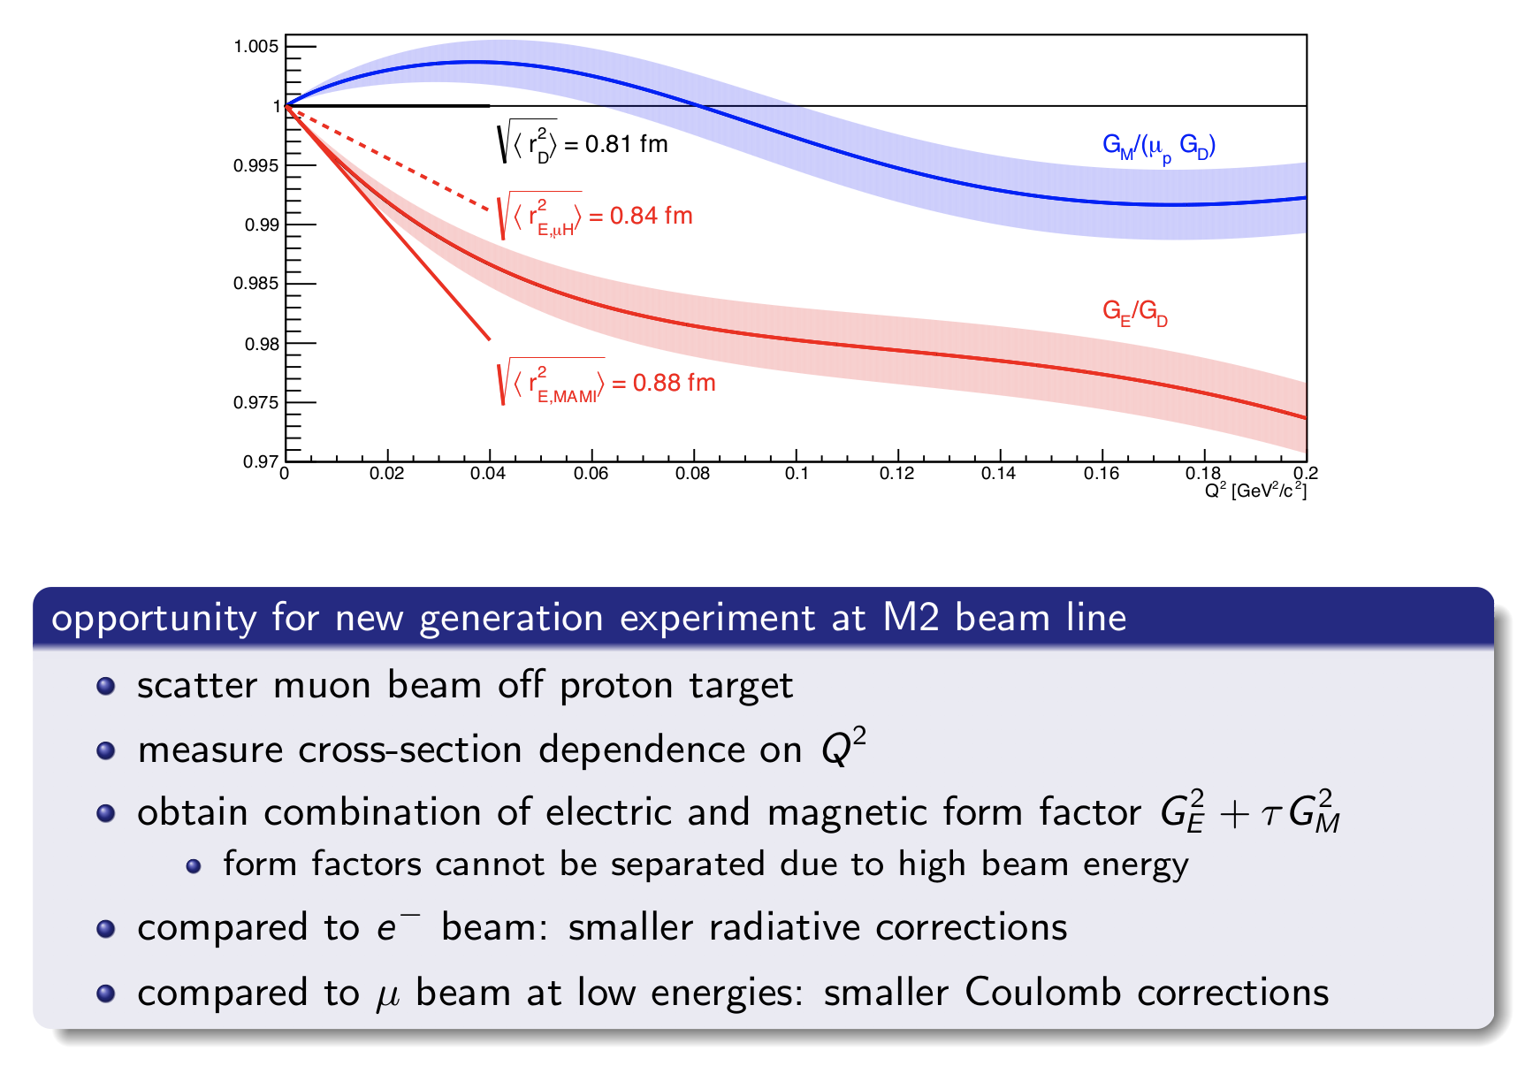
Why high-energy muons?

Slide 9
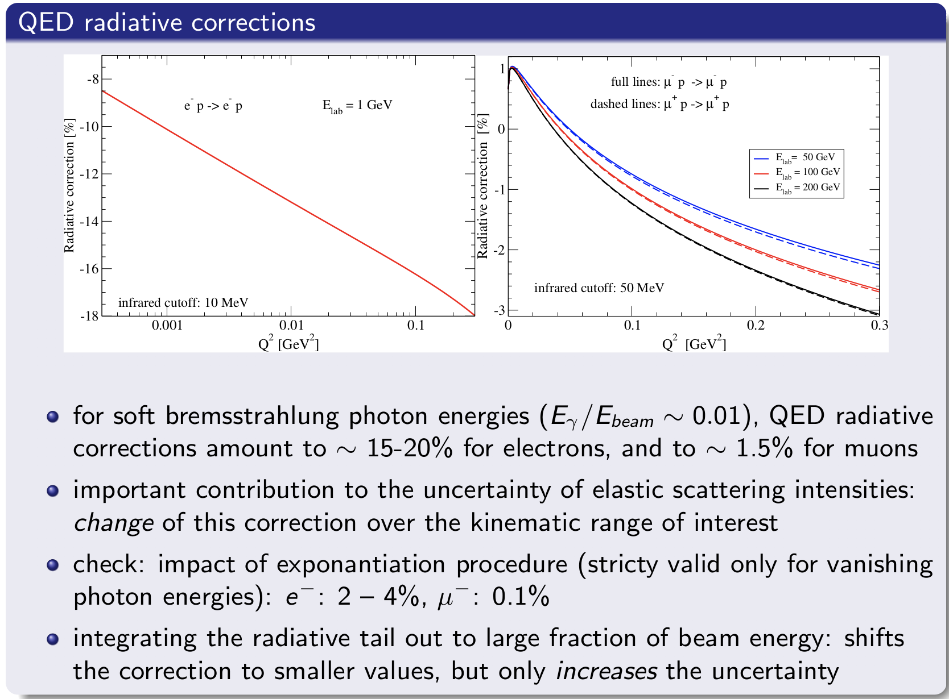
Why high-energy muons?

Slide 10
Other topics with „conventional beams“
muon beams
  proton radius: high-pressure TPC
  DVCS on a transversely polarized target: recoil (silicon) detector to be inserted in the cold volume of the target magnet → preparational for EIC?
hadron beams
  Drell-Yan and charmonium production with π⁻, Κ⁻, p-bar and the π⁺ , Κ⁺, p beams
  antiproton production through p beam
  antiproton spectroscopy: lower-energetic (<20GeV) negative beam contains large fraction of antiprotons: p-bar annihiliation can be used for X,Y,Z spectroscopy at luminosity 10³⁰ cm⁻² s⁻¹ → preparational step for PANDA?

Slide 11
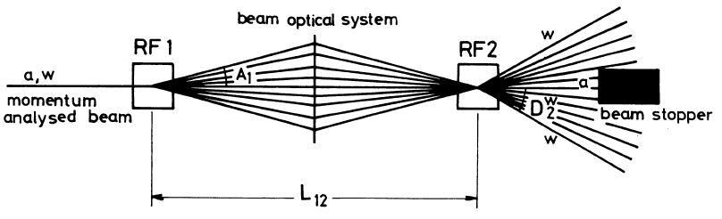
A new beamline: radio-frequency separation of hadron beams
Reminder: Panofsky-Schnell-System with two cavities (CERN 68-29)
Particle species: same momenta but different velocities
Time-dependent transverse kick by RF cavities in dipole mode
RF1 kick compensated or amplified by RF2
Selection of particle species by selection of phase difference
ΔΦ = 2π (L f / c) (β₁⁻¹ – β₂⁻¹)
For large momenta: β₁⁻¹ – β₂⁻¹ = (m₁²-m₂²)/2p²

Slide 12
Physics with RF-separated K beams
Drell-Yan process with kaons: partonic structure of K
Kaonic excitation spectrum in diffractive dissociation of a kaon beam

Slide 13

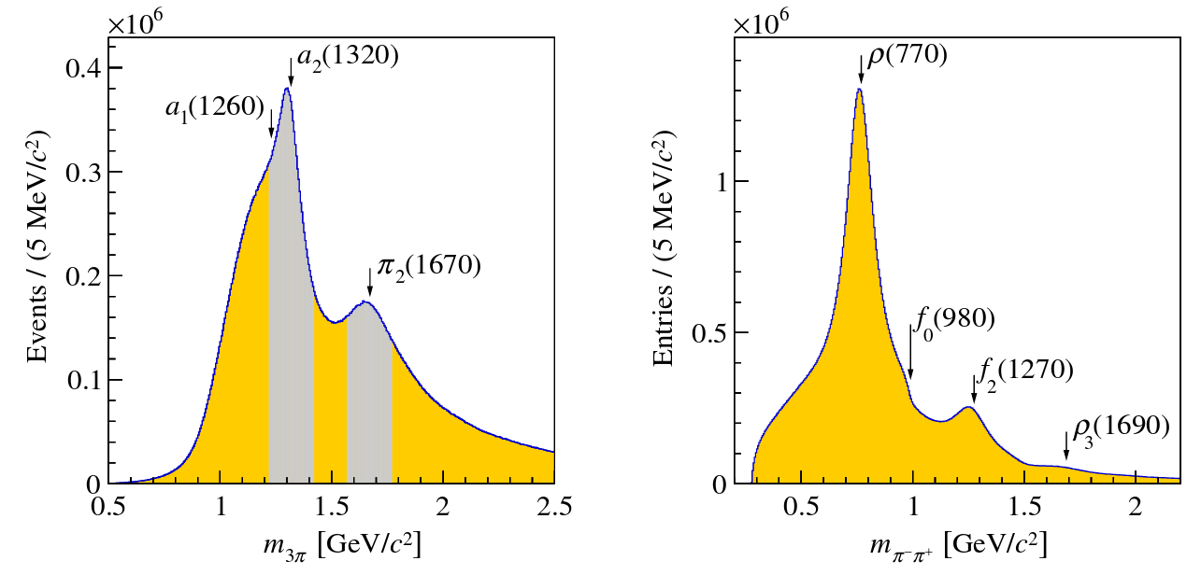
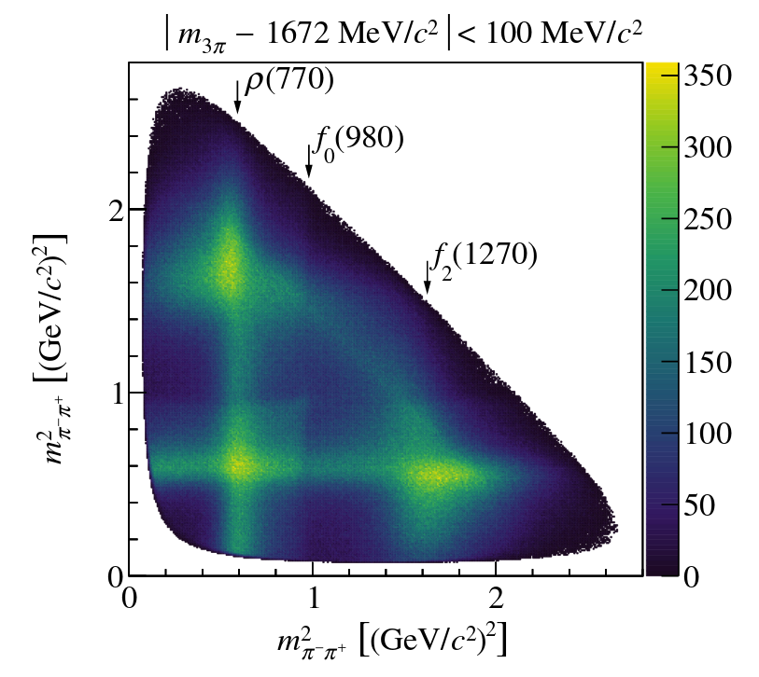
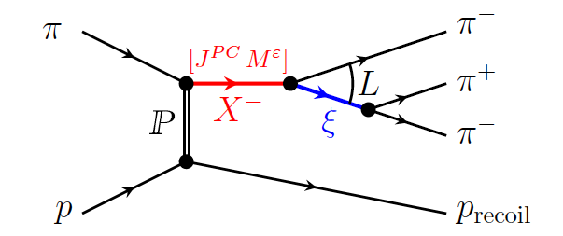
Blueprint for spectroscopy with kaon beam:
COMPASS main results with pion beam
published in 2017: PRD 59 pages
2008-2009 data taking, 190 GeV/c
hadron beam on a hydrogen target
3π data sample ~50 million events
10x to 100x previous experiments
allows for fine binning in masses and
momentum transfer
partial-wave analysis in 3π-mass slices,
detailed understanding of the 2π-isobars

Slide 14
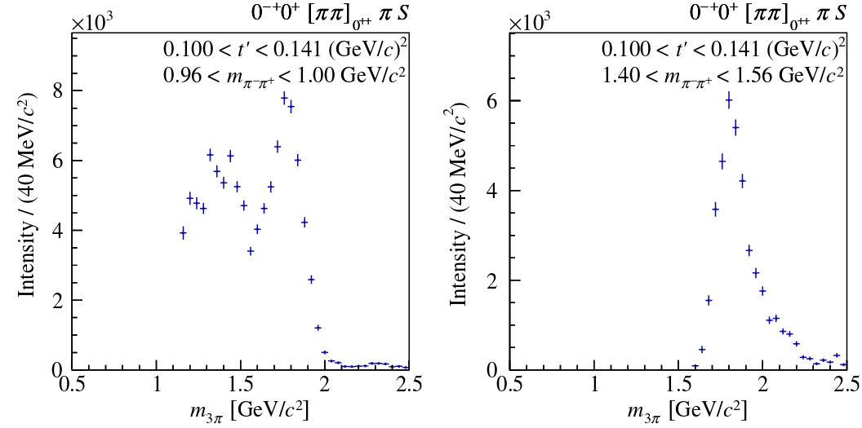
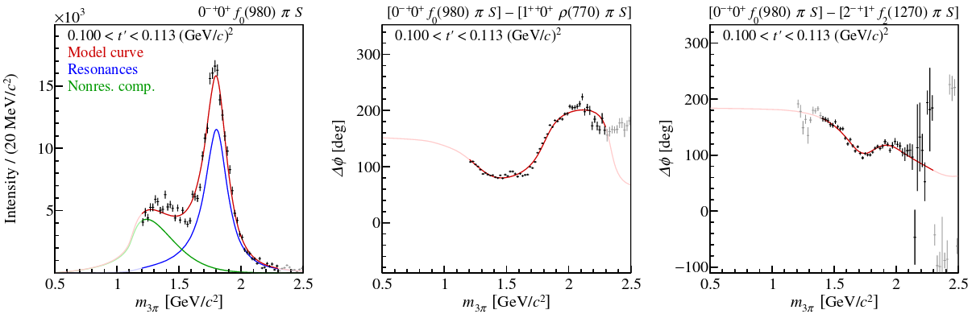
Physics with hadron beams: meson spectroscopy main results
example: partial wave for π(1800)
investigation of 2π isobar structure reveals contributions from f₀(980) and f₀(1500)
recently accepted: paper on partial-wave fits including 3π resonances,
PRD 75 pages

Slide 15
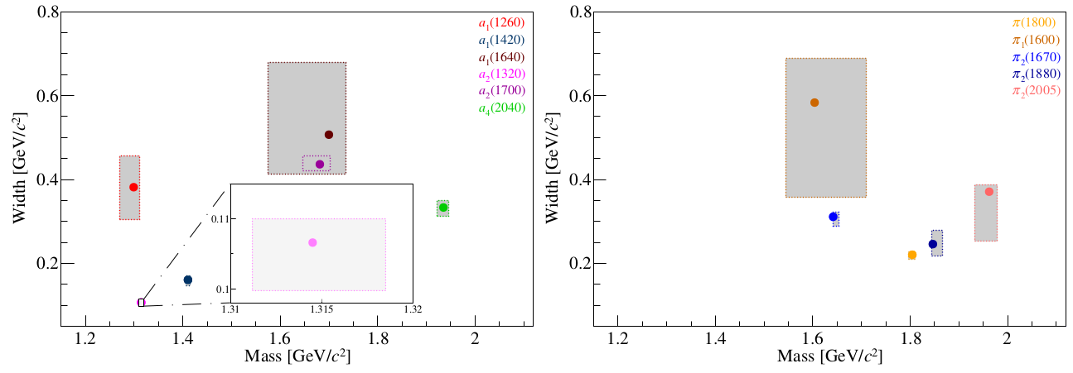
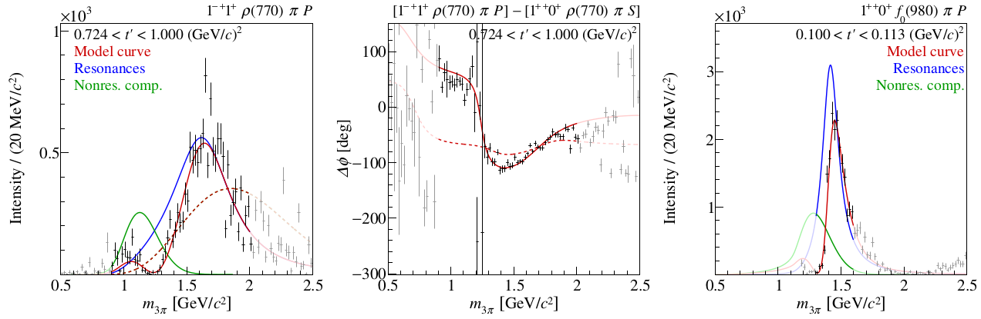
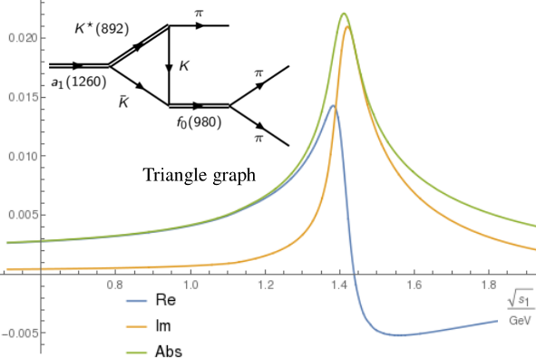
Physics with hadron beams: meson spectroscopy main results
resonance parameters with unprecedented precision and systematic investigations:
6 a-like and 5 π-like states
broad spin-exotic π₁(1600)
further investigations of the a₁(1420) found by COMPASS: triangle amplitude consistent with Breit-Wigner

Slide 16
Kaon excitation spectrum
25 kaon states listed by PDG (<3.1GeV), 13 of those need confirmation
many predicted quark-model states still missing
some hints for supernumerous states

Slide 17
New data with RF-separated K beam
Kaon content of negatively charged 190 GeV hadron beam: 2% (pions 97%), currently at COMPASS allowed 10⁵ K/s
Intensity can be increased by factor 10 if beam is RF-separated
corresponds to > 10⁷ K⁻ π⁺ π⁻ events, approx. 10x world data
Competition: J-PARC K⁻ beams (2-10 GeV → more complicated production mechanism, smaller CM energy), GlueX at Jlab (K_{L} beam, main focus hyperon spectroscopy, Phase IV photon beams, kaon excitations in subsystems, difficult analysis), τ lepton decays at BESIII, Belle2, LHCb
needed (upgraded) detector components: CEDAR detectors (beam PID) with increased stability and rate capability, improved target proton recoil detector, final-state PID: RICH detector covers the range10-50 GeV, add RICH0 for smaller momenta?

Slide 18
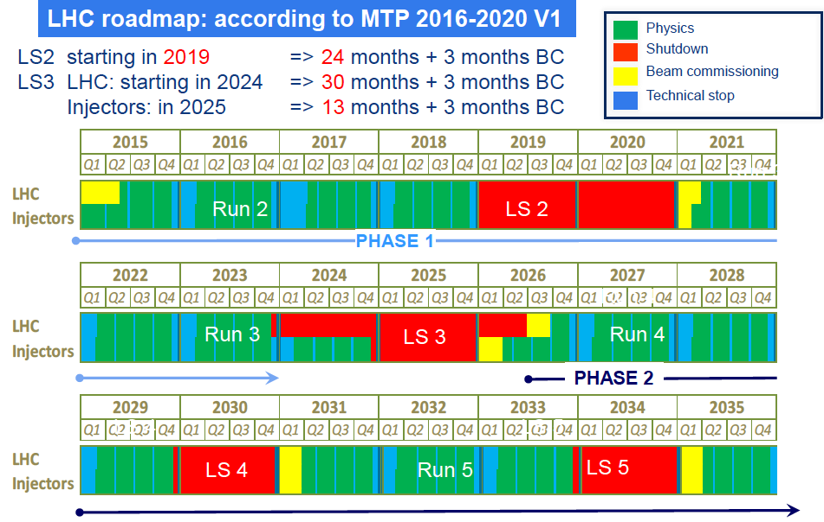
Timelines
conventional-beams program: 2022-2024
RF-separated beams: from 2026 on

Slide 19
Summary of Physics at a Future QCD facility at the SPS M2 beamline

Slide 20
Thank you!

Slide 21
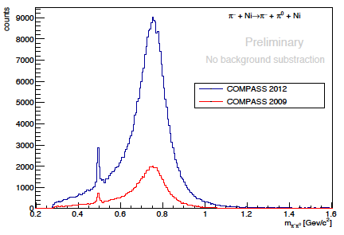
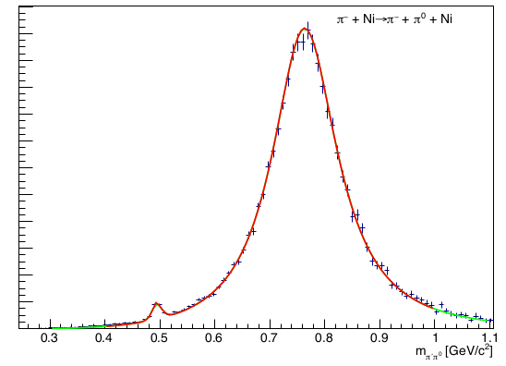
Measurement of chiral dynamics in reactions π⁻ γ^{(*)} ➔ π⁻ (nπ)
Primakoff data samples:
π⁻ -nucleus scattering at lowest momentum transfers ➔ π⁻γ reactions
π⁻ π⁰ final state: low-energy part dominated by the chiral anomaly
(shown last year)
Analysis progress: background subtraction (π⁻ π⁰ π⁰)
fit to theory (M. Hoferichter et al, 2012)
under investigation: luminosity determination

Slide 22
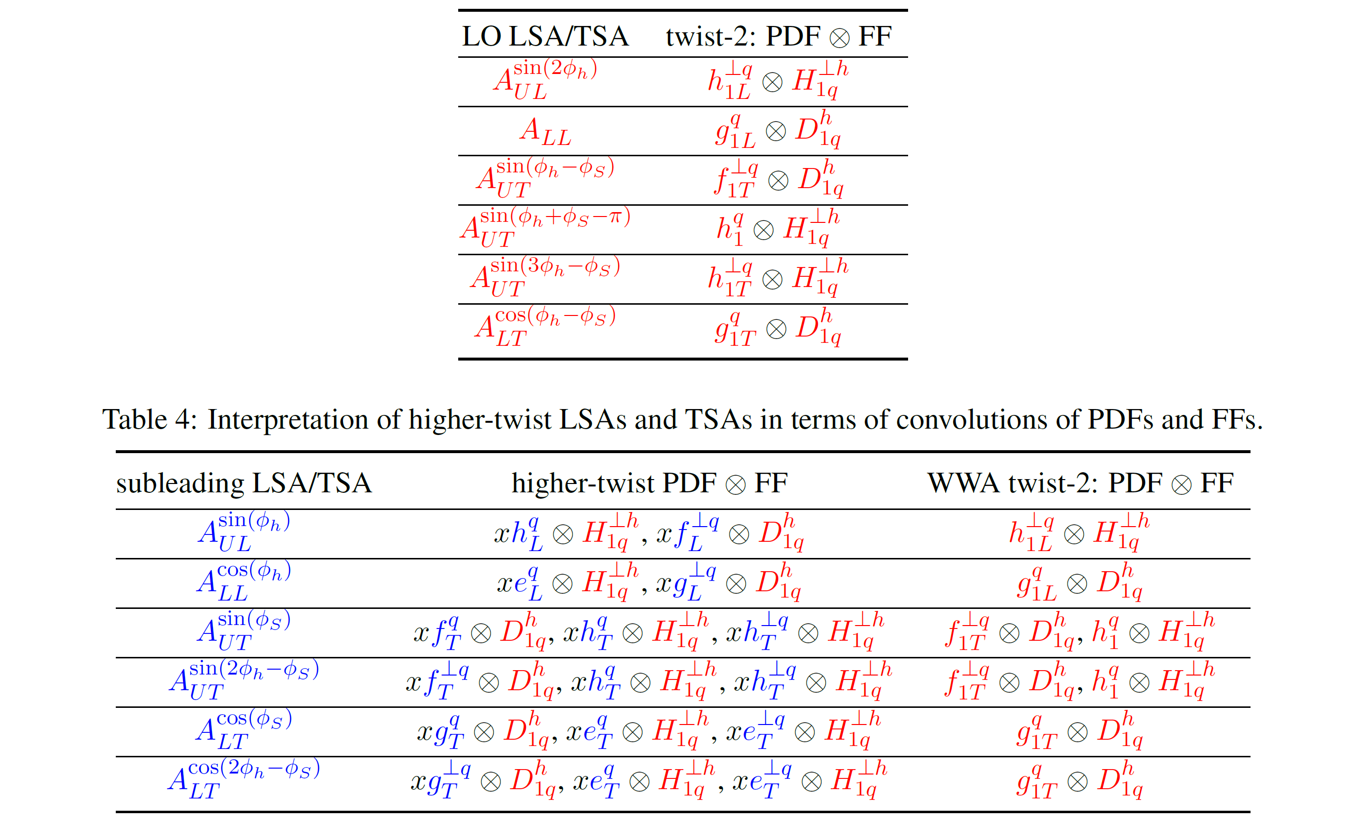
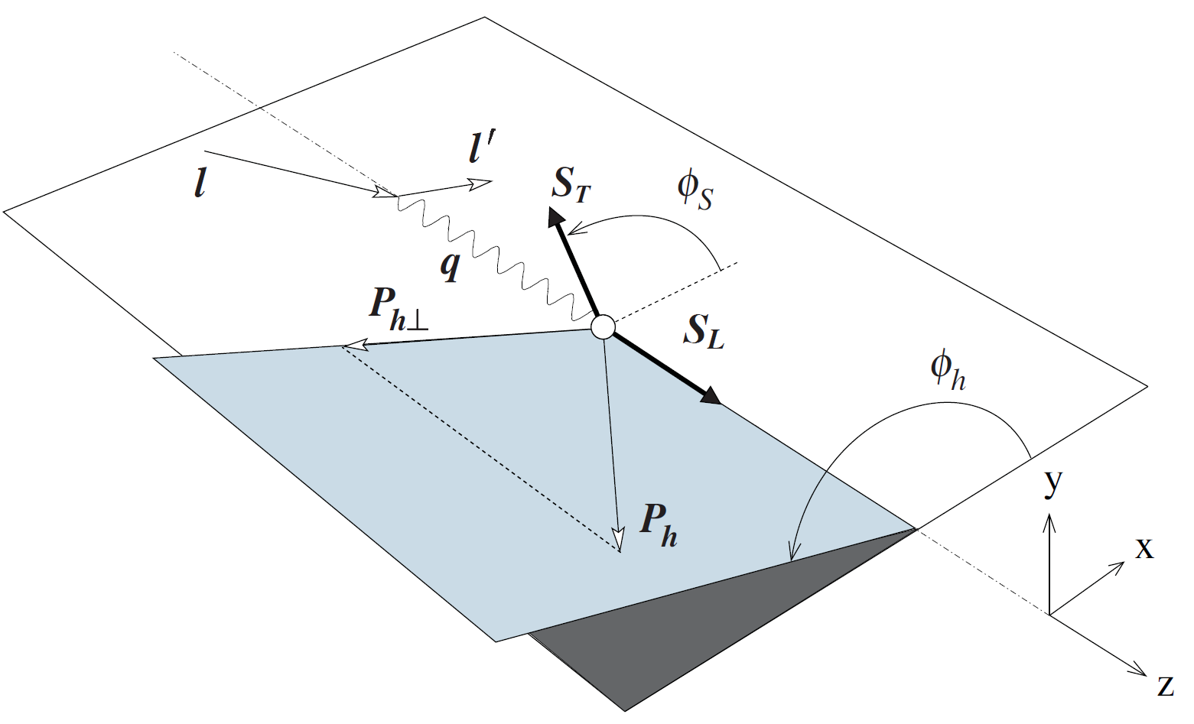
SIDIS transverse & longitudinal
l'
We continue to scrutinize polarised SIDIS data by studying various target-spin-dependent azimuthal asymmetries.
The general expression for polarised SIDIS cross-section contains 6 LO and 6 sub-leading asymmetries
h
l
γ*
FF
PDF
X

Slide 23
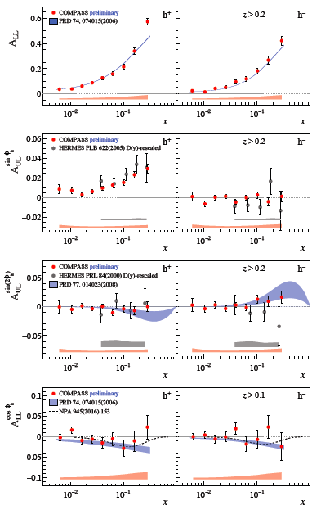
SIDIS longitudinal longitudinal target-spin-dependent asymmetries (LSA)
final results for the longitudinally polarised proton target (2007 and 2011 Runs).
error bars: statistical uncertainties
systematic uncertainties indicated by colour bands
compared to the similar studies presented by HERMES and CLAS, our results are characterised by an unprecedented precision, covering a much wider kinematic range

Slide 24
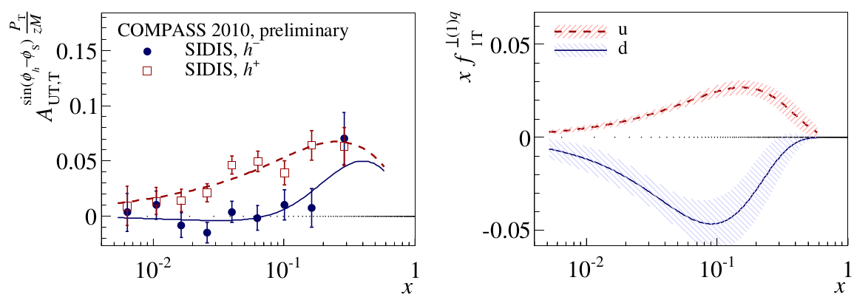


SIDIS transverse
New approach continued: weighted asymmetries
Important: large statistics, good acceptance.
Allows to extract first moment of Sivers
Work in progress:
analogous analysis for weight P_{T}/M

Slide 25
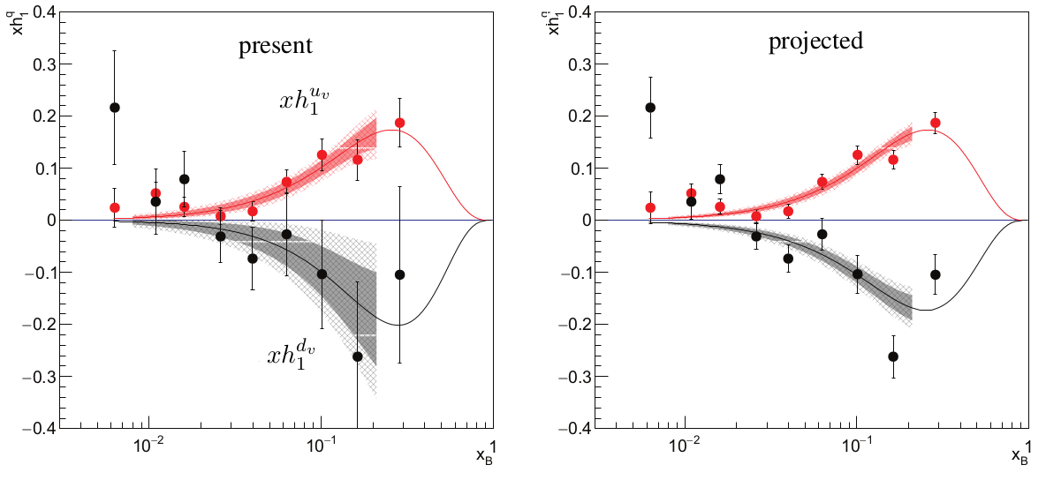
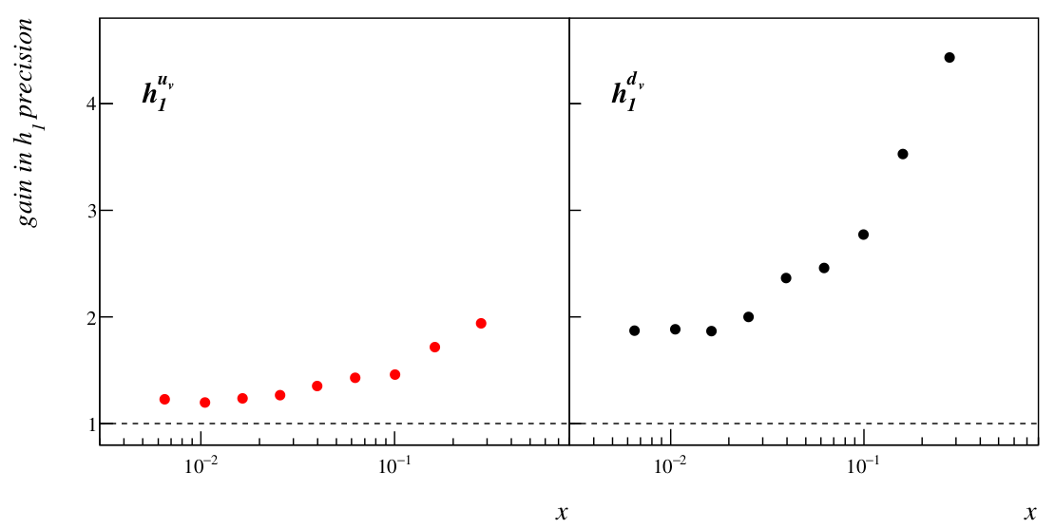
SIDIS transverse
Proposal for 2021: transverse-deuteron run
For a precise determination of the Collins functions for u and d, COMPASS is currently lacking an adequate data set with transversely polarised deuteron target.
recently recommended by SPSC for approval

Slide 26
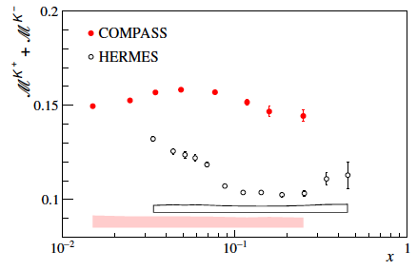
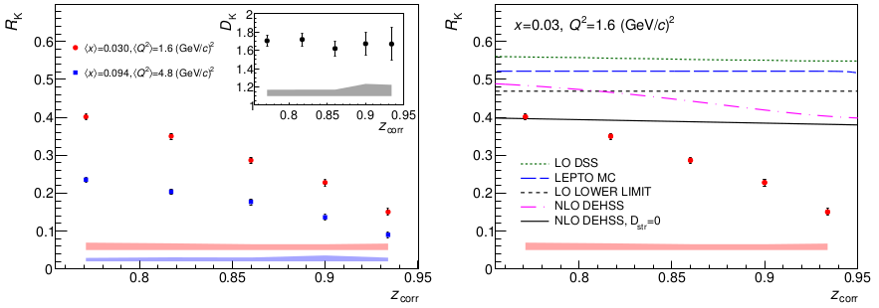
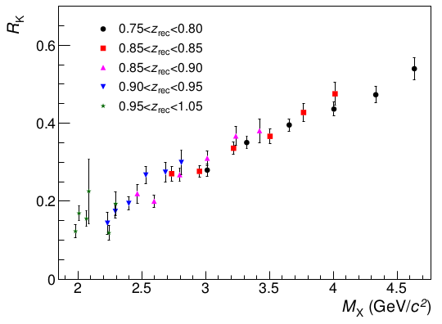
SIDIS (kaon) multiplicities
Charged kaon multiplicities (2006 160 GeV ⁶LiD) – published in PLB 767 (2017) 133
The 3-dimensional data set (x, y and z) ➔ important input for NLO pQCD analyses
of the world data in terms of FFs.
HERMES and COMPASS data are in tension
Can not be explained only by the different Q² range
results on the kaon multiplicity ratio K⁻/K⁺, at high z, 0.75 < z < 1: our data go far beyond the LO upper boundary value of (u+d)/(ū+đ) calculated at x=0.03 using MSTW08L as well as beyond the actual predictions of the ratio using Lund model or LO DSS fit. Recent finding: dependence on M_{X}

Slide 27
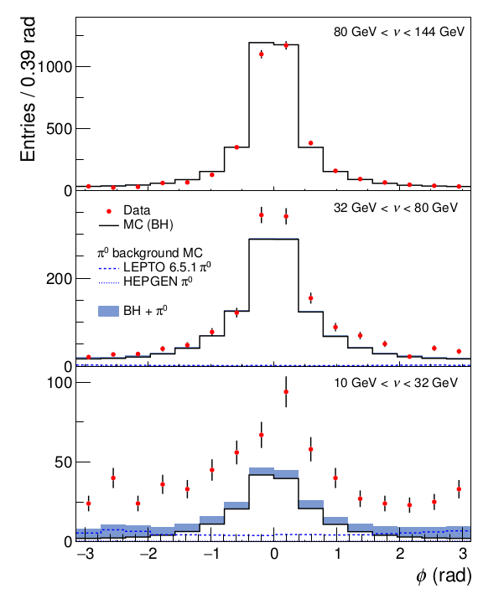

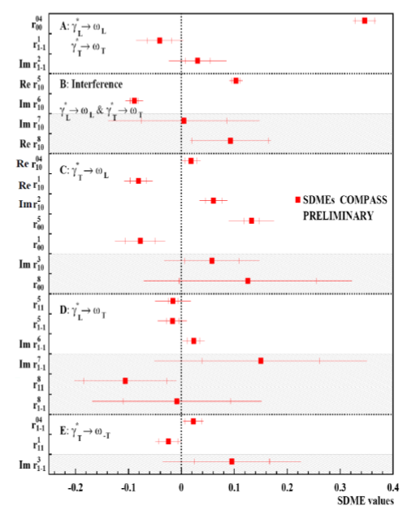
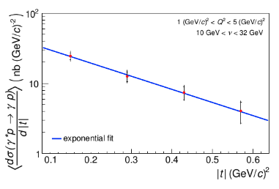
Generalised Parton Distributions – analysis of 2012 data
average transverse extension of partons in the proton probed by DVCS (subm. PRL):
SDME via exclusive ω production:

Slide 28
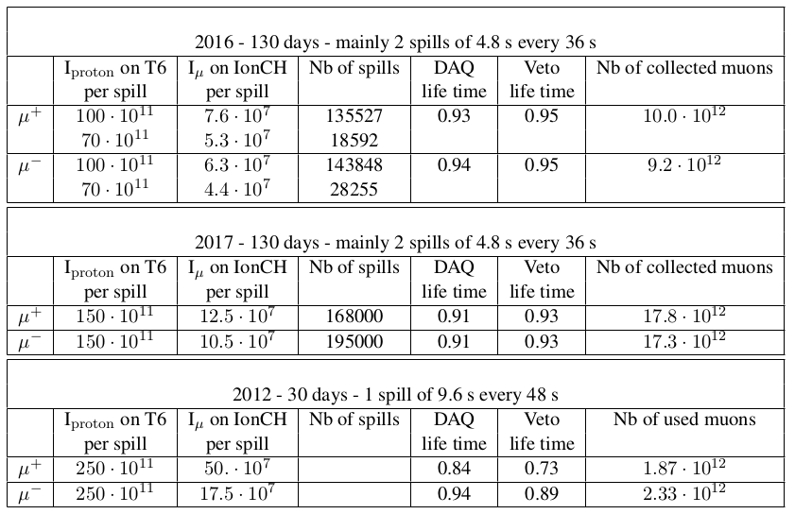
Deeply Virtual Compton Scattering – achieved statistics in 2012 and 2016/17
Assuming data quality in 2016/17 with 80% “good spills”, we collected
in 2016/17 about a factor of 10 more statistics compared to 2012

Slide 29
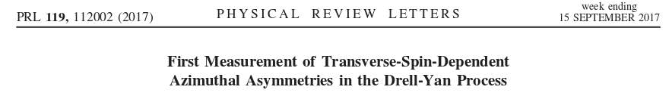
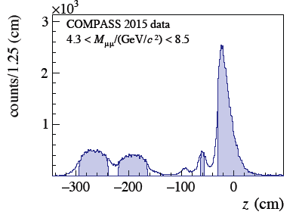
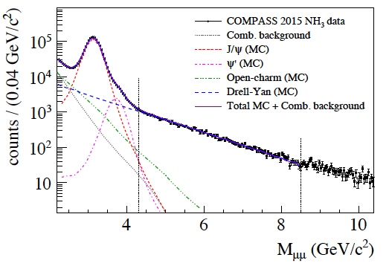
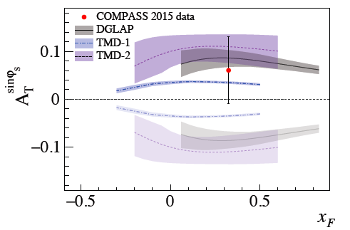
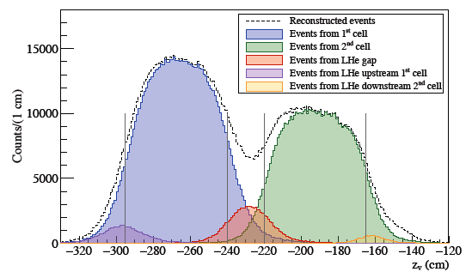
COMPASS Drell-Yan Run 2015 results
Total number of J/ψ (NH₃) is ~ 1.500.000
Total number of HM DY (4.3 GeV/c^{2 <} M_{μμ} < 8.5 GeV/ c² ) (NH₃) is ~35.000

Slide 30
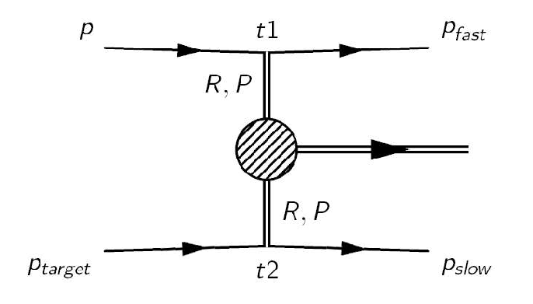
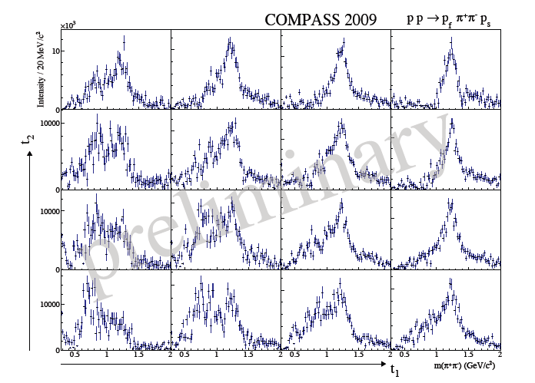
Central production II
Central production, 2008 and 2009 data.
t₁ t₂ bins, D-wave.
Interestingly, the f₂(1270) signal in the D wave shows a very similar behaviour, which puts strong doubts on the common belief that the f₂ (1270) is produced copiously in double-Pomeron processes.

Slide 31
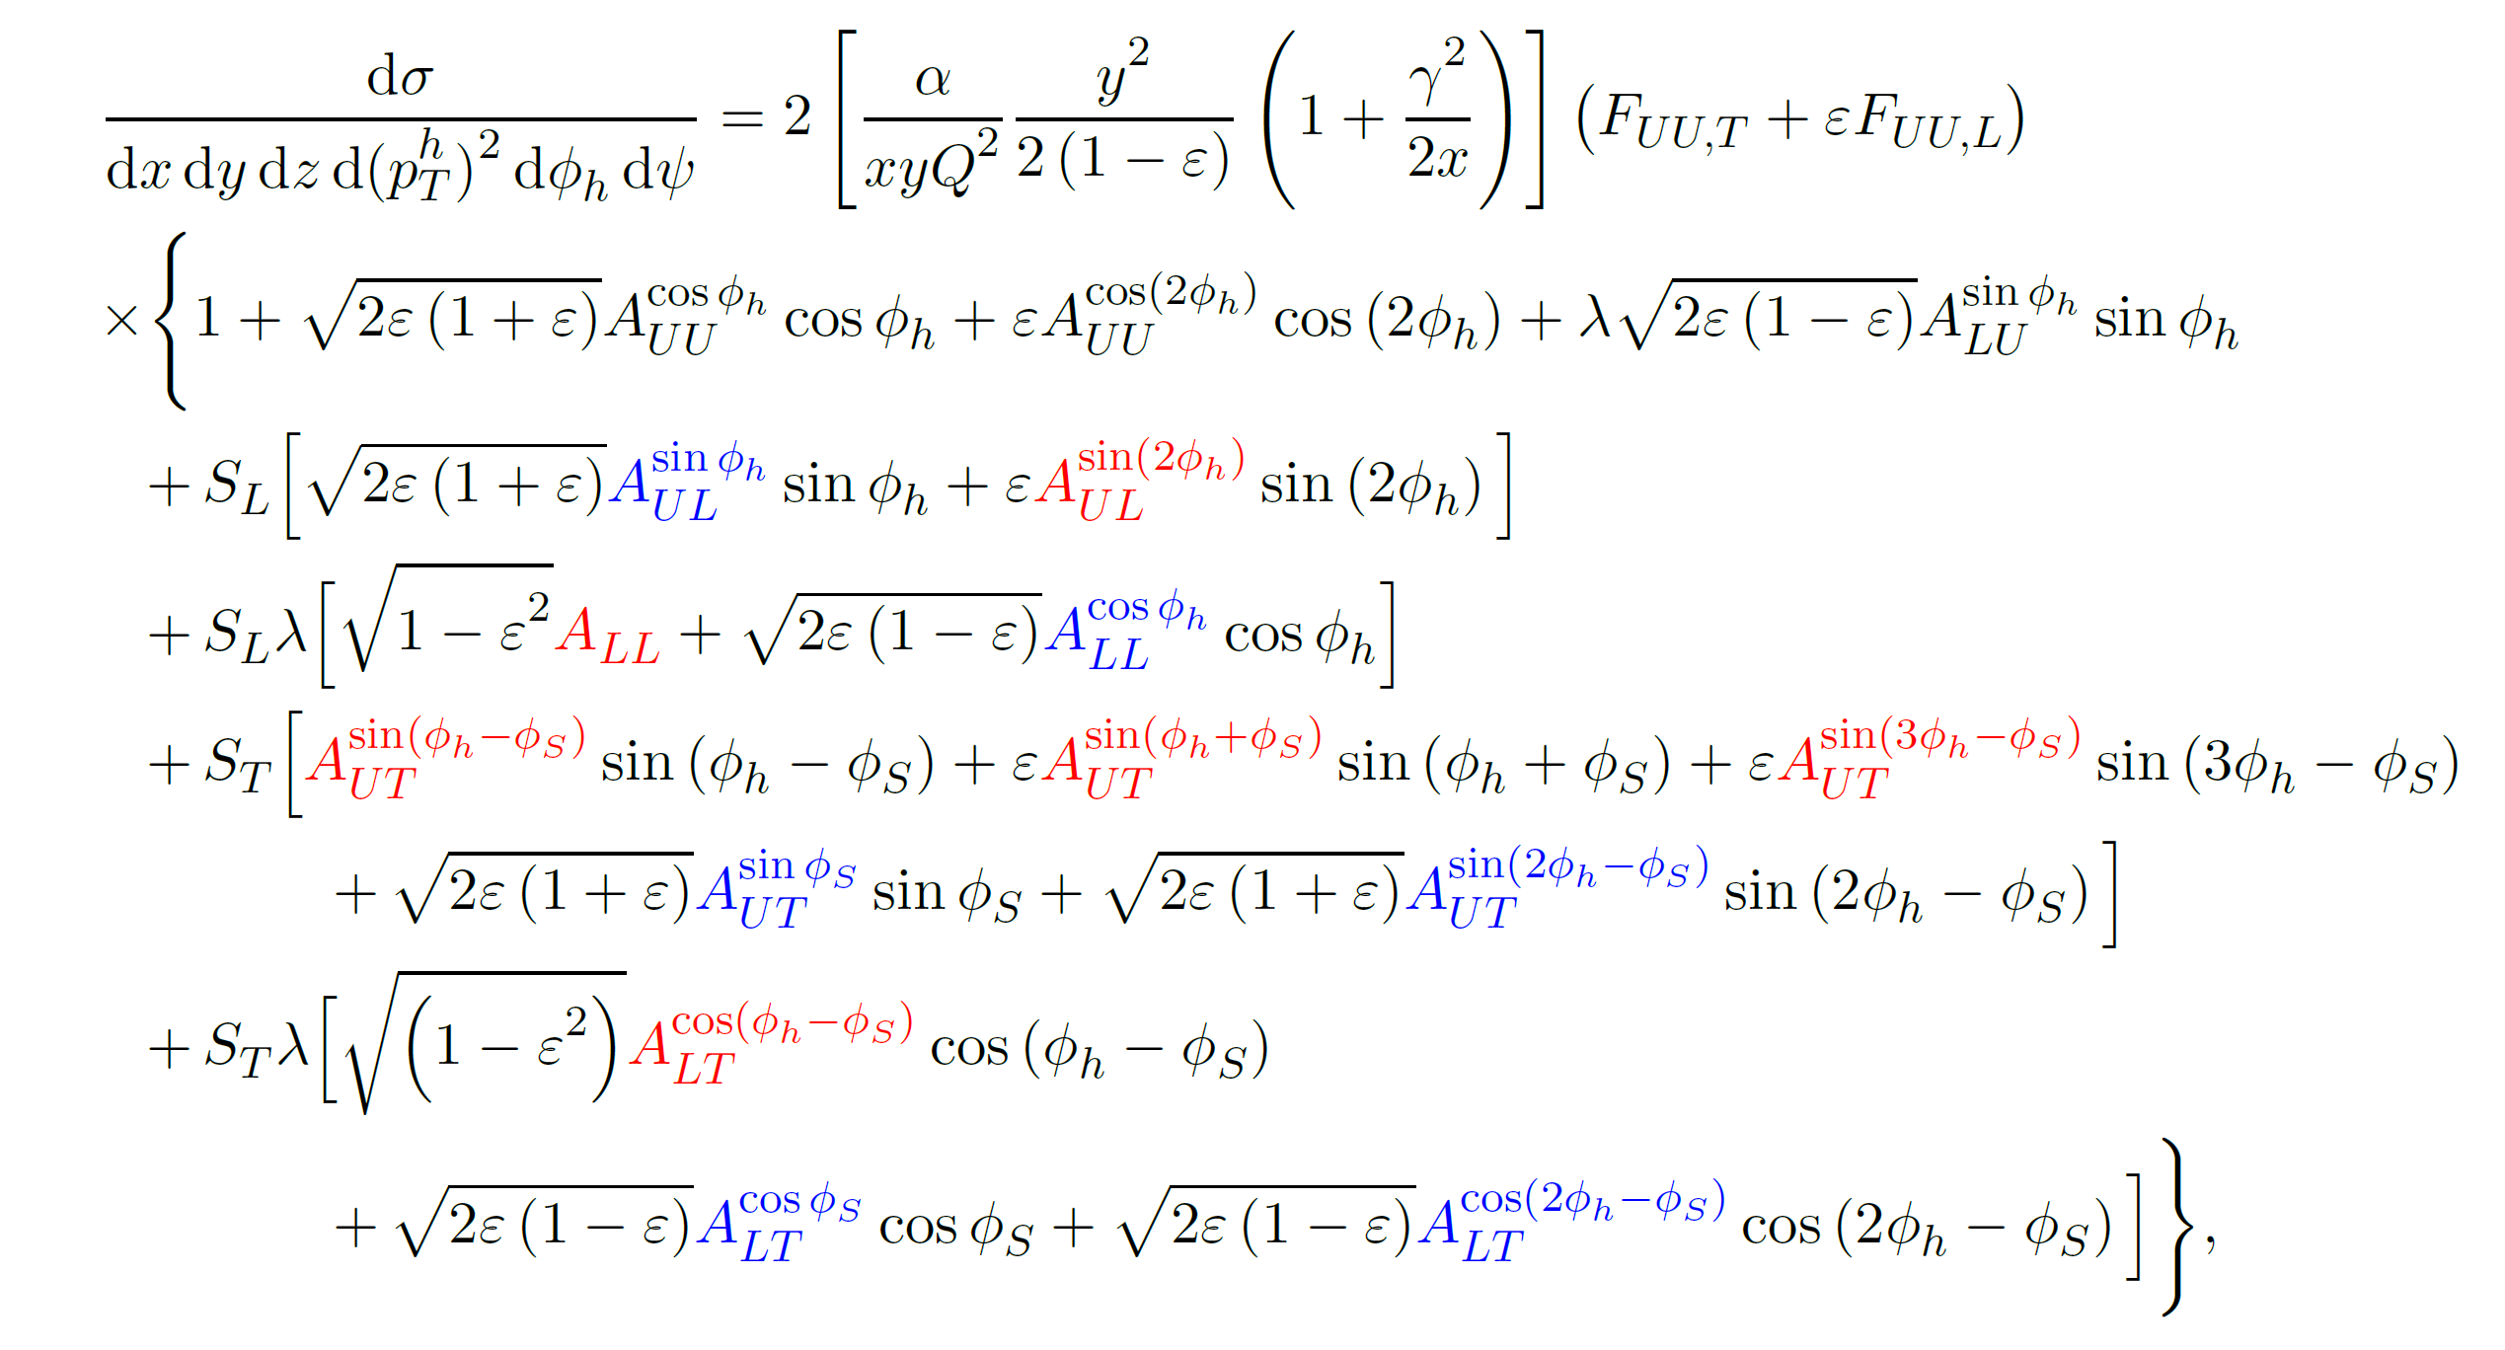
SIDIS transverse&longitudinal I
l'
We continue to scrutinize polarised SIDIS data by studying various target spin-dependent azimuthal asymmetries.
General expression for SIDIS cross-section in terms of asym.:
h
l
γ*
FF
PDF
X

Slide 32
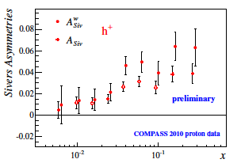
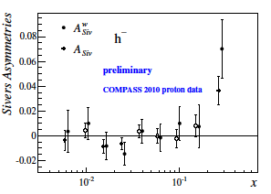
SIDIS transverse
New approach continued: weighted asymmetries
Asymmetries obtained by weighting the
spin-dependent part of the cross-section with
powers of p^{h}_{T}.
Main advantage - convolution integrals
becomes products ➔ no parametrization
of the unknown transverse momentum
dependence of PDFs and FFs is needed.
Important: large statistics, good acceptance.
Allows to extract first moment of Sivers
This is a first data on p^{h}_{T} weighted Sivers
asymmetry

Slide 33
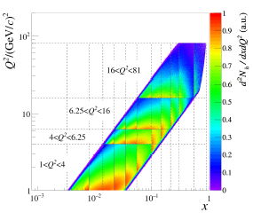
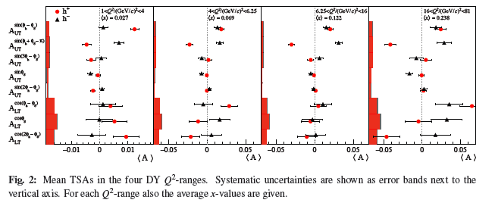
SIDIS transverse
Sivers and TSA in the Drell-Yan Q² bins
Sivers TMD PDF has a very particular feature - it contributes with opposite sign to SIDIS and DY. It is considered to be an essential prediction of Quantum Chromodynamics (QCD) going to be tested by COMPASS. If Sivers function comparison SIDIS⬅➔ DY is done at the same Q² we drop the uncertainties from the unknown QCD evolution of the Sivers TMD.

Slide 34
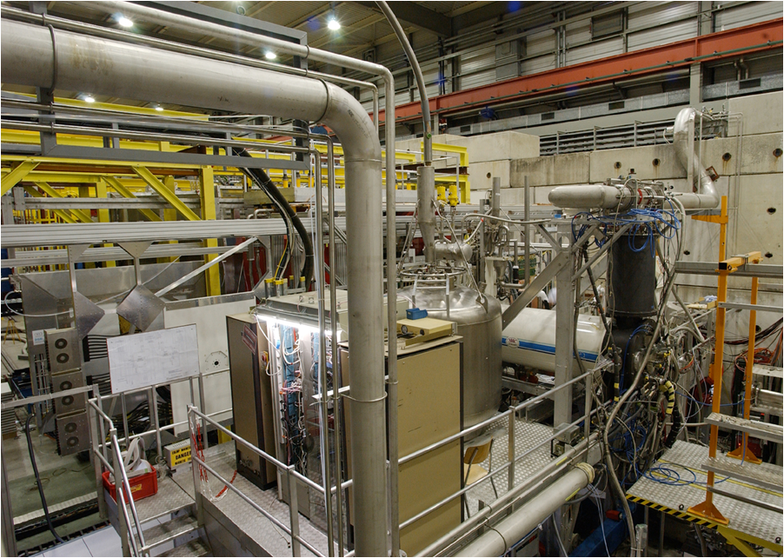
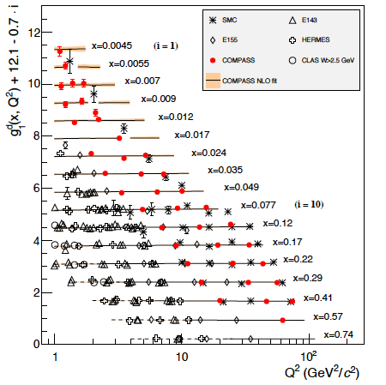

(SI)DIS longitudinal I – Final results
Deuteron g₁^{d} Q²>1
Published the final COMPASS result for double spin asymmetry A₁^{d} and longitudinal spin structure function g₁^{d} (deuteron data set 2002-2004, 2006) PLB 769 (2017) 034.
Together with the results on the proton spin structure function g₁^{p} , these results constitute the COMPASS legacy on the measurements of the g₁ structure function.
All Deuteron data Δg/g final result
EPJC 77 (2017) 209

Slide 35

Physics Case:
Quantum Chromodynamics
Nucleons (and all hadrons) are made from Dirac particles (Quarks) bound by the color force (Gluons)
The properties of bound states are not calculable from first principles but need modelling
Important experimental input comes from lepton-hadron and hadron-hadron scattering
Many open questions (quark/gluon distributions/correlations, hadron sizes etc) need more experimental input

Slide 36

COMPASS QCD facility at SPS M2 beam line (CERN) secondary hadron and lepton beams

Slide 37

COMPASS QCD facility at SPS M2 beam line (CERN) secondary hadron and lepton beams

Slide 38

COMPASS QCD facility at SPS M2 beam line (CERN) secondary hadron and lepton beams

Slide 39

COMPASS QCD facility at SPS M2 beam line (CERN) secondary hadron and lepton beams

Slide 40

COMPASS QCD facility at SPS M2 beam line (CERN) secondary hadron and lepton beams

Slide 41

Proton radius measurement at CERN
General idea: measure the proton form factor slope using the high-energy muon beam on a high-pressure hydrogen target
In a one-year measurement, we estimate to achieve a precision of ~0.01fm on the proton radius, thus contribute to resolve the proton radius puzzle between
0.84 fm (muonic hydrogen laser spectroscopy)
0.88 fm (electron scattering)
trigger concepts under study:
triggerless readout (for 2e6…2e7/s)
kink trigger (for Q² >3e-4)

Slide 42

A new TPC
high-pressure hydrogen target 4-20 bar
measurement of recoil proton
wide range of recoil energies 0.5 – 100 MeV
required energy resolution ~60 keV
development by PNPI (Gatchina, St. Petersburg)
A new dedicated TPC for the experiment at CERN is being developed, ATTRACT application for European research funding (GSI/TUM) , in view of a possible later usage at FAIR R3B

Slide 43

Test Measurement in 2018

Slide 44
Proton radius test measurement:
Vertex position (silicon detectors)

Slide 45

Combined information from TPC and silicons
recording by 2 independent DAQ systems for TPC and silicon detectors
→ reading of a common „speaking clock“ as time reference
(ongoing analysis)

Slide 46

we need you!
a diverse and exciting QCD physics programme is collected for being carried out at a powerful future facility at the M2 beamline of CERN SPS
further collaborators are currently searched for; signatures are collected until end of 2018
if interested sign up through our web page:

