Slide 1










Bericht zu NUSTAR Kernstruktur im Kosmos
Norbert Pietralla, TU Darmstadt
für die NUSTAR.de - Community
KHuK Meeting Dez. 2018
Physikzentrum, Bad Honnef, 7.12.2018
Finland
France
Germany
India
Poland
Romania
Russia
Slovenia
Sweden
UK

Slide 2
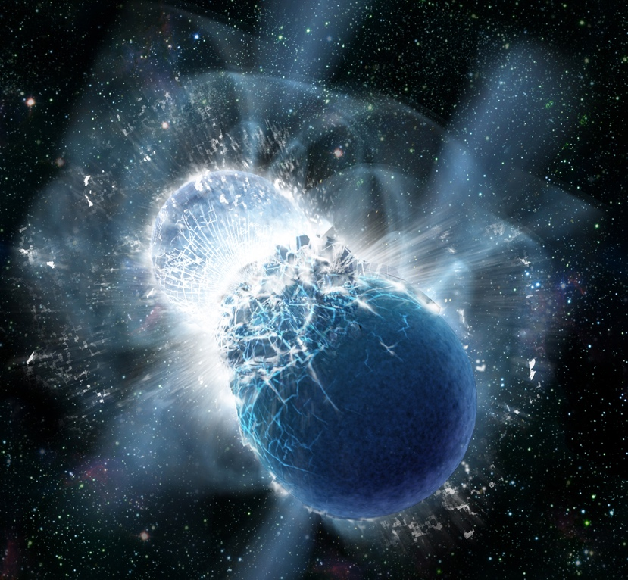
Interdisciplinary Research Approach:
Neutron Star Mergers and FAIR science …
Neutron Star Mergers
FAIR Research Pillars
Copyright: Dana Berry, SkyWorks Digital, Inc
Equation of State (Hades, CBM)
Gravitational wave signal
Amount of ejecta
Baryon-Baryon interaction (PANDA)
Exotic neutron-rich nuclei (NUSTAR)
r-process nucleosynthesis and abundances of the heaviest elements
Nuclear equation of state
  Kilonova EM transient lifetime
Plasma and atomic opacities (APPA)
FAIR offers unique opportunities for studying these fundamental questions!
2

Slide 3
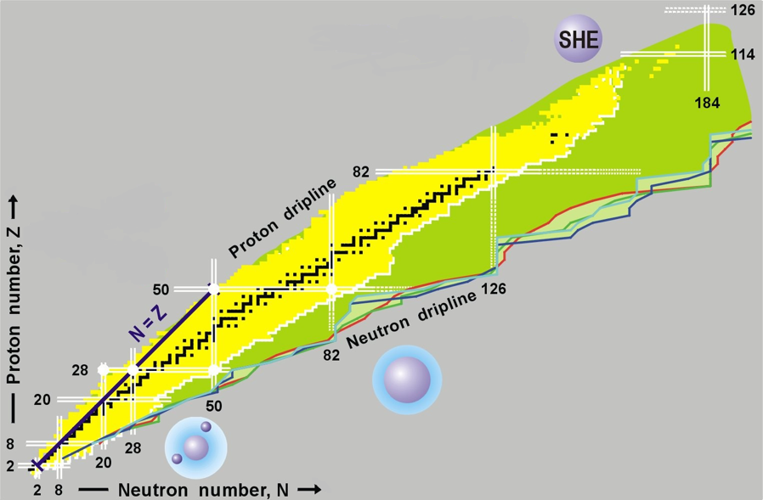
NUclear STructure Astrophysics and Reactions
The limits of nuclear existence (lifetimes, decays, …)
Ground state properties (masses, radii, …)
Structure of excited states (shell structure, shapes, …)
Unbound and other exotic system (halo, skin, hypernuclei, …)
Nuclear equation of state

Slide 4
NUSTAR - The Project
PSP code | Super-FRS | RIB production, separation, and identification
1.2.2 | HISPEC/ DESPEC | In-beam γ-spectroscopy at low and intermediate energy, n-decay, high-resolution γ-, β-, α-, p-, spectroscopy
1.2.3 | MATS | In-trap mass measurements and decay studies
1.2.4 | LaSpec | Laser spectroscopy
1.2.5 | R³B | Kinematical complete reactions with relativistic radioactive beams
1.2.6 | ILIMA | Large-scale scans of mass and lifetimes of nuclei in ground and isomeric states
1.2.10 | Super-FRS | High-resolution spectrometer experiments
1.2.11 | SHE | Synthesis and study of super-heavy elements
1.2.8 | ELISe(*) | Elastic, inelastic, and quasi-free e⁻-A scattering
1.2.9 | EXL(*) | Light-ion scattering reactions in inverse kinematics
(*) NESR required – alternative/intermediate “operation” within FAIR MSV under consideration.

Slide 5
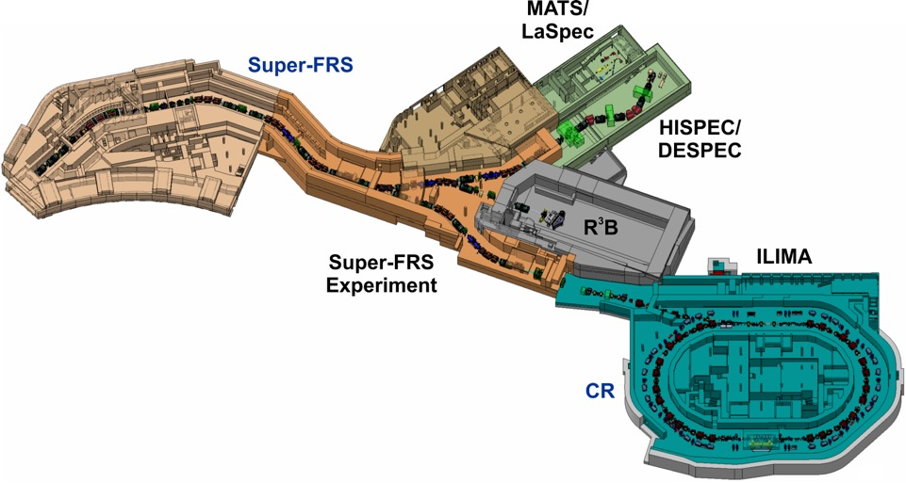
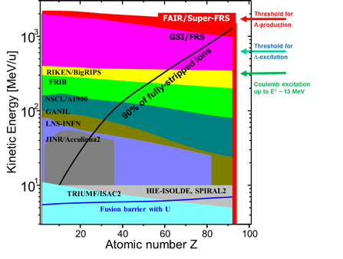
The Super-FRS facility for NUSTAR@FAIR

Slide 6
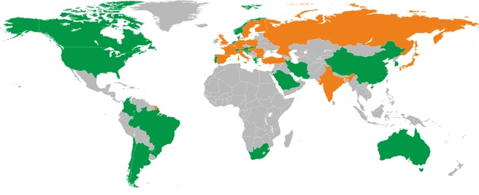
The NUSTAR collaboration
800 registered “interested” scientists in the NUSTAR data-base from
39 countries and more than
180 institutes
Secured funding and expression of interest in funding (September 2018):
from 19 countries
(incl. 9 FAIR partner countries)

Slide 7
Highlights of the NUSTAR Day-1 program
  Understanding the 3rd r-process peak by means of comprehensive measurements of lifetimes, masses, neutron branching ratios, dipole strength, and the level structure along the N=126 isotones;
  Equation of State (EoS) of asymmetric matter by means of measuring the dipole polarizability and neutron-skin thicknesses of heavy neutron-rich isotopes (in combination with the results of the first highlight);
  Exotics: Hypernuclei with large N/Z asymmetry and nucleon excitations in nuclei

Slide 8
Evolution of the FAIR/NUSTAR program
Phase 0 (2018-202x)
  – R&D and experiments to be carried out with present facilities,
e.g., GSI and external, with FAIR/NUSTAR equipment (basic set-ups)
Phase 1 (from 2024/25)
– Core detectors and subsystems completed (Day-1 configuration)
– First measurements with FAIR/Super-FRS beams
Ø Carry out “Day-1 experiments” with highest visibility and within the FAIR MSV
Phase 2
– FAIR evolving towards full power
– Completion of all experiments within MSV
Ø Essentially the full program of MSV can be performed
Phase 2
– Moderate projects, which have been initiated on the way (outside MSV) can be included (e.g. experiments related to return line for rings)
Phase 3
– Major new investments and upgrades for all experiments.

Slide 9
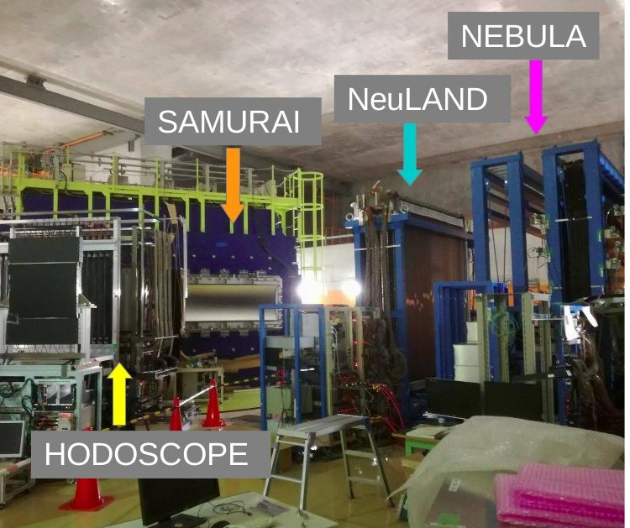
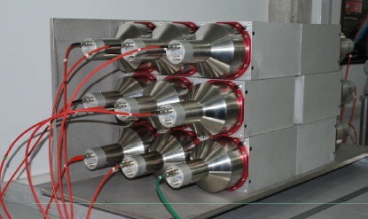
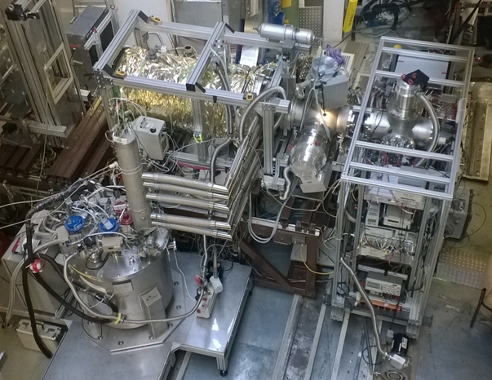
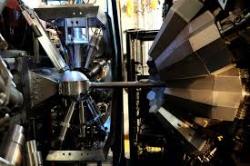
Phase-0 detectors in operation (a selection)
DTAS in operation at JYFL
NEULAND in operation at RIKEN
FATIMA
CSC
MR-TOF
AGATA
FATIMA in operation at GANIL
CSC coupled to MR-TOF tested at GSI

Slide 10
R³B in the Super-FRS High-Energy Branch
The R³B collaboration performs
kinematically complete measurement
of peripheral reactions induced by
relativistic heavy ion beams using a
flexible setup to accommodate experiments
utilizing different types of reactions and
addressing very different physics goals

Slide 11

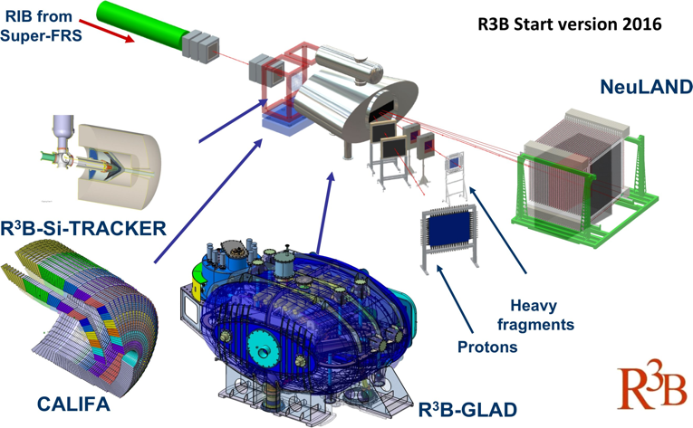
Start version from Phase 0 to Day-1
NeuLAND (Germany, Russia, Netherlands):
ready in 2020
Si tracker (UK):
ready in 2019/20
Proton arm (Russia) :
ready in 2022
Tracking system (Germany):
Reduced start version in 2018
GLAD (France, Germany):
Commissioning ongoing
CALIFA (Sweden, Spain, Germany, Russia):
Barrel (90% secured) available from 2019
Endcap (75% secured) available from 2019

Slide 12
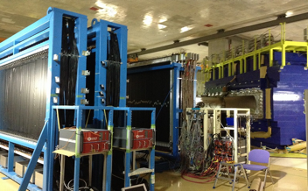
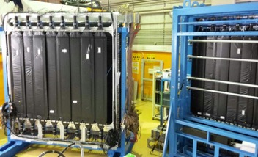
NeuLAND Detector at RIKEN and GSI
NeuLAND@SAMURAI
  Fully functional demonstrator (4 double-planes) sent to RIKEN for the time period from 2015 to 2017
  Joint operation with local NEBULA neutron detector for multi-neutron tracking (up to 4 neutrons)
NeuLAND@GSI
  Continuation of production of double planes
  Implementation on new electronics and HV system
  7 double planes installed at R3B for FAIR Phase-0 experimental program
  13 double planes produced
NEBULA
SAMURAI
NEULAND
March 2015
←NEULAND & VETO at 30° position for
Sπrit experiment
April 2016

Slide 13
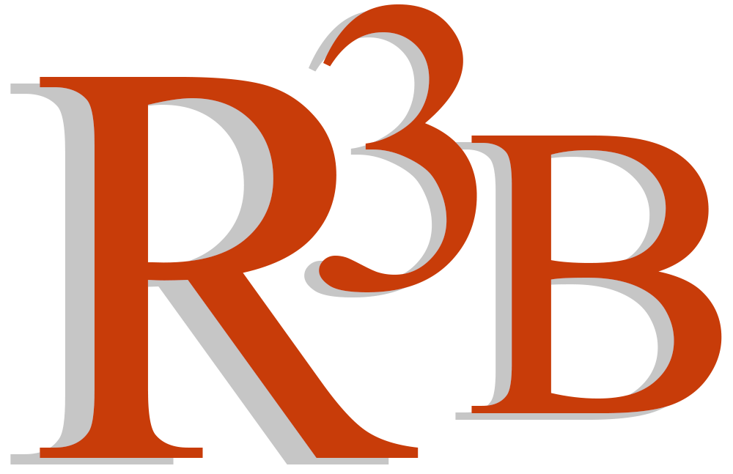




Reactions with Relativistic Radioactive Beams
New program at R3B
Pair correlations and
2(4)-neutron resonances
First approach at R3B-LAND
¹⁹N(p,2p)¹⁸C*→¹⁶C+n+n
Direct neutron-pair emission observed
Strongest correlation so far observed
(A. Revel et al., PRL 120, 152504 (2018))
FAIR-Phase0: Search for narrow 2n resonances (with NeuLAND)
Future: 4n resonances when NeuLAND is completed
Further R3B highlights 2018:
- (p,2p) reactions along oxygen chain: L. Atar et al., PRL 120
- New method to constrain the EoS of n-rich matter:
T. Aumann et al., PRL 119

Slide 14
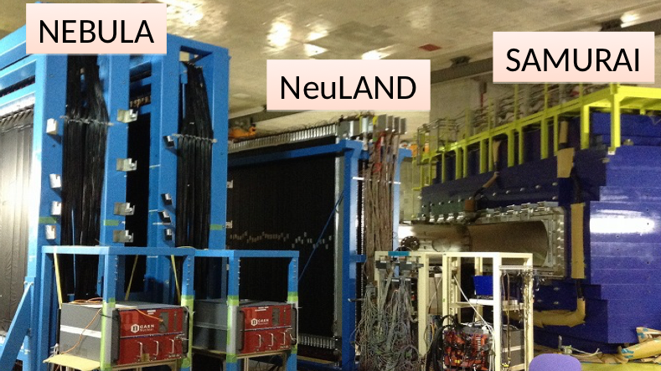
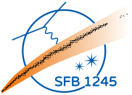
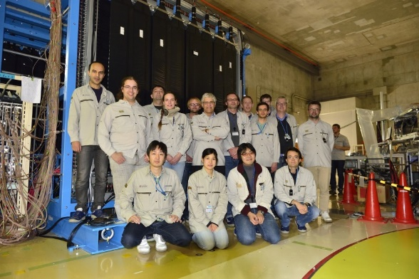
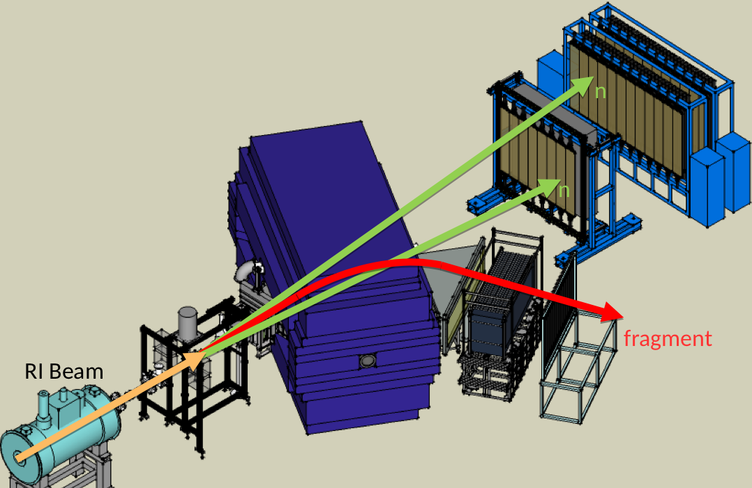
NeuLAND @ RIBF - RIKEN
Successful experimental campaign (2015-2017) with the R3B NeuLAND prototype
4 double-planes added to SAMURAI-NEBULA configuration
four-neutron efficiency increased by more then an order of magnitude (to 1.6%)
4-Neutron decay measured for the first time
Broad physics Program:
Spectroscopy of n-rich Ca isotopes
Dipole response of n-rich Ca isotopes
Soft dipole excitation of ⁸He
Deformed Halo nucleus ³¹Ne
EoS: Heavy-ion collisions
Highlights: beyond the neutron dripline
²⁸O → ²⁴O+4n: Ground-state resonance energy
Lifetime of ²⁶O ground-state
Search for the tetra neutron (run in July 2017)
Super-heavy hydrogen ⁷H (run in July 2017)
Detector is back at GSI and is being prepared for the 2019 beam-time

Slide 15
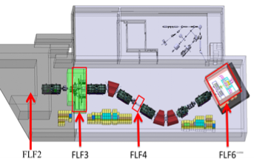
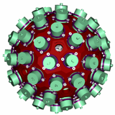
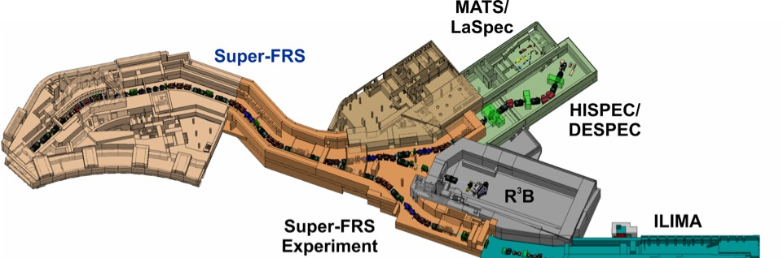
HISPEC/DESPEC in Low-Energy Branch
High-resolution in-flight gamma-ray spectroscopy using AGATA following secondary nuclear reactions induced by radioactive ion beams from E~100 MeV/u to 1 GeV/u
Energy Buncher
Spectrometer
Low-energy branch

Slide 16
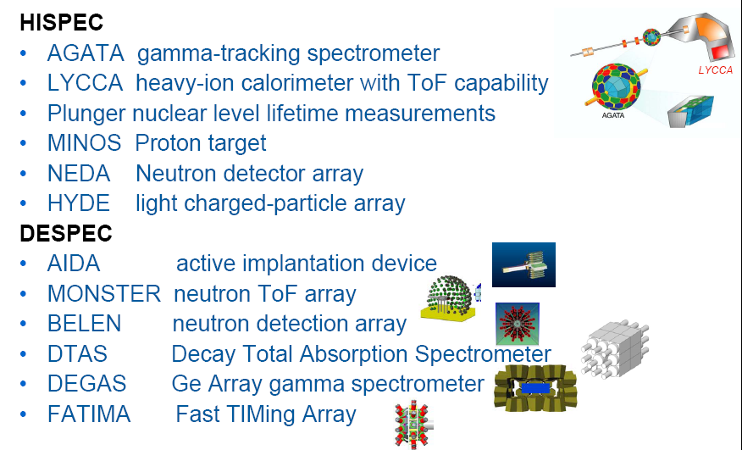
HISPEC / DeSPEC foreseen instrumentation

Slide 17
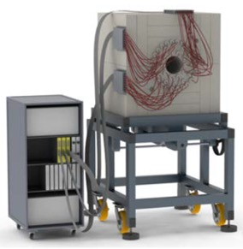
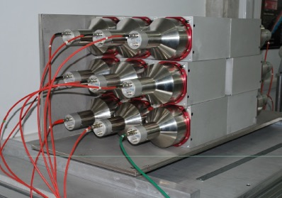
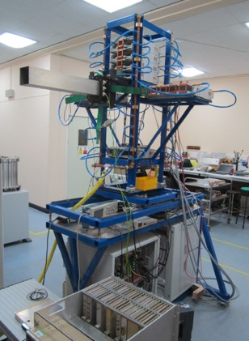
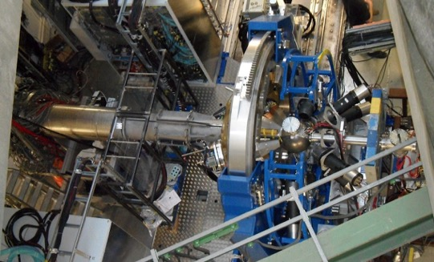
HISPEC/DESPEC detector systems ready
BELEN
DTAS
LYCCA
AIDA
AGATA

Slide 18
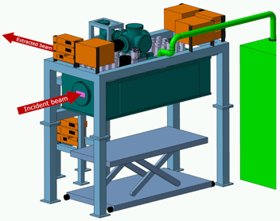
The Super-FRS Low-Energy Branch
Cryogenic Stopping Cell
LEB

Slide 19
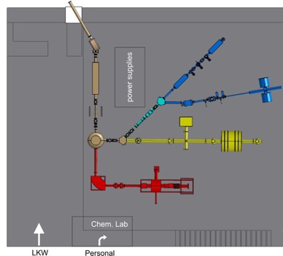
LaSpec & MATS in the Low-Energy Branch
LEB
LaSpec DAY-1
optical pumping
Phase 2

Slide 20
LaSpec & MATS in the Low-Energy Branch
LEB
Mats
DAY-1

Slide 21
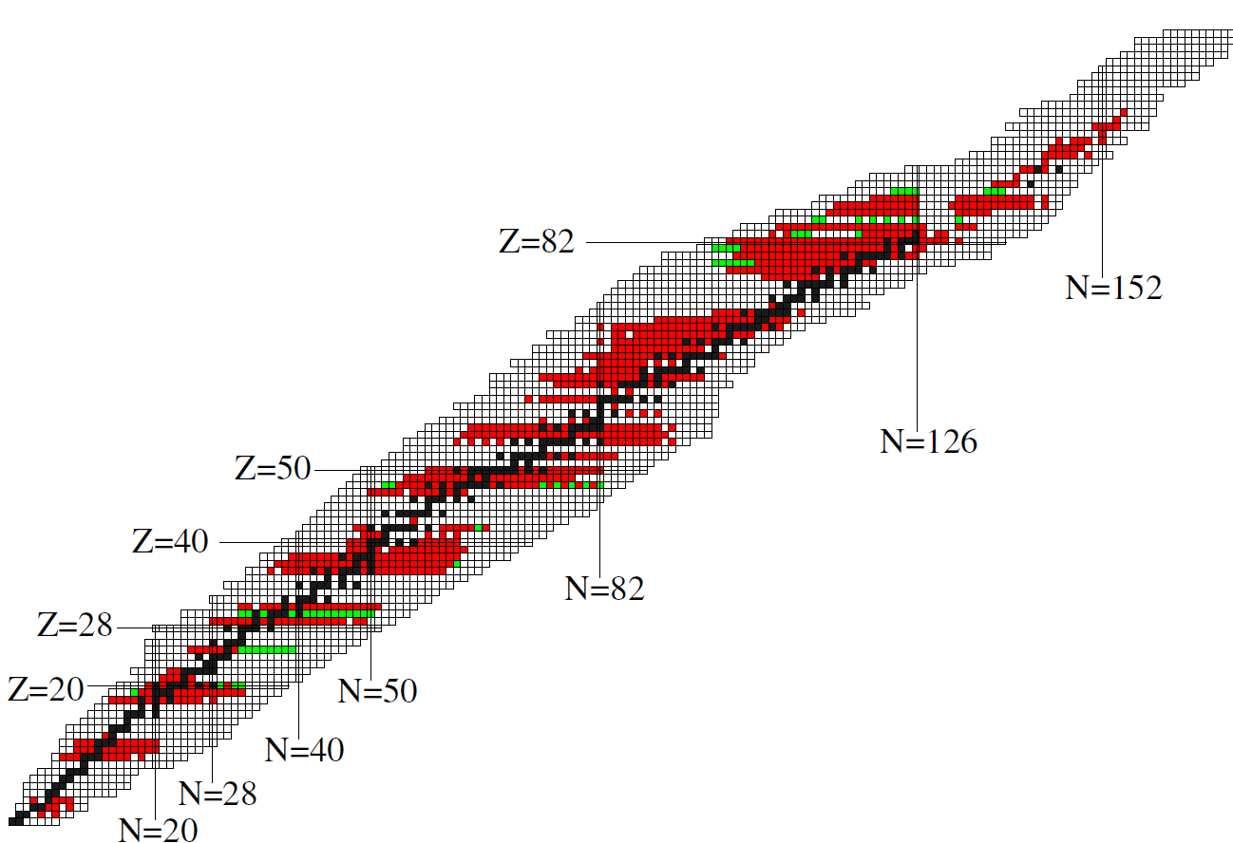

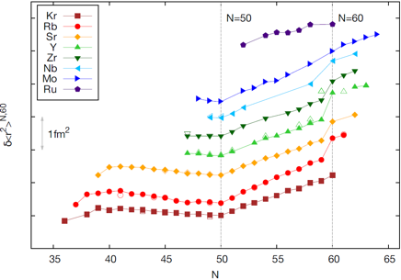



LaSpec – Phase 0 towards Phase 1
Laser spectroscopy in the region Zr (Z=40) → Ag (Z=47)
Challenges
The region of interest is primarily refractory
Transition metals (= complex atomic structure)
Tc (Z=43) to Ag (Z=47) require spectroscopy on atomic transitions
Zr (Z=40) to Mo (Z=42) can use ionic transitions
Z=40 → 47
Refractory elements, towards new neutron-rich isotopes (new regions of shape evolution, onset of triaxiality….)
?
N=60 shape change
Different shapes and sizes

Slide 22


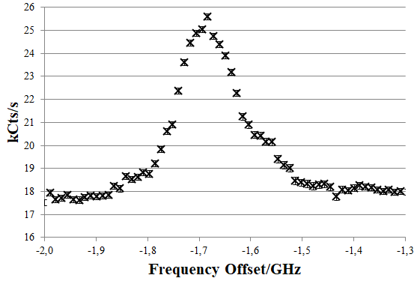
LASPEC - 2018
KOALA-Beamline @ TU-Darmstadt
new local development platform for LASPEC
high-accuracy masurements of Ba⁺ D1/D2 transitions
excellent agreement with theory, no anomaly as in Ca⁺ :
LASPEC-Beamline @ Argonne
Installed and in operation
On-line application at CARIBU in 2019
Ca D1
most accurate collinear
Measurement reported so far
4p ²P_{3/2}
393nm
Submited to PRA
4s ²S_{1/2}
low background level
F_{D2}/F_{D1} = 1.0186(9) [exp]
1.0206(7) [theory]
Asymmetry caused by the ion source, no restriction for on-line work
Notes:
The LASPEC beamline (previously TRIGA-LASER) has now been installed at Argonne National Lab and first resonance signals of stable calcium isotopes were observed (left figure). Th Its application at CARIBU is foreseen in 2019 to study Pd isotopes.
At TU Darmstadt a new collinear beamline has been established which is called KOALA (Collinear Apparatus for Laser spectroscopy and Applied physics) and will serve as a development platform for LASPEC related techniques. First results obtained at this beamline on stable Ba+ isotopes were recently submitted to Phys Rev A. Transition frequencies and isotope shifts were measured with an accuracy that is comparable or even slightly better than what was achieved on dipole transitions with laser-cooled ions in Paul-traps so far. They represent now the most accurate collinear measurements done so far. The King-plot shown on the right provides the ratio o the field shift factors of the two investigated transitions (this is the slope of the regression line). The deviation from 1 is caused by relatistic effects and the experimental result is in good agreement with theory.

Slide 23
MATS – Programme for Phase-0 and Day-1
FAIR phase 0:
operation of MATS prototype TRIGA-TRAP at TRIGA Mainz for technical and methodical developments:
  single–ion mass spectrometry with cryogenic trapping systems
  optimization of novel phase-imaging technique (PI-ICR) for short-lived nuclides and low-lying isomers
construction of RFQ system at JYFL
on-line experiments at different laboratories within the collaboration: ISOLTRAP, JYFLTRAP, SHIPTRAP ...
FAIR phase 1:
Experiments on neutron-rich nuclides relevant for
3rd r-process peak at LEB
Experiments on selected neutron-rich isotopes, e.g Zr isotopes

Slide 24
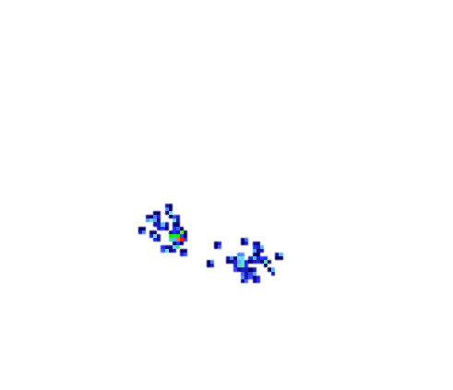

Recent results from the MATS collaboration
Two-week SHIPTRAP beamtime campaign at GSI in June/July 2018
new / improved mass values for ^{251,251m,254,254m}No and ^{254,254m,255m,255,256}Lr
pinned down nuclear isomers with supreme resolving power of
novel PI-ICR technique of up to m/Δm = 10⁷
^{257g,m}Rf (Z=104) measurement at a rate of about 1 event per shift
10 hour measurement
1.2 s phase acc. time
m/Δm ≈ 10⁷
35 keV isomer resolved
10
²⁵⁵Lr
^{center}
PRELIMINARY
0
y-position [mm]
Φ
2.5 s
22 s
-10
^{255g}Lr
^{255m}Lr
M. Block, O. Kaleja et al.
-10
0
10
x-position [mm]

Slide 25

ILIMA in the Collector Ring (CR)

Slide 26
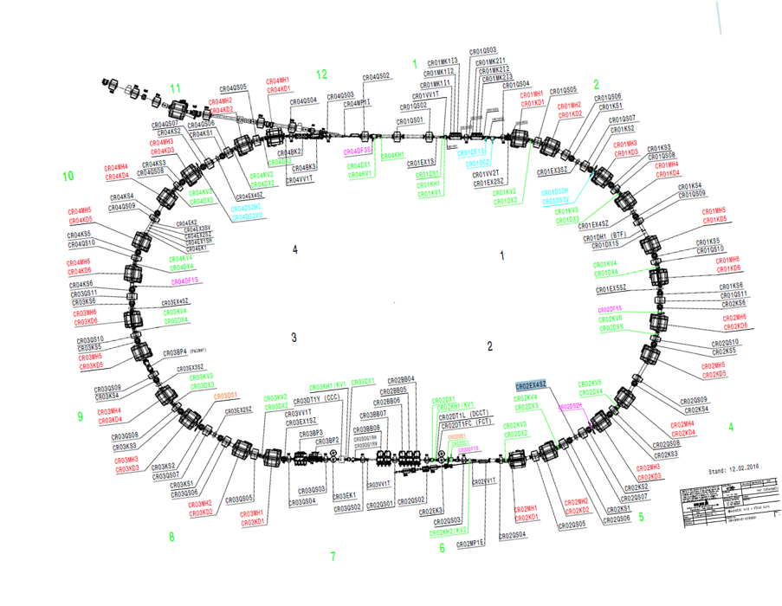
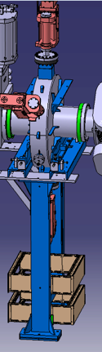
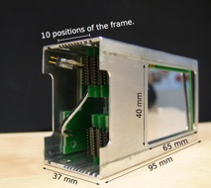
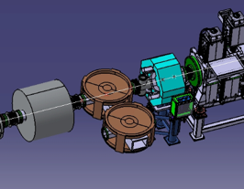
ILIMA Phase1@CR
Isomeric beams, Lifetimes and Masses
Schottky
pickup
Schottky pickups
longitudinal and transversal
Detector pockets
ToF detectors
TOF-2
TOF-1
Detector pocket
16.8m
ToF detector

Slide 27

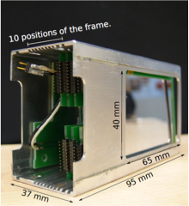
  ILIMA collaboration: Isomeric beams, Lifetimes and Masses
Precision measurements of nuclear masses and lifetimes of stored exotic nuclei at relativistic energies and studies with isomeric beams
Phase-0 at the GSI-ESR:
Measurement of the bound-state beta decay of bare ²⁰⁵Tl ions
123 scientists
37 institutes
21 countries
²⁰⁵Pb/²⁰⁵Tl pair as a s-process cosmochronometer
The flux of solar pp neutrinos (LOREX project)
ESR pocket
Heavy-ion detector
Development completed
TDR submitted
GSI unique
²⁰⁵Pb⁸¹⁺ will be detected with the in-ring detector after ESR gas stripping

Slide 28
SHE Phase 0 (2018-2020)
TASCA Experiments with approved beamtime
Chemical properties of element 113, Nh
Spokesperson: A. Yakushev, GSI
Nuclear structure along ₁₁₄Fl chains
Spokesperson: D. Rudolph, Lund U.
Study of volatility and reactivity of Nh on SiO₂ and Au surface
Study of odd-A chains A=287,289 chains
Search for new isotope ²⁹⁰Fl
Experiment:
Theory:
Theory:
V. Pershina, 2016&2018
α-γ-coincidence spectroscopy with TASISpec++/LUNDIUM
Nh on SiO₂
Nh on Au

Slide 29
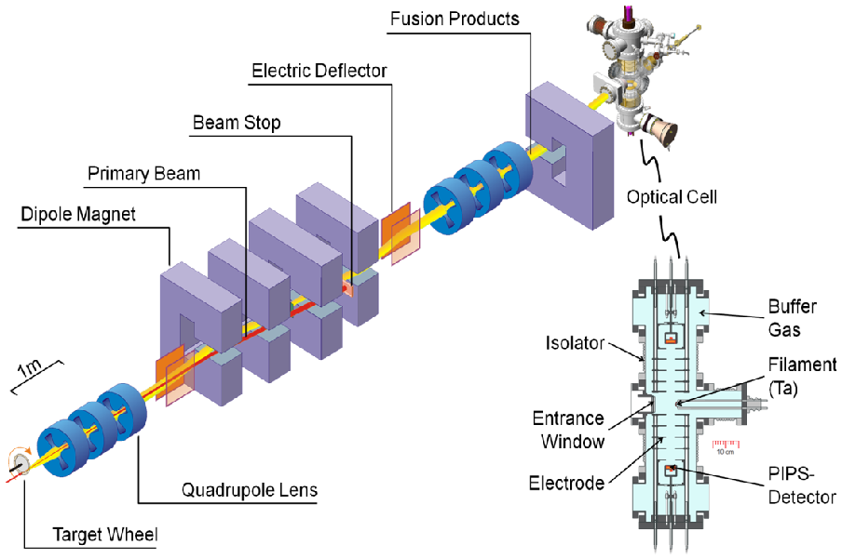
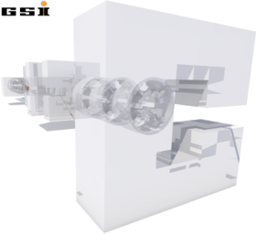
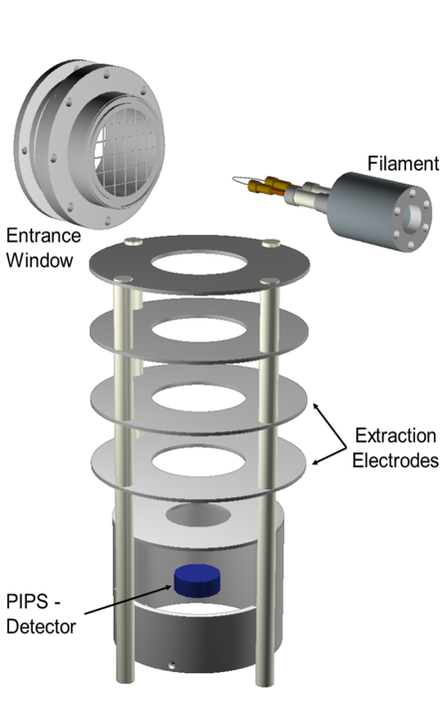
RADRIS: Laser Spectroscopy of No
SHIP
100 mbar
argon
Slow down particles
Neutralize
Evaporate atoms
Excite by laser light
Transport to detector
Register decay
M.Laatiaoui et al., Eur. Phys. J. D 68, 71 (2014)
H. Backe et al., Eur. Phys. J. D 45, 99 (2007)

Slide 30
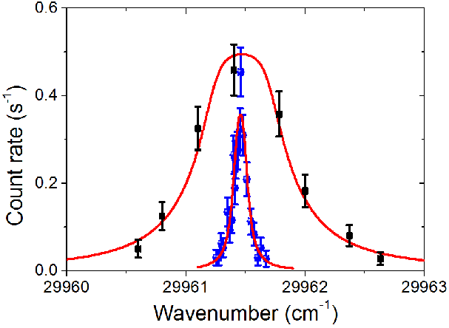
SHIPTRAP - RADRIS: Laser Spectroscopy of No
1st Resonance
Isotope Shift and Hyperfine Structure in No
M. Laatiaoui et al., Nature 538 (2016) 495
IP = 6.6261(3) via Rydberg Series
S. Raeder et al., PRL 120 (2018) 232503 (selected as Editor's suggestion and featured in Physics)
P. Chhetri et al., PRL 120 (2018) 263003

Slide 31
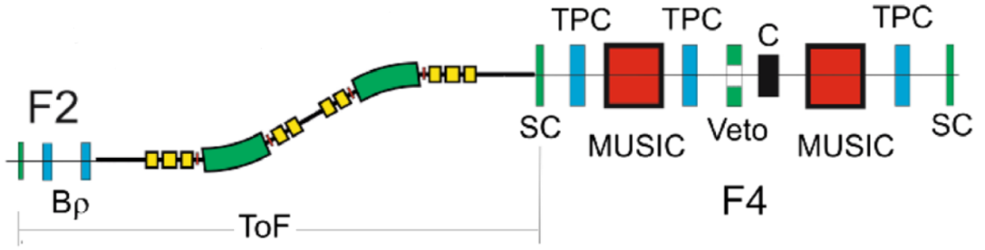
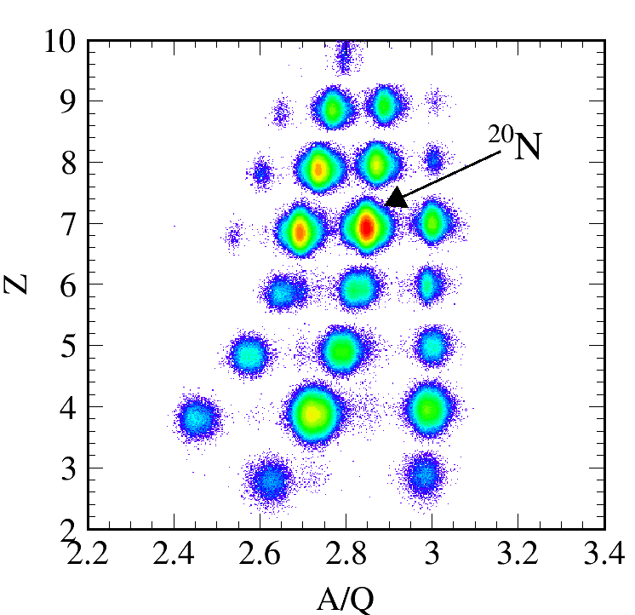
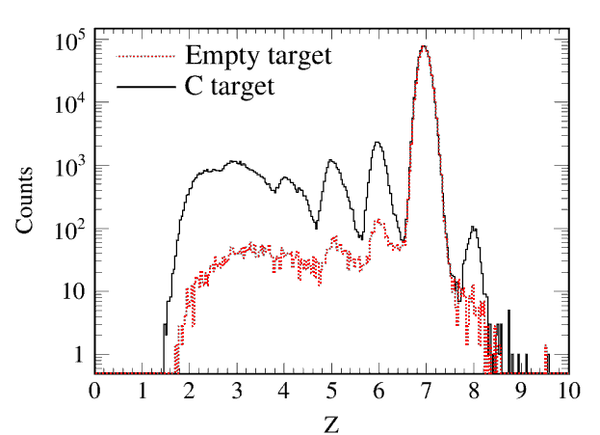
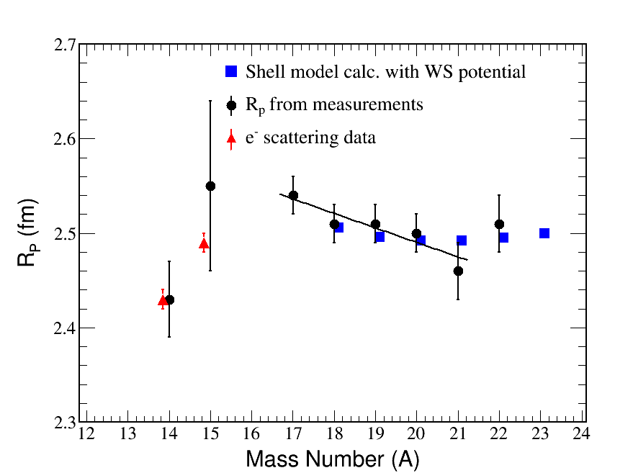
N=14 shell gap found from measured proton radii of neutron-rich N-isotopes (*)
FRS
Z identification in MUSIC behind target with selection of nucleus of interest in front of target
Empty target run needed to eliminate the effects of interaction of the beam from non-target material (detectors, windows,...)
R_{p} of ¹⁷⁻²⁰N gradually decrease
1d_{5/2} orbital is filled up, which is related to the decrease in deformation approaching the N = 14 shell closure
Increase in R_{p} within the uncertainty for ²²N results from its extended neutron density for valence neutron in the 2s_{1/2} orbital with a closed-shell core of ²¹N.
(*) S. Bagchi et al., subm. for publication

Slide 32
NUSTAR MSV – funding status
44.0 MEUR
funding (secured and expected) from:
(FAIR members/associates in bold face)
  Australia
  Belgium
  Bulgaria
  Canada
  Finland
  France
  Germany
  Hungary
  India
  Israel
  Netherlands
  Poland
  Romania
  Russia
  Spain
  Sweden
  Turkey
  United Kingdom
Status: November, 2018
Notes:
The last few minutes of my talk I would like use to give you an update on the financial and technical status. First the funding status needed for the full NUSTAR MSV configuration. I think it I worthwhile to note that funding has been secured (or is expected from EoI) from 19 countries including all 9 FAIR member countries. However, taking the no-secured funds account for ~33% of the full budget of 46.2 Meuro, which is one reason why it was decided to start with a reduced Day-1 configuration.

Slide 33
Day one configuration – funding status
32.5 MEUR
funding (secured and expected) from:
(FAIR members/associates in bold face)
  Bulgaria
  Canada
  Finland
  France
  Germany
  Hungary
  India
  Israel
  Netherlands
  Poland
  Romania
  Russia
  Spain
  Sweden
  United Kingdom
(inclu. common funds)
Status: November, 2018
Notes:
This reduced start version has a cost estimate of 32.4 ME from which more than 90% are already secured. The remaining expenses are mainly related to infrastructure items for which local and external groups have difficulties to obtain funding. Therefore we will also request the provision of common funds for these items, but to a much smaller extend than other FAIR collaborations. Missing items are for R3B part of the calorimeter and 2 planes NeuLAND, for DESPEC some DEGAS detectors and the magnet for g-factor measurements, for LASEPC the 2nd beam

Slide 34
Funding status of Day-1 configuration
Common funds needed to complete infrastructure
Super-FRS experiments not listed (awaiting final endorsement by council)
Status: November, 2018
Notes:
On this slide you find more details for the different NUSTAR experiments, both in terms of funding, TDR approval, but also the construction progress. Besides certain manpower issues (which are difficult to explicit in these graphs) the situation of NUSTAR is mostly green and everything seems to be well on track for the Day-1 experiments.

Slide 35
NUSTAR Operation Scenario
2018 | 2019 | 2020 | 2021 | 2022 | 2023 | 2024 | 2025 | 2026 | 2027
Super-FRS
Day one
construction and installation
commissioning
operation
NUSTAR caves
civil construction
Phase 0
Phase 1
NUSTAR experiments
construction/operation „outside“ FAIR (GSI and external)
installation
commissioning
operation at FAIR
Vielen Dank !

