Slide 1
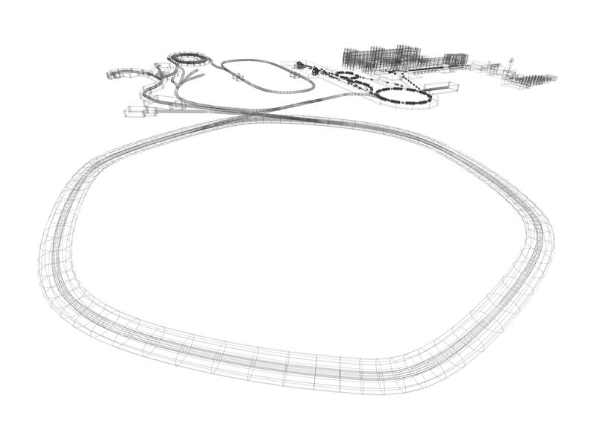
FAIR Status Report
Progress achieved and
science prospects for the coming years
Paolo Giubellino
KHuK meeting, 7 December 2018

Slide 2
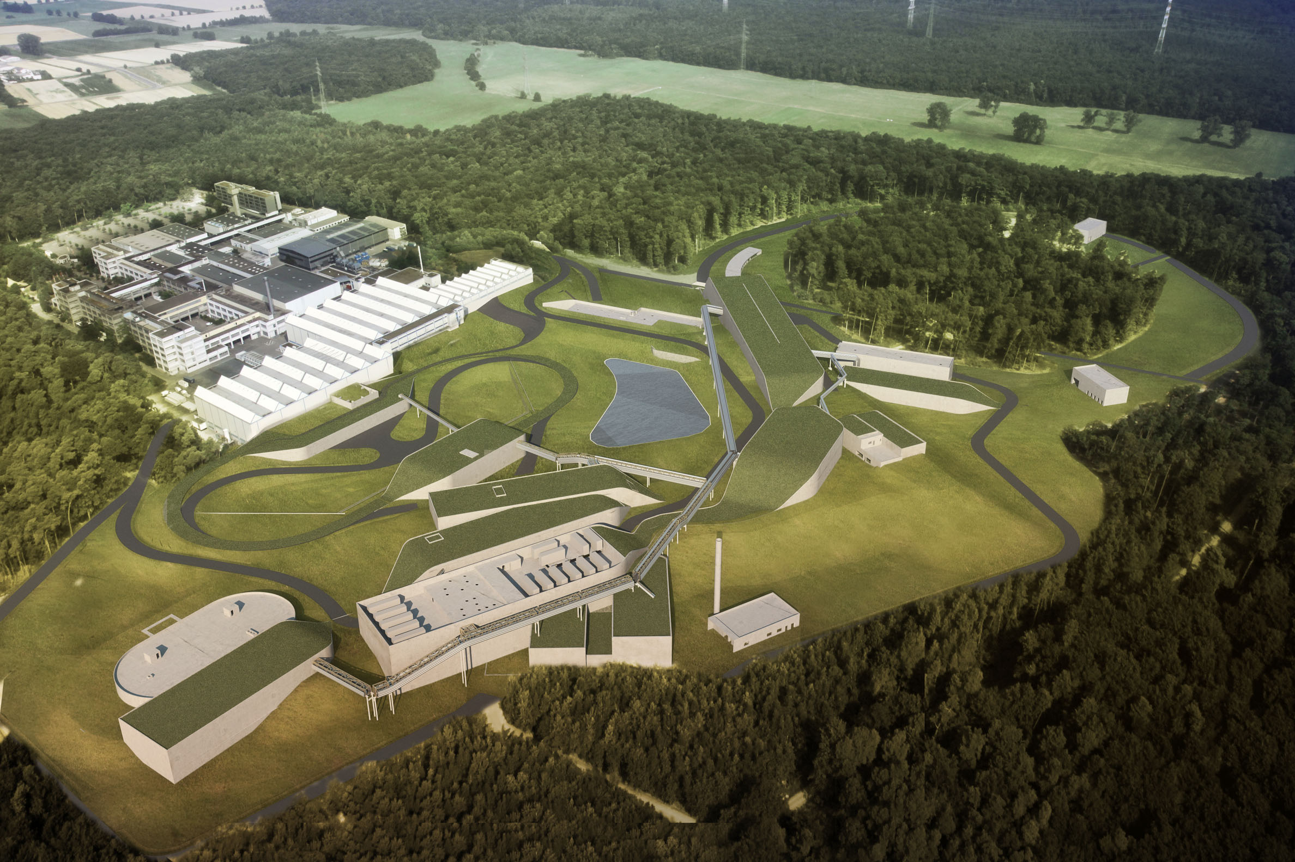









FAIR: Facility for Antiproton and Ion Research
– A World-Wide Unique Accelerator Facility
ESFRI Landmark
Top priority for European
Nuclear Physics Community
Driver for Innovation in Science and Technology
Finland
France
Germany
India
Poland
Romania
Russia
Slovenia
Sweden
UK
2

Slide 3
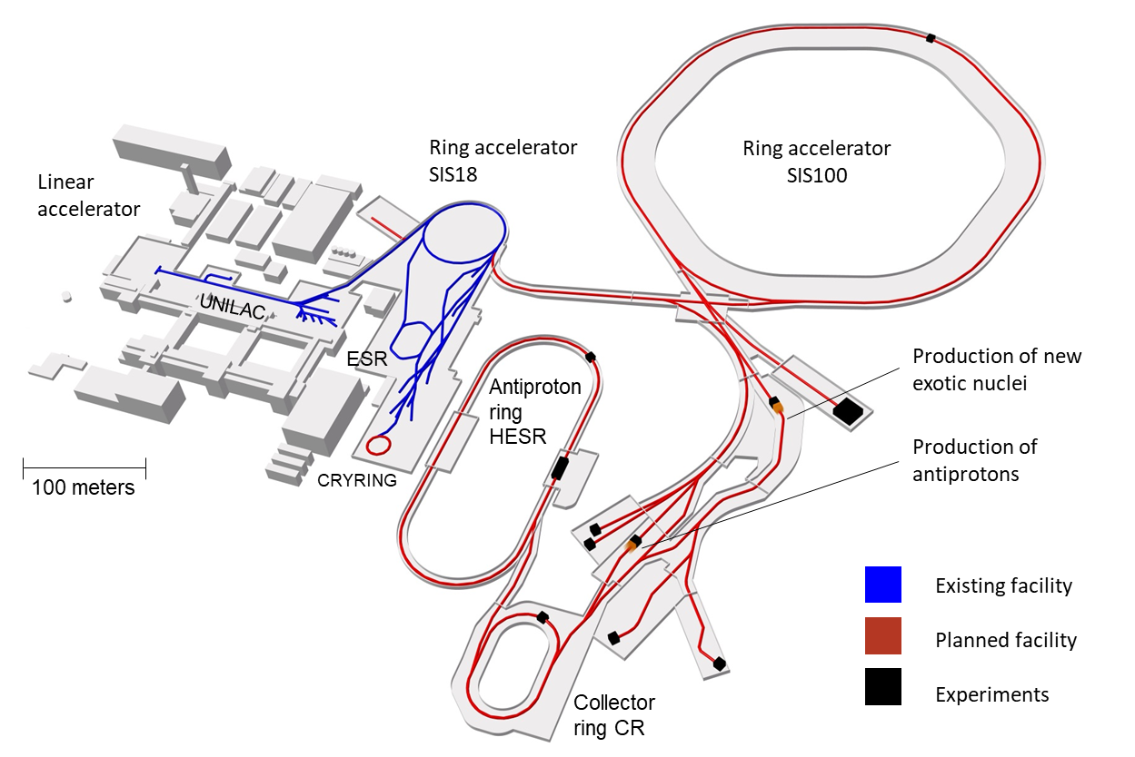
FAIR – The Facility
Intensity gain: x 100 – 1000
10 x energy (comp. to GSI)
Antimatter: antiproton beams
Precision: System of storage and cooler rings
KHuK meeting, 7 December 2018

Slide 4
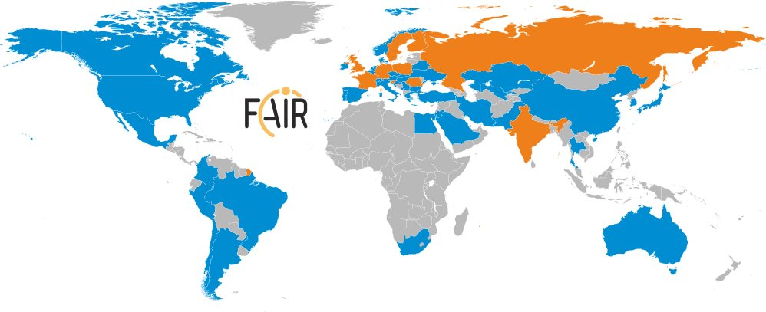
International Participation in FAIR
FAIR governed by international convention
  9 shareholders + 1 assoc. partner (orange)
Over 3000 Scientists and Engineers from all over the world
More than 200 institutions from 53 countries are involved with their scientists (orange + blue)
KHuK meeting, 7 December 2018

Slide 5
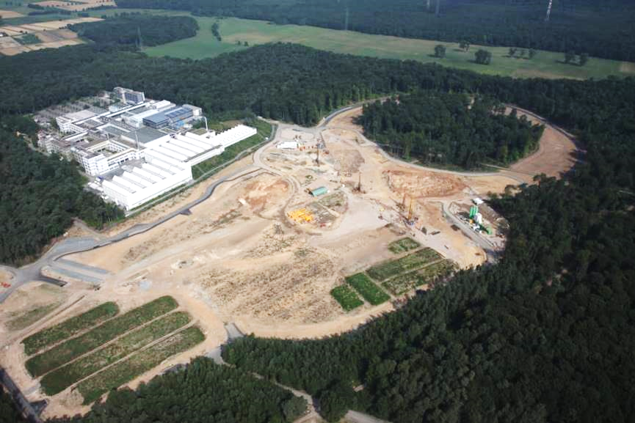
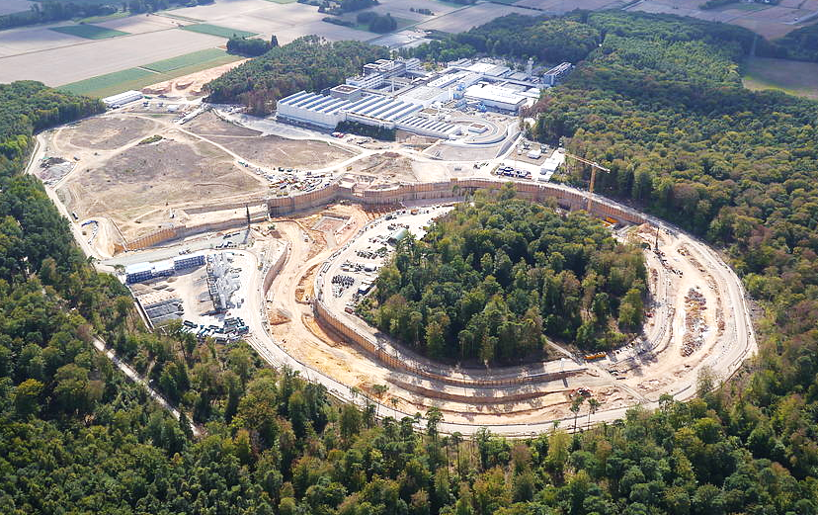
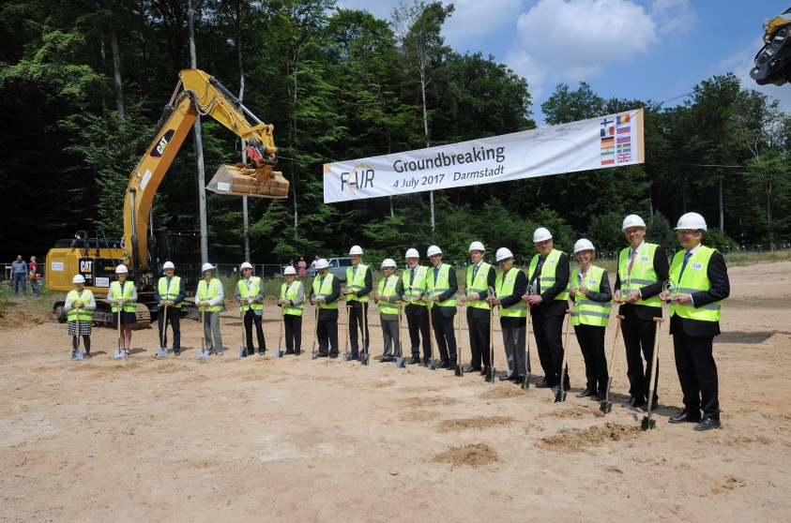
Status of FAIR Project: Civil Construction
Progress since official start on 4th of July 2017
before July 2017
July 4th 2017
October 2018
KHuK meeting, 7 December 2018

Slide 6
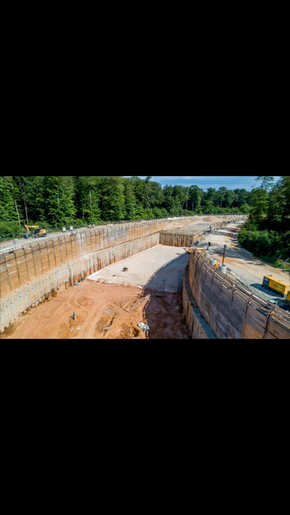
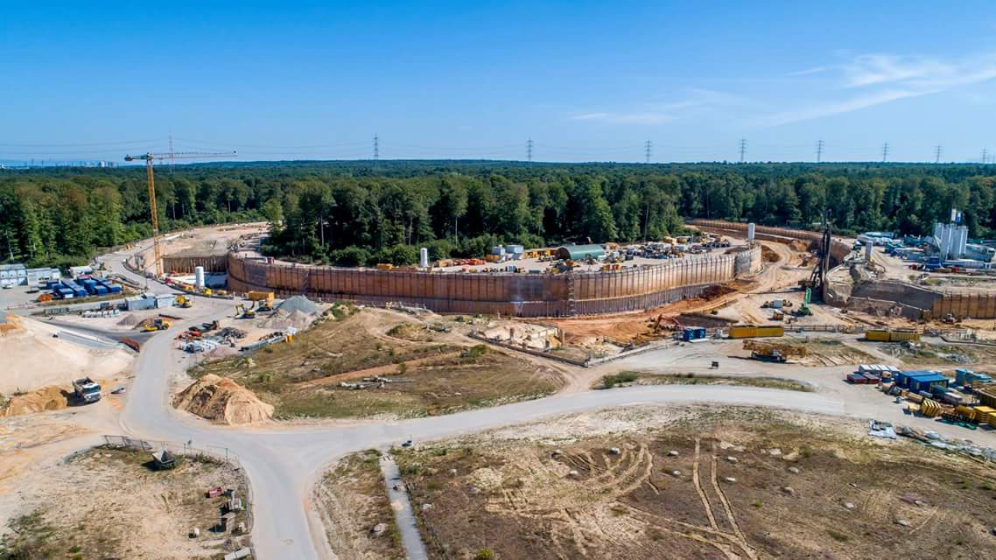
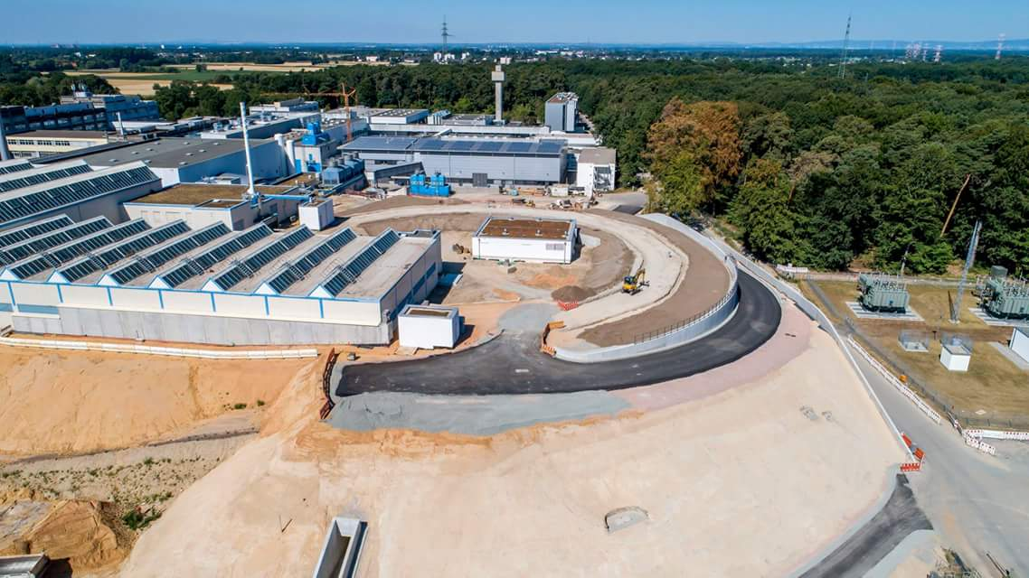
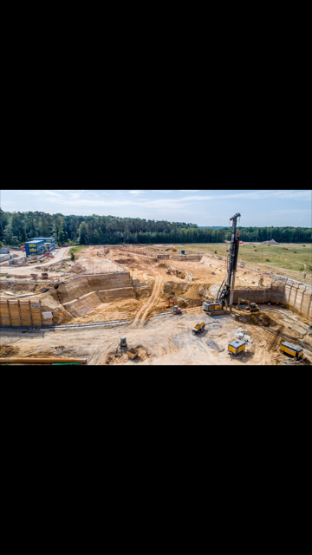
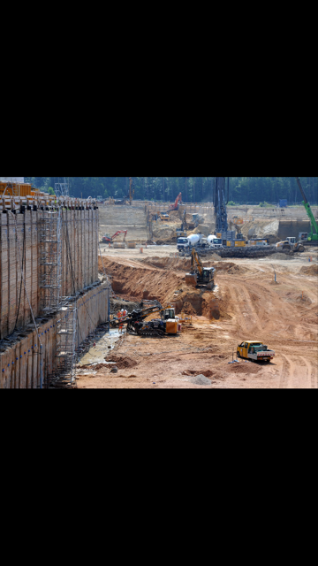
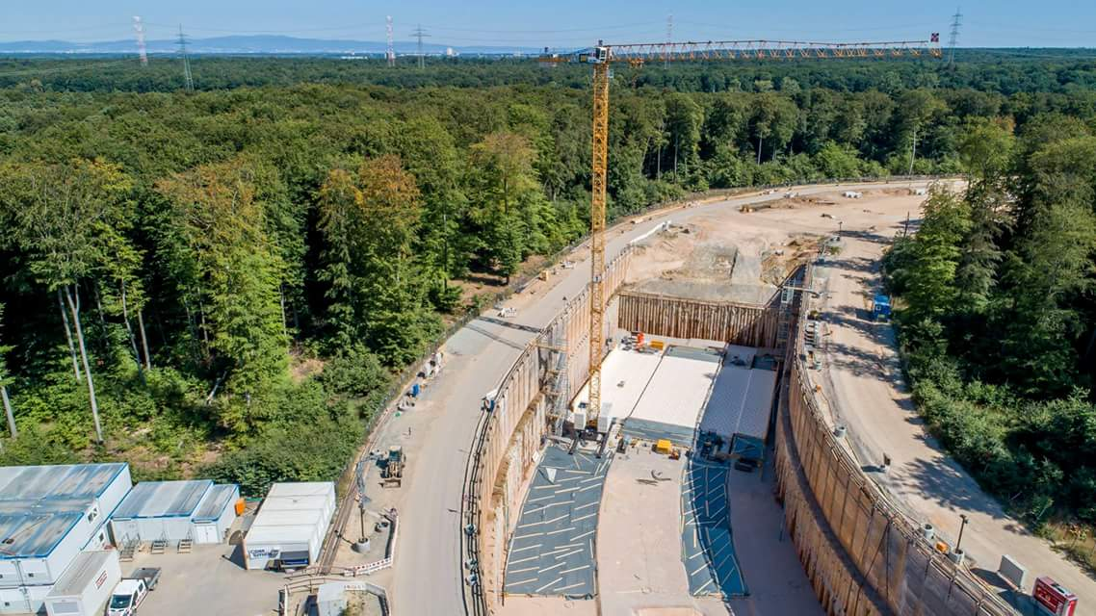
Status of FAIR Project: Civil Construction
Progress since official start on 4th of July 2017
Excavation SIS100 tunnel
Upgraded SIS18 completed ready for FAIR and FAIR phase 0
Excavation transfer building & CBM cave
Start of concrete shell works for SIS100
KHuK meeting, 7 December 2018

Slide 7
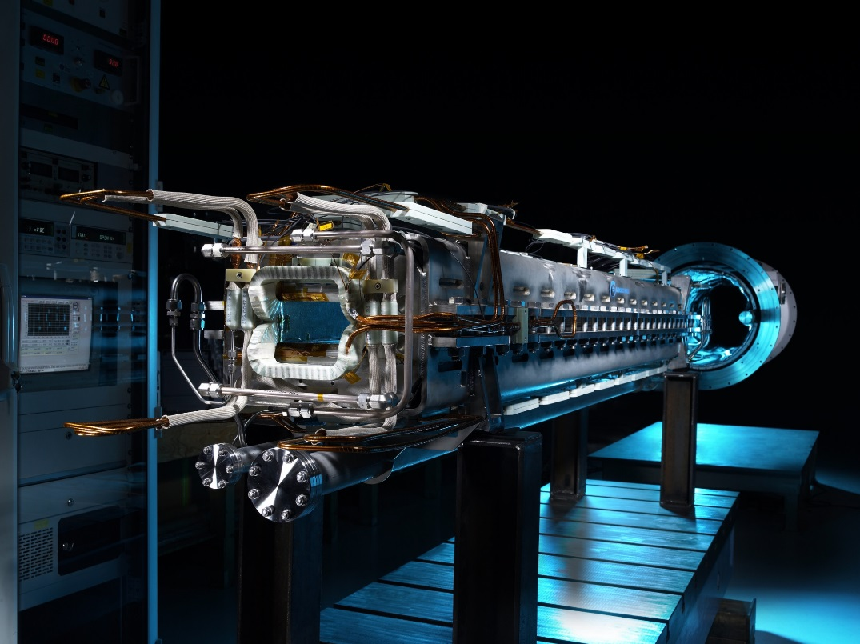
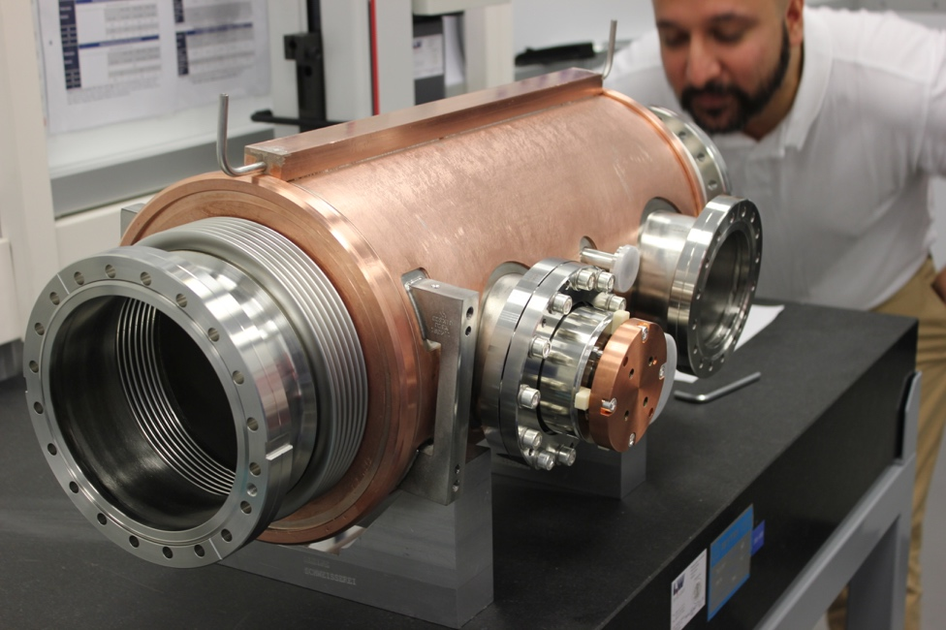
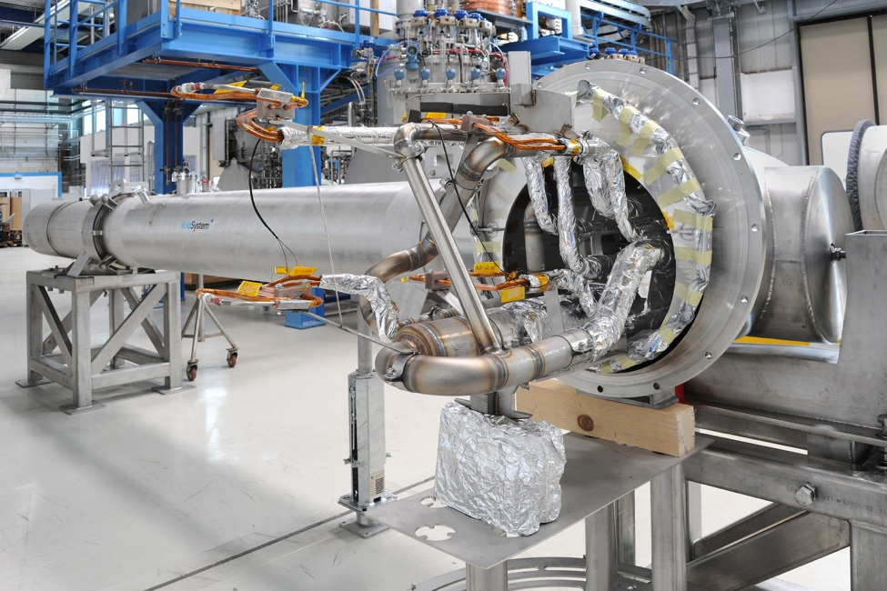
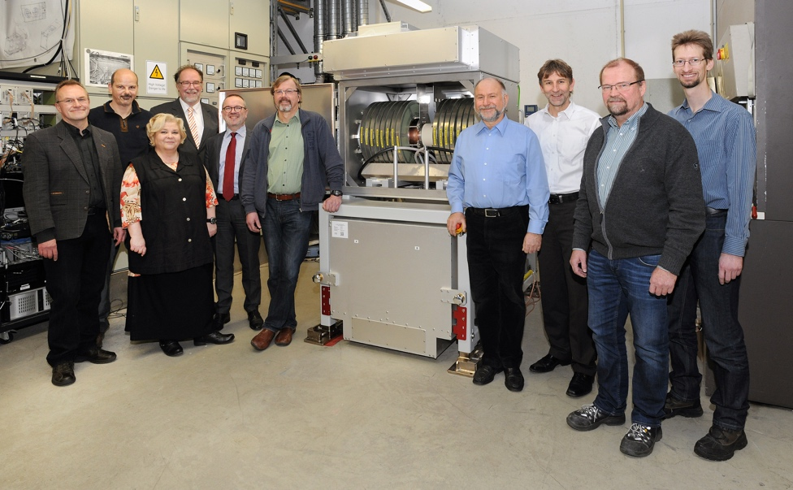
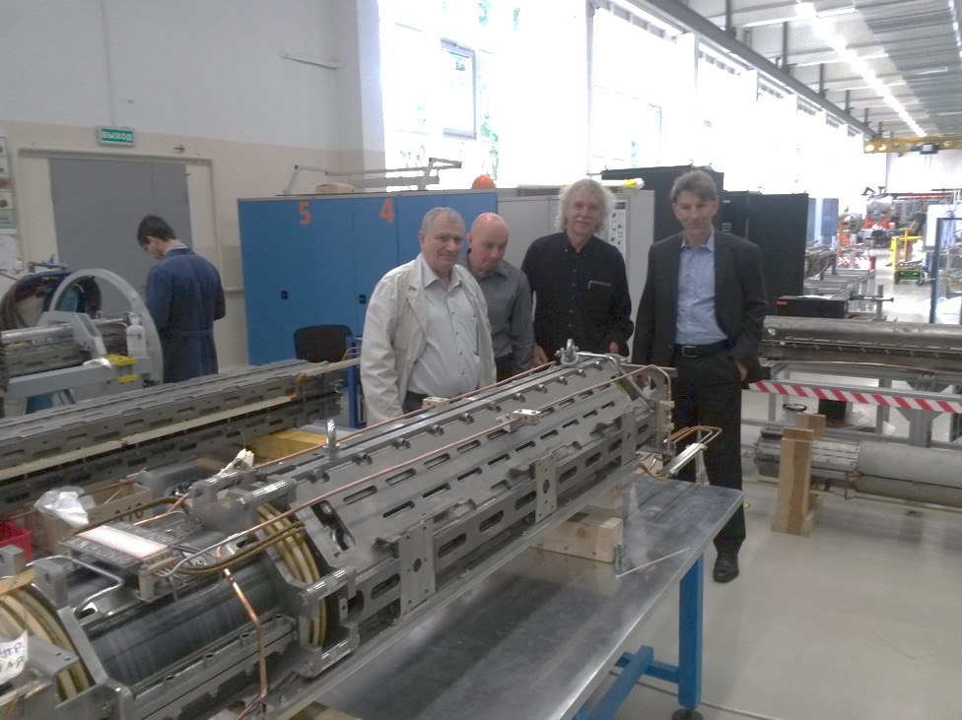
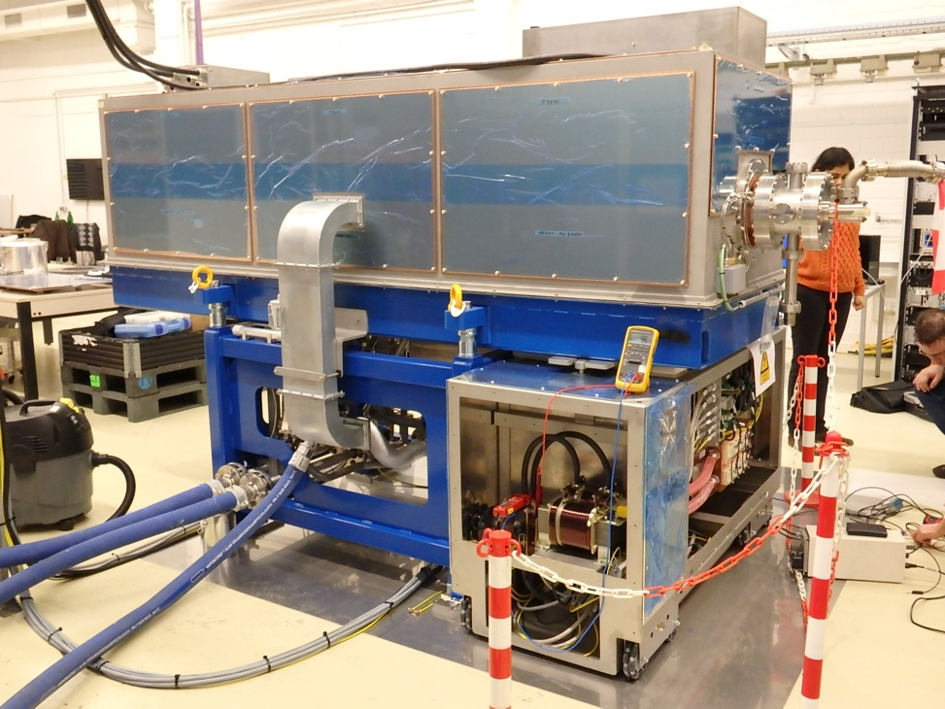
Status of FAIR: accelerators: construction / procurement progresses well
Serial production for major components for SIS 100 is progressing
with one third of the dipole magnets already manufactured.
SIS100 Dipole Magnets
Cryo Catcher
Cryo-Bypass Line
Bunch Compressor
Quadrupole Unit
RF Cavity System
KHuK meeting, 7 December 2018

Slide 8
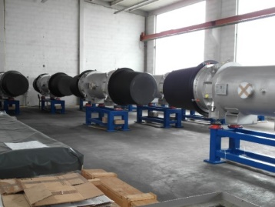
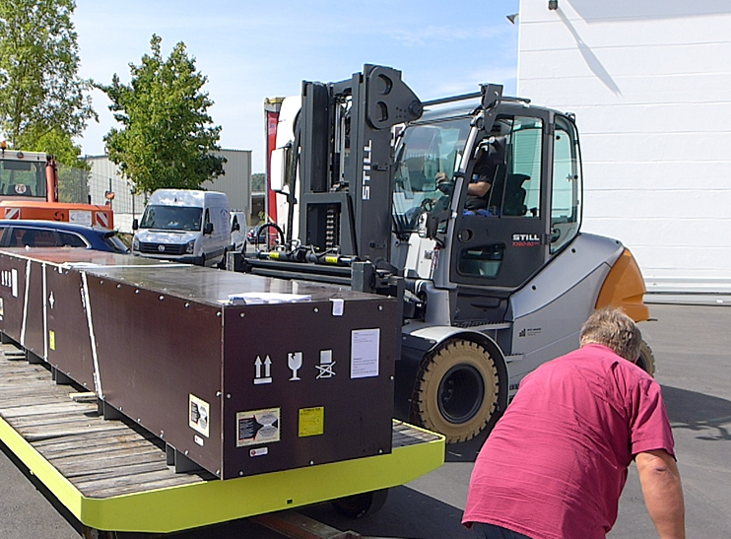
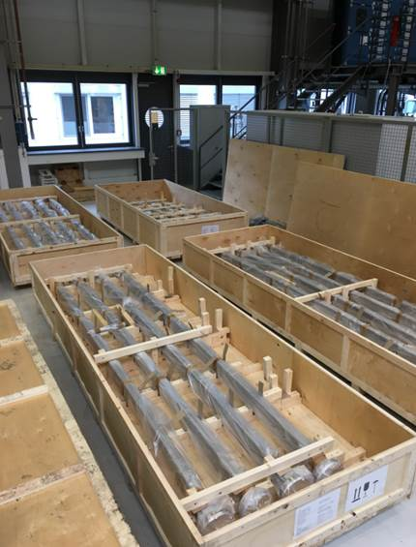
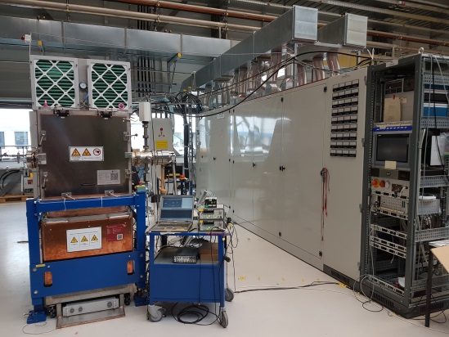
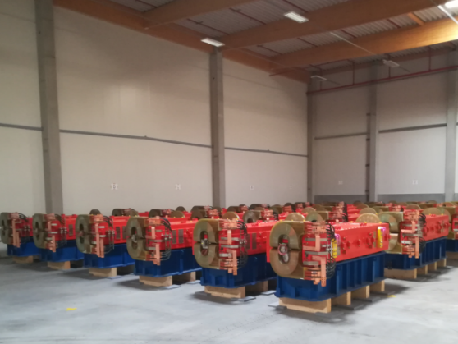
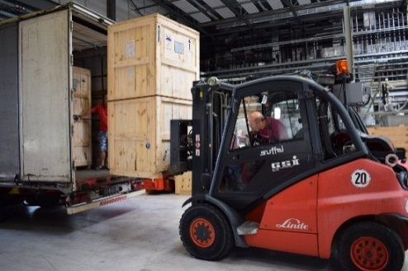
Status of FAIR: Accelerators: construction / procurement progress
36 sc dipole SIS100 modules manufactured at BNG and 22 shipped to GSI and tested
SIS100 quadrupole units shipped from JINR to BNG for integration into FOS module
All 51 HEBT vacuum chambers of batch 1 delivered (BINP, Russia)
The series production of RF – debunchers
All HESR Dipoles are produced, in Jülich and 65% are delivered to FAIR
Delivery of 1st 6 series Power Converter from India, (ECIL, India)
KHuK meeting, 7 December 2018

Slide 9
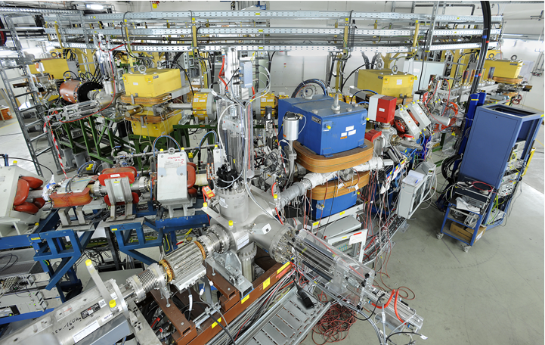
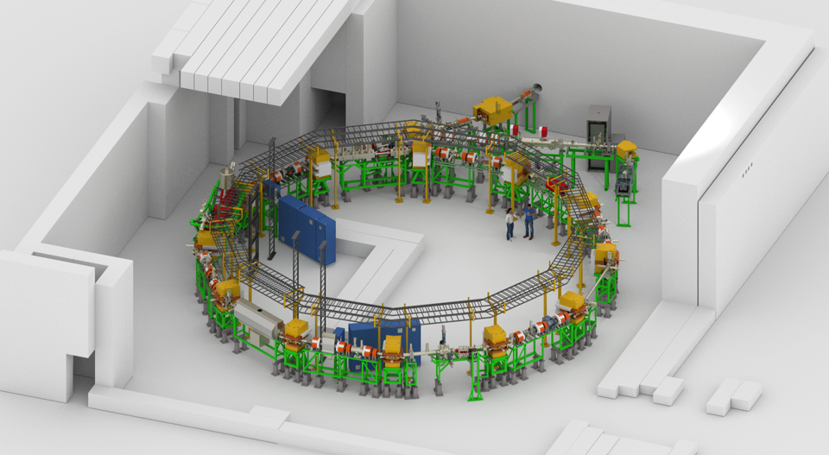
New CRYRING@GSI/FAIR
FIRST FAIR accelerator
ready for experiments and tests
View from local injector to the ring
KHuK meeting, 7 December 2018

Slide 10
FAIR Research Pillars:
- a fore-front scientific program in many areas
Atomic Physics and Fundamental Symmetries,
Plasma Physics,
Materials Research,
Radiation Biology,
Cancer Therapy with Ion Beams / Space Research
Dense and Hot Nuclear Matter
Nuclear Structure and Reaction Studies
with nuclei far off stability,
Physics of Explosive Nucleosynthesis (r-process)
Hadron Structure & Dynamics
with cooled antiproton beams
APPA
CBM
NUSTAR
PANDA
KHuK meeting, 7 December 2018

Slide 11
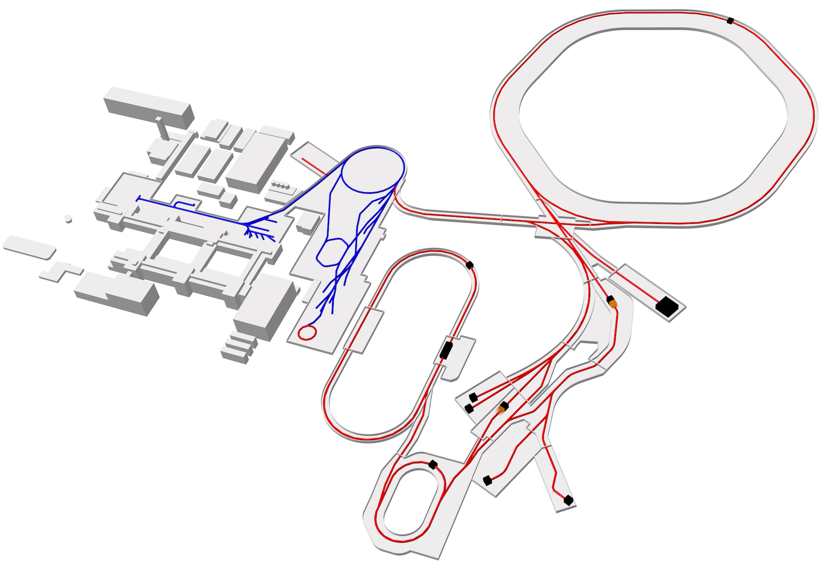
FAIR Modularised Start Version (MSV)
SIS100
SIS18
ESR
CBM/HADES
Modules
M0: SIS100
M1: APPA
M1: CBM/HADES
M2: NUSTAR
M3: PANDA ,NUSTAR, APPA
Super
FRS
Cryring
APPA
PANDA
HESR
CR
NUSTAR
KHuK meeting, 7 December 2018
Notes:
At the moment the so-called Modularized Start Version of the FAIR facility is under construction.

Slide 12
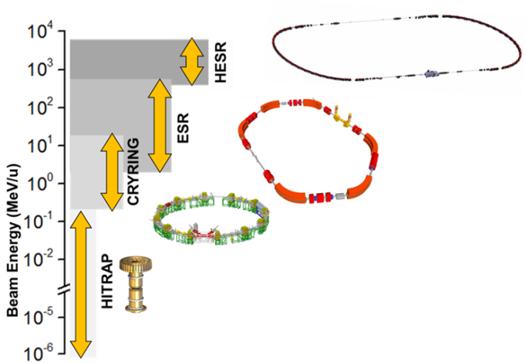
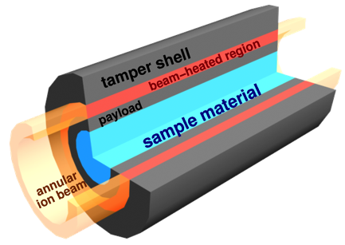
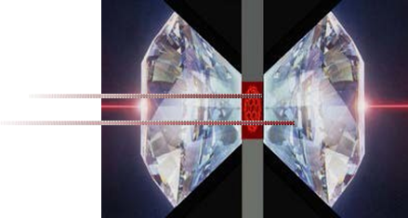
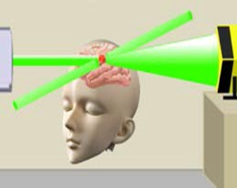
APPA
HED
plasma
Atomic, Plasma Physics and Applications
  About 800 members
  Wide field of science
    basic research into material, biological and medical applications and space research
BIO-MAT
SPARC
ESR
Atomic Physics
SPARC: ~400 members from 26 countries
Cryring
Plasma Physics
HED: ~300 members from 16 countries
HESR
Materials Research and Biophysics
BIOMAT: ~100 members from 12 countries
KHuK meeting, 7 December 2018

Slide 13
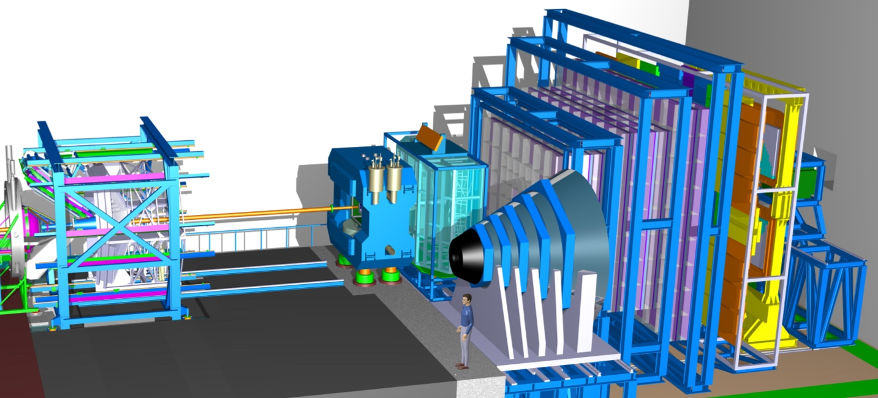
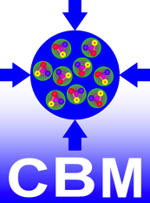
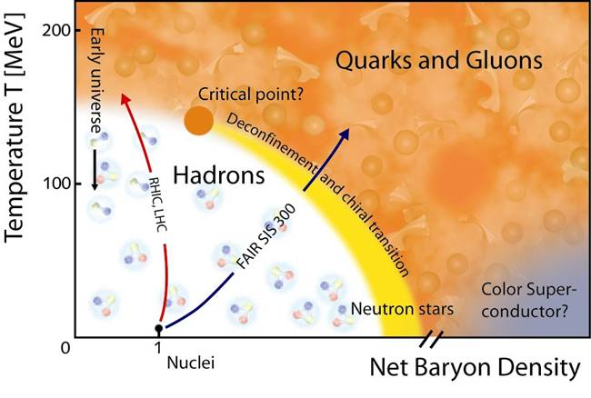
C.B.M.
HADES …… CBM
Compressed Baryonic Matter Experiments
  About 400 members
FAIR
SIS100
KHuK meeting, 7 December 2018

Slide 14
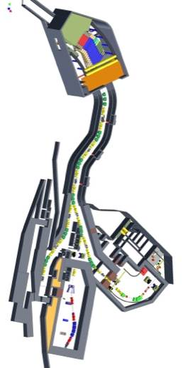

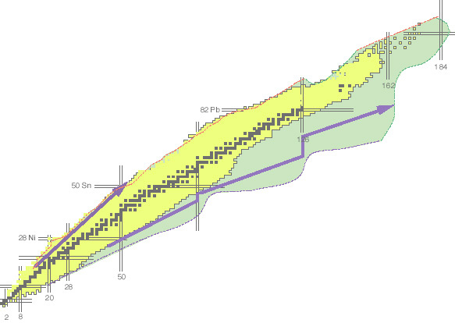
NUSTAR
Nuclear Structure, Astrophysics and Reactions
  About 800 members
Super-FRS
NUSTAR
KHuK meeting, 7 December 2018

Slide 15
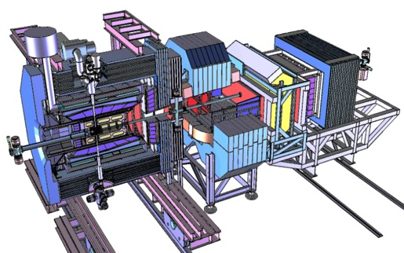

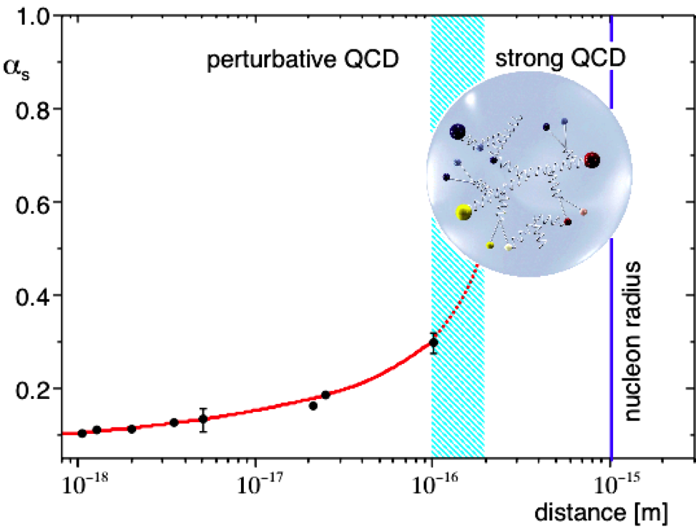
PANDA
antiProton ANnihilations
at DArmstadt
  About 500 members
PANDA
KHuK meeting, 7 December 2018

Slide 16
Experiments: Status Overview
Day-1 configurations guarantee efficient start at given level of funding
Vetted by committees of external experts: ECE and JSC
Several components already constructed and being tested in Phase-0
EoIs (yellow) contain additional 2.4 M€ secured by German pledge for APPA and NUSTAR,
PANDA secured funding includes conditional Russian pledge of 8.8 M€ (light green)
Experiment preparation is progressing well !
KHuK meeting, 7 December 2018

Slide 17
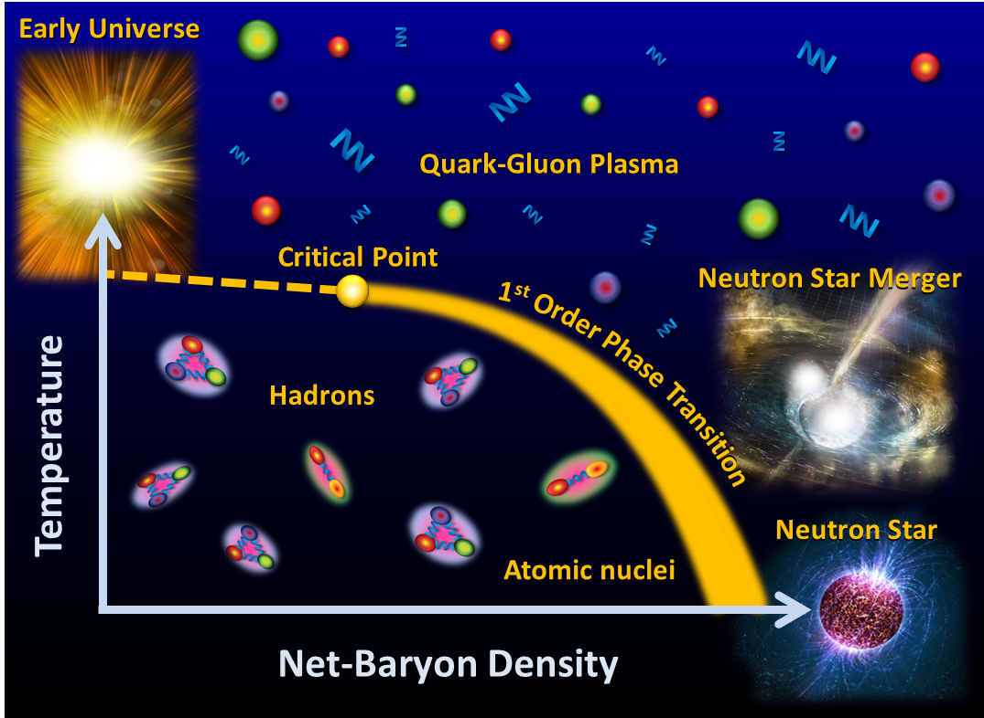
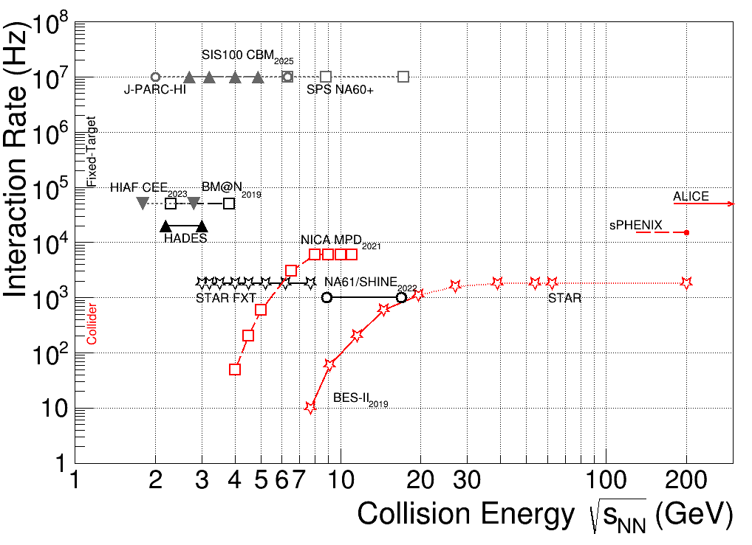
CBM - Compressed Baryonic Matter
CBM Experiment at FAIR: Systematically explore QCD matter at large baryon densities with high accuracy and rare probes, at highest interaction rates in the field.
Tetyana Galatyuk, Quark Matter 2018, “Future high-µB facilities“
KHuK meeting, 7 December 2018

Slide 18
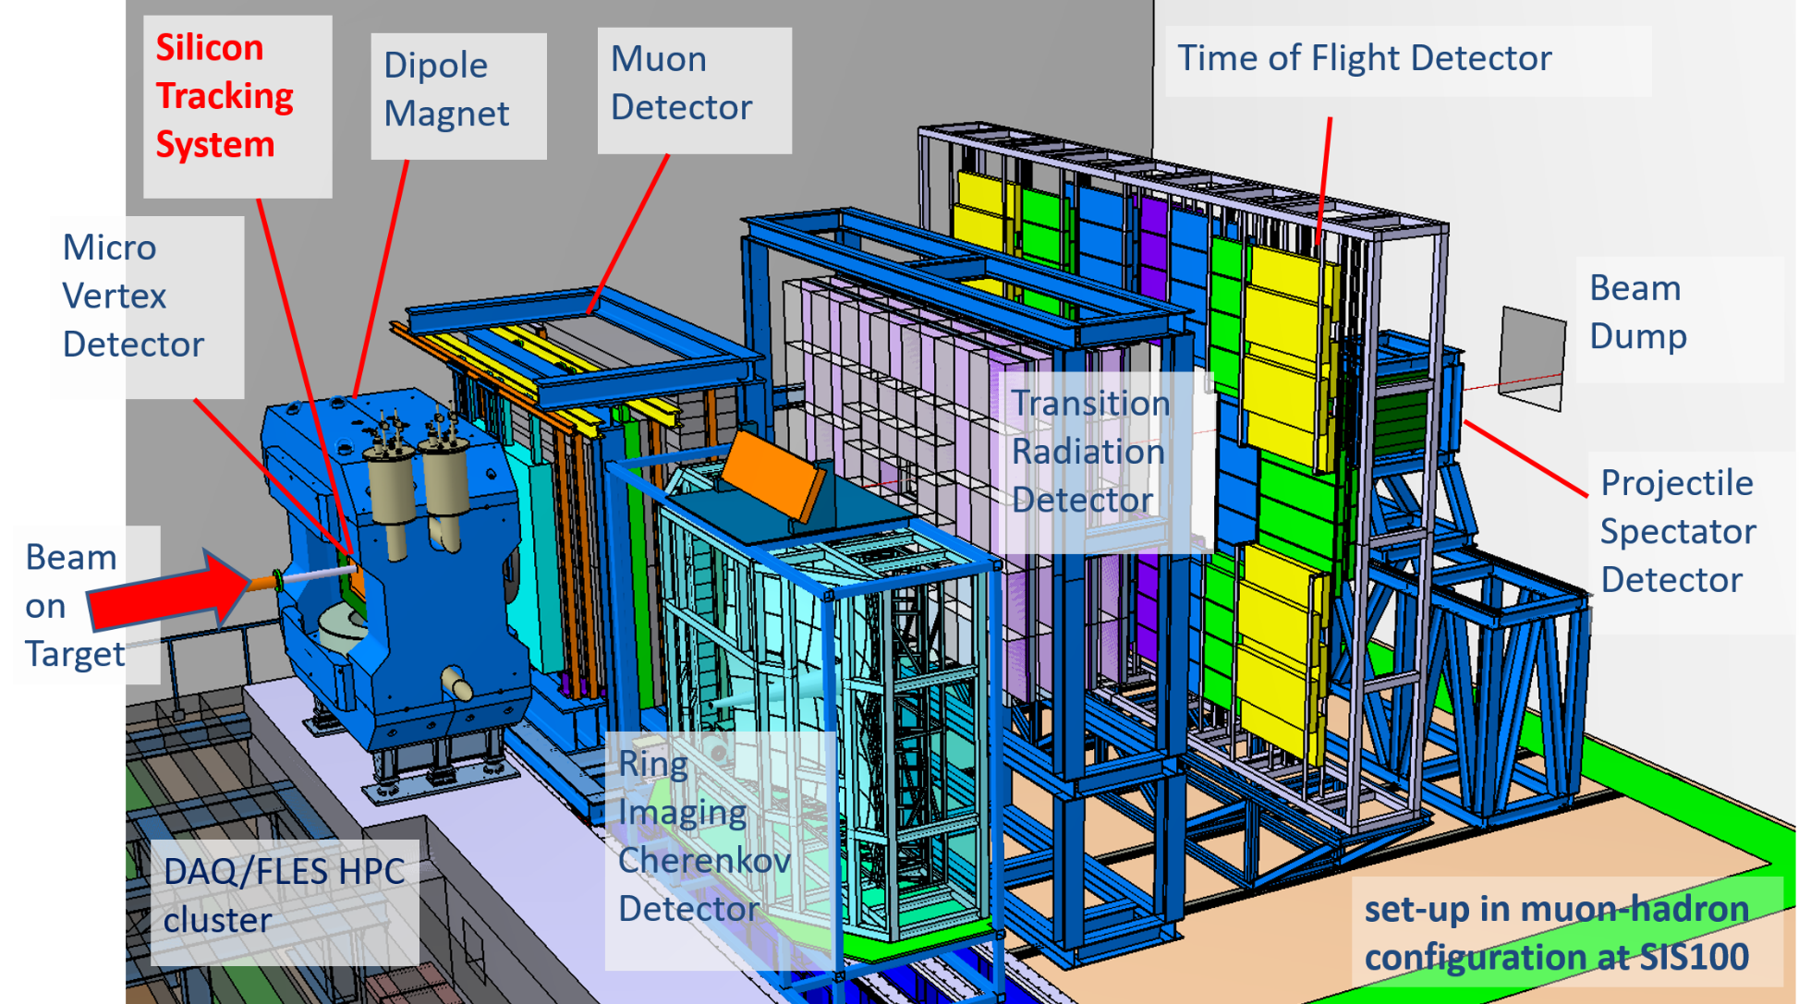
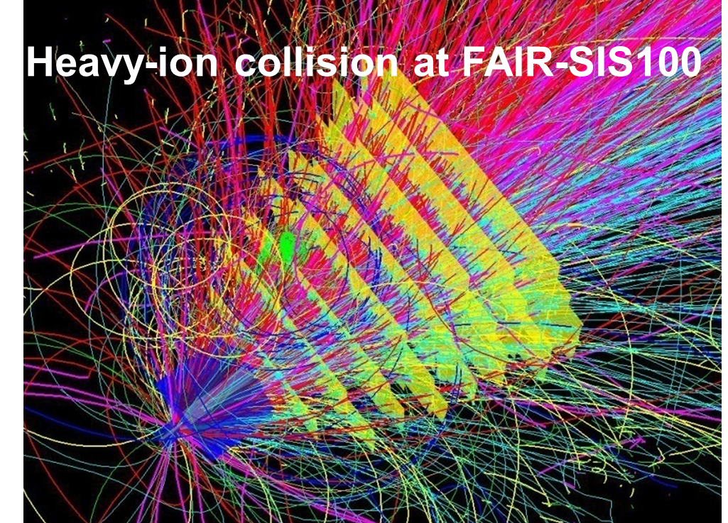
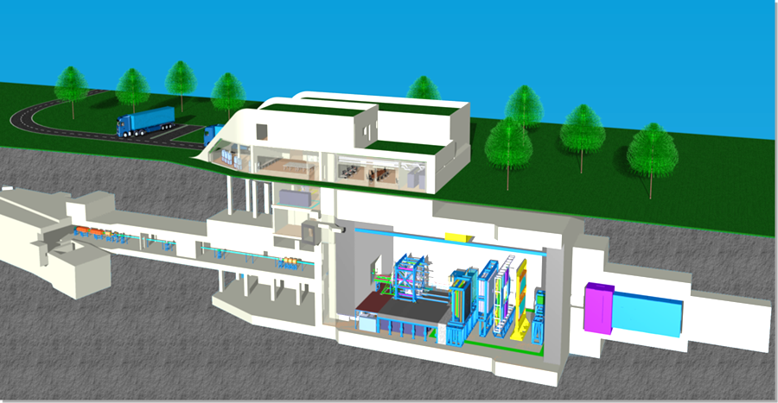
CBM Experiment at FAIR
typical collision system: Au⁷⁹⁺ +Au at 4 to 11 AGeV
Day 1: beam intensity: 5x10⁷ ions/sec; interaction rate 0.5 MHz
MSV: beam intensity: 10⁹ ions/sec; interaction rate 10 MHz
HADES CBM
KHuK meeting, 7 December 2018

Slide 19
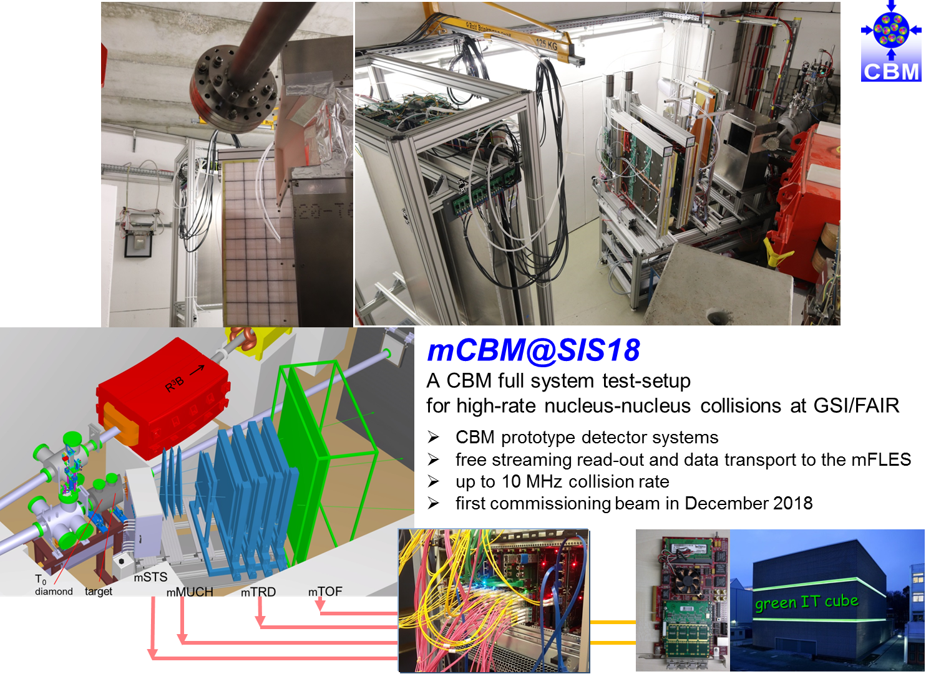
First beam on miniCBM@SIS18
A glimpse of actual beam-ready miniCBM setup which received beam on target.
Data from individual read-out chains of the subsystems mSTS, mMUCH and mTOF is possible.

Slide 20



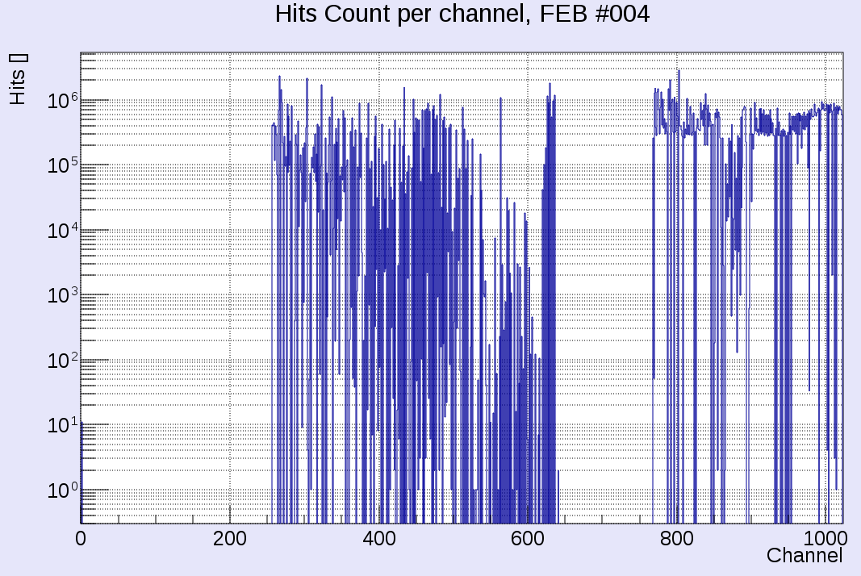
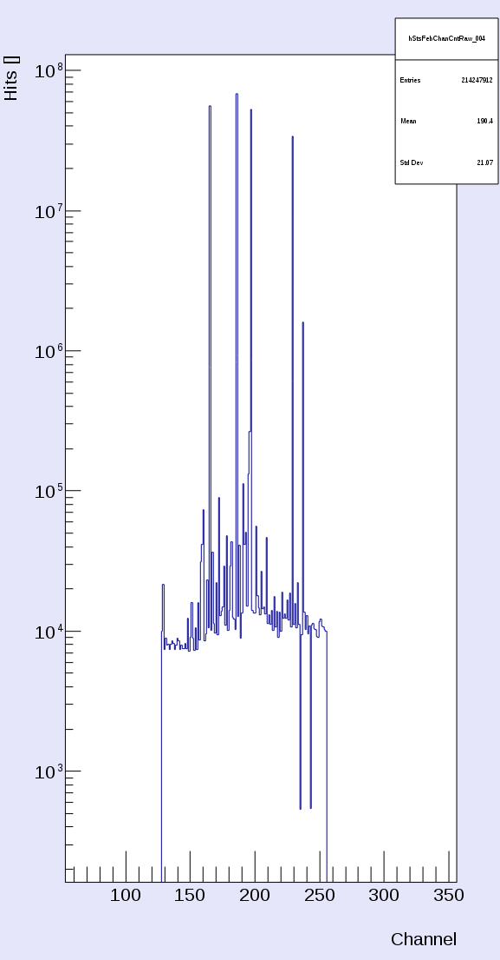
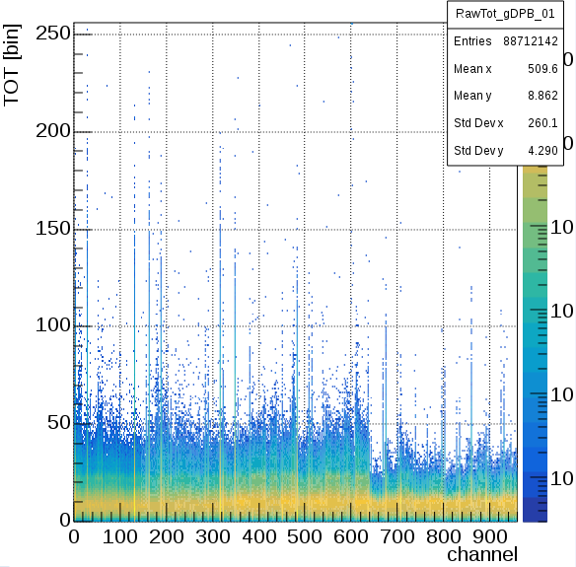
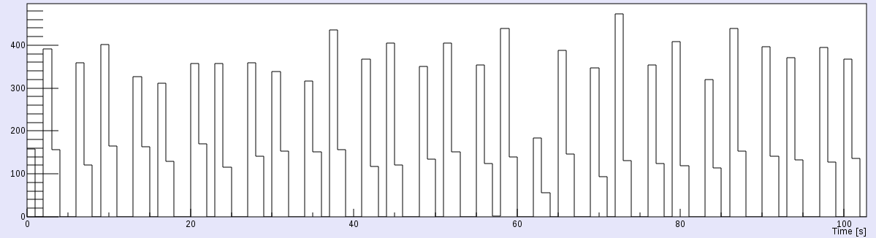
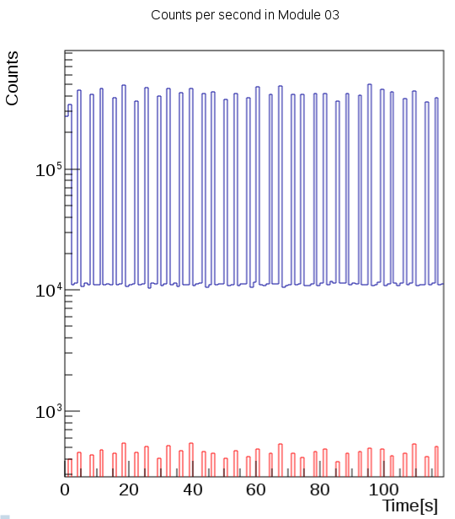



First beam on mCBM
data streams from:
mSTS
mMUCH
mTOF
beam profile
5m downstream
in front of beam dump
Dec. 5th, 2018, Ag (42+) 0.95AGeV

Slide 21





Status of FAIR: experiments
CBM and HADES
CBM TRD module test
at DESY
beam dump completed
HADES, ready for beam
KHuK meeting, 7 December 2018

Slide 22



First beam on HADES@SIS18
HADES Spectrometer
RICH Upgrade
HADES Calorimeter
Finished, Ready for Beam
a screen shot of a quick analysis of the diamond beam detector, HADES which is detecting each beam ion online!
the hits on the individual stripes of the diamond detector (x/y), a strip is 300 micrometer wide

Slide 23

Latest News! Beam stored in the ESR

Slide 24



NUclear
STructure Astrophysics and Reactions
The limits of nuclear existence (lifetimes, decays, …)
Ground state properties (masses, radii, …)
Structure of excited states (shell structure, shapes, …)
Unbound and other exotic system (halo, skin, …)
Nuclear equation of state
KHuK meeting, 7 December 2018

Slide 25







NUSTAR
- Origin of Elements in the Universe
Neutron Star Merger
„Nucleosynthesis sites“ in the universe
Type I Supernova
Nova
Type II Supernova
„Nucleosynthesis sites” at FAIR
Sun
MATS & LaSpec
HISPEC/DESPEC
R³B
SFRS
SIS
100
production
target
ILIMA, EXL at CR
and at ESR, HESR, Cryring
25
25

Slide 26

NUSTAR
- Origin of Elements in the Universe
Neutron Star Merger
„Nucleosynthesis sites“ in the universe
High SIS100 energies + SFRS: superior charge separation
and beam quality
Type I Supernova
Nova
Type II Supernova
Sun
MATS & LaSpec
HISPEC/DESPEC
R³B
SFRS
SIS
100
ILIMA
production
target
SPES-LNL
26

Slide 27

Status of NuSTAR experiments
- detector R&D and construction
MUCH
TRD
KHuK meeting, 7 December 2018

Slide 28


EXAMPLE:
R3B Start Version for Phase 0
GLAD magnet (French in-kind contribution)
Start of physics program with GLAD
using beams from SIS18 and FRS at 1 GeV/u
KHuK meeting, 7 December 2018

Slide 29


PANDA - AntiProton Annihilation at Darmstadt
NUPECC Long Range Plan
  The combination of PANDA’s discovery potential for new states, coupled with the ability to perform high-precision systematic measurements is not realised at any other facility or experiment in the world.
KHuK meeting, 7 December 2018
Notes:
Hadron Physics with Antiprotons at PANDA/FAIR
• Hadron Physics Goals
• Advantages of Antiprotons
• Competitiveness
• Status of Experiment
• Summary

Slide 30



PANDA - AntiProton Annihilation at Darmstadt
HESR
KHuK meeting, 7 December 2018

Slide 31


HESR – Storage Ring for Antiprotons
Parameters of HESR
injection of p at 3.7 GeV → slow synchrotron (1.5-15 GeV/c)
storage ring for internal target operation
luminosity up to L = 2 x 10³² cm⁻²s⁻¹
beam cooling (stochastic [& electron @ Phase-3])
E_{CM}
precision spectroscopy with p beams
Resonance scan
energy resolution ~50 keV
tune E_{CM} to probe resonance
extremely precise mass and width
KHuK meeting, 7 December 2018

Slide 32






Pellet
Target
Cluster Jet
Target
Muon
Detector
Target Beam Dump
Magnet Yoke Octant

Slide 33







Micro Vertex
Detector
Forward
TOF
Straw Tube Tracker
Forward Tracker
Luminosity
Detector
Forward RICH

Slide 34




APPA - Atomic Physics, Plasma Physics, and Applied Sciences
APPA Cave
KHuK meeting, 7 December 2018

Slide 35





BIOMAT / Materials Research & Bio Physics
Biophysics
APPA Cave
Materials Research
BIOMAT
Simulation of galactic radiation
main hindrance toward manned space exploration
Widely unknown biological effects of heavy ions
Space radiation biophysics
NASA and ESA started a large experimental campaign
Particle therapy
Materials behavior under extreme conditions
Irradiations under high pressure solids with new phases, unknown phase transitions in mineralogy and geophysics
Radiation hardness of accelerator and spacecraft components
Ion-matter interaction at relativistic beam energies
KHuK meeting, 7 December 2018

Slide 36



APPA Cave for Plasma Physics / HED@FAIR
Properties of materials driven to extreme conditions and relevant to planetary science.
Shocked matter and material equation of state (EOS).
Basic properties of strongly-coupled plasma created with heavy ion beams and lasers.
External Drivers
Dynamic compression (shocks, ramp) or fast heating by external drivers:
e.g.: high energy laser
Proton Radiography PRIOR:
Use protons for precise density measurements
PHELIX@GSI
KHuK meeting, 7 December 2018

Slide 37




Ion Beam Facilities / Trapping & Storage
Precision: Stored and Cooled
Highly-Charged Ions (e.g. U⁹²⁺) and Exotic Nuclei
From Rest to Relativistic Energies (up to 4.9 GeV/u)
Worldwide Unique
Radiative corrections in the non-perturbative regime
Correlated multi-body dynamics for atoms and ions
Precision determination of fundamental constants
Influence of atomic structure on nuclear decay properties
Astrophysics with Stored Highly Charged Ions
✓
✓
✓
KHuK meeting, 7 December 2018

Slide 38


Schedule for FAIR Science
Working towards the completion of FAIR by 2025+
Major thrust is on construction of FAIR accelerators and experiments.
At the same time staged approach to FAIR science and progressive commissioning of accelerators
and detectors:
    FAIR phase 0 : start in 2018/2019
    FAIR day 1 configurations/ phase 1 experiments with FAIR accelerators progressively approaching design parameters → 2024 …
    Full FAIR operation 2025+
APPA
CBM
NUSTAR
PANDA
KHuK meeting, 7 December 2018

Slide 39

FAIR phase-0 intermediate research program
Objectives:
  Commissioning of accelerators and detectors
  Forefront research by employing
  and testing new FAIR detectors
  Exploiting upgraded GSI
  accelerator facilities incl. the
  newly installed CRYRING
  Education of young scientists
  Maintain and extend skills and
  expertise
  Serve national and international
  user community
Requires careful techn. preparation:
  full re-commissioning of the
  UNILAC/SIS18/ESR complex
  incl. new controls
  gradual implementation from 2017 to 2019
KHuK meeting, 7 December 2018

Slide 40

Accelerator and Experimental Facilities
available for FAIR phase-0
up to 90 % speed of light
Accelerated ions: H⁺,..., U⁹²⁺
heavy-ion synchrotron
SIS 18
Experiment station
PHELIX
linear accelerator
UNILAC
M-branch
ion sources
Z6
Fragment Separator
HHT
storage ring ESR
8 % - 15 % speed of light
HITRAP
HADES, mCBM
Cave A, M
Cave C (R3B)
External Cooperations Related to FAIR Phase-0
RIKEN, MSU, IMP/Lanzhou, BESIII/Beijing/IHEP, JLAB/Newport, RHIC/Brookhaven,Dubna
CRYRING
GPAC: Beam time for FAIR Phase-0
149 experiments; more than 1000 scientists
KHuK meeting, 7 December 2018

Slide 41












Accelerator and Experimental Facilities available for FAIR phase-0
FRS
ESR
HITRAP
Cryring
SIS18
UNILAC
ESR
R3B
UNILAC / SIS18
CRYRING
PHELIX
TASCA
SHIP
HADES
KHuK meeting, 7 December 2018

Slide 42
FAIR Phase-0 – first campaign
Beam time started in June 2018 as planned
Interruption of the physics run due to the accident on the power supply (transformer damage) of the UNILAC on 13th July 2018
After a careful analysis of the damage and the situation, shift of the beam time 2018 to spring 2019
Until the beam time interruption about 25 days beam-on-target could be delivered with several exciting results, reflecting the scientific need and the promising prospects of FAIR phase-0 …
KHuK meeting, 7 December 2018

Slide 43



SHIP/SHIPTRAP
First direct mass measurement of a superheavy element
Two-week beamtime campaign in June/July 2018
new / improved mass values for ^{251,251m,254,254m}No and ^{254,254m,255m,255,256}Lr
pinned down nuclear isomers with supreme resolving power of
novel PI-ICR technique of up to m/Δm = 10⁷
^{257g,m}Rf (Z=104) measurement at a rate of about 1 event per shift
10 hour measurement
1.2 s phase acc. time
m/Δm ≈ 10⁷
35 keV isomer resolved
10
²⁵⁵Lr
^{center}
PRELIMINARY
0
2.5 s
22 s
y-position [mm]
Φ
-10
^{255g}Lr
^{255m}Lr
-10
0
10
x-position [mm]
Mitarbeiterversammlung, 11 December 2018
Notes:
PI-ICR stands for Phase Imaging Ion-Cyclotron-Resonance for short lived
A novel approach based on the projection of the Penning-trap ion motion onto a position-sensitive detector opens the door to very accurate mass measurements on the ppb level even for short-lived nuclides with half-lives well below a second. In addition to the accuracy boost, the new method provides a superior resolving power by which low-lying isomeric states with excitation energy on the 10-keV level can be easily separated from the ground state.
Determination of the cyclotron frequency of ion of charge q and mass m in a magnetic field B via the projection of the ion motion on a microchannel plate detector.
Groundstate 255Lr: Lebensdauer 22 s
Isomerer Zustand: 2.5 s (deshalb weisses Dreieck)
both alpha decay with a contribution of beta+

Slide 44
SHE Chemistry
Recommissiong of TASCA
Upgrades during 2017/18 shutdown:
new TASCA control system, integrated in GSI "control system" environment
relocation of TASCA control room due to renovation of SE building
upgraded shielding in cave X8 for improved background conditions
new quadrupole magnet power supplies
new TASCA detector chamber
→ more flexibility for focal plane detectors
det. systems, coupling chemical devices, ...
complete febex4-based digital DAQ for full focal plane detector
Beam commissioning (June 2018):
⁴⁸Ca/⁵⁰Ti+Yb / Au / Pb:
Ion optical performance verified
Control system and DAQ fully operational
Preliminary results obtained during TASCA Recommissioning 2018
Candidate events for new, most neutron-deficient Md isotope
(element 101) in ⁴⁸Ca + ¹⁹⁷Au reaction
Example of the ER-alpha correlations
²⁴⁵Md
Candidates
for ²⁴⁴Md
(new isotope)
(confirms known data)
SHE Chemistry, GSI/HIM
KHuK meeting, 7 December 2018

Slide 45

Isotopes discovered at GSI and FAIR
Mitarbeiterversammlung, 11 December 2018

Slide 46

2019 beam time plan for experiments

Slide 47



Planned Experiments within FAIR Phase-0
How Nature makes the building blocks of life
Alpha fusion on ¹²C is the stellar
reaction of paramount importance,
W.A. Fowler, Nobel lecture 1983
Rate insufficiently known at
astrophysically energies
Experiments in inverse kinematics:
Coulomb dissociation requires high energies
=> GSI/FAIR runs already in FAIR Phase-0 in 2019 or direct approach deep underground.
KHuK meeting, 7 December 2018

Slide 48








Planned Experiments within FAIR Phase-0:
Further reaction studies relevant to Nucleosynthesis
^{N}A^{Z+} (p, γ) in-flight studies
at low-energies
Astrum
Jan Glorius et al., to be published 2018
KHuK meeting, 7 December 2018

Slide 49

FAIR 2025
Unique Opportunities
. . . & Challenges
Thank You!
KHuK meeting, 7 December 2018

