Slide 1
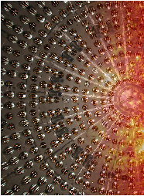
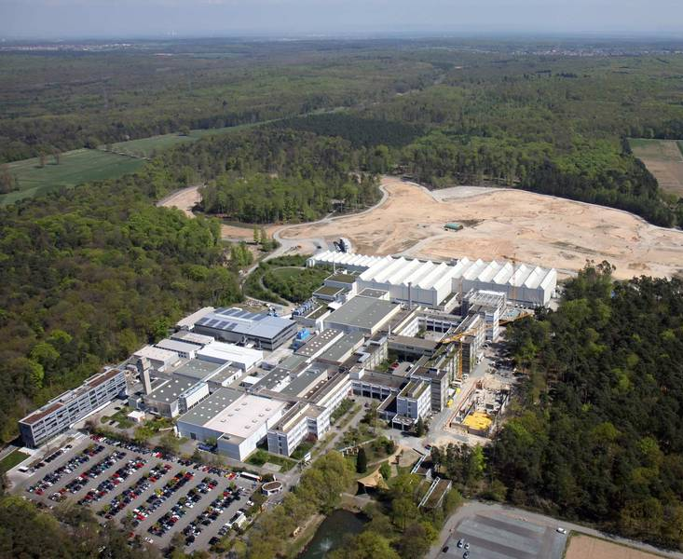
Status report on ikp of fz-jülich
JEDI
PANDA
HESR
COSY
Borexino
FAIR
„Transfair“
7.12.2018 I hans ströher (IKP, forschungszentrum jülich)

Slide 2
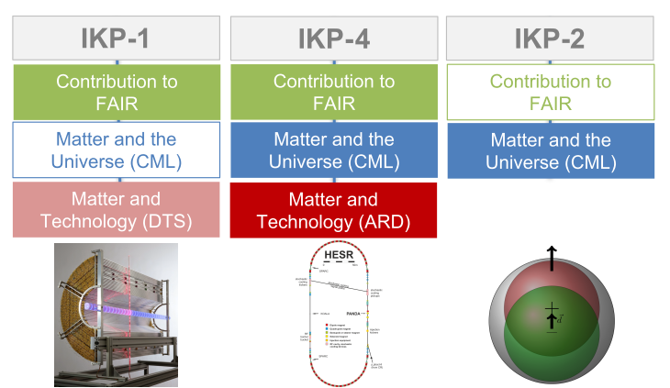
Institut für kernphysik (IKP)
Helmholtz Structure (PoF III)
Research Field
Programmes
Topics
Contributions by IKP
Contribution to FAIR
IKP-3/IAS-4 („Theory“) in „Key Technologies“
will be in „Information“ in PoF-IV

Slide 3
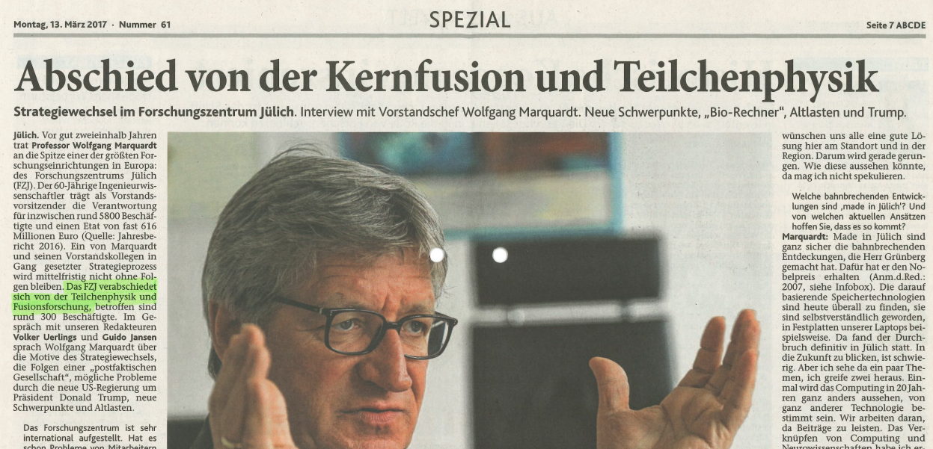
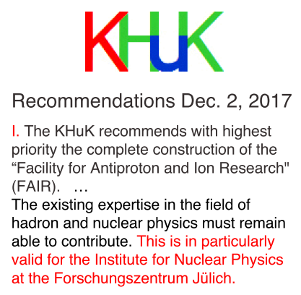
Institut für kernphysik (IKP)
Strategy Process of Forschungszentrum Jülich
11/2015 Draft … IKP a „posteriority“ in FZJ (decision not science-driven)
05/2017 Supervisory Board (Aufsichtsrat) FZJ … conditional approval
11/2018 Supervisory Board FZJ: acceptance
11/2018 Supervisory Board GSI: acceptance
„TransFAIR“: IKP/FZJ → GSI

Slide 4
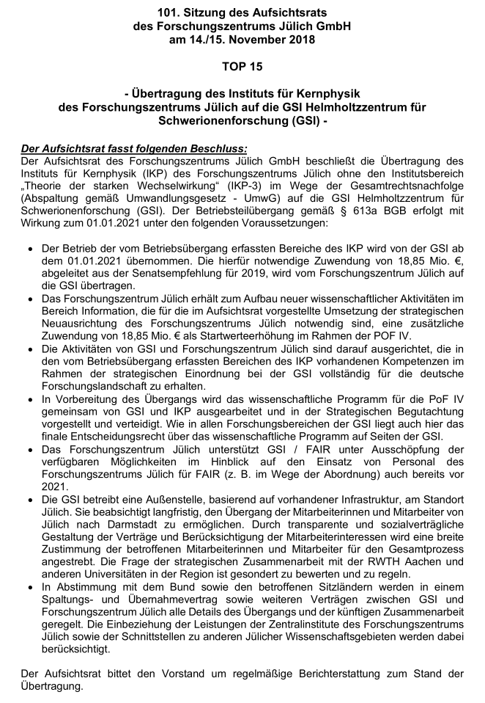
Institut für kernphysik (IKP)
TransFAIR – Decision Supervisory Boards of FZJ and GSI
IKP of FZJ (w/o IKP-3 (Theory))
IKP transferred to GSI as of Jan. 1, 2021
annual budget: 18.85 M€ (2019 value)
FZJ receives increase of starting values
of 18.85 M€
Perpetuation of IKP competences
Common scientific PoF-IV program
Help for FAIR prior to 2021
IKP outpost in FZJ, cooperation w/
RWTH, other nearby universities
All details in „transition contract“

Slide 5
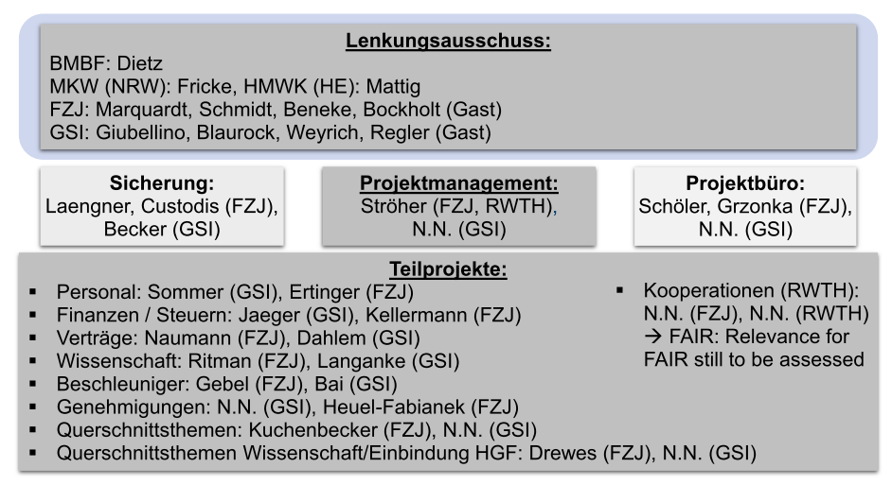
Institut für kernphysik (IKP)
TransFAIR – Details, Contract → Project Structure (tbc)

Slide 6
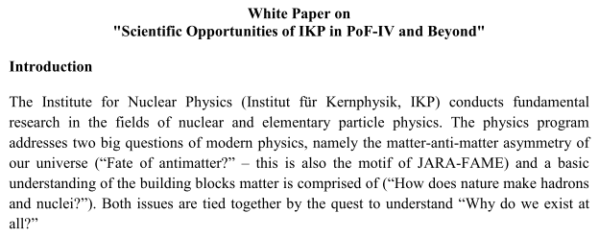
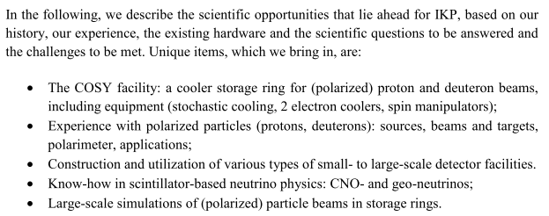
Institut für kernphysik (IKP)
TransFAIR – Science (White Paper „Science Opportunities of IKP …“)
(…)
COSY facility
Accelerator physics: storage rings (cooling)
Polarization (beams, targets)
Neutrino physics (underground labs)
(…)
Accelerator, CBM, PANDA, PAX
Charged particle EDM project
Neutrino: Borexino, JUNO

Slide 7
Institut für kernphysik (IKP)
TransFAIR – General Structure
IKP-1
(Bochum (JR))
IKP-4
(Aachen (AL))
Non
FAIR-
related:
(COSY, EDM,
Neutrino)
IKP-2
(Cologne (HS),
Aachen (LL),
Aachen (JP))
FAIR-
related:
(COSY, HESR,
PANDA; PAX)
How will this be transferred?

Slide 8
Institut für kernphysik (IKP)
TransFAIR – Preparation for PoF IV
… must start now
02/2020 Strategic Review Research Field „Matter“
01/2021 Start PoF IV (with IKP part of GSI)
10/2021 End of ERC srEDM (host institution commitment FZJ)
Next:
12/2018 Visit of GSI Board-of-Management to IKP/FZJ
Annual KHuK Mtg. 2019: Things should be clear(er)!

