Slide 1
Advancing Time Synchronization for Global Quantum Sensing: From GNOME Insights to the GravNet Cavity‑Network Framework
Daniel Gavilán and Oleg Tretiak
26.06.2025

Slide 2
Two general ways of time synchronization
“Dual Link”
“Passive”
Network Time Protocol (NTP)
Bad accuracy (> 1us). Useful for computer time synchronization
IEEE1588 (PTP)
White rabbit
Very good accuracy (< 1 ns)
Short synchronization distances (10km)
Requires “almost” direct connection
Two-way satellite time and frequency transfer (TWSTFT)
Good accuracy (about 1 ns) .
Long synchronization distances
Extremely expensive (> 100K)
Global Navigation Satellite System (GNSS)
Good accuracy (30ns) for many application (first navigation).
Relatively cheap
Affected by many factors (atmospheric phenomena, building, cables length, electronic warfare systems etc..)
Now way to monitor signal delay

Slide 3
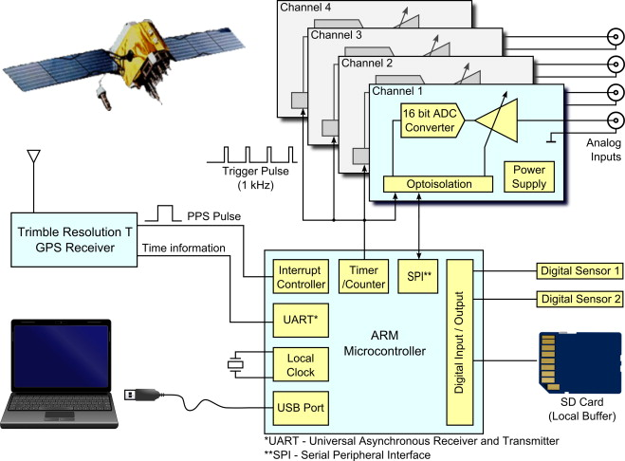
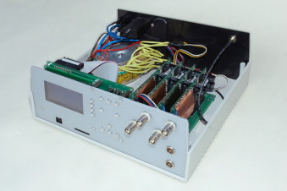
GNOME DAQ system
Włodarczyk, P., Pustelny, S., Budker, D., & Lipiński, M. (2014). Multi-channel data acquisition system with absolute time synchronization. Nuclear Instruments and Methods in Physics Research Section A: Accelerators, Spectrometers, Detectors and Associated Equipment, 763, 150-154.

Slide 4
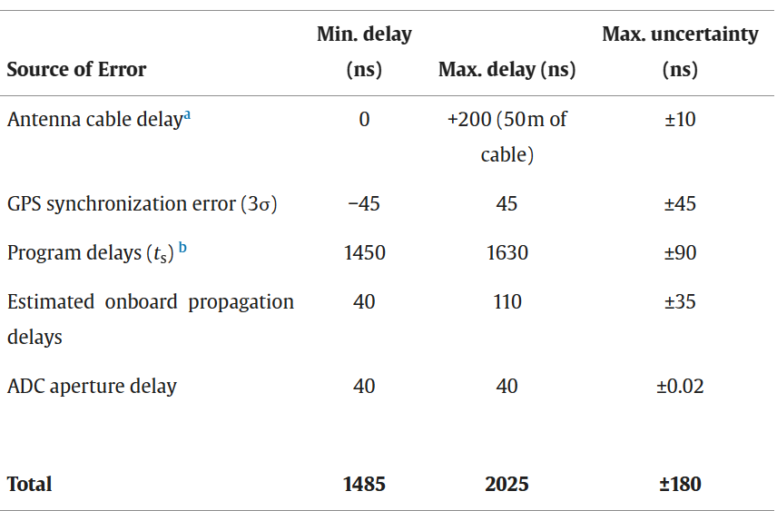
GNOME DAQ system
4 channels
16-bit analog-to-digital converter ADS8507
1 kSample/second data rate
Data logging on SD card (1-Minute-long files)
Włodarczyk, P., Pustelny, S., Budker, D., & Lipiński, M. (2014). Multi-channel data acquisition system with absolute time synchronization. Nuclear Instruments and Methods in Physics Research Section A: Accelerators, Spectrometers, Detectors and Associated Equipment, 763, 150-154.

Slide 5
Timestamping the data with pulse per second (PPS)
Data frame
GNSS PPS
1
0
0
0
0
0
0
0
0
0
0
0
0
1
1
0
0
…
1
1
0
1
0
0
…
1
1
0
1
0
0
…
1
1
1
1
0
0
…
1
1
0
1
0
0
…
1
1
0
1
0
0
…
1
1
1
1
0
0
…
1
1
0
1
0
0
…
1
1
0
1
0
0
…
1
1
1
1
0
0
…
1
1
0
1
0
0
…
1
1
0
1
0
0
…
1
1
1
1
0
0
…
1
1
0
1
0
0
…
1
1
1
Add time Bit on top of ADC readings
Data could be recovered if it is corrupted
ADC 0
1
0
0
…
1
1
1
1
0
0
…
1
1
0
1
0
0
…
1
1
1
1
0
0
…
1
1
0
1
0
0
…
1
1
0
1
0
0
…
1
1
1
1
0
0
…
1
1
0
1
0
0
…
1
1
0
1
0
0
…
1
1
1
1
0
0
…
1
1
0
1
0
0
…
1
1
0
1
0
0
…
1
1
1
1
0
0
…
1
1
0
1
0
0
…
1
1
1
ADC 1

Slide 6
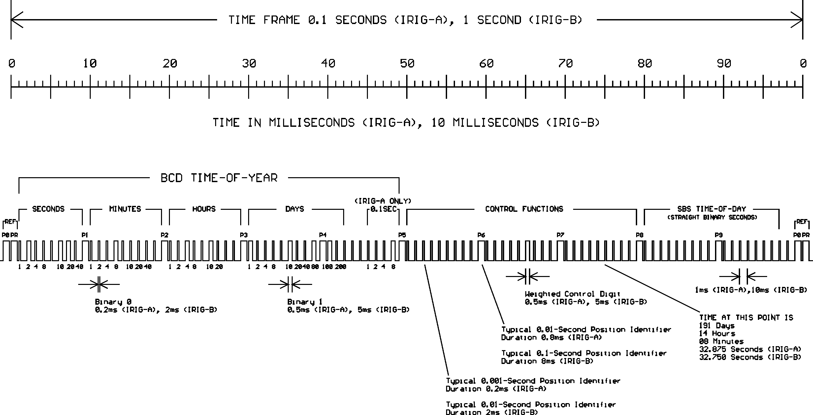
Inter-range instrumentation group (IRIG-B) timecode

Slide 7
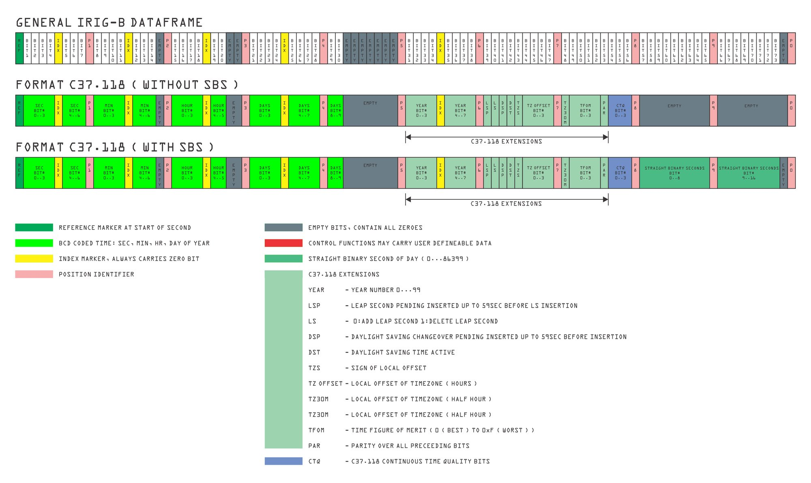
IRIG-B timecode

Slide 8
Timestamping the data with IRIG-B
Time code
Add time Bit and IRIG-B code on top of ADC readings
Data could be fully recovered if it was corrupted
GNSS PPS
1
0
0
0
0
0
0
0
0
0
0
0
0
1
1
0
0
…
1
1
0
1
0
0
…
1
1
0
1
0
0
…
1
1
1
1
0
0
…
1
1
0
1
0
0
…
1
1
0
1
0
0
…
1
1
1
1
0
0
…
1
1
0
1
0
0
…
1
1
0
1
0
0
…
1
1
1
1
0
0
…
1
1
0
1
0
0
…
1
1
0
1
0
0
…
1
1
1
1
0
0
…
1
1
0
1
0
0
…
1
1
1
ADC 0
1
0
0
…
1
1
1
1
0
0
…
1
1
0
1
0
0
…
1
1
1
1
0
0
…
1
1
0
1
0
0
…
1
1
0
1
0
0
…
1
1
1
1
0
0
…
1
1
0
1
0
0
…
1
1
0
1
0
0
…
1
1
1
1
0
0
…
1
1
0
1
0
0
…
1
1
0
1
0
0
…
1
1
1
1
0
0
…
1
1
0
1
0
0
…
1
1
1
ADC 1

Slide 9
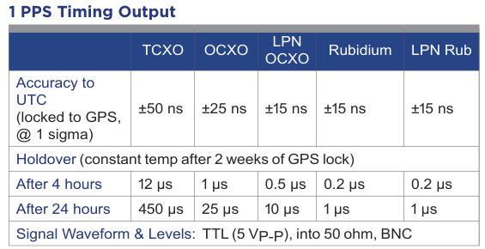
PRESISION TIME REFFERENCE

Slide 10
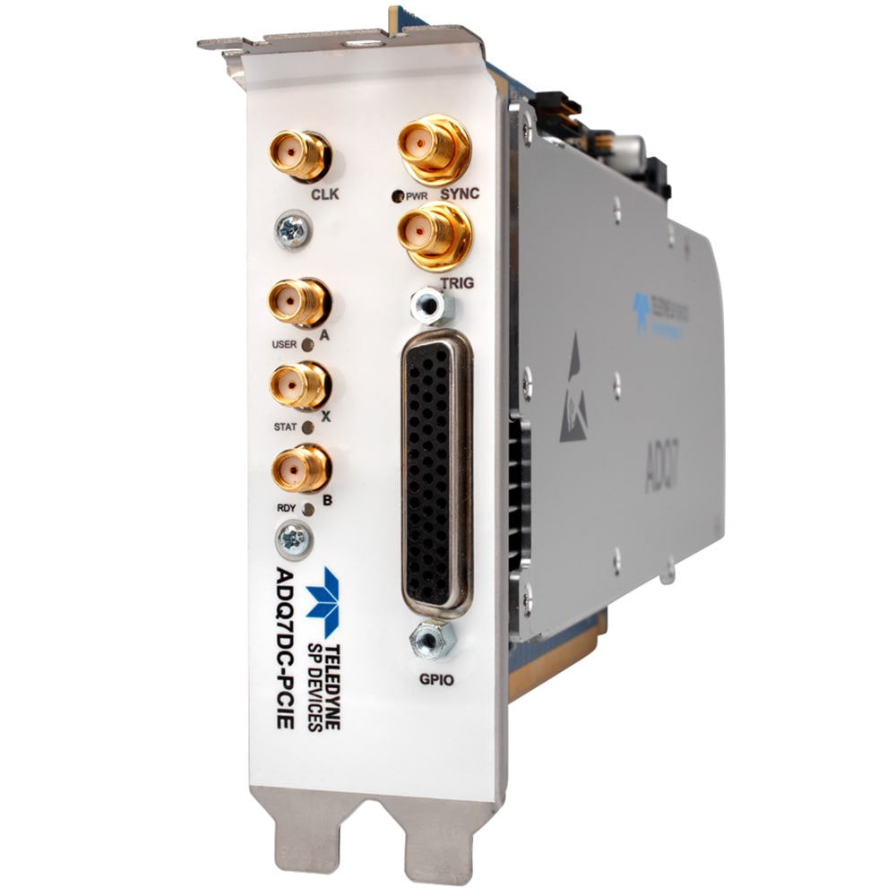
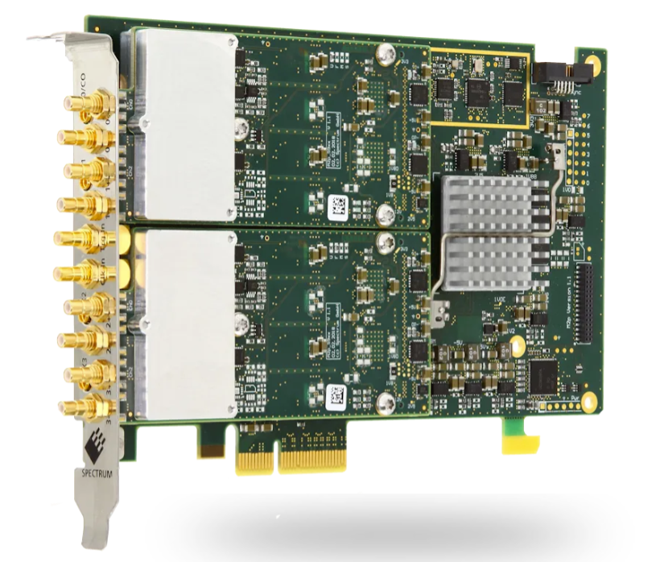
Commercial Daq cards with timestamp
ADQ7DC
M2p.59xx-x4 PCI Express

Slide 11
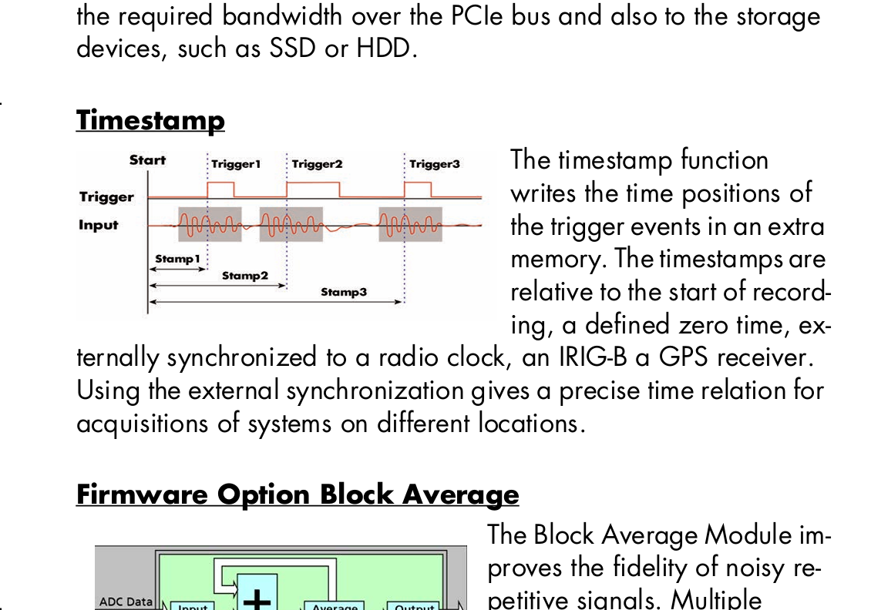
Commercial Daq cards with timestamp
ADQ7DC
M2p.59xx-x4 PCI Express

Slide 12
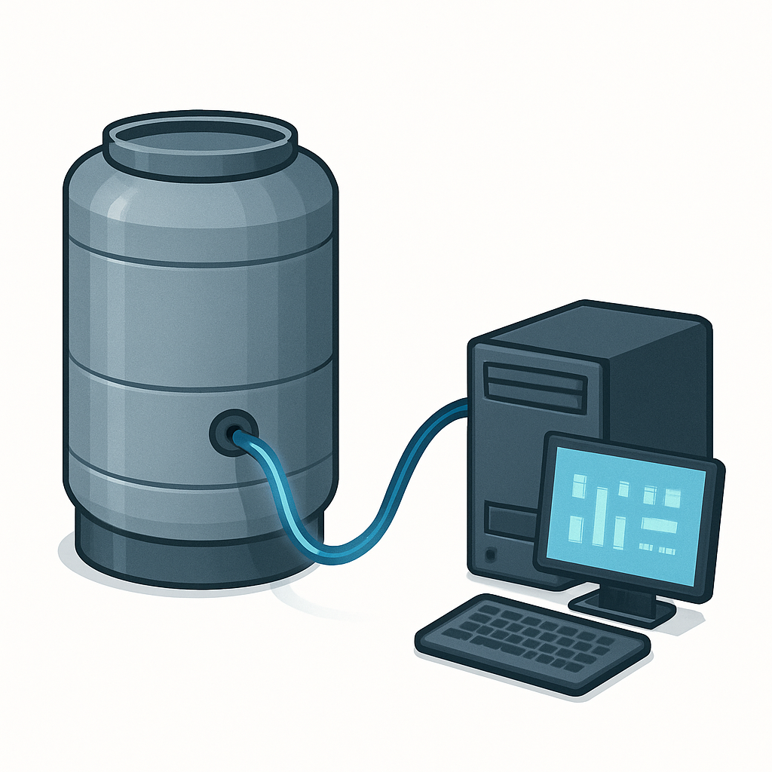
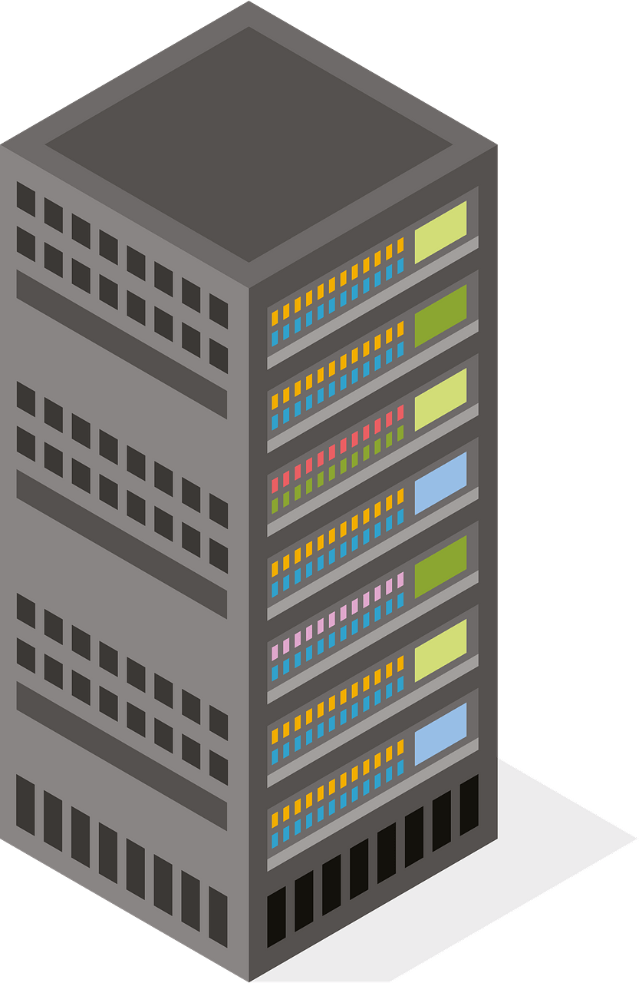
Data on demand Model
Station 1
I have signal! Take my data! Do others see it?
Station 2
Station 3
Data center

Slide 13
Data on demand Model
Station 1
I have signal! Take my data! Do others see it?
Station 2
Station 3
Data center

Slide 14
Data on demand Model
Station 1
Provide me the data for 2:23:45 PM
Station 2
Provide me the data for 2:23:45 PM
Station 3
Data center

Slide 15
Data on demand Model
Station 1
Take my data 2:23:45 PM
Station 2
Take data for 2:23:45 PM
Station 3
Data center

Slide 16
Data on demand Model
Station 1
Take my data 2:23:45 PM
Station 2
Take data for 2:23:45 PM
Station 3
Data center

Slide 17
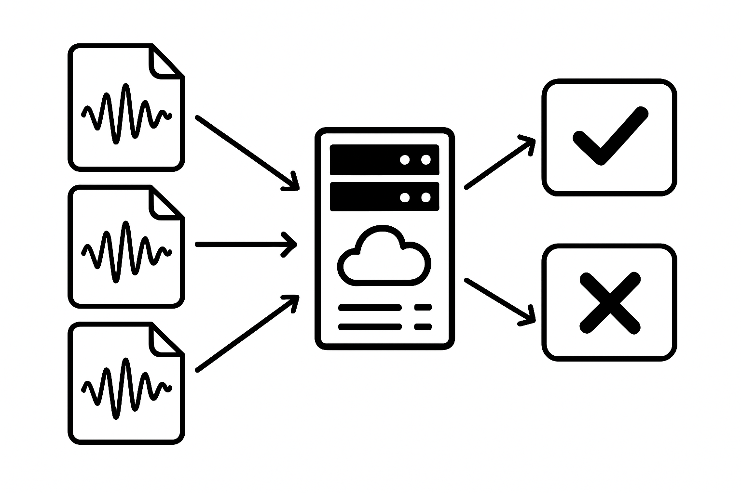
Data on demand Model
Station 1
Corrupted data with timestamps can be reconstructed
Station 2
Station 3
Data center

Slide 18
Thank you!

Slide 19
Network Time Protocol (NTP)
⏱ Precise Time Synchronization
Synchronizes clocks across networks with millisecond accuracy (or better).
🌐 Hierarchy with Stratum Levels
Tiered time sources (Stratum 0 to Stratum 15) ensure redundancy and trustworthiness.
🔁 Continuous Adjustment, Not Jumps
Gradually corrects time via slewing to avoid abrupt system changes.
🧭 Round-trip Delay Compensation
Accounts for network latency to improve accuracy.
🔒 Authentication Support
Can verify time source authenticity to prevent spoofing (e.g. using symmetric keys or Autokey).

Slide 20
Precision Time Protocol (PTP)
⏱ Sub-microsecond accuracy
Provides synchronization precision in the nanosecond to microsecond range — ideal for industrial, financial, and telecom systems.
🌐 Master–Slave Architecture
A Grandmaster clock distributes time to slaves via hierarchical or peer-to-peer setups.
📡 Hardware Timestamping Support
Works with network interface cards (NICs) or dedicated hardware to capture timestamps at the physical layer — boosts precision.
🔁 Delay Measurement & Compensation
Uses two-way message exchange to measure propagation delay and compensate for it in real time.
🧩 Profiles for Specific Industries
Customizable via PTP profiles (e.g., telecom, power systems, finance) that define timing behavior and accuracy requirements.
🧭 Boundary and Transparent Clocks
Specialized network devices that help correct or forward timing information without degradation — key in large or switched networks.
🔒 Security Still Emerging
Less mature than NTP in terms of security; standards like IEEE 1588-2019 are addressing this with new protections.

Slide 21
White rabbit
⏱ Sub-nanosecond Accuracy
Synchronizes clocks with <1 ns precision — far beyond standard PTP. Crucial for experiments, time-critical measurement systems, and high-frequency trading.
🔌 Based on IEEE 1588 (PTP) + SyncE
Combines Precision Time Protocol (PTP) with Synchronous Ethernet (SyncE) to achieve ultra-stable frequency and phase alignment.
🧭 Fixed Path Delay Measurement
Uses precise calibration of fiber lengths and deterministic switching to eliminate jitter and latency variability.
🧬 Deterministic Timing
Guarantees fixed and predictable latency, critical for scientific instrumentation and real-time systems.
🔁 Real-time Delay Compensation
Continuously measures and compensates for signal delay variations (e.g., due to temperature-induced fiber changes).
🛠 Open Hardware + Open Source
Developed at CERN; designs and firmware are openly available for research and industrial use.
🧩 Used in Large-Scale Distributed Systems
Powers timing at facilities like CERN's particle accelerators, radio telescopes, and smart grids.

Slide 22
Two-Way Satellite Time and Frequency Transfer (TWSTFT)
🔁 Two-Way Time Transfer via Satellite
Simultaneous exchange of timing signals between two ground stations using the same satellite — minimizes asymmetrical delays.
⏱ High Precision (few ns)
Achieves ~1–2 nanosecond accuracy, making it ideal for atomic clock comparison, metrology labs, and GNSS validation.
🧭 Delay Calibration Built-in
Because both stations send and receive, propagation delay is measured directly and compensated, improving accuracy over one-way systems.
🛰️ Satellite Link Dependency
Requires leased transponder time on geostationary satellites — high cost and infrastructure needs.
🧪 Used in Time Metrology and Standards
Key method for comparing time between national metrology institutes (NMIs) and maintaining UTC (alongside GNSS and optical fiber).
📶 Carrier-Phase Techniques
Advanced variants use carrier-phase measurements for even higher precision over longer time baselines.
🧷 Robust Against Interference
Independent of internet or local infrastructure; more resistant to network-related timing issues.

