Slide 1
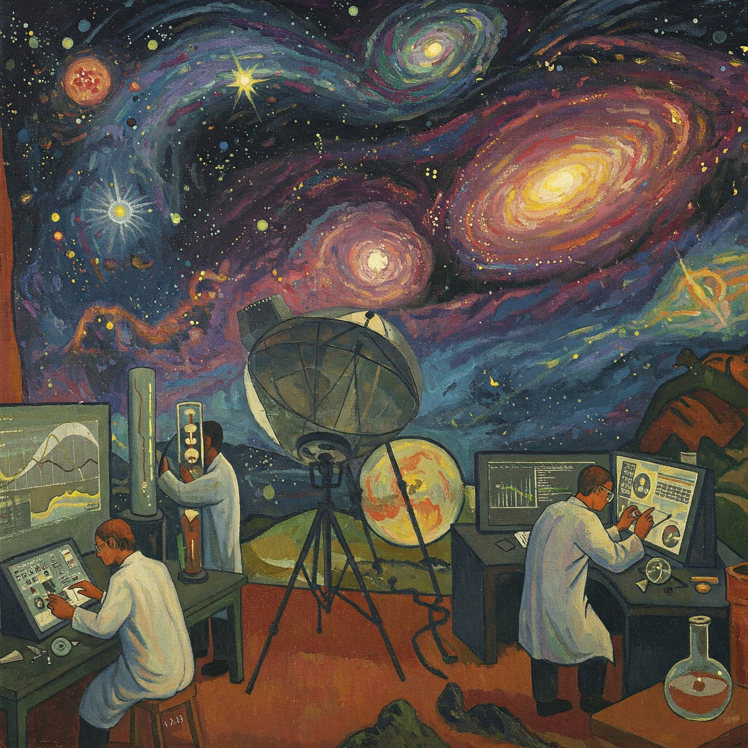
I've
Dark matter and gravitational wave search in Mainz, Europe, on Earth and in the Solar system
”Search for dark matter and gravitational waves in Mainz, Europe, on Earth, and in the Solar system” in the style of Paul Gaugin,
Made with Google Gemini
Dmitry Budker
Helmholtz Institute, Johannes Gutenberg University, Mainz & UC Berkeley
GravNet International Meeting, Mainz, June 26-27, 2025

Slide 2
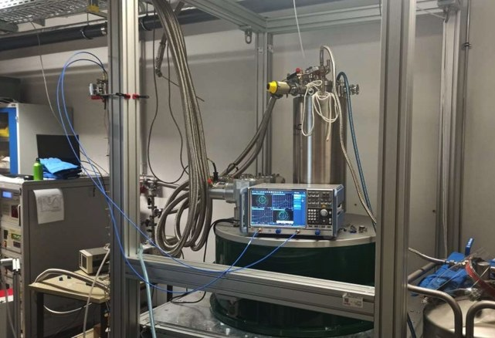
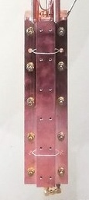
Detection of MHz-GHz Gravitational Waves with GravNet
Bonn, Mainz, Frascati, …
SC cavities; strong magnets
Fixed frequency (use GW chirp)
Global network
Single-photon detection
Supported by ERC
GravNet prototype
CASPEr Mainz
14.1 T magnet
Microwave cavity
© Kristof Schmieden

Slide 3
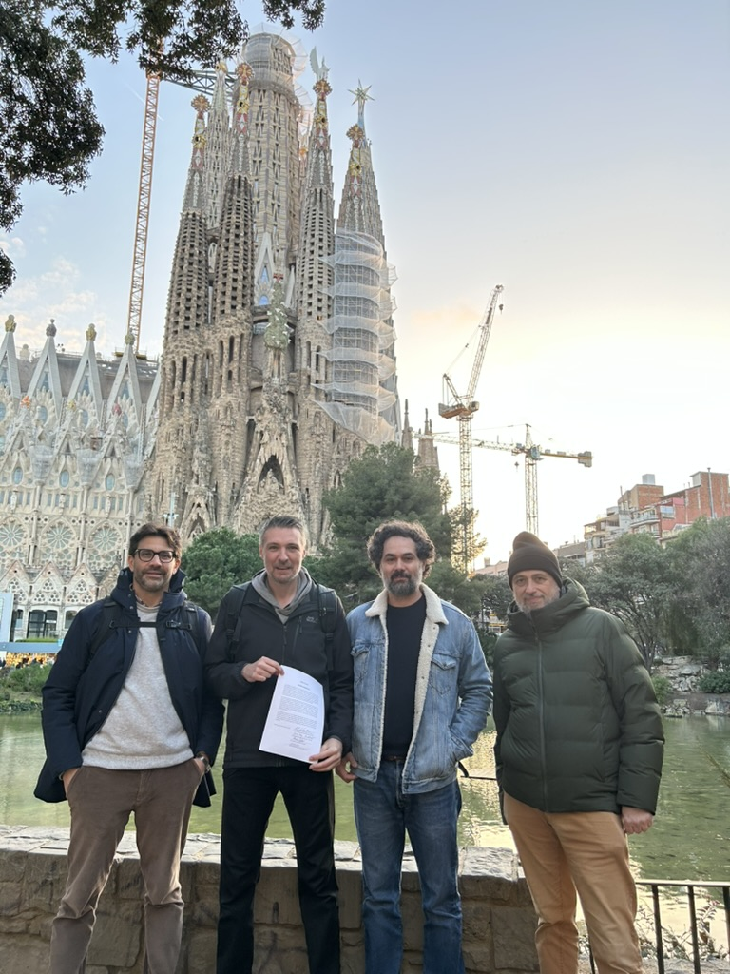
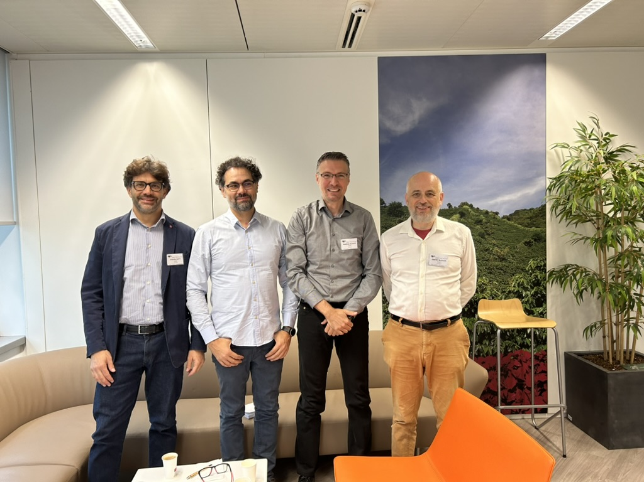
Barcelona
Brussels

Slide 4
The Four Pillars
GravNet
Analysis of axion data
e.g. from CAPP
Cavities in dil.fridges with magnets
Global Network
New Ideas

Slide 5
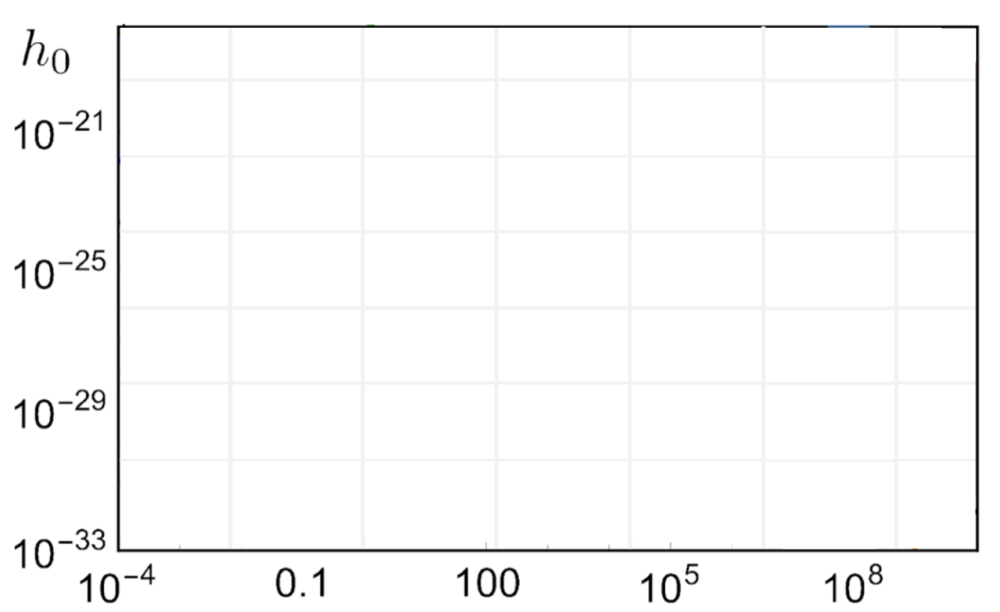
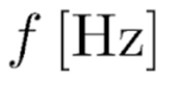
GravNet in 2031
7
Terra Incognita
Modelling and Data Analysis
Cavity Design & Construction
Quantum Amplifiers and Sensors
Amplitude of the wave
Primodial Sources
Network Operation
GravNet MHz
Combination of different frequencies
GravNet GHz
Big Bang Nucleosynthesis
Adding further detectors to network
Frequency of the wave
Notes:
I guess this explains the hype of gravitational waves physics nowadays. However, one easily forgets that they have already a very long history since they have been predicted by Einstein and others already in 1916. Even more strikingly the first experimental efforts using interferometers started in 1977, where you can see here a picture of the first setups. In the end it took nearly 40 years of R&D to allow for the first observations by LIGO and Virgo increasing the sensitivities by 8 orders of magnitude, yielding the second Nobel Prize.

Slide 6
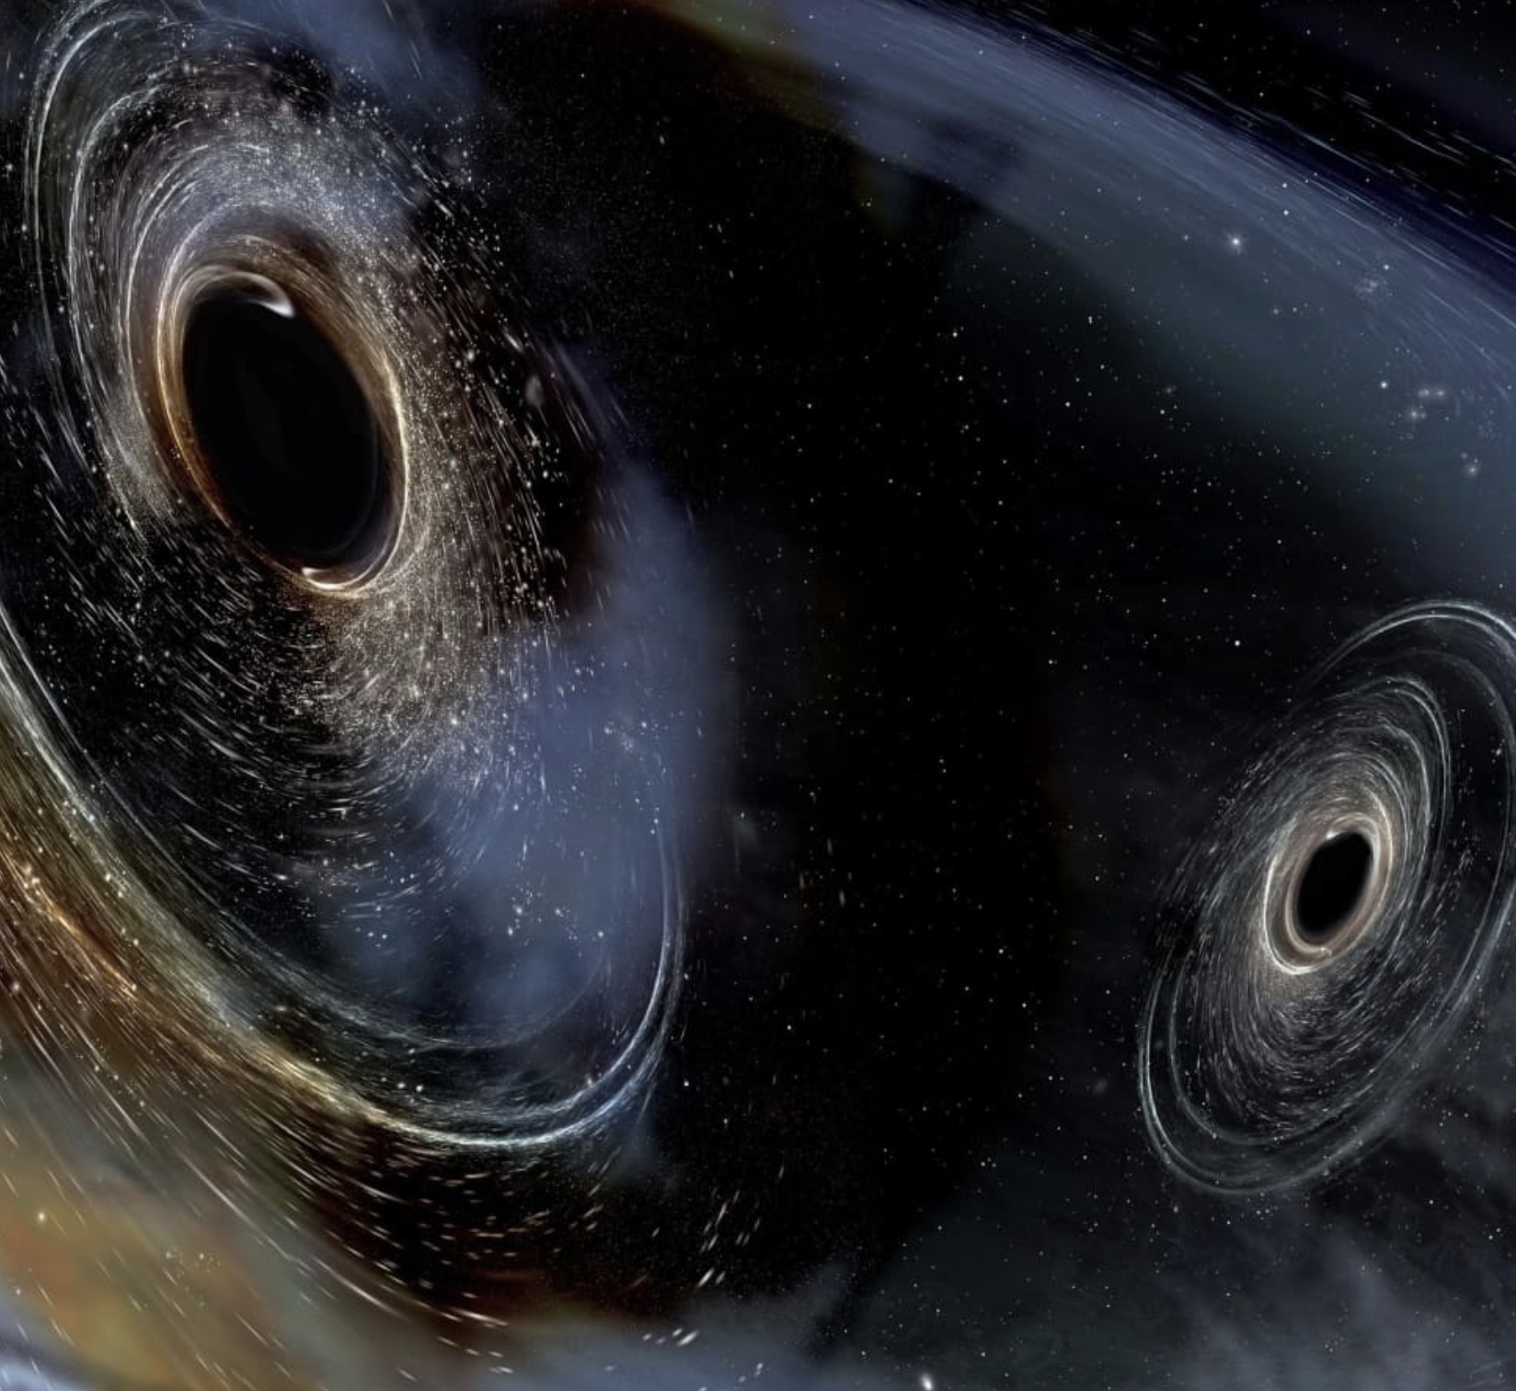
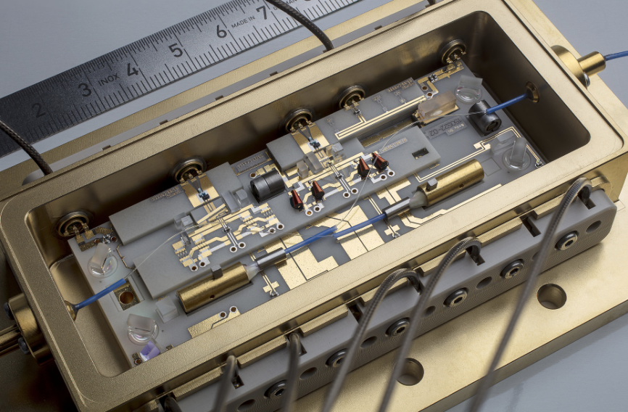
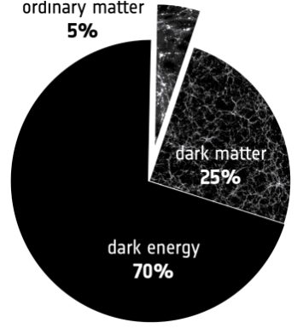
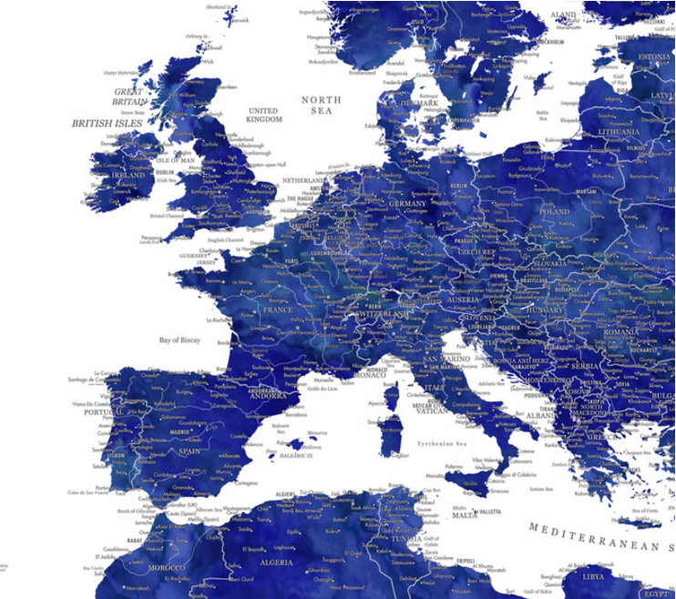
The GravNet Legacy
8
AI illustration of two primordial black holes
Launch program towards HFGW detection
Shape a new scientific community: QT $↔$ GW
Most stringent tests of the HFGW spectrum
Maybe a discovery: Identifying dark matter or „seeing“ the primodial universe
Development of long-lasting technologies
Universal network operation and data-acquisition
Plug-And-Play detection systems
Improve sensitivity with future collaborators
GravNet in 2031 - A new era of HFGW physics with global approach
Notes:
I guess this explains the hype of gravitational waves physics nowadays. However, one easily forgets that they have already a very long history since they have been predicted by Einstein and others already in 1916. Even more strikingly the first experimental efforts using interferometers started in 1977, where you can see here a picture of the first setups. In the end it took nearly 40 years of R&D to allow for the first observations by LIGO and Virgo increasing the sensitivities by 8 orders of magnitude, yielding the second Nobel Prize.

