Slide 1
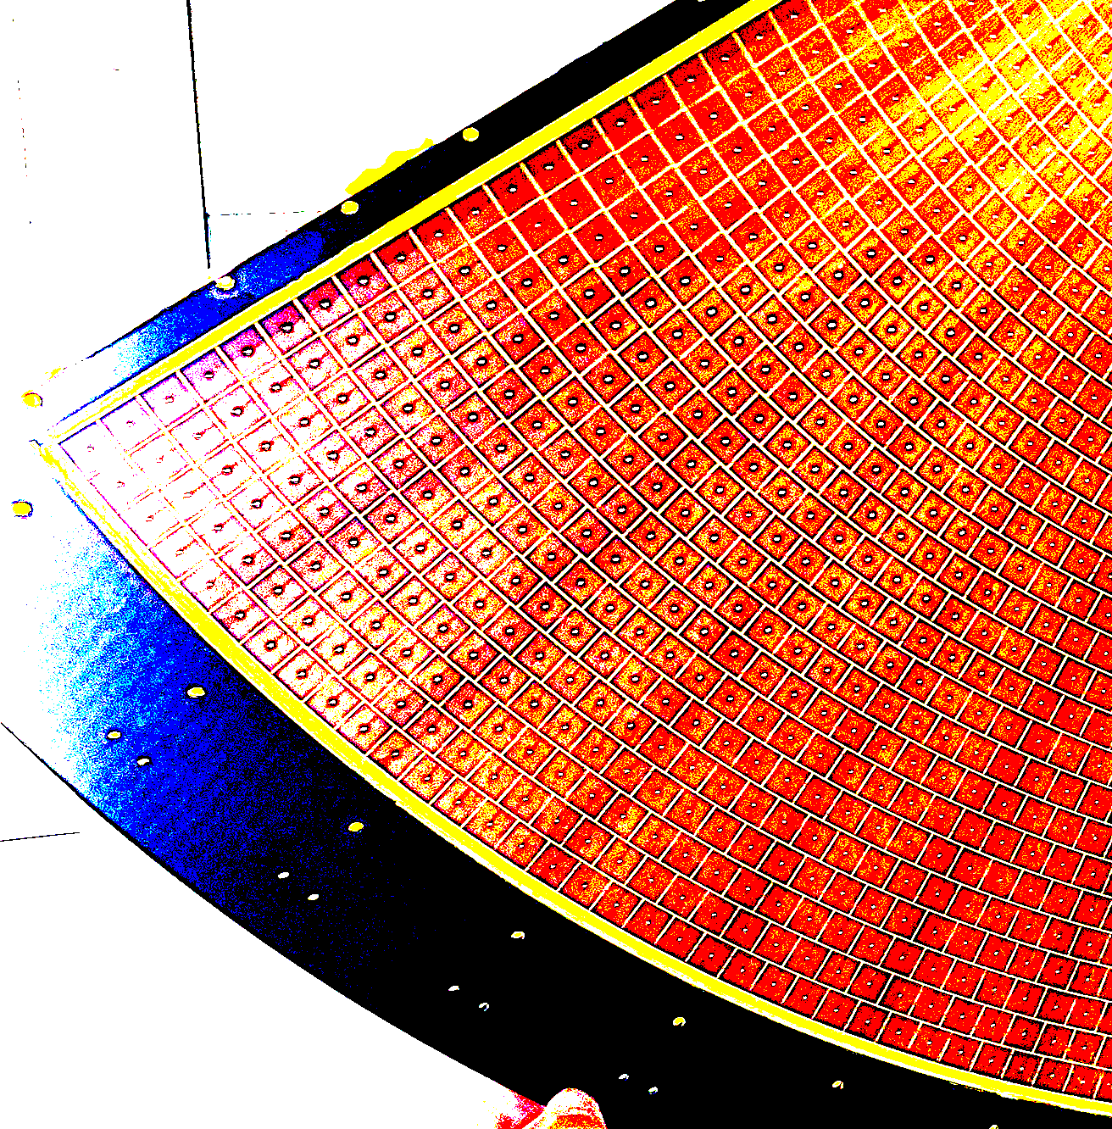
P2 Micromegas detectors at Saclay :
First tries and status
P2 Meeting – September 2024
Maxence Vandenbroucke for the Saclay MPGD lab
CEA Saclay
maxence,Vandenbroucke@cea.fr

Slide 2
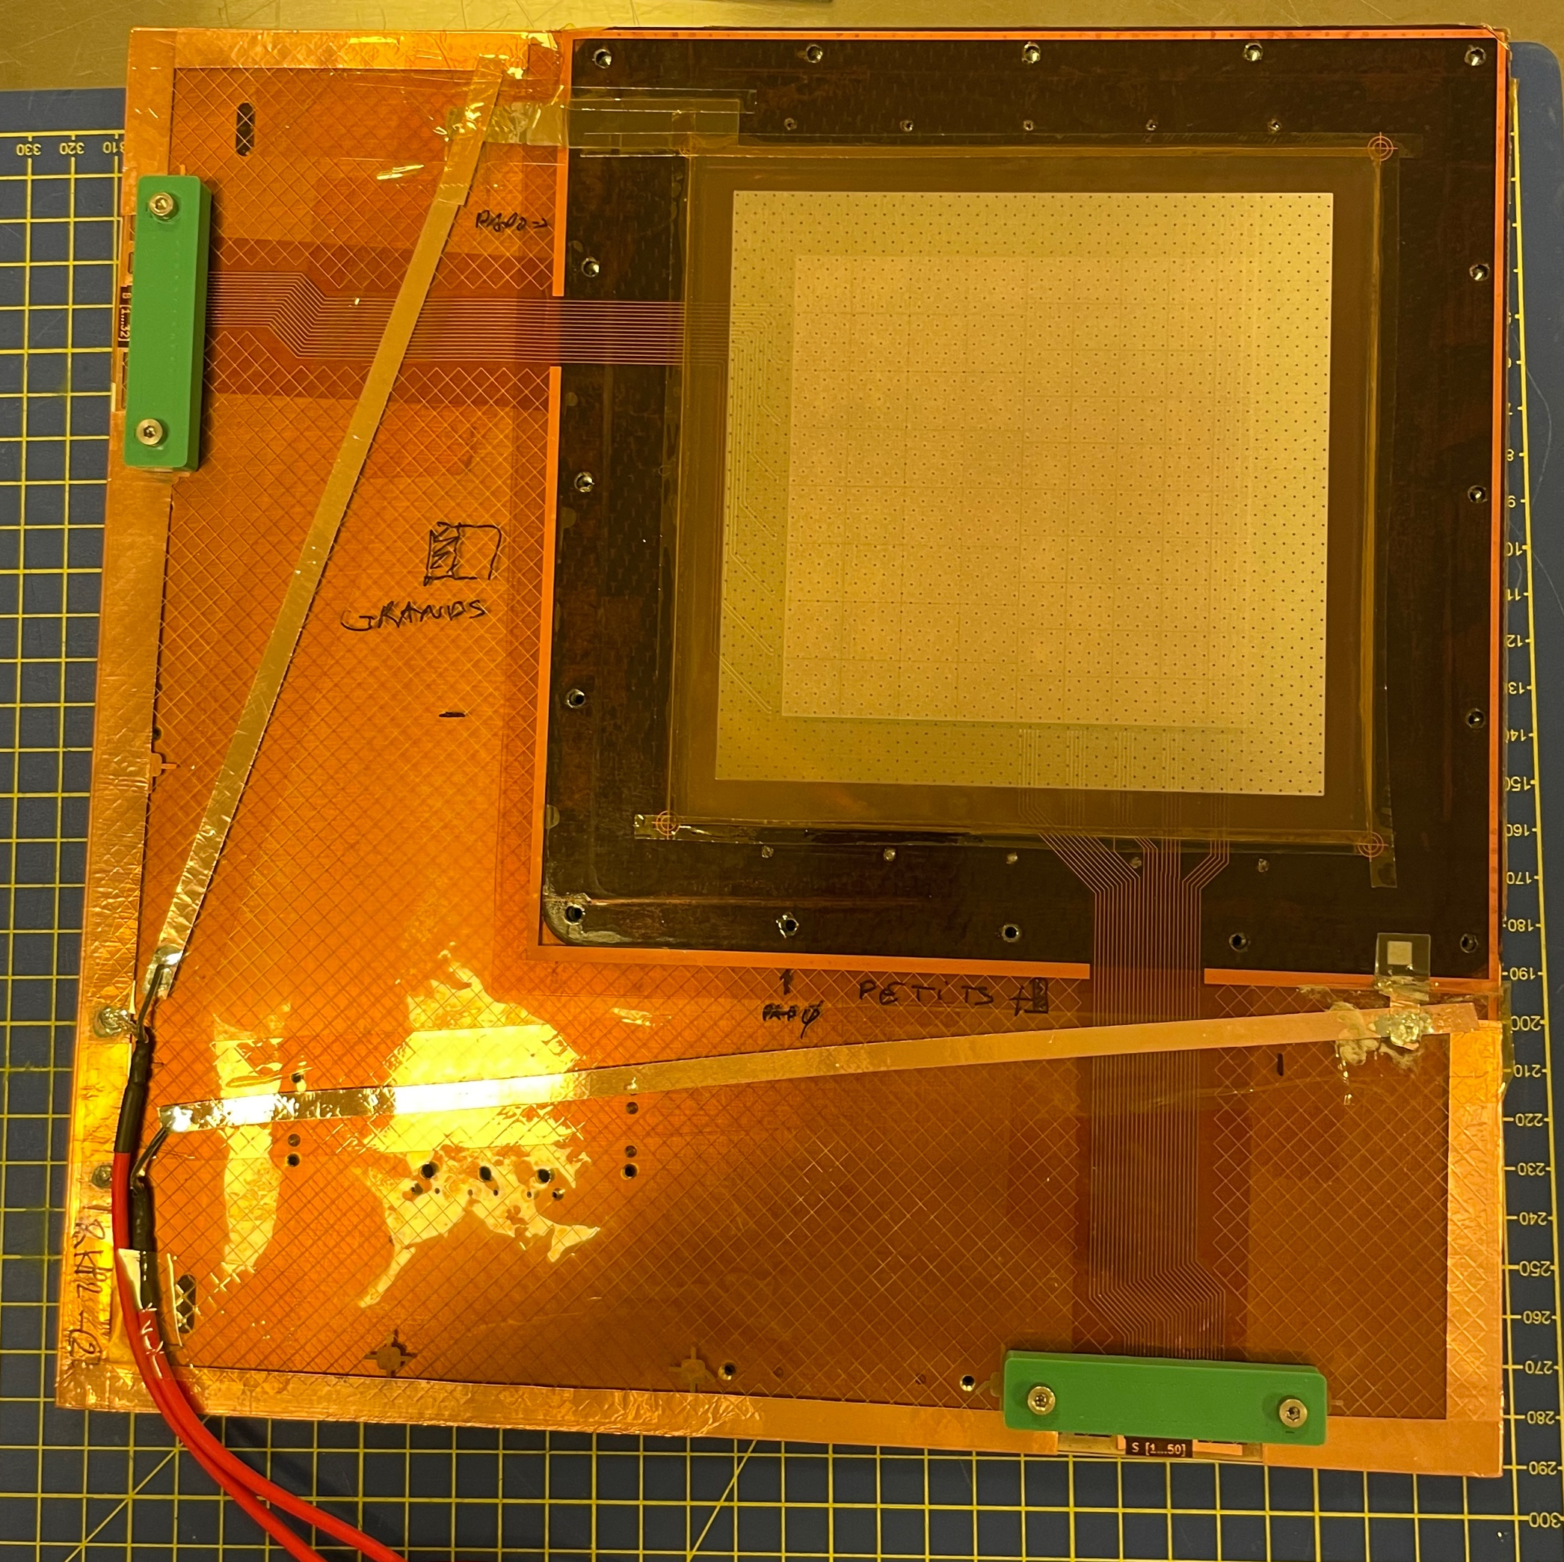
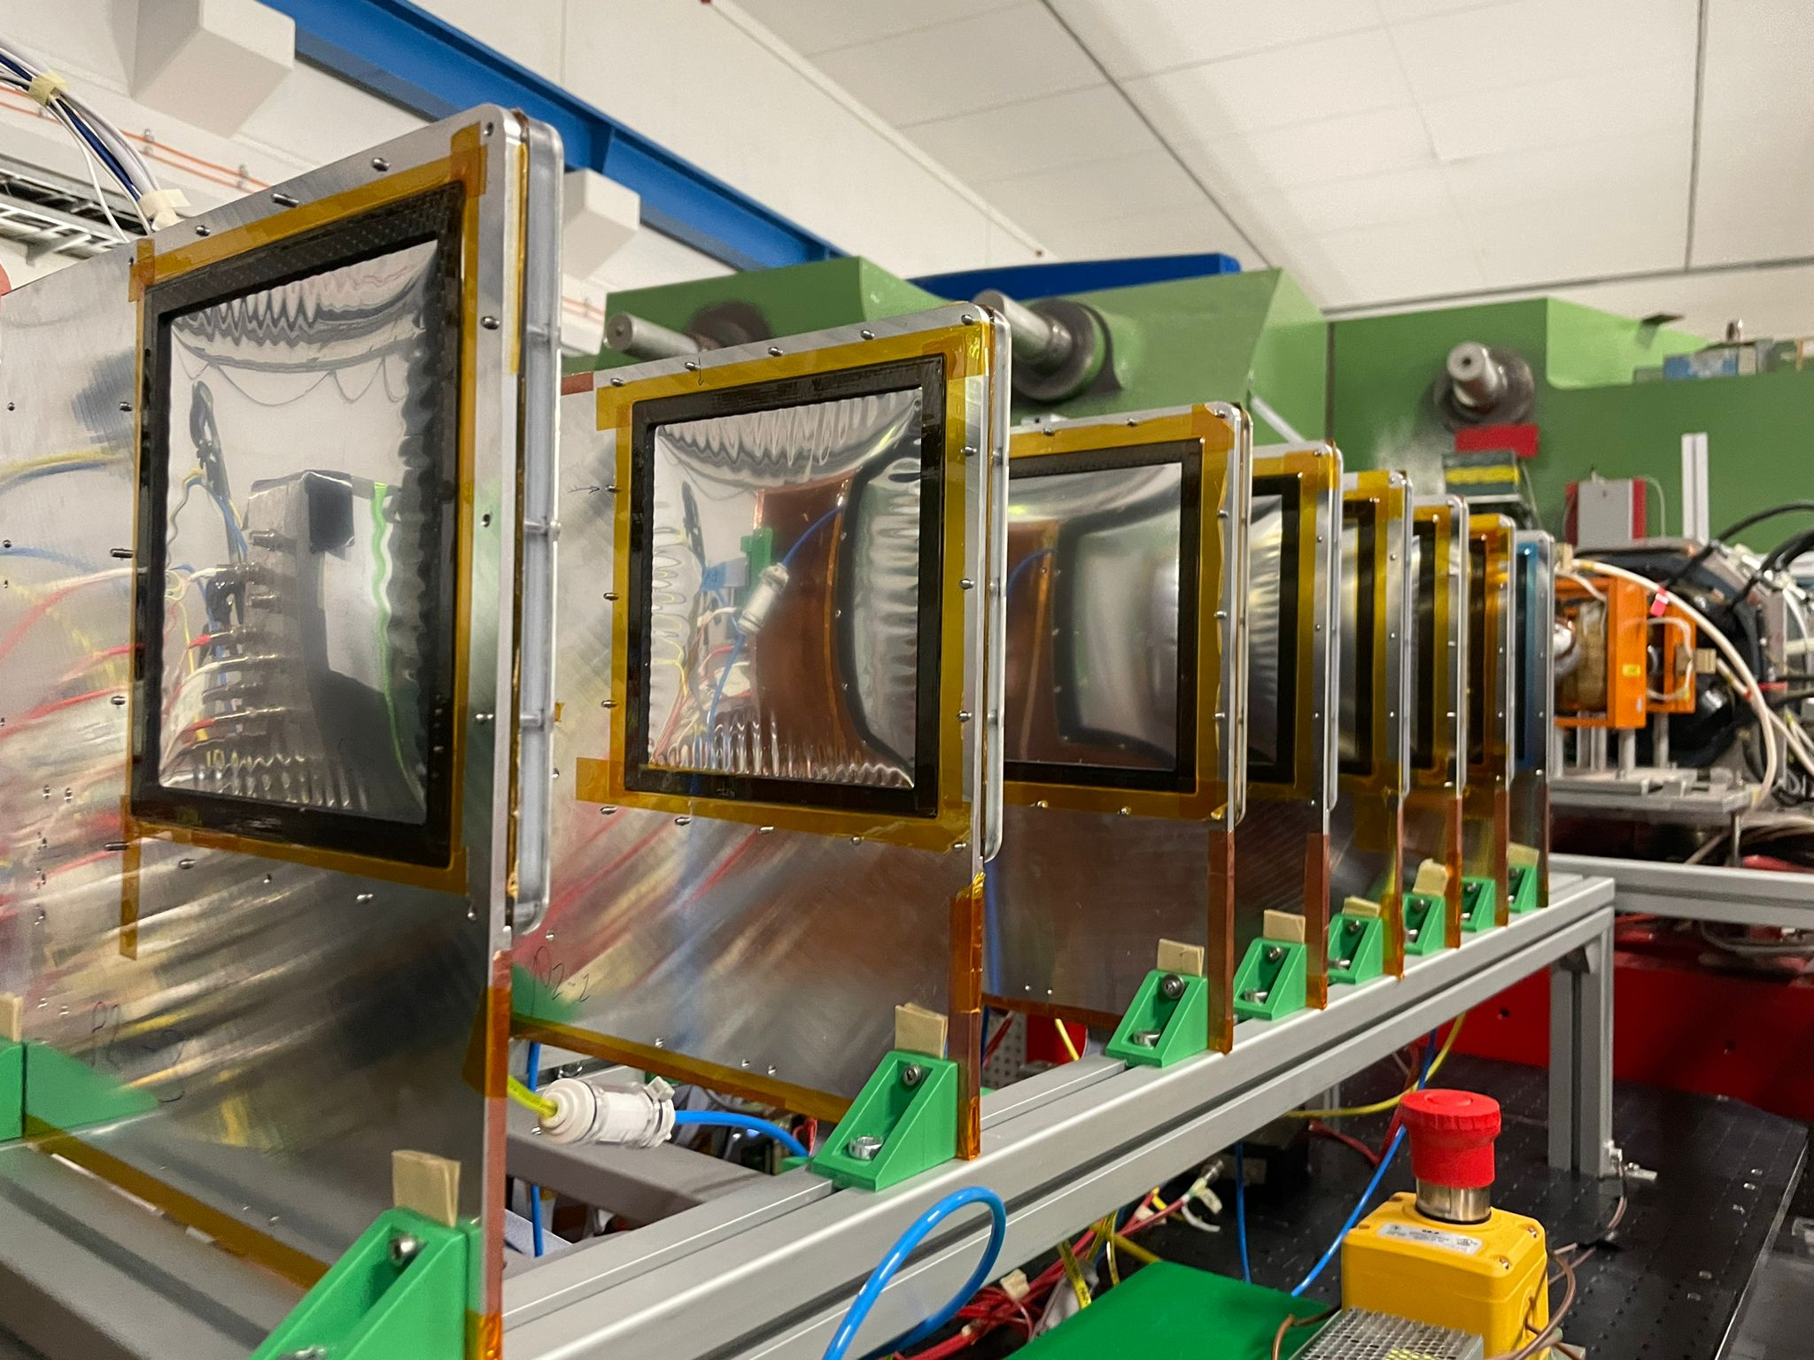
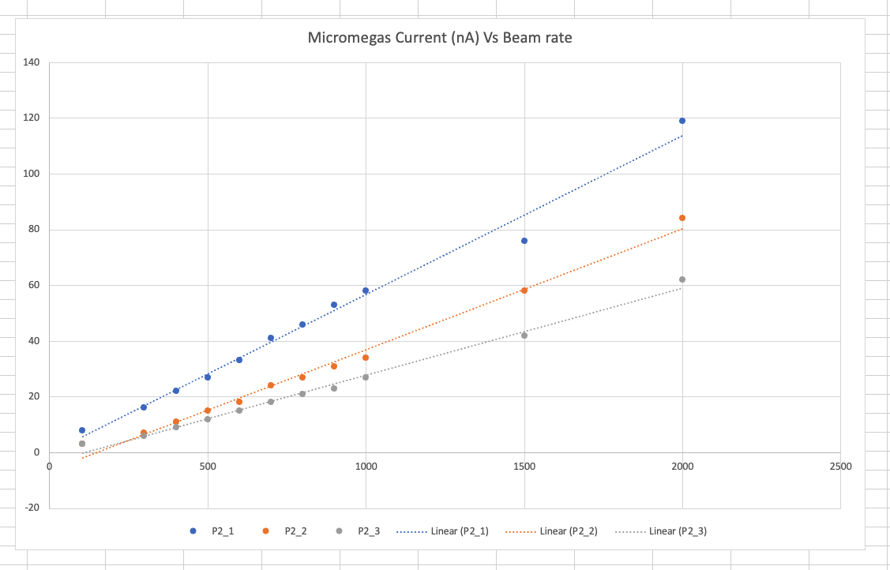
STATUS P2 BASKET MM
“RD4” 10x10cm2 prototypes
  3 100 pads prototypes build and ok
  Sail trackers with carbon frame OK
  Rate validated with 800MeV electrons at Mainz OK
  ~5 sparks during data taking (electrons below the hadronic threshold)
  Test beam with DREAM and VMM
Now : Full size Prototype
Mylar
Readout Kapton
Mesh
Drift
Mylar
Current Vs Rate

Slide 3
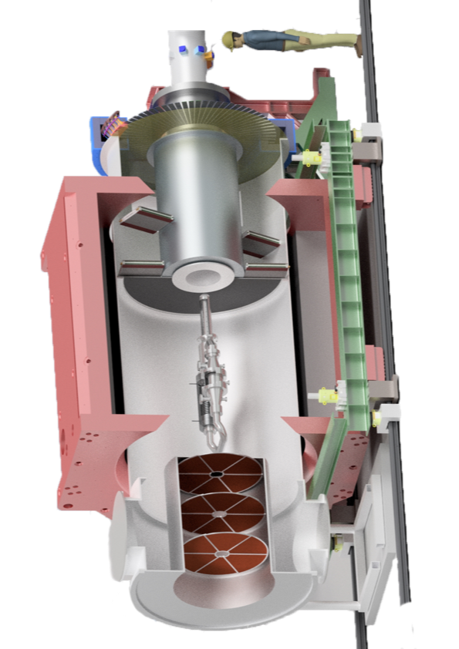
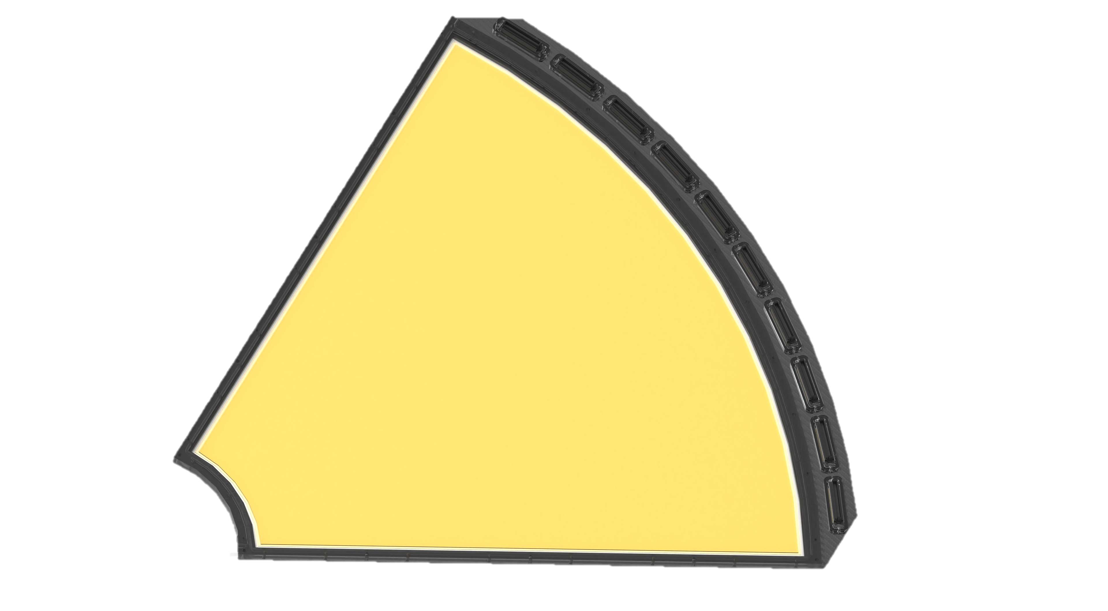
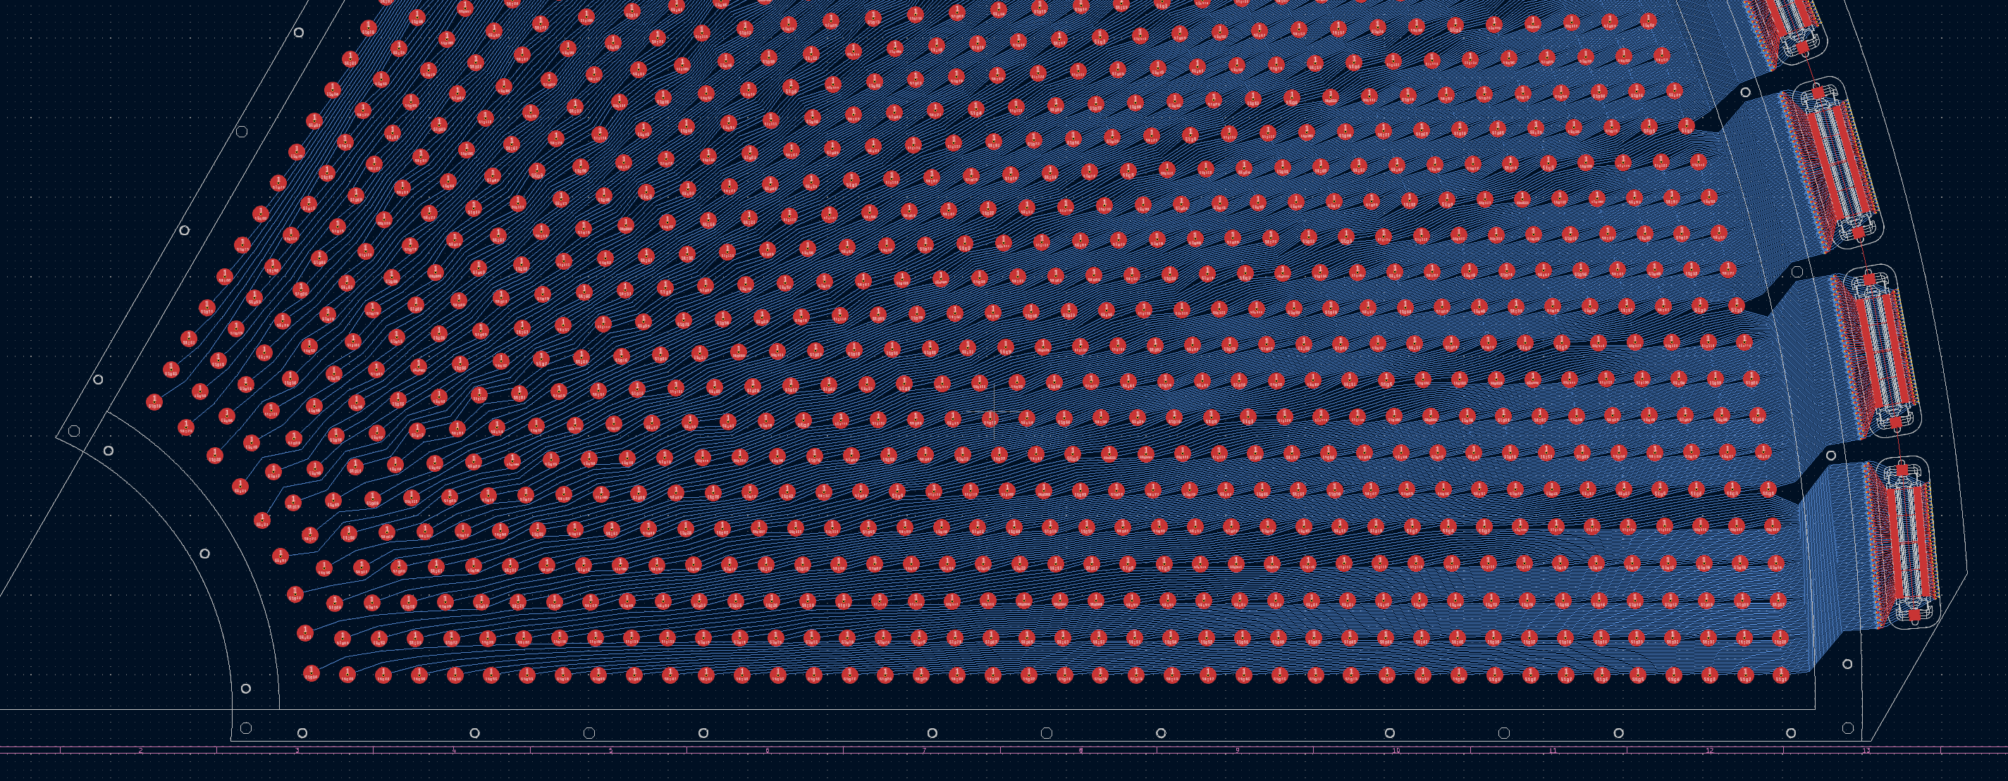

P2 Basket Micromegas
P2 Specifics
  Light metallic micromegas (aim at ~0.2% of an X0) “Sail tracker”
  VMM SRS FEE + custom made backend + Online Trigger
  1280x1cm² pads per 60º sector, 18 det. Total ~20k channels
Conditions :
  E_{beam} = 155 MeV, I_{beam} = 150 mA
  Backward scattered electron = Low energy (=xray)
  100MHz signal integrated in backward (100GHz forward …)
<- 60cm ->
e-
Challenging PCB routing
Bulk MM
Integration
Test

Slide 4
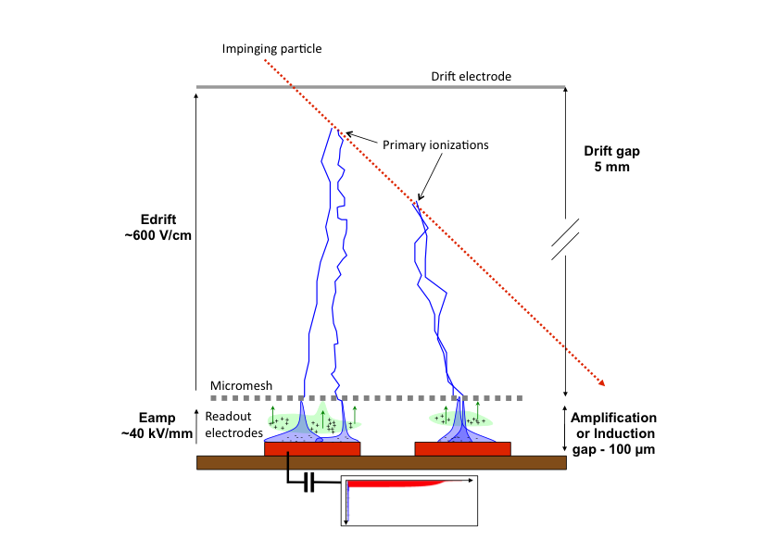
Micromegas
Mylar
Readout Kapton
Mesh
Drift
Mylar

Slide 5
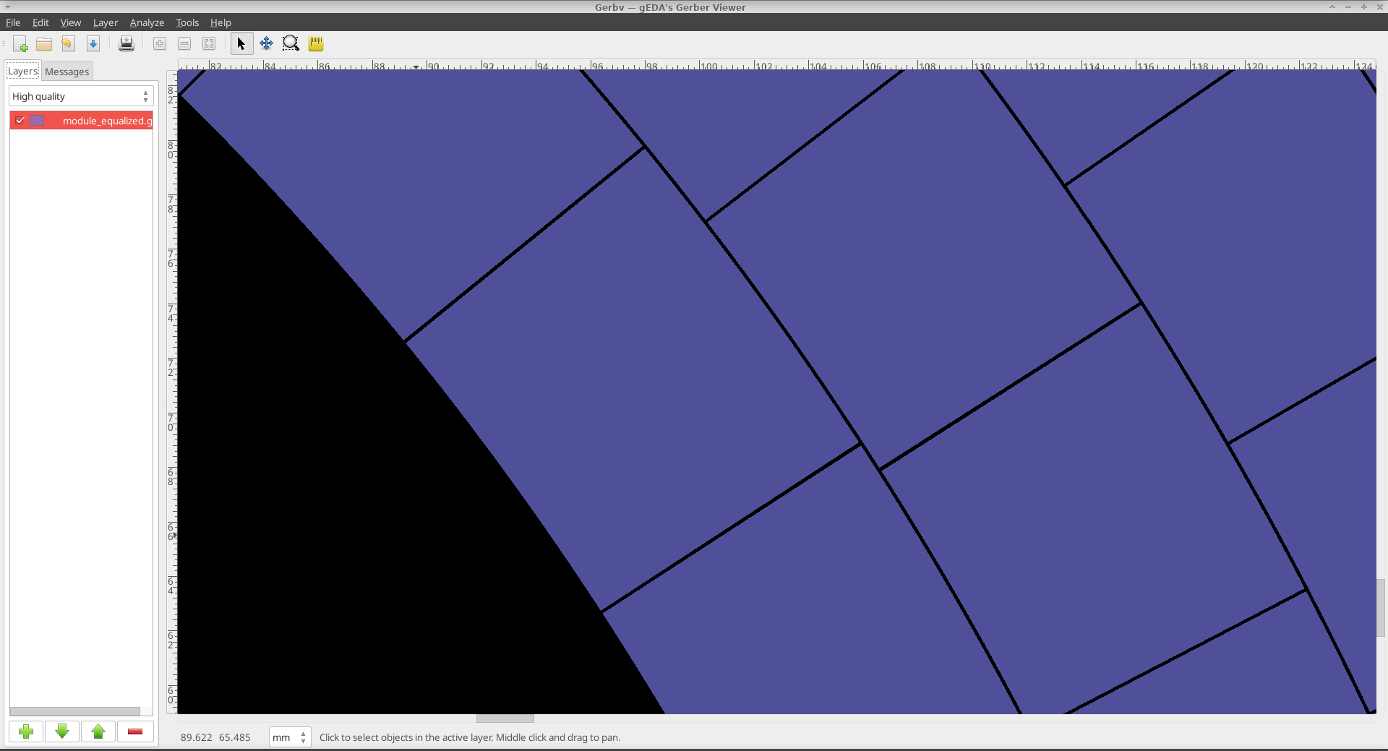
Readout Design
- Special section of a corona
drawn” algorithmically
- 1000 pads

Slide 6
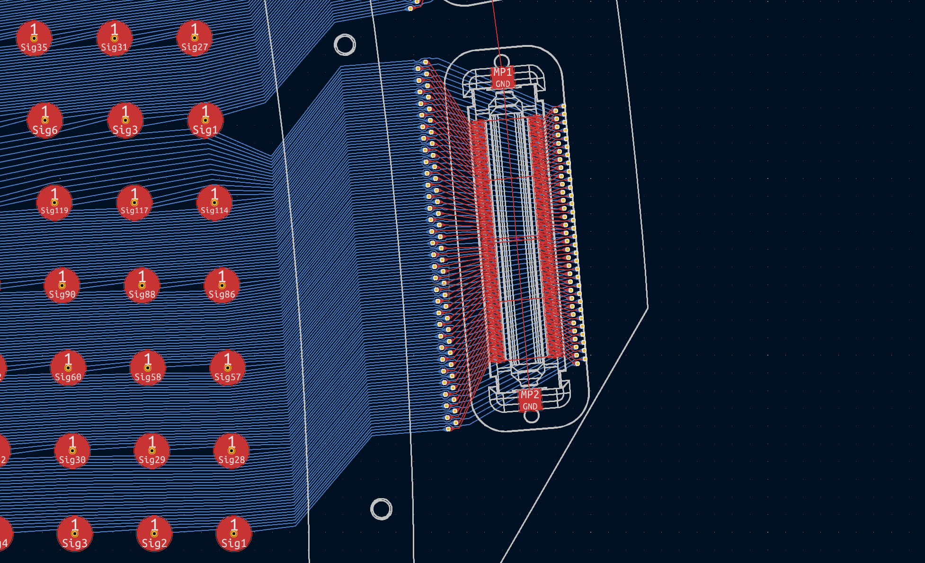
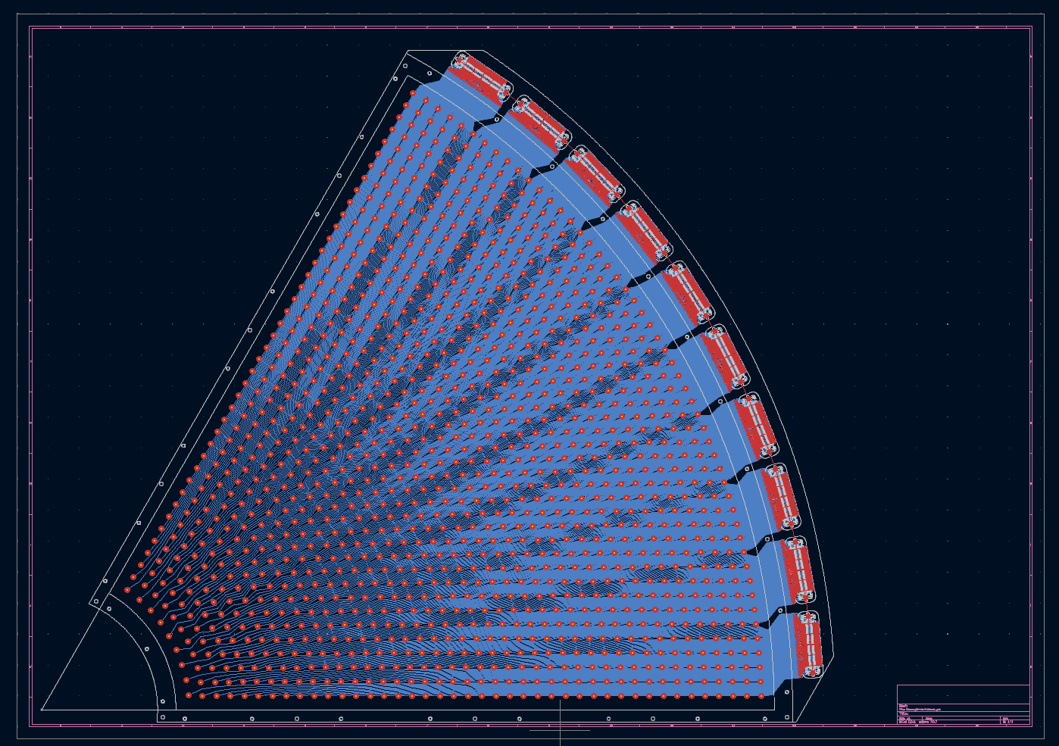
Routing

Slide 7
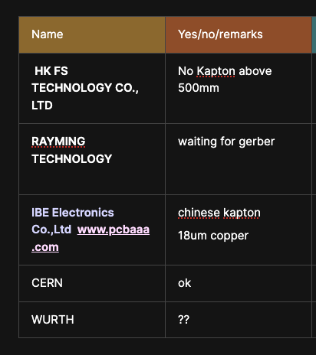
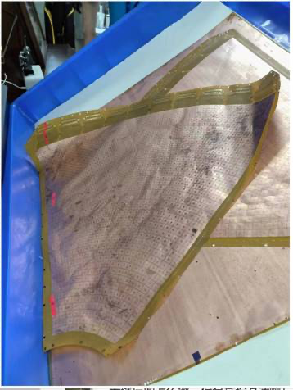
Readout production
Challenging object
  60x60cm2 Kapton flex
  Reduced 15um copper
  Good precision at the connector level
Testing the producers
  3 different supplier (CERN, IBE, NCAB)
  CERN ok but expensive (safe option) even quality is not great (received 08/24)
  NCAB had production problem, could ne keep the 15um copper (received 08/24)
  IBE were on time and great precision but material is PCB flex like and not Kapton (received 07/24)

Slide 8
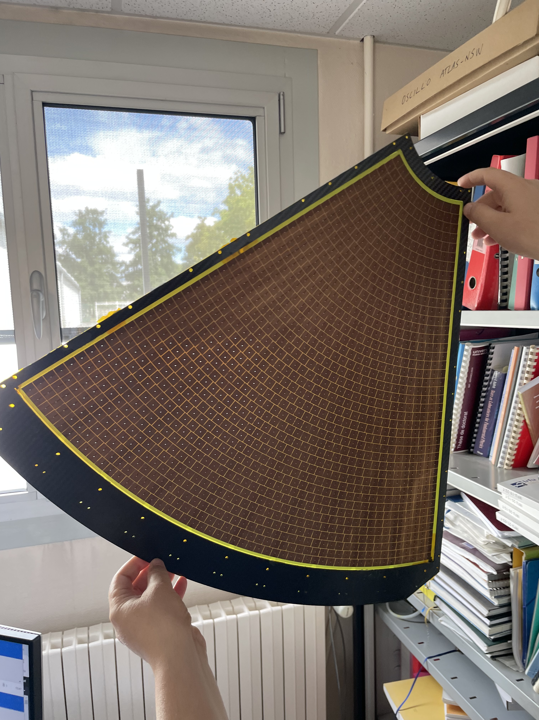
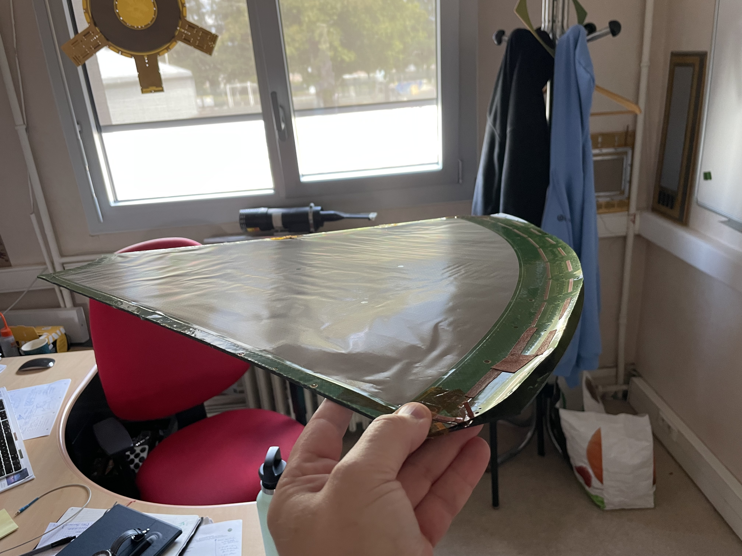
First Bulk at Saclay with IBE PCB (10/07/24)
=> Not usable

Slide 9
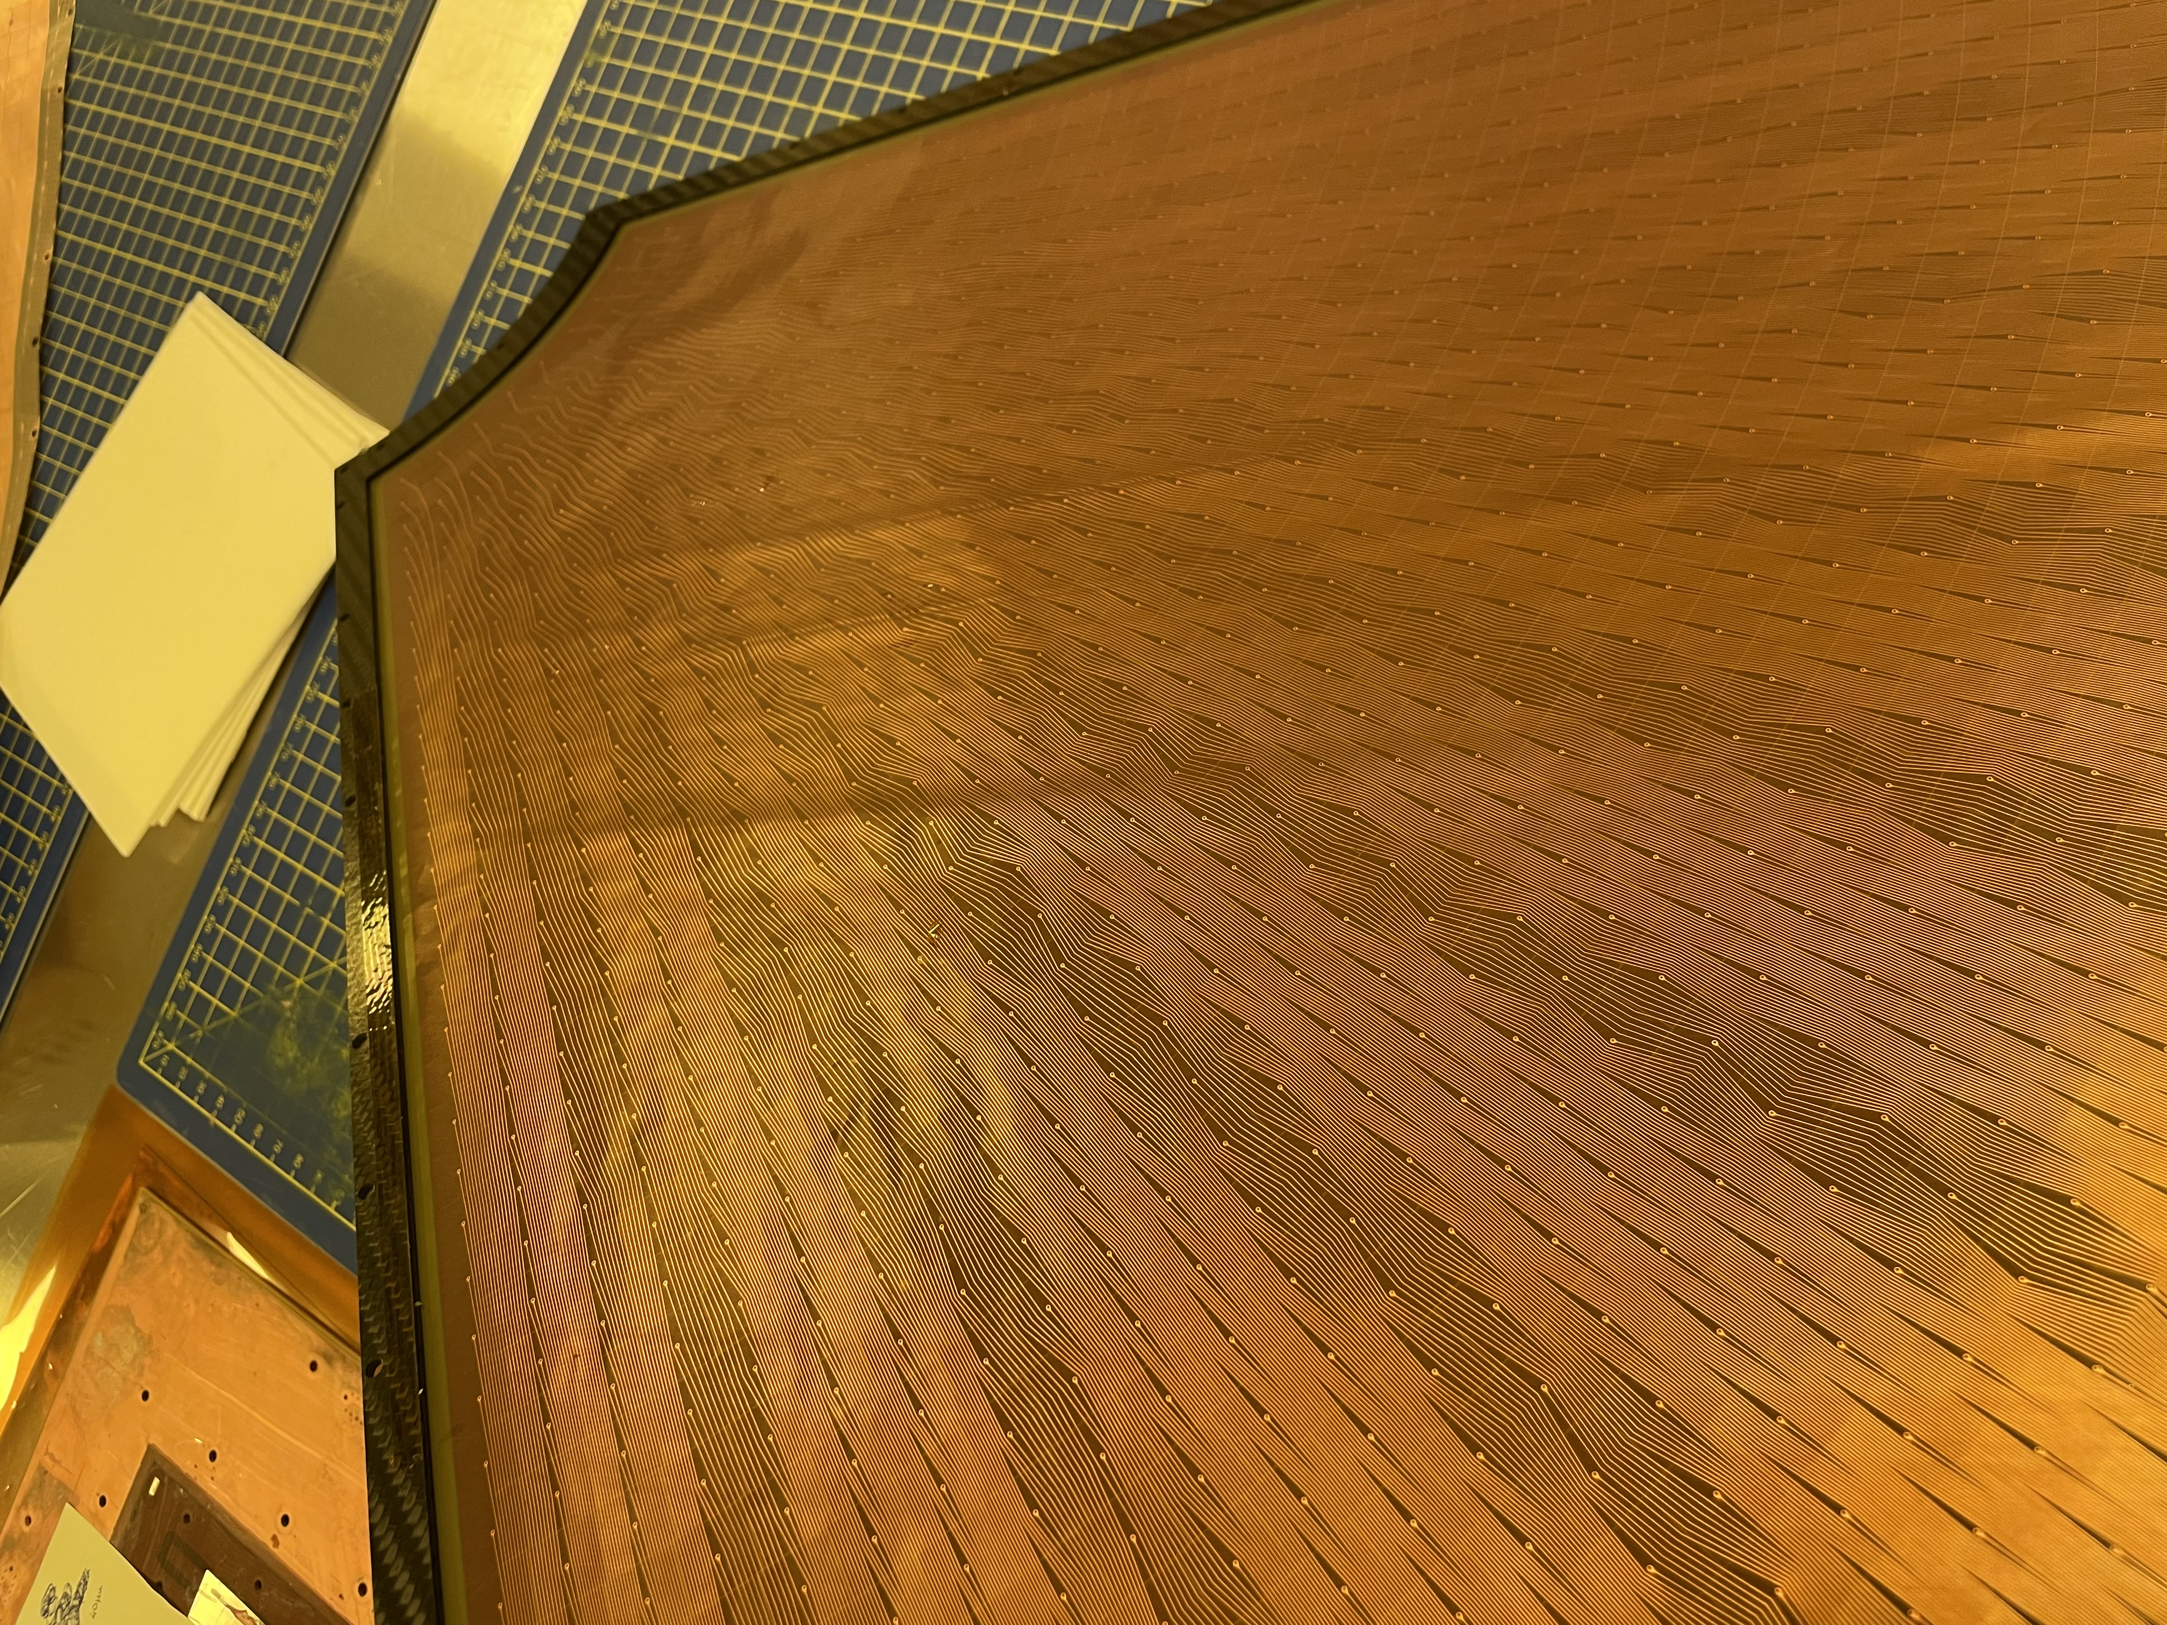
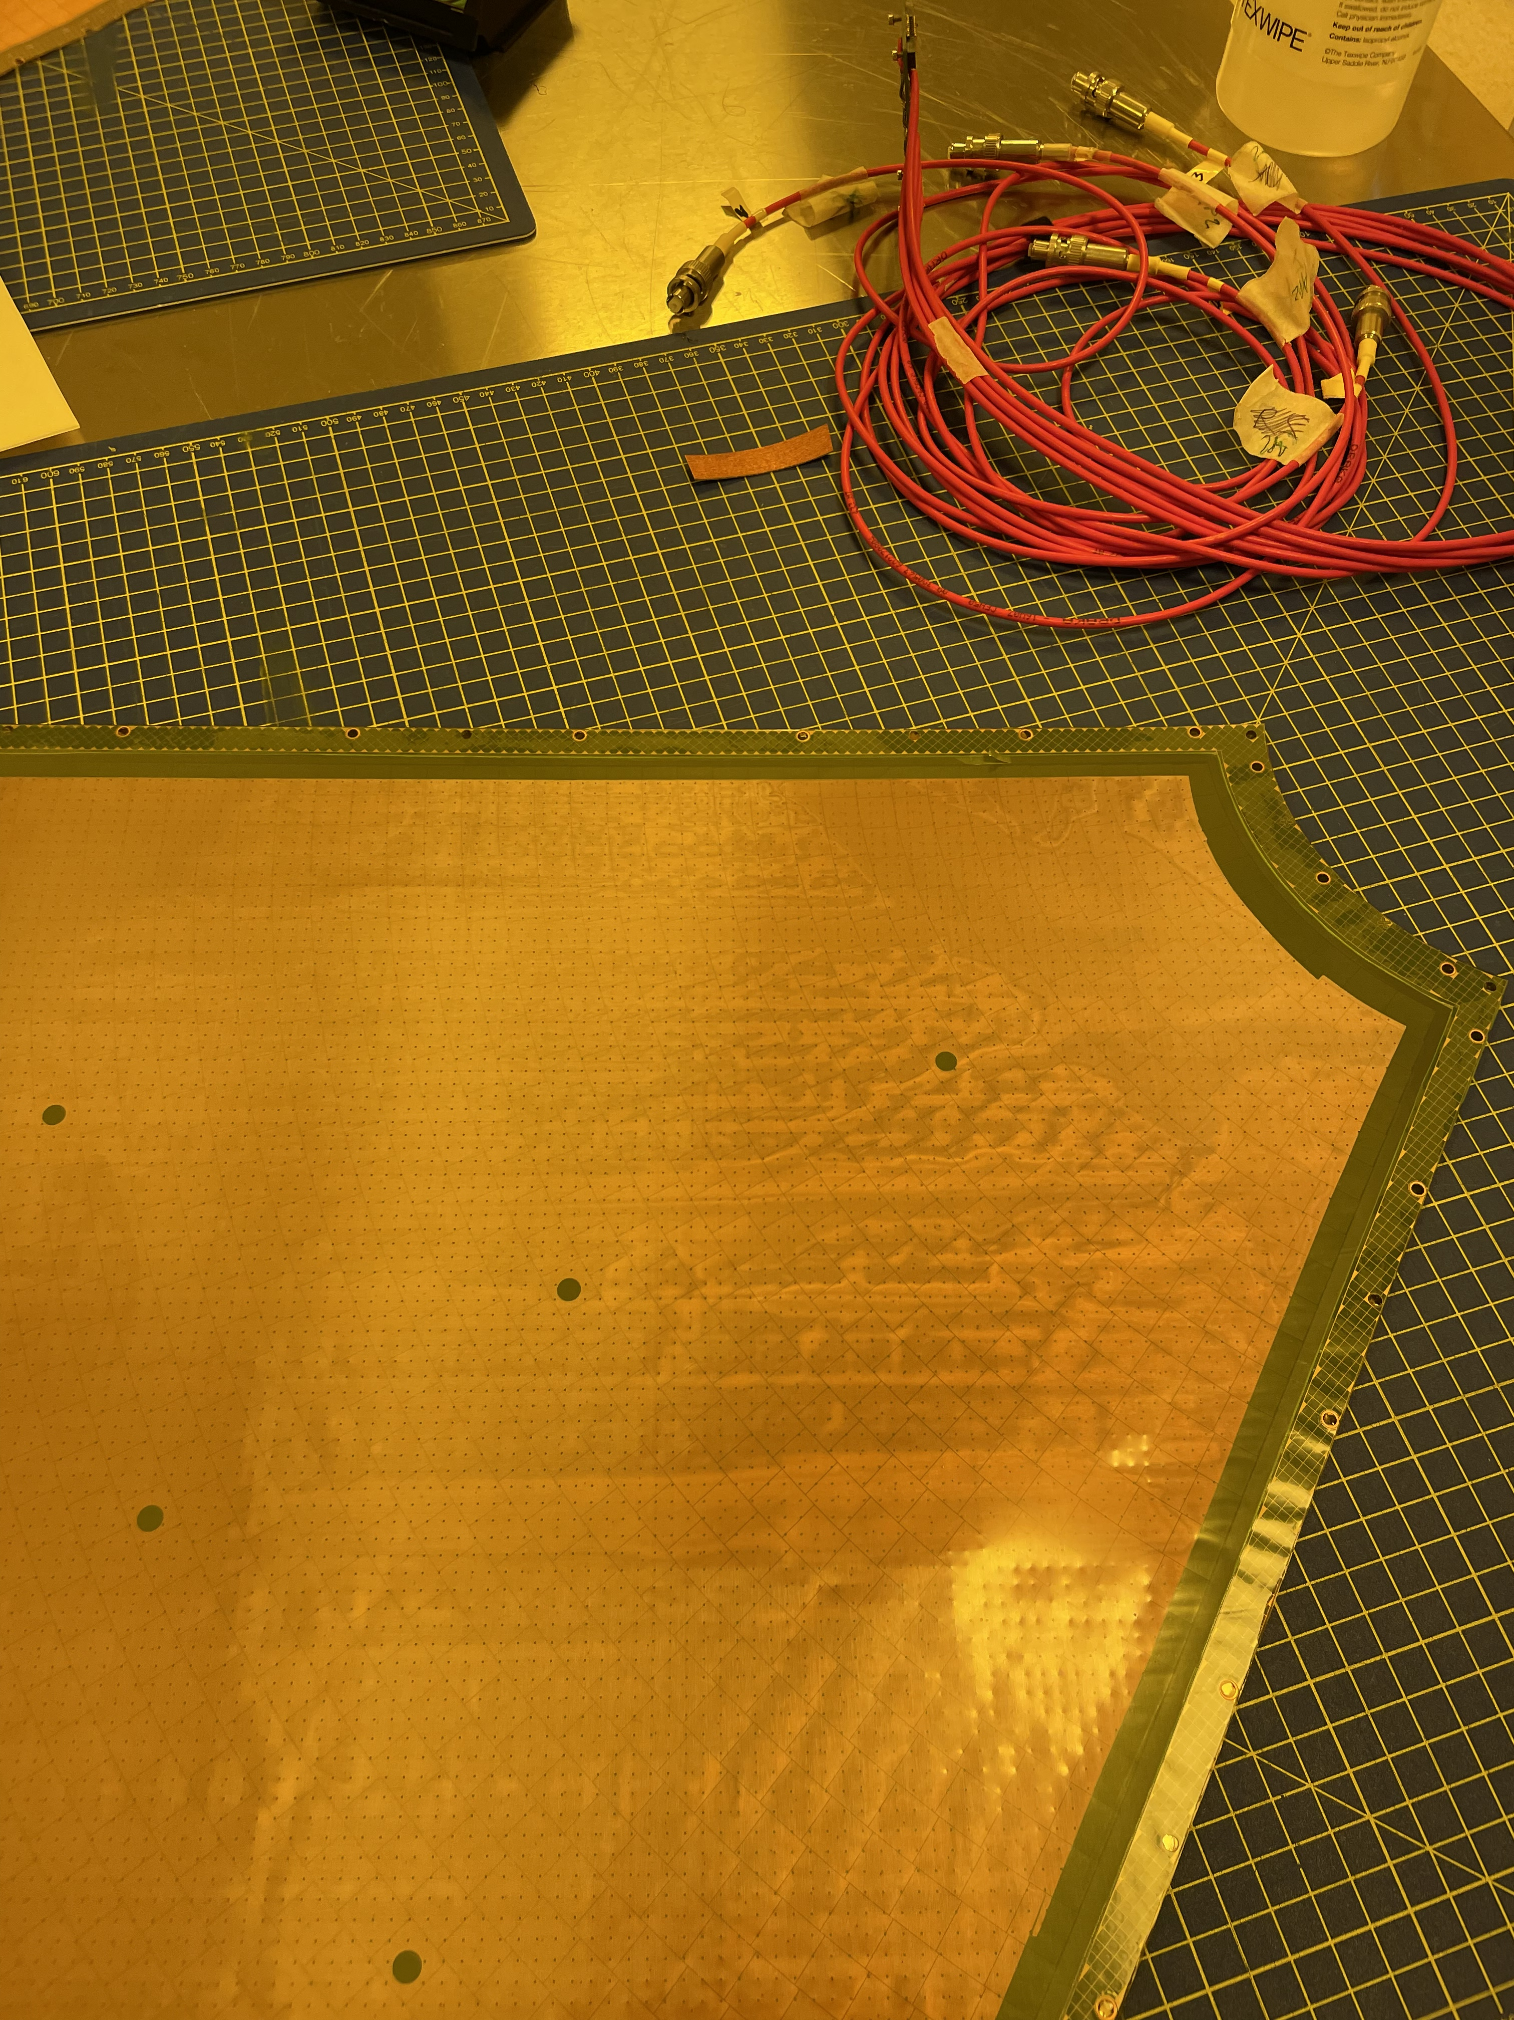
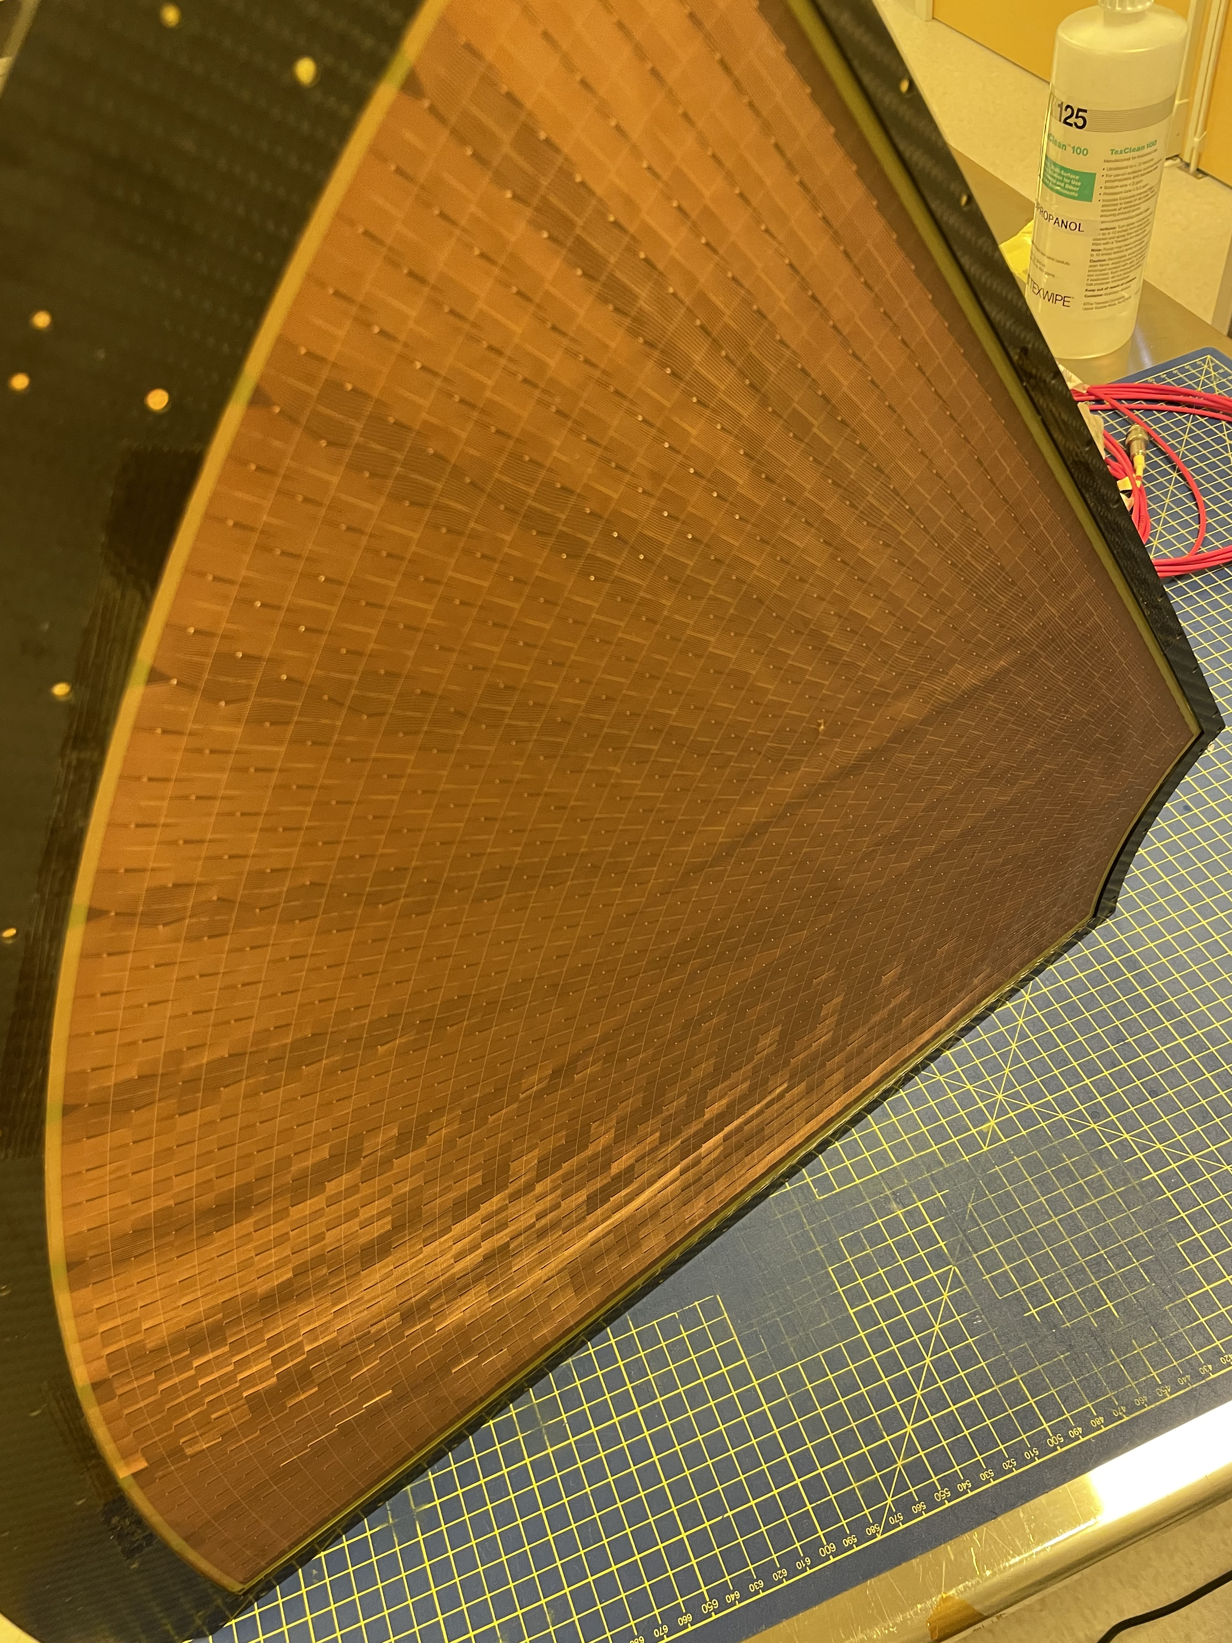
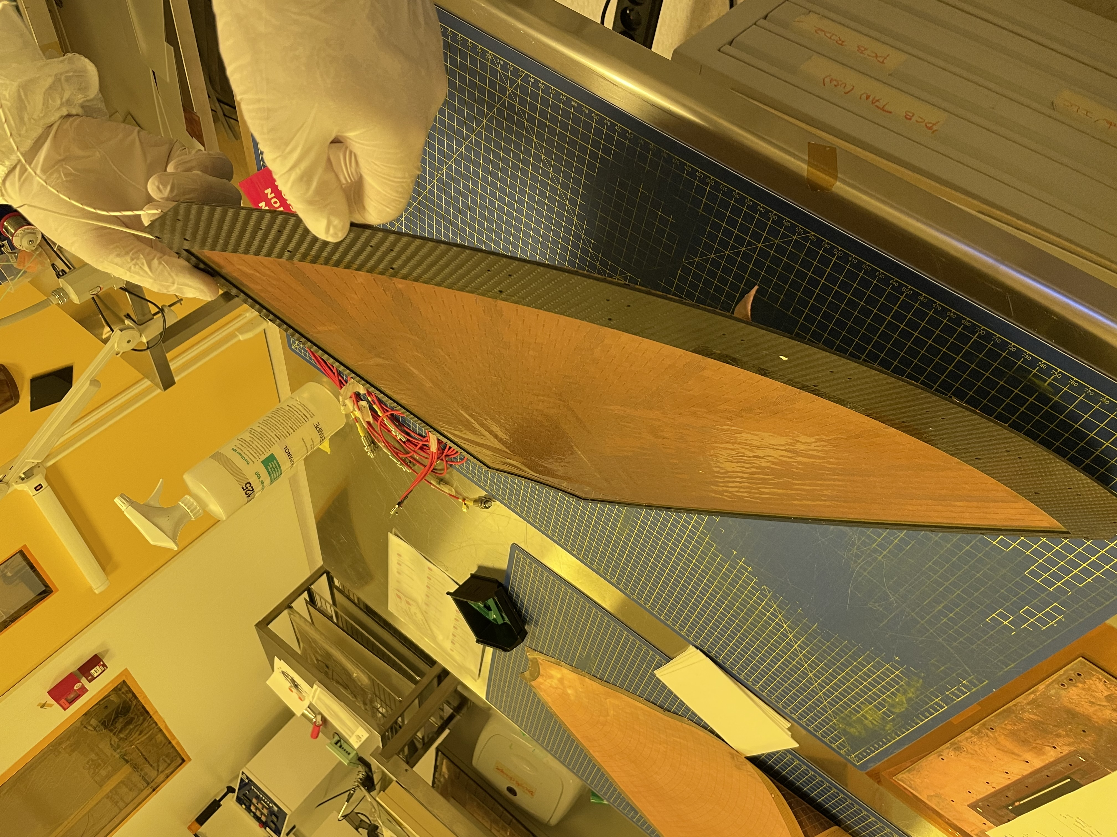
Second Bulk at Saclay with IBE PCB (20/07/24)
Much better but some wrinkles causing discharges

Slide 10
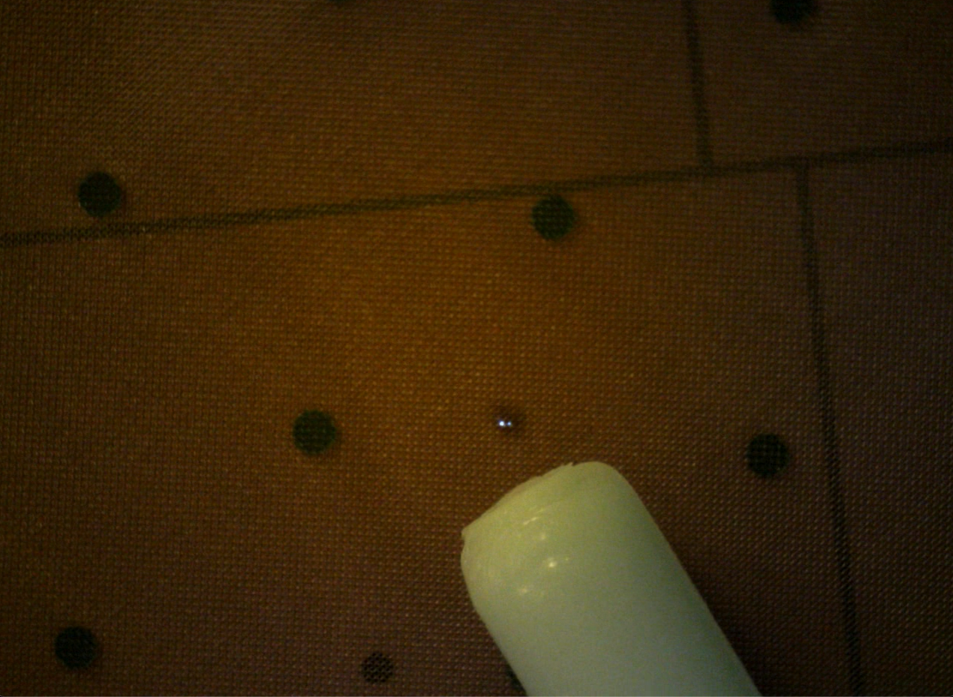
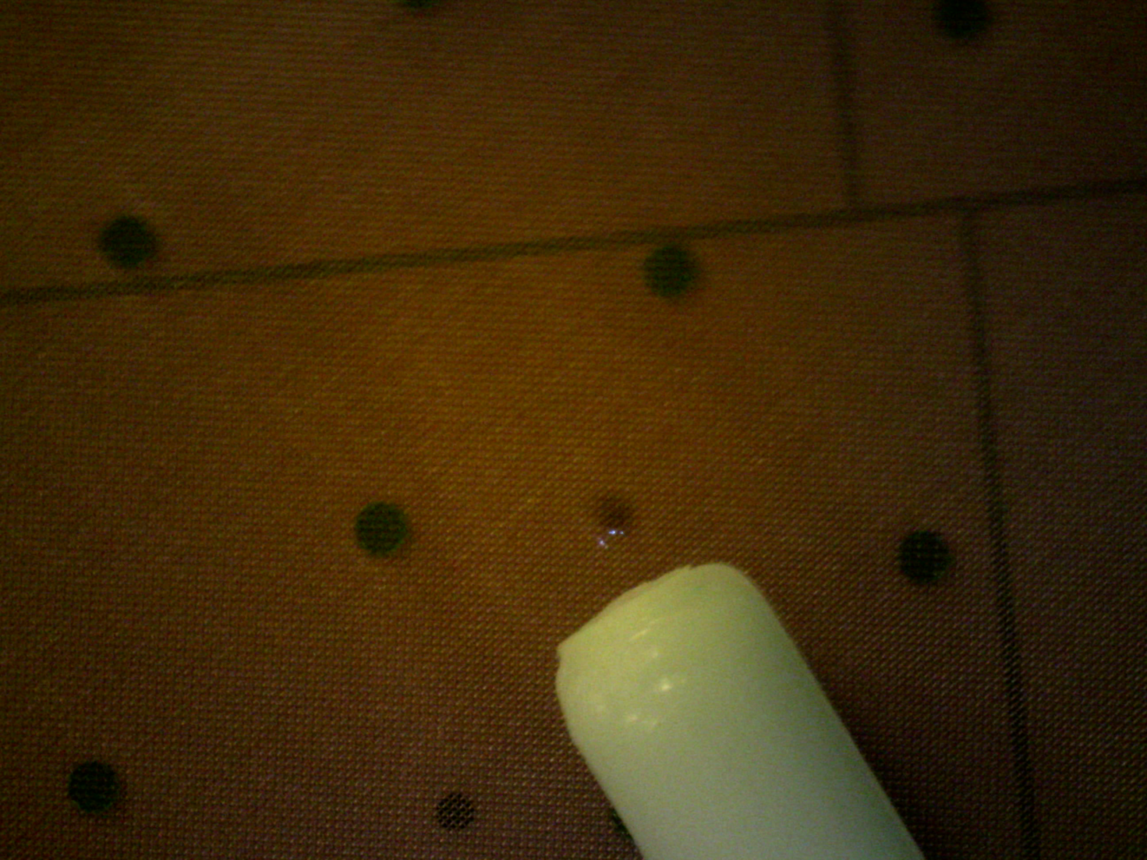
Sparks and local mesh variations
Sparks between pillars where amplification gap is lower
=> Increase pillar density and technical border on new fabrication masks

Slide 11
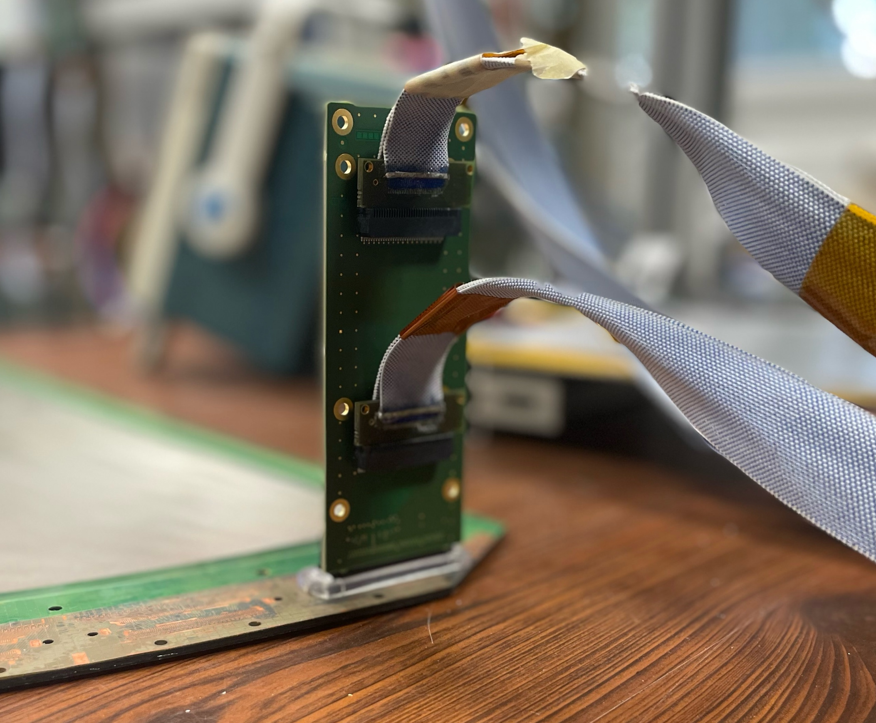
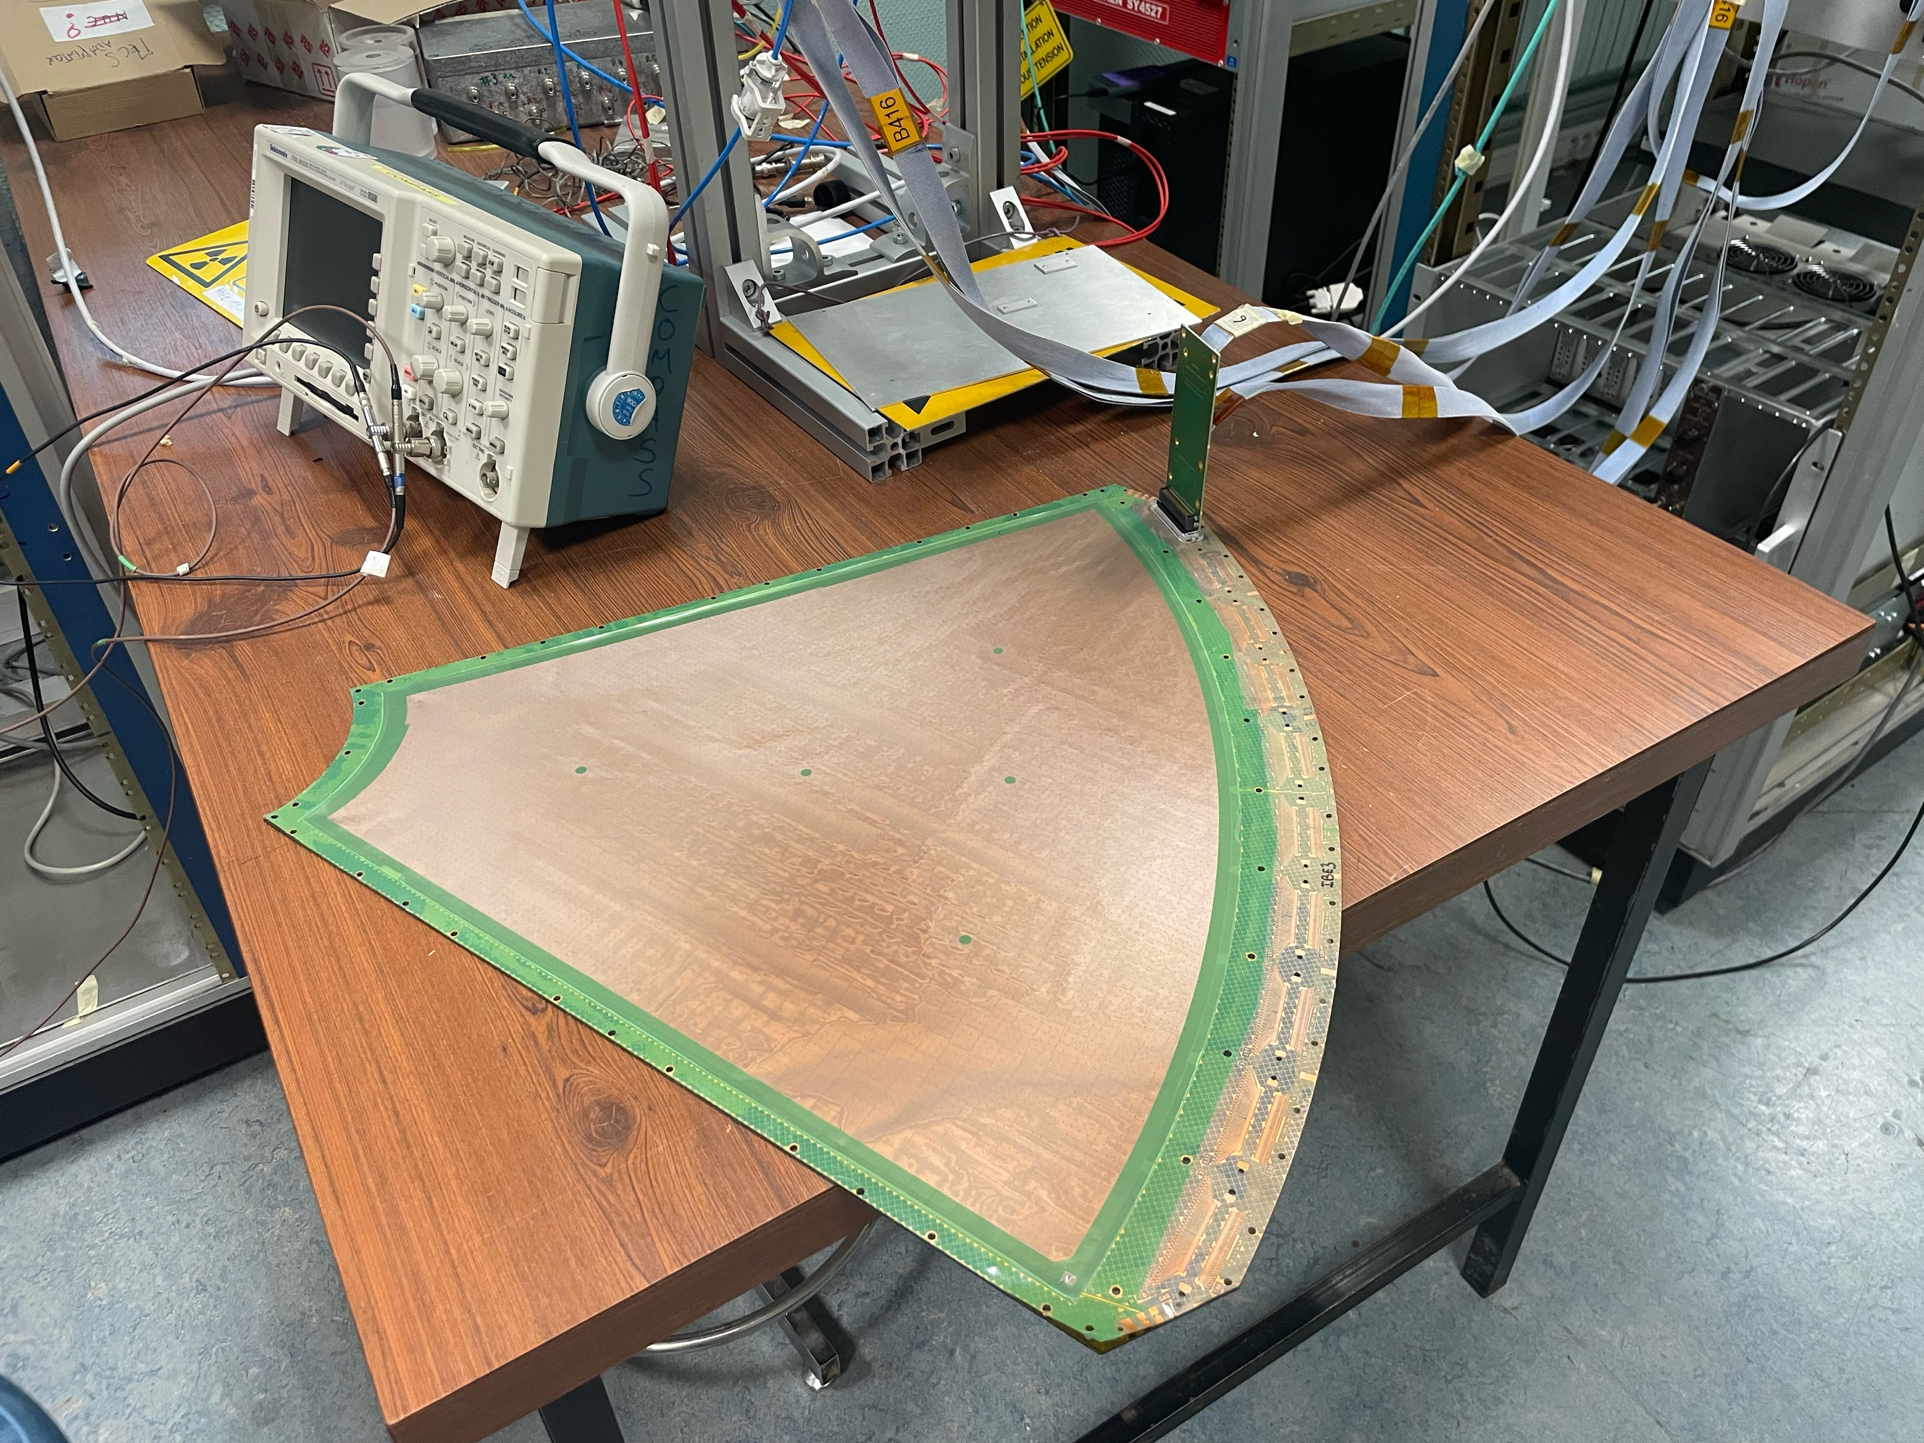
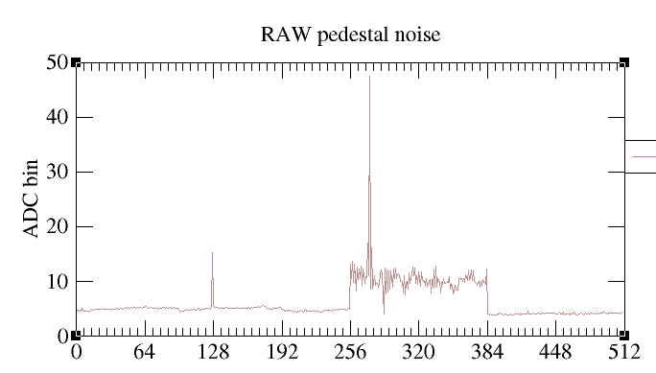
Electronical test of FX20 connector
First FX20 connector soldered
FX20 to DREAM transition
Noise looks good
  Factor ~2 from 10x10cm with ~30cm strips
  No common mode
Large p2
Small p2
Small p2

Slide 12
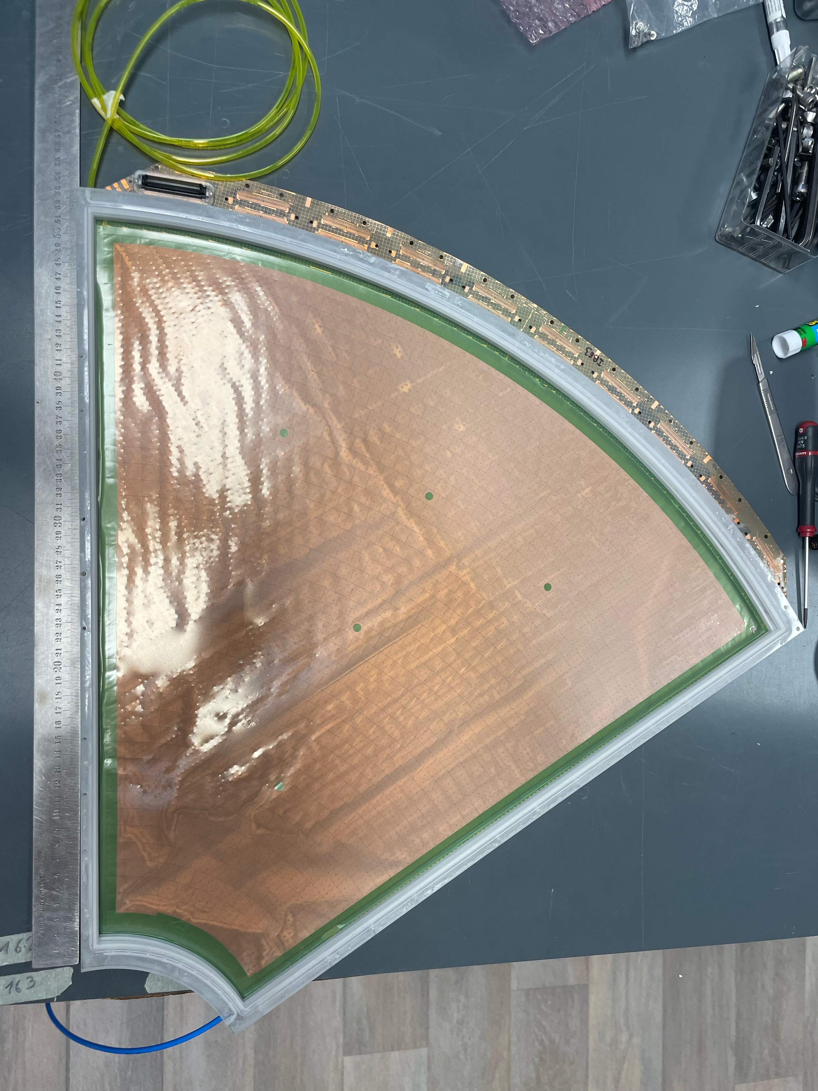
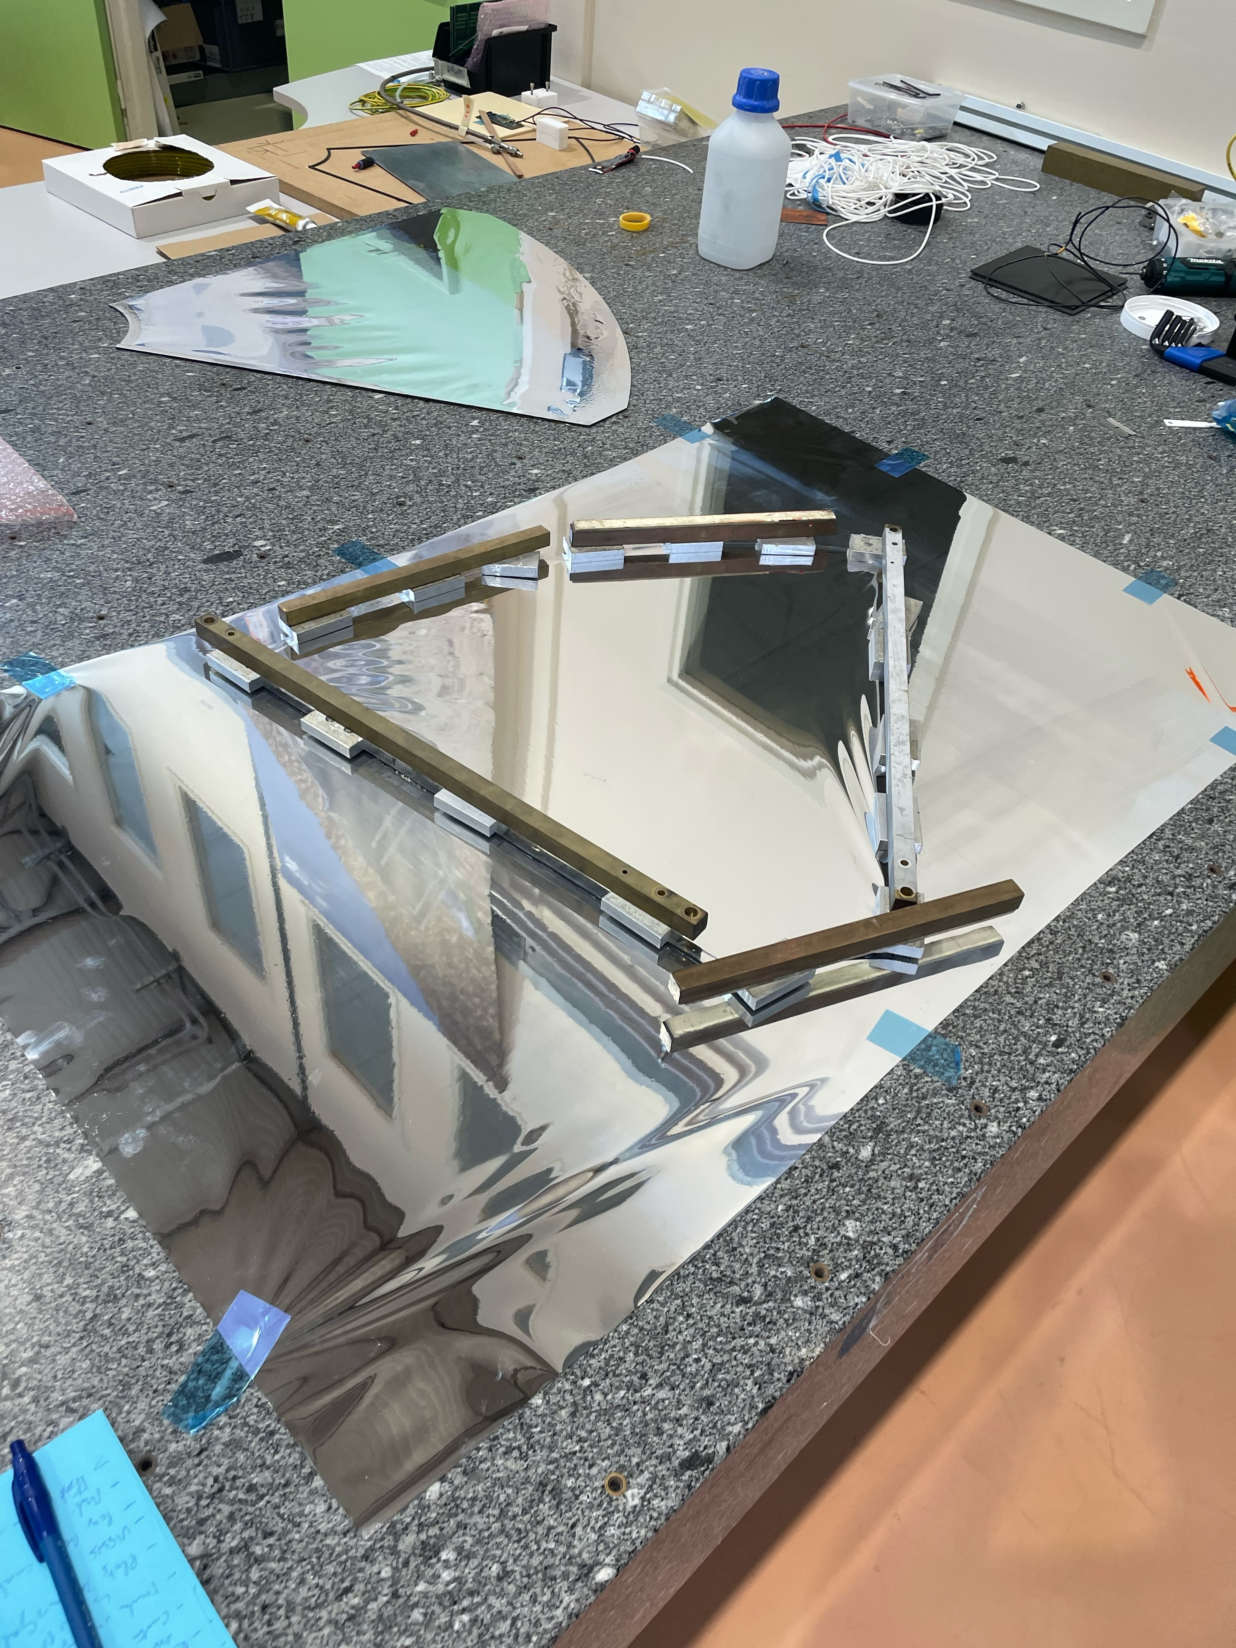
Drift electrode (Cathode)
Drift is composed of 2 mylar foils glued to a carbon frame
The carbon frame is glued to a 3D printed frame
  4 Frames printed out of 2D => all with a scaling issue (3mm out of 600)
  Re-order in process
Test of glueing mylar looks good
Mylar
Readout Kapton
Mesh
Drift
Mylar
3D frame on proto
Drift Glueing

Slide 13
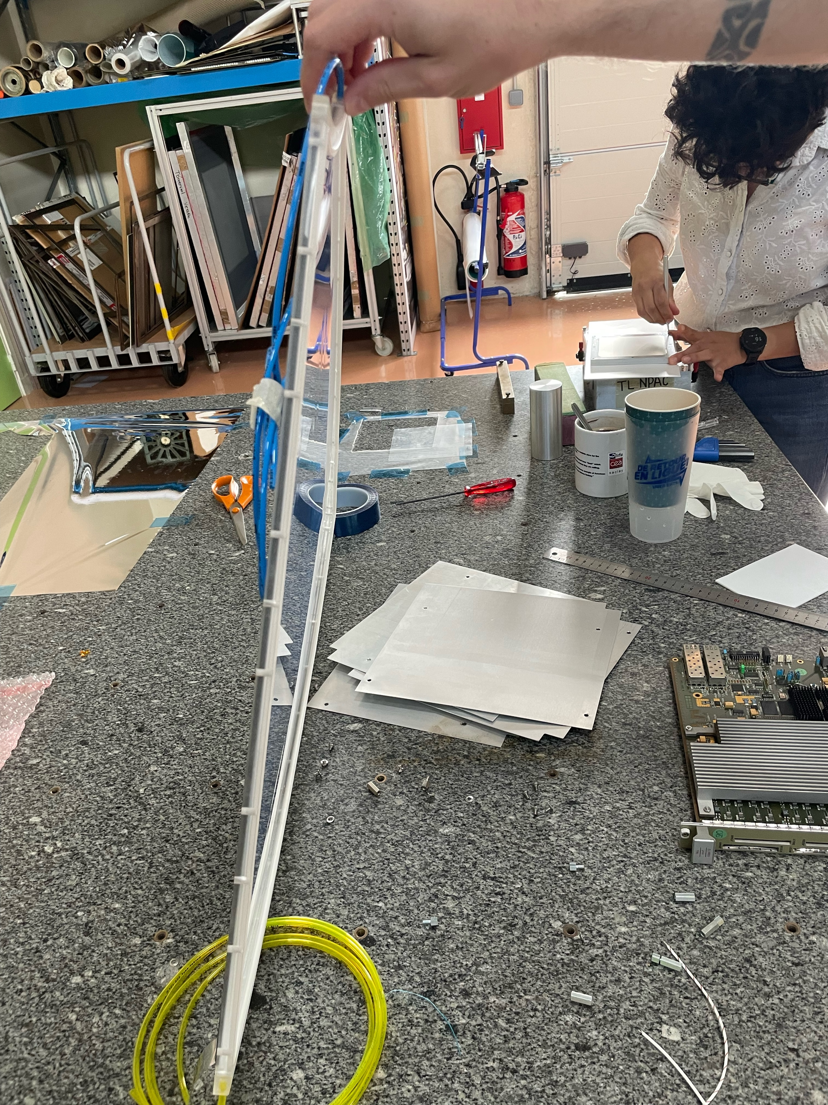
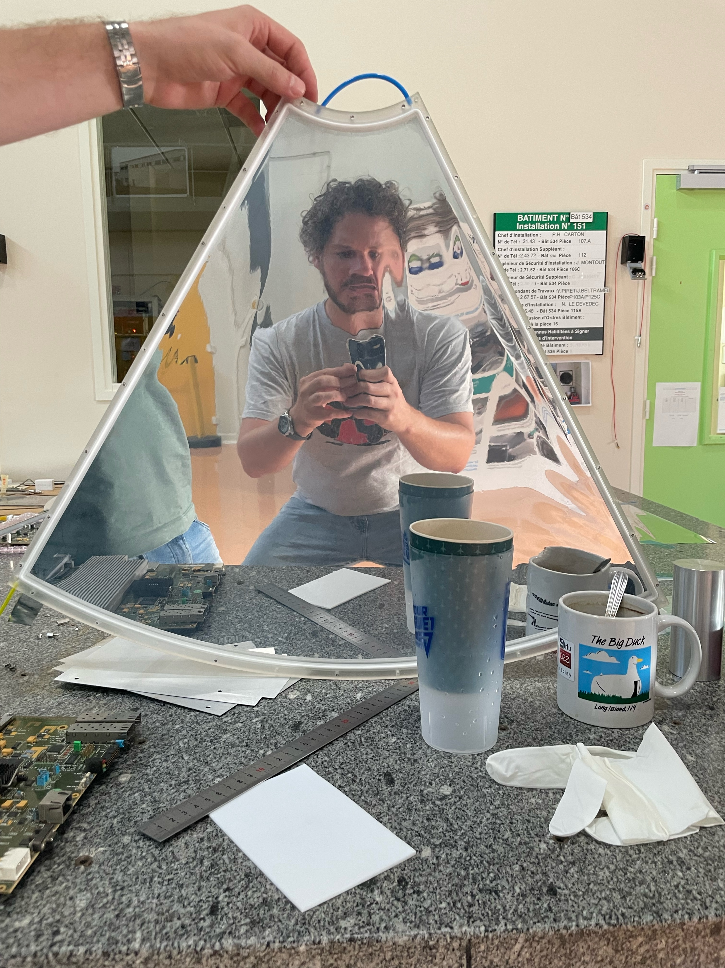
Drift
Glueing of mylar ok
Thin double membrane proto done

Slide 14
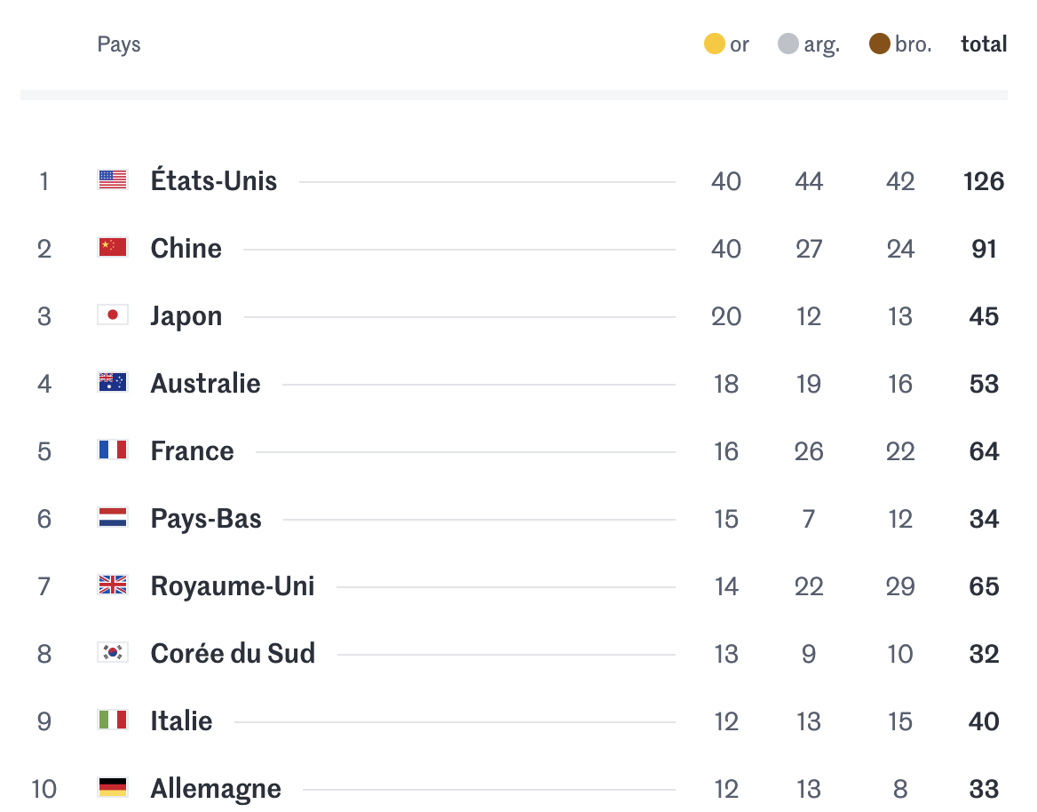
OUTLOOK
  Now that Olympics are finished we can resume work
  On the detector side, we are converging toward a working prototype v0 for end of 2024
  Readout :
    Suppliers selection will be done based on the PCB we received
    Next bulk process will happen when we receive the news mask (next week)
    FX20 connectors looks fine to solder by hand
  Drift :
    Contact / re-order of 3D frames ongoing
    First gluing
    Gas test next. If gluing too fragile => new frame design
  Other matter concerning detectors :
    HV card ready and tested
    Small current to be investigated

Slide 15
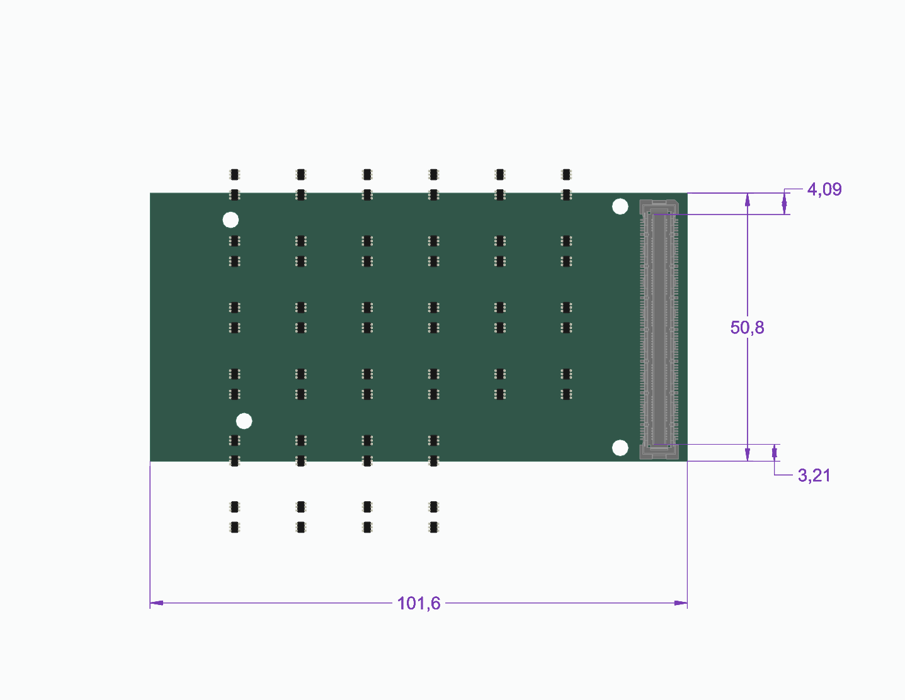
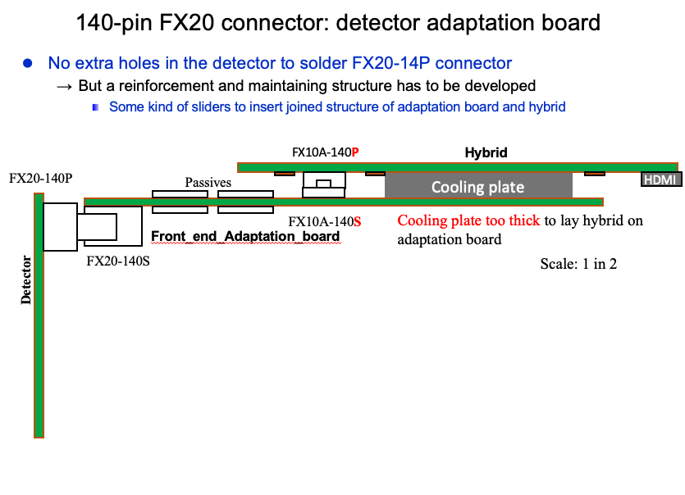
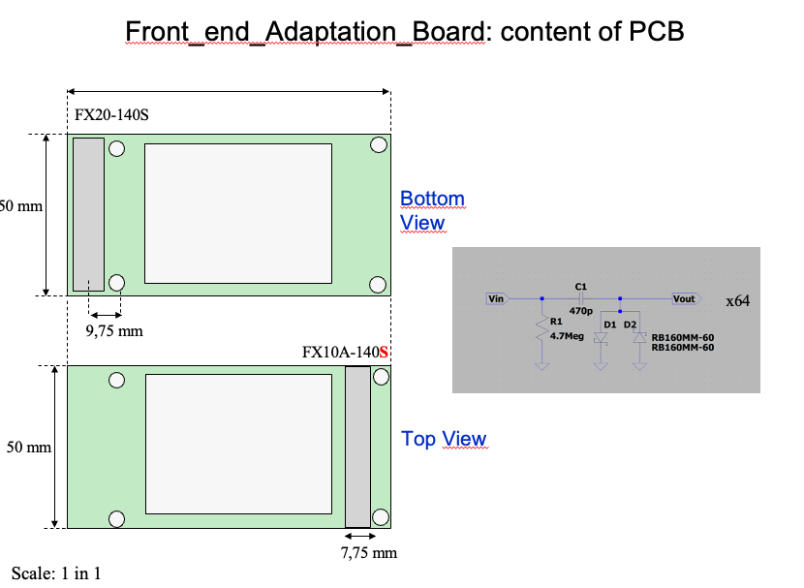
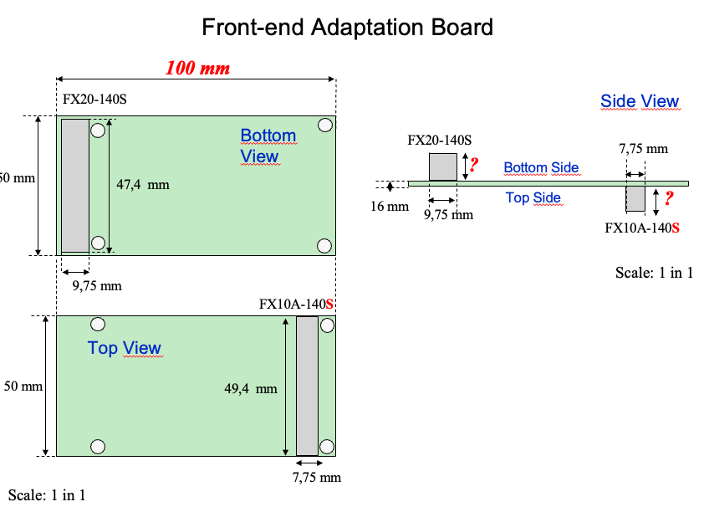
Transition

Slide 16
Rails alim basse tension
2V
P2 Rail alim ?
3.3V
HMDI
GND
Meca alu ?
Cooling ?
Alu arceau cylindrique
FX20
Alu chapeau - chambre a vide
VMM Hybride
Alu arceau

