Slide 1
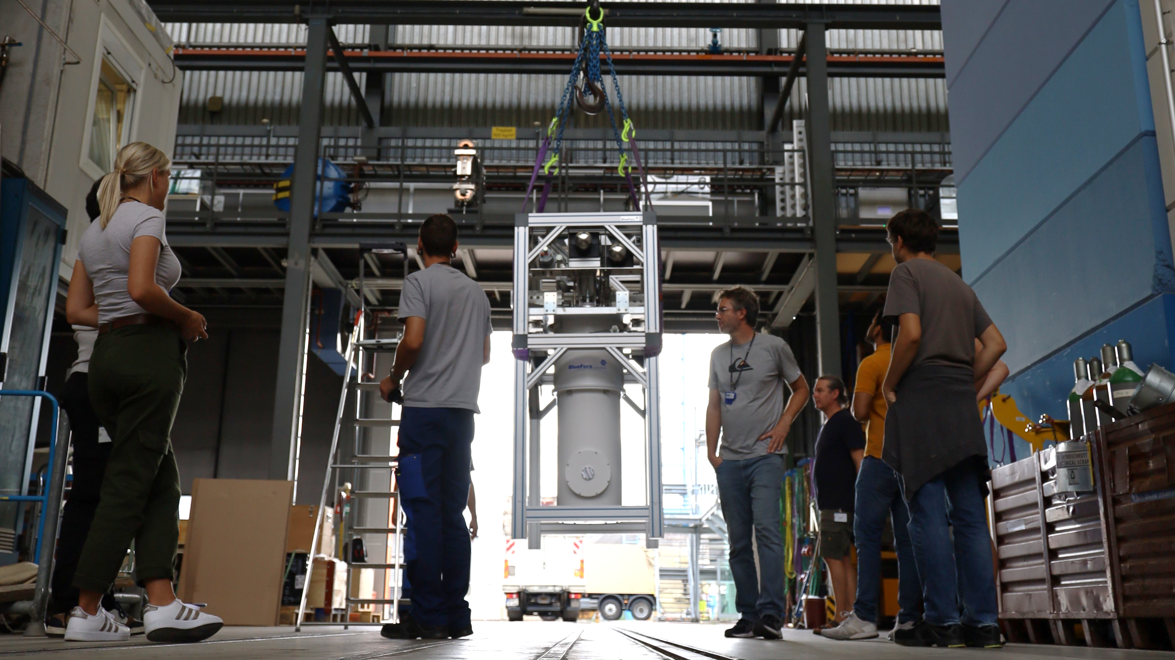
Towards the Measurement of
Charge Radii from Lithium to Neon
Ben Ohayon
For the QUARTET collaboration
PSAS June 2024, ETH Zürich

Slide 2
We are
workers in the fields of:
Exotic atoms
Quantum sensing
* Spokespersons: bohayon@technion.ac.il, npaul@lkb.upmc.fr

Slide 3
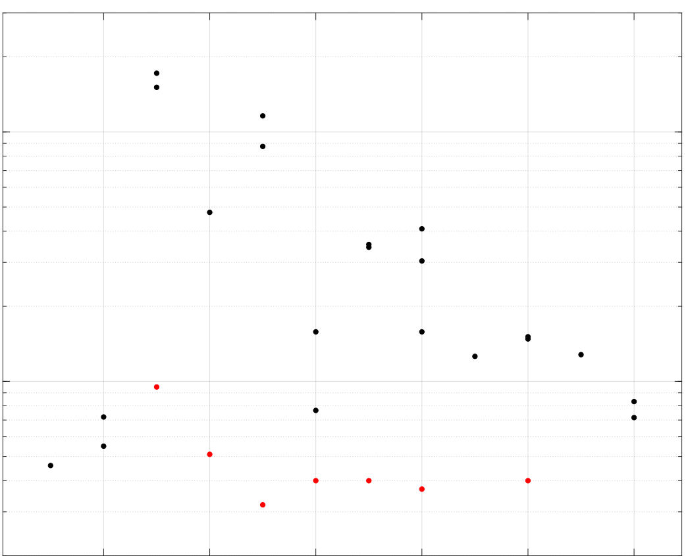
We want to
⁷Li
µ-Laser
El. Scat.
⁶Li
⁹Be
¹⁰B
µ-X (HPGe)
10⁻²
¹¹B
µ-X (Crystal)
µ-X (MMC)
Accurately measure absolute nuclear charge radii of stable nuclei from ⁶Li to ²²Ne
¹⁸O
^{14,15}N
$$σ_{r}/r$$
¹⁷O
¹³C
¹⁶O
^{20,22}Ne
¹⁹F
²³Na
10⁻³
¹²C
⁴He
³He
^{24,26}Mg
H
10⁻⁴
D
2
4
6
8
10
12
Z
3 / 30

Slide 4
How?
Muonic atoms
Muonic atoms
s levels very sensitive to nuclear radius:
Well-developed theory + Experiment
$$\frac{δE_{FNS}}{E_{0}}\sim Z^{2}{\left(\frac{r_{c}}{a_{0}}\right)}^{2}{\left(\frac{m_{μ}}{m_{e}}\right)}^{2}\sim {10}^{−4} Z^{2}$$
4 / 30

Slide 5
How?
Muonic atoms
Muonic atoms
Needed resolving power $\frac{E}{Γ_{E}}>{10}^{3}$ for $3≤Z$.
Solid-state detectors not adequate under $\sim 200 keV (Z=10)$
Laser spectroscopy not (yet) possible.
s levels very sensitive to nuclear radius:
Well-developed theory + Experiment
$$\frac{δE_{FNS}}{E_{0}}\sim Z^{2}{\left(\frac{r_{c}}{a_{0}}\right)}^{2}{\left(\frac{m_{μ}}{m_{e}}\right)}^{2}\sim {10}^{−4} Z^{2}$$
4 / 30

Slide 6
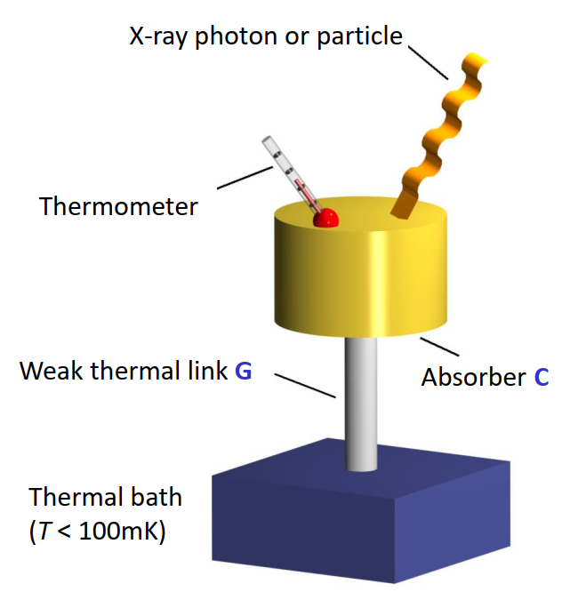
How?
Muonic atoms
Cryogenic microcalorimeters
Muonic atoms
Needed resolving power $\frac{E}{Γ_{E}}>{10}^{3}$ for $3≤Z$.
Solid-state detectors not adequate under $\sim 200 keV (Z=10)$
Laser spectroscopy not (yet) possible.
High quantum efficiency
Broadband (important for calibration)
Superb resolution $\left(\frac{E}{Γ_{E}}>{10}^{3}\right)$
Fast rise time (important for background suppression)
s levels very sensitive to nuclear radius:
Well-developed theory + Experiment
$$\frac{δE_{FNS}}{E_{0}}\sim Z^{2}{\left(\frac{r_{c}}{a_{0}}\right)}^{2}{\left(\frac{m_{μ}}{m_{e}}\right)}^{2}\sim {10}^{−4} Z^{2}$$
4 / 30

Slide 7
How?
Muonic atoms
Cryogenic microcalorimeters
Muonic atoms
Needed resolving power $\frac{E}{Γ_{E}}>{10}^{3}$ for$3≤Z$.
Solid-state detectors not adequate under $\sim 200 keV (Z=10)$
Laser spectroscopy not (yet) possible.
High quantum efficiency
Broadband (important for calibration)
Superb resolution $\left(\frac{E}{Γ_{E}}>{10}^{3}\right)$
Fast rise time (important for background suppression)
s levels very sensitive to nuclear radius:
Well-developed theory + Experiment
$$\frac{δE_{FNS}}{E_{0}}\sim Z^{2}{\left(\frac{r_{c}}{a_{0}}\right)}^{2}{\left(\frac{m_{μ}}{m_{e}}\right)}^{2}\sim {10}^{−4} Z^{2}$$
4 / 30

Slide 8
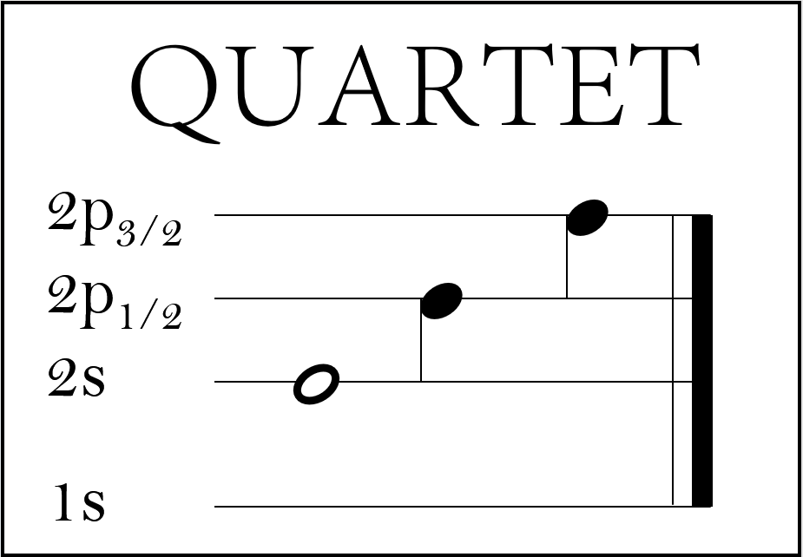
How?
Quantum Interactions with Exotic Atoms
Muonic atoms
Cryogenic microcalorimeters
Muonic atoms
Needed resolving power $\frac{E}{Γ_{E}}>{10}^{3}$ for$3≤Z$.
Solid-state detectors not adequate under $\sim 200 keV (Z=10)$
Laser spectroscopy not (yet) possible.
High quantum efficiency
Broadband (important for calibration)
Superb resolution $\left(\frac{E}{Γ_{E}}>{10}^{3}\right)$
Fast rise time (important for background suppression)
s levels very sensitive to nuclear radius:
Well-developed theory + Experiment
$$\frac{δE_{FNS}}{E_{0}}\sim Z^{2}{\left(\frac{r_{c}}{a_{0}}\right)}^{2}{\left(\frac{m_{μ}}{m_{e}}\right)}^{2}\sim {10}^{−4} Z^{2}$$

Slide 9
Experimental scheme
${10}^{4} μ^{−}/s$, $\sim 30 MeV/c$
Entrance counter and veto for tagging and timing
µ⁻ beam
veto
veto
^{Coincidence}
7 / 30

Slide 10
Experimental scheme
${10}^{4} μ^{−}/s$, $\sim 30 MeV/c$
Entrance counter and veto for tagging and timing
Target ladder in vacuum chamber with x-ray windows
X-ray tube and suitable targets
µ⁻ beam
veto
veto
^{Coincidence}
X-ray
beam
Target ladder
Target chamber
7 / 30

Slide 11
Experimental scheme
${10}^{4} μ^{−}/s$, $\sim 30 MeV/c$
Entrance counter and veto for tagging and timing
Target ladder in vacuum chamber with x-ray windows
X-ray tube and suitable targets
Solid-state detectors
µ⁻ beam
veto
veto
^{Coincidence}
X-ray
beam
^{HPGe Det.}
Target ladder
Target chamber
^{SDD}
7 / 30

Slide 12
Experimental scheme
${10}^{4} μ^{−}/s$, $\sim 30 MeV/c$
Entrance counter and veto for tagging and timing
Target ladder in vacuum chamber with x-ray windows
X-ray tube and suitable targets
Solid-state detectors
Microcalorimeter detector array “as close as possible”
µ⁻ beam
veto
veto
^{Coincidence}
X-ray
beam
Snout with
cold finger
^{Dilution}
^{Fridge}
^{HPGe Det.}
Target ladder
^{MMC det.}
Target chamber
^{SDD}
7 / 30

Slide 13
Experimental scheme
${10}^{4} μ^{−}/s$, $\sim 30 MeV/c$
Entrance counter and veto for tagging and timing
Target ladder in vacuum chamber with x-ray windows
X-ray tube and suitable targets
Solid-state detectors
Microcalorimeter detector array “as close as possible”
Calibration sources
µ⁻ beam
veto
veto
^{Coincidence}
X-ray
beam
Snout with
cold finger
^{Dilution}
^{Fridge}
^{HPGe Det.}
Target ladder
^{MMC det.}
Target chamber
Radioact.
Sources
^{SDD}
7 / 30

Slide 14
Calibration Strategy
E(2P-1S):
$$Li$$
$$Be$$
$$B$$
$$C$$
$$N$$
O
F
Ne
$$σ_{E} (eV)$$
$$E (keV)$$
8 / 30

Slide 15
Calibration Strategy
E(2P-1S):
$$Li$$
$$Be$$
$$B$$
$$C$$
$$N$$
O
F
Ne
$$σ_{E} (eV)$$
- Calibration sources
$$E (keV)$$
8 / 30

Slide 16
Calibration sources
E(2P-1S):
$$Li$$
$$Be$$
$$B$$
$$C$$
$$N$$
O
F
Ne
$$σ_{E} (eV)$$
¹³⁷Cs
²⁴¹Am
²¹⁰Pb
Ag XRF
- Calibration sources
- Muonic (2P-1S)
- Mo & Ag $K_{α}$
⁵⁵Fe
Mo XRF
$$E (keV)$$

Slide 17
Calibration sources
Will limit accuracy of absolute energies (but not isotope shifts)
E(2P-1S):
$$Li$$
$$Be$$
$$B$$
$$C$$
$$N$$
O
F
Ne
$$σ_{E} (eV)$$
¹³⁷Cs
²⁴¹Am
²¹⁰Pb
Ag XRF
- Calibration sources
- Muonic (2P-1S)
- Mo & Ag $K_{α}$
⁵⁵Fe
Mo XRF
$$E (keV)$$

Slide 18
Some open questions
Transport, integration, cooling, fast enough?
Sources of background in the accelerator environment.
Effect of muon-induced background?
Efficiency of detection & detector placement
Interplay of stability & calibration
9 / 30

Slide 19
Some open questions
Test beam:
October 23
1 week online
Transport, integration, cooling, fast enough?
Sources of background in the accelerator environment.
Effect of muon-induced background?
Efficiency of detection & detector placement
Interplay of stability & calibration

Slide 20
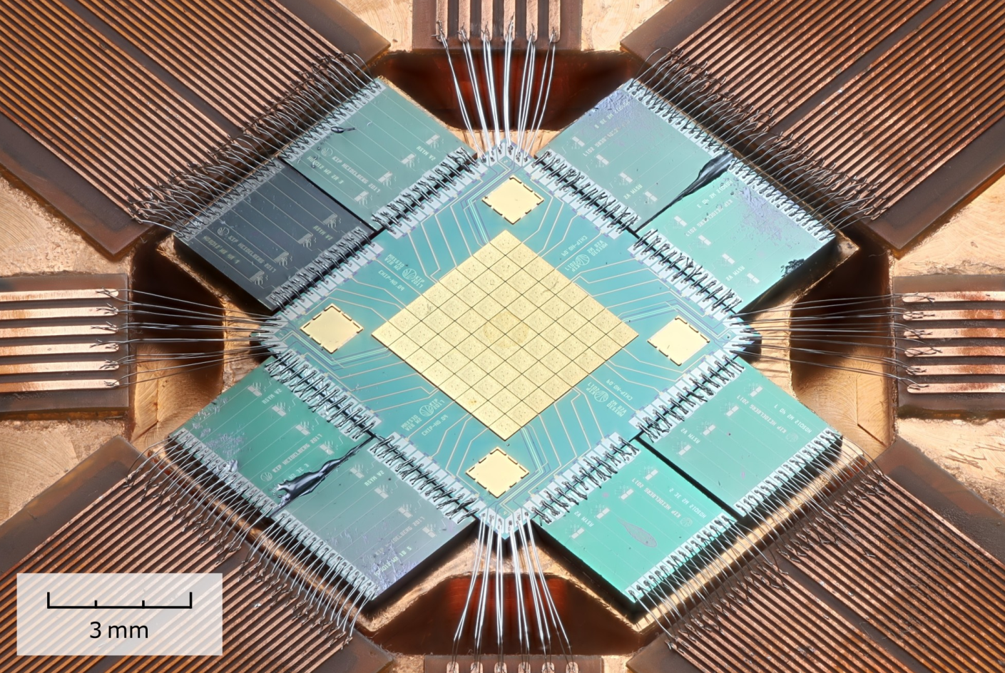
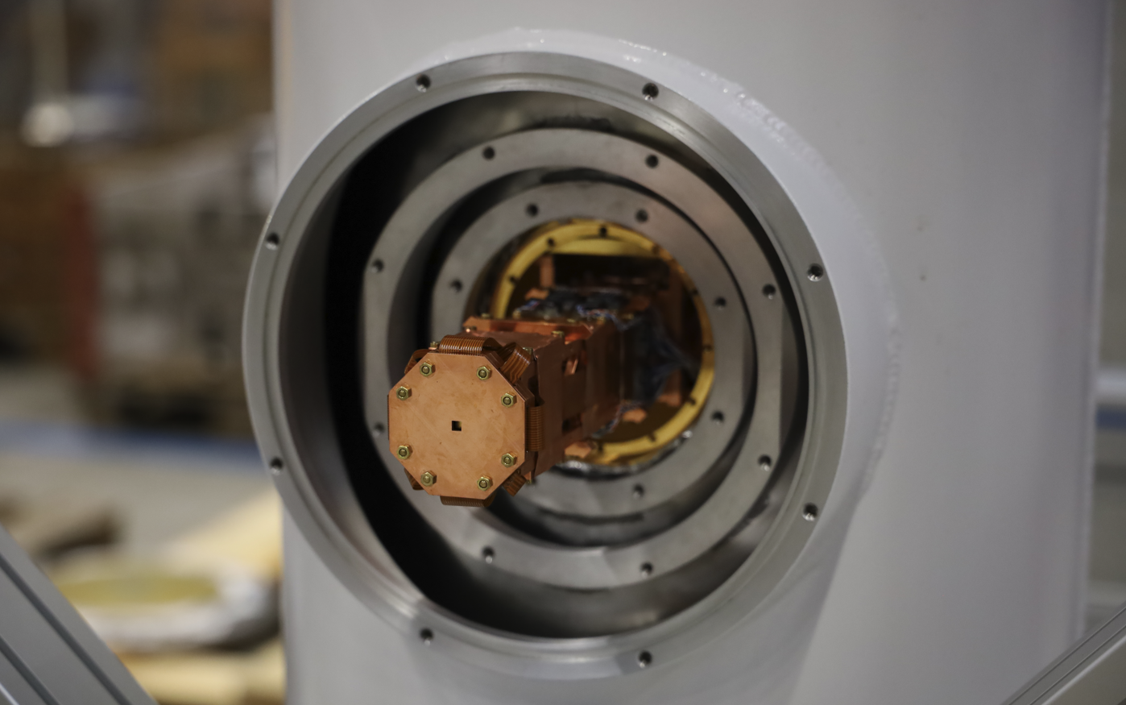
Test-beam summary: The detector
Use existing MaXs-30 detector
With dedicated sidearm
Efficiency: $97\% @ 19 keV, 7\% @ 75 keV$
Good for np-1s in muonic: Li, Be, B & (C)
10 / 30

Slide 21
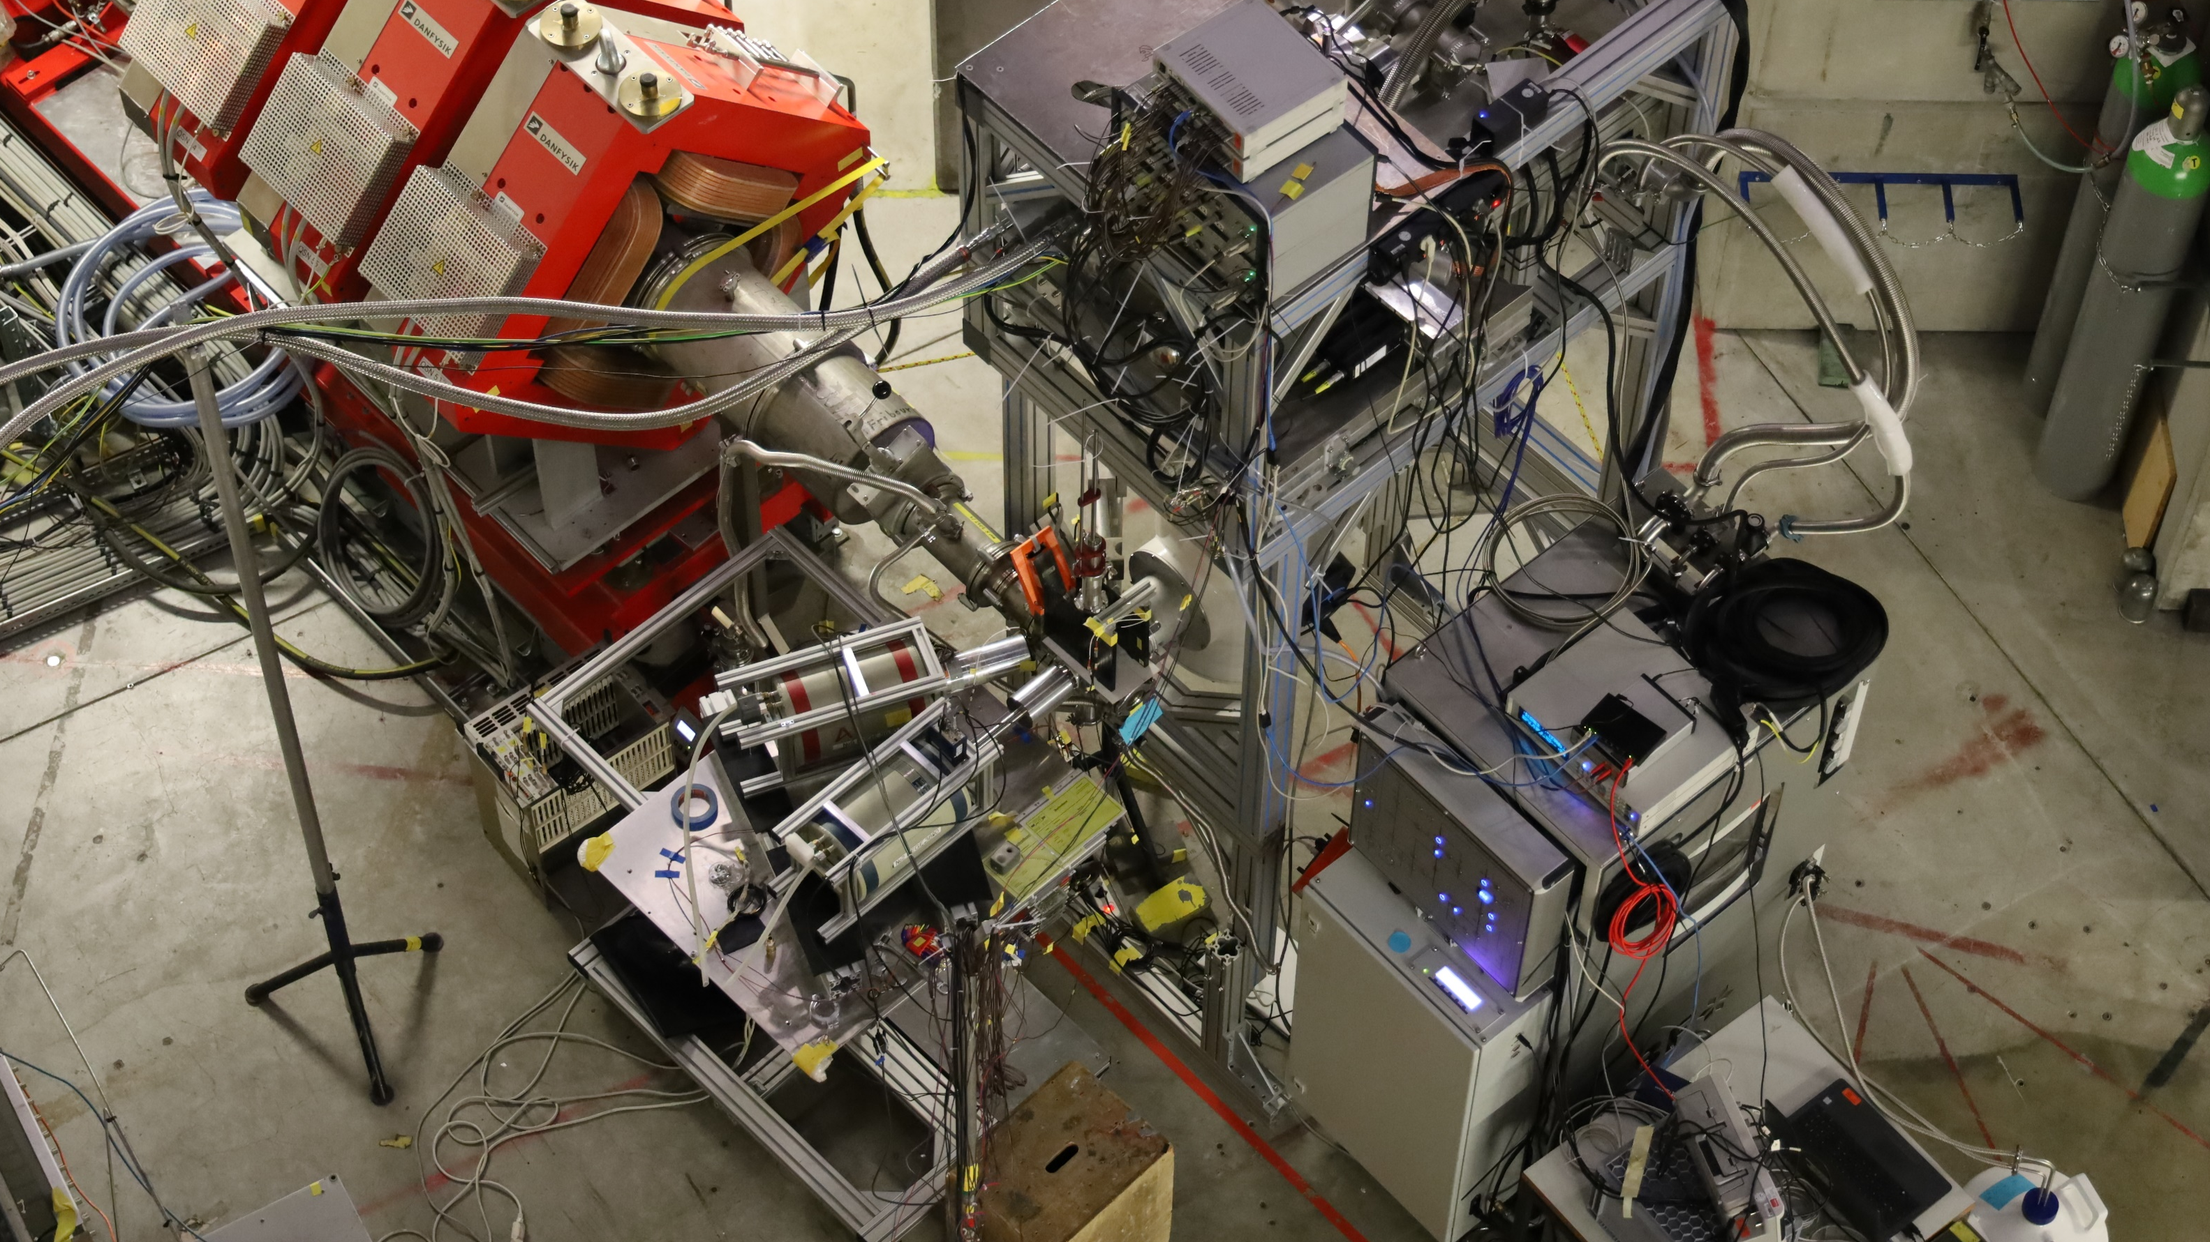

Slide 22
$μ^{−}$ beam
tagging and calibration
dilution refrigerator
MMC array
target ladder
solid-state detectors
Slide by D. Unger

Slide 23
Test-beam summary: Online schedule
Day | I |  |  |  | II |  |  |  | III |  |  |  |  | IV |  |  |  |  | V |  | (VI )
Time | 00:00 -1:00 | 2:00 -11:00 | 11:00 -12:00 | 12:00 -13:30 | 13:30 -11:30 | 11:30 -12:30 | 12:30 -16:30 | 17:00 -18:30 | 19:00 – 10:00 | 10:00 – 11:00 | 11:00 – 12:00 | 12:00 – 19:00 | 21:30 -23:00 | 23:30 -1:30 | 1:30 -13:30 | 14:00 -15:00 | 15:00 – 19:00 | 19:00 – 21:00 | 21:00 – 9:30 | 9:30 – 14:00 | 14:30-7:00
Goal | Calib. | Production | Calib. | Bgnd | Production | Calib. | Implant. test | Bgnd | Production | Calib. | Rate test | Production + beam tuning | Beam tuning while reset | Beam tuning while reset | Production | Pile-up test | Production? | Calib. | Production | Calib. + rate study | Production
Target | Mo-Ag | ⁷Li | Mo-Ag | Cu | ⁶Li | Mo-Ag | ¹²C | Empty | ^{10,11}B | Mo | Be | ^{10,11}B | ¹³C | ¹²C | ⁹Be | ¹²C | ¹²C | Mo-Ag | ⁶Li / (⁷Li) | Mo-Ag | ⁶Li / ⁷Li
Source |  | ⁵⁵Fe, ¹⁰⁹Cd, ²⁴¹Am | ← | ← | ← | ← | ⁵⁵Fe | ← | ⁵⁵Fe, ²¹⁰Pb, ²⁴¹Am, ¹³⁷Cs | ⁵⁵Fe, ²¹⁰Pb, ²⁴¹Am, ¹³⁷Cs | ← | ← | ← | ← | ← | ← | ← | ← | ← | ← | ←
Ladder | I | I | I | I | I | I | I |  | II | II | II | II | II | II | II | III | III | III | III | III | III
MMC Det. | V | V | V | V | V | V | V | V | V | V | V | V | Soft reset | Soft reset | V | V | V | V | V | V | V
DAQ |  |  |  |  | sync |  |  |  | MMC CSV output
Ladder I

Slide 24
Test-beam summary: Online schedule
Day | I |  |  |  | II |  |  |  | III |  |  |  |  | IV |  |  |  |  | V |  | (VI )
Time | 00:00 -1:00 | 2:00 -11:00 | 11:00 -12:00 | 12:00 -13:30 | 13:30 -11:30 | 11:30 -12:30 | 12:30 -16:30 | 17:00 -18:30 | 19:00 – 10:00 | 10:00 – 11:00 | 11:00 – 12:00 | 12:00 – 19:00 | 21:30 -23:00 | 23:30 -1:30 | 1:30 -13:30 | 14:00 -15:00 | 15:00 – 19:00 | 19:00 – 21:00 | 21:00 – 9:30 | 9:30 – 14:00 | 14:30-7:00
Goal | Calib. | Production | Calib. | Bgnd | Production | Calib. | Implant. test | Bgnd | Production | Calib. | Rate test | Production + beam tuning | Beam tuning while reset | Beam tuning while reset | Production | Pile-up test | Production? | Calib. | Production | Calib. + rate study | Production
Target | Mo-Ag | ⁷Li | Mo-Ag | Cu | ⁶Li | Mo-Ag | ¹²C | Empty | ^{10,11}B | Mo | Be | ^{10,11}B | ¹³C | ¹²C | ⁹Be | ¹²C | ¹²C | Mo-Ag | ⁶Li / (⁷Li) | Mo-Ag | ⁶Li / ⁷Li
Source |  | ⁵⁵Fe, ¹⁰⁹Cd, ²⁴¹Am | ← | ← | ← | ← | ⁵⁵Fe | ← | ⁵⁵Fe, ²¹⁰Pb, ²⁴¹Am, ¹³⁷Cs | ⁵⁵Fe, ²¹⁰Pb, ²⁴¹Am, ¹³⁷Cs | ← | ← | ← | ← | ← | ← | ← | ← | ← | ← | ←
Ladder | I | I | I | I | I | I | I |  | II | II | II | II | II | II | II | III | III | III | III | III | III
MMC Det. | V | V | V | V | V | V | V | V | V | V | V | V | Soft reset | Soft reset | V | V | V | V | V | V | V
DAQ |  |  |  |  | sync |  |  |  | MMC CSV output
¹²C
Be
¹³C
Ladder I
Ladder II
BeO
B
Mo

Slide 25
Test-beam summary: Online schedule
Day | I |  |  |  | II |  |  |  | III |  |  |  |  | IV |  |  |  |  | V |  | (VI )
Time | 00:00 -1:00 | 2:00 -11:00 | 11:00 -12:00 | 12:00 -13:30 | 13:30 -11:30 | 11:30 -12:30 | 12:30 -16:30 | 17:00 -18:30 | 19:00 – 10:00 | 10:00 – 11:00 | 11:00 – 12:00 | 12:00 – 19:00 | 21:30 -23:00 | 23:30 -1:30 | 1:30 -13:30 | 14:00 -15:00 | 15:00 – 19:00 | 19:00 – 21:00 | 21:00 – 9:30 | 9:30 – 14:00 | 14:30-7:00
Goal | Calib. | Production | Calib. | Bgnd | Production | Calib. | Implant. test | Bgnd | Production | Calib. | Rate test | Production + beam tuning | Beam tuning while reset | Beam tuning while reset | Production | Pile-up test | Production? | Calib. | Production | Calib. + rate study | Production
Target | Mo-Ag | ⁷Li | Mo-Ag | Cu | ⁶Li | Mo-Ag | ¹²C | Empty | ^{10,11}B | Mo | Be | ^{10,11}B | ¹³C | ¹²C | ⁹Be | ¹²C | ¹²C | Mo-Ag | ⁶Li / (⁷Li) | Mo-Ag | ⁶Li / ⁷Li
Source |  | ⁵⁵Fe, ¹⁰⁹Cd, ²⁴¹Am | ← | ← | ← | ← | ⁵⁵Fe | ← | ⁵⁵Fe, ²¹⁰Pb, ²⁴¹Am, ¹³⁷Cs | ⁵⁵Fe, ²¹⁰Pb, ²⁴¹Am, ¹³⁷Cs | ← | ← | ← | ← | ← | ← | ← | ← | ← | ← | ←
Ladder | I | I | I | I | I | I | I |  | II | II | II | II | II | II | II | III | III | III | III | III | III
MMC Det. | V | V | V | V | V | V | V | V | V | V | V | V | Soft reset | Soft reset | V | V | V | V | V | V | V
DAQ |  |  |  |  | sync |  |  |  | MMC CSV output
4 hours downtime of the MMC detector refrigerator
Detector up time: 96%
During reset, optimize implantation using solid-state detectors

Slide 26
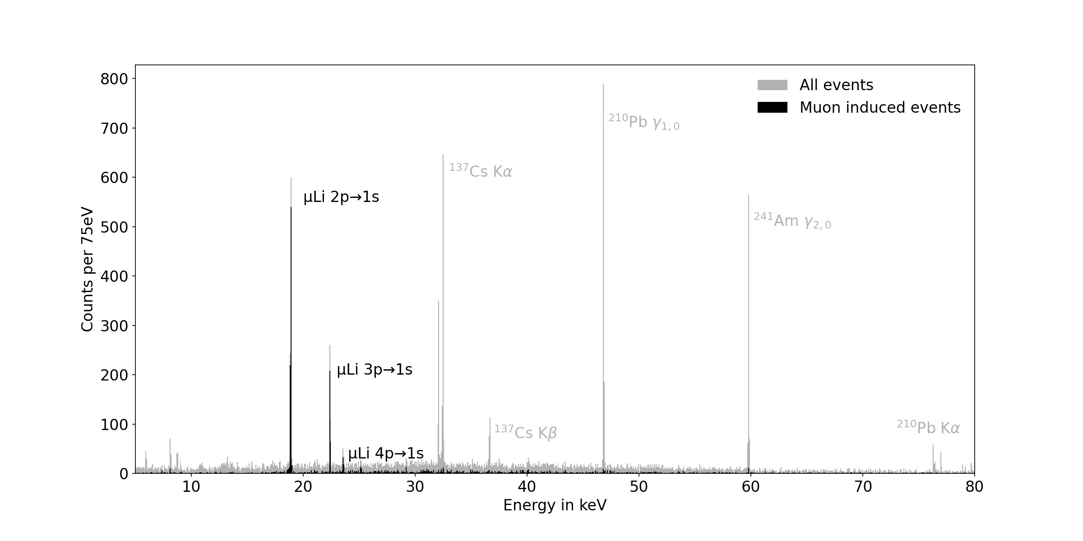
Preliminary calibrated spectrum with mixed Li target
19 / 30

Slide 27
Preliminary calibrated spectrum with mixed Li target
Transitions from higher lying states much more sensitive to electron screening effects (chemical shifts)
19 / 30

Slide 28
Preliminary calibrated spectrum with mixed Li target
X 200
19 / 30

Slide 29
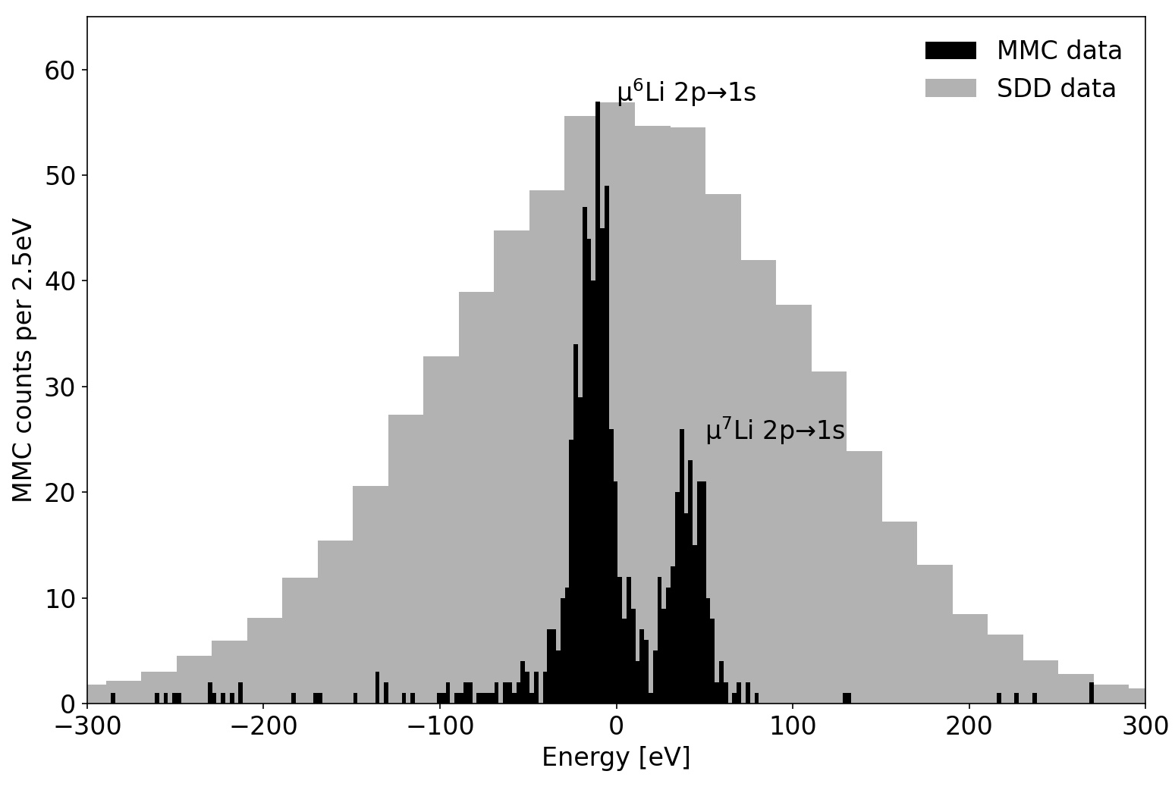
Preliminary zoomed-in spectrum of mixed Li target
Statistical uncertainty ~ 0.1 eV. Previous: 10 eV

Slide 30
Preliminary zoomed-in spectrum of mixed Li target
FS-HFS important!
Especially for isotope-shift where calibration unc. negligible
Statistical uncertainty ~ 0.1 eV. Previous: 10 eV

Slide 31
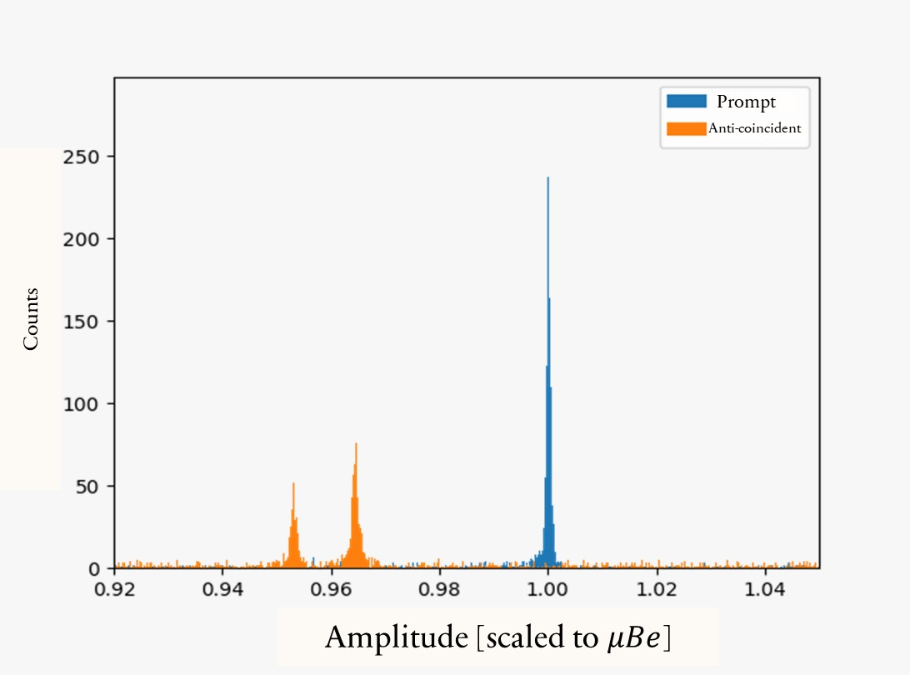
Preliminary zoomed-in spectrum of ⁹Be data:
$$μ^{ 9}Be (2p−1s)$$
32,193.3(1) keV
$$Ba K_{α2}$$
~1 keV,
$σ_{stat}\sim 0.5$ eV
$$Ba K_{α1}$$

Slide 32
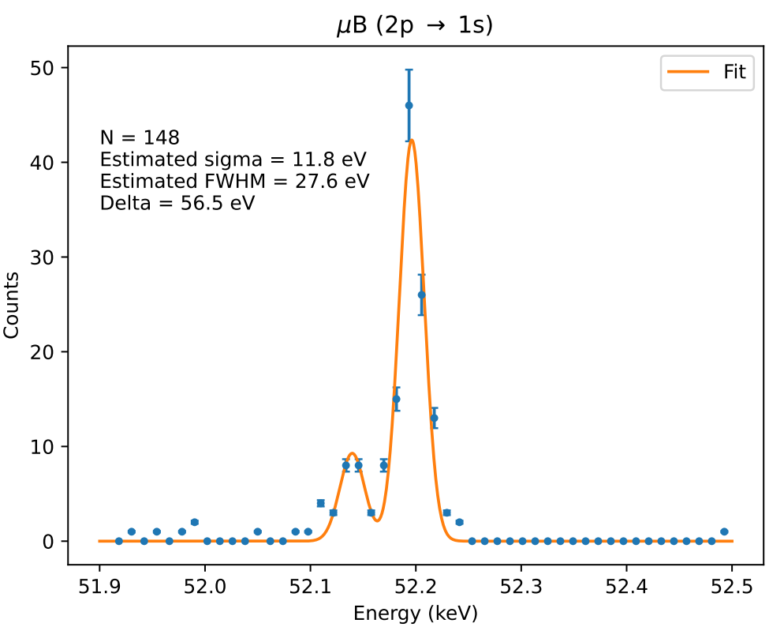
Preliminary zoomed-in spectrum of ^{nat}B data:
Roughly calibrated,
Just gaussians,
Missing FS, HFS, …

Slide 33
Preliminary zoomed-in spectrum of ^{nat}B data:
Roughly calibrated,
Just gaussians,
Missing FS, HFS, …
Need enriched
¹⁰B target!

Slide 34
Test beamtime results
Validated the QUARTET approach to muonic atom x-ray spectroscopy
Clear path to increased statistics and better calibration
Statistical uncertainty already competitive !
Nuclear polarization corrections urgently needed

Slide 35
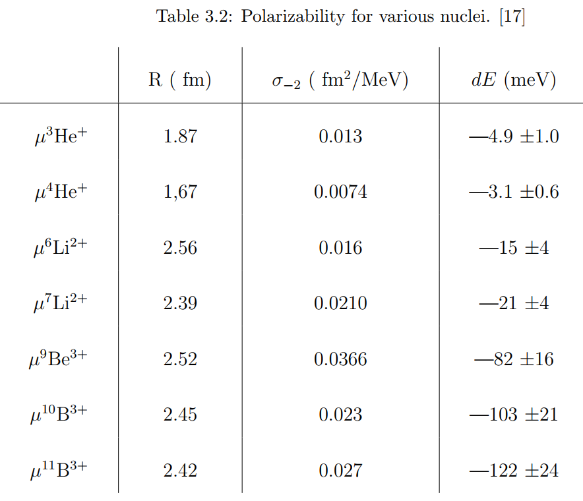
Status of Nuclear Polarization (inelastic TPE):
Borie-Rinker type estimations (Drake 85):
2S:

Slide 36
Status of Nuclear Polarization (inelastic TPE):
Borie-Rinker type estimations (Drake 85):
2S:
Ab Initio
(from Sonia’s group)
1S:
$$σ_{stat}(test beam)$$
meV
eV
eV
-4.23(4)
-2.3(1)
-12(?)
-0.1
0.2
-22(?)
-0.2
0.3
-0.7
0.5
-0.8
1.5
-1.0
1.5

Slide 37
Goals for 2024 and how to reach them:
With existing maXs-30 detector:
µ-Laser
⁷Li
El. Scat.
⁶Li
⁹Be
¹⁰B
Assuming resolution and rates as in test
48 hours per isotope
Upgrade digitizer modules to ppm-level non-linearity and ppm/°C-gain drift
Improved sources’ positioning
µ-X (HPGe)
10⁻²
¹¹B
µ-X (Crystal)
µ-X (MMC)
¹⁸O
^{14,15}N
$$σ_{r}/r$$
¹⁷O
¹³C
¹⁶O
^{20,22}Ne
¹⁹F
²³Na
10⁻³
¹²C
⁴He
³He
^{24,26}Mg
H
10⁻⁴
D
2
4
6
8
10
12
Z
22 / 30

Slide 38
Goals until 2026:
WP I
WP II
⁷Li
µ-Laser
With dedicated detector (10-200 keV):
El. Scat.
⁶Li
⁹Be
¹⁰B
optimized absorber dimensions balancing active area, stopping power & resolution
Protected on-chip T sensors to eliminate dead-time caused by x-ray events in them.
x10-100 increased rate hardness by improved pixel-heatsinking
µ-X (HPGe)
10⁻²
¹¹B
µ-X (Crystal)
µ-X (MMC)
¹⁸O
^{14,15}N
$$σ_{r}/r$$
¹⁷O
¹³C
¹⁶O
^{20,22}Ne
¹⁹F
²³Na
10⁻³
¹²C
⁴He
³He
^{24,26}Mg
H
Physics reach depends on theory effort!
10⁻⁴
D
2
4
6
8
10
12
Z
23 / 30

Slide 39
Anticipated impact

Slide 40
Output I: Z dependence of (unknown) high-order QED in Helium-like atoms
$E_{HO}(Z)≡E_{exp}−\left(E_{2}+E_{4}+E_{5}+E_{6}+δE_{FNS}\right)$
Z
2
3
4
5
6

Slide 41
Output I: Z dependence of (unknown) high-order QED in Helium-like atoms
$E_{HO}(Z)≡E_{exp}−\left(E_{2}+E_{4}+E_{5}+E_{6}+δE_{FNS}\right)$
High precision
Experiments in
Helium-like systems:
Talks: Yu Sun,
Gloria Claussen
Z
2
3
4
5
6

Slide 42
Output I: Z dependence of (unknown) high-order QED in Helium-like atoms
$E_{HO}(Z)≡E_{exp}−\left(E_{2}+E_{4}+E_{5}+E_{6}+δE_{FNS}\right)$
Radius from
Muonic atoms:
Talk: Randolf Pohl
High precision
Experiments in
Helium-like systems:
Talks: Yu Sun,
Gloria Claussen
Z
2
3
4
5
6

Slide 43
Output I: Z dependence of (unknown) high-order QED in Helium-like atoms
$E_{HO}(Z)≡E_{exp}−\left(E_{2}+E_{4}+E_{5}+E_{6}+δE_{FNS}\right)$
Radius from
Muonic atoms:
Talk: Randolf Pohl
Crystal Spec. @ PSI
High precision
Experiments in
Helium-like systems:
Talks: Yu Sun,
Gloria Claussen
Talk: Patrick Müller
Z
2
3
4
5
6
6

Slide 44
Output I: Z dependence of (unknown) high-order QED in Helium-like atoms
$E_{HO}(Z)≡E_{exp}−\left(E_{2}+E_{4}+E_{5}+E_{6}+δE_{FNS}\right)$
Radius from
Muonic atoms:
Talk: Randolf Pohl
Crystal Spec. @ PSI
Wuhan (beam)
High precision
Experiments in
Helium-like systems:
Darmstadt
MPQ?
(trap)
Talks: Yu Sun,
Gloria Claussen
Talk: Patrick Müller
Z
2
3
4
5
6
6

Slide 45
Output I: Z dependence of (unknown) high-order QED in Helium-like atoms
$E_{HO}(Z)≡E_{exp}−\left(E_{2}+E_{4}+E_{5}+E_{6}+δE_{FNS}\right)$
QUARTET
Radius from
Muonic atoms:
Talk: Randolf Pohl
Crystal Spec. @ PSI
Wuhan (beam)
High precision
Experiments in
Helium-like systems:
Darmstadt
MPQ?
(trap)
Talks: Yu Sun,
Gloria Claussen
Talk: Patrick Müller
Z
2
3
4
5
6

Slide 46
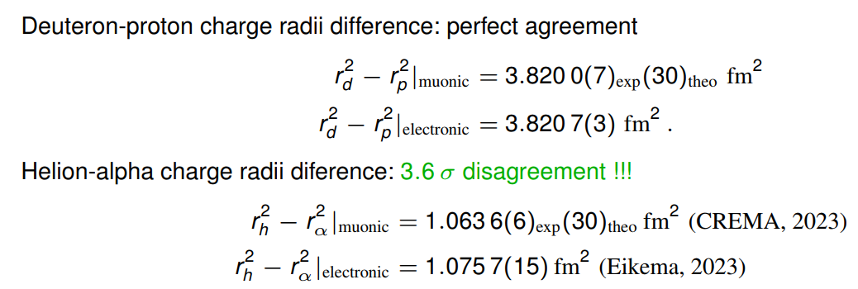
Output II: Muonic vs. electronic Isotope shifts
Pachucki’s talk:
Z=1
Z=2

Slide 47
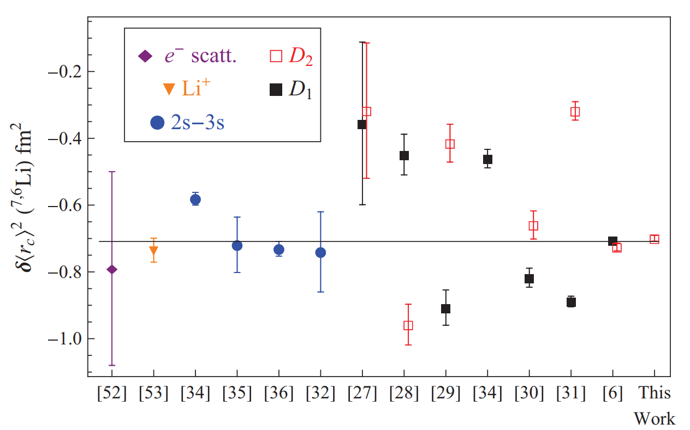
Output II: Muonic vs. electronic Isotope shifts
Pachucki’s talk:
Z=1
Z=2
Motivation to measure lithium:
Z=3
Goal
PRA 87, 032504 (2013)

Slide 48
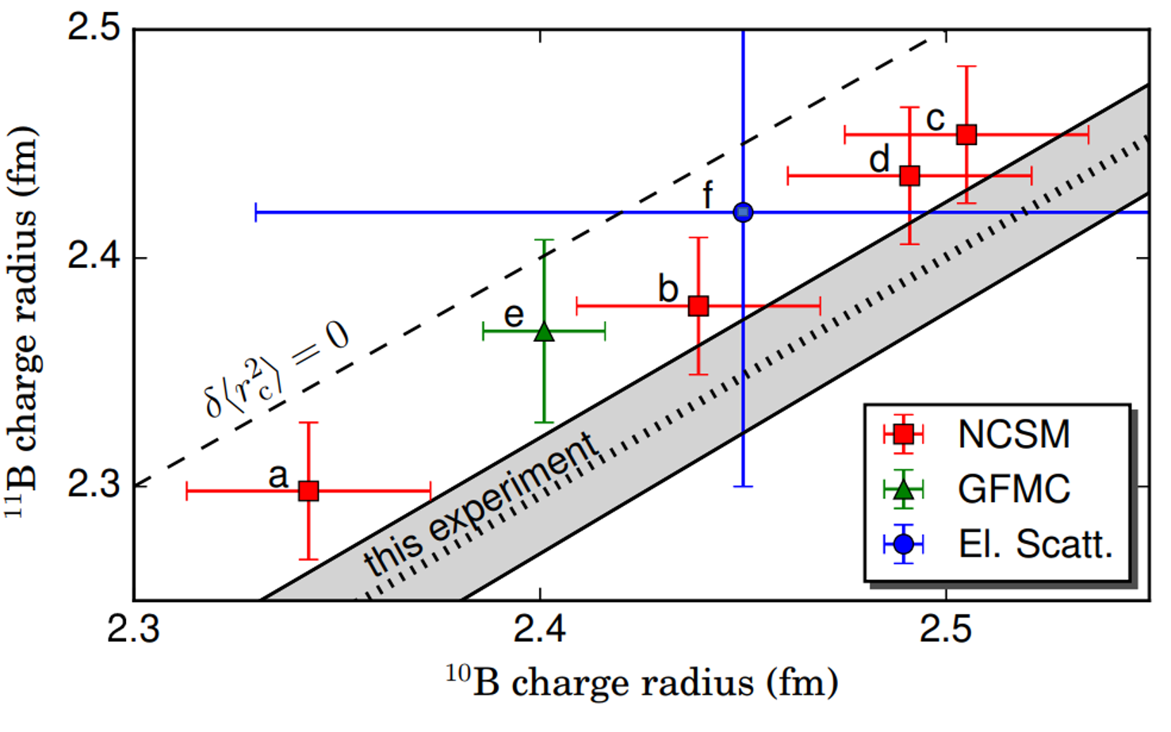
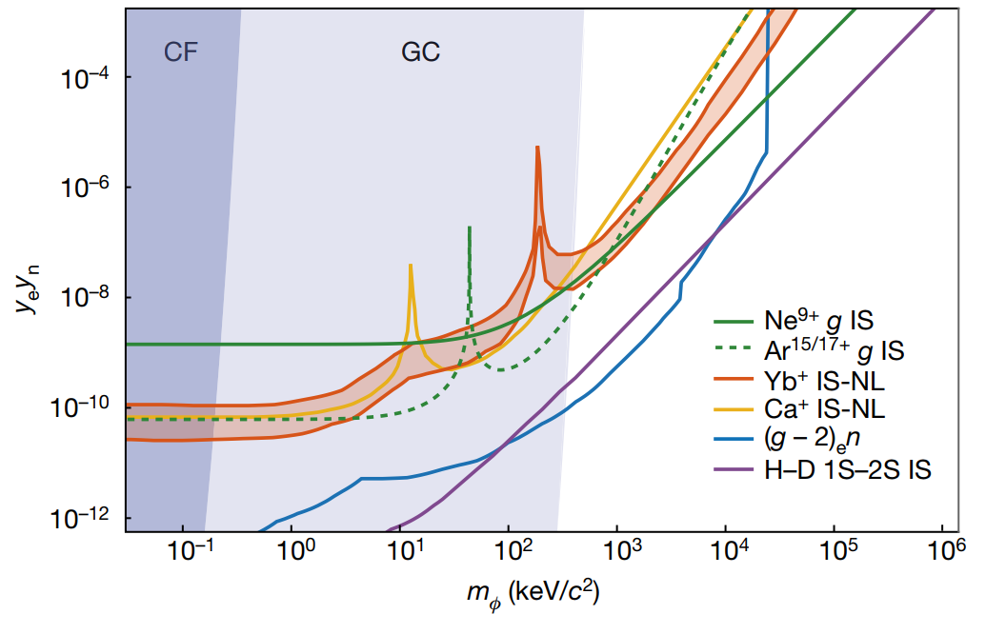
Output II: Muonic vs. electronic Isotope shifts
Pachucki’s talk:
Boron IS (desire to improve electronic measurements)
Z=5
Z=1
PRL 108, 142501 (2012)
Z=2
Motivation to measure lithium:
Goal
Z=3
Neon 20 and 22 (phase II):
Talk: Jonathan Morgner
Z=10
Goal
PRA 87, 032504 (2013)
PRA 87, 032504 (2013)
Nature volume 606, pages 479–483 (2022)

Slide 49
Output II: Muonic vs. electronic Isotope shifts
Boron IS (desire to improve electronic measurements)
Z=5
Z=1
PRL 108, 142501 (2012)
Also Carbon 12-13 IS!
(Patrik Müller talk)
Z=2
Motivation to measure lithium:
Goal
Z=3
Neon 20 and 22 (phase II):
Talk: Jonathan Morgner
Z=10
Goal
PRA 87, 032504 (2013)
PRA 87, 032504 (2013)
Nature volume 606, pages 479–483 (2022)

Slide 50
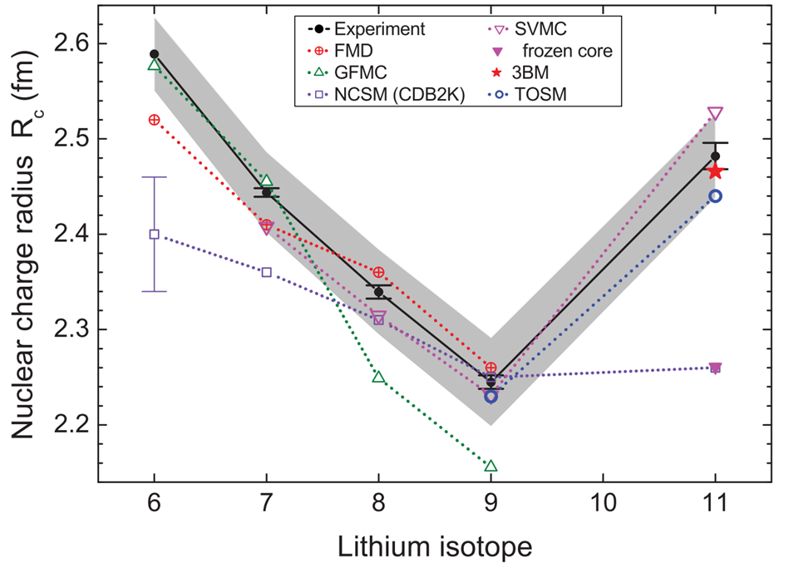
Output III: Radii of Mirror nuclei
Improve entire chains:
^{6-9,11}Li:
PRC 84, 024307 (2011)
Stable
Isotope shift measured
6
7
8
9
11
$$Li$$

Slide 51
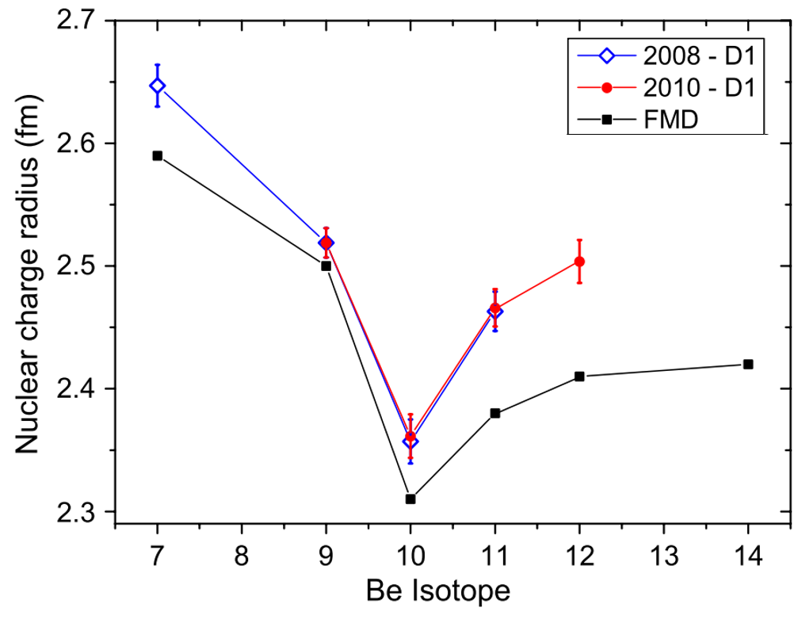
Output III: Radii of Mirror nuclei
Improve entire chains:
^{6-9,11}Li:
PRC 84, 024307 (2011)
⁷⁻¹²Be:
PRL 122, 182501 (2019)
^{10,11}B:
PRL 108, 142501 (2012)
8
10
11
Stable
$$B$$
7
9
10
11
12
$$Be$$
Isotope shift measured
6
7
8
9
11
$$Li$$

Slide 52
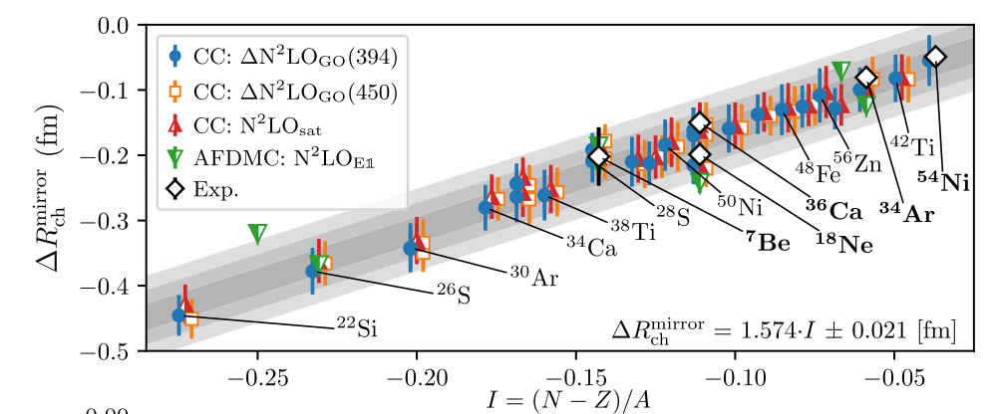
Output III: Radii of Mirror nuclei
S. J. Novario, et. al., PRL 130, 032501 (2023)

Slide 53
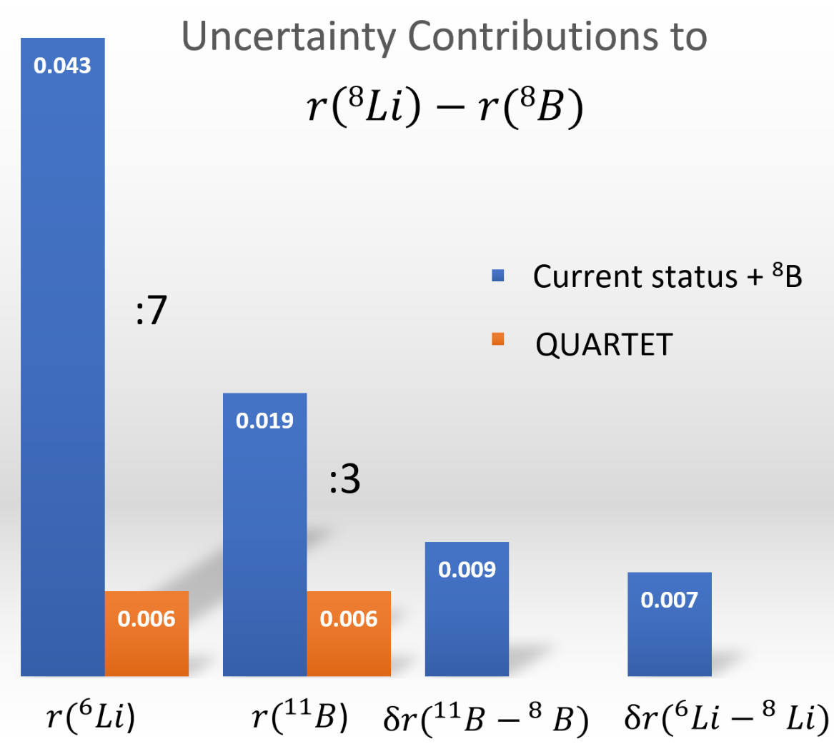
Output III: Radii of Mirror nuclei
Golden case $I=0.25$:
S. J. Novario, et. al., PRL 130, 032501 (2023)
*Priv. Com. With W. Nörtershäuser

Slide 54
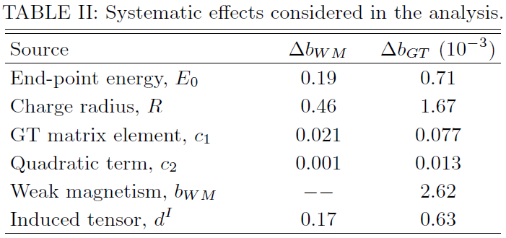
Why go up to neon?
Radius crucial for confronting experiment and theory in beta spectrum of ²⁰F
*Curtesy of Oscar Naviliat-Cuncic
Nuclear Theory
New Physics
28 / 30

Slide 55
17
18
19
20
Stable
$$Ne$$
19
$$F$$
Isotope shift measured
$$O$$
16
17
18
$$N$$
14
15
$$C$$
12
13
14
Z
8
10
11
$$B$$
7
9
10
11
12
$$Be$$
6
7
8
9
11
$$Li$$
N

Slide 56
17
18
19
20
Stable
$$Ne$$
19
$$F$$
Isotope shift measured
$$O$$
16
17
18
$$N$$
14
15
$$C$$
12
13
14
Z
8
10
11
$$B$$
7
9
10
11
12
$$Be$$
6
7
8
9
11
$$Li$$
N

Slide 57
ROLIN’
Radii Of Light
Mirror Nucleí

Slide 58
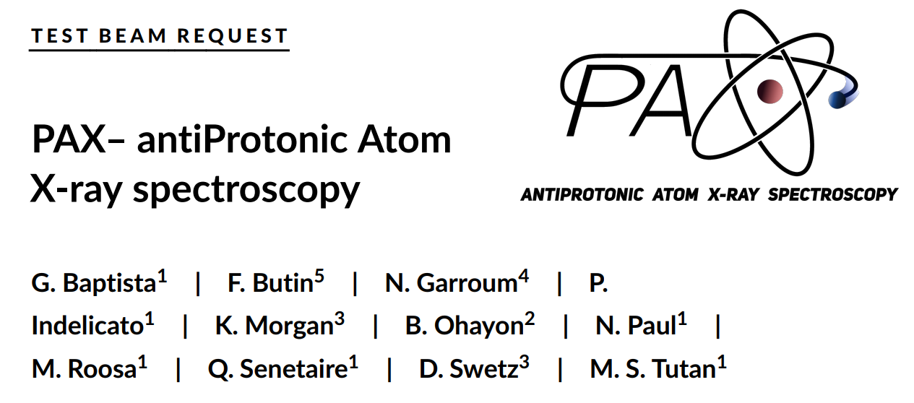
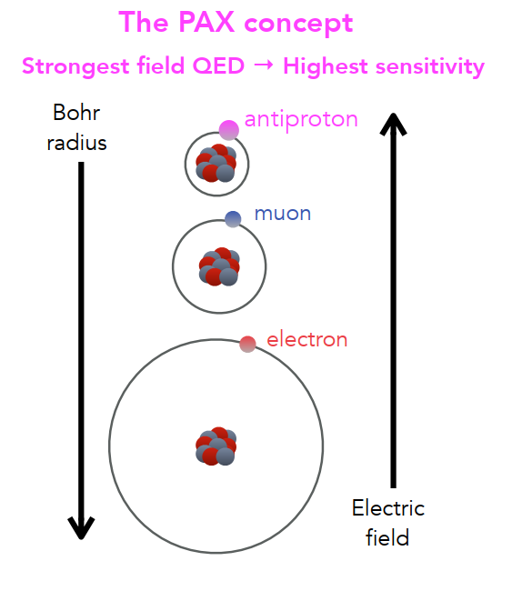
New Project:
Spokesperson: Nancy Paul npaul@lkb.upmc.fr

Slide 59
New Project:
Spokesperson: Nancy Paul npaul@lkb.upmc.fr
Circular transitions with antiprotonic noble gasses:
$$\left(\frac{αZ}{n}\right)$$
$$\%$$

Slide 60
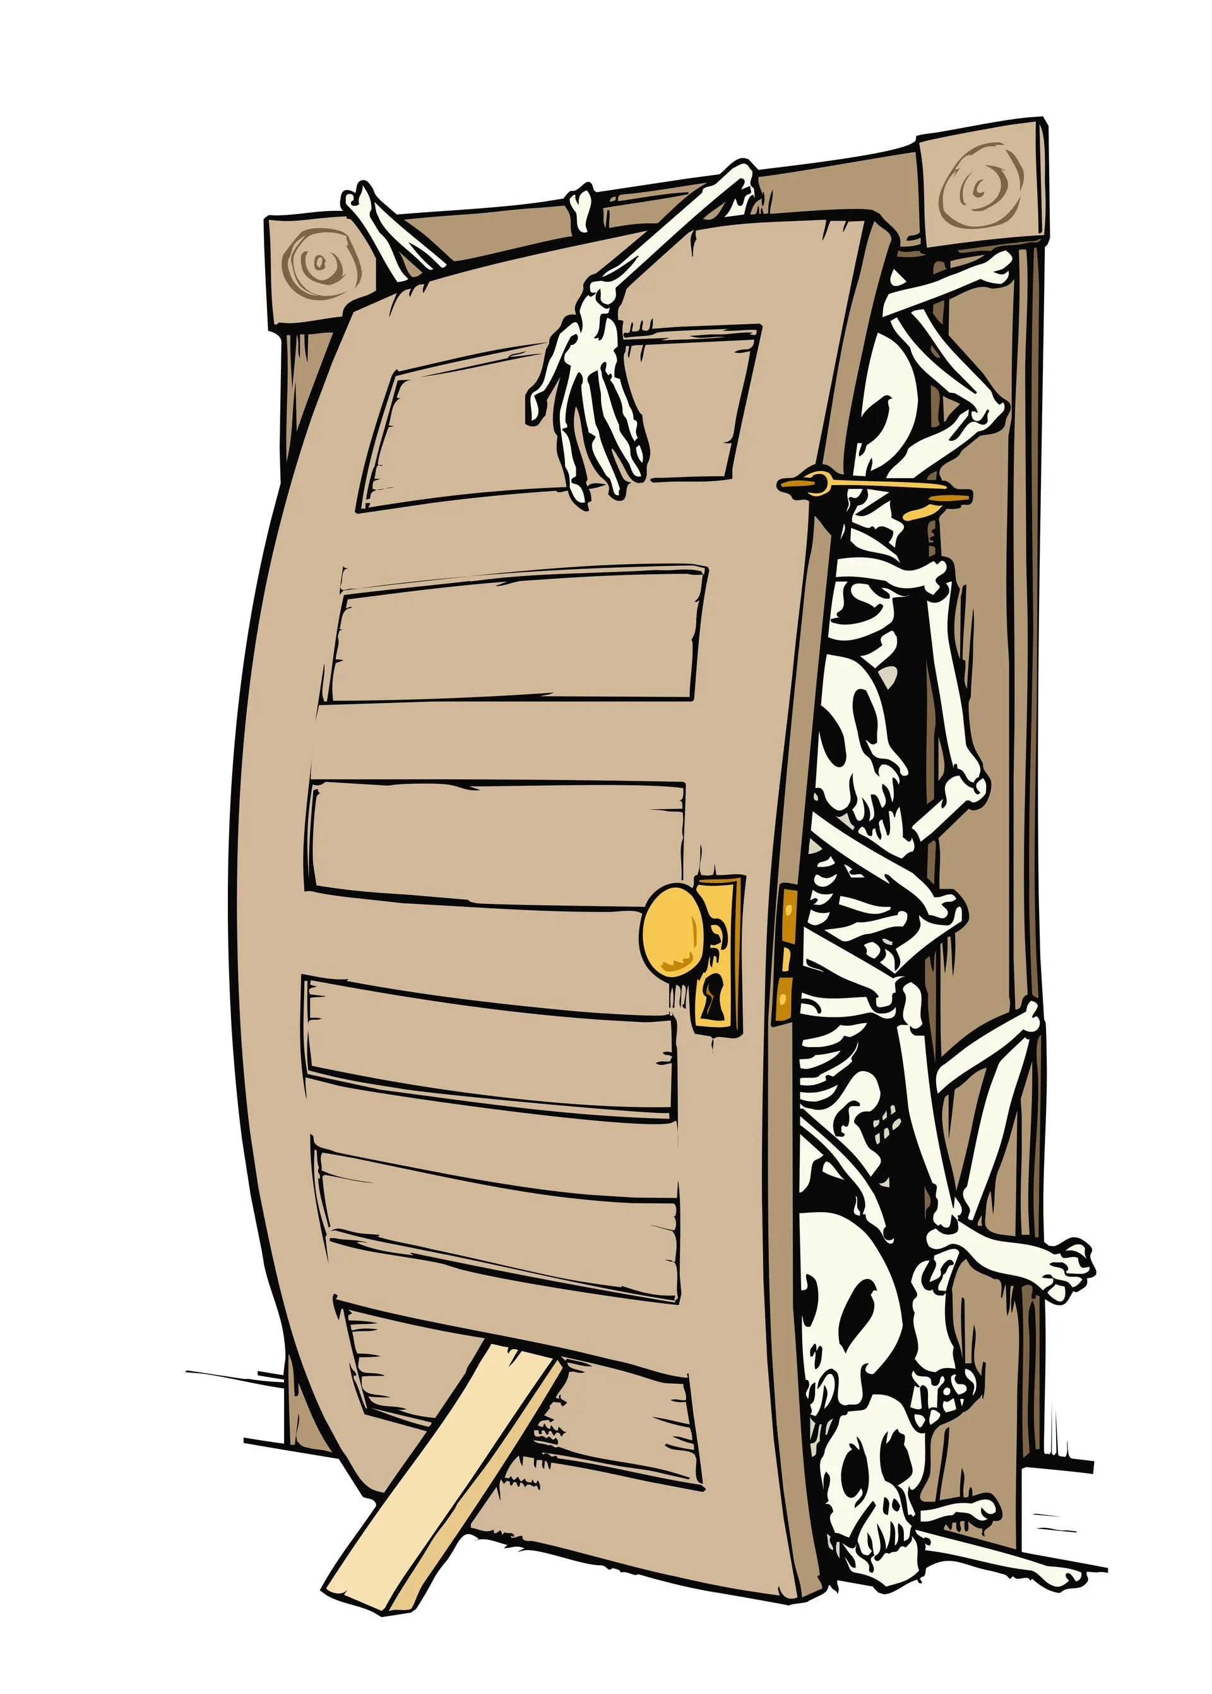
Summary
Charge radii are central for confronting theory with experiment (e.g. QED of HLIs, and nuclear theory of mirror nuclei)
Only for Z=1,2, they are both precise & reliable
For Z>10, they are precise bot not reliable (opportunities for theory)
For Z=3-10, not precise. Limited by available experimental methods
QUARTET: Determine radii via x-ray spectroscopy of light muonic atoms using cryo-calorimeters.
Successful test last October, physics run next October, stay tuned…

Slide 61
Thanks for listening!
PSI, October 2023

Slide 63
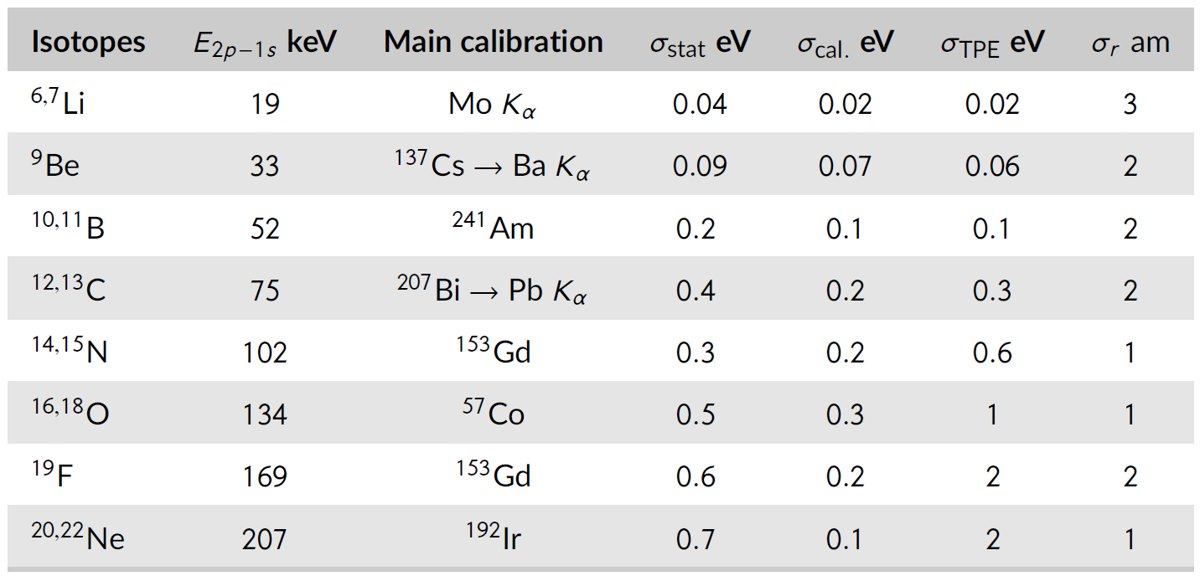
Guesstimated uncertainty budget:

Slide 65
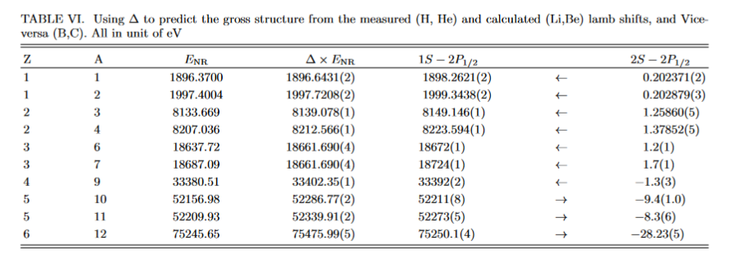

Slide 66
State of the art absolute ⁶Li radius:
Energy dependence on radius:
$$E_{FNS}(1s)=E_{QED}+\left(4.4\frac{eV}{fm^{2}}\right){ r}_{c}^{2}$$
$$σ_{E}=2\left(4.4\frac{eV}{fm^{2}}\right)\left(r_{c}^{}=2.6\right)\left(σ_{r}=0.04\right)=1 eV$$
Uncertainty from reliable Electron scattering radius:
Statistically speaking, highly promising! Up to factor of 5 improvement.

Slide 67
How about isotope-shift run?
Isotope shift: $σ_{stat}=0.25 eV$
Better than electron scattering radius diff $⇒$ 1 eV
Best optical measurements $⇒$ 0.01 eV
Target | ⁶Li | ⁶Li / ⁷Li
hours | 22 | 16
Prompt Rate Hz | 0.2 | 0.06
FWHM eV | 15 | 15
$$σ_{stat} \\ eV$$ | 0.07 | 0.2
Weird reduction
at end of beamtime
TW
PRA 87, 032504 (2013)

Slide 68
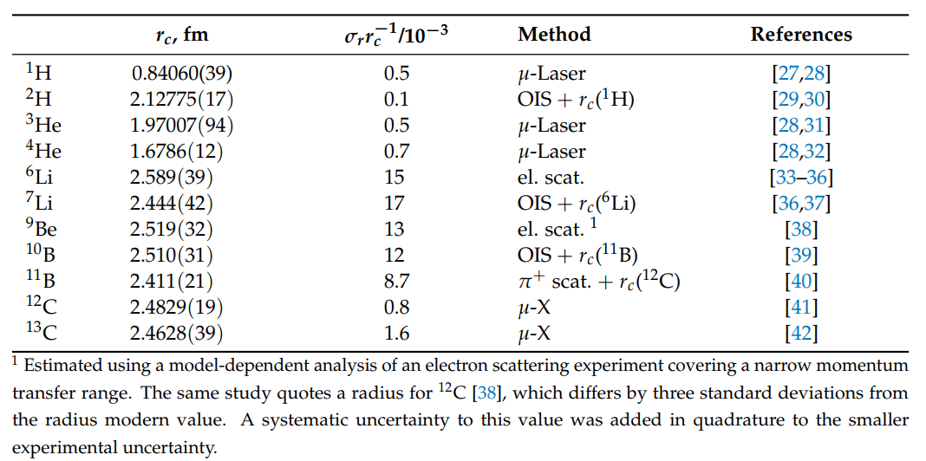
State of the art absolute ⁹Be radius:
Rough energy dependence on radius:
$$E_{FNS}(1s)=E_{QED}+\left(14\frac{eV}{fm^{2}}\right){ r}_{c}^{2}$$
$$σ_{E}=2\left(14\frac{eV}{fm^{2}}\right)\left(r_{c}^{}=2.5\right)\left(σ_{r}=0.03\right)=2.1 eV$$
Uncertainty from reliable Electron scattering radius:
From our PSAS “proceeding”:
Improve up to factor of 4 IF adding model dependency to el. scattering value

Slide 69
¹¹Boron absolute state of art
From muonic atoms:
$σ=5$ eV:
(HPGe resolution 400 eV)

Slide 70
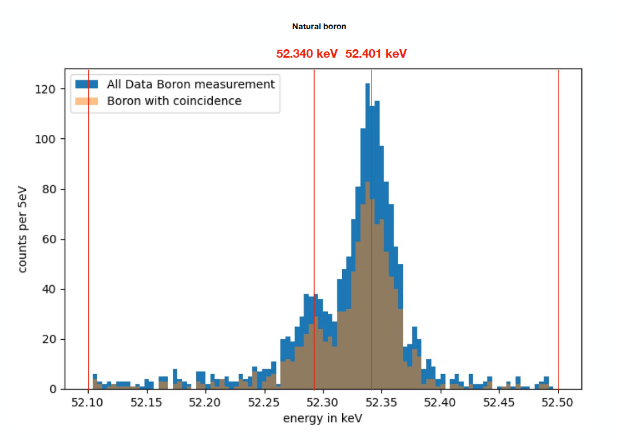
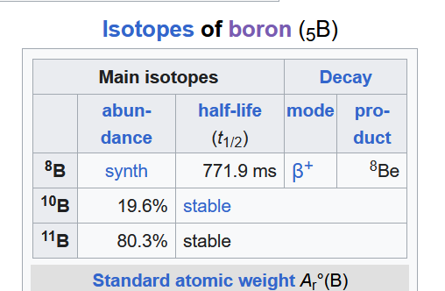
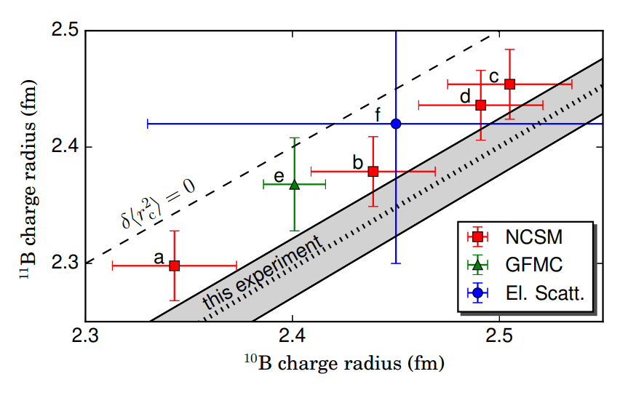
Boron isotope shift
Limited by statistic due to low
Natural abundance
$$σ_{stat}=0.7 eV⇒0.02 fm^{2}$$
6 times better…
PRL 122, 182501
This work
From electronic atoms:

Slide 72
“Old school” combined analysis of muonic atoms and electron scattering:

