Slide 1
The expansion of finite-size corrections in hydrogen-like atoms Sotiris Pitelis in collaboration with F. Hagelstein, V. Lensky and V. Pascalutsa 4th μASTI workshop June 2024

Slide 2
Challenges at the precision frontier
Theoretical predictions need to match ever-increasing experimental precision
Theory predictions naturally include approximations
Neglecting higher-order diagrams
Input from empirical parametrizations
When do our theoretical approximations fail?

Slide 3
Finite-size corrections
$$t_{0}$$
v
$$π^{0}$$
$$E_{2P−2S}^{\left\langle FS\right\rangle }=− \frac{{\left(Zα\right)}^{4}m_{r}^{3}}{2π} \int_{t_{0}}^{∞}{\text{d}t\frac{\text{Im}G_{E}(t)}{{\left(\sqrt{t}+Zαm_{r}\right)}^{4}}}$$

Slide 4
Finite-size corrections
Expanding the LS contribution in moments of the charge distribution:
The expansion holds if $Zαm_{r}≪\sqrt{t_{0}}$.
$$E_{2P−2S}^{\left\langle FS\right\rangle }=− \frac{{\left(Zα\right)}^{4}m_{r}^{3}}{2π} \int_{t_{0}}^{∞}{\text{d}t\frac{\text{Im}G_{E}\left(t\right)}{{\left(\sqrt{t}+Zαm_{r}\right)}^{4}}}$$
$$≈− \frac{{\left(Zα\right)}^{4}m_{r}^{3}}{12}\left[{\left\langle r^{2}\right\rangle }_{E}−Zαm_{r}{\left\langle r^{3}\right\rangle }_{E}\right]+O(α^{6})$$

Slide 5
Finite-size corrections
The expansion holds if $Zαm_{r}≪\sqrt{t_{0}}$
What could break it?
H
$$\sqrt{t_{0}}=2m_{e} ≈1 MeV$$
$$m_{r}=0.5 MeV$$
$$Zαm_{r}≈0.004 MeV$$
μH
$$e$$
$$π^{0}$$
$$m_{r}=95 MeV$$
$$Zαm_{r}≈0.7 MeV$$

Slide 6
Testing the waters
Lamb Shift
System | Expanded | Exact | Exp. precision
$$H [kHz]$$ | $$3×{10}^{−11}$$ | $$4×{10}^{−11}$$ | $$3.2$$
$$μH [μeV]$$ | $$3×{10}^{−8}$$ | $$−8×{10}^{−10}$$ | $$2.3$$
1S Hyperfine Splitting
System | Expanded | Exact | Exp. precision
$$H [{10}^{−6} kHz]$$ | $$−0.4$$ | $$−0.009$$ | $$2$$
$$μH [μeV]$$ | $$−{10}^{−5}$$ | $$−{10}^{−7}$$ | $$3$$ (1ppm, projected)

Slide 7
Conclusions
No relevant breaking of the finite-size contribution expansion for now
We should be regularly checking our approximations
Enhanced contributions depending on light cut & reduced mass: applications to BSM search!

Slide 8
Thank you!

Slide 9
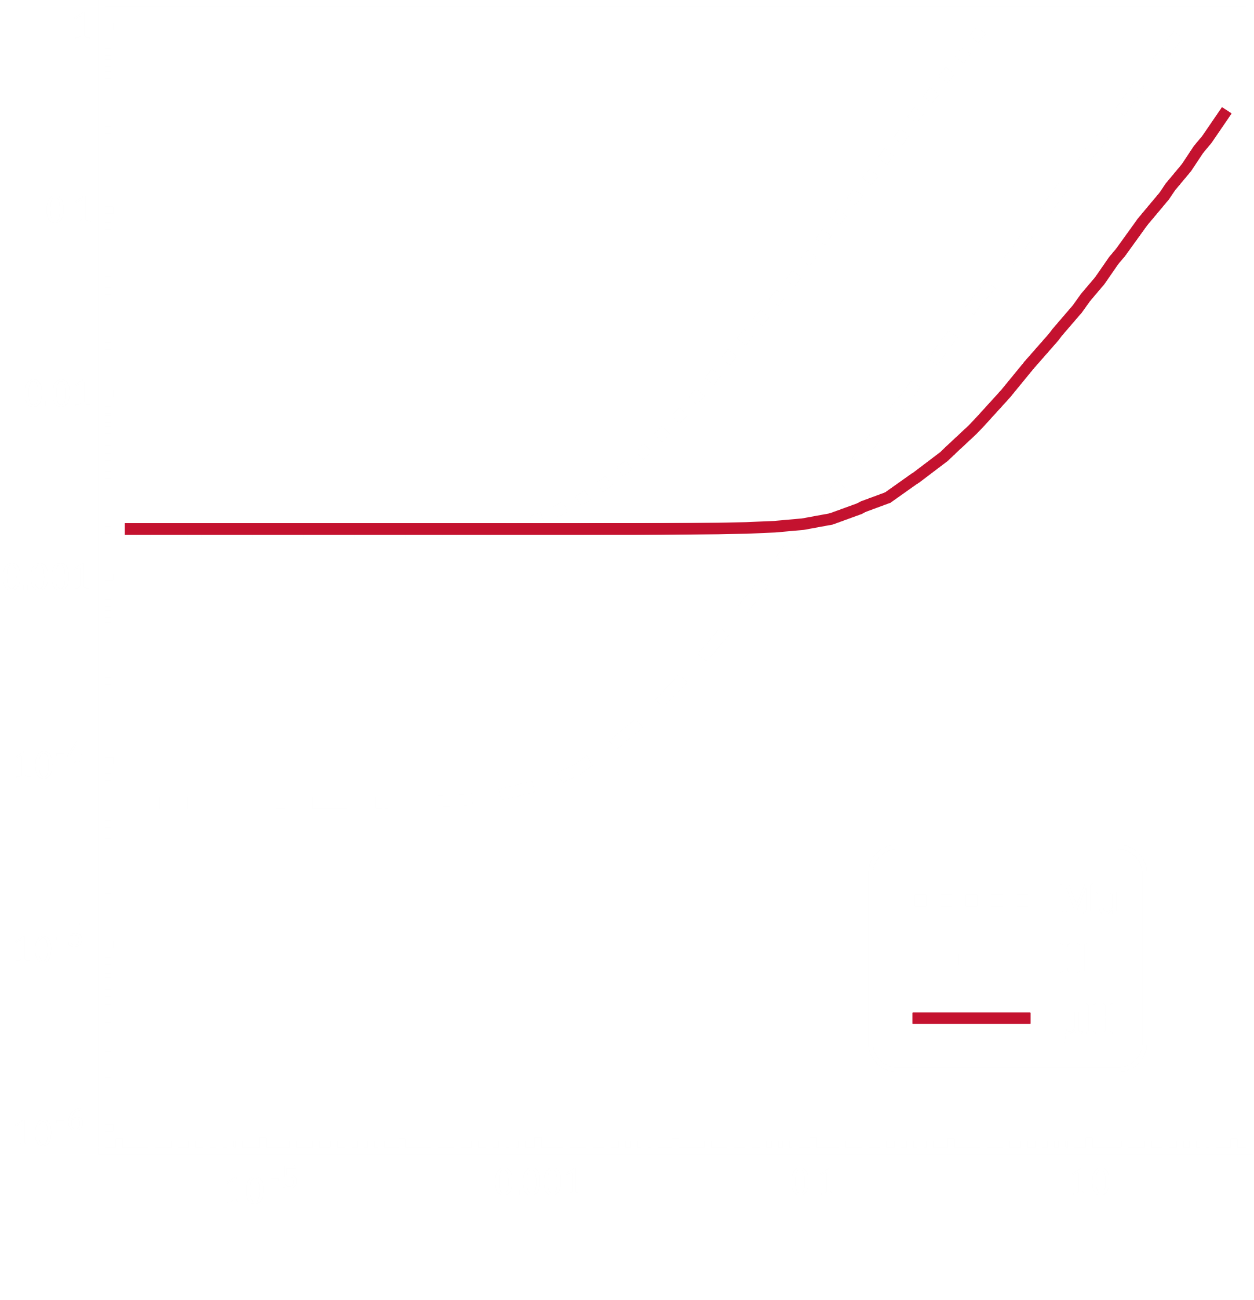
Dark Matter Fermion
$$εe$$
$$m_{χ}$$
$$ε$$
Lamb Shift Measurements
Mu: $4.3309(105) \text{μ}\text{eV}$
H: $4.37483(1) \text{μ}\text{eV}$
μH: $202.3706(23) \text{meV}$
$$m_{χ} [\text{MeV}]$$

Slide 10
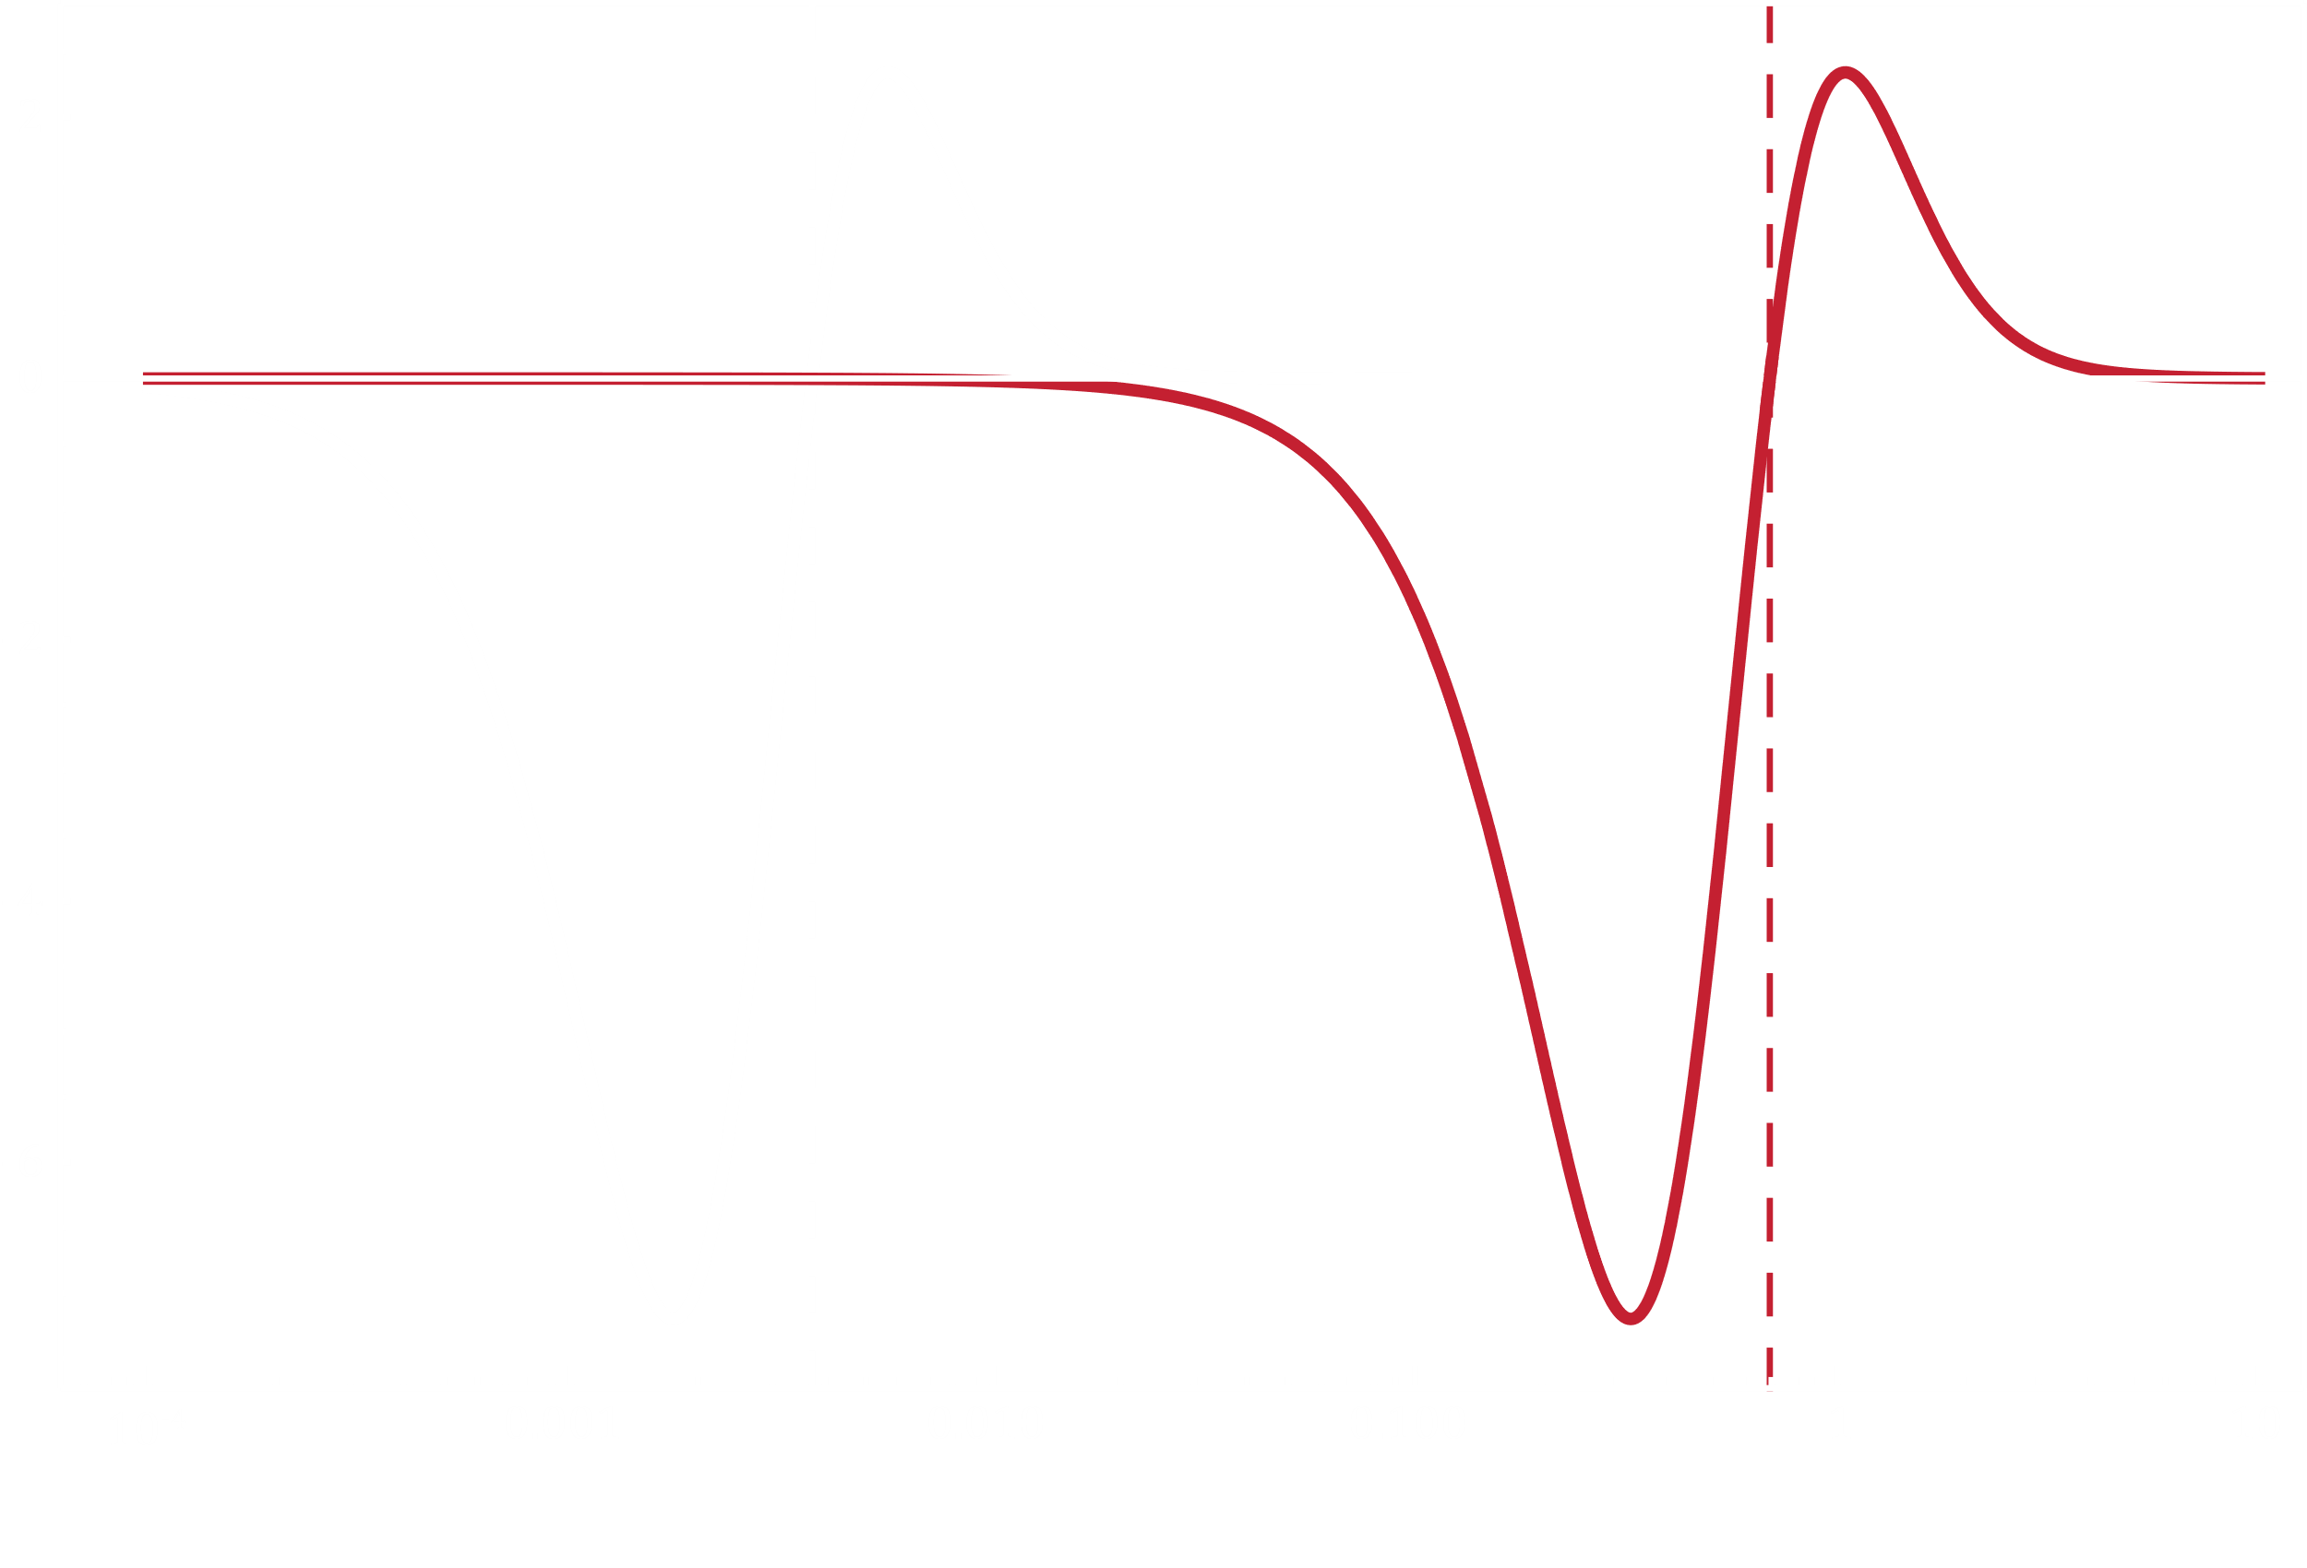
Weighting Functions
$$E_{2P−2S}^{\left\langle FS\right\rangle }=\int_{0}^{∞}{\text{d}Q}w\left(Q\right) G_{E}(Q^{2})$$
DOI:10.1103/PhysRevA.91.040502
Inv. Bohr radius:
$$a^{−1}=Zαm_{r}$$
$$w [{10}^{−4}]$$
$$H$$
$$μH$$
$$a_{H}^{−1}=3.73 \text{keV}$$
$$Q [\text{MeV}]$$
$$a_{μH}^{−1}=0.69 \text{MeV}$$

