Slide 1
Re-assesment of proton radii
from electron scattering
Vladyslava Sharkovska (PSI & UZH)
in collaboration with
F. Hagelstein, V. Lensky and V. Pascalutsa (JGU)
µASTI@PSAS’2024 15th June 2024

Slide 2
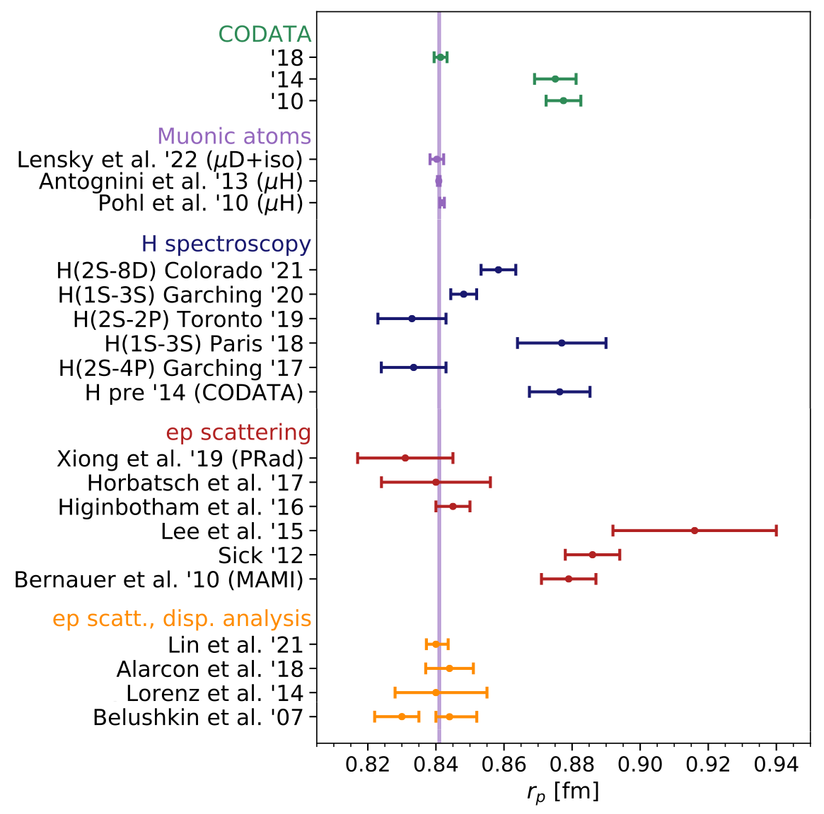
Status Proton Charge Radius
Complementary experimental approaches:
Muonic atoms allow for PRECISE extractions of nuclear charge radii
CODATA since 2018 included the μH result for $r_{p}$
Still open issues: H(2S-8D), H(1S-3S) @ Paris
Important question:
µASTI@PSAS’2024

Slide 3
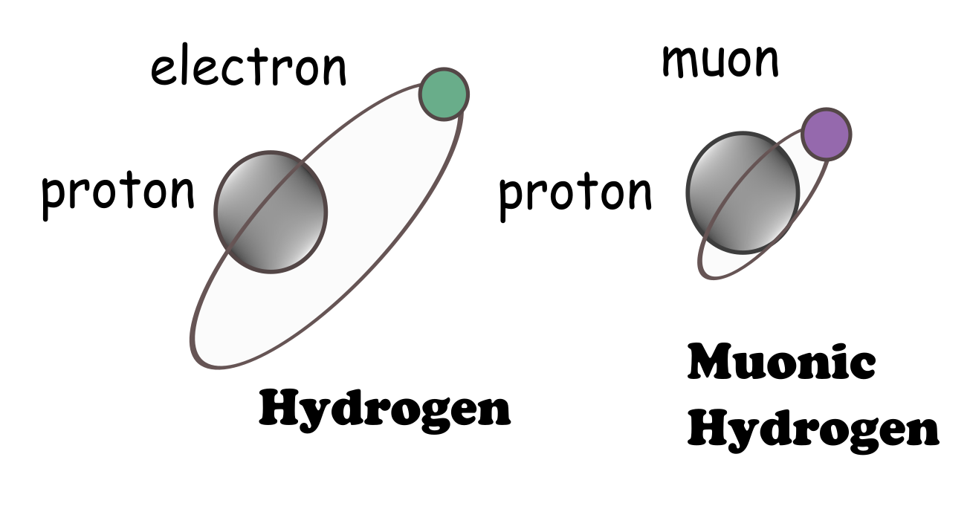
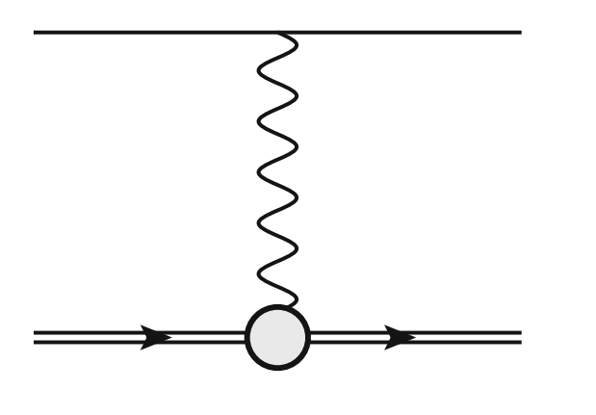
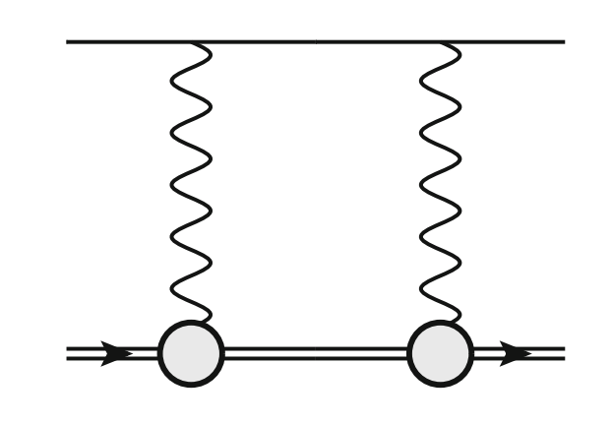
Why Muonic Atoms?
wave function at the origin
charge radius
Friar radius or 3rd Zemach moment
Lamb shift:
Fermi - Energy:
with Bohr radius
wi
NLO becomes appreciable in μH
HFS:
Zemach radius
µASTI@PSAS’2024

Slide 4
Talk Outline
More accurate (not necessarily more precise) constraints on proton radii from electron scattering
More accurate (less model-dependent) input from electron scattering for muonic hydrogen spectroscopy
Survey of constraints on proton radii from scattering, spectroscopy, lattice QCD
µASTI@PSAS’2024

Slide 5
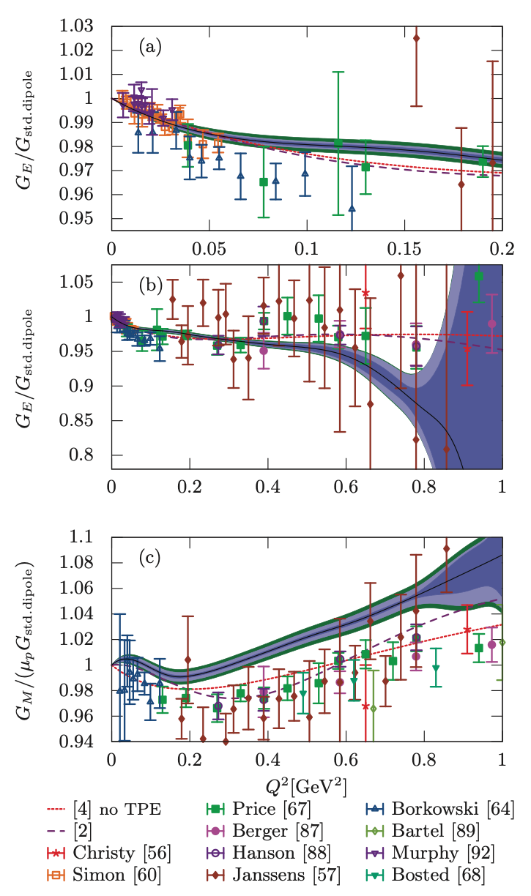
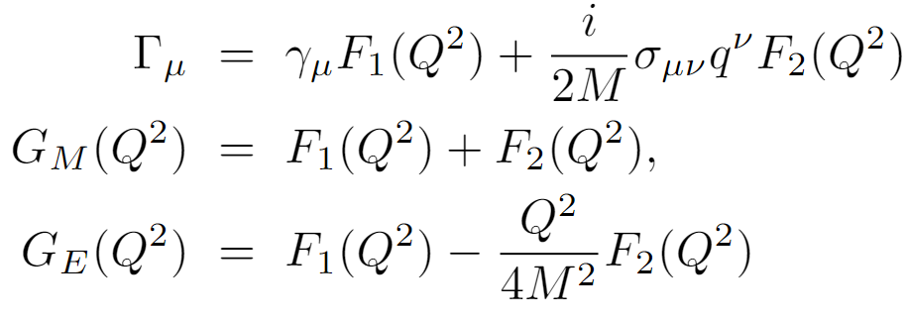
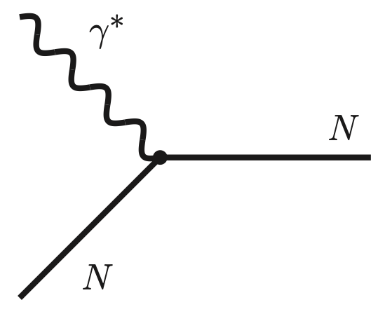
Electric and Magnetic Form Factors
Measured in lepton-proton scattering
Form factors (FF): Fourier transforms of charge and magnetization distributions
Root-mean-square (rms) radii of the proton:
J. C. Bernauer et al., Phys. Rev. C 90, 015206 (2014)
µASTI@PSAS’2024

Slide 6
Overview of Electron Scattering data
Observables to be included as constraints for the proton form factors
Unpolarized cross section: 1 (A1) +32 experiments, total of 2055 points
Polarization transfer: 14 experiments, total of 69 points
Initial state radiation extraction: 1 (MAMI) experiment, 25 points
A1 dataset:
1422 cross section points in the range of $Q^{2}$ € ~ [0.004, 0.977$]{ GeV}^{2}$
and the range of ε € [0.06, 0.96]
72 points from Rosenbluth separation, in the range of $Q^{2}$ € ~[0.02, 0.55] ${GeV}^{2}$
34 spectrometer settings (subsets) with 31 independent normalization parameters
Currently treated by us with 34 normalization parameters
µASTI@PSAS’2024

Slide 7
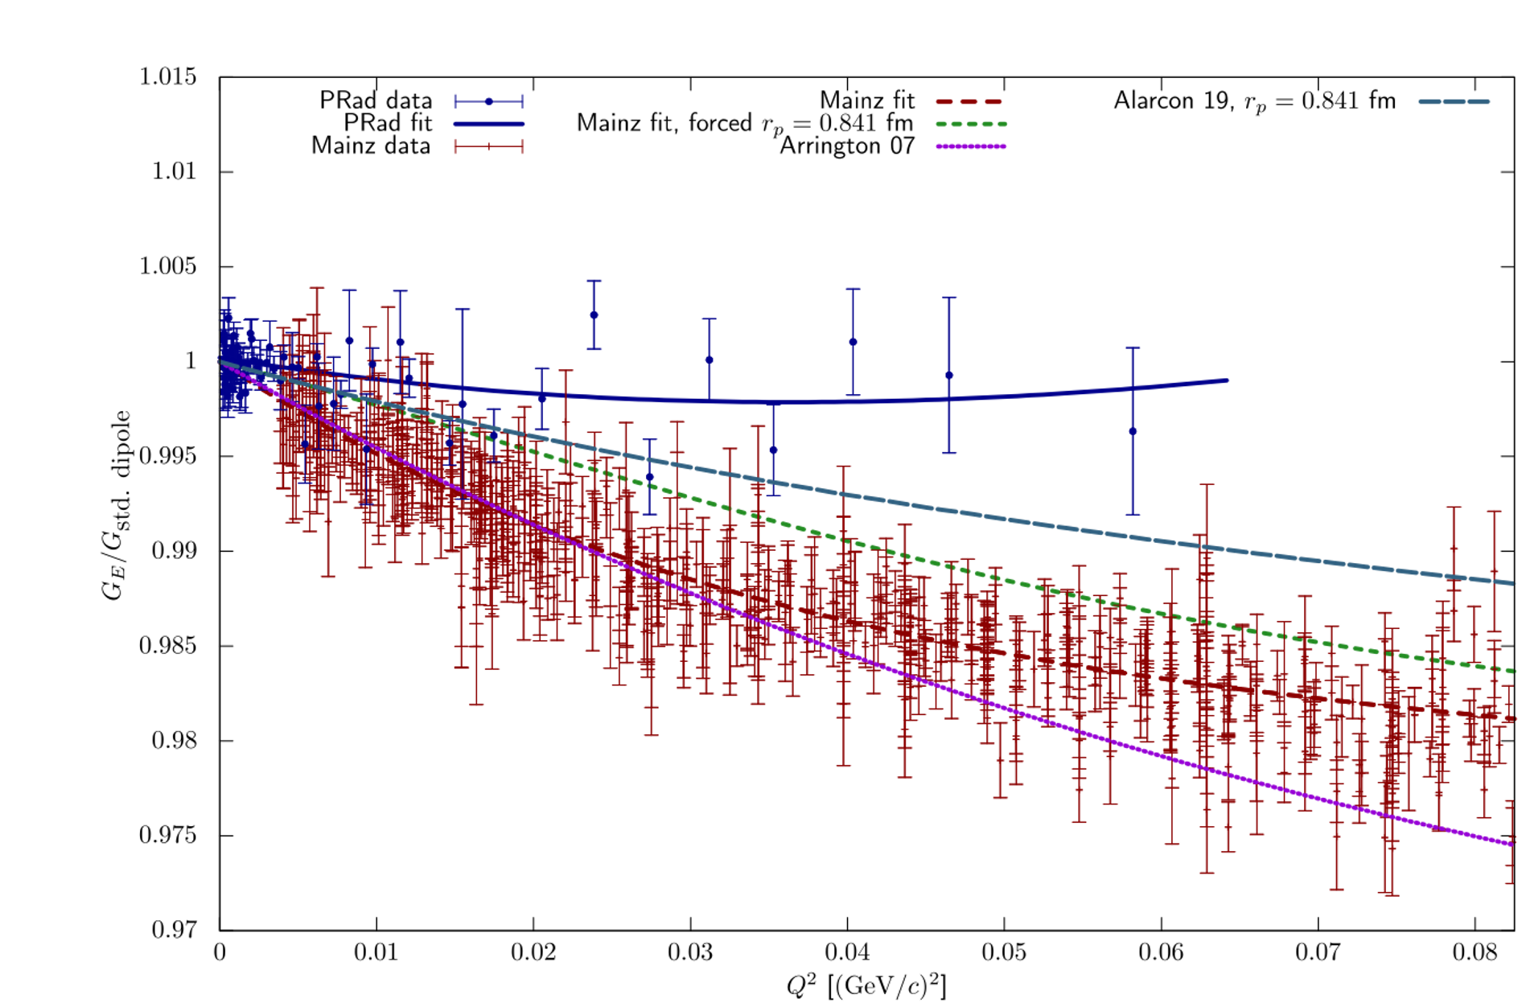
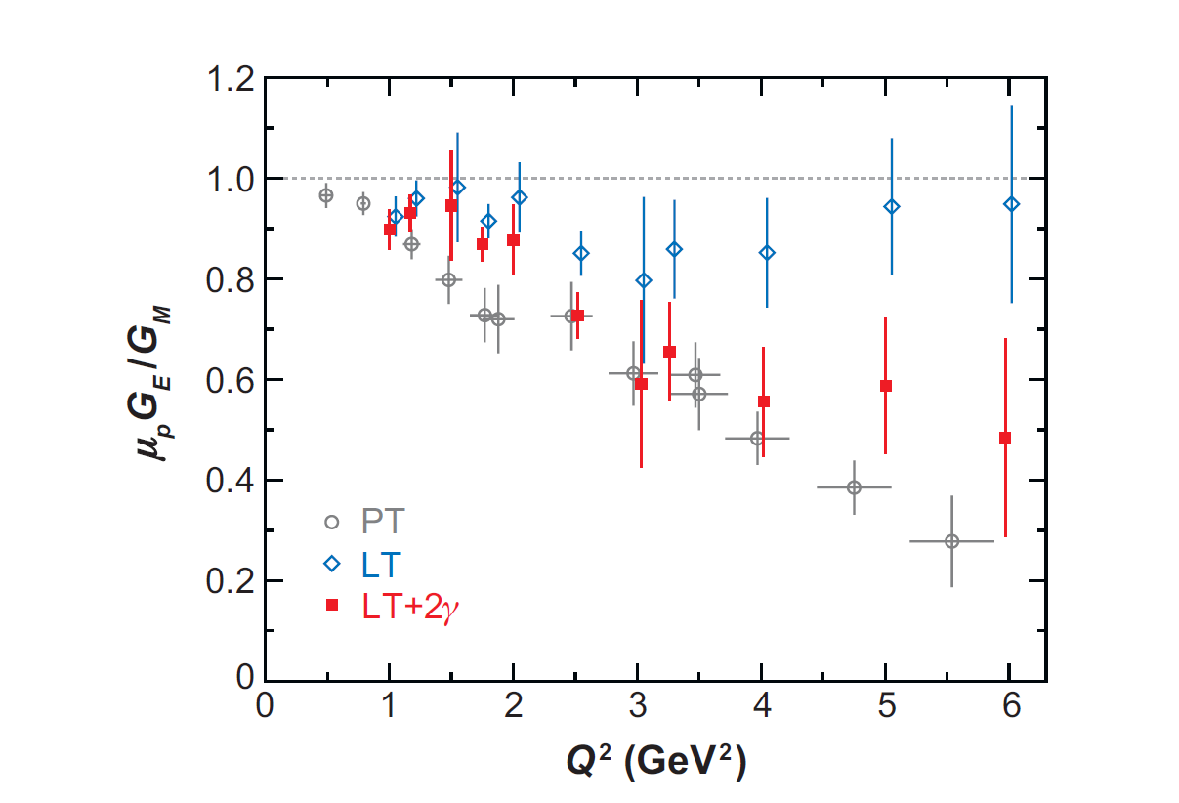
“Pitfalls” of Scattering Analysis
Data inconsistencies:
i. Form factor slope
ii. Form factor ratio
2. Radiative corrections needed to interpret lepton-scattering experiments
3. Model and extrapolation (to $Q^{2}=0)$ uncertainty
i.
ii.
µASTI@PSAS’2024

Slide 8
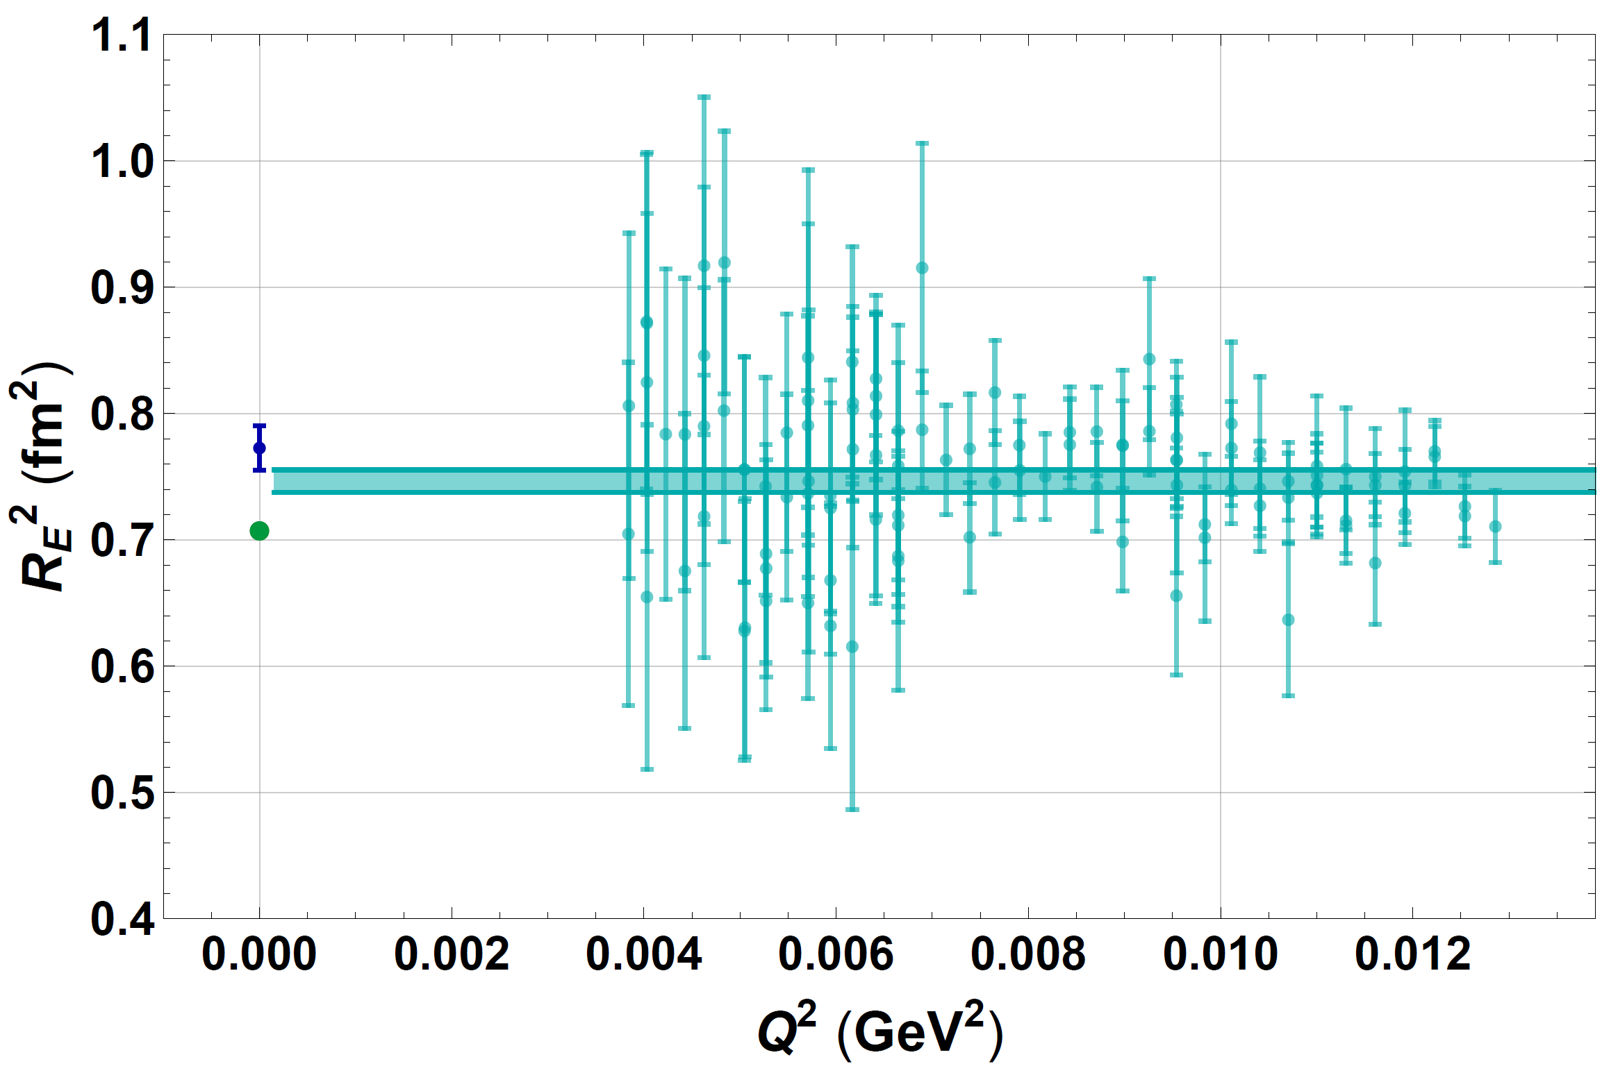
Lower Bound on Charge Radius
$$R_{E}^{2}(Q^{2})=−\frac{6}{Q^{2}}logG_{E}(Q^{2})\overset{Q^{2}=0}{⟶}R_{E}^{2}$$
is a lower bound
for
$$R_{E}^{2}(Q^{2})≤R_{E}^{2}$$
$$Q^{2}≥0$$
FH and V. Pascalutsa, Phys. Lett. B 797 (2019)
RE²(Q²) is monotonically increasing towards Q²=0
Lower bound follows from finite Q² data, no extrapolation of FF data required
tentative evaluation: lower bound from ISR and Bernauer data
µASTI@PSAS’2024

Slide 9
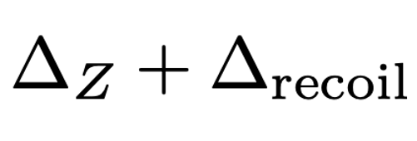
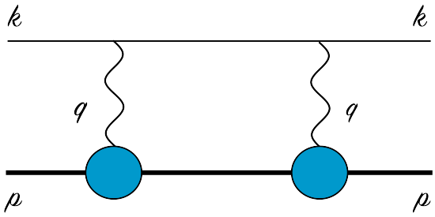
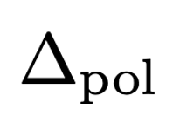
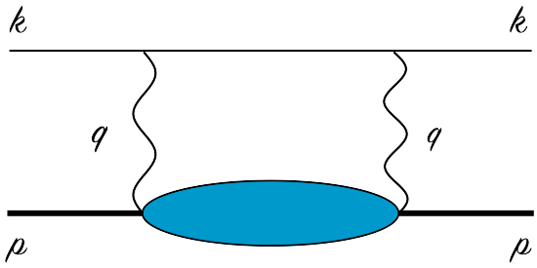
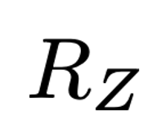
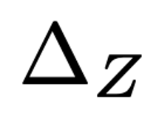
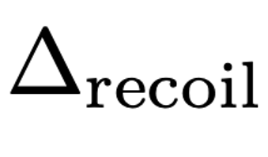
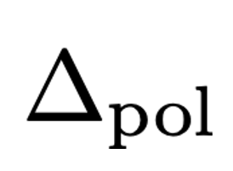
Finite-size Effects in HFS
with
Zemach radius:
experimental value:
[Antognini, et al. ’13]
+0.003
−0.002
+21
−16
ppm
1.054
fm
−7403
850 ppm
37(95) ppm (LO BChPT)
[Antognini, et al. ’22,
annual reviews]
[Antognini, et al. ’22]
[Hagelstein, et al. ’23]
[Lin, et al. ’22]
µASTI@PSAS’2024

Slide 10
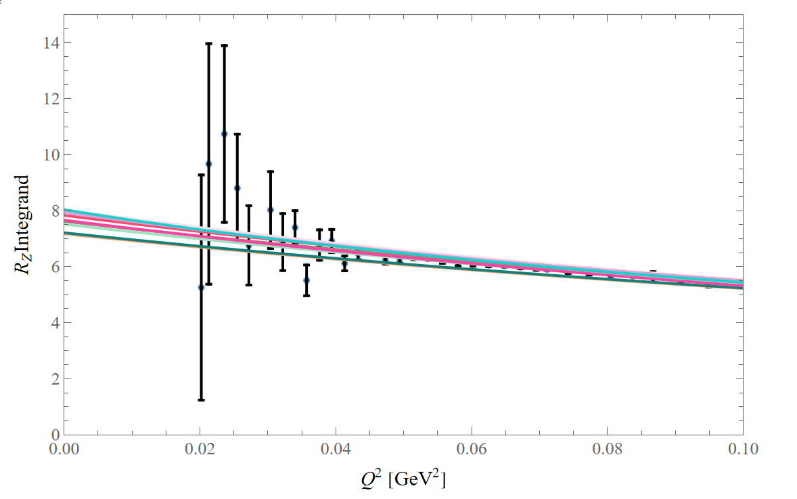
Zemach Radius Integrand Treatment
Use Rosenbluth separation data to remove model dependence from fitting cross sections
Splitting Q-region into three:
Low-Q: no data
Medium-Q: direct data
High-Q: no data
Direct numerical integration over data
World data fit applied in regions i and iii
Stumbling stone: model-dependence in the low-Q region
Idea!
Partial integration for the low-Q region to trade model-dependence
and extrapolation uncertainty for data uncertainty
µASTI@PSAS’2024

Slide 11
Partial Integration Trick for Zemach Radius
Initial integrand
The optimal choice: smallest integral contribution
µASTI@PSAS’2024

Slide 12
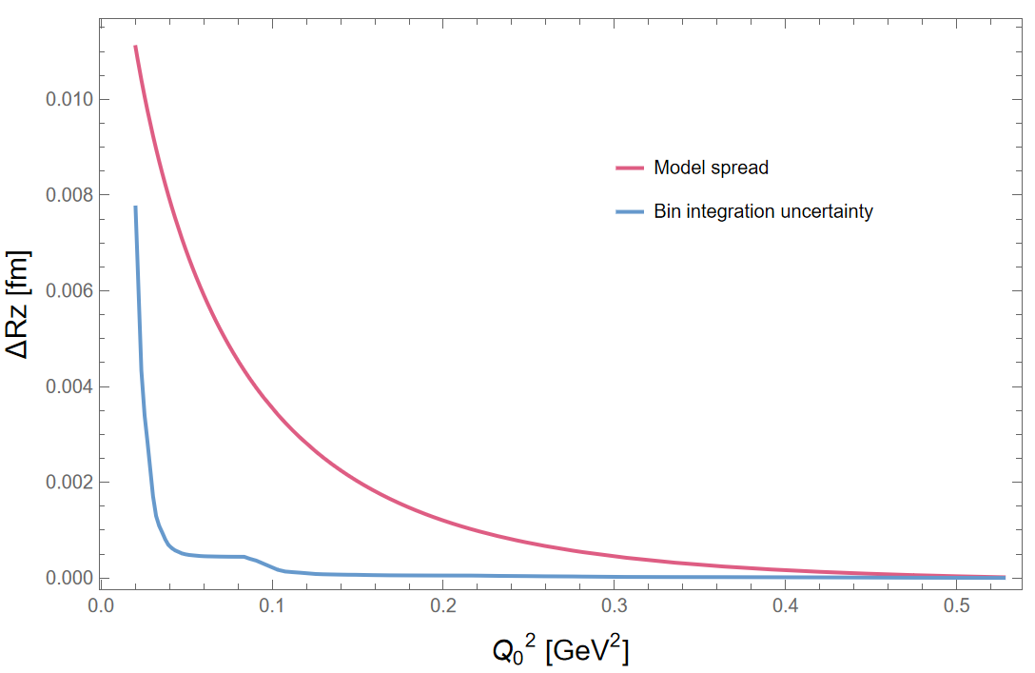
Optimal $Q_{0}$and Uncertainty Comparison
Both uncertainties depend on the “stitching” point $Q_{0}$
Model-dependence dominates the bin integration uncertainty
Our $Q_{0}$ choice depends on the uncertainty of the surface term:
Future strategy:
Taking a set of different $Q_{0}$ that do not exceed a fixed error budget
Checking the consistency of each $Q_{0}$ choice (do results agree within uncertainty?)
Averaging over the results
µASTI@PSAS’2024

Slide 13
Improved Zemach Radius Uncertainty
Q0 [${GeV}^{2}$] | 0 to Q0 | Surface term (at Q0) | Q0 to Q1 | Q1 to Infinity | Total
0.0413 Constraint: RE=0.84087 fm | 0.02659 0.00200 model ±0.00346 model+fit | 0.24533 ±0.01021 data | 0.42726 ±0.00063 data ±0.00005 num | 0.33804 constant -0.00535 ff ±0.00021 fit | 1.03188 ±0.00350 model+fit ±0.01023 data+num = 1.03188 ±0.01080 total
 | Total of 0 to Q0 0.27192
PRELIMINARY
Q0 | 0 to Q0 | Q0 to Q1 | Q1 to Infinity | Total
0.0413 Constraint: RE=0.84087 fm | 0.28320 central ±0.00850 model ±0.01010 fit+model | 0.42530 central ±0.00157 model ±0.00199 model+fit | [0.33804 -0.00535] central ±0.00021 fit | 1.04119 central ±0.01115 total
µASTI@PSAS’2024
13

Slide 14
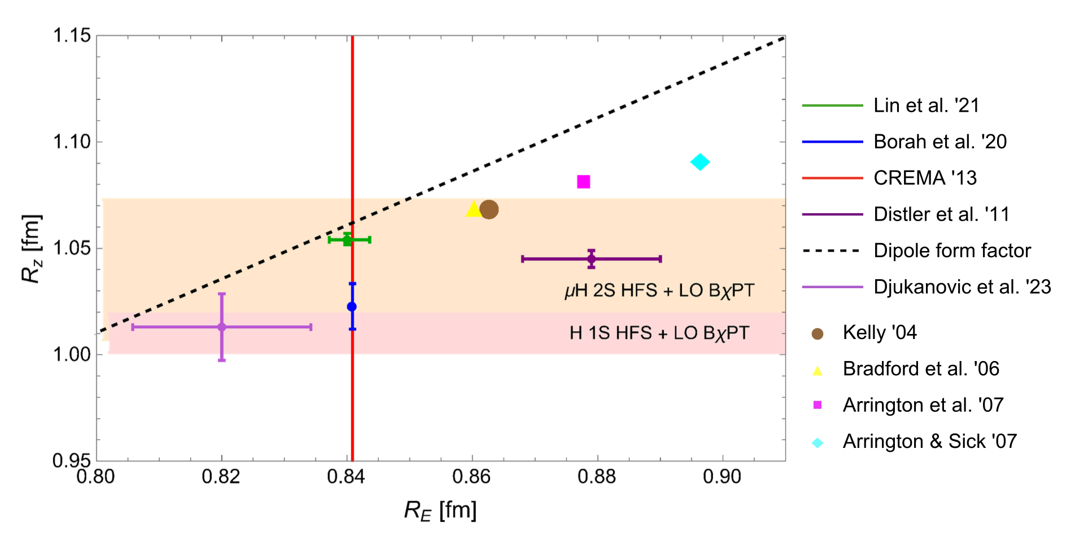
Correlation of Zemach and Charge, Magnetic Radii
Zemach
radius
µASTI@PSAS’2024

Slide 15
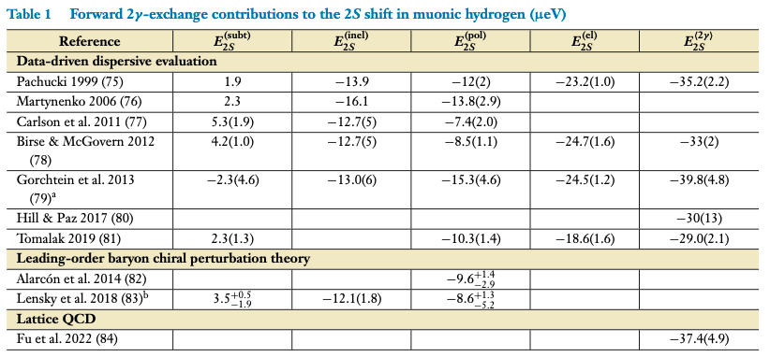
Friar Radius in 𝜇H Lamb Shift
Elastic TPE splits into Friar radius + recoil part
Recoil is small for µH ~ 0.03(5) µeV [Karshenboim et al., PRD 91 (2015) 073003]
$E_{2S}^{el}=−21.1(2)$ µeV based on $R_{F}^{3}=2.310(26){ \text{fm}}^{3}$ [Lin et al. (2022), PRL]
Aim: self-consistent extraction of $R_{E}$ from spectroscopy [Karshenboim, PRD 90 (2014) 053012]
compare to future exp. uncertainty ~ 0.4 µeV
← used Karshenboim 2014
µASTI@PSAS’2024

Slide 16
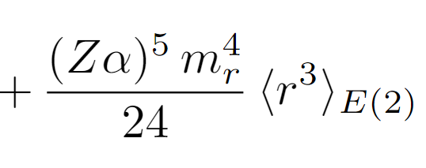
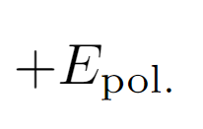
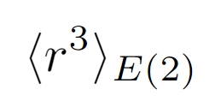
Self-consistent Charge Radius Extraction
Lamb Shift
charge radius
Friar radius
depends on charge radius
Our approach:
Splitting into low-Q, medium-Q and high-Q region
Directly integrating over the Rosenbluth form factor data
Using the World data fit for the low-Q and high-Q regions with the charge radius constraint
Obtaining Friar radius and theor. Lamb shift as a function of charge radius
Finding $R_{E}$ for which exp. and theor. Lamb shift agree within uncertainties
Extraction $R_{E}$ (band, w/o central value)
Importance of self-consistent extraction pointed out
by [Karshenboim ‘14]
µASTI@PSAS’2024

Slide 17
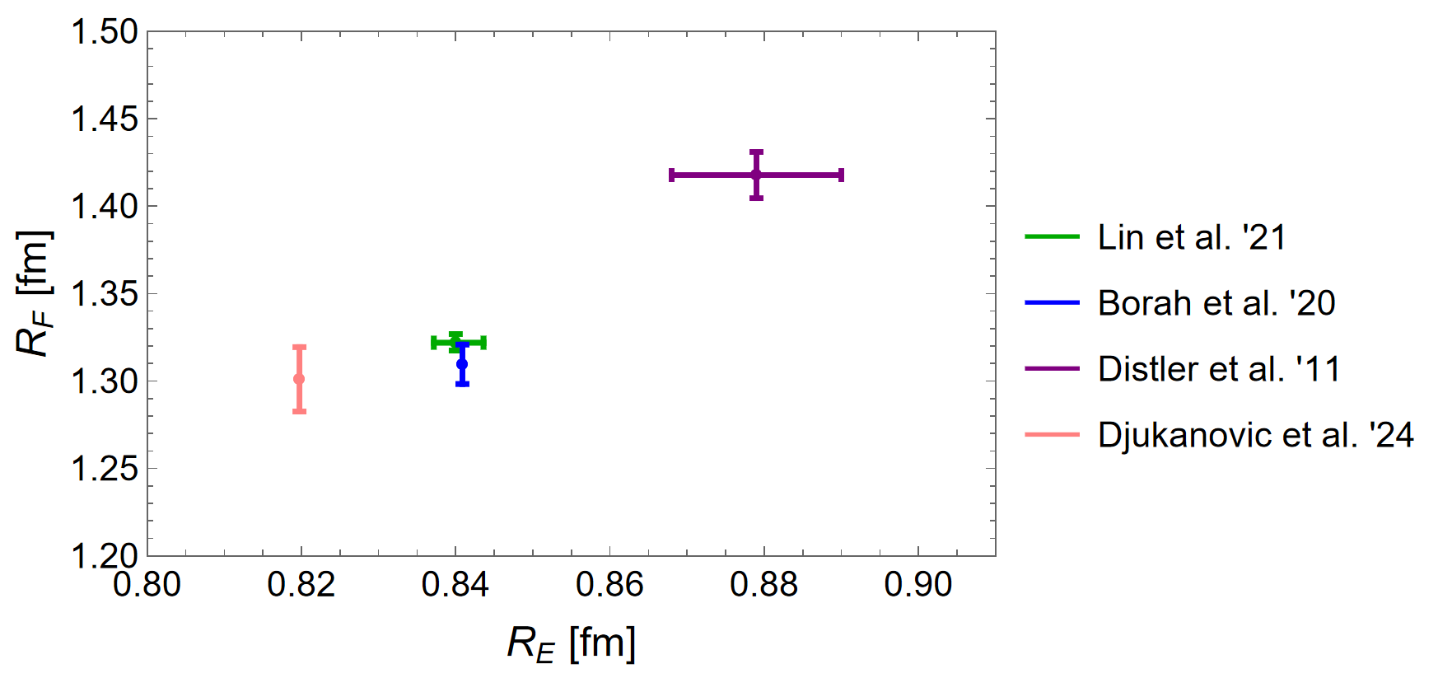
Correlation of Friar and Charge Radii
Friar radius or 3rd Zemach moment
charge radius
µASTI@PSAS’2024

Slide 18
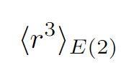
Partial Integration Trick for Friar Radius
Initial integrand
The optimal choice: smallest integral contribution
µASTI@PSAS’2024

Slide 19
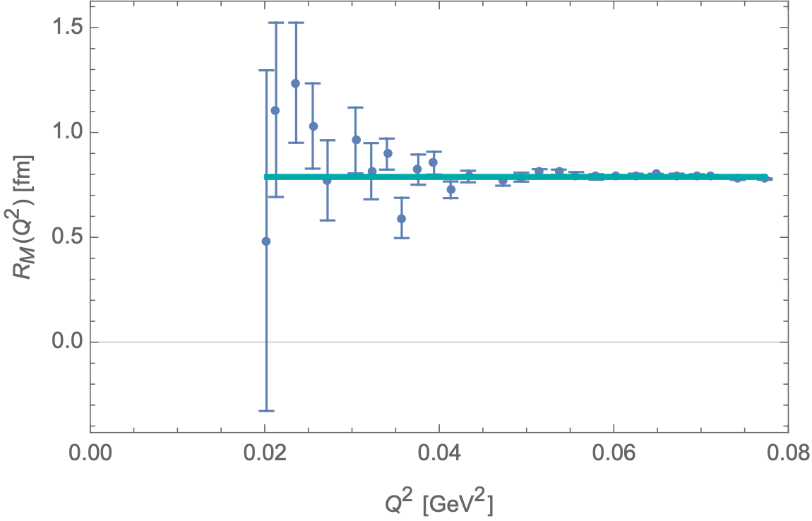
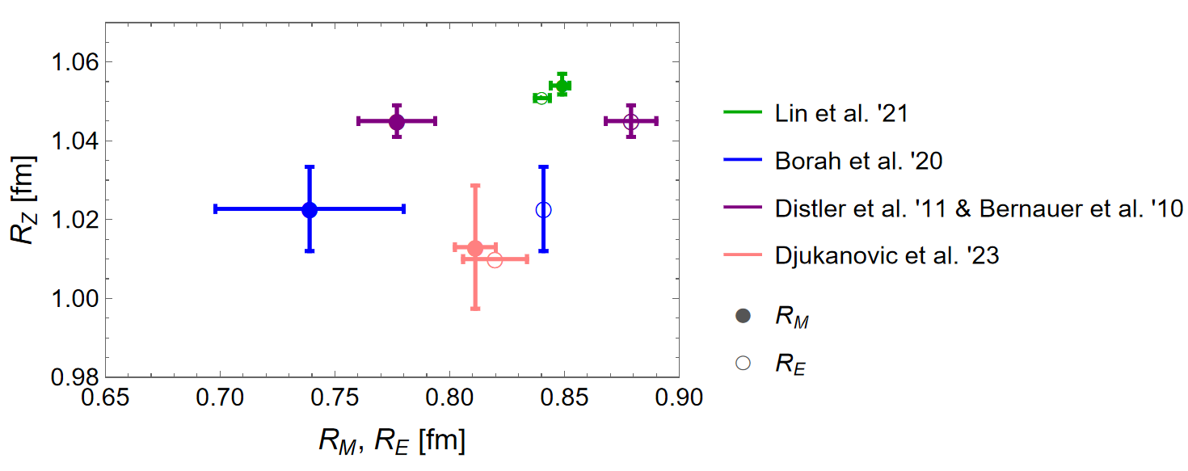
Lower Bound on Magnetic Radius
$$R_{M}>0.78fm$$
PRELIMINARY
A1 Rosenbluth data
µASTI@PSAS’2024

Slide 20
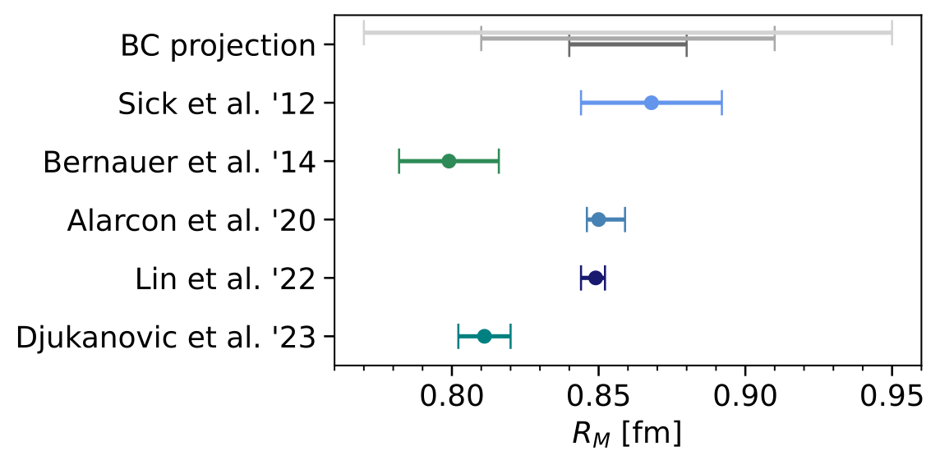
Magnetic Radius from Inelastic Scattering
Burkhardt-Cottingham sum rule relates elastic form factors to the zeroth moment of an inelastic spin structure function:
$$I_{2}(Q^{2})=\frac{2M^{2}}{Q^{2}}∫_{0}^{x_{0}}dxg_{2}(x,Q^{2})=\frac{1}{4}F_{2}(Q^{2})G_{M}(Q^{2})$$
Constrain the magnetic radius through inelastic scattering:
$$R_{M}={\left[\frac{1}{1+2κ}\left(−\frac{24I_{2}^{′}(0)}{1+κ}−\frac{3κ}{2M^{2}}+⟨r^{2}⟩_{E}\right)\right]}^{1/2}$$
Projection assuming 25 %, 15 % and 5 % relative uncertainty for $I_{2}^{′}(0)$
PRELIMINARY
µASTI@PSAS’2024

Slide 21
Outlook and Conclusions
Word of caution against optimistic view of uncertainties in extraction of proton radii from scattering
Guidance of resonance search in muonic hydrogen 1S HFS
Direct use of Rosenbluth extracted form factor data
Lower bound on $R_{E}$ and $R_{M}$
Numerical integration in $R_{Z}$ and $R_{F}$
Proton structure radii and TPE corrections in muonic atoms are dominated by low-Q
Partial integration trick:
Shifting the integrand weighting towards the date region
Trading model and extrapolation uncertainty for data uncertainty (surface term)
Self-consistent extraction of $R_{E}$ from muonic hydrogen LS
Determine $R_{F}$ as a function of $R_{E}$
µASTI@PSAS’2024

Slide 22
Thank you for your attention!

Slide 23
BACKUP
µASTI@PSAS’2024

Slide 24
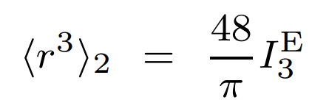
Self-consistent Charge Radius Extraction
3rd Zemach moment
with
Splitting the integral at q0 into two regions and treating them separately
Expanding the form factor for exact cancellation
Integration over data
Model
[Karshenboim, ‘14]
charge radius
µASTI@PSAS’2024

Slide 25
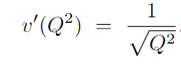
Finding an Optimal P.I. Weighting
Low-Q expansion shows that the remaining integral is the smallest
Optimal choice
µASTI@PSAS’2024

Slide 26
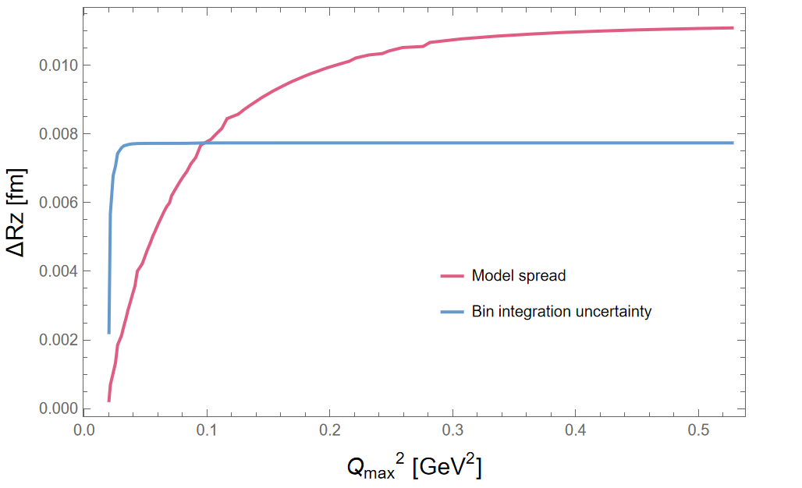
Uncertainty dependence on Qmax
µASTI@PSAS’2024

