Slide 1
Nuclear recoil effect
without expansion in Zα
Vladimir A. Yerokhin
Max-Planck-Institut für Kernphysik, Heidelberg
μASTI, June 14, 2024, Zurich
Notes:
1

Slide 2
Introduction
Approach without expansion in Zα => electronic and muonic atoms can be considered on the same footing.
However, for electronic atoms the point-nucleus limit is (generally) a good approximation; for muonic atoms it is NOT.
Limitation: we assume that the nucleus is described by form-factors == elastic part of nuclear effects.
Applicable for relatively heavy nuclei, for which one cannot calculate both elastic and inelastic nuclear effects on the same footing.

Slide 3
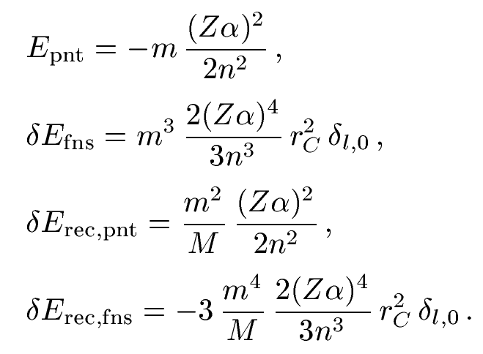
Two-body atom: nonrelativistic picture
Energy levels from Schrödinger equation
Point-nucleus nonrecoil energy
Finite nuclear size
Recoil point nucleus
Recoil finite nuclear size

Slide 4
Two-body atom: leading relativistic correction
Point-nucleus nonrecoil energy: known analytically (Dirac energy),
Finite nuclear size: can be obtained numerically from Dirac equation,
Recoil point nucleus: can be obtained from Breit equation,
Recoil finite nuclear size: CANNOT be obtained from Breit equation.
[Shabaev et al. PRA 57, 4235 (1998)]:
Recoil finite nuclear size within Breit approximation
contains terms of order (m³/M) (Zα)³ r_{C} , which are
numerically dominant but are exactly cancelled by the
QED contribution.
Recoil with finite nuclear size can be addressed only within QED

Slide 5
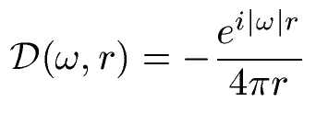
Nuclear recoil to all orders in Zα, point nucleus
where
and
Transverse part of the photon
propagator in the Coulomb gauge
Derivation:
V. M. Shabaev, Theor. Math. Phys. 63, 588 (1985)
K. Pachucki and H. Grotch, Phys. Rev. A 51, 1854 (1995)
Numerical calculations:
A.N. Artemyev, V.M. Shabaev, V.A. Yerokhin, PRA 52, 1884 (1995)
V.A. Yerokhin, V.M. Shabaev, PRL 115, 233002 (2015)
Point nucleus => results are not applicable for muonic atoms

Slide 6
Nuclear recoil to all orders in Zα, extended nucleus
The generalized photon propagator for one extended-size vertex
Point nucleus
Extended-size nucleus
For the exponential model of the nuclear charge distribution
we obtain
Formulas for nuclear recoil become valid for the extended-nucleus case
if we use the generalized photon propagator
K. Pachucki and V.A. Yerokhin, PRL 130, 053002 (2023)

Slide 7
Nuclear recoil to all orders in Zα, evaluation #1

Slide 8
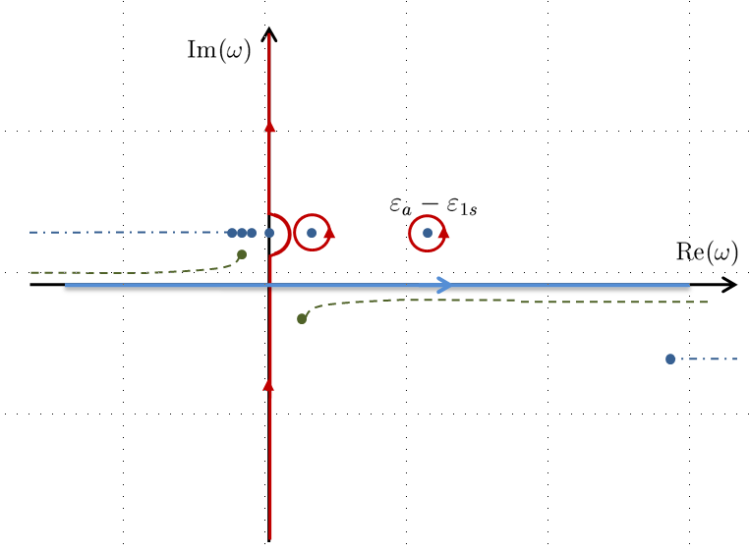
Nuclear recoil to all orders in Zα, evaluation #2
Wick rotation of integration contour

Slide 9
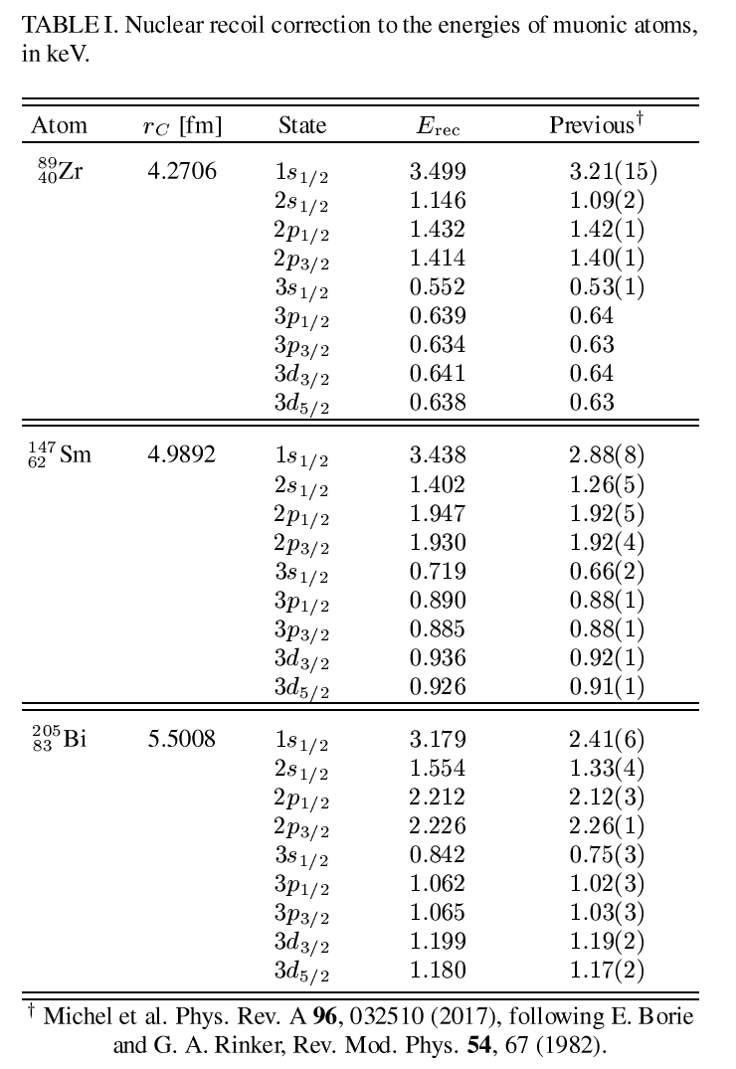
Results for muonic atoms
V.A. Yerokhin and N.S. Oreshkina , PRA 108, 052824 (2023)

Slide 10
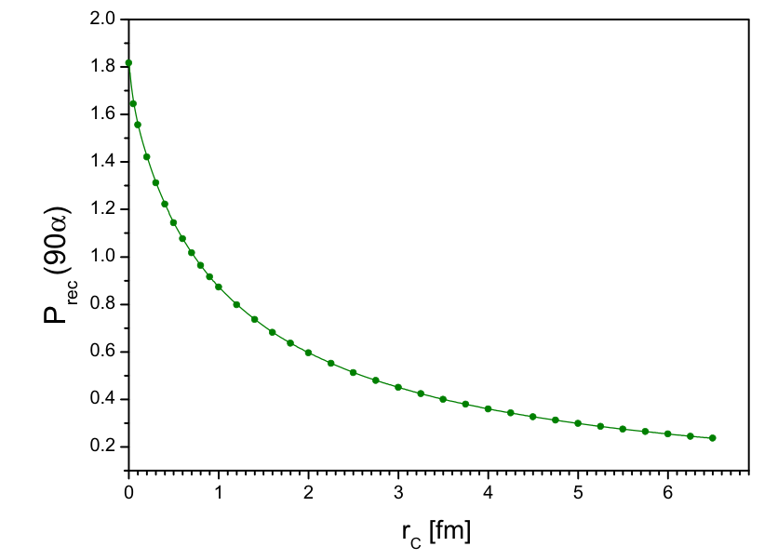
Results for muonic atoms: recoil with finite nuclear size
Nuclear recoil correction for Z = 90 and 1s state, as a function of the nuclear radius
Finite nuclear size reduces the recoil effect by an order of magnitude
V.A. Yerokhin and N.S. Oreshkina , PRA 108, 052824 (2023)

Slide 11
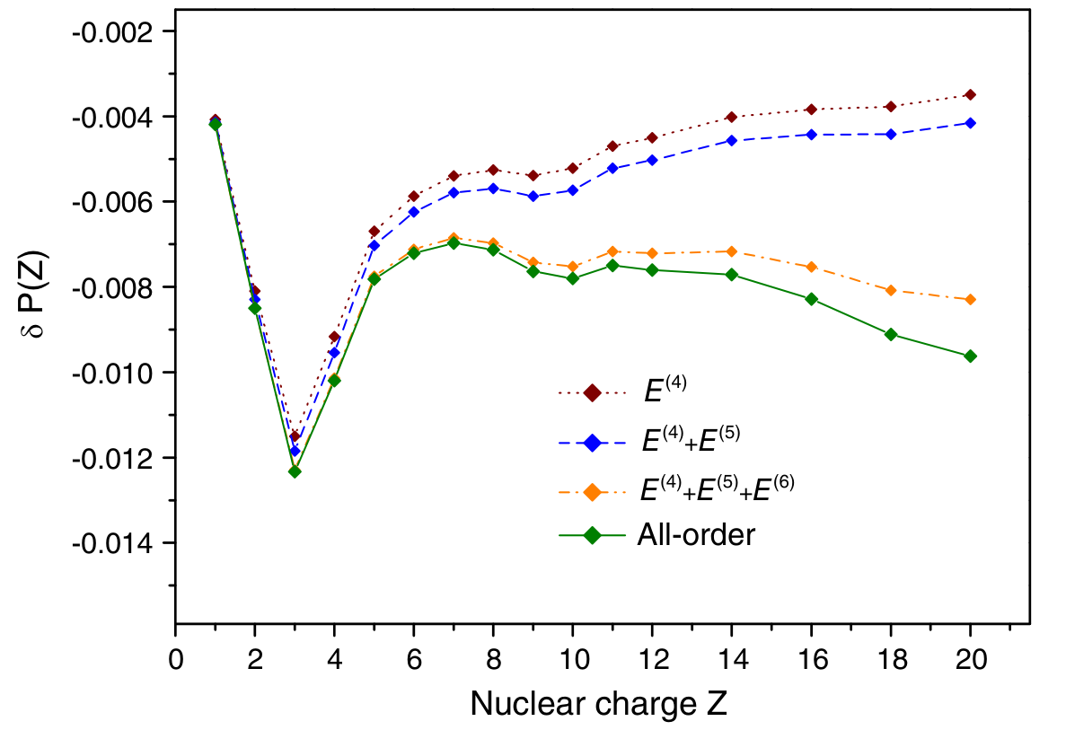
Results for electronic atoms: recoil with finite nuclear size
K. Pachucki and V.A. Yerokhin, PRL 130, 053002 (2023)

Slide 12
Outlook
All-order calculations of other nuclear recoil effects are possible:
Nuclear recoil + vacuum polarization
Radiative recoil
Second-order nuclear recoil (of order m²/M²)
Nuclear recoil for hyperfine splitting

