Slide 1

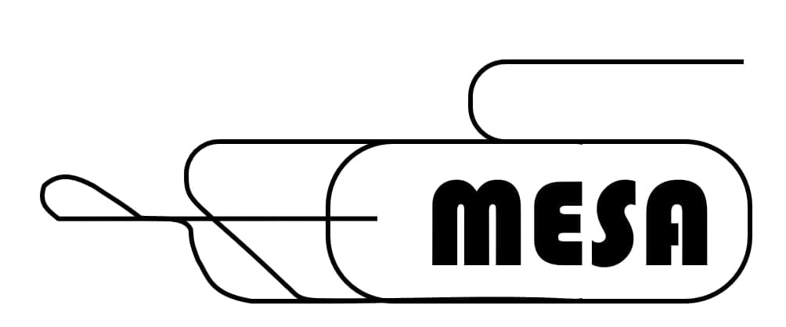
Overview – polarimeters MESA
Status and work(s) in progress
June 15 2023
Presented by Kurt Aulenbacher,
- work by R. Thapa, V. Tioukine & MESA-team

Slide 2
MESA-Polarimeter - overview
Real vs. “perfect”
The 5 MeV Mott polarimeter
The “Iron”-Möller
From Iron Möller to Hydro Möller

Slide 3
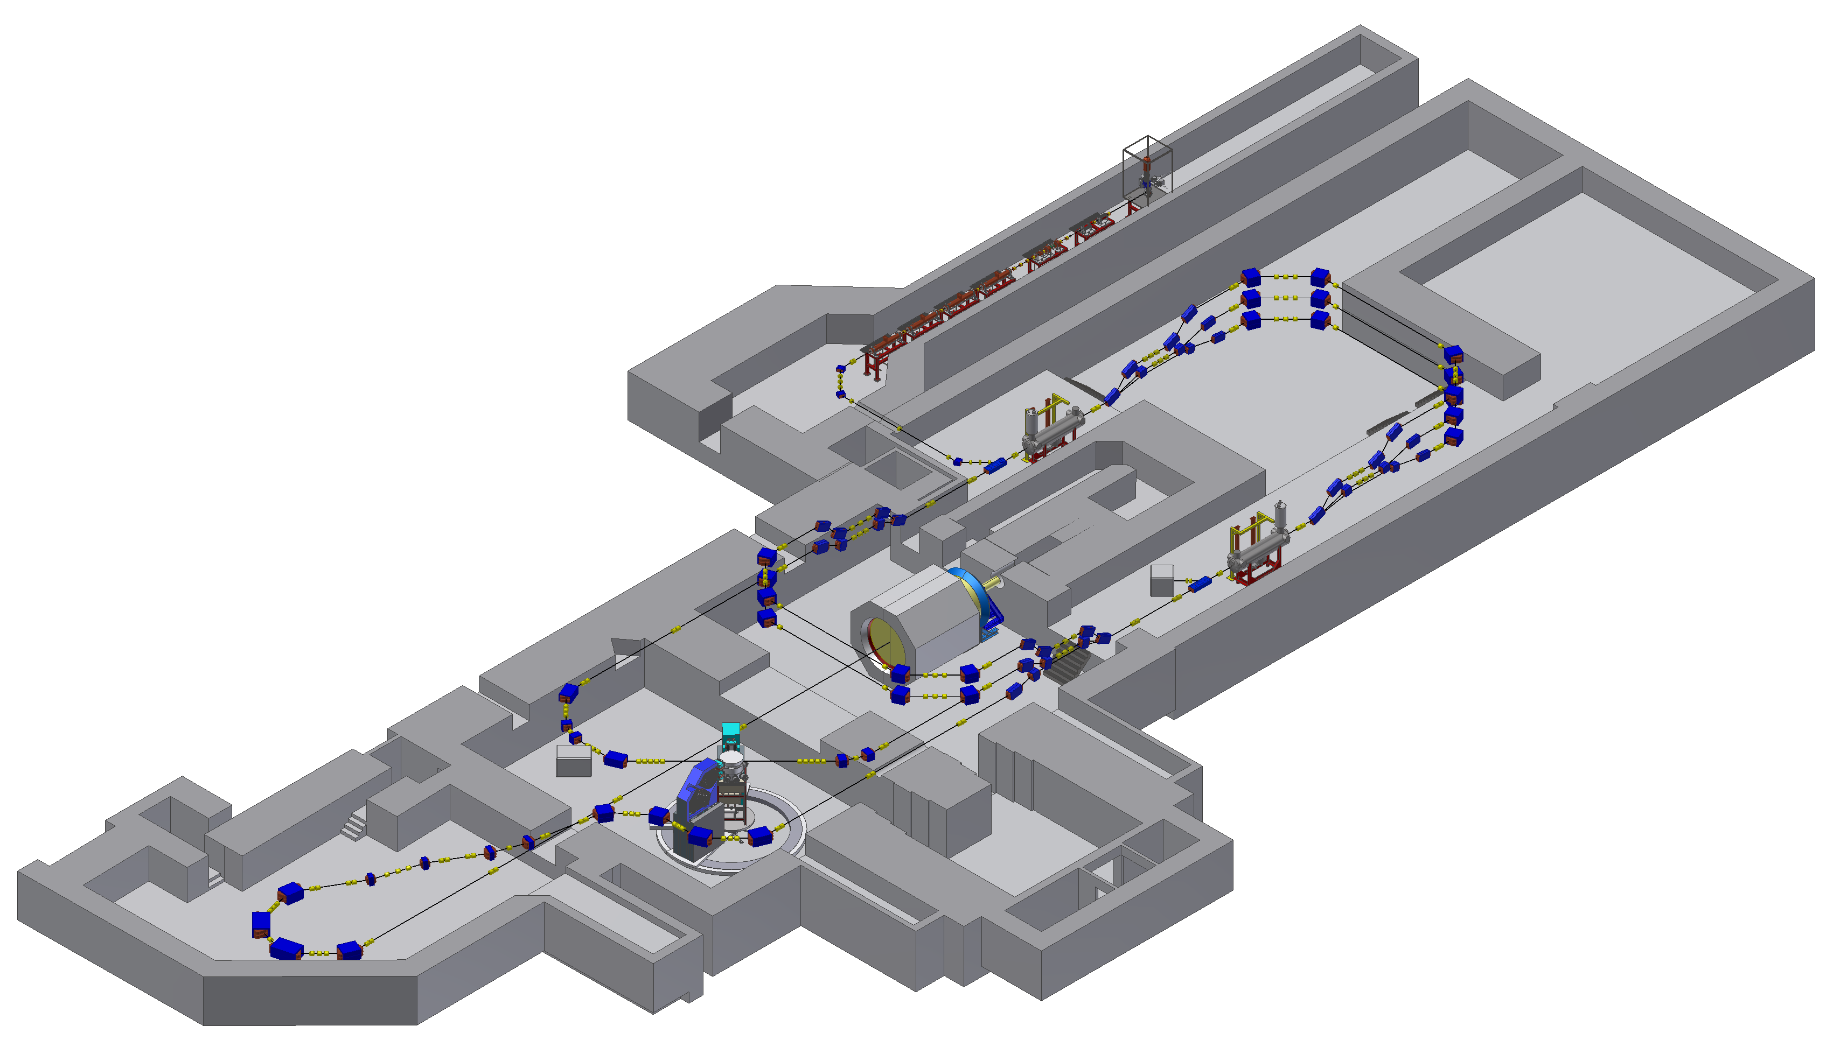
MESA Accelerator Layout
Double sided recirculation design with normal-conducting injector and superconducting main linac
Two different modes of operation:
(1300 MHz CW beam)
- EB-operation (P2/BDX experiment):
polarized beam,
up to 150 µA @ 155 MeV
- ERL-operation (MAGIX experiment):
(un)polarized beam,
up to 1 (10) mA @ 105 MeV
Gun
MELBA
MAMBO
Recirculation arcs 1-3-5
MEEC-1
155 MeV dump
MEEC-2
P2
5 MeV dump
Recirculation arcs 2-4
ERL loop
MAGIX
Ext. beamline
Picture&lattice layout : D. Simon

Slide 4
P2@MESA: High accuracy measurement of (very small) parity violating asymmetry
0.1%
But: A^{exp}=P*A^{PV}
Figures from: D. Becker et al., Eur. Phys. J. A (2018) 54 : 208

Slide 5
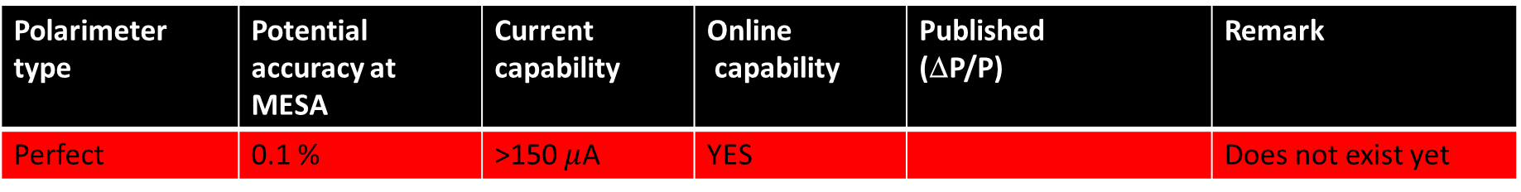
The Perfect Polarimeter at MESA
Polarimeter type | Potential accuracy at MESA | Current capability | Online capability | Published (ΔP/P) | Remark
Perfect | 0.1 % | >150 $μ$A | YES |  | Does not exist yet

Slide 6
Polarimeter Chain
See also: Talk by Rakshya this afternoon

Slide 7
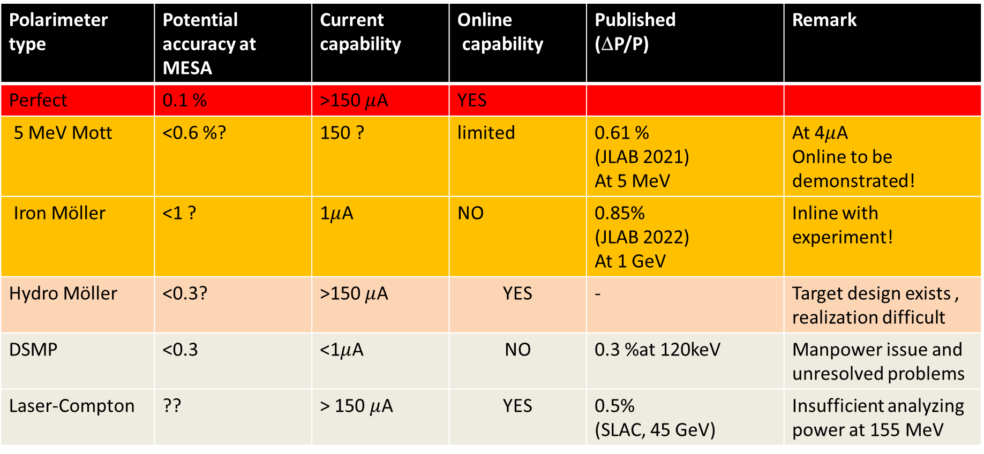
Perfect vs. realistic options
Polarimeter type | Potential accuracy at MESA | Current capability | Online capability | Published (ΔP/P) | Remark
Perfect | 0.1 % | >150 $μ$A | YES
5 MeV Mott | <0.6 %? | 150 ? | limited | 0.61 % (JLAB 2021) At 5 MeV | At 4$μ$A Online to be demonstrated!
Iron Möller | <1 ? | 1$μ$A | NO | 0.85% (JLAB 2022) At 1 GeV | Inline with experiment!
Hydro Möller | <0.3? | >150 $μ$A | YES | - | Target design exists , realization difficult
DSMP | <0.3 | <1$μ$A | NO | 0.3 %at 120keV | Manpower issue and unresolved problems
Laser-Compton | ?? | > 150 $μ$A | YES | 0.5% (SLAC, 45 GeV) | Insufficient analyzing power at 155 MeV

Slide 8
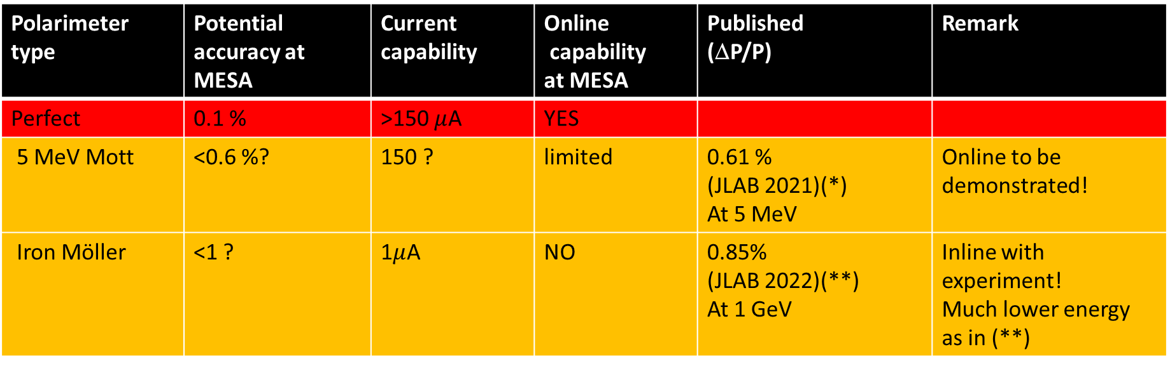
Perfect vs. Options with high priority
Polarimeter type | Potential accuracy at MESA | Current capability | Online capability at MESA | Published (ΔP/P) | Remark
Perfect | 0.1 % | >150 $μ$A | YES
5 MeV Mott | <0.6 %? | 150 ? | limited | 0.61 % (JLAB 2021)(*) At 5 MeV | Online to be demonstrated!
Iron Möller | <1 ? | 1$μ$A | NO | 0.85% (JLAB 2022)(**) At 1 GeV | Inline with experiment! Much lower energy as in (**)
(*) J. Grames et al. PHYSICAL REVIEW C 102, 015501 (2020) DOI: 10.1103/PhysRevC.102.015501
(**) E. King PSTP2022 --- 19th Workshop on Polarized Sources, Targets and Polarimeters, Proceedings of Science Vol 433 /30

Slide 9
The 5 MeV Mott at JLAB
Taken from: J. Grames et al.
PHYSICAL REVIEW C 102, 015501 (2020)
DOI: 10.1103/PhysRevC.102.015501
Caveats:
Source should be operated at full current to exclude change of polarization
Improved detection system needed ! (31 MHz operation at JLAB (2% d.f.) restricted beam current to ~4 μA )
Spin rotation between Mott and experiment!

Slide 10
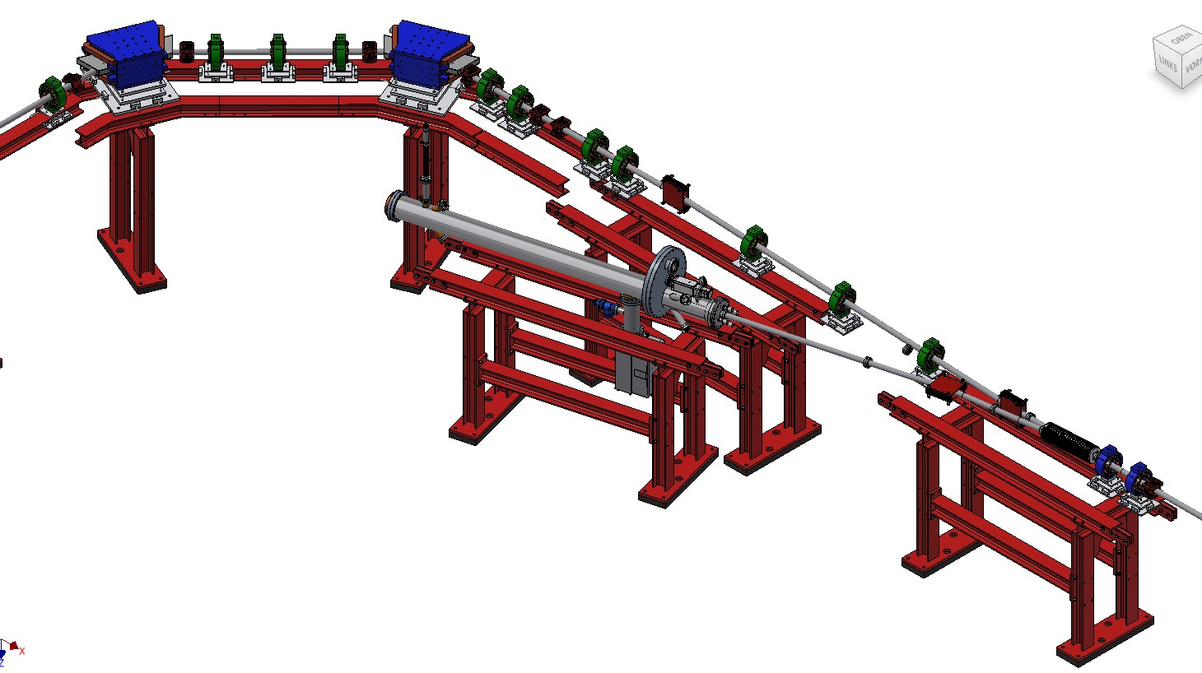
The 5 MeV Mott-Adaptation for MESA
Fast kicker Magnet
(see Valerys Talk)
Air coil extraction magnet („Kicker“) for reprodicible switching
„quasi“ online operation posible, if fast kicker system applied (to be demonstrated!)
Compton Absorption
Polarimeter
Mott polarimeter
(see Rakshyas talk)
5 MeV Beam
from MAMBO

Slide 11
Full current operation ?
Change of polarization because of cathode heating at high powers/increased cathode temperatures is possible.
DAQ/SNR system should be able to handle full current (Not the case at JLAB – large dead time corrections)
Also thermal issues (750 Watt on target/dump)
Kicker is important
V. Tioukine et al., REV. SC. INSTR. 82, 033303 (2011)
doi:10.1063/1.3556593

Slide 12
Constant bunch charge operation
Average beam current
1.7 μA at 204 MHz
(12 th subharmoic of MAMI)
Bunch length 62ps
Systematics to be explored by attenuation at CW and by varying duty cycle→ Laser system as explored in 2022 at MAMI is well suited (see internal note by R. Thapa)
Especially important for „Iron“ Möller → Operation with ~1% duty factor (Alternative 1:99 Möller/Mott kicker?)
Average beam current
13 μA at 204 MHz
(156 μA at CW)
Bunch length 78 ps

Slide 13
Spin rotation towards 155 MeV and Monitoring at 5 MeV
Depending on the energy chosen for an experiment at P2, the spin vector may not be perpendicular at the Mott and longitudinal at P2 simultaneously
Longitudinal at P2 requires 8 degree at Mott for 155 MeV
In this unfavorable situation polarisation monitoring should be done with an (available) Compton transmission polarimeter to avoid changing spin orientation!
Monitoring is always necessary because of drifts of polarisation
Simulatenous observation of longitudinal and
transverse spin components.
Data taken at MAMI at 30μA
From: R. Barday, et al. Proceedings of PESP2010

Slide 14
Iron Möller at JLAB
D.E. King et al. Møller polarimetry for PREX-2 and CREX. NIM-A, 1045:167506, 2023.
Note: current dependence (cathode heating) is taken into account!
Note: The foil polarization error has two components (knowledge of saturation polarization & and unknown degree of saturation )

Slide 15
Adaptation of Iron Möller for MESA
Similar to old Möller Polarimeter used at 180 MeV in MAMI-A…
…with the exception of B=8T Solenoid!
Caveat: Beam energy almost one order of magnitude lower than at JLAB!
→ Pro or Con ?
Suggestion for very simple „inline“ set up
Wagner et al. NIM A 294 541 (1990)

Slide 16

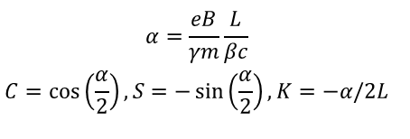
Adaptation of Iron Möller for MESA
Application of 8 T Solenoid offers advantages
Less uncertainty in saturation polarization
Transfer matrix for incident beam $M=1$ (leave Solenoid on during P2 data taking, only remove target, requires field integral 3.25 Tm at 155 MeV)
Spectroscopic effect of solenoid for Möller electrons of different energies (will be amplified by quadrupole magnet)
3.5 Tm Solenoid affordable (Cryocooled & warm bore) and suited for later Hydro-Möller installation
Very long „Do list“ :
Target moving system design
Detector system
Determination of acceptance
Systematic effects (Levchuk, dead time, current dependance,…)
$${\begin{aligned}α=\frac{eB}{γm}\frac{L}{βc} \\ C=\cos\left(\frac{α}{2}\right),S=−\sin\left(\frac{α}{2}\right),K=−α/2L \\ \end{aligned}}^{}$$

Slide 17
From Iron Möller to Hydro-Möller ?

Slide 18
Hydro-Möller: Promise
Suggested by E. Chudakov and V. Luppov:
Moller polarimetry with atomic hydrogen targets IEEE Transactions on Nuclear Science 51 (2004) 1533.
Areal density about 10¹⁶ spins/cm²→ sufficiently low for online operation
but reasonable statistical efficiency…(for specific high acceptance detection system→ see talk by Michail)
Hydrogen Polarization 1-ε with ε<10⁻⁴→ suppression of error from target polarization
No Levchuk effect
Full current & online cabability
→ ΔP/P < 0.5%?
Figure from: D. Becker et al., Eur. Phys. J. A (2018) 54 : 208
Schematic of Hydro-Möller-Target,

Slide 19
Replacing Iron with Hydrogen?
Iron Möller approach
Möller scattering from completely spin polarized hydrogen target: see V. Tioukine et al. Proceedings PSTP 2019

Slide 20
Hydro-Møller infrastructure
Length of set up ~8m
Two Helium circuits
needed
Estimated
lq. Helium consumption
<10l/h
Feasible, but technologically demanding!
To P2

Slide 21
Hydro-Möller: Technical Challenges and status
Powerful dilation refrigerator needed
(50mW at 0.3K)
Detailed design of refrigerator exists
Several parts already were fabricated at
JINR/Dubna (but not delivered)
Fabrication of remaining parts will be
delayed for unforeseeable time
because of the war in Ukraine.
Iron Möller only possible solution at the moment
Solenoid of Iron-Möller may be used for the
Hydro-Möller trap too.

Slide 22
From Iron Möller to Hydro-Möller ?
Moving towards Hydro-Möller is a project that should and can be pursued. It has reasonable chances, but we need partners to be succesful within a meaningful period of time

Slide 23
Summary/Outlook
5 MeV Mott is under design and partially under construction (→ talks by Valery, Rakshya)
Iron Möller under design, can be realized timely.
Beam for polarimeters becomes available 2024
MANY systematics to be checked!
5 MeV Mott and Iron Möller: May yield sufficient accuracy for P2-Lead, P2-H
P2-12C needs further improvements …
….like Hydro-Möller, improved 5 MeV Mott, DSMP (or all of them)

Slide 24
Thank you

Slide 25
The DSMP at MESA – technical issue
Polarized
Photosource STEAM
DSMP
High bunch charge/photosource MIST
Injection/extraction beamline
(under construction, PhD thesis A. Kalamaiko)
DSMP: Non-compatible vacuum technology → man power needed (installation postponed)

Slide 26
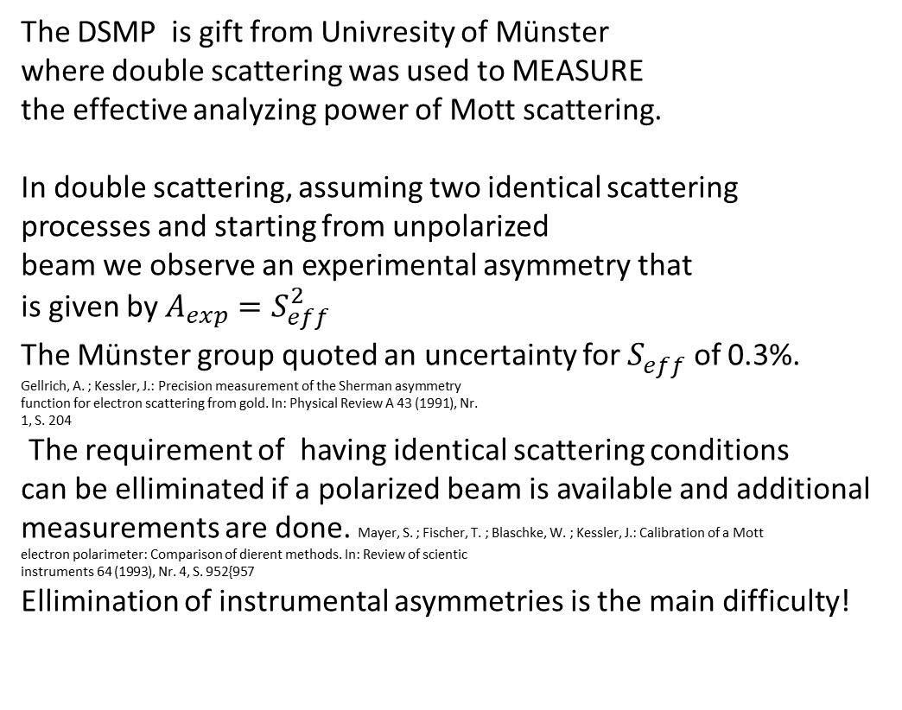
The DSMP at MESA – measurment issue
Monitor counters
The DSMP is gift from Univresity of Münster
where double scattering was used to MEASURE
the effective analyzing power of Mott scattering.
In double scattering, assuming two identical scattering
processes and starting from unpolarized
beam we observe an experimental asymmetry that
is given by $A_{exp}=S_{eff}^{2}$
The Münster group quoted an uncertainty for $S_{eff}^{}$ of 0.3%.
Gellrich, A. ; Kessler, J.: Precision measurement of the Sherman asymmetry
function for electron scattering from gold. In: Physical Review A 43 (1991), Nr.
1, S. 204
The requirement of having identical scattering conditions
can be elliminated if a polarized beam is available and additional
measurements are done. Mayer, S. ; Fischer, T. ; Blaschke, W. ; Kessler, J.: Calibration of a Mott
electron polarimeter: Comparison of dierent methods. In: Review of scientic
instruments 64 (1993), Nr. 4, S. 952{957
Ellimination of instrumental asymmetries is the main difficulty!
Polarisation
counters

Slide 27
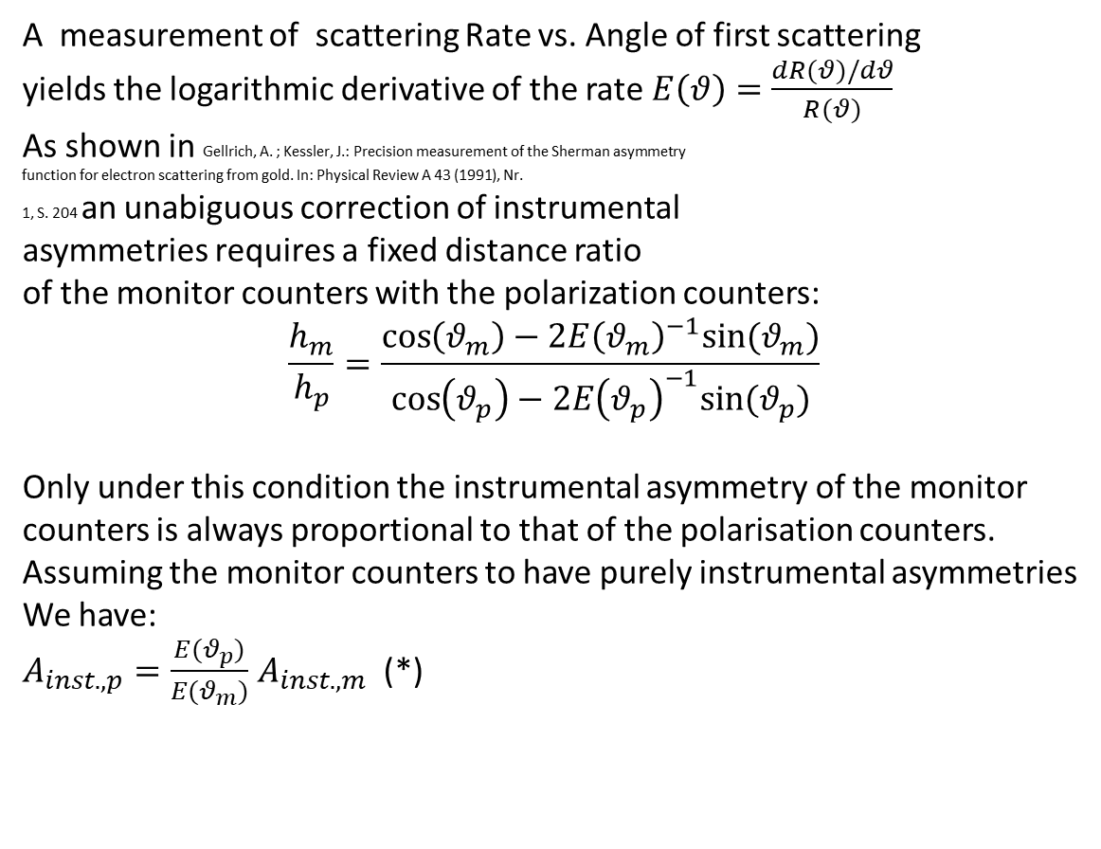
The DSMP at MESA – measurment issue
A measurement of scattering Rate vs. Angle of first scattering
yields the logarithmic derivative of the rate $E\left(θ\right)=\frac{dR(θ)/dθ}{R(θ)}$
As shown in Gellrich, A. ; Kessler, J.: Precision measurement of the Sherman asymmetry
function for electron scattering from gold. In: Physical Review A 43 (1991), Nr.
1, S. 204 an unabiguous correction of instrumental
asymmetries requires a fixed distance ratio
of the monitor counters with the polarization counters:
$$\frac{h_{m}}{h_{p}}=\frac{\cos\left(θ_{m}\right)−{2E\left(θ_{m}\right)}^{−1}sin⁡(θ_{m})}{\cos\left(θ_{p}\right)−{2E\left(θ_{p}\right)}^{−1}sin⁡(θ_{p})}$$
Only under this condition the instrumental asymmetry of the monitor
counters is always proportional to that of the polarisation counters.
Assuming the monitor counters to have purely instrumental asymmetries
We have:
$A_{inst.,p}=\frac{E(θ_{p})}{E(θ_{m})}$ $A_{inst.,m}$ (*)
Measurments by M. Molitor, PhD thesis
Mainz 2020

Slide 28
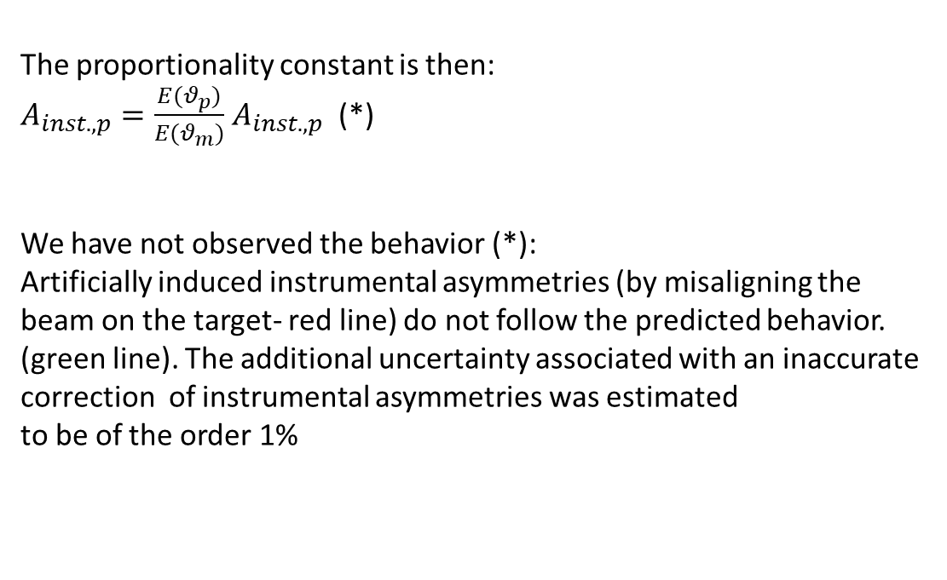
The DSMP at MESA – physics issue
The proportionality constant is then:
$A_{inst.,p}=\frac{E(θ_{p})}{E(θ_{m})}$ $A_{inst.,p}$ (*)
We have not observed the behavior (*):
Artificially induced instrumental asymmetries (by misaligning the
beam on the target- red line) do not follow the predicted behavior.
(green line). The additional uncertainty associated with an inaccurate
correction of instrumental asymmetries was estimated
to be of the order 1%
Measurement by M. Molitor, PhD thesis
Mainz 2020

Slide 29
The DSMP at MESA – physics issue
Measurement by M. Molitor, PhD thesis
Mainz 2020
Independend cross checks with polarised beam are only consistent to about plus/minus 1.5%
Supporting the suspicion that the correction for instrumental asymmetries is wrong
Additional problem was that beam for was not completely unpolarized
Additional issue is that switching of Wien filter for the cross check measurements may have changed the magnetic field in the DSMP with also adverse effects…

Slide 30
Thank You

Slide 31
P2@MESA:
Assumptions concerning error contributions
Statistics: Assuming 150 μA beam current on 55cm lq. Hydrogen for 10000 hours with P=0.85
Relative
error on
sin² of
weak mixing
angle
Polarization error
assumed as ΔP/P=0.5%!
Average scattering angle at E_{beam}=155 MeV
Content from: D. Becker et al., Eur. Phys. J. A (2018) 54 : 208

Slide 32

The beamline…
D. Simon Dissertation Thesis
http://doi.org/10.25358/openscience-5809

Slide 33
The cryogenic distribution

Slide 34
“Robust” Refrigerator parts…(fabricated in Germany)
If situation with russian institutions do not improve…
..one may try to fabricate in house/
Beam insert and
“Pumping line”
All welded
heat exchangers
For precooling stage

Slide 35
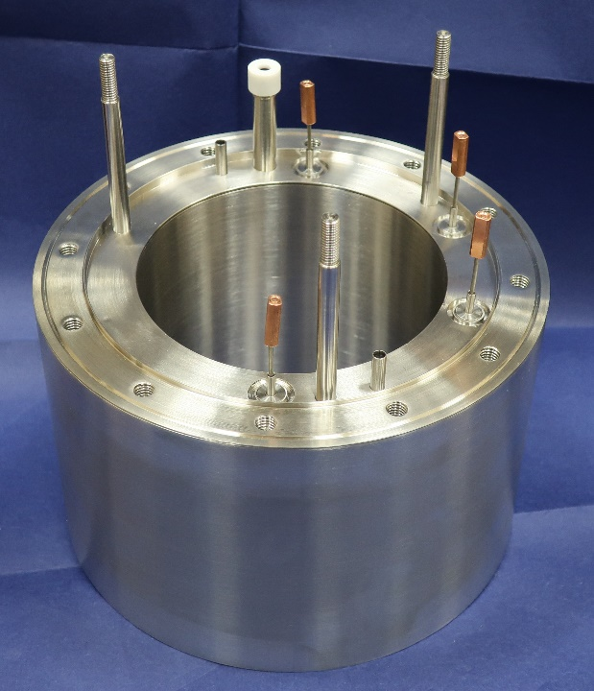
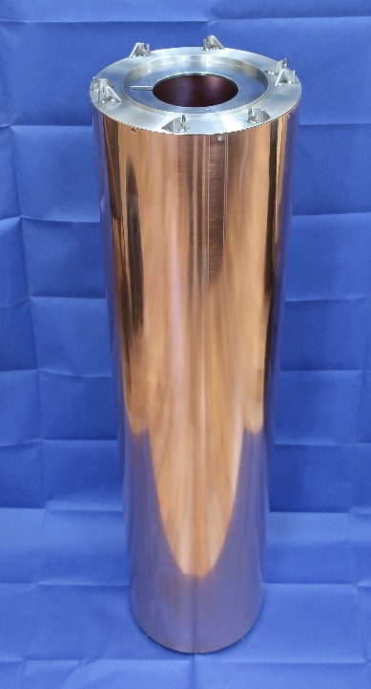
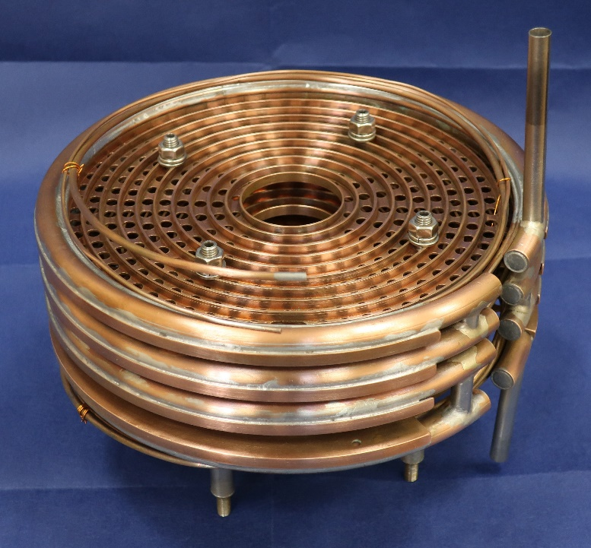
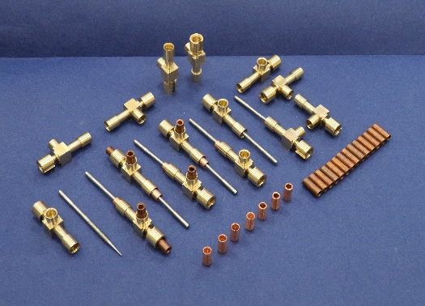
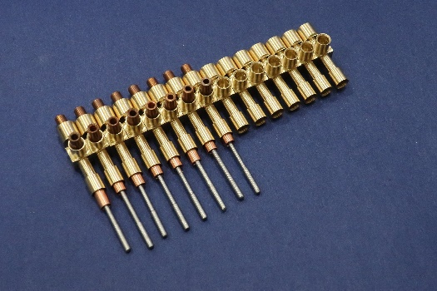
“Precooler ” parts (fabricated in Russia but not delivered)
..one may try to fabricate the missing pieces (many!)
in house/with industry in other cooperations → probbaly impossible to acquire necessary know how , in any many years of delay!

