Slide 1
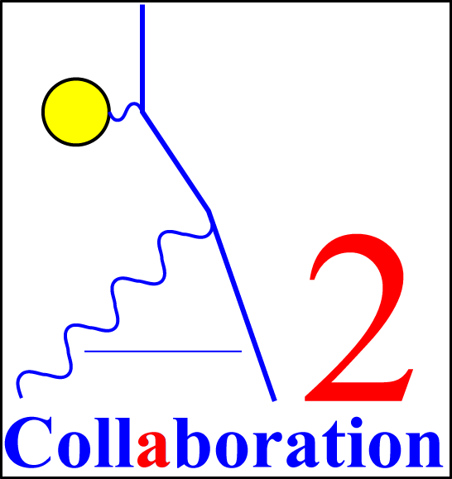
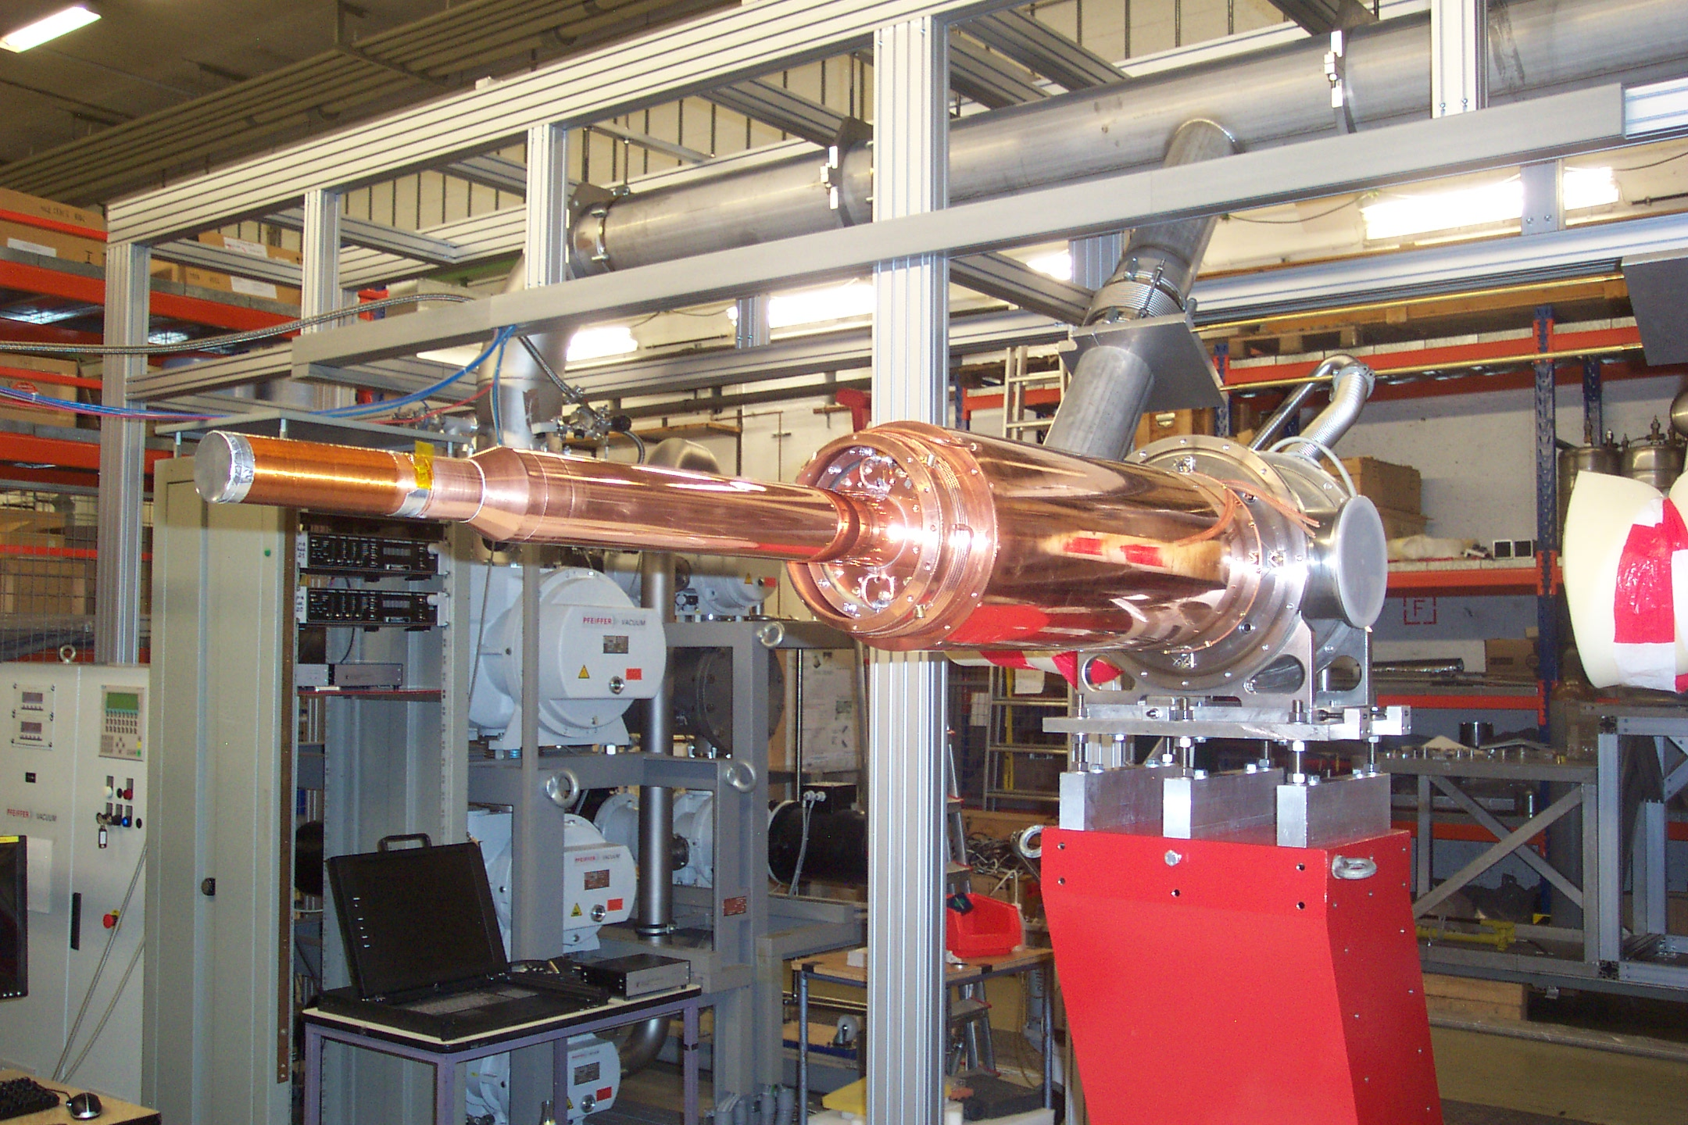
Institut
für Kernphysik
Cyrogenic tools
Cryogenics:
1.-Temperature scale
2.- How to reach low temperatures?
3.- Construction principles
Examples:
1.- Hydrogen/Deuterium Target
2.- Frozen Spin Target
Andreas Thomas
Mainz, May 24th, 2023
Andreas Thomas

Slide 2
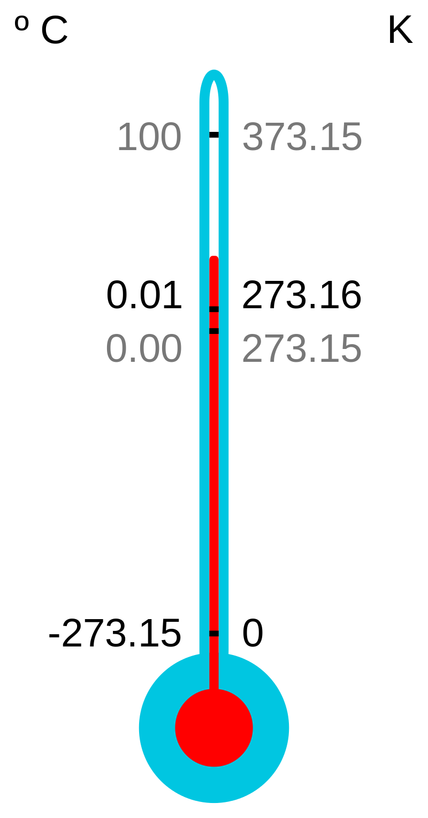
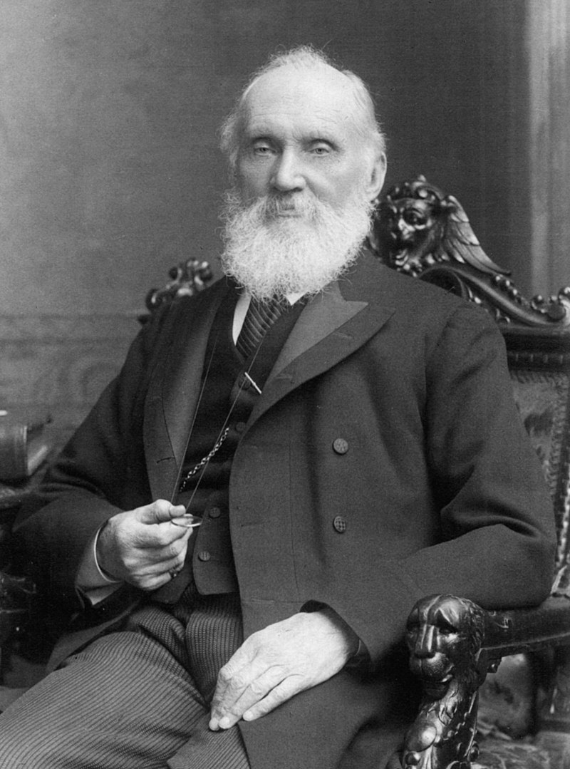
Temperature Scale
William Thomson, 1st Baron Kelvin
(26 June 1824 – 17 December 1907)
Kelvin Temperature scale 1848
Joule-Thomson Effect

Slide 3
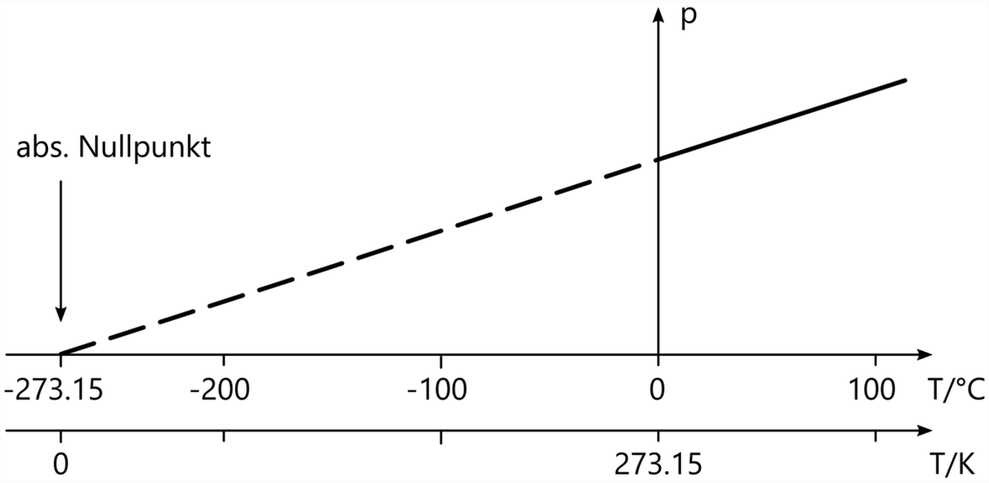
Absolute zero is the lowest limit of the thermodynamic temperature scale, a state at which the enthalpy and entropy of a cooled ideal gas reach their minimum value, taken as zero kelvin. The fundamental particles of nature have minimum vibrational motion, retaining only quantum mechanical, zero-point energy-induced particle motion. The theoretical temperature is determined by extrapolating the ideal gas law; by international agreement, absolute zero is taken as −273.15 degrees on the Celsius scale (International System of Units).
pV = N kBT

Slide 4
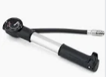
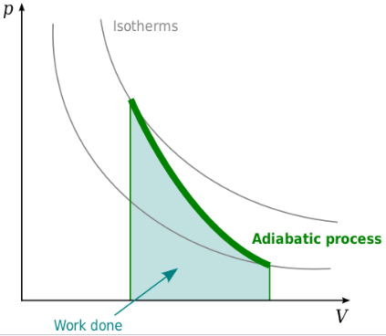
How to reach low temperatures?
Adiabatic expansion: A process without transfer of heat to or from a system.
Adiabatic process – Wikipedia
Ideal gas
C_{P} specific heat for constant pressure, C_{V} specific heat for constant volume, f number of degrees of freedom (3 for a monatomic gas, 5 for a diatomic gas).

Slide 5
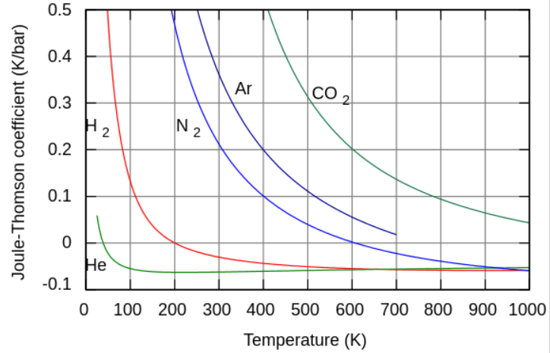
The Joule–Thomson effect (also known as the Joule–Kelvin effect or Kelvin–Joule effect) describes the temperature change of a real gas when it is forced through a valve or porous plug while keeping it insulated so that no heat is exchanged with the environment.
At room temperature, all gases except hydrogen, helium, and neon cool upon expansion by the Joule–Thomson process when being throttled through an orifice; these three gases experience the same effect but only at lower temperatures.

Slide 6
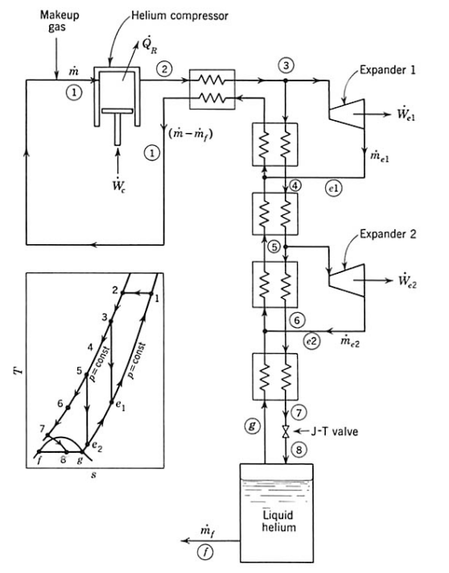
Helium liquefier:
combination of adiabatic expansion
and J-T- effect
Expander +
Counterflow
Heat
exchangers
https://uspas.fnal.gov/materials/10MIT/Lecture_2.1.pdf

Slide 7
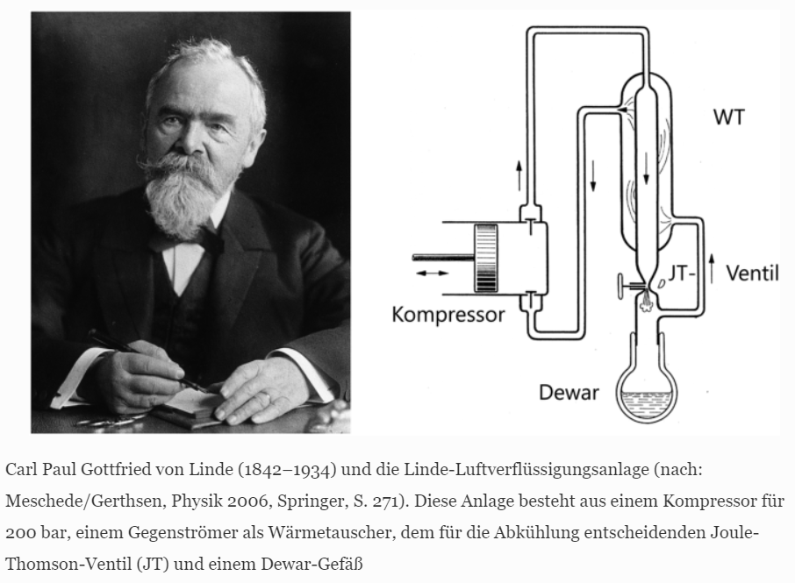

Slide 8
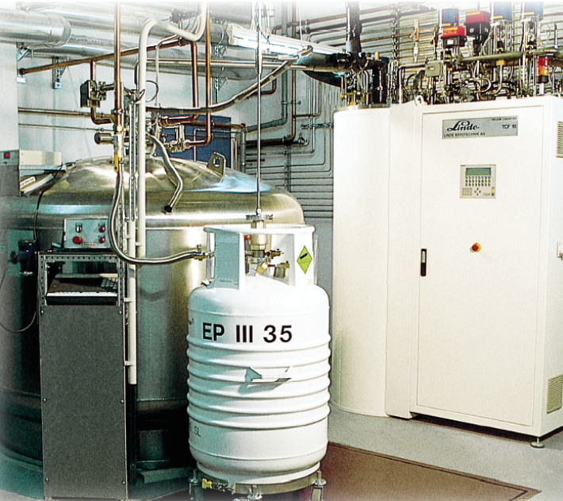
Helium transfer line
Cold Box
Helium Dewar

Slide 10
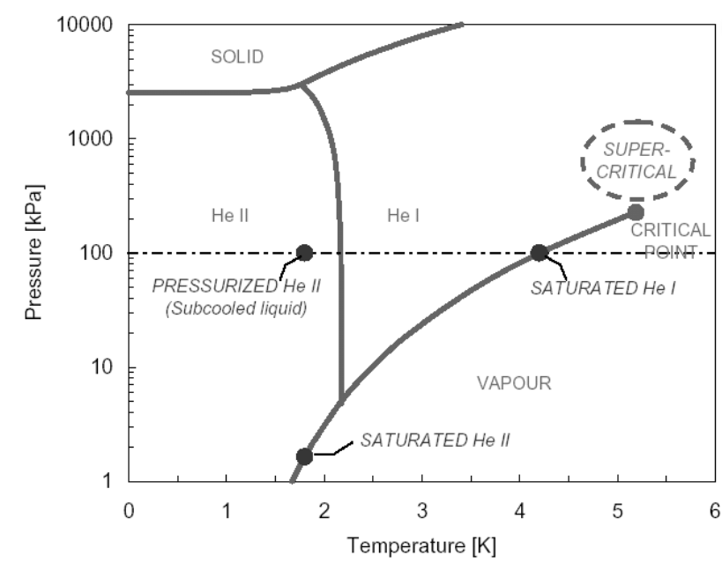
Phase diagram helium4
Liquid
@4.2K
Superfluid @2.17K

Slide 11
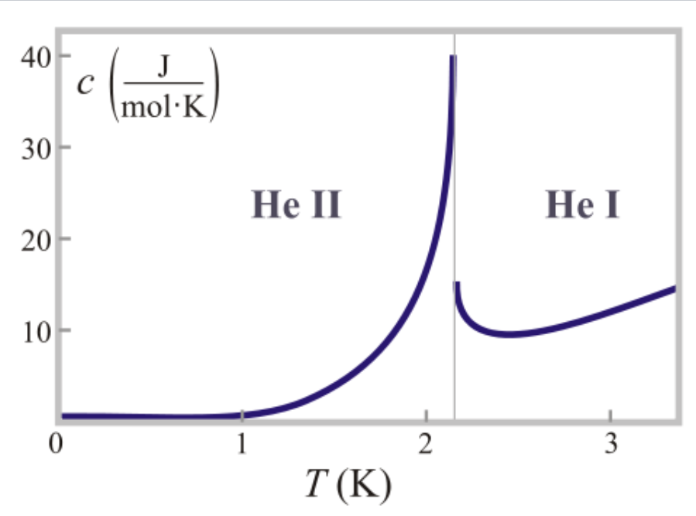
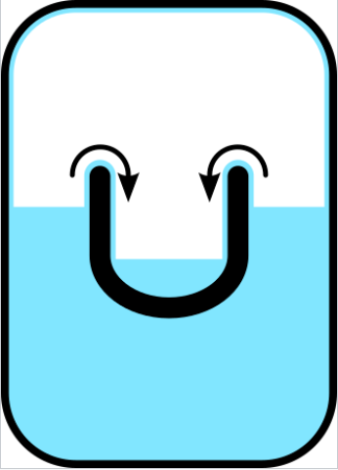
Specific heat capacity helium4
λ point @ 2.17K
Bose-Einstein condensation.
Transition to
superfluid helium II
Film flow is not restricted by its viscosity but by a critical velocity which is about 20 cm/s.
Becomes restricted if the pore diameter is less than 0.7 nm (i.e. roughly three times the classical diameter of helium atom).

Slide 12
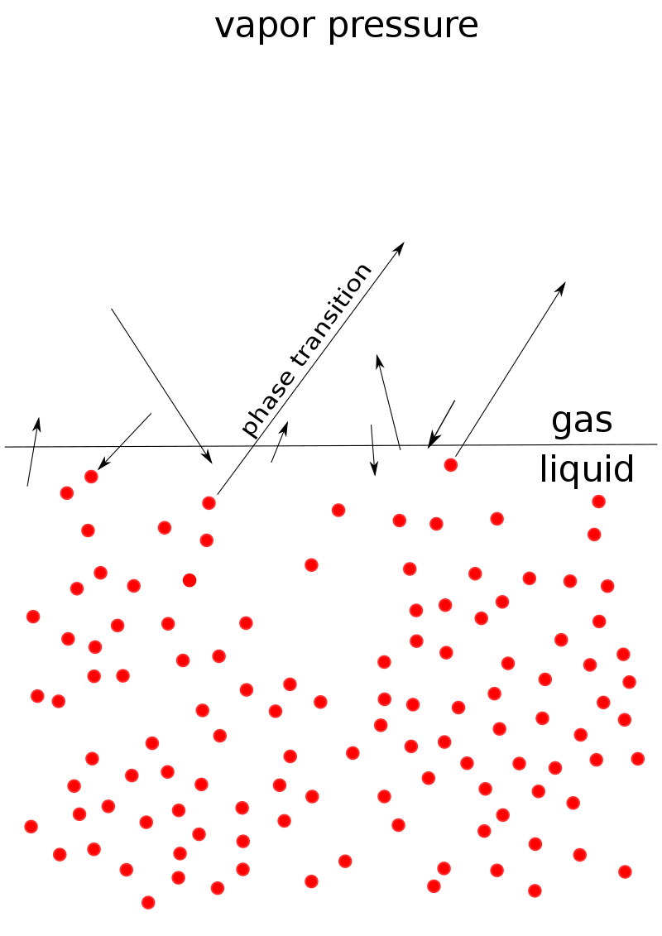
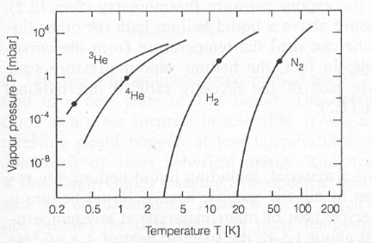
Evaporation cooling
Picture: remove the fasted atoms by pumping it from the gas phase of an isolated pot.
Helium: P= 1000mbar, T =4.2K
P= 0.1mbar, T=0.9K

Slide 13
Construction principles
Thermal Conduction – proper choice of materials and dimensions
Thermal Radiation – Shields, Superisolation foil
Heat transport by gas – Isolation vacuum
Heat transport by liquid - Geometry

Slide 14
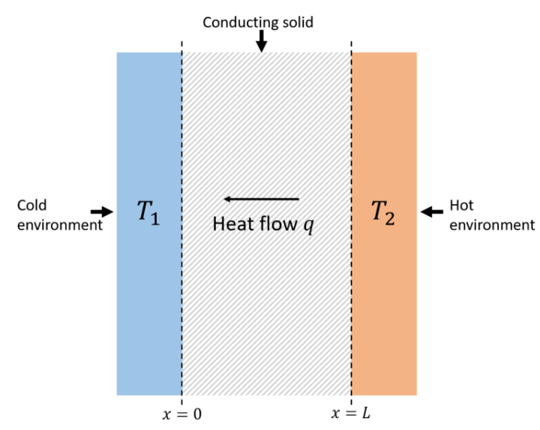
Thermal Conduction – proper choice of materials and dimensions
On a microscopic scale, heat conduction occurs as atoms and molecules interact with neighboring atoms and molecules, transferring some of their energy (heat) to these neighboring particles. In other words, heat is transferred by conduction when adjacent atoms vibrate against one another, or as electrons move from one atom to another. Conduction is the most significant means of heat transfer within a solid.
Copper
Aluminum
Stainless Steal
Plastic
Dimensions to isolate: Long and small area

Slide 15
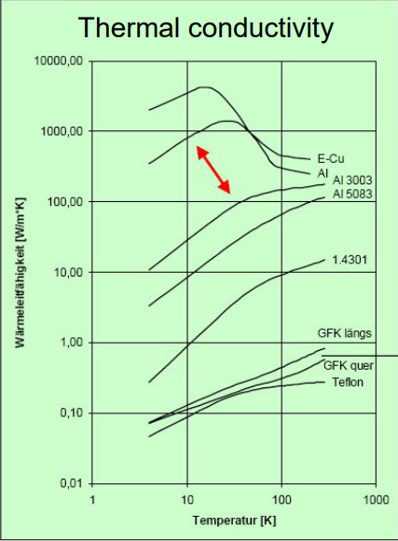
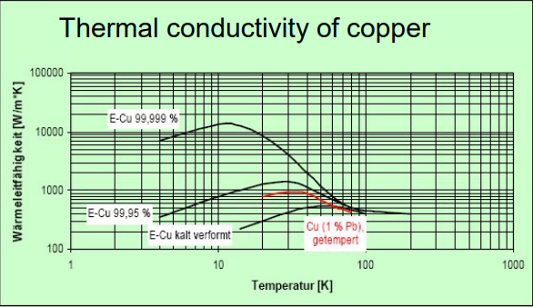
Thermal Conduction – Temperature dependence

Slide 16
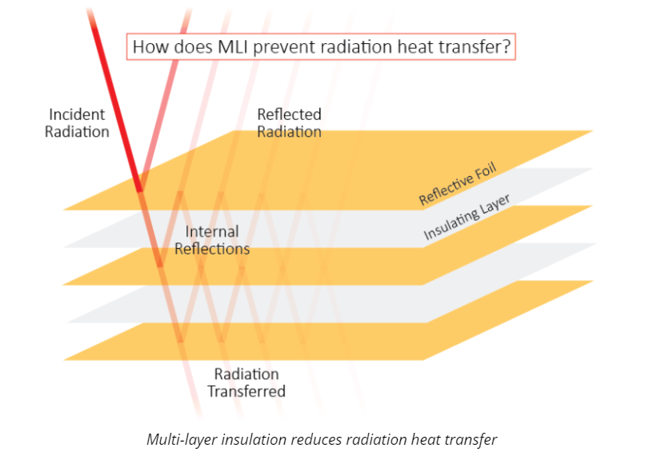
Thermal Radiation – Shields, Superisolation foil
Radiation heat transfer occurs via electromagnetic waves. Unlike conduction and convection, radiation does not need a medium for transmission.
Stefan–Boltzmann law
Radiative heat transfer

Slide 17
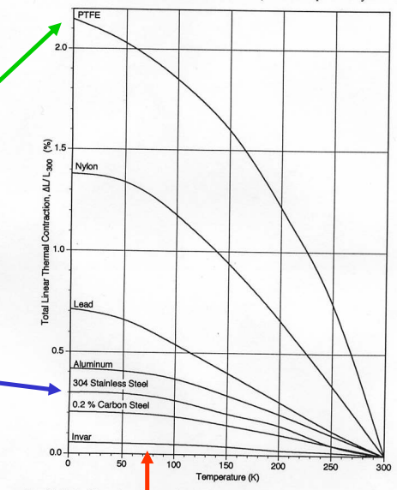
Thermal stress – Thermal expansion
Plastic:
20-30mm/meter
Thermal expansion strong from room
To Liquid N2
Temperatures.
Metal:
~3mm/meter

Slide 18
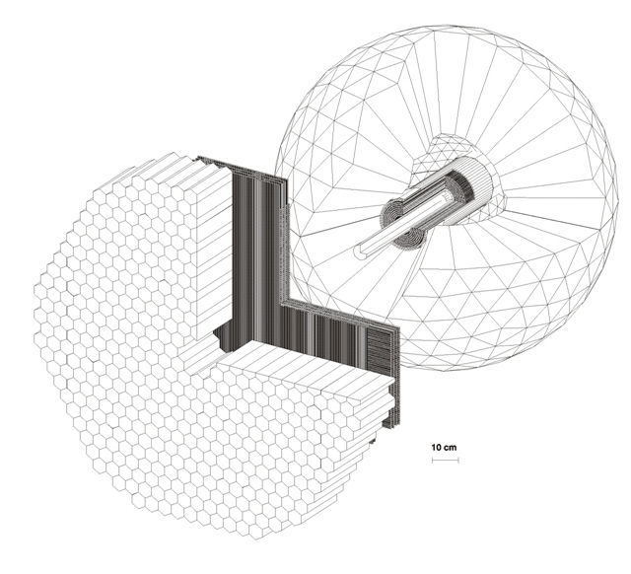
Examples
4π photon Spectrometer @ MAMI
TAPS:
510 BaF₂ detectors
Max. kin. energy:
π⁺⁻ : 180 MeV
K⁺⁻ : 280 MeV
P : 360 MeV
Crystal Ball:
672 NaJ detectors
Max. kin. energy:
μ⁺⁻ : 233MeV
π⁺⁻ : 240 MeV
K⁺⁻ : 341 MeV
P : 425 MeV
Vertex detector:
2 Cylindr. MWPCs
480 wires, 320stripes
PID detector:
24 thin plastic detectors
γp ◊ S11 ◊ pη
π⁰π⁰π⁰
γγγγγγ

Slide 19
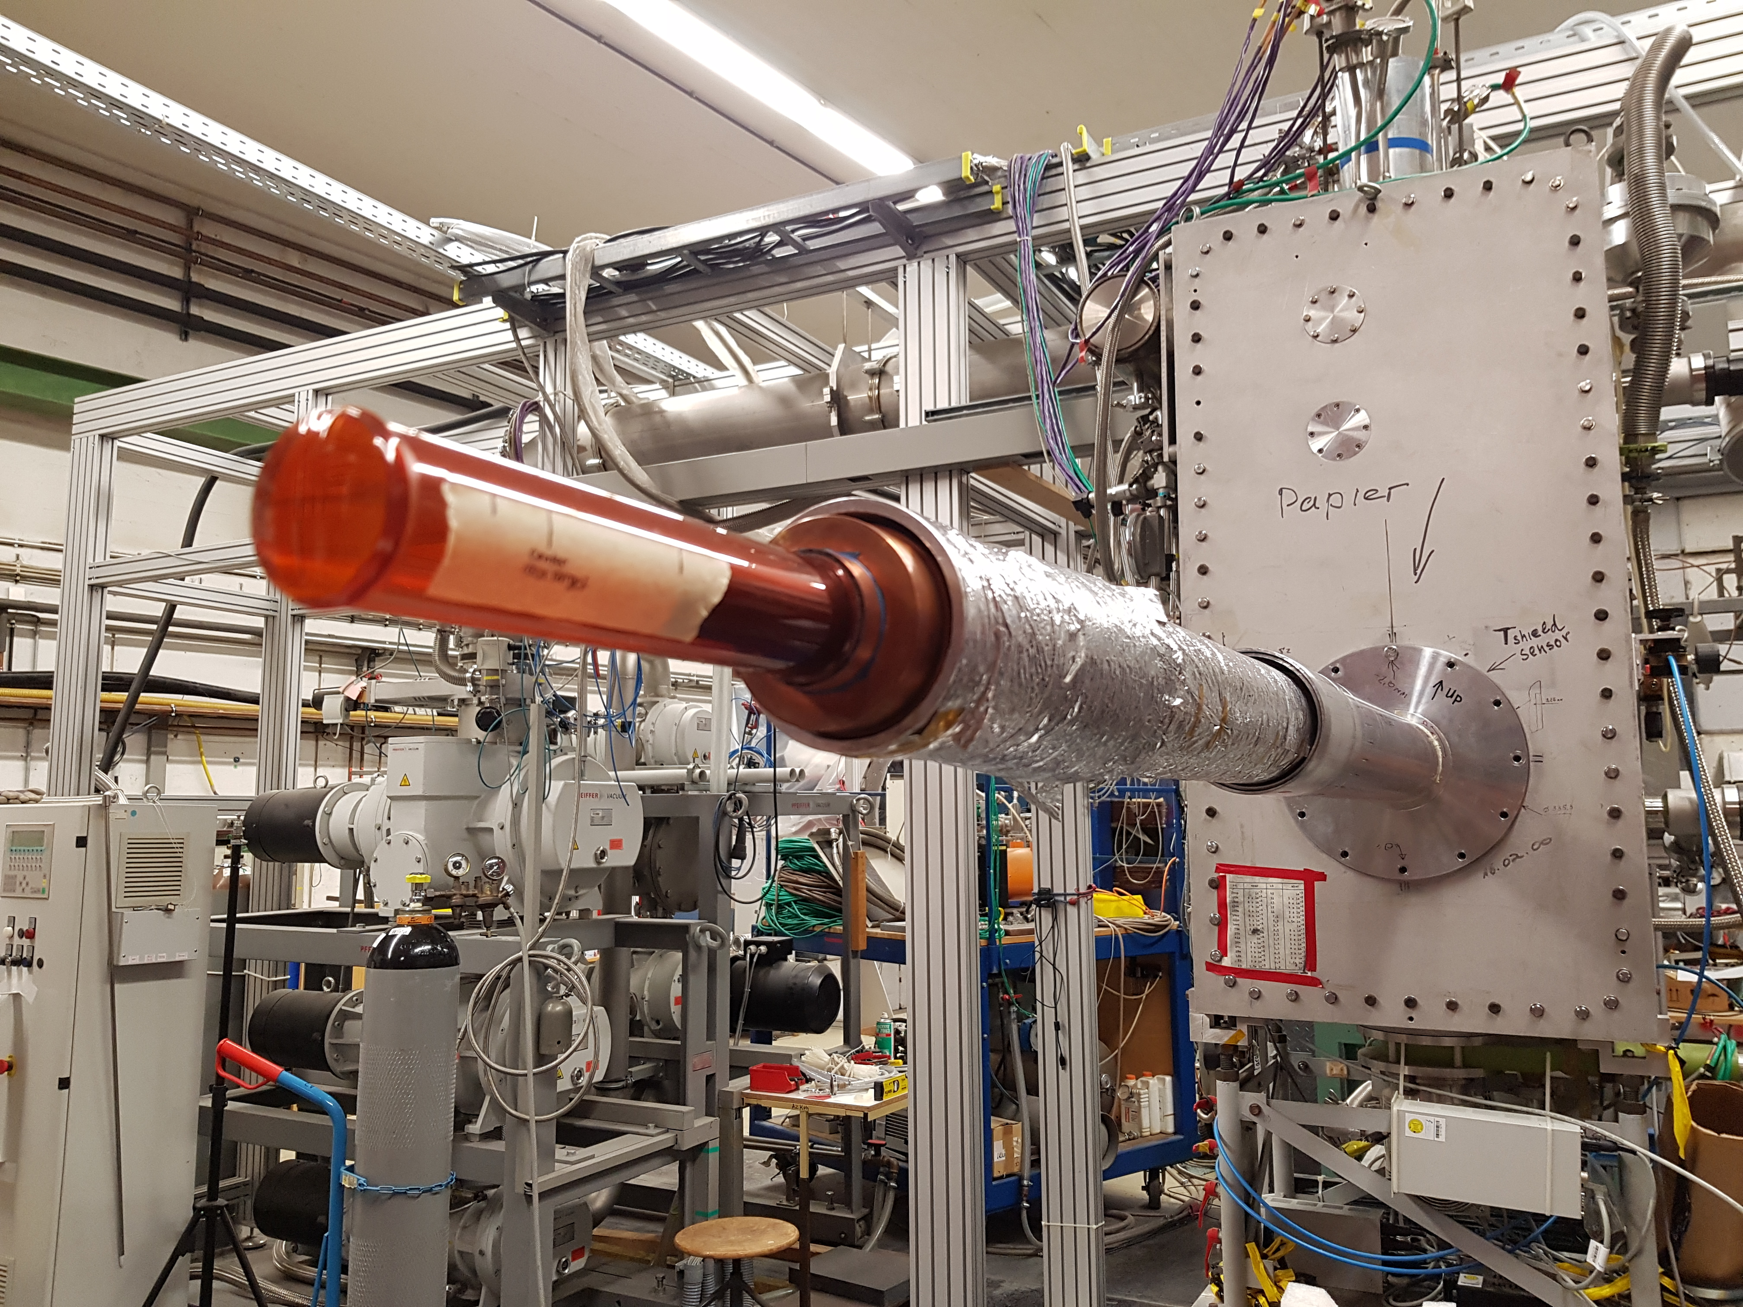
Hydrogen/Deuterium Target
New Target cell after reparation (O.Kostikov) in 2022

Slide 20
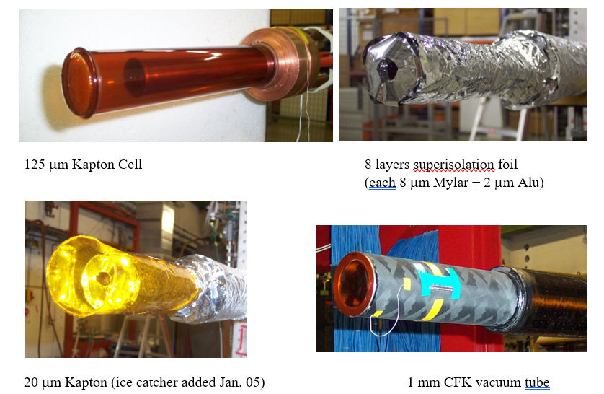

Slide 21
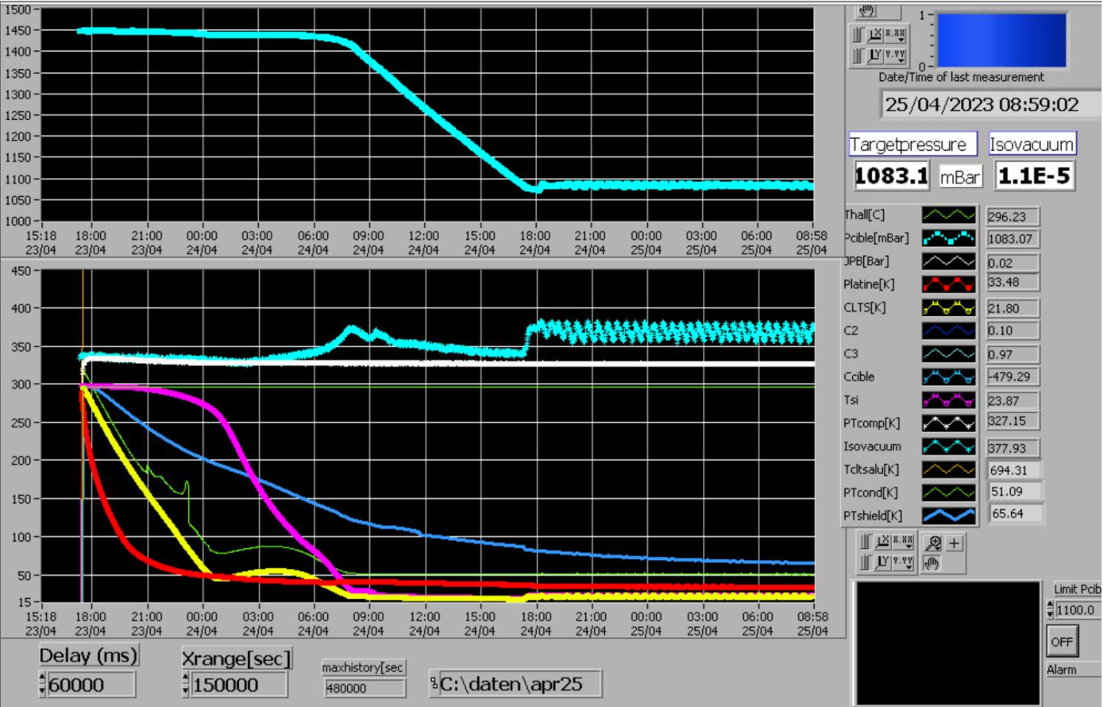
Target was cooled down last week with Deuterium within 25 hours.

Slide 22
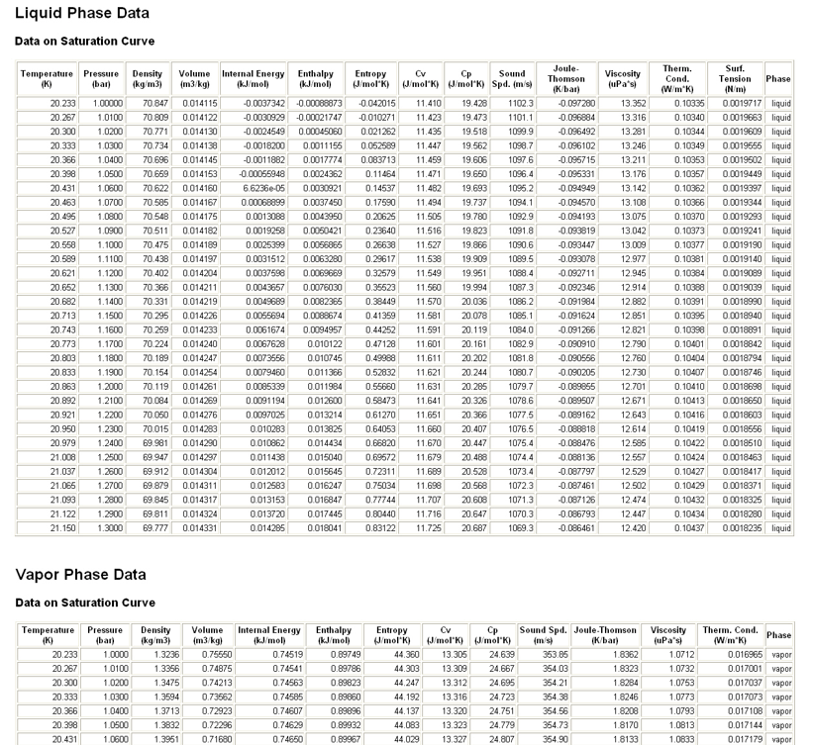
Material Properties of Hydrogen and many other cryoliquids: http://webbook.nist.gov/chemistry/fluid/
H₂ p=1080mbar T=21K
Liquid ρ=70,548 kg/m³
Gas ρ=1.419 kg/m³
Risk of overpressure in cell!

Slide 23
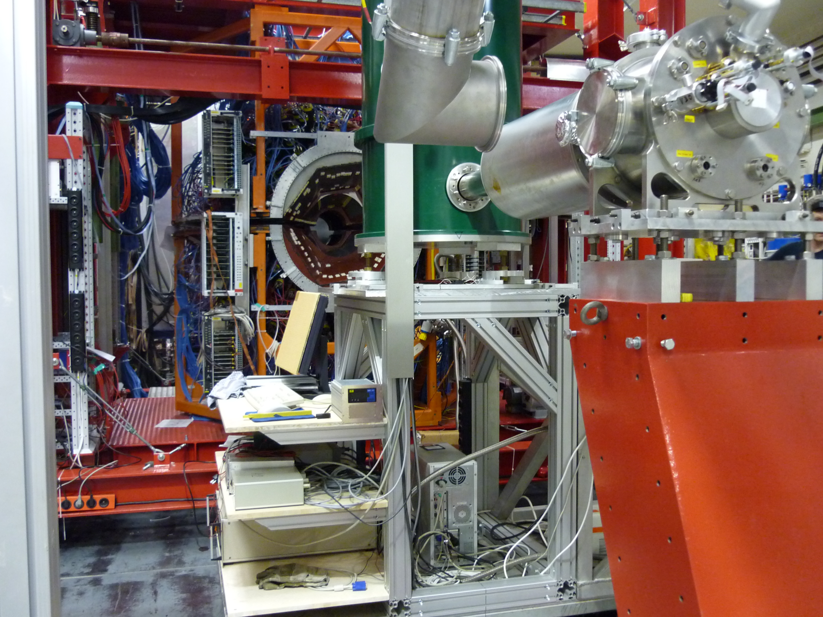
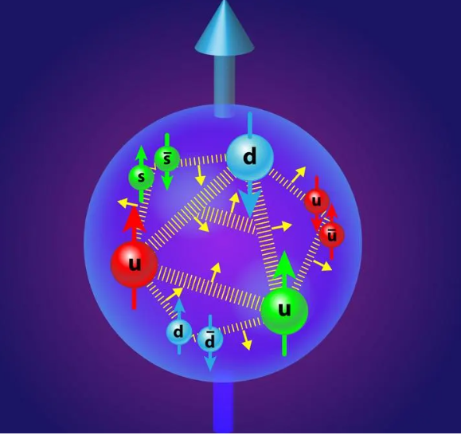
Polarised Frozen Spin Target
Cryostat
Movable
Crystal Ball
4π-
Photon
Detector
Movable
5Tesla
Polarising
Magnet
Beam with polarised photons started in 2010 at MAMI.
Cryostat and Helium3-Circuit in Bonn since 2017 at ELSA.

Slide 24
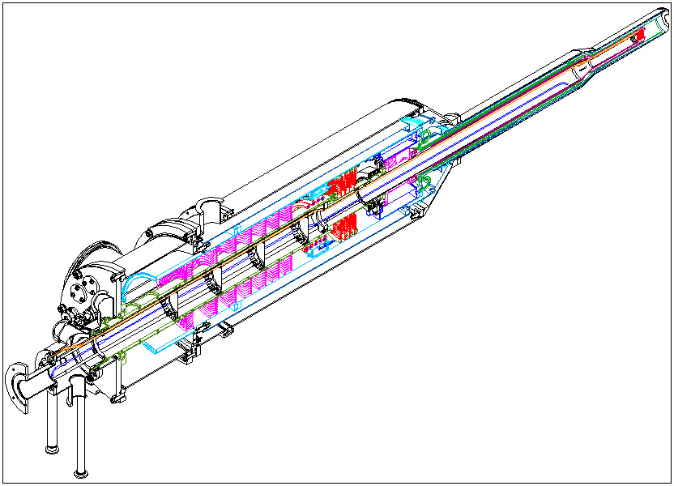
Polarized Target for Crystal Ball
Tagged CW photon beam
4π- detector
Frozen spin target (26 mKelvin achieved).
P_{proton} ~ 90%
P_{deuteron}~70%
All directions of polarization.
τ~1400hours
³He⁴He-Dilution refrigerator
(in collaboration with JINR Dubna)

Slide 25
2 Precooling stages:
Evaporator
(1.5Kelvin)
Separator
(4.2Kelvin pot)
Cryogenics
Evaporation cooling
³He⁴He-Dilution refrigerator
Dilution circuit
(0.03Kelvin)

Slide 26
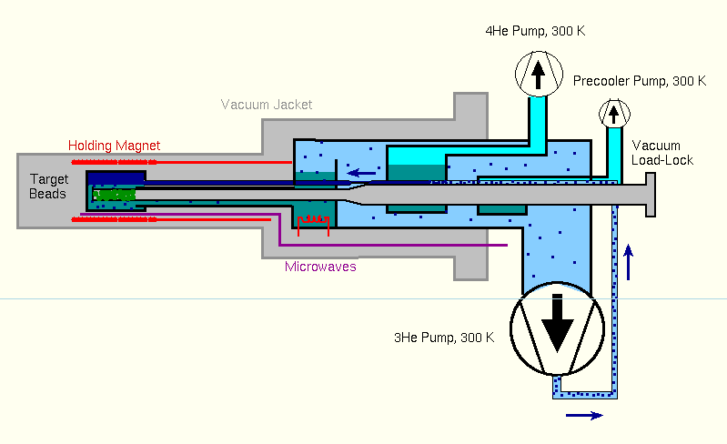
Precooling stages
Evaporation cooling
2 Precooling stages:
Separator
(4 Kelvin pot)
Evaporator
(1.5Kelvin)
Dilution circuit
(0.03Kelvin)
³He⁴He-Dilution refrigerator

Slide 27
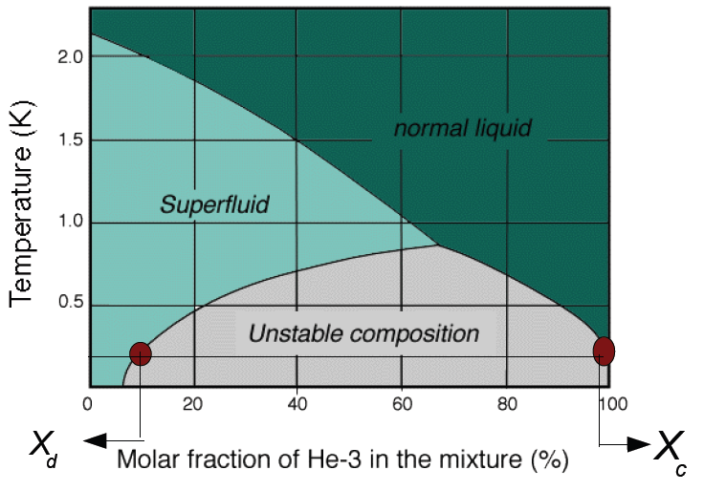
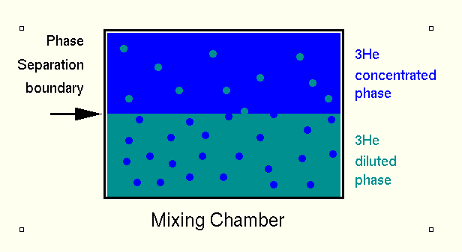
³He-⁴He-Dilution Cooling
³Helium: Spin ½, Fermion
⁴Helium: Spin 0, Boson
Cooling a 25%- gas-mixture
from 300K to 0.6K
Separation of both phases
Further cooling using
„dilution effect“

Slide 28
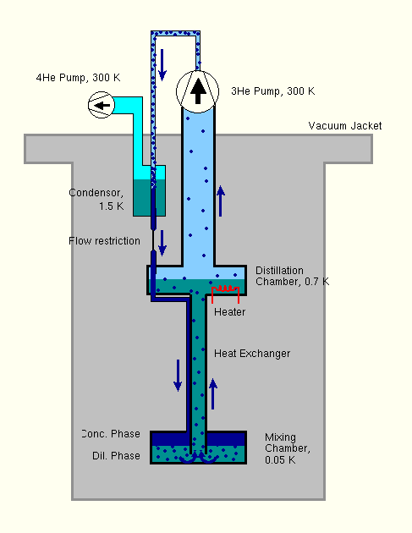
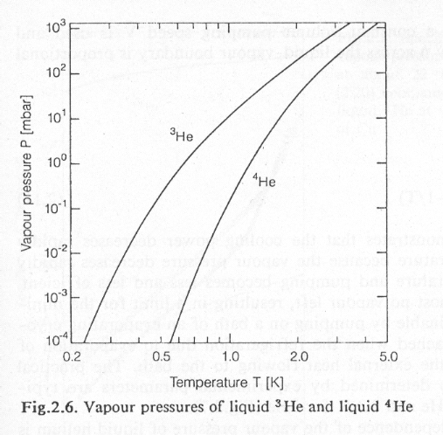
³Helium absorbs energy when it
dissolved into diluted phase
Heat Q absorbed by n moles 3Helium
Distillation in the „Still“ at 0.7K

Slide 29
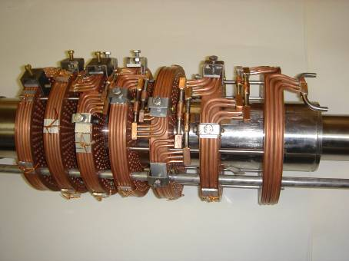
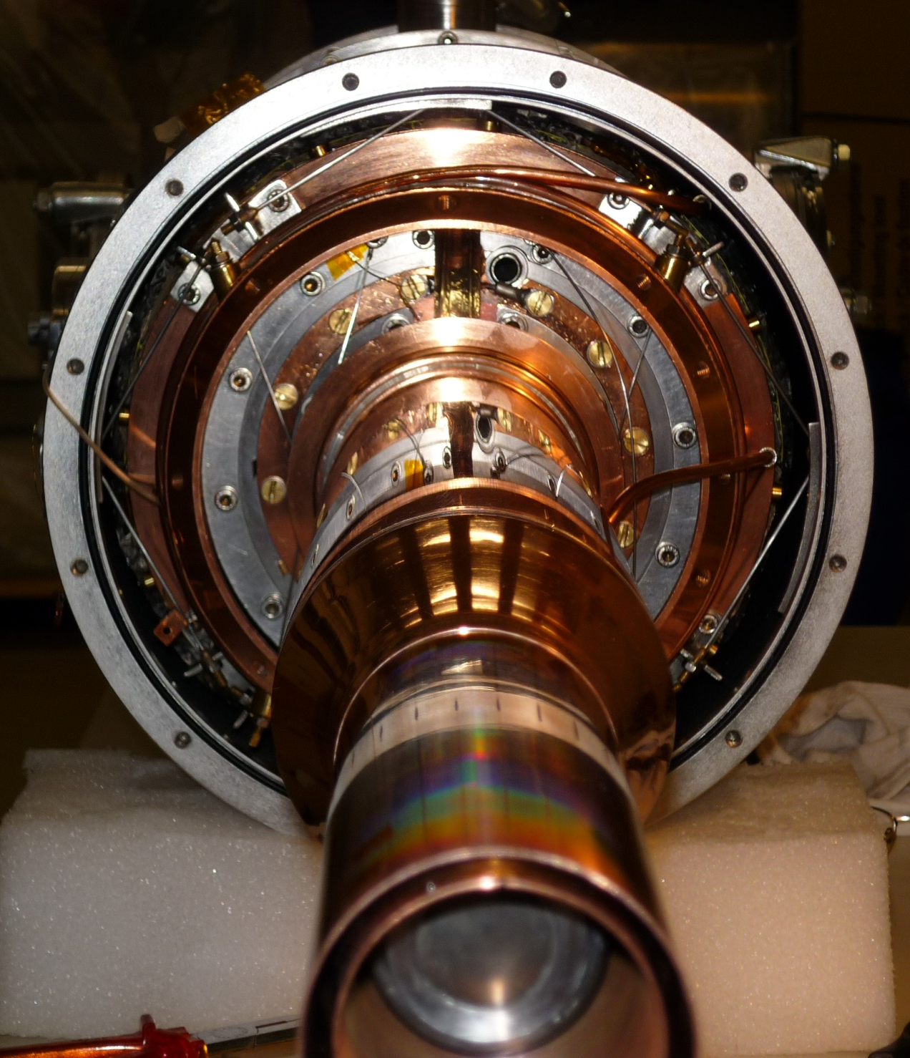
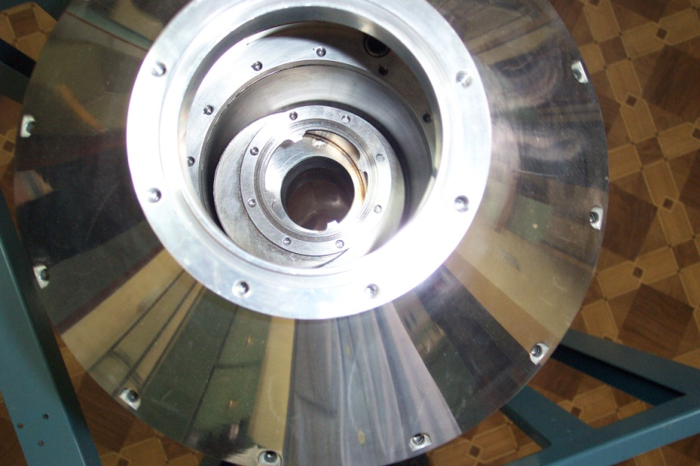
Impressions from the technical realisation
High temperature heat exchanger
Alignment thermal radiation shields
Alignment still and evaporator

Slide 30
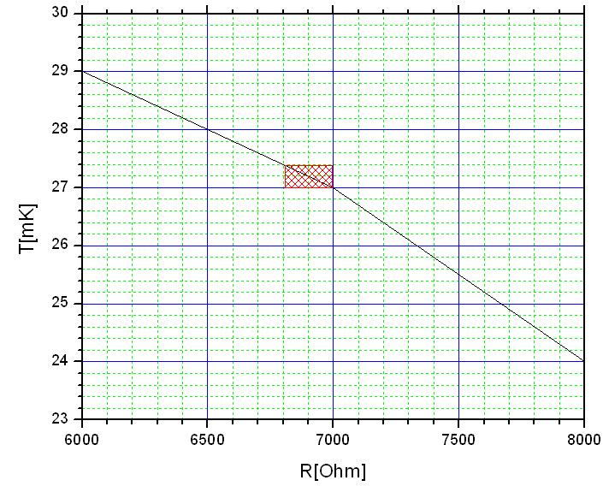
Cryostat Performance
T=24mK
T=27mK
T=29mK
Δt=40h
Temperature stability:
ΔT ~ +- 0.2mKelvin (one day)
(typical one week measurement period).

Slide 31
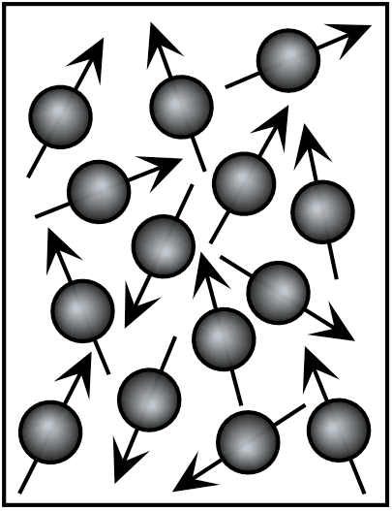
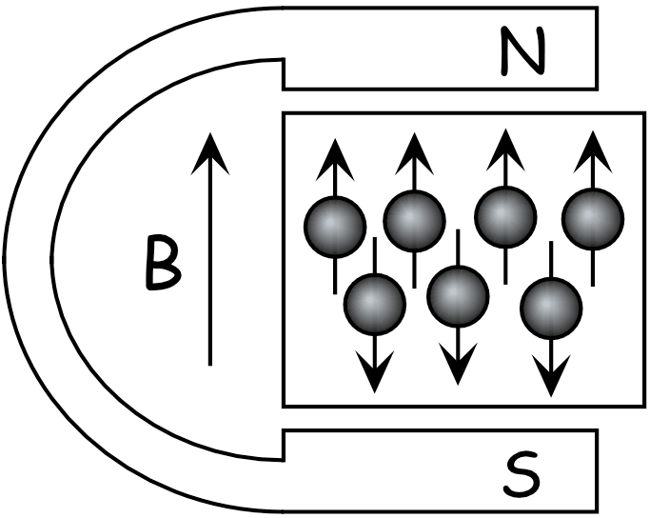
Polarised SolidTarget
Polarisation = Orientation of Spins in a magnetic field
P=100% is not so easy to realise: Complicated interplay between Polarising force ~ magnetic field B
and
Depolarising force ~ thermal motion of spins
(temperature T – relaxation)

Slide 32
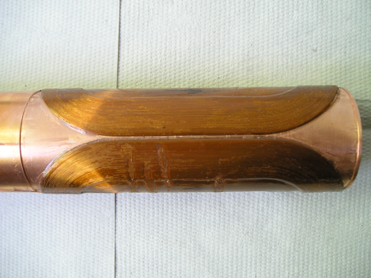
Magnet Technology
DNP at 200mK and 2.5T with 70GHz microwaves.
Frozen spin target (25mKelvin, 0.6T).
Secondary particles punch through holding coil.
All directions of polarization.
Transverse (Saddle coil)
and
Longitudinal (Solenoid)
Internal
Holding Field (1.2K, 0.6T)

Slide 33
Magnetic moment in magnetic field:
ΔE
B=0T
B=2.5T
B=0T
B=2.5T
electron
proton
Thermal equilibrium
Boltzmann distribution
B [Tesla] | T [mK] | e⁻ [%] | p [%] | d [%]
2,5 | 100 | 99,8 | 0,51 | 0,10
 | 1000 | 93,3 | 0,25 | 0,05
5,0 | 100 | 100,0 | 5,09 | 1,05
 | 1000 | 99,8 | 1,28 | 0,11
Trick: Transfer of the high electron polarization to the nucleon via
μ-wave irradiation (DNP)

Slide 34
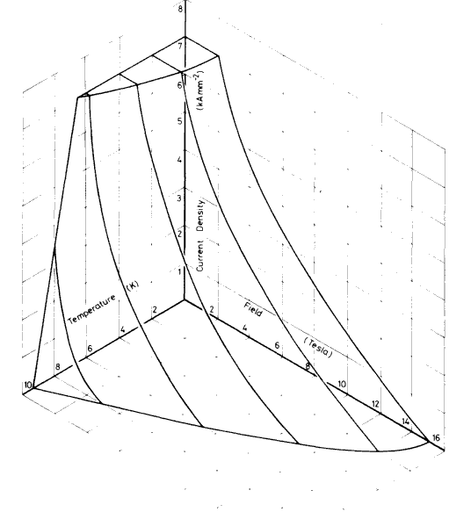
Holding Coil
j_{crit}
Coil has to be as thin as
possible to allow low
energetic particles
to punch through.
Subcooled Superconductor
F54-1.35(0.20)TV
@4.2Kelvin
@1.3Kelvin
T
B

Slide 35
Copper/scandium wire with 54 Nb-Ti filaments embedded in it.
Cu:Sc=1.35:1
Alloy composition: Nb47wt.%Ti
Diameter=0.222mm
It achieves currents up to 50A at 4.2K and 1T.

Slide 36
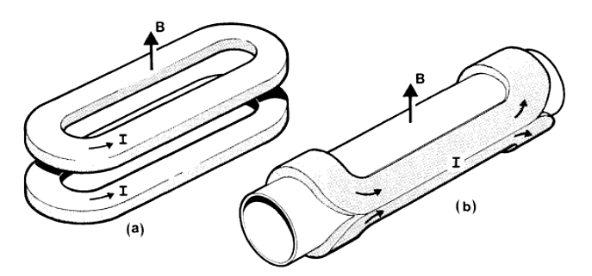
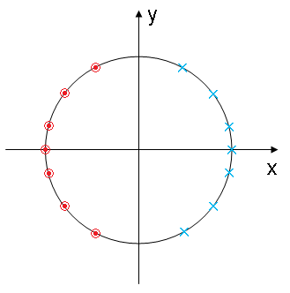
Simulation and Optimisation Transverse Field
Ideal case for dipole magnet:
4-layer dipole:
N1=N2=138
N3=N4=78

Slide 37
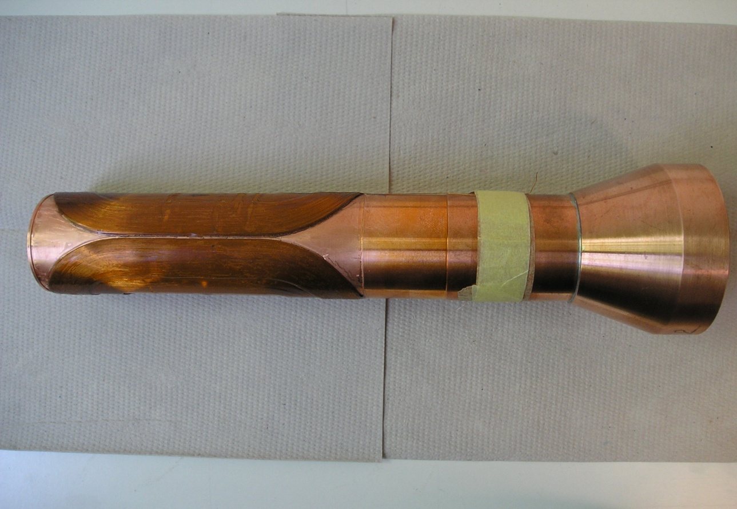
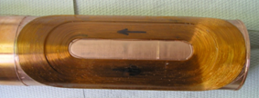
4-layer dipole:
N1=N2=138
N3=N4=78
150mm

Slide 38
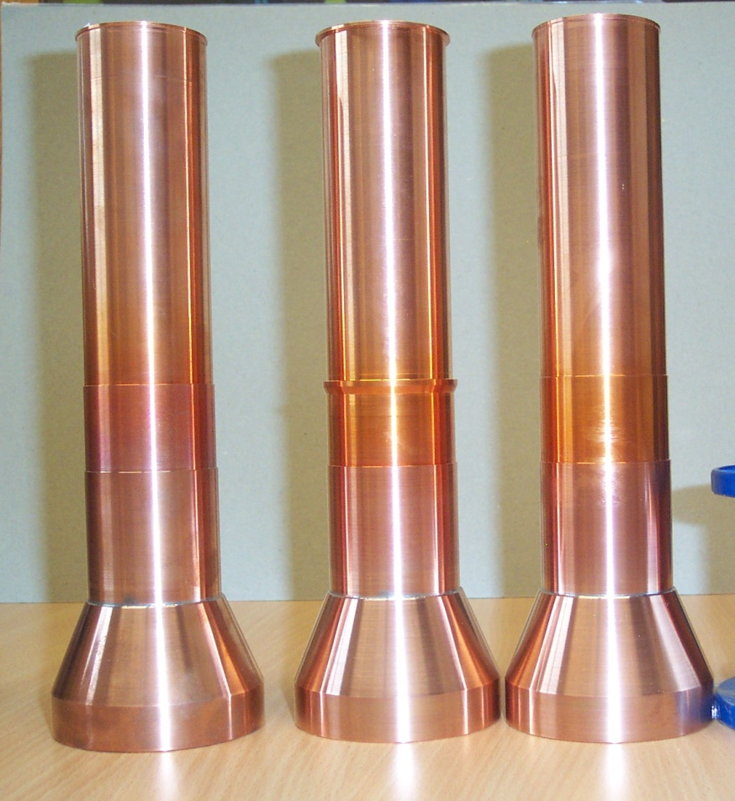
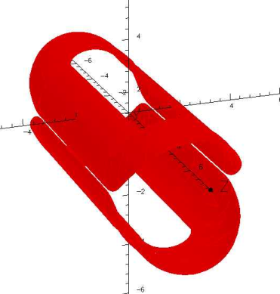
High Field 1T
Threshold Production
Transverse Field

Slide 39
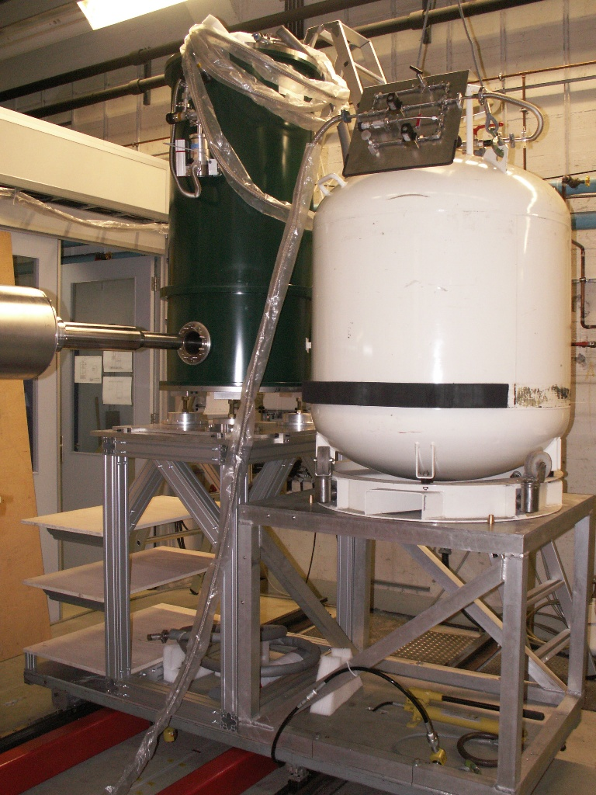
Polarizing
magnet
He4(liq)

Slide 40
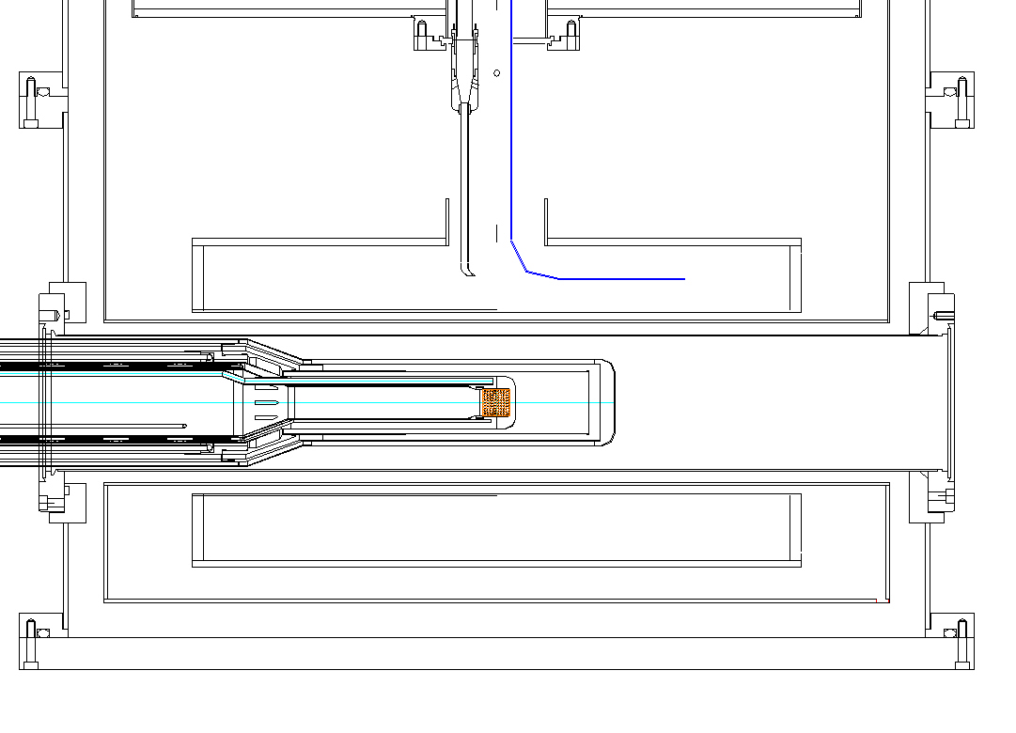
Polarising → Holding Field
B_{z}=2.5Tesla
2) B_{z}=0.5Tesla
Superconducting 2.5Tesla Magnet for polarising in z-direction

Slide 41
Rotation of the Holding Field
2) B_{z}=0.5Tesla
3) B_{y}=0.5Tesla
Superconducting 2.5Tesla Magnet for polarising in z-direction

Slide 42
Rotation of the Holding Field
4) B_{z}=0.0Tesla
B_{y}=0.5Tesla
Superconducting 2.5Tesla Magnet for polarising in z-direction

Slide 43
Frozen Spin Target Waltz
Crystal Ball
Cryostat
Microwaves
Microwaves
Polarizing
magnet
Polarizing
magnet
External magnet 2.5 T
Polarize with microwaves
Internal holding coil 0.7 T
Remove external magnet
Move CB detector in.
Data taking.
Repolarization

Slide 44
Literature
Wikipedia
F. Pobell
Matter and Methods at Low Temperatures
Springer 1996
D.R. Tilley and J. Tilley
Superfluidity and Superconductivity
Adam Hilger 1990
C. Enss and S. Hunklinger
Low-Temperature Physics
Springer 2005
H. Frey, R. A. Haefer, Tieftemperaturtechnologie
Herrmann, R. (2019). Die Erforschung der Kälte. In: Die Tieftemperaturphysik an der Humboldt-Universität im 20. Jahrhundert. Springer Spektrum, Berlin, Heidelberg. https://doi.org/10.1007/978-3-662-59575-6_1

