Slide 1
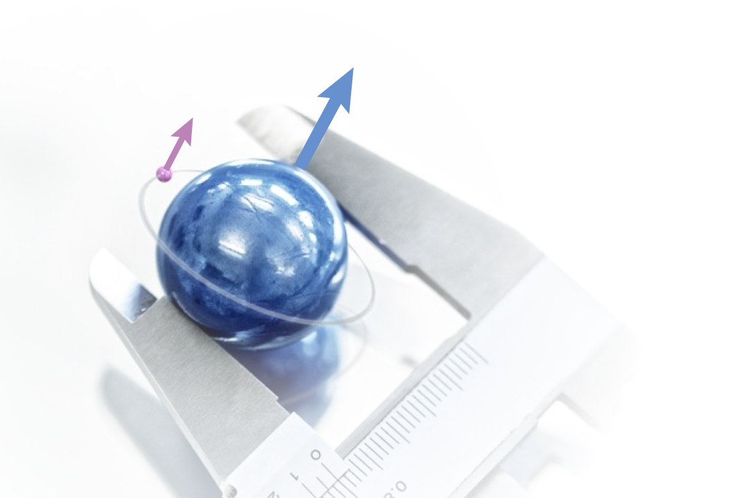

Hyperfine Splitting in Muonic Hydrogen
AG Pohl
CREMA
𝜇
The Zemach radius of the proton

Slide 2
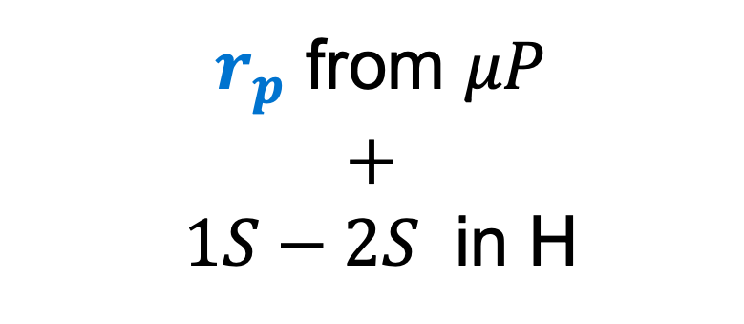

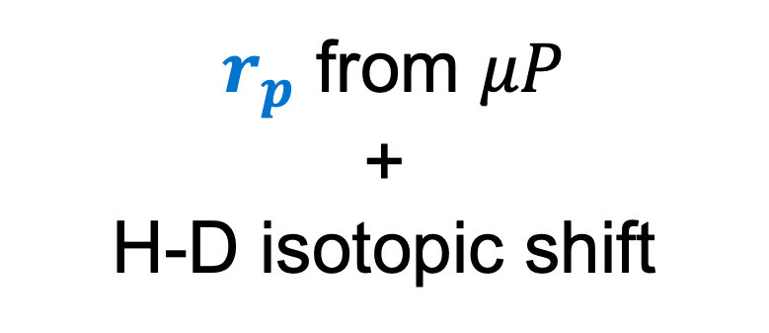

Beyond the proton radius puzzle
Measurement
Result
$r_{p}$ from $μP$
$$+$$
$1S−2S$ in H
Most precise $R_{∞}$
$r_{p}$ from $μP$
+
H-D isotopic shift
Most precise $r_{d}$
Notes:
Limitation on the QED bound state is coming from the finite size.
Finite size proton is not point like
charge and magnetic distribution

Slide 3
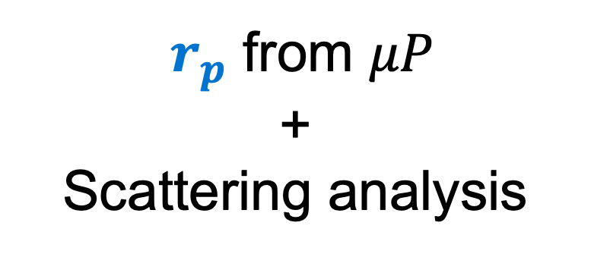
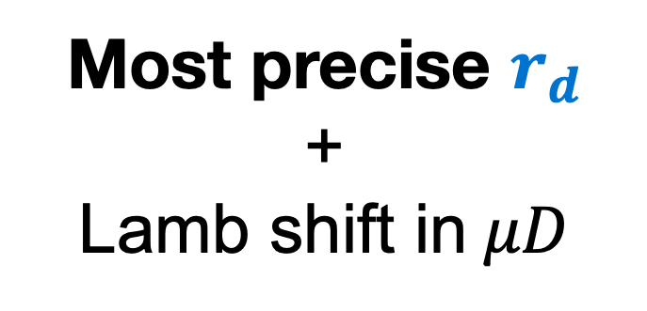
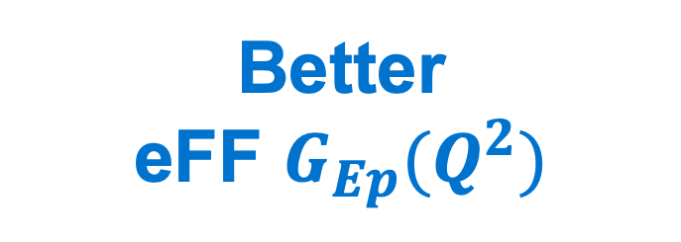
Beyond the proton radius puzzle
Measurement
Result
Most precise $r_{d}$
+
Lamb shift in$μD$
Theory of deutron structure
(nucleon-nucleon)
$r_{p}$ from $μP$
+
Scattering analysis
Better
eFF $G_{Ep}(Q^{2})$
Notes:
Limitation on the QED bound state is coming from the finite size.
Finite size proton is not point like
charge and magnetic distribution

Slide 4
The Zemach radius
From charge to Zemach radius
+
P
𝜇
P
+
+
𝜇
-
-
-
-
+
+
+
+
+

Slide 5
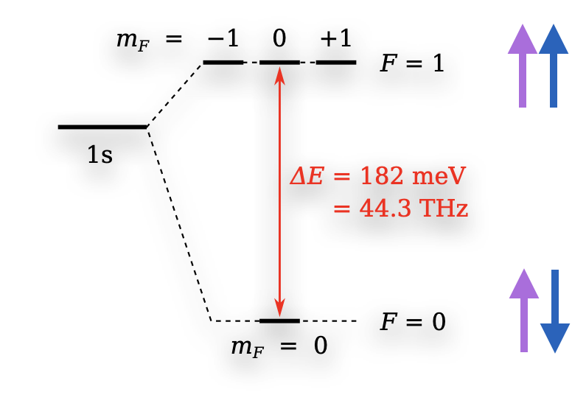
Hyperfine Splitting of GS in muonic hydrogen
Antognini, Hagelstein, Pascalutsa, Annual reviews 389, 418 (2022)

Slide 6
Hyperfine Splitting of GS in muonic hydrogen
Goal
Measure the 1s-HFS in 𝜇p with 1 ppm (40 MHz) precision
Antognini, Hagelstein, Pascalutsa, Annual reviews 389, 418 (2022)

Slide 7

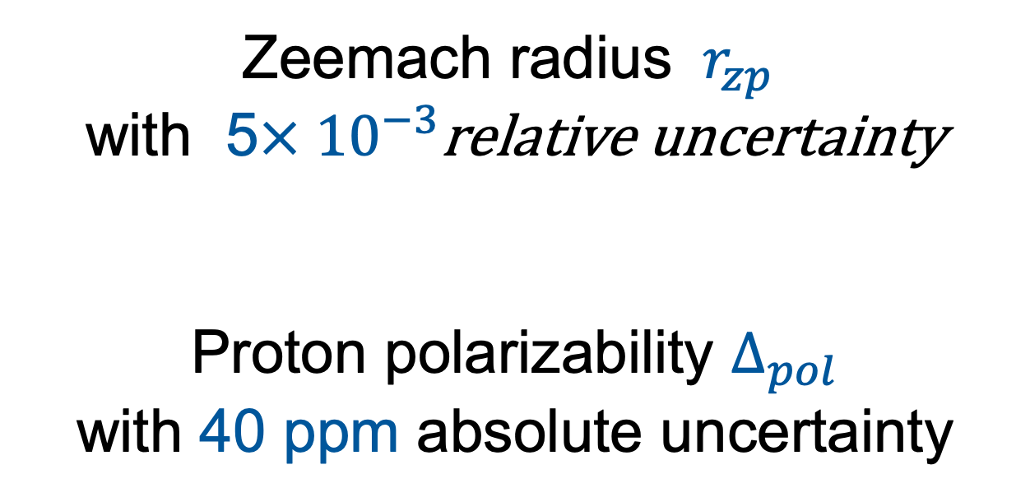
Hyperfine Splitting of GS in muonic hydrogen
1s-HFS in 𝜇p with 1 ppm + 1s-HFS in H
Zeemach radius $r_{zp}$
with 5$× {10}^{−3}$relative uncertainty
Proton polarizability $∆_{pol}$
with 40 ppm absolute uncertainty
Two photon exchange

Slide 8



Proton structure dependent contributions
Zemach
Lin, Yong-Hui, Hammer, Meißner (2022)
Recoil
Antognini, Yong-Hui, Hammer, Meißner(2022)
Polarizability
$∆_{pol}=$351(114) ppm
$∆_{pol}=$364(89) ppm

Slide 9



Proton polarizability
Proton polarizability
Chiral Perturbation
theory
Dispersive analysis
Data driven
$∆_{pol}$ $= − 0.16$ ppm
uncertainty in $∆_{pol}$ $=$364 (86)

Slide 10
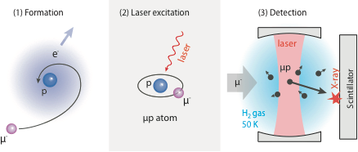
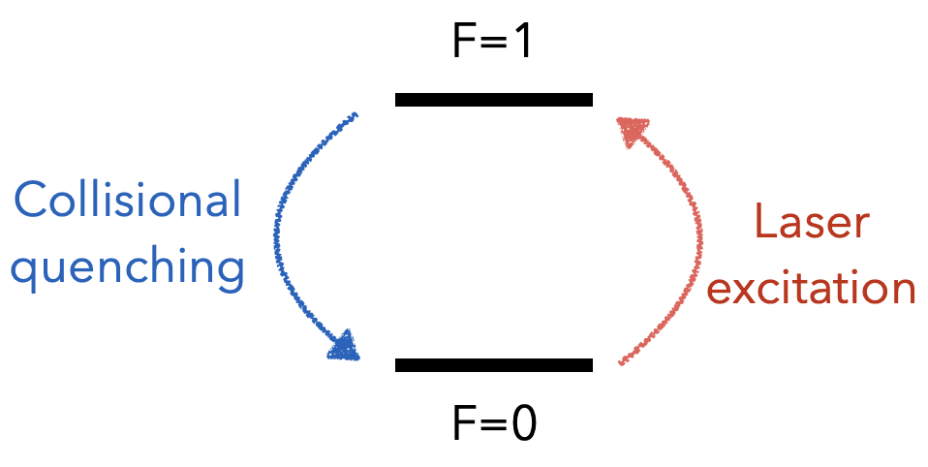

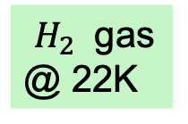
The principle of the experiment
6.78 µm
$H_{2}$ gas
@ 22K
Laser pulse: µp(F=0) + ɣ → µp(F=1)
De-excitation: µp(F=1) + H2→µp(F=0) + H2 + Ekin
Diffusion: X-rays produce at target walls
Resonance: Number of X-ray vs laser freq.

Slide 11

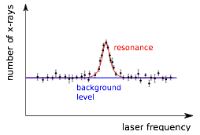
The principle experiment
6.78 µm
$H_{2}$ gas
@ 22K
Laser pulse: µp(F=0) + ɣ → µp(F=1)
De-excitation: µp(F=1) + H2→µp(F=0) + H2 + Ekin
Diffusion: X-rays produced at target walls
Resonance: Number of X-ray vs laser freq.
Related Proposals: FAMU at RIKEN/RAL, muonic H at J-PARC

Slide 12
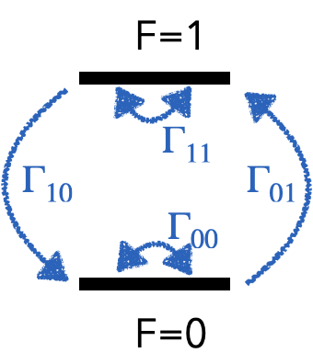

$μP$ thermalization
Understand the thermal distribution of the target atoms
Understand the collisional process dependence on the kinetic energy
J. Nuber, arXiv (Nov. 2022)
µp formation
Laser excitation

Slide 13
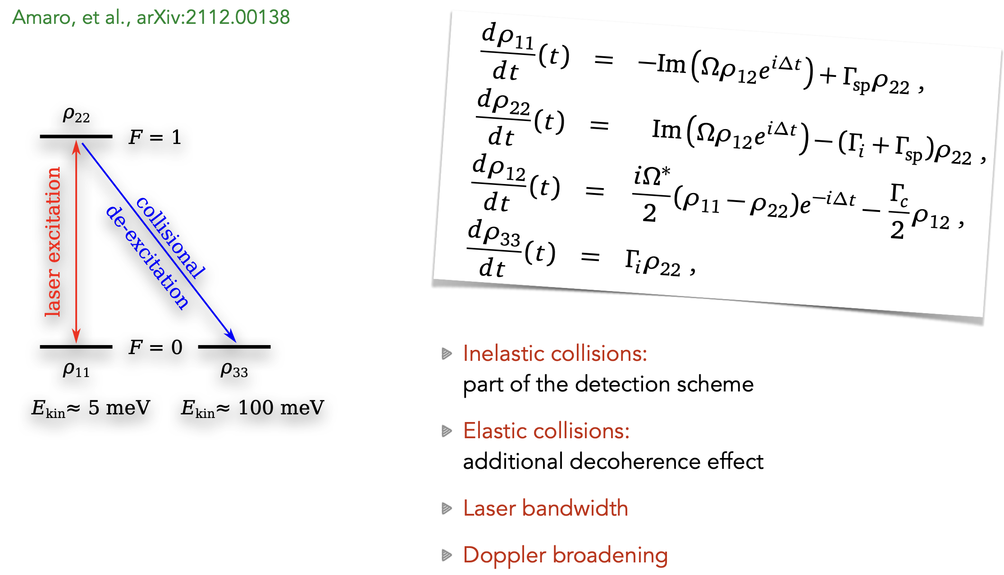

$$Laser excitation modeled$$

Slide 14
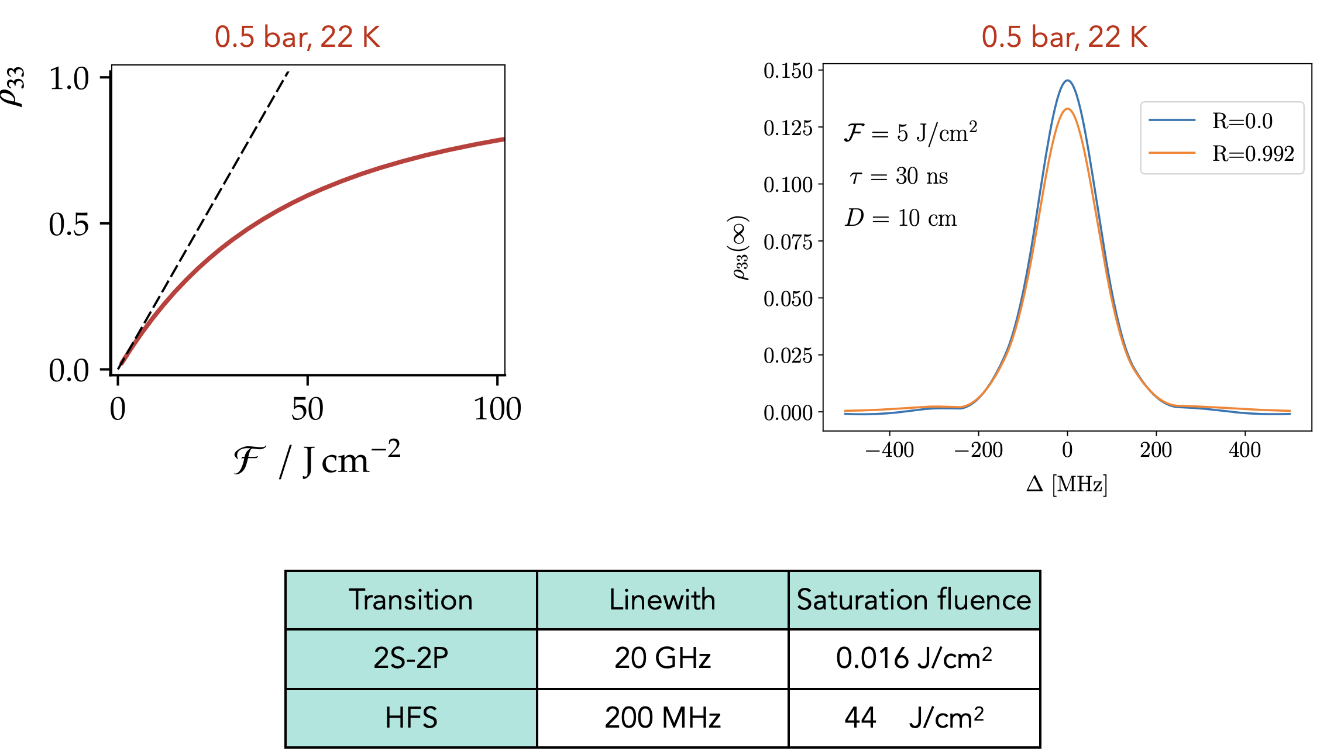

$$Saturation Fluence and lienwidth$$

Slide 15
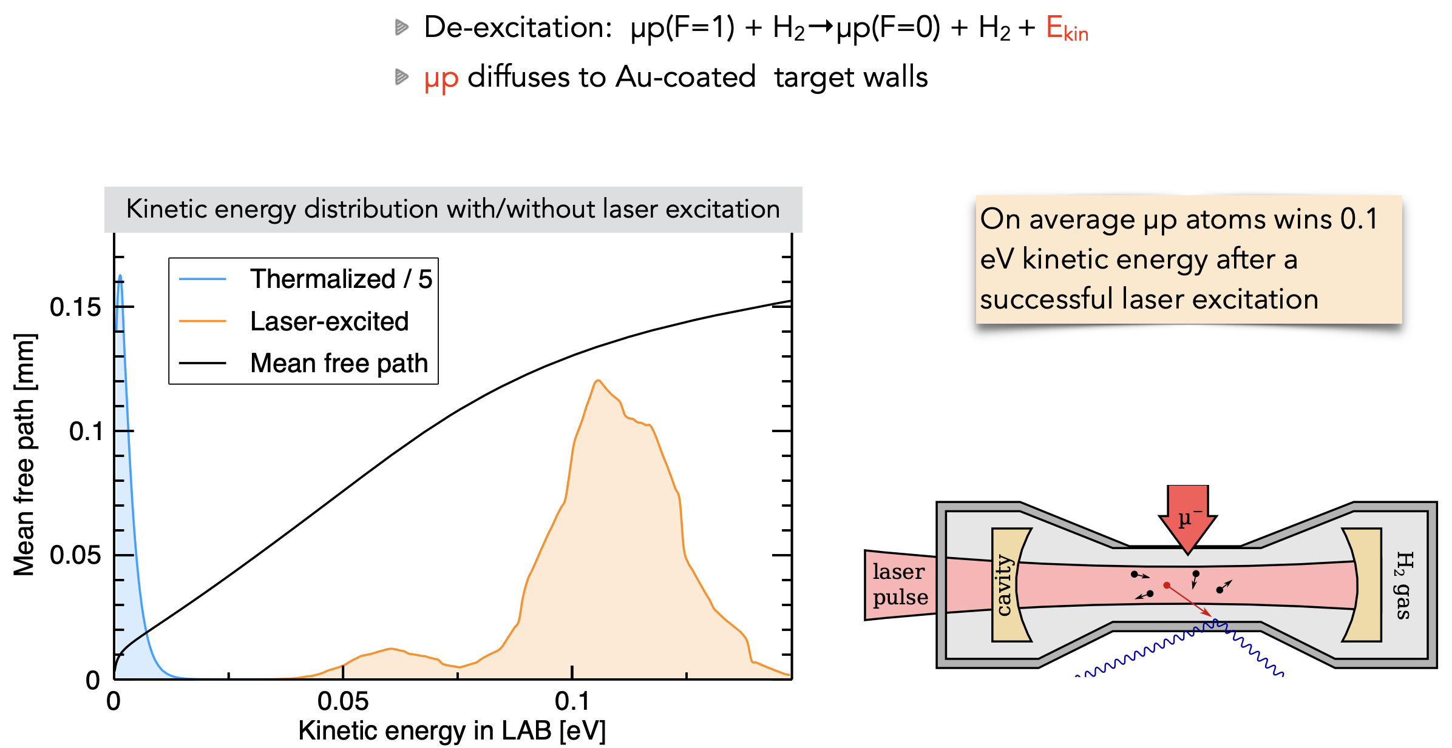

$$Thermalised vs laser excited atoms$$

Slide 16
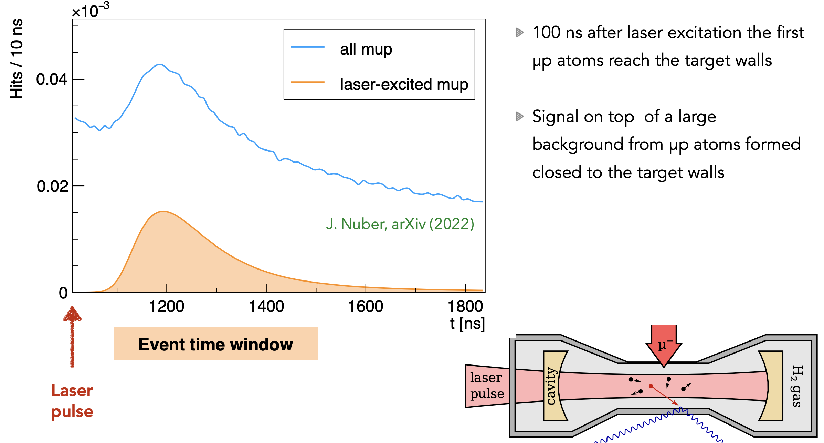

$$Difussion to target$$

Slide 17



laser challenges
@
Pulse energy 5 mJ
Wavelength = 6.8 μm
Stochastic trigger
Response time 1 μs
Incoming muon detected
Muon lifetime
Tunability = 39 GHz
Bandwidth < 100 MHz

Slide 18
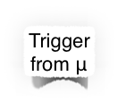




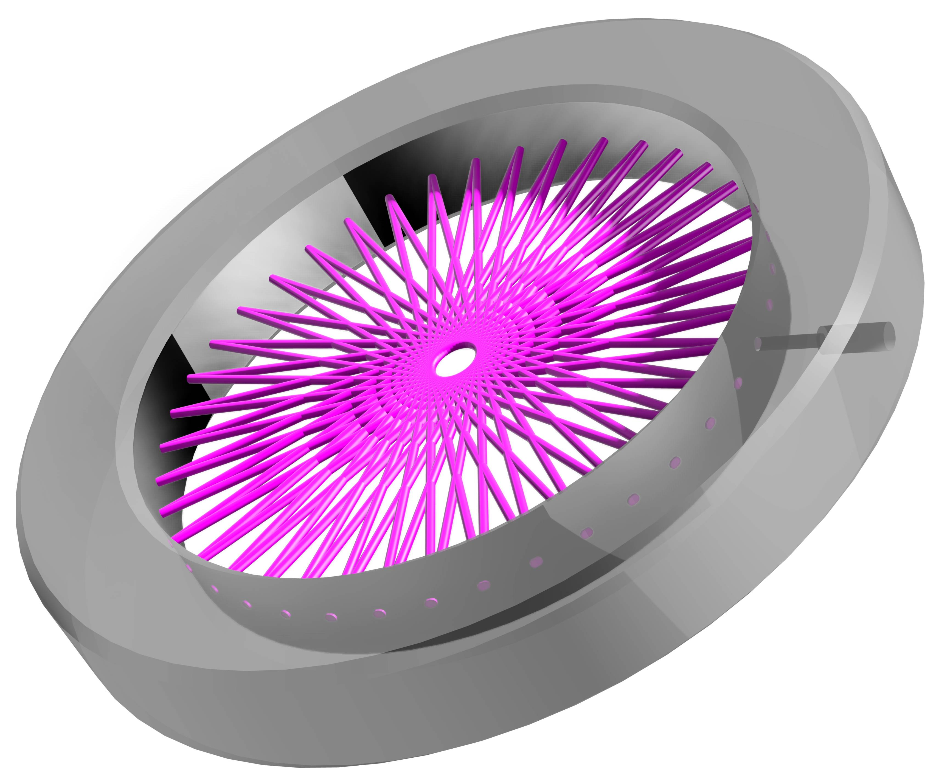

The laser system
lambda-meter
cw seed
1534 nm
1532 nm
1532 nm
1030 nm
1030 nm
OPO I
3135 nm
atomic
reference
TDL osc.
50 mJ
TDL amp.
300 mJ
OPAs
3135 nm
1030 nm
6800 nm
cw seed
1030 nm
Pump diodes
400 W, 940 nm
Pump diodes
3 kW, 940 nm
DFG
ZGP
5 mJ
TDL osc.
50 mJ
TDL amp.
300 mJ
1030 nm
2148 nm
OPAs
OPO II
1030 nm
1030 nm
2148 nm
atomic
reference
cw seed
1978 nm
1978 nm
1978 nm

Slide 19
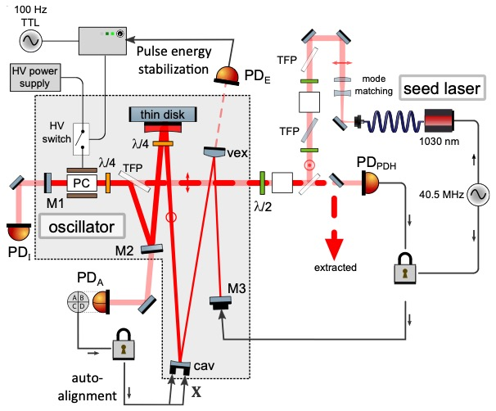
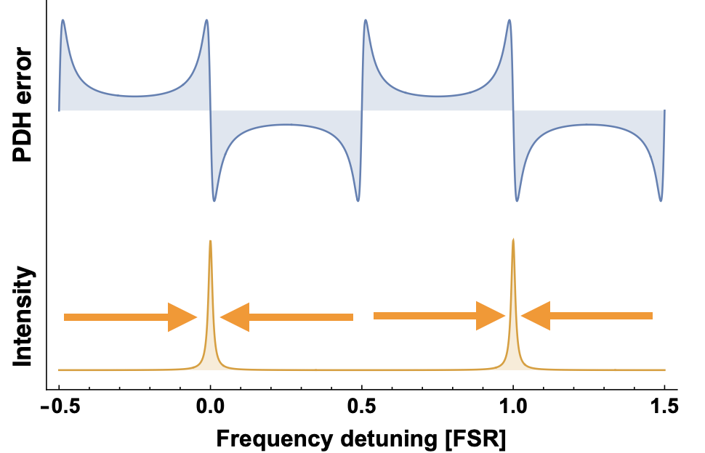
Master oscillator
Delay: 700 ns
Energy: 50 mJ
Pulse-to-pulse stability: <0.5% (rms)
Single-frequency operation
Laser chirp < 2 MHz
PDH lock scheme with infinite dynamic range
Zeyen, Manuel, et al. review of scientific instruments 2023.
Zeyen, Manuel, et al. arxiv, 2023.

Slide 20
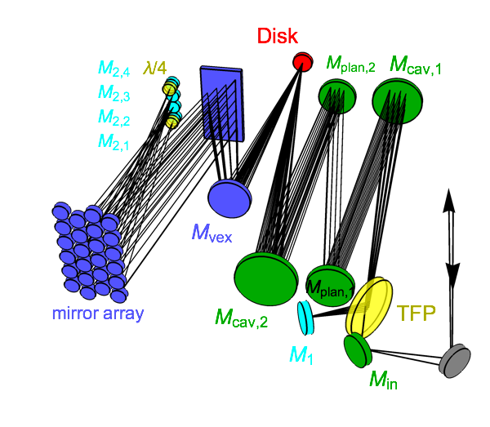
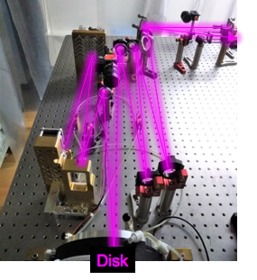
Multi pass amplifier
Insensitive to thermal lensing
Zeyen, Manuel, et al. Solid State Lasers XXVIII: Technology and Devices. Vol. 10896., 2019.
K. Schuhmann et al., Appl. Opt. 57, 10323-10333 (2018)

Slide 21
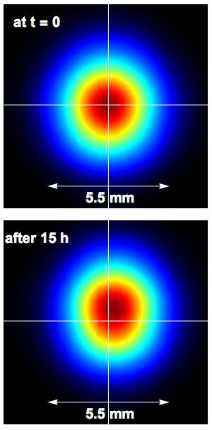
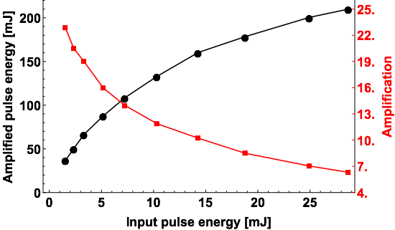
Multi pass Amplifier
Amplifier tested 210 mJ
M² ≤ 1.03

Slide 22
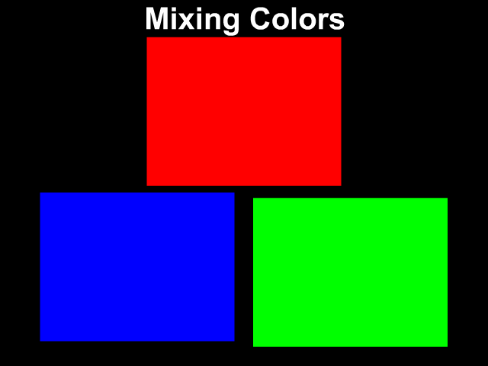
Down conversion =

Slide 23
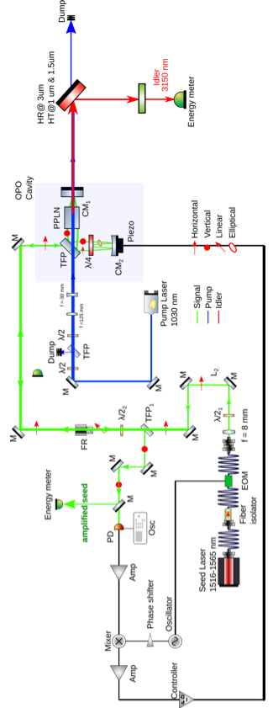
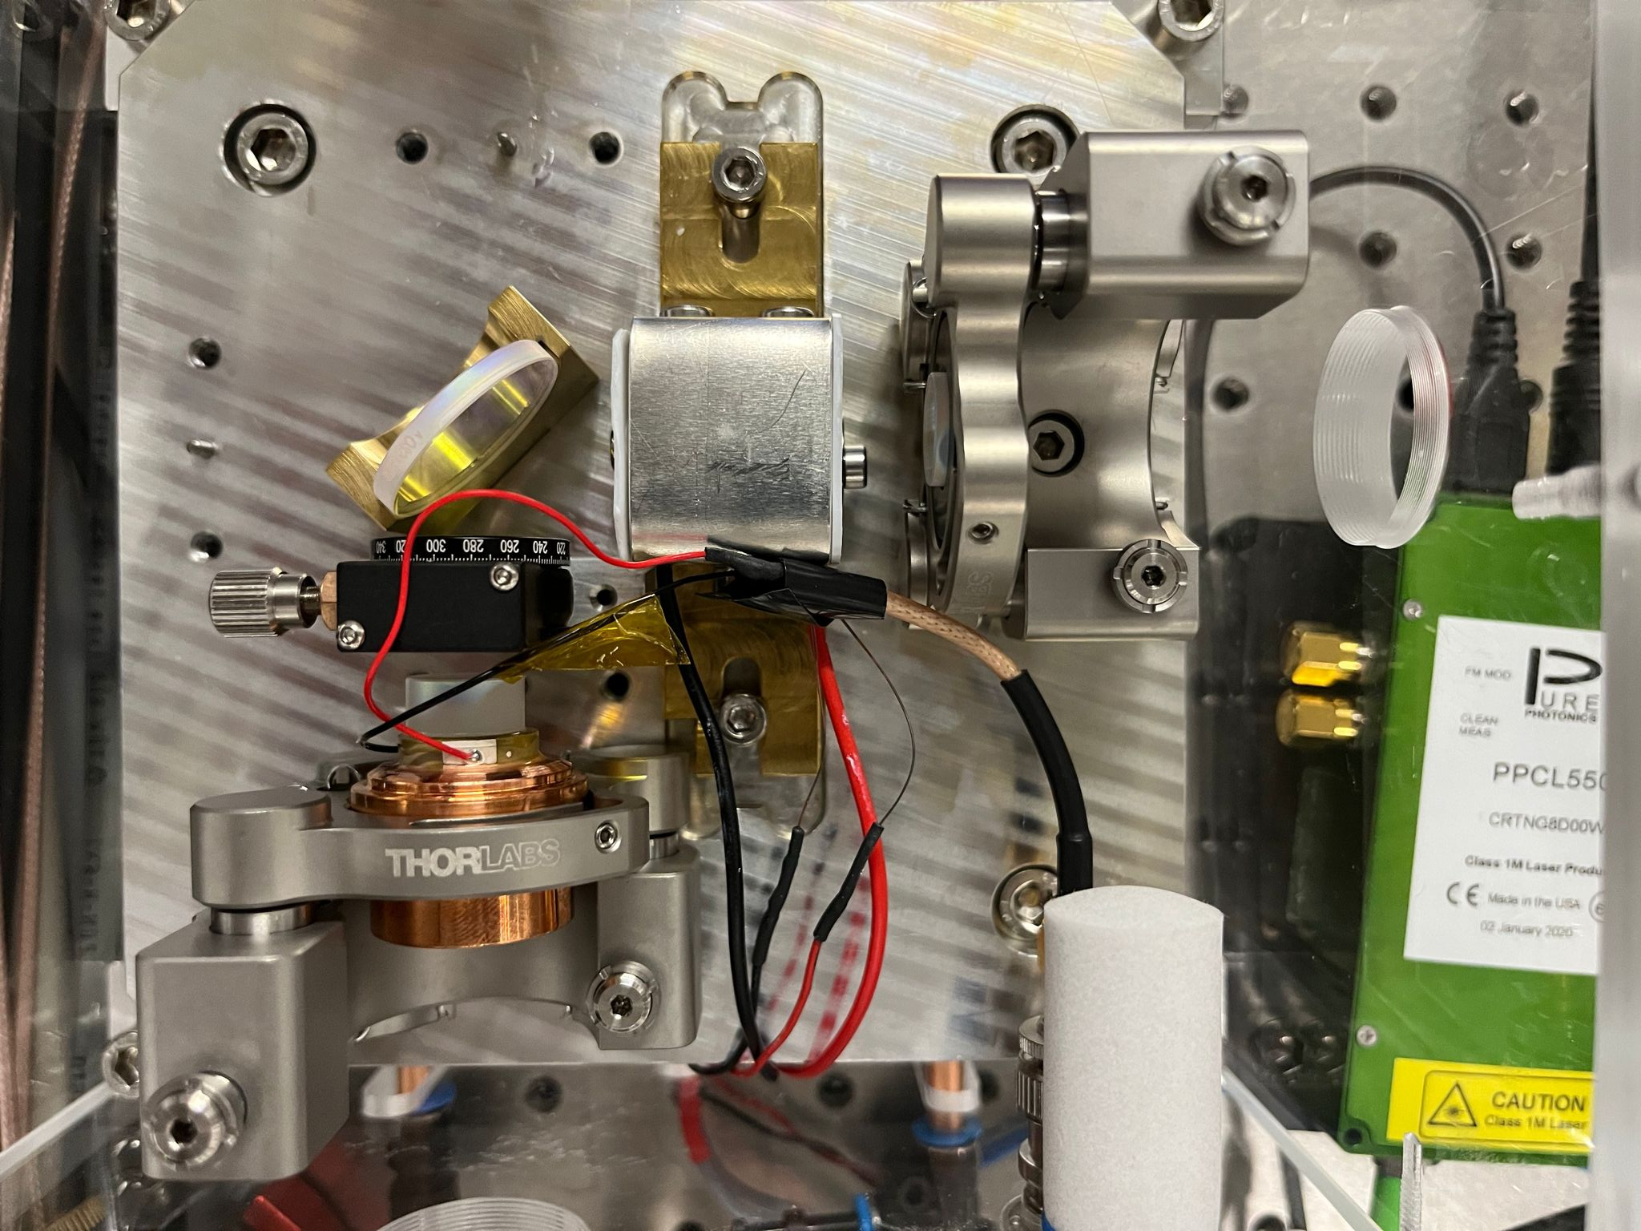
OPO @1534 nm
Variable outcoupling
PDH lock with infinite range
Pulse chirp < 2 MHz
Total conversion efficiency of 45%

Slide 24
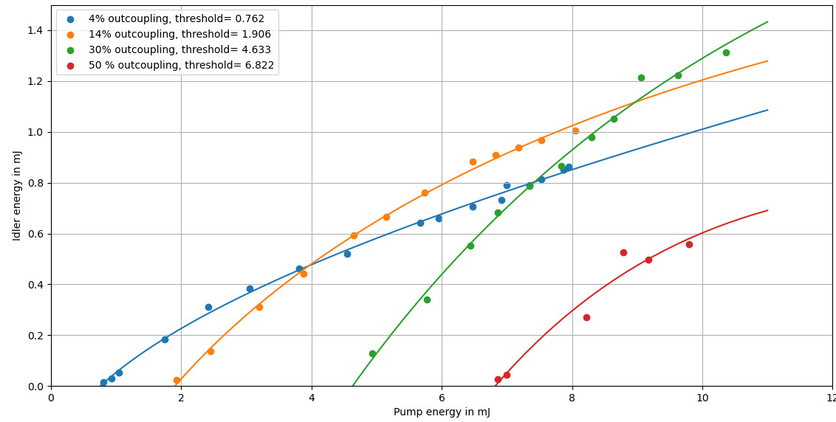
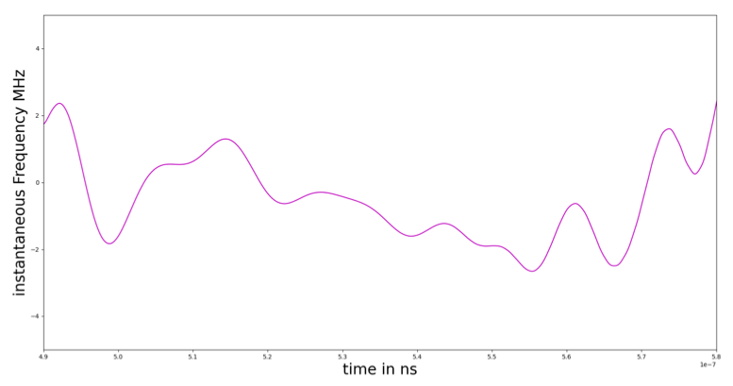
OPO energy and chirp
output energy @ 3135 nm
Pump energy @ 1030 nm
Pulse chirp < 2 MHz

Slide 25
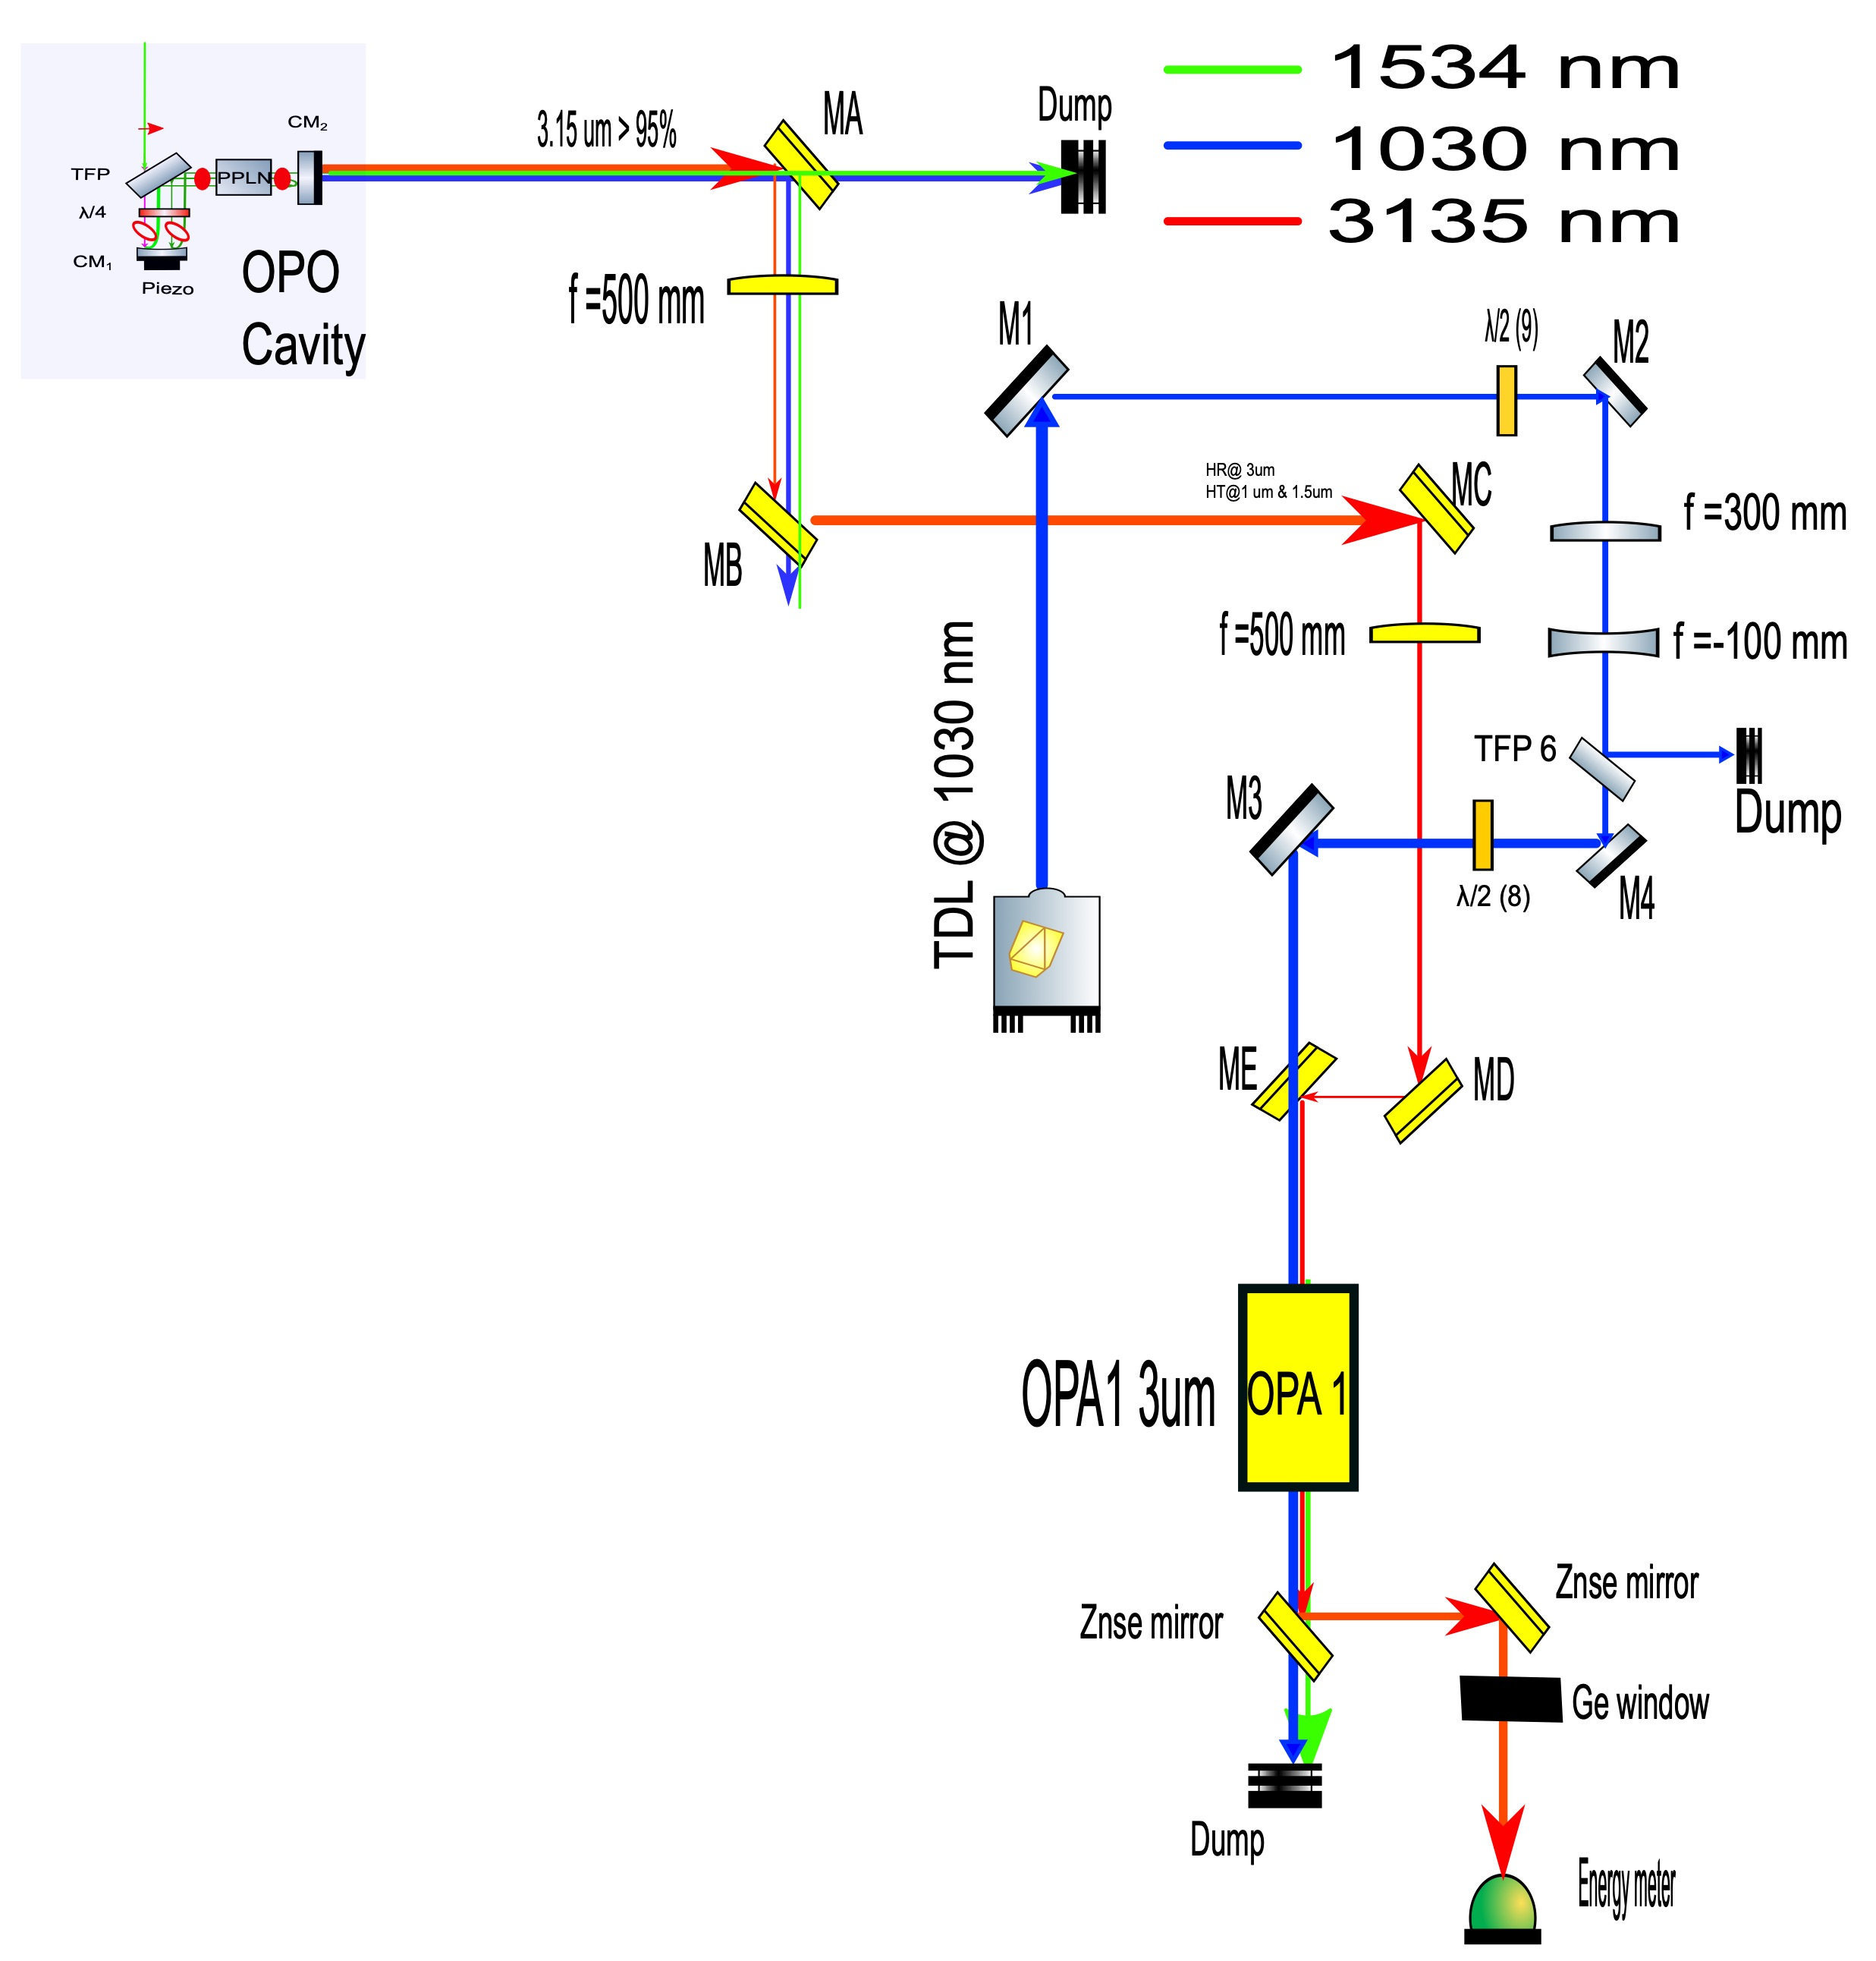
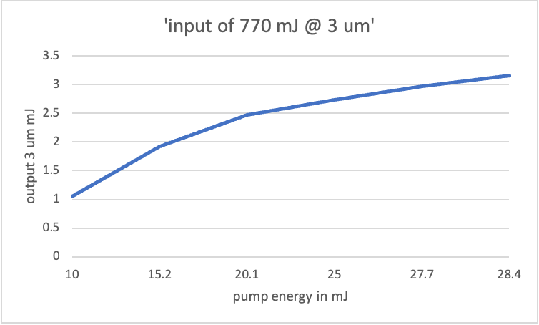
OPA @3135 nm
3.2 mJ @ 3135 nm

Slide 26
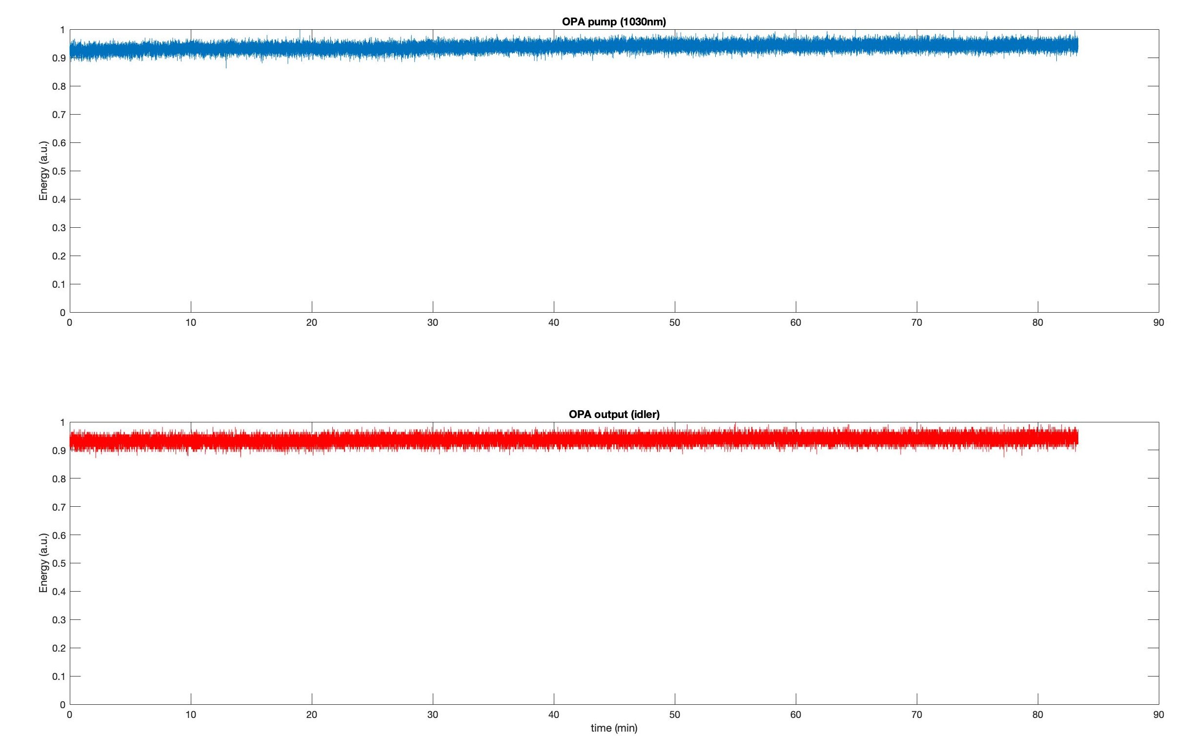
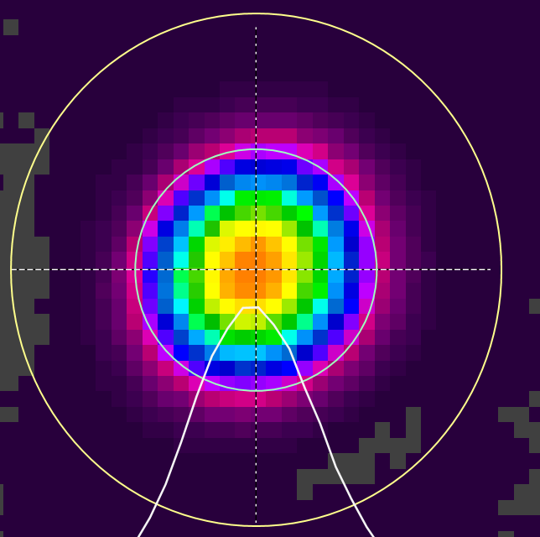
3 um energy output
Pulse to pulse energ stability < 2 % over long term
Perfect beam quality
OPA pump input @ 1030 nm
Energy a.u
OPA output @ 3135 nm

Slide 27
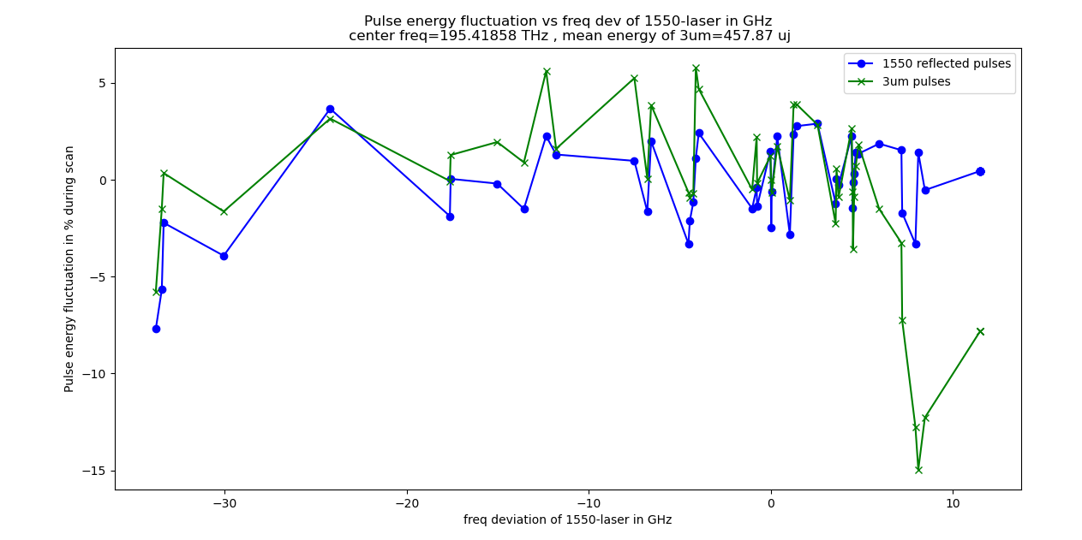
Tunability
Without optimization
Pulse energy variation of max 10% over 40 GHz
Pulse energy variation
Freq of the seed laser @1534 nm

Slide 28
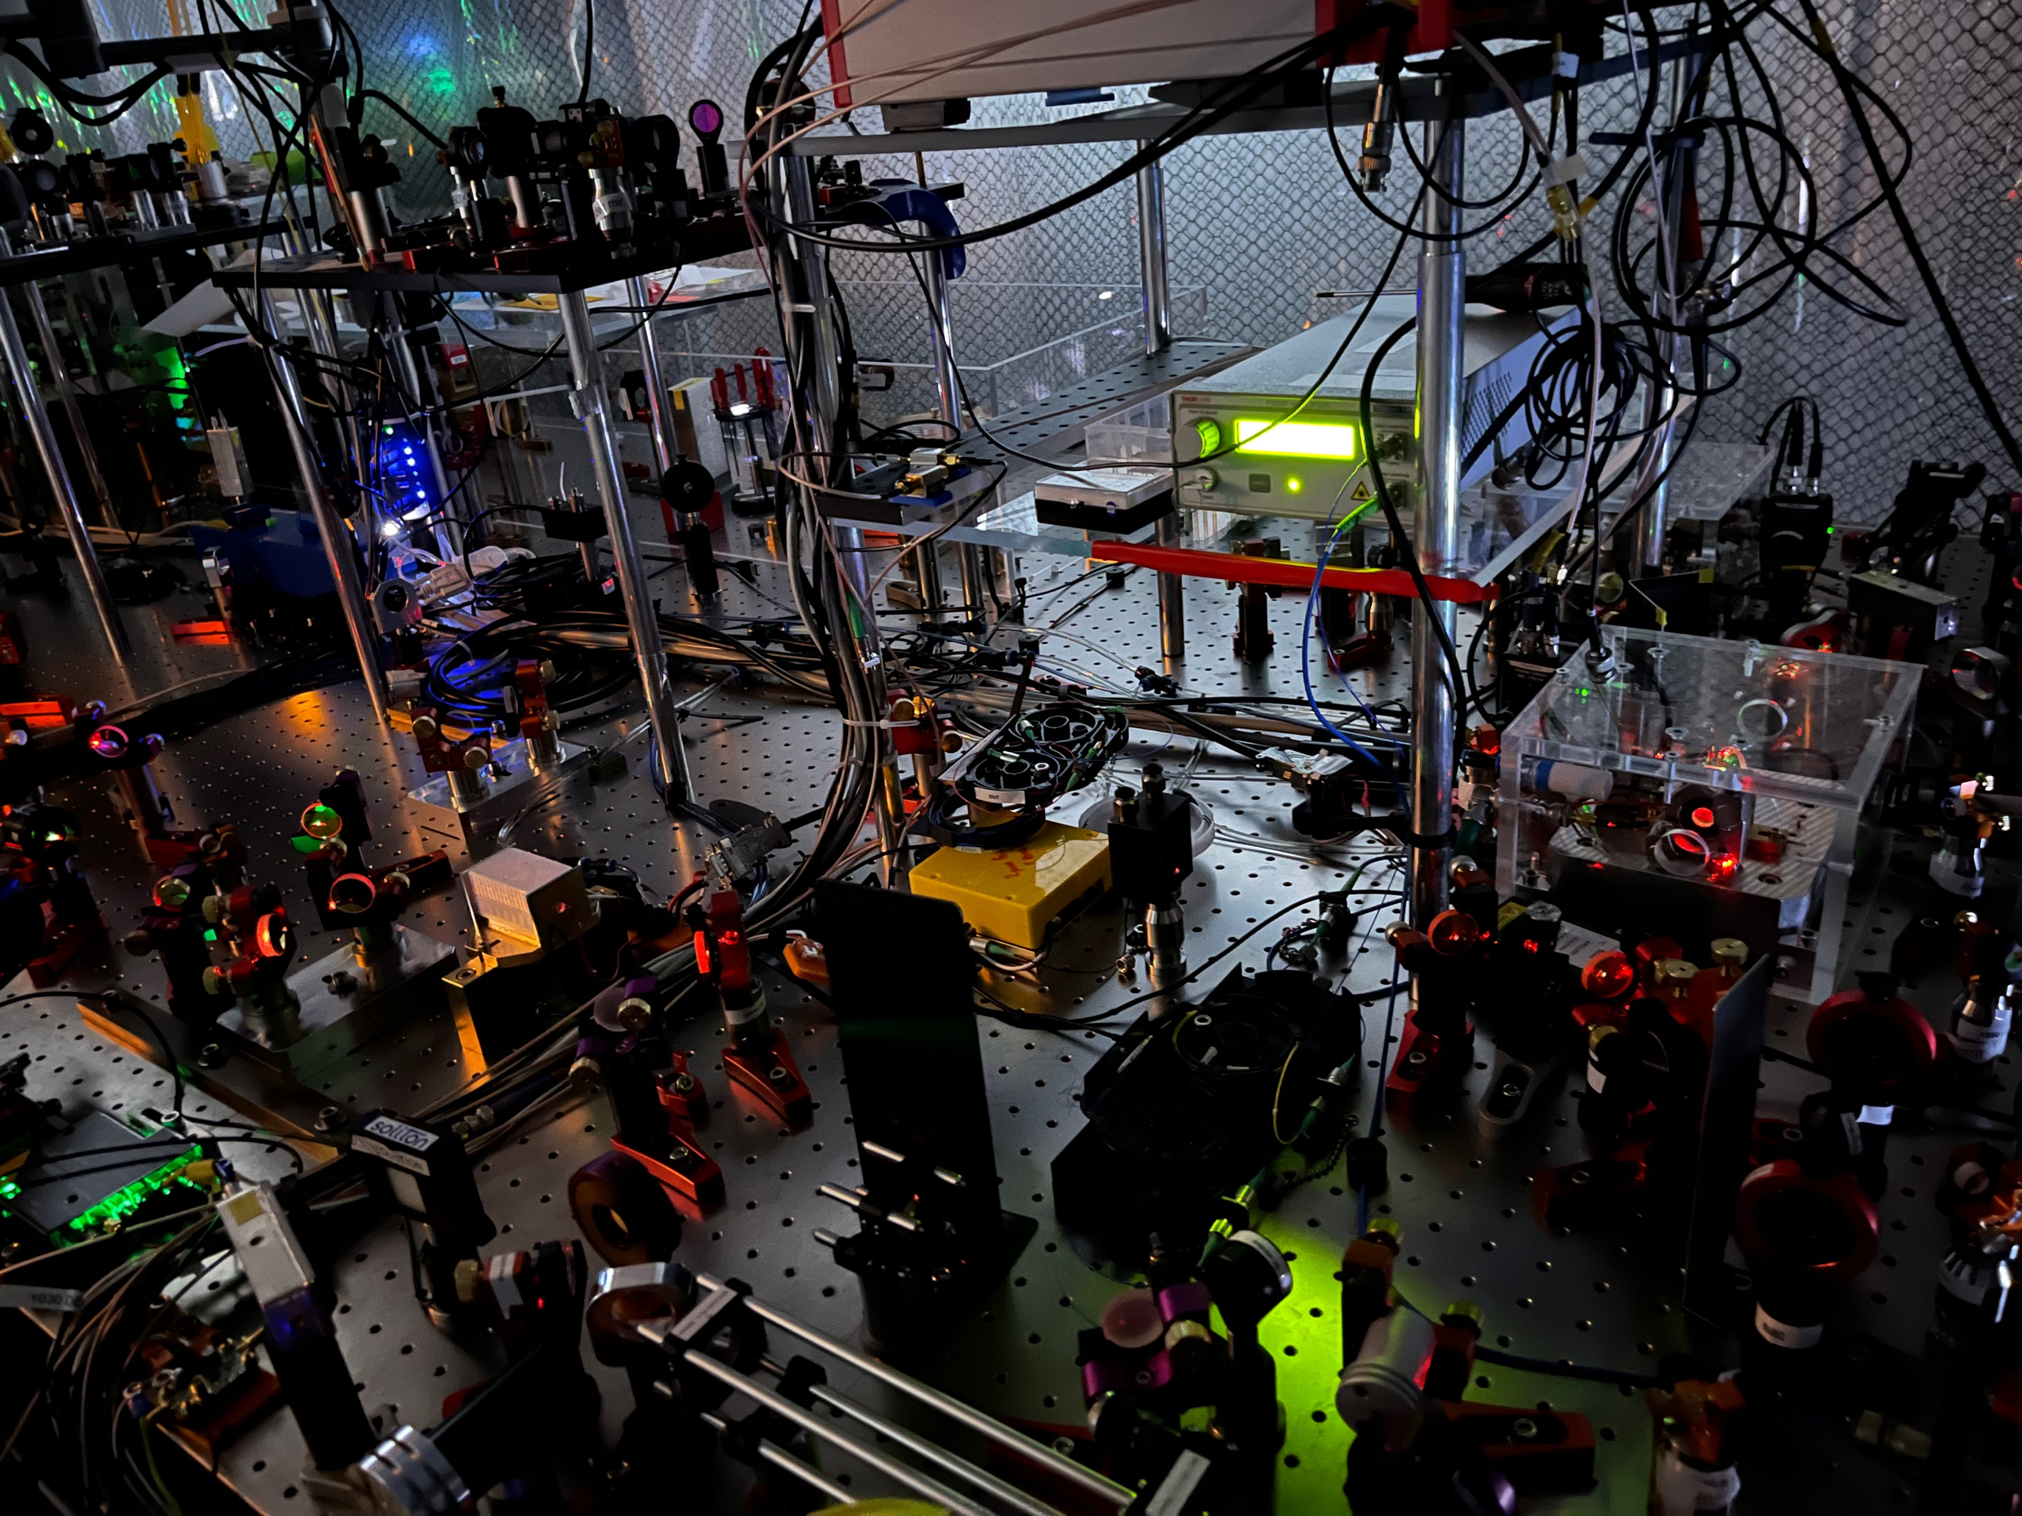
Speaking of colours

Slide 29
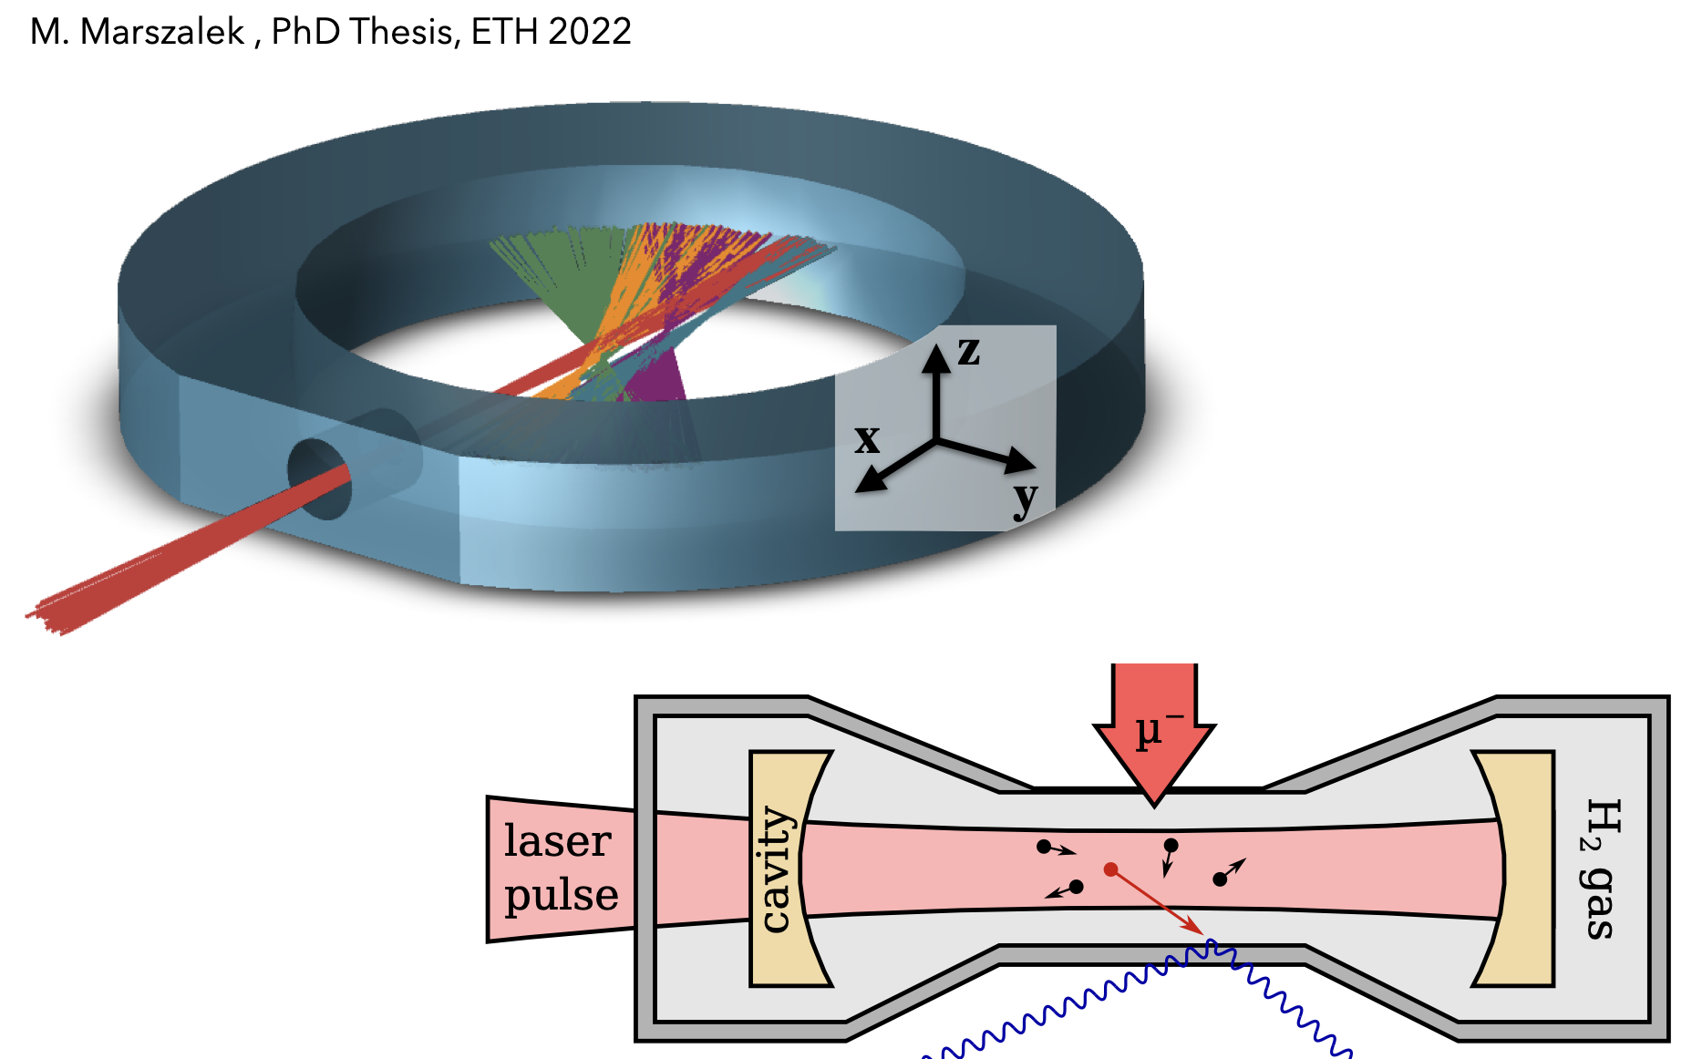
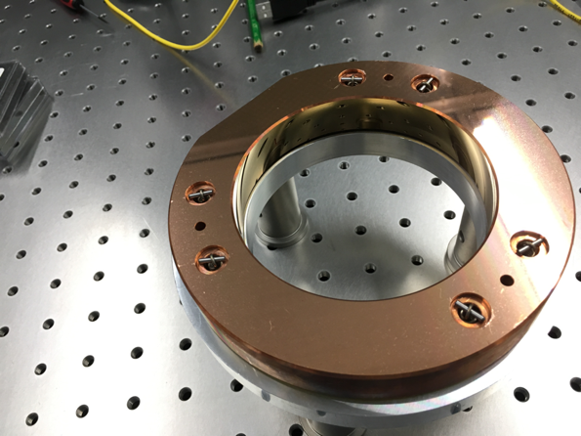
Enhancement Cavity

Slide 30
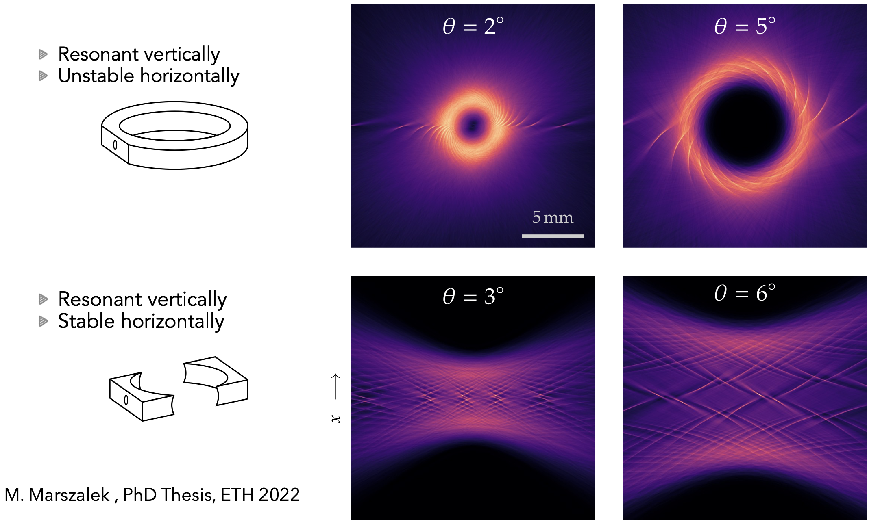
Two different configurations

Slide 31

Toroidal cavity
Results
Developed two cavity designs
Cavities perform as expected
Developed monitoring method

Slide 32
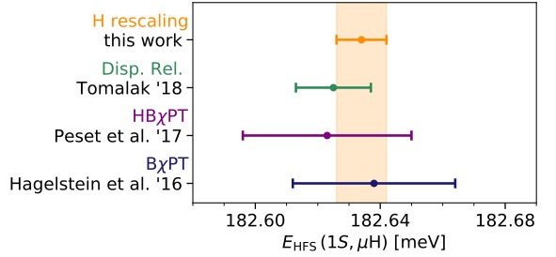
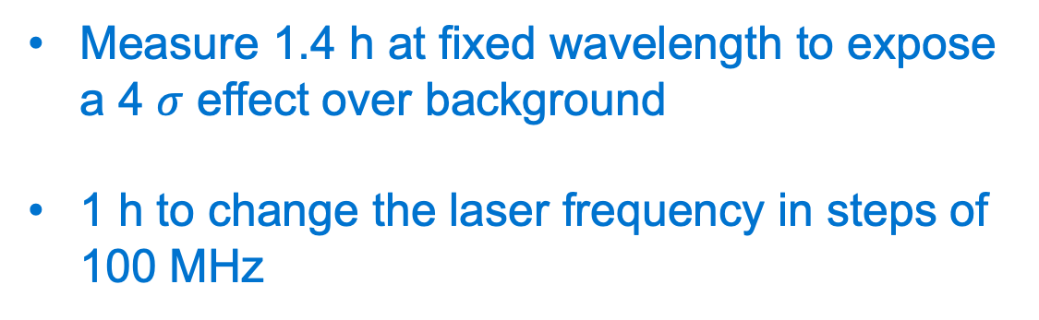
Lamb shift in muonic Hydrogen
Search for the resonance
0.16 meV (40 GHz) search range
Steps to search for resonance
Simulation of the search for resonance
Measure 1.4 h at fixed wavelength to expose a 4 $σ$ effect over background
1 h to change the laser frequency in steps of 100 MHz
8 Weeks of beam time

Slide 33
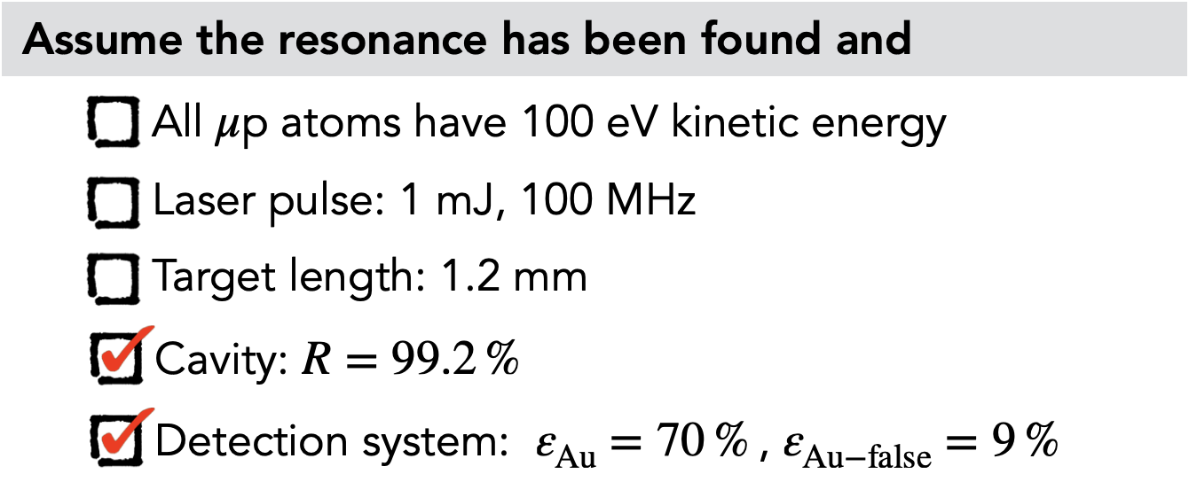
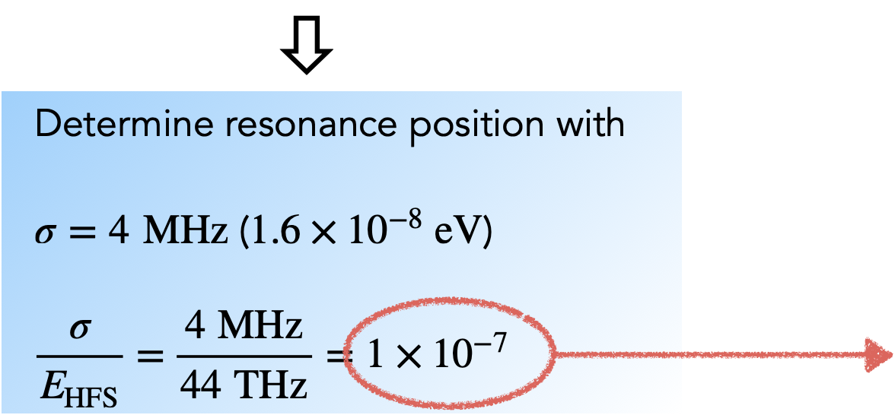

Lamb shift in muonic Hydrogen
Search for the resonance

Slide 34
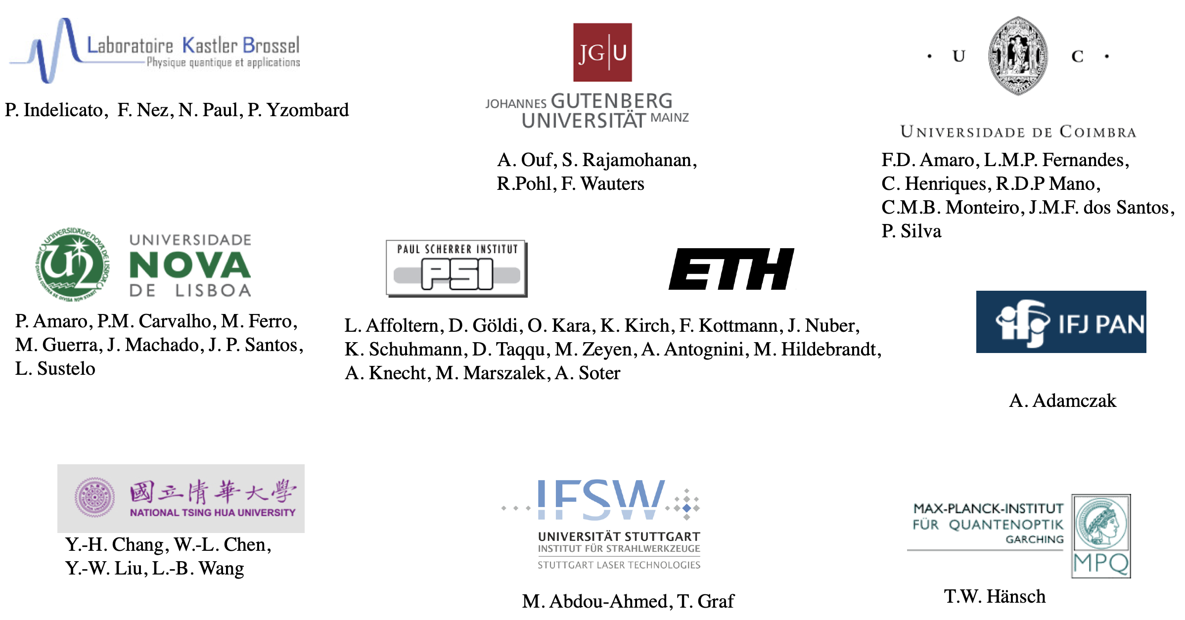
The CREMA collaboration

Slide 35
Thanks
Questions ?

Slide 36
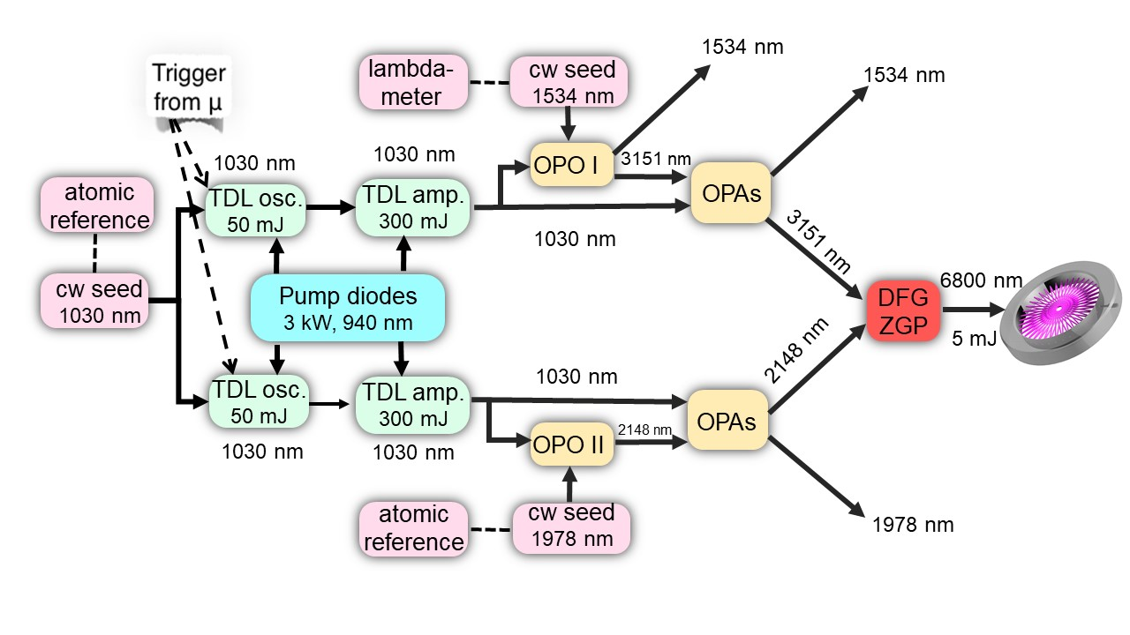


Wavelength Solution

Slide 37

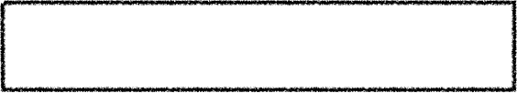

Outlook
Reach 6.8μm by early 2022
Complete Laser system by late 2022
Measurement in 2023

Slide 38


Challenge 1
Background
Diffusion without excitation
𝜇
e
x-rays
$$ν$$
$$\overline{ν}$$
Radiation area background

Slide 39
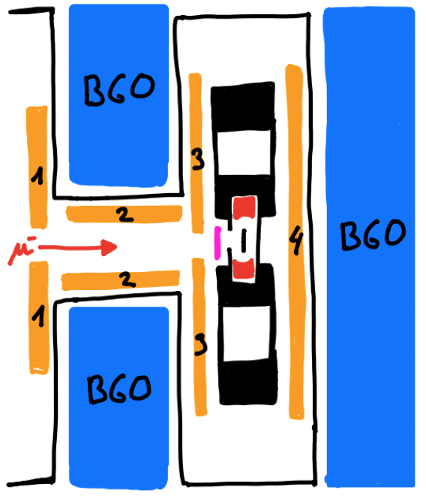
Detection
1: veto to shield electrons
2: veto to
shield
electrons
BGO
X- rays
3,4 :
For decay
electrons

Slide 40
Beam Area

Slide 41
Detection tests
Plastic
Scintillators
BGOS
Front

Slide 42
Also Exercises !!

Slide 43
Outlook
Optical Cavity
H2 at 50 k, 1 bar
Fluence > 2 J cm⁻²
Diameter of illuminated
volume < 1 mm

Slide 44

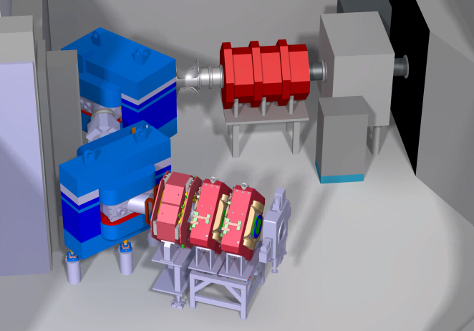
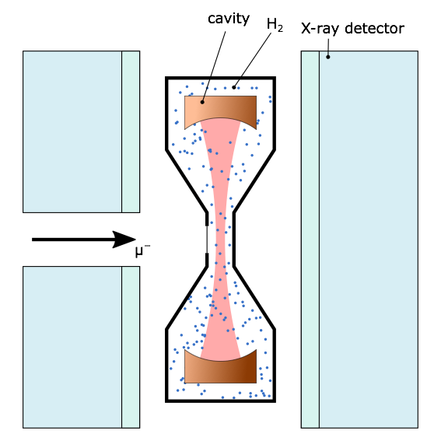

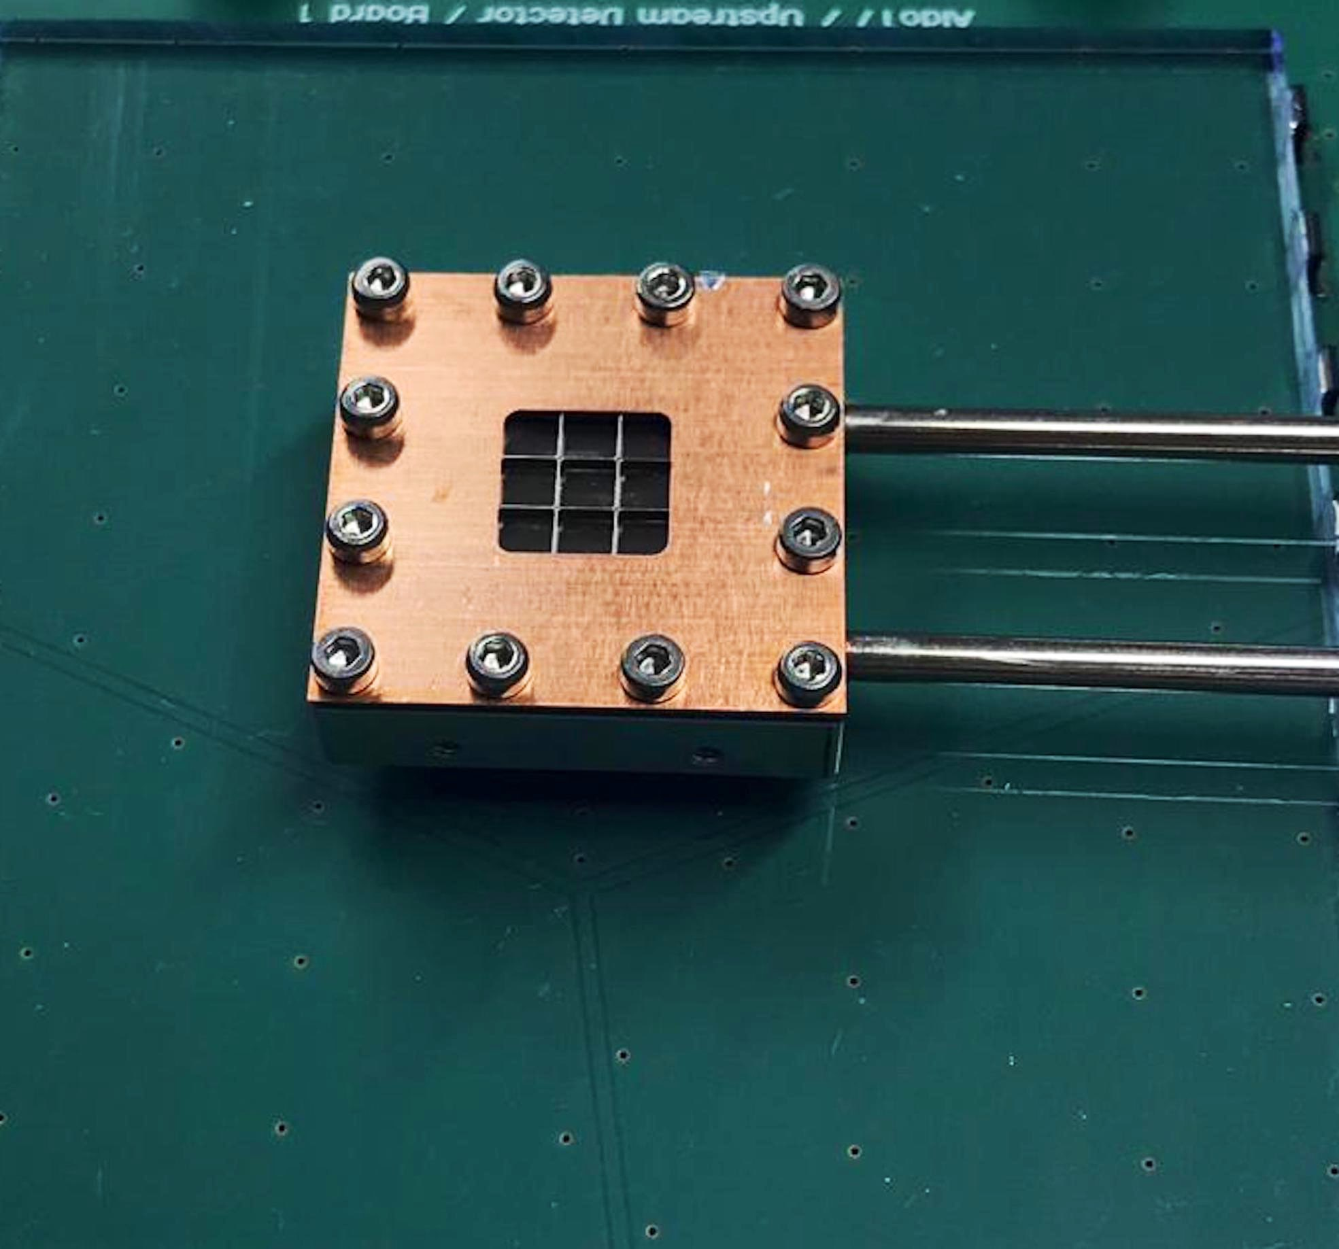
Progress
Muons come from PSI Proton accelerator
Target
current
status

Slide 45



The proton charge radius puzzle
10 Times more accurate but
5.6 𝝈 from the 2014 CODATA value
$$r_{E}=0.84087\left(39\right)$$
fm
$$r_{E}=0.8775\left(51\right)$$
fm
R. Pohl et al., Nature 466, 213 (2010).
A.Bayer, et al., Science 358, 79–85 (2017)
Fleurbaey H et al., Phys. Rev. Lett. 120 183001
P. J. Mohr, B. N. Taylor, D. B. Newell, Rev. Mod. Phys. 84, 1527 (2012).
A. Antognini et al., Science 339, 417 (2013).
Notes:
1S state electron probability to be inside the proton
Attractive force reduced due to less field inside the charge distribution >> proton size

Slide 46




Muonic Hydrogen Theory
$$ΔE_{HFS}^{th}\left(μp\right)=183.788\left(7\right)+1.0040ΔE_{2PE}\text{meV}$$
$$ΔE_{2PE}=ΔE_{Z}+ΔE_{\text{recoil}}+ΔE_{pol}$$
$$ΔE_{2PE}$$
Uncertainty of 4%
Uncertainty of 32%
$$ΔE_{pol}$$
$$\text{CE} \text{Carlson} \text{et} \text{al}\text{ (2008)}$$

Slide 47


Spectroscopy of muonic Hydrogen
Measured energy
206.2949(32) meV
Giving
Lamb
shift
= 0.84087(39) fm
$$r_{p}$$

Slide 48

Hyperfine Splitting of 1S in normal Hydrogen
21 cm line in Regular Hydrogen measured in 71
νexp = 1 420 405. 7 51 766 7 ± 0.000 001 kHz
νtheo = 1 420 403. 1 ± 0.6(finite size) ± 0.4(pol) kHz

Slide 49



Proton Zemach radius
$$ΔE_{finite}∝r_{z}\left(Zemachradius\right)$$
$$r_{z}=∫d^{3}r∨r∨∫d^{3}r^{{}^{′}}ρ_{E}\left(r\right)ρ_{M}\left(r−r^{{}^{′}}\right)$$
From 2S1/2 - 2P1/2 Lamb shift
𝝘 = 18.6 GHz
rz = 1.082(37)
Ur = 3.5 %
$$ΔE_{HFS}α0.1621\left(10\right)r_{z}$$
Limited by life time of 2p
A. Antognini et al., Science 339, 417 (2013).

Slide 50

Reflectivity plots
Large laser fluence required (100 J/cm²)
~500 reflections through a 1 mm gap
Large illuminated volume
Operation at 50 K

Slide 51
Bohr model
e
Definite orbits
P
Quantization of angular momentum
e
P
Quantum jumps

Slide 52




Hydrogen Atom
²S1/2 - ²P1/2 Lamb shift
1 S hyperfine splitting
QED
F = 1
HFS
next ?
F = 0

Slide 53

Proton structure

Slide 54


Proton structure
I feel attracted
P
I feel less attracted
P
e
u
u
e
u
u
d
d

Slide 55




Proton charge radius
Experimental methods
Form factor
Lamb shift
charge radius
Image by Phys ETH

Slide 56



Why muonic atoms
$$a_{bohr}∝\frac{1}{m_{red}}$$
Bohr radius
$$m_{μ}≈207m_{e}$$
e
𝜇
P
P
$$\frac{a_{bohr}\left[H\right]}{186}$$
$$a_{bohr}\left[H\right]$$
Notes:
1S state electron probability to be inside the proton
Attractive force reduced due to less field inside the charge distribution >> proton size

Slide 57



Lamb shift in muonic hydrogen
$$ΔE_{finite}=\frac{2πα⟨r_{E}^{2}⟩}{3}∨ψ\left(0\right){}^{2}$$
Energy shift of :
2 % of Lamb shift
$$⟨r_{E}^{2}⟩=∫d^{3}rr^{2}ρ_{E}\left(r\right)$$
Where
Few million times more sensitivity in muonic H
$$ψ\left(0\right){}^{2}∝m_{r}^{3}$$
R. Pohl et al., Nature 466, 213 (2010).

Slide 58


Spectroscopy of muonic hydrogen
Measuring
$$ΔE_{1},ΔE_{2}$$
Lamb
shift
$$ΔE_{1}$$
$$ΔE_{2}$$
$$r_{p}$$
= 0.84087(39) fm
$$ΔE_{HFS}$$
$$r_{z}$$
A. Antognini et al., Science 339, 417 (2013).

Slide 59



Proton charge radius puzzle
= 0.84 fm
= 0.88 fm
$$r_{p}$$
$$r_{p}$$
Alexey Grinin et al, Science 2020
N. BEZGINOV et al, Science 2019

Slide 60

Hyperfine Splitting of GS in muonic hydrogen
Goal
Measure the 1s-HFS in 𝜇p with 1 ppm accuracy

Slide 61





Proton Zemach radius
$$ΔE_{HFS}=22.9763\left(15\right)−0.1621\left(10\right)r_{Z}+ΔE_{HFS}^{pol}$$
$$ΔE\left[\text{Zemach}\right]$$
$$r_{z}=∫d^{3}r∫d^{3}r^{}r^{{}^{′}}$$
$$ρ_{E}\left(r\right)$$
$$ρ_{M}\left(r−r^{{}^{′}}\right)$$
Zemach, A. C., Physical Review 104,1771 (1956).
A. Antognini et al., Science 339, 417 (2013).

Slide 62


Proton Zemach radius
From 2S hyperfine splitting
rz = 1.082(37)fm
Ur = 3.5 %
$$ΔE_{1}$$
𝝘 = 18.6 GHz
$$ΔE_{2}$$
Limited by life time of 2P
A. Antognini et al., Science 339, 417 (2013).

Slide 63
Hyperfine Splitting of GS in muonic hydrogen
Goal
Measure the 1s-HFS in 𝜇p with 1 ppm accuracy

Slide 64


Hyperfine Splitting of 1S in muonic Hydrogen
$$ΔE_{HFS}\left[r_{z}\left(H_{μ}\right)\right]=186∗ΔE_{HFS}\left[r_{z}\left(H_{e}\right)\right]$$
Few million times more sensitivity in muonic H
$$ψ\left(0\right){}^{2}∝m_{r}^{3}$$
21 cm line in regular hydrogen measured in 1971
6.8 µm line
Essen et al., Nature 229, 110 (1971)
Eides et al., Springer Tracts 222, 217 (2007)

Slide 65


The principle of 𝛍p hyperfine splitting
6.78 µm
Laser pulse: µp(F=0) + ɣ → µp(F=1)
De-excitation: µp(F=1) + H2→µp(F=0) + H2 + Ekin
Diffusion: X-rays produce at target walls
Resonance: Number of X-ray vs laser freq.

Slide 66

OPO characteristics
Frequency stability

Slide 67
Toroidal cavity

Slide 68
Down conversion
cw diode
1.53 μm
1030 nm
3.15 μm, tunable
OPA
OPO
stage
stages
Thin-disk laser
500 mJ, 500 ns delay
single frequency
DFG
OPO
2.1 μm
OPA
stage
stages
1030 nm
cw diode
6.8 μm tunable
1.97 μm

