Slide 1
Hyperfine structure of the lower states of light muonic atoms
Paul Indelicato
Mainz June. 2023

Slide 2
Outline
Introduction: theoretical context
All-order, relativistic evaluation of hyperfine structure for the 1s level of muonic hydrogen
New measurement of QED effect in muonic Ne (HEATES)
The structure of light-elements for QUARTET
Conclusion
PREN 2023 & µASTI, Mainz

Slide 3
QED corrections
Main energy and HFS
PREN 2023 & µASTI, Mainz

Slide 4
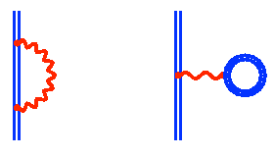
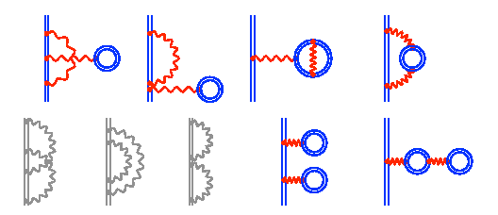
QED at order α and α² for energy
Self Energy
Vacuum Polarization
H-like “One Photon” order α
H-like “Two Photon” order α²
Z α expansion; replace exact Coulomb propagator by expansion in number of interactions with the nucleus
PREN 2023 & µASTI, Mainz

Slide 5
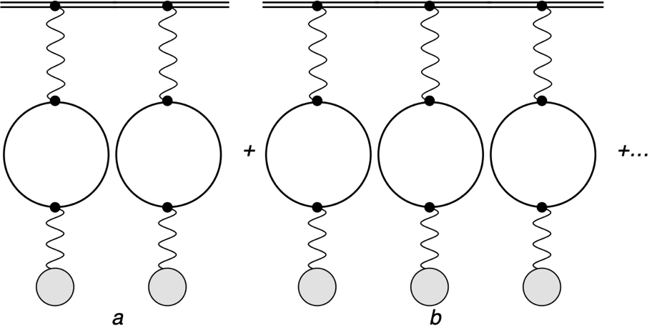
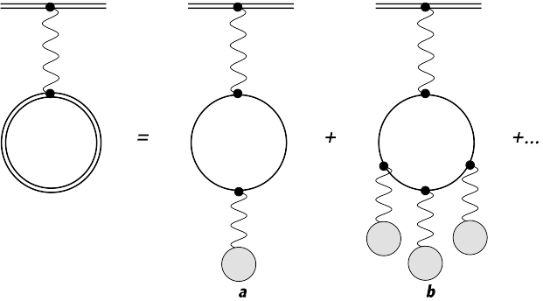
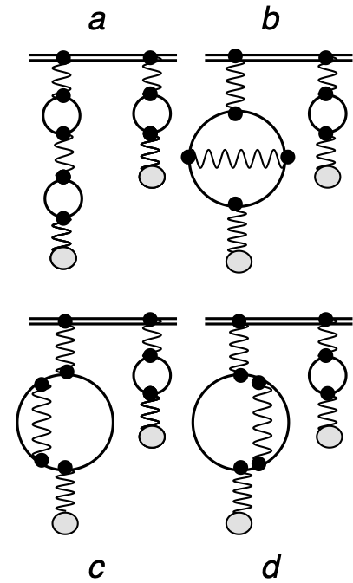
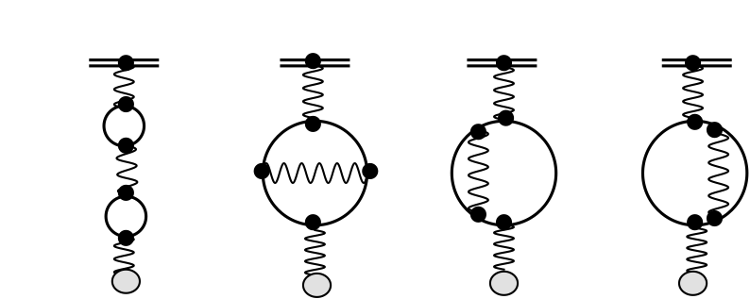
Contributions included to all-order
All-order: the charge distribution is included exactly in the wavefunction and in the operator, when relevant. Higher order Vacuum Polarization contribution included by numerical solution of the Dirac equation
Nonperturbative evaluation of some QED contributions to the muonic hydrogen n=2 Lamb shift and hyperfine structure, P. Indelicato. Phys. Rev. A 87, 022501 (2013).
PREN 2023 & µASTI, Mainz

Slide 6
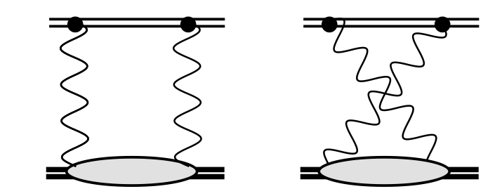
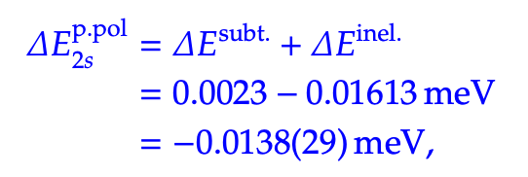
Proton polarization
Several calculations
Rosenfelder (1999)
Pachucki (1999)
Martynenko (2006)
Carlson and Vanderhaeghen (2011)
Hill and Paz (2011+DPF 2011)
Could be wrong by 0.04 meV
PREN 2023 & µASTI, Mainz

Slide 7
Hyperfine structure
All order corrections
PREN 2023 & µASTI, Mainz

Slide 8
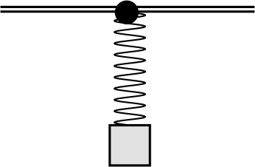
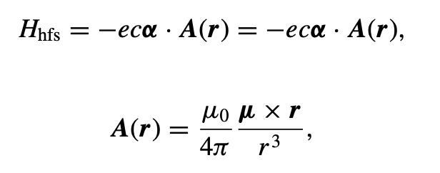
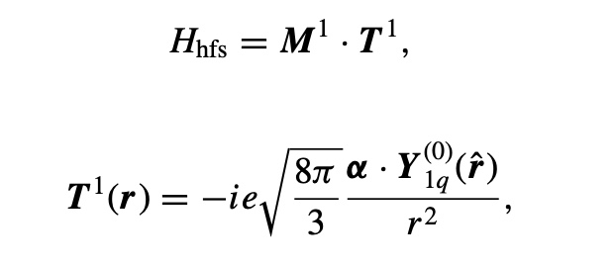
Hyperfine correction
Bound electron in the framework of the Dirac equation
HFS interaction
Angular part
Nuclear moment
Dirac WF
can be solved for finite nucleus
and various nuclear models
Nuclear
Atomic
PREN 2023 & µASTI, Mainz

Slide 9
m
Bound electron in the framework of the Dirac equation
muon anomalous
mag. moment
HFS interaction
×aμ
×(mr/mμ)
Dirac WF
Nuclear
Atomic
PREN 2023 & µASTI, Mainz

Slide 10
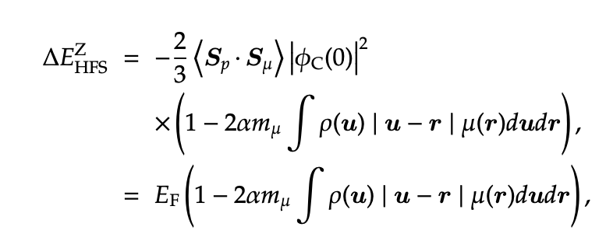
Hyperfine structure in Dirac Eq.
magnetic moment distribution
Non Relat.: Zemach radius
PREN 2023 & µASTI, Mainz

Slide 11
Hyperfine structure QED corrections
new in 2023 version of the mdfgme code: µ Uehling and Wichmann and Kroll self-consistent
HFS
Z𝛼
mixed Uehling
& W&K diagrams
Wichmann and Kroll in Dirac Eq.
includes all loop after loop corrections of the same kind, all cross terms…
Uehling vacuum polarization in Dirac Eq.
Nonperturbative evaluation of some QED contributions to the muonic hydrogen n=2 Lamb shift and hyperfine structure, P. Indelicato. Phys. Rev. A 87, 022501 (2013).
PREN 2023 & µASTI, Mainz

Slide 12
Hyperfine structure QED corrections
new Wichmann and Kroll
new: also muon loops
Uelhing corr. to
HFS interaction
Mixed corrections
to wavefunction
and HFS interaction
Including Uelhing vacuum polarization in the Dirac equation
Nonperturbative evaluation of some QED contributions to the muonic hydrogen n=2 Lamb shift and hyperfine structure, P. Indelicato. Phys. Rev. A 87, 022501 (2013).
PREN 2023 & µASTI, Mainz

Slide 13
QED corrections: Vacuum polarization order 𝛼(Z𝛼)
Uelhing part to renormalize
𝛼
Z𝛼
All order VP to HFS interaction
The use of the V13 potential can only
represent the point nucleus Wichmann
and Kroll correction as the real FNS value
would be non-linear in the nuclear
charge density
T. Beier, Physics Reports 339, 79 (2000).
PREN 2023 & µASTI, Mainz

Slide 14
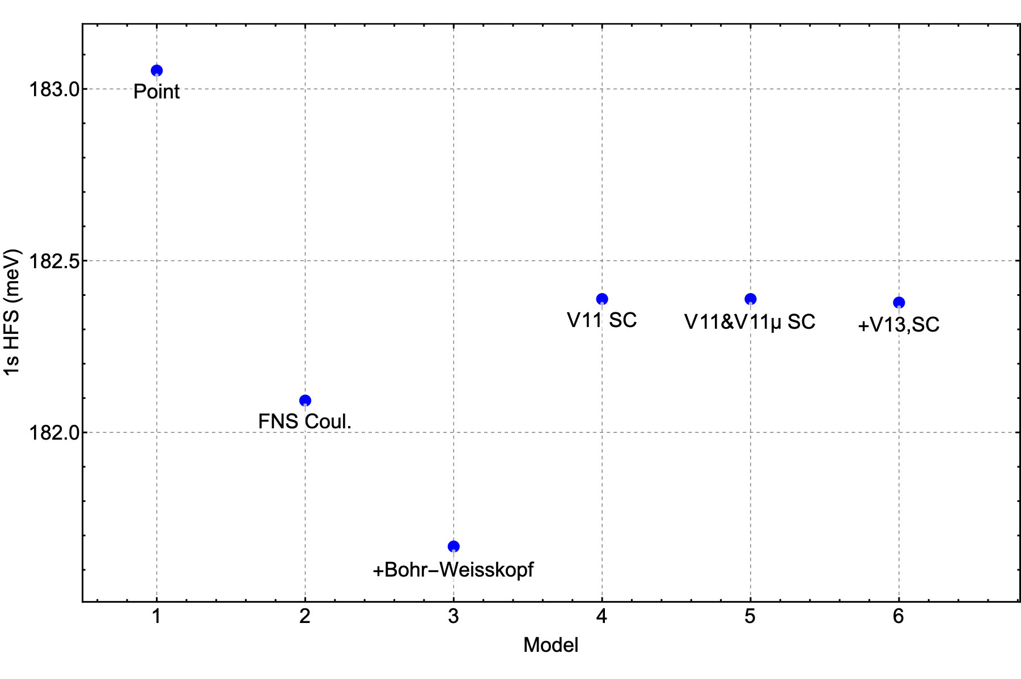
Contributions: SCF VP
PREN 2023 & µASTI, Mainz

Slide 15
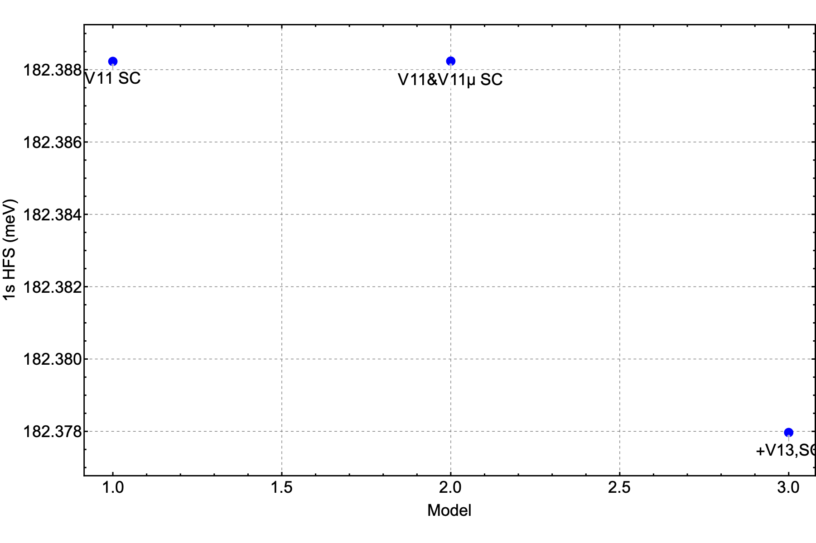
Contributions: SCF VP
PREN 2023 & µASTI, Mainz

Slide 16
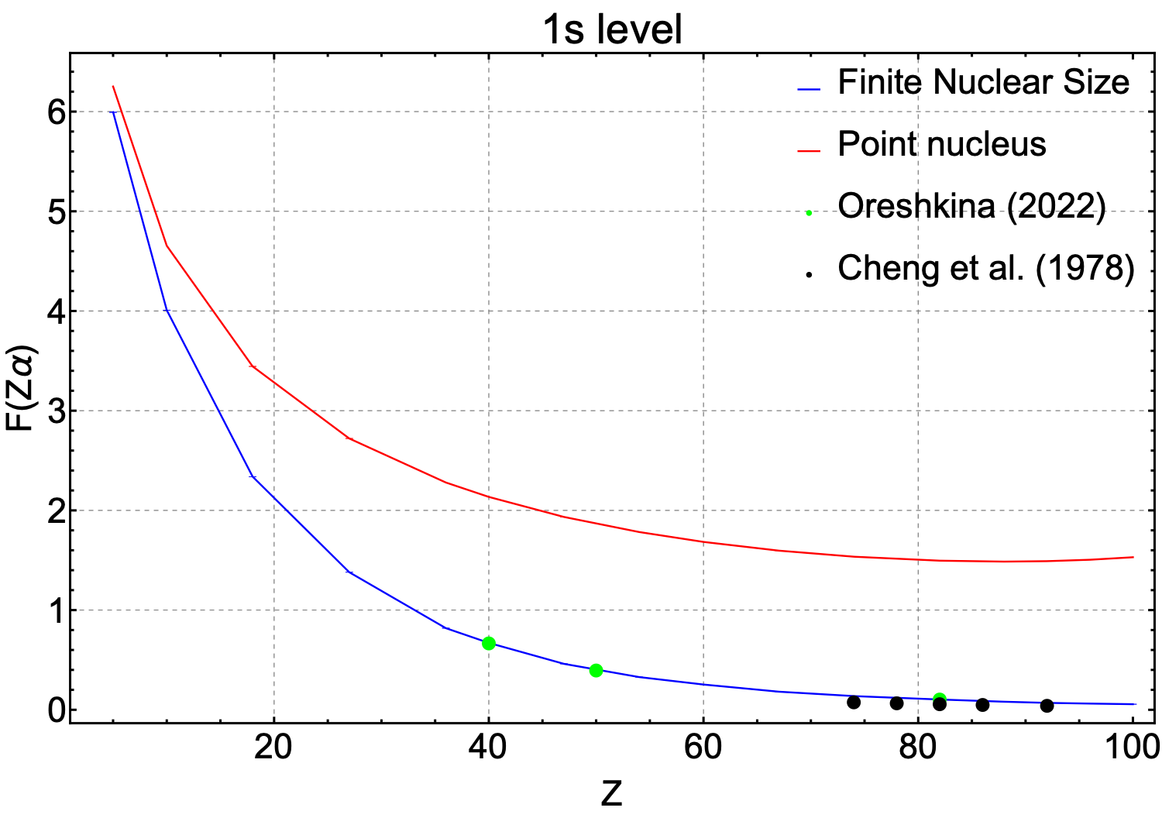
New results: all-order self-energy with finite size
Indelicato and Mohr (2023)
PREN 2023 & µASTI, Mainz

Slide 17
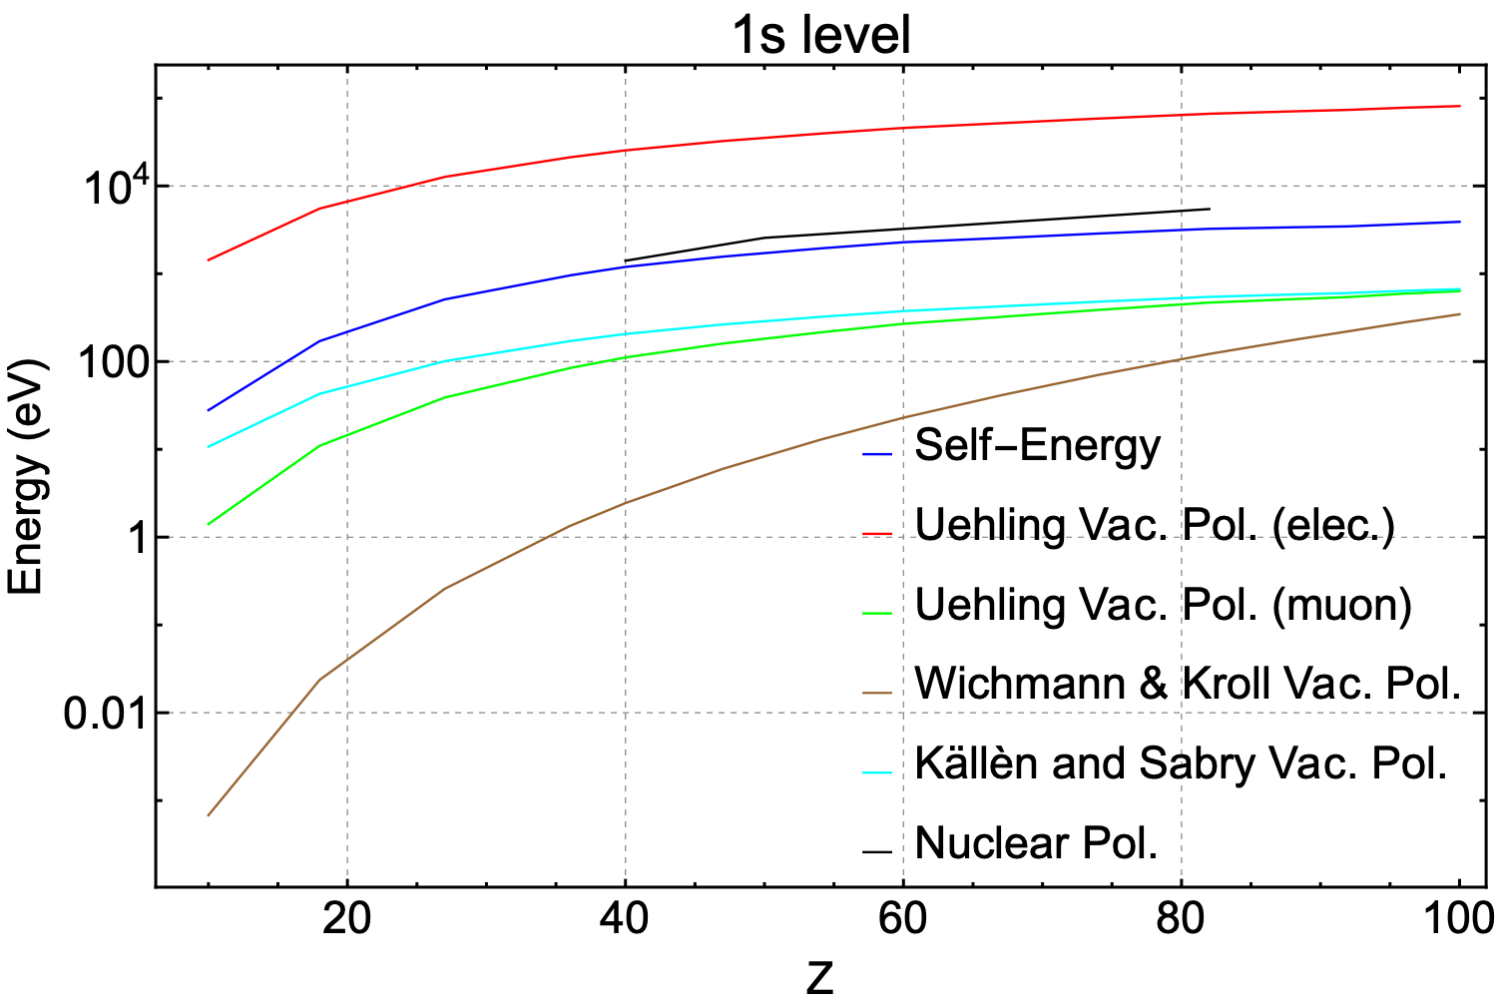
New results: all-order self-energy with finite size
SE with FNS: Indelicato and Mohr (2023)
Nuclear Polarization: Oreshkina (2022)
Can we extend all-order SE calculations to lower-Z and perform the
same for HFS?
PREN 2023 & µASTI, Mainz

Slide 18
The role of the nuclear model
Dependence on the charge distribution
PREN 2023 & µASTI, Mainz

Slide 19
Dependence on the magnetic radius
We can extract the magnetic radius from the Zemach radii
For example for the dipole approximation for the nuclear charge distribution (Exponential charge distribution)
PREN 2023 & µASTI, Mainz

Slide 20
Nuclear magnetic radii
Zemach moment (fm) | Err. | Mag. mom. radius | Ref.
1.047 | 0.016 | 0.817011 | A. Volotka, et al., Eur. Phys. J. D 33, 23 (2005)
1.037 | 0.016 | 0.800923 | A. Dupays, et al, Phys. Rev. A 68, 052503 (2003)
1.082 | 0.037 | 0.872342 | A. Antognini et al., Science 339, 417 (2013)
1.1108 | 0.0074 | 0.916867 | K. M. Graczyk and C. Juszczak, Phys. Rev. C 91, 045205 (2015).
1.086 | 0.012 | 0.878577 | J. L. Friar and I. Sick, Physics Letters B 579, 285 (2004)
1.0227 | 0.0107 | 0.77768 | K. Borah, R. J. Hill, G. Lee, and O. Tomalak, Phys. Rev. D 102, 074012 (2020).
1.077 |  | 0.864524 | J. Arrington, W. Melnitchouk, J.A. Tjon, Phys. Rev. C 76 (2007) 035205,
1.085 | 0.003 | 0.87702 | .C. Bernauer, et al., Phys. Rev. Lett. 105 (2010) 242001, & Arrington
1.013 | 0.016 | 0.761744 | S. J. Brodsky, C. E. Carlson, J. R. Hiller, and D. S. Hwang, Phys. Rev. Lett. 94, 022001 (2005).
PREN 2023 & µASTI, Mainz

Slide 21
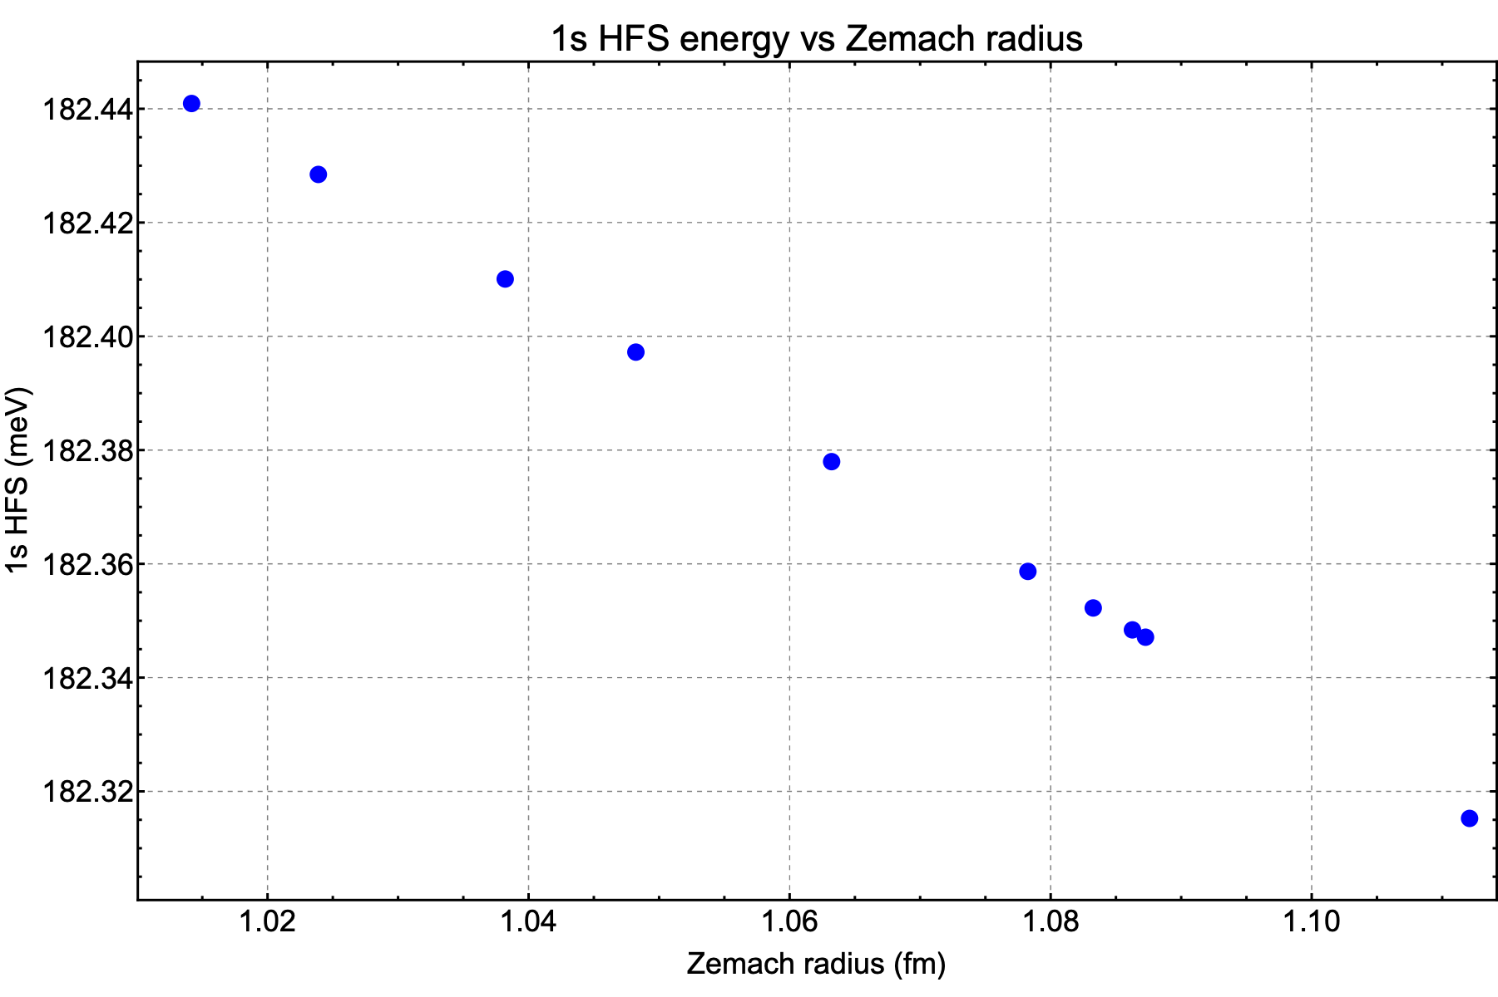
Nuclear magnetic radii: effect on HFS
PREN 2023 & µASTI, Mainz

Slide 22
Results and comparisons
 | RZ=1.086 | RZ=1.0227 | RZ=1.045
HFS PN | 182.45790 | 182.45790 | 182.45790
HFS FNS | -0.94458 | -0.94458 | -0.94458
Bohr-Weisskopf | -0.45483 | -0.37449 | -0.40288
VP11 | 0.36524 | 0.36524 | 0.36524
Hadronic VP | 0.00146 | 0.00146 | 0.00146
muon V11 | 0.00150 | 0.00150 | 0.00150
K&S VP | -0.00001 | -0.00001 | -0.00001
All order VP11 | 0.71923 | 0.72016 | 0.71983
All order VP11 µ | 0.00001 | 0.00001 | 0.00001
All order V13 | -0.01025 | -0.01026 | -0.01026
g-2 correction | 0.21236 | 0.21245 | 0.21242
µSE with p structure | 0.00830 | 0.00830 | 0.00830
Vertex corr. With p structure | -0.01400 | -0.01400 | -0.01400
Jellyfish corr. | 0.00400 | 0.00400 | 0.00400
proton polarizability | 0.08390 | 0.08390 | 0.08390
Recoil corr. | 0.17005 | 0.17005 | 0.17005
eVP + proton structure corr. | -0.02080 | -0.02080 | -0.02080
proton structure | -0.01360 | -0.01360 | -0.01360
Rel. + Radiat RC + AMM (?) | 0.01440 | 0.01440 | 0.01440
Total | 182.580279 | 182.661634 | 182.632889
Martynenko (2005) with 1.045 fm |  |  | 182.632
Borie | 182.6547
PREN 2023 & µASTI, Mainz

Slide 23
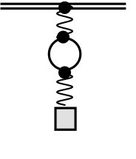
milli-charged particle pair
assume a charge qmilli so that the energy shift for very low mass is
equal to the muonic self-energy: 0.0015 meV (which is 1 ppm of the total energy
PREN 2023 & µASTI, Mainz

Slide 24
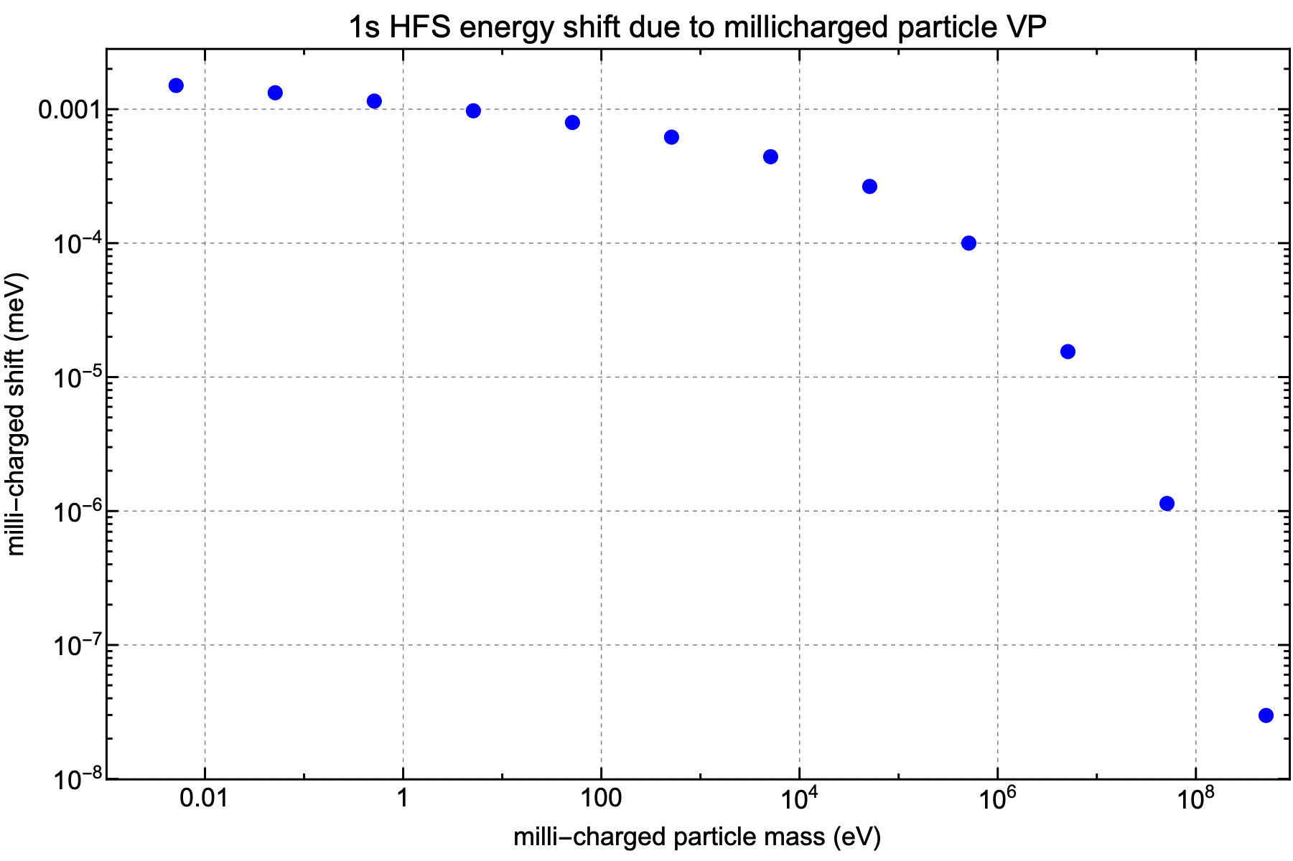
Could the µH HFS be sensitive to milli-charged particles
qmilli=0.0165 qe
PREN 2023 & µASTI, Mainz

Slide 25
Exotic atoms and QED
Nuclear effects and QED contributions
PREN 2023 & µASTI, Mainz

Slide 26
D. A. Bennett, W. B. Dories, M. S. Durkin, J. W. Fowler, G. C. Hilton, J. D. Gard, K.S. Morgan, G. C. O’Neil, C. D. Reintsema, D. R. Schmidt, D. S. Swetz, U. Ullom
P. Indelicato, N. Paul
T. Azuma, T. Okumura,
Y. Ueno, T. Isobe, S. Kanda
T. Takahasi, P. Caradonna, M. Katsuragawa, T. Minami, K. Mine, S. Nagasawa, S. Takeda, Y. Tsuzuki, G. Yabu
N. Kawamura, Y. Miyake, K. Shimomura, P. Strasser, S. Tampo, B. S. Takeshita, G. Yoshida
Y. Ichinohe. S. Yamada
S. Okada
T. Hashimoto ,T. U. Ito,
T. Osawa
R. Hayakawa,
H. Suda,
H. Tatusno
A. Taniguchi
K. Ninoyima, I. Chiu, M. Kasino, H. Noda, K. Terada
Y. Kino, T. Nakamura. T. Okutsu
I. Umegaki
S. Wantanabe
K. Kubo

Slide 27
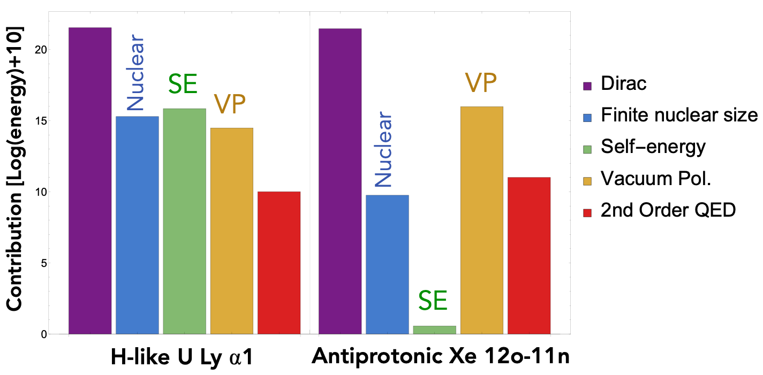
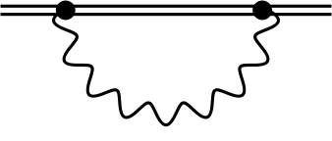
HCI and Exotic Atoms: a complementary pair
Self energy (SE)
Vacuum pol. (VP)
Highly charged ion: SE>VP
Exotic atom: VP>SE
Self-energy is dominant in HCI, vacuum polarization is dominant in exotic atoms
Unique probe of vacuum polarization, « one of the most interesting phenomena predicted by contemporary quantum electrodynamics » (Foldy and Eriksen, Physical Review (1954))
Complementary to vacuum studies with high-intensity lasers
PREN 2023 & µASTI, Mainz

Slide 28
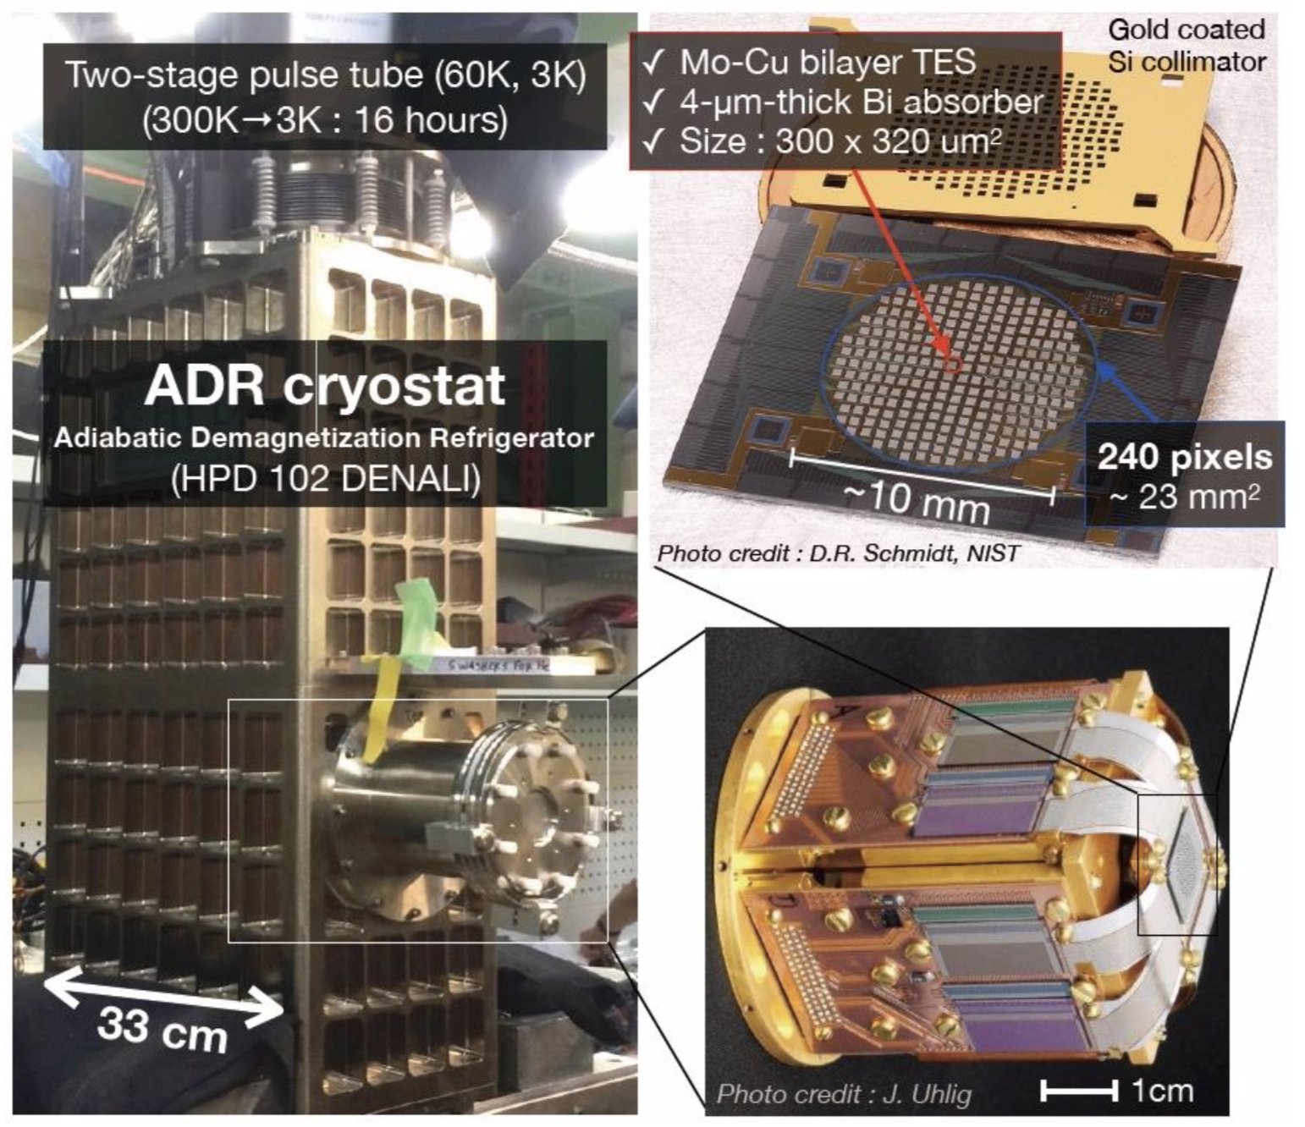
Key technology : NIST Transition Edge Sensing detector
PREN 2023 & µASTI, Mainz
Notes:
But as we have seen, it is exotic atoms that may offer a promising alternative to precision QED tests, and thus we have a 5 year accepted campaign at JPARC in Japan to perform precision x-ray spectroscopy of Rydberg states in muonic atoms. The key to these experiments is a new type of quantum sensor technology developed by our collaborators at NIST, a transition edge sensing microcalorimeter detector. These detectors are unique because they combine high resolution, so a few eV for a 6 keV transition, here you can see the comparison between a TES and a normal solid-state detector that we use for in-beam spectroscopy. At the same time they have high quantum efficiency, which is essential for doing physics with exotic beams. We were there for three weeks in Jan 2020 as you can see here.

Slide 29
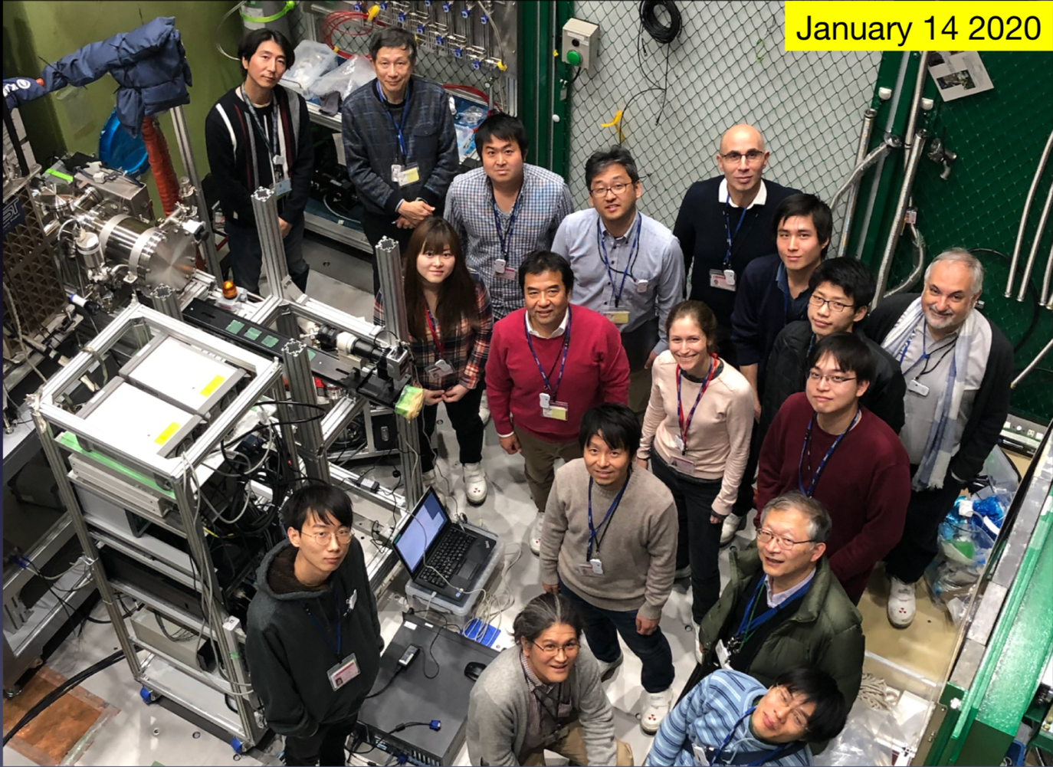
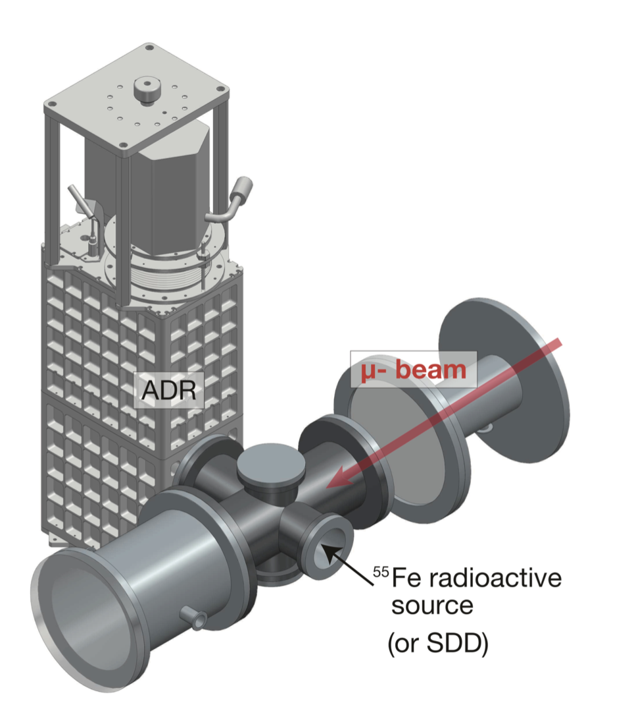
First experiments with muonic atoms at J-PARC
5-year accepted scientific program at J-PARC muon facility in Japan (2020-2025)
QED tests=precision x-ray spectroscopy of Rydberg states in muonic atoms
LKB @ JPARC—Jan 14, 2020
Collaboration: RIKEN, JAEA, JAXA, KEK, Osaka University, Rikkyo University, Tohoku University, Tokyo Metrolopolitan University, NIST, LKB
X-ray tube
PREN 2023 & µASTI, Mainz
Notes:
But as we have seen, it is exotic atoms that may offer a promising alternative to precision QED tests, and thus we have a 5 year accepted campaign at JPARC in Japan to perform precision x-ray spectroscopy of Rydberg states in muonic atoms. The key to these experiments is a new type of quantum sensor technology developed by our collaborators at NIST, a transition edge sensing microcalorimeter detector. These detectors are unique because they combine high resolution, so a few eV for a 6 keV transition, here you can see the comparison between a TES and a normal solid-state detector that we use for in-beam spectroscopy. At the same time they have high quantum efficiency, which is essential for doing physics with exotic beams. We were there for three weeks in Jan 2020 as you can see here.

Slide 30
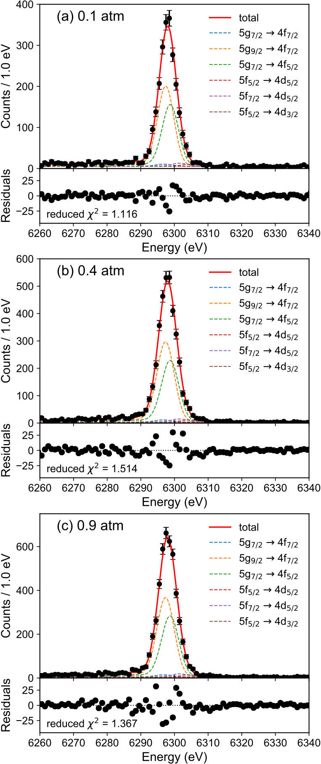
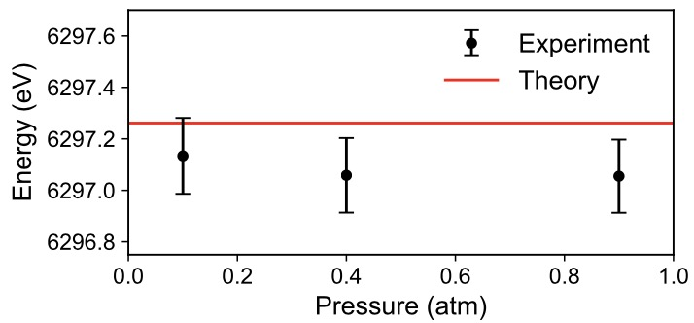
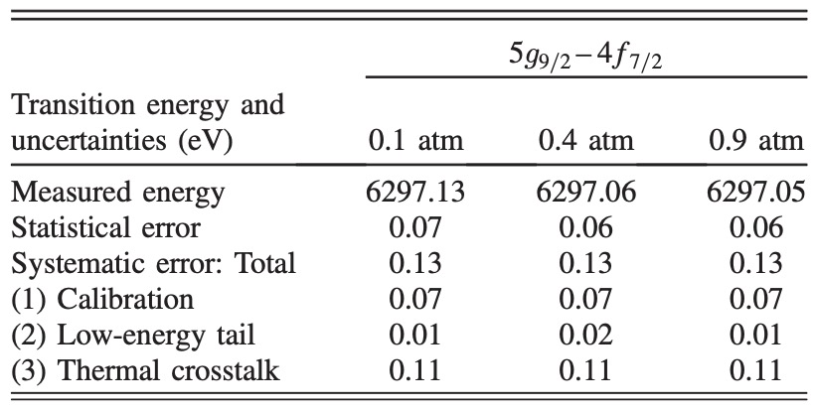
Experimental spectra and pressure dependence
shift due to presence of 1 electron: -1.25 eV
PREN 2023 & µASTI, Mainz

Slide 31
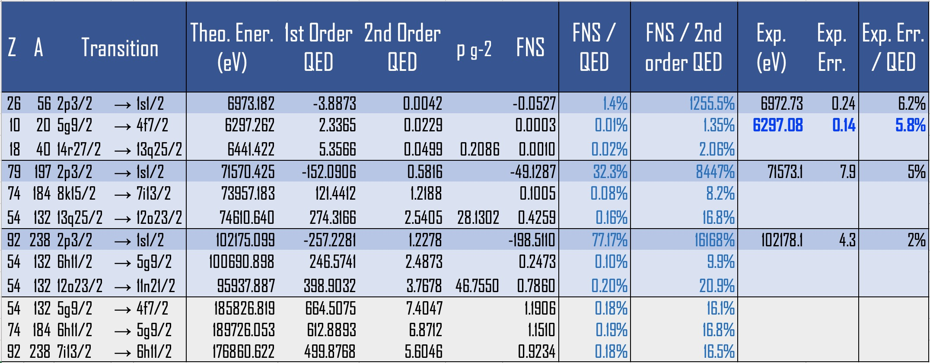
Comparison with theory for µNe
J-PARC
Theory-Exp.: 0.18±0.14 eV
T. Okumura, T. Azuma, D.A. Bennett, P. Caradonna, I. Chiu, W.B. Doriese, M.S. Durkin, J.W. Fowler, J.D. Gard, T. Hashimoto, R. Hayakawa, G.C. Hilton, Y. Ichinohe,
P. Indelicato, T. Isobe, S. Kanda, M. Katsuragawa, N. Kawamura, Y. Kino, K. Mine, Y. Miyake, K.M. Morgan, K. Ninomiya, H. Noda, G.C. O'Neil, S. Okada,
K. Okutsu, N. Paul, C.D. Reintsema, D.R. Schmidt, K. Shimomura, P. Strasser, H. Suda, D.S. Swetz, T. Takahashi, S. Takeda, S. Takeshita, M. Tampo,
H. Tatsuno, Y. Ueno, J.N. Ullom, S. Watanabe, S. Yamada, Testing Quantum Electrodynamics: High Precision X-ray Spectroscopy of Muonic Neon Atoms,
Phys. Rev. Lett. 130, 173001 (2023).
PREN 2023 & µASTI, Mainz

Slide 32
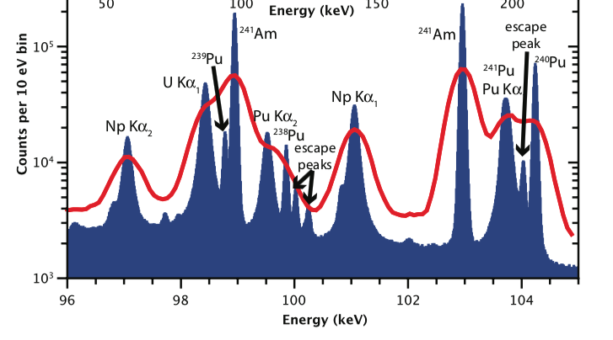
Next step: high-energy TES
Key technology
High energy resolution (ΔE/E ~10⁻⁴)
High efficiency (~10⁻⁴)
Transition Edge Sensing (TES) μcalorimeter (NIST)
Ge detector
TES μcalorimeter
X-ray tube
Rev. Sci. Instrum. 83, 093113 (2012)
enable to do up to muonic Xe or W (using WF6 gas)
should be ready and first experiment planned for march 2023
PREN 2023 & µASTI, Mainz
Notes:
Ce détecteur est un Transition Edge Sensing microcalorimètre, qui a à la fois une haute efficacité et une haute resolution en énergie, jamais disponible auparavant dans la gamme des rayons-X. Pour démontrer le gain qu’on a pour la physique avec ce detecteur, ici vous avez un comparison entre un détecteur de germanium standard pour ce type de mesure, et ce détecteur TES. Cette bonne resolution en energie nous permet de tester la QED avec des atomes exotiques.

Slide 33
Other measurements
Structure of light atoms for microcalorimeters measurements
PREN 2023 & µASTI, Mainz

Slide 34
muonic ⁶Li
2p3/2
F=5/2
0.011 eV
F=3/2
-0.008 eV
F=1/2
-0.019 eV
Electric Q-pole negligible
18671.579 eV, EM width=0.007 eV
F=3/2
0.440 eV
1s
1.346 eV
F=1/2
-0.880 eV
⁶Li nuclear spin I=1 µ=0.8220473 µN Q=-0.000808 barns
PREN 2023 & µASTI, Mainz
N.J. Stone. Atomic Data and Nuclear Data Tables 90, 75-176 (2005)

Slide 35
muonic ⁷Li
F=3
0.047 eV
-0.037 eV
2p3/2
F=2
0.111 eV
-0.016 eV
F=1
-0.058 eV
-0.037 eV
F=0
-0.079 eV
-0.185 eV
18724.019 eV, EM width=0.007 eV
Electric Q-pole
F=2
1.766 eV
1s
4.793 eV
F=1
-2.943 eV
⁷Li nuclear spin I=3/2 µ=3.2564625 µN Q=-0.0401 barns
PREN 2023 & µASTI, Mainz

Slide 36
muonic ⁹Be
F=0
0.068 eV
0.351 eV
2p3/2
F=1
0.050 eV
F=2
0.014 eV
-0.117 eV
F=3
-0.041 eV
-0.117 eV
-0.585 eV
Electric Q-pole
33393.464 eV, EM width=0.022 eV
F=1
2.477 eV
1s
4.064 eV
F=2
-1.486 eV
⁹Be nuclear spin I=3/2 µ=-1.17743µN Q=-0.05288 barns
PREN 2023 & µASTI, Mainz

Slide 37
muonic ¹⁰B
0.883 eV
F=9/2
0.123 eV
0.368 eV
2p3/2
F=7/2
0.000 eV
F=5/2
-0.096 eV
-0.221 eV
F=3/2
-0.164 eV
-0.736 eV
52223.187 eV, EM width=0.053 eV
Electric Q-pole
F=7/2
4.360 eV
1s
10.493 eV
F=5/2
-5.813 eV
¹⁰B nuclear spin I=3 µ=1.80064478µN Q=0.0847 barns
PREN 2023 & µASTI, Mainz

Slide 38
muonic ¹¹B
0.886 eV
F=5/2
0.184 eV
2p3/2
0.177 eV
F=3/2
-0.123 eV
F=1/2
-0.307 eV
-0.709 eV
Magnetic
52279.234 eV, EM width=0.053 eV
Electric Q-pole
F=3/2
6.537 eV
1s
20.222 eV
F=1/2
-13.074 eV
¹¹B nuclear spin I=1 µ=2.6886489µN Q=0.0407 barns
PREN 2023 & µASTI, Mainz

Slide 39
Conclusions
A number of all-order contributions to the HFS of the 1s level of muonic hydrogen have been evaluated
There is a close agreement with perturbative calculations
Sensitivity to low mass millicharged particle vacuum polarization has been evaluated
A new measurement with a TES microcalorimeter of muonic Ne show the potential of the method
Structure of the light elements to be studied by QUARTET has been evaluated following the same procedure
PREN 2023 & µASTI, Mainz

