Slide 1
Isotope shifts and King-plot nonlinearities in Ca+
Anna Viatkina, Vladimir Yerokhin, Andrey Surzhykov
28.06.2023
PREN 2023 & μASTI, Mainz

Slide 2
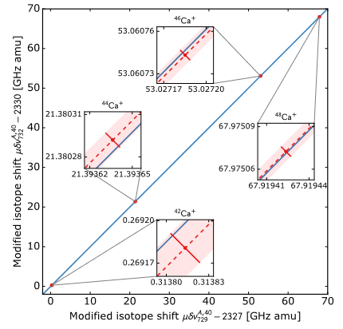
Why Ca⁺ ?
Ca⁺
3d ²D_{5/2}
High-precision atomic spectroscopy
3d 5/2 → 4s accuracy < 10 Hz
3d 5/2 – 3d 3/2 accuracy ~20 Hz
Many stable & long-lived isotopes
A = 40, 42, 44, 46, 48
One valence electron
Linear King plots (so far)
King plot in ( 3d 3/2 → 4s ; 3d 5/2 → 4s ) is linear.
3d ²D_{3/2}
729 nm
732 nm
4s ²S_{1/2}
(3d_{3/2} → 4s, 3d_{5/2} → 4s)
? ? ?
Plots constructed from isotope shifts.
[Knollmann et al. PRA 100, 022514 (2019)]
[Solaro et al. PRL 125, 123003 (2020)]

Slide 3
Isotope shifts
mass shift
field
shift
$$∆ν_{AA^{′}}= +$$
1st order perturbation theory:
$$ν$$
$$ν+Δν_{AA′}$$
$$∆ν_{AA^{′}}=K∙{ μ}_{AA^{′}} + F∙δR_{AA′}^{2}$$
electronic
(isotope-independent)
nuclear
(isotope-dependent)
Z, A
Z, A’
$$μ_{AA^{′}}=\frac{m}{M_{A}}−\frac{m}{M_{A^{′}}}$$
$$δR_{AA′}^{2}=\frac{1}{λ_{C}^{2}}\left(\left\langle r_{A^{′}}^{2}\right\rangle −\left\langle r_{A}^{2}\right\rangle \right)$$
To construct a King plot, you need TWO transitions.

Slide 4
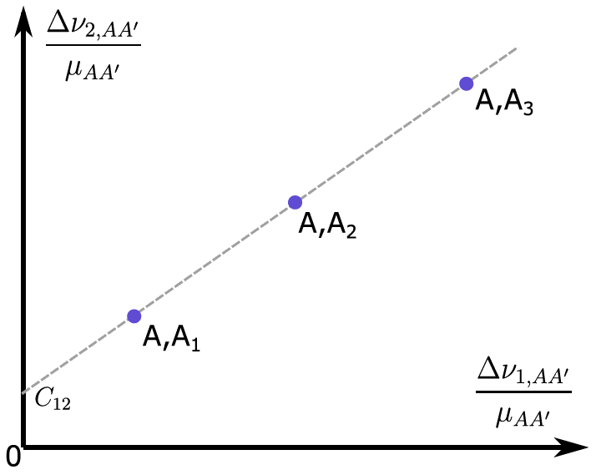
King plot
Two different transitions:
$$\left\{\begin{aligned}∆ν_{1,AA^{′}}=K_{1}∙{ μ}_{AA^{′}} +F_{1}∙δR_{AA′}^{2} \\ ∆ν_{2,AA^{′}}=K_{2}∙{ μ}_{AA^{′}} +F_{2}∙δR_{AA′}^{2}\end{aligned}\right.$$
King plot
$$μ_{AA^{′}}=\frac{m}{M_{A}}−\frac{m}{M_{A^{′}}}$$
$$\frac{∆ν_{2,AA^{′}}}{{ μ}_{AA^{′}}}$$
$$\left\{\begin{aligned}\frac{∆ν_{1,AA^{′}}}{{ μ}_{AA^{′}}}=K_{1} +F_{1}∙\frac{δR_{AA′}^{2}}{{ μ}_{AA^{′}}} \\ \frac{∆ν_{2,AA^{′}}}{{ μ}_{AA^{′}}}=K_{2} +F_{2}∙\frac{δR_{AA′}^{2}}{{ μ}_{AA^{′}}}\end{aligned}\right.$$
$$\frac{∆ν_{1,AA^{′}}}{{ μ}_{AA^{′}}}$$
$$\frac{∆ν_{2,AA^{′}}}{{ μ}_{AA^{′}}}=\left(K_{2}−\frac{F_{2}}{F_{1}}K_{1}\right)+\frac{F_{2}}{F_{1}}∙\frac{∆ν_{1,AA^{′}}}{{ μ}_{AA^{′}}}$$
Linear dependence

Slide 5
King plot
$$\left\{\begin{aligned}∆ν_{1,AA^{′}}=K_{1}∙{ μ}_{AA^{′}} +F_{1}∙δR_{AA′}^{2}+… \\ ∆ν_{2,AA^{′}}=K_{2}∙{ μ}_{AA^{′}} +F_{2}∙δR_{AA′}^{2}+…\end{aligned}\right.$$
King plot
$$\frac{∆ν_{2,AA^{′}}}{{ μ}_{AA^{′}}}$$
Additional terms ???
A,A₂
Possible sources:
New physics
Standard model corrections
$$\frac{∆ν_{1,AA^{′}}}{{ μ}_{AA^{′}}}$$

Slide 6
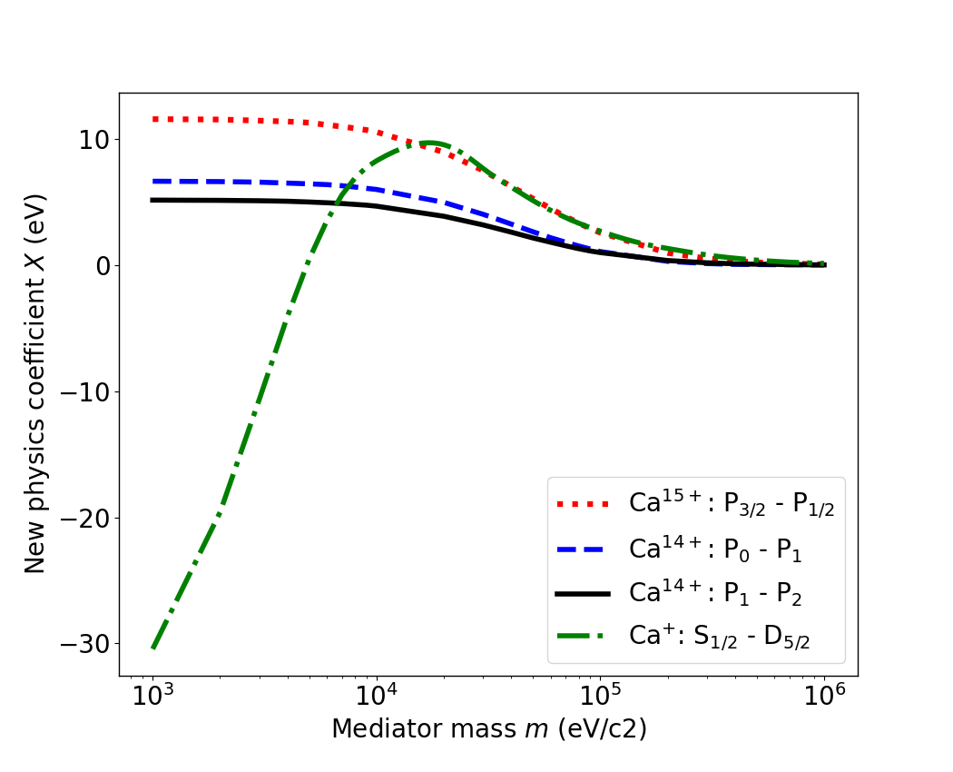
New physics?
new physics boson with mass m
coupling constant $α_{NP}$
$$U_{NP}=α_{NP}N\frac{e^{−mr}}{r}$$
$$∆ν_{AA^{′}}=K_{1}∙{ μ}_{AA^{′}} +F_{1}∙δR_{AA^{′}}^{2}+α_{NP}X_{i}∙γ_{a}$$
electronic
factor
(some) nuclear
parameter
(by Jan Richter and Agnese Mariotti)

Slide 7
Isotope shifts in Ca⁺ : SM predictions
1st order mass shift (MS)
1st order field shift (FS)
$${δR}_{ia}^{2}=\frac{1}{λ_{C}^{2}}\left(\left\langle r_{i}^{2}\right\rangle −\left\langle r_{a}^{2}\right\rangle \right)$$
$$ΔE_{ij}=K^{(1)}\left(\frac{m}{M_{i}}−\frac{m}{M_{j}}\right) + F^{(1)}δR_{ij}^{2}$$
$$+{ K}^{(2)}\left(\frac{m^{2}}{M_{i}^{2}}−\frac{m^{2}}{M_{j}^{2}}\right) + {δ_{R_{i}}F}^{(1)}δR_{ij}^{2} + F^{(2)}{\left(δR_{ij}^{2}\right)}^{2}$$
1st order FS correction
2nd order FS
2nd order MS
$$+ { Δ}_{np, ij} + Δ_{MS−FS,ij}$$
Many-body
perturbation theory !
nuclear polarization
MS-FS cross term

Slide 8
Isotope shift: FS
$${δR}_{ia}^{2}=\frac{1}{λ_{C}^{2}}\left(\left\langle r_{i}^{2}\right\rangle −\left\langle r_{a}^{2}\right\rangle \right)$$
$$F^{(1)}δR_{ia}^{2} + {δ_{R_{i}}F}^{(1)}δR_{ia}^{2}$$
1st order FS
1st order FS correction
COMES FROM
$$\left\langle ψ_{a} | δV_{ia} | ψ_{a}\right\rangle$$
where $δV_{ia}=V\left(R_{i}\right)−V(R_{a})$ change in electrostatic potential of the nucleus between the isotopes
$$δV_{ia}=\frac{∂V}{∂(R^{2})}{δR}_{ia}^{2}+\left(\frac{δV_{ia}}{{δR}_{ia}^{2}}−\frac{∂V}{∂(R^{2})}\right){δR}_{ia}^{2}$$
$\left\langle ψ_{a} | δV_{ia} | ψ_{a}\right\rangle ={ F}^{(1)}δR_{ia}^{2}$ + ${δ_{R_{i}}F}^{(1)}δR_{ia}^{2}$
1st order FS
1st order FS correction

Slide 9
Isotope shift: nuclear polarization
$A_{a}=40$,
$$A_{i}=42, 44, 46, 48 .$$
$$ΔE_{np}(ζ)=−α\sum_{LM}{B\left(EL\right)\sum_{n}{\frac{{\left|\left\langle ζ | ℱ_{L}Y_{LM} | n\right\rangle \right|}^{2}}{E_{n}−E_{ζ}+sgn\left(E_{n}\right)ω_{L}}}}$$
$B\left(EL\right)$: Giant resonances L=0,1,2.
Dominant rotational transition L=2.
Result for isotope shift (convenient to express that way):
$$Δ_{np}={−F}^{\left(1\right)}(R_{i}^{2}g_{i} −R_{a}^{2}g_{a})$$

Slide 10
Isotope shifts in Ca⁺ : SM predictions
1st order mass shift (MS)
1st order field shift (FS)
$${δR}_{ia}^{2}=\frac{1}{λ_{C}^{2}}\left(\left\langle r_{i}^{2}\right\rangle −\left\langle r_{a}^{2}\right\rangle \right)$$
$$ΔE_{ij}=K^{(1)}\left(\frac{m}{M_{i}}−\frac{m}{M_{j}}\right) + F^{(1)}δR_{ij}^{2}$$
$$+{ K}^{(2)}\left(\frac{m^{2}}{M_{i}^{2}}−\frac{m^{2}}{M_{j}^{2}}\right) + {δ_{R_{i}}F}^{(1)}δR_{ij}^{2} + F^{(2)}{\left(δR_{ij}^{2}\right)}^{2}$$
1st order FS correction
2nd order FS
2nd order MS
$$+ { Δ}_{np, ij} + Δ_{MS−FS,ij}$$
nuclear polarization
MS-FS cross term

Slide 11
Isotope shifts in Ca⁺ : SM predictions
We calculated
Electronic constants
$$K^{(1)},K^{(2)},F^{(1)},F^{(2)}$$
~10% accuracy
in theoretical calculations
${δ_{R_{i}}F}^{(1)} ,$ ${ Δ}_{np, ij} , { Δ}_{MS−FS,ij}$
$$ΔE_{ij}$$
~100 MHz theoretical accuracy
in isotope shift
(but errors are correlated)
Isotope shifts

Slide 12
King plot nonlinearity?
displacement
triangle
[Hz]
[kHz^2]
Optimal:
three points
Ca
$A_{a}=40$,
$$A_{i}=42, 44, 46, 48 .$$
(four points)
$${(∆}_{1}+∆_{2})/2$$

Slide 13
King plot nonlinearity
Transitions | Last isotope | Calculated NL (Hz) | Error
(3d_{3/2} → 4s, 3d_{5/2} → 4s) | 46 | 44 | 3000 %
 | 48 | 181 | 500 %
(4p_{1/2} → 4s, 3d_{3/2} → 4s) | 46 | 13652 | 35 %
 | 48 | 13706 | 50 %
Visible at ~ 1 kHz experimental accuracy?
Includes:
theoretical errors of
$K^{(1)},K^{(2)},F^{(1)},F^{(2)}$ (10% and 5%)
and experimental errors of
nuclear radii $\left\langle r_{i}^{2}\right\rangle$ [ Angeli & Marinova (2013) ]

Slide 14
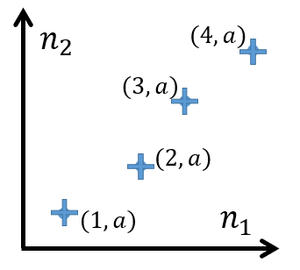
How do we investigate King plots?
Two questions:
Which SM effect causes most nonlinearity?
How an error bar in isotope shifts translates to King-plot nonlinearity uncertainty?

Slide 15
Which SM effect causes most nonlinearity?
(3d_{3/2} → 4s, 3d_{5/2} → 4s)
Ca+: A = 40, 42, 44, 46, 48
(four points in KP)
Both methods
A = 40, 42, 44, 46
2nd order MS,
nuclear polarization
:
99% NL due to 2nd order MS
(3d_{3/2} → 4s, 3d_{5/2} → 4s)
A = 40, 42, 44, 48
75% NL due to 2nd order MS
25% NL due to nuclear polarization

Slide 16
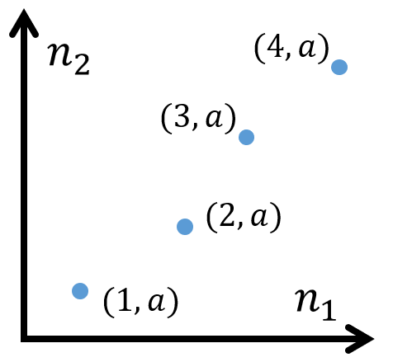
How isotope shift errors affect NL errors?
Idealized case:
All isotope shifts have the same error bar
(1 Hz, 10 Hz, …)
Ca+
$$A_{a}=40$$
$$A_{i}=42, 44, 46, 48$$

Slide 17
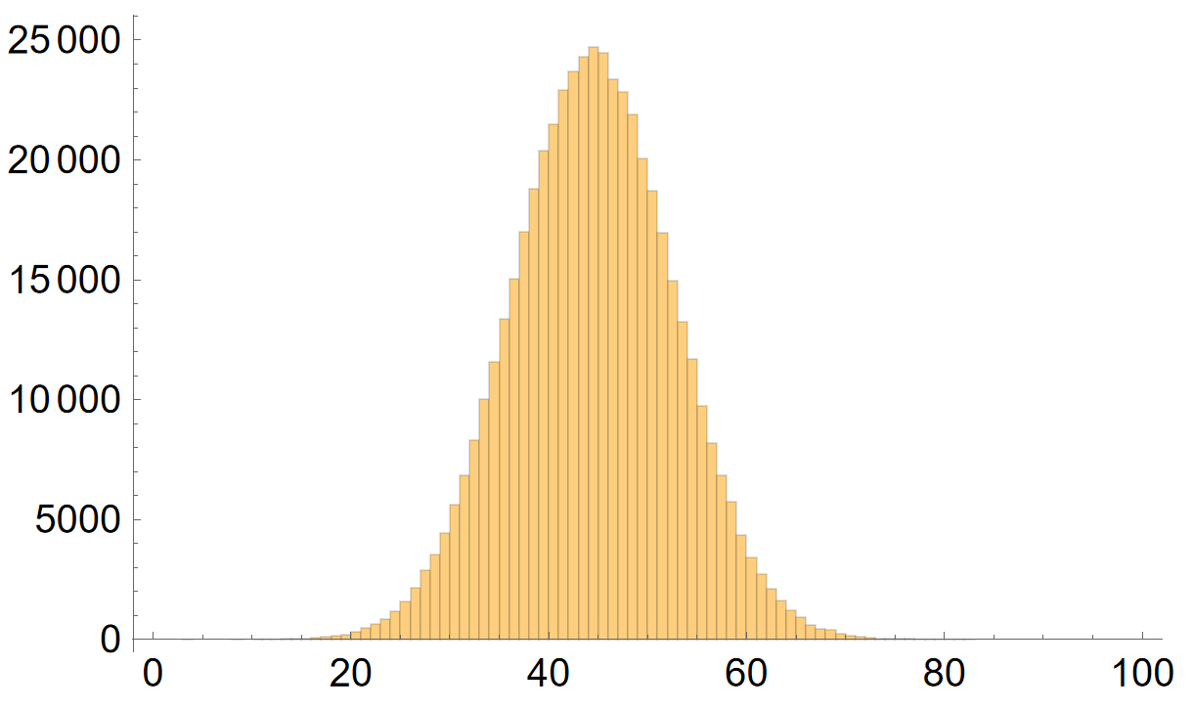
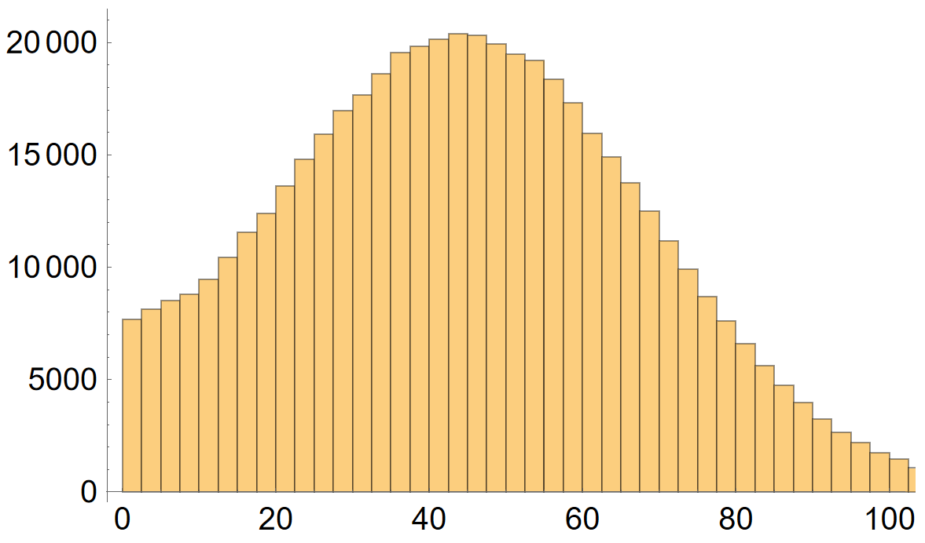
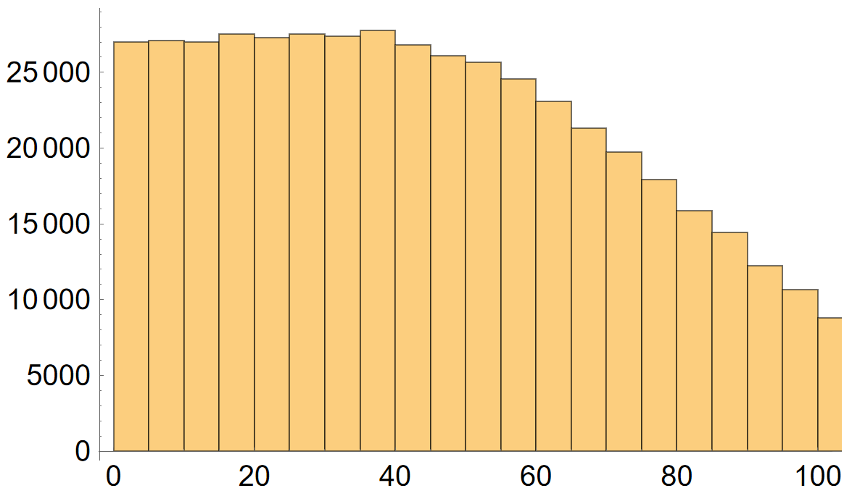
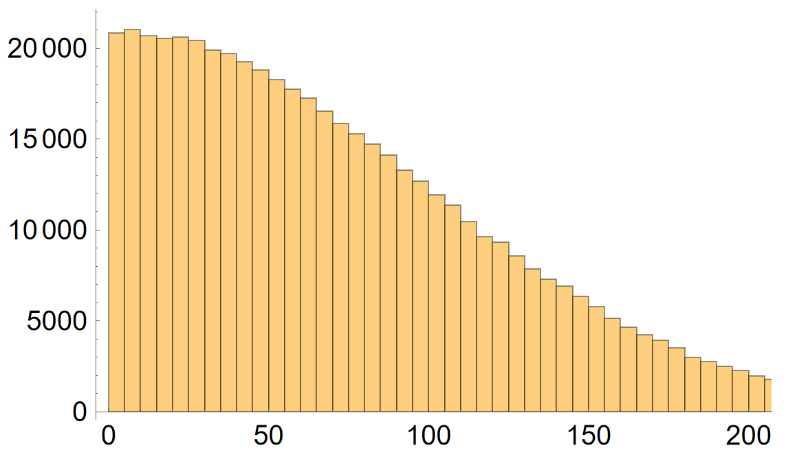
Isotope shift errors → NL errors in Ca⁺
Monte-Carlo simulation
Example:
1 Hz error bar in IS
3 Hz error bar in IS
count
count
$${(∆}_{1}+∆_{2})/2$$
Hz
Hz
(3d_{3/2} → 4s, 3d_{5/2} → 4s)
for 40-42,44,46
5 Hz error bar in IS
10 Hz error bar in IS
count
count
Nonlinearity 44 Hz
Hz
Hz

Slide 18
Isotope shift errors → NL errors in Ca⁺
(3d_{3/2} → 4s, 3d_{5/2} → 4s)
Isotope-shift error bar
 | Last point | NL value | 1 Hz | 3 Hz | 5 Hz | 10 Hz | 15 Hz | 20 Hz
Method a) | A=46 | 44 Hz | 8 | 25 | 43 | 89 | 122 | 155
 | A=48 | 181 kHz² | 14 | 43 | 71 | 153 | 299 | 347
Method b) | A=46 | 1052 Hz | 193 | 602 | 1150 | 2211 | 2950 | 3881
 | A=48 | 3338 kHz² | 261 | 783 | 1304 | 2789 | 5846 | 5824
Hz
kHz²
Hz
kHz²

Slide 19
Isotope shift errors → NL errors in Ca⁺
(3d_{3/2} → 4s, 3d_{5/2} → 4s)
Isotope-shift error bar
 | Last point | NL value | 1 Hz | 3 Hz | 5 Hz | 10 Hz | 15 Hz | 20 Hz
Method a) | A=46 | 44 Hz | 8 | 25 | 43 | 89 | 122 | 155
 | A=48 | 181 kHz² | 14 | 43 | 71 | 153 | 299 | 347
Method b) | A=46 | 1052 Hz | 193 | 602 | 1150 | 2211 | 2950 | 3881
 | A=48 | 3338 kHz² | 261 | 783 | 1304 | 2789 | 5846 | 5824
Hz
kHz²
Hz
kHz²

Slide 20
Conclusion
count
The error bars in isotope shifts blur nonlinearity rather quickly (10-20 Hz)
Theoretical error of calculated isotope shifts does not allow us to predict nonlinearity in (3d_{3/2} → 4s, 3d_{5/2} → 4s) pair.
But we still can see the relative impact of IS terms:
2nd order MS and nuclear polarization are the main sources in (3d_{3/2} → 4s, 3d_{5/2} → 4s)
Hz

Slide 21
Thank you!

Slide 23
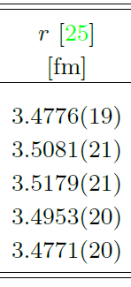
Ca+
$$A_{a}=40$$
$$A_{i}=42, 44, 46, 48$$
Angeli, I., Marinova, K. P. (2013). Atomic Data and Nuclear Data Tables, 99 (1), 69-95.

Slide 24
Isotope shift: cross term
$A_{a}=40$,
$$A_{i}=42, 44, 46, 48 .$$
Comes from reduced mass:
$$F^{(1)}→{μ^{3}F}^{(1)}≈F^{\left(1\right)}(1−3\frac{m}{M})$$
$$Δ_{MS−FS}=−3\left(\frac{m}{M_{i}}−\frac{m}{M_{a}}\right)F^{(1)}δR_{ia}^{2}$$
(But it‘s small, weak, and insignificant anyway)

Slide 25
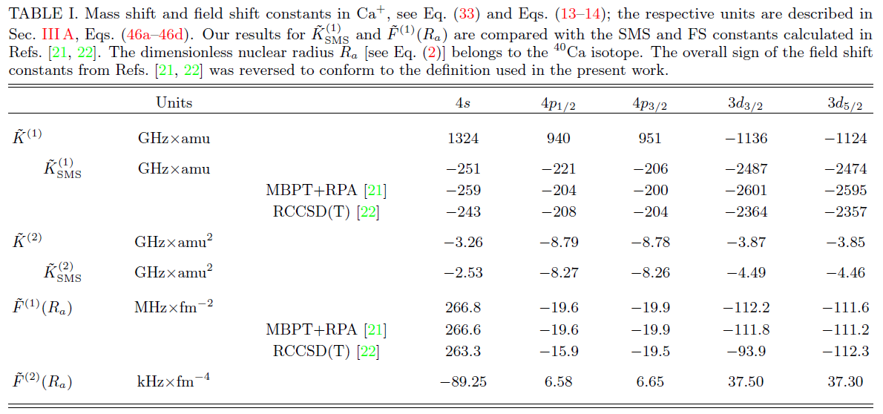
Electronic constants
~10% accuracy
in theoretical calculations

Slide 26
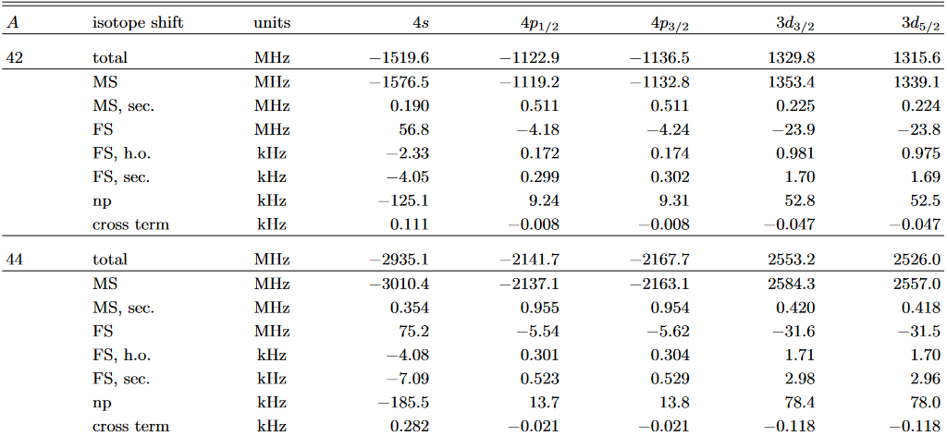
~100 MHz theoretical accuracy
in isotope shift
40-
40-

Slide 27
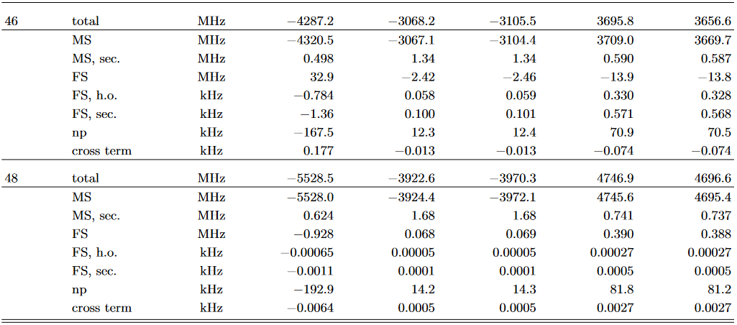
~100 MHz theoretical accuracy
in isotope shift
40-
40-

Slide 28
Nonlinearity & individual terms in Ca⁺
(3d_{3/2} → 4s, 3d_{5/2} → 4s)
(4p_{1/2} → 4s, 3d_{3/2} → 4s, 3d_{5/2} → 4s)
Hz
kHz²
Hz
kHz²
2nd order MS,
nuclear polarization

