Slide 1

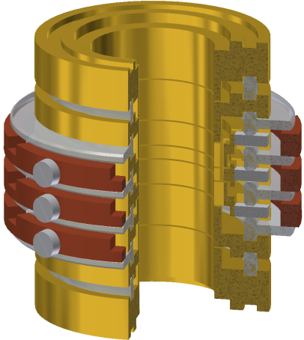





Exploring fundamental interactions and constants with trapped ions
Sven Sturm
MPIK Heidelberg

Slide 2






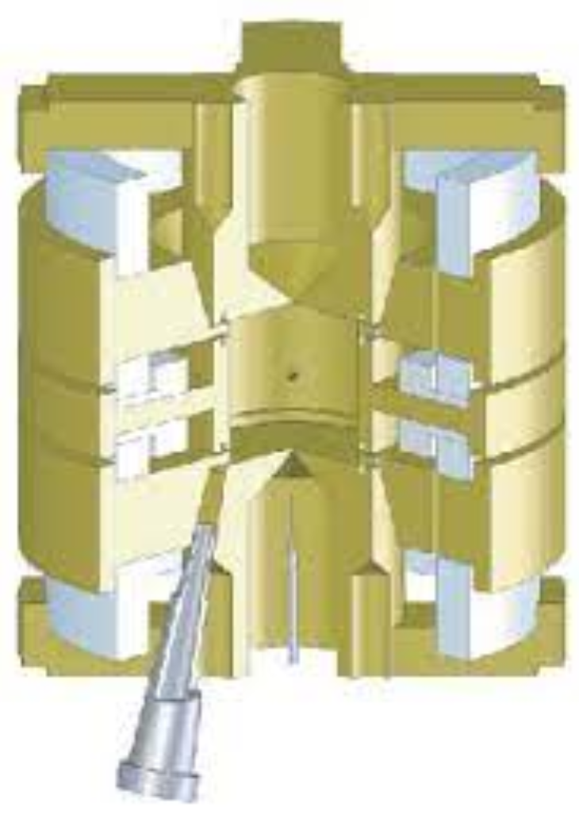

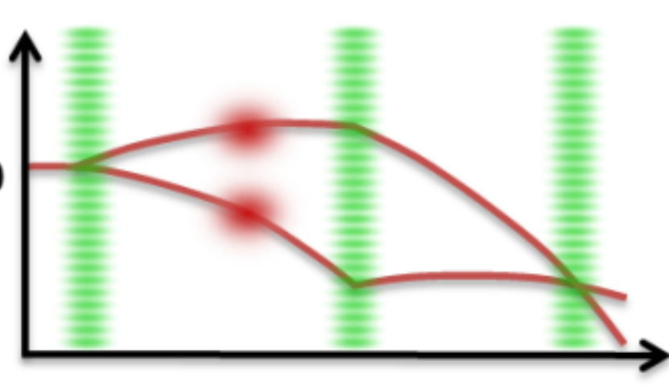
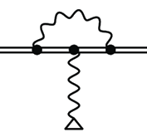

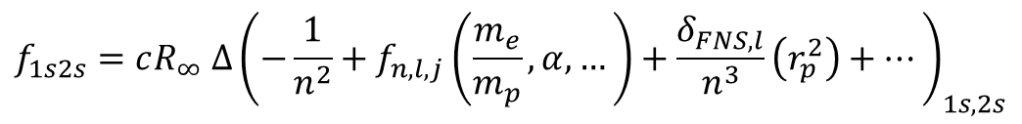

How do precision measurements test the SM?
Penning trap MS
Hydrogen 1s→2s
Muonic hydrogen
2s
Theory
p
1s
p
?
$$f_{1s2s}=cR_{∞} ∆{\left(−\frac{1}{n^{2}}+f_{n,l,j}\left(\frac{m_{e}}{m_{p}},α,…\right)+\frac{δ_{FNS,l}}{n^{3}}\left(r_{p}^{2}\right)+…\right)}_{1s,2s}$$
?
$R_{∞}=\frac{ c}{2}\frac{m_{Rb}}{h}$ $\frac{m_{e}}{m_{Rb}} α^{2}$
$R_{∞}=\frac{ c}{2}\frac{m_{e}}{h}$ $α^{2}$
Electron g-factor
Theory
Penning trap MS
Atom interferometry

Slide 3

A look into our toolbox - the Penning trap

Slide 4
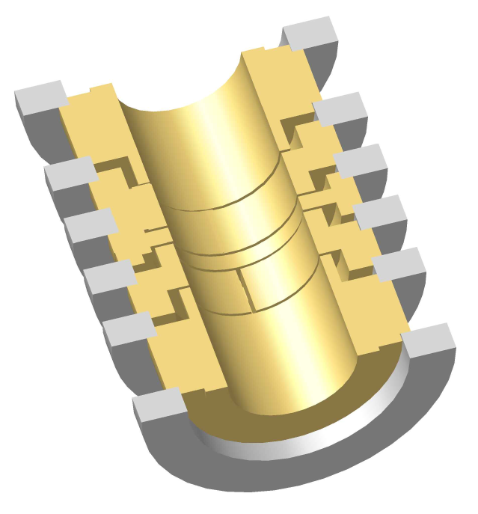

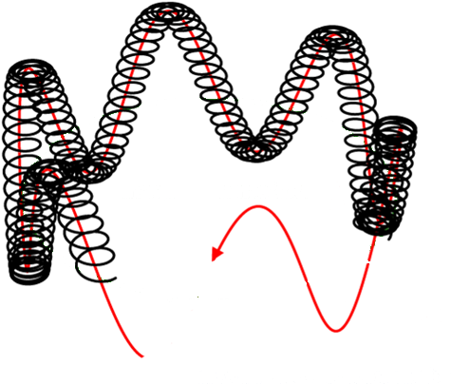
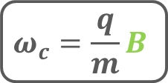
The Penning trap
B
Trap eigenfrequencies
Reduced cyclotron
frequency:
~2π∙ 27 MHz
U₀
Magnetron drift
frequency:
~ 2π∙ 9 kHz
Axial frequency:
~ 2π∙ 700 kHz
Larmor frequency:
~ 2π∙ 110 GHz
Free cyclotron frequency
(Brown-Gabrielse invariance theorem)
$$ω_{c}=\frac{q}{m}B$$

Slide 5
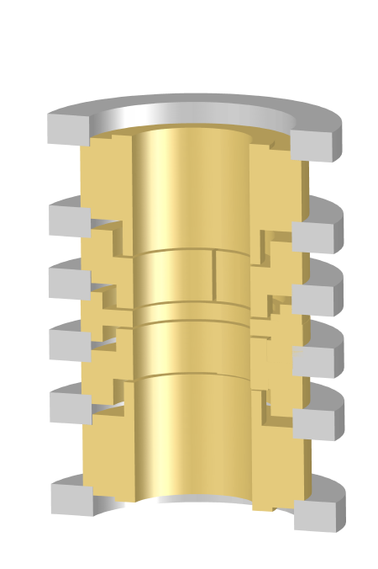
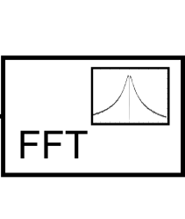
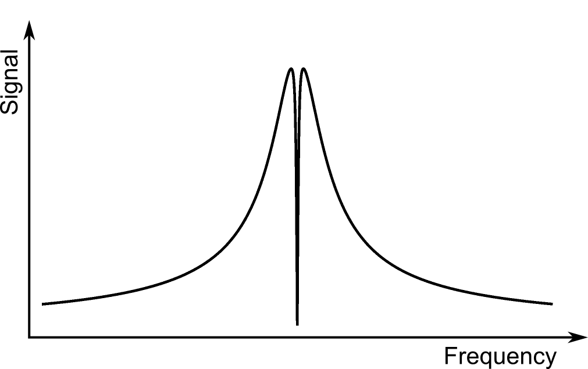
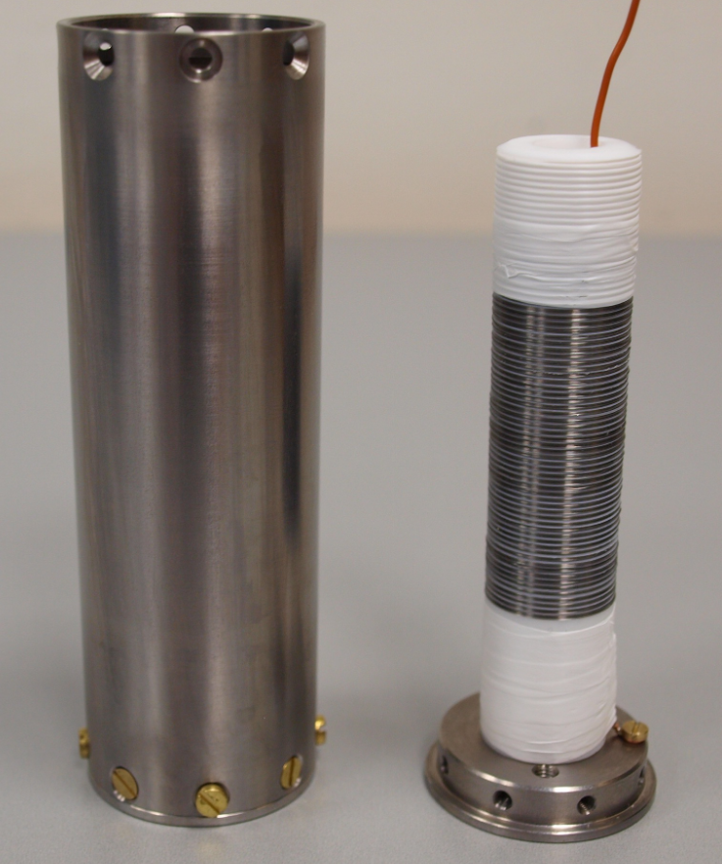
Eigenfrequency Detection
A
Cryogenic ultra low-noise amplifier
e_{n} = 800pV/ √Hz
i_{n} ≤ 4fA/ √Hz
Ion is resistively cooled until it reaches thermal equilibrium with the tank circuit
Q = 43000
R_{p} = 350 MΩ
Oscillating ion
induces image charges
in trap electrodes
Fast Fourier Transformation to obtain the frequency information

Slide 6
Eigenfrequency Detection
A
Cryogenic ultra low-noise amplifier
e_{n} = 800pV/ √Hz
i_{n} ≤ 4fA/ √Hz
Ion is resistively cooled until it reaches thermal equilibrium with the tank circuit
Q = 43000
R_{p} = 350 MΩ
Oscillating ion
induces image charges
in trap electrodes
Fast Fourier Transformation to obtain the frequency information

Slide 7
Eigenfrequency Detection
A
Cryogenic ultra low-noise amplifier
e_{n} = 800pV/ √Hz
i_{n} ≤ 4fA/ √Hz
Ion is resistively cooled until it reaches thermal equilibrium with the tank circuit
Q = 43000
R_{p} = 350 MΩ
Oscillating ion
induces image charges
in trap electrodes
Fast Fourier Transformation to obtain the frequency information

Slide 8
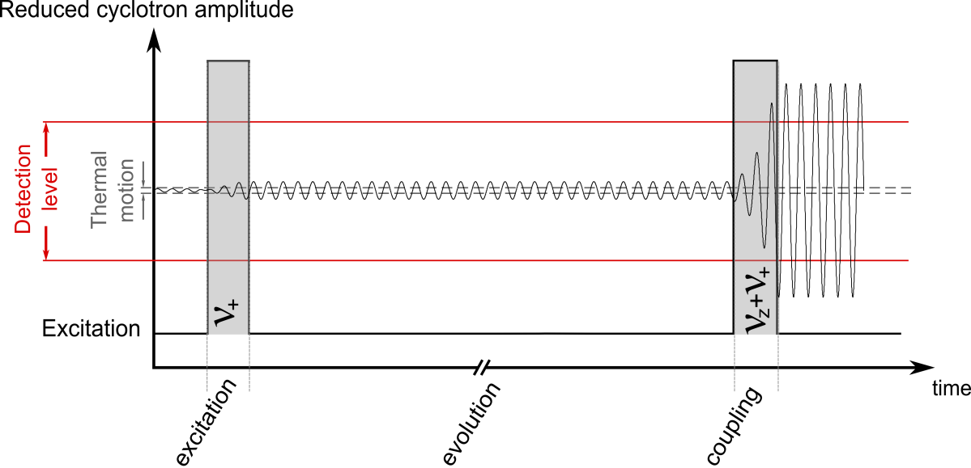
Eigenfrequency Detection
A
Cryogenic ultra low-noise amplifier
e_{n} = 800pV/ √Hz
i_{n} ≤ 4fA/ √Hz
Ion is resistively cooled until it reaches thermal equilibrium with the tank circuit
Q = 43000
R_{p} = 350 MΩ
Oscillating ion
induces image charges
in trap electrodes
Fast Fourier Transformation to obtain the frequency information

Slide 9
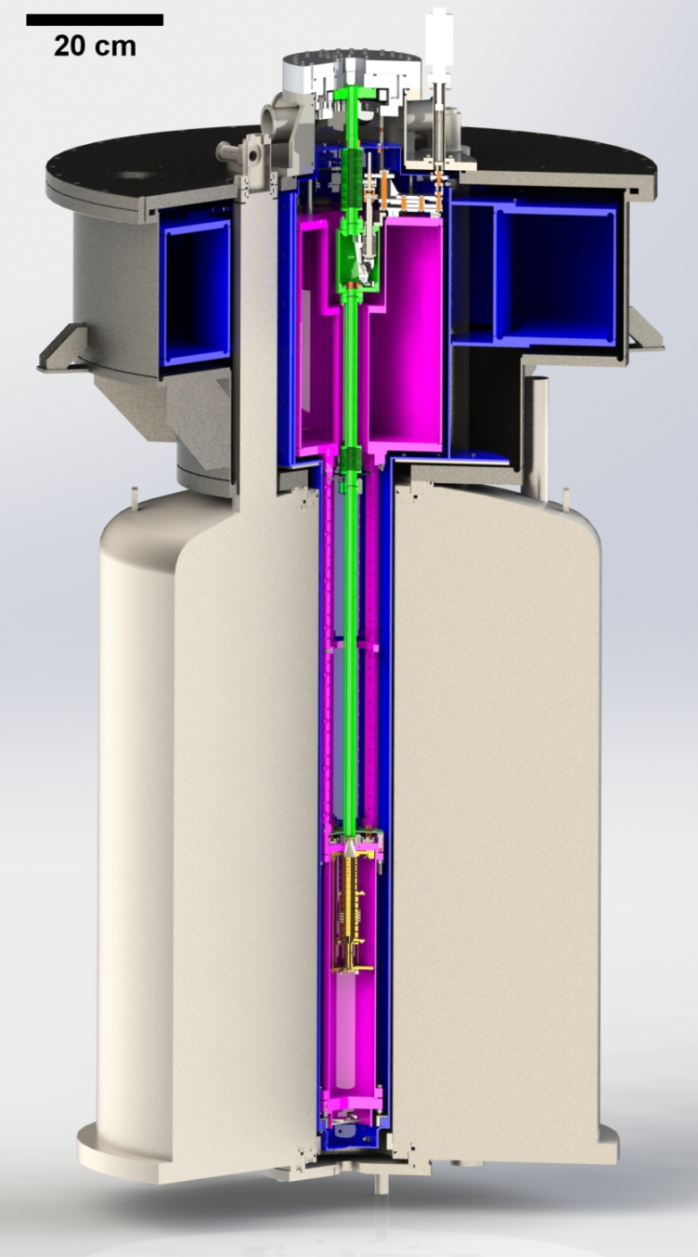
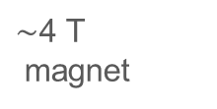
Experimental Setup
Beamline
Liquid
nitrogen
Cryogenic
vacuum valve
Liquid
helium
Cryogenic
electronics
Trap chamber with Penning Traps
$\sim$4 T
magnet
Cooling & Spectroscopy laser

Slide 10
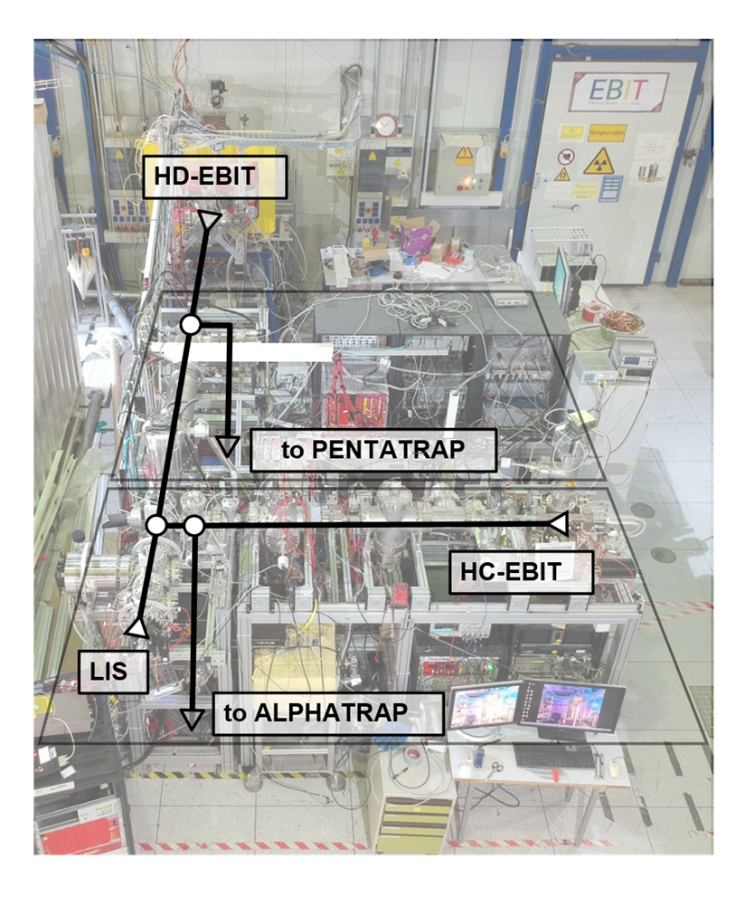
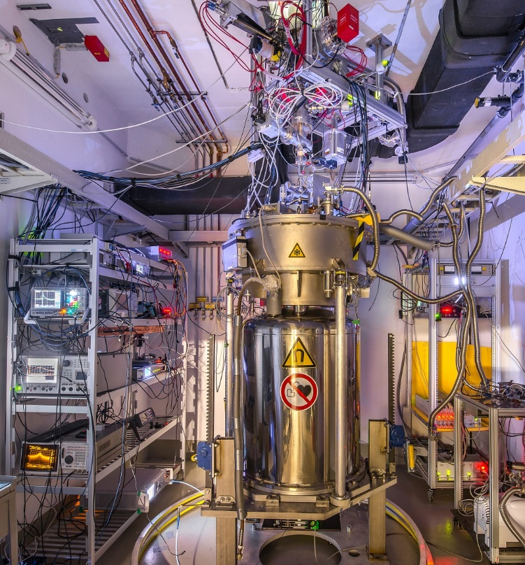
Experimental Setup

Slide 11
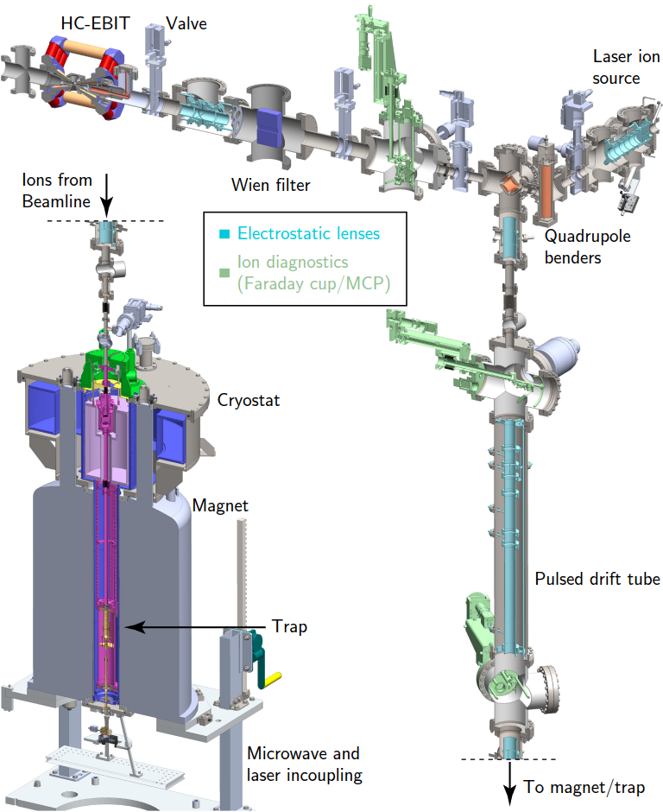
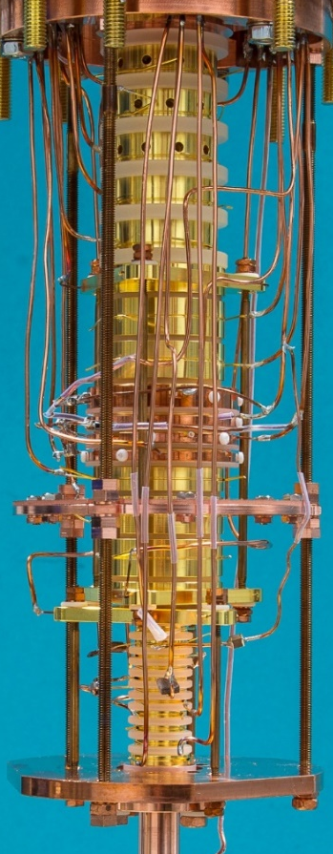
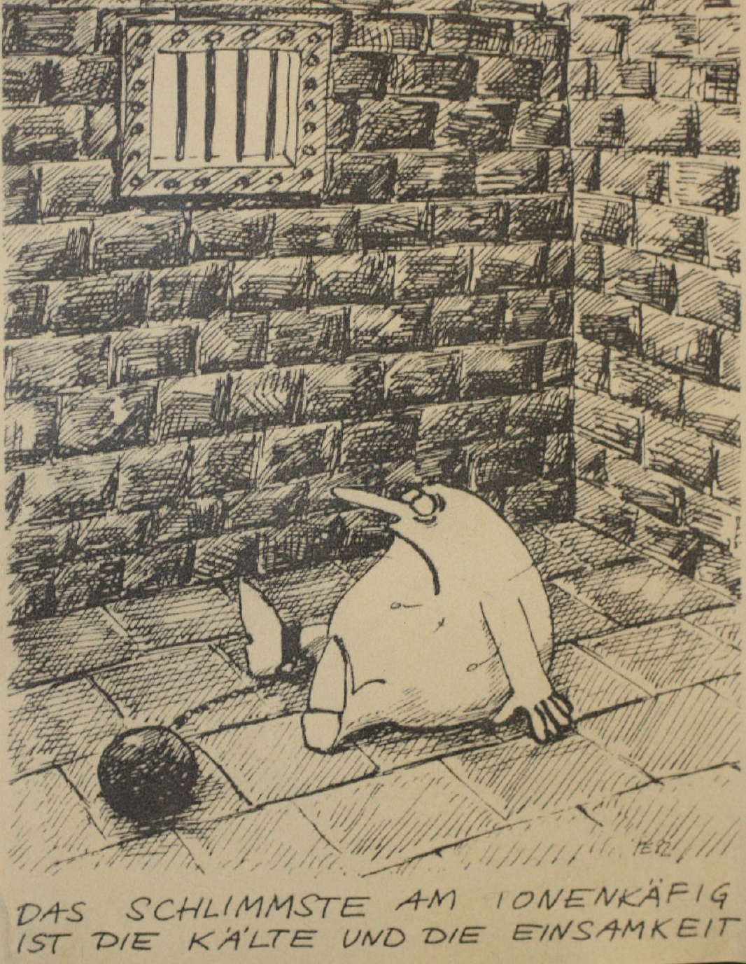
Experimental Setup (ALPHATRAP)
Ions from HD-EBIT
cryogenic temperatures (4.2K)
Vacuum better than 10⁻¹⁷ mbar
  basically no rest gas

Slide 12
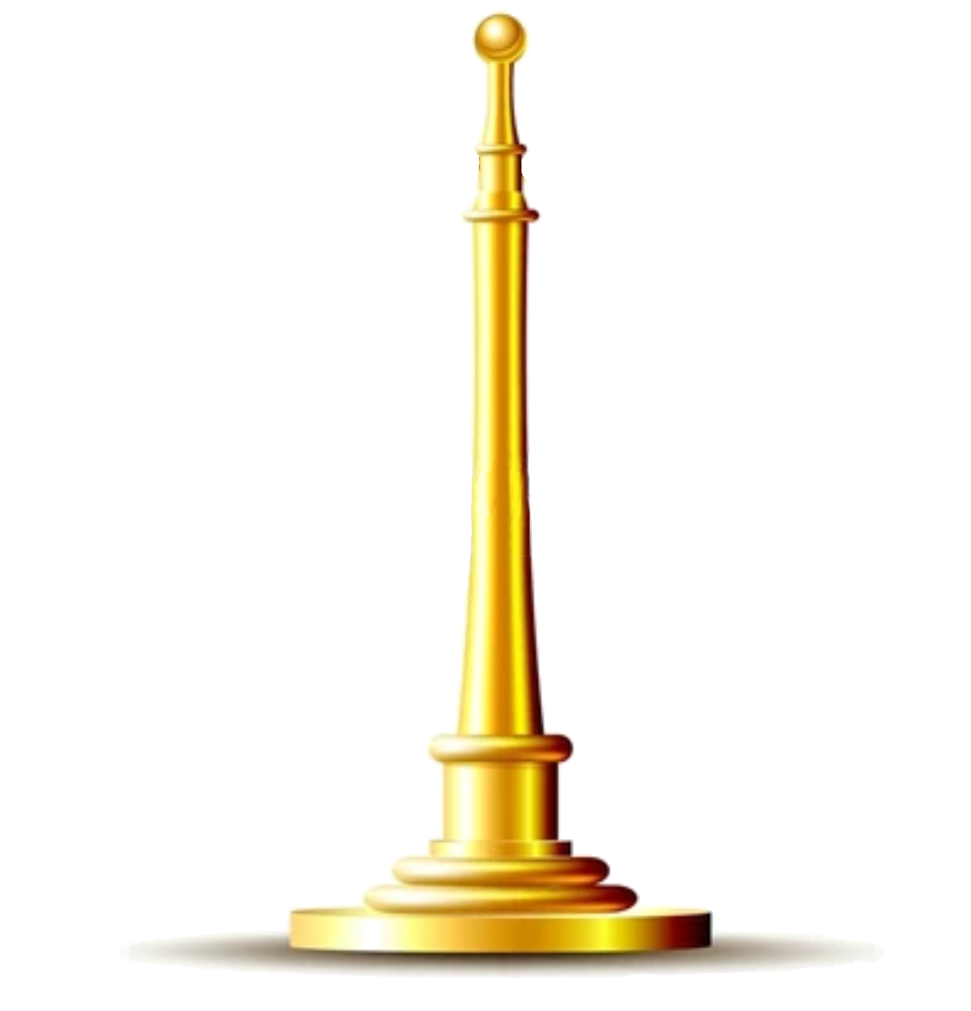
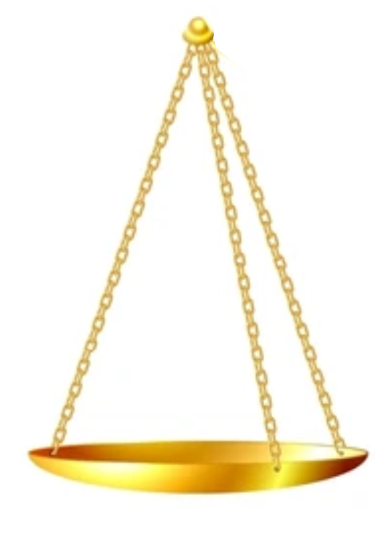

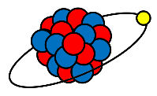
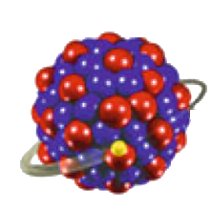
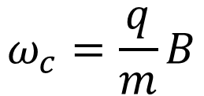
Application 1: Mass measurements
$$ω_{c}=\frac{q}{m}B$$

Slide 13
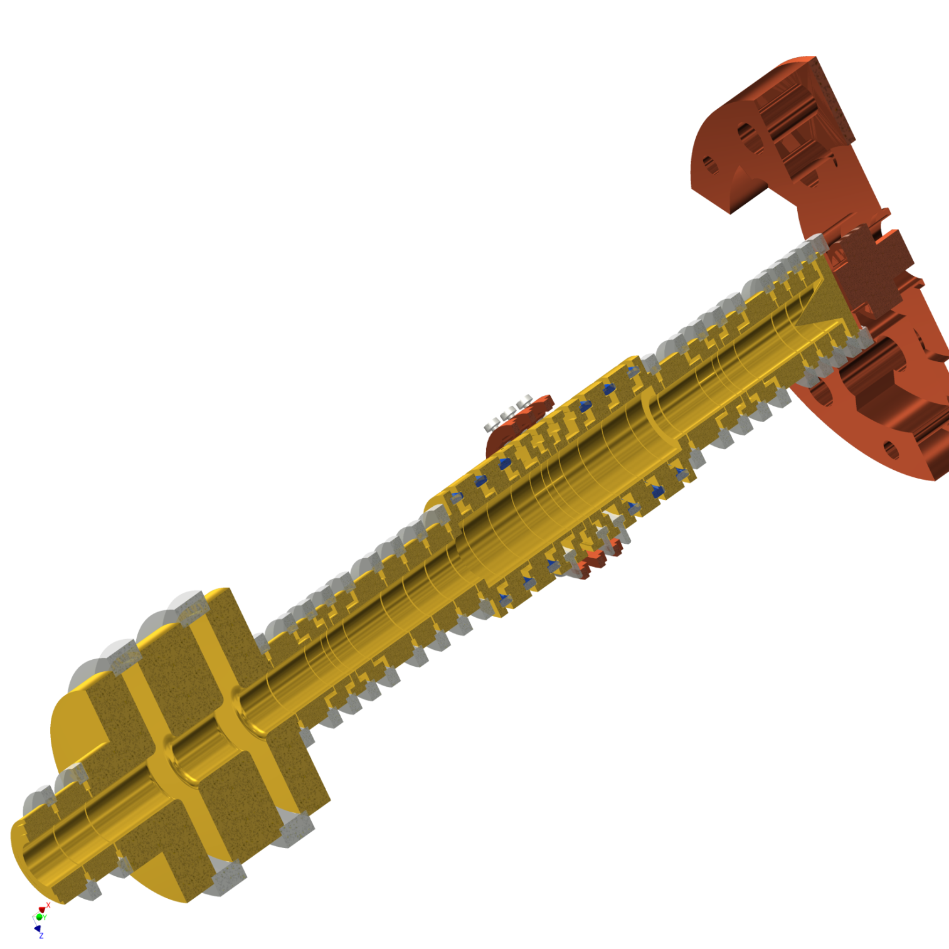
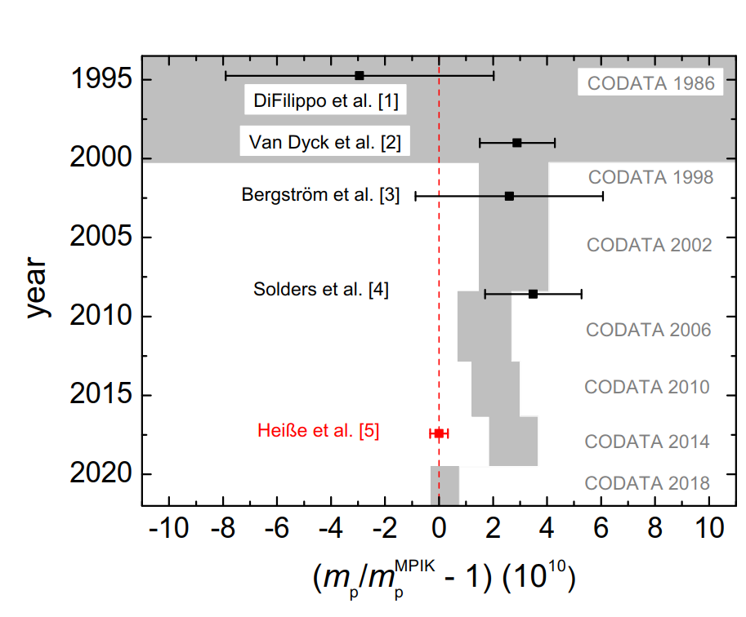
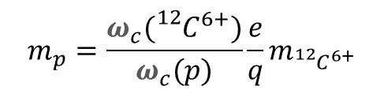

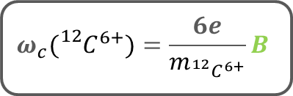
Ultra-precise q/m measurements
$$ω_{c}({{}_{}^{12}C}^{6+})=\frac{6e}{m_{{{}_{}^{12}C}^{6+}}}B$$
$$ω_{c}(p)=\frac{e}{m_{p}}B$$
$$m_{p}=\frac{ω_{c}({{}_{}^{12}C}^{6+})}{ω_{c}(p)}\frac{e}{q}m_{{{}_{}^{12}C}^{6+}}$$

Slide 14
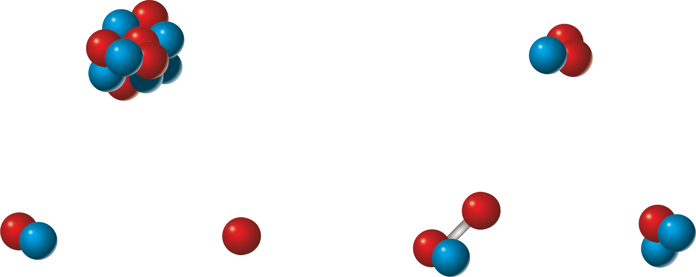
Puzzle of Light Atomic Masses
R.S. Van Dyck et al. @ UW
[2]
¹²C
³He
[2]
D
H
HD
T
[3] E. Myers et al., PRL 114, 013003 (2015)
[1] F. Heiße et al., PRL 119, 033001 (2017)
[4] Yan et al., PRA 67, 062504 (2003)
[2] S. L. Zafonte et al., Metrologia 52, 280 (2015)
[5] S. Hamzeloui et al, PRA 96, 060501 (2017)
Notes:
0.47(10) nu

Slide 15
Puzzle of Light Atomic Masses
R.S. Van Dyck et al. @ UW
E. Myers et al. @ FSU
[2]
¹²C
³He
New Measurement
[5]
[2]
[3]
D
H
HD
T
+ Binding Energy [4]
[3] E. Myers et al., PRL 114, 013003 (2015)
[1] F. Heiße et al., PRL 119, 033001 (2017)
[4] Yan et al., PRA 67, 062504 (2003)
[2] S. L. Zafonte et al., Metrologia 52, 280 (2015)
[5] S. Hamzeloui et al, PRA 96, 060501 (2017)
Notes:
0.47(10) nu

Slide 16
Puzzle of Light Atomic Masses
R.S. Van Dyck et al. @ UW
E. Myers et al. @ FSU
[2]
¹²C
?
³He
5σ
discrepancy
New Measurement
[5]
[2]
?
?
[3]
D
H
HD
T
+ Binding Energy [4]
[3] E. Myers et al., PRL 114, 013003 (2015)
[1] F. Heiße et al., PRL 119, 033001 (2017)
[4] Yan et al., PRA 67, 062504 (2003)
[2] S. L. Zafonte et al., Metrologia 52, 280 (2015)
[5] S. Hamzeloui et al, PRA 96, 060501 (2017)
Notes:
0.47(10) nu

Slide 17
Puzzle of Light Atomic Masses
R.S. Van Dyck et al. @ UW
[2]
¹²C
?
Currently measured
³He
3σ
remain
New Measurement
[5]
[6]
Liontrap
[1]
Liontrap
[3]
Liontrap
D
H
HD
T
[3] E. Myers et al., PRL 114, 013003 (2015)
+ Binding Energy [4]
[4] Yan et al., PRA 67, 062504 (2003)
[5] S. Hamzeloui et al, PRA 96, 060501 (2017)
[1] F. Heiße et al., PRL 119, 033001 (2017)
[6] S. Rau et al. Nature 585, 43–47 (2020)
[2] S. L. Zafonte et al., Metrologia 52, 280 (2015)
[7] D. J. Fink et al., PRL 124, 013001 (2020)
Notes:
0.47(10) nu

Slide 18
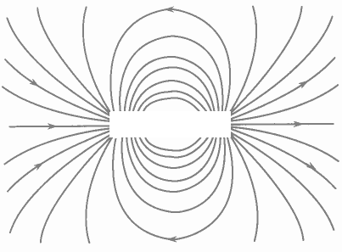
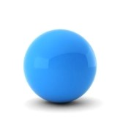

Application 2: g-factors

Slide 19
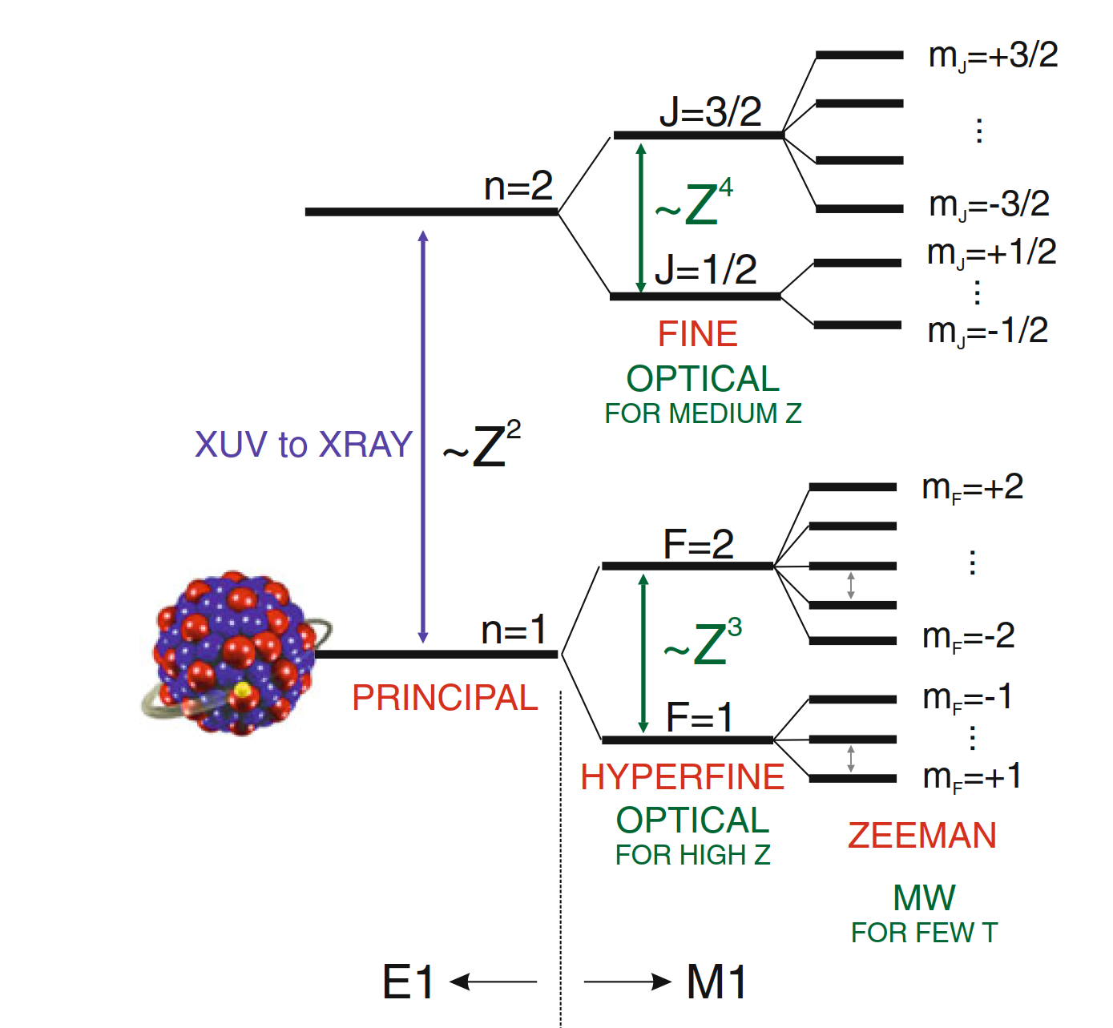
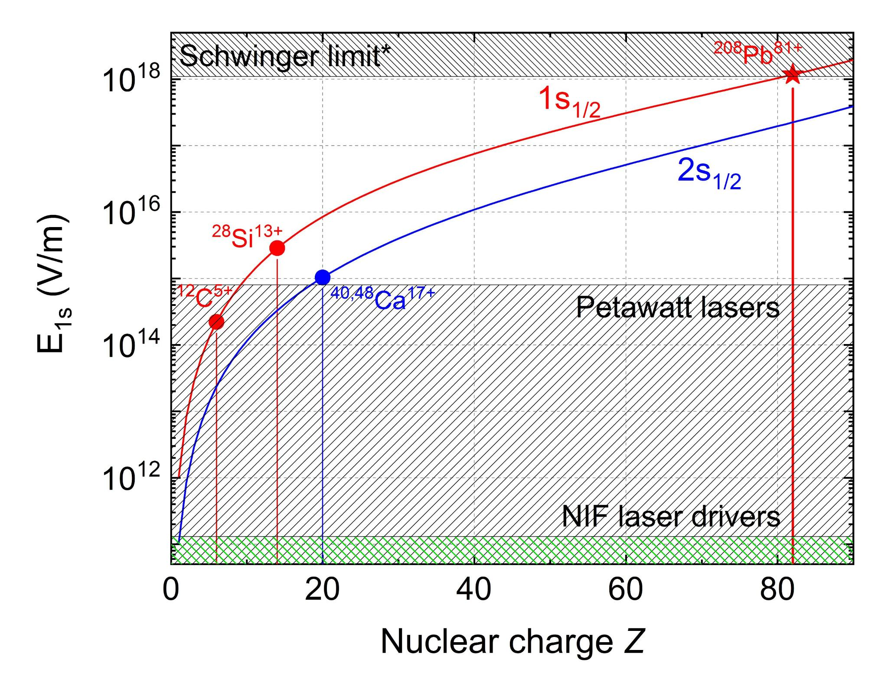
Highly charged ions

Slide 20
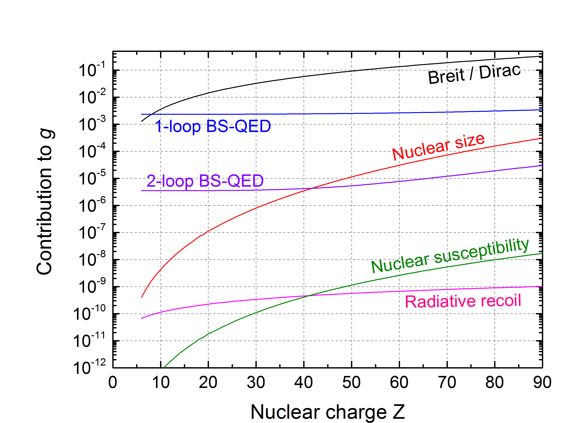
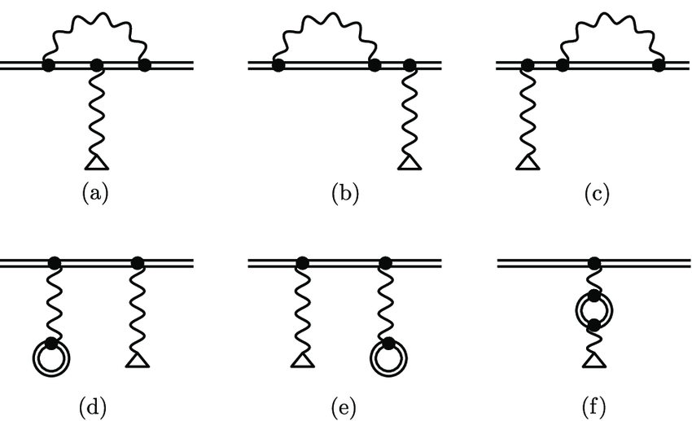
Highly charged ions

Slide 21
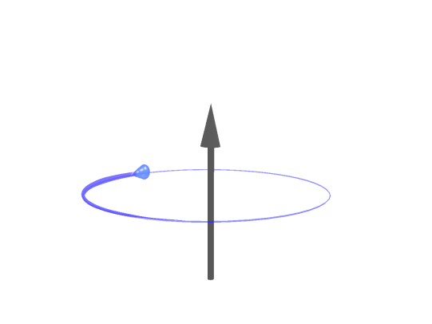

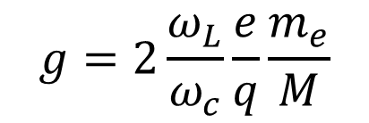

g-factor measurement in a Penning trap
B
B
$$ω_{L}=\frac{g}{2}\frac{e}{m_{e}}B$$
$$ω_{c}=\frac{q}{M}B$$
Larmor frequency
in a magnetic field B
Cyclotron frequency
in the same magnetic field B
$$g=2\frac{ω_{L}}{ω_{c}}\frac{e}{q}\frac{m_{e}}{M}$$
Larmor-to-cyclotron frequency ratio (Γ)

Slide 22
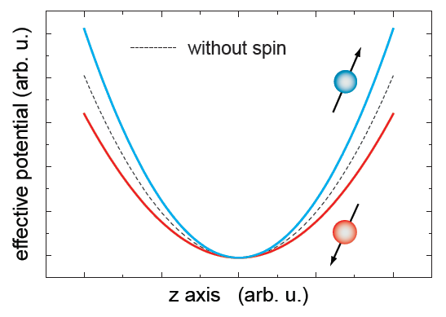
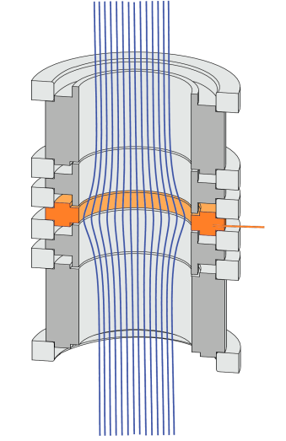

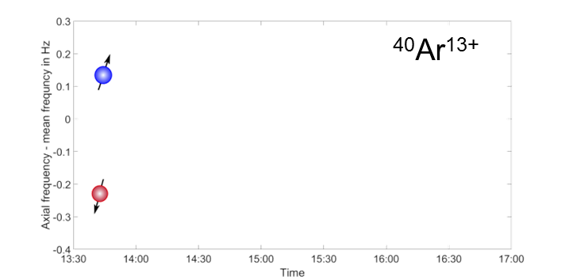
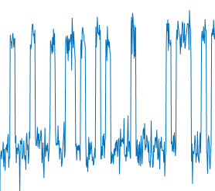
The continuous Stern-Gerlach effect
Magnetic bottle
B
e
ferromagnetic
ring
Axial frequency indicates spinflips:
Notes:
Spinflip bild aus Sven PhD thesis S.96
B₂:
Mainz 10mT/mm²
ALPHATRAP 45mT/mm²

Slide 23

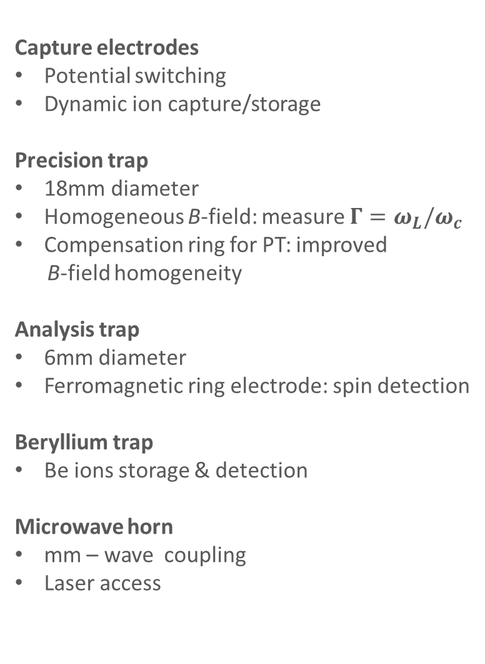
Double Penning trap
Capture electrodes
Potential switching
Dynamic ion capture/storage
Precision trap
18mm diameter
Homogeneous B-field: measure ${Γ=ω}_{L}/ω_{c}$
Compensation ring for PT: improved
B-field homogeneity
Analysis trap
6mm diameter
Ferromagnetic ring electrode: spin detection
Beryllium trap
Be ions storage & detection
Microwave horn
mm – wave coupling
Laser access

Slide 24
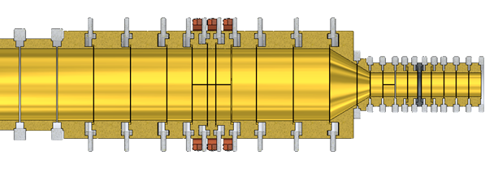
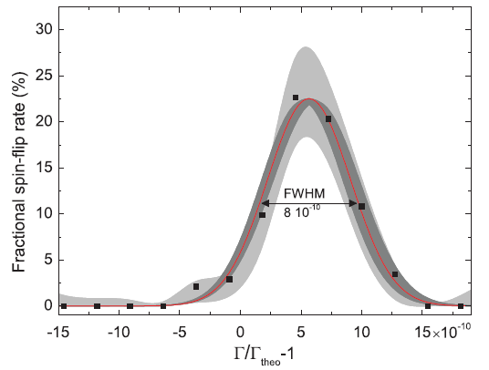
Double Penning trap
Capture electrodes
Potential switching
Dynamic ion capture/storage
Precision trap
18mm diameter
Homogeneous B-field: measure ${Γ=ω}_{L}/ω_{c}$
Compensation ring for PT: improved
B-field homogeneity
Analysis trap
6mm diameter
Ferromagnetic ring electrode: spin detection
Beryllium trap
Be ions storage & detection
Microwave horn
mm – wave coupling
Laser access

Slide 25
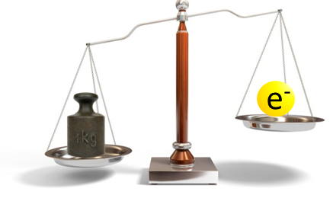
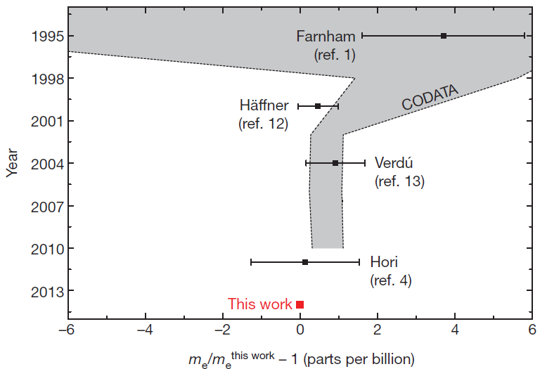
The electron mass
g from theory + solve for electron mass:
m_{e}=0.000 548 579 909 067(16) u
Nature 506, 467-470, 2014

Slide 26

QED of Bound States
up to IP ~ 150 keV ?
Probe validity of QED in the strongest fields
  Precision experiment with heavy, highly charged ions
  Strongly coupled (Zα≈1) electron, beyond the Furry picture
  Extract nuclear structure information
up to IP ~ 5 keV
Range accessible in the Mainz HCI experiment
Range accessible by ALPHATRAP

Slide 27

QED of Bound States
¹¹⁸Sn⁴⁹⁺: (Zα)~0.36
Jonathan Morgner
¹¹⁸Sn⁴⁹⁺
up to IP ~ 150 keV ?
Probe validity of QED in the strongest fields
  Precision experiment with heavy, highly charged ions
  Strongly coupled (Zα≈1) electron, beyond the Furry picture
  Extract nuclear structure information
up to IP ~ 5 keV
Range accessible in the Mainz HCI experiment
Range accessible by ALPHATRAP

Slide 28




QED of Bound States
¹¹⁸Sn⁴⁹⁺: (Zα)~0.36
Jonathan Morgner
¹¹⁸Sn⁴⁹⁺
up to IP ~ 150 keV ?
Probe validity of QED in the strongest fields
  Precision experiment with heavy, highly charged ions
  Strongly coupled (Zα≈1) electron, beyond the Furry picture
  Extract nuclear structure information
up to IP ~ 5 keV
Best test in fields
> 10¹⁵ V/cm
Range accessible in the Mainz HCI experiment
Range accessible by ALPHATRAP
Unique access to strong field QED in few electron systems
Investigate discrepancies at high Zα
ALPHATRAP demonstrates HCI lifetimes > weeks

Slide 29

QED of Bound States
¹¹⁸Sn⁴⁹⁺: (Zα)~0.36
Jonathan Morgner
¹¹⁸Sn⁴⁹⁺
up to IP ~ 150 keV ?
Probe validity of QED in the strongest fields
  Precision experiment with heavy, highly charged ions
  Strongly coupled (Zα≈1) electron, beyond the Furry picture
  Extract nuclear structure information
up to IP ~ 5 keV
Best test in fields
> 10¹⁵ V/cm
Range accessible in the Mainz HCI experiment
Range accessible by ALPHATRAP
Unique access to strong field QED in few electron systems
Investigate discrepancies at high Zα
ALPHATRAP demonstrates HCI lifetimes > weeks

Slide 30


Towards the highest Z: New EBIT

Slide 31



Application 3: Laser spectroscopy
of long-lived states
- towards a CPT test with ${\overline{H}}_{2}^{−}$
H₂⁺
e
p
p
${\overline{H}}_{2}^{−}$

Slide 32

Ro-vibrational spectroscopy on HD⁺
vibration (ν)
HD⁺
e
p
d
(0,2)
(1,2)
(2,2)
(0,1)
(1,1)
(2,1)
(N,v)=(0,0)
(1,0)
(2,0)
(3,0)
rotation (N)

Slide 33
Ro-vibrational spectroscopy on HD⁺
vibration (ν)
HD⁺
e
p
d
(0,2)
(1,2)
(2,2)
(0,1)
(1,1)
(2,1)
(N,v)=(0,0)
(1,0)
(2,0)
(3,0)
rotation (N)

Slide 34



HD⁺ hyperfine structure
Rovibrational ground state @B=0
s_{e} = ½
I_{p} = ½
I_{d} = 1
Charlotte König
F = I_{p} + s_{e}
J = F + I_{d}

Slide 35



HD⁺ hyperfine structure
Rovibrational ground state in magnetic field:
s_{e} = ½
I_{p} = ½
I_{d} = 1
Charlotte König
All transitions measured to 10-20Hz precision.

Slide 36
Ro-vibrational spectroscopy on HD⁺
vibration (ν)
Probe @
112 GHz + ε
HD⁺
Collaboration with Stephan Schiller
e
p
d
E2 (4.6μm)
Zeeman splitting in B
(e⁻ & p) & d
Probe @
112 GHz
e⁻ & p
rotation (N)

Slide 37

A leap in precision:
Fully coherent simultaneous measurements

Slide 38
Coherent g₁-g₂ difference measurement
B
t
Magnetic field fluctuations quickly (~ms) render Larmor precession incoherent
B

Slide 39
Coherent g₁-g₂ difference measurement
B
t
Magnetic field fluctuations quickly (~ms) render Larmor precession incoherent
Crystallized ions see the identical field
  The phase difference (correlation) stays coherent (>seconds!)
B

Slide 40





Coherent g₁-g₂ difference measurement
B
Coherent difference
t
Magnetic field fluctuations quickly (~ms) render Larmor precession incoherent
Crystallized ions see the identical field
  The phase difference (correlation) stays coherent (>seconds!)
B
Simultaneous Ramsey cycle
$$p\left(\left|\left.↓↓\right\rangle \right.→\left|\left.↑↑\right\rangle \right.\right)={\cos\left(\left(ω_{1}−ω_{rf}\right)t\right)}^{2}×{\cos\left(\left(ω_{2}−ω_{rf}\right)t\right)}^{2}$$
$=$ $\frac{1}{4}\left[cos\left(2\left(ω_{1}−ω_{2}\right)t\right)+⋯\right]$
$$\frac{π}{2}$$
$$\frac{π}{2}$$
$${\left\langle B\left(t\right)\right\rangle }_{t}$$
Small difference

Slide 41




Coherent g₁-g₂ difference measurement
Dr. Tim Sailer
Sets limits on scalar bosons coupling neutrons and electron
δΔg/g=5.6 10⁻¹³

Slide 42





Lepton Symmetry experiment
Compare electron and positron spin precession simultaneously in the same trap
Positron has to be ground-state cooled - sub-500mK black-body radiation in the trap !

Slide 43


Lepton Symmetry experiment
Compare electron and positron spin precession simultaneously in the same trap
Positron has to be ground-state cooled - sub-500mK black-body radiation in the trap !

Slide 44



Lepton Symmetry experiment
Compare electron and positron spin precession simultaneously in the same trap
3He 300mK stage
Positron has to be ground-state cooled - sub-500mK black-body radiation in the trap !

Slide 45

Lepton Symmetry experiment
Compare electron and positron spin precession simultaneously in the same trap
Positron has to be ground-state cooled - sub-500mK black-body radiation in the trap !

Slide 46


Summary
Precision measurements on simple systems allows testing QED
  The g-factor of HCI gives most stringent test of QED in strong electric fields
Coherent spectroscopy of crystalized ion pairs yield a leap in precision and sensitivity
Magnetic bottle enables spectroscopy of molecular (anti?-)hydrogen ions
Thanks to my team:
Dr. Fabian Heiße
Jonathan Morgner
Charlotte König
Dr. Tim Sailer
Dr. Bingsheng Tu
Sangeetha Sasidharan
Olesia Bedronova
Sascha Rau
Klaus Blaum (Director)
Stephan Schiller and group:
Ivan Kortunov & Victor Vogt

Slide 48
Lepton Symmetry experiment
Compare electron and positron spin precession simultaneously in the same trap
Positron has to be ground-state cooled - sub-500mK black-body radiation in the trap !

