Slide 1
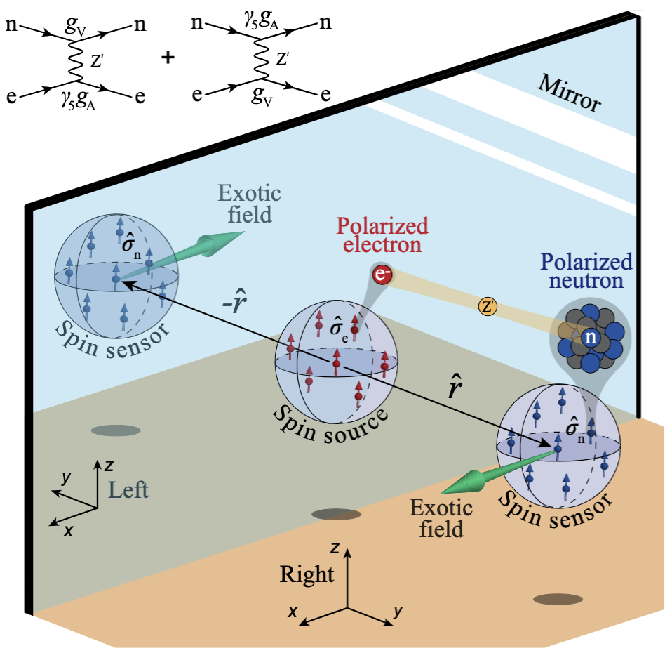
Searches for New Physics along the sensitivity frontier:
a few examples
Dmitry Budker
Helmholtz Institute, Johannes Gutenberg University, Mainz & UC Berkeley
PREN & μASTI: June 28st, 2023

Slide 2
Quantum sensors for new-physics discoveries
November 2022

Slide 3
Dark matter: an elephant in the room
Cover image from D. Budker and A. O. Sushkov, Physics on Your Feet; Second Edition, 280 pp, OUP 2021

Slide 4
What can it be ?
Ultralight bosonic particles
Axions (pseudoscalar)
ALPs (pseudoscalar)
Dilatons (scalar)
Vector particles
Antiquark Nuggets (AQN)
Millicharged particles
Not even particles
A gross misunderstanding of gravity (MOND, …) ???
Proca MHD (finite photon mass) ☹?
Black holes, dark planets, interstellar gas, … ☹?
WIMPS ☺
Relaxions (mixed)

Slide 5
Elephant Safari
Direct DM searches
Indirect DM searches
Spectroscopy
NMR
Antimatter
EDMs
Astrophysics
Accelerator based searches

Slide 6
Indirect searches via fifth forces (examples)

Slide 7
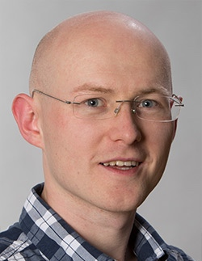
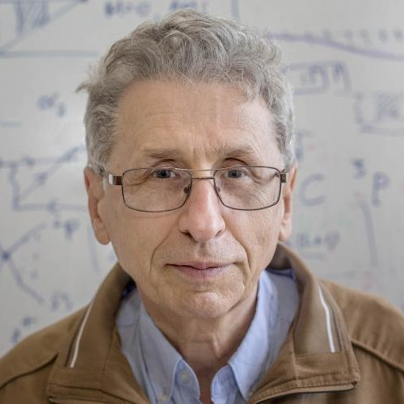
The latest catalog of EXOTIC potentials
Previous catalogs:
J. E. Moody and F. Wilczek, Phys. Rev. D 30, 130 (1984)
B. A. Dobrescu and I. Mocioiu, J. High Energy Phys. 11 (2006)

Slide 8
arXiv:2205.07222
Science Advances 9, eade0353 (2023)
Dr. Min Jiang, USTC
P-odd, T-even
Dr. Wei Ji, HI Mainz
Notes:
arXiv:2205.07222

Slide 9
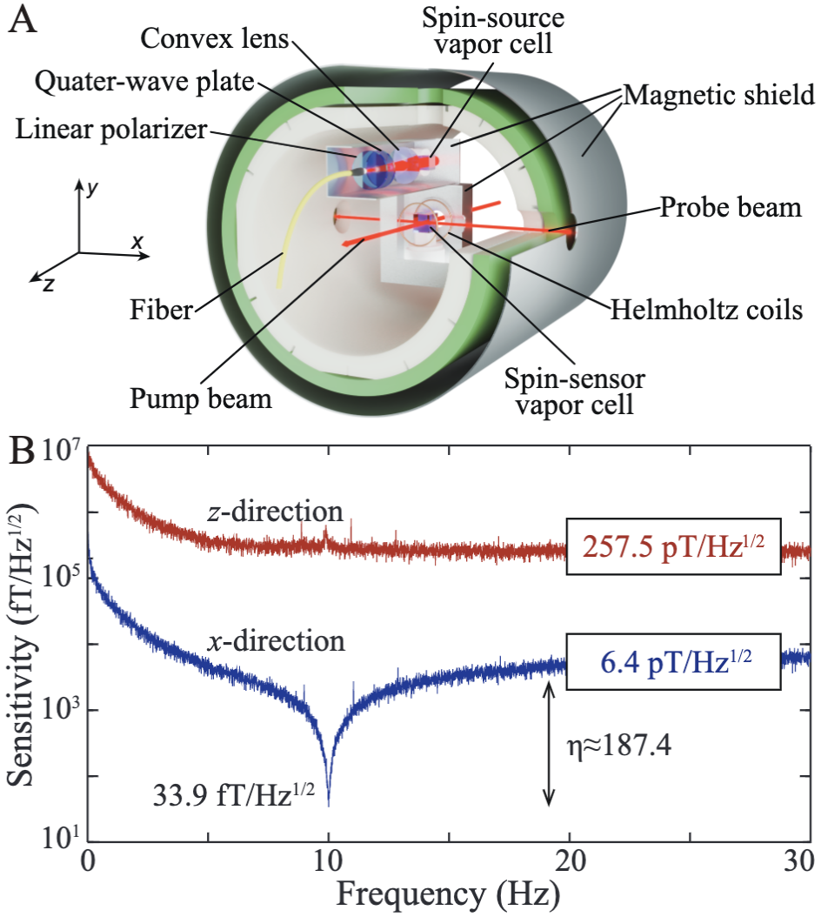
arXiv:2205.07222
Science Advances 9, eade0353 (2023)

Slide 10
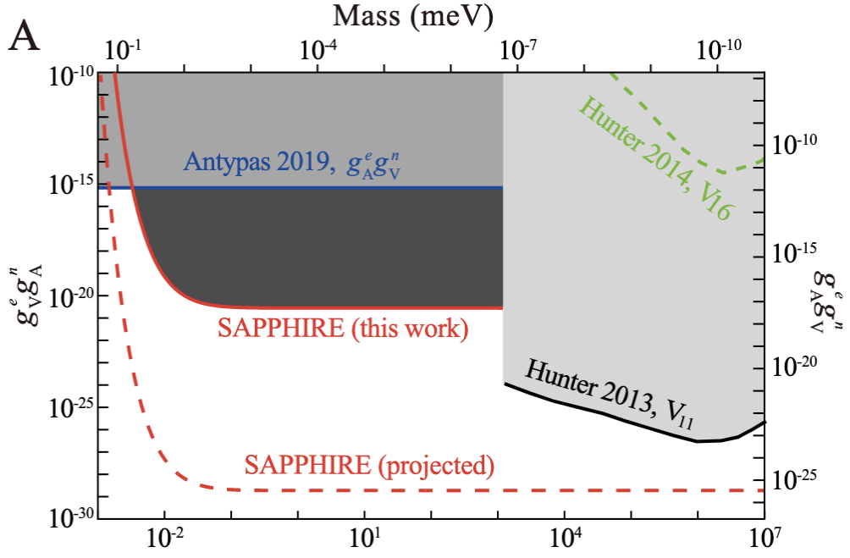
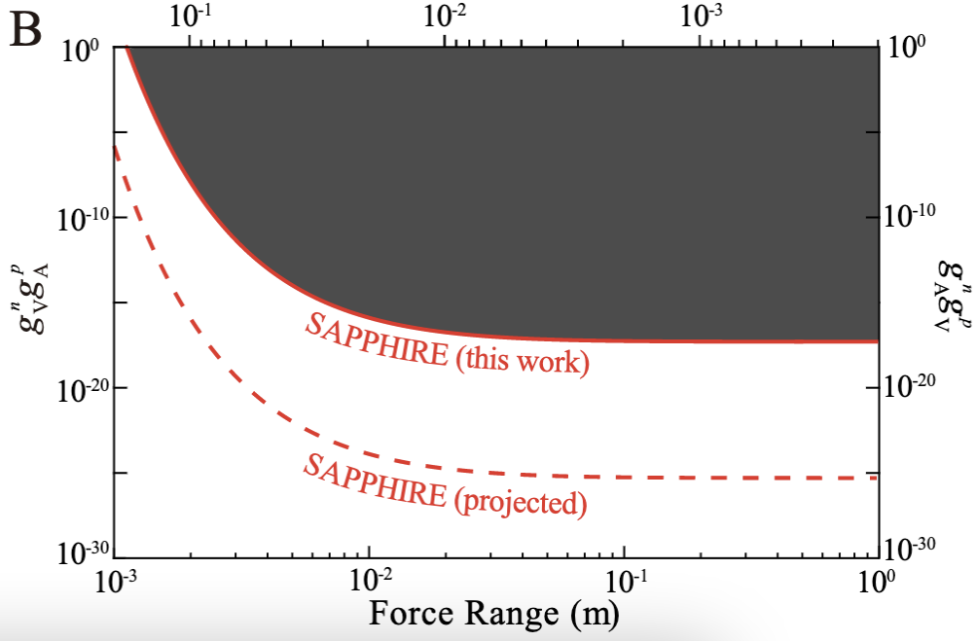
arXiv:2205.07222
Science Advances 9, eade0353 (2023)
Electron-neutron couplings
Proton-neutron couplings

Slide 11
In another geometry---also sensitive to parity-conserving fifth forces

Slide 12
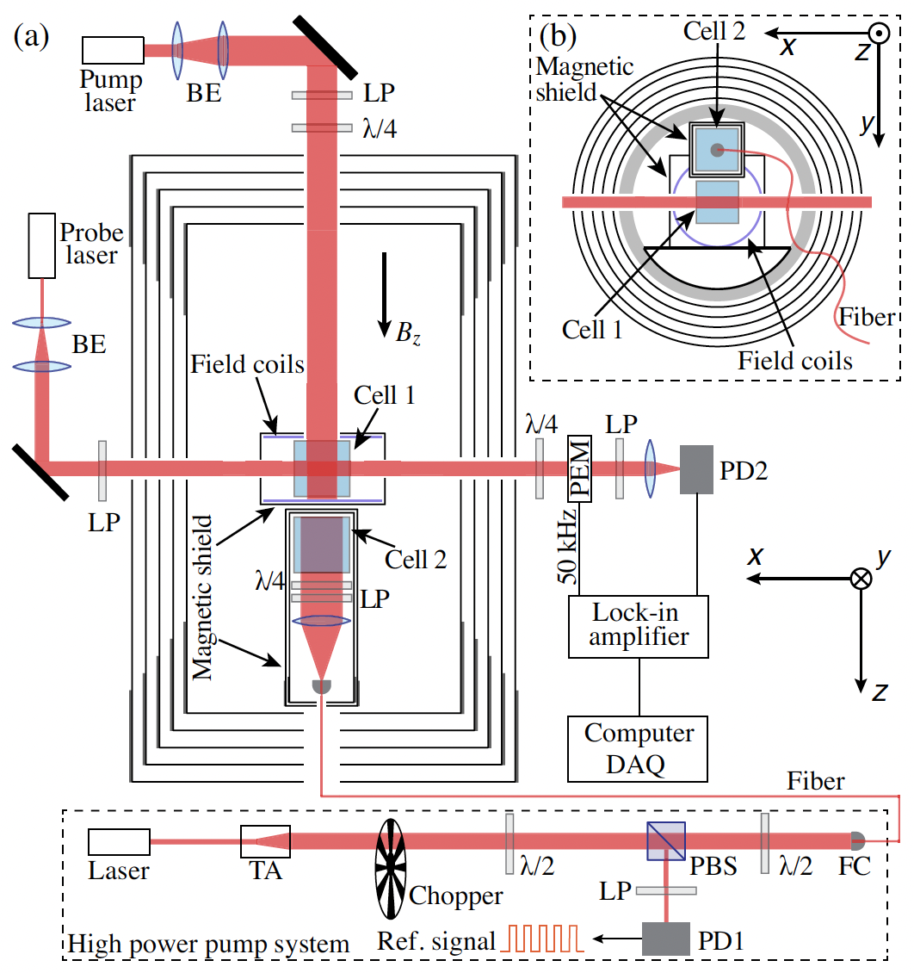
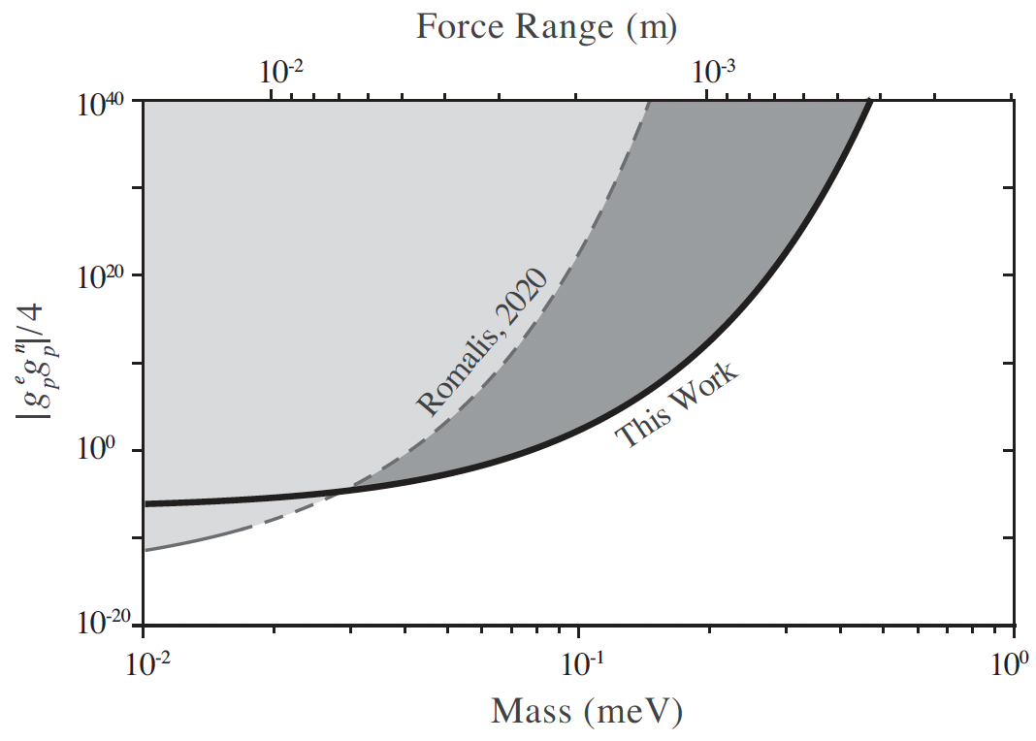
P-even, T-even

Slide 13
…and velocity-dependent monopole-dipole coupling

Slide 14
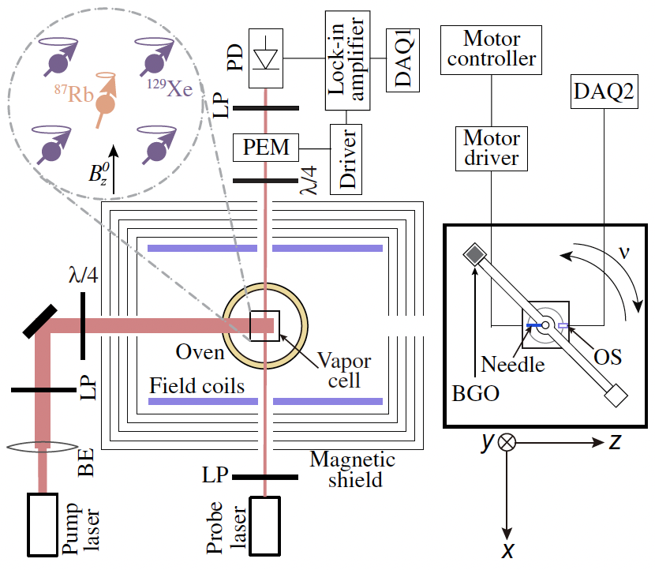
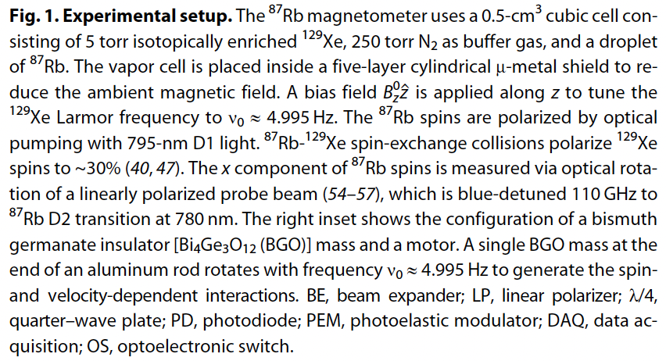
P-even, T-even
P-odd, T-even

Slide 15
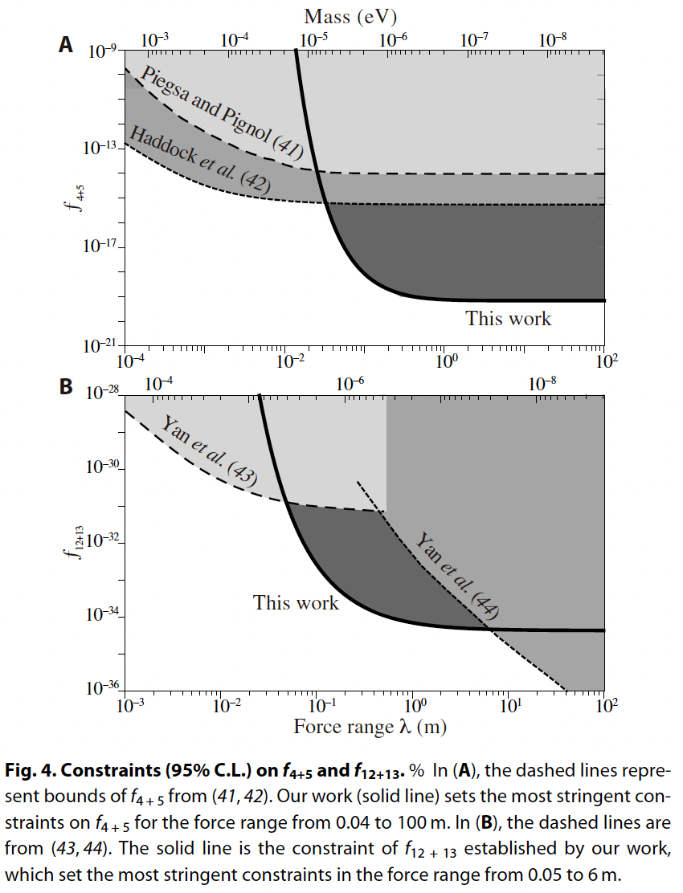

Slide 16
Direct searches for pseudoscalars (example)

Slide 17
How to search for halo Axions (ALPs) ?
Axion (ALP) Interactions
Gravity
+
Gauge Fields
Fermions
axion field amplitude
symmetry breaking scale
nEDM, HfF⁺,…
CASPEr-E
GNOME, QUAX, nEDM, comag,…
CASPEr-grad
Most Searches,
DM radio
17
Notes:
Concentrate on the electric and gradient couplings

Slide 18
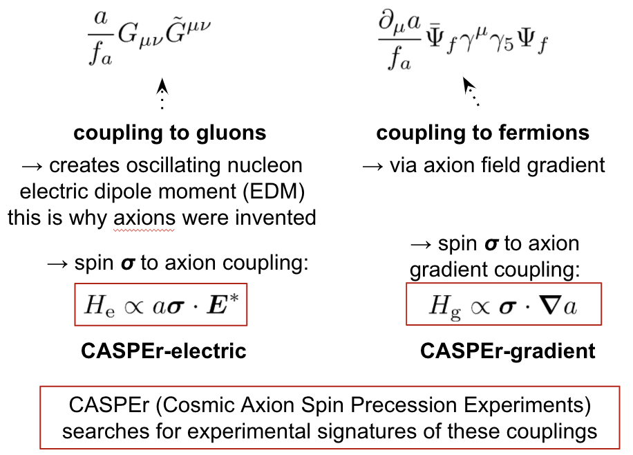
Nonrelativistic forms
P-odd, T-odd
P-even, T-even
A. Sushkov

Slide 19
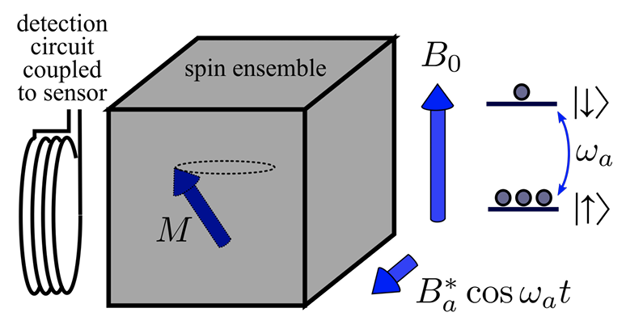
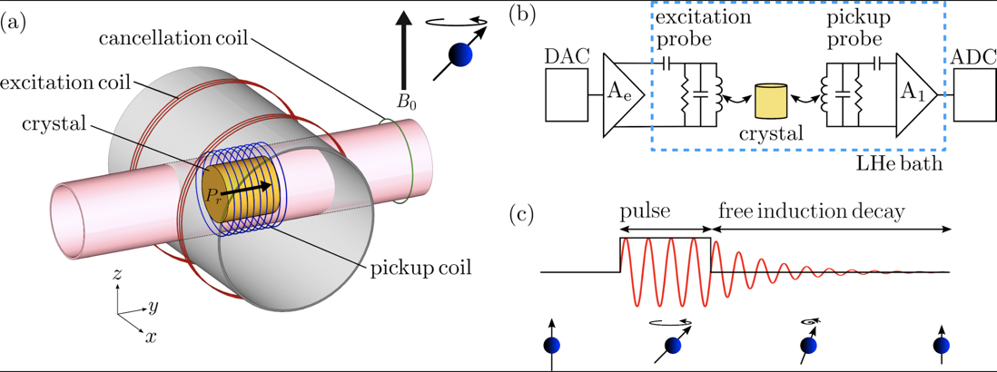
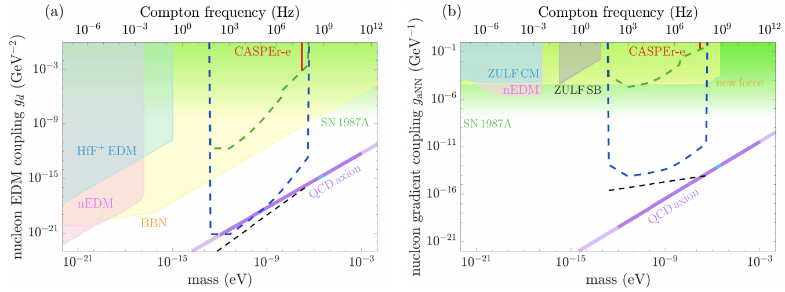
CASPEr: cosmic axion spin-precession experiments; first physics results: 2019-21
Boston and Mainz
D. Aybas et al PhysRevLett.126.141802 (2021)

Slide 20
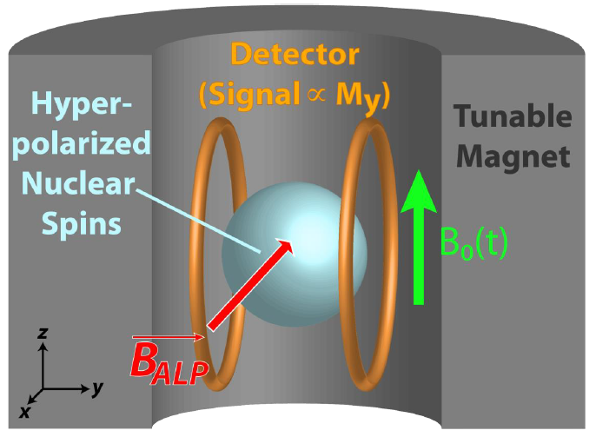
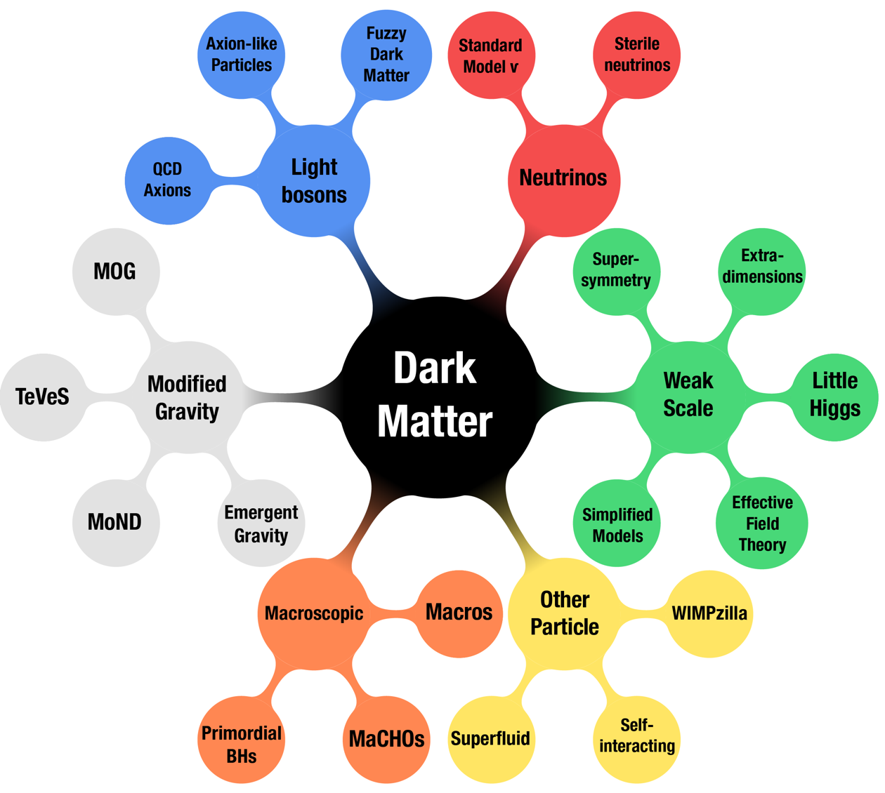
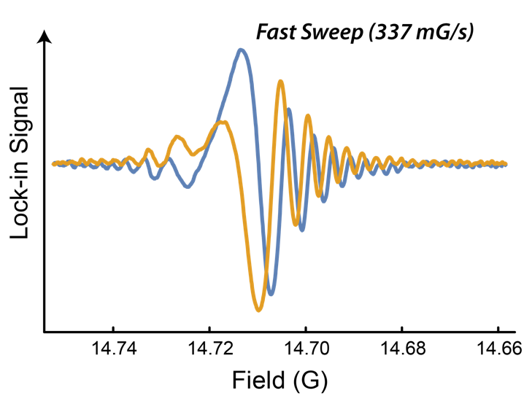
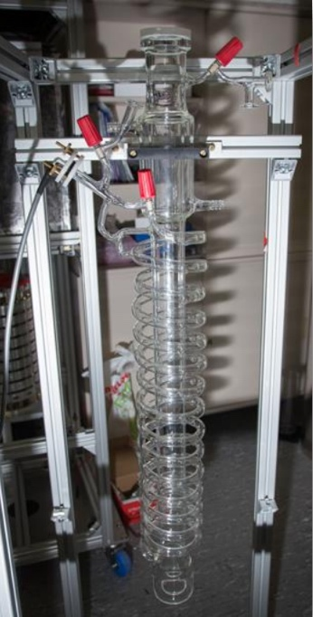
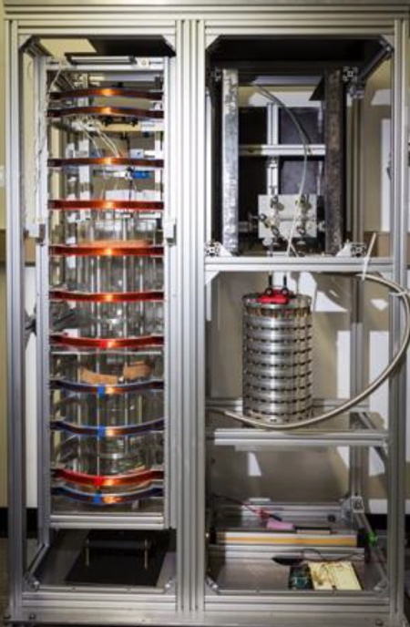
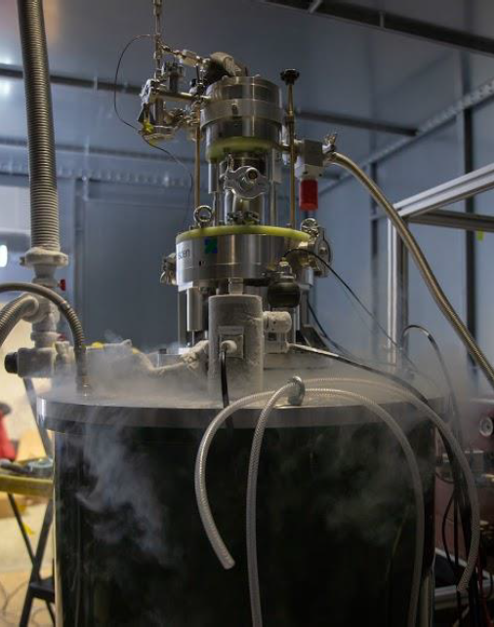
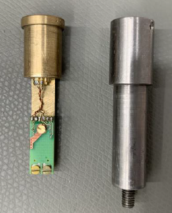
CASPEr-gradient-low-field Mainz

Slide 21
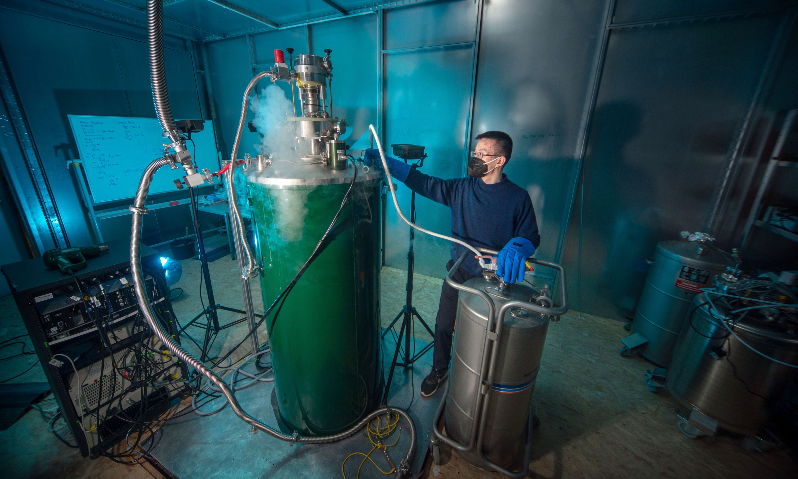

Slide 22
A lot is going on in UBDM searches…

Slide 23
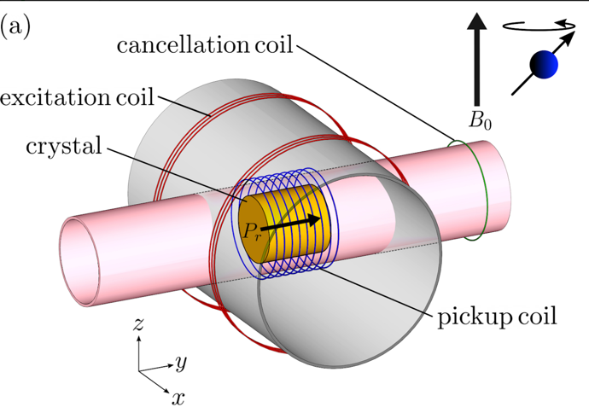
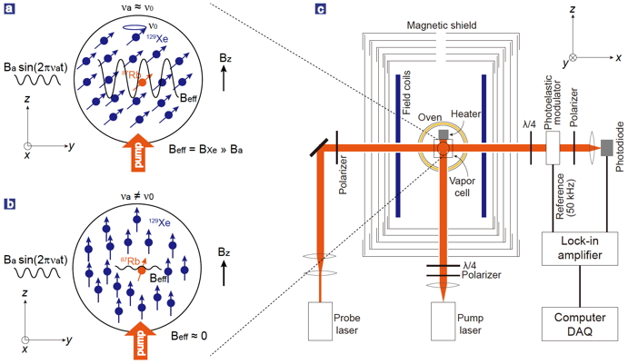
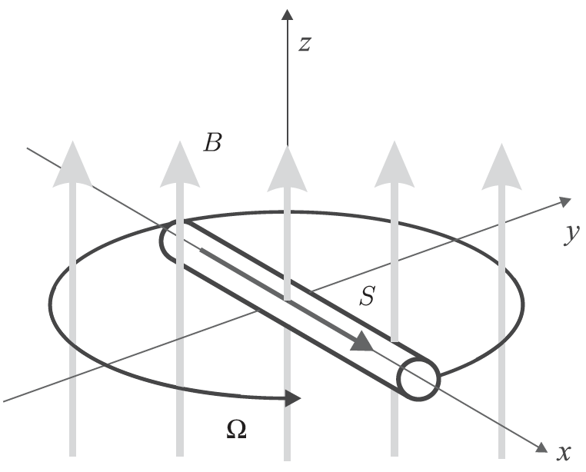
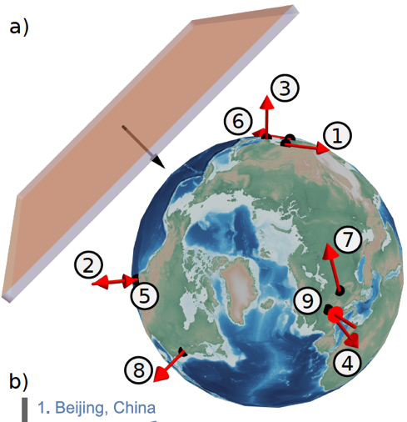
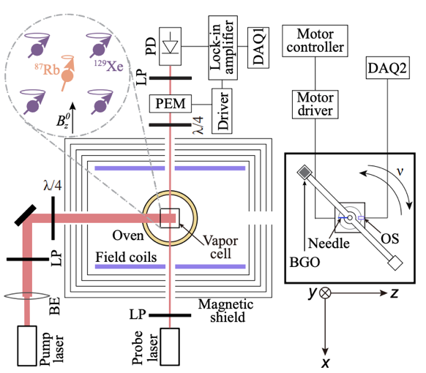
Searching for Ultralight Bosonic (and other) DM
NMR (CASPEr)
Spin-based sensors for DM: masers, spin amplifiers
Spin-based sensors for fifth-force searches (single NV, cells)
GNOME, clock networks, hybrid networks
Gravimeters
Atomic spectroscopy
Antimatter
Levitated magnets
Nataniel Figueroa Liegh

Slide 24
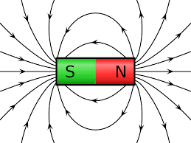
Hot off the press:
Abhishek Banerjee et al, Oscillating nuclear charge radii as sensors for ultralight dark matter, arXiv:2301.10784 (2023)
I.M. Bloch et al , Scalar dark matter induced oscillation of permanent-magnet field, Phys. Rev. D 107, 075033, arXiv:2301.08514 (2023)
Xue Zhang et al, Search for ultralight dark matter with spectroscopy of radio-frequency atomic transitions, Phys. Rev. Lett. (accepted) arXiv:2212.04413 (2022)
Kai Wei et al , Ultrasensitive atomic comagnetometer with enhanced nuclear spin coherence, Phys. Rev. Lett. 130, 063201 (2023), arXiv:2210.09027

Slide 25
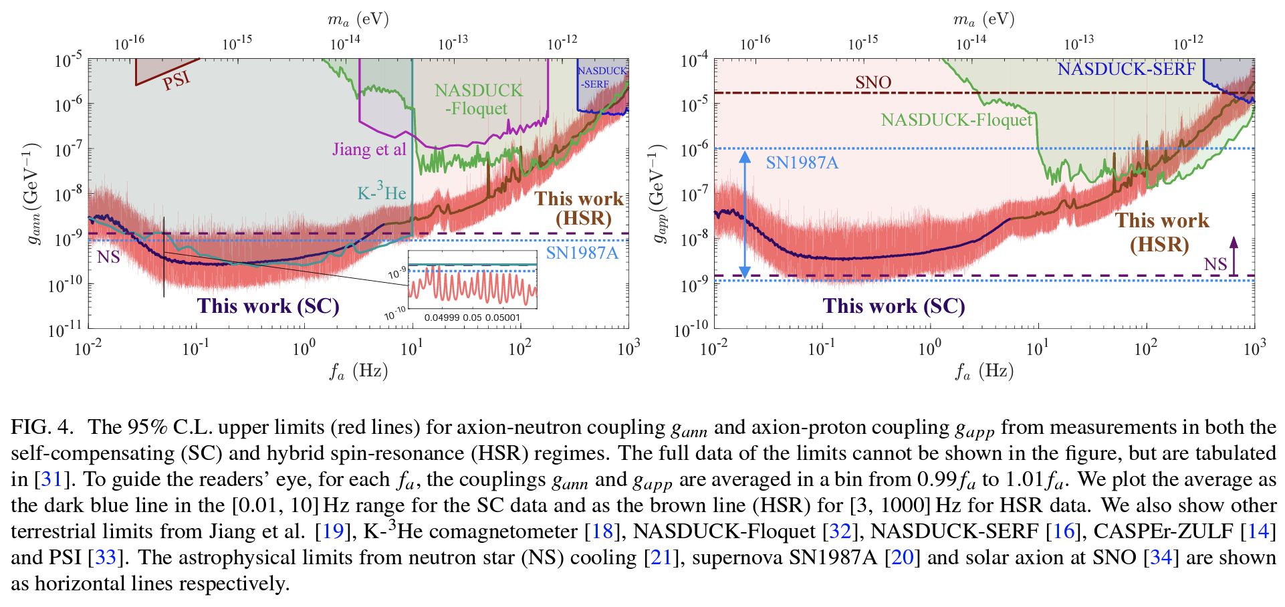
Hot off the press:
Kai Wei, Zitong Xu, Yuxuan He, Xiaolin Ma, Xing Heng, Xiaofei Huang, Wei Quan, Wei Ji, Jia Liu, Xiaoping Wang, Jiancheng Fang, and Dmitry Budker, Dark matter search with a strongly-coupled hybrid spin system, arXiv:2306.08039 (2023)

