Slide 1
Proton spin structure functions and polarizability contribution to Hyperfine Splitting in muonic hydrogen
David Ruth
PREN/μASTI Workshop 2023
6/27/2023

Slide 2
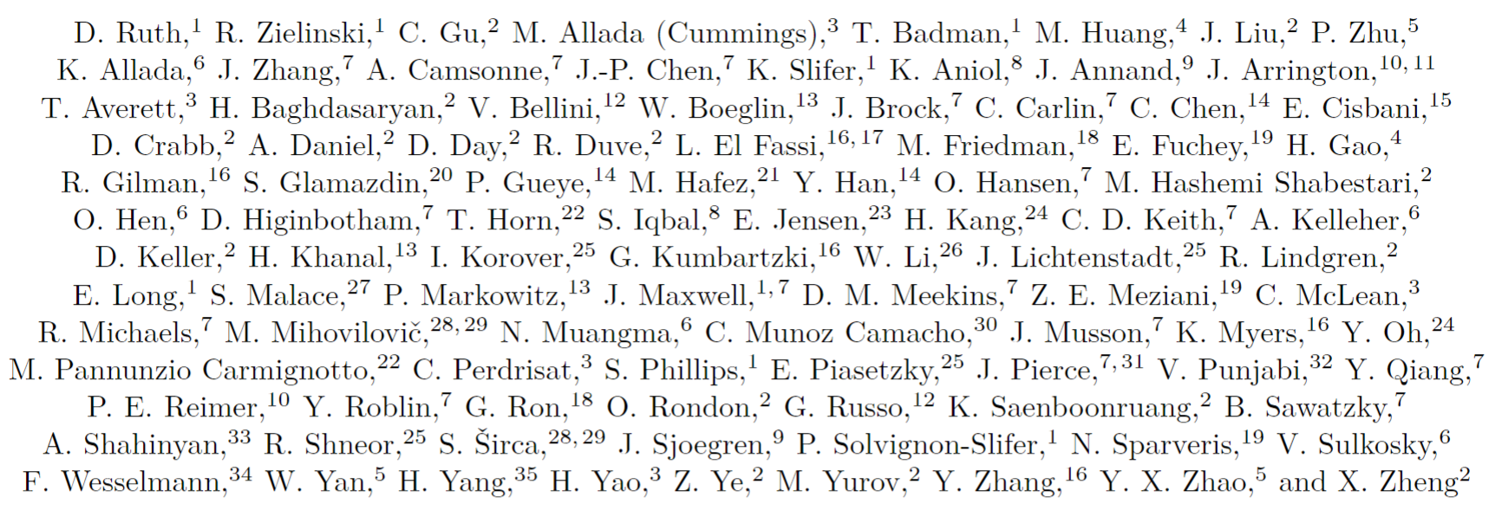
A big thanks to the whole g2p collaboration!

Slide 3
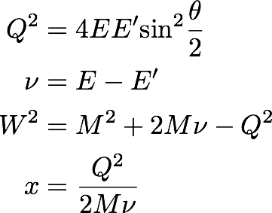
Electron-Proton Scattering Formulation
e⁻
E
E’
e⁻
Goal: study the proton’s spin structure and understand QCD in the regime where quark-gluon correlations are significant
Inclusive electron scattering measurement
γ
X
p

Slide 4
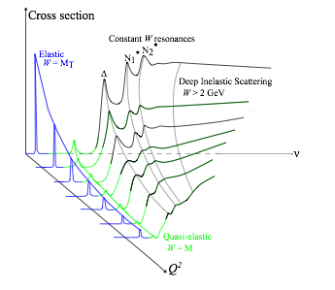
Cross section can be decomposed into Form Factors & Structure Functions
Elastic Scattering: target remains in ground state
Form factors G_{e} and G_{m} describe electric and magnetic distribution
Inelastic Scattering: target is excited by interaction
Structure functions F₁ and F₂ describe quark-gluon distribution
Inelastic Scattering with polarized beam & target:
g₁ and g₂ describe spin distribution & quark-gluon correlations

Slide 5
Proton Spin Structure contributes to Hyperfine Splitting of Hydrogen
See Carl Carlson’s previous talk…
Uncertainty in theoretical calculations of Hyperfine splitting is presently dominated by proton structure term
Requires experimental constraint from spin structure functions!
A. Antognini, F. Hagelstein, and V. Pascalutsa (2022)
$$E_{nS−hfs}^{2γ}=\frac{E_{F}}{n^{3}}\left(Δ_{Z}+Δ_{recoil}+Δ_{pol}\right)$$
$$Δ_{1}=\frac{9}{4}\int_{0}^{∞}{\frac{dQ^{2}}{Q^{2}}\left[{\left(\frac{G_{M}\left(Q^{2}\right)+G_{E}^{2}\left(Q^{2}\right)}{1+τ}\right)}^{2}+\frac{8M_{p}^{2}}{Q^{2}}\int_{0}^{x_{th}}{\tilde{β_{1}}\left(x , Q^{2}\right)g_{1}\left(x , Q^{2}\right)dx}\right]}$$
$$Δ_{2}=−24M_{p}^{2}\int_{0}^{∞}{\frac{dQ^{2}}{Q^{4}}}\int_{0}^{x_{th}}{\tilde{β_{2}}\left(x , Q^{2}\right)g_{2}\left(x , Q^{2}\right)dx}$$
$$Δ_{pol}=\frac{αm_{l}}{πg_{p}M_{p}}\left(Δ_{1}+Δ_{2}\right)$$

Slide 6
Kinematic weighting for muonic hydrogen
$$\tilde{β_{1}}\left(Q^{2}\right)=\frac{x^{2}β_{1}\left(τ\right)−{\left(\frac{m_{l}}{m_{p}}\right)}^{2}β_{1}\left(τ_{l}\right)}{x^{2}−{\left(\frac{m_{l}}{m_{p}}\right)}^{2}}$$
$$\tilde{β_{2}}\left(Q^{2}\right)=\frac{x^{2}\left[β_{2}\left(τ\right)−β_{2}\left(τ_{l}\right)\right]}{x^{2}−{\left(\frac{m_{l}}{m_{p}}\right)}^{2}}$$
$$β_{1}\left(Q^{2}\right)=\frac{4}{9}\left(−3τ+2τ^{2}+2\left(2−τ\right)\sqrt{τ\left(τ+1\right)}\right)$$
$$β_{2}\left(Q^{2}\right)=1+2τ−2\sqrt{τ\left(τ+1\right)}$$
$$τ=\frac{υ^{2}}{Q^{2}}$$
$$τ_{l}=\frac{Q^{2}}{4m_{l}^{2}}$$

Slide 7
Extracting structure functions
$${∆σ}_{∥}$$
$${∆σ}_{⊥}$$
Can solve for the structure functions
${∆σ}_{∥}$ dominated by g₁
${∆σ}_{⊥}$ dominated by g₂

Slide 8
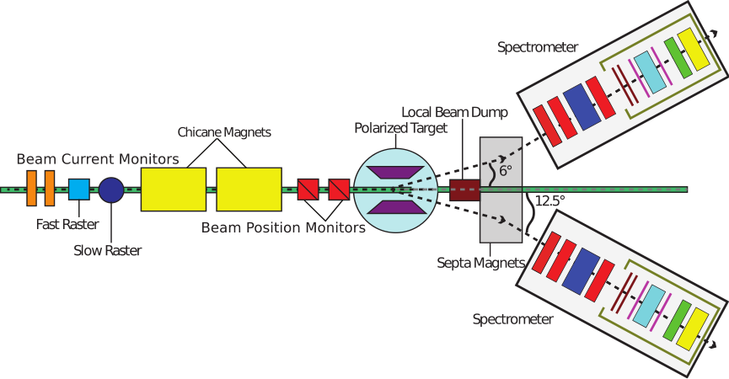
Hall A Experimental Setup:
g2p experiment ran spring 2012 at Jefferson Lab in Hall A
Transverse polarized NH₃ target (2.5/5.0T)
Dipole chicane magnets help compensate for target field bending of beam
Measuring
Electron Beam
Polarized Proton Target
Spectrometer/Detectors
Small Scattering Angle
Spectrometer detectors provide trigger, tracking and particle identification
Achieved record Hall A DAQ rate of 6-7 kHz during the run period
Spectrometer detectors provide trigger, tracking and particle identification
Achieved record Hall A DAQ rate of 6-7 kHz during the run period
Spectrometer detectors provide trigger, tracking and particle identification
Achieved record Hall A DAQ rate of 6-7 kHz during the run period

Slide 9
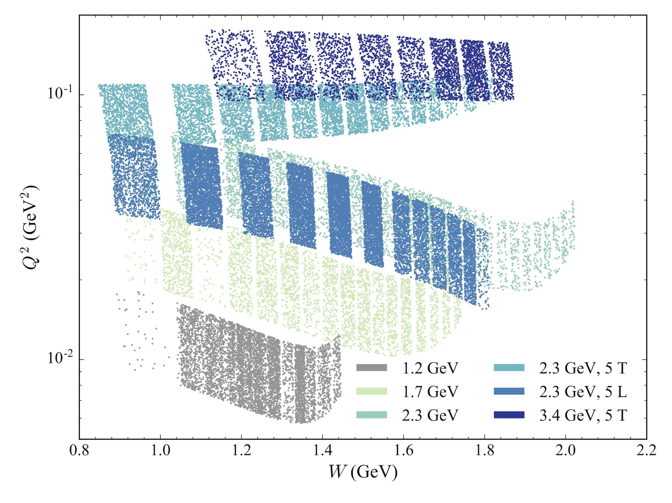
Kinematic Settings
5 Transverse settings and 1 Longitudinal setting
1.2 GeV setting only used for radiative corrections
2.2 GeV 5T Longitudinal & 2.2 GeV 2.5T Transverse fall at almost the same Q² and so can be used together

Slide 10
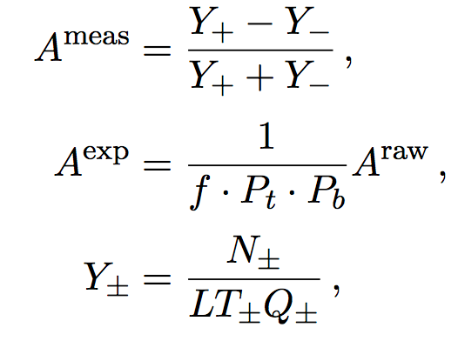
Forming polarized cross section differences
$${∆σ}_{∥} =2A_{∥}σ_{0}$$
$${∆σ}_{⊥} =2A_{⊥}σ_{0}$$
Form with an asymmetry and an unpolarized cross section
Lots of unpolarized world data for the proton, so the models are very good
Asymmetries are easy because they cancel many quantities:
$$A_{⊥} =\frac{σ^{↑⇒}−σ^{↓⇒}}{σ^{↑⇒}+σ^{↓⇒}}$$

Slide 11
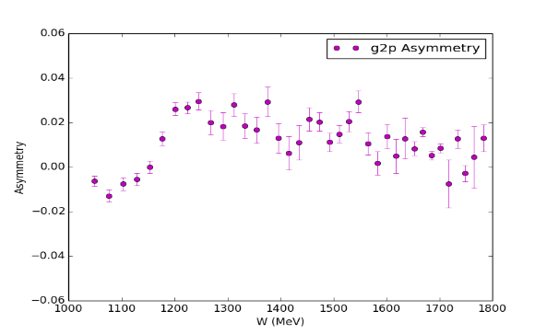
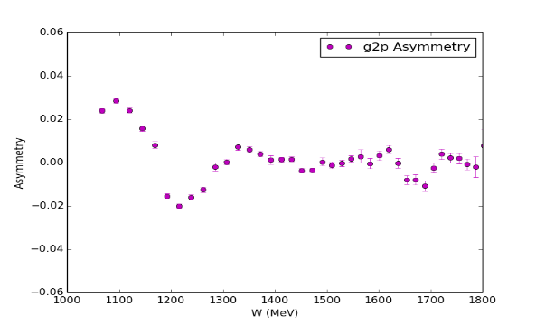
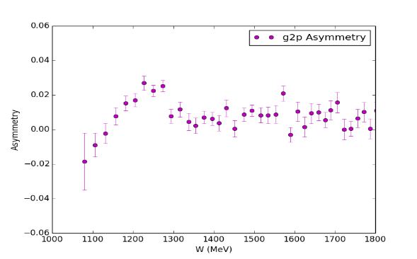
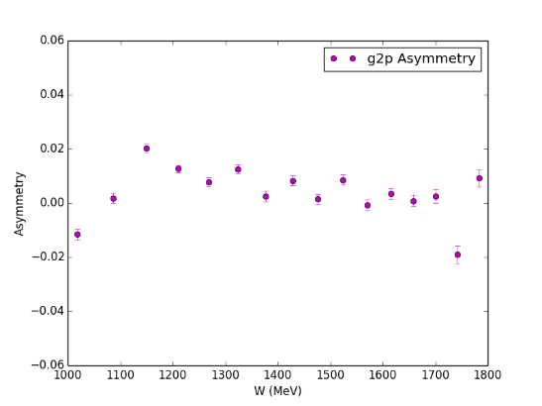
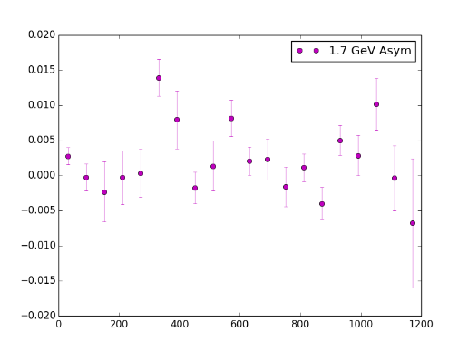
Asymmetry Results
2.2 GeV 5T Transverse
2.2 GeV 5T Parallel
3.3 GeV 5T Transverse
LHRS and RHRS combined for better statistics
2.2 GeV 2.5T Transverse
1.7 GeV 2.5T Transverse

Slide 12
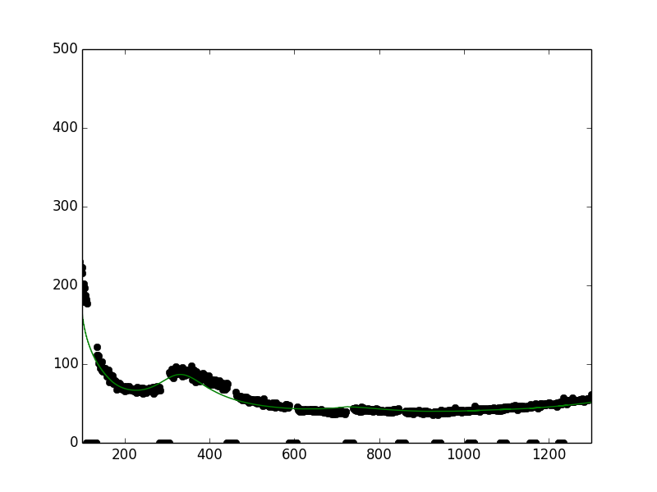
Unpolarized Cross Section
$$\frac{d2σ}{dΩdE′}=\frac{(ps)N}{N_{in}ρ(LT)ε_{det}}\frac{f}{ΔΩΔE′ΔZ}$$
Acceptance issues on the edge of transverse momentum settings made the unpolarized cross section extraction challenging, with large associated systematics
Instead, use a model unpolarized cross section
Bosted-Christy model used, shows good agreement with our longitudinal setting cross section in the resonance region
σ₀
ν (MeV)

Slide 13
Extraction of Structure Functions
$$g_{1}\left(x,Q^{2}\right)= K_{1}\left[Δσ_{∥}\left(1+\frac{1}{K_{2}}\tan{\frac{θ}{2}}\right)\right]+ \frac{2 g_{2}(x,Q^{2})}{K_{2}y}\tan{\frac{θ}{2}}$$
Input from Hall B model
$$g_{2}\left(x,Q^{2}\right)= \frac{K_{1}y}{2}\left[Δσ_{⊥}\left(K_{2}+\tan{\frac{θ}{2}}\right)\right]+ \frac{g_{1}\left(x,Q^{2}\right)y}{2}$$
Combination of data & Bosted model
CLAS Hall B model used as g₁ input for most settings
For 0.045 GeV² setting, we have both polarized XS differences, so we can form g₁ and g₂ from data

Slide 14
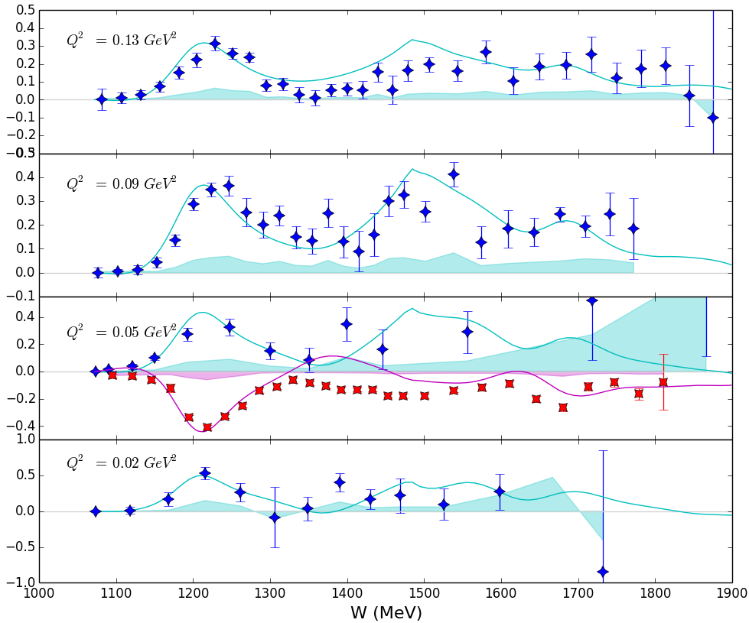
Structure Function Results
Blue stars: g₂
Red stars: g₁
g₁ data has very good statistics and goes very close to pion production threshold

Slide 15
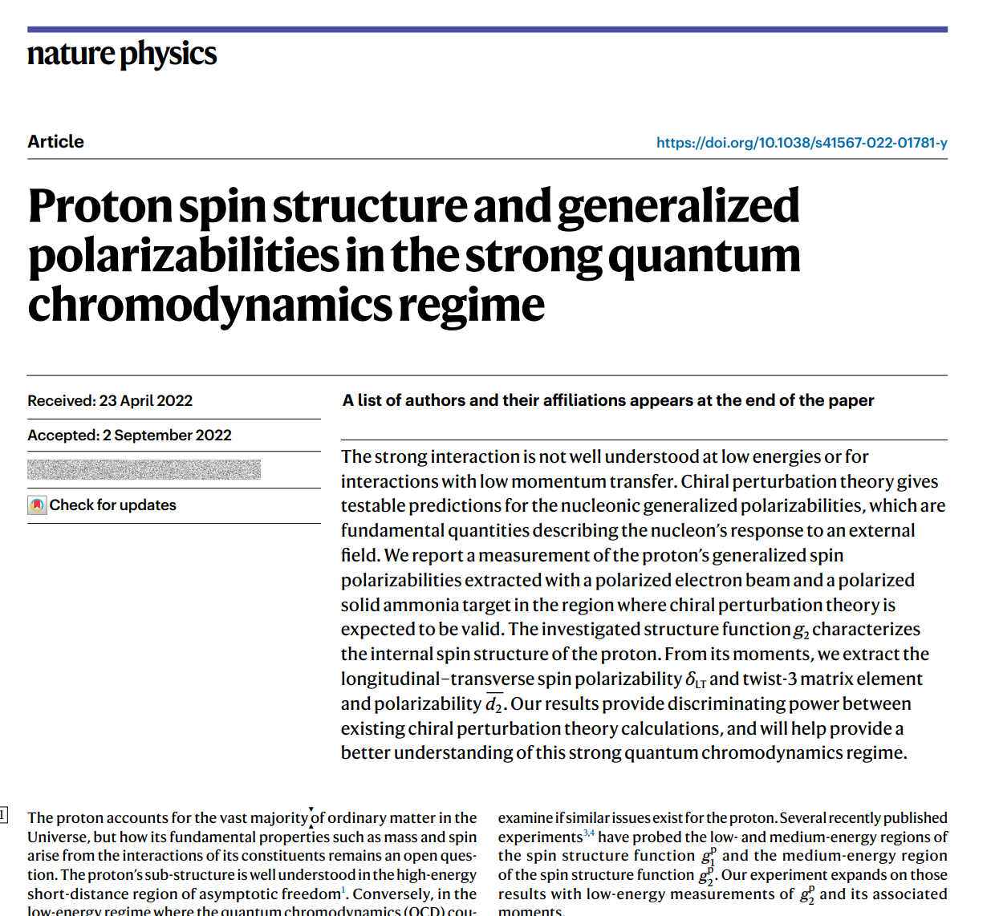
First publication released in October!
First publication released October 2022 in Nature Physics!
Highlights g₂ results as well as the $δ_{LT} and$ $\overline{d_{2}}$ moments
https://www.nature.com/articles/s41567-022-01781-y
Published!

Slide 16
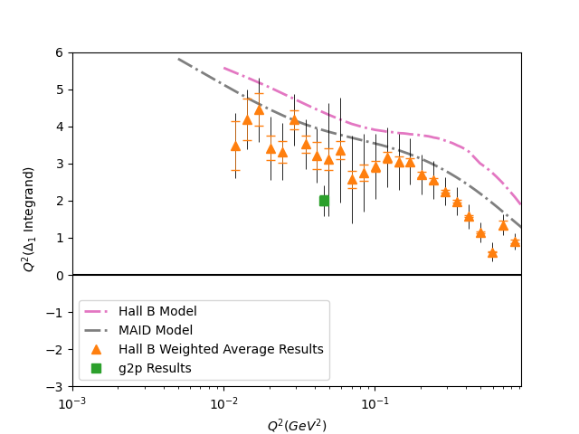
Δ₁ Results (Muonic Hydrogen)
Hall B Data constructed from EG4 and EG1b data from Jefferson Lab
See X. Zheng et al (Nature Physics 2021) and R. Fersch et al (PRC 2017)
Many thanks to Alexandre Deur for sharing the EG4 Data
Preliminary
New data from g2p and other Jefferson Lab experiments constrains Δ₁ above Q² = 0.01 GeV²

Slide 17
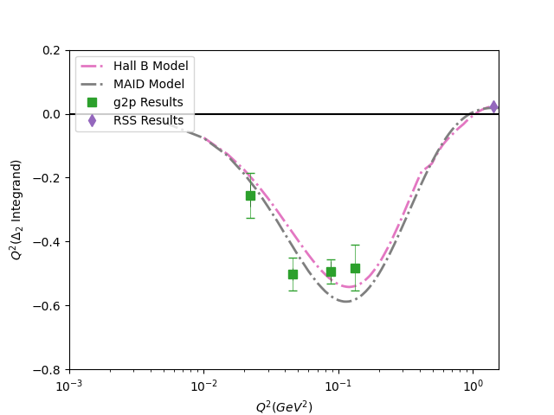
Δ₂ Results (Muonic Hydrogen)
RSS Data constructed from F. Wesselman, K. Slifer, S. Tajima et al (PRL 2007)
Preliminary
First ever experimental results for this quantity!
Q² both above and below g2p contributes strongly to Δ₂

Slide 18
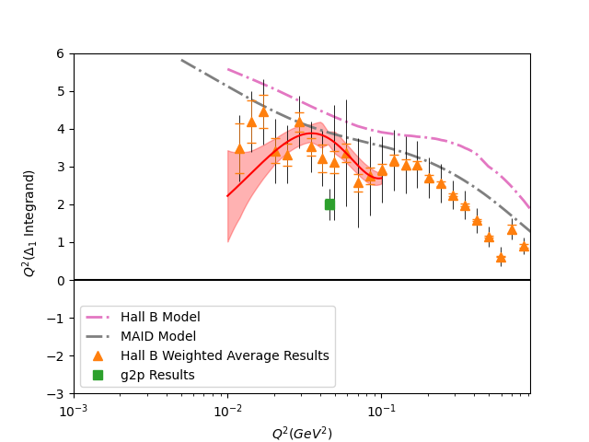
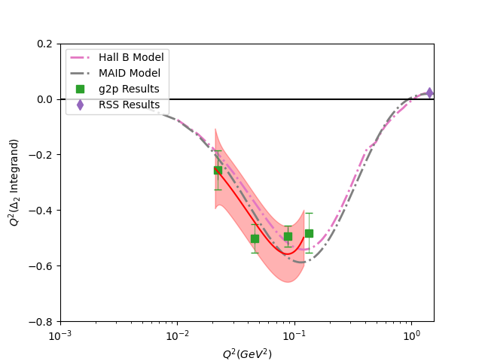
Δ_{1,2} Results (Fits)
Preliminary
Preliminary

Slide 19
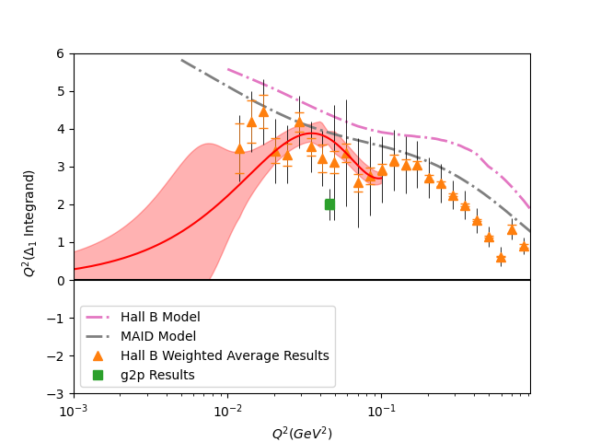
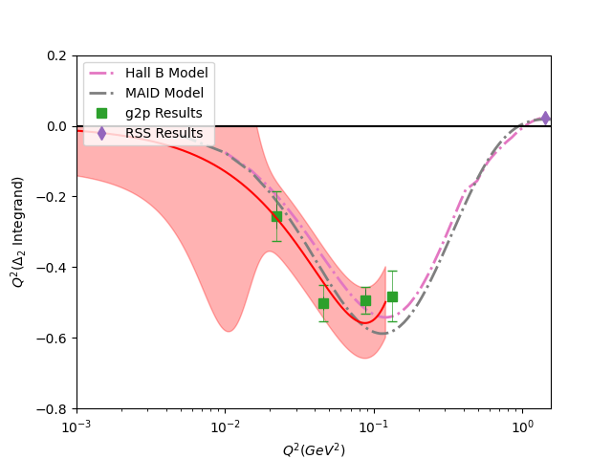
Δ_{1,2} Results (Fits)
Preliminary
Preliminary

Slide 20
Low Q² Limit
Franziska Hagelstein and Vladimir Pascalutsa working with us to determine a constraint at Q² of 0
Possible options include using static polarizability predictions to determine a value for the Deltas at Q²=0, attempting to employ MAID’s lowest Q² prediction
Without such a constraint, the large extrapolation error bar shown combined with 1/Q⁴ weighting means the error below Q² =0.01 is impossibly large
Proceeding integrals are performed from Q²=0.01 up

Slide 21
Muonic Hydrogen Hyperfine Contribution Results
Integrate data where possible, and MAID above the region of the data
Results does NOT include integral contribution below Q² = 0.01 GeV²
Δ₁ = 12.44 ± 3.65
Δ₂ = -1.38 ± 0.23
Δ_{pol} = 516.502 ± 170.92 ppm
Previous data-driven approaches were largely based on higher Q² data which relies on the assumption of leading twist
However, this new result is compatible within error bars of these previous approaches
Still unexplained tension with BχPT result
$$Δ_{pol}=\frac{αm_{l}}{πg_{p}M_{p}}\left(Δ_{1}+Δ_{2}\right)$$
A. Antognini, F. Hagelstein, and V. Pascalutsa (2022)

Slide 22
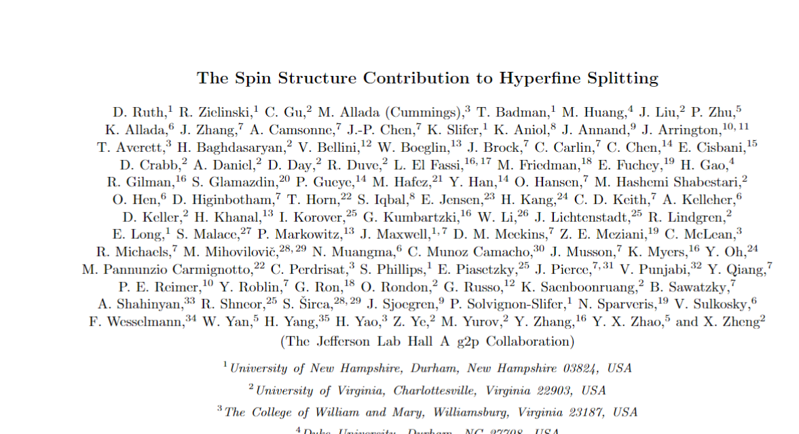
Hyperfine Structure Publication in preparataion
Paper is in preparation with the hope of submitting soon
Highlights polarizability contributions shown on previous slides
Any feedback or suggestions welcomed!!
In Preparation!

Slide 23
Acknowledgements
Spokespeople:
J.P. Chen
Karl Slifer
Alexandre Camsonne
Don Crabb
Graduate Students:
Ryan Zielinski
Chao Gu
Toby Badman
Melissa Cummings
Min Huang
Jie Liu
Pengjia Zhu
Thanks to Alexandre Deur for providing the EG4 Data!
Post-Docs:
Kalyan Allada
James Maxwell
Vince Sulkosky
Jixie Zhang

Slide 24
References
R. Zielinski, The g2p Experiment: A Measurement of the Proton’s Spin Structure Functions, Ph.D. thesis, Univer- sity of New Hampshire (2017), arXiv:1708.08297 [nucl- ex].
C. Gu. The Spin Structure of the Proton at Low Q2: A Measurement of the Structure Function g2p. PhD thesis, University of Virginia, 2016.
X. Zheng, A. Deur, H. Kang, et al., Nature Physics, 17, 736 (2021).
V. Sulkosky, C. Peng, J. Chen, et al., Nature Physics, 17, 687 (2021).
J. M. Alarcón, F. Hagelstein, V. Lensky, and V. Pasca- lutsa, Phys. Rev. D, 102, 114026 (2020).
V. Bernard, E. Epelbaum, H. Krebs, and U.-G. Meissner, Phys. Rev. D, 87, 054032 (2013).
M. E. Christy and P. E. Bosted, Phys. Rev. C, 81, 055213 (2010).
J. Alcorn et al. Basic Instrumentation for Hall A at Jefferson Lab. Nucl. Instrum. Meth., A522:294–346, 2004.

Slide 25
Extra Slide: Gamma0
Preliminary

Slide 26
Extra Slide: Schwinger Sum Rule
Preliminary

Slide 27
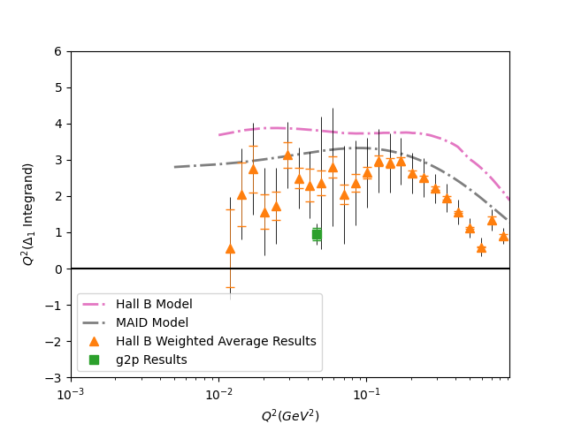
Δ₁ Results (Electronic Hydrogen)
Hall B Data constructed from EG4 and EG1b data from Jefferson Lab
See X. Zheng et al (Nature Physics 2021) and R. Fersch et al (PRC 2017)
Many thanks to Alexandre Deur for sharing the EG4 Data
Preliminary
New data from g2p and other Jefferson Lab experiments constrains Δ₁ above Q² = 0.01 GeV²

Slide 28
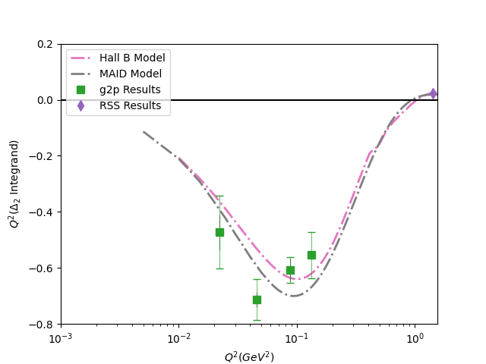
Δ₂ Results (Electronic Hydrogen)
RSS Data constructed from F. Wesselman, K. Slifer, S. Tajima et al (PRL 2007)
Preliminary
First ever experimental results for this quantity!
Q² both above and below g2p contributes strongly to Δ₂

Slide 29
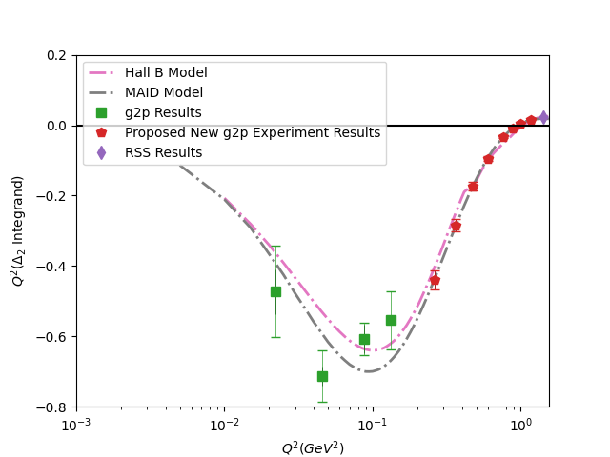
Proposal in Progress to Measure another relevant region of Δ₂
In preparation for JLab PAC deadline next week with Karl Slifer, Jian-Ping Chen, and Nathaly Santiesteban
Intend to propose transverse polarized target experiment in Hall C for 0.27 GeV² < Q² < 1.1 GeV²
Please let us know if you are interested in being part of the proposal!!
Preliminary

Slide 30
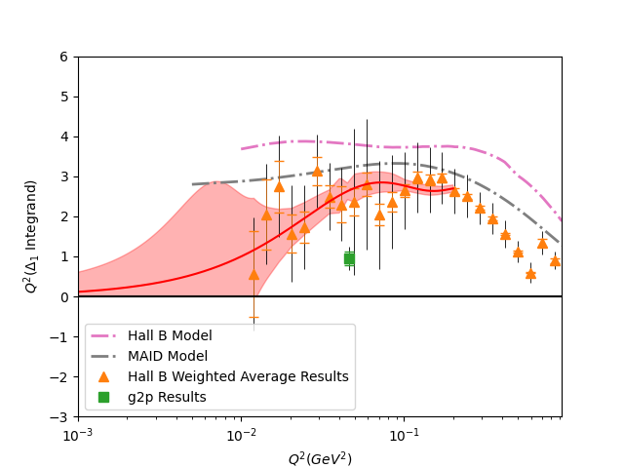
Δ₁ Results (Fits)
μ
e
Preliminary
Preliminary

