Slide 1

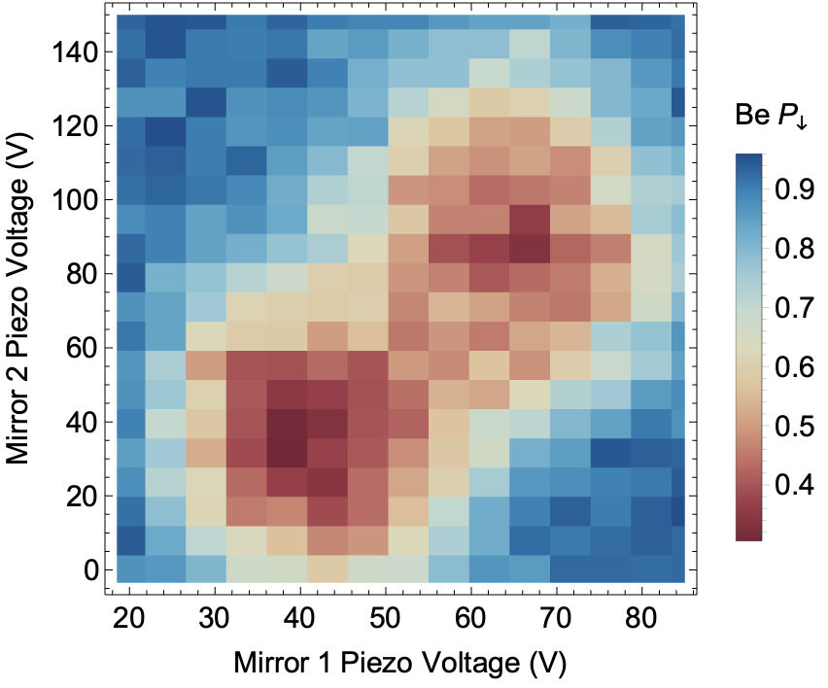
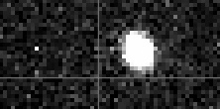



Quantum logic detection of H₂⁺
Postdoc
H₂⁺
Be⁺
H₂⁺
Fabian Schmid
PhD students
Be⁺
H₂⁺
Be⁺
Nick Schwegler
David Holzapfel
Daniel Kienzler
PREN+μASTI, Mainz, 2023

Slide 2
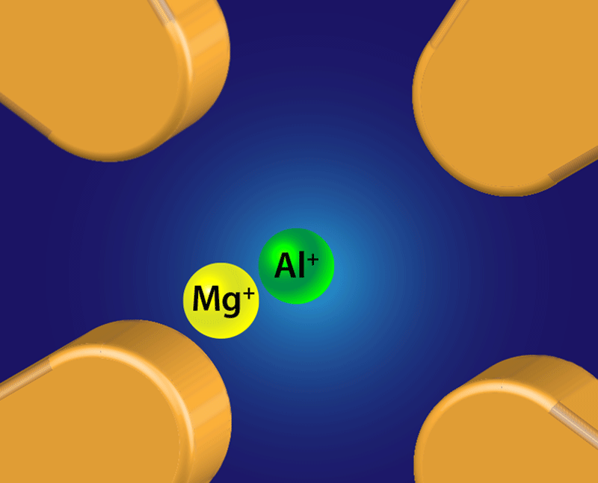
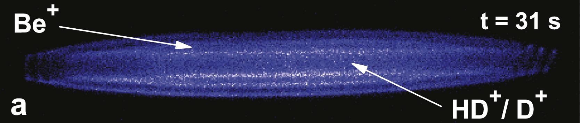
Towards Quantum Logic Spectroscopy of hydrogen molecular ions
Quantum Logic Spectroscopy
P. O. Schmidt et al. (2005)
Hydrogen molecular ions
Atomic clocks
B. Roth et al. PRA 75, 023402 (2007)
Single ion:
Low systematic errors
Requires quantum control
State-preparation
Non-destructive readout
Provided by coupling ion of interest to “helper” ion
Theory (10⁻¹²)
V. I. Korobov et al. PRL 118, 233001 (2017)
S. Patra et al. Science 369, 6508 (2020)
I. V. Kortunov et al. Nature Phys. 17, 569-573 (2021)
M. German et al. PRR 3, L022028 (2021)
m_{p}/m_{e} (10⁻¹²)
S. M. Brewer et al. (2019)
Probing QED, fifth force
H₂⁺
Be⁺
Implementation for molecules
MgH⁺ - F. Wolf et al. Nature 530, 457-460 (2016)
CaH⁺ - C.-W. Chou et al. Nature 545, 203-207 (2017)
N₂⁺ - M. Sinhal et al. Science 367, 6483 (2020)
S. Schiller et al. Phys. Rev. Lett. 113, 023004 (2014)
J.-P. Karr et al. J. Phys. Conf. Ser. 723 012048 (2016)

Slide 3
H₂⁺
Symmetric molecule (homo-nuclear)
No permanent dipole moment.
Rotation, vibration dipole forbidden
Huge, long-lived Hilbert space.
Good for spectroscopy (narrow lines)
Hard(er) to control: rovibration does not thermalize…
-
+
+
S
Hyperfine structure
2 protons + 1 electron
Rotation
15 THz
66 THz (4.5 um)
12 THz
5 THz
8 THz
1.5 GHz
Vibration
Para-H₂⁺
(I = 0)
Ortho-H₂⁺
(I = 1)

Slide 4
The plan
S. Schiller et al. Phys. Rev. A 95, 043411 (2017)
M. Hernández Vera et al. J. Chem. Phys. 146, 124310 (2017)
M. Hernández Vera et al. Eur. Phys. J. D 71, 106 (2017)
He
Trap Be⁺ (photoionization)
Trap H₂⁺ (electron impact ionization)
  ortho/para random
  rovibrational state random,
  does not decay
Prepare H₂⁺ ro-vibrational ground state by buffer-gas cooling with He
Do spectroscopy experiments with quantum logic spectroscopy
  pure hyperfine/Zeeman state preparation
  non-destructive readout
Slow (O(10) minutes)
do once
H₂⁺
Be⁺
Fast, do many times
MgH⁺ - F. Wolf et al. Nature 530, 457-460 (2016)
N₂⁺ - M. Sinhal et al. Science 367, 6483 (2020)
CaH⁺ - C.-W. Chou et al. Nature 545, 203-207 (2017)

Slide 5
Apparatus, loading and H₂⁺ lifetime
Ion getter pump + NEG
Cryo, ~10K
Be⁺
H₂⁺
Be⁺
H₃⁺
Vacuum
chamber
H₂
H
Laser
beams
+
+
11⁺⁶₋₃ hours
Cryo-chamber
He
Camera, PMT
Leak valve
N. Schwegler et al. arXiv:2212.06456

Slide 6
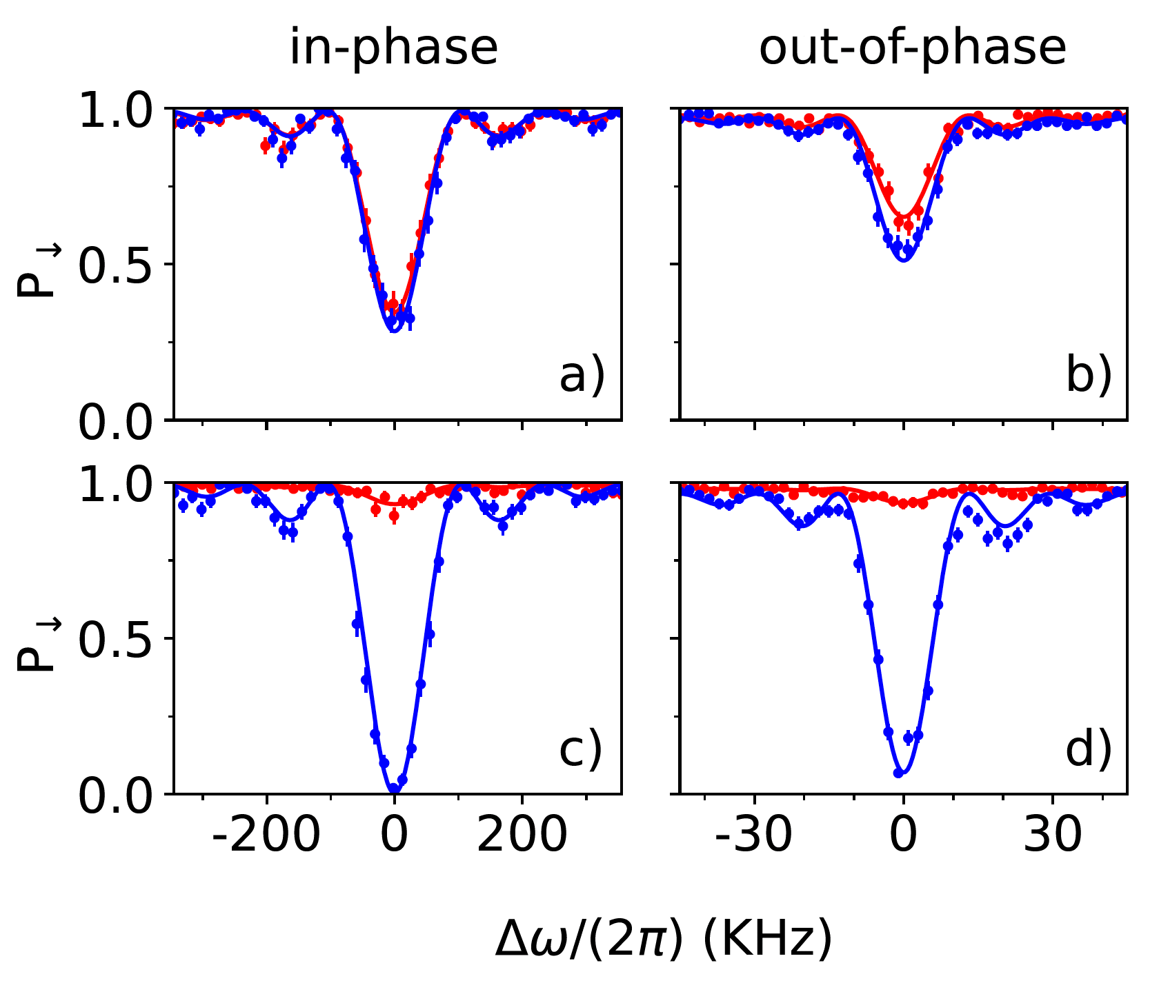
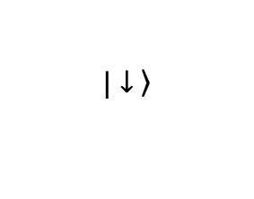
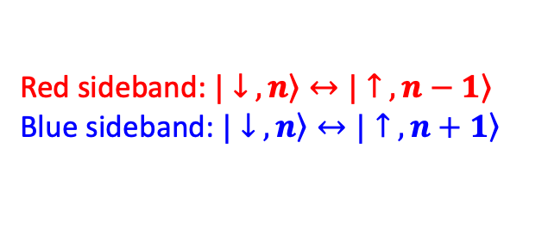
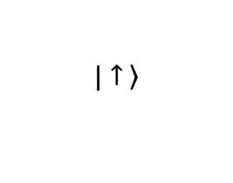
Ground state cooling and motion detection
Trap axis
in-phase mode mode @ 2 π x 1.3 MHz
out-of-phase mode
@ 2 π x 3.4 MHz
Doppler cooled
$$\left.|↑ \right\rangle$$
Ground-state cooled
…
2
$$\left.|↓ \right\rangle$$
1
n = 0
Be⁺ Motion detect
Red sideband: $\left.|↓ ,n\right\rangle ↔\left.|↑ ,n−1\right\rangle$
Blue sideband: $\left.|↓ ,n\right\rangle ↔\left.|↑ ,n+1\right\rangle$
N. Schwegler et al. arXiv:2212.06456

Slide 7
Optical dipole force
Simplified,
not to scale
H₂⁺
$$\left.|↑ \right\rangle$$
High-power beams
-> Stark shift
…
2
$$\left.|↓ \right\rangle$$
1
n = 0
1050 nm
Pulse sequence
Ground-state cooling
Optical dipole force
Be⁺ Motion detect
MgH⁺ - F. Wolf et al. Nature 530, 457-460 (2016)
N₂⁺ - M. Sinhal et al. Science 367, 6483 (2020)

Slide 8
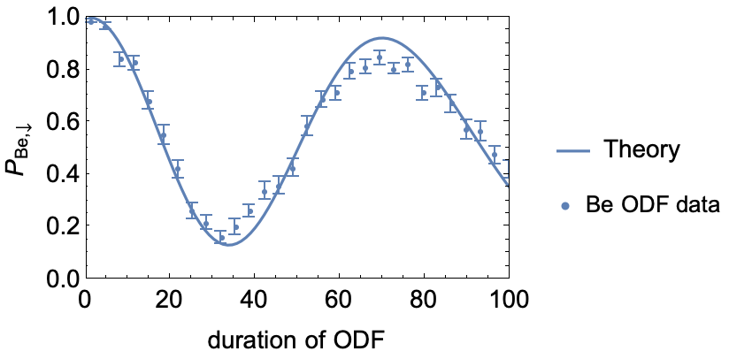
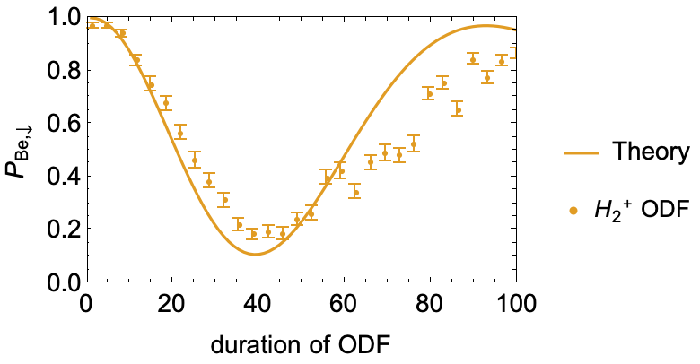
Optical dipole force results
Pulse sequence
Ground-state cooling
Optical dipole force
Be⁺ Motion detect

Slide 9
Quantum logic detection
H₂⁺
Be⁺
Pulse sequence
Ground-state cooling
Optical dipole force
Be⁺ Motion detect
Notes:
two_ion_plot.png

Slide 10
Buffer-gas Cooling and Polarizability
e⁻
H₂
H₂⁺
He
e⁻
e⁻
Rotation
Vibration
ODF: Strength proportional to polarizability
Be⁺, H₂⁺ polarizabilities known
H₂⁺ depends on vibration, rotation, hyperfine
ODF as probe for H₂⁺ state, diagnose buffer gas cooling
Para
Ortho
L = 0
L = 1
S. Schiller et al. Phys. Rev. A 95, 043411 (2017)
M. Hernández Vera et al. J. Chem. Phys. 146, 124310 (2017)
M. Hernández Vera et al. Eur. Phys. J. D 71, 106 (2017)
MgH⁺ - F. Wolf et al. Nature 530, 457-460 (2016)
N₂⁺ - M. Sinhal et al. Science 367, 6483 (2020)

Slide 11
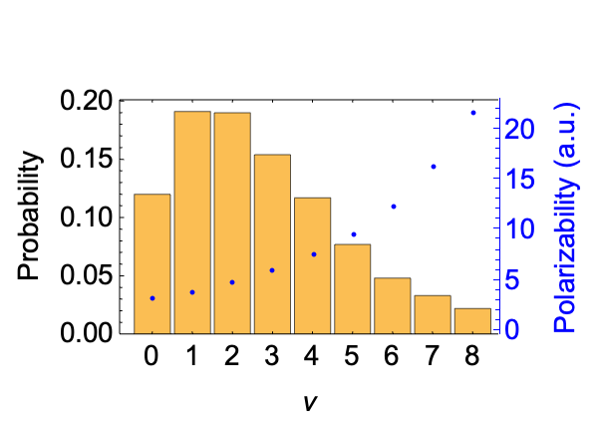
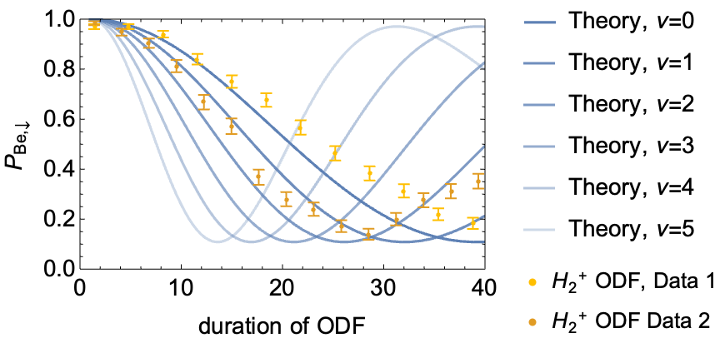
Vibrational states
Preliminary
Complications
He pressure finite -> can’t observe signal without He
Drifts after loading -> can’t observe ODF signal right after loading
Vibrational state probabilities after electron impact ionization and corresponding polarizabilities
J. P Karr et al. Appl Phys B 107:1043–1052 (2012)
S. Schiller et al. PRA 89, 052521 (2014)
Vibrational state cooled. In ground state?

Slide 12
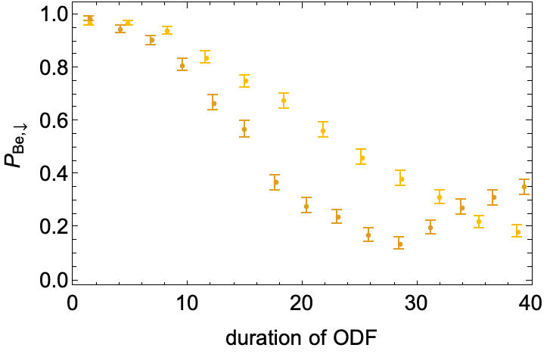
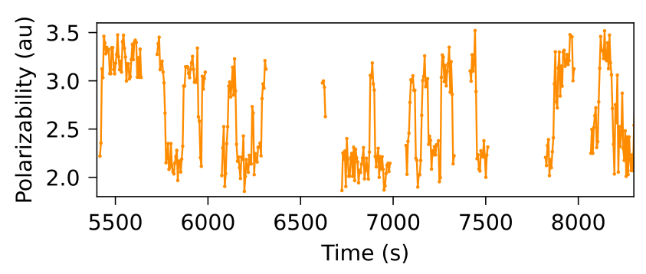
Fluctuations of H₂⁺ Signal
Preliminary
H₂⁺ Quantum jumps?
Record signal with fixed probe duration over time
At cryo temperature (~15K) would expect polarizability to only drop when vibration gets cooled
Increase and decrease of polarizability over time points to Hyperfine structure (possibly combined with rotational state change)

Slide 13
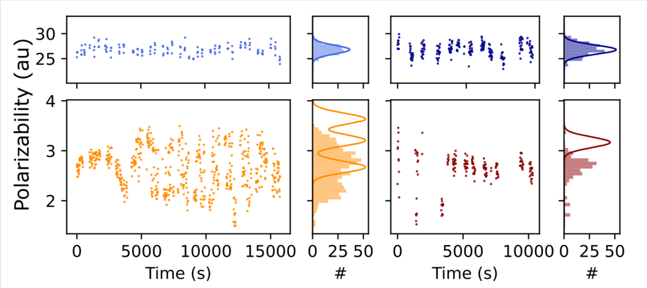
Hyperfine structure and rotational cooling?
Preliminary
Be⁺
H₂⁺
L=1?
L=2?
L=0?

Slide 14
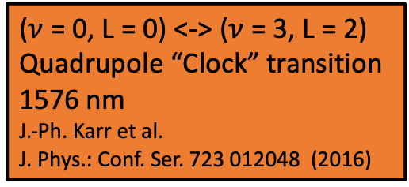
Outlook
($ν$ = 0, L = 0) <-> ($ν$ = 3, L = 2)
Quadrupole “Clock” transition 1576 nm
J.-Ph. Karr et al.
J. Phys.: Conf. Ser. 723 012048 (2016)
Hyperfine structure
Prepare pure HFS state
HFS spectroscopy
CaH⁺ - C.-W. Chou et al. Nature 545, 203-207 (2017)
Vibration
Rotation
Be⁺
H₃⁺
Rotation: Frequency comb spectroscopy
CaH⁺ - C.-W. Chou et al. Science 367 (6485) 1458-1461 (2020)

Slide 15
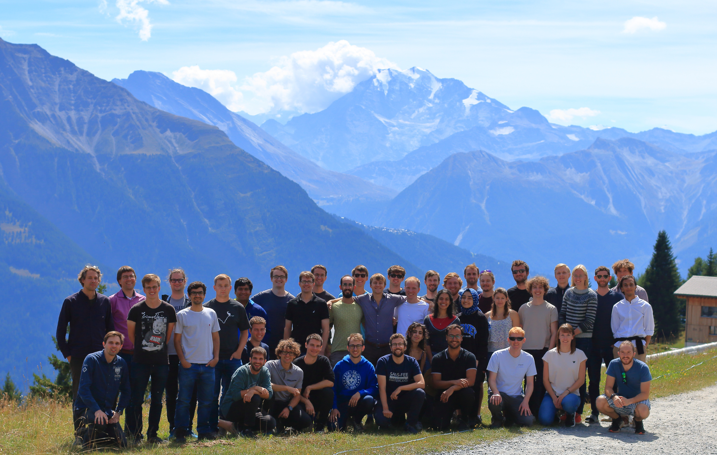


PhD students
Postdoc
Thank you for your attention!
Nick Schwegler
David Holzapfel
Fabian Schmid
Molecules sub-group
DK
Prof. J. P. Home
Martin Stadler:
Experiment computer control!
Lasers
Trapped ion quantum information group, ETH Zürich

Slide 16
Summary
H₂⁺ buffer-gas cooling
Thank you for your attention!
H₂⁺
H₂⁺ Quantum jumps?
Be⁺

