Slide 1
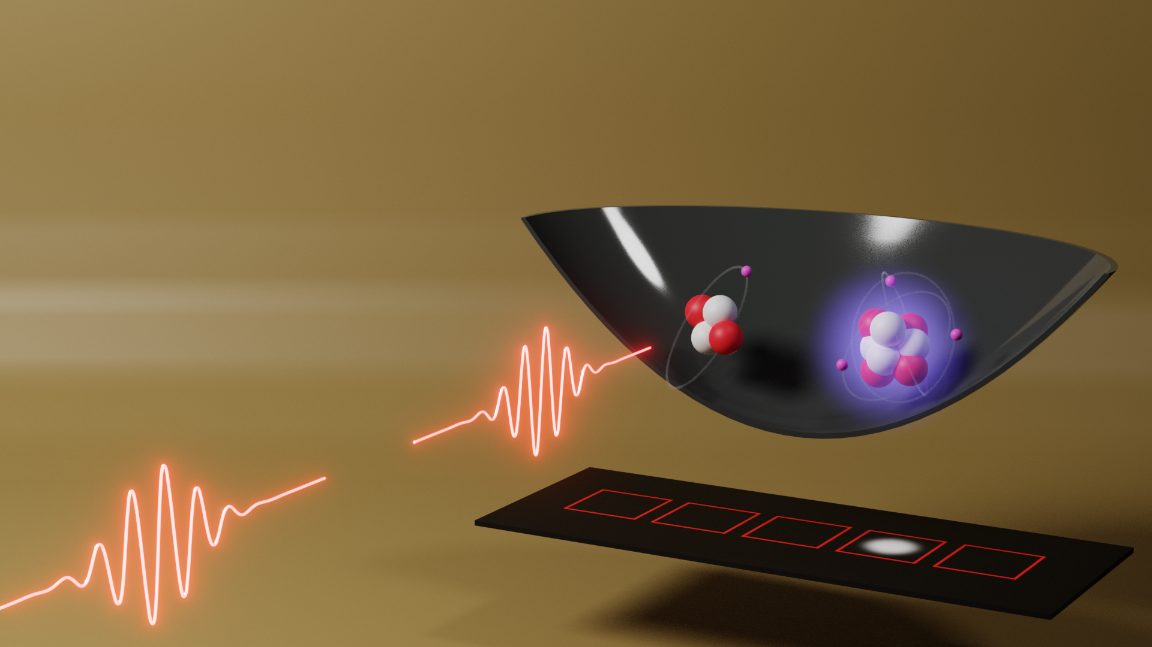




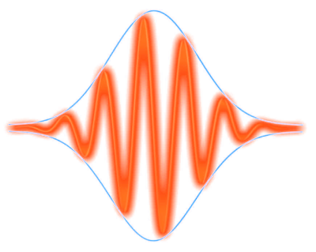
First observation of the He⁺ 1S-2S transition in an atomic beam
Kjeld Eikema
LaserLaB, Vrije Universiteit Amsterdam,
Quantum Metrology and Laser Applications group
Kjeld Eikema
LaserLaB, Vrije Universiteit Amsterdam,
Quantum Metrology and Laser Applications
ECTI November 2021
Funding:
PREN Mainz, 26 June 2023

Slide 2
Outline
  Introduction spectroscopy 1S-2S in He⁺
  Ramsey-comb spectroscopy (RCS)
  First 1S-2S excitation of He⁺ using an atomic beam (1 pulse)
  Comparison with TDSE simulations
  Conclusion and outlook for RCS of 1S-2S in He⁺
2

Slide 3
Precision measurement for searching new physics
New
Physics?
Theory
(Trapped) particle measurements
m_{p}/m_{e} , m_{d}/m_{p}, α, ...
CODATA
Fundamental
constants
EDM (e & n) measurements,
and other methods
Precision spectroscop on bound systems
H, μH, μHe⁺, H₂, D₂, HD, HT, H₂⁺, HD⁺, He, He⁺...
Black: pursued
at LaserLaB
Vrije Universiteit Amsterdam
3

Slide 4

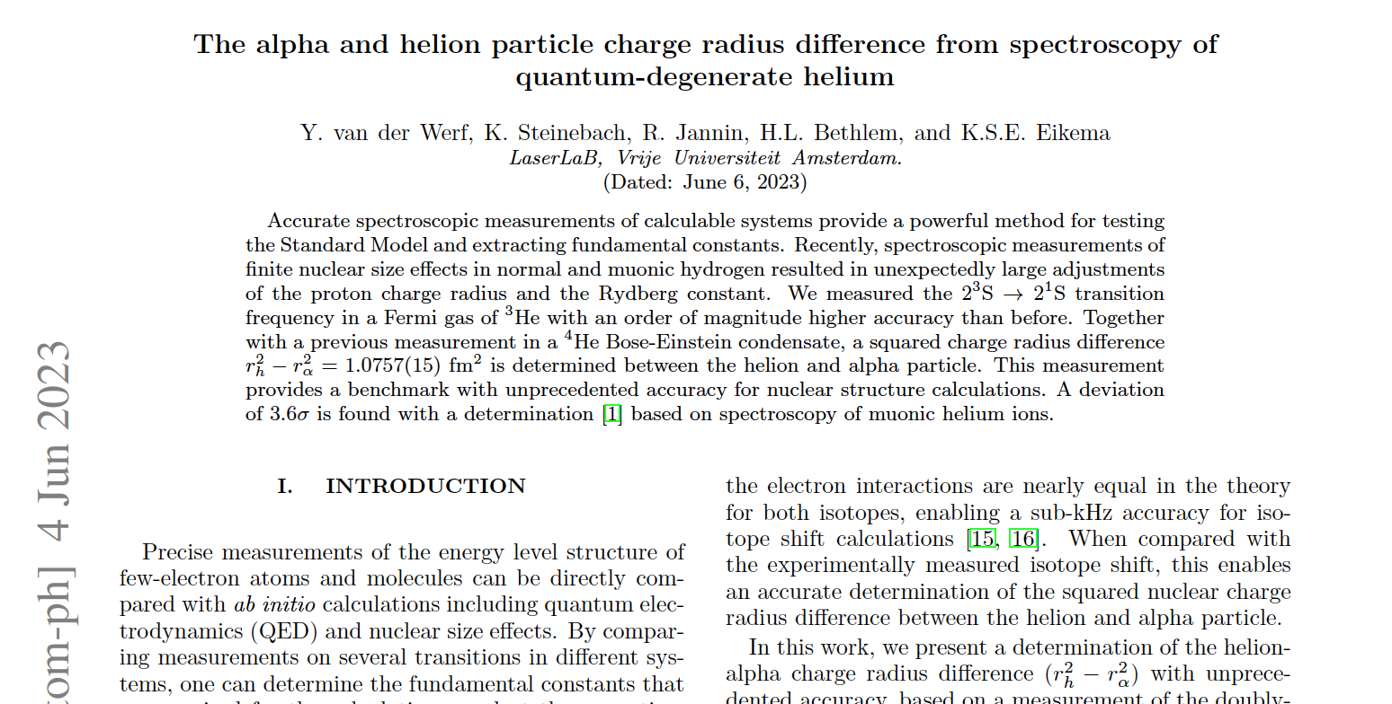
Precision measurement for searching new physics
4

Slide 5
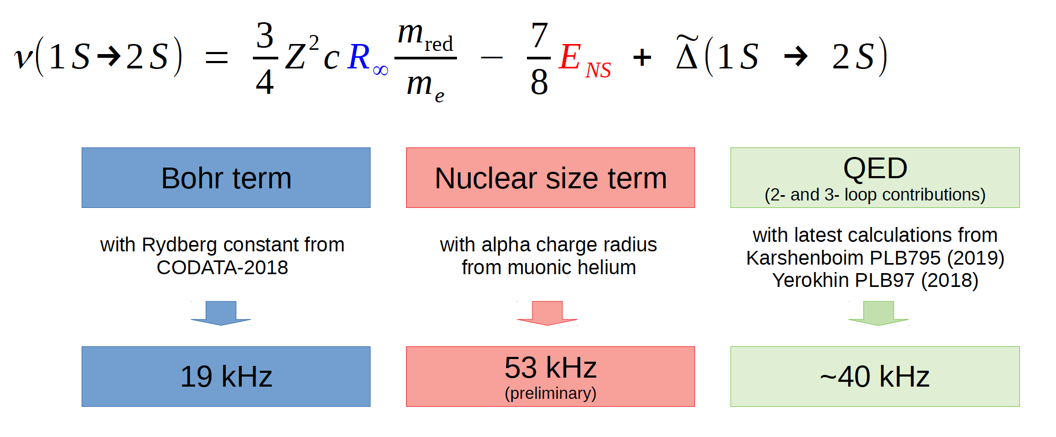
Possibilities ⁴He⁺ 1S-2S combined with H and μ⁴He⁺
⁴He⁺
2S
2P
With r_{α} from μ⁴He⁺ and
Karshenboim PLB795 (2019)
Yerokin Ann. Phys. 531 (2019)
With r_{α} from μ⁴He⁺
With current R♾ and slightly improved QED
λ = 30 nm
(XUV)
Ry. test at 24 kHz
r_{α} test at 60 kHz
QED test 41 kHz
1S
Experimental target 1S-2S in He⁺ is < 1 kHz
See: Krauth, J.J., Schuhmann, K., Ahmed, M.A. et al. Nature 589, 527–531 (2021)
5

Slide 6
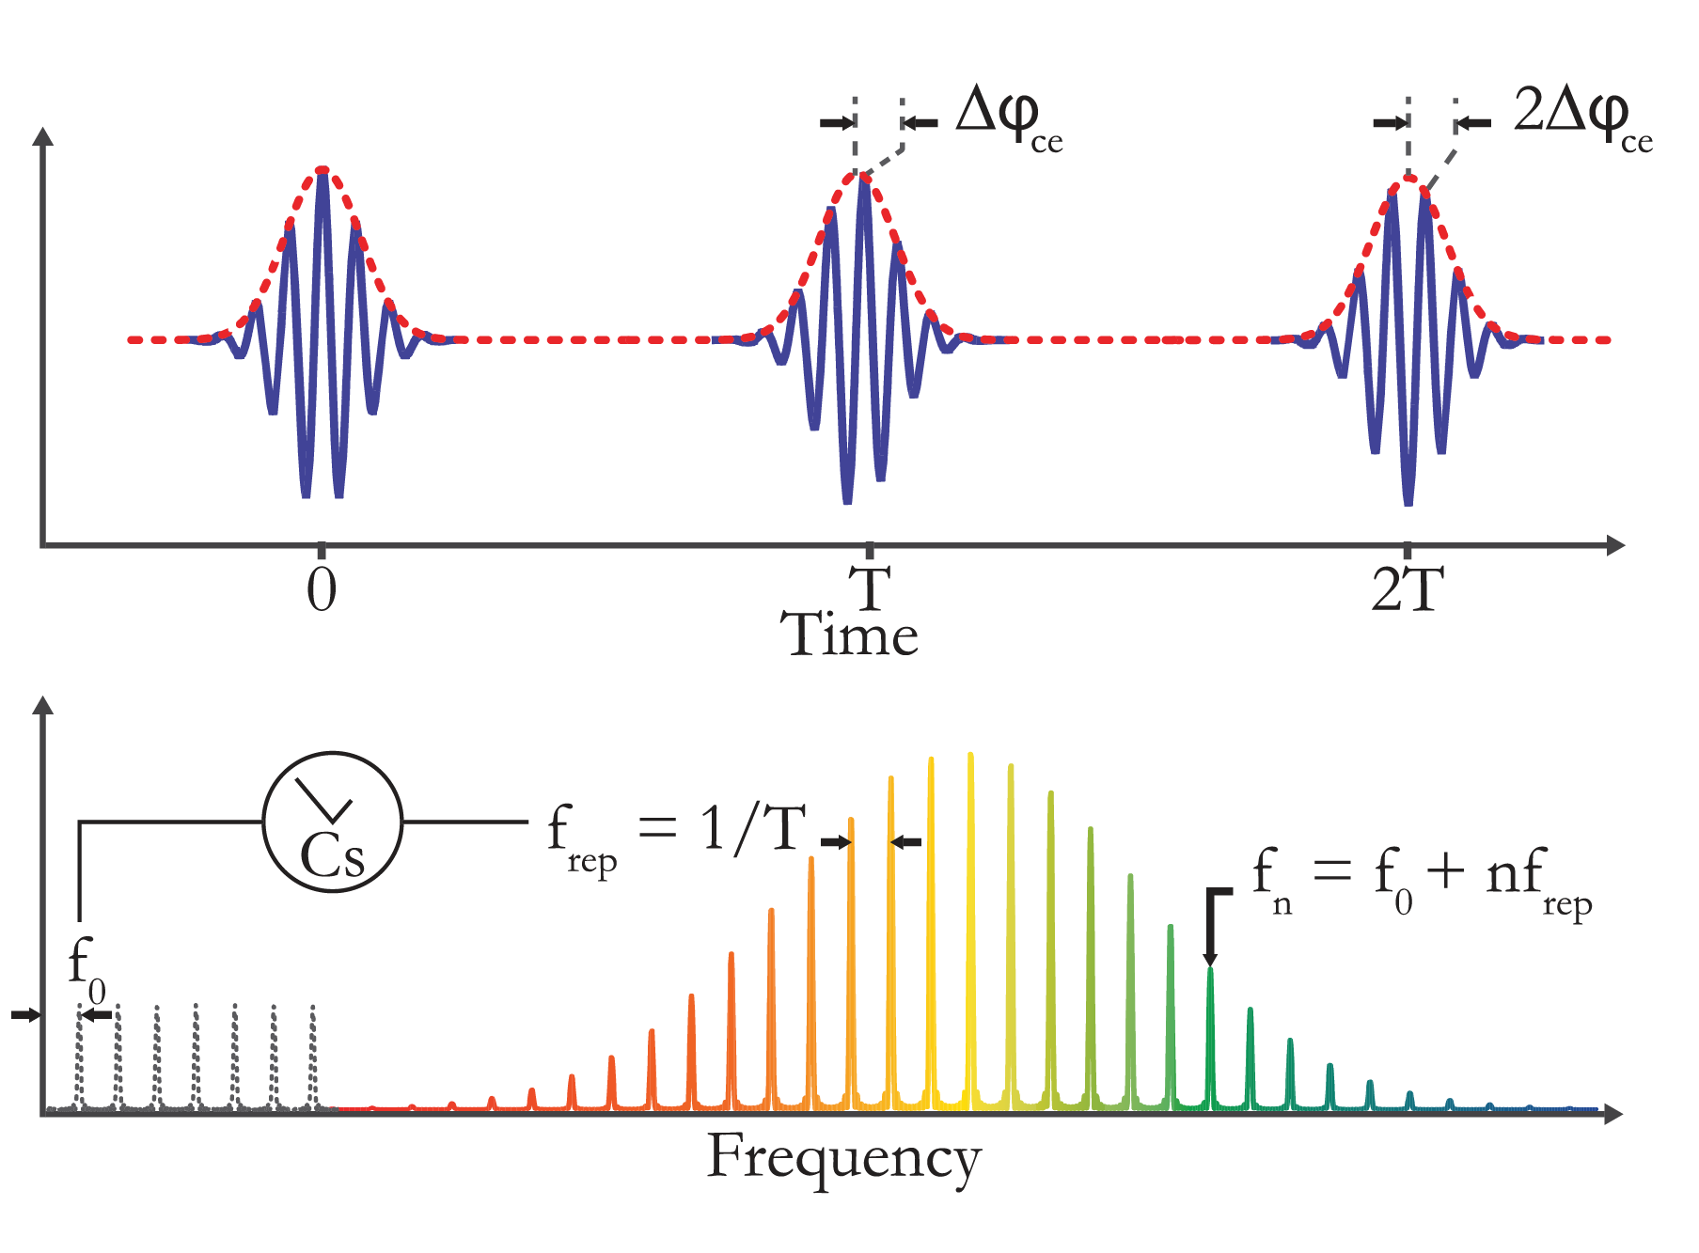
Frequency comb lasers
Frequency domain (averaged):
f₀ and f_{rep} locked to atomic clock
Narrow and well defined modes

Slide 7
Frequency comb lasers
Time domain (averaged):
attosecond pulse timing accuracy
sub-mrad phase evolution accuracy
Frequency domain (averaged):
f₀ and f_{rep} locked to atomic clock
Narrow and well defined modes

Slide 8
He⁺ 1S-2S spectroscopy – two approaches
Frequency domain approach
Time domain approach
⁴He⁺
2S
2P
2x 60 nm
1S
Munich, MPQ (Udem group)
Herrmann et al., PRA 79, 052505 (2009)
Moreno et al., Eur. Phys. J. D 77, 67 (2023)
8

Slide 9
He⁺ 1S-2S spectroscopy – two approaches
Frequency domain approach
Time domain approach
⁴He⁺
⁴He⁺
2S
2P
2S
2P
790 nm
32 nm
2x 60 nm
1S
1S
Munich, MPQ (Udem group)
Herrmann et al., PRA 79, 052505 (2009)
Moreno et al., Eur. Phys. J. D 77, 67 (2023)
Amsterdam, LaserLaB (Eikema group)
Krauth et al., PoS (FFK2019) 353, 1 (2020)
Dreissen et al., PRL 123, 143001 (2019)
9

Slide 10
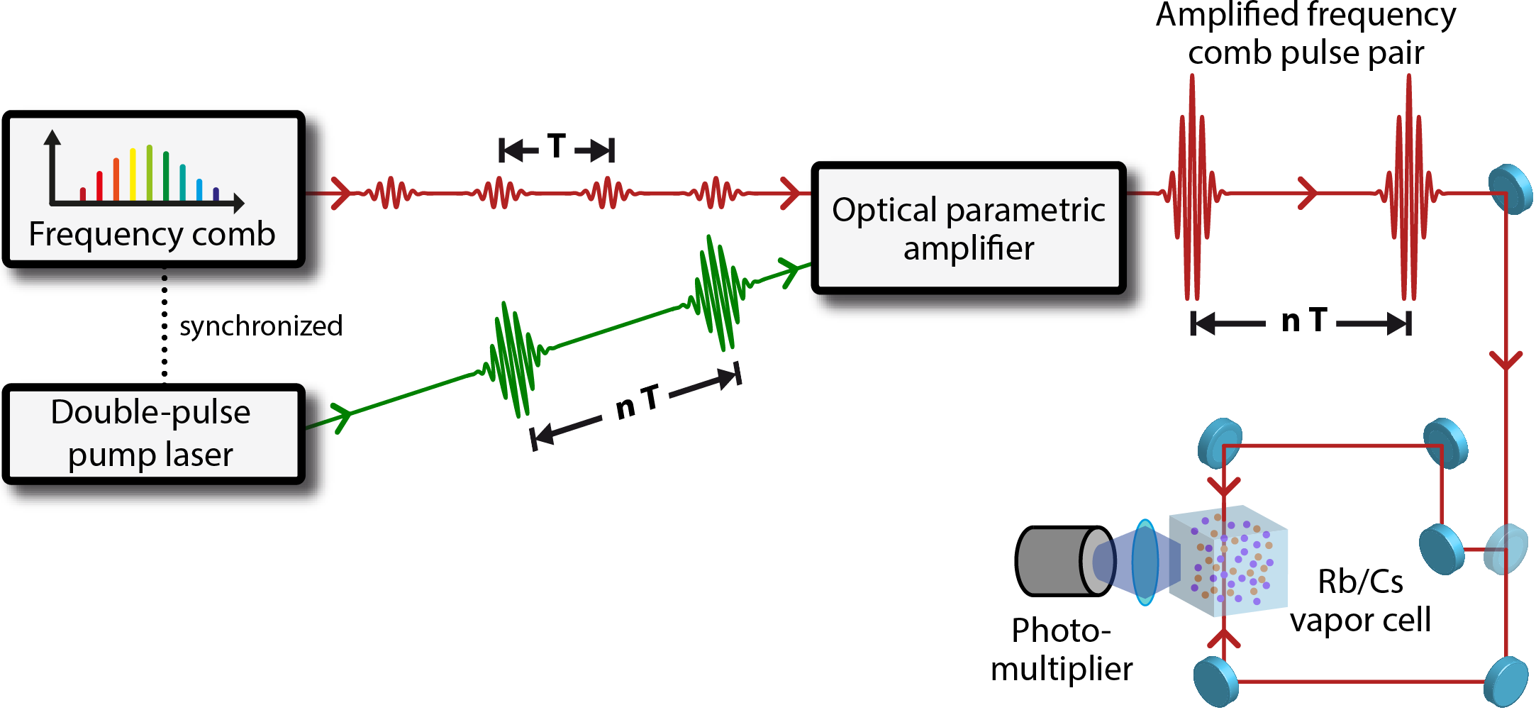
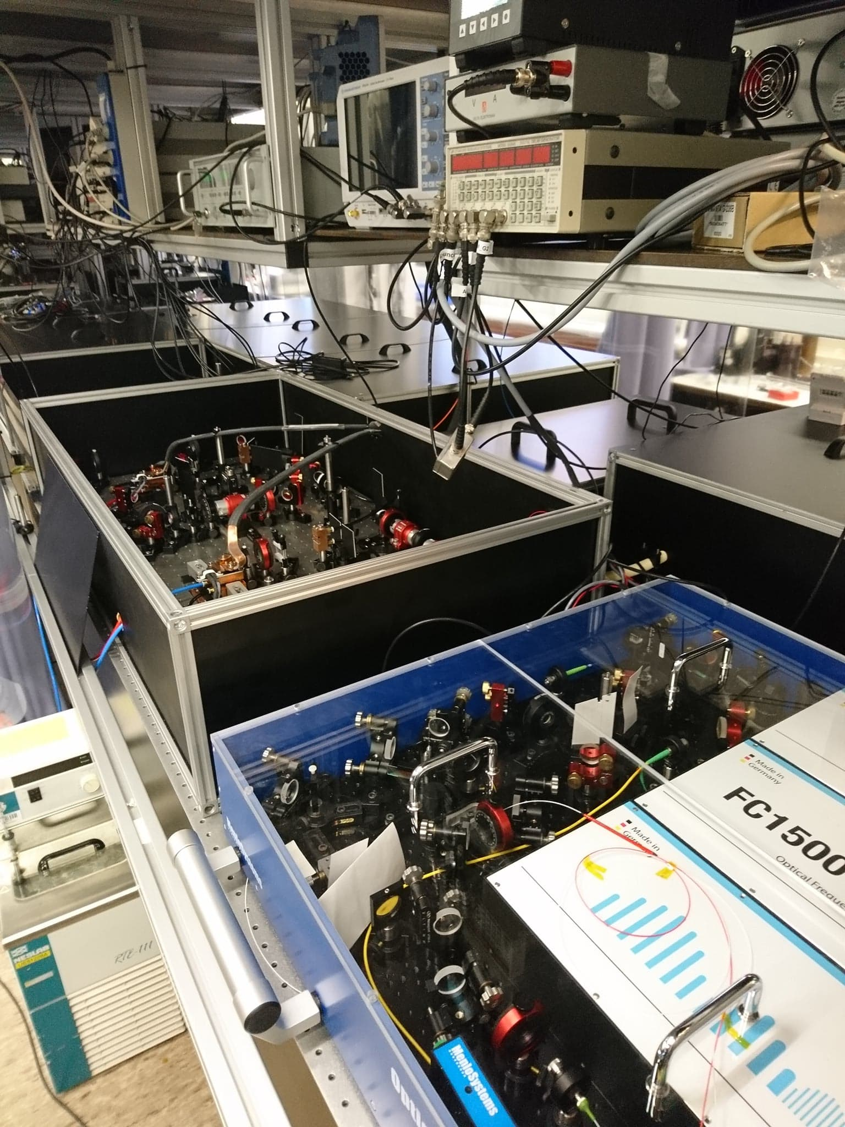
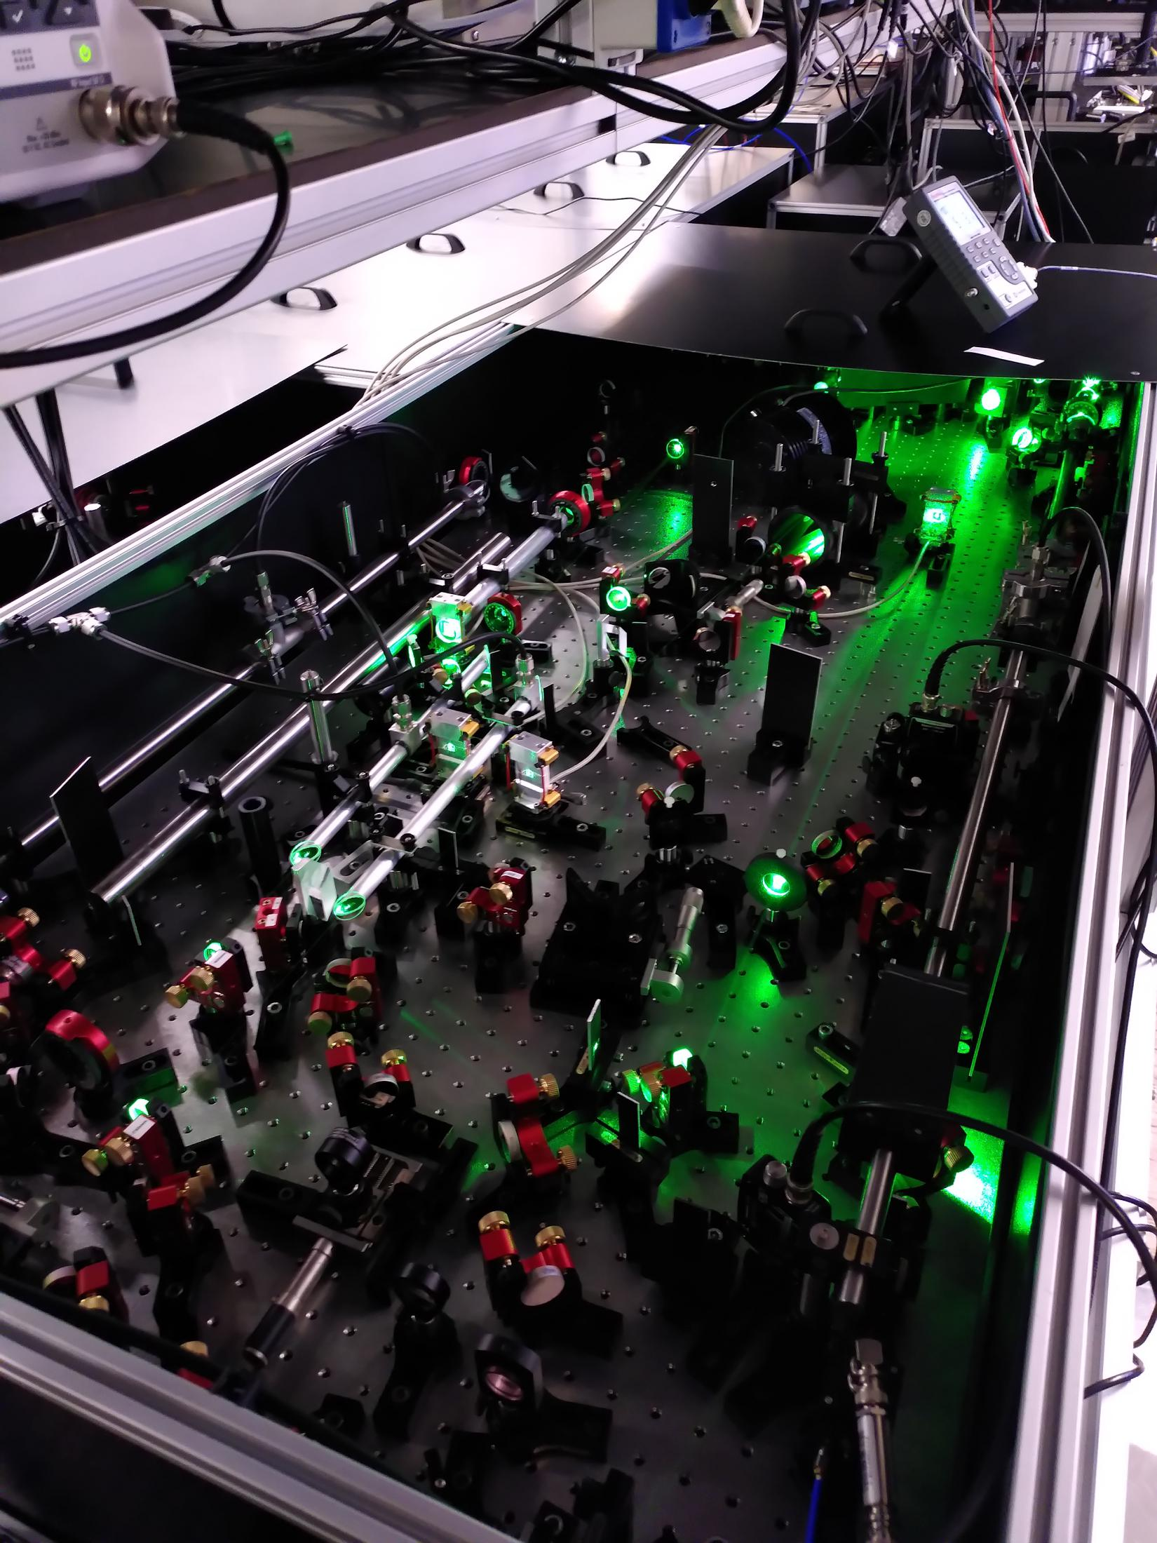
The Ramsey-comb laser → power & precision
Δφ phase measurement
Cs
clock
upconversion & spectroscopy
532 nm
two amplified FC pulses (5mJ)
pulse length fs – ps range
easy wavelength selection
av. phase constant at ~ 1 mrad
phase noise ~50 mrad for BBO,
and 15 mrad expected for LBO
Nat. Phys. 10, 30-33 (2014)
PRA 89, 052510 (2014)
PRL 117, 173201 (2016)
PRL 120, 043204 (2018)
PRL 123, 143001 (2019)
Mol. Phys. Accepted (2023)
LBO-based OPA
10
10

Slide 11
Ramsey-comb spectroscopy – the principle
nano or microsecond delay: N T_{rep}
|e>
}
= ΔE
|g>
2nd
1st
Ramsey fringe recording
Excitation probability
0
Δt = NΔT + δt →

Slide 12
Ramsey-comb spectroscopy – the principle
nano or microsecond delay: N T_{rep}
|e>
}
= ΔE
|g>
2nd
1st
Phase evolution
e^{i 2π ΔE Δt /h}
|e>
Ramsey fringe recording
} A² = p
|g>
2nd
1st
Excitation probability
p
0
Δt = NΔT + δt →

Slide 13
Ramsey-comb spectroscopy – the principle
nano or microsecond delay: N T_{rep}
|e>
}
= ΔE
|g>
Signal ~ 1+ cos (2π f_{trans} Δt + Δφ)
2nd
1st
Phase evolution
e^{i 2π ΔE Δt /h}
|e>
Ramsey fringe recording
} A² = p
|g>
2nd
1st
|e>
|g>
} (2A)² = 4p
Excitation probability
2nd
Δt = NΔT + δt →

Slide 14
Ramsey-comb spectroscopy – the principle
nano or microsecond delay: N T_{rep}
|e>
}
= ΔE
|g>
Signal ~ 1+ cos (2π f_{trans} Δt + Δφ)
2nd
1st
Phase evolution
e^{i 2π ΔE Δt /h}
|e>
Ramsey fringe recording
} A² = p
|g>
4p
2nd
1st
|e>
|g>
} (4A)² = 4p
Excitation probability
2nd
attosecond micro-delay
by adjusting f_{rep}
δt
|e>
|g>
} A² = 0
2nd
Δt = NΔT + δt →

Slide 15
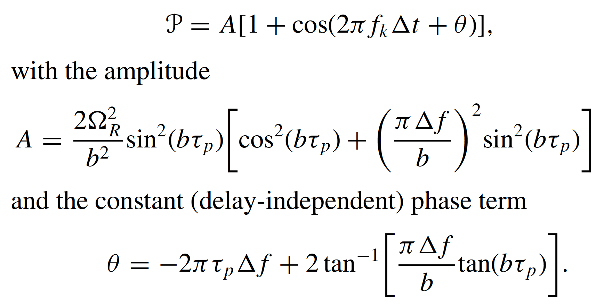
Ramsey-comb spectroscopy – the principle
Transition frequency
Excitation probability after 2 identical pulses*:
tr
τ_{p} = pulse length (square pulses)
Ω_{R} = Rabi frequency (depends on intensity)
b = Rabi frequency with detunig taken into account
Δf = detunig center of pulse spectrum
* see PRA 89, 052510 (2014)

Slide 16
Ramsey-comb spectroscopy – the principle
Transition frequency
Excitation probability after 2 identical pulses*:
tr
τ_{p} = pulse length (square pulses)
Ω_{R} = Rabi frequency (depends on intensity)
b = Rabi frequency with detunig taken into account
Δf = detunig center of pulse spectrum
* see PRA 89, 052510 (2014)

Slide 17
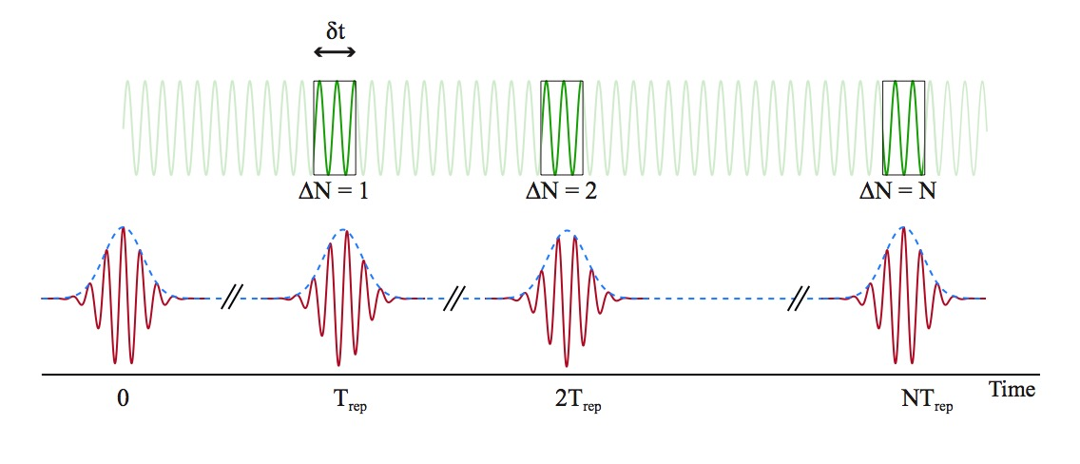
Solution: Ramsey-comb spectroscopy – macro delays
Signal ~ 1+ cos (2π f_{trans} [T_{rep}+δt] + Δφ)
What to do about the unknown Δφ ?
Ramsey
signal
Nat. Phys. 10, 30-33 (2014)
PRA 89, 052510 (2014)

Slide 18
Ramsey-comb spectroscopy – macro delays
Change macro delay by taking different FC pulses
Signal ~ 1+ cos (2π f_{trans} [T_{rep}+δt] + Δφ)
Pure relative phase analysis gives f_{transition}!
Suppression of common mode phase shifts,
including AC-Stark shift
Ramsey
signal
Nat. Phys. 10, 30-33 (2014)
PRA 89, 052510 (2014)

Slide 19
Ramsey-comb spectroscopy – macro delays
Change macro delay by taking different FC pulses
Signal ~ 1+ cos (2π f_{trans} [NT_{rep}+δt] + Δφ)
Pure relative phase analysis gives f_{transition}!
Suppression of common mode phase shifts,
including AC-Stark shift
Longer delay gives better accuracy & resolution
Ramsey
signal
Nat. Phys. 10, 30-33 (2014)
PRA 89, 052510 (2014)

Slide 20
The plan: Ramsey-comb excitation of He⁺ 1S-2S in a trap
2S
2P
790 nm
32 nm
He⁺
He⁺
Be⁺
1S
32 nm +
790 nm
32 nm +
790 nm
20

Slide 21
1st order Doppler cancellation by synchronization
f_{sec} = 5 MHz
Recoil =55 MHz
He⁺
Movement ion periodic
with f_{sec} and f_{RF}
→ Match T_{rep} of laser to T_{sec} and T_{RF}
21

Slide 22
1st order Doppler cancellation by synchronization
f_{sec} = 5 MHz
Recoil =55 MHz
He⁺
Movement ion periodic
with f_{sec} and f_{RF}
→ Match T_{rep} of laser to T_{sec} and T_{RF}
22

Slide 23
1st order Doppler cancellation by synchronization
He⁺
f_{sec} = 5 MHz
Recoil =55 MHz
Movement ion periodic
with f_{sec} and f_{RF}
→ Match T_{rep} of laser to T_{sec} and T_{RF}
23

Slide 24
1st order Doppler cancellation by synchronization
f_{sec} = 5 MHz
Recoil =55 MHz
He⁺
Movement ion periodic
with f_{sec} and f_{RF}
→ Match T_{rep} of laser to T_{sec} and T_{RF}
24

Slide 25
1st order Doppler cancellation by synchronization
He⁺
f_{sec} = 5 MHz
Recoil =55 MHz
Movement ion periodic
with f_{sec} and f_{RF}
→ Match T_{rep} of laser to T_{sec} and T_{RF}
25

Slide 26
1st order Doppler cancellation by synchronization
f_{sec} = 5 MHz
Recoil =55 MHz
He⁺
Movement ion periodic
with f_{sec} and f_{RF}
→ Match T_{rep} of laser to T_{sec} and T_{RF}
26

Slide 27
1st order Doppler cancellation by synchronization
Spectroscopy accuracy depends on
accuracy synchronization,
recoil from 32+790 nm
vibrational state occupation
harmonicity
f_{sec} = 5 MHz
Recoil =55 MHz
He⁺
Lock at 10⁻⁴ → 11 kHz
Movement ion periodic
with f_{sec} and f_{RF}
→ Match T_{rep} of laser to T_{sec} and T_{RF}
27

Slide 28
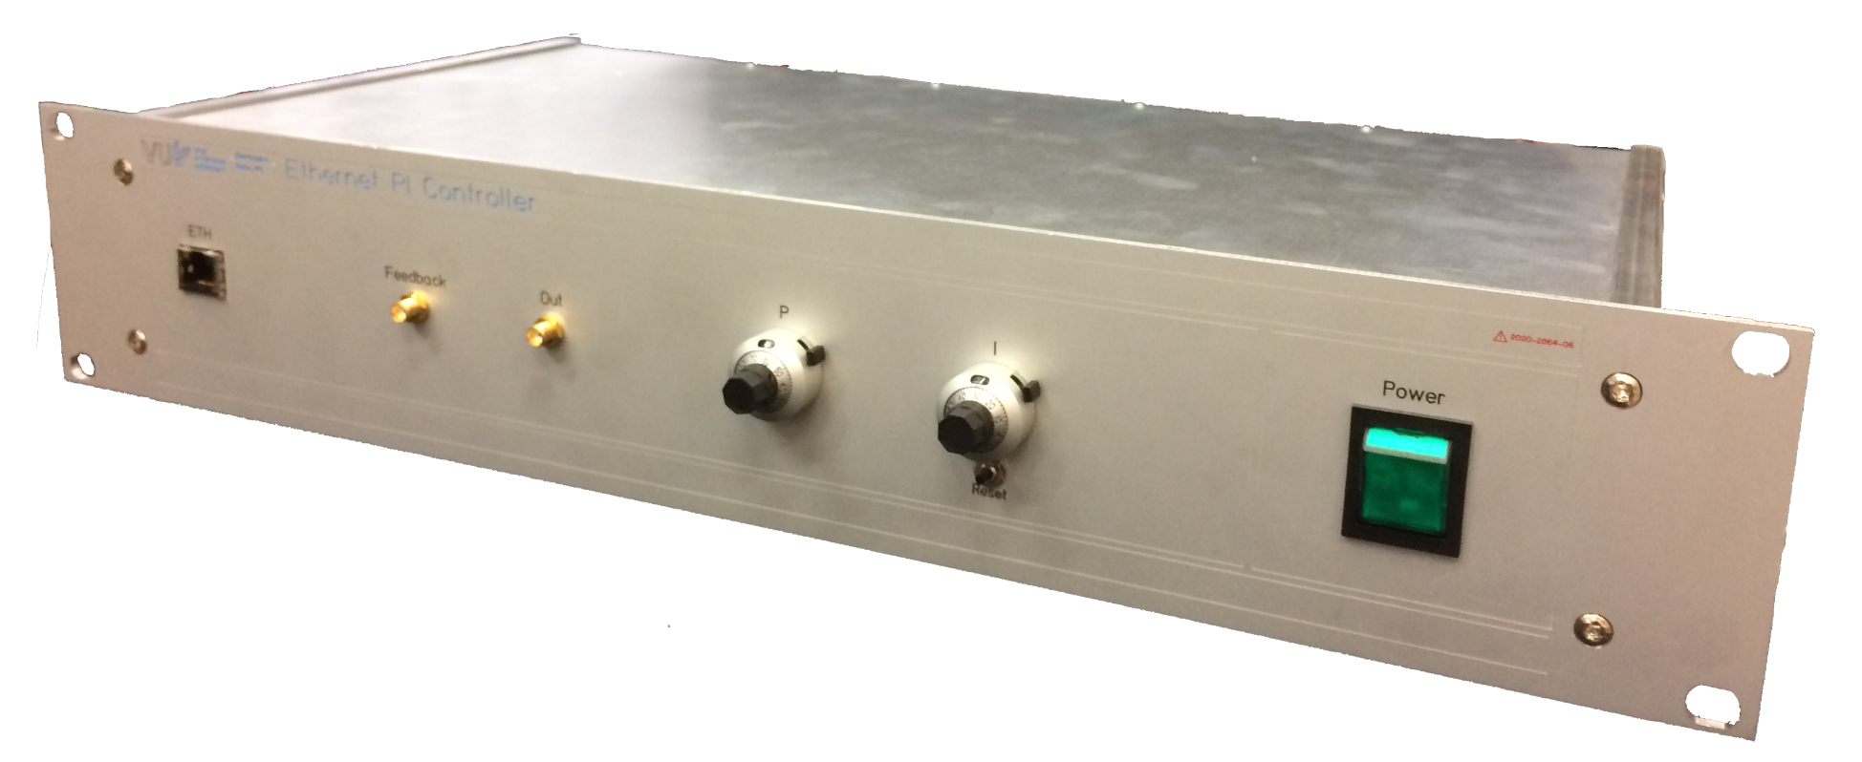
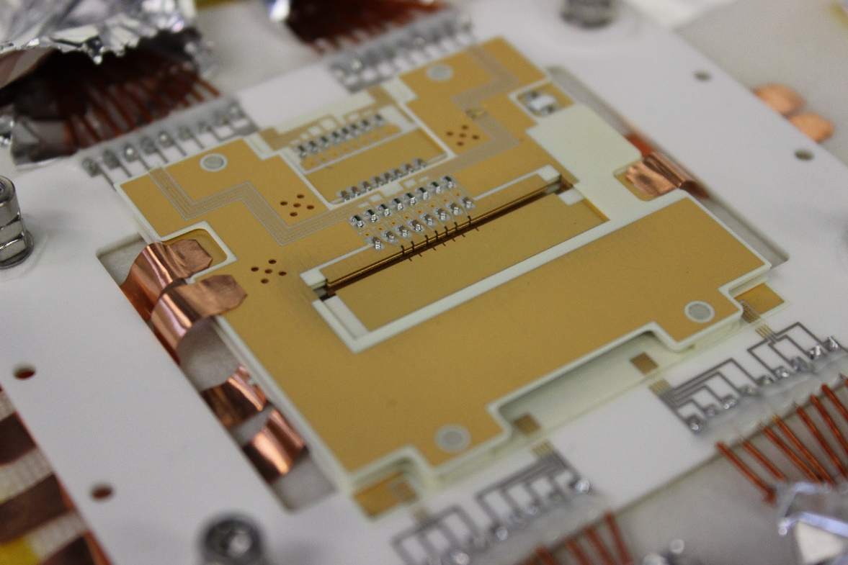
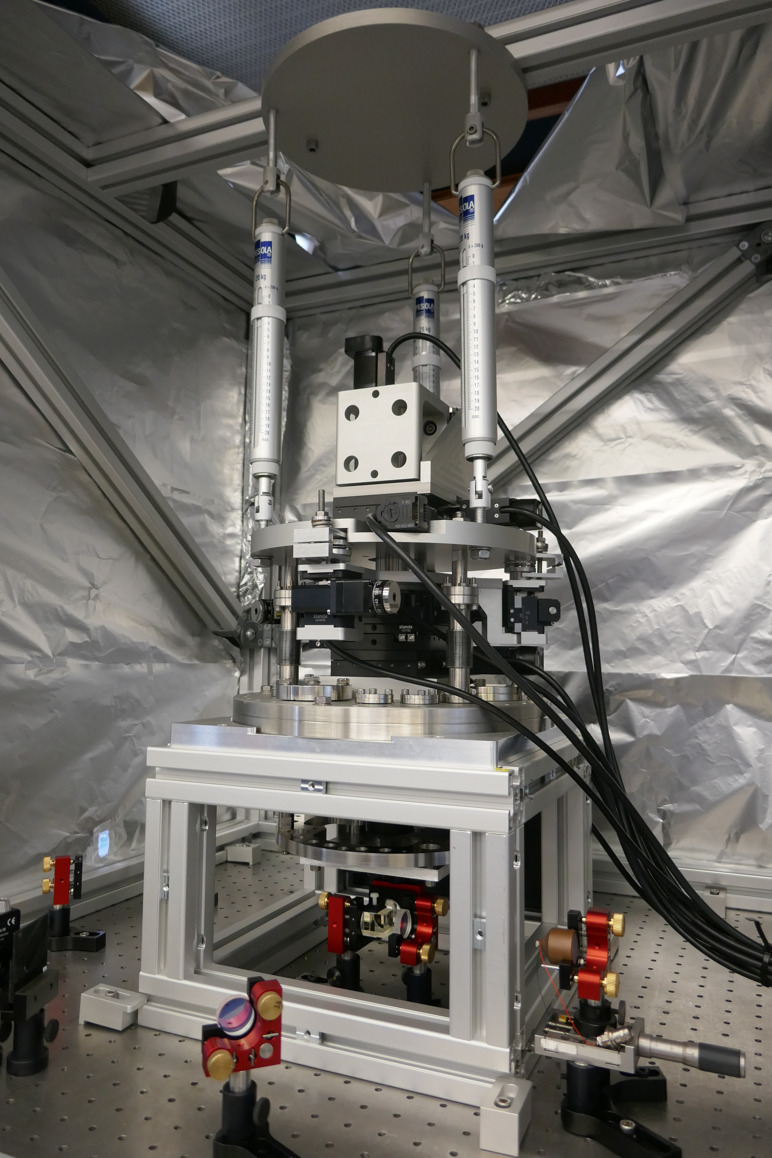
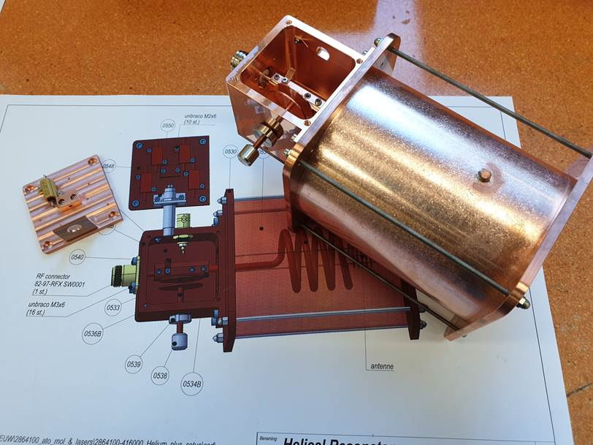
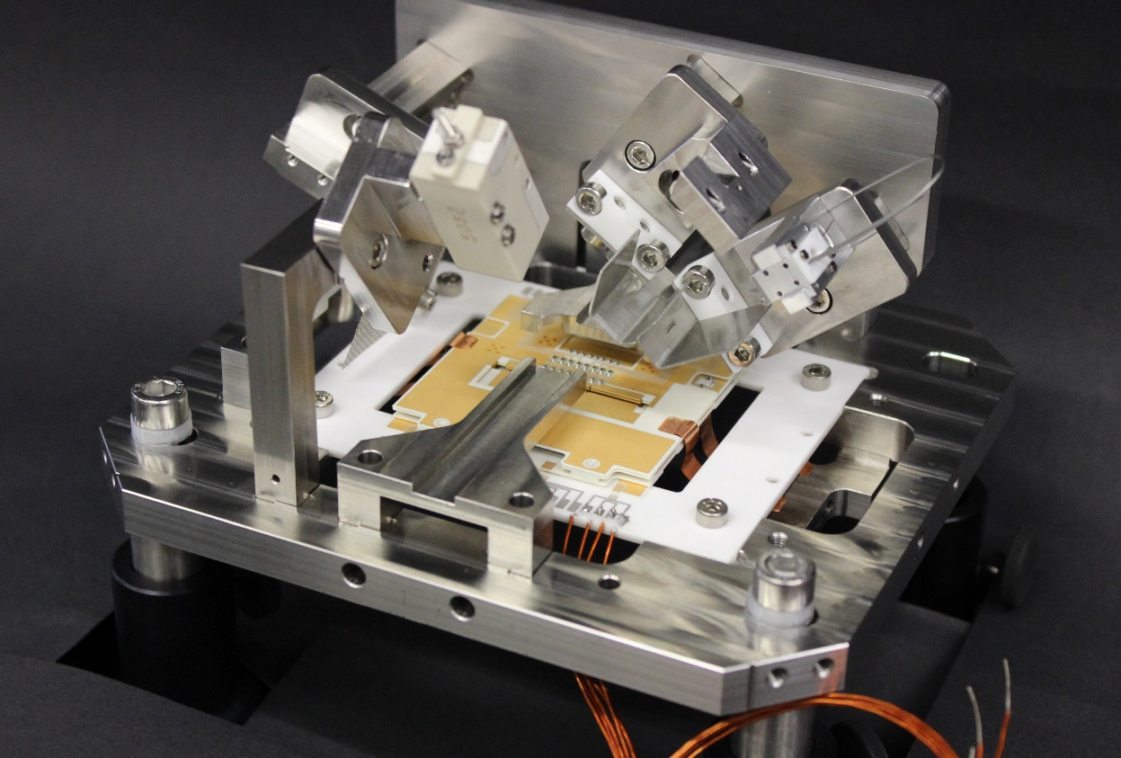
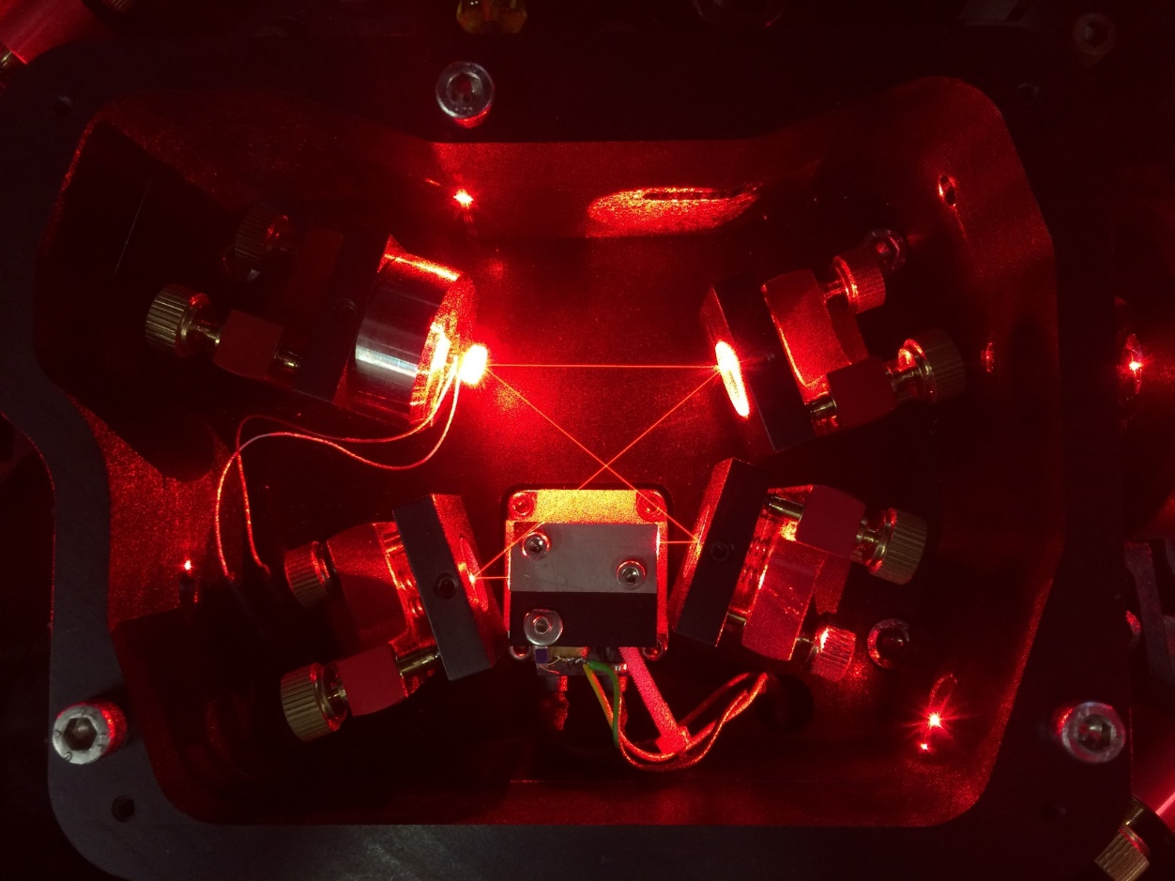
1st order Doppler cancellation by synchronization
Resonator with tuning and
RF amplitude stabilisation
313 nm
laser cooling
Ion trap, collaboration with
Tanja Mehlstäubler (PTP)
28

Slide 29
XUV (frequency comb) generation
XUV light
>10¹³ W/cm²
29

Slide 30
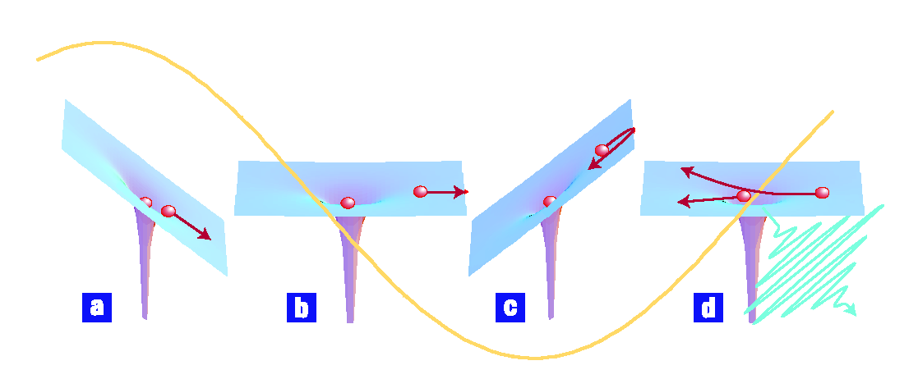
XUV (frequency comb) generation
UV – XUV comb
>10¹³ W/cm²
Electric field of light (orange line) deforms Coulomb potential atoms in the jet
‘simple man’
Three step
model
PRL 71, 1994-1997 (1993).
PRA 49, 2117-2131 (1994).
Nature Physics 3, 381 (2007)
1: tunneling
2: acceleration
3: recombination
30

Slide 31
XUV (frequency comb) generation
UV – XUV comb
>10¹³ W/cm²
Harmonic orders
Int.
Int.
NIR comb
p^{th}
harmonic
XUV comb
f₀
f = f_{ceo} + n f_{rep}
f = p f_{ceo} + m f_{rep}
31

Slide 32
Xe experiment to test (ionization) phase effects HHG
Argon jet
Xe
1064 nm
5p⁵ 8s
(τ=24 ns)
110 nm
(7th harm.)
5p⁶

Slide 33
First demonstration of RCS with HHG, in Xe at 110 nm
Phase effects quickly diminish to few mrad in tens of ns at 0.8 ⨉ 10¹⁴ W/cm²
Enabled most accurate spectroscopy to date with HHG: dν/ν = 2.3 ⨉ 10 ⁻¹⁰
HHG power 2nd pulse recovers after 100 ns (transit of Ar)
Xe @ 110 nm
Contrast reduction:
- Transit time
- 8s lifetime of 23 ns
- Doppler
L.S. Dreissen et al.,
PRL 123, 143001 (2019)
L.S. Dreissen et al.,
PRA 101, 052509 (2020)

Slide 34
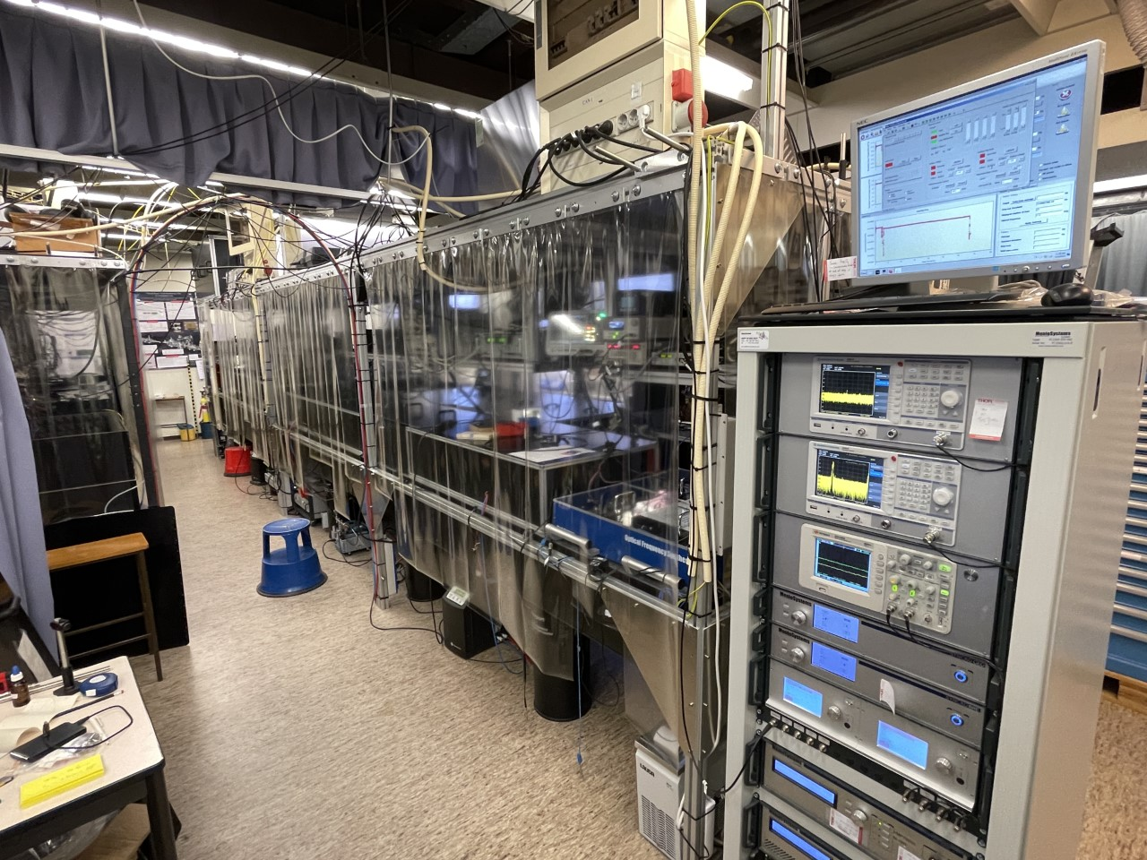
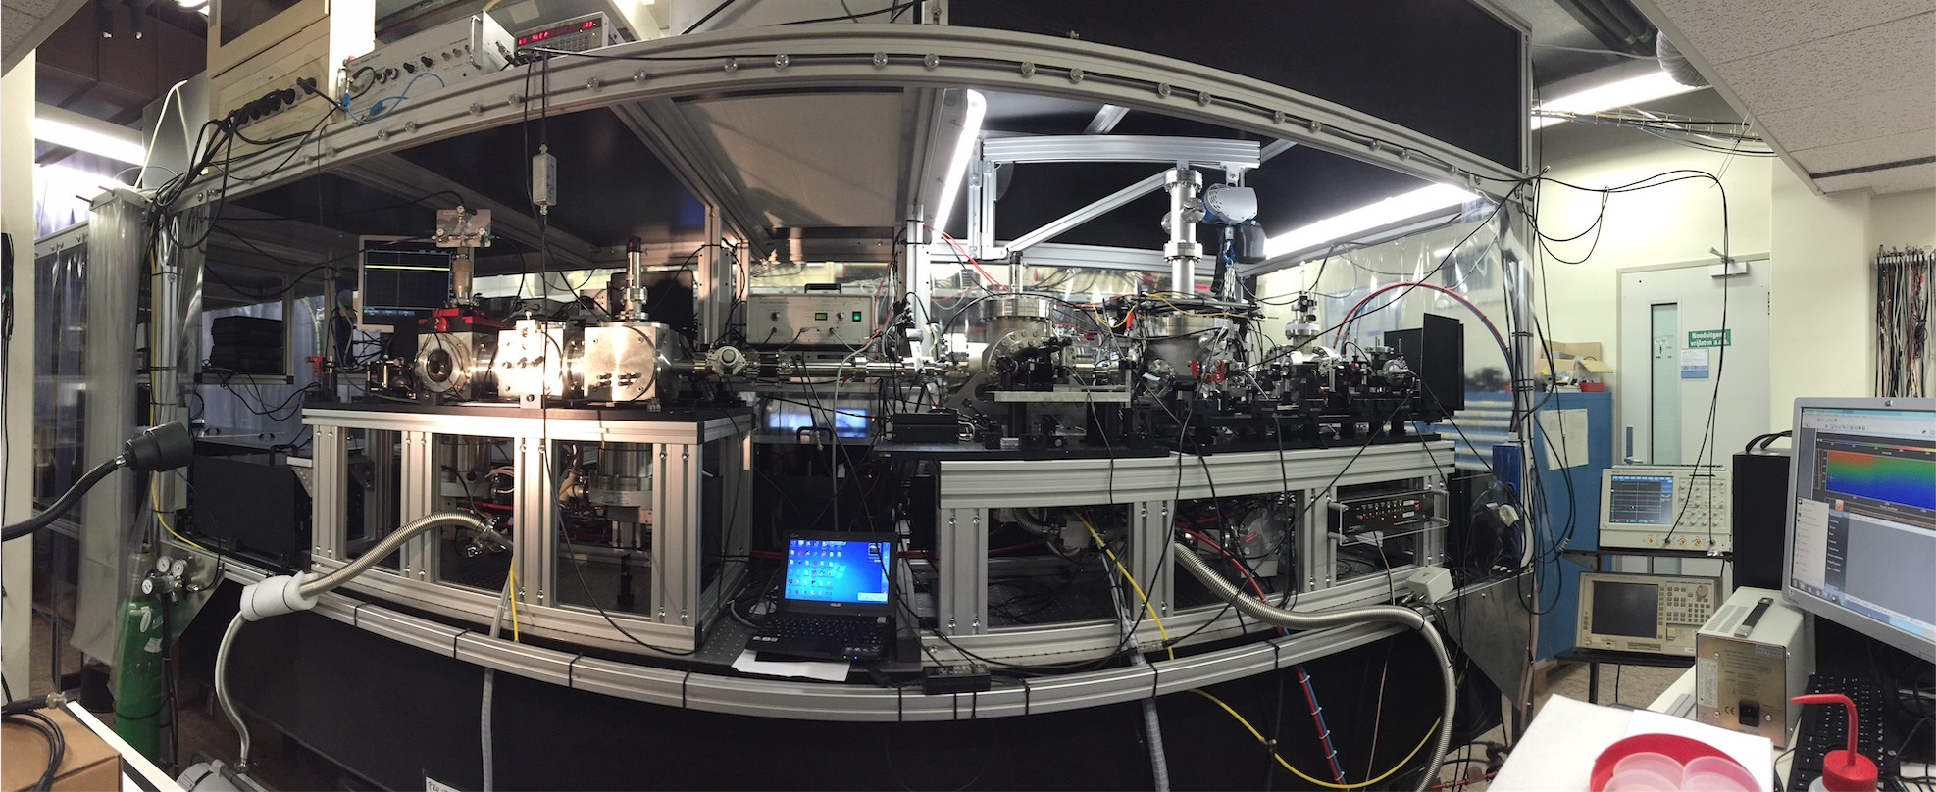
What does this mean for He⁺ 1S-2S?
kHz-level accuracy possible at 30 nm for microseconds pulse delay
NIR phase noise has to stay < 40 mrad over a few microseconds (contrast): possible
Negligible phase shift due to HHG process (pulse delays > 100 ns)
No time-of-flight limitation as we had with Xe
...

Slide 35
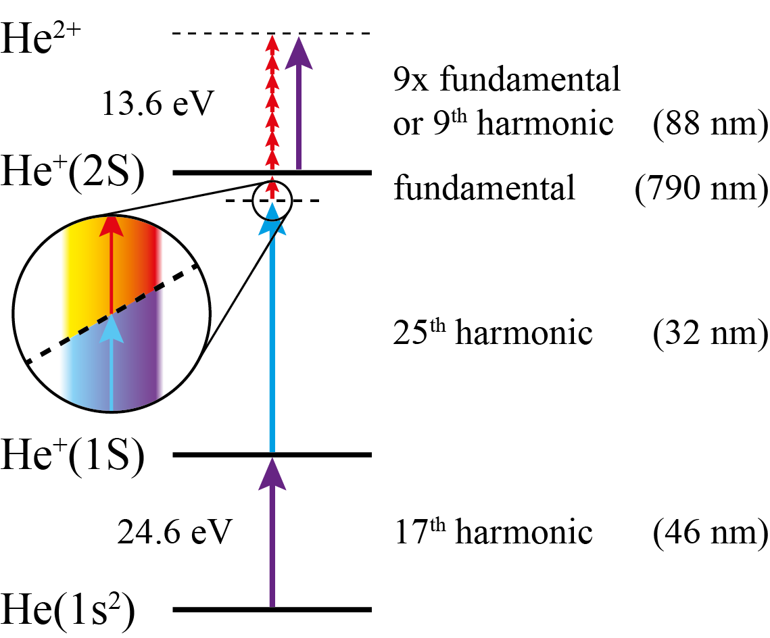
Single-pulse excitation of He⁺ in an atomic beam
Enables to test all aspects of generation, excitation, and detection of He⁺
Excitation probability only 4x lower than 2-pulse RCS & trapping
Total experiment done in 150 fs...
Excitation
1S - 2S He⁺
Ionization
He to He⁺
Ionization
2S He⁺ to He²⁺
intensity
NIR (790 nm)
150 fs
HHG
time

Slide 36
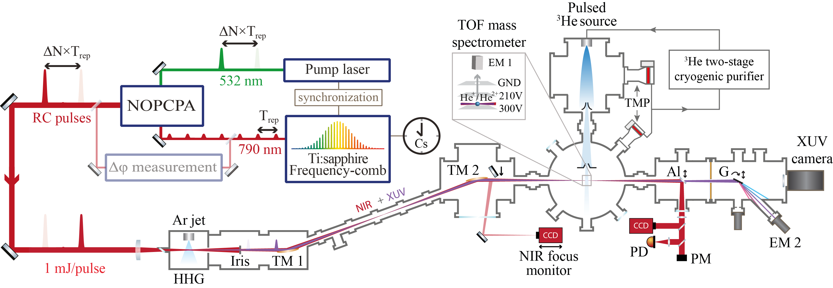
³He⁺ 1S-2S excitation setup
³He to avoid H₂⁺
background signal
XUV, + NIR power adjustment with iris

Slide 37
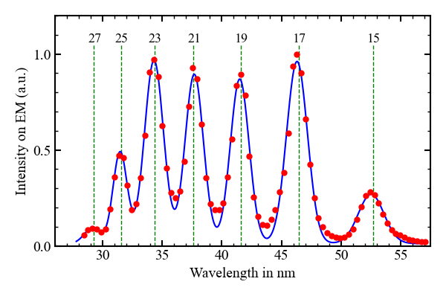
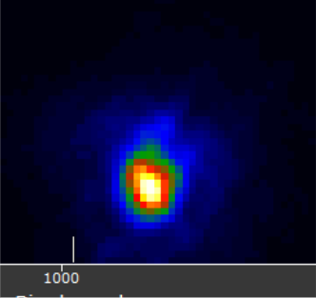
High-harmonic generation spectrum
HHG in argon
resolution limited
by spectrometer
NIR pulse 1 mJ, 150 fs
f=30 cm focusing to 33 μm FWHM
XUV beam
after int. zone
32 nm right at HHG cutoff

Slide 38
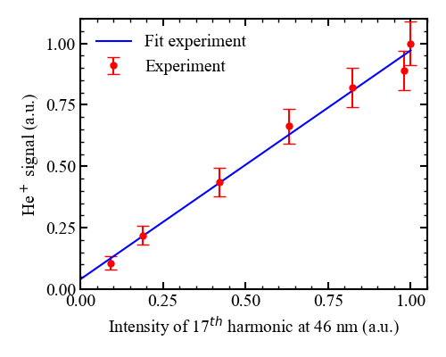
He⁺ generation by ionization He with 17th harm.
up to 150 He⁺ ions per laser pulse
great news for ion trap loading;
low intensity He beam possible

Slide 39
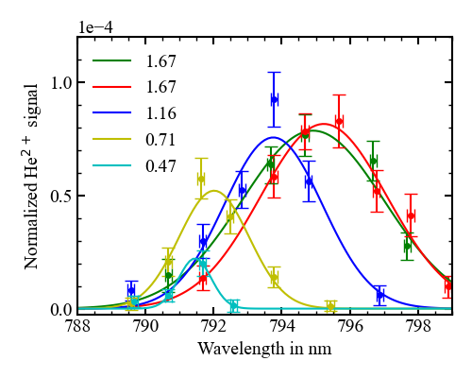
First 1S-2S excitation of He⁺
NIR intensity in 10¹⁴ W/cm²
Excitation probabilty, He²⁺ det.
Center NIR wavelength (nm)
Massive ac-Stark shift from NIR intensity (max. 50 THz on the 1S − 2S)
Excitation probability ~ 10⁻⁴ per pulse of NIR+XUV → 10⁻³ expected for RCS (2 pulses)
Saturation effects visible

Slide 40
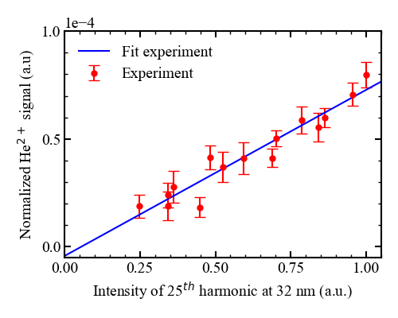
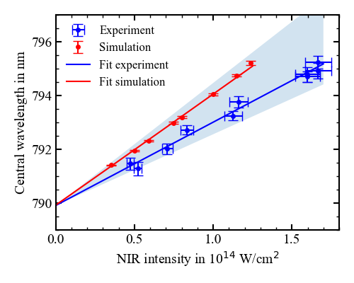
Is this really pure 1S-2S excitation?
ac-Stark shift from NIR
He²⁺ signal vs. 32 nm harmonic
Strongly suggests 1S-2S:
2P excitation would extrapolate to 760 nm
Only 1 photon at 32 nm is involved,
and without NIR: no signal

Slide 41
Is this really pure 1S-2S excitation?
ac-Stark shift from NIR
He²⁺ signal vs. 32 nm harmonic
Experiment: 789.95(18) nm
Theory: 789.842 nm
accuracy: 2.2 * 10⁻⁴ 😉
Strongly suggests 1S-2S:
2P excitation would extrapolate to 760 nm
Only 1 photon at 32 nm is involved,
and without NIR: no signal

Slide 42
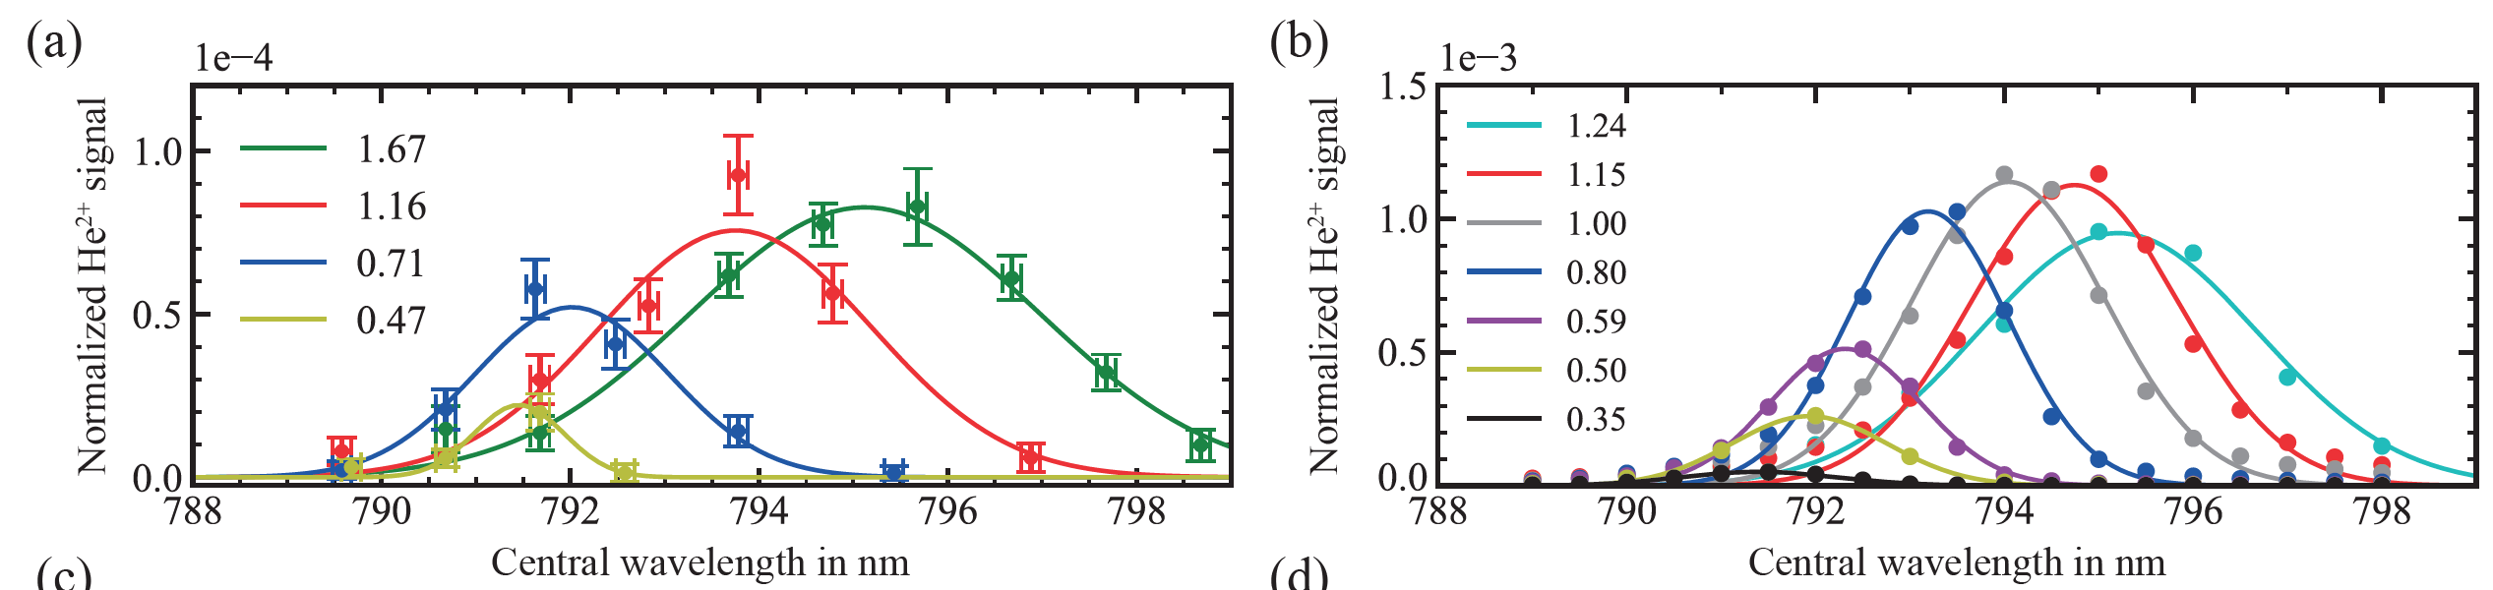
TDSE simulation
Experiment
TDSE simulation
Integration step 0.5 attoseconds
Central wavelength NIR beam
Central wavelength NIR beam
HHG field simulation by
Andrés Martinez de Velasco
TDSE simulation by
Richard Taieb (Sorbonne, UPMC, Paris)

Slide 43
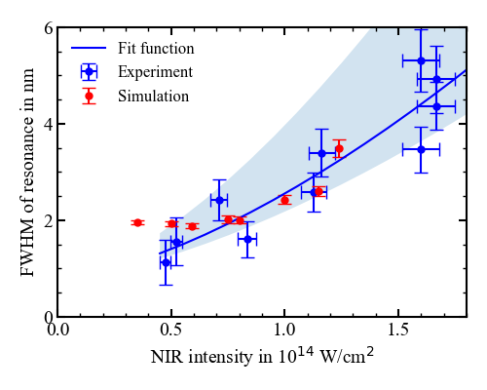
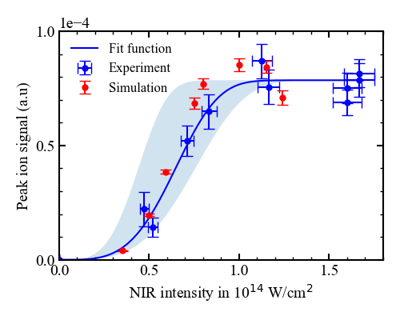
TDSE simulation – resonance height and width
Trends the same: for high NIR power the resonance signal saturates
Resonance width
Resonance height (scaled to experiment)

Slide 44
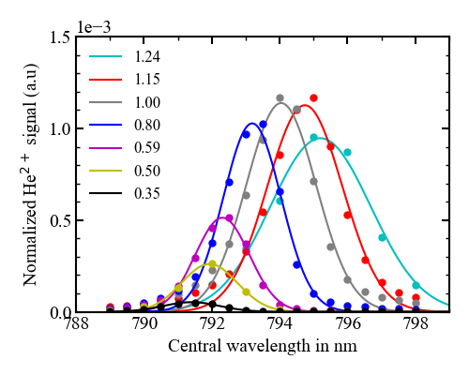
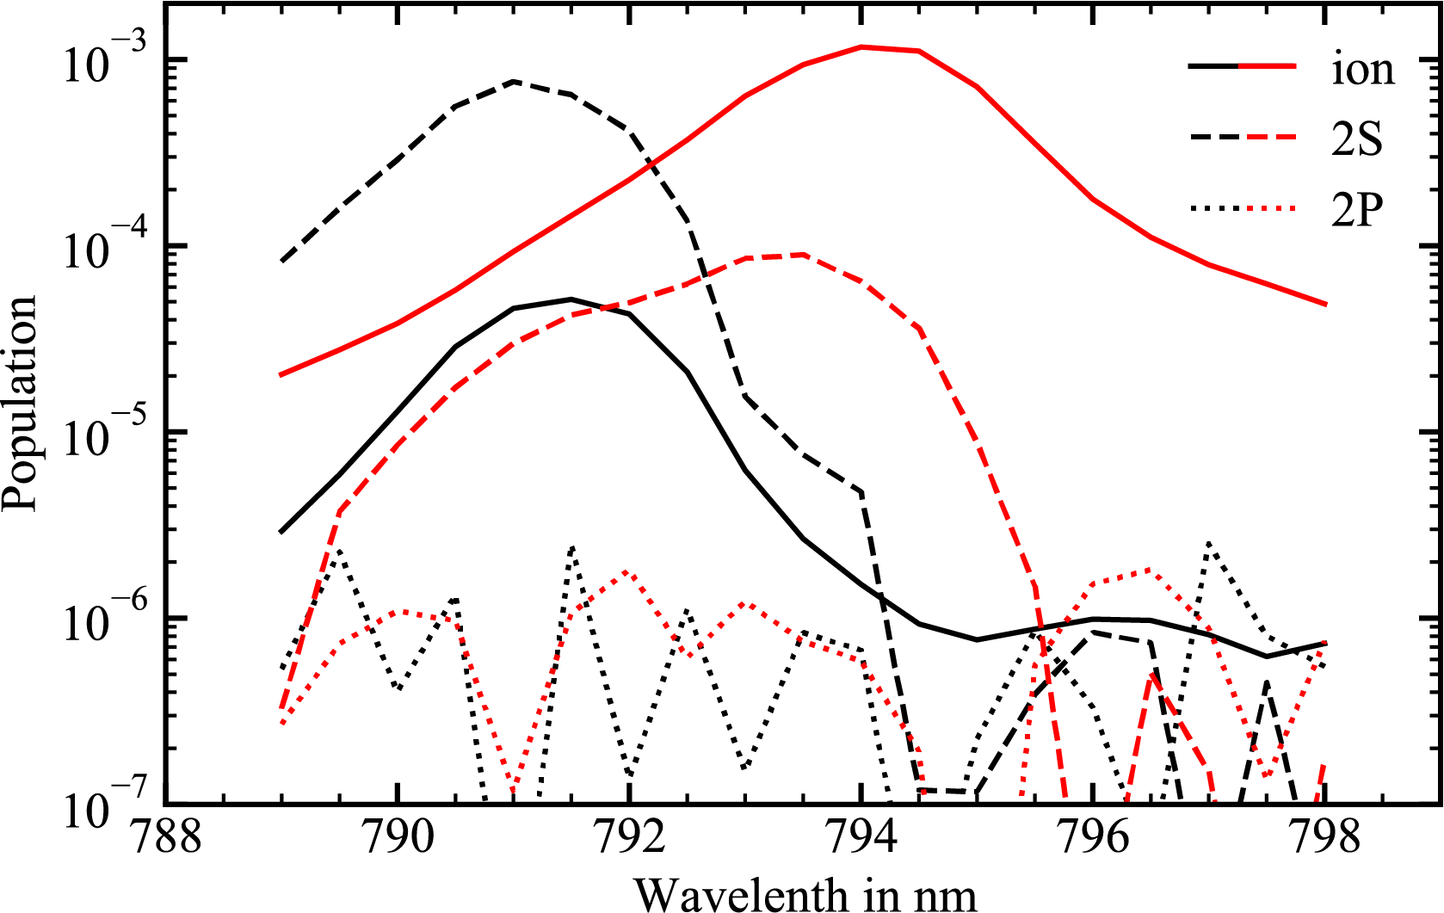
TDSE simulation – 2S, 2P, and He²⁺ population
NIR @ 0.35x10¹⁴ W/cm²
NIR @ 1.00x10¹⁴ W/cm²
2S
He²⁺
States other than 2S
at least 1000x less excited!
2S
He²⁺
NIR dependence gives
nice opportunity to control
ionization detection without
strong inpact on excitation
2P
2P

Slide 45
TDSE simulation – 2S, 2P, and He²⁺ population
NIR @ 0.35x10¹⁴ W/cm²
NIR @ 1.00x10¹⁴ W/cm²
2S
He²⁺
States other than 2S
at least 1000x less excited!
2S
He²⁺
NIR dependence gives
nice opportunity to control
ionization detection without
strong inpact on excitation
2P
2P

Slide 46
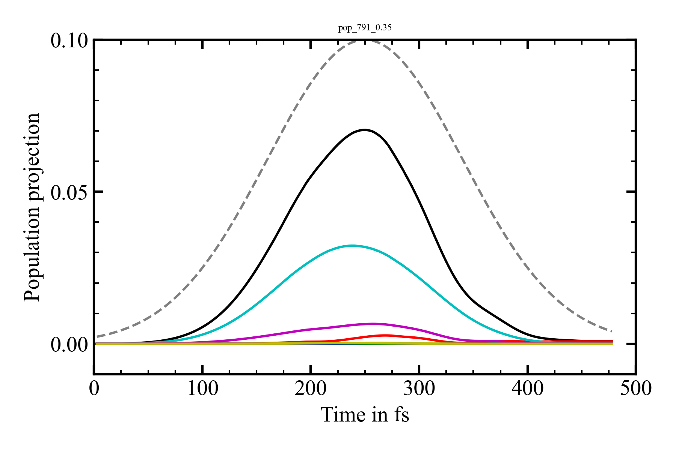
TDSE simulation – interesting time dynamics
NIR at 791 nm and 0.35x10¹⁴ W/cm²
Strong mixing to P states,
which disappears when NIR → 0
2S appears when 25th harmonic
is generated
1-1S
Envelope NIR field
2P
3P
2S

Slide 47
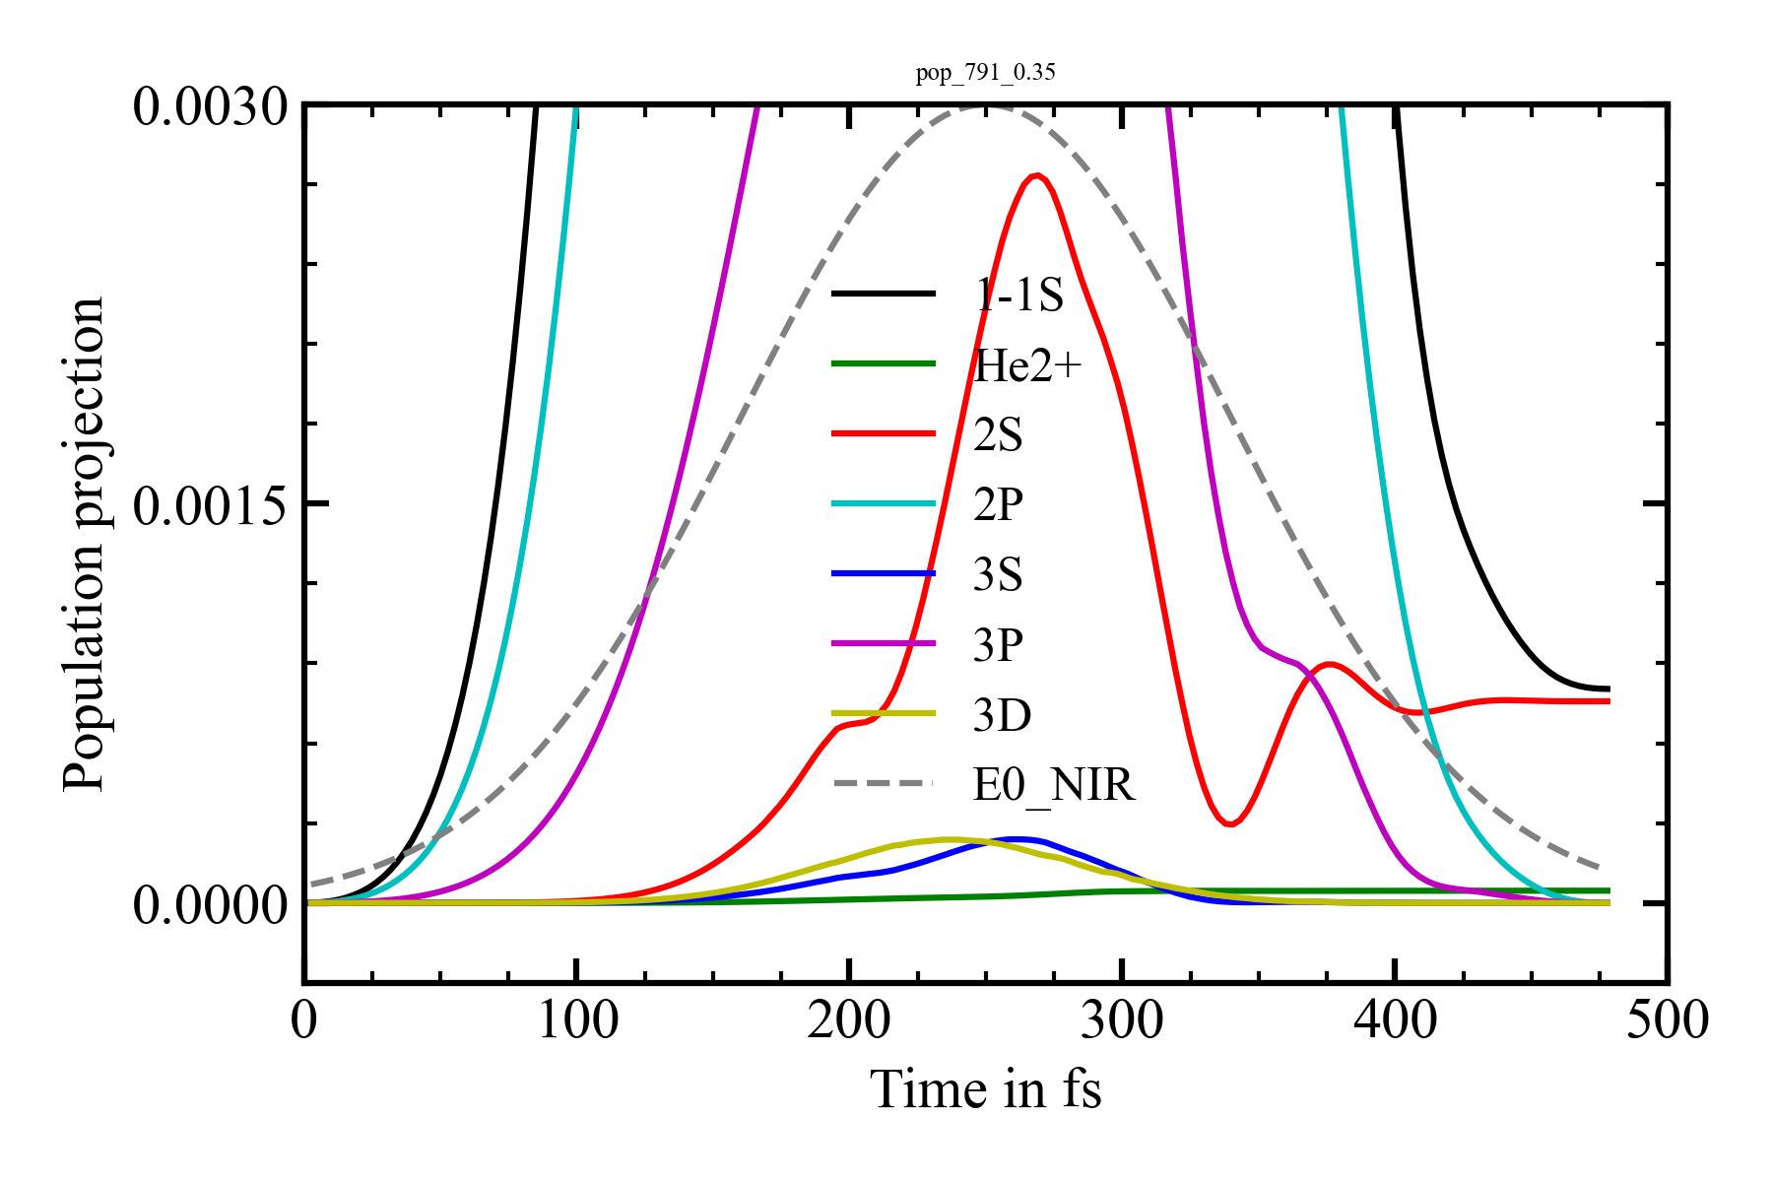
TDSE simulation – interesting time dynamics
‘Low’ NIR power
0.35x10¹⁴ W/cm²
0.075 % in 2S
0.005 % He²⁺

Slide 48
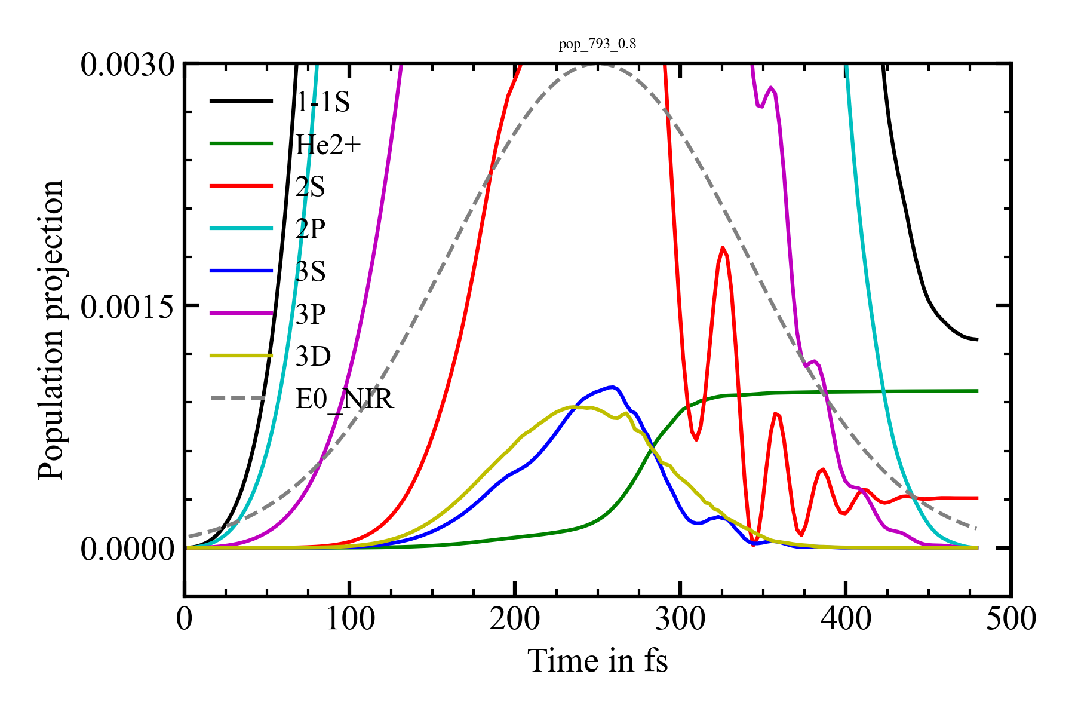
TDSE simulation – interesting time dynamics
‘High’ NIR power
0.8x10¹⁴ W/cm²
0.1 % as He²⁺
0.03 % in 2S

Slide 49
20 THz ac-Stark shift – precision spectroscopy?
ac-Stark shift of Δf = 20 THz on 1S-2S at 0.35 x 10¹⁴ W/cm²
20 THz
1S-2S He⁺
Comes from 3.8 rad in 30 fs (XUV generation window)
In RCS the NIR pulse has longer influence than 30 fs; ~5x more = 19 rad
Shift proportional to pulse energy, with 0.1% dependence on N
So remaining effect in RCS = 19 rad x 0.1% = 19 mrad
Leads in total to ~ 7.6 kHz error for 400 ns time delay in RCS (and scales down with 1/ΔT)
Δω = Δφ/Δt

Slide 50
20 THz ac-Stark shift – precision spectroscopy?
ac-Stark shift of Δf = 20 THz on 1S-2S at 0.35 x 10¹⁴ W/cm²
20 THz
1S-2S He⁺
Comes from 3.8 rad in 30 fs (XUV generation window)
In RCS the NIR pulse has longer influence than 30 fs; ~5x more = 19 rad
Shift proportional to pulse energy, with 0.1% dependence on N
So remaining effect in RCS = 19 rad x 0.1% = 19 mrad
Leads in total to ~ 7.6 kHz error for 400 ns time delay in RCS (and scales down with 1/ΔT)
Δω = Δφ/Δt

Slide 51
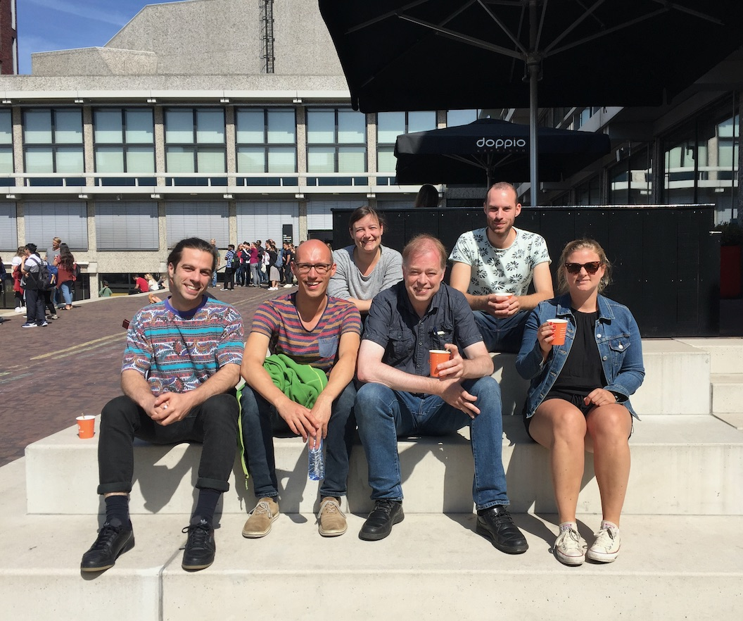
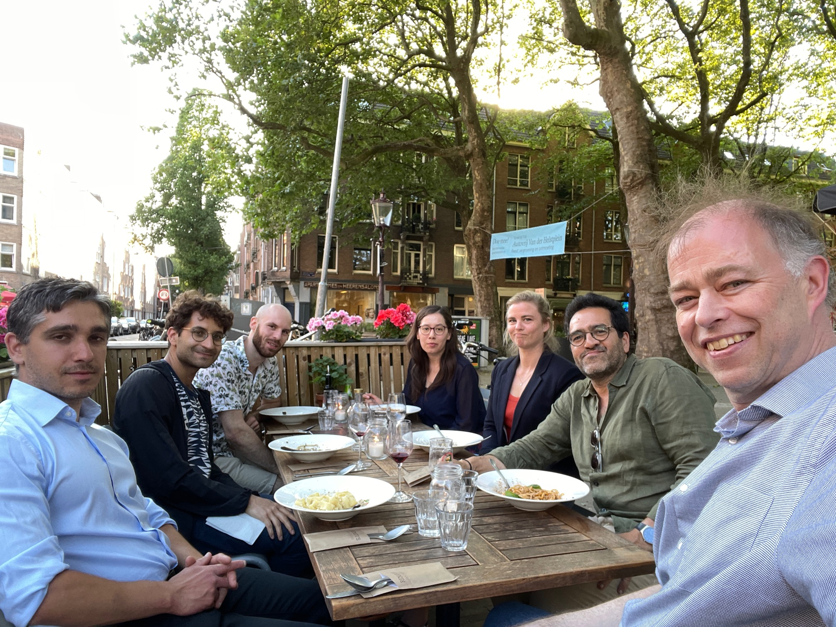
Thanks to the Ramsey-comb He⁺/H₂ team!
Andrés
Martinez
de Velasco
TDSE calculations (Paris, Sorbonne):
Richard Taieb
Vincent
Barbé
KE
Alejandra Dias
Julian
Krauth
Elmer
Gründeman
Laura
Dreissen
Collaboration for ion trap He⁺ with PTB:
Tanja Mehlstäubler and group members,
& Piet Schmidt
Mathieu
Collombon
Charlaine
Roth

Slide 52

Summary
RCS successfully combined with HHG; Xe spectroscopy at 110 nm with 2.3 x 10⁻¹⁰
Demonstrated first 1S-2S excitation of He⁺
Excitation scheme 32 nm + 790 nm, with ionization control
1-pulse excitation probability 10⁻⁴; for RCS 10⁻³ expected
Other states like 2P excited at least a 1000x less
ac-Stark shift small enough for (sub)-kHz precision
TDSE simulations confirm 1S-2S excitation
1S-2S He⁺

Slide 53
Outlook
Extensive TDSE simulation of full RCS excitation
Measure the phase (noise) of new RCS laser based on LBO
Install the ion trap with electronics and mechanics in the coming months
Followed by: demonstration of fast loading He⁺ and Be⁺
And then ... a precision 1S-2S measurement at 20 kHz accuracy! (hopefully)

Slide 54
Extra slides
54

Slide 55
Outlook on (initial) accuracy: < 20 kHz on 1S-2S
Contrast effects up to few μs time scale
RC laser induced phase noise: 40 mrad * 26th harm. = 1.1 rad in XUV = 1/6 of an optical cycle; OK
Vibrations (turbo’s): < 1 nm (random) = 0.2 rad = 1/30th of a cycle; ok
HHG induced phase noise: ~ 0.2 rad = 1/30th of an optical cycle; ok
ac-Stark shift phase noise: ~ 20 mrad; no issue
Systematics at initial Ramsey-comb ΔT=400 ns Error: Scaling:
Syncing T_{rep} with T_{sec} and T_{micr} at level of 10⁻⁴
NOPCPA phase shift accuracy < 1 mrad @ 790nm
ac-Stark on 1S-2S for 0.1% dependence 790 nm pulse energy on N
HHG differential phase
Thermal drift effects
11 kHz ΔT independent
10 kHz 1/ΔT
9 kHz 1/ΔT
4 kHz 1/ΔT
<< kHz ΔT
So an initial accuracy expected of <20 kHz

Slide 56
Outlook on (initial) accuracy: < 20 kHz on 1S-2S
Contrast effects on RCS signal for up to few μs pulse time delay
Laser noise expected: 40 mrad * 26th harm. = 1.1 rad in XUV; OK: 1/6 of an optical cycle) @ 30 nm
Vibrations (turbo’s): < 1 nm (random) = 0.2 rad = 1/30th of a cycle; ok
ac-Stark phase shift noise (I@0.1%): < 0.01 rad in XUV; no problem
HHG phase noise 0.2 rad = 1/30th of a cycle.
Effects reduced by sync T_{rep} with T_{sec} and T_{mic} at level of frac = 10⁻⁴
Systematic error from recoil: Δf = h frac / (m λ²) = 11 kHz
Ion temperature: < 1 nm random phase shift; no serious contrast loss or shift
Thermal: << 1 nm; systemati phase shift, but drops mostly out in RCS and is initially negligible
Other systematics RCS with ΔT = 400 ns
OPA differential phase effects: <1 mrad accuracy at 790nm, gives a 1S-2S shift of <10 kHz
HHG differential phase effects (I@0.1%): < 20 mrad at 32nm, gives 1S-2S shift of <4 kHz
ac-Stark differential phase (I@0.1%): < 20 mrad at 32nm, gives 1S-2S shift of <9 kHz
Thermal: < 0.1 pm (systematic, 20 μrad phase): can for the moment be neglected
So an initial 1S-2S measurement accuracy of <20 kHz is expected

Slide 57
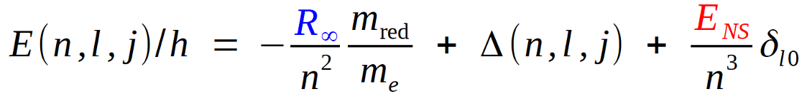
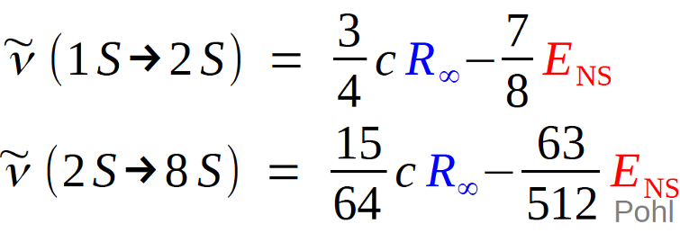

How to measure proton size r_{p} and Rydberg with H?
Measure ratios to determine $R_{∞}$ and r_{p}
Bohr
QED, Rel. etc
Nuclear size
H
R. Pohl et al., Metrologica 54, L1 (2017)

Slide 58

2010-2013: conflicting proton radii
Muonic H spectroscopy
2S-2P at 6 μm
‘Normal’ H spectroscopy
& electron scattering
@ PSI
Nature 2010
Randolf Pohl et al. Nature, vol. 466, pp. 213-216 (2010)
Measurement 2S-2P @ 6 μm of muonic hydrogen: 4% smaller proton?
Picture above from Science 339, 417-420 (2013). Many more publications followed
58

Slide 59
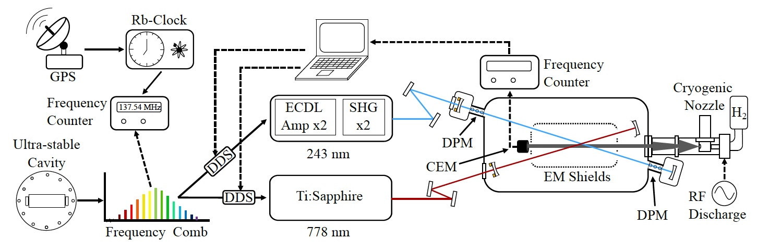
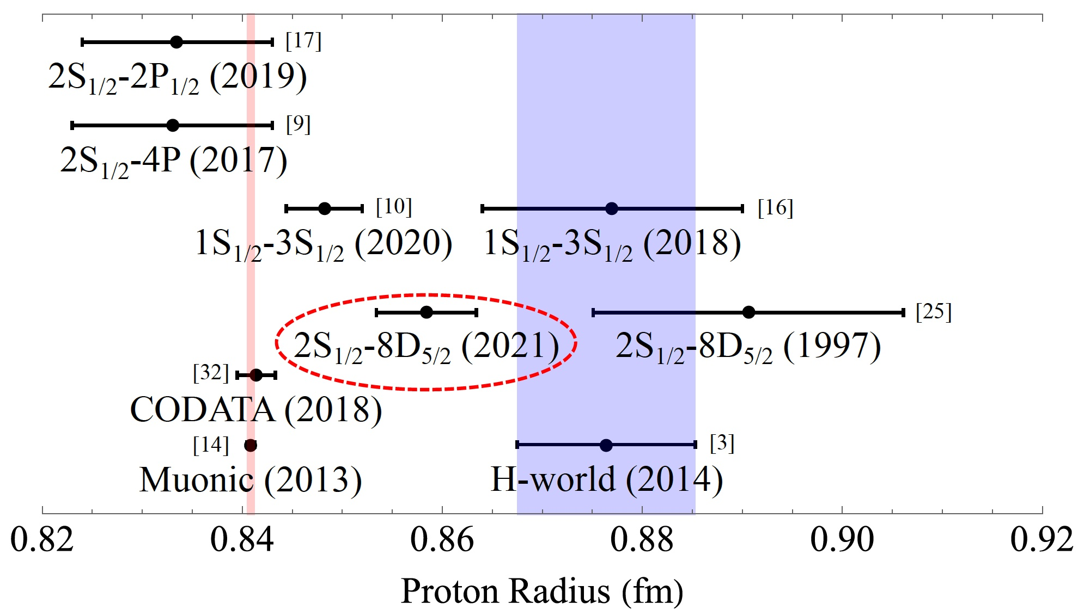
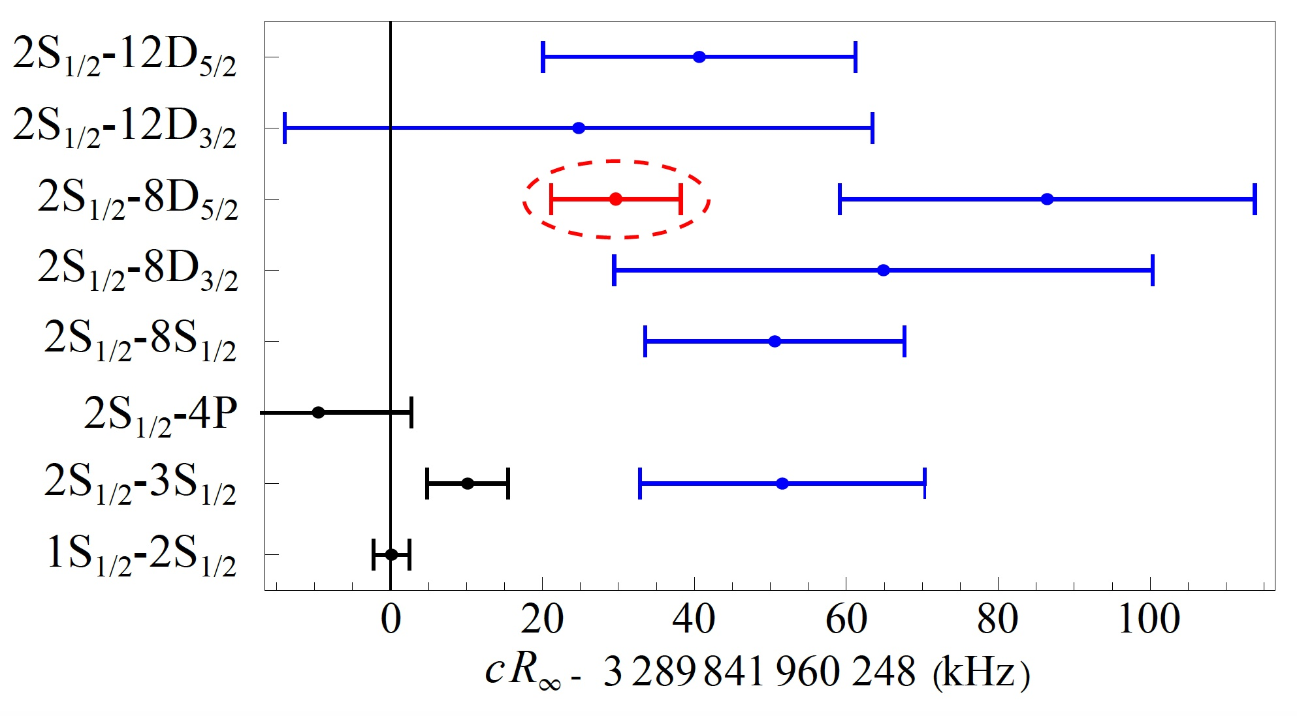
2022: Still some confusing/intriguing results
Measurement of the 2S_{1/2} – 8D_{5/2} transition in hydrogen
Phys. Rev. Lett. 128, 023001 (2022)
A.D. Brandt et al. (group D. Yost)
Colorado State University & Russian Quantum Center
59
59

Slide 60
Single pulse
Int.
0
frequency
60

Slide 61
Frequency comb lasers: repetition
...
...
Int.
0
frequency
f_{n} = f_{ceo} + n.f_{rep}
61

Slide 62
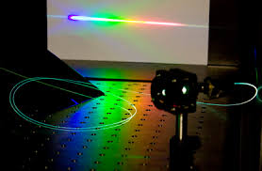
Equal pulse distortion = OK!
...
...
Photonic or holey fiber broadening
Phases and intensities changed, but frequencies at the same position!
Int.
0
f_{n} = f_{ceo} + n.f_{rep}
62

Slide 63

Equal pulse distortion = OK!
...
...
Phases and intensities changed, but frequencies at the same position!
Int.
0
frequency
f_{n} = f_{ceo} + n.f_{rep}
63

Slide 64
High-harmonic generation (HHG)
Coulomb potential periodically deforms by electric field of light (orange line)
‘simple man’
Three step
model
1: tunneling
2: acceleration
3: recombination
Corkum, P. B. Phys. Rev. Lett. 71, 1994-1997 (1993).
Lewenstein, M. et al. Phys. Rev. A 49, 2117-2131 (1994).
Picture from: Corkum & Krausz, Nature Physics 3, 381 (2007)
64

Slide 65
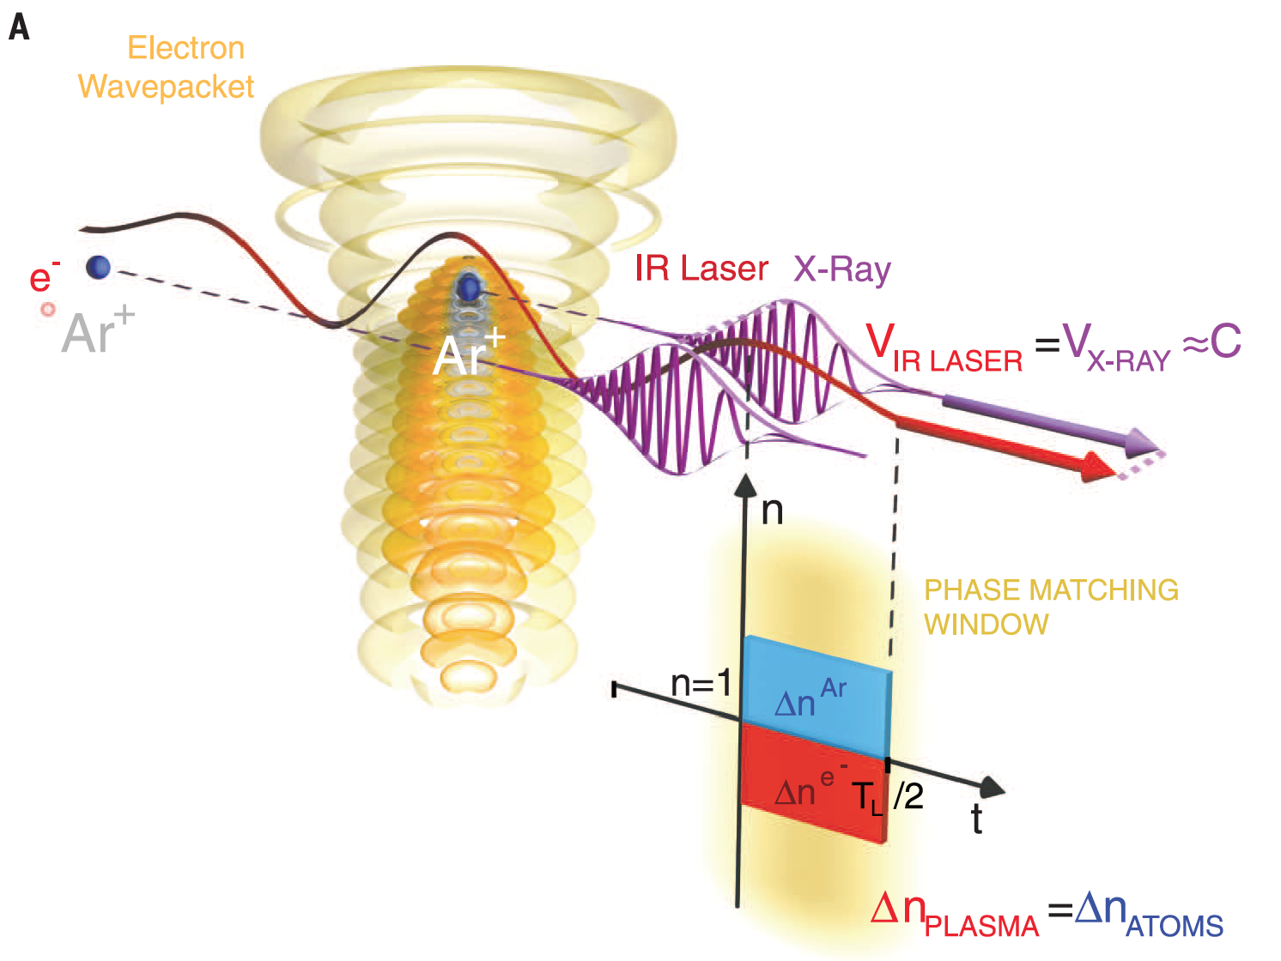
HHG: periodic electron wavepacket recollision
The situation with a NIR fundamental beam and low ionization:
D. Popmintchev ... T. Popmintchev,
Science 350, 1225-1231 (2015)
Murnane and Kapteyn group
65

Slide 66
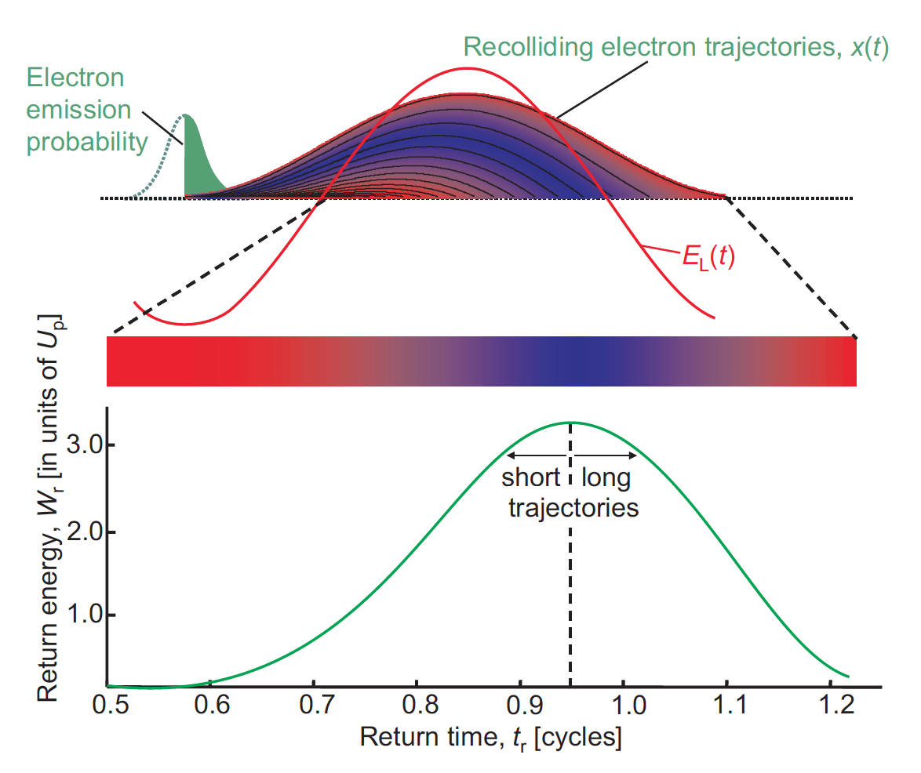
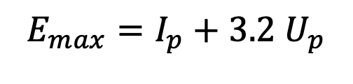
Long and short quantum paths
¾ optical period
Max. electron energy:
(‘pondoromotive energy’)
¼
Max. photon energy:
$$E_{max}=I_{p}+3.2 U_{p}$$
⬅
3.2 U_{p}
I_{p} = ionization potential
of the atoms
E_{l} = electric field laser
I_{l} = laser intensity
λ = wavelength laser
ω = ang. freq. laser
Krausz & Ivanov Rev. Mod. Phys. 81, 163 (2009)
66

Slide 67
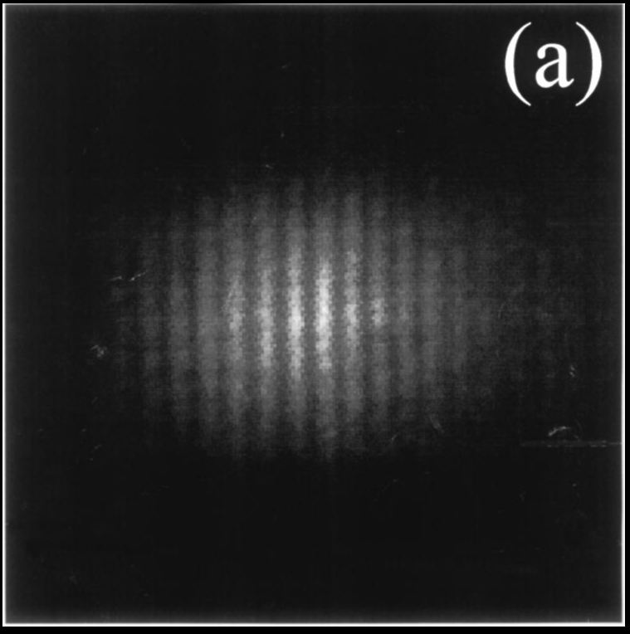
HHG phase stability / coherence
Phase of emission:
q=harm. order
Action "S", depends on momentum p, which in turn depends on laser intensity
R. Zerne et al.,
PRL 79, 1006 (1997)
Emission time
(laser phase)
'Action'
(laser intensity)
For plateau harmonics
K_{short} ~ 0.3
K_{long} ~ 2.9
2 HHG sources interfere: high coherence
Keep the intensity stable (~1%), then the XUV phase is too!
(and use the short quantum path: also less divergent)
67

Slide 68
From harmonics to an XUV comb
Fundamental intensity
Each fundamental pulse
generates a train
of XUV pulses
Short-term periodic emission = harmonics in frequency domain
Looks a bit like a frequency comb! (but not quite)
Emission twice per fundamental period, with π phase shift per emission:
only odd harmonics produced: 3rd, 5th, 7th ...
Harmonic orders
Int.
Freq.
68

Slide 69
When repeated for each comb pulse: XUV comb
Fundamental intensity
Each fundamental pulse
generates a train
of XUV pulses
...
...
Short-term periodic emission = harmonics in frequency domain
Looks a bit like a frequency comb! (but not quite)
Emission twice per fundamental period, with π phase shift per emission:
only odd harmonics produced: 3rd, 5th, 7th ...
Dipole phase tightly linked to fundamental driving field for each wavelength
at ‘constant intensity’ (energy per pulse) of the fundamental
Maintains repeatability, so will upconvert frequency combs faithfully!
(apart from noise power; that scales up quadratically).
Coherent emission per wavelength for equal fundamental intensity
Harmonic orders
Int.
Freq.
p^{th}
harmonic
f = p f_{ceo} + m f_{rep}
69

Slide 70
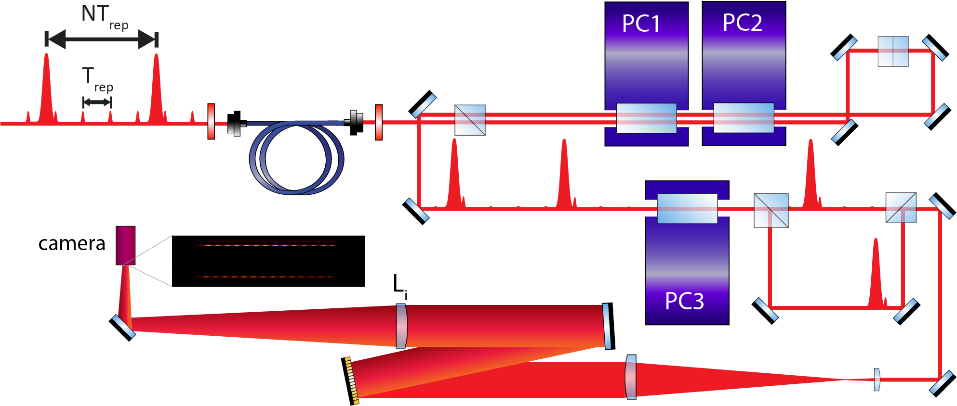
Phase measurement setup
reference pulses (FC pulse train)
Pulse picking
amplified pulses
Swapping
CMOS image

Slide 71
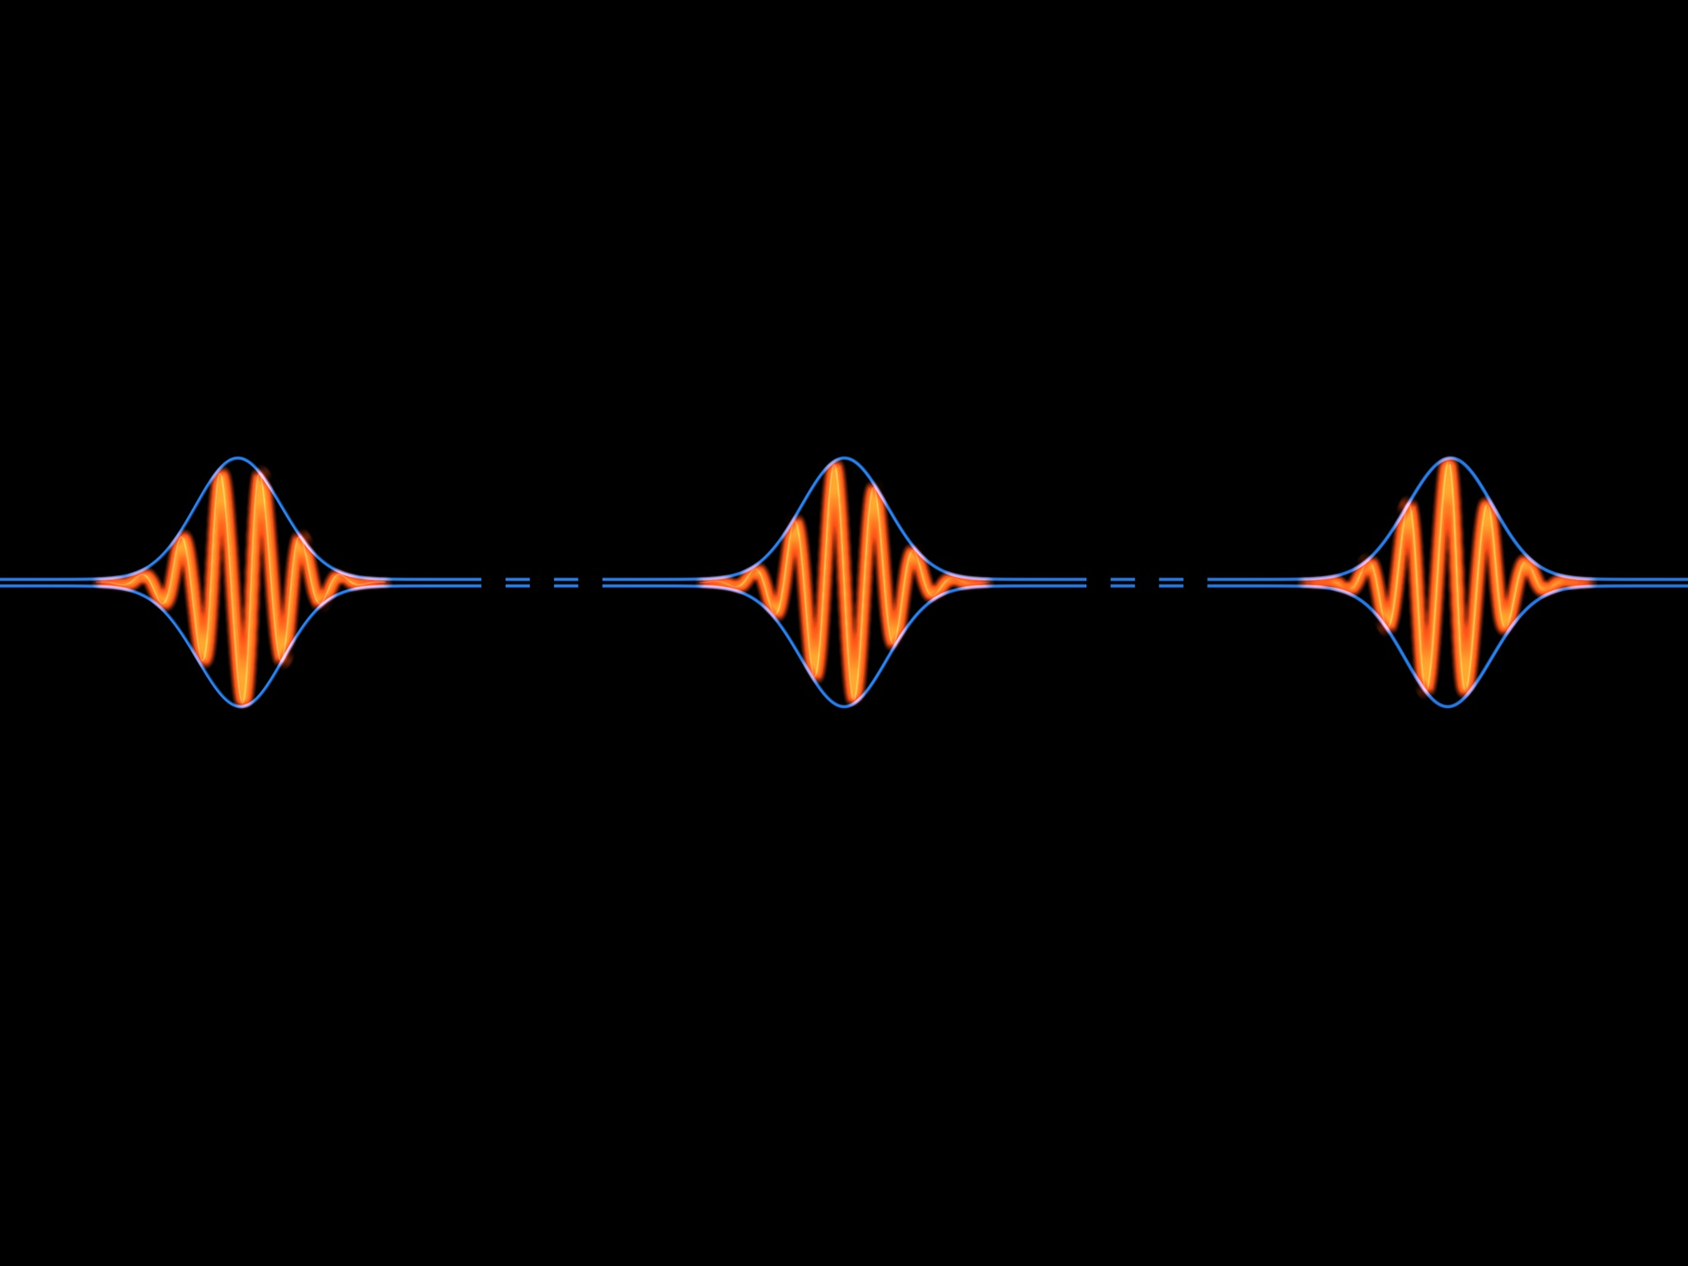
Example: Ramsey XUV spectroscopy with 2 FC pulses
Only 2 pulses from comb amplified to mJ level and upconverted
T
φ_{CE}= 0
φ_{CE}= π/2
time
f₀ = f_{rep} x Δφ_{CE} / 2π
f_{rep} = 1/T
Int.
f_{n} = f₀ + n.f_{rep}
frequency
0
D. Kandula et al. PRL 105, 063001 (2010)
71

Slide 72
Example: Ramsey XUV spectroscopy with 2 FC pulses
Only 2 pulses from comb amplified to mJ level and upconverted
T
φ_{CE}= 0
φ_{CE}= π/2
Yikes, true repetition violated!
time
f₀ = f_{rep} x Δφ_{CE} / 2π
f_{rep} = 1/T
Int.
f_{n} = f₀ + n.f_{rep}
frequency
0
D. Kandula et al. PRL 105, 063001 (2010)
72

Slide 73
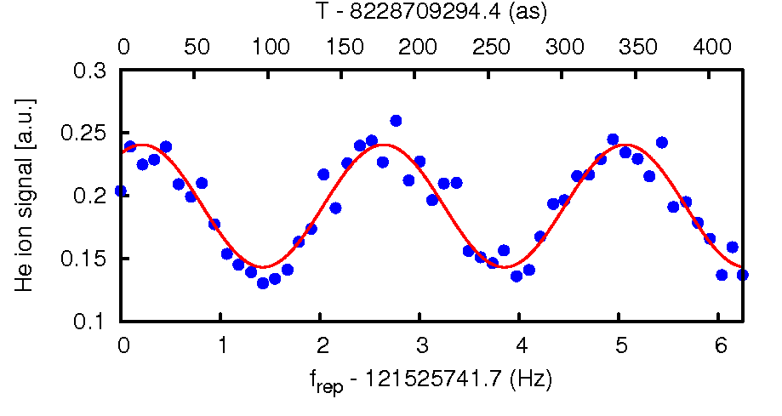


Ramsey XUV spectroscopy with 2 FC pulses
Helium 1 ¹S₀ – 5 ¹P₁ transition
at 51 nm (15th harmonic)
121 MHz
Accuracy: 6 MHz
Limitation:
Phase shifts between the pulses
from amplification and HHG.
HOW TO SOLVE THIS?
D. Kandula et al. PRL 105, 063001 (2010)
D. Kandula et al. PRA 84, 062512 (2011)
Dominik Kandula
Christoph Gohle
73

Slide 74








X-EF para-H2 Ramsey-comb spectroscopy at 2x 202 nm
Pure H₂
Contrast: 78% 51% 31%
Charlaine Roth
Accuracy X-EF transition for para* H₂ (N=0) 30 kHz,
and for D₂ (N=1) 19 kHz ; paper submitted February 2023
Mixture H₂/Ne (slow beam)
Contrast: 72% 56% 47%
Andrés
Martinez
de Velasco
* Para H₂: nuclear spins anti-parallel. Ortho-H₂: nuclear spins parallel.

Slide 75
X-EF para-H2 Ramsey-comb spectroscopy at 2x 202 nm
Pure H₂
Contrast: 78% 51% 31%
Poster by Andrés Martinez de Velasco
Charlaine Roth
Accuracy X-EF transition for para* H₂ (N=0) 30 kHz,
and for D₂ (N=1) 19 kHz ; paper submitted February 2023
Mixture H₂/Ne (slow beam)
Contrast: 72% 56% 47%
Andrés
Martinez
de Velasco
* Para H₂: nuclear spins anti-parallel. Ortho-H₂: nuclear spins parallel.

Slide 76


Influence of ionization during HHG: intensity
VUV yield 7th harmonic in Ar at 110 nm
VUV Intensity pulse 2 / pulse 1
Time =(ΔN*8ns)
New atoms need to fly in HHG zone
which takes ~ 50-100 ns
Intensity effect from loss of neutral atoms and disrupted phase-matching
76

Slide 77

Phase influence of the HHG process in argon
Phase difference pulses measured with Xe Ramsey signal,
relative to phase for ΔN=2 (=16 ns)
W/cm²
Fast & large phase effect from electrons
Slow & small phase effect from ions
At 0.8x10¹⁴ W/cm² effect only few mrad in the VUV
L.S. Dreissen et al., PRL 123, 143001 (2019)
L.S. Dreissen et al., PRA 101, 052509 (2020)

Slide 78
Absolute calibration for 110 nm xenon transition
300 measurements
ν_{Ar(8S)} = 2726086012473(630) kHz
Most accurate
frequency measurement with a HHG source:
dν/ν = 2.3 ⨉ 10 ⁻¹⁰
Improvement 10 000⨉ relative to previous measurement:
Yoshino et al., J. Opt. Soc. Am. B 2, (1985)
L.S. Dreissen et al., PRL 123, 143001 (2019)
L.S. Dreissen et al., PRA 101, 052509 (2020)

Slide 79



Low-phase noise Ramsey-comb laser, No. 2
New Ramsey-comb laser ready after 4 years of development
2 times 5 mJ amplified pulses @ 28 Hz, 10 - 20 nm bandwidth, 1 % rms energy stability
Still to check: target phase noise <40 mrad in total for microsecond pulse delay
Pump laser
Bounce amp & ULN Comb laser
New parametric amplifier
Mathieu Collombon
Vincent Barbé
Charlaine Roth

Slide 80

Overview vacuum setup for He⁺
High-harmonic generation
6-D trap adjustment
Detection platform
He and He* beam
Toroidal mirror chambers
spectrometer
NIR adjustment
and XUV filtering
Laser cooling
platforms
80

Slide 81

Planar trap and light collection from Be⁺ ion

Slide 82


Ion trap in collaboration with PTB Germany
Segmented Paul trap with micromotion compensation.
Separate loading and spectroscopy zones
Collaboration with PTB (T. Mehlstäubler and P. Schmidt) for the design
Comp. chip
RF chip
RF chip
Comp. chip
Carrier board
RF ~ 40 MHz
ω_{sec} (He⁺) ~ 5 MHz

Slide 83



Ion trap built at PTB
Be+ and He+ in trap
Design modified/built by Elmer Gründeman (VU)
with generous help from the group of Tanja Mehlstäubler (PTB)
(a.o. Malte Brinkmann)

Slide 84


XUV beam fixed; ion trap movement 6 DOF
Test ion trap movement and 313 nm detection
13 motors to control 6 degrees-of-freedom for
trap and fluorescence detection
Stability/resolution ~1 micrometer long term
and sub-nm for 10’s of microseconds confirmed
Diffraction-limited
Be⁺ 313 nm detection
with double-aspheric
lens (NA=0.5)
Julian
Krauth

Slide 85


Many more components now ready
To trap
Heating resistors
Capacitive tuner
RF in
Trap-voltage amplifiers
Combined with ARTIQ hardware
313 nm Be+ laser
with all beams
for sideband cooling
TDC
micromotion detection
RF power
stabilisation

Slide 86

Motivation for He⁺ 1S-2S spectroscopy
Hydrogen-like system: calculable (Pachucki et al.)
Test fundamental physics; obtain a consistant picture
QED and nuclear size effects bigger in He⁺ than H
Can be trapped in a Paul trap for long observation
Compare with μHe⁺ measurements
⁴He⁺
2S
2P
1.9 ms
(84 Hz)
λ = 30 nm:
extreme-ultraviolet
(XUV)
See: J.J. Krauth et al. Nature 589, 527–531 (2021) & arXiv (2023)
1S
(NS = nuclear size, charge)
86
86

Slide 87

Ramsey (comb) spectroscopy – the principle
}
Phase evolution ~ e^{i 2π ΔE Δt /h}
Two amplified FC pulses
|e>
ΔE
Δt
|g>
Atomic states
Probe phase evolution of the excited superposition with amplified frequency comb pulses
high timing and phase accuracy
easy upconversion
high probability excitation
efficient detection – short time window
‘isolation’ from environment noise
broad bandwidth: we always hit the transition
Subtle differences with
‘normal’ Ramsey spectroscopy:
Norman Ramsey, Phys. Rev. 76, 996 (1949)
Norman Ramsey, Phys. Rev. 78, 695 (1950)

Slide 88
The plan: Ramsey-comb excitation of He⁺ 1S-2S in a trap
2S
2P
790 nm
32 nm
He⁺
He⁺
Be⁺
1S
32 nm +
790 nm
32 nm +
790 nm
88

Slide 89

General approach 1S-2S transition in trapped He⁺
NIR Ramsey-comb near 790 nm
32nm + 790 nm Ramsey-comb pulses
XUV mirror
toroidal pair
lens
Ar jet
Cs
atomic
clock
frequency
comb laser
2-pulse
amp.
HHG
Extra
laser(s)
Sub-Hz
laser
Be⁺ cooling
laser 313 nm
Reference
cavity
Be⁺
He⁺
Planar ion trap.
Collaboration with
Tanja Mehlstäubler
& Piet Schmidt
from PTB Germany
EMCCD 313 nm
detection
89

Slide 90
What about the 1st order Doppler effect?
Relax trap axially, &
lock He⁺ movement radial
frequency f_{sec} & f_{mic}
(single trap mode) to T_{rep}
Not excited
313 nm
Loading and
sympathetic cooling
RCS 1S-2S excitation
+ 2S ionizaton
313 nm
He⁺
Be⁺
He⁺
Be⁺
He⁺
Be⁺
He⁺
Be⁺
If He²⁺ then Be⁺ moves
1S-2S He⁺ excited
Synchronize ion (1 He⁺!) movement with the
Ramsey-comb excitation pulses: no first-order Doppler
Spectroscopy accuracy depends on
accuracy synchronization,
recoil from 32+790 nm
vibrational state occupation
He²⁺
Be⁺
}
Lock at 10⁻⁴ → 11 kHz

