Slide 1

Towards High-Precision Spectroscopy
of the 1S–2S Transition in He⁺
Jorge Moreno
Fabian Schmid
Akira Ozawa
Johannes Weitenberg
Theodor. W. Hänsch
Thomas Udem
Max Planck Institute of Quantum Optics, Germany
MAX PLANCK INSTITUTE
OF QUANTUM OPTICS
PREN2023, Mainz
26, June 2023

Slide 2
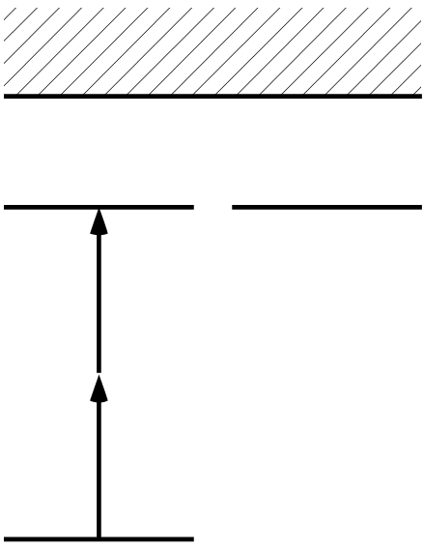
Spectroscopy of the 1S–2S Transition in He⁺
He⁺⁺
2S
2P
Γ ≈ 2π × 84 Hz
2 x 60.8 nm
1S
Difference from Hydrogen spectroscopy:
Trapped and cooled target → smaller systematics
QED test for Z=2 system
Frequency comb spectroscopy in XUV (extreme ultraviolet) wavelength

Slide 3
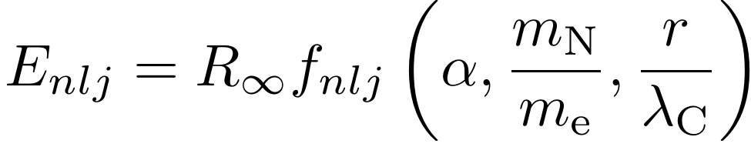
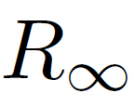

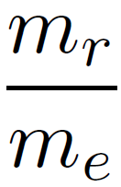

QED for He⁺
Nucleus/electron mass ratio
Fine structure constant
State energy in
SI units (m⁻¹)
Rydberg
constant
Normalized nuclear charge radius
Parameters | Contribution to Uncertainty (He⁺ 1S2S)
 | 2x10⁻¹² (19 kHz )
 | 6x10⁻¹² (61 kHz)
 | 5x10⁻¹⁵ (45 Hz)
 | 2x10⁻¹⁴ (166 Hz)
Rydberg constant
Hydrogen spectroscopy
μ-H + H (1s-2s), CODATA2018
45% larger uncertainty
In Pachucki et al.
arXiv (2023)
Nuclear charge radius
μ-He spectroscopy
J. Krauth et al. Nature (2021)
Nucleus/electron mass
Mass ratio measurements
in Penning trap
Fine structure constant
Atomic recoil (atom interferometer)
g-2 measurement

Slide 4
Uncertainty due to QED theory for He⁺ 1S-2S transition
[1] Yerokhin. A and Shabaev V. M , Phys. Rev. A 93, 062514 (2016).
[2] Karshenboim, S. G et al. , Physics Letters B 795, 432–437 (2019)
[3] Karshenboim, S. G et al. , Phys. Rev. A 100, 032515 (2019).
[4] Karshenboim, S. G et al. , Phys. Rev. A 98, 022522 (2018)
[5] V. Yerokhin et al. , Annalen der Physik 531, 1800324 (2019).
[6] A.Czarnecki et al. , Phys. Rev. A 94, 060501 (2016).
[7] S. Laporta, Physics Letters B 800, 135137 (2020).
[8] Karshenboim, S. G and Shelyuto V. A. , Phys. Rev. A 100, 032513 (2019)
Contribution | Uncertainty (in kHz)
Relativistic Recoil | 0
Nuclear Polarizability | 3
Self Energy | 0
Vacuum Polarization | 1
Two Photon Corrections | 32
Three Photon Corrections | 9.5
Four Photon Corrections | 0
Nuclear Size Correction to Self Energy | 0
Nuclear Size Correction to Vacuum Polarization | 0
Radiative Recoil | 12
Nuclear Self Energy | 0.6
Total | ~36 kHz
[1]
[2-6]
[2,3]
[7]
[8]
Total QED uncertainty : 36 kHz (4x10⁻¹²) (preliminary)

Slide 5
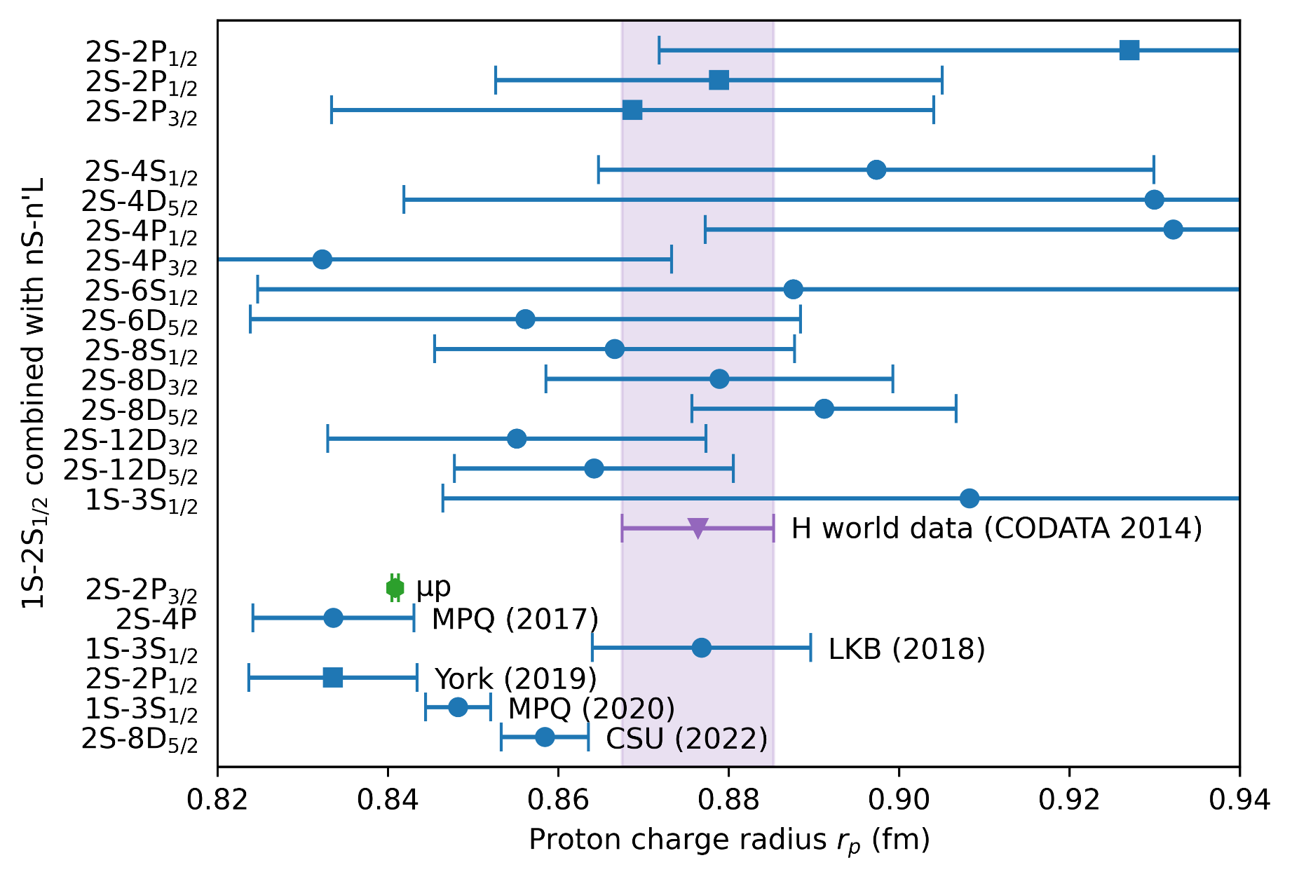
Proton radius puzzle
Known to 4 x 10⁻¹⁵
P. Mohr et al., Rev. Mod. Phys. 88, 035009 (2016)
R. Pohl et al., Nature 466, 213 (2010)
A. Beyer et al., Science 358, 79 (2017)
H. Fleurbaey et al., Phys. Rev. Lett. 120, 183001 (2018)
N. Bezginov et al., Science 365, 1007 (2019)
A. Grinin et al., Science 370, 1061 (2020)
A. D. Brandt et al., Phys. Rev. Lett. 128, 023001 (2022)

Slide 6
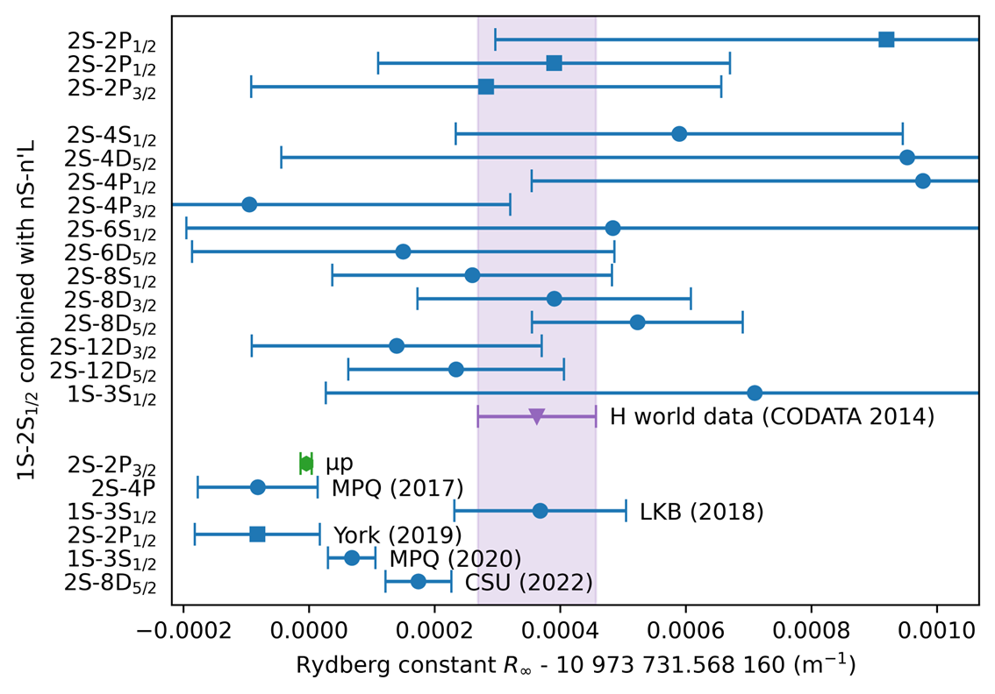
Rydberg constant puzzle
Known to 4 x 10⁻¹⁵
P. Mohr et al., Rev. Mod. Phys. 88, 035009 (2016)
R. Pohl et al., Nature 466, 213 (2010)
A. Beyer et al., Science 358, 79 (2017)
H. Fleurbaey et al., Phys. Rev. Lett. 120, 183001 (2018)
N. Bezginov et al., Science 365, 1007 (2019)
A. Grinin et al., Science 370, 1061 (2020)
A. D. Brandt et al., Phys. Rev. Lett. 128, 023001 (2022)

Slide 7

He⁺ spectroscopy for testing QED
Measuring the 1S-2S transition
better than 400kHz (4x10⁻¹¹)
Determine and contribute to the proton charge radius puzzle
better than 60 kHz (6x10⁻¹²)
[90 kHz from Pachucki et al. arXiv (2023)]
Determine charge radius, which can be compared with μ-He measurement
better than 36 kHz (4x10⁻¹²)
QED theory uncertainty will be a limitation
Measuring other transitions in ⁴He⁺
QED test more independent from μ-He and Hydrogen
Measuring ³He⁺
Charge radii difference, which can be compared with neutral He spectroscopy

Slide 8
⁴He⁺ Nuclear charge radius
r_{α} = 1.681(4)
Scattering
I.Sick (2008)
r_{α} = 1.678 24 (13)_{exp}(82)_{theo}
μ-He spectroscopy
J. Krauth et al. (2021)
r_{α} = 1.678 60 (120)_{theo}
Pachucki et. al (2023)
r_{α} uncertainty J. Krauth et al. (2021) | Contribution to He⁺ 1S-2S uncertainty
QED (r-independent) 0.04 am | 2.9x10⁻¹³
2PE 0.70 am | 5.2x10⁻¹² = 52 kHz
3PE 0.42 am | 3.1x10⁻¹²
1PE 0.06 am | 4.5x10⁻¹³
Theory Total: 0.82 am | 6.1x10⁻¹²
Experiment (statistics) : 0.13 am | 9.7x10⁻¹³ = 9.6 kHz
4x10⁻¹²: He⁺ QED theory uncertainty

Slide 9
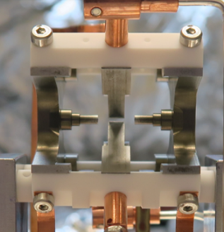
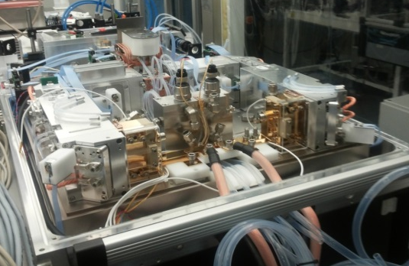
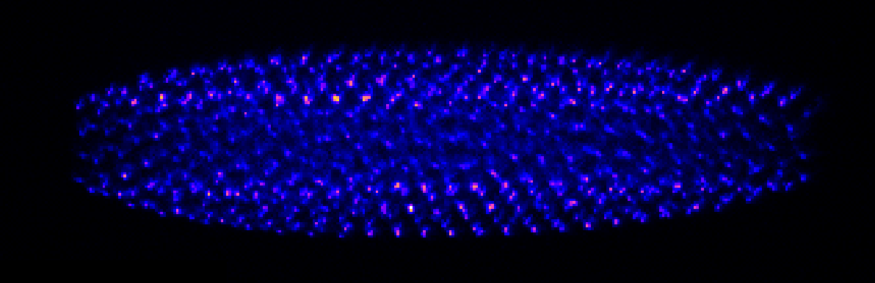
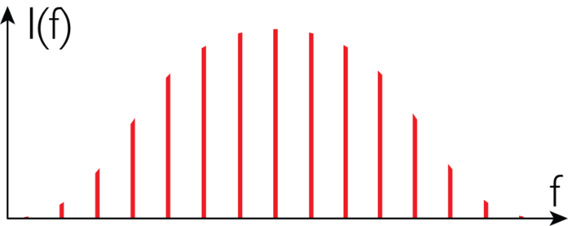
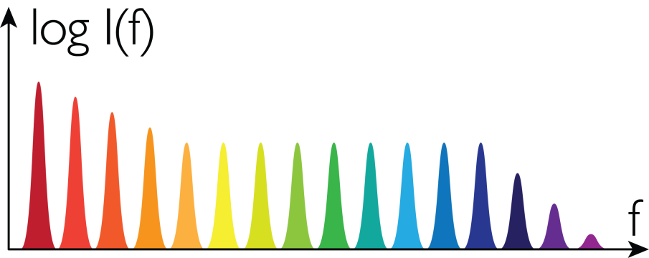
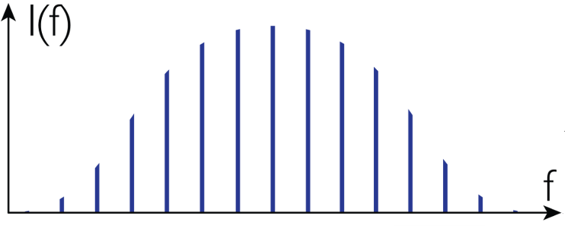
He⁺ spectroscopy setup: overview
High-power IR
frequency comb
Frequency comb
at 60.8 nm
Trapped He⁺ ions
Yb:KYW laser + amplifiers
@1030 nm
Intracavity
high-harmonic generation
17th harmonic
300 W Innoslab amplifier
(Fraunhofer ILT)
HHG
High-harmonic generation
17th harmonic
IR frequency comb
1030 nm
Odd-order harmonics
XUV frequency comb
61 nm

Slide 10



Direct frequency comb spectroscopy
Line width of a single laser mode
Efficient nonlinear frequency conversion due to high peak power of pulsed laser
As efficient as CW laser of same average power
Spectroscopy signal: He²⁺
< 91 nm
2S
XUV comb at 61nm
2 x 61 nm
1S
He⁺
Pioneered by: Ye. V. Baklanov and V. P. Chebotayev, Appl. Phys. 12, 97 (1977)
Hydrogen 1S-3S: A. Grinin et al., Science 370, 1061 (2020)

Slide 11
61 nm laser system
Yb:KYW oscillator (frequency comb)
Seed laser
f
40 MHz, 10 mW, λ = 1030 nm
Yb:LuAG preamplifier
Yb:YAG amplifier (Innoslab)
Multi-pass-cell spectral broadening
Amplification
&
compression
(+ double-pulse generation)
(two stages)
2.7 W
Δλ = 2.3 nm
270 W, Δλ = 1.6 nm, 𝜏 = 1.1 ps
230 W , 1010 - 1060 nm, 59 fs
Intracavity high-harmonic generation
XUV comb
generation
XUV comb
to He⁺ trap
HHG
5 kW, < 100 fs

Slide 12
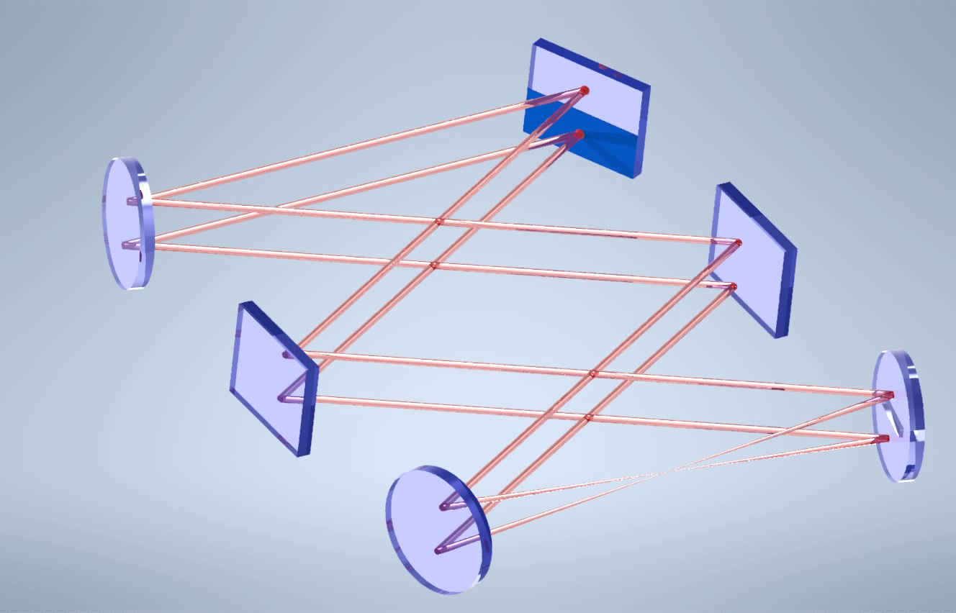
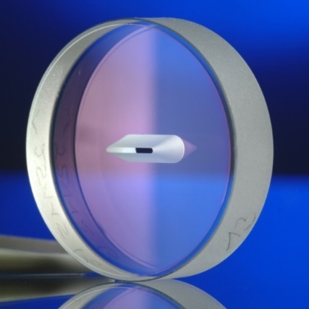
Enhancement Resonator for HHG
Comb f_{rep} = 40 MHz
Cavity FSR = 20 MHz
Mirror with slit
to He⁺ trap
Wedge mirror
Side view
Xe gas for HHG

Slide 13
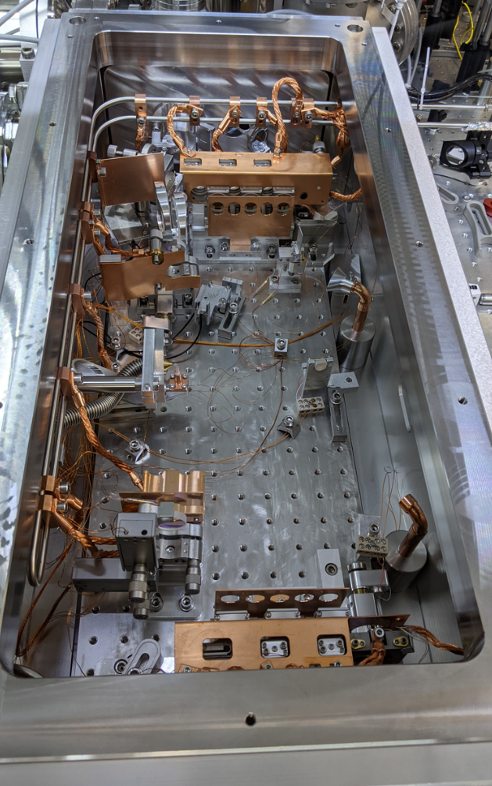
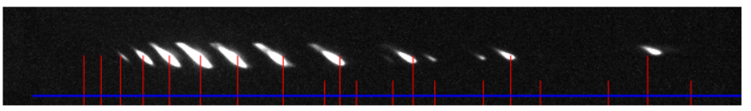
Enhancement Resonator for HHG
Segmented input coupler
Slit mirror
H23
H19
~30 µW at 60.8 nm (preliminary)
~ 0.1 Hz signal rate (ionization)
H25
41nm
H21
H17
61nm
H15
H13
H11
H9
115nm

Slide 14



Comb stabilization
Cavity-stabilized cw laser (ECDL)
Comb mode locked at $f_{1S−2S}/34$
Yb:KYW oscillator
f
Noise cancelled by two-photon excitation

Slide 15
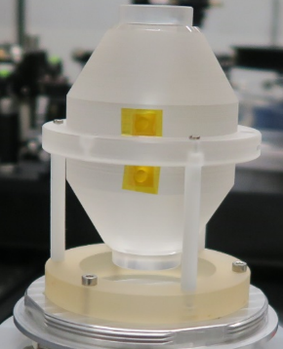
Stabilization of frequency comb
double-pulse
generation
Yb:YAG Innoslab amplifier
nonlinear pulse compression
HHG enhancement resonator
Yb:KYW
mode-locked
oscillator
fast
AOM
Pre-Amplifier
Yb:LuAG
Pre-Amplifier
Yb:LuAG
slow
AOM
PZT
Beat detection
Beat detection
Beat detection
Cavity-stabilized
CW laser (ECDL)
frequency
comb

Slide 16
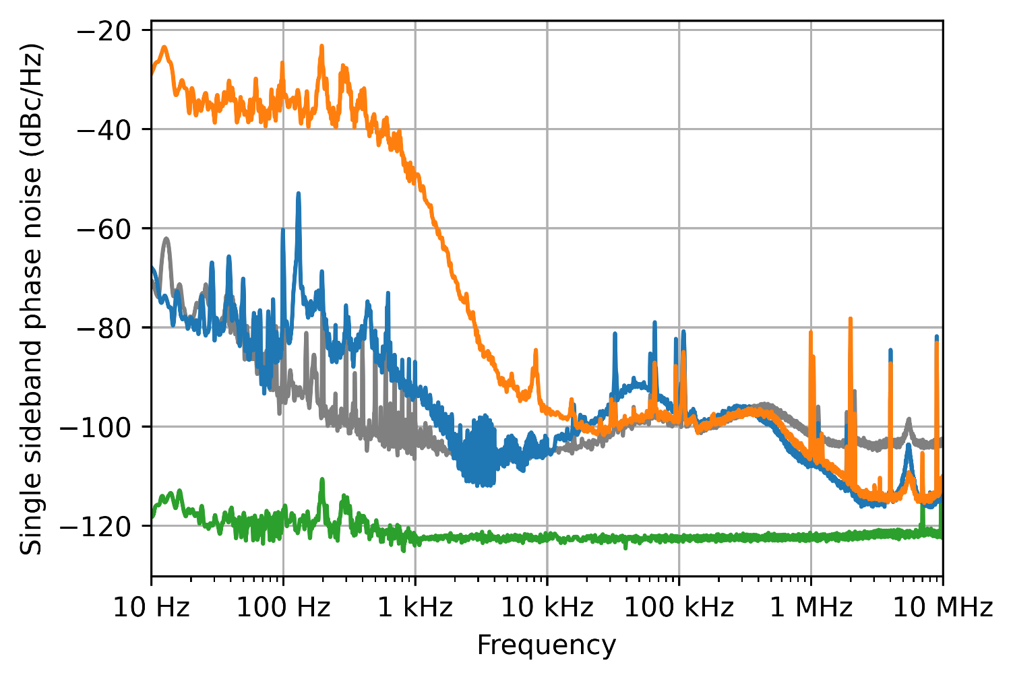
Stabilization of frequency comb
OFF path length stabilization
ON path length stabilization
Noise at oscillator output
Noise floor
80% of power in carrier at XUV
Less than 20% of signal loss due to phase noise

Slide 17
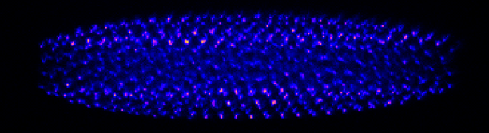
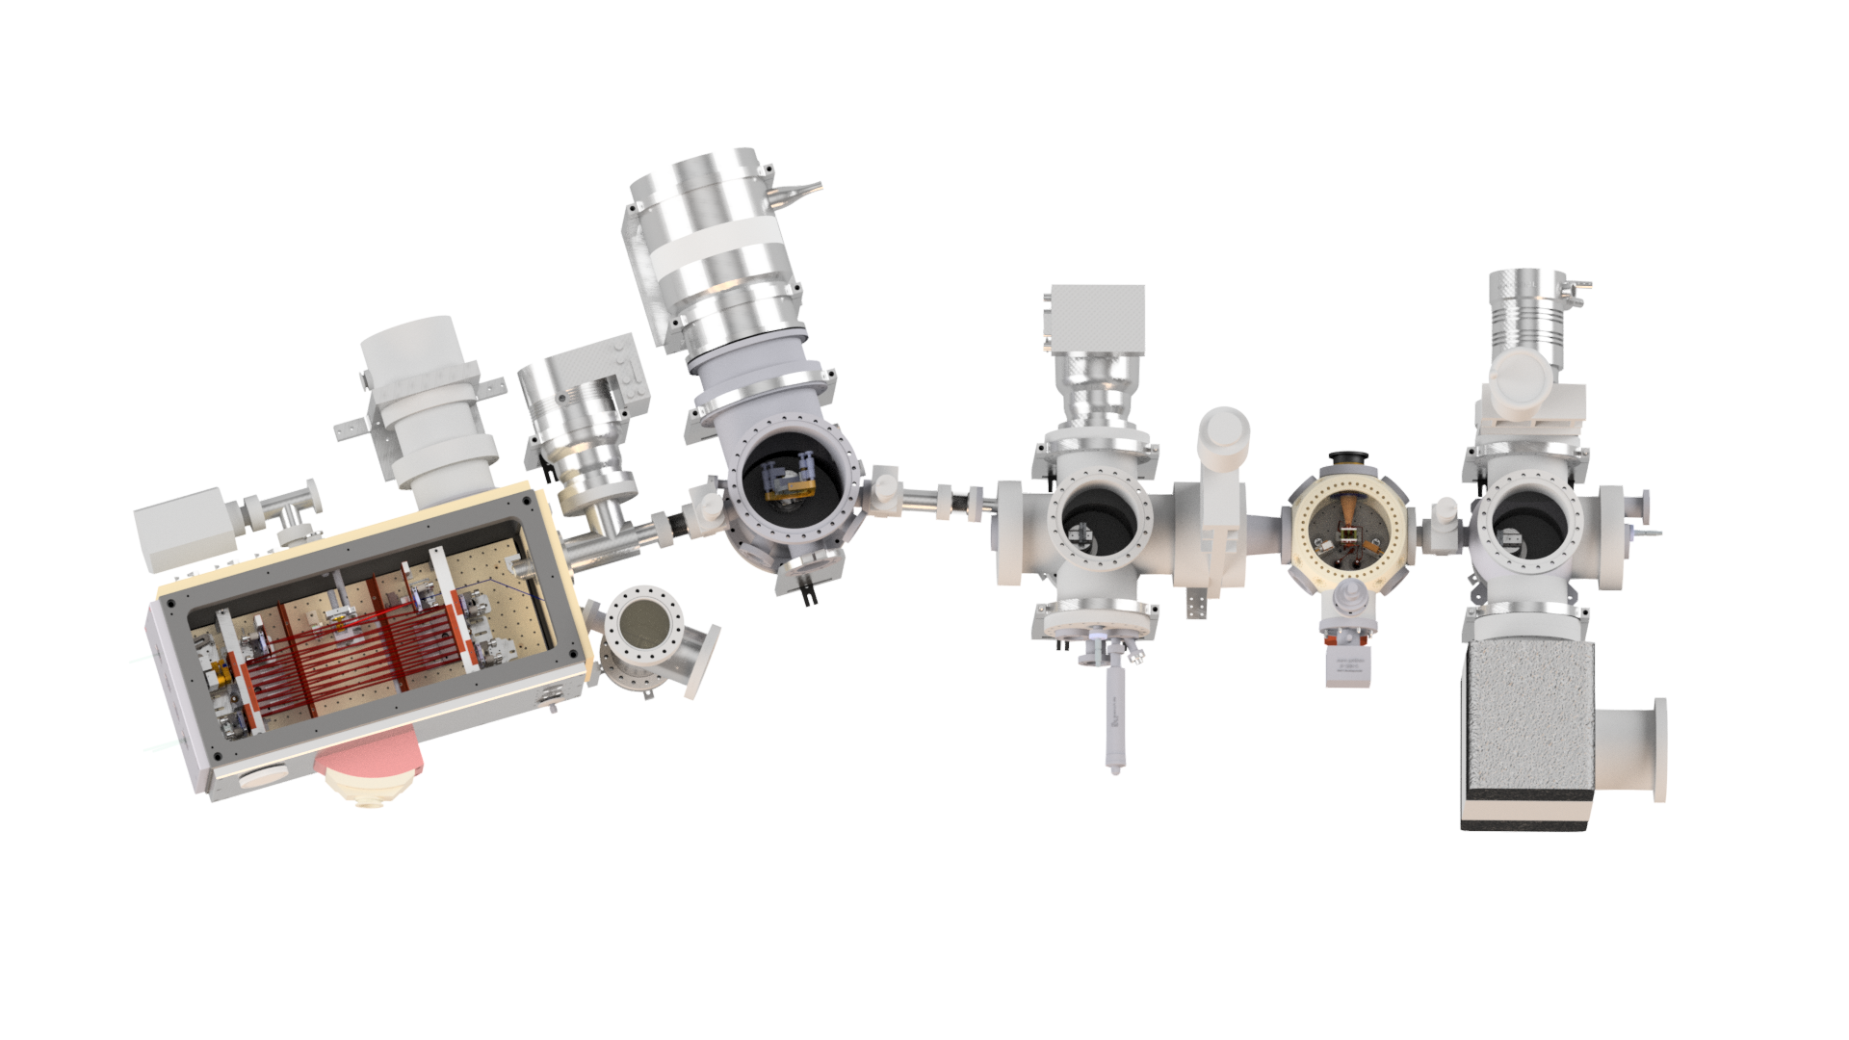

XUV beam delivery to trapped He⁺
Sympathetically cooled He⁺
in mixed ion crystal (He⁺/Be⁺)
Ion trap
Ion trap
HHG chamber
HHG chamber
XUV focusing mirrors
(R=30% @ 61 nm)
XUV grazing incidence mirror
(R=70% @ 61 nm)
XUV focusing mirrors
(R=30% @ 61 nm)
XUV grazing incidence mirror
(R=70% @ 61 nm)
Doppler-free
Anti-collinear excitation

Slide 18
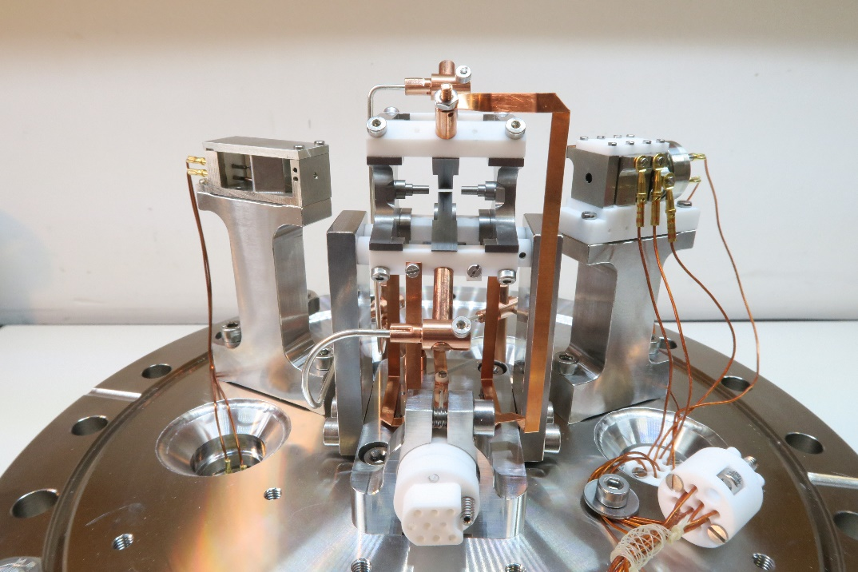
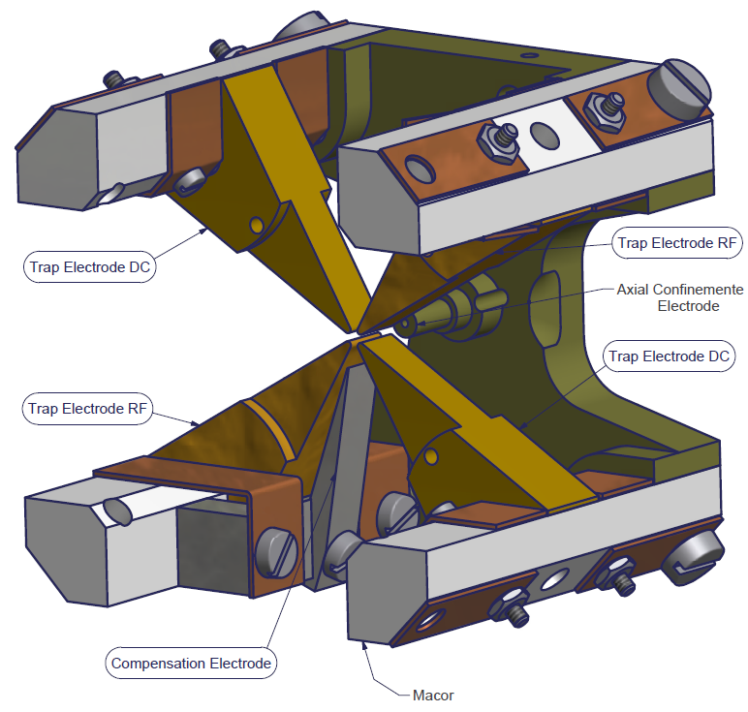
Be⁺/He⁺ ion trap
3 cm
RF electrodes

Slide 19
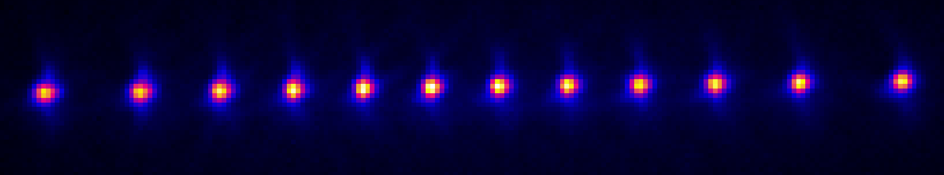
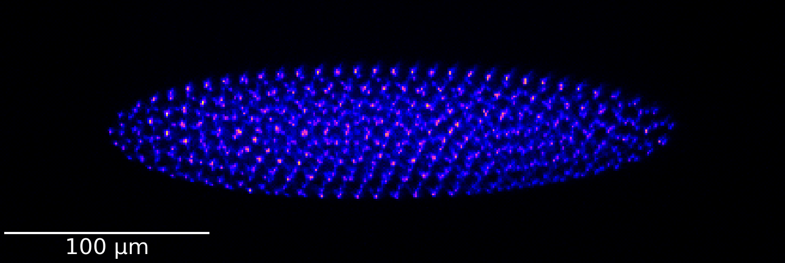
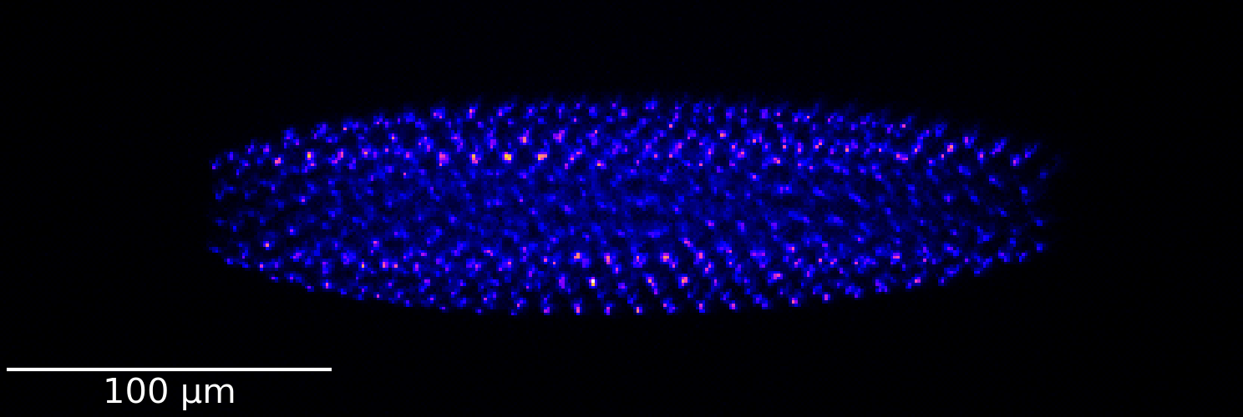
Ion crystals and sympathetic cooling
≈15 µm
Be⁺ laser cooled to a few mK
He⁺
He⁺ sympathetically cooled
Be⁺

Slide 20
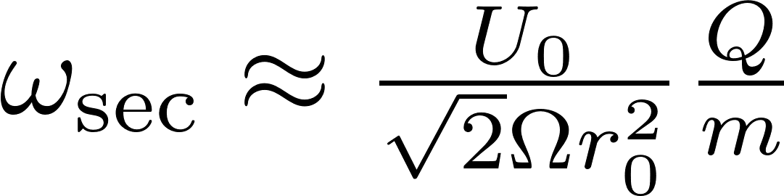
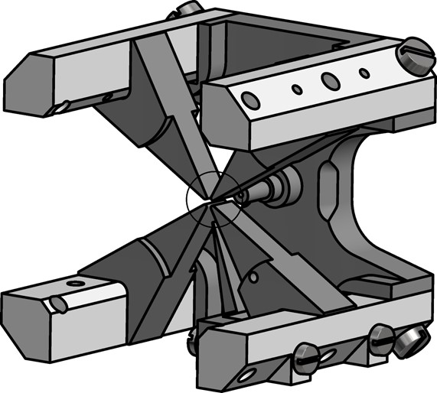
Spectroscopy signal:
Secular excitation detection
Motional resonance:
Trap
Species
PMT
Signal: fluorescence from Be⁺ ions
Signal generator:
scan frequency

Slide 21
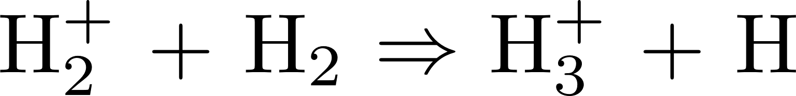
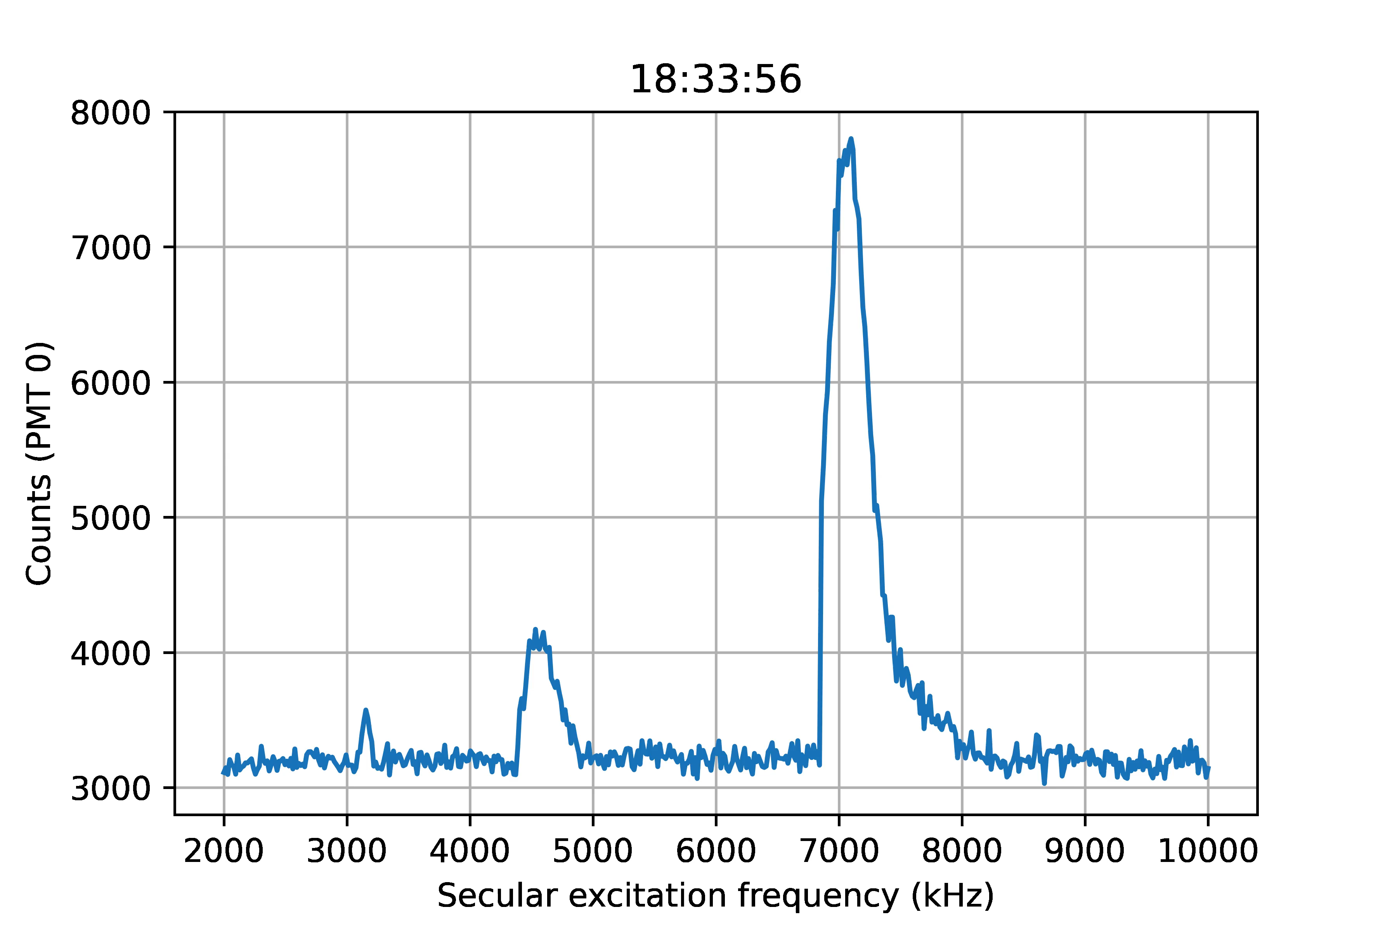
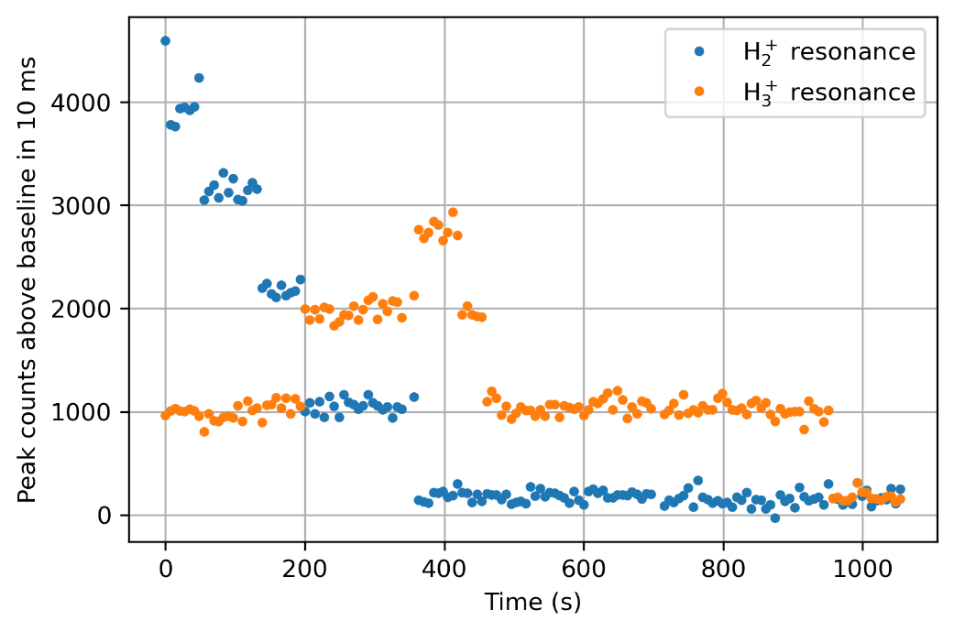
Single event sensitive detection
Testing secular excitation detection
H₂⁺: Same charge-to-mass ratio as He²⁺
H₂⁺
H₃⁺
F. Schmid et al., Phys. Rev. A 106, L041101 (2022)

Slide 22
Driving two-photon transition in Be⁺
1s²3p
1s²3d
1s²3s
Γ = 2π x 176 MHz
2 x 203.97 nm = 2 x 1019.8 nm/5
1s²2p
313 nm
Laser cooling,
shelving
1 mW focused to 5 µm
→ ~Hz excitation rate
1s²2s

Slide 23
5th harmonic generation in crystals
BBO
255 nm
LBO
510 nm
DM
1020 nm
DM
BBO
204 nm
Delay line

Slide 24
Achieved:
Generation of 61nm comb
Trapped and cooled He⁺
Demonstrated sensitive He²⁺ detection
Plans :
Optimization of 61nm comb
(power, spectrum)
Testing spectroscopy setup with easier transition
(Two-photon transition at 204 nm with Be⁺)
Finding He⁺ 1S-2S signal:
QED prediction: ~ 70 kHz
Expected linewidth of signal: ~ 1 kHz

Slide 25

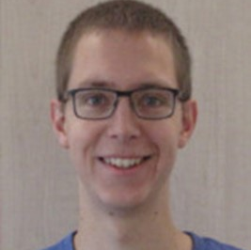
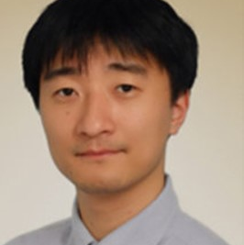
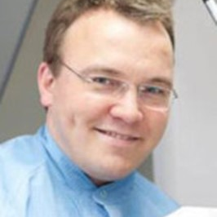
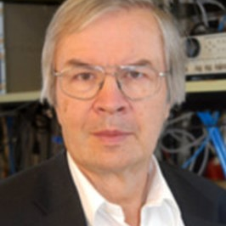
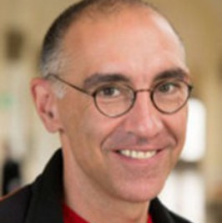
The He⁺ team
Jorge Moreno
Fabian Schmid
Akira
Ozawa
Johannes Weitenberg
Theodor W. Hänsch
Thomas Udem
Thank you for your attention!

Slide 26
