Slide 1
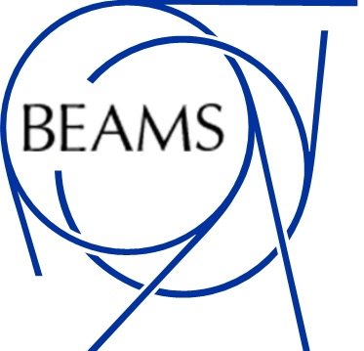
Status and Update on Results of the NA64 Experiment at CERN
Johannes Bernhard (CERN) on behalf of the NA64 collaboration
19.10.2023

Slide 2
Dark Sectors
Dark sectors are showing up naturally in many theoretical models (e.g., SUGRA, DarkSUSY, U_{D}(1), 2HDM).
In the Standard Model, only weak coupling via gravitation (SM singlets) seems possible.
In BSM models, additional portals occur, for instance via gauge-kinetic mixing.
One example: U_{D}(1) vector portal with “dark photon” A’.
A’ decays:
If m_{A’} < 2 m_{χ}: visible decays into SM particles (e⁺e–, µ⁺µ–, hadrons).
If m_{A’} > 2 m_{χ}: invisible decays A’ →χχ.

Slide 3
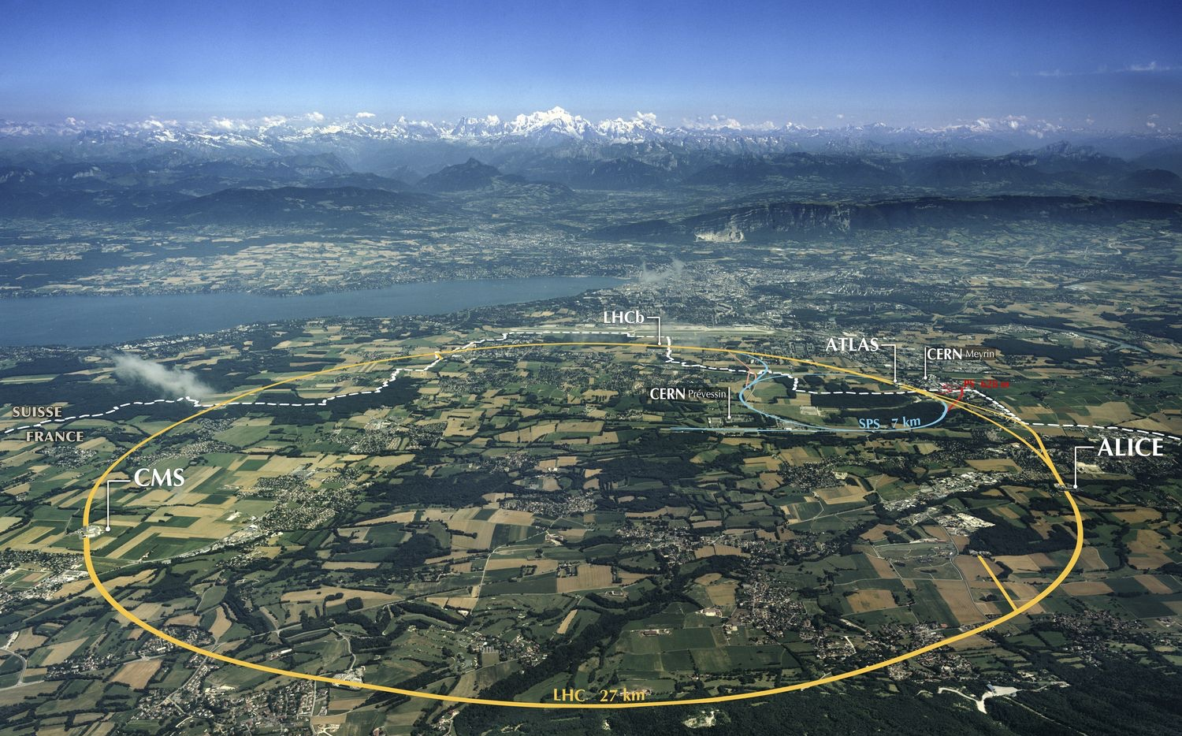
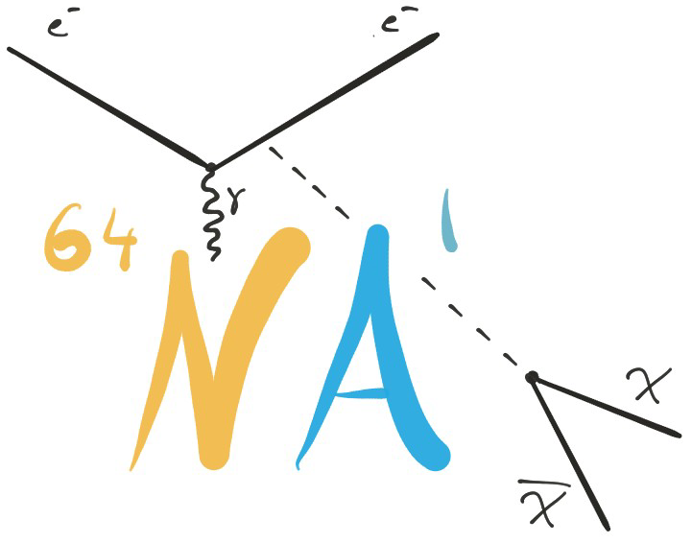
The NA64 Experiment at CERN
Active beam-dump experiment at the CERN SPS North Area
International collaboration of 60+ researchers from 15 institutes
Search for dark sector physics / feebly interacting particles in the sub-GeV range with missing energy events
A’ - mediated LDM (scalar, Majorana, Pseudo-Dirac fermion)
ALP particles, light scalars
L𝝻-L𝝉 models with light Z’ →connection to muon g-2 anomaly
B-L Z’ models (complementary to dedicated v-scattering experiments)
Visible A’ models (e.g. A’ → e+ e- decay, X17 anomaly from Atomki ⁸Be measurement)
Semi-visible A’ models
New physics at the precision frontier in electron g-2

Slide 4
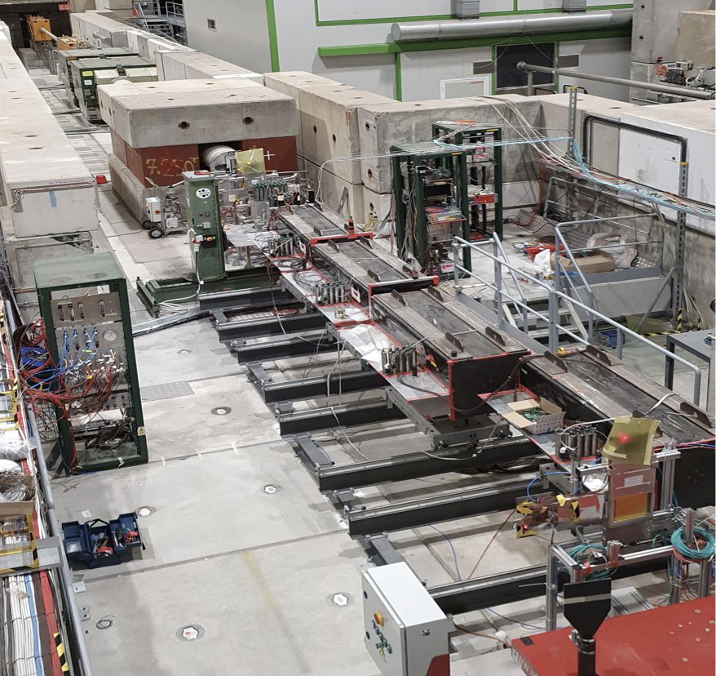
NA64 in Invisible Mode
Tertiary electron beam at 100 GeV/c in H4 beam line,intensity O(10⁷) electrons per 4.8 s SPS extraction
Hermetic 4π detector with active target: electromagnetic calorimeter (pre-shower and ECAL, 40 X₀ in total) with σ_{E}/E ~ 10% / √E ⊕ 3%, design to avoid any non-hermeticity (e.g. spiral WLF fibers to avoid leaks)
Electron tagging by synchrotron radiation detector (SRD)
HCAL: high-hermeticity (4 modules à 9 λ_{I}) Fe/Sc hadronic calorimeter, σ_{E}/E ~ 60% / √E, fourth module HCAL4 installed at zero degrees to detect neutral particles from upstream electro-nuclear interactions
Micromega and GEM trackers (T1 – T4) around magnetic spectrometer (MBPL 1+2) with 1% resolution
Coincidence Trigger with scintillators (S1 – S3) and Veto system (V)

Slide 5
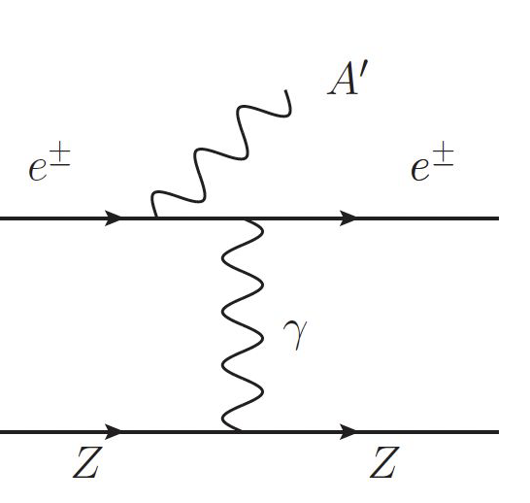
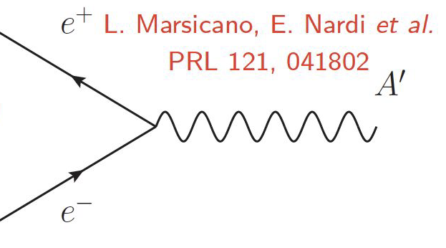
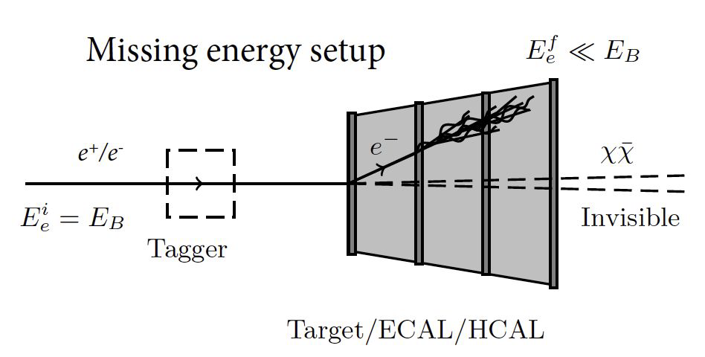
NA64: A Missing Energy Experiment
Key characteristics:
Electromagnetic calorimeter as active target
High energy electron beam of 100 GeV
High beam purity (< 0.4% hadrons)
Beam time structure: particles on detectors can be individually resolved
Signal: any event from a clearly identified beam particle with large E_{miss} = E_{Beam} – E_{deposited} of several tens of GeV and no activity in the downstream detectors
Background: production of highly penetrating and/or long-lived particles escaping the ECAL
Possible production mechanisms for light dark matter:
Radiative production (σ ~ ɛ² Z² α³_{EM}) Bremstrahlung-like process with high-energy, forward-focused A’
Resonant production (σ ~ ɛ² Z α_{EM}) Breit-Wigner like cross section peaked at M²_{A′} = 2m_{e}E_{e+} Signal enhancement:

Slide 6
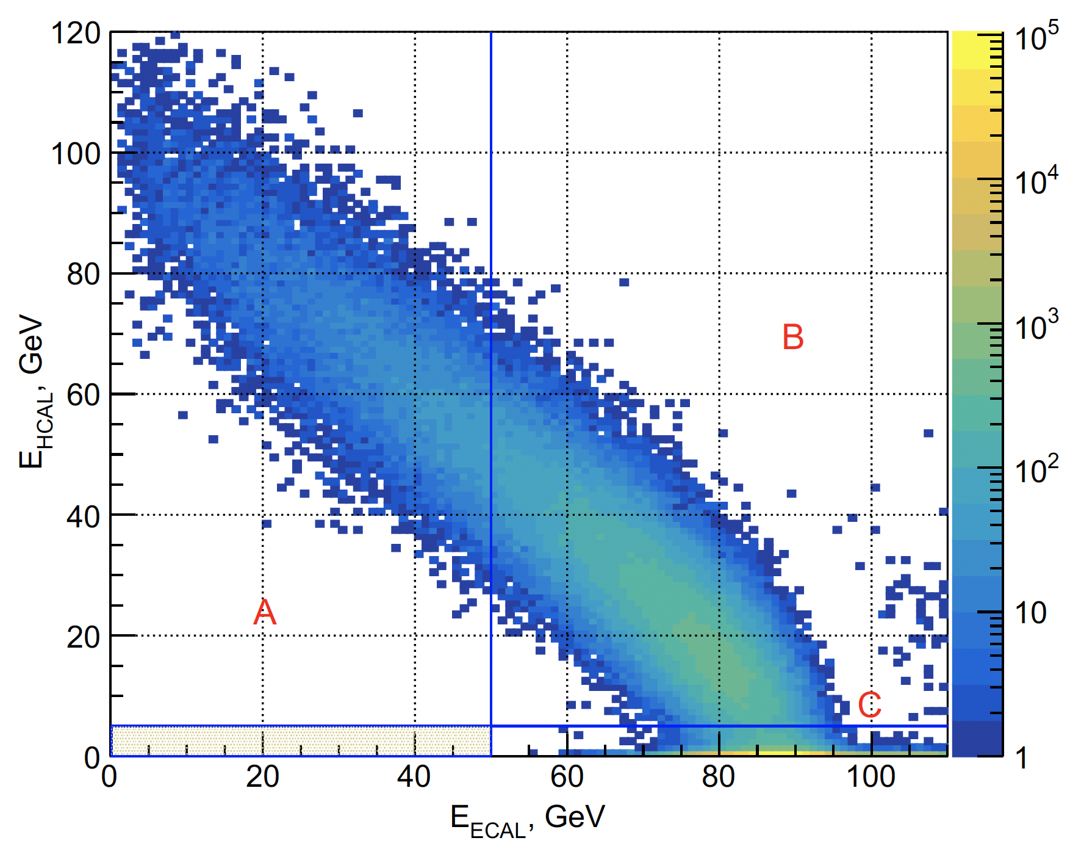
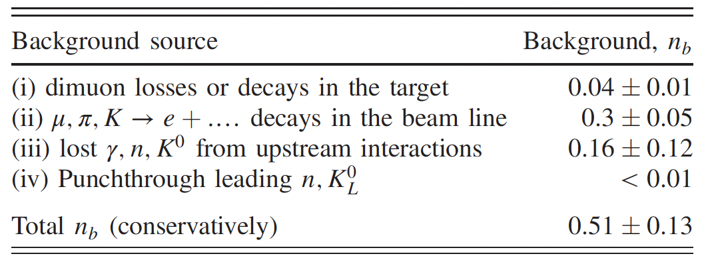
NA64 Results – Update with 2021/2022 Data
Phys. Rev. Lett. 131, 161801 (2023)
Accumulated statistics: 6⋅10¹⁰ (2021) + 6.3⋅10¹¹ (2022), in total, 9.37 ⋅ 10¹¹ electrons on target (2016-2022).
Selection cuts:
Clean impinging of 100 GeV/c e–, no activity in VETO/HCAL, including HCAL4.
Multiplicity cut on STRAW detectors to further suppress background from upstream interactions.
EM shower-shape compatible with e– induced one (data-driven shower shape χ² distribution).
Signal window: E_{ECAL} < 47 – 50 GeV, E_{HCAL[1+2+3]} < 1 GeV, optimised on run conditions and detector performance aiming at maximising the experiment sensitivity to LDM, including e⁺e– resonance contribution.
Expected background yield: 0.5 events.
Dominant contribution from in-flight decay of mis- identified muons and hadrons, estimated from simulation.
Contribution of upstream electro-nuclear reactions extrapolated from data via sideband fit.
No events observed in signal box after unblinding.
Sidebands A, B, C for background estimation
Signal Region (box size increased vertically for visibility)

Slide 7
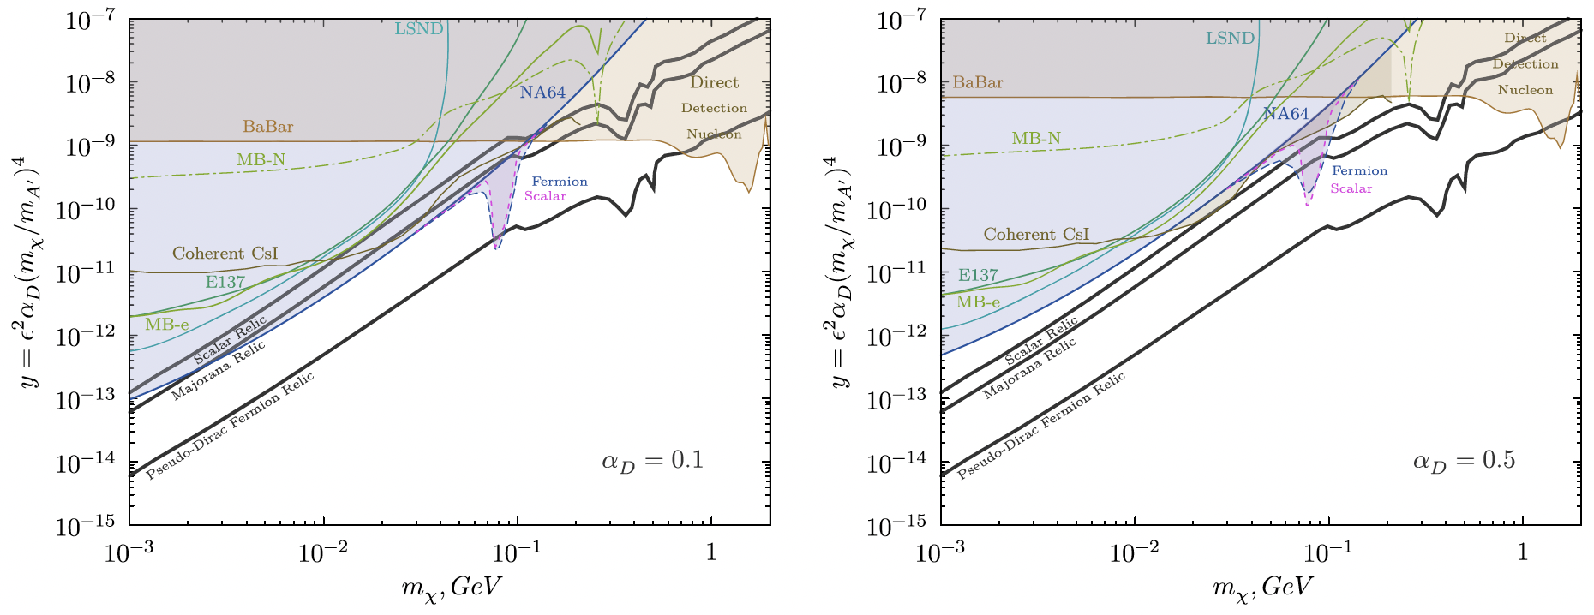
NA64 Results – Update with 2021/2022 Data
Phys. Rev. Lett. 131, 161801 (2023)
Phys. Rev. Lett. 131, 161801 (2023)
NA64 results represent the most stringent limits in the LDM parameter space so far:
For α_{D}=0.1, NA64 excludes the Scalar and Majorana scenarios for almost all m_{χ} values. The scalar case was also scrutinized recently with the PandaX-4T result, insensitive to Majorana and Pseudo-Dirac scenarios → Strong complementarity of NA64 and direct detection experiments.
Due to e⁺e– resonant enhancement, NA64 excludes Pseudo-Dirac Fermion scenario for a narrow m_{χ} interval.

Slide 8
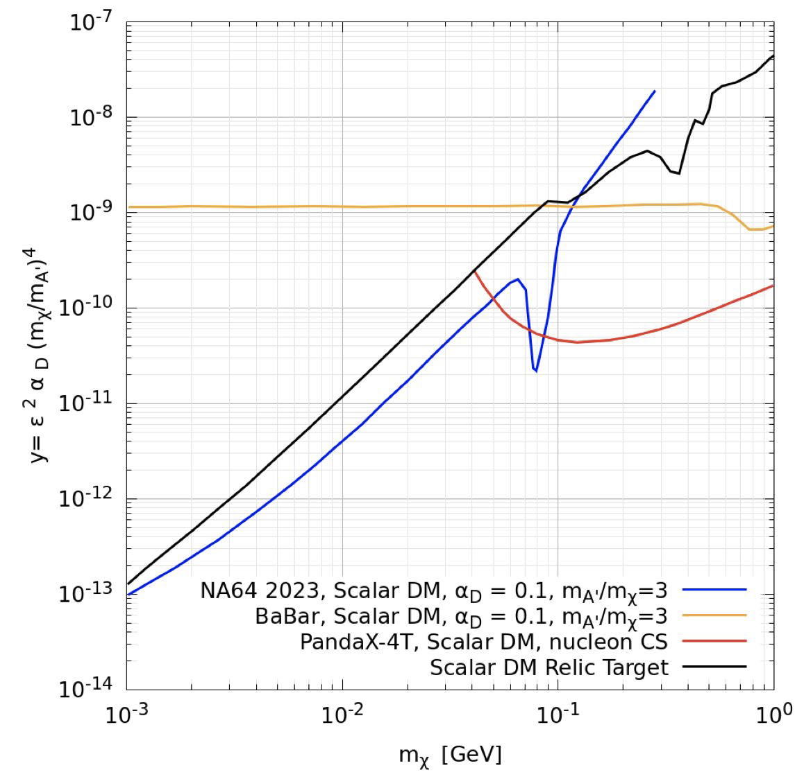
NA64 Results – Update with 2021/2022 Data
Phys. Rev. Lett. 131, 161801 (2023)
Data PANDAX-4T arXiv: 2308.01540
NA64 results represent the most stringent limits in the LDM parameter space so far:
For α_{D}=0.1, NA64 excludes the Scalar and Majorana scenarios for almost all m_{χ} values. The scalar case was also scrutinized recently with the PandaX-4T result, insensitive to Majorana and Pseudo-Dirac scenarios → Strong complementarity of NA64 and direct detection experiments.
Due to e⁺e– resonant enhancement, NA64 excludes Pseudo-Dirac Fermion scenario for a narrow m_{χ} interval.

Slide 9
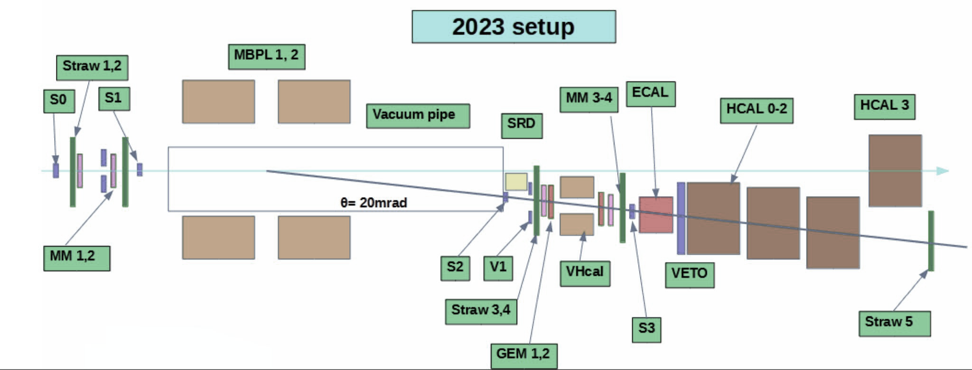
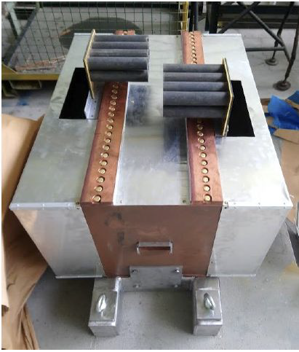
2023 Run
VHCAL
A new veto hadronic calorimeter (VHCAL) was installed in front of ECAL to further suppress upstream electro-nuclear reactions with large-angle neutral hadrons.
Detector geometry and setup has been optimized through high-statistics simulations (Geant4 and FLUKA).
The DAQ system has been optimised, including a programmable trigger pre-scaler to acquire full-energy electron events in parallel to the main production trigger.
Excellent beam quality in 2023 with further reduction of hadronic contamination down to 0.3%.
About 6 weeks physics run in May/June with ~ 6.5 ⋅ 10⁶ electrons/spill → Increase total available statistics on invisible mode by 5.1 ⋅ 10¹¹ electrons on target.
Analysis ongoing.

Slide 10
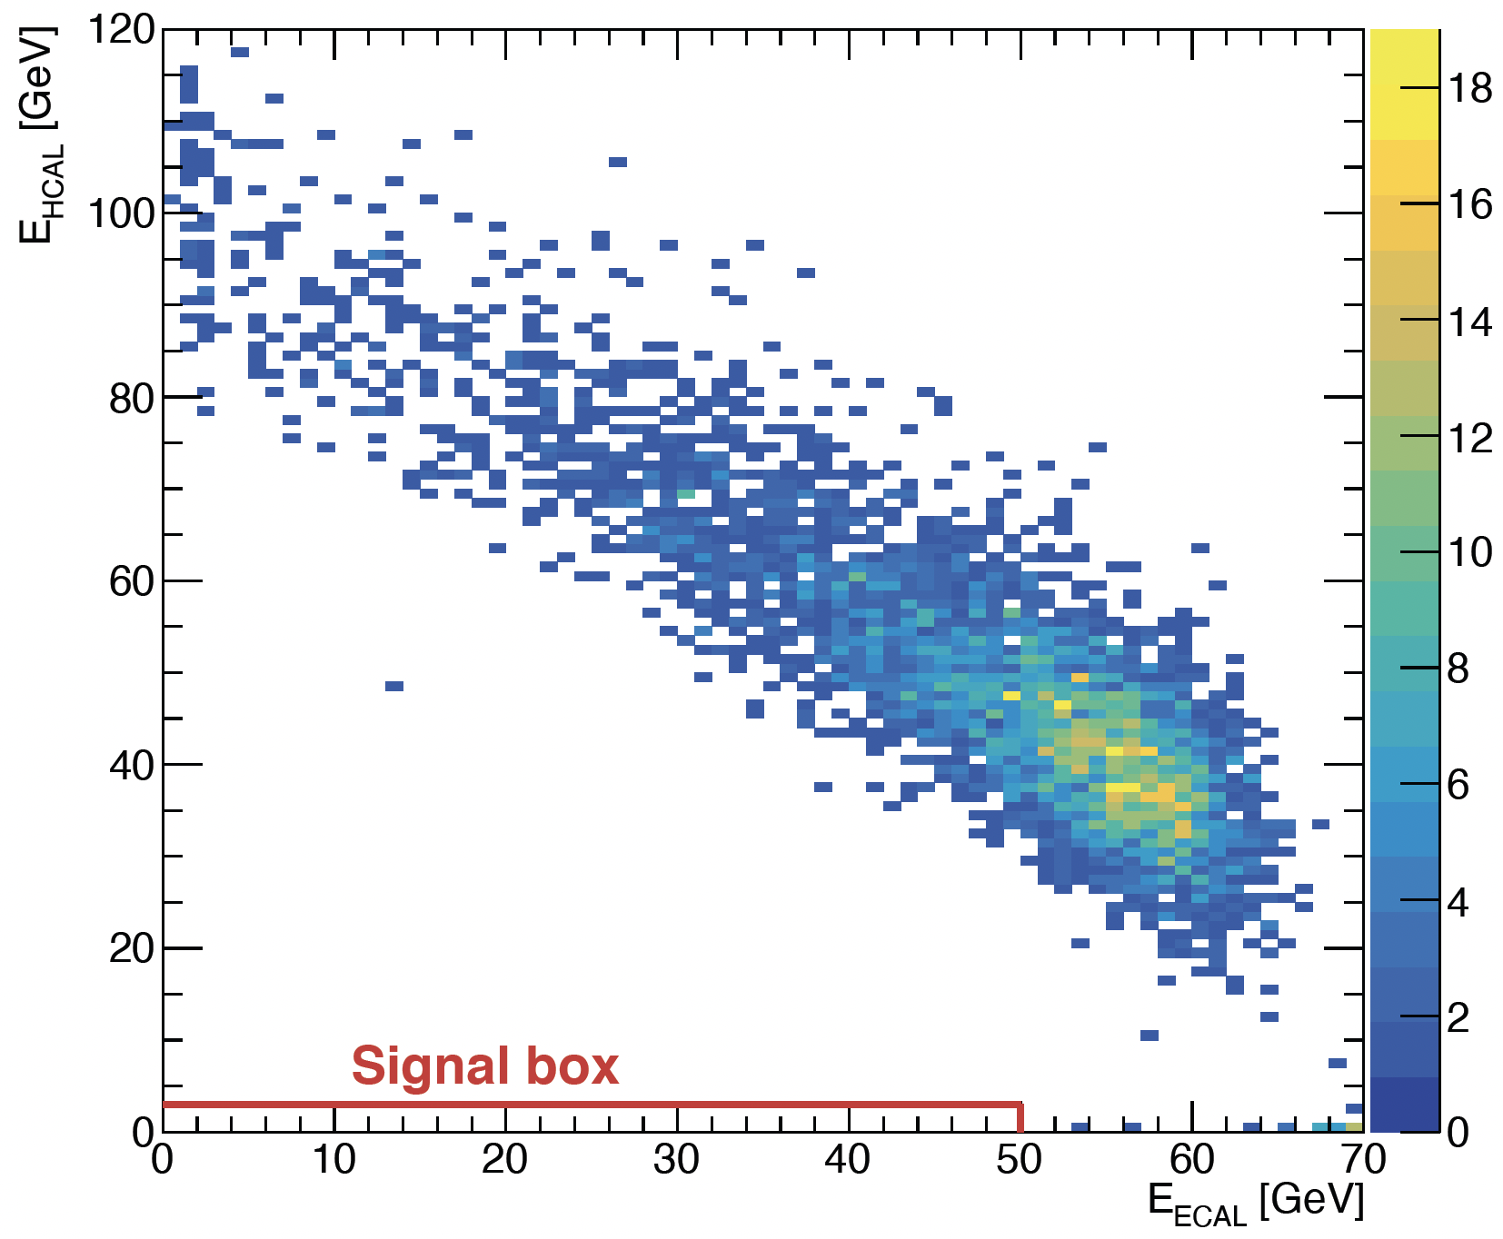
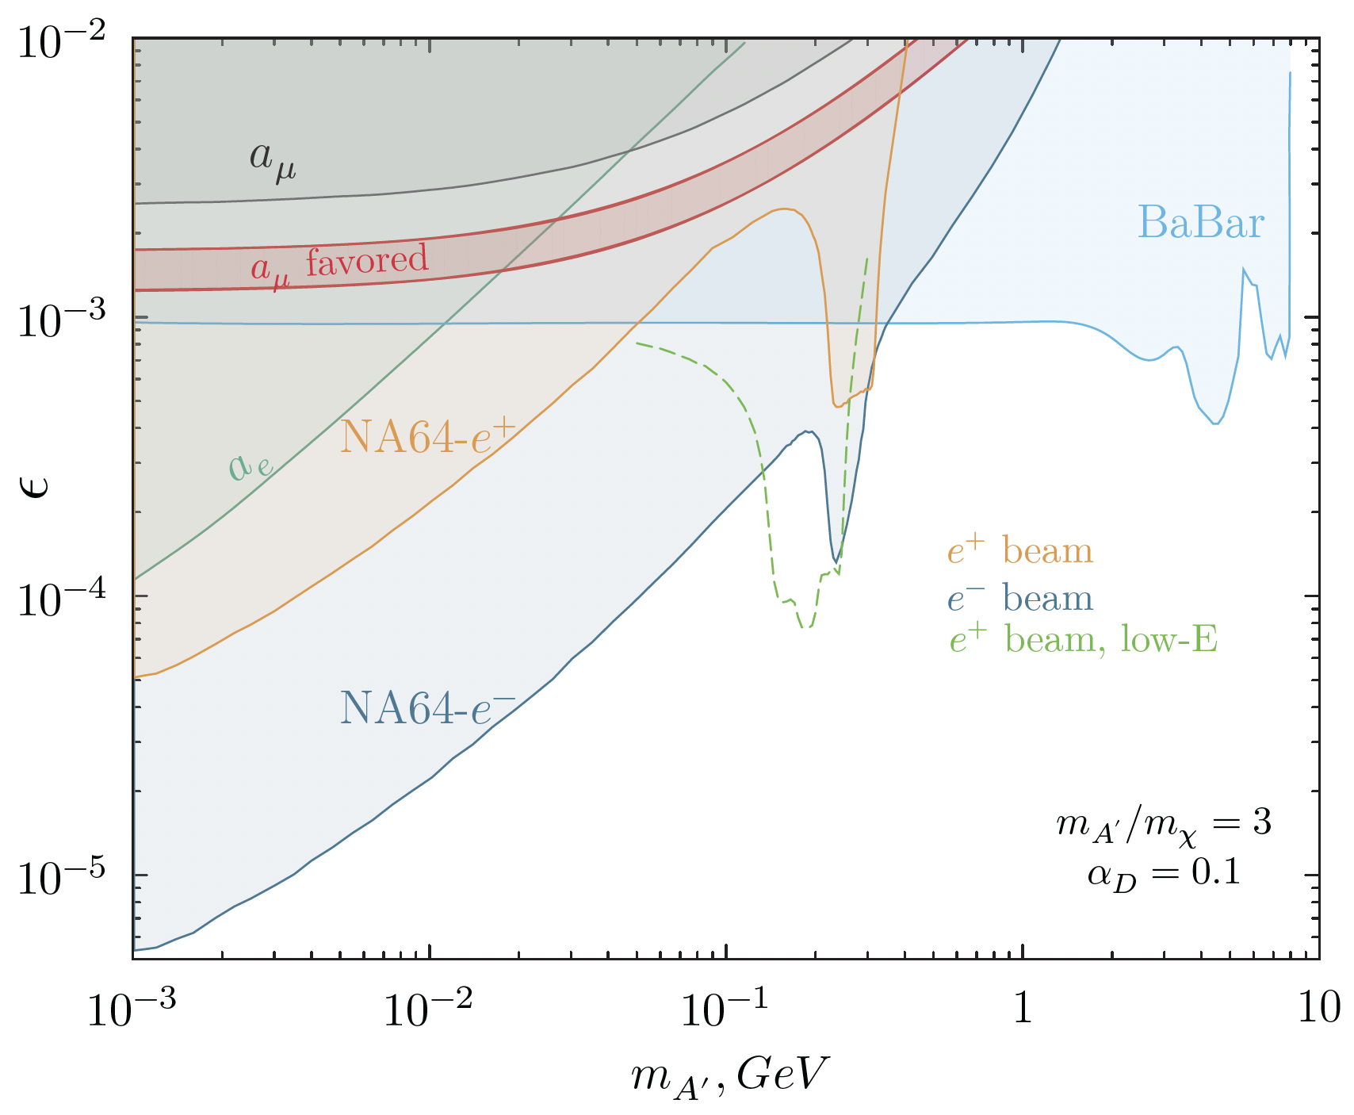
Positron Beams
arXiv:2308.15612
Submitted to PRL
The A’ Bremsstrahlung production mechanism scales with 1/m²_{A’}, hence is suppressed towards higher masses.
Resonant production peaks at M²_{A′} = 2m_{e}E_{e+} and can thus be used to boost the signal → use a positron beam.
A first pilot positron beam missing-energy measurement was performed in 2022 with a 100 GeV beam, but with a much higher hadronic contamination in the order of 4%.
The main background source is in-flight decay of misidentified hadrons. Their yield has been evaluated from simulation, with a crosscheck by an ad-hoc experimental measurement of the hadron contamination (arXiv: 2305.19411, submitted to PRL).
No events were observed in the signal region after unblinding, with an expected background yield of 0.5 events.
Despite the factor 100 lower statistics, an upper limit was set in the LDM parameters space touching the electron beam limits in the 100 MeV mass region → Plan to start a dedicated positron beam campaign.
arXiv:2308.15612
Submitted to PRL

Slide 11
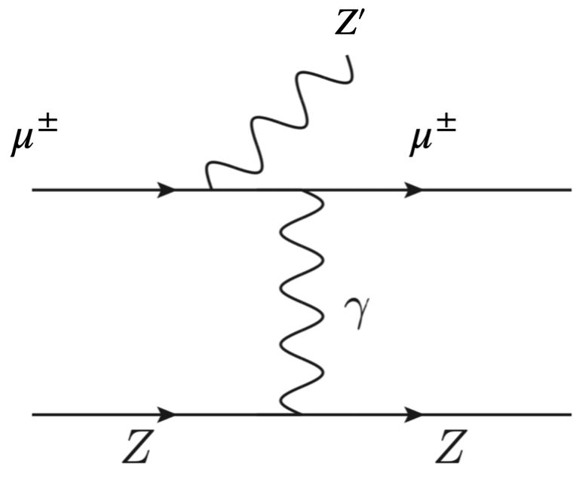
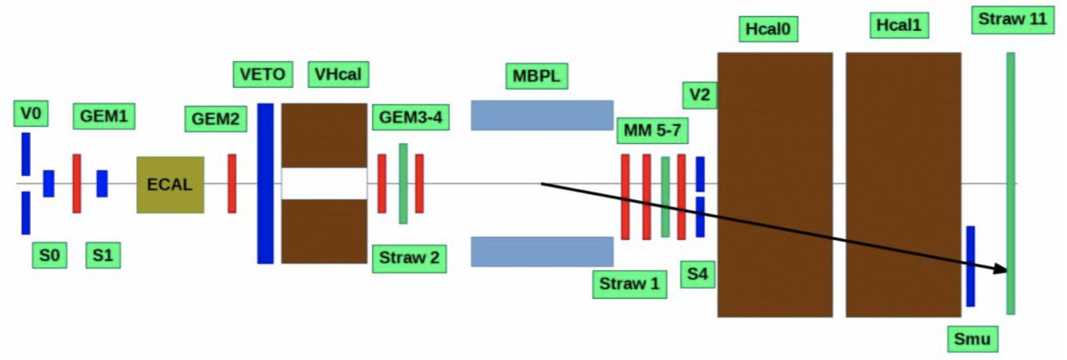
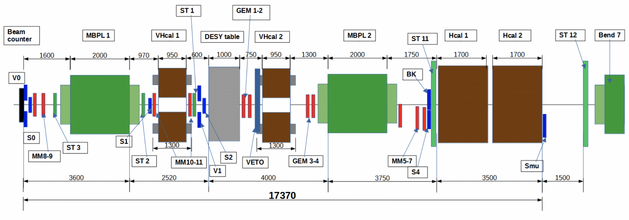
NA64µ
The explanation of the (g-2)_{µ} anomaly has been ruled out in both visible e⁺e– and invisible channels.
Still, it might be possible in case of a new scalar or vector state coupling pre-dominantly to µ and τ: Think of anomaly-free Lμ-Lτ models with light Z’ as the simplest and most predictive solution to (g-2)_{µ} and LDM (Phys. Rev. Lett. 128, 141802, 2022).
The NA64µ proposal has been brought forward in context ofthe “Physics beyond Colliders” initiative at CERN and first data has been taken already in pilot runs with about 2 ⋅ 10¹⁰ muons on target with one spectrometer magnet in 2022 and just recently 1.5 ⋅ 10¹¹ muons on target with two spectrometer magnets and an improved setup in 2023. Analysis is ongoing.
Additional benefit: Improvement of NA64e sensitivity towards higher mass ranges.
σ ~ g² Z² α²_{EM} / m²
2022
2023

Slide 12
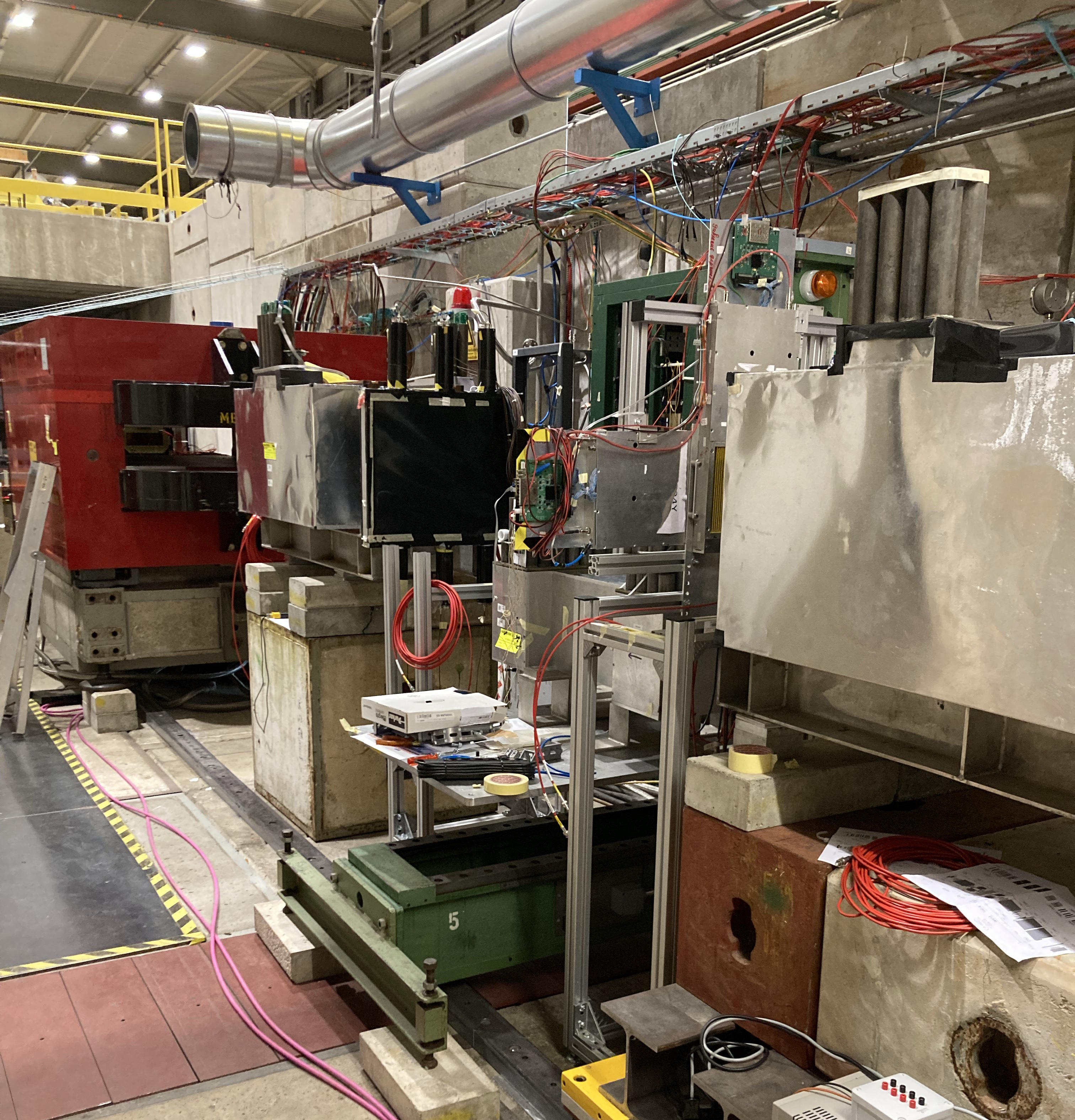
NA64µ
The explanation of the (g-2)_{µ} anomaly has been ruled out in both visible e⁺e– and invisible channels.
Still, it might be possible in case of a new scalar or vector state coupling pre-dominantly to µ and τ: Think of anomaly-free Lμ-Lτ models with light Z’ as the simplest and most predictive solution to (g-2)_{µ} and LDM (Phys. Rev. Lett. 128, 141802, 2022).
The NA64µ proposal has been brought forward in context ofthe “Physics beyond Colliders” initiative at CERN and first data has been taken already in pilot runs with about 2 ⋅ 10¹⁰ muons on target with one spectrometer magnet in 2022 and just recently 1.5 ⋅ 10¹¹ muons on target with two spectrometer magnets and an improved setup in 2023. Analysis is ongoing.
Additional benefit: Improvement of NA64e sensitivity towards higher mass ranges.
2023

Slide 13
Summary and Outlook
NA64 at CERN is an experiment which has unique sensitivity to Dark Sector physics.
In the next years, the aim is either to discover or reject nearly all benchmark thermal LDM models…
Electron beam:
Collected so far 1.5 ⋅ 10¹² EOT (2016-2023), aiming to reach about 3 ⋅ 10¹² EOT before LS3.
Background-free results from 2016-2022 statistics (~ 10¹² EOT) allowed to probe for the first time the scalar and the Majorana thermal targets - excluded by NA64 for α_{D} < 0.1.
Results currently being exploited to probe other representative Dark Sector scenarios (Lμ-Lτ Z’, B-L Z’, non-diagonal (inelastic) LDM, ALPs, …).
Positron beam:
Complementary high-sensitivity probe to explore the large A’ mass region exploiting the e⁺e– annihilation channel.
First results from 2022 pilot run (10¹⁰ E⁺OT at 100 GeV) confirm the feasibility at NA64. Due to resonant enhancement, the results touch the latest limits from the full electron-beam statistics.
Muon beam:
Total statistics accumulated during 2021-2023 runs is 1.9 ⋅ 10¹¹ MOT, aiming at reaching ~10¹² MOT by LS3
First look at analysis from the 2022 data set (2 ⋅ 10¹⁰ MOT) indicate part of the remaining (g-2)_{µ} parameter space can be probed.
Additional results for muon-philic scalar boson and light dark matter are expected.
On-going analysis of the recent 2023 run planned by the end of the year – Stay tuned!

Slide 14
Thank you very much!
Acknowledgements to my NA64 colleagues, in particular to A. Celentano (INFN-Genova) and H. Sieber (ETH Zurich) who are the original authors for a lot of these slides.

