Slide 1




Perspectives of SIDIS
Anselm Vossen
Thanks to content
shown at

Slide 2
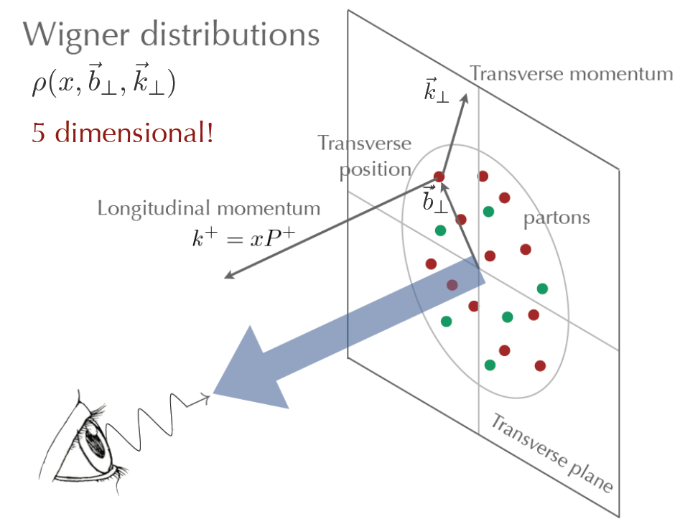
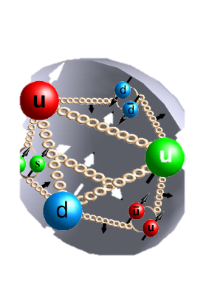

Hard Scattering is a premier tool to probe the quark and gluon degrees of freedom
Proton Structure extracted using QCD factorization theorem
FFs contribute to virtually all processes
h
q
FF_{q}
σ
$′$
  $Q^{2}$scale” of the probe,
  “resolution”
  $x$: bjorken scaling variable, in partonic picture momentum fraction of the struck parton, “shutter speed”
  $z$ fractional quark momentum carried by hadron
  $p_{T}$
f_{b}
X’
pQCD
fragmentation
function
Proton Structure
$$\frac{{ d}^{2}σ(ep→πX)}{dx dz{ p}_{hT}}∝q\left(x,k_{T}\right)×\frac{dσ^{2}\left(e q→e^{′}q^{′}\right)}{dx}×FF\left(z,p_{T}\right)δ(p_{hT}−(k_{T}+p_{T})$$

Slide 3
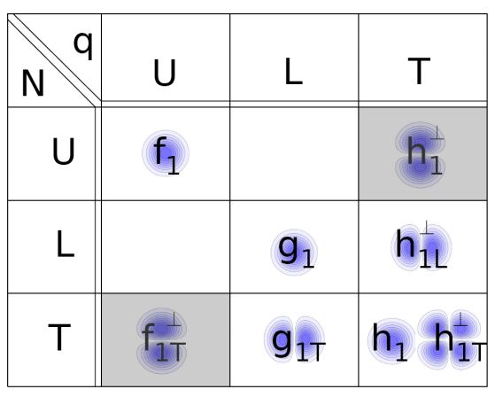
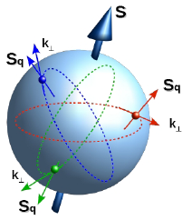
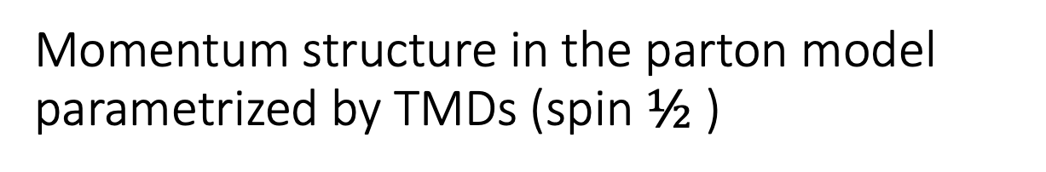
Momentum structure in the parton model parametrized by TMDs (spin $½$)
In addition to the spin-spin correlations can have spin momentum correlations!
Spin-orbit correlations

Slide 4
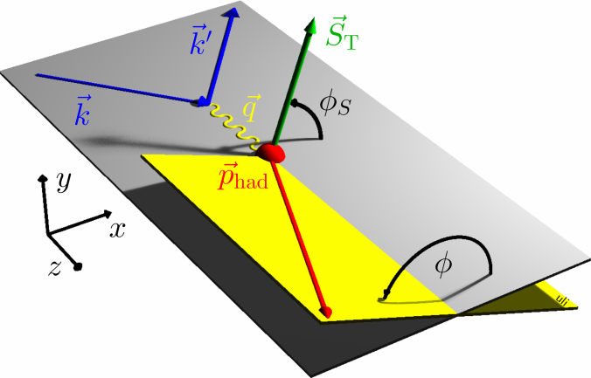
SIDIS X-section in the Parton Model
Boer-Mulders
Unpolarized
Worm Gear
Transversity
Polarized target
Sivers
Pretzelosity
Polarzied beam and target
Worm Gear
S_{L} and S_{T}: Target Polarizations; λe: Beam Polarization
x: momentum fraction carried by struck quark, z: fractional energy of hadron
4

Slide 5
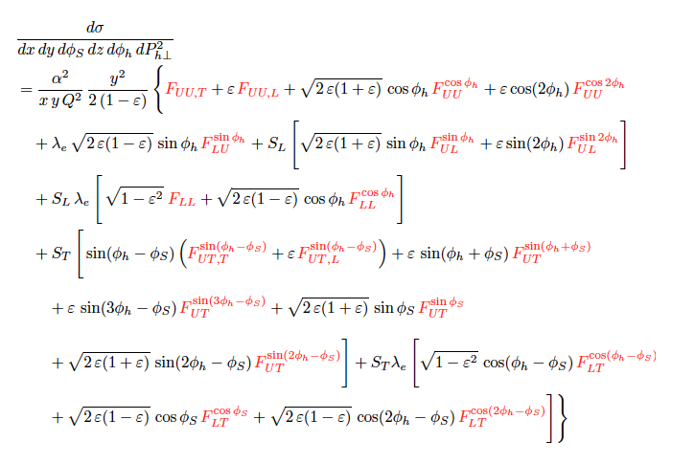
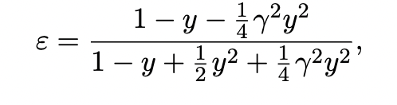
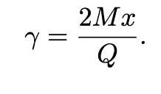
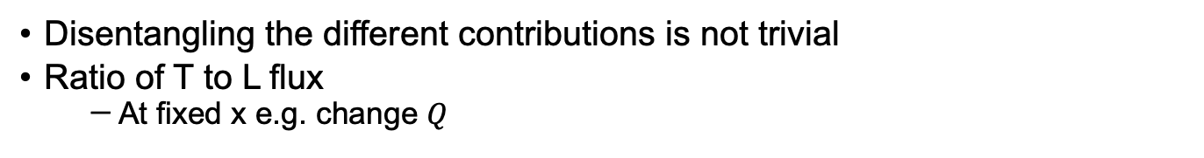
SIDIS cross-section
Disentangling the different contributions is not trivial
Ratio of T to L flux
  At fixed x e.g. change $Q$

Slide 6
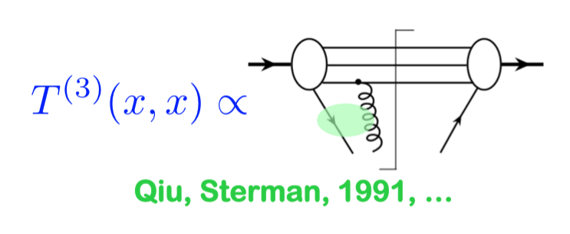
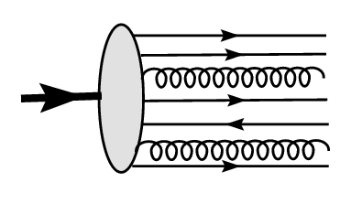
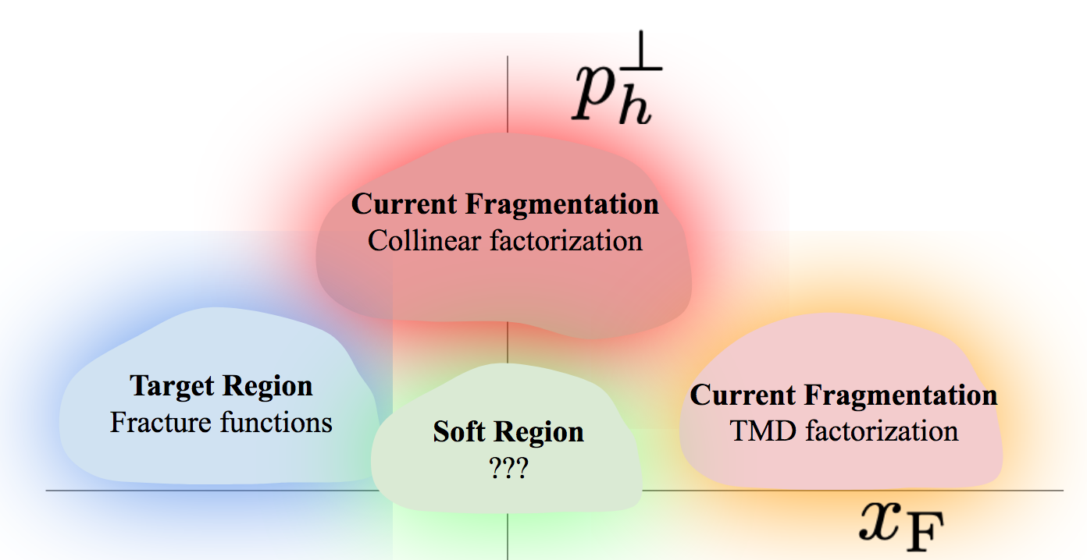
Beyond the parton picture
Higher Twist Contributions
Overlap of regions that are not captured by factorized TMD picture
VM Meson decays
Radiative corrections
Assumption of suppressed long photon contributions
One persons ‘complication’ is another person's signal…
➔Need high lumi, leverarm in kinematics to disentangle various contributions

Slide 7
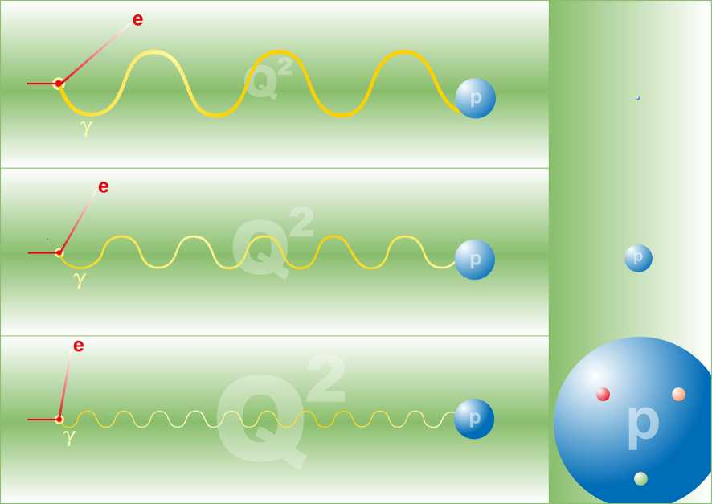
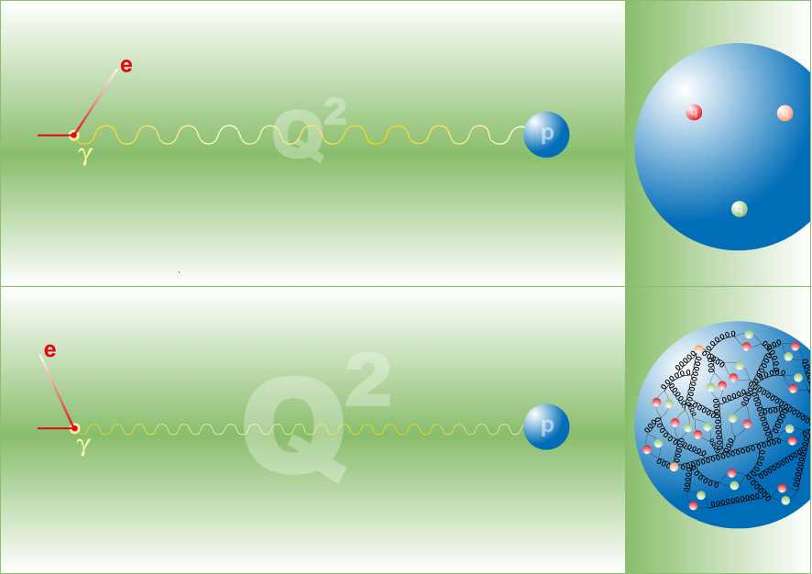
Landscape
Valence Quarks
JLab22
To extract 3D structure
Need luminosity
JLab12
Exposure
Glue and sea-quarks
wavelength
Jlab12: 2018+
JLab22:

Slide 8
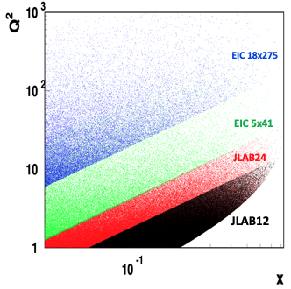
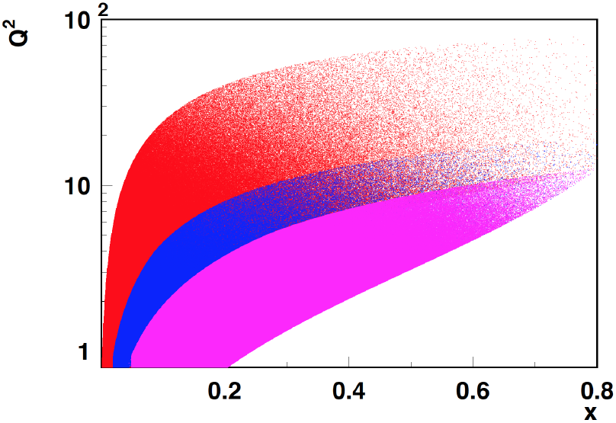
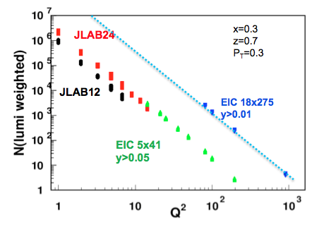
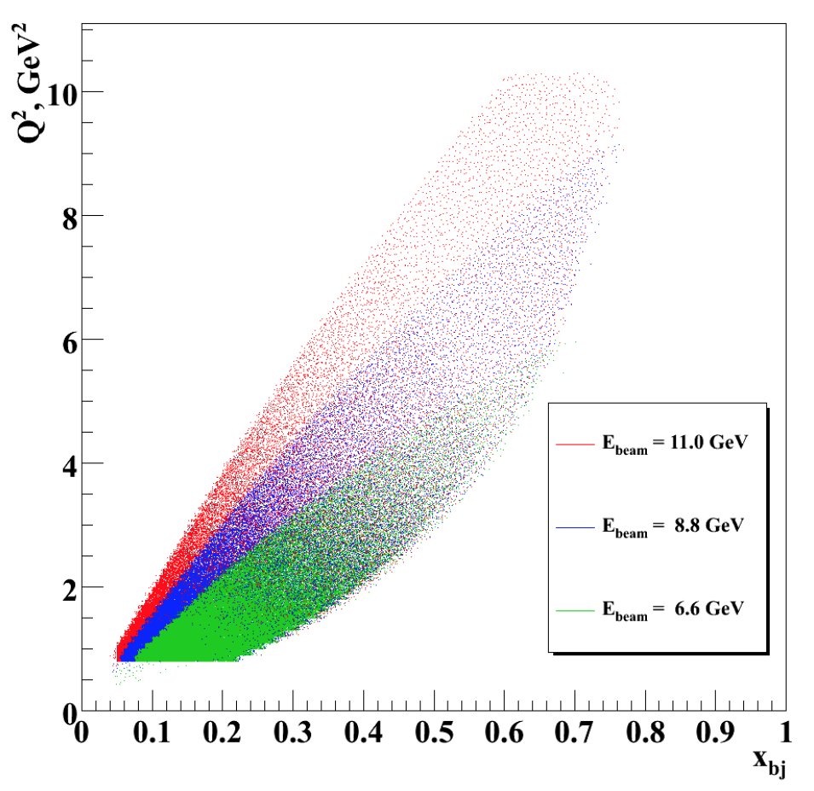
Kinematic comparisons
COMPASS
HERMES/JLab24
JLab12
Plot by H. Avakian
JLab7/9/11
NB: Kinematic slice heavily biased towards Jlab

Slide 9

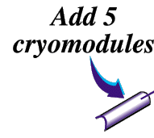






Jefferson Lab with CEBAF at 12 GeV
Hall D
Hall B
Hall A
Hall C
CHL-2

Slide 10
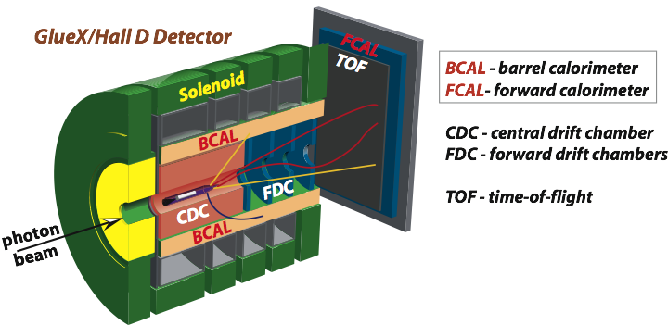
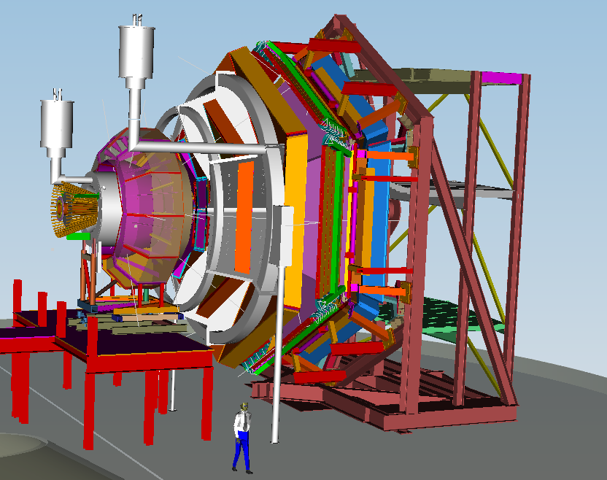
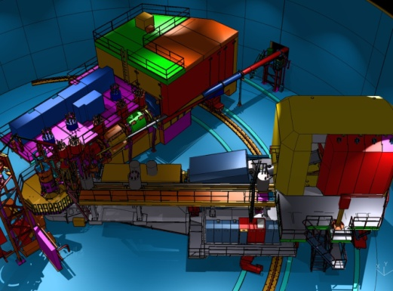

Detector Requirements: Complementarity
Hall D | Hall B | Hall C | Hall A
excellent hermeticity | luminosity 10³⁵ | energy reach | custom installations
polarized photons | Hermeticity | precision
E_{γ}~8.5-9 GeV | 11 GeV beamline
10⁸ photons/s | target flexibility
good momentum/angle resolution |  | excellent momentum resolution
high multiplicity reconstruction |  | luminosity up to 10³⁸
particle ID

Slide 11
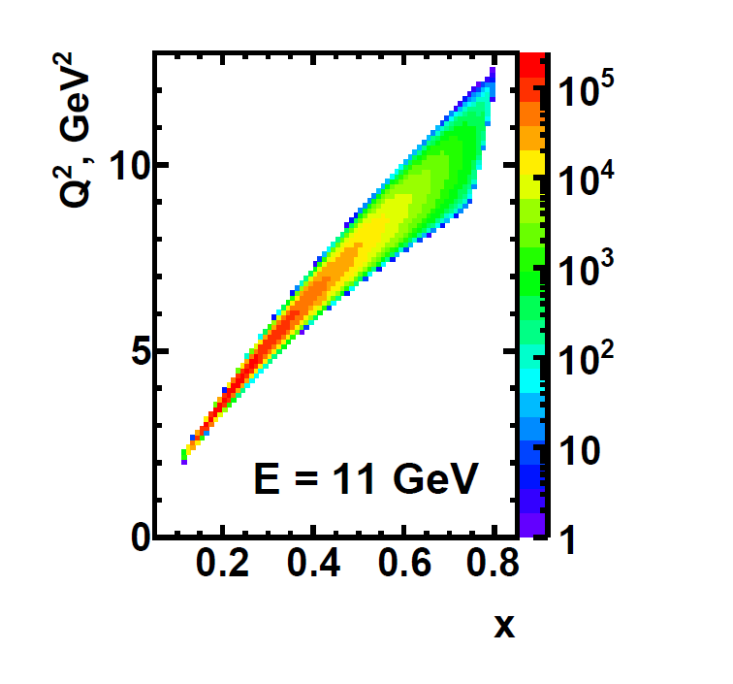
Detector Requirements: Complementarity
Hall D | Hall B | Hall C | Hall A
excellent hermeticity | luminosity 10³⁵ | energy reach | custom installations
polarized photons | hermeticity | precision
E_{γ}~8.5-9 GeV | 11 GeV beamline
10⁸ photons/s | target flexibility
good momentum/angle resolution |  | excellent momentum resolution
high multiplicity reconstruction |  | luminosity up to 10³⁸
particle ID

Slide 12
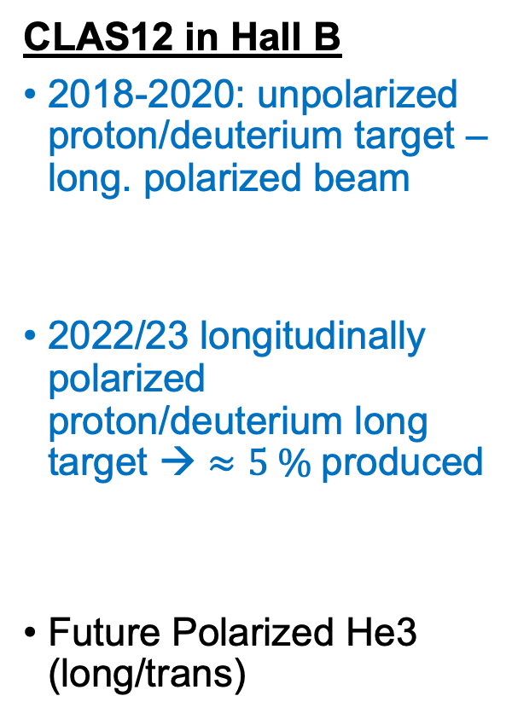
Tentative Timelines relevant for TMD program shown here
CLAS12 in Hall B
2018-2020: unpolarized proton/deuterium target – long. polarized beam
2022/23 longitudinally polarized proton/deuterium long target → $≈5 \%$produced
Future Polarized He3 (long/trans)
Hall A
2028 SoLID with He3/proton target (long/transverse)
See talk by Chao Peng

Slide 13

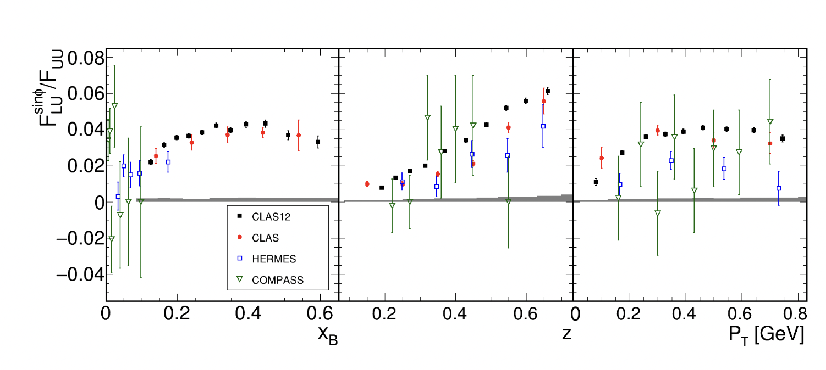
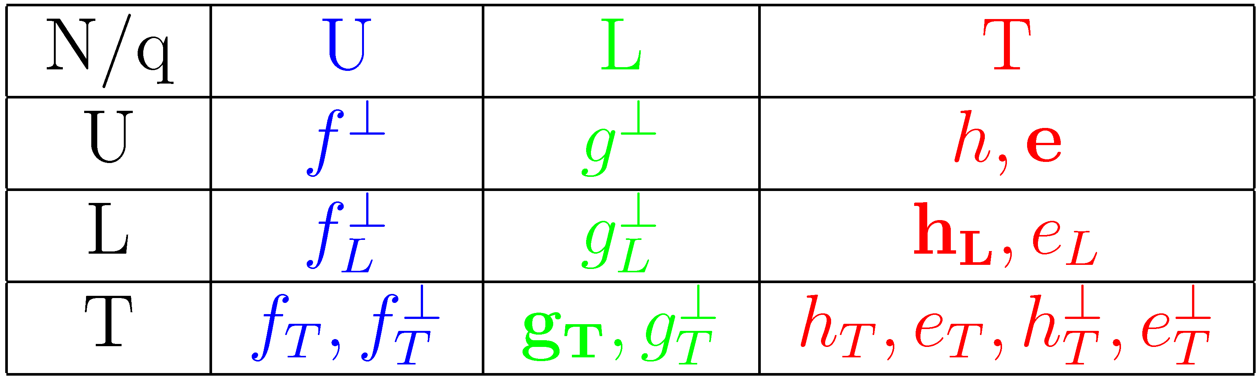
CLAS12 pion BSAs
Phys.Rev.Lett. 128 (2022) 6, 062005
Higher Twist PDFs
twist-3 pdf
unpolarized PDF
twist-3 t-odd PDF
Boer-Mulders
Collins FF
twist-3 FF
unpolarized FF

Slide 14
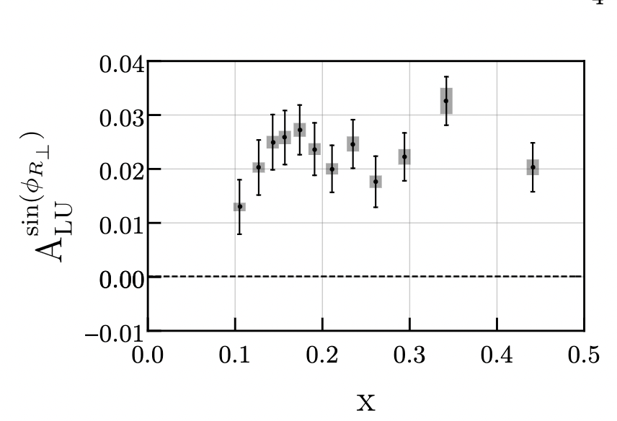
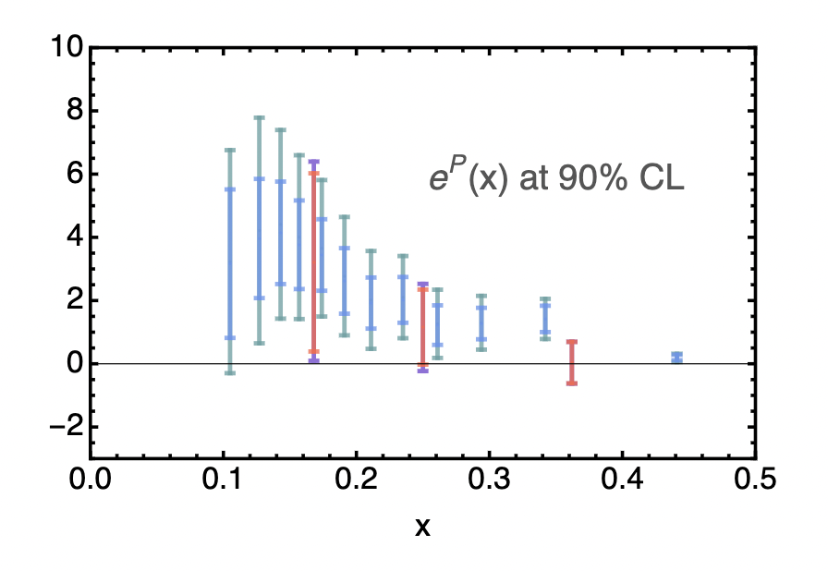
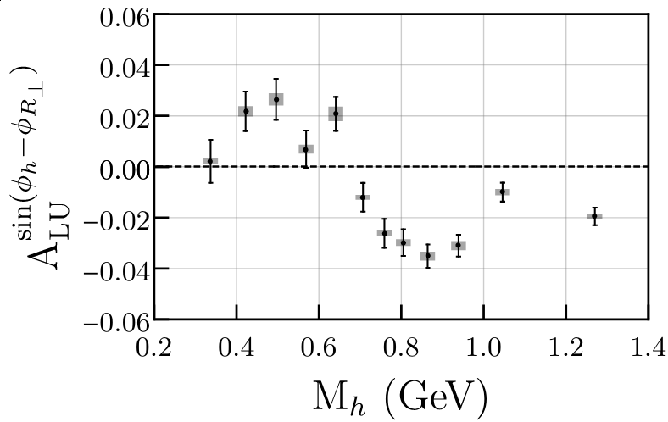



Better: di-hadrons
π⁺
π–
$$∝f×G_{1}^{⊥}$$
First extraction of $e(x)$
Further constrains from $F_{UL}$ and $F_{LL}$
$$∝e⋅H_{1}^{∠}$$
Phys.Rev.Lett. 126 (2021) 152501
Phys.Rev.D 106 (2022) 1, 014027

Slide 15
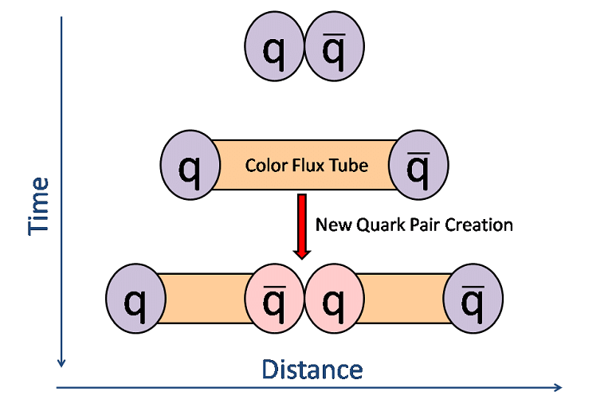
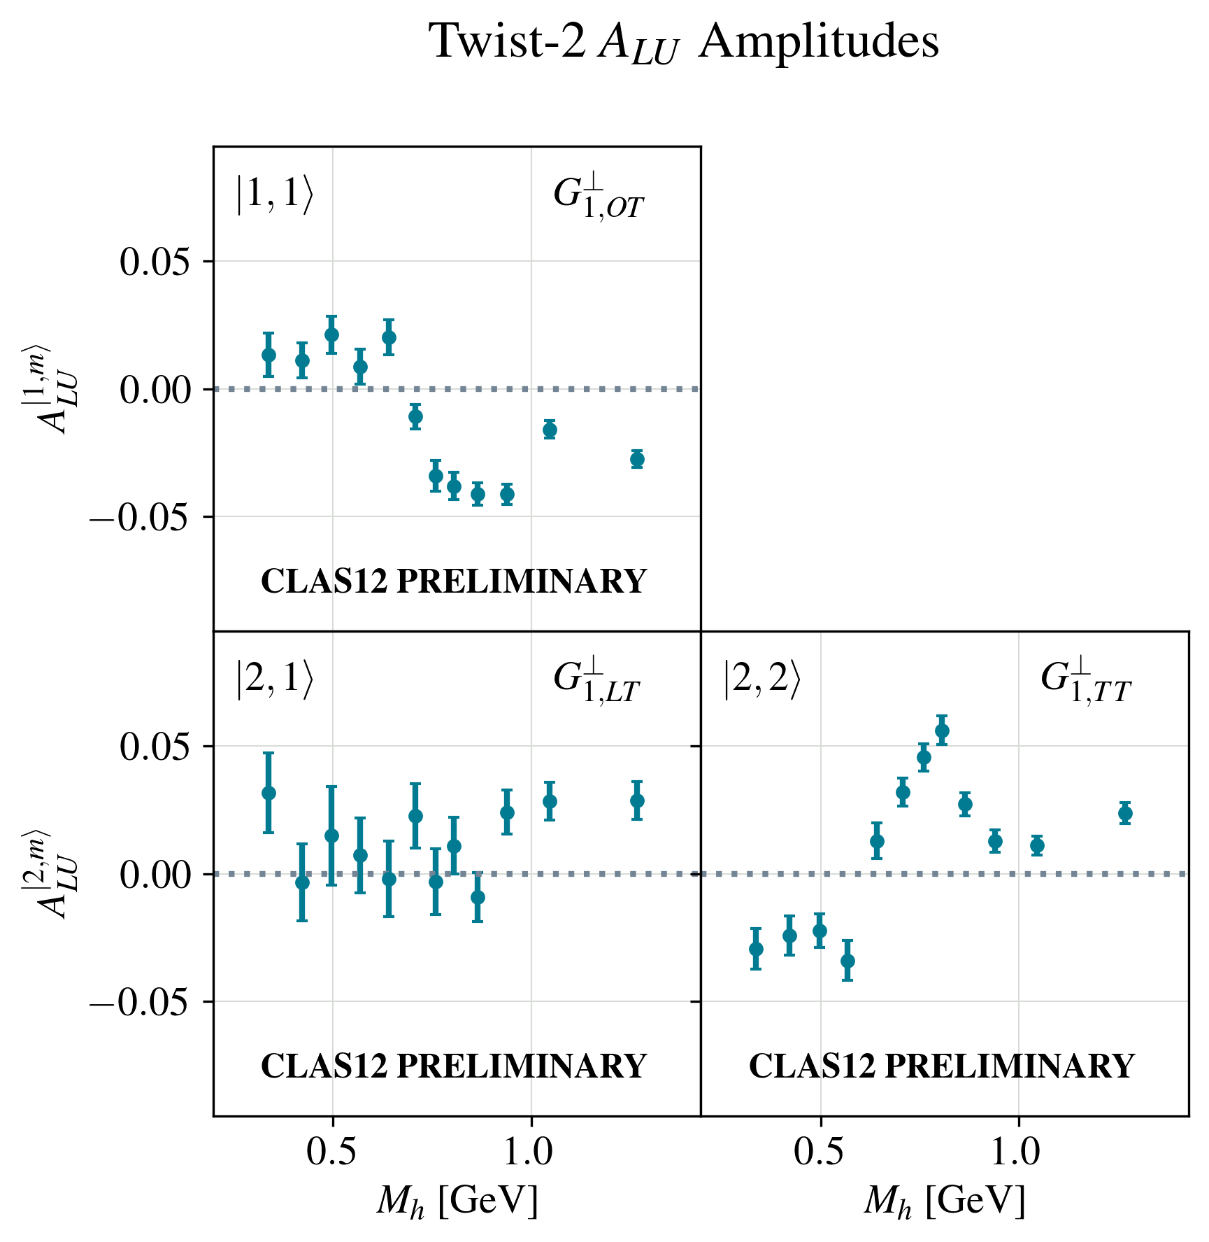
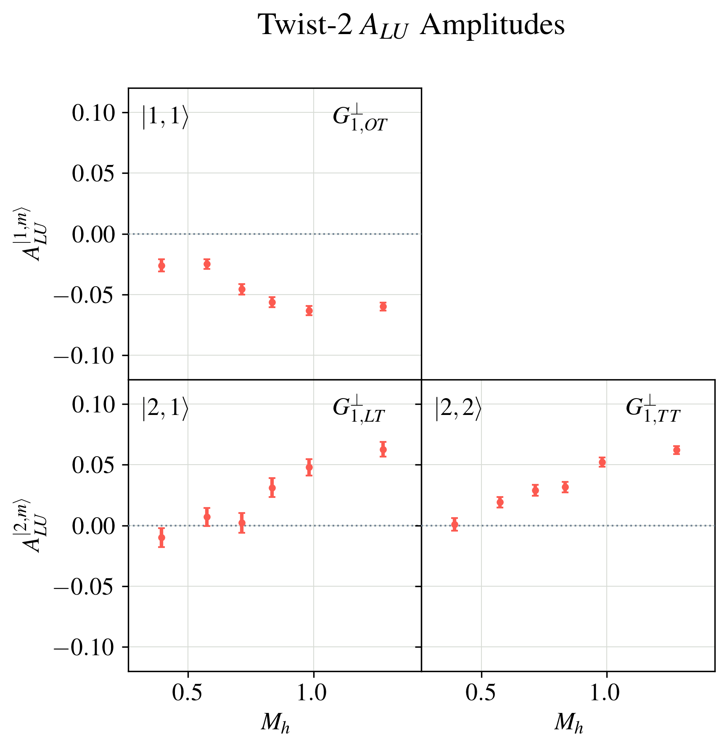
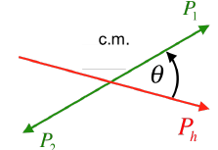
Compare Partial Wave Decomposition in MC and Data
Comparing to Polarized Lund model here (StringSpinner, A. Kerbizi et al, Comput.Phys.Commun. 272 (2022))
New version of string+${3P}_{0}$ model shown at SPIN (Kerbizi) with improved VM treatment

Slide 16
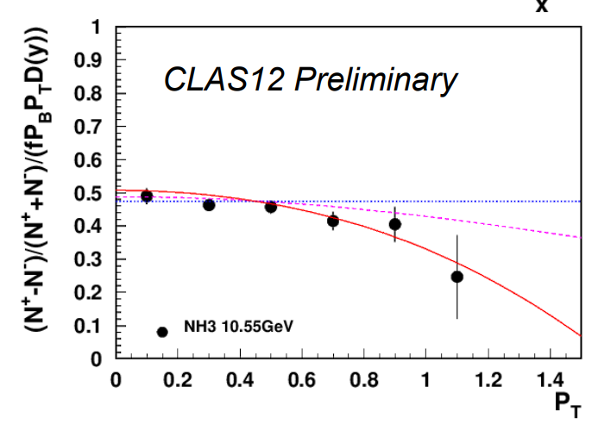
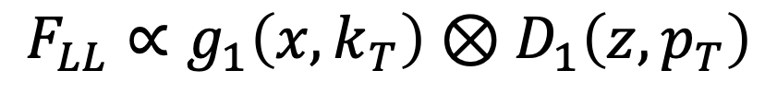
Longitudinal target results
Results represent 5% proton target
Harut Avakian at
$$F_{LL}∝g_{1}\left(x,k_{T}\right)⊗D_{1}\left(z,p_{T}\right)$$
Convolution over transverse momentum space
Rich program underway

Slide 17
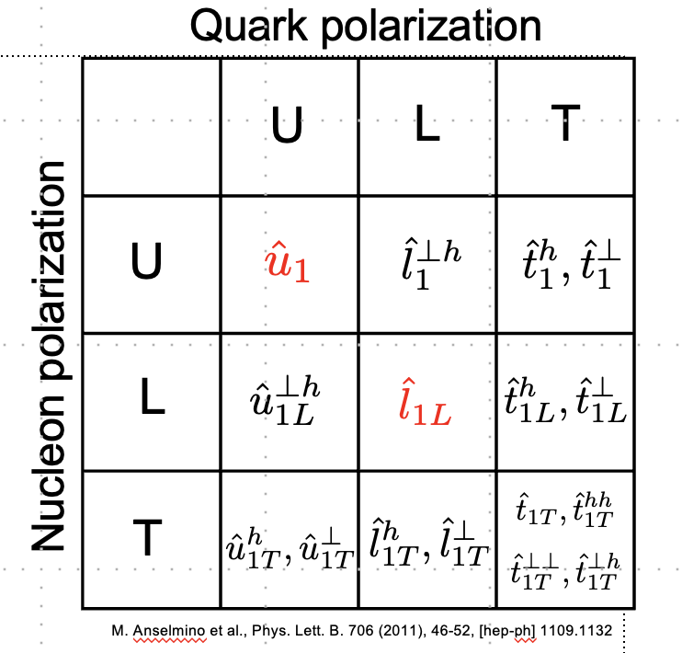
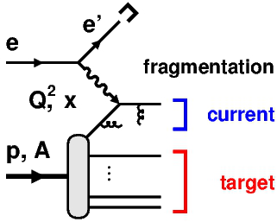
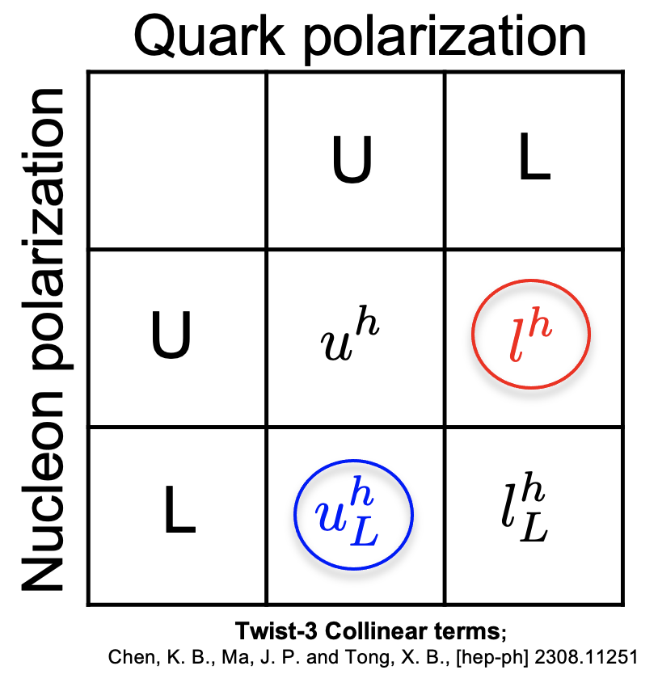
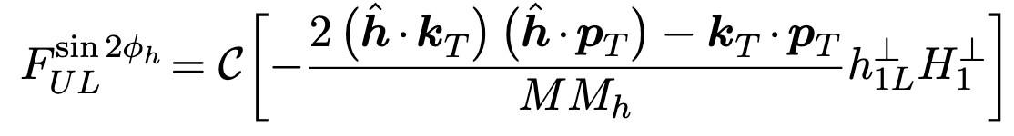

Target Fragmentation → Fracture Functions
Sum rule with $g_{1}$
Correlations between CFR-TFR allows to extract fracture functions coupled to FFs
T. Hayward at SPIN

Slide 18
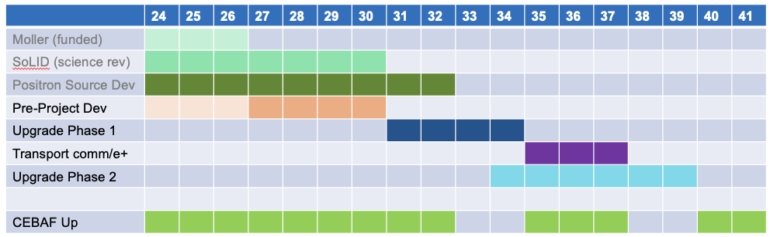
Notional CEBAF & upgrade schedule (FY24 – FY42)
Accelerator and engineering team have worked up an early schedule and cost estimate
  Schedule assumptions based on a notional timing of when funds might be available (near EIC ramp down based on EIC V3 profile)
  For completeness, Moller and SoLID (part of 12 GeV program) are shown; positron source development also shown
Tia Keppel at
18

Slide 19
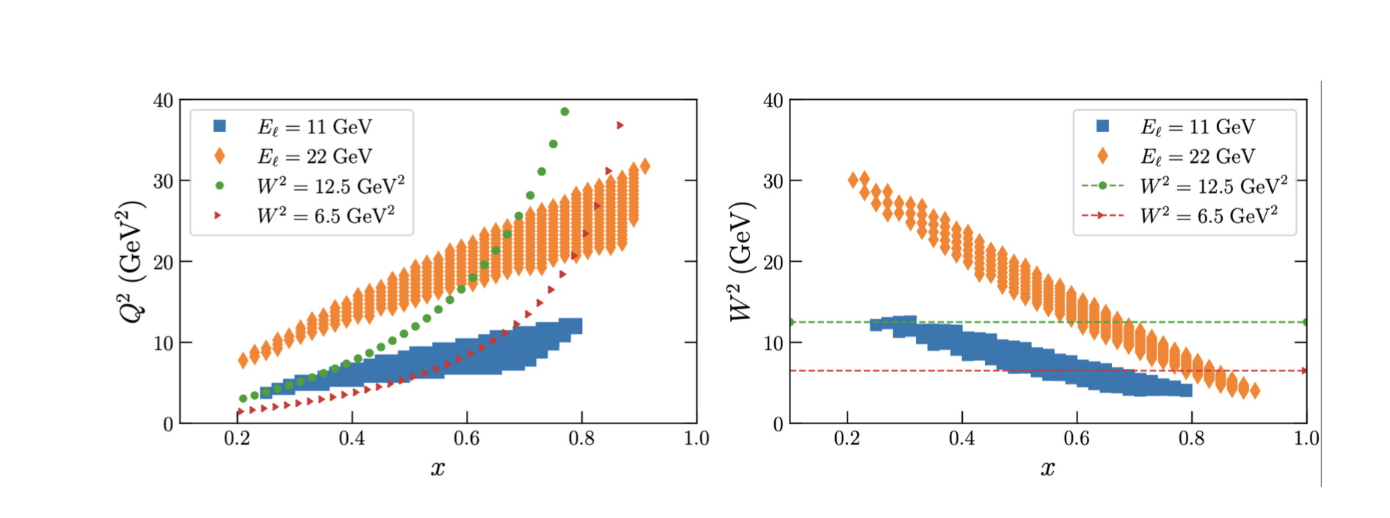
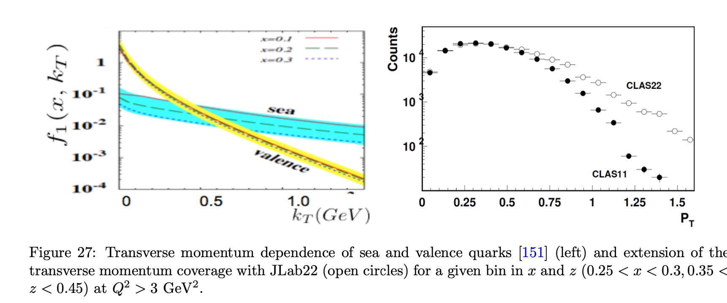

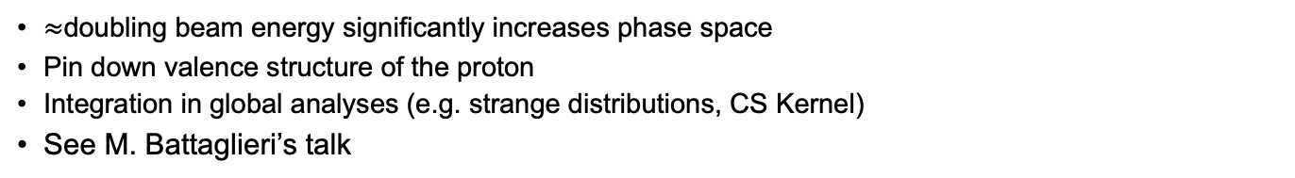
High x at Jlab 22
P.Schweitzer et al. arXiv:1210.1267
e-Print: 2306.09360 [nucl-ex]
$≈$doubling beam energy significantly increases phase space
Pin down valence structure of the proton
Integration in global analyses (e.g. strange distributions, CS Kernel)
See M. Battaglieri’s talk

Slide 20
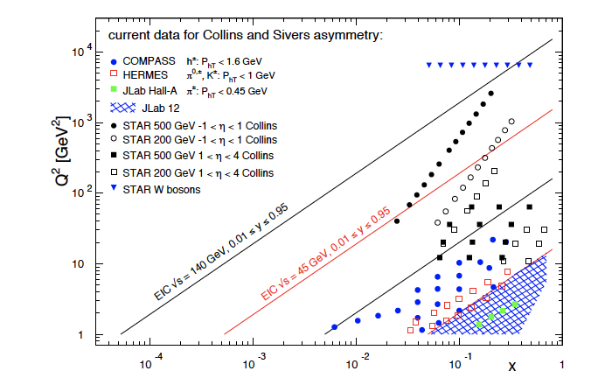
SIDIS physics at an EIC: Coverage
Common theme on EIC impact
  Extended kinematic coverage and precision, along with polarization
  and possible beam charge degrees of freedom allow multi-pronged approach →needed to extract multidimensional objects
  TMD factorization is valid
Large $Q^{2}$ lever arm: probe evolution, disentangle contributions to $σ$
Coverage to low $x:$ access sea and gluon distributions

Slide 21
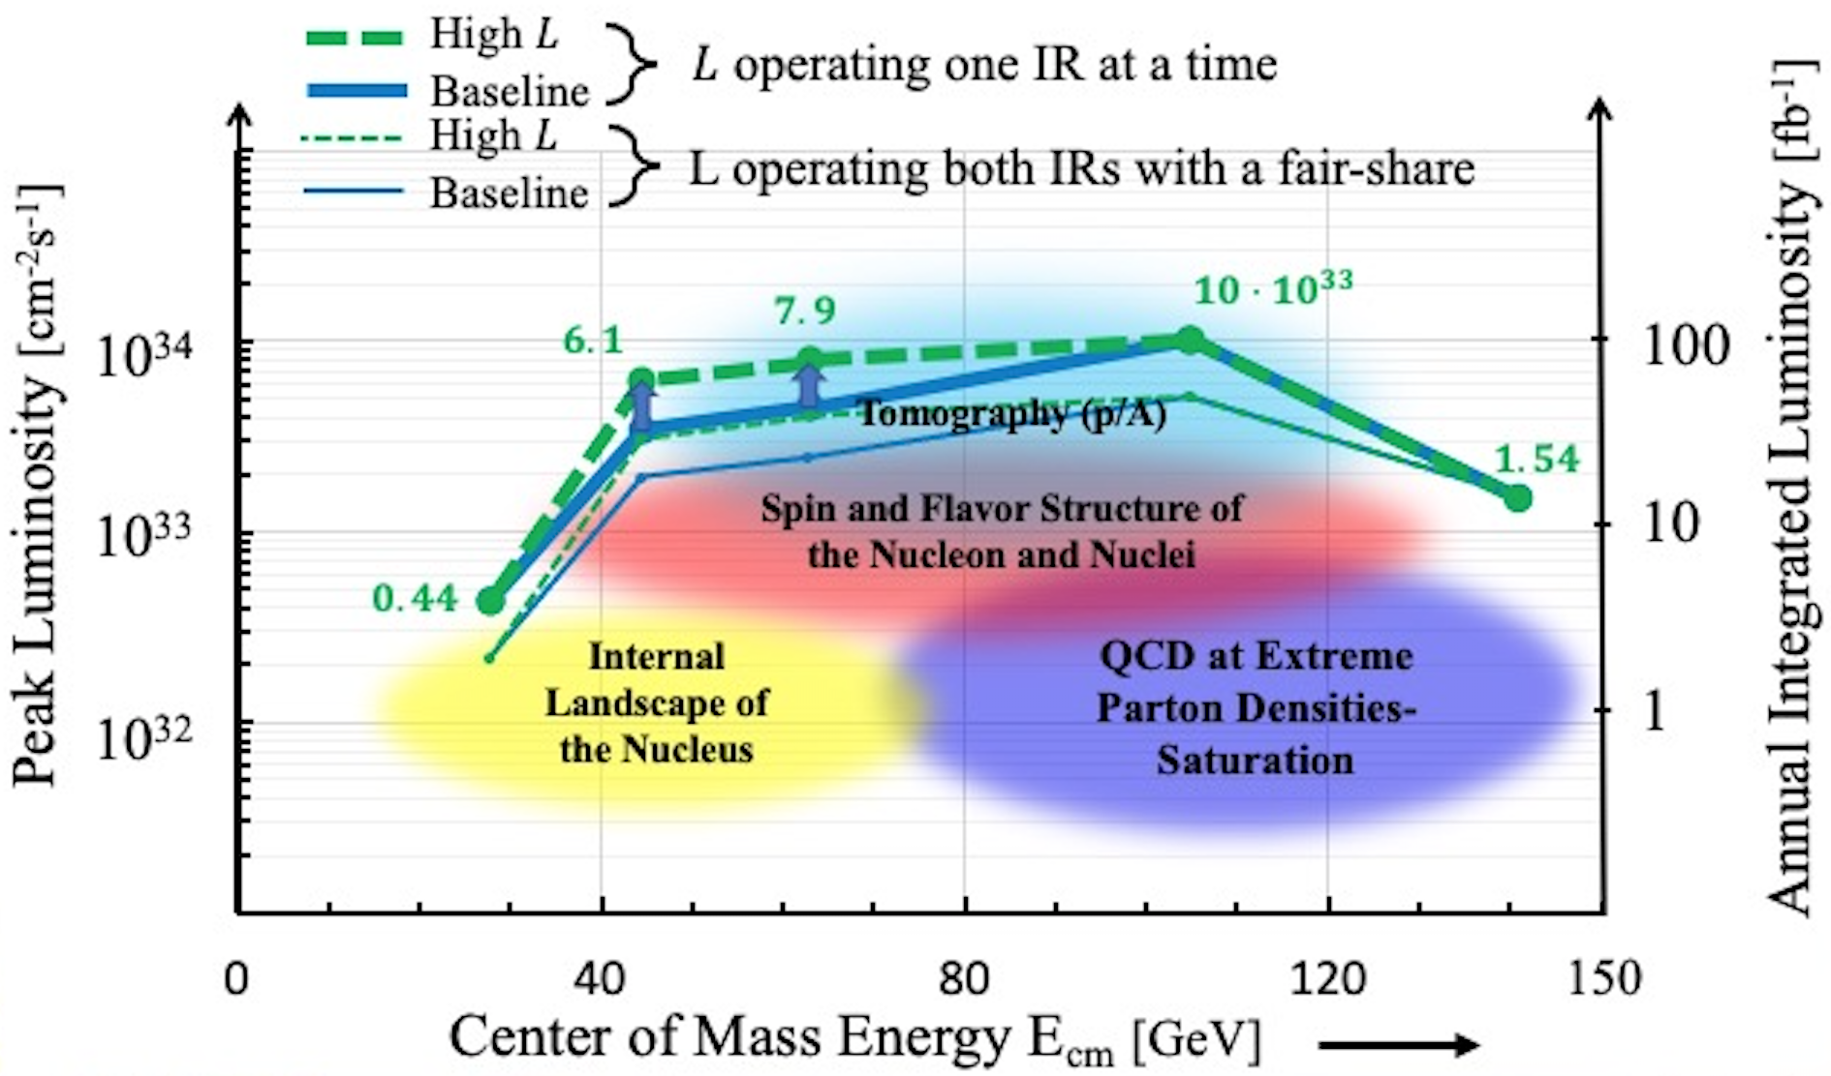
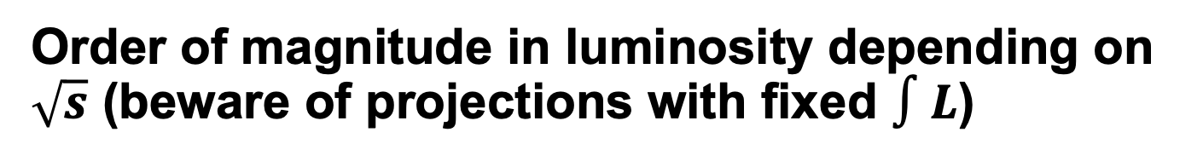
Order of magnitude in luminosity depending on $\sqrt{s}$ (beware of projections with fixed $∫L$)

Slide 22
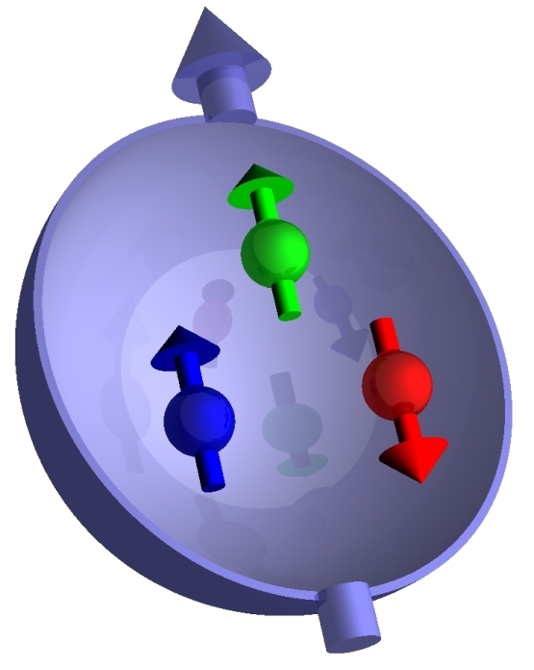






Longitudinal double spin asymmetries
$A_{LL}=\frac{σ^{↑⇑}−σ^{↑⇓}}{σ^{↑⇑}+σ^{↑⇓}}∝g_{1}$
2105.04434, $100fb^{−1}$
Projections for Athena (2022 JINST 17 P10019)
3$\%$ point-to-point, $2\%$scale uncertainties (from Hera experience)
$z>0.2$
$15.5 fb^{−1}$ at $18x275,$other datasets scaled accordingly

Slide 23

Access to TMDs: Kinematic factors
Twist 2
Twist 3
Slide from C. Dilks

Slide 24



Statistical uncertainty scaling factor for $18x275$
C/A
WG (LT)
$G_{1}^{⊥}$
W/A
$e,$
$g_{T}$
Slide from C. Dilks

Slide 25
Depolarization Factors
Twist 2
Suppressed at EIC
Twist 3
Slide from C. Dilks

Slide 26


Example: transversity extraction from Jlab and the EIC
But careful with parametrization bias…
Phys.Lett.B 816 (2021) 136255

Slide 27





$He^{3}$Double Tagging at the EIC allows clean neutron measurement
Neutron is to $87\%$ polarized
Double tagged events thus
provide access to polarized
neutron beam
Reconstruction of initial neutron
momentum from tagged protons allows reduction of uncertainties
from nuclear corrections
Friščić, I, Nguyen, D, Pybus, JR, Jentsch et al

Slide 28


Precision $Λ$ physics at the EIC
Phys.Rev.D 105 (2022) 9, 094033
Also $→↑$ spin transfer, in-jet fragmentation
$40 fb^{−1}$ at each energy
Significant impact of low $√s$ data

Slide 29

Lambda feed-down composition vs JLab20
EIC
JLAB12
Xiaoyan Zhao at SPIN
Study by M. McEneaney(Duke)
JLab22 similar
Possible to unfold at the EIC (not so much at Jlab)
ML methods might help

Slide 30
Summary/Conclusion/Outlook
Broad and diverse SIDIS program
  Present: JLab12, COMPASS
  Future: JLab22, EIC
Wide kinematic reach enabling us to understand the full QCD picture
Jlab: unprecendented precision in valence quark regime
EIC: new frontiers
What is missing in this talk:
  COMPASS
    Deuterium target: Statistics now similar to proton target
    Work on radiative corrections: RADGEN→DJANGOH
    Exciting/large datasets still to be analyzed
  Exclusive limit
  TMDs in medium
  Charged current at the EIC
  Details on JLab12, 22 and EIC programs can be found in review papers and detector proposals
    Yellow Report, Athena, ECCE, CORE proposals, PSQ report…
  …(and a lot more)

Slide 32


Wide Coverage

Slide 33






Electroproduction kinematics
COMPASS
HERMES/JLab24
EIC
JLab12
Experiments measure azimuthal dependence of the cross section as a function of x,Q²,z,P_{T}
JLab7/9/11
Studies of azimuthal modulations give access to underlying dynamics (3D partonic distributions,…)
QCD predicts the Q²-dependence of 3D PDFs

Slide 34






Hadron production in hard scattering
polarized quark
x_{F}>0 (current fragmentation)
X. Artru & Z. Belghobsi
h
q’
L
FSI
x_{F}<0 (target fragmentation)
x_{F} – fractional momentum in the CM frame
L
tornado
0 0.5 1.0
Non-perturbative sea is significant in the valence region
It contribute in spin-orbit correlations, more at large transverse momenta

Slide 35




Appearance of perturbative asymmetries
Additionally: perturbative generation of asymmetries from $g_{T}$
What about di-hadron correlations?
Abele, Aicher, Piacenza, Schafer, Vogelsang (2022)
Benic et al. Phys. Rev. D 104, 094027

Slide 36


Unpolarized TMDs
Top: Explicit z dependence of select pion multiplicities in 3 x-Q² bins, including the double-Gaussian fits
hep-ex:2207.10893
Impact on $f(x,k_{T})$ from Athena proposal
$\frac{q_{T}}{Q}<1.0, y>0.01$
Experimental uncertainties dominated by $2\% p2p,$
$3\%$ scale, theoretical uncertainties driven by
uncertainties on evolution

Slide 38



Slide 39

Lambda

Slide 40


Example, Access of e(x) in SIDIS x-section
Di-hadron cross section: Clean access to e(x)
See e.g. Aurore Courtoy, arXiv:1405.7659
Evidence from CLAS6:
0.25
x_{B}
AV, DNP 2018

Slide 41
f

Slide 42





Slide 43
Structure functions and depolarization factors in SIDIS
fast moving hadron
arXiv:1904.12882
x_{F} – fractional momentum in the CM frame
Theory works well for P_{T}/Q<0.25,
Kinematic regions not trivial to separate at lower energies
Multi-dimensional measurements critical, requiring high lumi
Decays can lead to additional contamination

Slide 44
Maybe not the full picture
Twist-3
Regions
Mesons
Decays
Rad corr
Some projections from the EIC
Jlab 22

Slide 45



e(x) in single hadrons
1
The 3D nucleon structure in momentum space can be described by TMDs
SIDIS provides an effective tool to probe the transverse momentum dependent
partonic structure of the nucleon
SIDIS cross section for an unpolarized target:
→ Contains model independent structure functions
➔ A convolution of 4 TMDs and 4 fragmentation functions
➔ The results can be used in a global fit to constrain the TMDs and FF
See talk by Stefan Diehl

Slide 46



Projection of transverse TSSAs
Athena projections for the measurement
of Sivers asymmetries
$$0.2<z<0.7, Q^{2}>1.0, y>0.05,\frac{qT}{Q}<1.0$$
2207.10890
Projected uncertainties on Collins
Asymmetries by ECCE

Slide 47

Detector Requirements: Complementarity
Hall D | Hall B | Hall C | Hall A
excellent hermeticity | luminosity 10³⁵ | energy reach | custom installations
polarized photons | hermeticity | precision
E_{γ}~8.5-9 GeV | 11 GeV beamline
10⁸ photons/s | target flexibility
good momentum/angle resolution |  | excellent momentum resolution
high multiplicity reconstruction |  | luminosity up to 10³⁸
particle ID
SOLID

Slide 48
Detector Requirements: Complementarity
Hall D | Hall B | Hall C | Hall A
excellent hermeticity | luminosity 10³⁵ | energy reach | custom installations
polarized photons | hermeticity | precision
E_{γ}~8.5-9 GeV | 11 GeV beamline
10⁸ photons/s | target flexibility
good momentum/angle resolution |  | excellent momentum resolution
high multiplicity reconstruction |  | luminosity up to 10³⁸
particle ID

Slide 49
Tentative Timelines relevant for TMD program shown here
CLAS12 in Hall B
2018-2020: unpolarized proton/deuterium target – long. polarized beam
2022+ polarized long target?
Future Polarized He3 (long/trans)
Polarized transverse HD
Hall A
2023 Transverse single spin asymmetries on He3 (64 beam days)
2028 SoLID with He3/proton target (long/transverse)

Slide 50


Accessing e(x) in the TMD framework
The PDF e can be measured in the F_{LU} structure function of the cross section for the production of a pion on an unpolarized target.
twist-3 pdf
unpolarized PDF
twist-3 t-odd PDF
Boer-Mulders
Collins FF
twist-3 FF
unpolarized FF
twist-3 FF
Complicated combination of four terms in the structure function.
TMD factorization at twist-3 not yet proven!
Figure from hep-ph/0208124
A. Efremov, K. Goeke, and P. Schweitzer, Phys.Rev. D67, 114014 (2003)

Slide 51
Example, Access of e(x) in SIDIS x-section
Di-hadron cross section: Clean access to e(x)
See e.g. Aurore Courtoy, arXiv:1405.7659
Evidence from CLAS6:
0.25
x_{B}
AV, DNP 2018

Slide 52
Partial Wave, Model comparisions, VM, stringspinner string-P03 model

Slide 53
Analog to PDFs; Momentum Sum Rules
A direct relationship exists to the eight leading twist PDFs after the fracture functions are integrated over the fractional longitudinal nucleon momentum, ζ.
M. Anselmino et al., Phys. Lett. B. 699 (2011), 108, [hep-ph] 1102.4214
Quark polarization
Quark polarization
U
L
T
U
L
T
U
Unpolarized PDF analog
U
Nucleon polarization
Nucleon polarization
L
helicity PDF analog
L
T
etc. etc.
T
M. Anselmino et al., Phys. Lett. B. 706 (2011), 46-52, [hep-ph] 1109.1132
CFR
TFR

Slide 54





Can We Separate Target and Current?
Unpolarized H₂ data (RGA experiment)
ep → e’pX
TFR
CFR
No clear experimental definition of what constitutes current production versus target production.
Odd structure functions, with different production mechanisms in both regions, give a possible clue.
Protons (as opposed to mesons) at CLAS12 kinematics give a unique opportunity because they have extensive coverage in both regions.

Slide 55

Current and Target Separation
Odd-function (sine) modulations exhibit a sign flip around the transition from target to current fragmentation. Interestingly, we observe F_{LU} ~ F_{UL}.
Even-function (cosine) behavior of double-spin asymmetry does not show a sign flip; possible signs decreasing F_{LL} as x_{F} → ±1 (x_{B} decreasing but likely not the only cause).
Consistent beam-spin asymmetries in unpolarized H₂ and polarized NH₃ indicates minimal nuclear medium modification.

Slide 56
Kotzinian-Mulders Asymmetry
The F_{UL}^{sin2φ} asymmetry is purely generated by the Collins mechanism – whereby a transversely polarized quark flips orientation during hadronization and produces an asymmetric distribution in the transverse plane.
Hadronization in the TFR is more isotropic – there is no additional chiral-odd quantity like the Collins function to pair with the Kotzinian-Mulders TMD because factorization into separate soft and hard scale processes does not hold.
No Collins mechanism in the TFR so F_{UL}^{sin2φ} (and F_{UU}^{cos2φ}) are pure twist-4. We would expect small magnitude at -x_{F}.
Early signs give a possible hint but need more statistics!

Slide 57

Statistical uncertainty scaling factor for $5x41$
Slide from C. Dilks

Slide 58



Back-to-back (dSIDIS) Formalism
When two hadrons are produced “back-to-back”^{1,2} with one in the CFR and one in the TFR the structure function contains a convolution of a fracture function and a fragmentation function.
Leading twist beam(target)-spin asymmetry.
Unique access to longitudinally polarized quarks in unpolarized nucleon… no corresponding PDF!
h₁ in the CFR with production dictated by the fragmentation function
h₂ in the TFR with production dictated by the fracture function
Long range correlation depends on the difference in azimuthal angles of both hadrons
Handbag diagram for dihadron production; lower blob contains FrFs and upper blob contains the FFs.
Kinematic plane for b2b dihadron production.
1. M. Anselmino et al., Phys. Lett. B. 706 (2011), 46-52, [hep-ph] 1109.1132
2. M. Anselmino et al., Phys. Lett. B. 713 (2012), 317-320, [hep-ph] 1112.2604
58

Slide 59

Access to unmeasured fracture functions
x-dependence increases in magnitude in the valance quark region.
ζ₂-dependence shows decreasing amplitude with increasing momenta. Possibly due to correlations with x.
Relatively flat as a function of z₁, possibly due to cancellation of fragmentation functions.
First observation of TMD fracture functions and long-range correlations between current and target. Already working on follow up (negative pion, deuteron target, more statistics etc.)
ep → e’pπ⁺X
H. Avakian, T.B. Hayward et al., Phys. Rev. Lett. 130 (2023), [hep-ex] 2208.05086

Slide 60
Target-Current

Slide 61
Ex mesons

Slide 62
Long target

Slide 63
Compass rad corrections

Slide 64





New e(x) Extraction – Proton Flavor Combination
twist-3 DiFF
Scenario I: Wandzura-Wilczek (WW) Approximation
  Drop twist-3 DiFF
Scenario II: Beyond WW approximation
  Estimate max integrated twist-3 DiFF from COMPASS A_{UL} and A_{LL}
Legend
CLAS12
CLAS6
Scenario I
Scenario II
Courtoy, Aurore, et al. Phys.Rev.D 106 (2022)
Courtoy, Aurore – CPHI 2022

Slide 65
Future
Timeline
LRP

Slide 66
Physics with Jlab 22
High X phasespace-->seaquarks (e.g. strange)
Lambda/charm
Collins Soper Kernel

Slide 67
EIC
See slides from MC for EIC workshop, summer school

Slide 68
SIDIS physics at an EIC: Coverage
Common theme on EIC impact
  Extended kinematic coverage and precision, along with polarization
  and possible beam charge degrees of freedom allow multi-pronged approach →needed to extract multidimensional objects
  TMD factorization is valid
Large $Q^{2}$ lever arm: probe evolution, disentangle contributions to $σ$
Coverage to low $x:$ access sea and gluon distributions

Slide 69
Order of magnitude in luminosity depending on $\sqrt{s}$ (beware of projections with fixed $∫L$)

Slide 70
Wide Coverage

Slide 71

Longitudinal double spin asymmetries
$A_{LL}=\frac{σ^{↑⇑}−σ^{↑⇓}}{σ^{↑⇑}+σ^{↑⇓}}∝g_{1}$
2105.04434$100fb^{−1}$
Projections for Athena (2022 JINST 17 P10019)
3$\%$ point-to-point, $2\%$scale uncertainties (from Hera experience)
$z>0.2$
$15.5 fb^{−1}$ at $18x275,$other datasets scaled accordingly

Slide 72
Depolarization Factors
Twist 2
Twist 3
Slide from C. Dilks

Slide 73
Statistical uncertainty scaling factor for $5x41$
Slide from C. Dilks

Slide 74
Depolarization Factors
Twist 2
Suppressed at EIC
Twist 3
Slide from C. Dilks

Slide 75
Unpolarized TMDs
Top: Explicit z dependence of select pion multiplicities in 3 x-Q² bins, including the double-Gaussian fits
hep-ex:2207.10893
Impact on $f(x,k_{T})$ from Athena proposal
$\frac{q_{T}}{Q}<1.0, y>0.01$
Experimental uncertainties dominated by $2\% p2p,$
$3\%$ scale, theoretical uncertainties driven by
uncertainties on evolution

Slide 76
Projection of transverse TSSAs
Athena projections for the measurement
of Sivers asymmetries
$$0.2<z<0.7, Q^{2}>1.0, y>0.05,\frac{qT}{Q}<1.0$$
2207.10890
Projected uncertainties on Collins
Asymmetries by ECCE

Slide 77
Example: transversity extraction from Jlab and the EIC
But careful with parametrization bias…
Phys.Lett.B 816 (2021) 136255

Slide 78
$He^{3}$Double Tagging at the EIC allows clean neutron measurement
Neutron is to $87\%$ polarized
Double tagged events thus
provide access to polarized
neutron beam
Reconstruction of initial neutron
momentum from tagged protons allows reduction of uncertainties
from nuclear corrections
Friščić, I, Nguyen, D, Pybus, JR, Jentsch et al

Slide 79
What has been discussed before
Landscape of experiments, what can be done where… (case for Jlab, kinematics, twist3)
See EIC, AMBER talks
(pick up ‘CT’ thing from Jianwei: CT needs lumi…
Introduce HW
New developments
  Radcor: (how is that for di-hadrons)
JLab22 (see cynthias talk)
Compass deuterium
Long range plan…

Slide 80

QCD dynamics complex
1. Introduction/theoretical background
Clip from [2]
Notes:
However, proton is more complex, not complete in a collinear picture
As shown in artistic rendition here
Depicting proton structure at varying x
Small-x: gluon dominance
Medium x: quark-antiquark sea (?)
Large x: valence quarks
Partons move in three dimensions, interact with gluon field, carry OAM

Slide 83
High x at Jlab 22

Slide 84
Detector Requirements: Complementarity
Hall D | Hall B | Hall C | Hall A
excellent hermeticity | luminosity 10³⁵ | energy reach | custom installations
polarized photons | hermeticity | precision
E_{γ}~8.5-9 GeV | 11 GeV beamline
10⁸ photons/s | target flexibility
good momentum/angle resolution |  | excellent momentum resolution
high multiplicity reconstruction |  | luminosity up to 10³⁸
particle ID

Slide 85
Detector Requirements: Complementarity
Hall D | Hall B | Hall C | Hall A
excellent hermeticity | luminosity 10³⁵ | energy reach | custom installations
polarized photons | hermeticity | precision
E_{γ}~8.5-9 GeV | 11 GeV beamline
10⁸ photons/s | target flexibility
good momentum/angle resolution |  | excellent momentum resolution
high multiplicity reconstruction |  | luminosity up to 10³⁸
particle ID
SOLID

Slide 86
Detector Requirements: Complementarity
Hall D | Hall B | Hall C | Hall A
excellent hermeticity | luminosity 10³⁵ | energy reach | custom installations
polarized photons | hermeticity | precision
E_{γ}~8.5-9 GeV | 11 GeV beamline
10⁸ photons/s | target flexibility
good momentum/angle resolution |  | excellent momentum resolution
high multiplicity reconstruction |  | luminosity up to 10³⁸
particle ID

Slide 87
Tentative Timelines relevant for TMD program shown here
CLAS12 in Hall B
2018-2020: unpolarized proton/deuterium target – long. polarized beam
  →Results shown here correspond to 15% of p-Data (120/90 beam days)
FY22 polarized long target?
Polarized He3 (long/trans)
Polarized transverse HD
Hall A
2023 Transverse single spin asymmetries on He3 (64 beam days)
2028 SoLID with He3/proton target (long/transverse)

Slide 88


SBS+BB Projected Results: Collins and Sivers SSAs
Projected A_{UT}^{Sivers} vs. x (11 GeV data only)
Projected A_{UT}^{Collins} vs. x (11 GeV data only)
E12-09-018 will achieve statistical FOM for the neutron ~100X better than HERMES proton data and ~1000X better than Hall A E06-010 neutron data. Near-future more precise COMPASS deuteron data will sharpen expected impacts, urgency of E12-09-018
SBS installation starts 2020. E12-09-018 could run as early as 2022; 2023 more likely.

Slide 89




SoLID@12-GeV JLab: QCD at the intensity frontier
SoLID provides unique capability combining high luminosity (10³⁷⁻³⁹ /cm²/s) (>100 of CLAS12; >1000 times of EIC) and large acceptance with full $φ$coverage to maximize the science return of the 12-GeV CEBAF upgrade
SoLID with unique capability for rich physics programs
  Pushing the phase space in the search of new physics and of hadronic physics
  3D momentum imaging of a relativistic strongly interacting confined system (nucleon spin)
  Superior sensitivity to the differential electro- and photo- production cross section of J/$ψ$ near threshold (proton mass)
  SoLID physics complementary and synergistic with the EIC science (proton spin and mass, two important EIC science questions) – high-luminosity SoLID unique for valence quark tomography (separation of structure from collision) and precision J/$ψ$ production near the threshold

Slide 90


Nucleon momentum tomography and confined motion
Polarized ³He (``neutron”) @ SoLID
Sivers: an example of TMDs
Confined quark motion inside nucleon
Quantum correlations between nucleon spin
and quark motion
QCD dynamics
SoLID impact on tensor charge
SoLID
EIC
Tensor charge: a fundamental QCD quantity to test lattice QCD
Probe new physics combined with EDMs
JAM20: arxiv:2002.08384

Slide 92
Notional CEBAF & upgrade schedule (FY24 – FY42)
Accelerator and engineering team have worked up an early schedule and cost estimate
  Schedule assumptions based on a notional timing of when funds might be available (near EIC ramp down based on EIC V3 profile)
  For completeness, Moller and SoLID (part of 12 GeV program) are shown; positron source development also shown
92

