Slide 1
Hadron spectroscopy studies at JPAC
Alessandro Pilloni
MENU 2023, October 18th, 2023

Slide 2
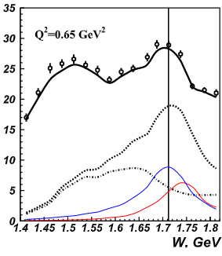
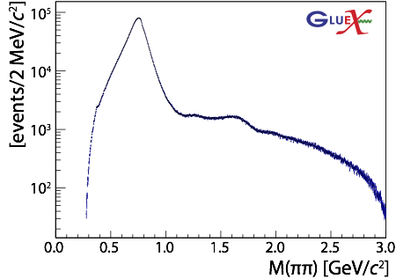
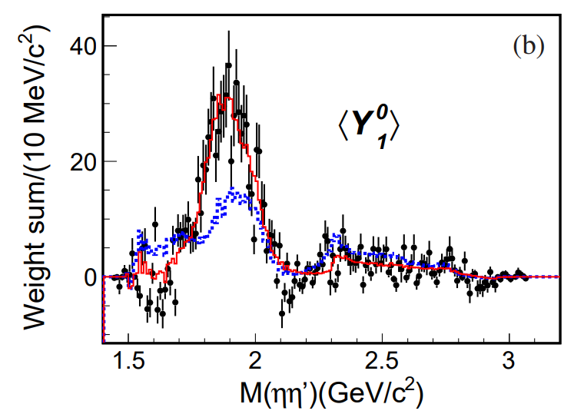
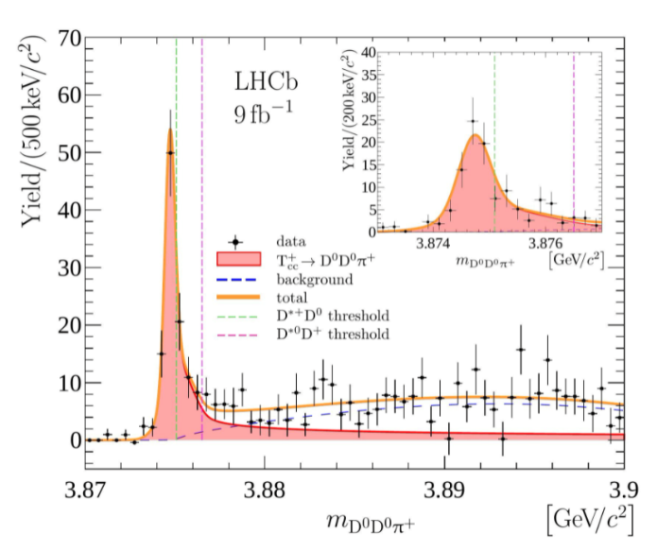
The richness of hadron spectrum
The structures populating hadron reactions are extremely rich
Ultimate goal is to understand them in term of QCD degrees of freedom
To do so, the spectrum of resonances must be correctly reconstructed
A. Pilloni – Hadron spectroscopy studies at JPAC
Notes:
2 slides su Zc, a Bes e a Belle
2 slide su tetraquark model: dall’hamiltoniana di Jaffe al calcolo delle masse
1 slide su molecular models, dove sono i carichi? (non in Tornqvist, si in Hanhart, vedere Braaten, citare Nefediev)
2 slides su decay channels, dove si dovrebbe vedere, e a seconda del modello, vedere qualche plot
1 slide su Y(4260), tetraquark? C’è lo strano (si vede la f0)
1 slide su Zc a cleo (anche il neutro)

Slide 3
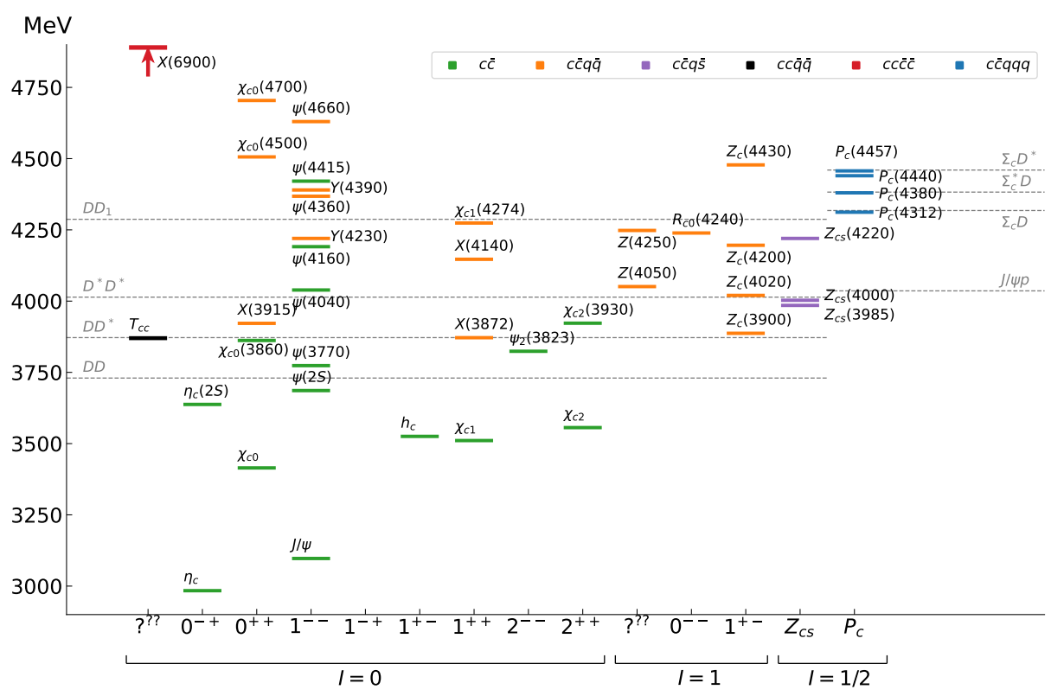
Exotics
The quark model is still the simplest tool to organize the spectrum
JPAC, PPNP 127 (2022), 103981
«Exotic hadrons» are Beyond the Standard (quark) Model
Organizing them teaches us some more about quark-gluon interactions
A. Pilloni – Hadron spectroscopy studies at JPAC
Notes:
2 slides su Zc, a Bes e a Belle
2 slide su tetraquark model: dall’hamiltoniana di Jaffe al calcolo delle masse
1 slide su molecular models, dove sono i carichi? (non in Tornqvist, si in Hanhart, vedere Braaten, citare Nefediev)
2 slides su decay channels, dove si dovrebbe vedere, e a seconda del modello, vedere qualche plot
1 slide su Y(4260), tetraquark? C’è lo strano (si vede la f0)
1 slide su Zc a cleo (anche il neutro)

Slide 4
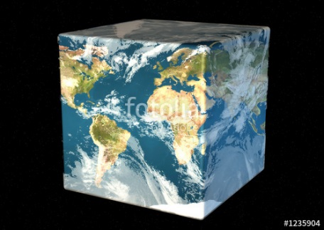
Hadron Spectroscopy
Hybrids
Tetraquark
Meson
Baryon
Glueball
$$π$$
$$π$$
$$J/ψ$$
$$π$$
Hadroquarkonium
Molecule
Experiment
Data
Amplitude analysis
QCD
Lattice QCD
Interpretations on the spectrum leads to understanding fundamental laws of nature

Slide 5
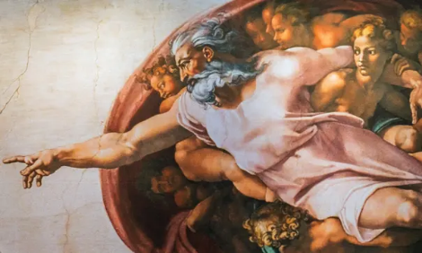
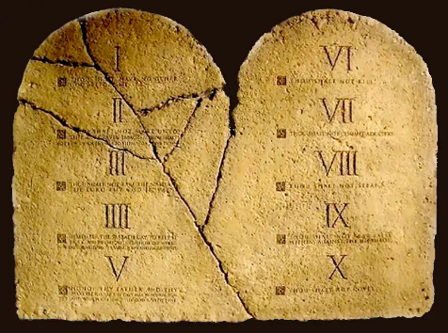
Top-down approach
You are given a model/theory
$$f(s)$$
You calculate the amplitude
You compare with data. Or you don’t.
Predictive power ✓
Physical interpretation ✓ (within the model! ✗) Biased by the input ✗
A. Pilloni – Hadron spectroscopy studies at JPAC

Slide 6
Potential problems
We can’t afford being misguided by simplistic resonance extraction! (life is already hard enough without red herrings)
Amplitude analysis requires collaboration of theorists and experimentalists
However, we don’t have a universal recipe to do things right
We have to proceed:
Case-by-case
Keep in mind the limitations of each approach
Overstudy (the more approaches the better)
No overstatement (do-no-harm)
A. Pilloni – Hadron spectroscopy studies at JPAC

Slide 7
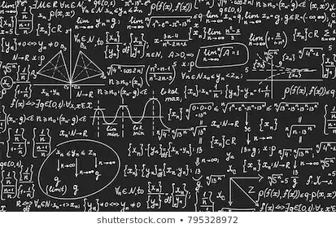
Bottom-up approach
Less predictive power ✗
Some physical interpretation ✗ Minimally biased ✓
You extract physics
You choose a set of generic amplitudes
You start with data
A. Pilloni – Hadron spectroscopy studies at JPAC

Slide 8
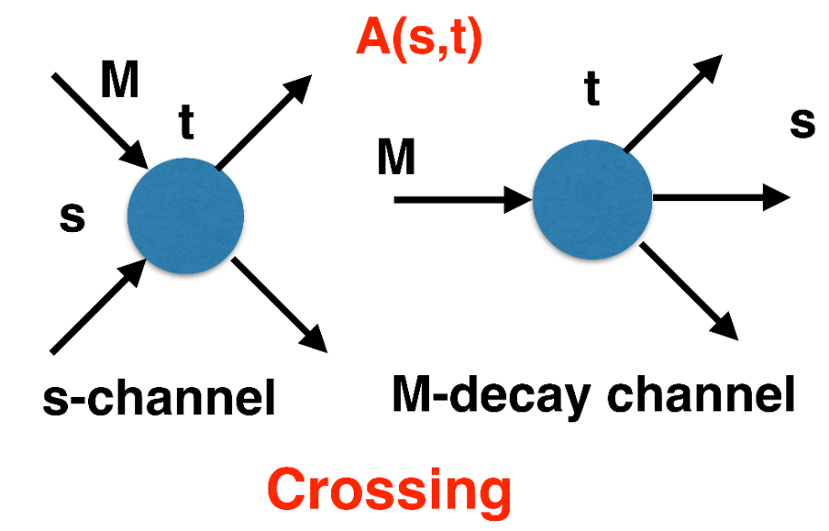
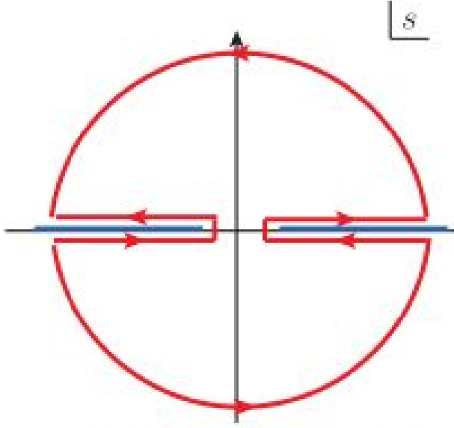
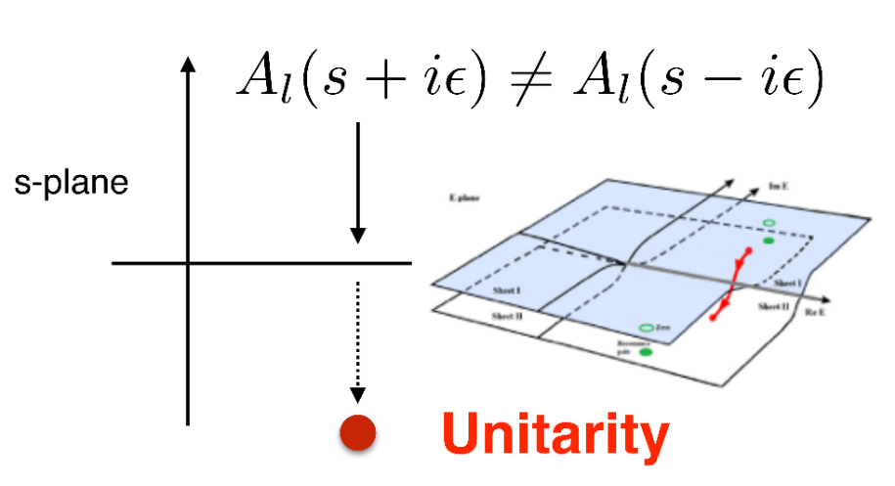
$S$-Matrix principles
$$t_{l}\left(s\right)=\lim_{ε→0}t_{l}(s+iε)⁡$$
Analyticity
$$\text{Im} t_{l}=ρ_{l}{\left|t_{l}\right|}^{2} ⁡$$
These are constraints the amplitudes have to satisfy, but do not fix the dynamics
They can be imposed with an increasing amount of rigor, to extract robust physics information
The «background» phenomena can be effectively parameterized in a controlled way
+ Lorentz, discrete & global symmetries
A. Pilloni – Hadron spectroscopy studies at JPAC
Notes:
Controlla la parte su Regge

Slide 9
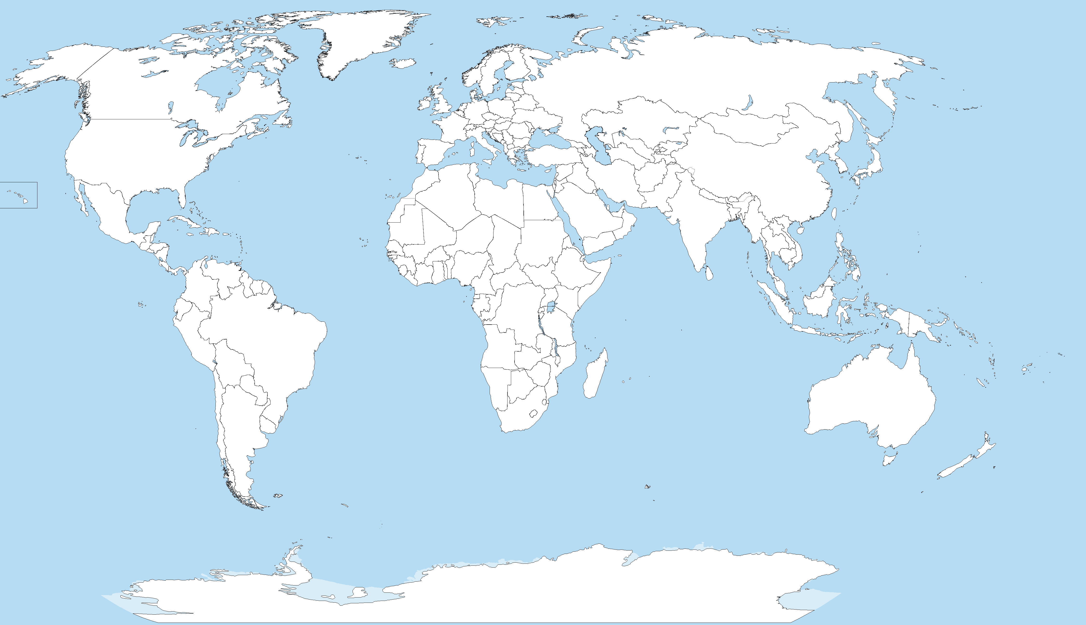
Joint Physics Analysis Center
Funded in 2013 as theory support originally for JLab exps, but grew up much larger
Creates bridges between theorists and experimentalists
40+ researchers affiliated during a decade
Running
Planned
A. Pilloni – Hadron spectroscopy studies at JPAC
Notes:
Controlla la parte su Regge

Slide 10
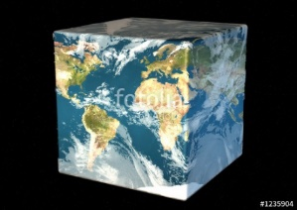
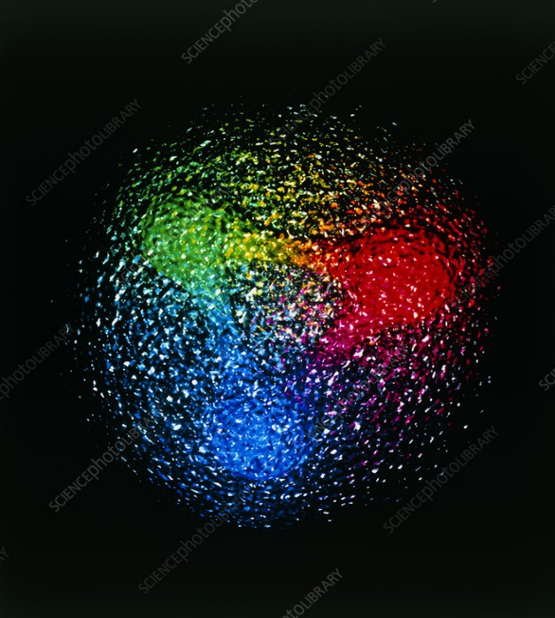
Exo(tic) Had(ron) TC
Funded in 2023 by DoE as a Topical Collaboration in Nuclear Physics
Hybrids from Scattering
Form factors
Lattice QCD
Aims at exploring all aspects of exotics (= hybrids at GlueX)
Quark model calculations
Lessons from EFTs
QCD
Studying details of production mechanisms of exotics at GlueX
Finite energy sum rules
Amplitude Analysis
Phenomenology
A. Pilloni – Hadron spectroscopy studies at JPAC
Notes:
Controlla la parte su Regge

Slide 11
Latest publications
Scalar and tensor resonances in J/ψ radiative decays Rodas et al., EPJC 82, 1, 80
Deep learning exotic hadrons Ng et al., PRD 105, L091501
XYZ spectroscopy at electron-hadron facilities: II. Semi-inclusive processes with pion exchange Winney et al., PRD 109, 094009
Khuri-Treiman analysis of $J/ψ→π^{+}π^{−}π^{0}$ Albaladejo et al., PRD 108, 014035
Dynamics in near-threshold J/ψ photoproduction Winney et al. PRD 108, 054018
Ambiguities in partial wave analysis of two spinless meson photoproduction W. Smith et al., PRD 108, 076001
A. Pilloni – Hadron spectroscopy studies at JPAC

Slide 12
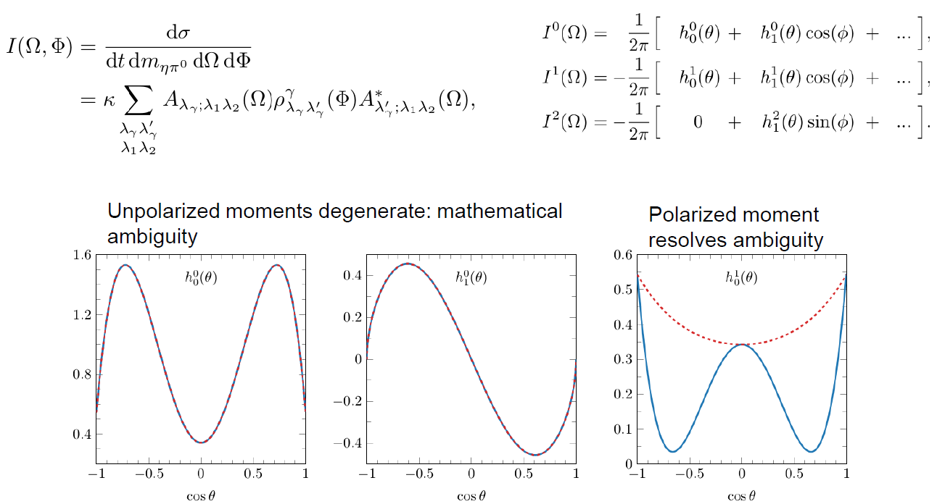
Ambiguities in $γp→PP^{′}p$
W. Smith et al., PRD 108, 076001
A. Pilloni – Hadron spectroscopy studies at JPAC

Slide 13
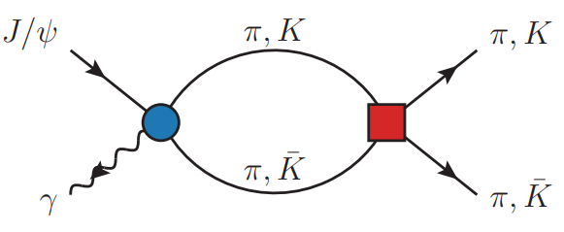
Amplitudes for $J/ψ→γ PP$
Rodas et al., EPJC 82, 1, 80
We build the partial wave amplitudes according to the $N/D$ method
$$n(s)$$
$$a\left(s\right)=\frac{n\left(s\right)}{D\left(s\right)}$$
$$D(s)$$
The $n\left(s\right)$ → background physics, process-dependent, smooth
The $D(s)$ contains all the Final State Interactions constrained by unitarity → universal
A. Pilloni – Hadron spectroscopy studies at JPAC
Notes:
Controlla la parte su Regge

Slide 14
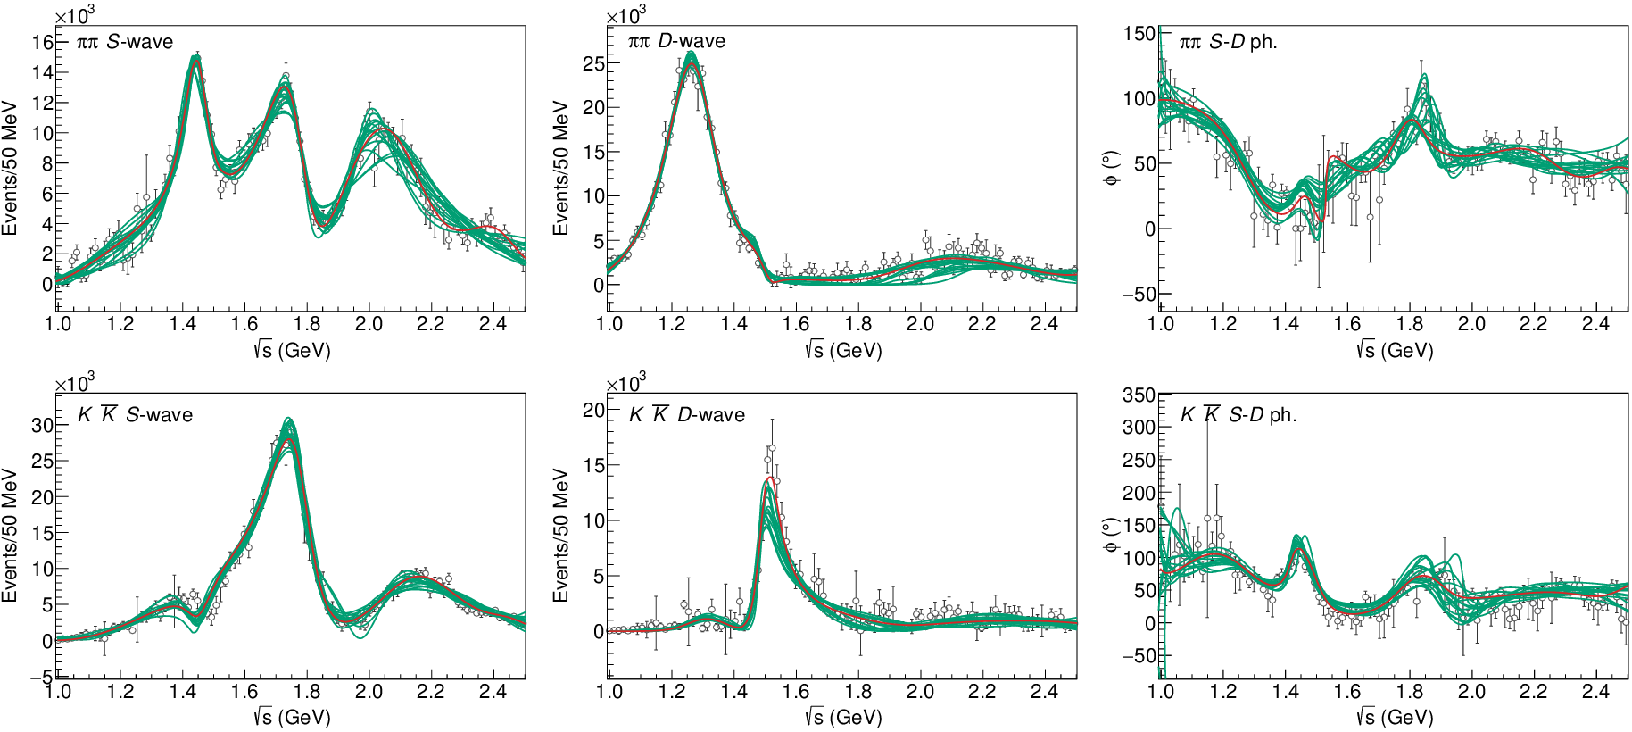
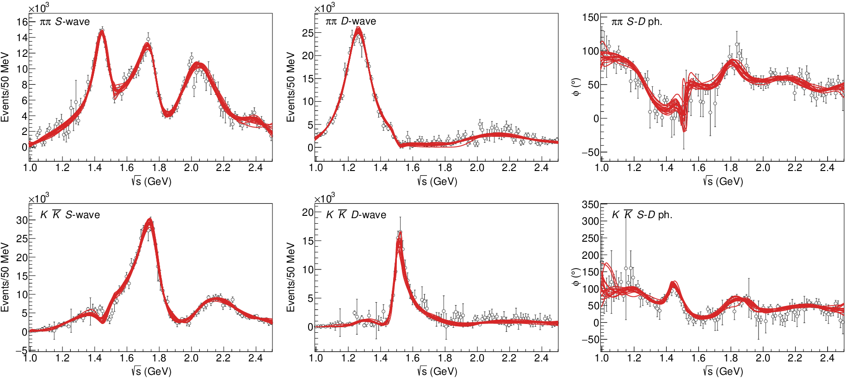
$J/ψ→γ π^{0}π^{0} and→γ K_{S}^{0}K_{S}^{0}$
The fit is decent, but it’s struggling in getting the $f_{2}′$ right Being quasi-elastic, it’s too constrained
Fit quality and local description improve when a third $ρρ$ channel is added
( data)
A. Pilloni – Hadron spectroscopy studies at JPAC

Slide 15
Pole extraction
A. Pilloni – Hadron spectroscopy studies at JPAC

Slide 16
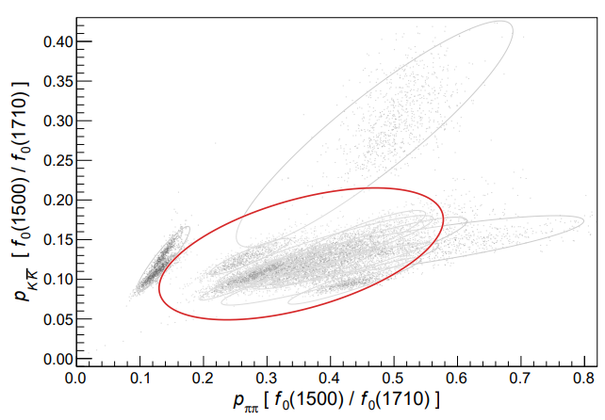
Looking at the residues
Despite the large systematics, the $f_{0}\left(1710\right)$ couples to kaons more than the $f_{0}\left(1500\right)$
Also, the $f_{0}\left(1710\right)$ couples to the initial gluon-rich state more than the $f_{0}\left(1500\right)$
Both these fact suggest a sizeable glueball component for the $f_{0}\left(1710\right)$
Caveats:
some of the relevant channels are neglected, hopefully ratios not affected
Left-hand cuts of scattering processes contribute to scattering. Poorly known and neglected here.
A. Pilloni – Hadron spectroscopy studies at JPAC

Slide 17
New pentaquarks discovered
The lowest $P_{c}(4312)$ appears as an isolated peak at the $Σ_{c}^{+}{\overline{D}}^{0}$ threshold
A detailed study of the lineshape provides insight on its nature
Bottom-up: DON’T YOU DARE describing everything!!! Focus on the peak region
A. Pilloni – Hadron spectroscopy studies at JPAC
Notes:
Controlla la parte su Regge

Slide 18
Minimal(istic) model for $P_{c}(4312)$
Fernandez-Ramirez et al. (JPAC), PRL 123, 092001
Effective range expansion We can set $c_{ii}=0$ to reduce to the scattering length approximation
Points to a virtual state
$$c_{ii}=0$$
Finite $c_{ii}$
A. Pilloni – Hadron spectroscopy studies at JPAC
Notes:
2 slides su Zc, a Bes e a Belle
2 slide su tetraquark model: dall’hamiltoniana di Jaffe al calcolo delle masse
1 slide su molecular models, dove sono i carichi? (non in Tornqvist, si in Hanhart, vedere Braaten, citare Nefediev)
2 slides su decay channels, dove si dovrebbe vedere, e a seconda del modello, vedere qualche plot
1 slide su Y(4260), tetraquark? C’è lo strano (si vede la f0)
1 slide su Zc a cleo (anche il neutro)

Slide 19
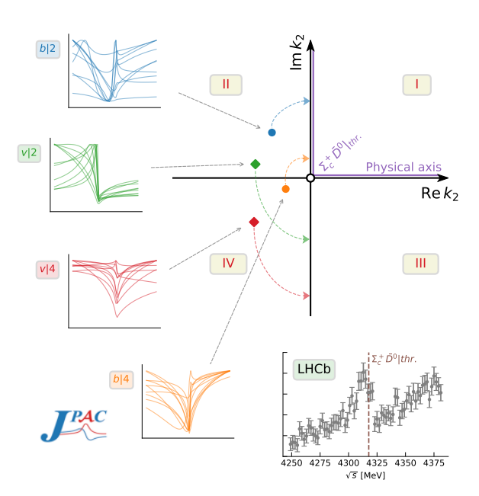
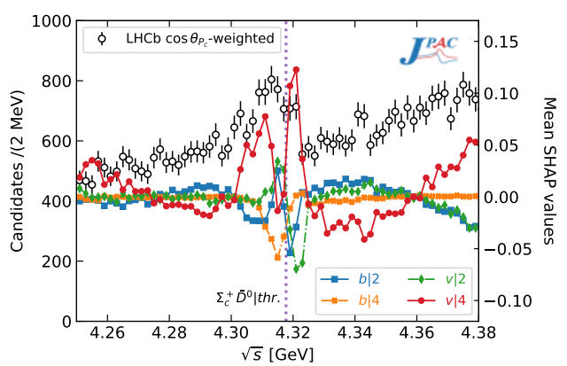
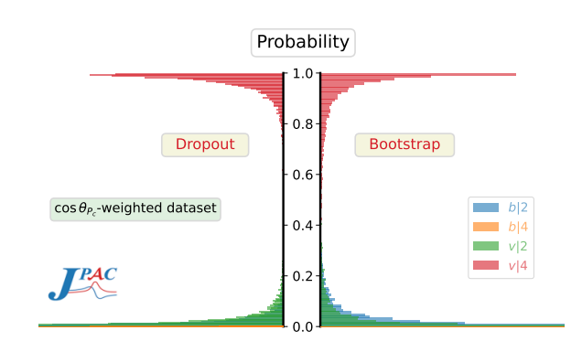
Minimal(istic) model with ANN
Ng, et al. (JPAC), PRD 105, L091501
Same conclusion reached if the analysis is performed with a Deep Neural Network
The peak region has the largest impact for the decision
Highest probability for a virtual state in the IV sheet
A. Pilloni – Hadron spectroscopy studies at JPAC
Notes:
2 slides su Zc, a Bes e a Belle
2 slide su tetraquark model: dall’hamiltoniana di Jaffe al calcolo delle masse
1 slide su molecular models, dove sono i carichi? (non in Tornqvist, si in Hanhart, vedere Braaten, citare Nefediev)
2 slides su decay channels, dove si dovrebbe vedere, e a seconda del modello, vedere qualche plot
1 slide su Y(4260), tetraquark? C’è lo strano (si vede la f0)
1 slide su Zc a cleo (anche il neutro)

Slide 20
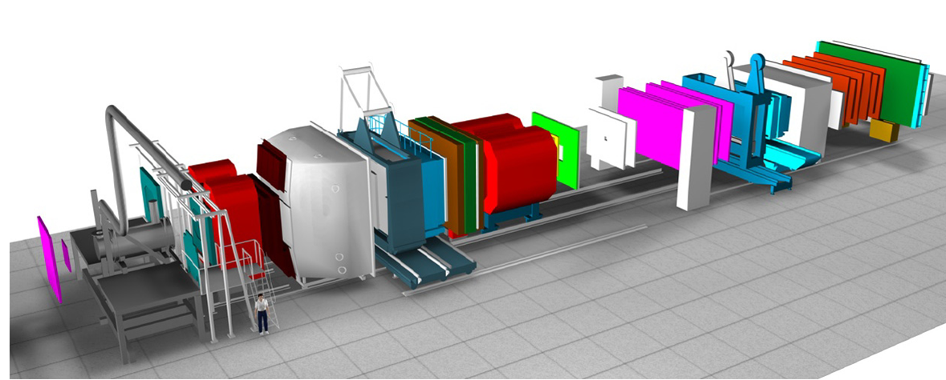
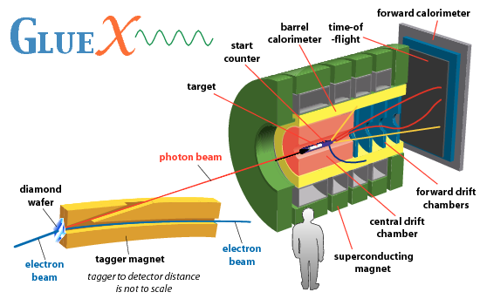
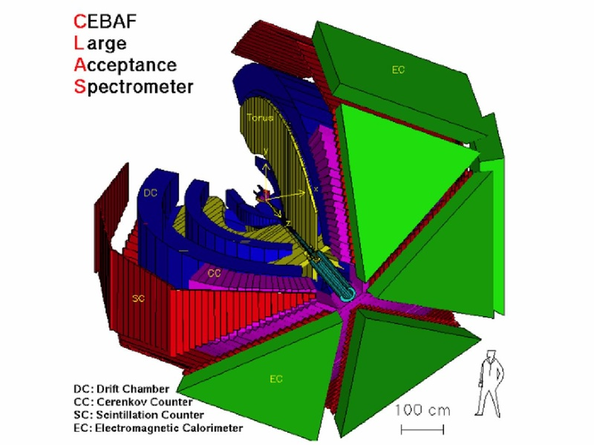
Spectroscopy from peripheral production
Need to establish Regge factorization
Single Regge pole dominate
See N. Hammoud’s talk, tomorrow 5:50pm
A. Pilloni – Hadron spectroscopy studies at JPAC
Notes:
2 slides su Zc, a Bes e a Belle
2 slide su tetraquark model: dall’hamiltoniana di Jaffe al calcolo delle masse
1 slide su molecular models, dove sono i carichi? (non in Tornqvist, si in Hanhart, vedere Braaten, citare Nefediev)
2 slides su decay channels, dove si dovrebbe vedere, e a seconda del modello, vedere qualche plot
1 slide su Y(4260), tetraquark? C’è lo strano (si vede la f0)
1 slide su Zc a cleo (anche il neutro)

Slide 21
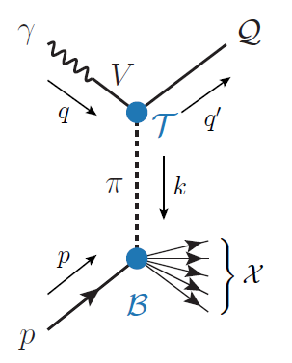
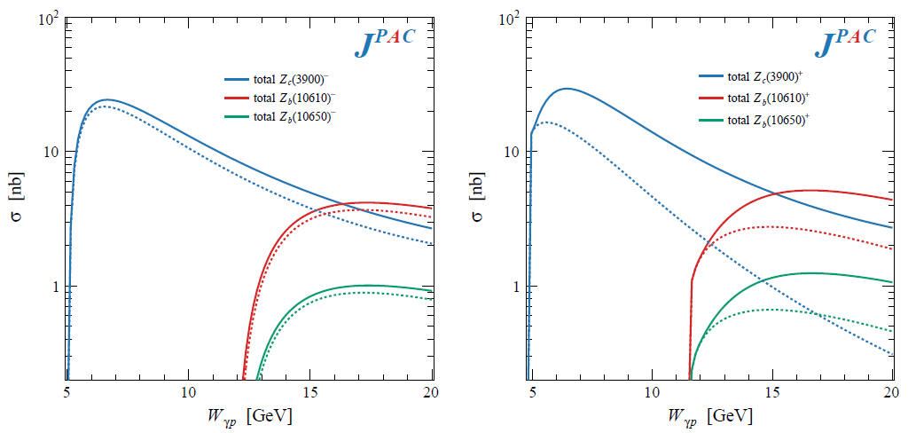
XYZ photoproduction
VMD-based predictions for reactions of interest at EIC and JLab22
Exclusive reactions: Albaladejo et al., PRD 102, 114010
Inclusive reactions with pion exchange: Winney et al., PRD 109, 094009
Code available on https://github.com/dwinney/jpacPhoto
$$Z_{c}^{−}Δ^{++}$$
$$Z_{c}^{+}n$$
A. Pilloni – Hadron spectroscopy studies at JPAC

Slide 22
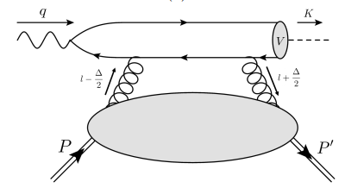
$J/ψ$ photoproduction at threshold
The common lore is that the study of vector quarkonium photoproduction at threshold is directly related to nucleon matrix elements
GPD
Assumptions:
Factorization proof for timelike DVCS can be extended at threshold as the heavy quark mass plays the role of a hard scale
The top vertex contains the trivial $γ$-$ψ$ coupling ${\left|ψ\left(0\right)\right|}^{2}$
The exchange of anything but gluons is (OZI-, mass-) suppressed
The exchange is dynamically dominated by gluons carrying $J=2$
Then one extracts matrix element of the energy momentum tensor $\left\langle p′ | T_{μν}(0) | p\right\rangle$
A. Pilloni – Hadron spectroscopy studies at JPAC

Slide 23
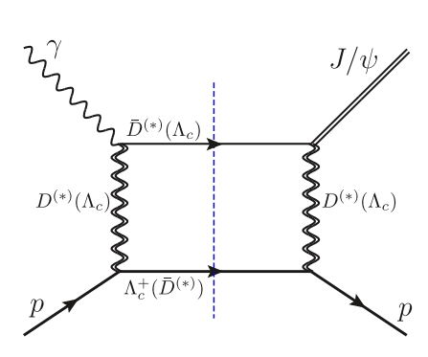
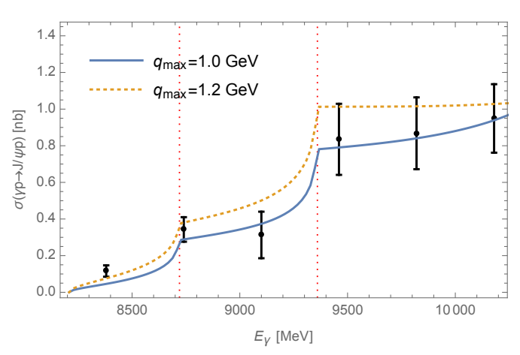
Role of open charm
Du et al. Eur.Phys.J.C 80, 11, 1053
The role of intermediate open charm thresholds has been pointed out,
Maybe «all that glitters is not glue» ….
Calculation based on EFT and known couplings, S-wave saturates the cross section
A. Pilloni – Hadron spectroscopy studies at JPAC
Notes:
2 slides su Zc, a Bes e a Belle
2 slide su tetraquark model: dall’hamiltoniana di Jaffe al calcolo delle masse
1 slide su molecular models, dove sono i carichi? (non in Tornqvist, si in Hanhart, vedere Braaten, citare Nefediev)
2 slides su decay channels, dove si dovrebbe vedere, e a seconda del modello, vedere qualche plot
1 slide su Y(4260), tetraquark? C’è lo strano (si vede la f0)
1 slide su Zc a cleo (anche il neutro)

Slide 24
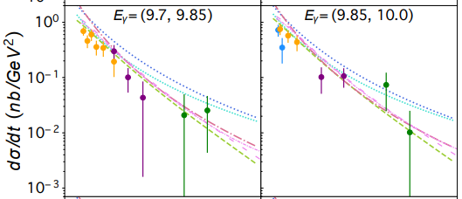
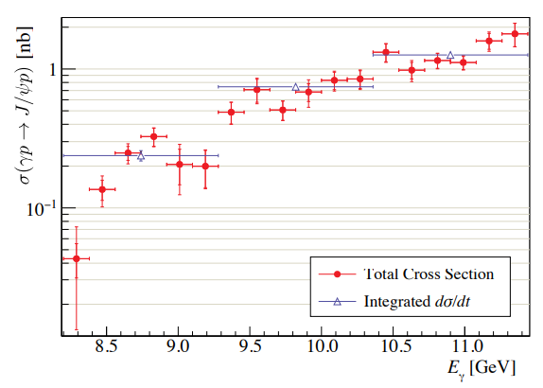
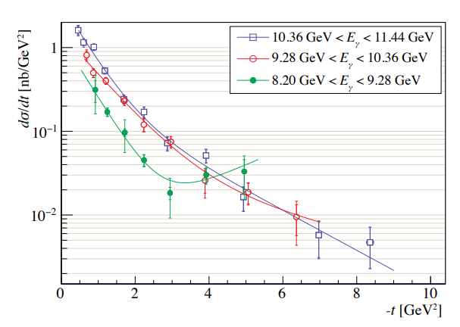
$J/ψ$ photoproduction at threshold
Nature 615, 813
Cusp at the $Λ_{c}\overline{D^{∗}}$ treshold
PRC108, 025201
A. Pilloni – Hadron spectroscopy studies at JPAC

Slide 25
Unitary reanalysis
Winney et al. PRD 108, 054018
Differential and total cross sections are fitted with a unitary model
In lack of polarization observables and SDME, only orbital angular momentum is considered (spinless approx.)
Truncated sum of PWs, $ℓ≤3$
The dominant S-wave can include coupled channels, for higher waves cusps are suppressed and there is no point
A. Pilloni – Hadron spectroscopy studies at JPAC

Slide 26
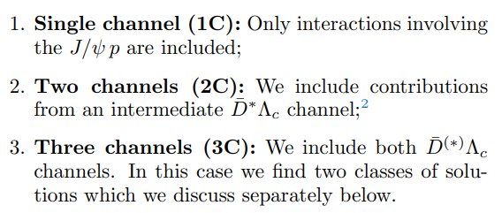
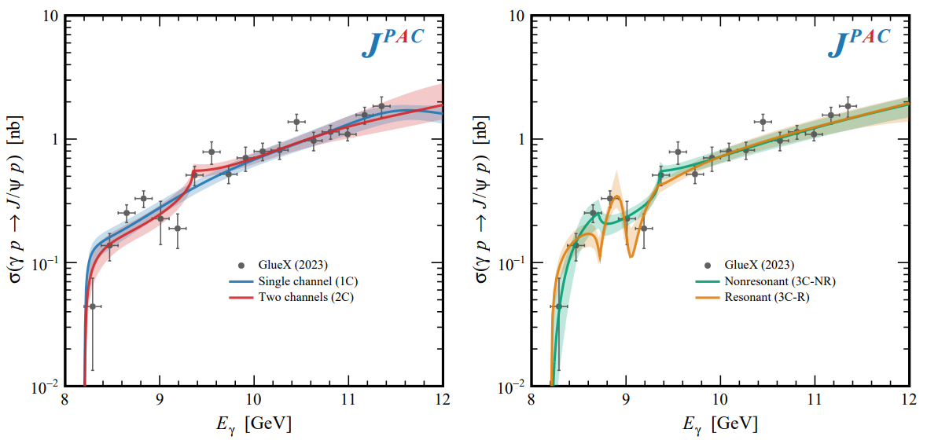
Total cross section
A. Pilloni – Hadron spectroscopy studies at JPAC

Slide 27
Contribution of open charm
Naively Wilk’s theorem says the single channel is unfavored at $3.7σ$
(no look elsewhere etc.),
indication but not the end of the story
Contribution of open charm $>25\%$ at 90% CL
A. Pilloni – Hadron spectroscopy studies at JPAC

Slide 28
Vector Meson Dominance
Since unitary model parametrize separately the production and scattering amplitude, one can compare with the predictions of VMD
$$γ$$
$$ψ$$
$$ψ$$
$$ψ$$
$$F\left(s,t\right)=$$
$=g_{γψ}×$
But $G\left(s_{\text{th}}\right)=0$
$$p$$
$$p$$
$$p$$
$$p$$
The value of the scattering amplitude at threshold is called scattering length
According to VMD, a small photoproduction cross sections implies a small scattering length O(1am)
With the unitary model, the value of the amplitude at threshold is an unrelated parameter, the scattering length enters with the energy dependence
A. Pilloni – Hadron spectroscopy studies at JPAC

Slide 29
Vector Meson Dominance
VMD badly excluded, except for the poorly constrained 3C-R model
Scattering lengths generally of O(1fm), but smaller ones are not excluded
Crucial to constrain better these fits by measuring open charm final states
A. Pilloni – Hadron spectroscopy studies at JPAC

Slide 30
Conclusions
Bottom-up approaches are important!
They allow us to get the most out of high statistics data!
JPAC and ExoHad will continue providing tools and results to understand the exciting spectrum of QCD
See N. Hammoud’s talk, tomorrow 5:50pm
Thank you!
A. Pilloni – Hadron spectroscopy studies at JPAC
Notes:
2 slides su Zc, a Bes e a Belle
2 slide su tetraquark model: dall’hamiltoniana di Jaffe al calcolo delle masse
1 slide su molecular models, dove sono i carichi? (non in Tornqvist, si in Hanhart, vedere Braaten, citare Nefediev)
2 slides su decay channels, dove si dovrebbe vedere, e a seconda del modello, vedere qualche plot
1 slide su Y(4260), tetraquark? C’è lo strano (si vede la f0)
1 slide su Zc a cleo (anche il neutro)

Slide 31
Backup

Slide 32
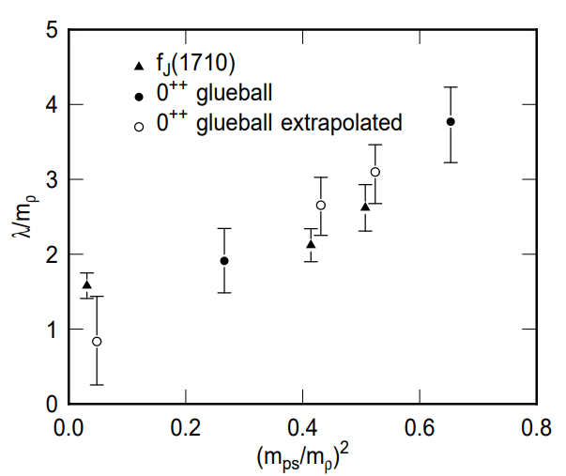
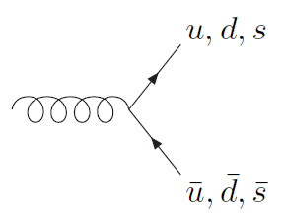
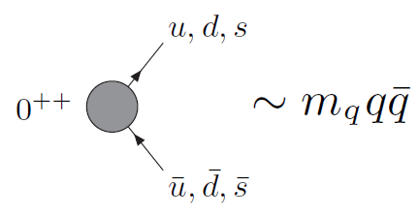
How to identify a glueball
You don’t. Since it mixes with light isoscalars, there is no model-independent way of saying which state is (mostly) the glueball. Only suggestions:
There is one too many wrt QM. Indeed, $f_{0}\left(1370\right),f_{0}\left(1500\right),$ $f_{0}\left(1710\right)$
A glueball couples to photons only throughout mixing, so radiative widths should be small
Their production is enhanced in gluon-rich processes, as $J/ψ$ radiative decays
It couples equally to mesons of all flavors (?)
$$c$$
However, an argument based on chiral symmetry claims the coupling proportional to quark mass
$$J/ψ$$
$$\overline{c}$$
G
A. Pilloni – Hadron spectroscopy studies at JPAC

Slide 33
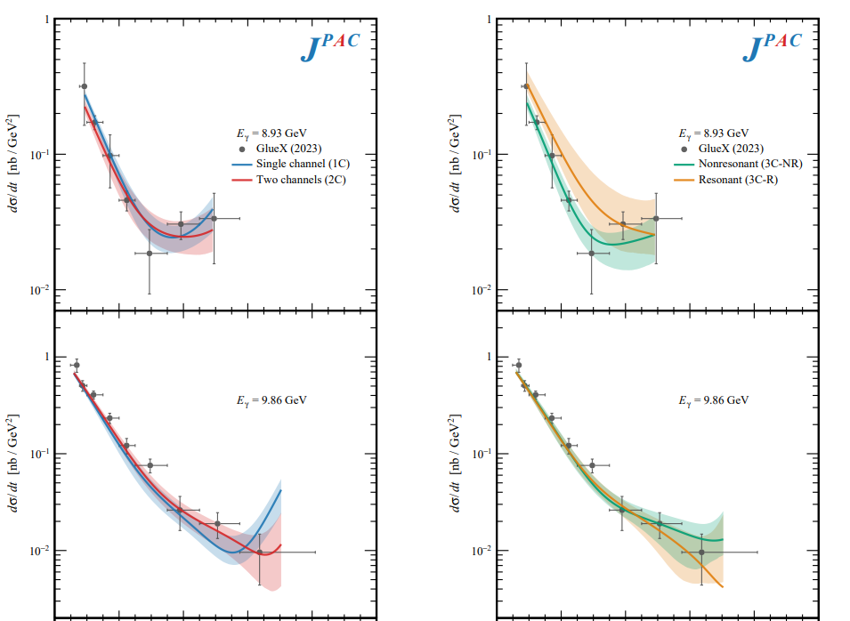
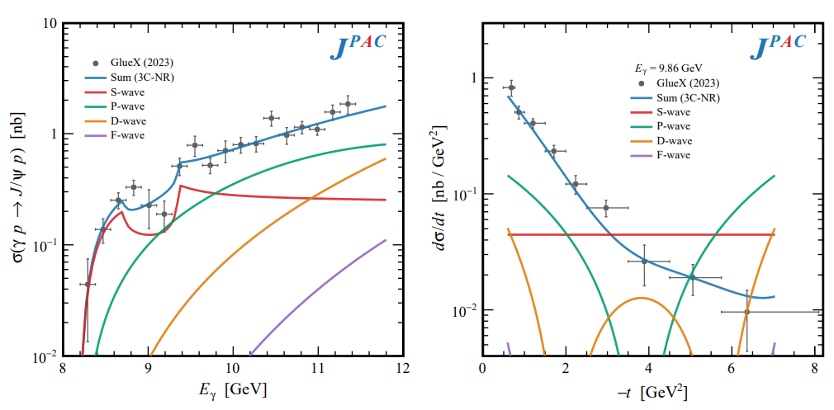
Differential cross section
This is realized with the interference of various waves, - constructive in the forward direction - distructive in the backward direction because of the Legendre polynomials
Good hierarchy between waves
A. Pilloni – Hadron spectroscopy studies at JPAC

Slide 34
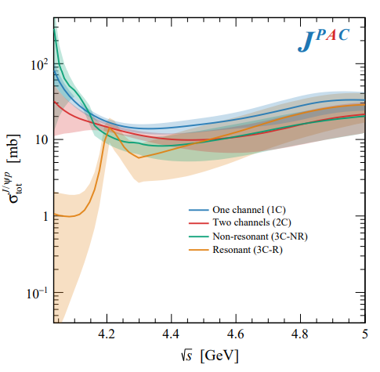
Total cross section
With optical theorem one gets the total cross section $J/ψ p→\text{X}$.
This has been estimated from the A-dependence of nuclear targets, $4\text{mb}$ at $\sqrt{s}=6.2 \text{GeV}$. VMD estimates provide values at least 1order of magnitude smaller
A. Pilloni – Hadron spectroscopy studies at JPAC

Slide 35
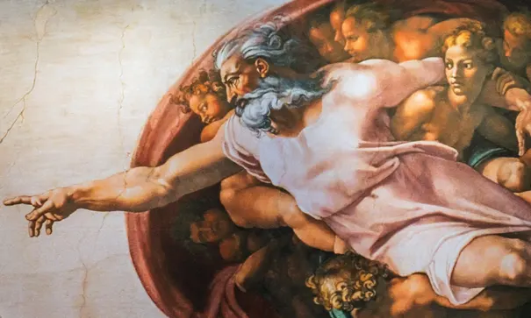
Options on the market
Quark-level calculations:
Quark models, pNRQCD, Hybrids, ...
Spectrum generally calculated as bound states of some potential
Decay rates as «overlap integrals» between two static configurations
Comprehensive picture ✓ Little scattering dynamics ✗
Hadron level calculations:
Microscopic models inspired to EFT + Unitarization
Compact states vs. molecules, triangles...
States as poles of scattering amplitudes
Couplings as residues at the poles
Scattering dynamics ✓ More case-by-case ✓✗
A. Pilloni – Hadron spectroscopy studies at JPAC

Slide 36
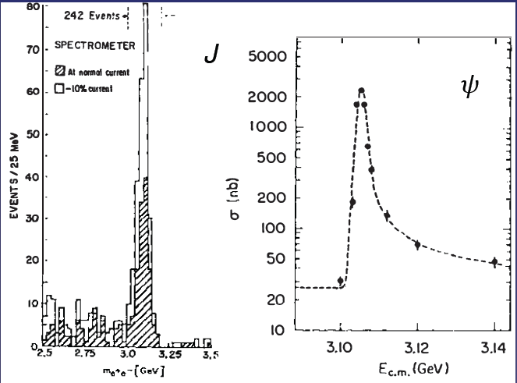
Quarkonium orthodoxy
$$Q$$
$$\overline{Q}$$
Potential models
(meaningful when $M_{Q}→∞$)
$$V\left(r\right)=−\frac{C_{F}α_{s}}{r}+σr$$
(Cornell potential)
$$α_{s}\left(M_{Q}\right)∼0.3$$
(perturbative regime)
OZI-rule, QCD multipole
Solve NR Schrödinger eq. → spectrum
Effective theories
(HQET, NRQCD, pNRQCD...)
Heavy quark spin flip suppressed by quark mass, approximate heavy quark spin symmetry (HQSS)
Integrate out heavy DOF
↓
(spectrum), decay & production rates
A. Pilloni – Hadron spectroscopy studies at JPAC
Notes:
2 slides su Zc, a Bes e a Belle
2 slide su tetraquark model: dall’hamiltoniana di Jaffe al calcolo delle masse
1 slide su molecular models, dove sono i carichi? (non in Tornqvist, si in Hanhart, vedere Braaten, citare Nefediev)
2 slides su decay channels, dove si dovrebbe vedere, e a seconda del modello, vedere qualche plot
1 slide su Y(4260), tetraquark? C’è lo strano (si vede la f0)
1 slide su Zc a cleo (anche il neutro)

Slide 37
Exotic landscape in $c\overline{c}$
Esposito, AP, Polosa, Phys.Rept. 668
JPAC, PPNP
A host of unexpected resonances have appeared
decaying mostly into charmonium + light Hardly reconciled with usual $q\overline{q}$ pheno
A. Pilloni – Hadron spectroscopy studies at JPAC
Notes:
2 slides su Zc, a Bes e a Belle
2 slide su tetraquark model: dall’hamiltoniana di Jaffe al calcolo delle masse
1 slide su molecular models, dove sono i carichi? (non in Tornqvist, si in Hanhart, vedere Braaten, citare Nefediev)
2 slides su decay channels, dove si dovrebbe vedere, e a seconda del modello, vedere qualche plot
1 slide su Y(4260), tetraquark? C’è lo strano (si vede la f0)
1 slide su Zc a cleo (anche il neutro)

Slide 38
Exotic landscape
Broad mesons seen in $b$ decay:
$X(4140)$, $Z(4430)$, $Z_{cs}(4000)$...
Narrow structures seen in $b$ decay:
$X\left(3872\right), P_{c}$, $(P_{cs})$
Scarce consistency between various production mechanisms
Narrow structures seen in $e^{+}e^{−}$:
$X(3872)$, $Y(4260)$, $Z_{c,b}^{(′)}$
A. Pilloni – Hadron spectroscopy studies at JPAC

Slide 39
Why photoproduction?
It’s new: no XYZ state has been uncontroversially seen so far
Rescattering mechanisms that could mimic resonances in multibody decays can be controlled better (one can change the energy beam but not the $B$ mass…)
The framework is (relatively) clean from a theory point of view
Radiative decays offer another way of discerning the nature of the states
A. Pilloni – Hadron spectroscopy studies at JPAC

Slide 40
Exclusive (quasi-real) photoproduction
XYZ have so far not been seen in photoproduction: independent confirmation
Not affected by 3-body dynamics: determination of resonant nature
Experiments with high luminosity in the appropriate energy range are promising
We study near-threshold (LE) and high energies (HE)
Couplings extracted from data as much as possible, not relying on the nature of XYZ
M. Albaladejo et al. [JPAC], PRD
$$<λ_{𝒬}λ_{N}^{′}|T|λ_{γ}λ_{N}>=\underset{V,ℰ}{∑}\frac{ef_{V}}{m_{V}}𝒯_{λ_{V}=λ_{γ},λ_{𝒬}}^{α_{1}⋯α_{j}}𝒫_{α_{1}⋯α_{j};β_{1}⋯β_{j}}ℬ_{λ_{N}λ_{N}^{′}}^{β_{1}⋯β_{j}}$$
VMD is used to couple the incoming photon to a vector quarkonium V
….we’ll come back to that!
A. Pilloni – Hadron spectroscopy studies at JPAC

Slide 41
Exclusive (quasi-real) photoproduction
XYZ have so far not been seen in photoproduction: independent confirmation
Not affected by 3-body dynamics: determination of resonant nature
Experiments with high luminosity in the appropriate energy range are promising
We study near-threshold (LE) and high energies (HE)
Couplings extracted from data as much as possible, not relying on the nature of XYZ
M. Albaladejo et al. [JPAC], PRD
$$<λ_{𝒬}λ_{N}^{′}|T|λ_{γ}λ_{N}>=\underset{V,ℰ}{∑}\frac{ef_{V}}{m_{V}}𝒯_{λ_{V}=λ_{γ},λ_{𝒬}}^{α_{1}⋯α_{j}}𝒫_{α_{1}⋯α_{j};β_{1}⋯β_{j}}ℬ_{λ_{N}λ_{N}^{′}}^{β_{1}⋯β_{j}}$$
Top vertex from measured $𝒬→Vℰ$ decay width
A. Pilloni – Hadron spectroscopy studies at JPAC

Slide 42
Exclusive (quasi-real) photoproduction
XYZ have so far not been seen in photoproduction: independent confirmation
Not affected by 3-body dynamics: determination of resonant nature
Experiments with high luminosity in the appropriate energy range are promising
We study near-threshold (LE) and high energies (HE)
Couplings extracted from data as much as possible, not relying on the nature of XYZ
M. Albaladejo et al. [JPAC], PRD
$$<λ_{𝒬}λ_{N}^{′}|T|λ_{γ}λ_{N}>=\underset{V,ℰ}{∑}\frac{ef_{V}}{m_{V}}𝒯_{λ_{V}=λ_{γ},λ_{𝒬}}^{α_{1}⋯α_{j}}𝒫_{α_{1}⋯α_{j};β_{1}⋯β_{j}}ℬ_{λ_{N}λ_{N}^{′}}^{β_{1}⋯β_{j}}$$
Bottom vertex from standard photoproduction pheno, exponential form factors to further suppress large t
A. Pilloni – Hadron spectroscopy studies at JPAC

Slide 43
Threshold vs. high energy
Fixed-spin exchanges expected to hold in the low energy region
$t$ channel grows as $s j$, exceeding unitarity bound, Regge physics kicks in: Reggeized tower of particles with arbitrary spin at HE
$$s^{j}⟶s^{α_{0}+α^{′}t }$$
Holds at low energy, fixed spin
Holds at high energy, resummation of leading $s$ power
If $ε≠$IP, $α_{0}<1$, $dσ/dt$ decreases with energy
Exchange of heavy particles further suppressed
A. Pilloni – Hadron spectroscopy studies at JPAC

Slide 44
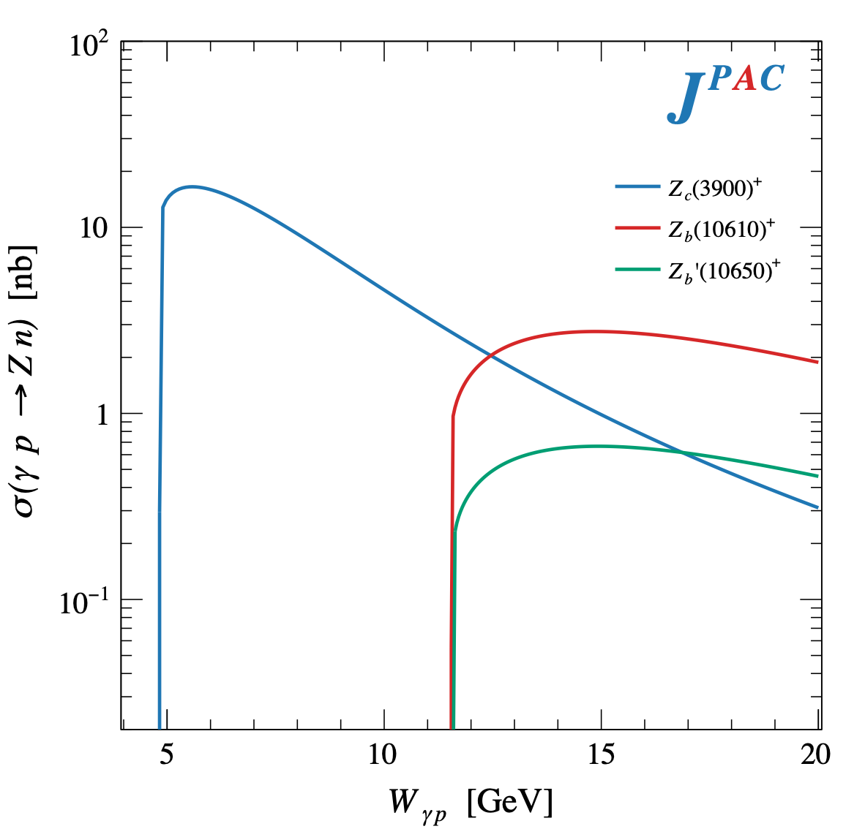
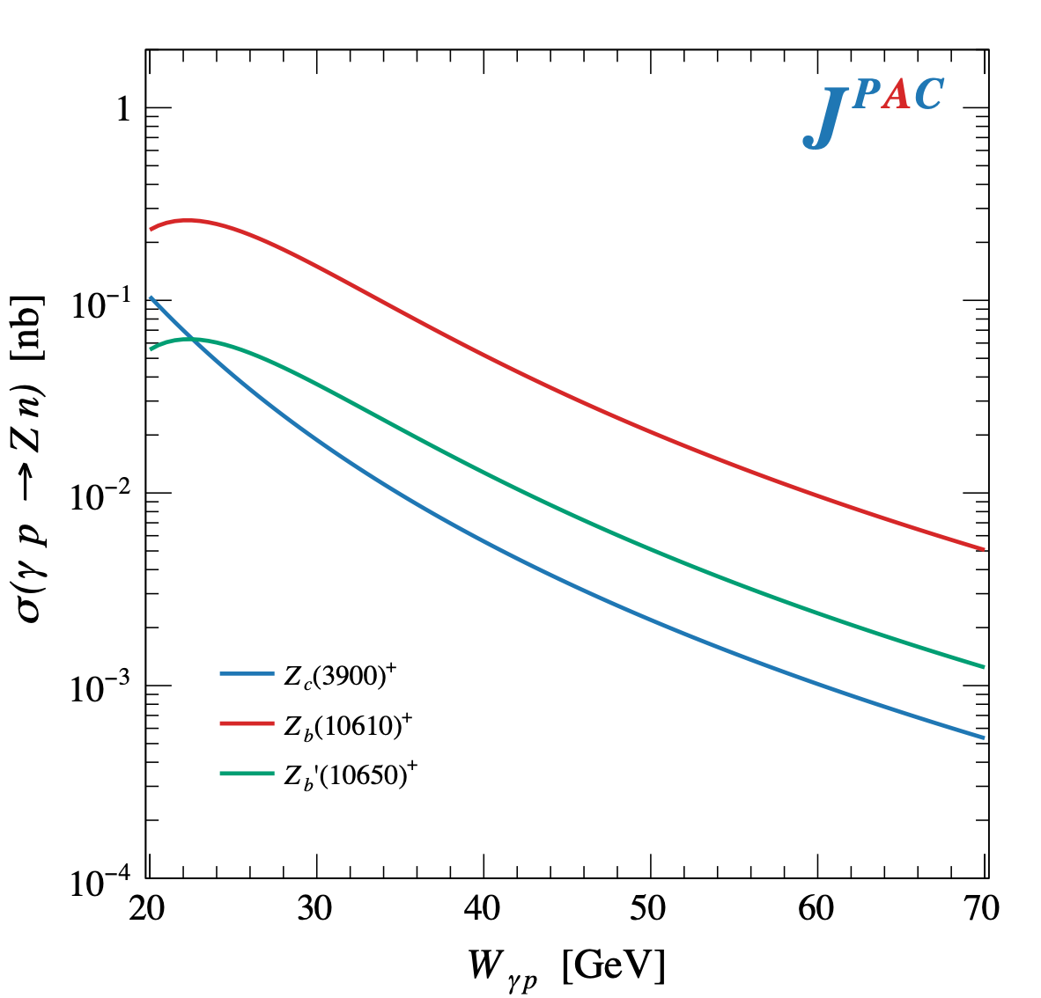
$Z$ photoproduction
The $Zs$ are charged charmoniumlike $1^{+−}$ states close to open flavor thresholds
Focus on $Z_{c}{\left(3900\right)}^{+}→J/ψ π^{+}$, $Z_{b}{\left(10610\right)}^{+},Z_{b}^{′}{\left(10650\right)}^{+}→Υ(nS) π^{+}$
The pion is exchanged in the $t$-channel
A. Pilloni – Hadron spectroscopy studies at JPAC

Slide 45
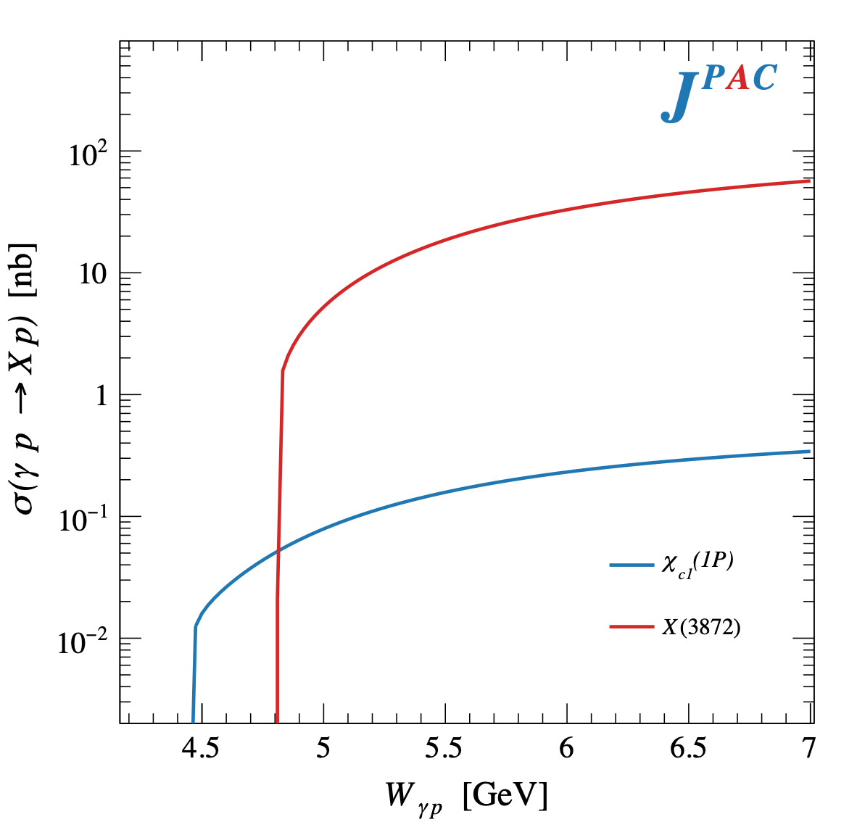
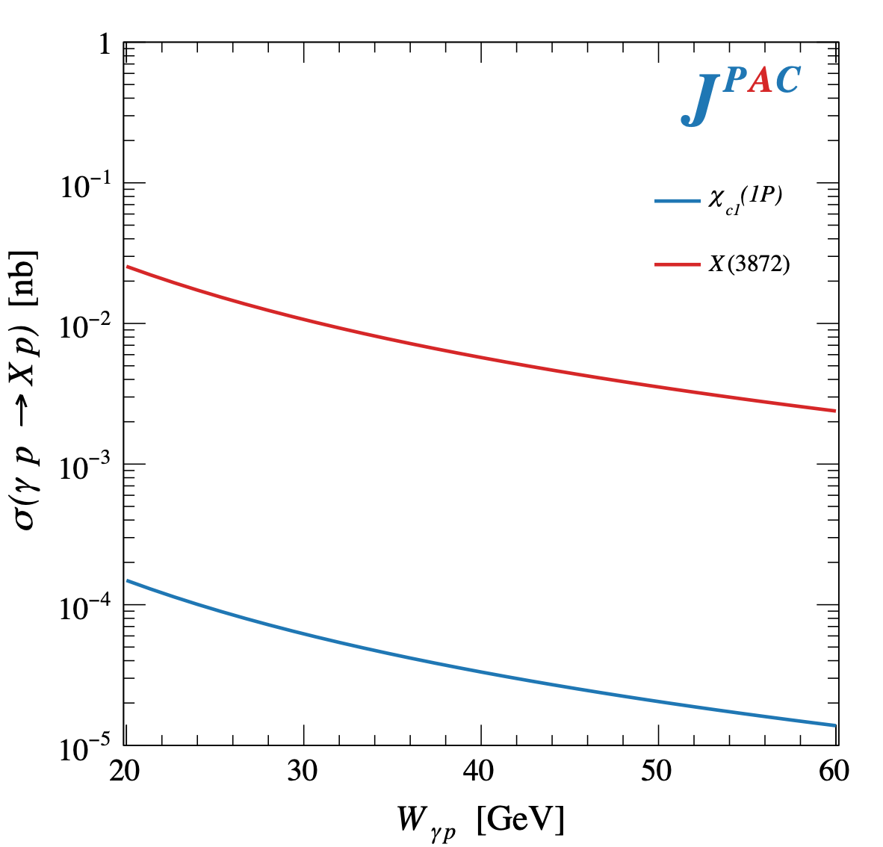
$X$ photoproduction
Focus on the famous $1^{++} X\left(3872\right)→J/ψ ρ,ω$
𝛚 and 𝛒 exchanges give main contributions:
Large theory uncertainty in the intermediate region
A. Pilloni – Hadron spectroscopy studies at JPAC

Slide 46
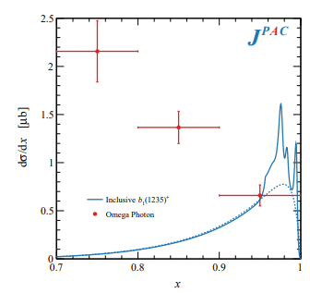
Semi-inclusive photoproduction
Semi-inclusive cross sections are typically larger
For small $t$ and large $x$, one can assume the process to be dominated by pion exchange
The bottom vertex depends on the (known) pion-proton total cross section
The pion is exchanged in the $t$-channel
Model benchmarked on $b_{1}$ production
Model underestimates lower bins, conservative estimates
The model is expected to hold in the highest bin
A. Pilloni – Hadron spectroscopy studies at JPAC

Slide 47
Semi-inclusive photoproduction
For the $Z_{c}^{+}$, the inclusive cross section is sizably larger than the exclusive process
$$Z_{c}^{−}Δ^{++}$$
$$Z_{c}^{+}n$$
A. Pilloni – Hadron spectroscopy studies at JPAC

Slide 48
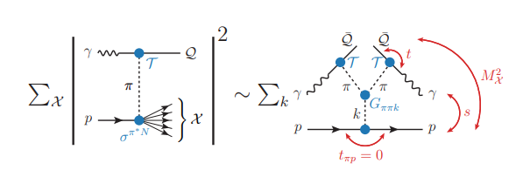
Semi-inclusive photoproduction
At higher energies the triple Regge regime is reached, cross sections saturate
A. Pilloni – Hadron spectroscopy studies at JPAC

Slide 49
Hybrid hunting
Constituent gluon (quasiparticle excitation), $J^{PC}=1^{+−}$, mass $∼1.0\text{−}1.5 \text{GeV}$
Look for a $π_{1}$ state with $J^{PC}=1^{−+}$
decaying into $\left\{\begin{matrix}η π \text{and} η^{′}π \\ ρ π→3π \\ b_{1}π→5π\end{matrix}\right.$
$$\overline{r}$$
$$\overline{g}$$
$$r$$
$$g$$
A. Pilloni – Hadron spectroscopy studies at JPAC
Notes:
2 slides su Zc, a Bes e a Belle
2 slide su tetraquark model: dall’hamiltoniana di Jaffe al calcolo delle masse
1 slide su molecular models, dove sono i carichi? (non in Tornqvist, si in Hanhart, vedere Braaten, citare Nefediev)
2 slides su decay channels, dove si dovrebbe vedere, e a seconda del modello, vedere qualche plot
1 slide su Y(4260), tetraquark? C’è lo strano (si vede la f0)
1 slide su Zc a cleo (anche il neutro)

Slide 50
Amplitudes for $η^{(′)}π$
We build the partial wave amplitudes according to the $N/D$ method
Jackura, Mikhasenko, AP et al. (JPAC & COMPASS), PLB
Rodas, AP et al. PRL
$$a\left(s\right)=\frac{n\left(s\right)}{D\left(s\right)}$$
$$D(s)$$
The $D(s)$ contains all the Final State Interactions constrained by unitarity → universal
A. Pilloni – Hadron spectroscopy studies at JPAC
Notes:
Controlla la parte su Regge

Slide 51
Amplitudes for $η^{(′)}π$
We build the partial wave amplitudes according to the $N/D$ method
Jackura, Mikhasenko, AP et al. (JPAC & COMPASS), PLB
Rodas, AP et al. PRL
$$a\left(s\right)=\frac{n\left(s\right)}{D\left(s\right)}$$
$$D(s)$$
$$n(s)$$
The $n\left(s\right)$ → background physics, process-dependent, smooth
A. Pilloni – Hadron spectroscopy studies at JPAC
Notes:
Controlla la parte su Regge

Slide 52
Fit to $η^{(′)}π$
( data)
$$π_{1}\left(1400\right)?$$
$$a_{2}\left(1320\right)$$
$$a_{2}^{′}\left(1700\right)$$
$$π_{1}\left(1600\right)?$$
$$a_{2}\left(1320\right)$$
$$a_{2}^{′}\left(1700\right)$$
$$J^{PC}=1^{−+}$$
$$J^{PC}=2^{++}$$
A. Pilloni – Hadron spectroscopy studies at JPAC
Notes:
Controlla la parte su Regge

Slide 53
Pole hunting
( data)
$$π_{1}$$
$$π_{1}$$
A. Pilloni – Hadron spectroscopy studies at JPAC
Notes:
Controlla la parte su Regge

Slide 54
Final results
Agreement with Lattice is restored
That’s the most rigorous extraction of an exotic meson available so far!
A. Pilloni – Hadron spectroscopy studies at JPAC
Notes:
Controlla la parte su Regge

Slide 55
Primakoff X photoproduction
Using measurement of $Γ(X→γγ^{∗})$ from Belle, one can get predictions for Primakoff
Makes use of ion targets, enhancement of cross sections as $Z^{2}$
A. Pilloni – Hadron spectroscopy studies at JPAC

Slide 56
$Y$ (vector) photoproduction
Diffractive production, dominated by Pomeron (2-gluon) exchange
Existing data allow to put a 95% upper limit on the ratio of $ψ′/Y(4260)$ yields
Assuming previous formula, one gets: $Γ_{ee}^{Y}=930 eV$
(cfr. hep-ex/0603024, 2002.05641)
$BR\left(Y→J/ψππ\right)=0.96\%$
$R_{Y}=0.84$
$$R_{Y}=\frac{ef_{ψ}}{m_{ψ}}\sqrt{\frac{g^{2}(Y→ψππ)}{g^{2}(ψ→γgg)}\frac{g^{2}(ψ^{′}→ψgg)}{g^{2}(ψ^{′}→ψππ)}}$$
A. Pilloni – Hadron spectroscopy studies at JPAC

Slide 57
$Y$ (vector) photoproduction
Focus on the $1^{−−} Y\left(4260\right)→J/ψ π^{+}π^{−}$, check with $ψ′→J/ψ π^{+}π^{−}$
Diffractive production, dominated by Pomeron (2-gluon) exchange
Good candidates for EIC: diffractive production increases with energy!
We have $γψ$-pomeron coupling from our analyses 1606.08912, 1907.09393
How to rescale from $J/ψ$ to $ψ′$ ?
$$R_{ψ^{′}}=\sqrt{\frac{g^{2}(ψ^{′}→γgg)}{g^{2}(ψ→γgg)}}∼0.55$$
$$g^{2}(ψ→γgg)=\frac{6m_{ψ}ℬ(ψ→γgg)Γ_{ψ}}{PS(ψ→γgg)}$$
A. Pilloni – Hadron spectroscopy studies at JPAC

Slide 58
$Y$ (vector) photoproduction
Focus on the $1^{−−} Y\left(4260\right)→J/ψ π^{+}π^{−}$, check with $ψ′→J/ψ π^{+}π^{−}$
Diffractive production, dominated by Pomeron (2-gluon) exchange
Good candidates for EIC: diffractive production increases with energy!
We have $γψ$-pomeron coupling from our analyses 1606.08912, 1907.09393
How to rescale from $J/ψ$ to $Y(4260)$ ?
We assume VMD and $g^{2}\left(Y→ψππ\right)=g^{2}\left(Y→ψgg\right)×g^{2}(gg→ππ)$ (Novikov & Shifman)
$$R_{Y}=\frac{ef_{ψ}}{m_{ψ}}\sqrt{\frac{g^{2}(Y→ψππ)}{g^{2}(ψ→γgg)}\frac{g^{2}(ψ^{′}→ψgg)}{g^{2}(ψ^{′}→ψππ)}}$$
Caveat : $BR(Y→ψππ)$ only known times the leptonic width $Γ_{ee}^{Y}$
A. Pilloni – Hadron spectroscopy studies at JPAC

Slide 59
$Y$ (vector) photoproduction
Data from H1 hep-ex/971112
Existing data allow to put a 95% upper limit on the ratio of $ψ′/Y(4260)$ yields
Assuming previous formula, one gets: $Γ_{ee}^{Y}=930 eV$
(cfr. hep-ex/0603024, 2002.05641)
$BR\left(Y→J/ψππ\right)=0.96\%$
$R_{Y}=0.84$
A. Pilloni – Hadron spectroscopy studies at JPAC

Slide 60
Minimal(istic) model for $P_{c}(4312)$
( data)
Fernandez-Ramirez, AP et al. (JPAC), PRL 123, 092001
Effective range expansion We can set $c_{ii}=0$ to reduce to the scattering length approximation
$$c_{ii}=0$$
Finite $c_{ii}$
A. Pilloni – Hadron spectroscopy studies at JPAC
Notes:
2 slides su Zc, a Bes e a Belle
2 slide su tetraquark model: dall’hamiltoniana di Jaffe al calcolo delle masse
1 slide su molecular models, dove sono i carichi? (non in Tornqvist, si in Hanhart, vedere Braaten, citare Nefediev)
2 slides su decay channels, dove si dovrebbe vedere, e a seconda del modello, vedere qualche plot
1 slide su Y(4260), tetraquark? C’è lo strano (si vede la f0)
1 slide su Zc a cleo (anche il neutro)

Slide 61
Minimal(istic) model for $P_{c}(4312)$
Effective range expansion We can set $c_{ii}=0$ to reduce to the scattering length approximation
$$c_{ii}=0$$
Finite $c_{ii}$
A. Pilloni – Hadron spectroscopy studies at JPAC
Notes:
2 slides su Zc, a Bes e a Belle
2 slide su tetraquark model: dall’hamiltoniana di Jaffe al calcolo delle masse
1 slide su molecular models, dove sono i carichi? (non in Tornqvist, si in Hanhart, vedere Braaten, citare Nefediev)
2 slides su decay channels, dove si dovrebbe vedere, e a seconda del modello, vedere qualche plot
1 slide su Y(4260), tetraquark? C’è lo strano (si vede la f0)
1 slide su Zc a cleo (anche il neutro)

Slide 62
Minimal(istic) model for $P_{c}(4312)$
Effective range expansion We can set $c_{ii}=0$ to reduce to the scattering length approximation
Points to a virtual state
Doesn’t point to a resonance
$$c_{ii}=0$$
Finite $c_{ii}$
A. Pilloni – Hadron spectroscopy studies at JPAC
Notes:
2 slides su Zc, a Bes e a Belle
2 slide su tetraquark model: dall’hamiltoniana di Jaffe al calcolo delle masse
1 slide su molecular models, dove sono i carichi? (non in Tornqvist, si in Hanhart, vedere Braaten, citare Nefediev)
2 slides su decay channels, dove si dovrebbe vedere, e a seconda del modello, vedere qualche plot
1 slide su Y(4260), tetraquark? C’è lo strano (si vede la f0)
1 slide su Zc a cleo (anche il neutro)

Slide 63
Glueballs
The clearest sign of confinement in pure Yang-Mills The worst state to search in real life
Morningstar and Peardon PRD60, 034509
Gregory et al. JHEP1210, 170
A. Pilloni – Hadron spectroscopy studies at JPAC

Slide 64
$J/ψ→γ π^{0}π^{0} and→γ K_{S}^{0}K_{S}^{0}$
We consider the $S$ and $D$ wave by BESIII to use the information about their relative phase.
The D-wave is populated by two almost elastic resonances: the $f_{2}(1270)$ and $f_{2}′(1525)$
$f_{2}(1270)$
$f_{2}′(1525)$
A. Pilloni – Amplitude analysis of $J/ψ→γ π^{0}π^{0}$

