Slide 1
A New High-intensity Facility at the CERN North Area
Johannes Bernhard (CERN)
17.10.2023

Slide 2
Physics Beyond Colliders

Slide 3
Physics Beyond Colliders
Physics Beyond Colliders (PBC) is an exploratory study aiming at exploiting the full scientific potential of CERN's accelerator complex and its scientific infrastructure through projects complementary to the LHC, HL-LHC and other possible future colliders.
It features projects targeting fundamental physics questions that are similar in spirit to those addressed by high-energy colliders, but that require different types of beams and experiments.
The first PBC phase from 2016 to 2020 was an important input to the 2020 European Strategy of Particle Physics.
Several proposed experiments of the first phase already are in operation and taking data, for instance NA64µ, NA66/AMBER, and LHC Forward detectors such as FASER and SND.
The CERN North Area takes a unique place in PBC due to the versatile primary and secondary beam options, available experimental areas, and the ability to slowly extract stable beams over spills of several seconds with high intensities and high energies of up to 400 GeV/c.

Slide 4
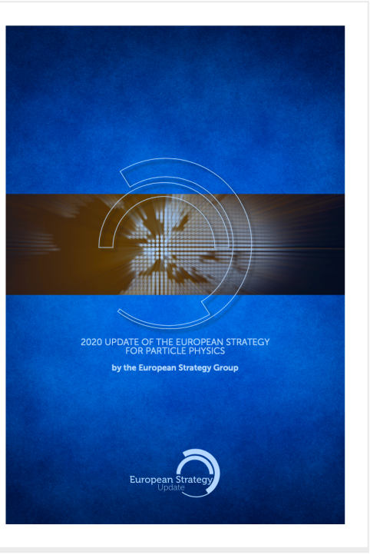
Update of the European Strategy for Particle Physics
Detector R&D
for HL-LHC, FCC, space/satellites, R2E, crystal collimation, muon collider, irradiation facilities
Dark Matter
Feebly Interacting Particles
through beam dump experiments (SHiP, Shadows, NA64e/µ, HIKE)
Precision Physics
ultra-rare decays, kaon physics (NA62, HIKE), NA63, MUonE
Hot and cold QCD
emergence of mass (COMPASS, AMBER), ions and dense hadronic systems (NA61, NA60+)
Neutrino Beams
DUNE, tagged neutrino beams (ENUBET/NuTAG), production cross sections, DsTau
A diverse programme that is complementary to the energy frontier is an essential part of the European particle physics Strategy. Experiments in such diverse areas that offer potential high-impact particle physics programmes at laboratories in Europe should be supported, as well as participation in such experiments in other regions of the world… https://europeanstrategy.cern/

Slide 5
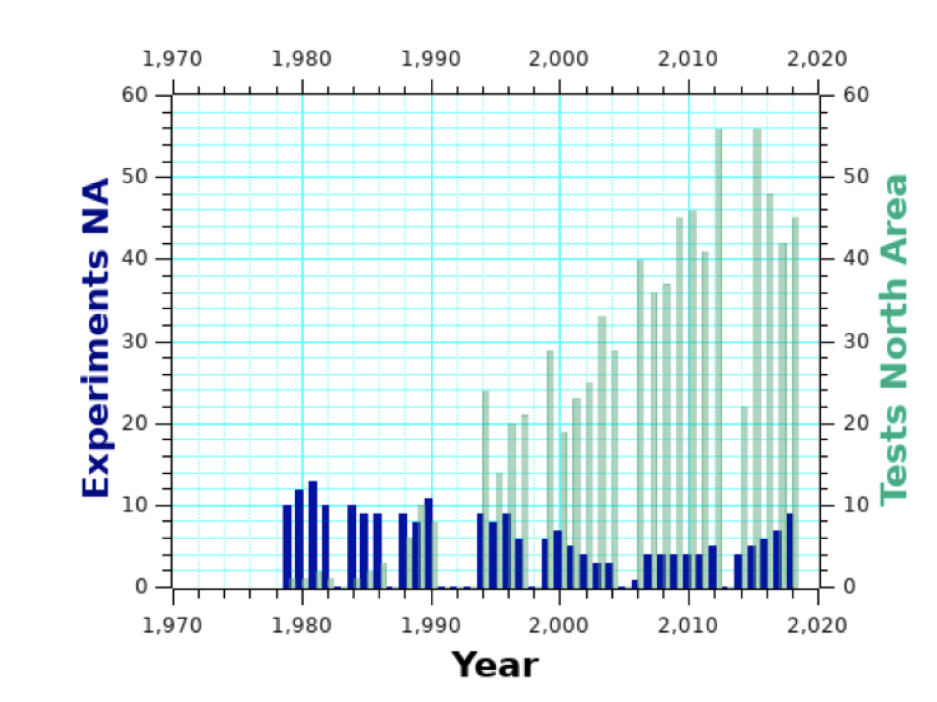
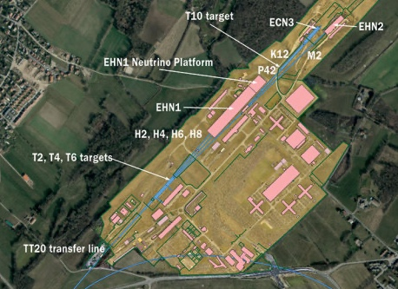
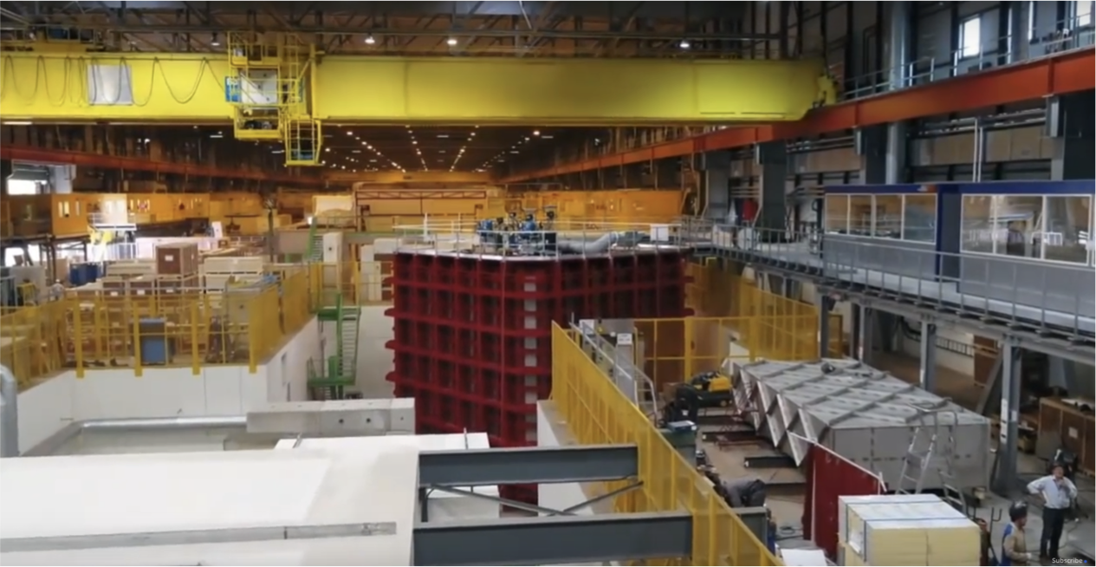
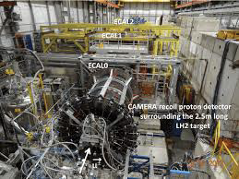
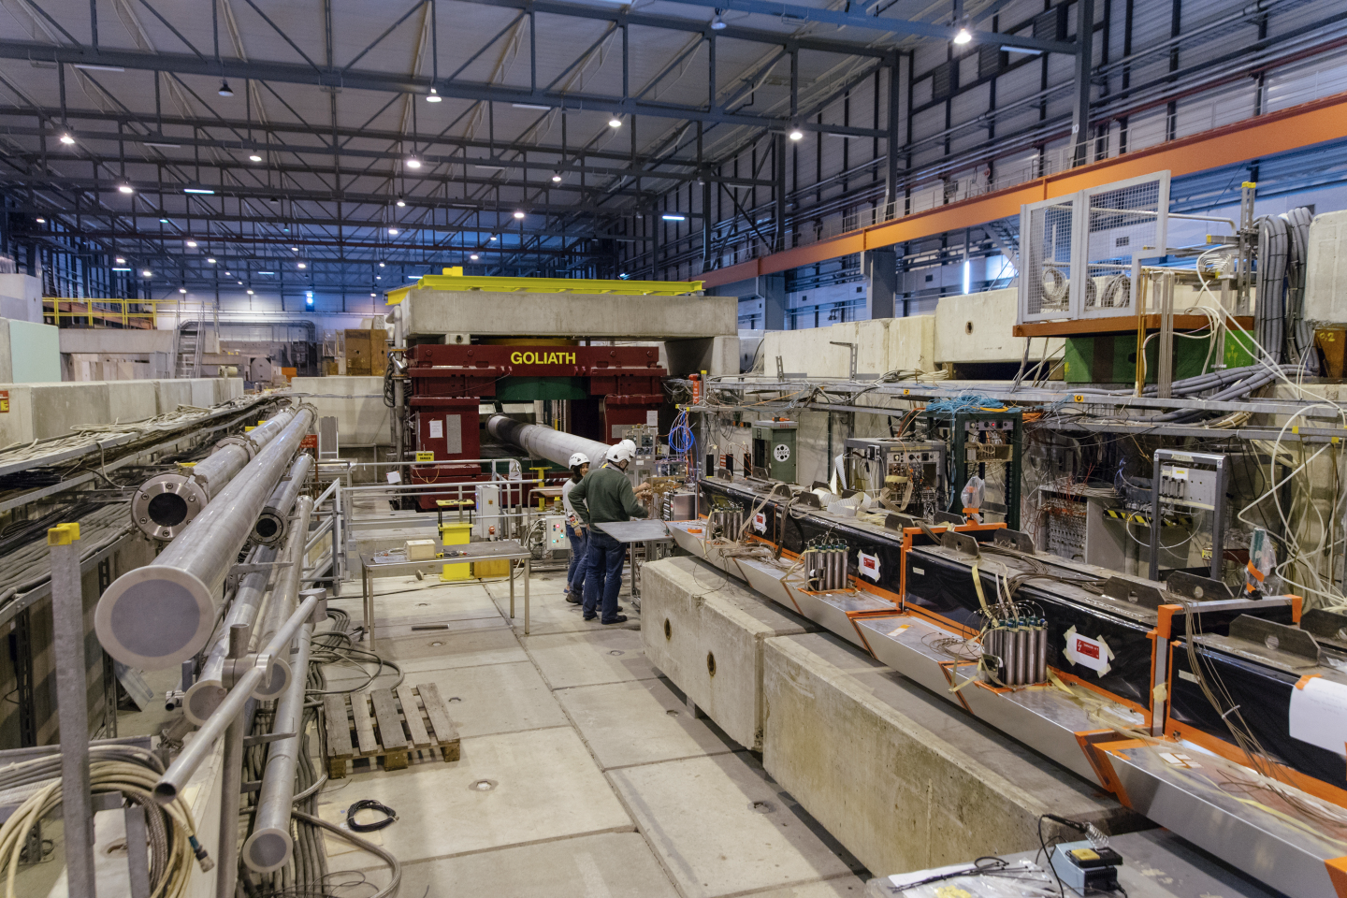
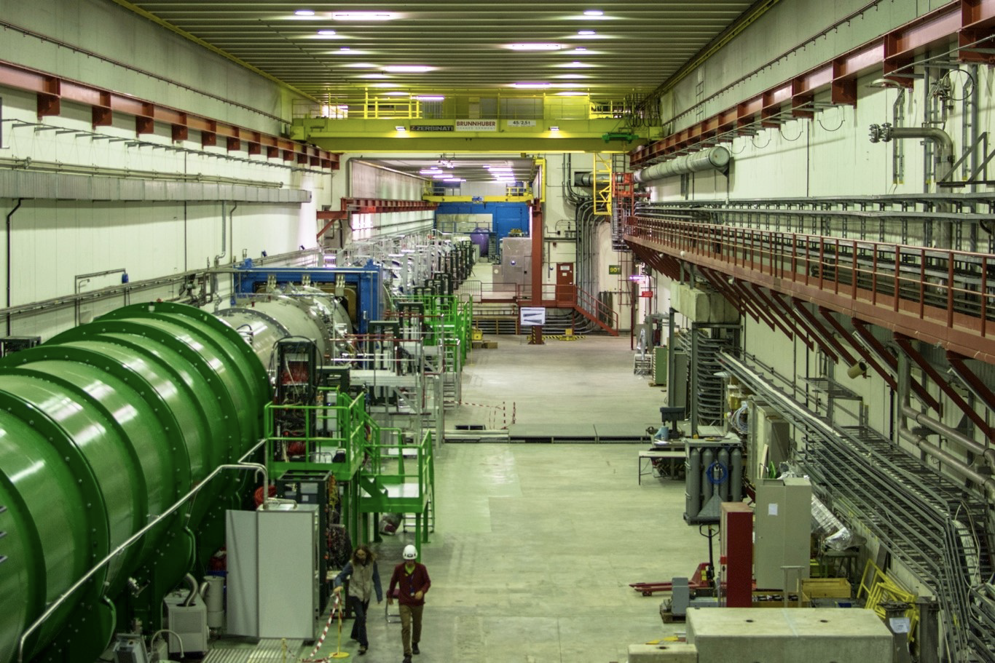
Science Diversity at the CERN North Area
The North Area at CERN is one of the most diverse experimental facilities that currently exists, serving proton, hadron, electron, muon, and ion beams to yearly over 200 user teams for detector R&D and to the NA58/COMPASS, NA62, NA63, NA64e, NA64mu, NA65/DsTau and NA66/AMBER experiments, the two large neutrino platform cryostats, as well as to the GIF++ and CERF irradiation facilities, with combined more than 2000 users.
Link

Slide 6
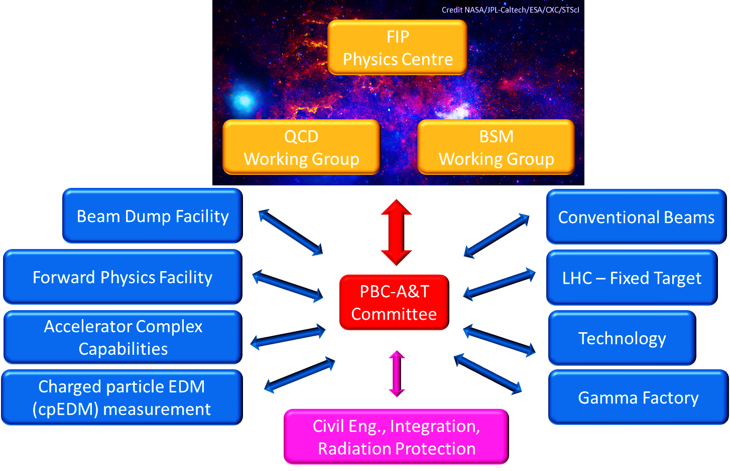
Physics Beyond Colliders Phase 2
Given the success of the first PBC initiative, the mandate was renewed and extended in 2021:
Studying the complementarity to the goals of the main experiments of CERN’s collider programme
Supporting projects using experimental techniques of nuclear, atomic, and astroparticle physics as well as emerging technologies such as quantum sensors benefitting form CERN competence and expertise
Providing a central forum for exchanges between PBC experimental community and theorists to assess the physics reach of proposed projects in a global landscape
CERN’s initial portal for new fixed target experiment ideas, facilitating and supporting the evaluation of their relevance and technical feasibility

Slide 7
Towards a New High-Intensity Facility
The CERN North Area being at the focus of many present and proposed explorations for BSM Physics, a number of proposals requiring higher intensities have been brought forward.
The ECN3 underground cavern could host such a high intensity experiment after the next planned long stop of CERN operations.

Slide 8
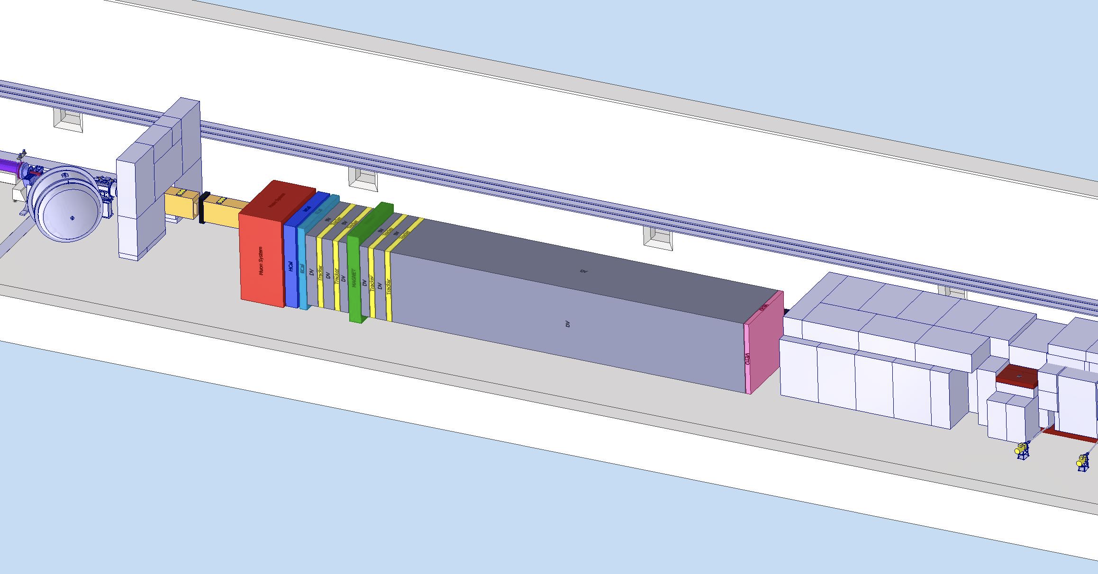
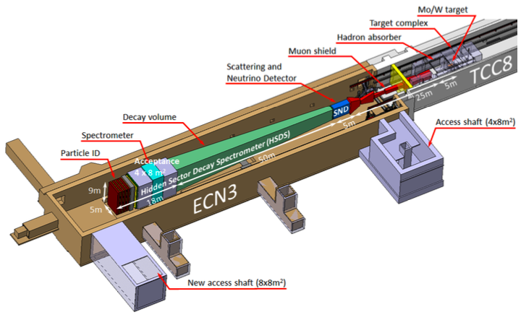
Towards a New High-Intensity Facility
HIKE High Intensity Kaon Experiment
combines NA62-HI, NA62-BeamDump and KLEVER
(Phase 1: 1.3x10¹³ protons per spill, later up to 2x10¹³)
SHiP Proton beam-dump experiment
(4x10¹³ proton per spill, 2x10²⁰ pot in 5 years)
+ SHADOWS Off-axis search for feebly interacting particles, can run in parallel to HIKE-BD
Possible Scenario 1
All experiments have submitted their proposals to the CERN SPSC scientific committee.
A recommendation on what experiment shall be selected is expected by the end of the year.
Please note that this talk is not given on behalf any of these experiments. For further details, please contact the experiment representatives.
Possible Scenario 2

Slide 9
HIKE
HIKE (High-Intensity Kaon Experiments) proposed a two-phase approach for a new experiment on high-precision flavour physics, based on the experience gained with the NA62 experiment.
Highlights of the physics programme would be
Over-constraining the CKM triangle via ultra-rare charged and neutral Kaon decays, mainly by measuring the channels K⁺ → π⁺νν (Phase 1) and K_{L} → π⁰l⁺l– (Phase 2), but also with access to many more charged and neutral decay modes.
Search for feebly interacting particles (FIPs) in both Kaon decays and in a beam dump mode.
C. Lazzeroni et al.

Slide 10
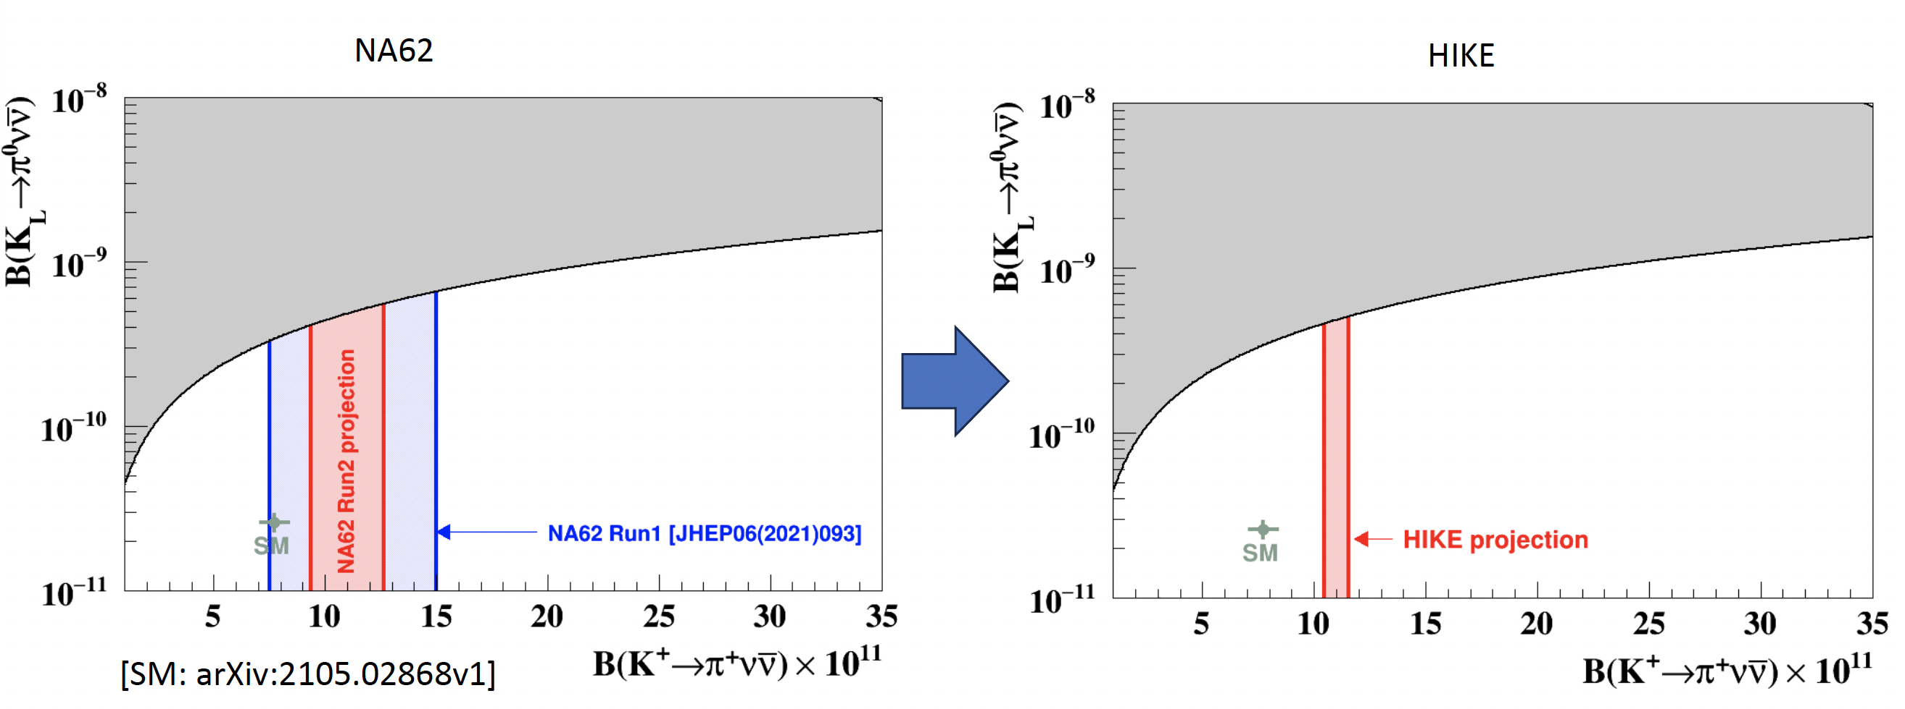
HIKE
HIKE (High-Intensity Kaon Experiments) proposed a two-phase approach for a new experiment on high-precision flavour physics, based on the experience gained with the NA62 experiment
Highlights of the physics programme would be
Over-constraining the CKM triangle via ultra-rare charged and neutral Kaon decays, mainly by measuring the channels K⁺ → π⁺νν (Phase 1) and K_{L} → π⁰l⁺l– (Phase 2), but also with access to many more charged and neutral decay modes.
Search for feebly interacting particles (FIPs) in both Kaon decays and in a beam dump mode.
C. Lazzeroni et al.

Slide 11
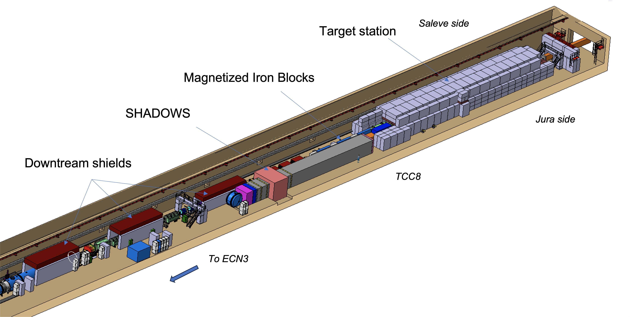
SHADOWS
SHADOWS (Search for Hidden And Dark Objects With the SPS) is an off-axis beam dump experiment that could run in parallel with the HIKE beam dump mode.
Highlights would be
Search for FIPs complementary to HIKE, covering parameter space around the Kaon mass.
Simultaneous running allowing to make use of the same protons in two experiments.
G. Lanfranchi et al.

Slide 12
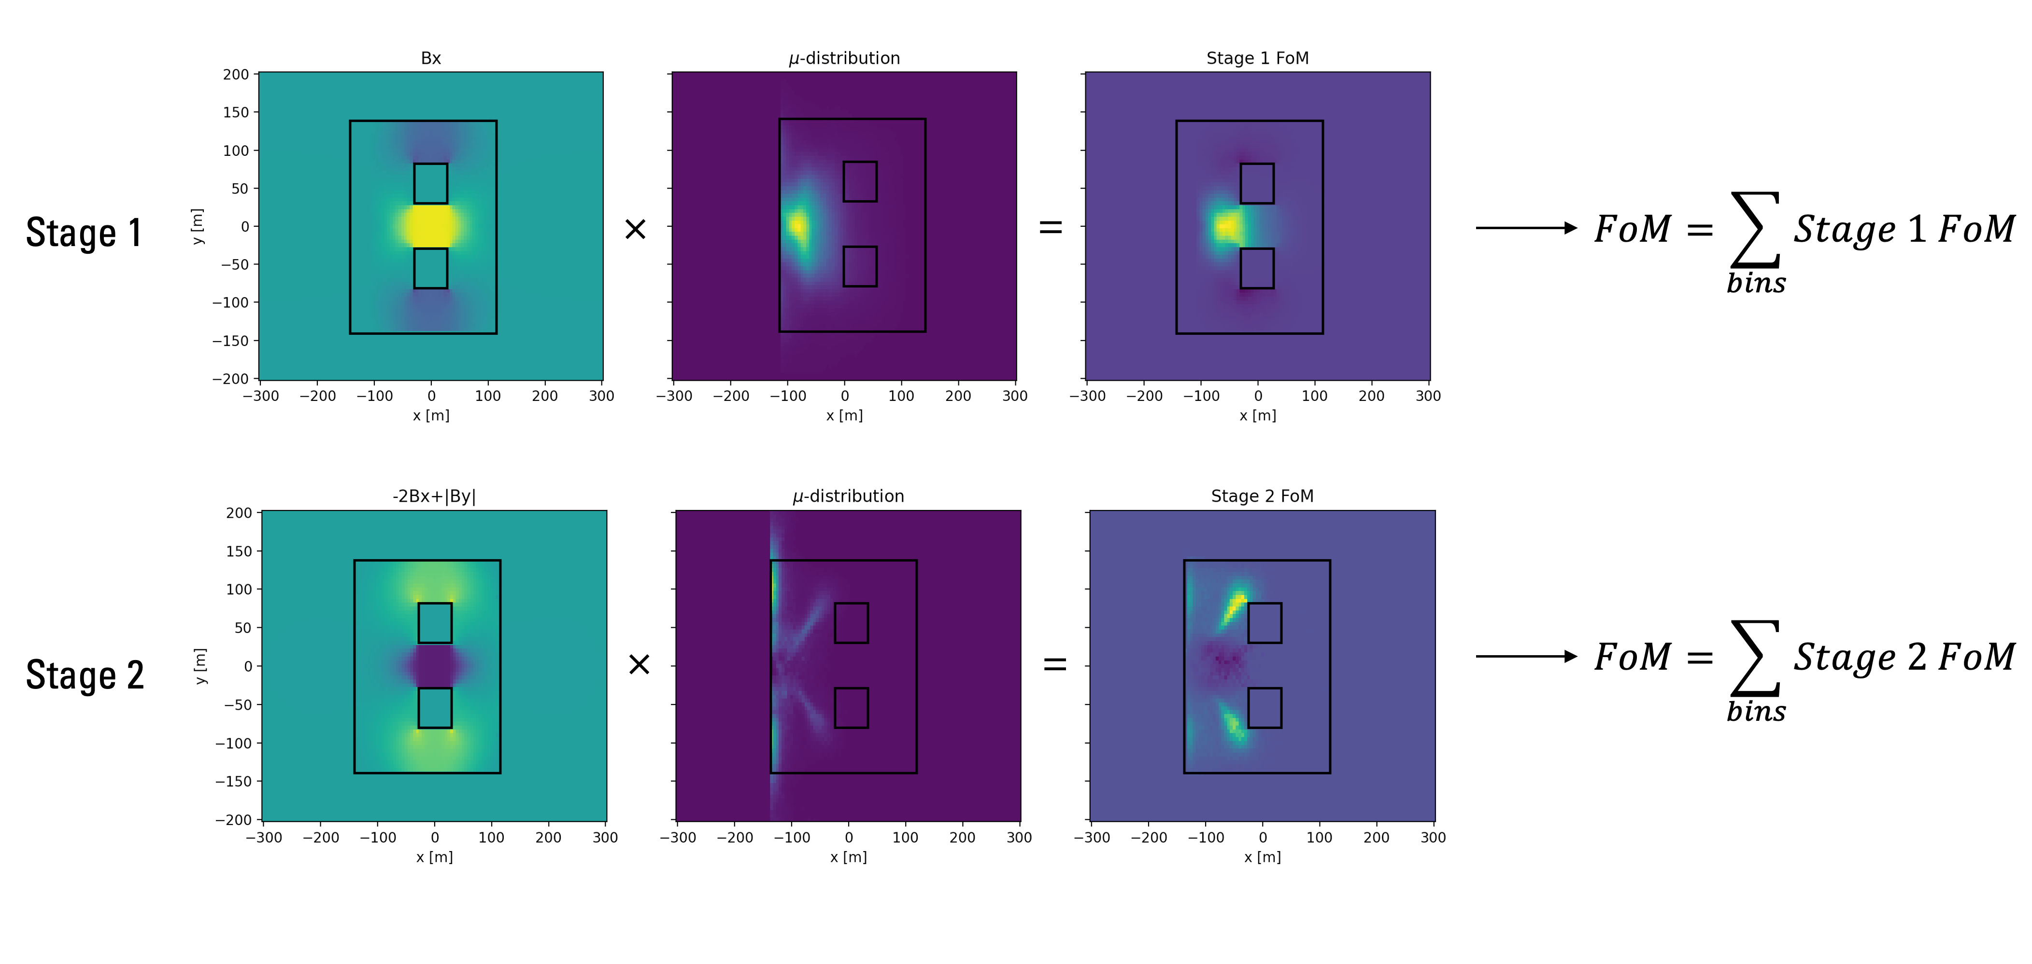
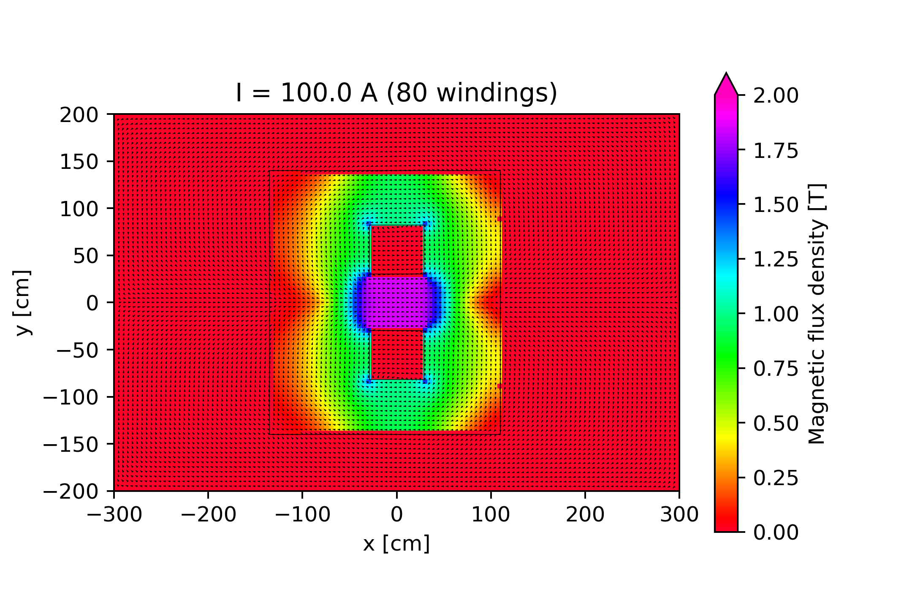
Example of PBC Support: Design of SHADOWS Muon Shield
A Figure of Merit (FoM) has been constructed, including the initial muon distributions as well as the preferred deflection and maximum field of the two stages.
Then, a set of 20000 different magnet designs has been generated with field calculations in FEMM, varying the most important magnet parameters.
coil current I
top yoke
hole y
symmetric
hole distance
left yoke
right yoke
hole x
F. Stummer, T. Zickler

Slide 13
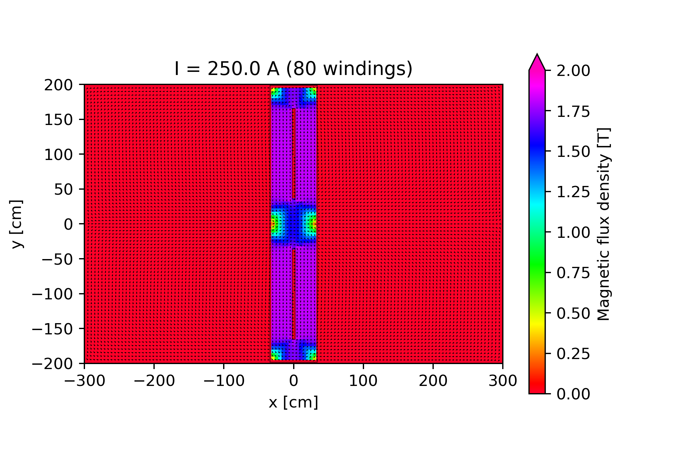
Example of PBC Support: Design of SHADOWS Muon Shield
A deep neural network (DNN) was then trained with the FoM of the 20000 generated samples,
The 100 designs giving the best FoM have then been modified by the DNN for further design optimisation.
The procedure then has been iterated several times for stage 1 and stage 2.
SHADOWS FoM
Stage 1
Stage 2
Detector cover
SHADOWS detector
Stage 2
Beam Dump
MTR3
MTR4
Quadrupoles
BEND3
Stage 1
Magnet
Stage 2
Magnet
F. Stummer (CERN)

Slide 14
Example of PBC Support: Design of SHADOWS Muon Shield
The new design proposal reduces the muon background for SHADOWS by a factor of 157 without impact on the HIKE muon rates.
F. Stummer (CERN)

Slide 15
SHiP
SHiP (Search for Hidden Particles) is a general-purpose beam dump experiment proposed to search for feebly interacting particles (FIPs).
Highlights of the physics programme would be
Ability to search for a variety of FIPs, i.e., heavy neutral leptons, dark photons, dark scalars, axion-like particles, and light supersymmetric particles.
Access an abundance of tau and muon neutrinos.
Several extensions possible, e.g. adding an irradiation facility, adding an LAr TPC to search for milli-charged particles.
A. Golutvin et al.

Slide 16
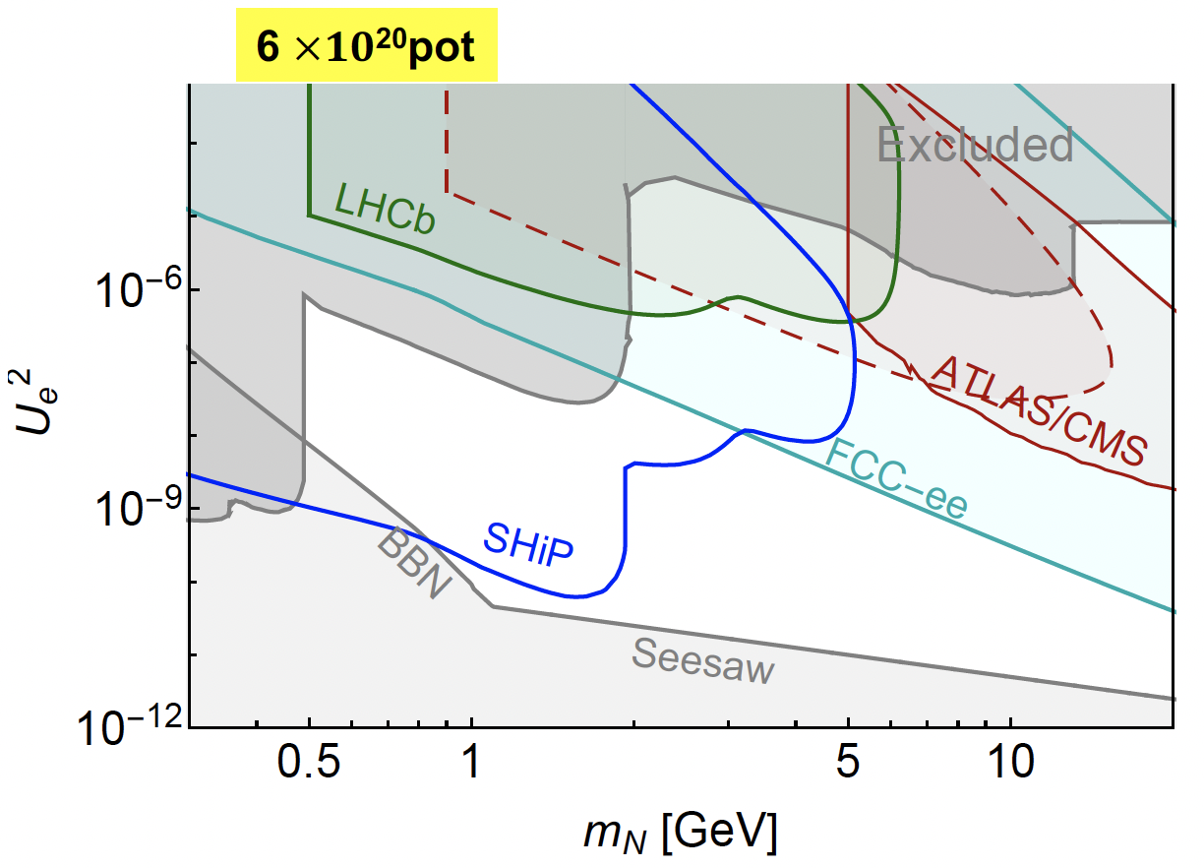
SHiP
SHiP (Search for Hidden Particles) is a general-purpose beam dump experiment proposed to search for feebly interacting particles (FIPs).
Highlights of the physics programme would be
Ability to search for a variety of FIPs, i.e., heavy neutral leptons, dark photons, dark scalars, axion-like particles, and light supersymmetric particles.
Access an abundance of tau and muon neutrinos.
Several extensions possible, e.g. adding an irradiation facility, adding an LAr TPC to search for milli-charged particles.
A. Golutvin et al.

Slide 17
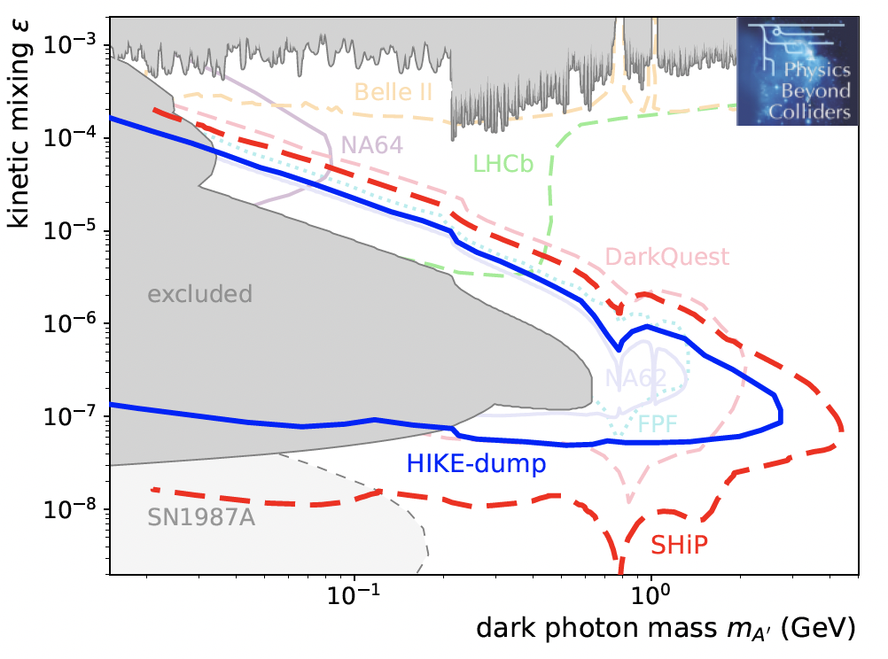
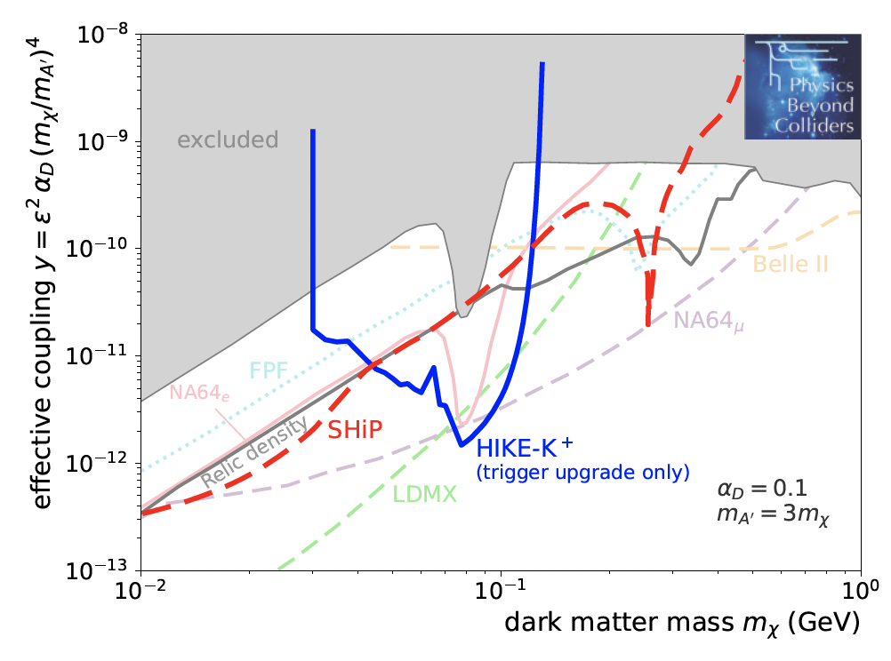
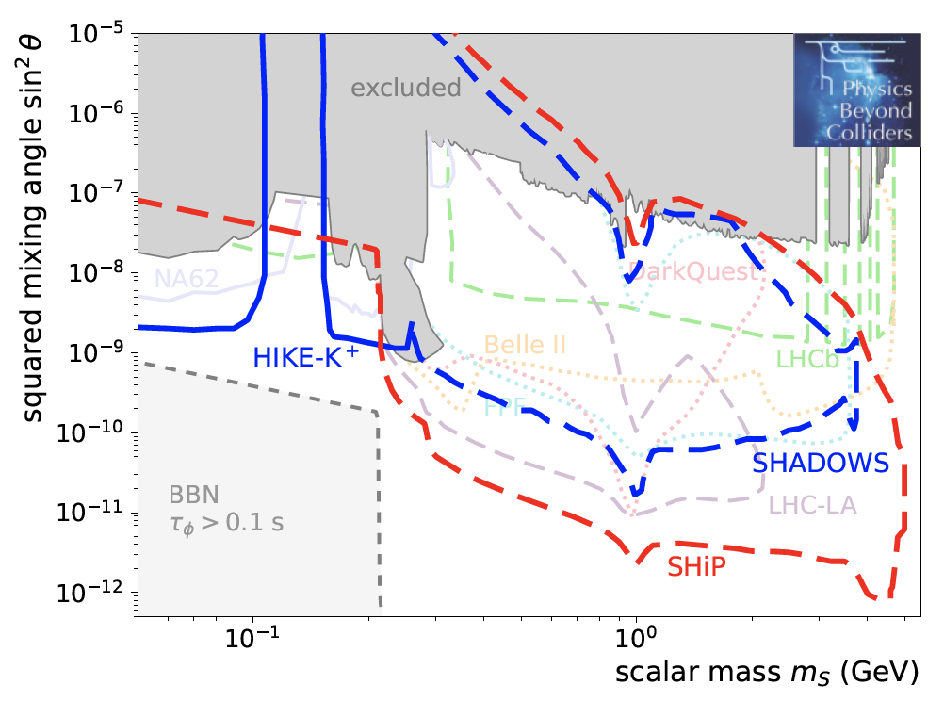
Example of PBC Support: FIPs Benchmark Studies
BC1: dark photons with kinetic mixing
BC2: dark photons decaying into stable dark fermions
BC4: dark scalars with Higgs mixing

Slide 18
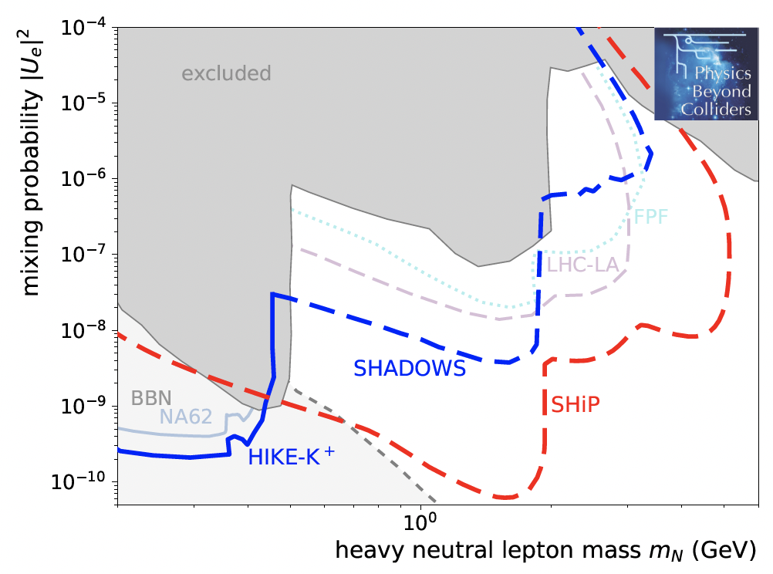
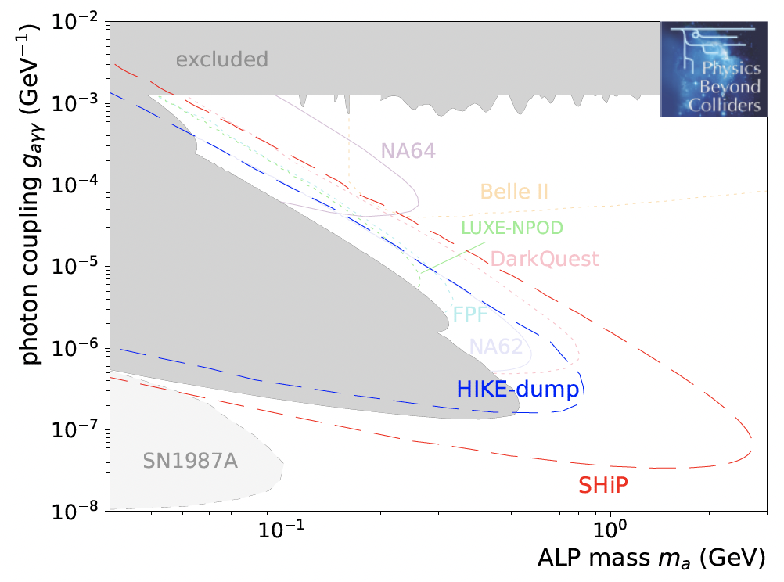
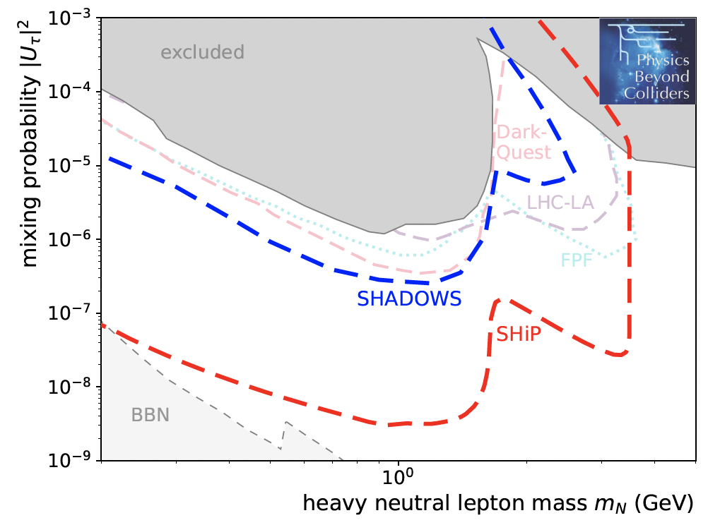
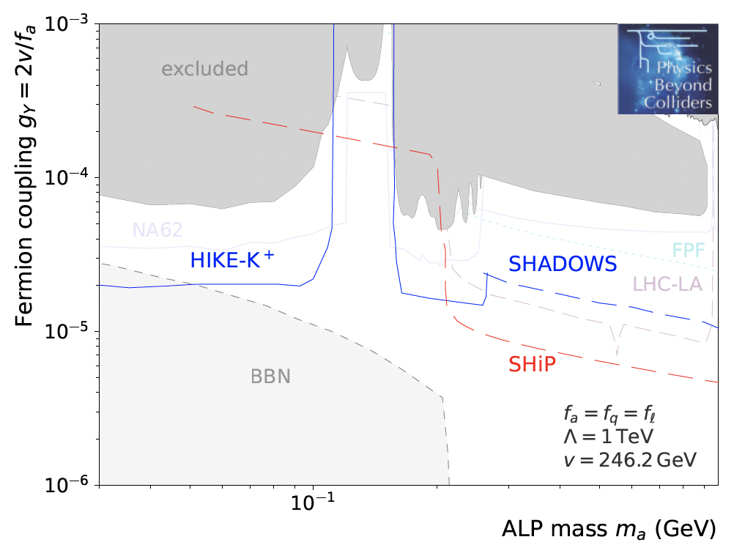
Example of PBC Support: FIPs Benchmark Studies
BC6: heavy neutral leptons with electron mixing
BC9: axion-like particles with photon couplings
BC8: heavy neutral leptons with tau mixing
BC10: axion-like particles with fermion couplings

Slide 19
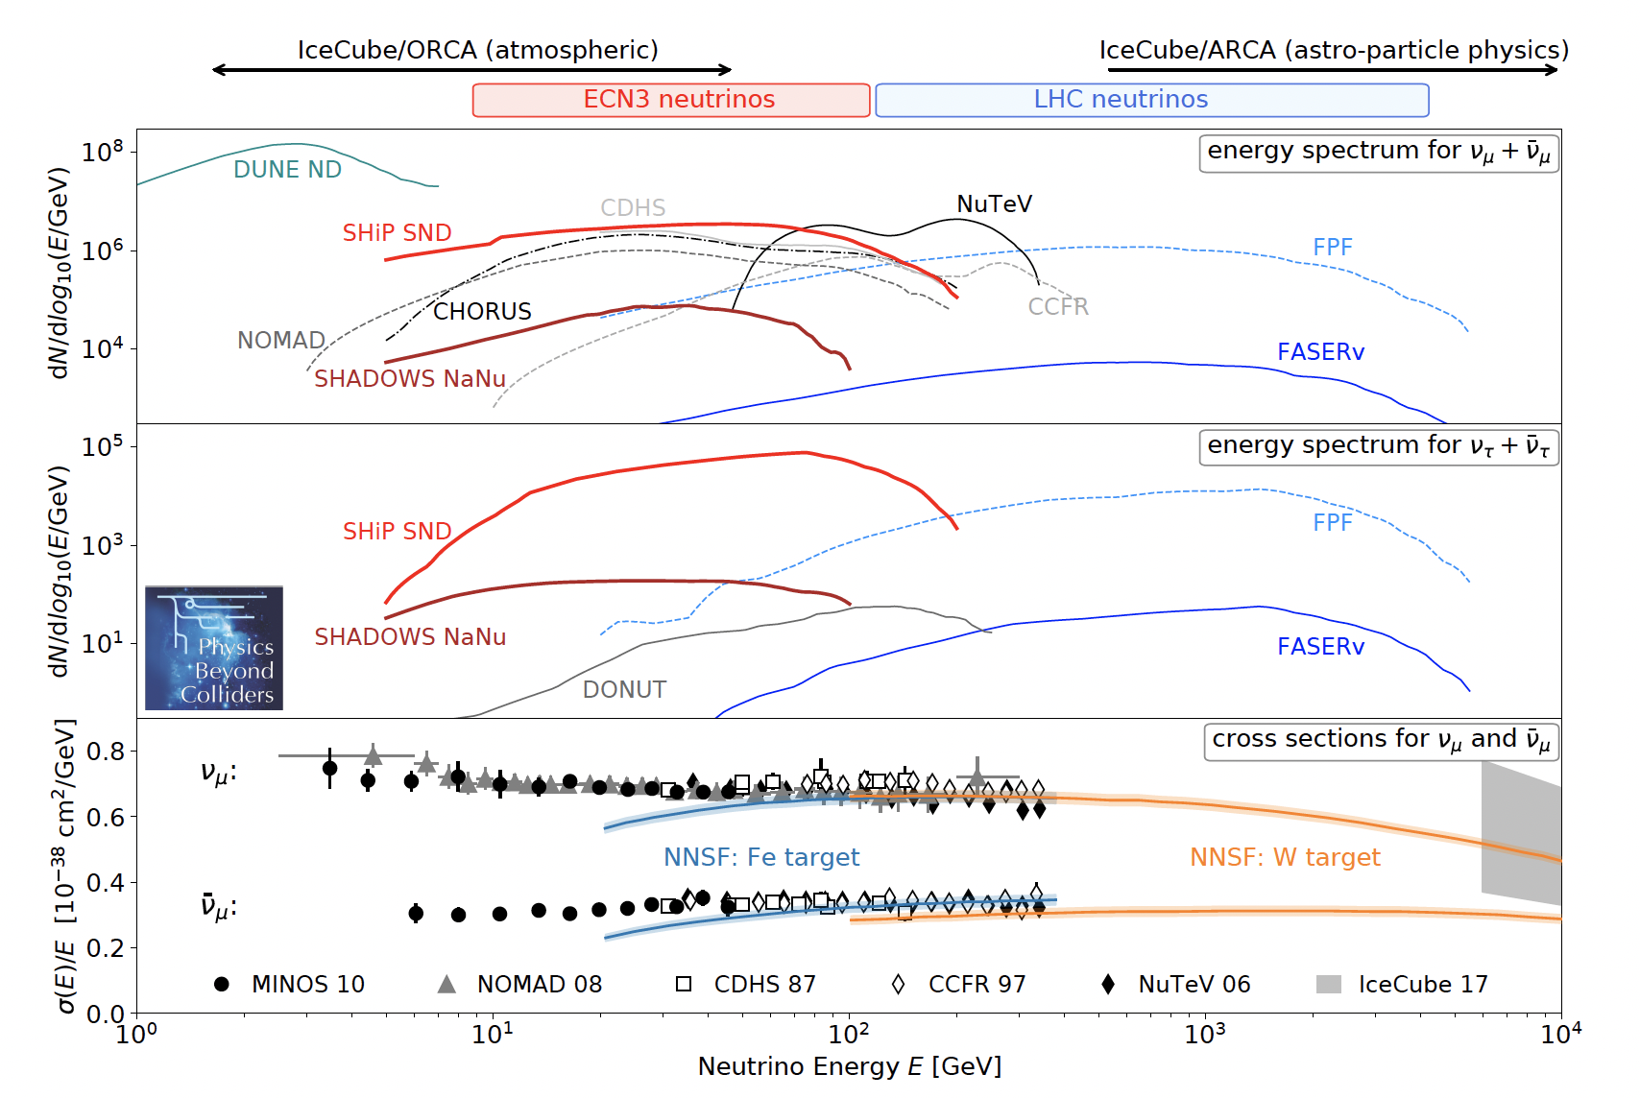
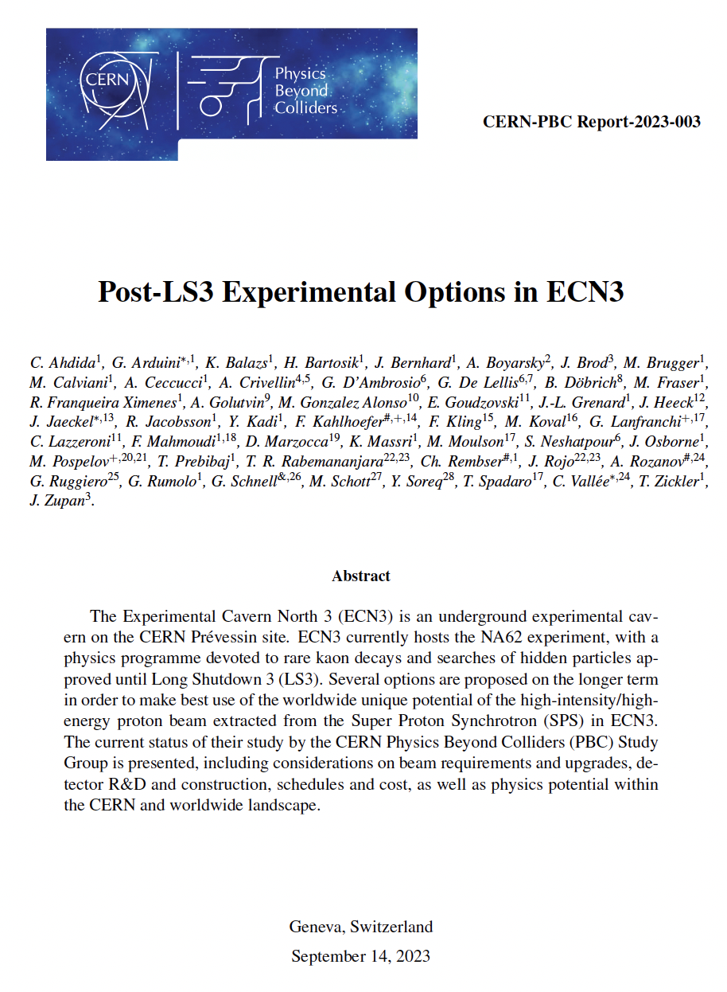
Example of PBC Support: Overview on Neutrino Physics Reach
More information in the PBC Report Post-LS3 Experimental Options in ECN3

Slide 20
Towards a New High-Intensity Facility
Beam loss, radiation control, beam quality (reproducibility, spill structure) are challenging future requirements.
A dedicated working group has studied these limitation and paved the way to a technical design phase, which can be launched after a decision on which experiment will run will have been taken.

Slide 21
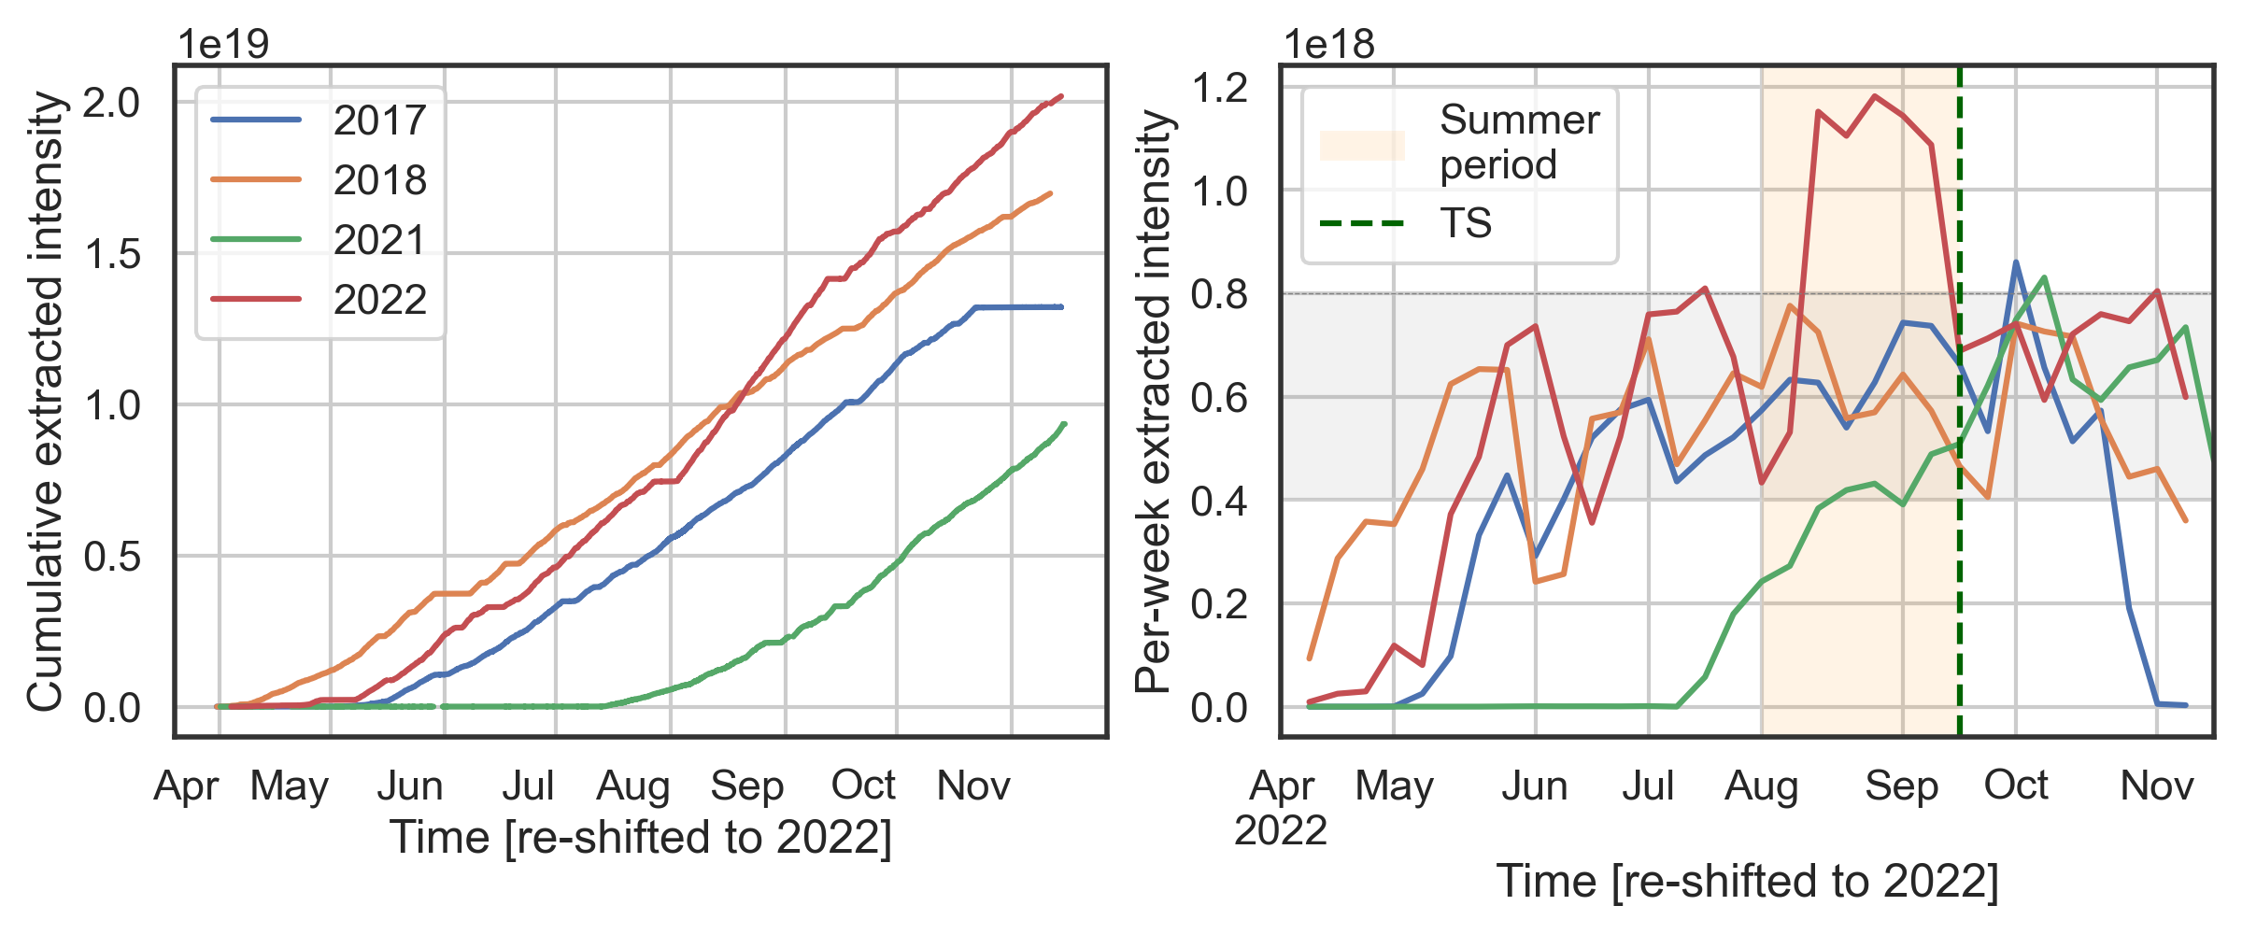
Proton Intensity – also a Frontier for the Accelerators
K.Li (CERN)
The demand for higher intensities and the increasing number of users requesting beam time confirms the attractiveness of the North Area, but also becomes more and more challenging on the accelerator side.
For test beam users, beam lines are already overbooked, sometimes with 20 parallel user set-ups in one line.
In 2022, the three major experiments Compass, NA62, and NA64e required running at the same time with high intensities, leading to an all-time intensity record for the North Area – however also with record activation of the beam line elements, potentially leading to equipment failures.

Slide 22
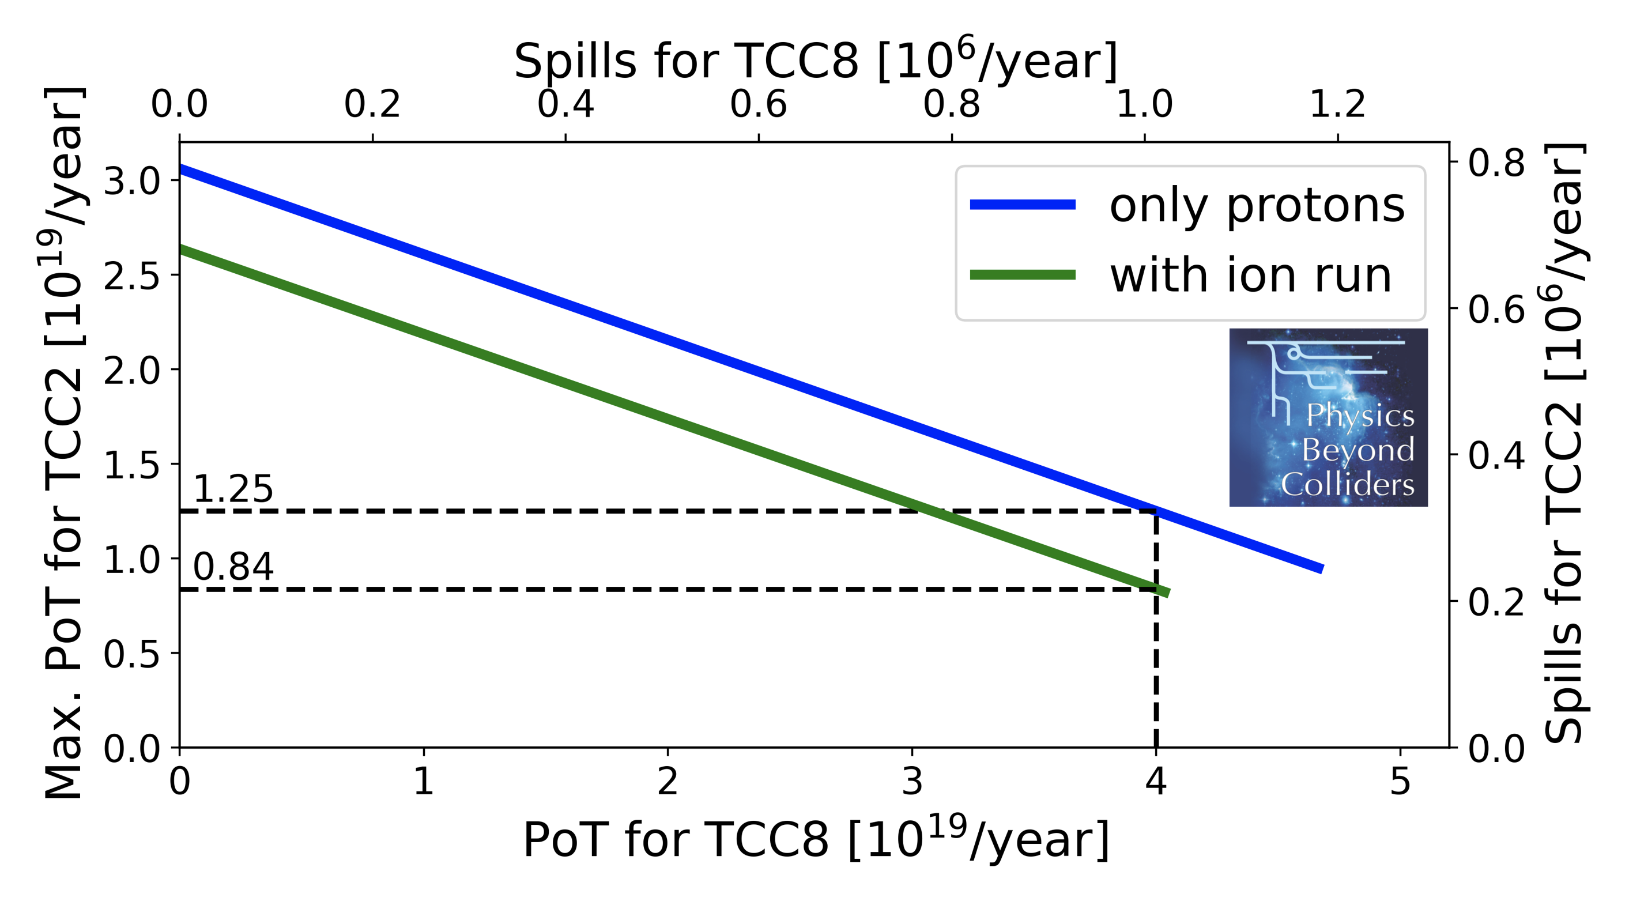
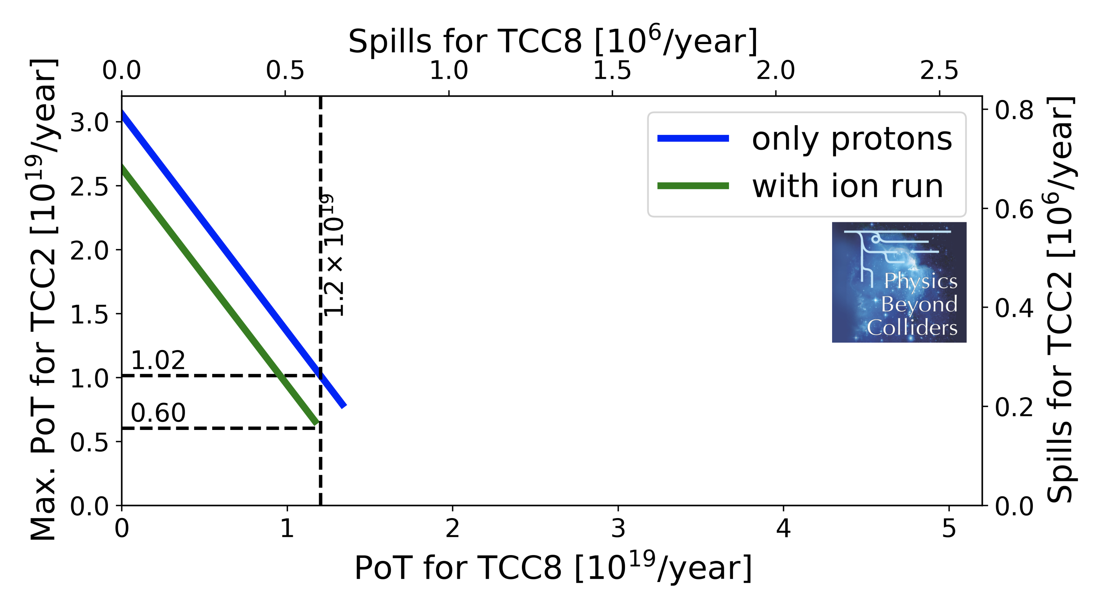
Proton Intensity – Sharing between Experiments
1.2 s dedicated ECN3
4.8 s other NA experiments
4.8 s dedicated ECN3
4.8 s other NA experiments
Dedicated 1.2 s
NA 4.8 s
Dedicated 4.8 s
NA 4.8 s / 9.6 s
With a new ECN3 high-intensity facility, there would be a dedicated extraction only to ECN3, interleaved with extractions serving the other NA experiments and test beam users.

Slide 23
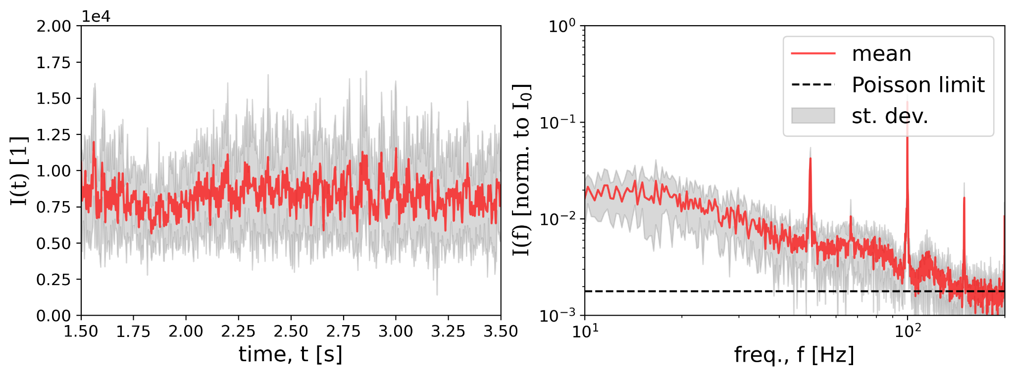
Extraction Quality
P. Arrutia (CERN)
EBC on
With experiments requiring to run at highest intensities, the extraction quality becomes more important.
Especially time structures at 50 Hz and 150 Hz, introduced via power converters, can easily lead to data acquisition issues due to peaks in the instantaneous intensity.
Amongst several improvements on the hardware and controls-side, empty bucket channelling looks very promising: the de-bunched beam is forced up and “channelled” between the empty buckets.
EBC off

Slide 24
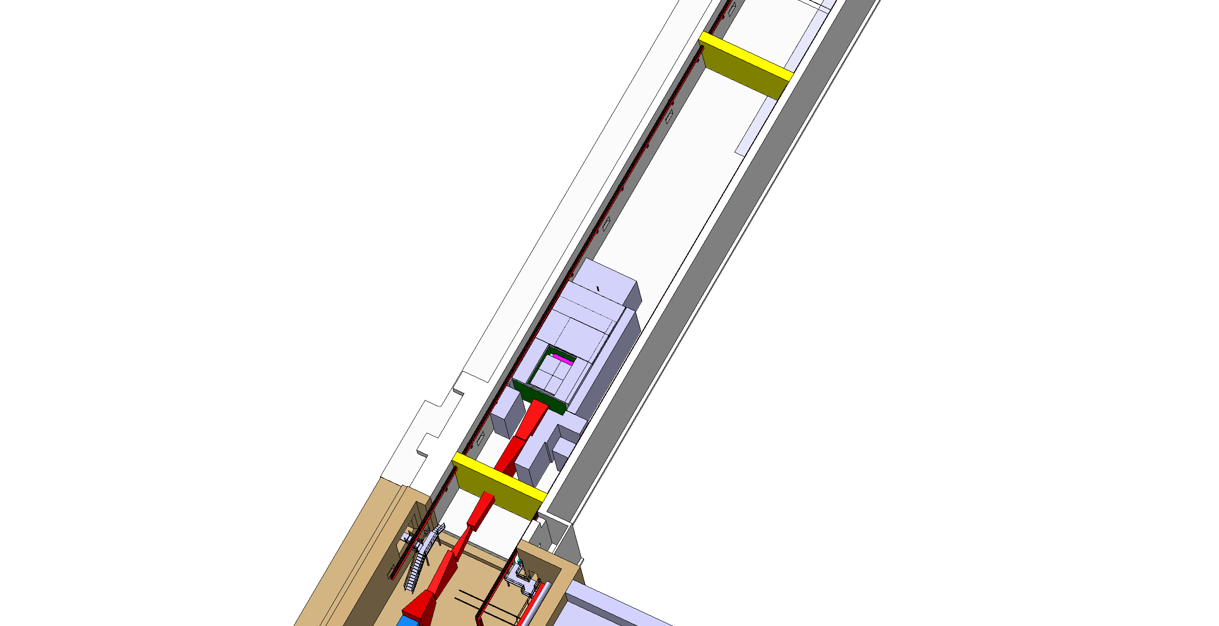
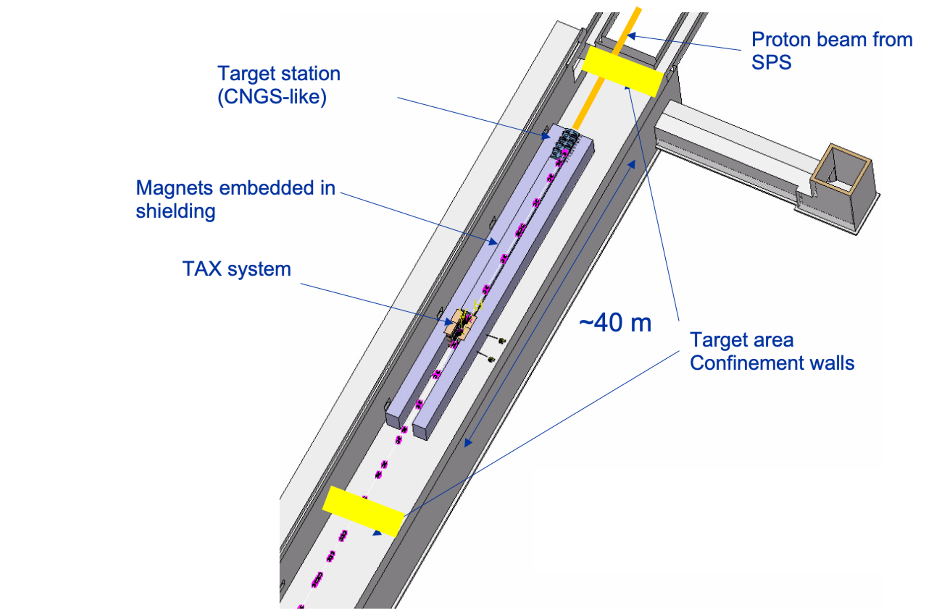
Target Complex
A new target complex will make sure that the new intensity step can be optimally exploited while upgrading the facility to modern radiation protection and handling standards.
Space for shielding temporary storage
Diluted proton
TCC8
Target area
confinement walls
~11m
Access chicane
J.L. Grenard (CERN)
J.L. Grenard (CERN)
BDF/SHiP
HIKE/SHADOWS

Slide 25
Summary
Within the Physics Beyond Collider Study, several experiments have proposed physics programmes with very high proton intensities.
The ECN3 experimental cavern at the CERN North Area is well suited for such demands and an extensive study has taken place to demonstrate the feasibility of beam delivery to ECN3.
In a next step, the experiments will hand in their final proposal to SPSC scientific committee at CERN, which will recommend one or more experiments to run in the new facility. A final decision is expected towards beginning of 2024.
After a TDR phase within the newly funded ECN3 High Intensity project, works in ECN3 can be started, and first experiments are expected to operate from the early 2030s.

Slide 26
Thank you very much!
Acknowledgements to SY/STI, HSE/RP, BE-EA, the PBC ECN3 task force, the PBC BDF working group, the PBC Conventional Beams Working Group, and all other groups contributing to this study.

Slide 27
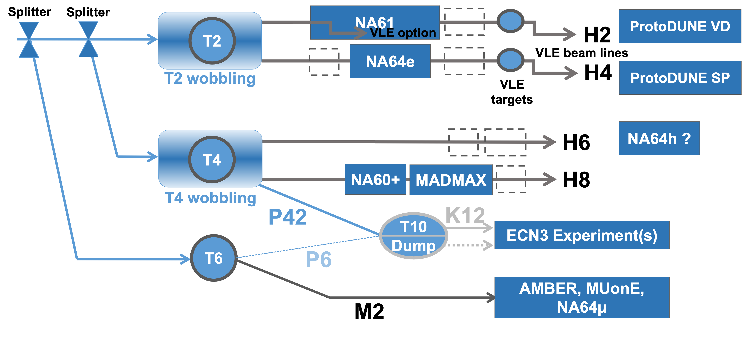
Physics Beyond Colliders in the North Area
from SPS protons/ions
GIF++
CERF
+ test beams (HL-LHC, FCC, detector R&D, space/satellites, R2E)

