Slide 1
Hadron Spectroscopy at LHCb
Zan Ren*
(On behalf of the LHCb collaboration)
*School of Physical Sciences, University of Chinese Academy of Sciences
Oct 17, 2023 @ Mainz, Germany

Slide 2
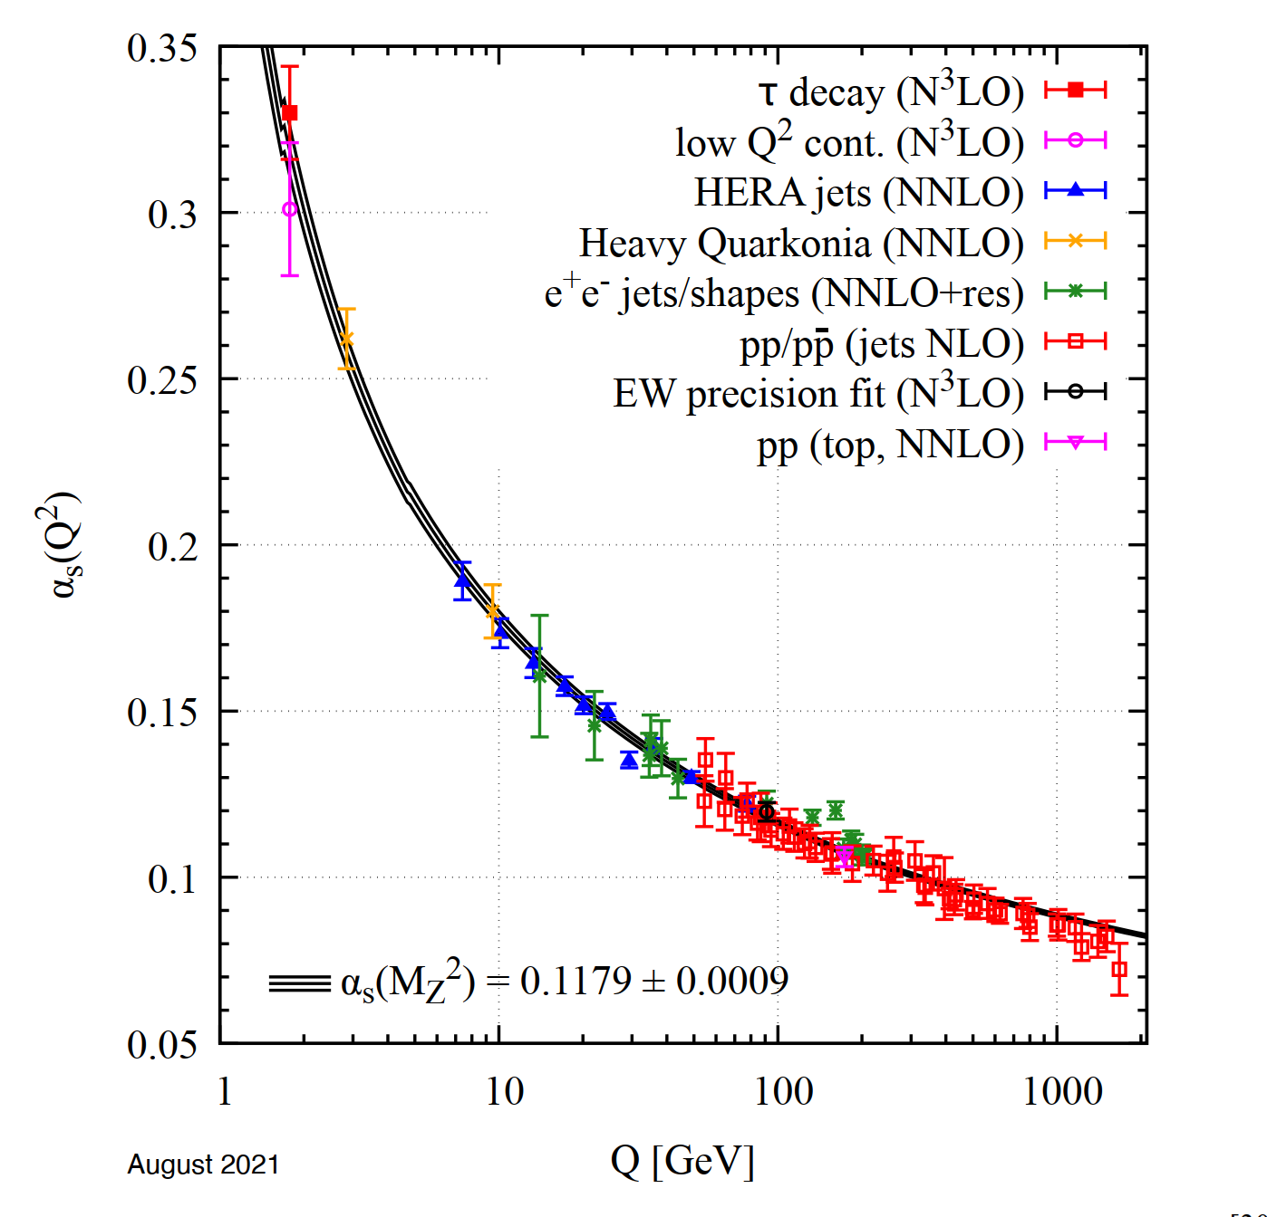
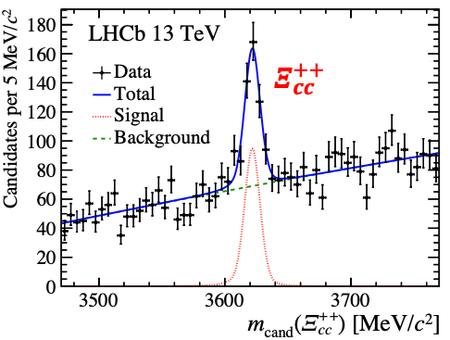
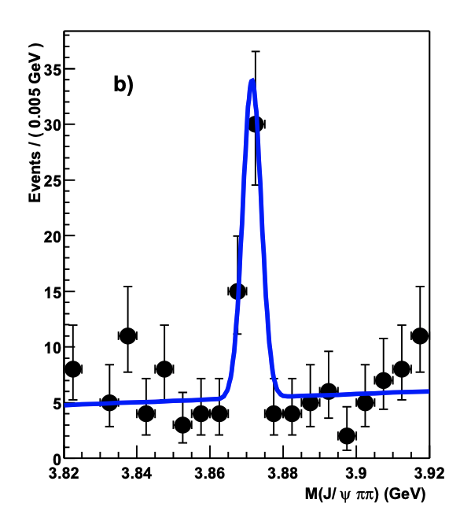
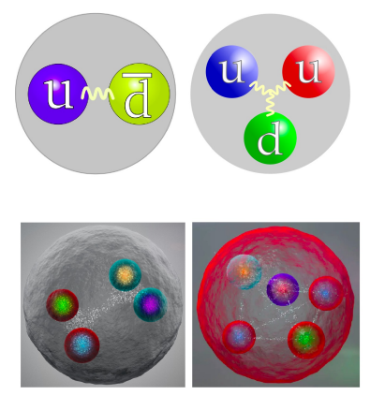
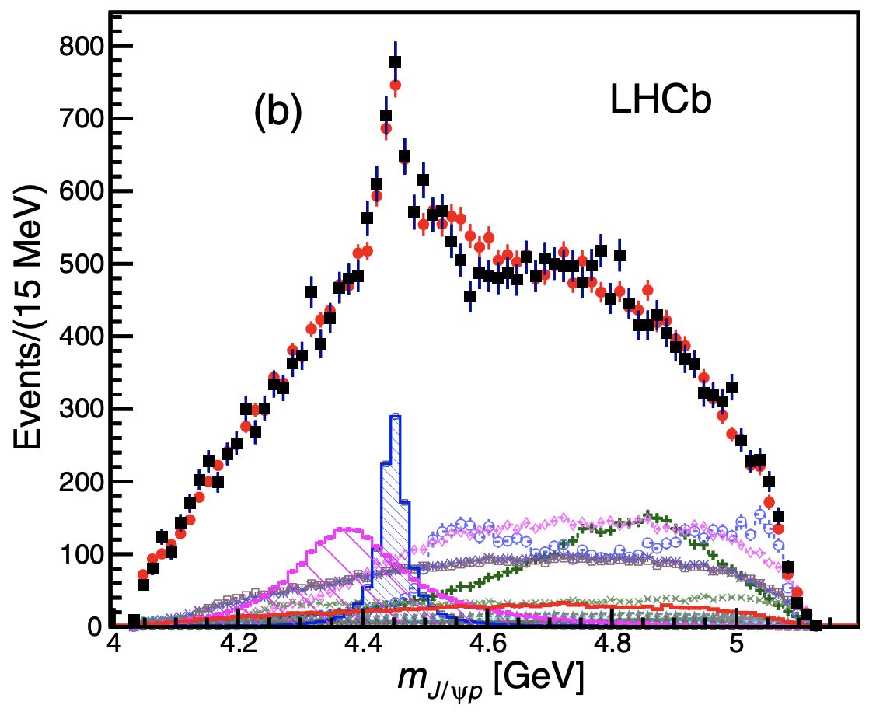
Background review
QCD shows non-perturbative behavior at the energy scale of nuclei and hadrons.
Spectroscopy is the powerful tool to understand QCD at this energy scale. Experimental results will be important to test the relevant theories.
Spectroscopy of conventional hadrons (mesons and baryons) enriched in the past decades.
Exotics are predicted since 1960s, but first observed until 2003.
In the last 20 years, many new exotic candidates have been discovered in $e^{+}e^{−}$ collision and hadron collision experiments.
PDG Appendix
Belle
$$X(3872)$$
$$P_{ψ}^{N}{\left(4450\right)}^{+}$$
PRL 91 (2003) 262001
PRL115(2015)072001
PRL117(2017) 112001

Slide 3
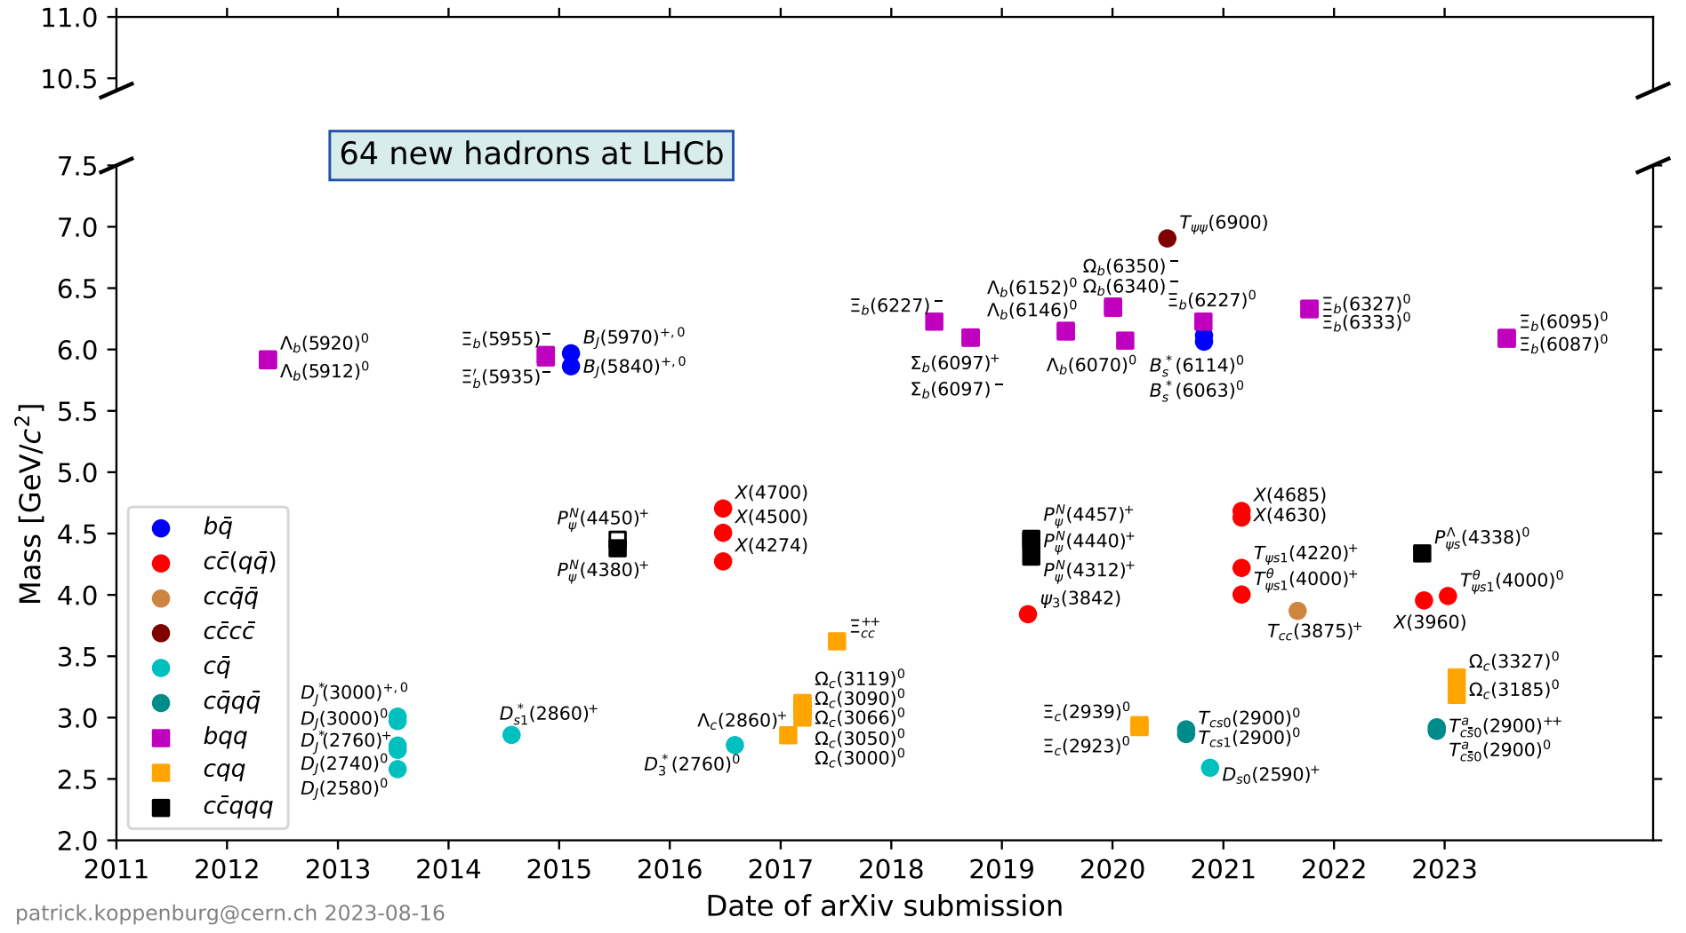
Hadrons discovered by LHCb
https://www.nikhef.nl/~pkoppenb/particles.html
30 new states since the last MENU conference

Slide 4
Results shown in this talk
Only limited (more recent) published analyses are covered by this talk.
Conventional hadrons
New excited $Ω_{c}^{0}$ states:
$Ω_{c}{\left(3327\right)}^{0},Ω_{c}{\left(3185\right)}^{0}$
New excited $Ξ_{b}^{0}$ states:
$Ξ_{b}{\left(6095\right)}^{0},Ξ_{b}{\left(6087\right)}^{0}$
New $b$-baryon decay mode
Observation & BF measurement of $Ξ_{b}^{−}→Λ_{b}^{0}π^{−}$
Exotics
New pentaquark candidate:
$P_{ψs}^{Λ}{\left(4338\right)}^{0}$
New tetraquark candidates:
$T_{ψs1}^{θ}{\left(4000\right)}^{0}$
$T_{c\overline{s}0}^{a}{\left(2900\right)}^{++/0}$
30 new states since the last MENU conference
PRL131 (2023)131902
arXiv:2307.13399, Accepted by PRL
PRD108 (2023) 072002
PRL131 (2023) 031901
PRL131 (2023) 131901
PRL131 (2023) 041902

Slide 5
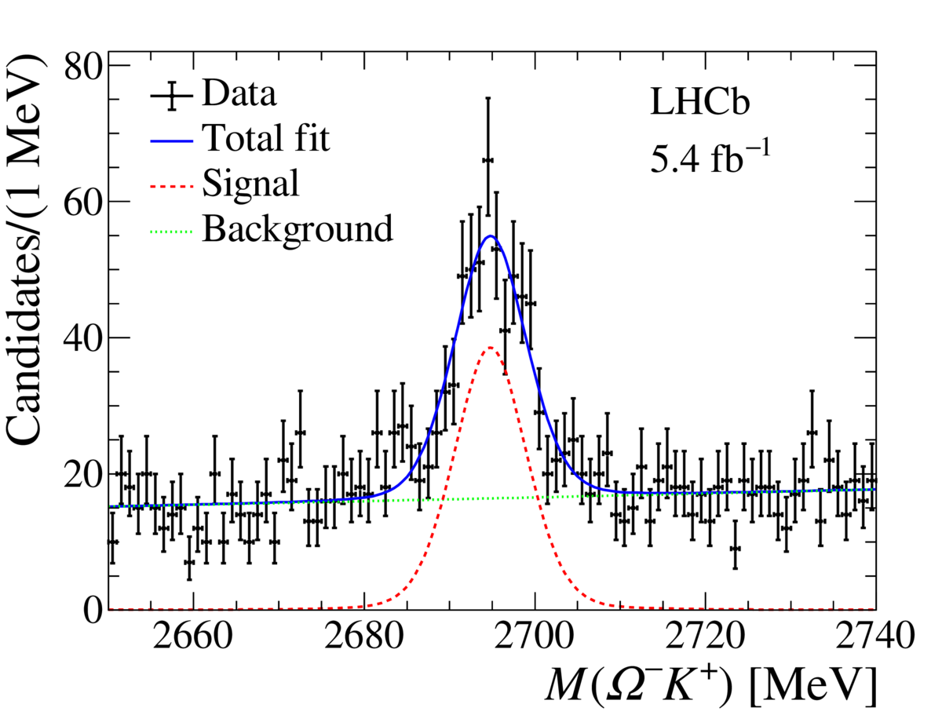
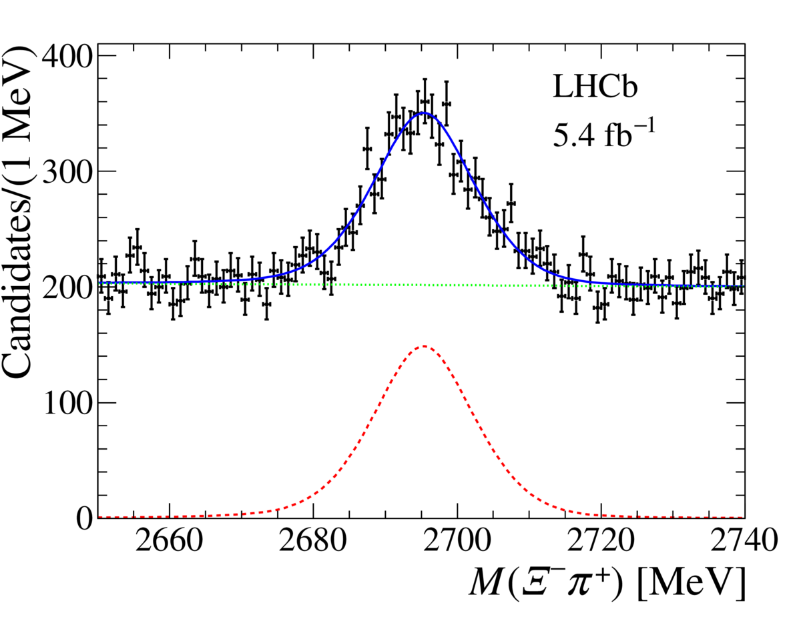
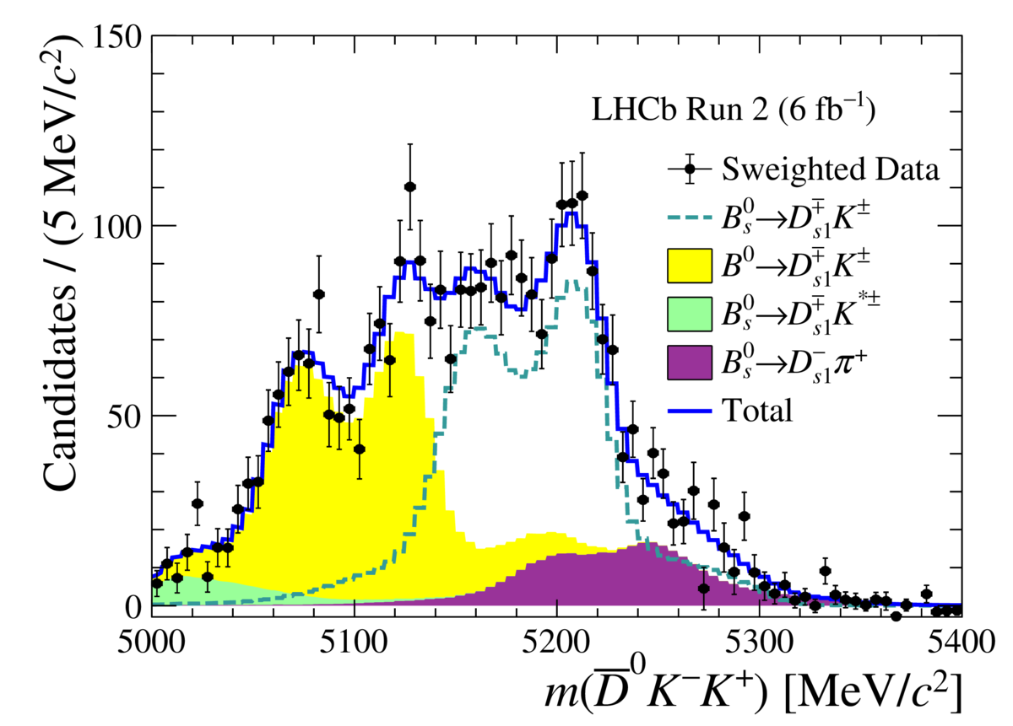
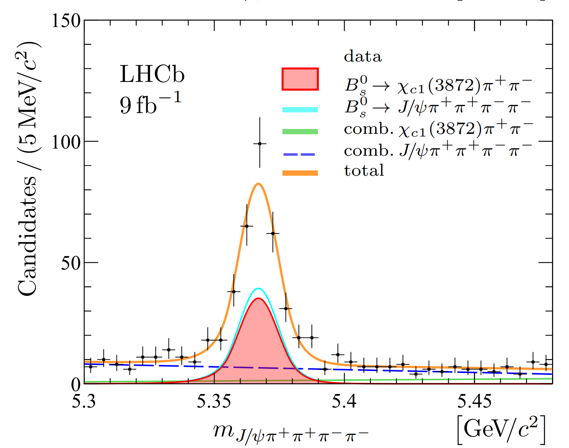
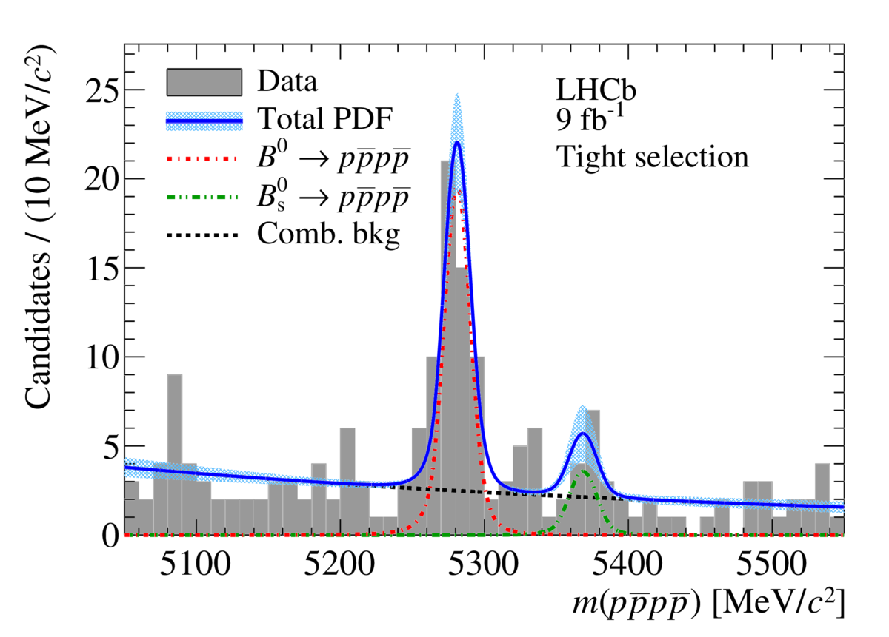
Results not specially included in this talk
…… but worth mentioning
About new measurements of the decay properties of established hardon states, or products of the corresponding exotic states research.
Observation of $Ω_{c}^{0}→Ω^{−}K^{+}$/$Ξ^{−}π^{+}$ and precision $Ω_{c}^{0}$ mass measurement
Obs. & BF of $Λ_{b}^{0}→Λ_{c}^{+} {\overline{D}}^{\left(∗\right)0}K^{−}$ and $Λ_{b}^{0}→Λ_{c}^{+}D_{s}^{∗−}$
Obs. & BF of $Ξ_{b}^{0}→Ξ_{c}^{+}D_{s}^{∗−}$ and $Ξ_{b}^{−}→Ξ_{c}^{0}D_{s}^{−}$
Observation of $B_{\left(s\right)}^{0}→D_{s1}{\left(2536\right)}^{∓}K^{±}$
Obs. & BF of $B^{+}→J/ψη^{′}K^{+}$
Observation of $B_{s}^{0}→χ_{c1}\left(3872\right)π^{+}π^{−}$
PWA of $D_{(s)}^{+}→π^{+}π^{−}π^{+}$ ($ω\left(782\right)$ contribution is found)
Observation of $B^{0}→p\overline{p}p\overline{p}$ decays
New naming convention for exotics is submitted by LHCb (LHCb-PUB-2022-013).
$m\left(Ω_{c}^{0}\right)$=2695.28 ± 0.07(stat) ± 0.27(syst)±0.30(ext) MeV
arXiv:2308.08512
See Marian Stahl’s talk in the parallel session
arXiv:2308.00587
JHEP08(2023)174
JHEP07(2023)084
JHEP07(2023)204
PRL131 (2023) 091901
arXiv:2206.15233

Slide 6
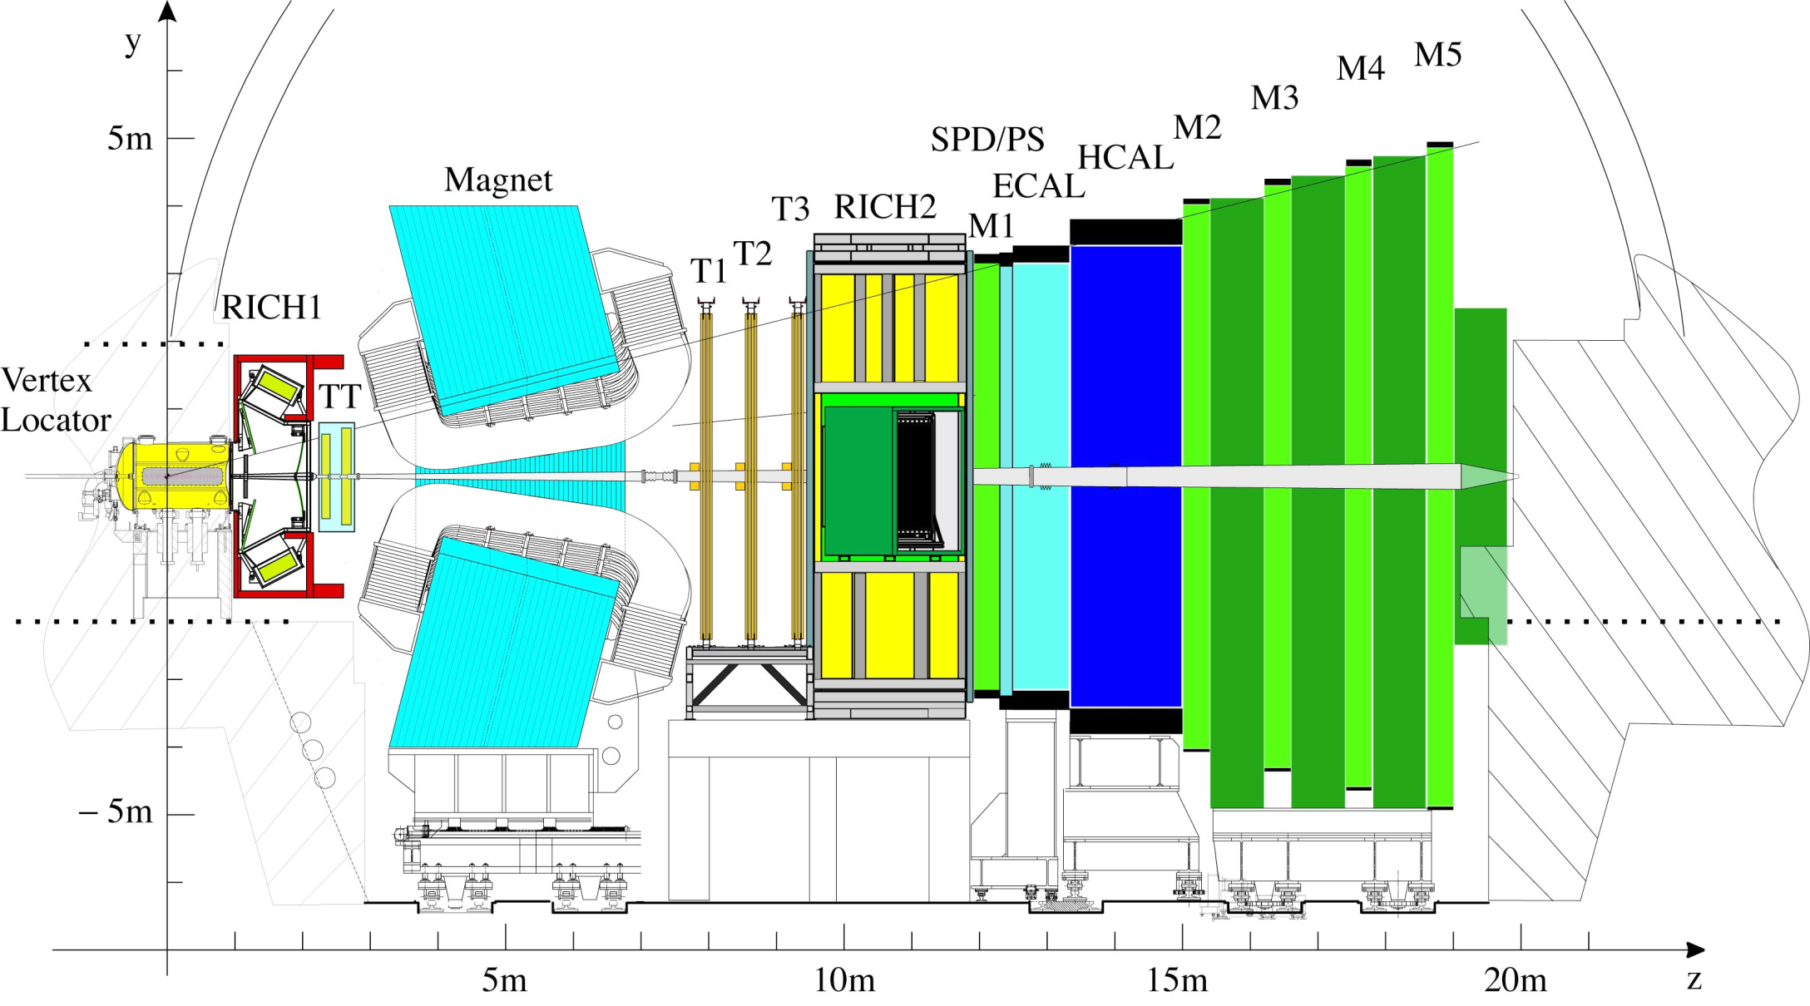
LHCb detector
Single-arm, forward. Specifically designed for heavy-flavour physics.
LHCb Run 1&2 detector
2 < 𝜂 < 5, $ℒ_{int}$(pp) = 9 fb⁻¹
p
p
JINST3 (2008) S08005
IJMPA 30 (2015) 1530022

Slide 7
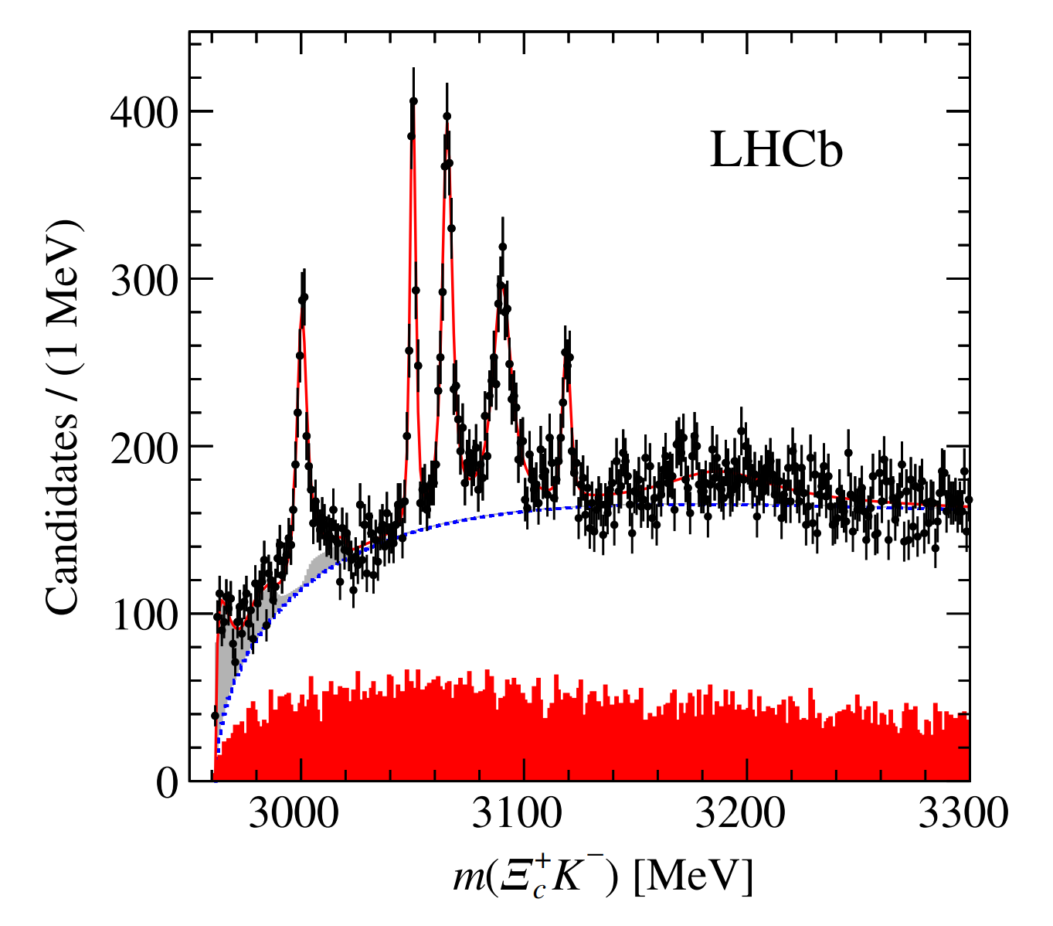
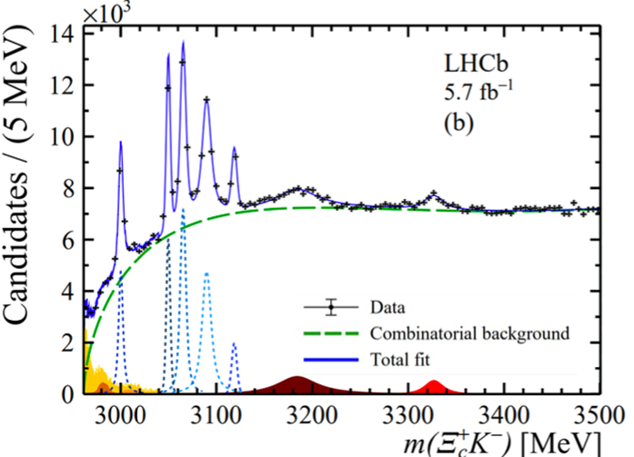
New excited $Ω_{c}^{0}$ states
Five narrow $Ω_{c}^{0∗}$ states observed in Run1. $⇒$ updated with Run1&2 data
Run 1
PRL118(2017) 182001
PRL131(2023)131902
Confirmed the Run 1 results.
Two broader states, namely $Ω_{c}{\left(3185\right)}^{0}$ and $Ω_{c}{\left(3327\right)}^{0}$, are observed for the first time.

Slide 8
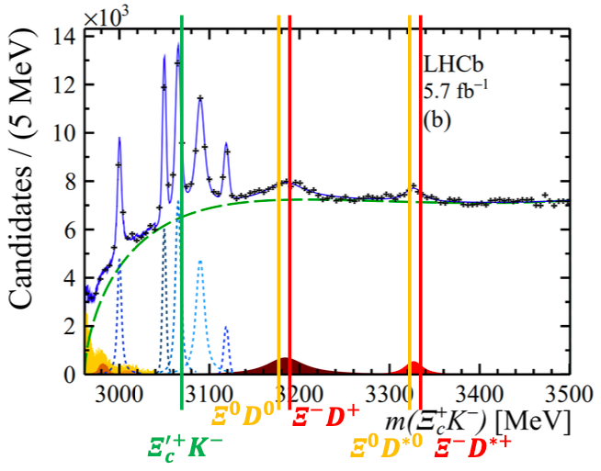
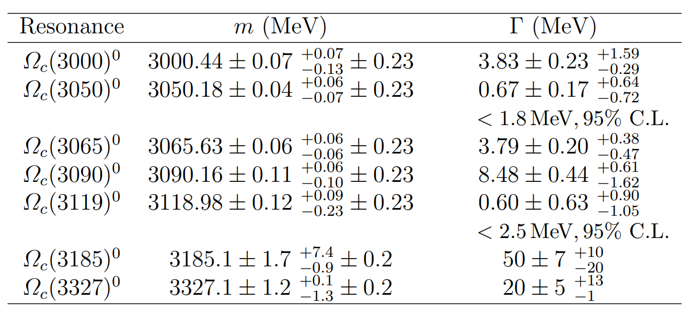
New excited $Ω_{c}^{0}$ states
PRL131(2023)131902
Two broader states, namely $Ω_{c}{\left(3185\right)}^{0}$ and $Ω_{c}{\left(3327\right)}^{0}$, are observed for the first time.
Mass and width are measured
Near $Ξ^{0}D^{∗0}$ and $Ξ_{c}^{+}K^{−}$ thresholds
confirmed
new

Slide 9
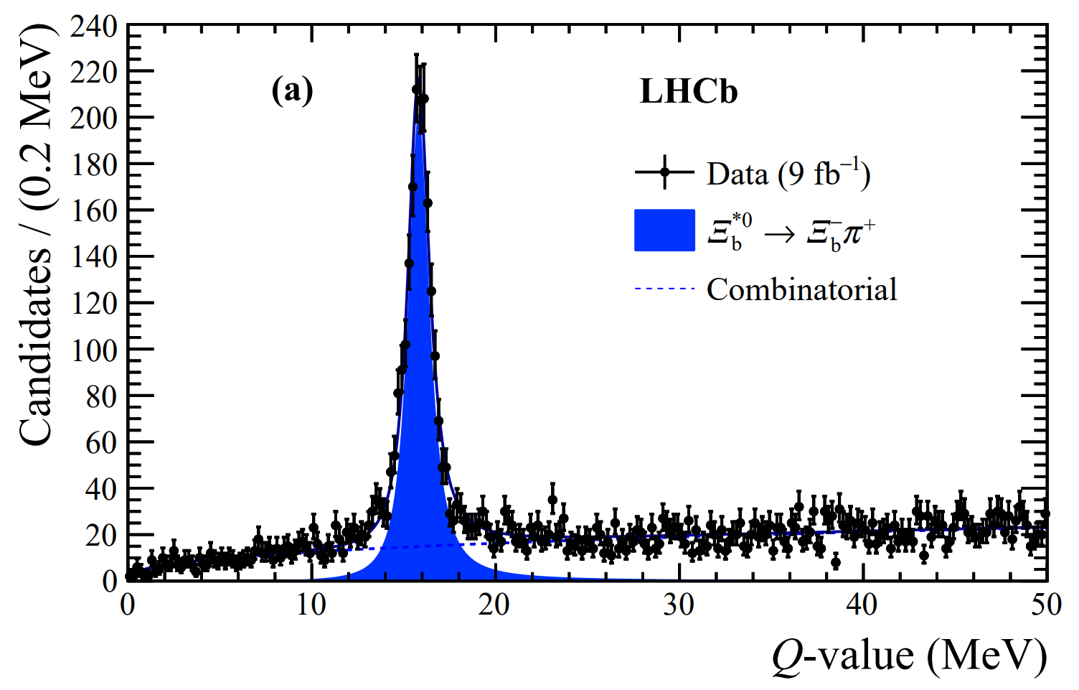
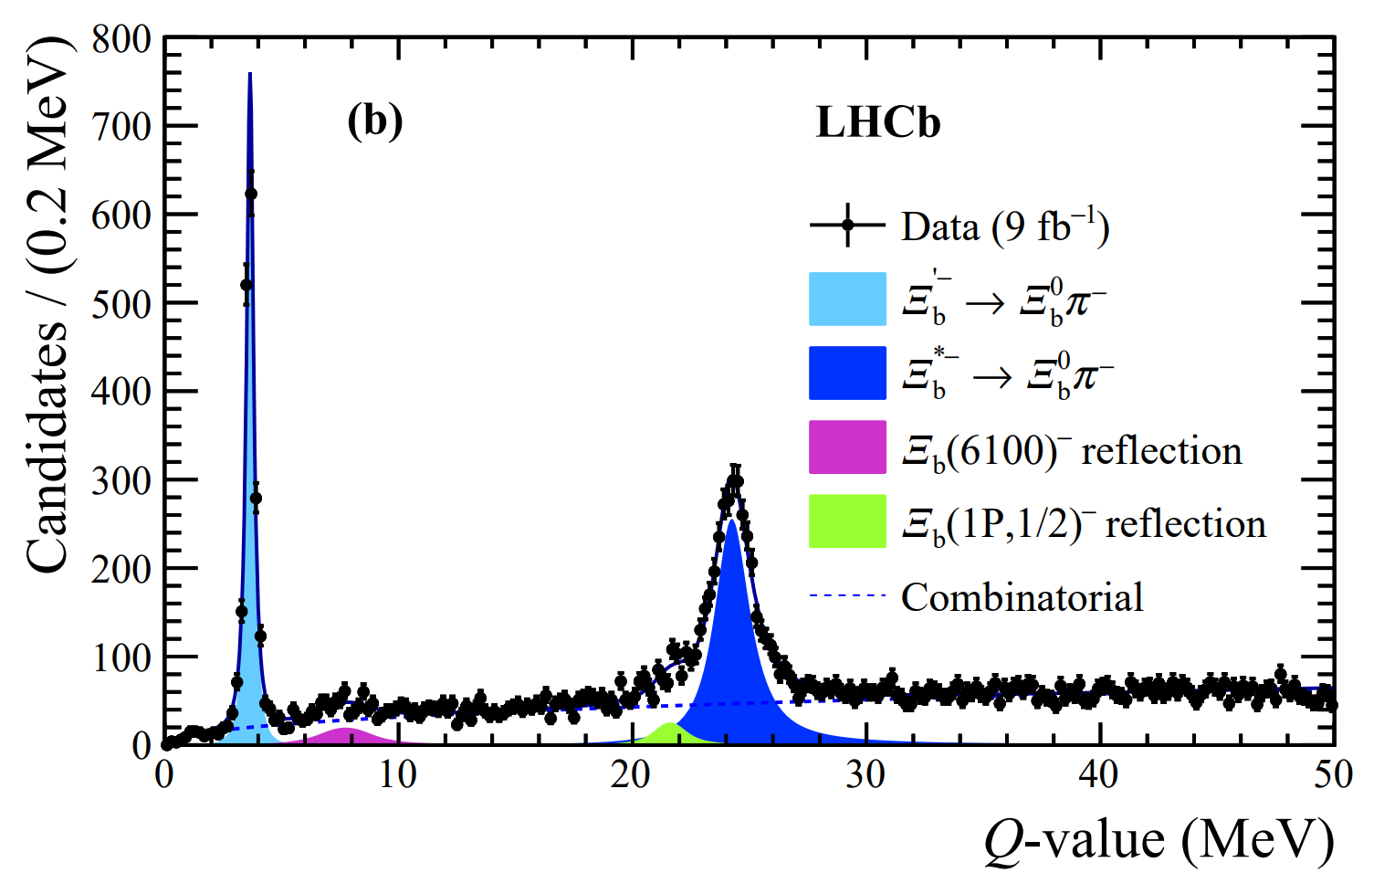
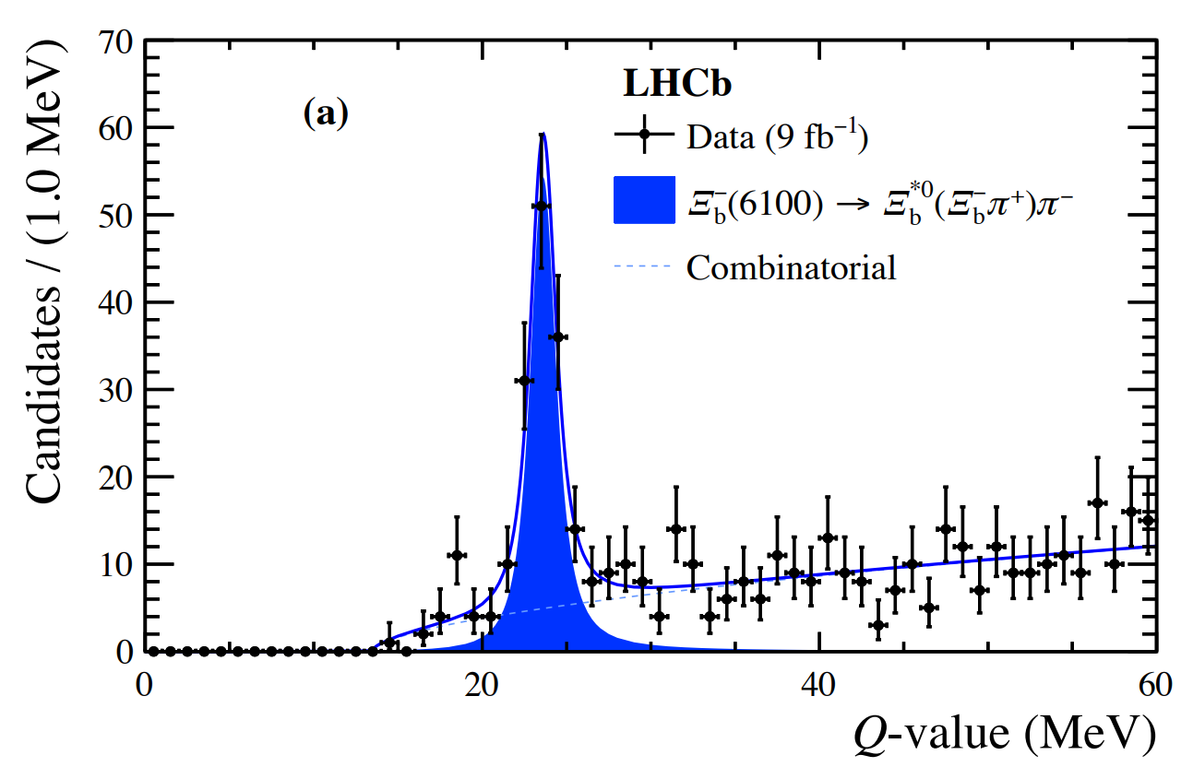
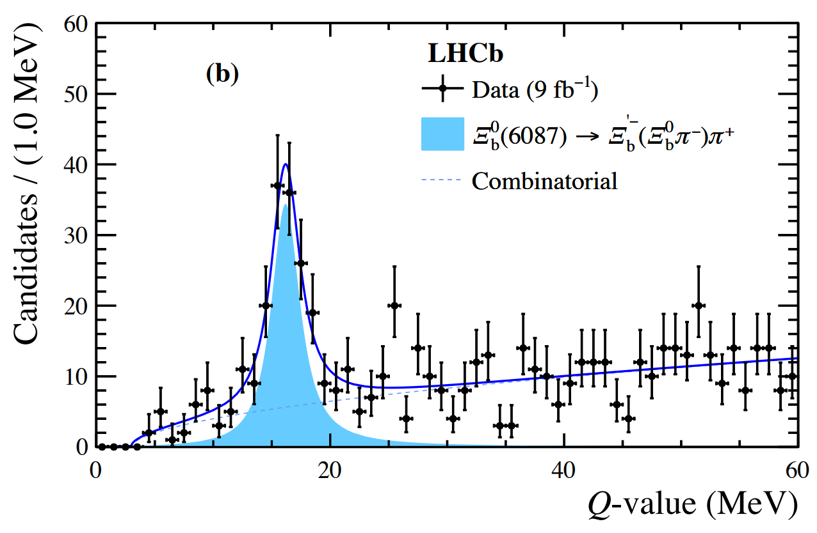
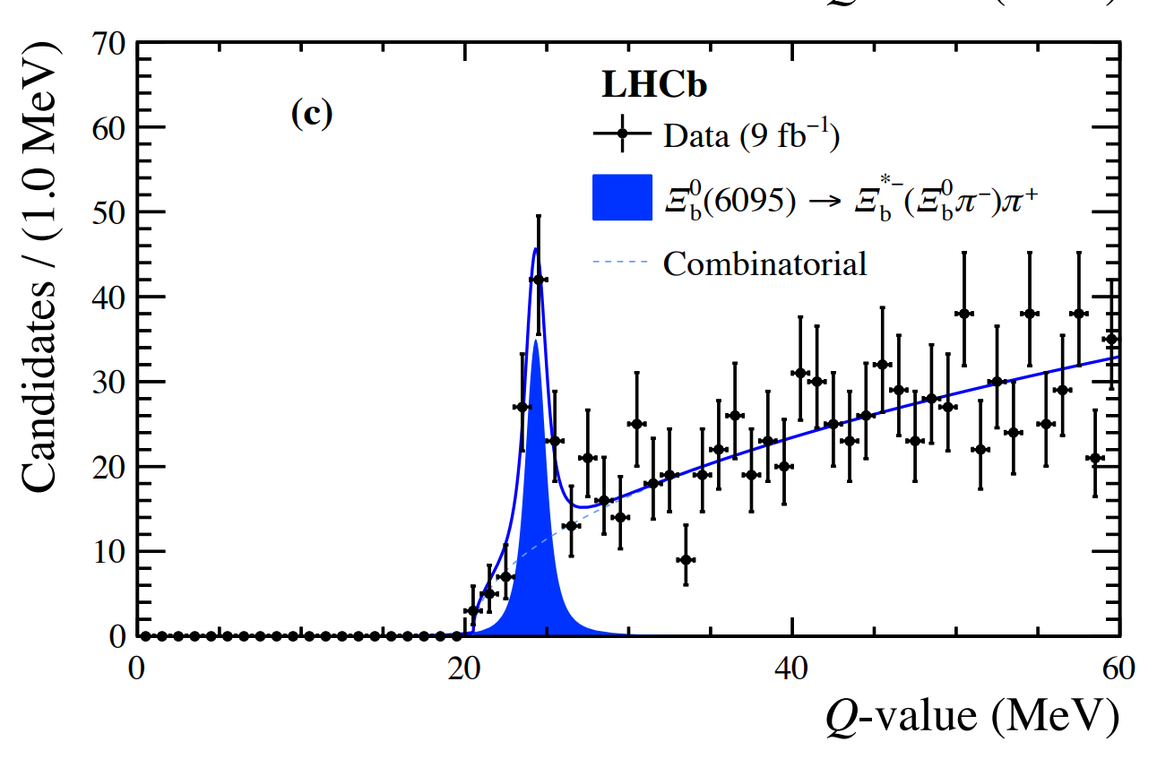
New excited $Ξ_{b}^{0}$ states
arXiv:2307.13399, Accepted by PRL
The ground state $Ξ_{b}^{0/−}$ was reconstructed by combining $Ξ_{c}^{+/0}$ with $π^{−}$ or $π^{−}π^{+}π^{−}$.
Then combined with another pion $⇒Ξ_{b}^{∗0}$ or ${Ξ_{b}^{′}}^{−}$/ $Ξ_{b}^{∗−}$
Finally combined it with the second opposite-charged pion
$$Q=m\left(Ξ_{b}^{−}π^{+}\right)−m\left(Ξ_{b}^{−}\right)−m\left(π^{+}\right)$$
$$Q=m\left(Ξ_{b}^{0}π^{−}\right)−m\left(Ξ_{b}^{0}\right)−m\left(π^{−}\right)$$
$$Q=m\left(Ξ_{b}^{−}π^{+}π^{−}\right)−m\left(Ξ_{b}^{−}\right)−2m\left(π^{±}\right)$$
$$Q=m\left(Ξ_{b}^{0}π^{−}π^{+}\right)−m\left(Ξ_{b}^{0}\right)−2m\left(π^{±}\right)$$
$$Q=m\left(Ξ_{b}^{0}π^{−}π^{+}\right)−m\left(Ξ_{b}^{0}\right)−2m\left(π^{±}\right)$$

Slide 10
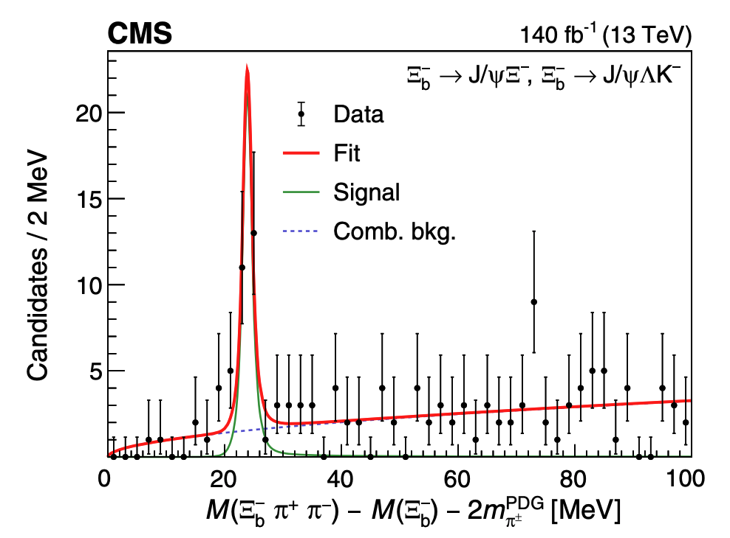
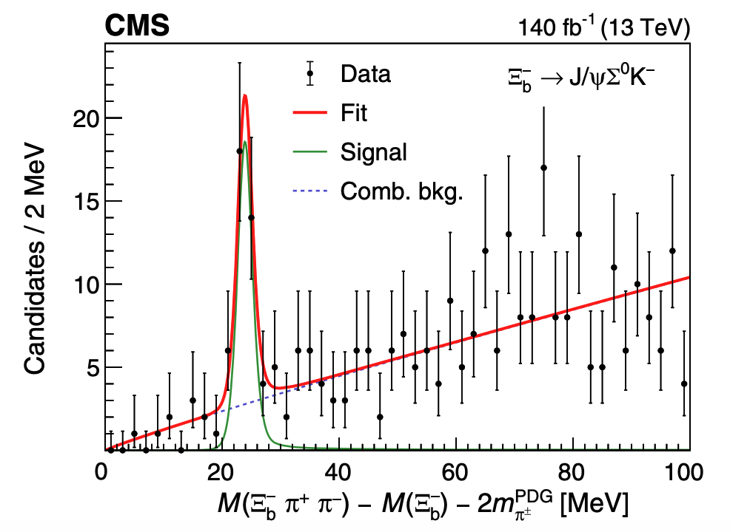
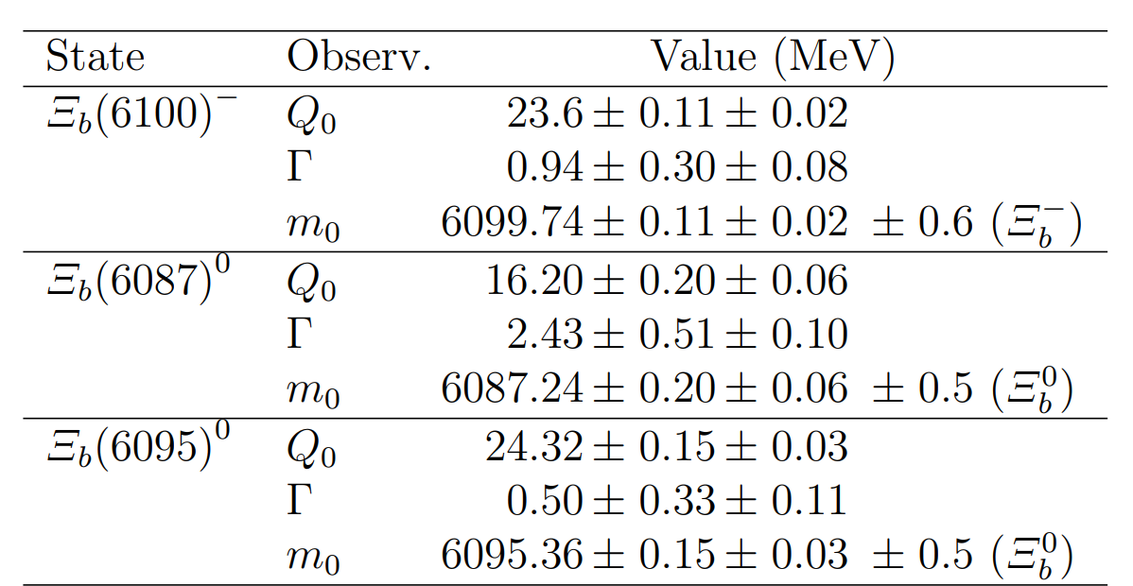
New excited $Ξ_{b}^{0}$ states
arXiv:2307.13399, Accepted by PRL
$$Q=m\left(Ξ_{b}^{−}π^{+}π^{−}\right)−m\left(Ξ_{b}^{−}\right)−2m\left(π^{±}\right)$$
PRL126 (2021)252003
$Ξ_{b}{\left(6100\right)}^{−}$ (observed by CMS) is confirmed by LHCb with significance >12$σ$.
First observation of $Ξ_{b}{\left(6087\right)}^{0}$ and $Ξ_{b}{\left(6095\right)}^{0}$:
Significance >10$σ$(and 8$σ$).
Decay properties are measured.
Maybe P-wave states coupling to the b quark to give a pair of states with $J^{P}={\frac{1}{2}}^{−}$ and $J^{P}={\frac{3}{2}}^{−}$
confirmed
new
new

Slide 11
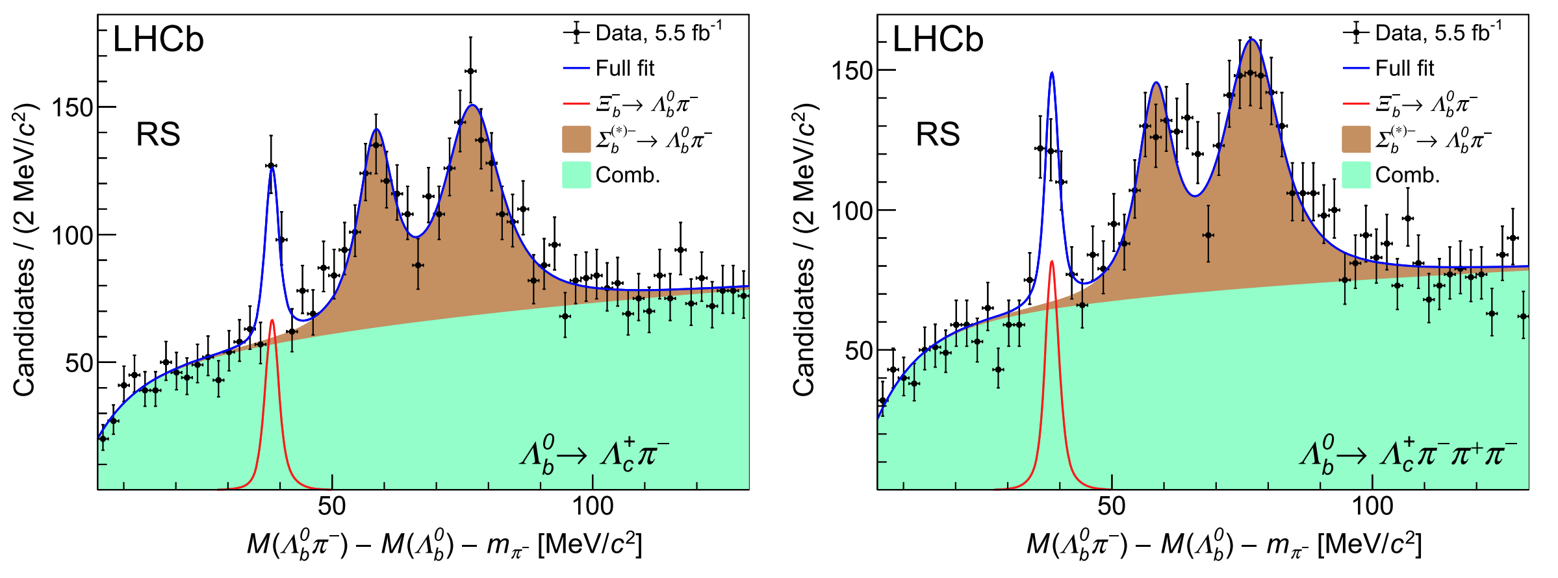
Observation & BF measurement of $Ξ_{b}^{−}→Λ_{b}^{0}π^{−}$
1st show
PRD108 (2023) 072002
A previous LHCb study using Run 1 dataset shows an evidence for the strangeness-changing weak decay $Ξ_{b}^{−}→Λ_{b}^{0}π^{−}$. $⇒$ Updated with Run 2 dataset.
PRL115 (2015) 241801
Using the independent $f_{Ξ_{b}^{−}}/f_{Λ_{b}^{0}}$ measurement from PRD 99 (2019) 052006, the BF is determined as:
Consistent with predictions from
some diquark model : H.Y. Cheng et.al. JHEP03(2016)028
current algebra approaches: e.g., PLB 750. (2015) 653
duality: e.g., PRD 93 (2016) 034020
Notes:
parity-violating S-wave matrix element sd(0+) -> ud(0+) + pi^- (0-) , b is a spectator, s->u ubar d

Slide 12
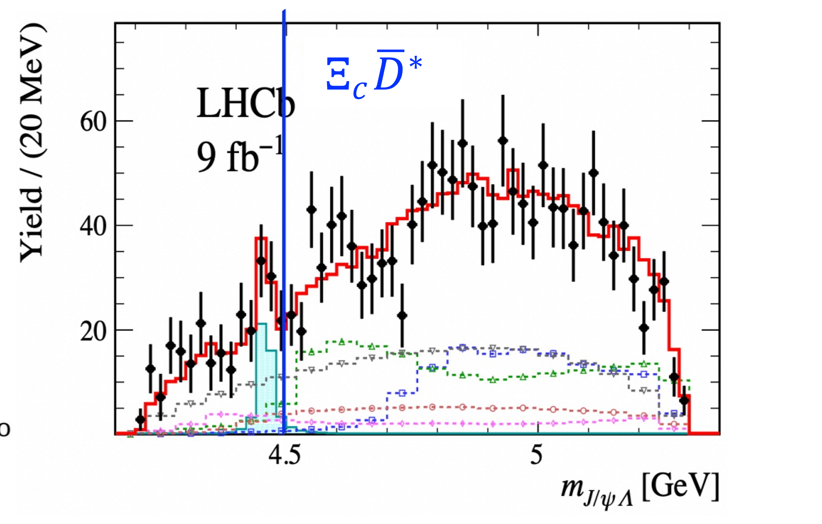
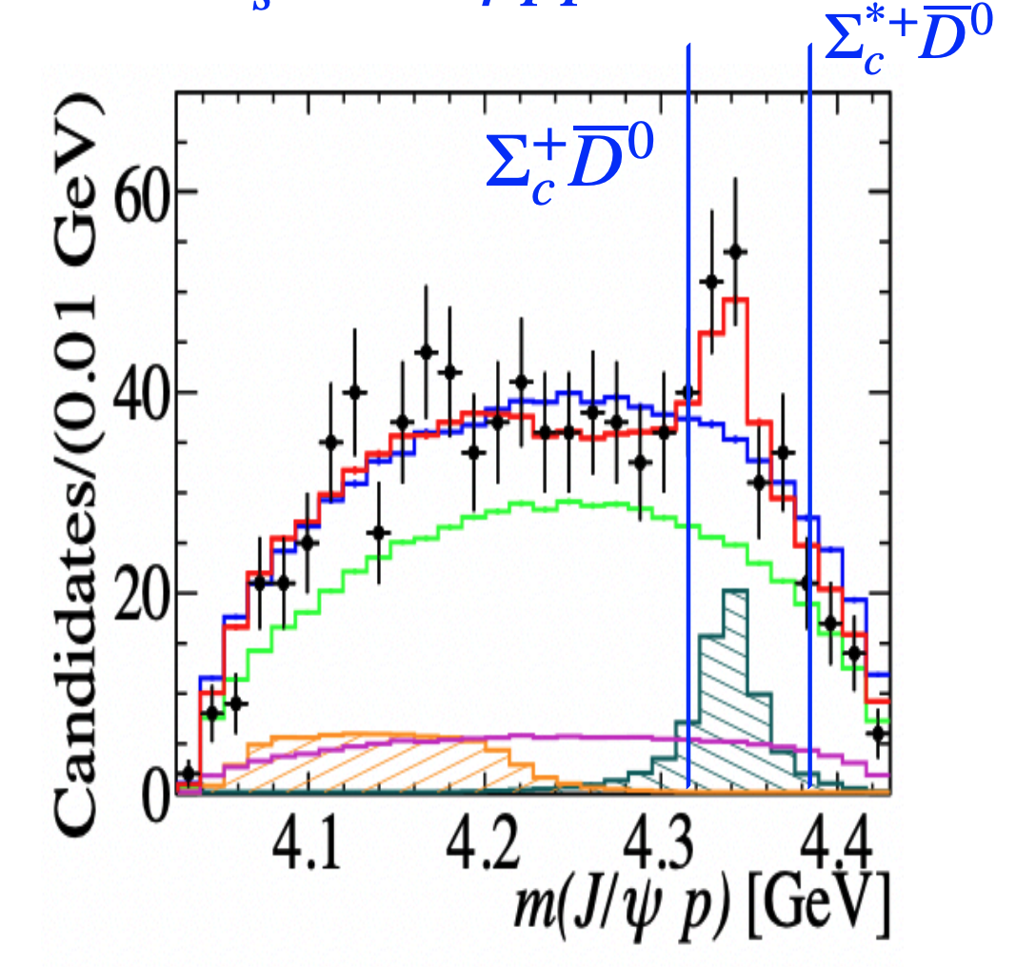
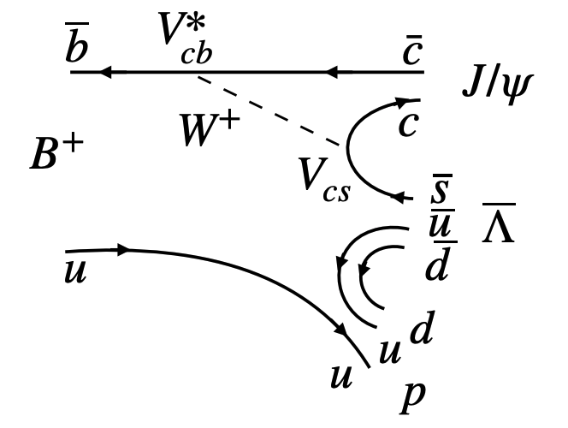
Observation of $P_{ψs}^{Λ}{\left(4338\right)}^{0}$
PRL131 (2023) 031901
The mass of pentaquarks is found to be close to charm-baryon and charm-meson threshold.
The interpretation as hadronic molecular-state is one of the popular theories.
Evidence of $P_{ψs}^{Λ}$in $Ξ_{b}^{−}→J/ψΛK^{−}$
Evidence of $P_{ψ}^{N}$in $B_{s}^{0}→J/ψp\overline{p}$
PRL 128(2022) 062001
$P_{ψ}^{N}$ in $Λ_{b}^{0}→J/ψpK$
PRL 122 (2019) 222001
$$\left(c\overline{c}uds\right)$$
Sci.Bull.66 (2021) 1278
$$\left(c\overline{c}uud\right)$$
$$\left(c\overline{c}uud\right)$$
$B^{+} → J/ψ\overline{Λ}p$ is an ideal decay to search for pentaquark candidates related to the thresholds of $Ξ_{c}^{+}D^{−}$, $Λ_{c}^{+}D_{s}^{−}$ , and $Λ_{c}^{+} {\overline{D}}^{0},Σ_{c}{\overline{D}}^{(∗)}$at the same time.
93% purity of 4617 B candidates.
6D amplitude fit is performed.
𝐽/𝜓$Λ$
𝐽/𝜓$p$
Tree-level Feynman diagram for $B^{+} → J/ψ\overline{Λ}p$decay

Slide 13
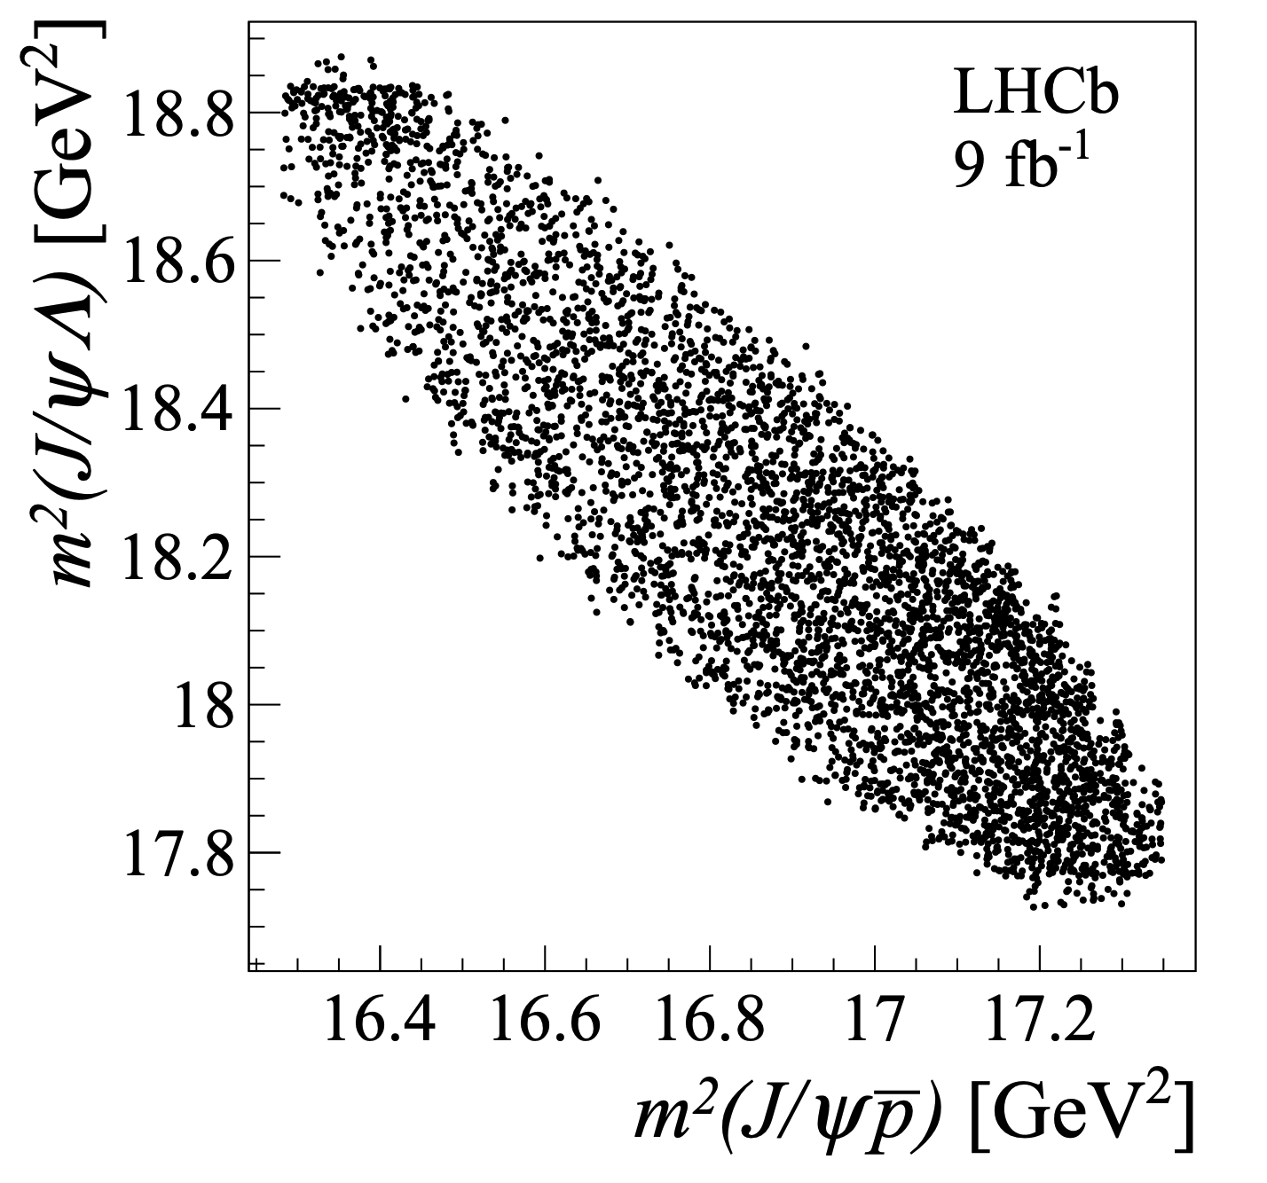
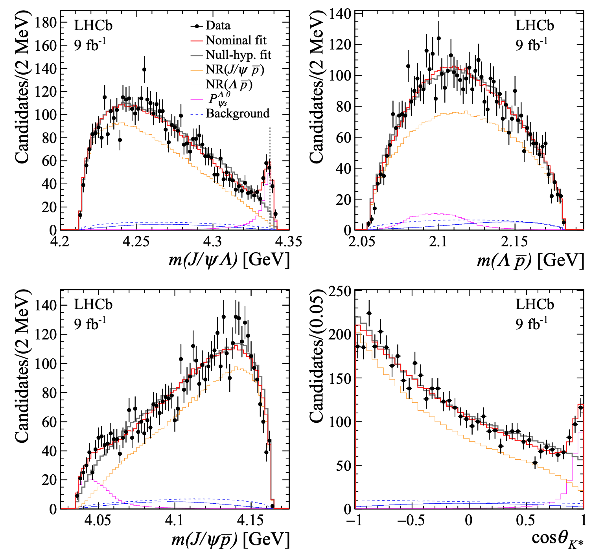
Observation of $P_{ψs}^{Λ}{\left(4338\right)}^{0}$
PRL131 (2023) 031901
Start from the $K^{∗}$model: $K_{2,3,4}^{∗}$ and NR($Λ\overline{p}$) - can’t describe the data well.
Nominal model: NR($Λ\overline{p}$), NR($J/ψ\overline{p}$) and $P_{ψs}^{Λ}$ - significantly improve the likelihood.
$P_{ψs}^{Λ}{\left(4338\right)}^{0}$is observed for the first time with significance >10$σ$ (w.r.t. to the non-${P_{ψs}^{Λ}}^{0}$ hypo).
Minimal quark component: $c\overline{c}uds$
The first observation of a hidden-charm pentaquark candidate with strangeness.
$J^{P}={\frac{1}{2}}^{−}$ preferred. BW mass and width are reported.
Close to $Ξ_{c}^{+}D^{−}$ threshold and $J^{P}$ consistent with S-wave $Ξ_{c}\overline{D}$ molecular state.
$$\begin{matrix}M\left(P_{ψs}^{Λ}\right)=4338.2±0.7±0.4MeV \\ Γ\left(P_{ψs}^{Λ}\right)=7.0±1.2±1.3MeV\end{matrix}$$

Slide 14
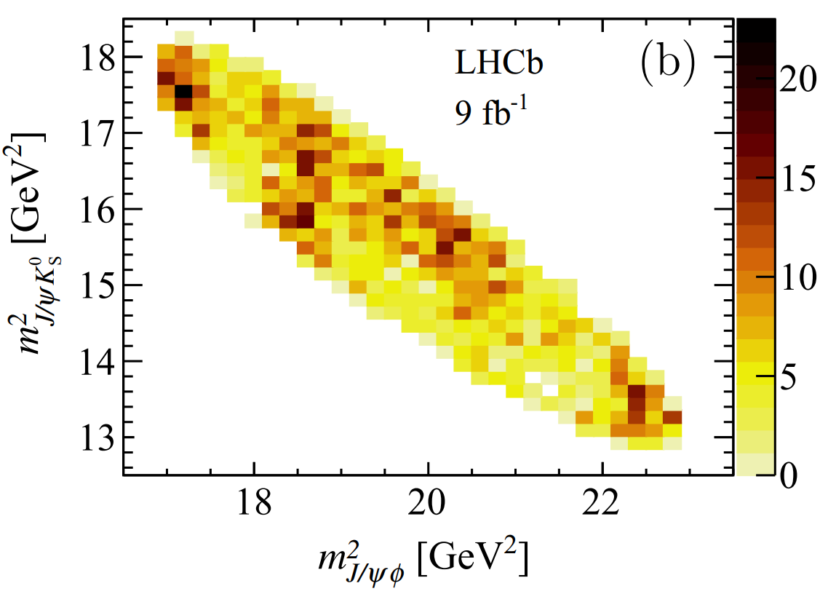
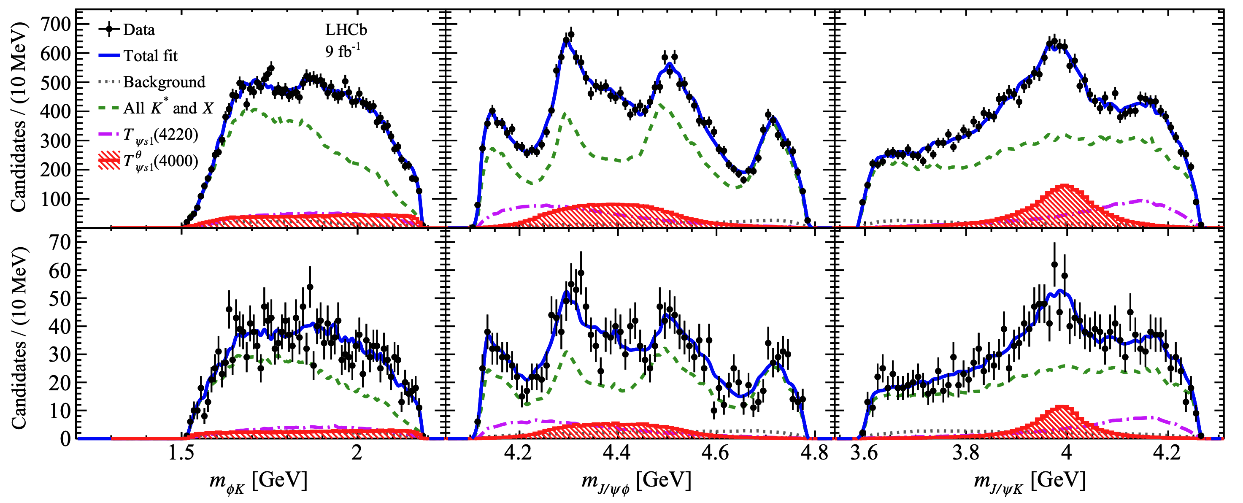
Evidence of $T_{ψs1}^{θ}{\left(4000\right)}^{0}$
PRL131 (2023) 131901
PRL127 (2021) 082001
$T_{ψs1}^{θ}{\left(4000\right)}^{+}$ and $T_{ψs1}^{}{\left(4220\right)}^{+}$ are observed in $B^{+}→J/ψφK^{+}$ decays.
Searching for their isospin partners to identify the full SU(3) nonet that involves these states.
The $B^{0}→J/ψφK_{S}^{0}$ decay is an ideal process to search for that states due to the isospin symmetry.
Simultaneous fit is performed to $B^{0}→J/ψφK_{S}^{0}$ and the $B^{+}→J/ψφK^{+}$ samples.
Evidence of a $J/ψK_{S}^{0}$ structure with a significance of 4$σ$ is seen.
Denoted as $T_{ψs1}^{θ}{\left(4000\right)}^{0}$ ($c\overline{c}d\overline{s}$), which likely to be the isospin partner of $T_{ψs1}^{θ}{\left(4000\right)}^{+}$ ($c\overline{c}u\overline{s}$).
$$B^{+}$$
$$B^{0}$$
$$M\left(T_{ψs1}^{θ}(4000)^{0}\right)={3991}_{−10−17}^{+12+9} MeV$$
$$Γ\left(T_{ψs1}^{θ}(4000)^{0}\right)={105}_{−25−23}^{+29+17} MeV$$
$$ΔM=−{12}_{−10}^{+11}{}_{−4}^{+6} MeV$$

Slide 15
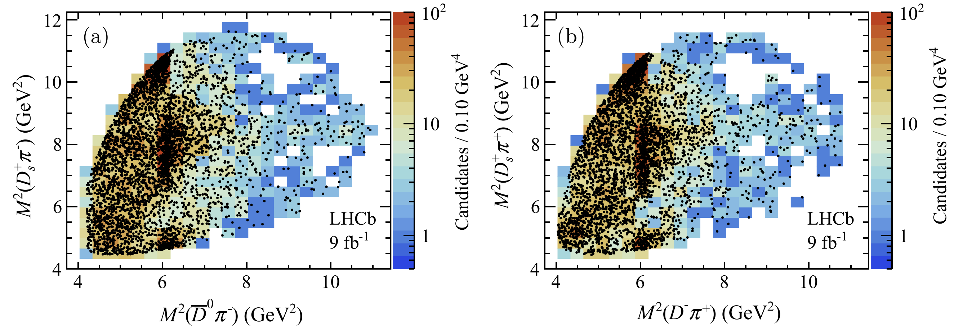
Observation of $T_{c\overline{s}0}^{a}{\left(2900\right)}^{++}$ and $T_{c\overline{s}0}^{a}{\left(2900\right)}^{0}$
PRD108 (2023) 012017
PRL131 (2023) 041902
Exotics composed of four different quark types attracts great interest in studies of hadron spectroscopy.
$X_{0}\left(2900\right)$ and $X_{1}(2900)$, with quark component $cs\overline{u}\overline{d}$, are observed in $B^{+}→D^{+}D^{−}K^{+}$ decay.
Search for tetraquark candidates, with quark component $c\overline{s}u\overline{d}$ or $c\overline{s}\overline{u}d$, can be performed in $B^{+}→D^{−}D_{s}^{+}π^{+}$ and $B^{0}→{\overline{D}}^{0}D_{s}^{+}π^{−}$ decays.
A combined amplitude analysis of the $B^{+}→D^{−}D_{s}^{+}π^{+}$ and $B^{0}→{\overline{D}}^{0}D_{s}^{+}π^{−}$ decays is performed.
Structure at 2.9 GeV in $D_{s}^{+}π^{+/−}$ spectra can not be well described by any known or new $D^{∗+/0}→{\overline{D}}^{0/−}π^{+}$ resonances.
PRL125 (2020) 242001
PRD102 (2020) 112003

Slide 16
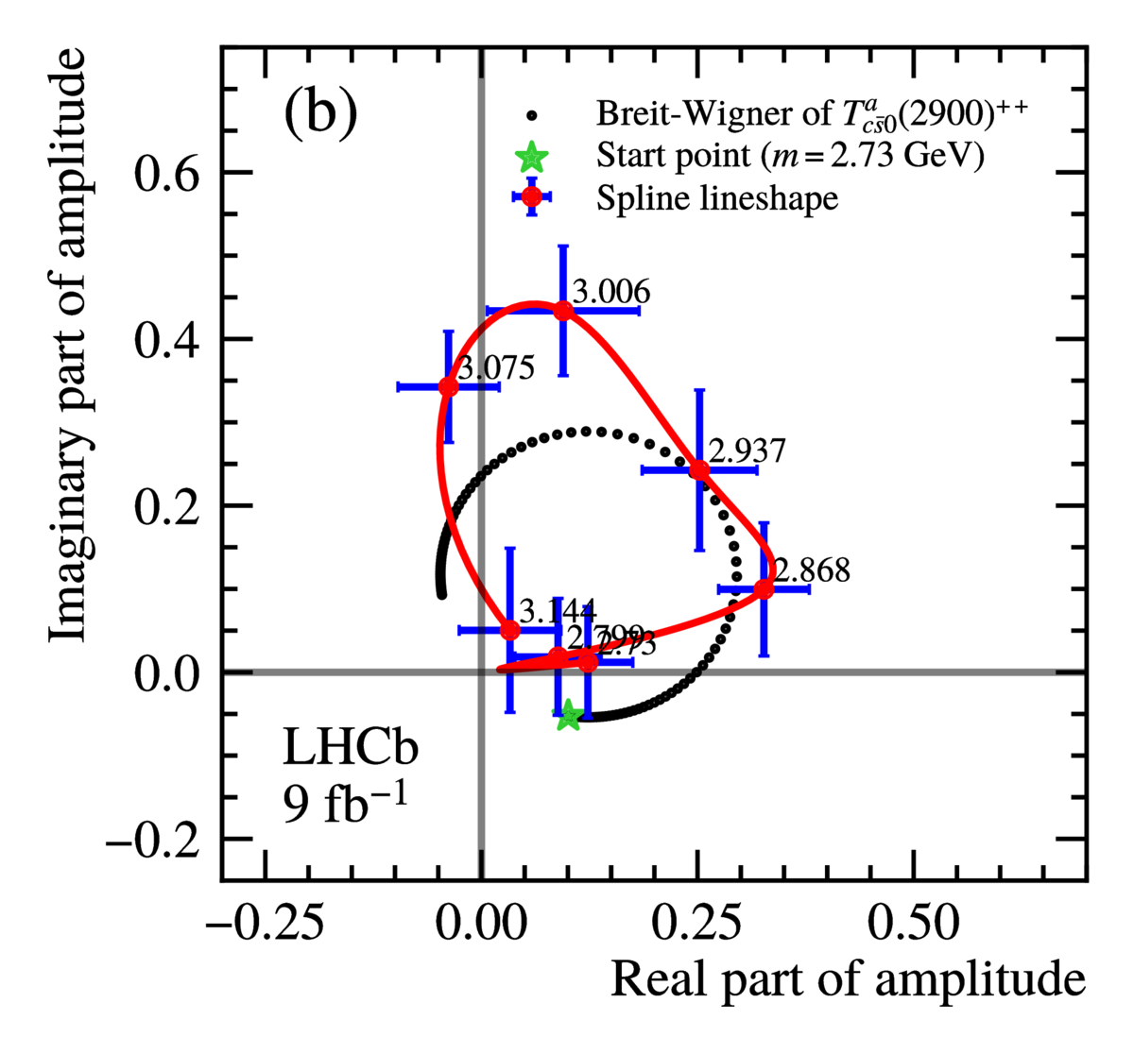
Observation of $T_{c\overline{s}0}^{a}{\left(2900\right)}^{++}$ and $T_{c\overline{s}0}^{a}{\left(2900\right)}^{0}$
PRL131 (2023) 041902
With two additional $D_{s}^{+}π^{±}$ components, the data is better described.
Both states prefer $J^{P}=0^{+}$ ($1^{−}$ is rejected by >7$σ$).
Separated fit reports:
Shared fit reports: (assume they belong to isospin triplet)
(both M and $Γ$ in great agreement)
8.0$σ$
6$.5σ$
Combined significance >9.0$σ$
$T_{c\overline{s}0}^{a}{\left(2900\right)}^{++}$ is the first observed doubly-charged tetraquark candidate.

Slide 17
Summary and prospects
arXiv:2305.10515
Some recent interesting results presented:
New conventional hadrons
New excited $Ω_{c}^{0}$ states: $Ω_{c}{\left(3327\right)}^{0},Ω_{c}{\left(3185\right)}^{0}$
New excited $Ξ_{b}^{0}$ states: $Ξ_{b}{\left(6095\right)}^{0},Ξ_{b}{\left(6087\right)}^{0}$
New exotics
New pentaquark candidates: $P_{ψs}^{Λ}{\left(4338\right)}^{0}$
New tetraquark candidates: $X\left(3960\right), T_{ψs1}^{θ}{\left(4000\right)}^{0}, T_{c\overline{s}0}^{a}{\left(2900\right)}^{++/0}$
Higher statistics in upgrade boosts hadron spectroscopy studies at LHCb:
Search for more conventional excited states
Evidence of some hadrons/decay modes $⇒$ Observation
Search for new decay modes of observed exotic hadrons, e.g., ${P_{ψ}^{N}}^{+}$
Determine $J^{P}$ and other properties of multiquark states
……

Slide 18
Thanks for listening
Questions and comments are welcomed.

Slide 19
Backup

Slide 20
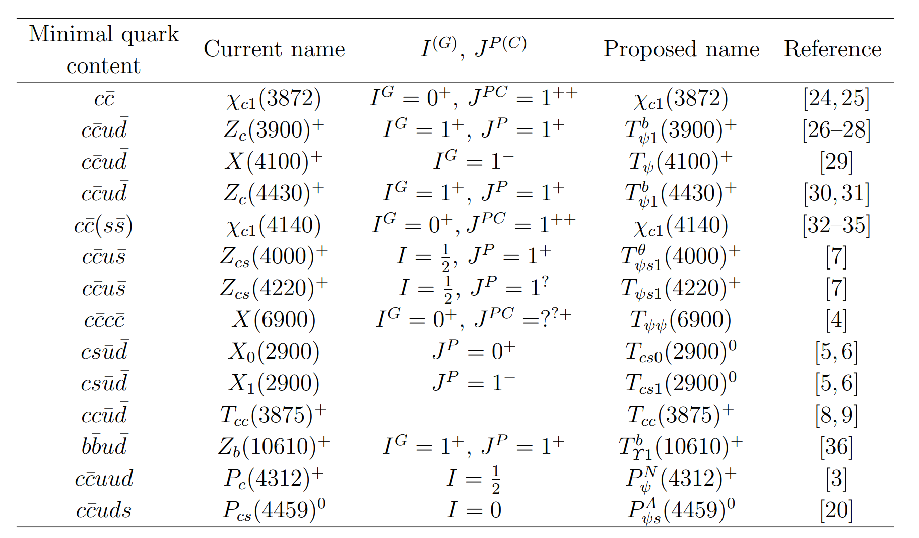
Impact on recently discovered hadrons

