Slide 1
Investigation of the transition form factors of excited Baryons with HADES
Apr. 24th 2018 I Jim RItman
668. WE-Heraeus-Seminar on Baryon Form Factors: Where do we stand?
23-27 April 2018
Physikzentrum Bad Honnef, Germany

Slide 2
OUTLINE
Introduction
Δ(1232) Dalitz decay in pp reactions
Second resonance regime with pion induced reactions
Dalitz decay of excited hyperons with proton beam and HADES upgrade
Summary & Conclusions

Slide 3
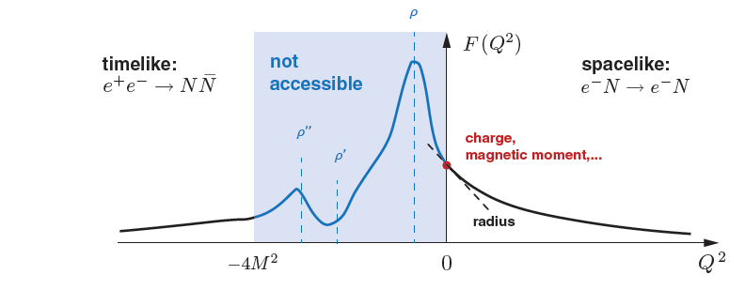
Radiative Decays of Excited Baryons
Timelike (G_{M}(q²), G_{E}(q²)) complementary to Spacelike kinematic region
Low energy TL complementary to high energy TL
(e.g. BES-III, CLEO)
Access to kinmatically
forbidden region for
annihilation
𝐵𝐵→M 𝑒⁺𝑒⁻
𝐵₁ →𝐵₂𝑒⁺𝑒⁻

Slide 4
Δ(1232) Dalitz decay in pp reactions
Phys. Rev. C 95, 065205 (2017)

Slide 5
Δ(1232) Dalitz decay
Dalitz decays give access to „kinematically forbidden“ region (for annihilation experiments)
Baryon transitions non-perturbative, and connected to question of degrees of freedom
Small q² is suitable to study coupling to vector mesons and thus VDM
Branching ratio to real photons (0.55-0.65)%
Branching ratio to γ* not measured (theory ~4x10⁻⁵) [M. Zétényi and Gy. Wolf, Heavy Ion Phys. 17 (2003) 27]
N→Δ described by 3 helicity amplitudes A_{1/2}(q²), A_{3/2}(q²), S_{1/2}(q²) (S_{1/2}(q²=0) →0)
amplitudes unknown for q²>0
Partial decay width requires eTTF, which can be complex in TL region
VDM calculations are dominated by rho
Incoherent contribution from NN bremsstrahlung

Slide 6
Δ(1232) Dalitz decay with HADES at T = 1.25 GeV
Beam energy below η threshold to favor Δ
Hadronic decay channel extensively studied using HADES data and BN-Gatchina PWA
HADES Data (7500 e⁺e⁻ pairs)
(Phys. Rev. C95 (2017) no.6, 065205 )
Blue: Δ → Nπ⁰ → Ne⁺e⁻γ
Black: N(1440) → Nπ⁰ → Ne⁺e⁻γ
Red: Δ → Ne⁺e⁻
(pointlike γ*NR coupling)

Slide 7
Δ(1232) Dalitz decay with HADES at T = 1.25 GeV
Comparison of π⁰ and e⁺e⁻ γ final states
Consistency between both reconstruction paths → verification of dilepton channel
PWA of distributions (blue)

Slide 8
Δ(1232) Dalitz decay with HADES at T = 1.25 GeV
Angular distribution of e⁺ - γ* in γ* rest frame (from π⁰)
Expect dσ/dΩ ~ 1 + B cos²Θ
with B=1 for ps-v-v transitions (only transverse virtual photons)

Slide 9
Δ(1232) Dalitz decay with HADES at T = 1.25 GeV
Identification of Δ Dalitz decay
Expect M_{miss}(pe⁺e⁻) ~ M(p)
for exclusivity
Expect M(e⁺e⁻) > M(π⁰)
to suppress π⁰ Dalitz

Slide 10
Δ(1232) Dalitz decay with HADES at T = 1.25 GeV
Angular distribution of e⁺ - γ* in γ* rest frame
Expect dσ/dΩ ~ 1 + B cos²Θ with B=1 for transverse virtual photons)
Corroborates identification as Δ

Slide 11
Δ(1232) Dalitz decay with HADES at T = 1.25 GeV
Form Factor
Ratio of data (after subtraction of
bremsstrahlung) to simulated
Δ contributions with pointlike
coupling (QED)
Dashed green:
F. Iachello and Q. Wan, Phys. Rev. C 69 (2004) 055204.
Blue: Δ Dalitz
G. Ramalho et al., Phys. Rev. D 93 (2016) 033004.
Red/Black: components of Ramalho-Peña

Slide 12
Second Resonance Region with
π⁻ p → n e⁺e⁻

Slide 13
Pion Beam at HADES
Goal: scan N(1520) region to improve π⁺π⁻ database and investigate R→Ne⁺e⁻ (no data available)
Federico Scozzi, ECT* Trento 2017

Slide 14
Pion Beam at HADES
Elastic Scattering for normalization with SAID

Slide 15
Pion Beam at HADES
PWA of dipion final state, and importance of the ρ meson

Slide 16
Pion Beam at HADES
Inclusive dilepton spectrum

Slide 17
Pion Beam at HADES
Exclusive dilepton spectrum
Select events with 0.9 < MM_{ee} < 1.02 GeV
further information
in angular distributions
on the different contributions
(spin density matrix)

Slide 18
Pion Beam at HADES
Dilepton Form Factor

Slide 19
Dalitz decay of excited hyperons with proton beam

Slide 20
Radiative Hyperon Decays
Decays to real and virtual photons
sensitive to baryon structure:
Hyperon →Λee not measured at all:
strong effects of vector mesons (VDM)
expected
Only few γ transitions measured
Λ(1520)
Γ = 15.6
I=0
J= 3/2-
Σ*(1385)
= 36
J = 3/2+
Λ(1405)
= 50
J = 1/2-
I=1
0.85%±0.15%
1.2%±0.13%
Σ(1192)
J = 1/2+
Λ(1115)
J =1/2+
100 %

Slide 21
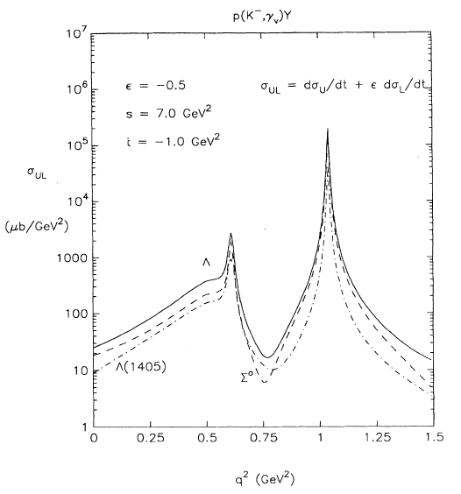
Hyperon production in pp and decays to Dileptons
VMD: Huge enhancement predicted
R. Williams et. al. PRC48(1993)1381
Inclusive @ 4.5 GeV
Λ ~350 μb
Λ(1520) ~ 50 μb
Proof of principle:
HADES pp@ 3.5 GeV PRC95(2017)015207
K⁻p →Y γ*
(M_{e+e-}) ²

Slide 22
USING HADES TO MEASURE Y*→Λee
Proposed reaction:
p p(A) →Y (any hyperon) X →Λe+e- X (BR~10⁻⁵)
High intensity AND energy proton beams (T = 4.5 GeV)
Measured BR (Λγ) are large! (comparable to Δ→Nγ)
Hyperon states are narrow
HADES has excellent Λ and e⁺e⁻ capabilities
Upgrade challenges:
  Increase DAQ rate
  Improve γ, e⁺e⁻ efficiency (ECAL, RICH)
  Improve Λ efficiency (STS, FTOF)

Slide 23
HADES Upgrade
New:
RICH photon-detector
& Readout
e⁺e⁻ eff. gain x 5
ECAL (Pb-glass)
g, e⁺, e⁻
σ(E) / ⎷(E) ~ 5.5%
Forward Detector:
PANDA Straws
σ(x) ~ 140 micron
RPC TOF
σ(t) ~ 70 ps

Slide 24
Excited Hyperon Program with PRoton beam at HADES
Plan: 30 days of proton beam at close to max. SIS18 energy
Improve BR for Σ*⁰→Λγ (10% ◊ 3%)
Improve BR for Σ*⁺→Σ⁺γ (25% ◊ 5%)
Establish BR for Σ⁰→ Λe⁺e⁻ ((QED) 0.5%)
Establish BR for Σ*⁰→ Λe⁺e⁻ ( ~10⁻⁴ )
Establish BR for Λ* (1520)→ Λe⁺e⁻ ( ~8x10⁻⁵ )
Form Factors (mostly magnetic) q²<(260) MeV² (never measured, expect 600-4000 events)
Explore double strange Ξ⁻ (1321) production (complementary to PANDA with pbar-p)

Slide 25
Simulations of occupied Phase Space
p(T=4.5GeV) + p → Ξ⁻ K⁺K⁺p
p in FT
π in HADES
Reactions with low Q, and also the baryon from hyperon decay are strongly forward peaked
(→ Tracker + TOF Upgrade)
Pions (and electrons) from hyperon decay are emitted with a large polar angle
(→ HADES)

Slide 26
Inclusive Lambda Production
pp→ p K⁺ Λ(1520) [ Λ [pπ⁻] e⁺e⁻ ]
Larger phase space leads to more protons in HADES

Slide 27
Inclusive Λ(1520) Reconstruction
HADES
Forward Detectors

Slide 28
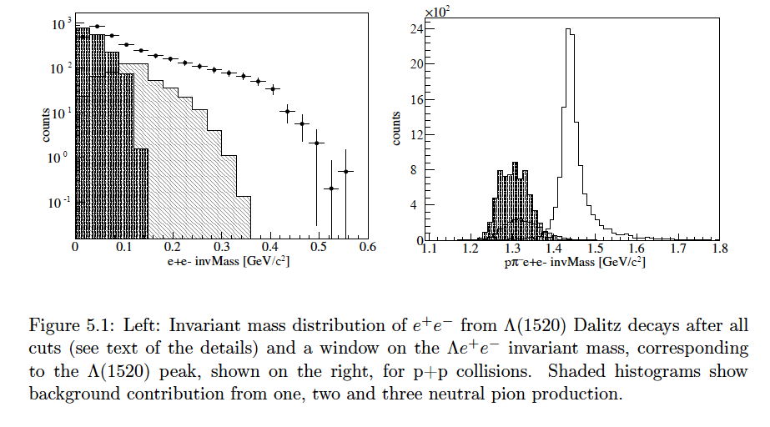
RATE ESTIMATES FOR Λ(1520) ◊ Λee

Slide 29
SummarY & Conclusions
Δ Dalitz decay measured for first time
BR and TFF determined
Pion interactions to study second resonance region
Indications of VDM in higher mass TFF of N(1520)
Upcoming experiments to measure hyperon TFF
Expect 600 (LH2) or 4000 (PE) reconstructed events for 4 week beamtime

Slide 30
Spare slides

