Slide 1

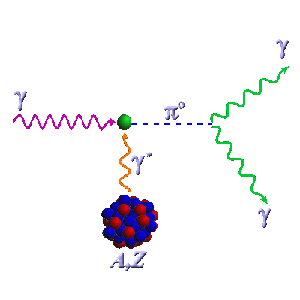
π⁰→ γγ decay width from the PrimEx-II experiment
Ilya Larin
University of Massachusetts Amherst
for the PrimEx-II Collaboration

Slide 2
Outline
Physics motivation
Experimental methods
The PrimEx experiment
PrimEx-II results
Further experiments within 12 GeV program at Jefferson Lab

Slide 3

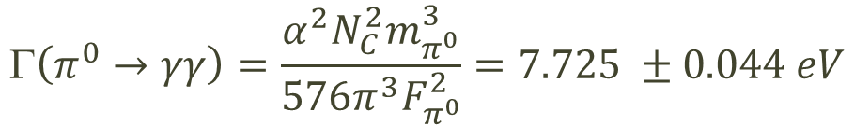
QCD predictions for Γ(π⁰→γγ)
π⁰→ γγ proceeds primarily via chiral anomaly
Chiral anomaly predicts exact value for decay width at the leading order:
Next to the leading order corrections have been calculated taking into account different quark masses and mixing effects with percent level precision:
  J.Goity et al.: 8.1eV±1.0%
  K.Kampf, B.Moussalam: 8.09±1.4%
  B.Ananthanarayan et al.: 8.06±1.0%
  B.Ioffe, A.Oganesian (QCD sum rules): 7.93±1.5%
γ
π⁰
γ
$$\left(π^{0}→γγ\right)=\frac{α^{2}N_{C}^{2}m_{π^{0}}^{3}}{576π^{3}F_{π^{0}}^{2}}=7.725 ±0.044 eV$$

Slide 4
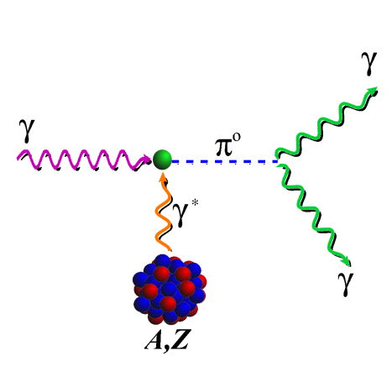
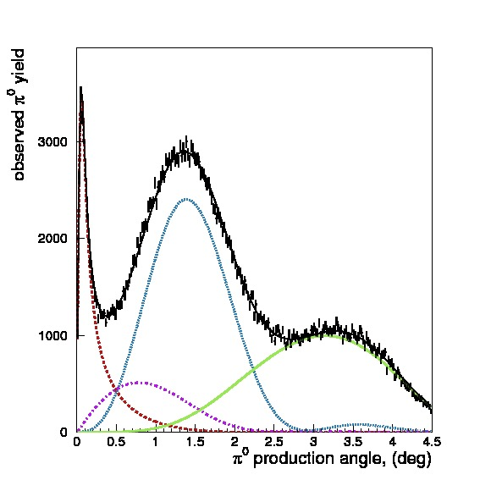
Γ(π⁰→γγ): experimental methods and measurements:
Primakoff method
π⁰ photoproduction in nucleus coulomb field
Coulomb part of photoproduction cross section needs to be extracted:
Limited by accuracy of photoproduction theory
Most recent measurements (preceding PrimEx-II):
  Cornell (1974) Γ(π⁰→ γγ ) = 7.92eV±5.3%
  PrimEx-I (2011) Γ(π⁰→ γγ ) = 7.82eV±2.8%
Primakoff
Strong coherent
Interference
Strong Incoherent

Slide 5
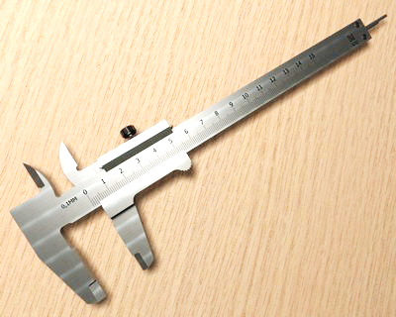
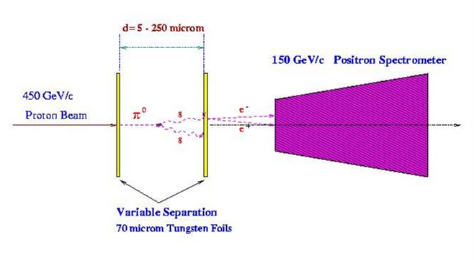
Γ(π⁰→γγ): experimental methods and measurements:
Direct measurement
Direct decay length measurement
Decay length is only ~20μm at 100GeV
Limited by unknown π⁰ momentum spectrum
No need to know production mechanism and cross section
Measurements:
  CERN (1984) Γ(π⁰→ γγ ) = 7.34eV±3.1%
  A new measurement is being planned at CERN (very exciting!)
π
π⁰
π⁰

Slide 6
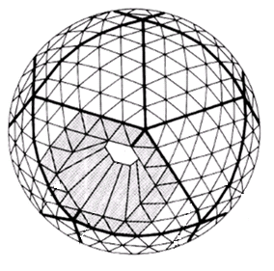
Γ(π⁰→γγ): experimental methods and measurements: production in e⁺e⁻ collisions
“Photoproduction” on virtual γ*γ* in e⁺e⁻ collisions
No need to separate coulomb and strong production
Photoproduction cross section needs to be extracted
Limited by the luminosity of crossing beams accuracy
Measurements:
  CBAL (1988) Γ(π⁰→ γγ ) = 7.75eV±6.4%

Slide 7
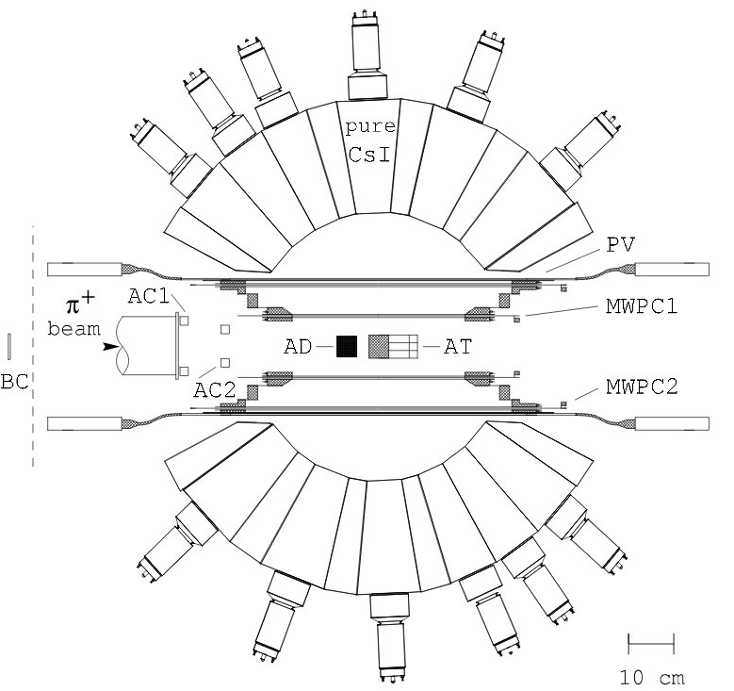
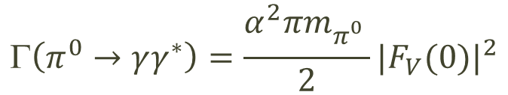
Γ(π⁰→γγ): experimental methods and measurements: π⁺ radiative decay measurement
Γ(π⁰→ γγ) can be calculated from π⁺→ eνγ radiative decay parameters
π⁺→ eνγ decay in rest analysis
Γ(π⁰→ γγ) extracted from vector form factor F_{V}(0):
Measurements:
  PIBETA (2009) Γ(π⁰→ γγ ) = 7.65eV±13%
$$\left(π^{0}→γγ^{∗}\right)=\frac{α^{2}πm_{π_{}^{0}}}{2}{|F_{V}(0)|}^{2}$$

Slide 8
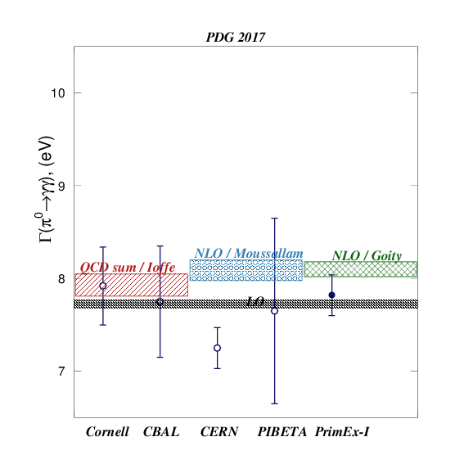
Γ(π⁰→γγ) status: theory calculations and (previous) measurements
Measurement | Method | Result [eV]
PrimEx-I, 2011 | Primakoff | 7.82 ± 0.22
PIBETA, 2009 | π⁺ decay | 7.65 ± 1.0
CERN, 1984 | Direct | 7.25 ± 0.22
CBAL, 1988 | Collider | 7.75 ± 0.6
Cornell, 1974 | Primakoff | 7.92 ± 0.42

Slide 9
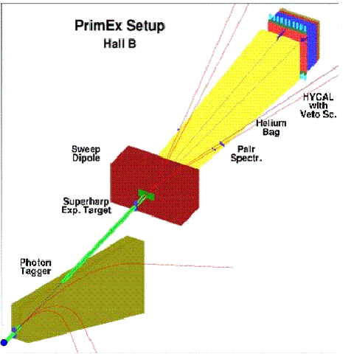
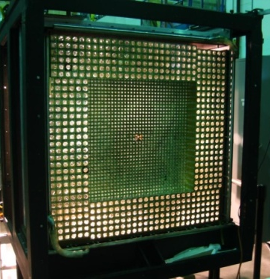
PrimEx Setup
Tagging facility:
  Precise photon beam flux control
  High resolution beam energy and time
Hybrid EM calorimeter:
  Excellent energy, spatial and time resolution
  Large geometrical acceptance
Pair spectrometer for additional flux monitoring
Ability to control apparatus systematics by QED processes

Slide 10
PrimEx-I and II data chart
PrimEx-I
¹²C
²⁰⁸Pb
PrimEx run | Target | Thickness [% r.l.] | Beam flux [×10¹²]
I | ¹²C | 5 | 1.4
I | ²⁰⁸Pb | 5 | 0.72
II | ¹²C | 8 | 2.0
II | ²⁸Si | 10 | 5.3
²⁸Si
PrimEx-II

Slide 11
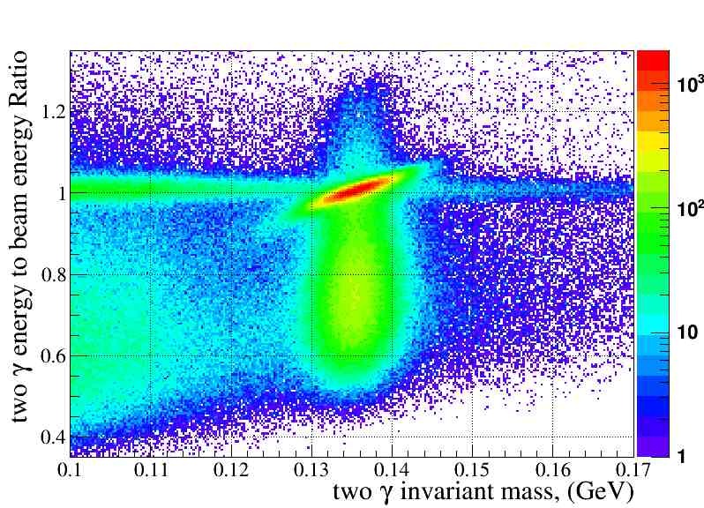

π⁰→γγ event selection
Electromagnetic background
π
Exclusive π⁰
photoproduction

Slide 12
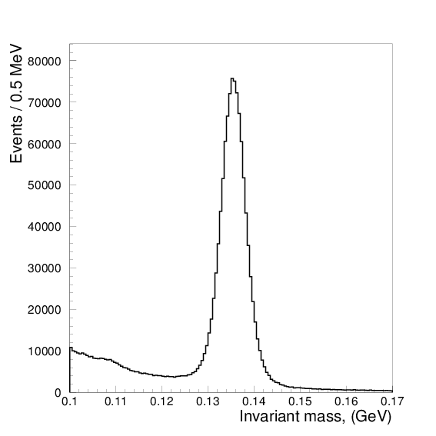
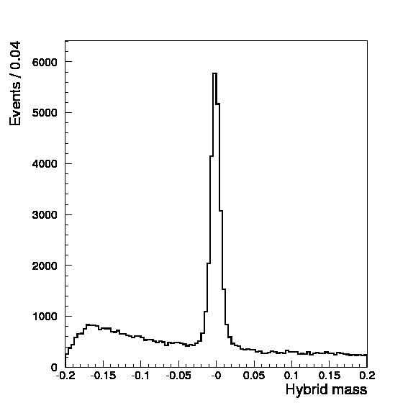
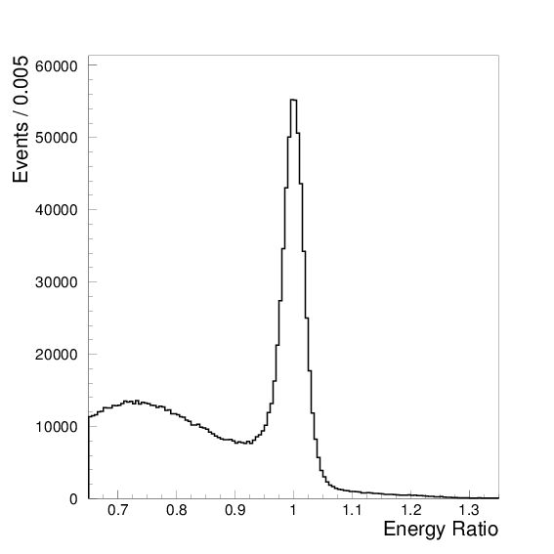
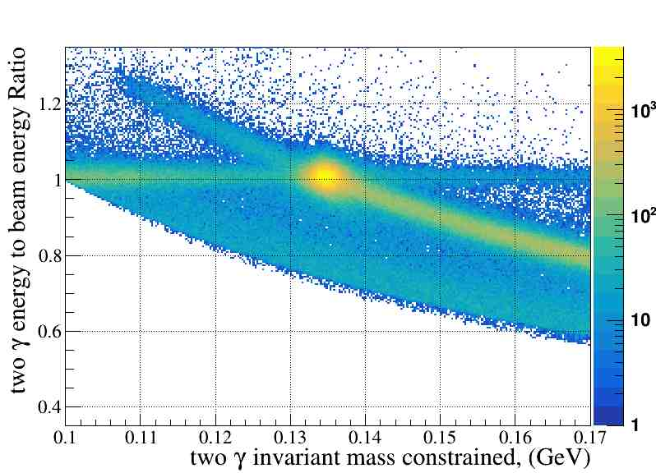
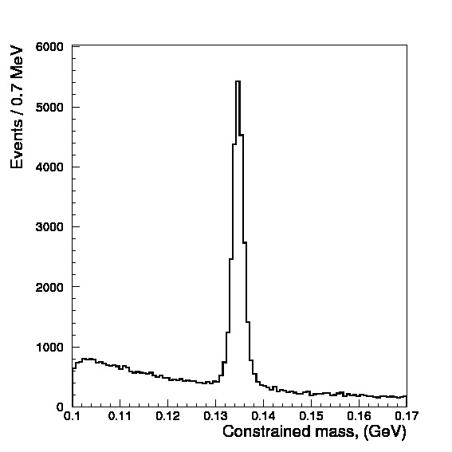
Elastic π⁰ yield extraction
Invariant mass
“Hybrid” mass
Elasticity
Energy constraint mass

Slide 13
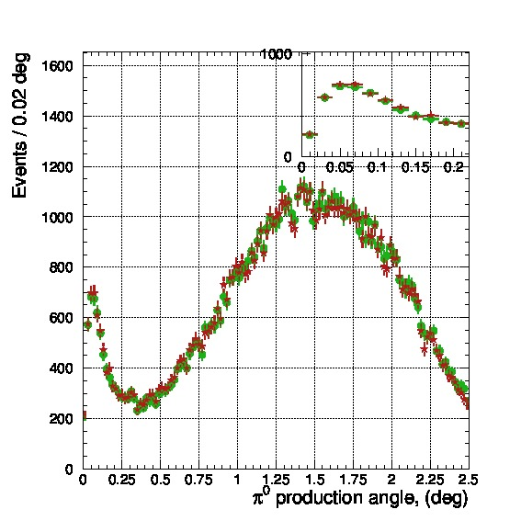
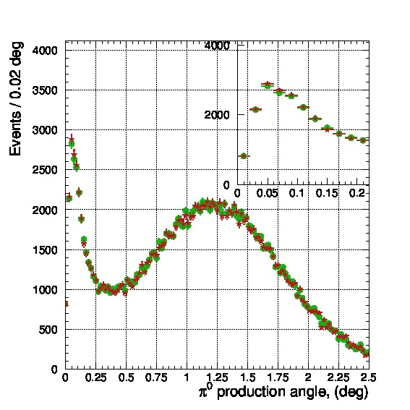
Comparison of two methods
Carbon-12
Silicon-28
- Hybrid mass
- Constrained mass
Extracted π⁰ yield up to 2.5 deg.
method | ¹²C | ²⁸Si
Hybrid mass | 83,751 | 165,329
Constr. mass | 84.015 | 165,736

Slide 14
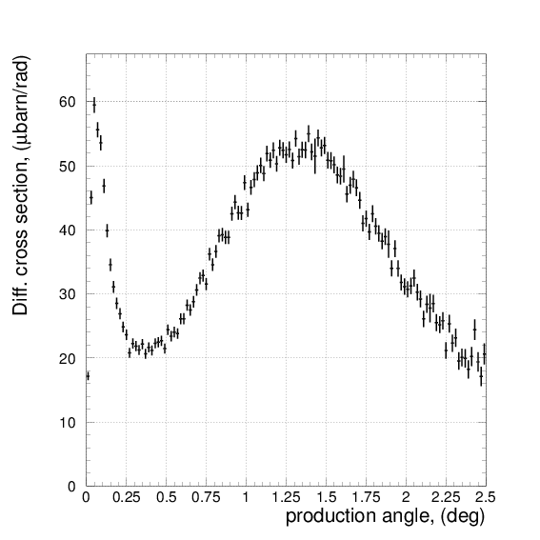
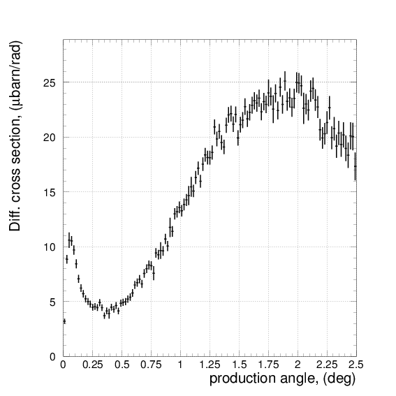
Differential cross section vs production angle
²⁸Si
¹²C
4.45GeV…5.3GeV photon beam energy range
0.02° bin size

Slide 15
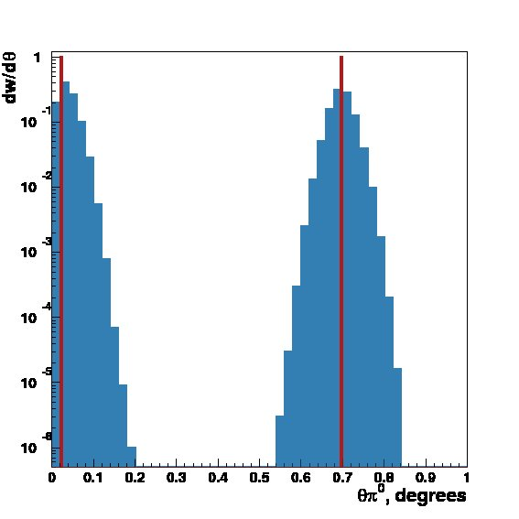
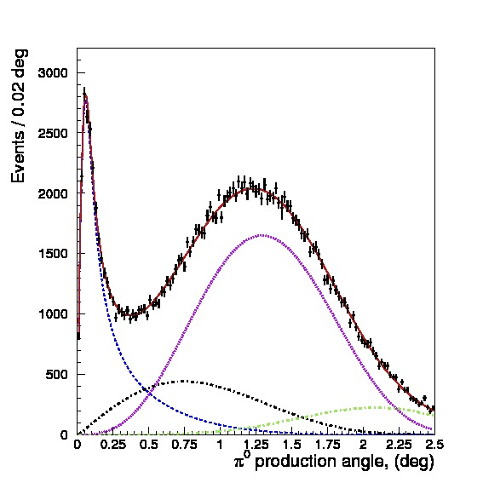
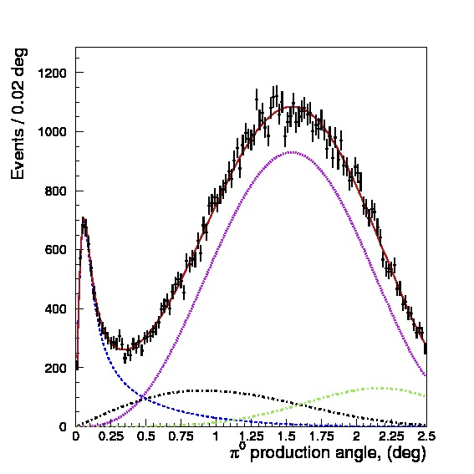
Fit to extract Γ(π⁰→γγ)
Theory functions have been folded with experimental resolution and setup acceptance to fit the data
²⁸Si
¹²C

Slide 16
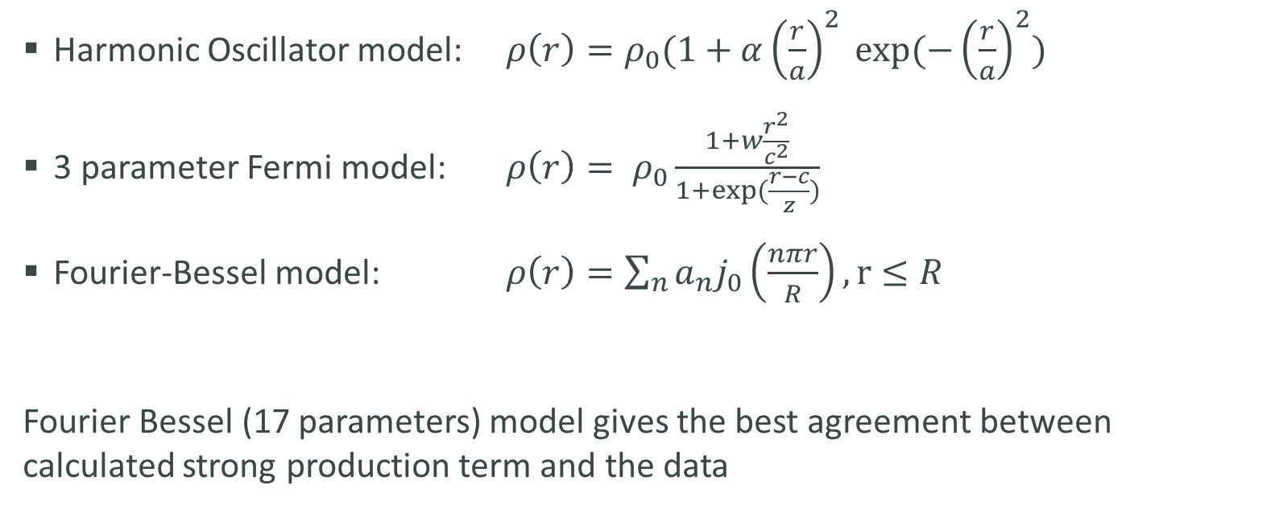
Nuclear density models tried for Form Factors calculations
Harmonic Oscillator model: $ρ\left(r\right)=ρ_{0}(1+α{\left(\frac{r}{a}\right)}^{2} exp⁡(−{\left(\frac{r}{a}\right)}^{2})$
3 parameter Fermi model: $ρ\left(r\right)= ρ_{0}\frac{1+w\frac{r^{2}}{c^{2}}}{1+exp⁡(\frac{r−c}{z})}$
Fourier-Bessel model: $ρ\left(r\right)=\sum_{n}{a_{n}j_{0}\left(\frac{nπr}{R}\right)}, r≤R$
Fourier Bessel (17 parameters) model gives the best agreement between calculated strong production term and the data

Slide 17
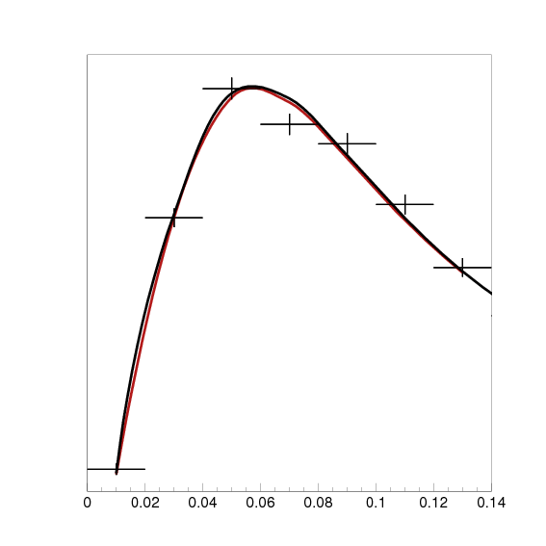
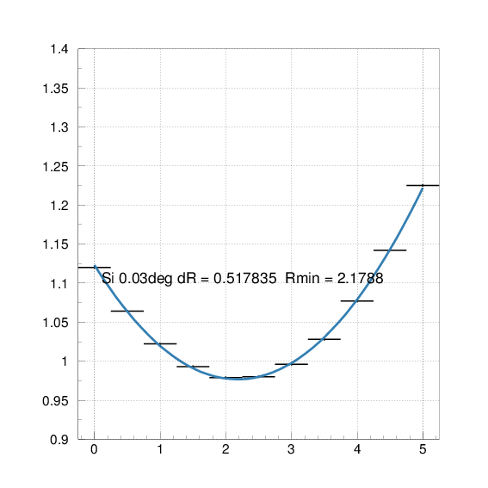
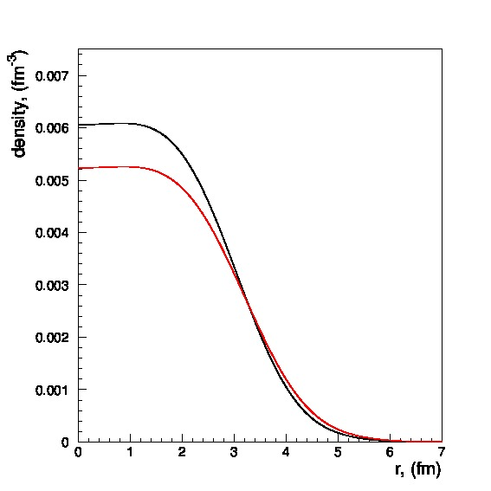
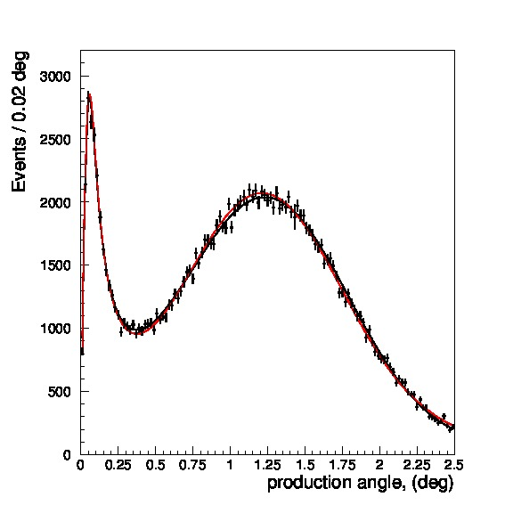
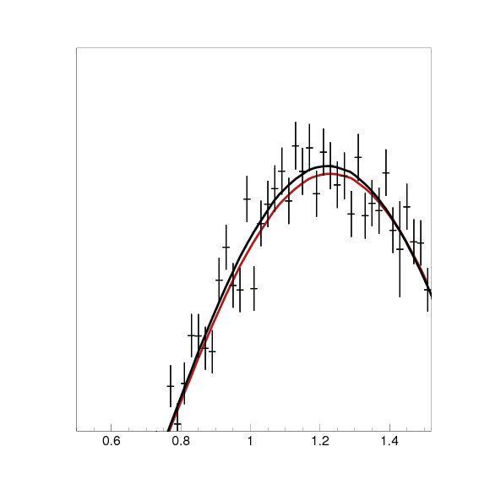
Model parameter: strong nucleus radius
nominal
5% inflated
nuclear density
π⁰ yield fit curves
Fit χ²/Ndof dependence vs strong radius inflation [%]
Obtained cross section has few times less statistical uncertainty than PrimEx-I data and is sensitive to nucleus strong radius with (sub) percent level precision

Slide 18
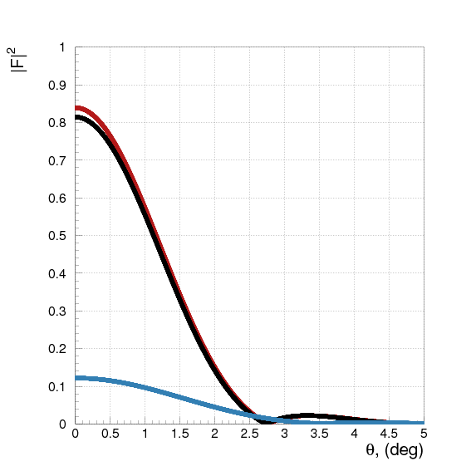


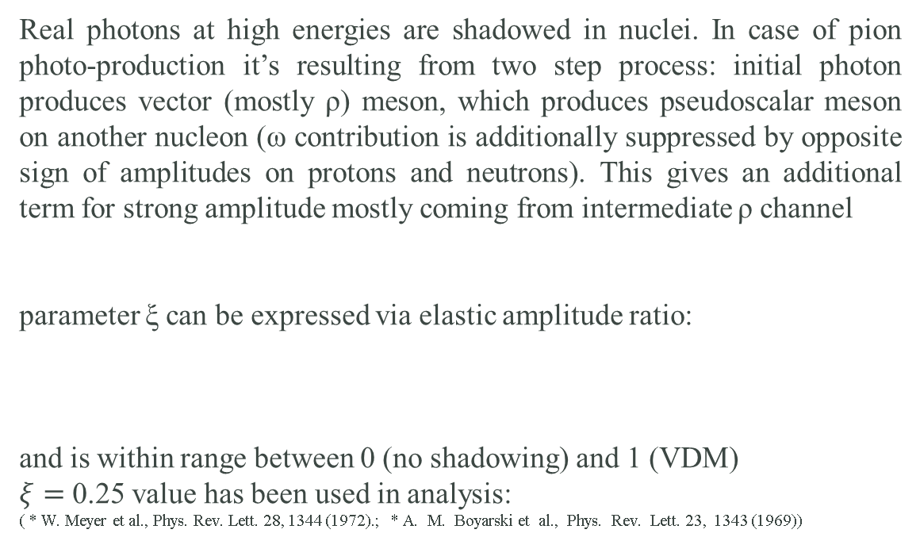




“Second step” contribution (“shadowing” effect)
Real photons at high energies are shadowed in nuclei. In case of pion photo-production it’s resulting from two step process: initial photon produces vector (mostly ρ) meson, which produces pseudoscalar meson on another nucleon (ω contribution is additionally suppressed by opposite sign of amplitudes on protons and neutrons). This gives an additional term for strong amplitude mostly coming from intermediate ρ channel
parameter ξ can be expressed via elastic amplitude ratio:
and is within range between 0 (no shadowing) and 1 (VDM)
$ξ=$ 0.25 value has been used in analysis:
( * W. Meyer et al., Phys. Rev. Lett. 28, 1344 (1972).; * A. M. Boyarski et al., Phys. Rev. Lett. 23, 1343 (1969))
$${\left|F_{st}\right|}^{2}$$
$${\left|F_{I}\right|}^{2}$$
$${\left|F_{st}−ξF_{I}\right|}^{2}$$
$$T_{st}\left(q\right)=\left(\vec{h}∙\vec{q}\right) φ\left(0\right) (F_{st} − ξF_{I})$$
$$\vec{h}=\left[\vec{k}×\vec{ε}\right]/k$$
$$ξ= \frac{f\left(γN→ρN\right)f(ρN→πN)}{f\left(ρN→ρN\right)f(γN→πN)}$$

Slide 19
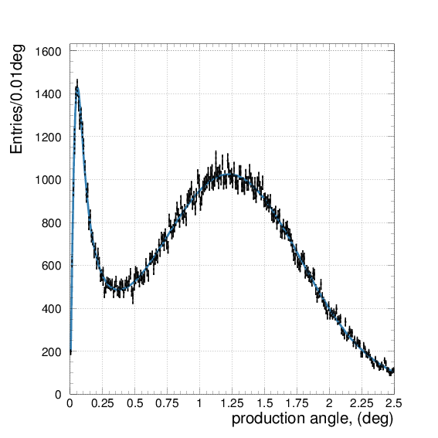
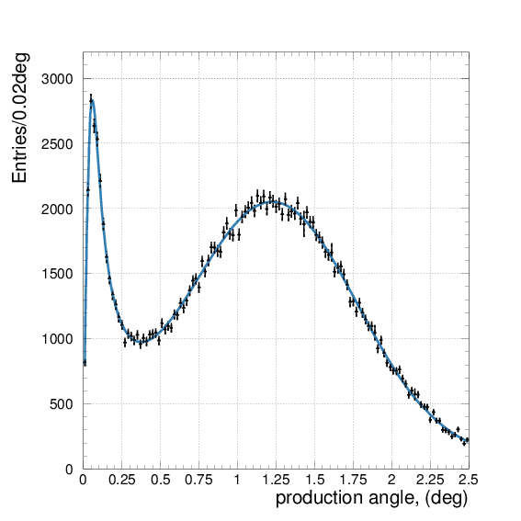
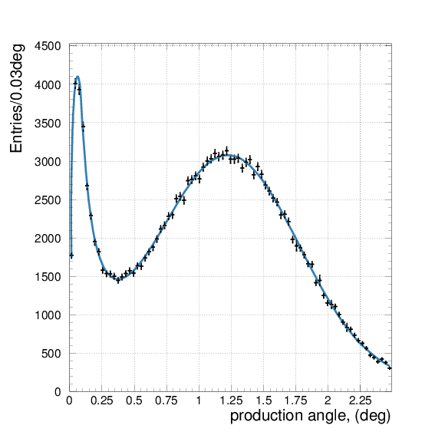
π⁰ yield fit, Silicon target
0.01° binning
0.02° binning
0.03° binning

Slide 20
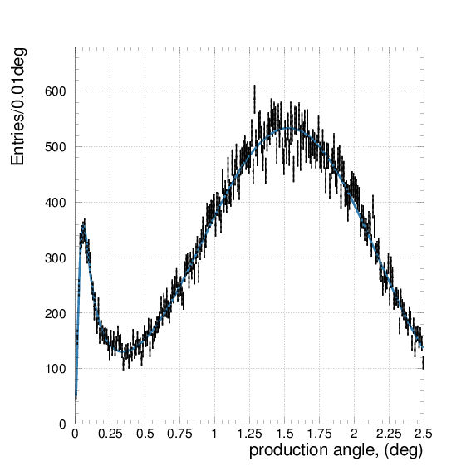
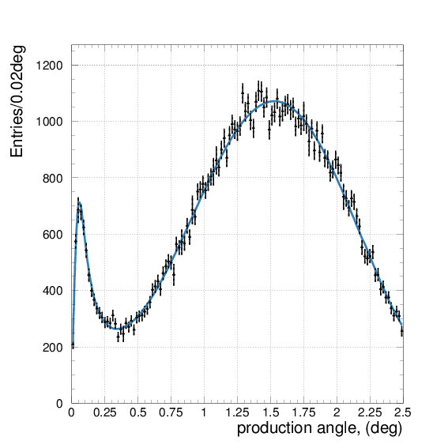
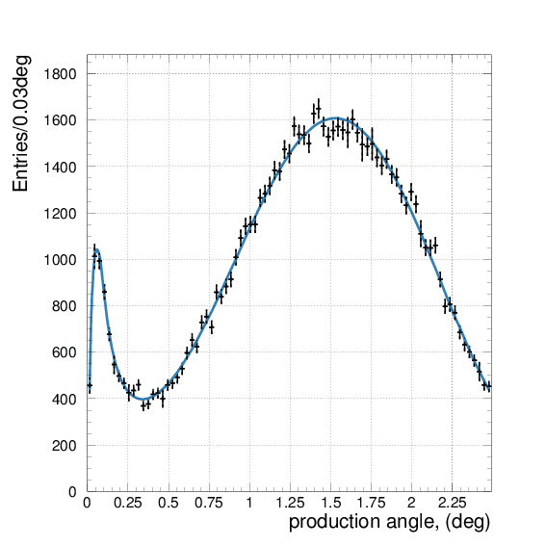
π⁰ yield fit, Carbon target
0.01° binning
0.02° binning
0.03° binning

Slide 21
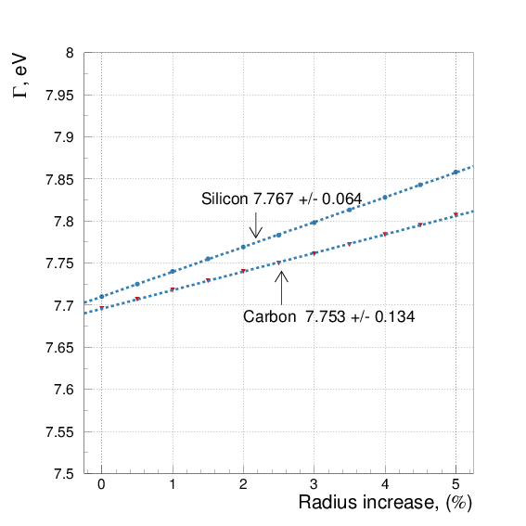
Γ(π⁰→γγ) value vs Strong radius increase
Radius increase, minimizing χ²:
Si +2.18% ± 0.63%
C +2.54% ± 1.86%
has been used in the final result, statistical uncertainty of this procedure is going directly to the theory systematics

Slide 22
PrimEx-II Γ(π⁰→γγ) systematic uncertainty
πN cross section and phase 0.1%
Shadowing effect amplitude 0.31%
Nuclear coherent shape 0.08%
Incoherent model 0.08%
Non-zero spin admixture ≤0.1%
Nuclear strong vs EM radius 0.14%
Total 0.36%
Energy 0.14%
Position 0.07%
Slope 0.08%
Width 0.12%
Total 0.22%
beam
Absolute tagging ratio 0.37%
Electron counting 0.55%
Beam collimation 0.18%
Relative tagging ratio 0.4%
Total 0.80%
Theory
Photon Beam Flux
Background shape 0.4%
Fitting range 0.4%
Empty target subtraction 0.2%
Fit parameter uncertainty 0.5%
Signal count method 0.55%
Omega/rho background subtraction 0.09%
Bin migration at zero angle 0.2%
dN/dθ binning 0.01°, 0.02°, 0.03° 0.12%
Total 0.94%
π⁰ yield extraction
Density 0.35%
Thickness 0.03%
Purity <0.01%
Total 0.35%
Trigger efficiency <0.1%
ADC errors <0.1%
Dead channels <0.1%
Total 0.1%
target
Monte
Carlo
Target absorption 0.24%
Pi0 angular resolution 0.17%
Pi0 two gamma decay branching 0.034%
Calorimeter geometry 0.05%
Calorimeter energy response 0.45%
Limited statistics 0.02%
Total 0.55%
DAQ
Gamma energy cut 0.13%
Pion energy cut <0.1%
Time window 0.05%
Wrong beam candidate 0.10%
Total 0.18%
Event selection

Slide 23
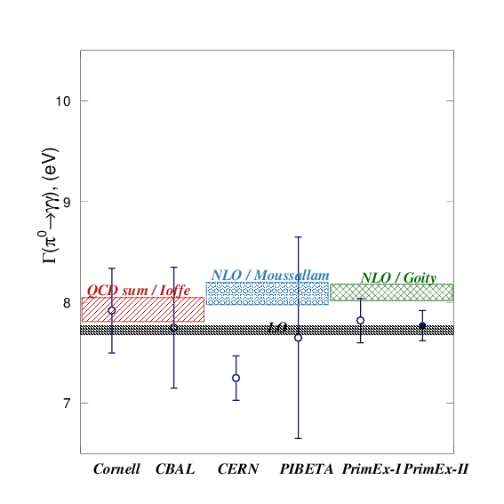
Updated Γ(π⁰→γγ) status: with PrimEx-II measurement added added
  PrimEx-II combined result for two targets averaged over two analyses:
  Γ(π⁰→γγ) = 7.80eV ± 0.13eV,
  (1.7% total uncertainty)

Slide 24
Planned and scheduled future experiment at Jefferson Lab
Precision measurement of two photon decay width (photon beam, Hall D, with upgraded GlueX detector):
  Γ(η→γγ) scheduled to run in 2019
  Γ(η′→γγ) proposal is being prepared for Program Advisory Committee
Transition Form Factors at low q²~0.001…0.5 GeV²/c² (electron beam, Hall B):
  Γ(γγ*→π⁰)
  Γ(γγ*→η) part of approved 12 GeV program
  Γ(γγ*→η′)
}

Slide 25
Summary
  Two PrimEx experiments have been successfully carried out
  Compton cross section measurement verifies PrimEx systematical
  uncertainty for the cross section on the 1.5% level (related PhD defended in May 2018)
  PrimEx-II reduced measurement error below 2% (one of two analyses related PhD defended in February 2018)
  Result has been recently approved by the PrimEx-II Collaboration:
  Γ(π⁰→γγ) = 7.80eV ± 0.7% stat. ± 1.5% syst. (1.7% total)
This experiment was supported in part by
NSF MRI PHY 0079840
and RFBR 18-02-00938A

