Slide 1
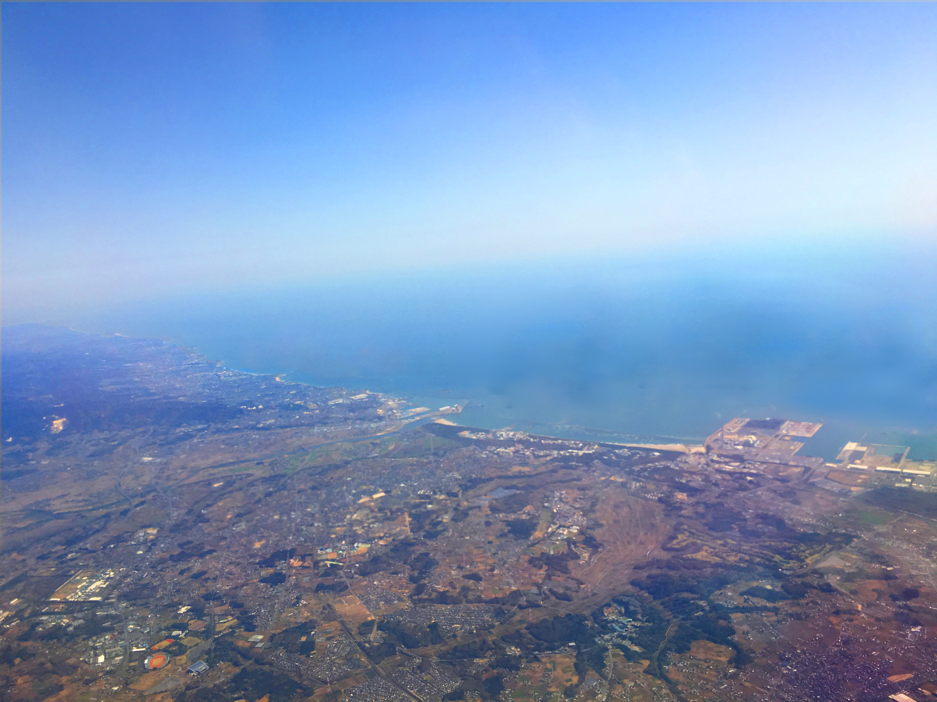
Updates on muon g-2/EDM experiment at J-PARC
June 20, 2018
Tsutomu Mibe (KEK)
www.g-2.kek.jp

Slide 2
Summary
We plan to measure muon’s g-2 and EDM with ultra-cold muon beam at J-PARC.
  Complemental & independent from BNL and Fermilab g-2 measurements
News since last year
  Oct. 2017, First muon acceleration to 90 keV
  Mar 2018, Cross calibration of NMR probes (J-PARC,Fermilab)
  April 2018, Major funding for construction of the upstream muon beamline is provided.
  May 2018, Received very positive replies from the TDR review committee (FRC)
  (July 2018), Waiting for full approval from the lab.

Slide 3
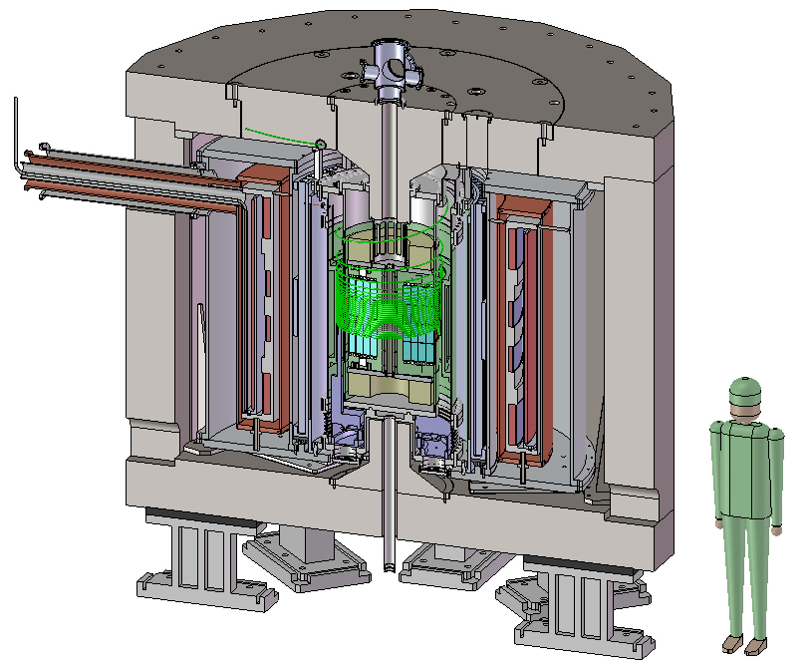
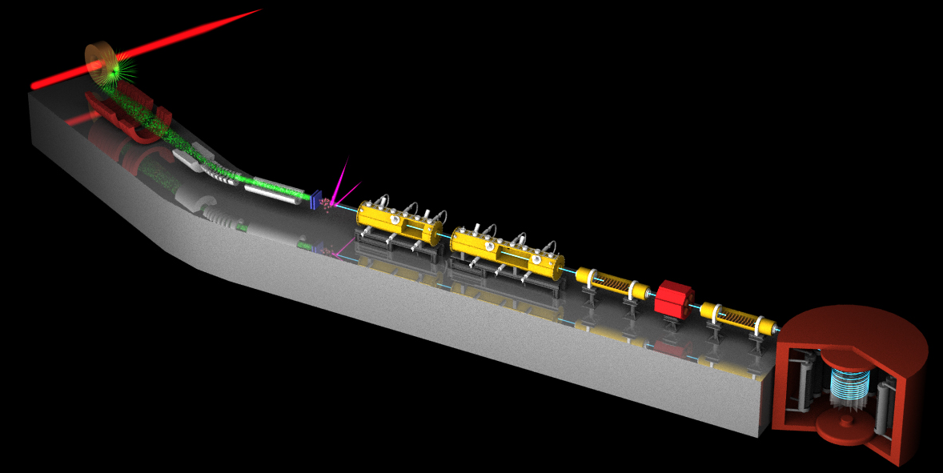
Muon g-2/EDM Experiment at
J-PARC with Ultra-Cold Muon Beam
Silicon
Tracker
3 GeV proton beam
( 333 uA)
Production target
(20 mm)
Surface muon beam
(28 MeV/c)
66 cm
Muonium Production
(300 K ~ 25 meV⇒2.3 keV/c)
Surface muon
Super Precision Storage Magnet
(3T, ~1ppm local precision)
Ultra Cold μ+ Source
Muon
storage
Features:
Super-low emittance muon beam
No strong focusing
Compact storage ring
Full tracking detector
Completely different from BNL/FNAL method
Muon LINAC (300 MeV/c)

Slide 4
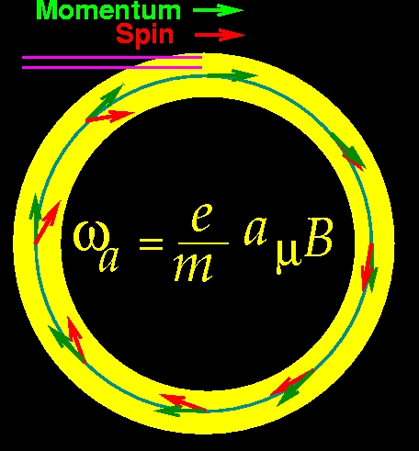
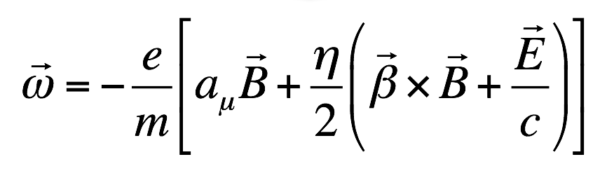
muon g-2 and EDM measurements
In uniform magnetic field, muon spin rotates ahead of momentum due to g-2 = 0
general form of spin precession vector:
BNL E821 approach
γ=30 (P=3 GeV/c)
J-PARC approach
E = 0 at any γ
FNAL E989
J-PARC E34

Slide 5
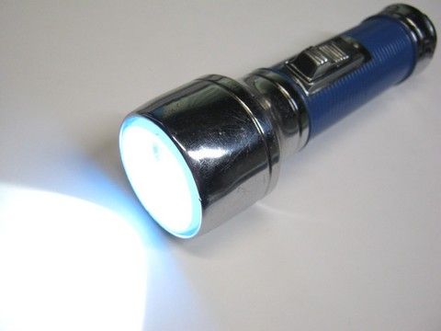
Muon beam at BNL/FNAL
Conventional muon beam
proton
π⁺
μ⁺
emittance
~1000π mm・mrad
pion
production
Strong focusing
Muon loss
BG π contamination
decay

Slide 6
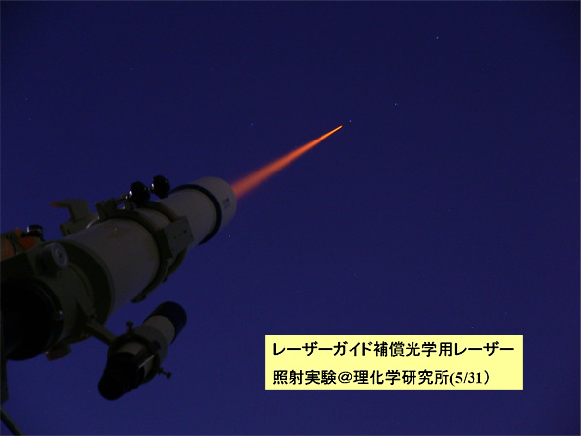
Muon beam at J-PARC
Conventional muon beam
proton
π⁺
μ⁺
emittance
~1000π mm・mrad
pion
production
Strong focusing
Muon loss
BG π contamination
decay
cooling
μ⁺
emittance
1π mm・mrad
Ultra-cold
muon beam
Free from any of these

Slide 7
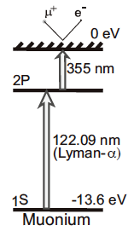
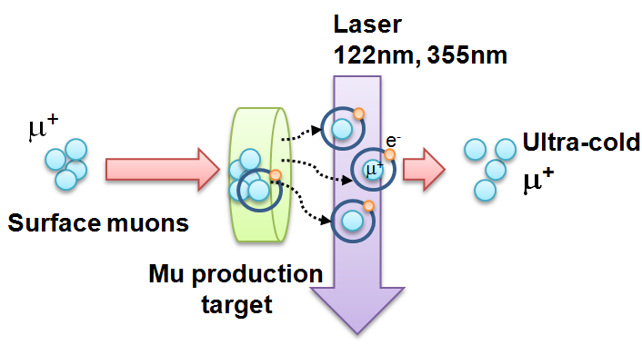
Ultra-cold Muon
Requirement for zero E-field:
Muons should be kept stored without E-focusing
→ Beam with ultra-small transverse dispersion,
i.e. Δp_{T}/p ~0
Laser resonant ionization of Mu (μ⁺e⁻)
re-acceleration
p =
28MeV/c
3 keV/c
300 MeV/c
Δp_{T}/p ~3 keV / 300 MeV =1E-5

Slide 8
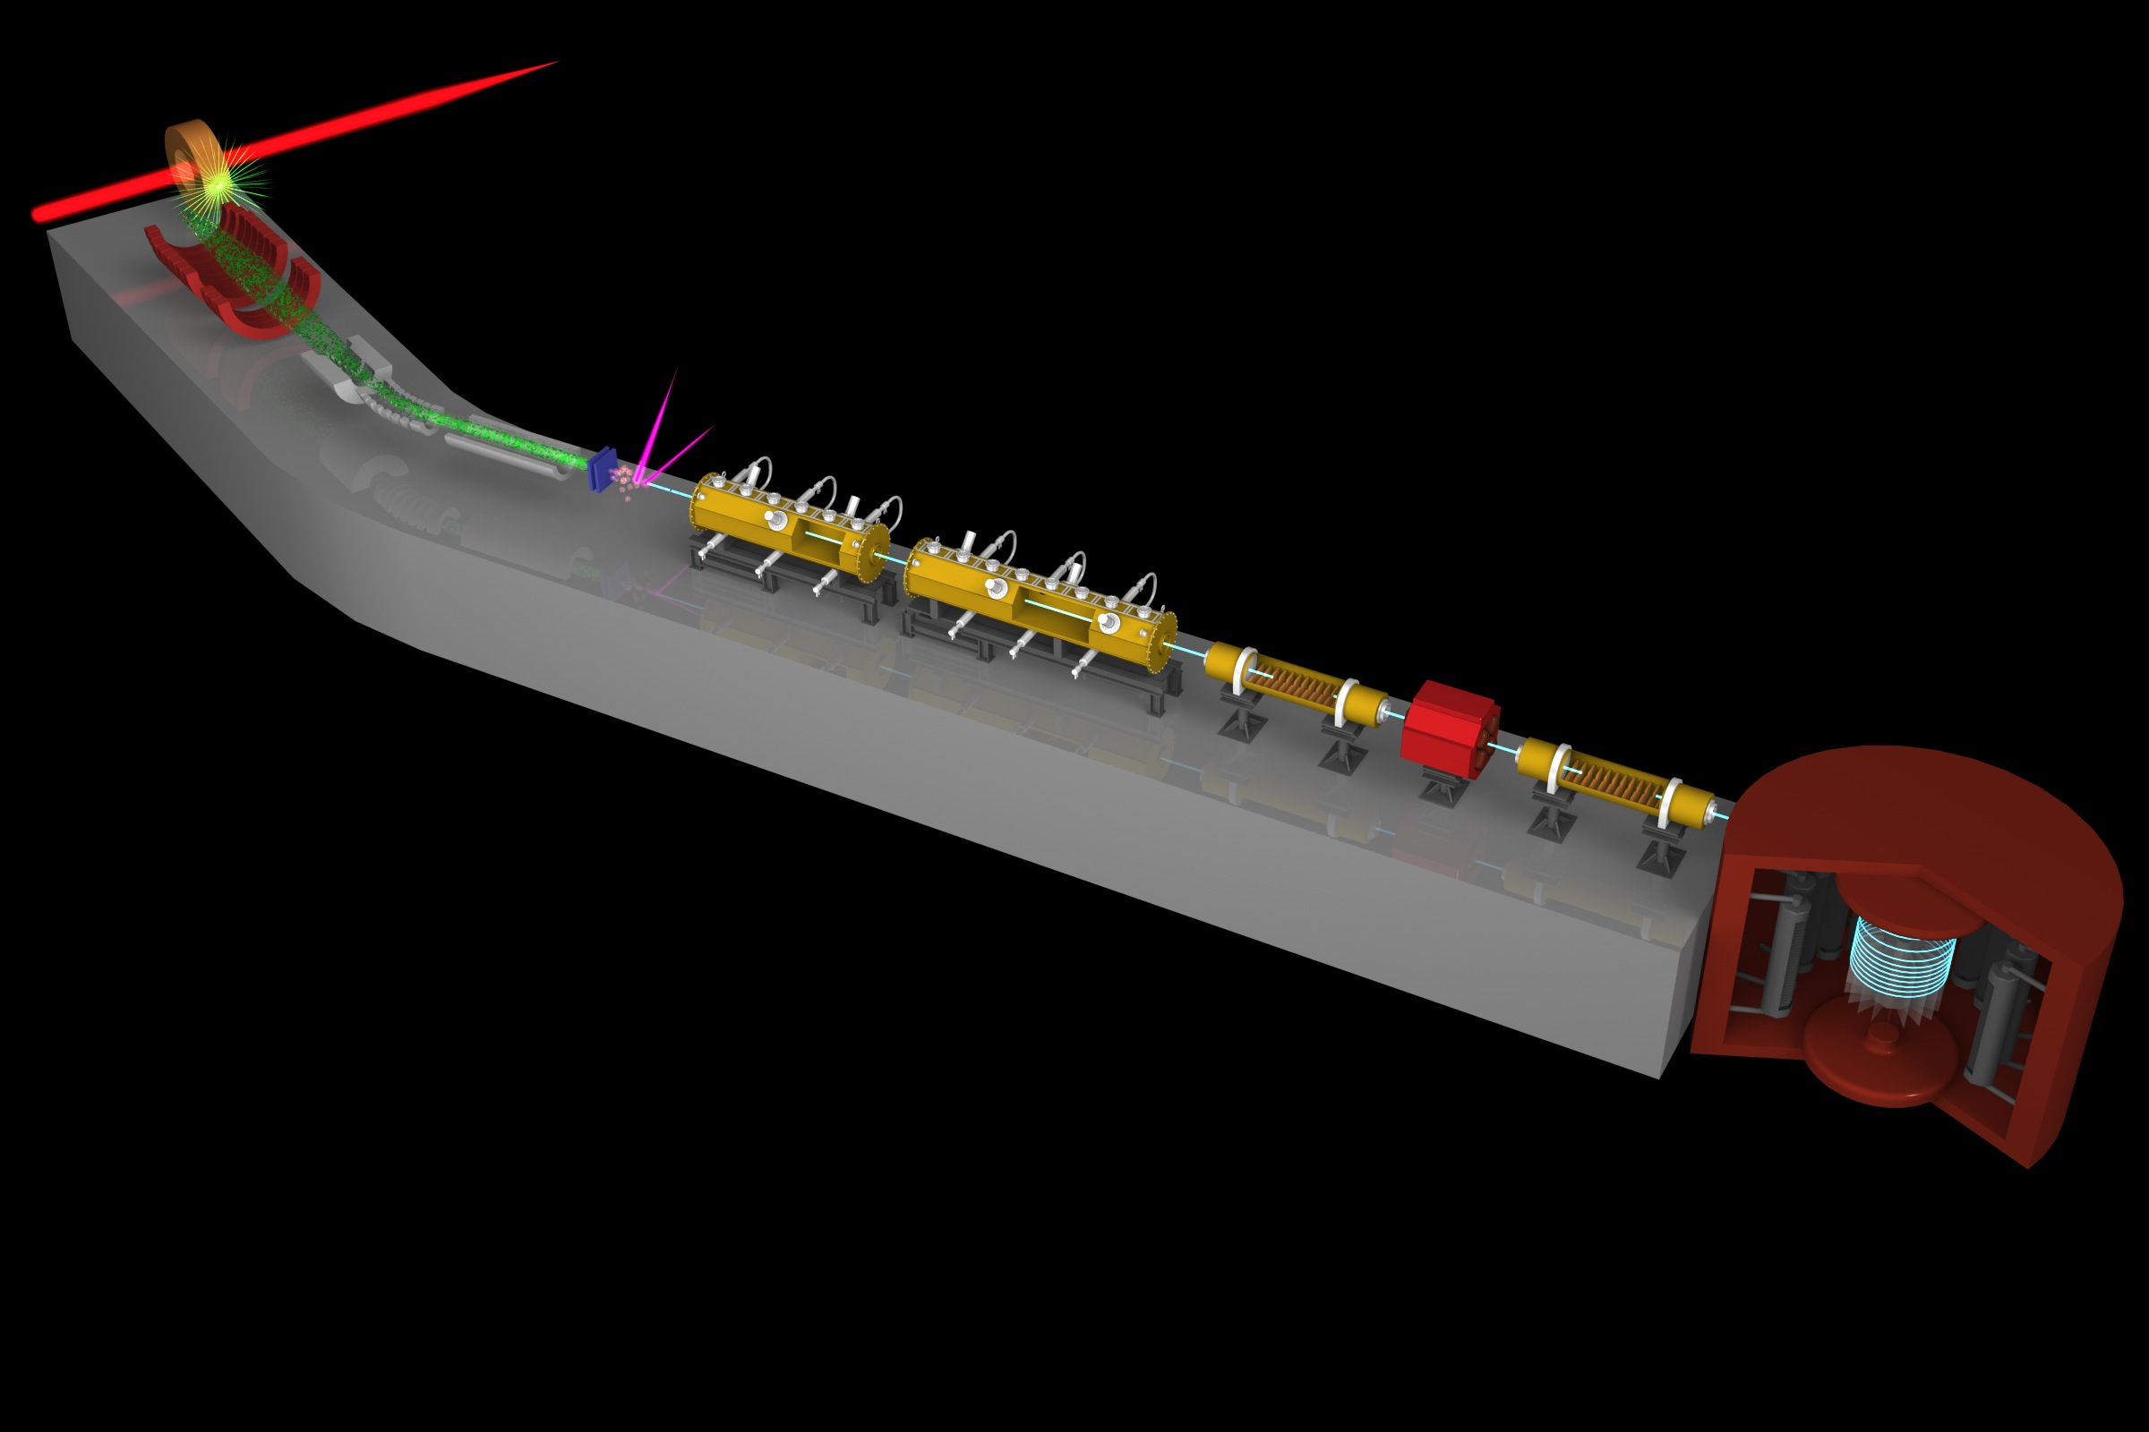
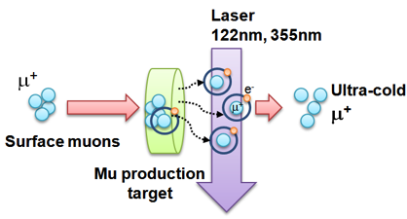
Muon g-2/EDM Experiment at
J-PARC with Ultra-Cold Muon Beam
Silicon
Tracker
3 GeV proton beam
( 333 uA)
Production target
(20 mm)
Surface muon beam
(28 MeV/c)
Muonium Production
(300 K ~ 25 meV⇒2.3 keV/c)
66 cm
Surface muon
Super Precision Storage Magnet
(3T, ~1ppm local precision)
Ultra Cold μ+ Source
Muon
storage
Resonant Laser Ionization of Muonium (~10⁶ μ⁺/s)
Muon LINAC (300 MeV/c)
Δ(g-2) = 0.1 ppm
ΔEDM = 10⁻²¹ e・cm

Slide 9
Experimental sequence
40ms (25 Hz)
Surface
muon beam
(28 MeV/c)
μ⁺
laser ionization
Mu
Thermal
muonium
(3keV/c)
~1μs
μ⁺
~1ns
Ultra-slow muon
(3keV/c)
μ⁺
~3ns
Acceleration + injection
(300 MeV/c)
40 μs
Storage and detection
(300 MeV/c)
μ⁺→e⁺

Slide 10
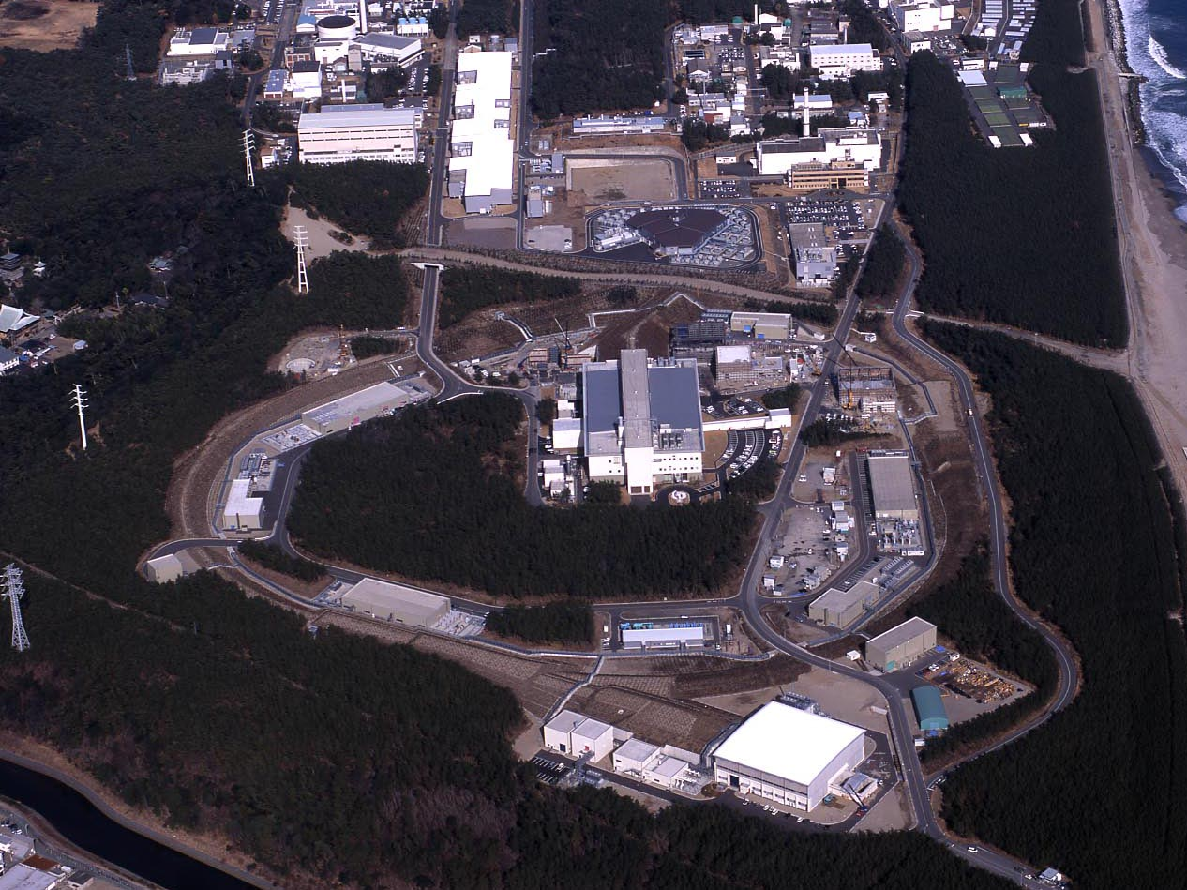
J-PARC Facility
LINAC
3 GeV
Synchrotron
Neutrino Beam
To Kamioka
Material and Life Science
Facility
Main Ring
(30 GeV)
Beam energy: 3 GeV
Beam power : 1 MW (500 kW as of Jun 2018)
Intensity: 2E15 protons/sec
Repetition rate: 25 Hz (double bunches)
Hadron Hall
Bird’s eye photo in Feb. 2008

Slide 11
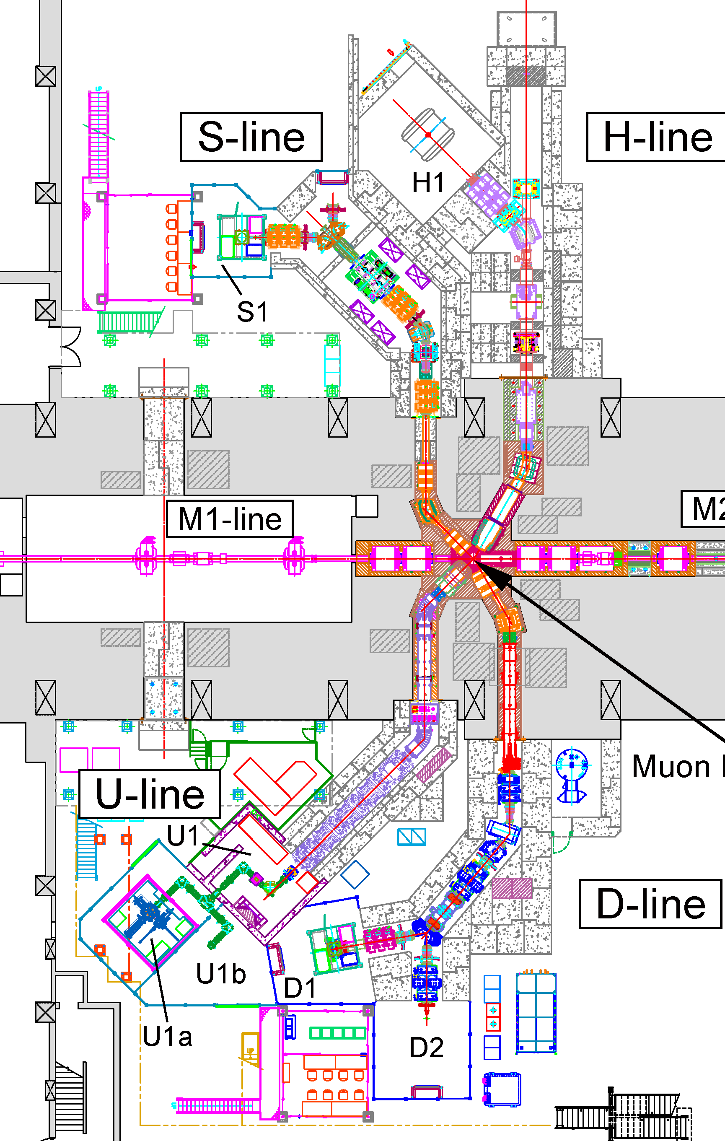
Muon experimental facility (MUSE)
S-line
µ⁺
H-line
µ±
Surface muon
（4 MeV）, (2014~)
Surface muon
for muon g-2/EDM
and Mu-HFS
(Under construction)
µ⁺
U-line
D-line
µ±
Ultra slow beam
（0.1〜 30 keV）
(2016~)
General purpose
（50 keV~50 MeV）,
(2009~)

Slide 12
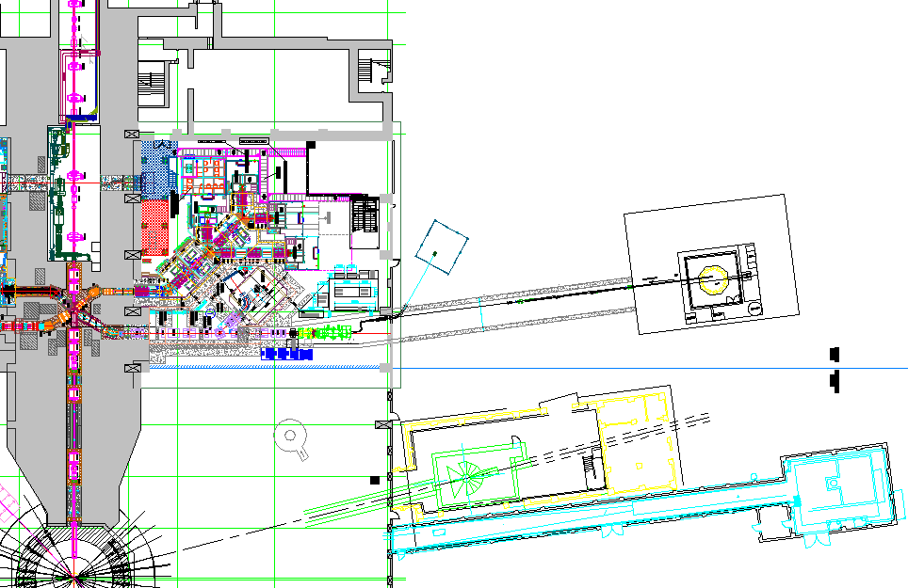
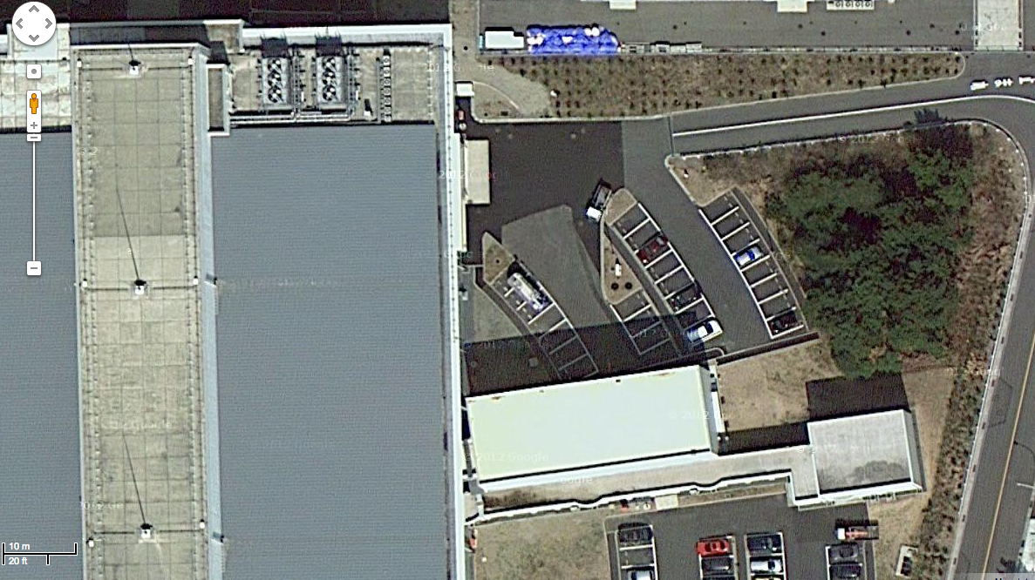
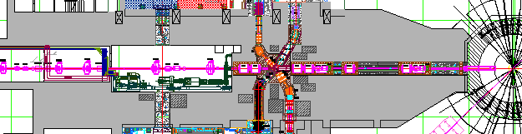
Proposed experimental site
Material and Life science Facility in J-PARC
New Electric
Power substation
Parking lot
g-2/EDM
storage magnet
H-Line
muon linac
muon
production
target
MuSEUM
DeeMe
sparation neutron
source

Slide 13
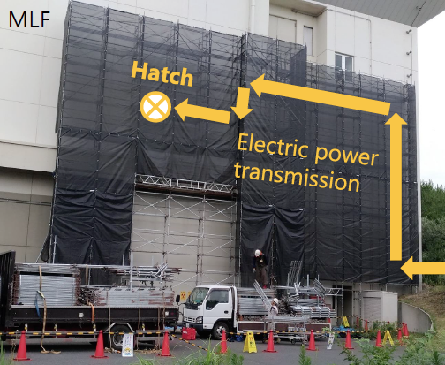
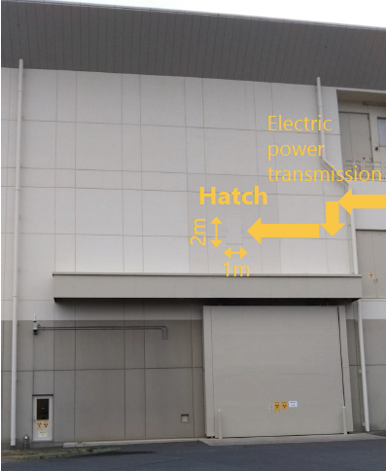
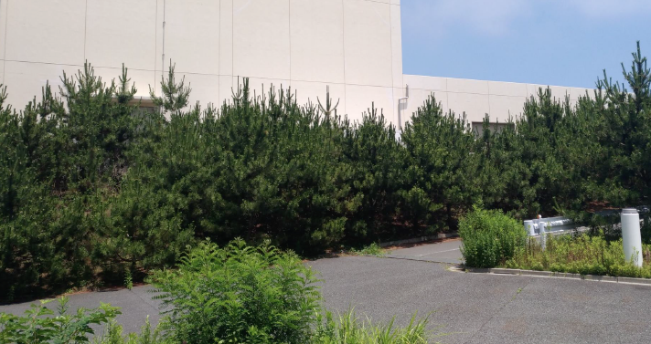
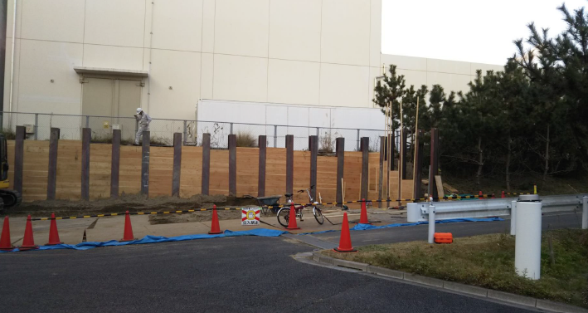
New electric sub-station for H-line
Cabling hole on the wall
Pictures by T. Yamazaki
Bedding for the sub-station

Slide 14
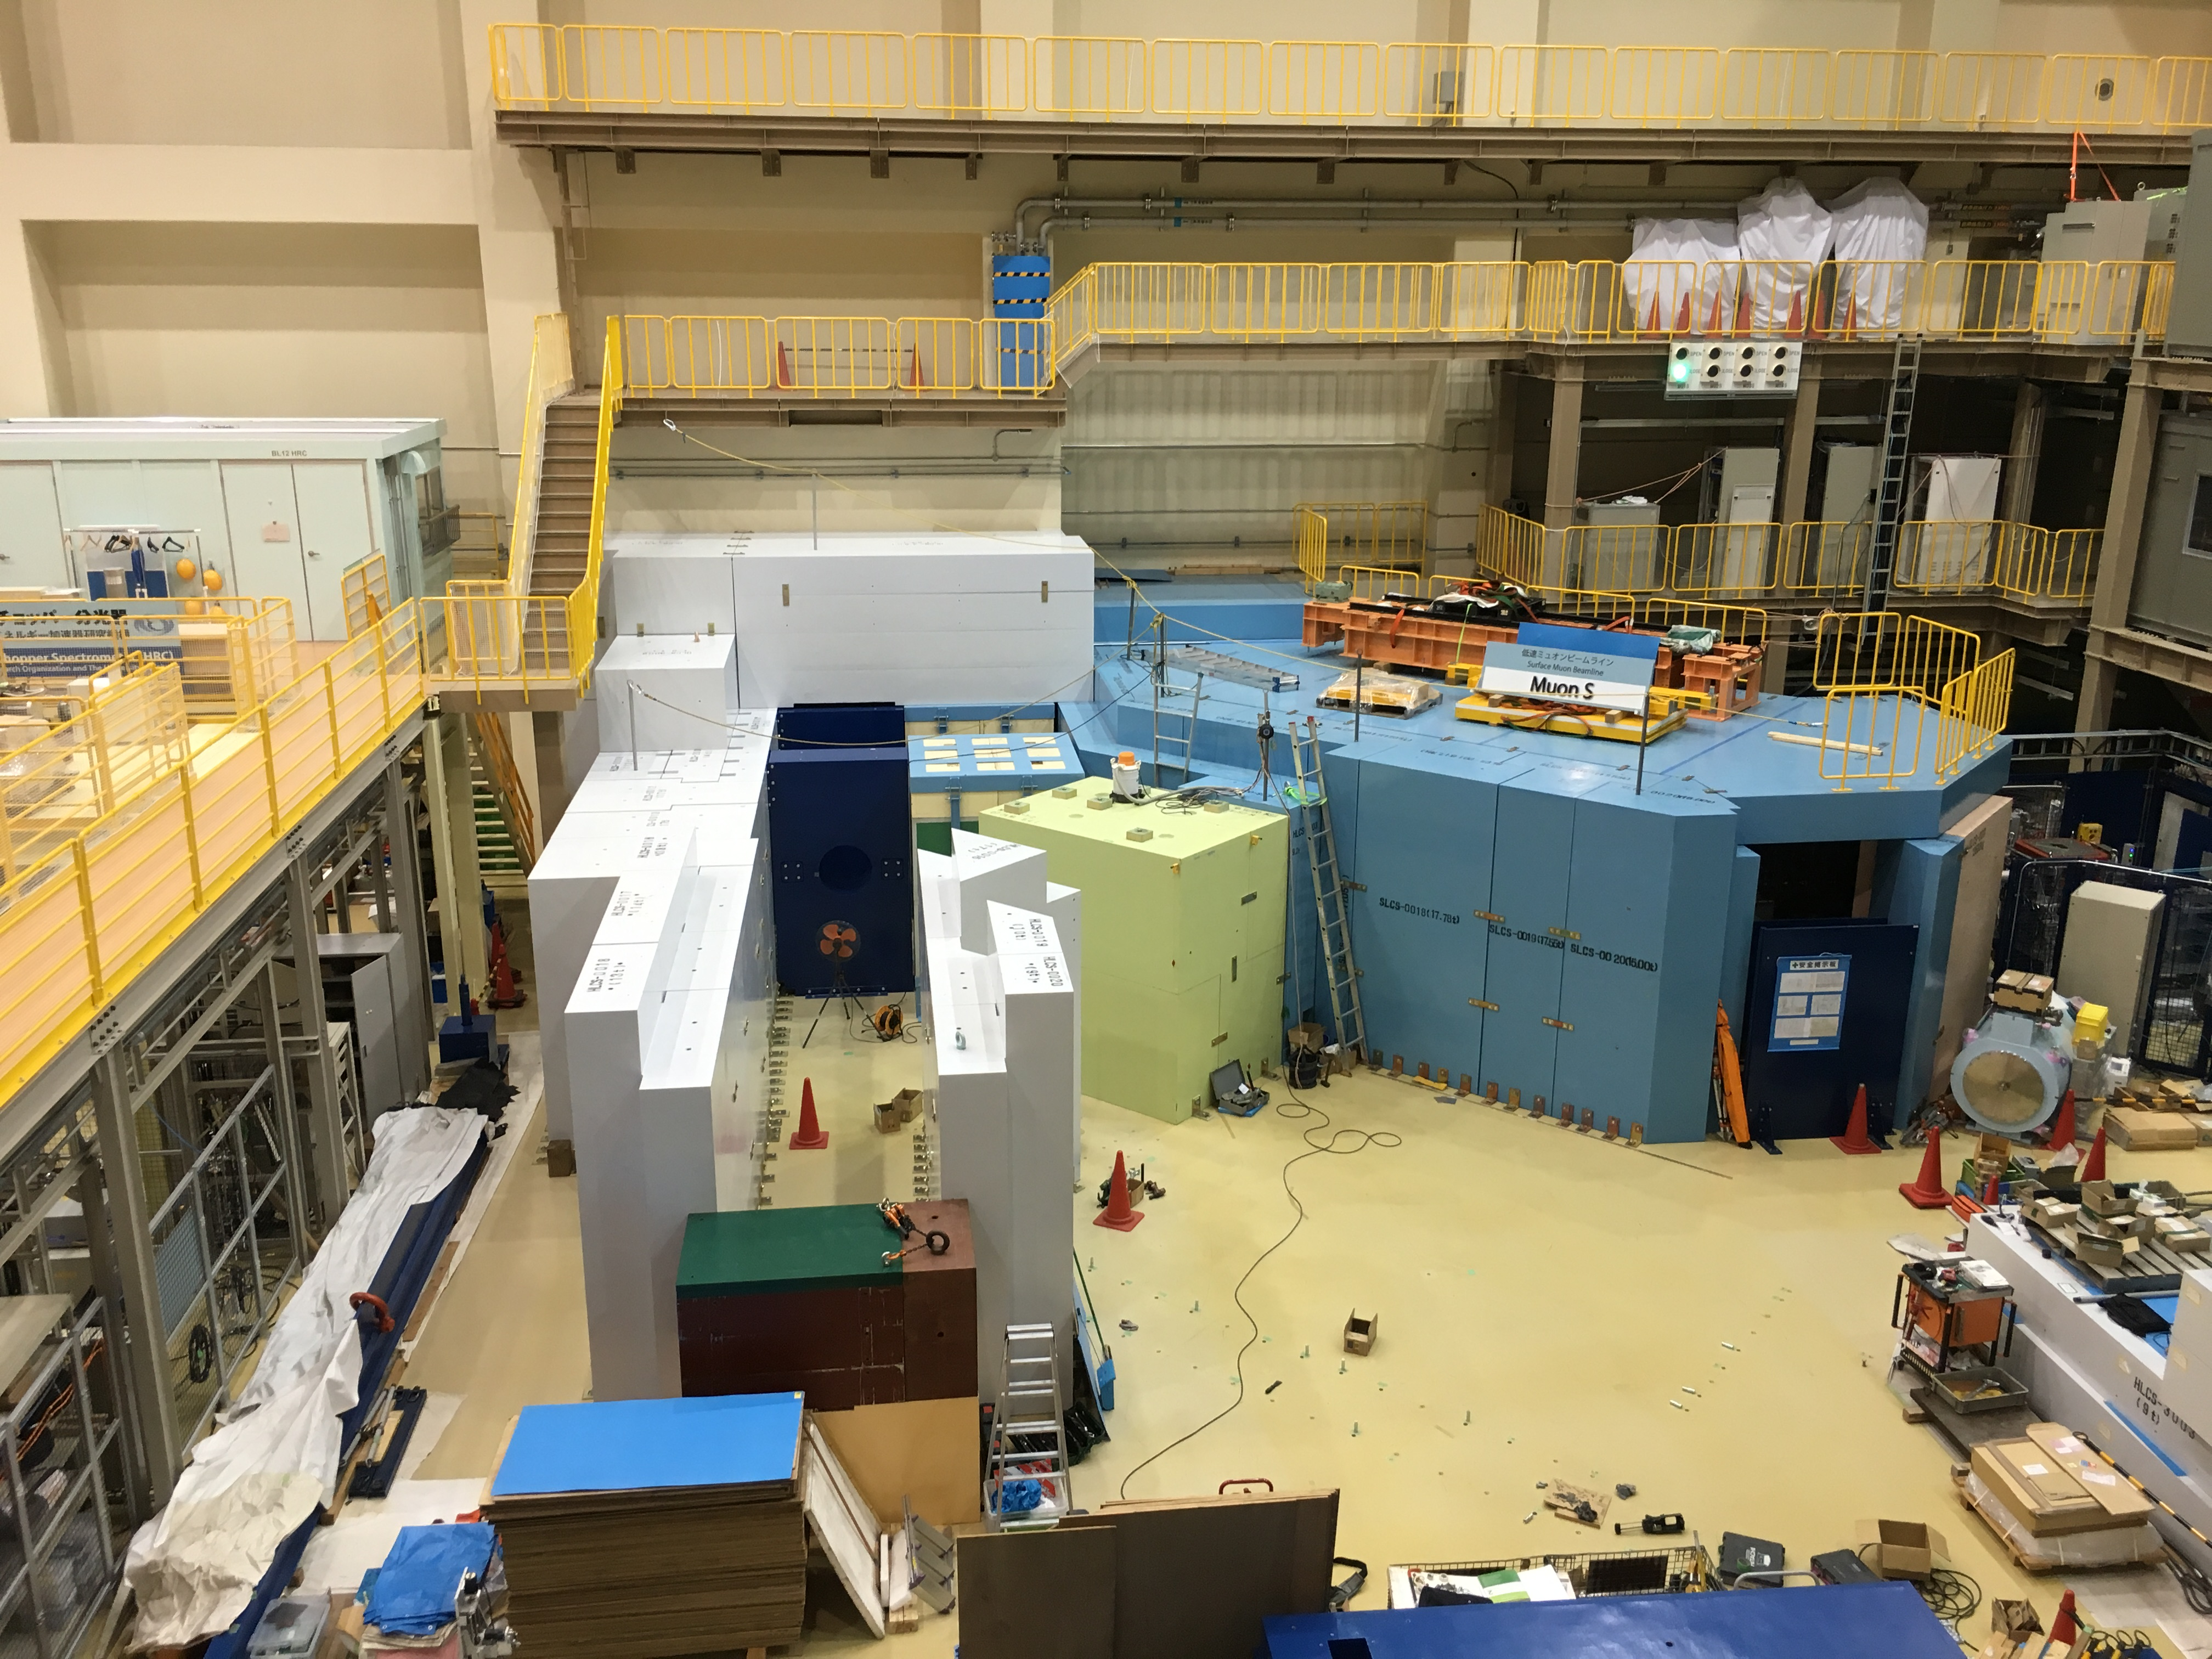
2016.8.17

Slide 15
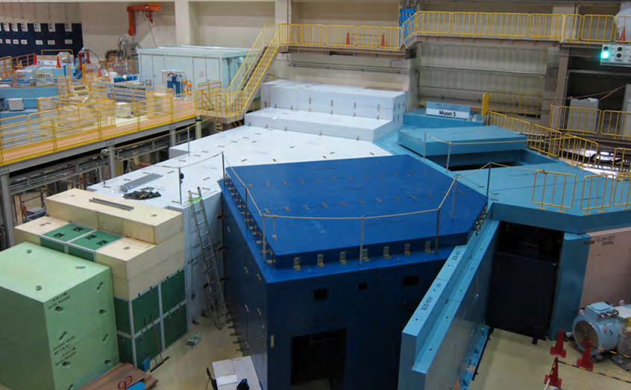
surface muon
branch
mu LINAC
MuSEUM (Mu-HFS, μ_{μ}/μ_{p})
DeeMe (mu-e conv.)

Slide 16
Muon g-2/EDM Experiment at
J-PARC with Ultra-Cold Muon Beam
Silicon
Tracker
3 GeV proton beam
( 333 uA)
Production target
(20 mm)
Surface muon beam
(28 MeV/c)
Muonium Production
(300 K ~ 25 meV⇒2.3 keV/c)
66 cm
Surface muon
Super Precision Storage Magnet
(3T, ~1ppm local precision)
Ultra Cold μ+ Source
Muon
storage
Resonant Laser Ionization of Muonium (~10⁶ μ⁺/s)
Muon LINAC (300 MeV/c)
Δ(g-2) = 0.1 ppm
ΔEDM = 10⁻²¹ e・cm

Slide 17
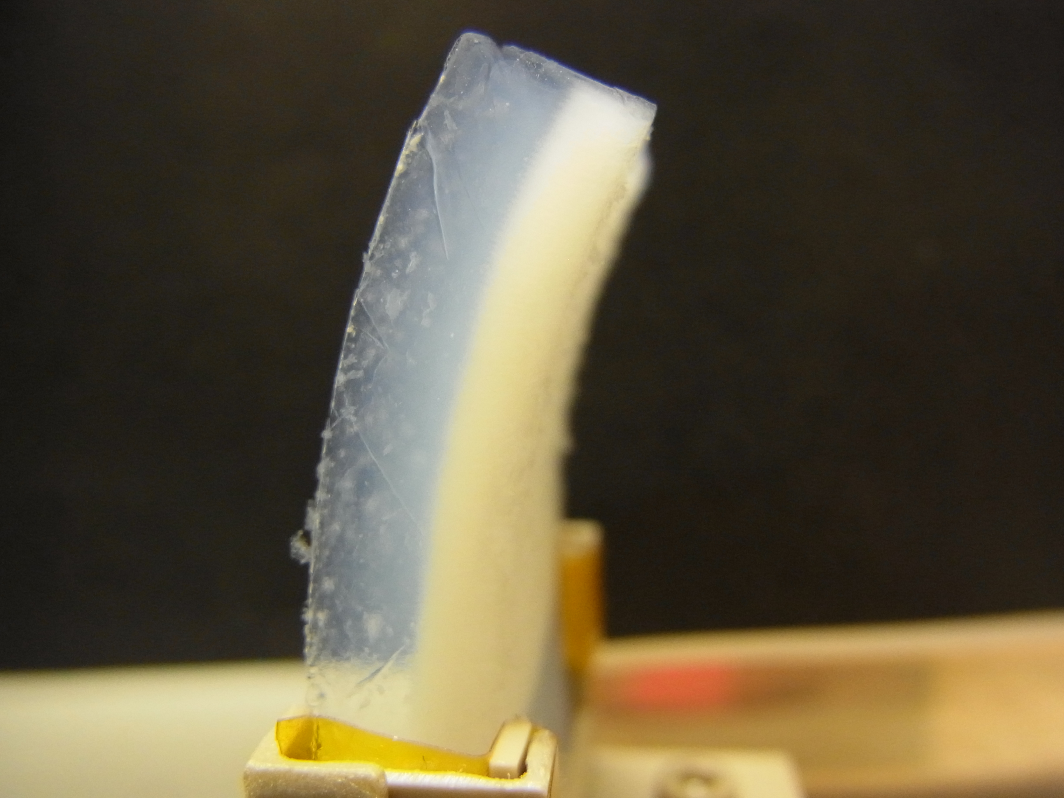
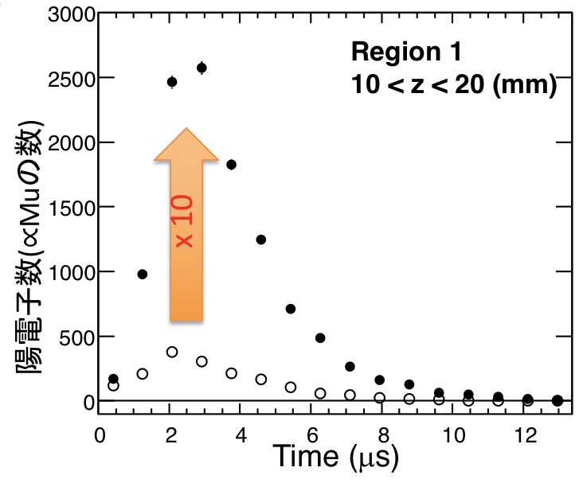
Silica aerogel
（SiO₂, 30 mg/cc）
Laser-ablated holes
Muonium
(μ⁺e⁻)
muon beam
○ no hole
● w/ holes
8 mm
P. Bakule et al., PTEP 103C0 (2013)
G. Beer et al., PTEP 091C01 (2014)

Slide 18
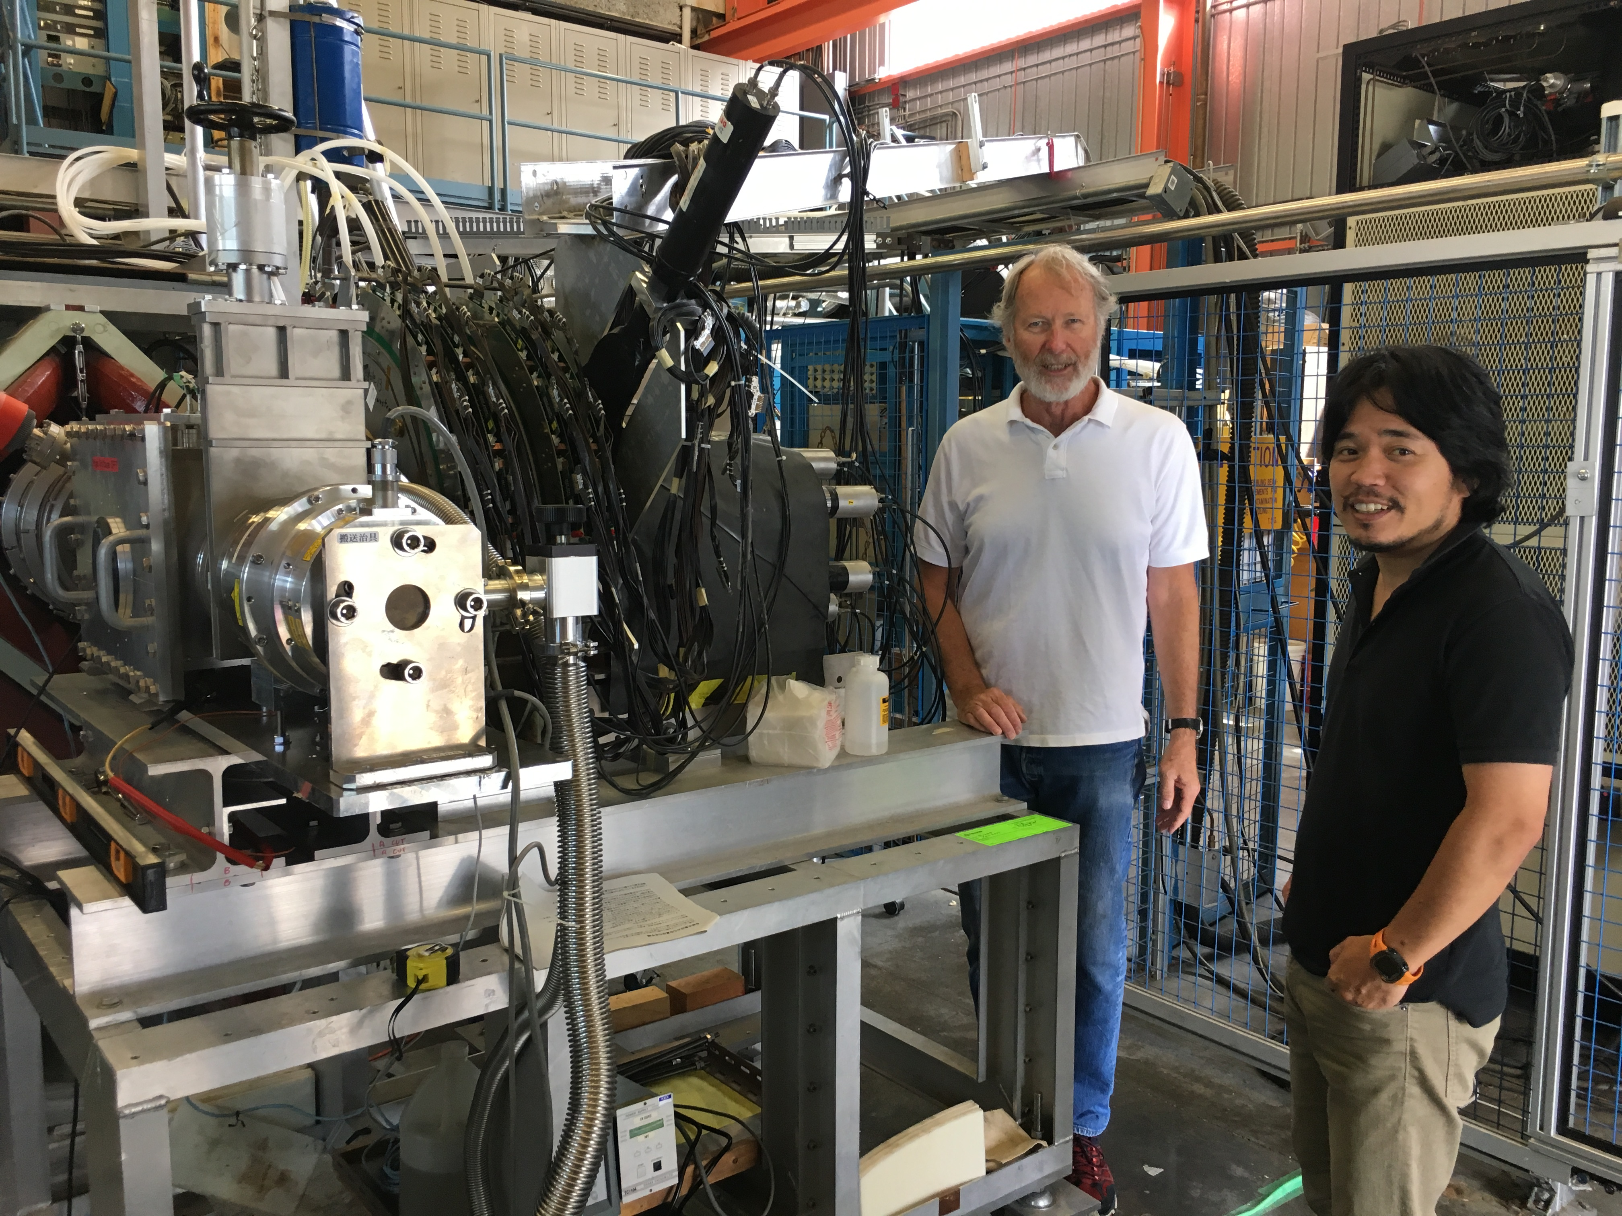
Mu production experiment at TRIUMF (June-July, 2017)
Tested 25 samples in 3 weeks.
2/3rd of them were produced during run on the fly

Slide 19
Long-term stability of Mu yield
TRIUMF-S1249
(Online data)
No hint of degradation observed for 2.5 days

Slide 20
Muonium spin precession in vacuum
TRIUMF-S1249
(Online data)
Reconfirmed polarization of Mu in vacuum.

Slide 21
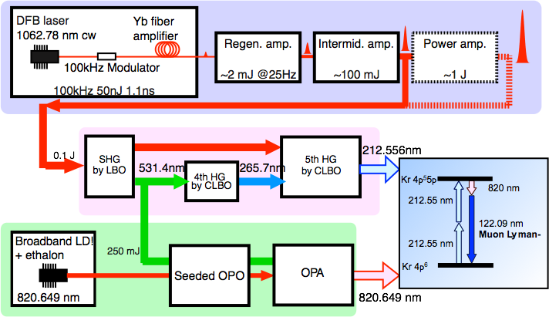
Schematic of laser system
Slide by Satoshi Wada (RIKEN)

Slide 22
Schematic of laser system
Slide by Satoshi Wada (RIKEN)
Generation of Lyman-α at J-PARC U-line
Lyman-α
guide laser
estimated energy = 8.4μJ (after LiF)
(design goal: 100μJ)

Slide 23
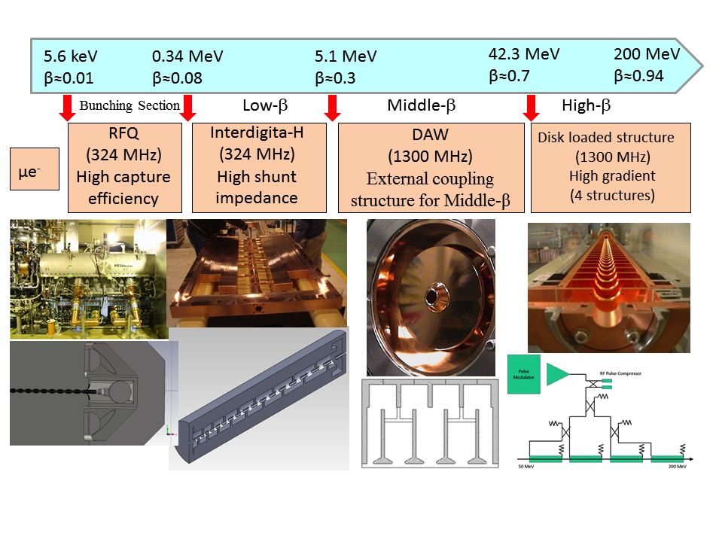
Adopted technology for muon acceleration
Bunching
Section
External coupling
structure for low-β
Similar to electron
accelerator to obtain
high gradient.
High hunt impedance
M. Otani et al., Phys. Rev. Accel. Beams 19, 040101 (2016)

Slide 24
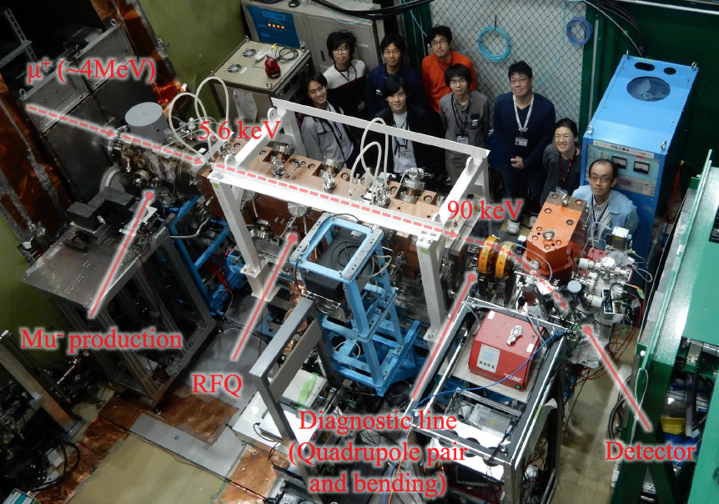
Muon RF acceleration for the first time!
J-PARC MLF D2 area, October 2017
Slide by M. Otani

Slide 25
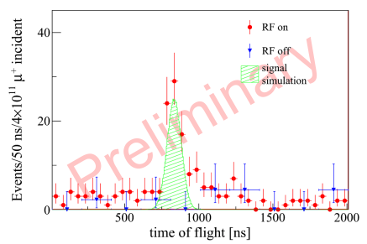
Muon RF acceleration for the first time!
J-PARC MLF D2 area, October 2017
Slide by M. Otani
S. Bae et al.,Phys. Rev. AB 21, 050101 (2018).

Slide 26
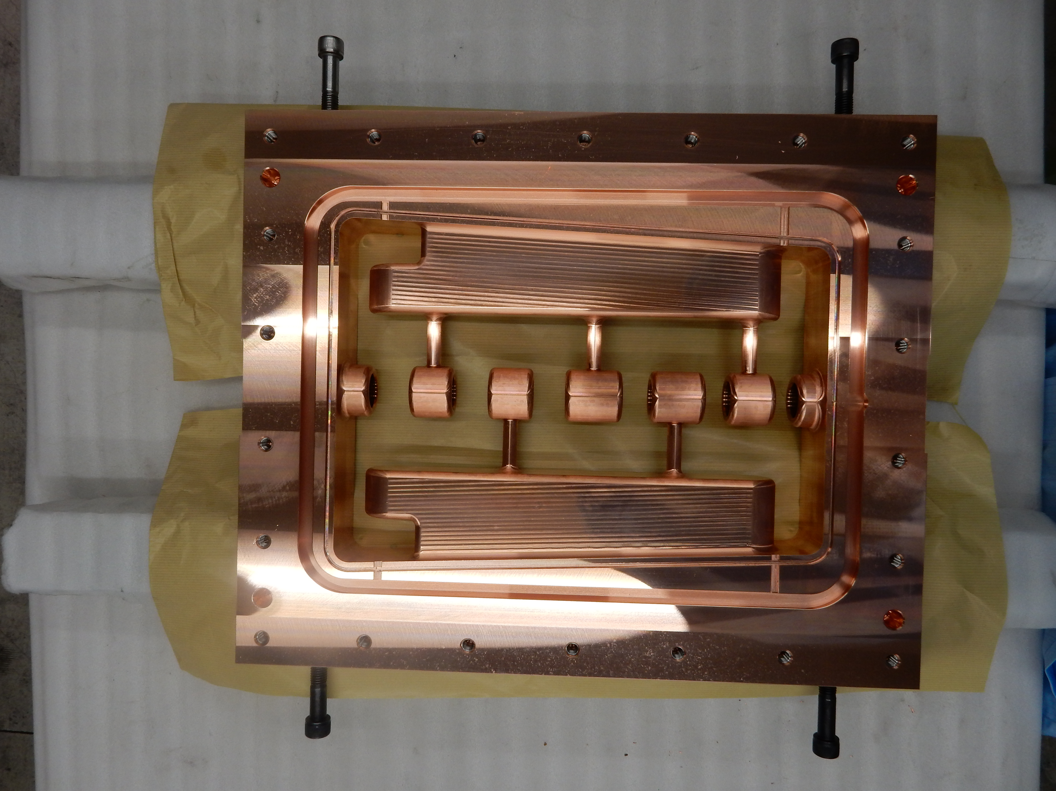
An accelerating structure (IH-DTL cavity) to 1.3 MeV
Mar 2017, Photo by M. Otani

Slide 27
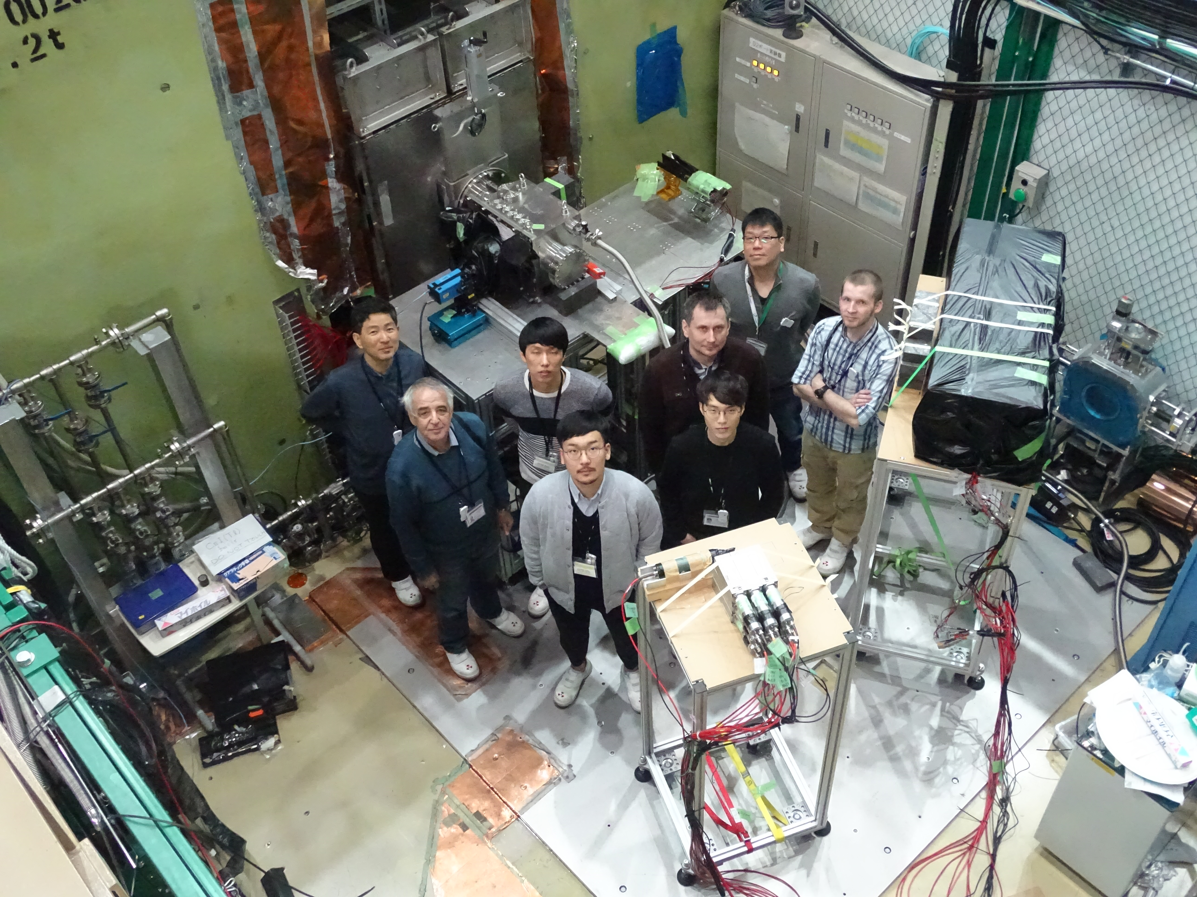
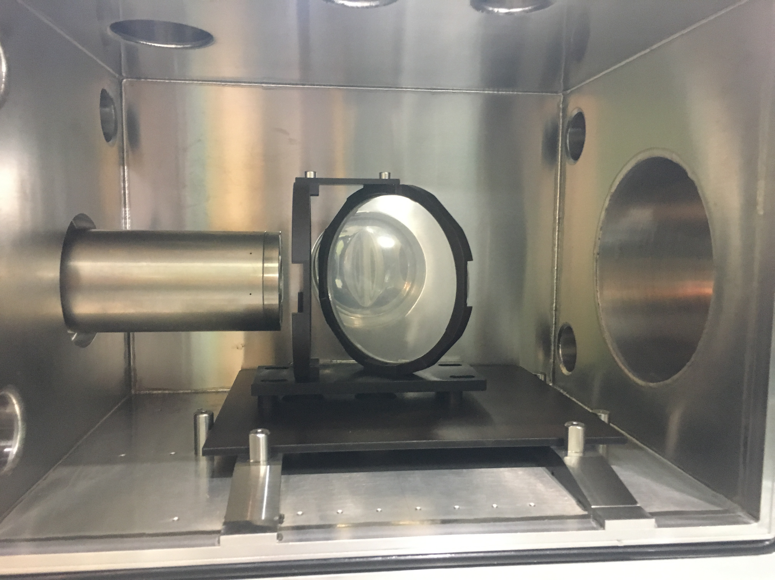
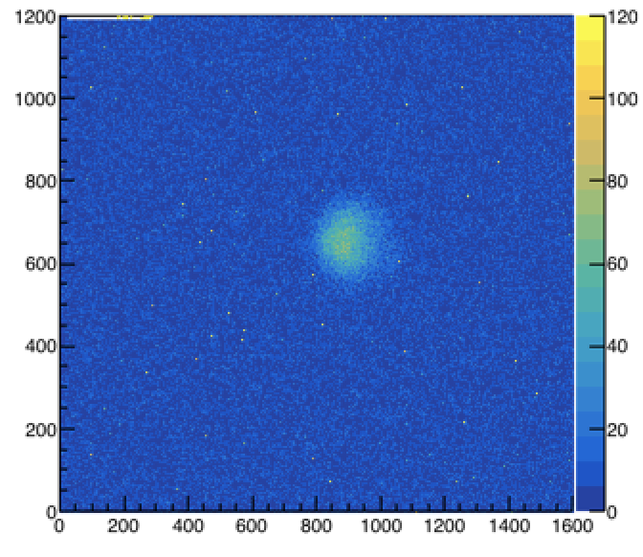
A test of thin beam profile monitor at J-PARC (Feb 2018)
BINP-SNU-KEK
CsI(Tl) film
(3μm)
Raw data
μ⁺

Slide 28
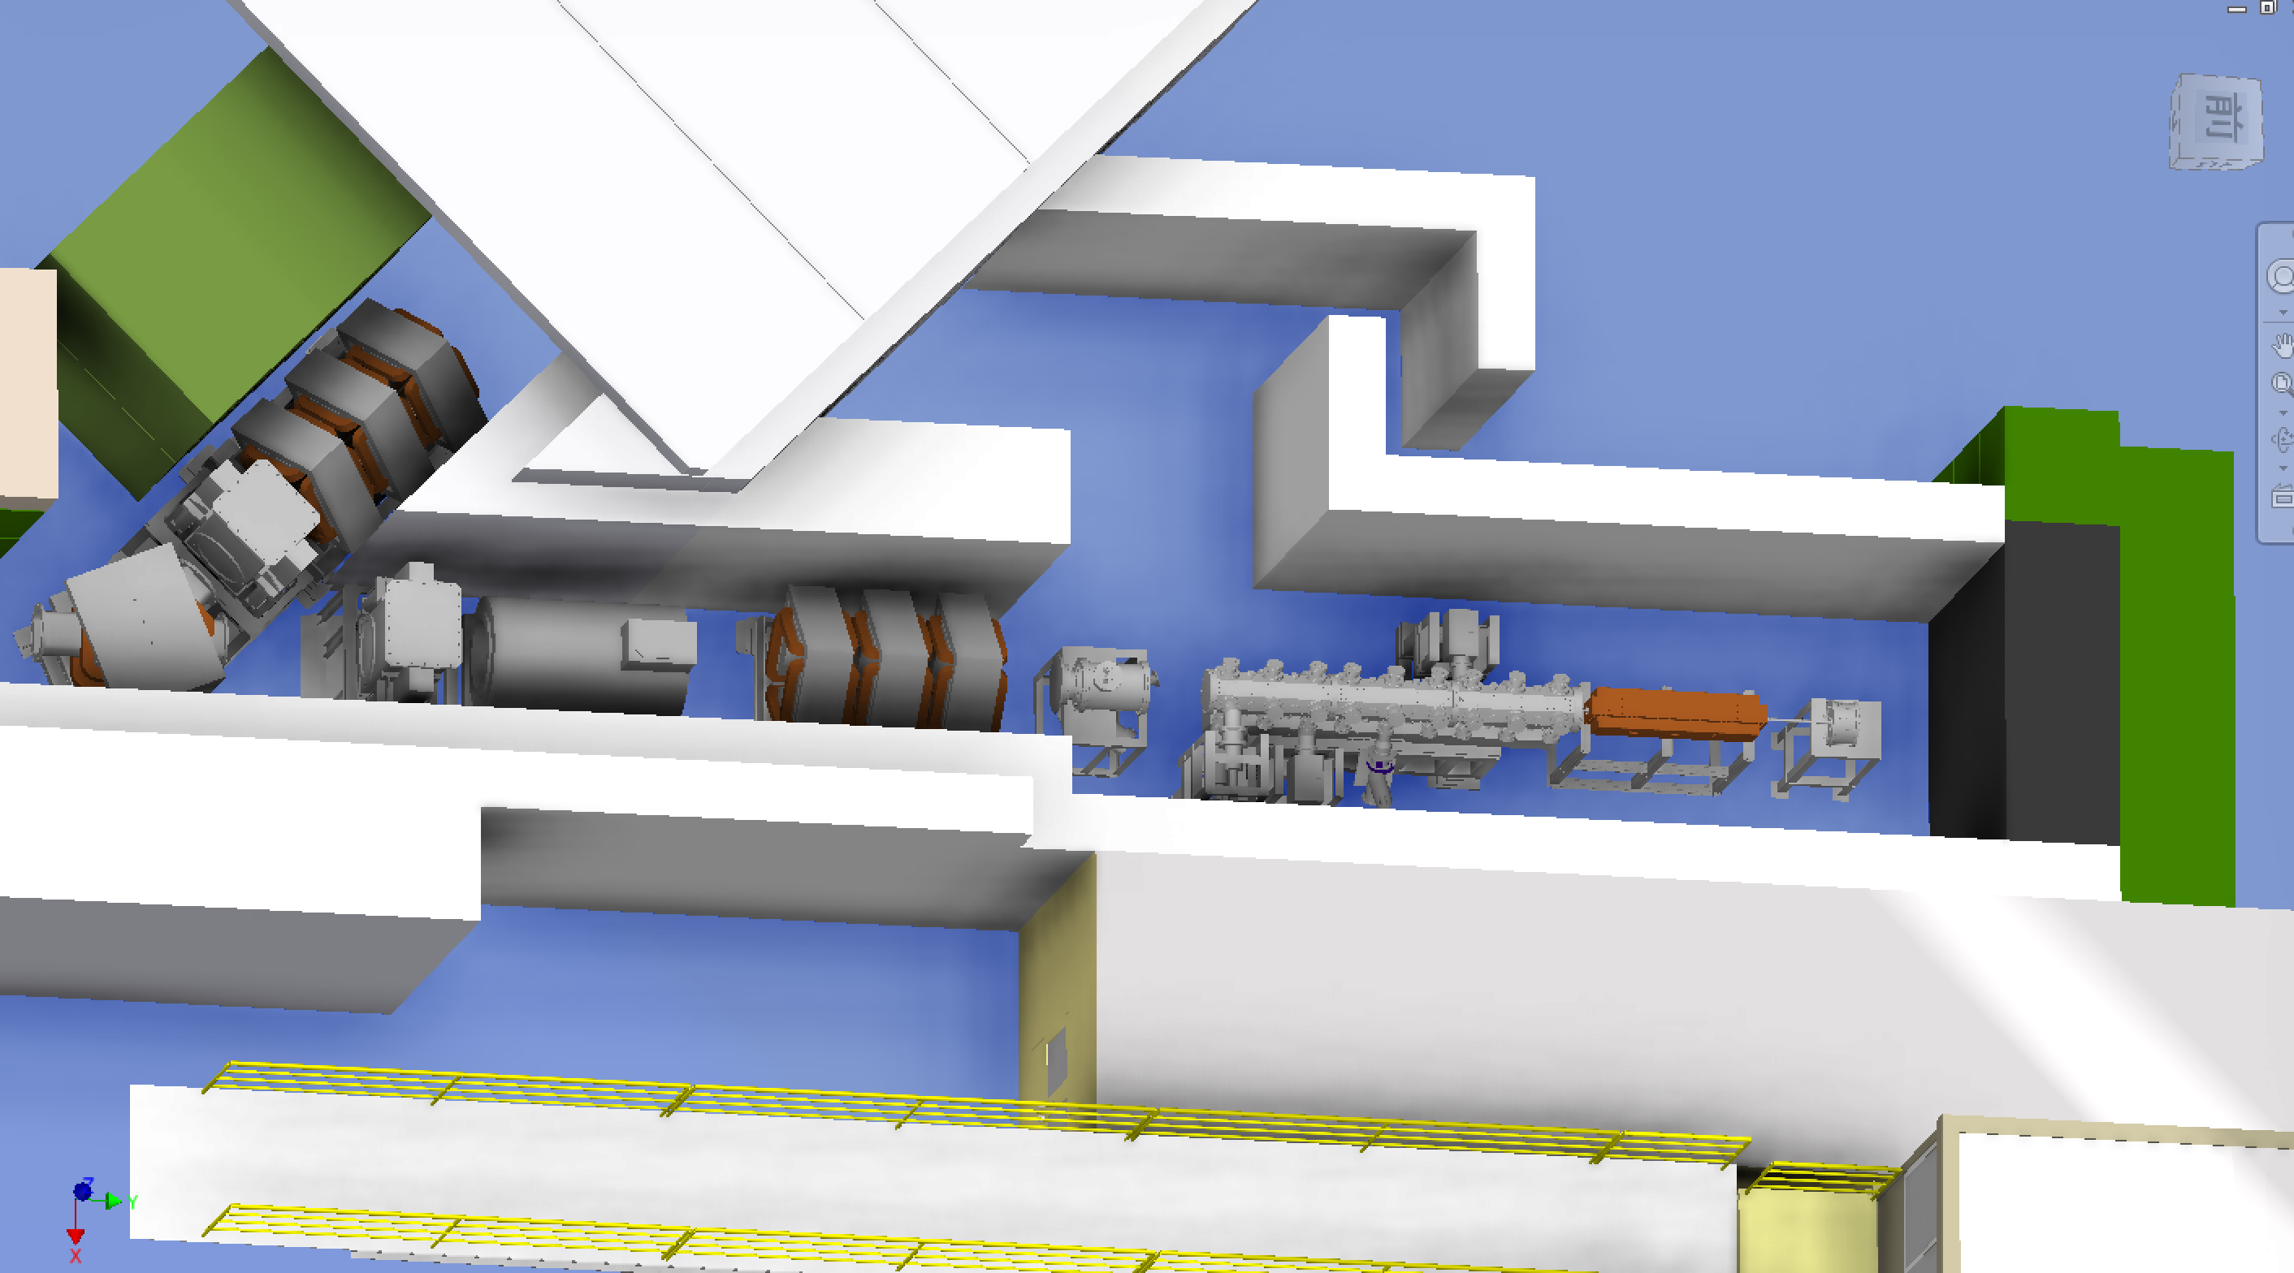
Next step: re-acceleration to 1 MeV
J-PARC MLF
Experimental Hall
H1 area
(MuSEUM/DeeMe)
Q-magnets
blocker
surface muon (4 MeV)
Mu
production
Initial
Accel.
RFQ
IH
Beam
diagnostics
detectors
Bend
magnet
Beam
Blocker
Solenoid
Q-magnets
accelerated muon (25meV→1.3 MeV)

Slide 29
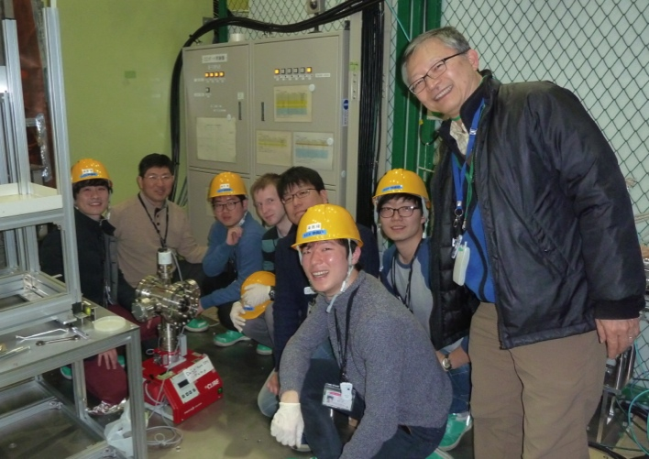
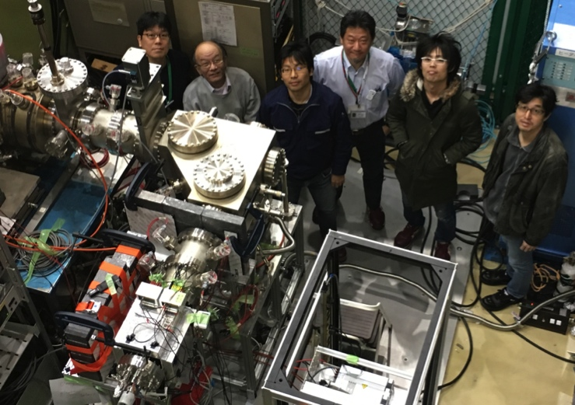
Next step: re-acceleration to 1 MeV
H1 area
(MuSEUM/DeeMe)
Q-magnets
Tested in 2016
Tested in 2016
blocker
surface muon (4 MeV)
Mu
production
Initial
Accel.
RFQ
IH
Beam
diagnostics
detectors
Bend
magnet
Beam
Blocker
Solenoid
Q-magnets
accelerated muon (25meV→1.3 MeV)
Tested in 2017
To be tested
Tested in 2016
Prototype

Slide 30
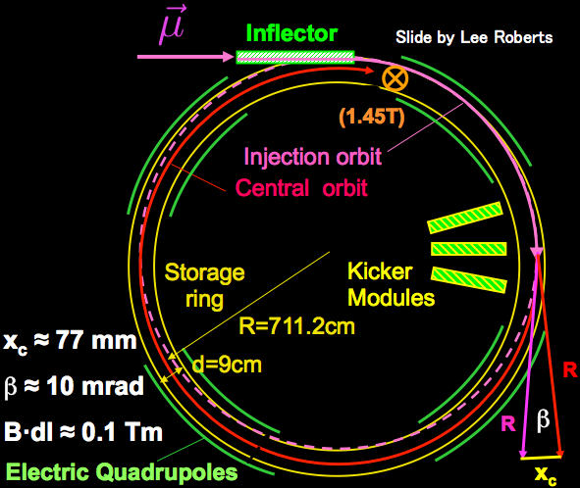
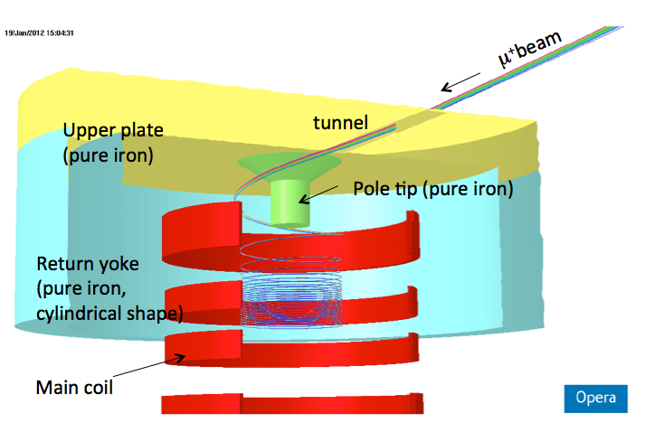
Muon beam injection and storage
Horizontal injection + kicker
(BNL E821, FNAL E989)
3D spiral injection + kicker
(J-PARC E34)
Injection efficiency : 3-5%(*)
(*) PRD73,072003 (2006)
Injection efficiency : ~85%
H. Iinuma et al., Nucl. Instr. And Methods. A 832, 51 (2016)

Slide 31
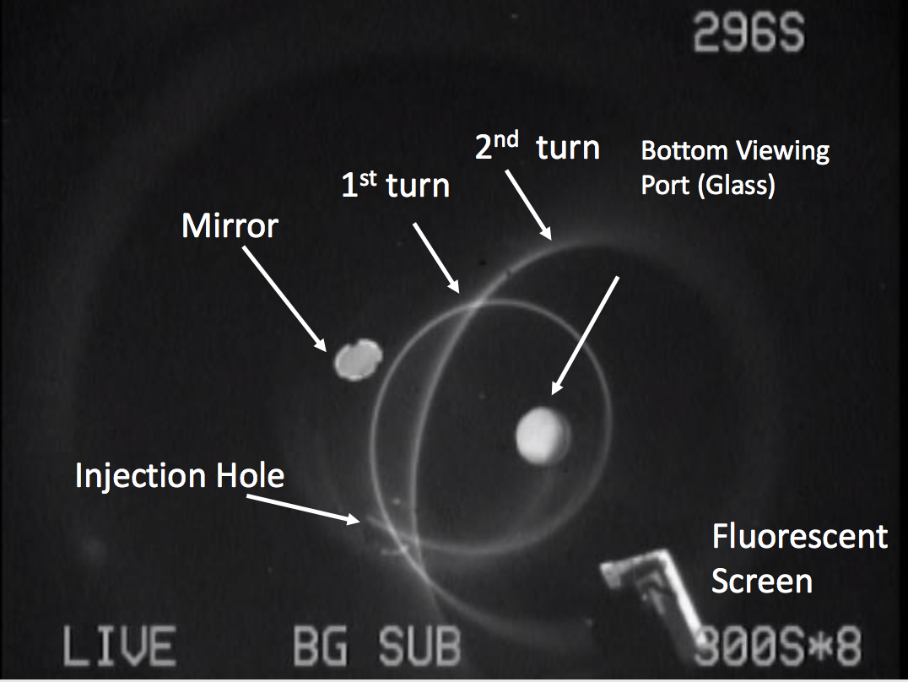
Spiral Injection Test Experiment with low-energy electron beam
H. Iinuma (Ibaraki), M. A. Rehman (Sokenai)
beam energy: 112 keV
magnetic field: 102 G

Slide 32
Muon storage magnet and detector
Drawn by Hitachi Co.
Iron yoke
Cryogenics
Muon storage orbit
2900 mm
e+ tracking
detector
Super conducting coils
666 mm
32
32
32
M. Abe et. al., Nuclear Inst. and Methods in Physics Research A 890, 51 (2018)

Slide 33
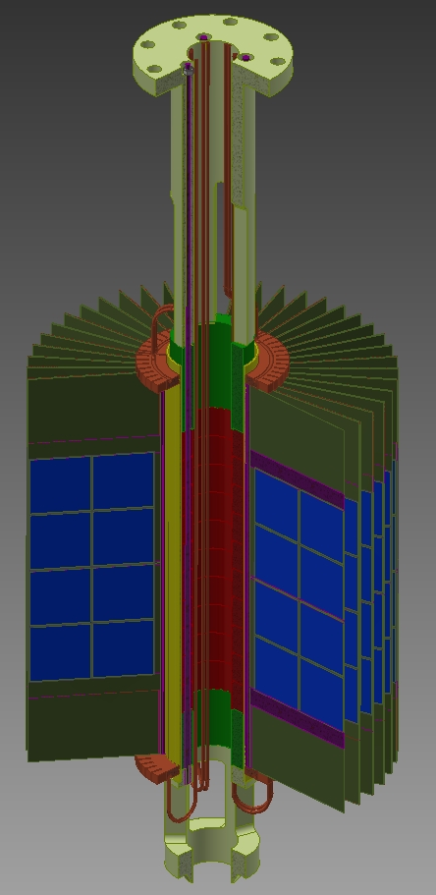
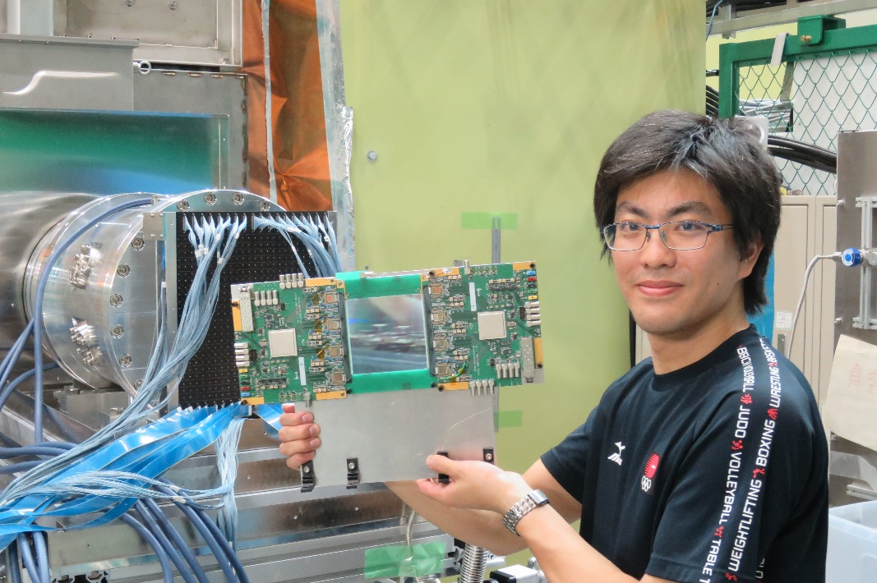
Positron tracking detector
A tracking detector ( vs. calorimeter)
  Robust against pileups
Partial funding available to construct a part of detector system
First working test module
tested in Mu-HFS experiment (June 2017)
KEK
Mechanical
Engineering
Center

Slide 34
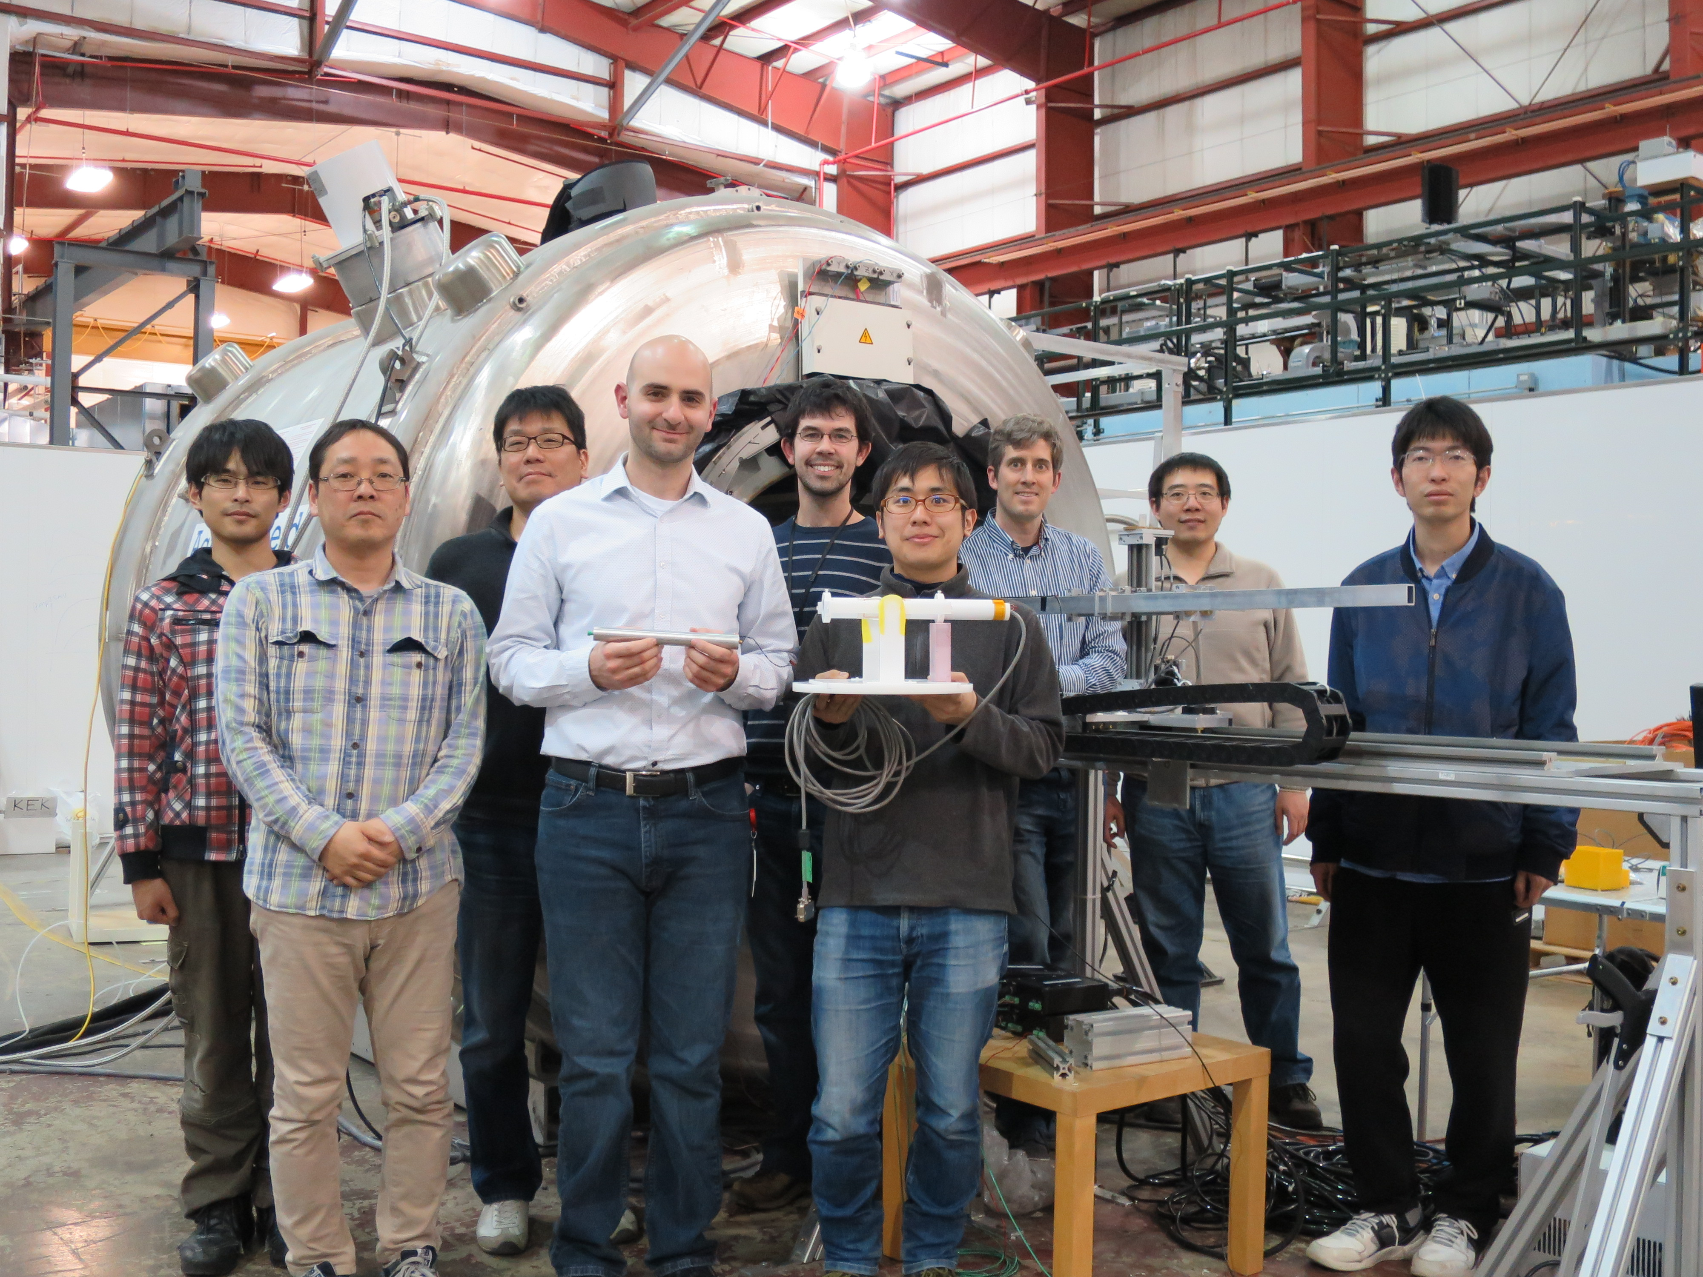
Second-round with many improvements
ANL, March 27 2018

Slide 35
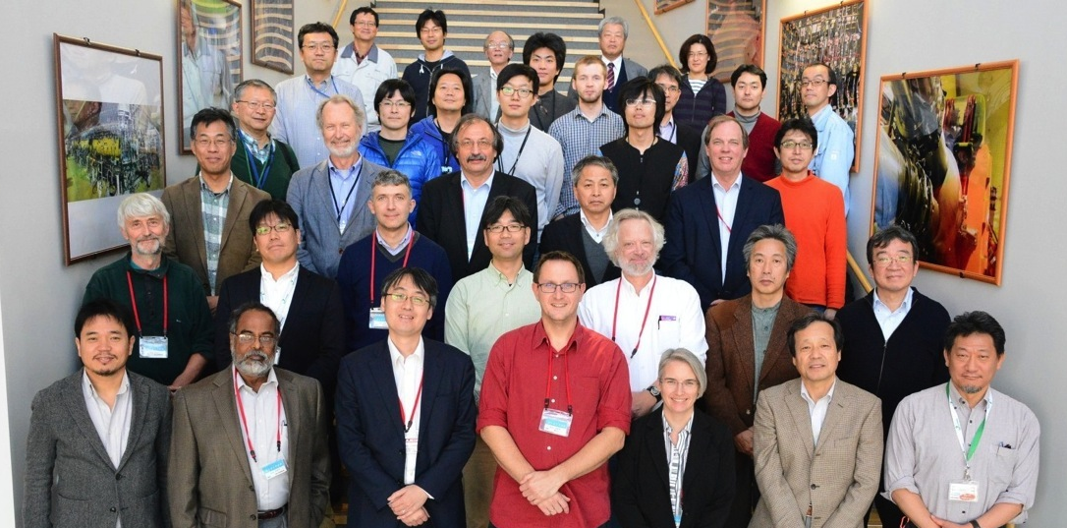
TDR focused review (Nov 15-16,2016)
Oct 15, 2016 Technical Design Report (TDR) submitted
Nov 15-16, 2016 Review meeting
Dec 15, 2017 Responses from the collaboration submitted
May 25, 2018 Report from the committee
July 18-20, 2018 Approval will be discussed in the PAC meeting

Slide 36
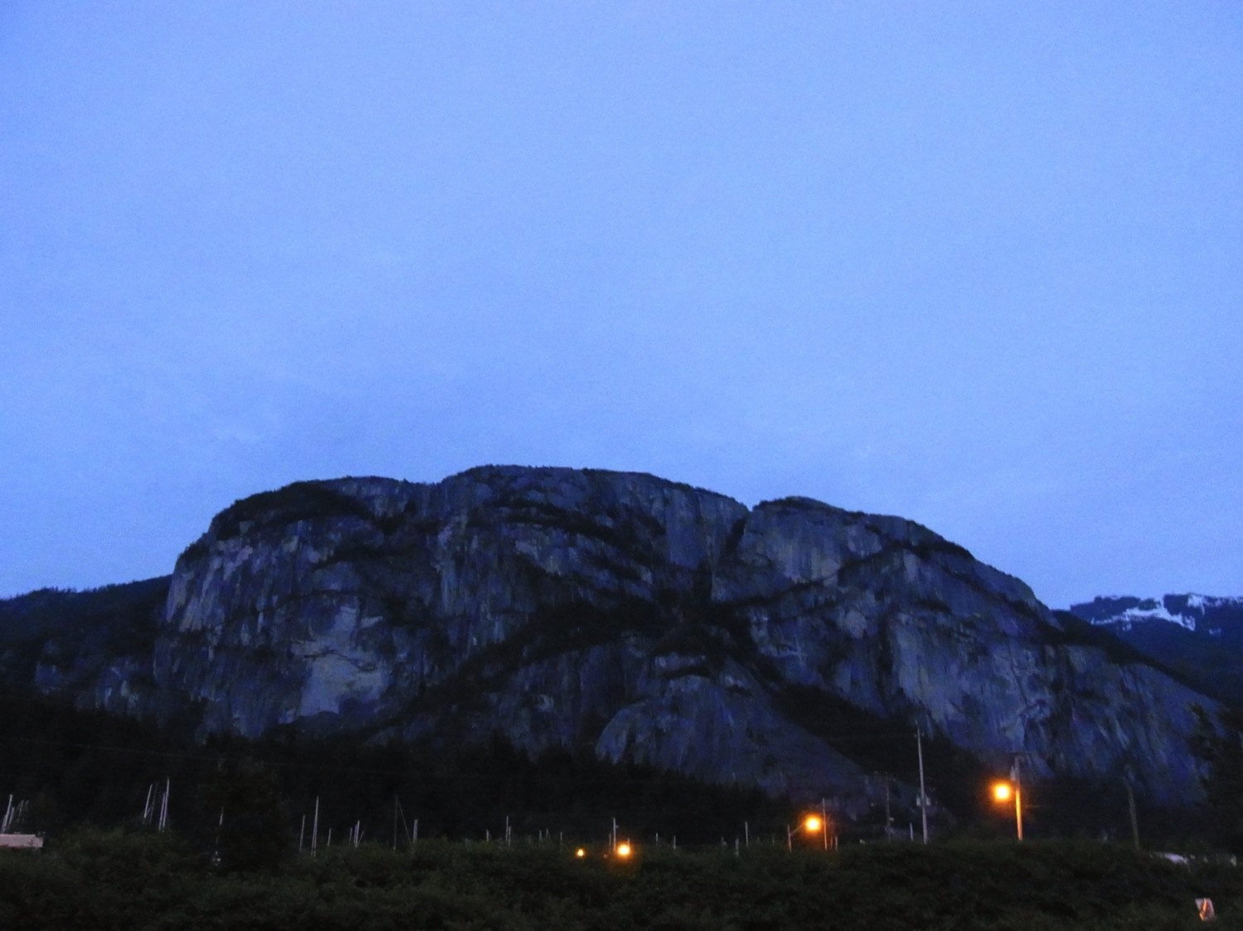
physics
data & results
construction
TDR
Squamish, BC (Canada)

Slide 37
Technically-driven schedule and cost
Assumption : Major construction fund becomes available in JFY201X
(1.5 Oku secured by Grant-in-aids)

Slide 38
Summary
We plan to measure muon’s g-2 and EDM with ultra-cold muon beam at J-PARC.
  Complemental & independent from BNL and Fermilab g-2 measurements
News since last year
  Oct. 2017, First muon acceleration to 90 keV
  Mar 2018, Cross calibration of NMR probes (J-PARC,Fermilab)
  April 2018, Major funding for construction of the upstream muon beamline is provided.
  May 2018, Received very positive replies from the TDR review committee (FRC)
  (July 2018), Waiting for full approval from the lab.

