Slide 1
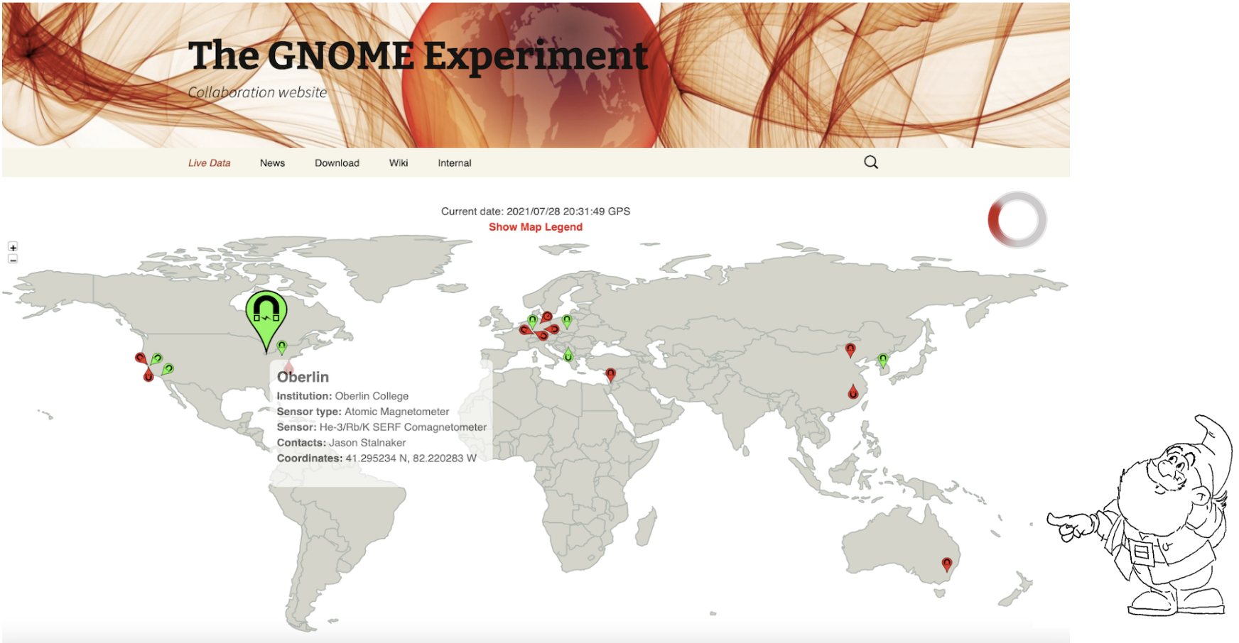
Data Analysis for Dark Matter Axion Star Search
GNOME Collaboration
Dhruv Tandon

Slide 2
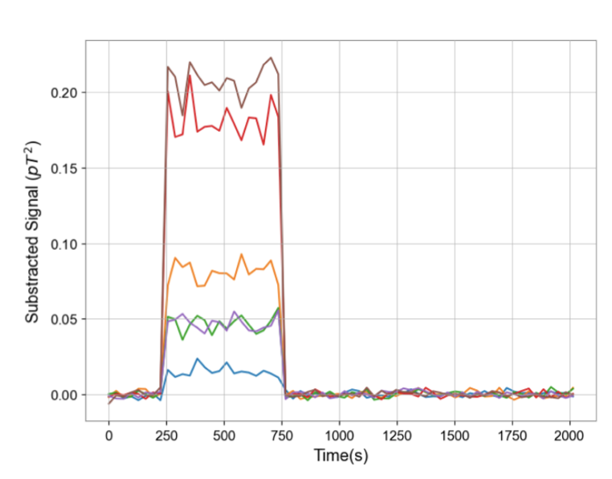
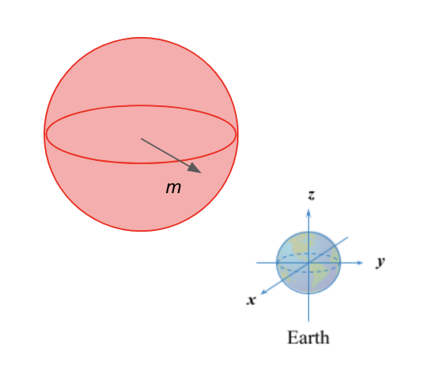
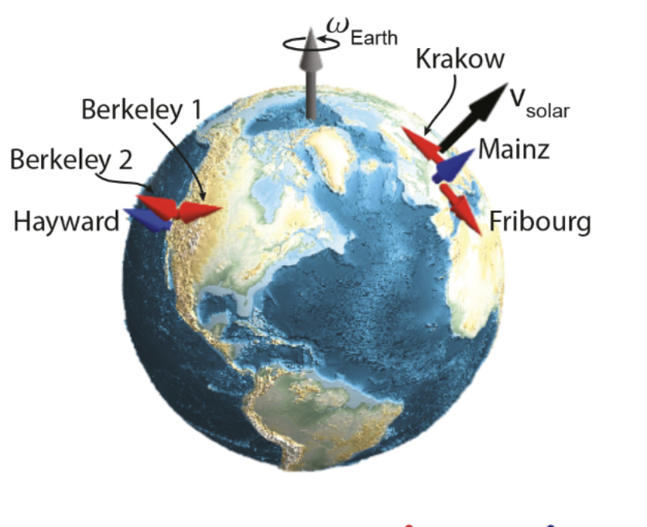
Search Target is a Transient Oscillatory Signal
Limit the effective amplitude (coupling)
Limit the rate of encounter

