Slide 1
of unexpected effects
Unexpected Planetary relationships as the new signature
in astro-particle physics
Konstantin Zioutas
University of Patras / Greece
Observationally driven
➔ DM remains elusive
10th August 2022
1

Slide 2
Dima BUDKER et al. : START-UP collaboration work ( + Poland, USA, Israel,. ) >> too many Qs
Related REFERENCES:
[1] https://doi.org/10.1016/0370-2693(91)90330-S , On the possibility of Bose-star formation
[2] https://arxiv.org/abs/0711.1105 , The fine-grained phase-space structure of CDΜ halos.
[3] https://arxiv.org/abs/0812.0362 , Phase-space structure in the local dark matter distribution and its signature in direct detection experiments
[4] https://arxiv.org/abs/0906.4341 , Caustics in growing Cold Dark Matter Haloes.
[5] https://arxiv.org/abs/1002.3162 , Streams and caustics: the fine-grained structure of ΛCDM haloes
[6] https://doi.org/10.1016/S0927-6505(03)00138-5, Gravitational lensing by the Sun of non-relativistic penetrating particles.
[7] https://arxiv.org/abs/1305.2454 , Flux Enhancement of Slow-moving Particles by Sun or Jupiter: Can they be Detected on Earth?
[8] https://arxiv.org/abs/1309.4021 , The 11-years solar cycle as the manifestation of the dark Universe.
[9] https://arxiv.org/abs/1507.07009 , Dense Dark Matter Hairs Spreading Out from Earth, Jupiter and Other Compact Bodies.
[10] https://arxiv.org/abs/1602.03666 , The Sun and its Planets as detectors for invisible matter.
[11] https://arxiv.org/abs/1809.02555 , Planetary dependence of melanoma.
[12] https://doi.org/10.1142/S1793048020500083 , Observation of a 27 Days Periodicity in Melanoma Diagnosis.
[13] https://arxiv.org/abs/2004.11006 , Stratospheric temperature anomalies as imprints from the dark Universe.
[14] https://arxiv.org/abs/2005.08252 , Gravitational Focusing of Low-Velocity Dark Matter on the Earth's Surface.
[15] https://arxiv.org/abs/2012.03353 , On the Direct Detection of Dark Matter in the Stratosphere.
[16] https://arxiv.org/abs/2108.11647 , The dark Universe is not invisible. See ref’s therein.
[17] https://arxiv.org/abs/2106.15408 , Gaia, Fundamental Physics, and Dark Matter.
[18] Marios Maroudas, PhD thesis, 2022 University of Patras /Greece.
[19] Abaz Kryemadhi, this workshop.
2

Slide 3
Unexpected cosmic observations ➔ DM
Dunkle
Materie
Anomaly / mystery => missing explanation
Insisting local anomalies / mysteries ➔ the unnoticed
trigger by the
dark Universe!
> Why? ➔ [6-19]
ZWICKY
1933
For diverse observables:
Unexpected planetary Relationships⬄ invisible streams
dynamic Sun => dynamic Earth.
The key signature
what else?
3

Slide 4
Sun’s dynamical behaviour
=> a mystery <=
Frank Wilczek (CERN seminar):
“~focus on anomalies / mysteries”
➔
4

Slide 5
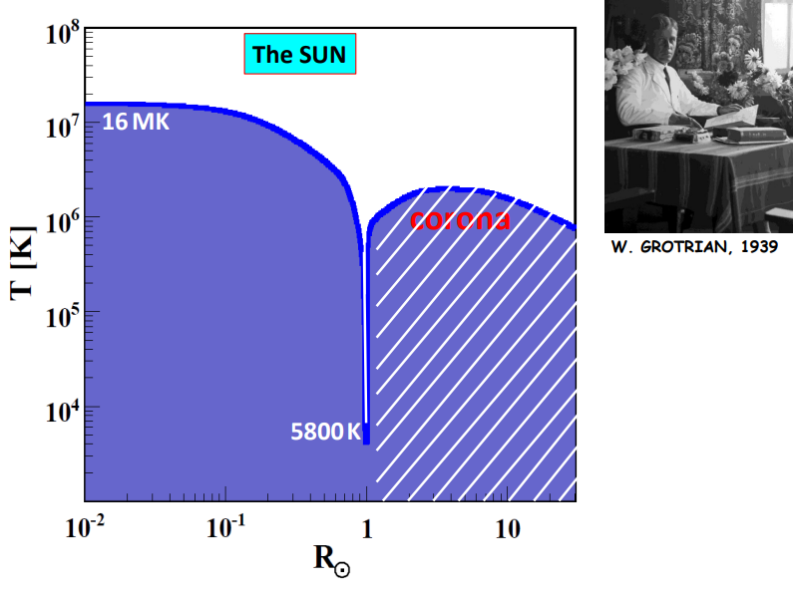
A mysterious solar observation: T_{SUN} = ƒ(R)
W. Grotrian 1939
[Leibniz Institute for
Astrophysics, Potsdam]
… few facts ➔
Surface
5

Slide 6
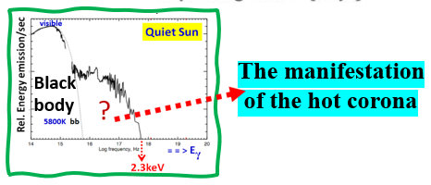
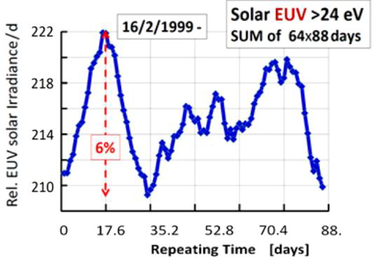
The solar corona paradox.
2017
2002
[10]
NOT
EXPECTED
20eV
Solar EUV / d
NOT EXPECTED
[H. Hudson]
Repeating time 88 d
[L. Di Lella, K. Z., AP 19 (2003) 145];
https://arxiv.org/abs/astro-ph/0207073
=Mercury orbit
Planetary relationship
➔ Paradox²
But….➔
6

Slide 7
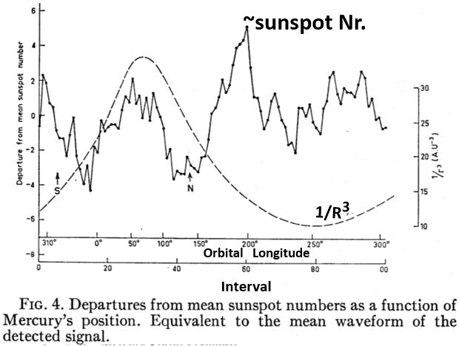
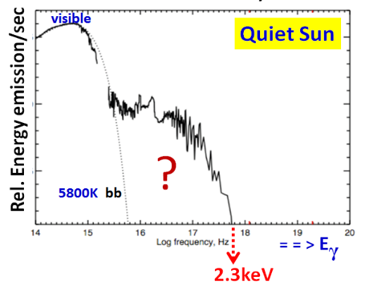
MERCURY
Discarded...1967 2017Planetary dependence
…because inconsistent w’ 1/R³ tidal force
➔ the ONLY remote force!
http://dx.doi.org/10.1016/j.dark.2017.06.001
Phys.DarkUniv. (2017)
http://adsabs.harvard.edu/abs/1967AJ.....72..463BAJ(1967)
observed
expect
“Itisimmediatelyobviousthatnosimpletheory will
entirely accountforthiscomplexpattern,butoneof
Themaximaoccurs nearMercury’sclosestapproachtothe
Sunandthetwo conspicuousminimaoccurquitecloseto
theplanet’sgreatest departuresfromtheplaneoftheearth’s
orbit(NandSinFig.).”
The manifestation
of the hot corona
Black
body
UNEXPECTED
7

Slide 8
1st take away:
A peaking dependence excludes
a remote planetary force !
+
tidal
confirms this work
+
Planetary relationship ⬄ exo-solar origin
8

Slide 9
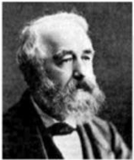
The 11-year solar cycle
R. WOLF
P^{JUPITER} = 11.86 years ≈ 11 years
1859- Suspected planetary dependence
>= = = =>
The only remote tidal planetary force => too weak!
missing factor ~10¹¹
Following
known
physics
follow-up!
…. more quantitatively ➔
9

Slide 10
[6,7] & solar cycle suggestive for planetary
Gravitational focusing of streaming DM [8].
Working hypothesis:
Streaming invisible matter
⊗
Gravitational lensing
⊗
Large σ
As suspected:
Pretend remote interaction!
10

Slide 11
…. NOT from mc²
⬅ [6,7]
Gravitational deflection ΔΦ ∝ 1/v²
Deflection (v~1‰ c) ➔ ×10⁶ Deflection (v=c)
planetary lensing within inner solar system ✓
+ Moon => Earth!
[6,7,10]
⬅ 2003
2014
⬅ 2017
11

Slide 12
[A. Kryemadhi, A. Mastronikolis, K. Z. (2022)
in preparation]
Overlooked in DM research
+)
Also: planetary grav. self-focusing: Streams ➔ “hairs” [9,14]
Flux enhancements : >10⁴×
+) [A. Kryemadhi]. This workshop
12

Slide 13
DM presence is known through its gravitational pull on visible matter in space.
DM does not emit, absorb, or, reflect light.
.
Therefore, dark matter remains as elusive as Alice in Wonderland's Cheshire Cat – where you only see its grin (in the form of gravity) but not the animal itself.
https://www.nasa.gov/feature/goddard/2020/hubble-observations-suggest-a-missing-ingredient-in-dark-matter-theories
Misleading? => counter examples => this work. E.g.:
various energetic events of unknown origin, like
Flares, Solar EUV, and terrestrial obs’s, etc…
This work: DM => “Invisible matter”
13

Slide 14
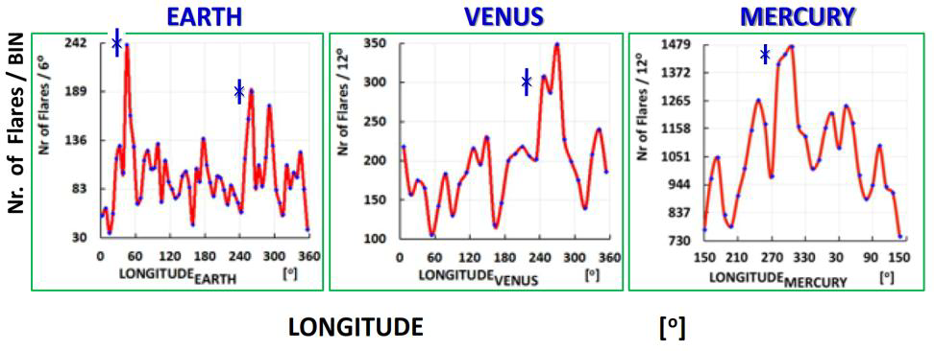
Solar Flares
Peaking planetary relationship,
excludes a remote planetary interaction, e.g., tidal forces
Data from M.J. Aschwanden
14

Slide 15
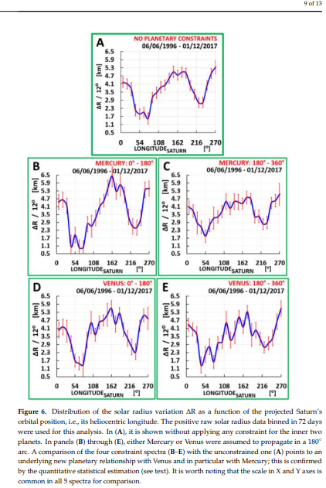
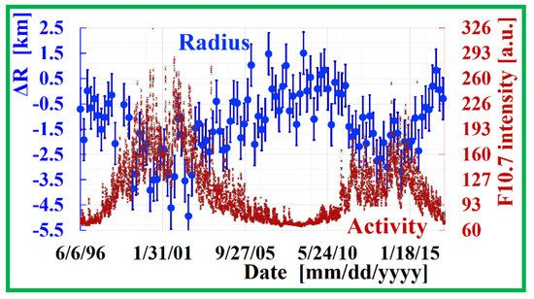
Solar radius variation:
from helioseismology
- minimum BIN=72 days
Planetary relationship✓
ΔR [km]
⬅Mercury
0-180º 180º-360º
OR
ΔR [km]
⬅ Venus
0-180º 180º-360º
LONGITUDE-SATURN
ΔR [km]
Lift 1km photosphere by 1km:
required ~ 10³⁰ erg.
LONGITUDE-MARS
15

Slide 16
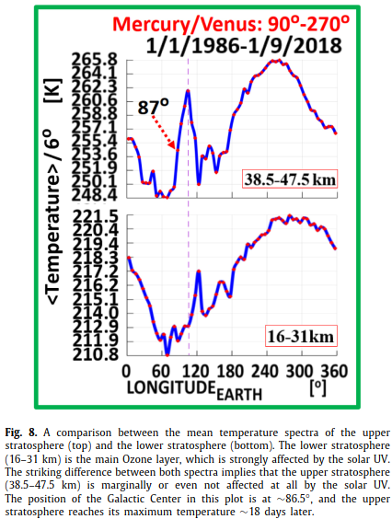
Stratosphere: temperature anomalies
as imprints from the dark Universe
.. similarly for the ionosphere!
➔ planetary relationships ✓
Energy deposition:
~ W/m²
Energy
~10⁶ GeV/cm²/s/
huge for usual DM
In the Ionosphere above, too!?
https://doi.org/10.1016/j.dark.2020.100497
16

Slide 17
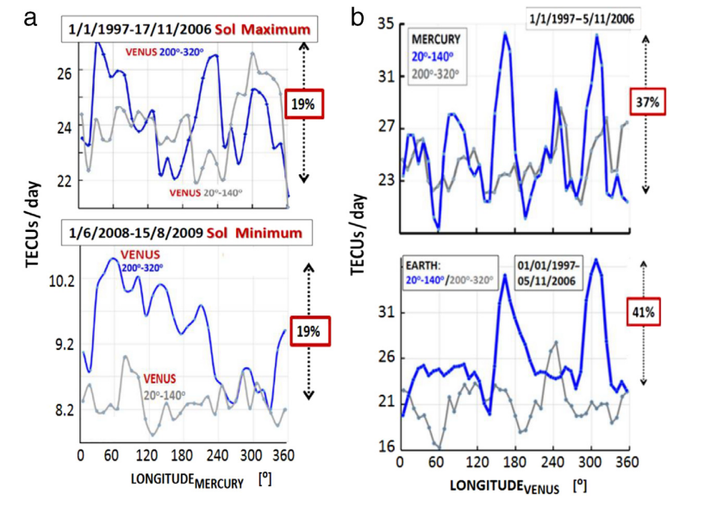
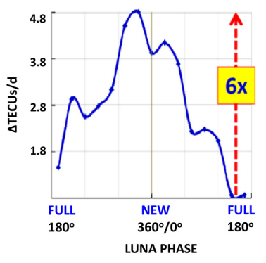
Ionosphere annual anomaly 1937-: planetary relationship [10]
➔ Where atmosphere meets outer space.
=> ~pico-gram of electrons/cm² .
ΔTEC / d
Plasma density
MOON PHASES
LONGITUDE [º]
17

Slide 18
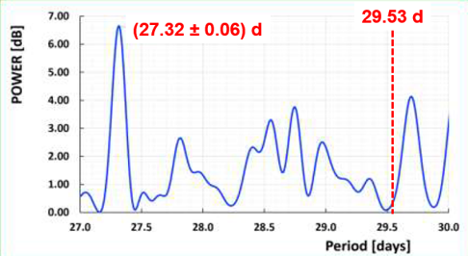
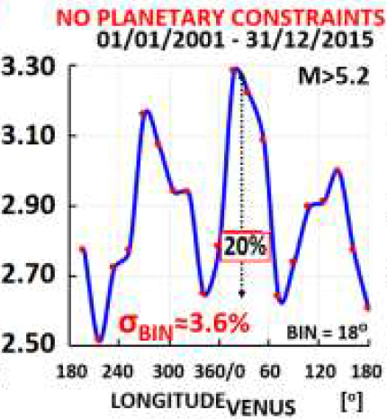
EARTHquakes
Planetary relationships for EQs with Magnitude M > 5.2 (> 5σ). Total number of EQs =15696, and it is normalized to daily rates compensating for eccentricity related effects
Fourier periodogram on the number of EARTHQUAKES (EQs) with
M > 5.2 and by selecting only days with maximum 25 EQs / day
(1/1/2001 to 31/12/2015). Total Nr. of EQs = 15696 with M > 5.2
and maximum 25 EQs/day worldwide. Of note, the appearance only
of the sidereal lunar periodicity at (27.32 ± 0.06) days, while the
synodic one at 29.53 days is absent.
[ M. Maroudas, PhD thesis, University of Patras 2022 ]
18

Slide 19
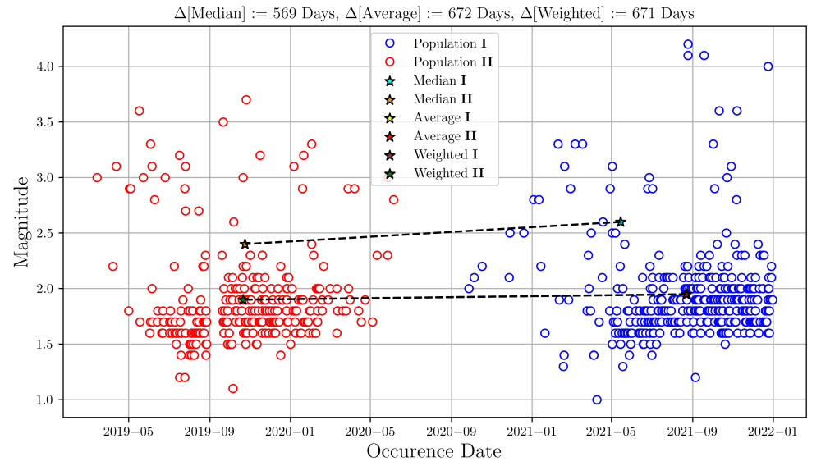
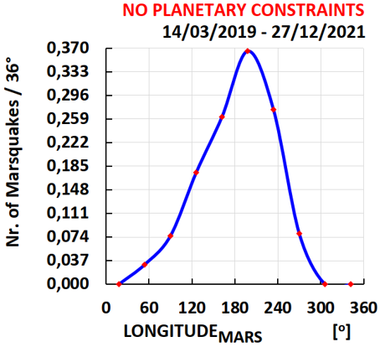
MARSquakes
Confirmed!
This is the projection of Marsquakes
on the Heliocentric Mars longitude,
time normalized; possible eccentricity related effects are suppressed
Data from NASA
=> Thanks for the fast response!
19

Slide 20
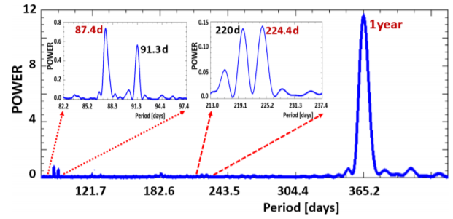
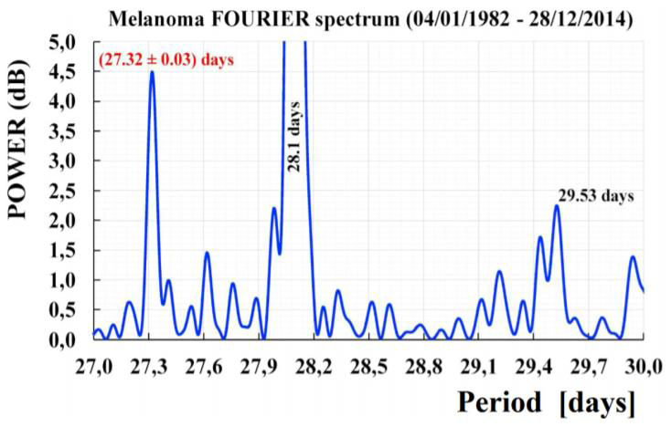
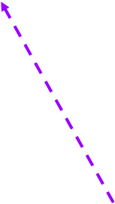
Melanoma
2018⬅ ➔ 2020
..a 27 Days Periodicity in Melanoma Diagnosis
Planetary Dependence of Melanoma
http://dx.doi.org/10.1142/S179304801850008X
https://doi.org/10.1142/S1793048020500083
AUSTRALIA daily data 1982-2015
USA <monthly> data 1973-2011
±0.76d
87.97 days
@Mercury’sorbit @Moon’sorbit 27.32 days (sidereal)
=>fixed to remote stars
Confirmed independently
Origin: exo-solar!
➔ overlooked!
https://doi.org/10.1142/S1793048019200029
20

Slide 21
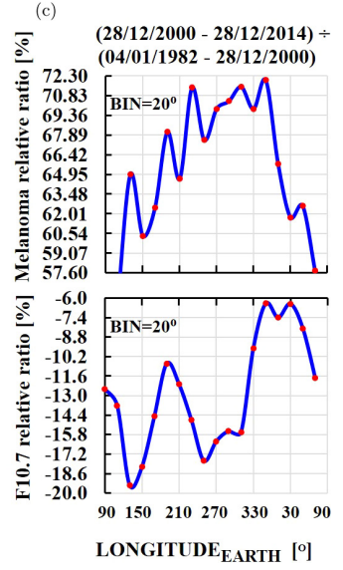
The origin of the 27.32 d line:
NOT SOLAR
21

Slide 22
P. Sikivie
Clean energy from DM?
Let us also consider dark matter constituted of axion-like particles (ALPs). These are light
spin zero bosons like axions[3] but they do not solve the Strong CP Problem of the Standard
Model of particle physics. ALPs are much less constrained than axions. In particular their
coupling strengths are not necessarily proportional to their mass (as is the case for axions)
and they may be very light. Consider for example dark matter constituted of ALPs of mass 10⁻¹⁵ eV. Eqs. (1), (2) and (13) apply, so their oscillation frequency is 0.24 Hz, their coherence time is of order 4 months and the maximum amount of power that can extracted from them is 1.3·10¹² TW, Which is quite a lot more than needed. The remaining issue is the coupling strength. We may consider the ALP coupling to two photons which gives rise to Eq. (4). Let us assume that a high quality resonator can be found that Exploits that coupling in the ALP case and that B2V CQ has the same value as achieved in ADMX. The power is boosted by the factor 1/m_{a}. Although g is unrelated to m_{a}, it is bounded by the CAST solar axion search [4]. Assuming g saturates the CAST bound, we would get P∼10⁻² W. https://arxiv.org/abs/2107.14300
22

Slide 23
DM & cotemporally applications?
A.
B.
➔ Enhanced flux during peaking planetary relations? ⬅
e.g., in the Ionosphere & stratosphere & …?
➔ health related impact ⬅
First results unexpected. More to come?
FOLLOW-UP
23

Slide 24
Conclusions:
•Various planetary measurements of solar system observables fit-in streaming invis. Matter
•Our diverse results are suggestive for more investigations of this type at ~zero cost ().
Similarsearches: in exo-solarplanetary systems [17] ➔ + solar systems bodies.
Any ~11yearsrelationship suggests re-analysis, i.e., search for planetary relationship
Aiming to
- ID the suspected invisible matter constituents.
- address direct DM searches, see [15].
43

Slide 25
The”DarkWorld”isnotdark!
THANK YOU
zioutas@cern.ch
24

Slide 26
Additional slides
25

Slide 27
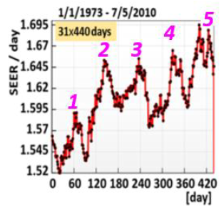
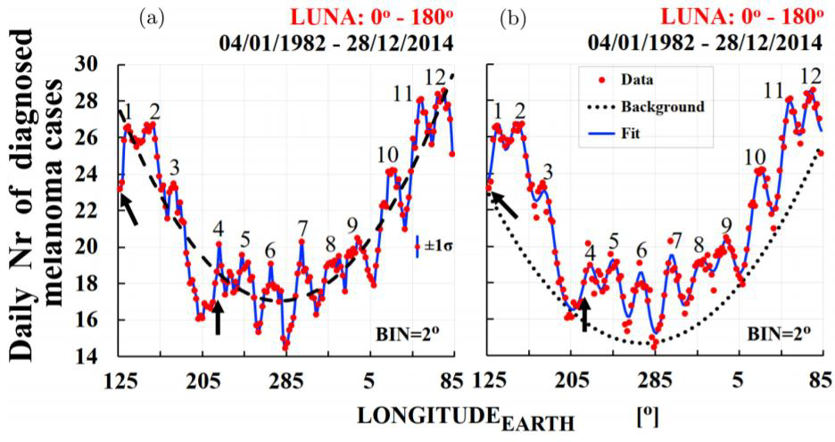
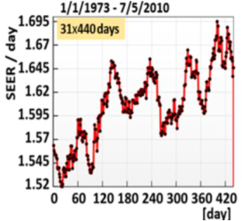
Planetary Dependence of Melanoma
http://dx.doi.org/10.1142/S179304801850008X
..a 27 Days Periodicity in Melanoma Diagnosis
USA <monthly> data 1973-2011
https://doi.org/10.1142/S1793048020500083
AUSTRALIA daily data 1982-2015
Adding up consecutive 5×88 d => 440days:
33

Slide 28
The 27-day variations of plasma densities and temperatures in the topside ionosphere
other factors that affect TEC more strongly than F_{10.7} and mask the effects of daily solar EUV variations. TEC=TotalElectronContent
https://agupubs.onlinelibrary.wiley.com/doi/full/10.1029/2002JA009731
“…when they did not see a correlation 2003
they even did NOT publish it,..”
27

Slide 29
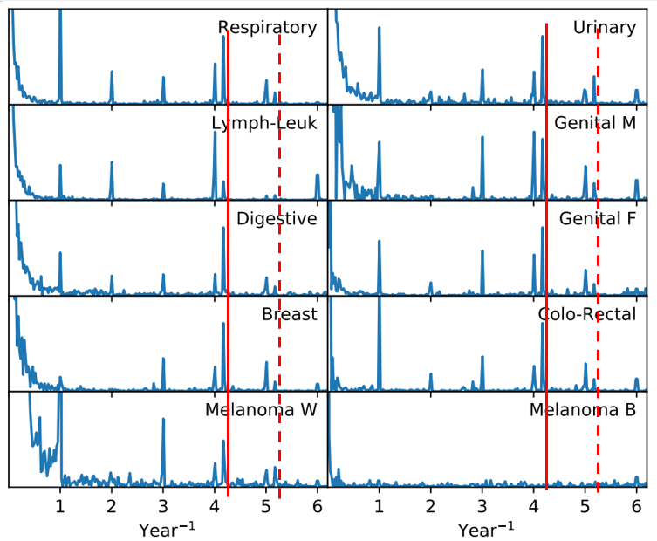
H. Socas-Navarro
https://arxiv.org/abs/1812.02482
Multiple confirmation of our first
result at ~88days (= 4.17/year);
See also https://arxiv.org/abs/1812.10332
Continuous and dashed red lines are next
to 4.17/Year and 5.17/Year, respectively.

Slide 30
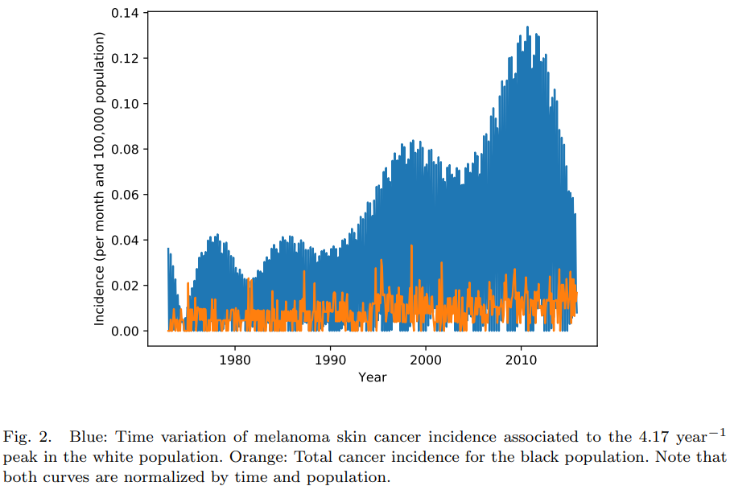
H. Socas-Navarro
https://arxiv.org/abs/1812.02482

Slide 31
30

Slide 32
Planetary relationship as the new signature from the dark Universe
ABSTRACT:
The discovery of dunkle Materie (DM) by ZWICKY came from unexpected cosmological observations. Similarly, the last ~160 years a number of unexpected local energetic observations could be the manifestation of the dark Universe. We refer to this class of particle candidates as “invisible” to distinguish them from the already excluded parameter phase space of WIMPs and axions. In this work we stress a simple feature as the common signature of such observations within the solar system. Namely, the widely
discussed dark sector constituents with velocity of ~1‰ c (c=velocity of light). As pointed out since 20 years, streams of constituents with such velocities can be gravitationally focused or deflected by any solar system body to others. The aforementioned energetic observations include the unpredictable flaring Sun, its irradiance, its size variation, its elemental composition, etc, but also terrestrial phenomena including the dynamic atmosphere and other highly crossdisciplinary observations like the not randomly appearing Earthquakes. All observations follow otherwise unexpected planetary relationships. More results may come out until this conference following more out-of-the-box thinking including exo-solar planetary systems. To conclude, a planetary relationship is a key signature pointing on its own at exo-solar origin. In this conference we will focus on Earthquakes. The only viable explanation is thanks to planetary gravitational focusing of streaming invisible matter, which is tentatively identified with constituents from the dark Universe, interacting with large cross section with ordinary matter. Implications in (ongoing) DM experiments will be discussed. The mostly inspiring particle constituents fitting-in a number of observations are Anti Quark Nuggets, magnetic monopoles and dark photons. Though, more emerging candidates like the pearls (see talk by Holger Nielsen) are encouraged to investigate whether they also fit-in, and, how to identify their possible involvement.
Further reading: https://arxiv.org/abs/2108.11647 ; https://arxiv.org/abs/2106.15408 ; https://arxiv.org/abs/2202.04447 ;
https://arxiv.org/abs/2004.11006 ; https://arxiv.org/abs/1309.4021 ; https://arxiv.org/abs/1703.01436 ; https://arxiv.org/abs/1602.03666 ; …
1A

Slide 33
AntiQuarkNuggets (AQNs):
dark matter +missing antimatter +(much) more?
https://indico.desy.de/indico/event/20012/session/19/contribution/54/material/slides/0.pdf
N. Raza, L. van Waerbeke, A. Zhitnitsky,
Solar Corona Heating by the AQN Dark
Matter,arXiv:1805.01897(2018),
Phys. Rev. D 98 (2018)103527 ^{Candidates:}
1. - AQNs
- Pearls
Pearls
>> see Holger Nielsen’ talk, this workshop
2. Magnetic monopoles
Dark photons
Or,a combination from + more?
https://inspirehep.net/record/1235677/plots
37

Slide 34
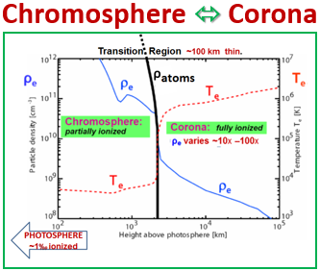
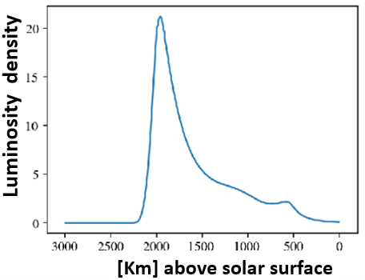
AQNs: ♦the only solar atmospheric model explaining
the ~100 km thin Transition Region
♦planetary dependence of the flaring Sun
♦more?>>> unexplained obs’?!
N. Raza, L. van Waerbeke, A. Zhitnitsky, Solar Corona Heating by the AQN DM, arXiv:1805.01897(2018)₃₅

Slide 35
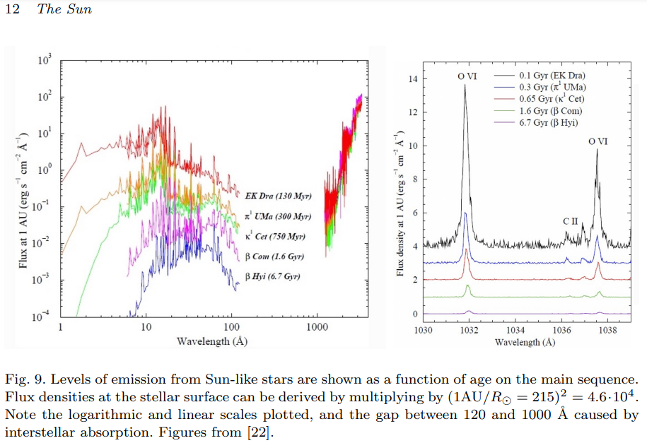
https://arxiv.org/abs/2205.03498

Slide 36
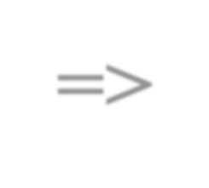
The key signature:
Planetary relationships➔ (exo-)solar impact
➔remote planetary forces unknown, except:
=>gravitational tidal forces:
-Smooth change ~1/R³ ➔do not fit obs’s
- -too feeble: missing factor ≤10^{-11 &)}
-Peaking dependence excludes
aremote planetary interaction
&) DOI:10.1023/A:1022912430585Sol. Phys. (2003) ₁₀

Slide 37
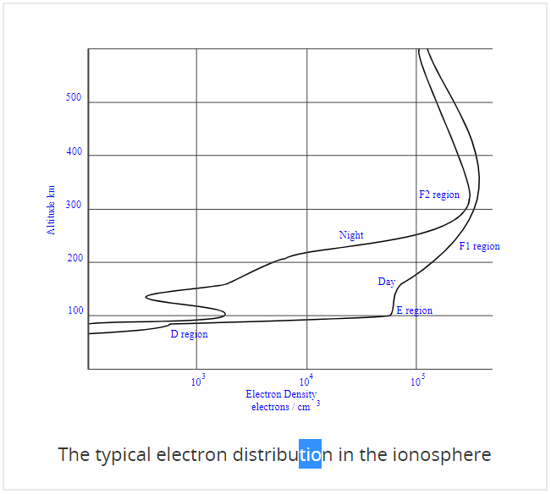
https://www.electronics-notes.com/articles/antennas-propagation/ionospheric/ionospheric-layers-regions-d-e-f1-f2.php

Slide 38
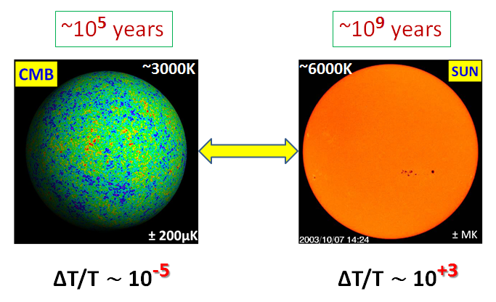
UNIVERSE SUN
~3000K
~6000K
SUN:
not thermalized after 4.5 Gyrs => WHY NOT?
6

