Slide 1
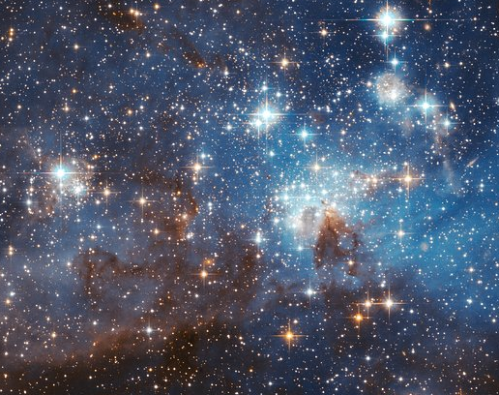
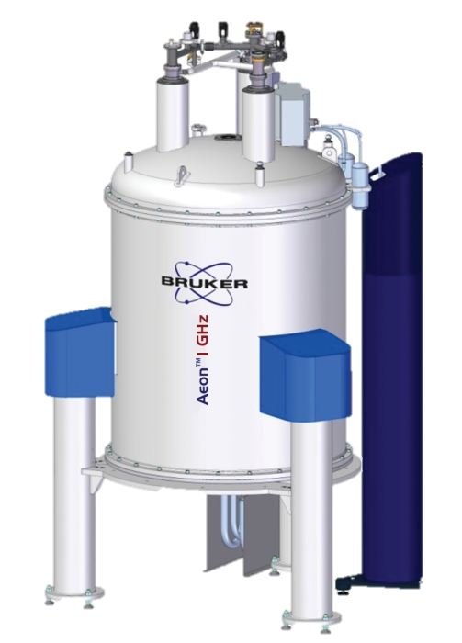
Probing the axion gradient-coupling with nuclear magnetic resonance spectroscopy
Hendrik Bekker
for the CASPEr collaboration

Slide 2
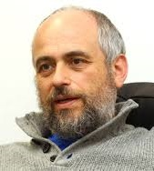
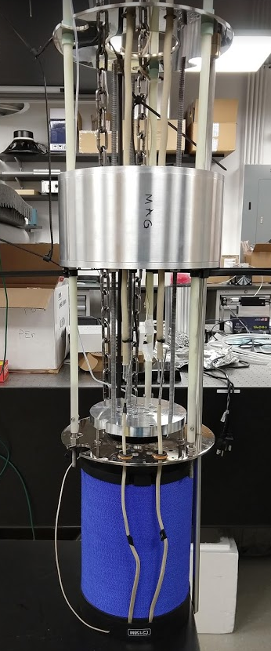
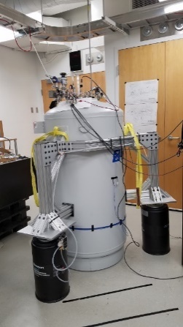
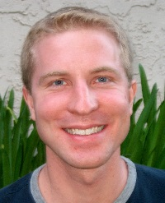
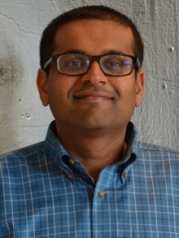
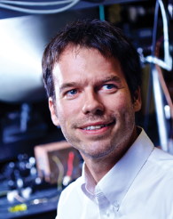
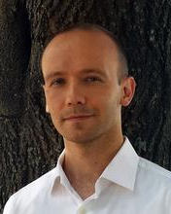
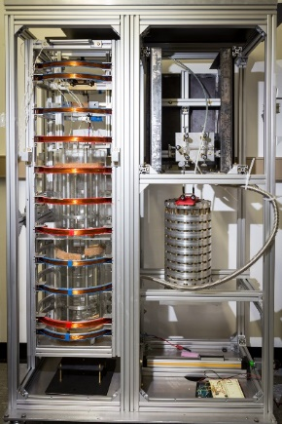
The Cosmic Axion Spin Precession Experiment program
Deniz Aybas
Alex Wilzewski
Janos Adam
Sasha Gramolin
Dorian Johnson
Annalies Kleyheeg
Arne Wickenbrock
John Blanchard
Antoine Garcon
Gary Centers
Nataniel Figueroa
Marina Gil Sendra
Yuzhe Zhang
Arian Dogan
Julian Walter
Ophir Rumi
Jiaxuan Xu
Pengyu Zhou
Teng Wu
Alfredo Ferella
Matthew Lawson
Dmitry Budker
Peter Graham
Derek Kimball
Surjeet Rajendran
Alex Sushkov
Boston University:
CASPEr-electric using spins in solids
Helmholtz institute Mainz:
CASPEr-gradient using hyperpolarized liquids

Slide 3
Cosmic Axion Spin Precession Experiment
CASPEr-electric (gluon) CASPEr-gradient (fermion)
Nuclear magnetic resonance
pseudo-magnetic field
$$B_{ALP}∝g_{aNN}v_{a} \sqrt{2ρ_{DM}}\sin\left(ω_{a}t\right)$$
coupling constant
oscillating at ALP Compton frequency
ALP velocity
D. Budker et al., Phys. Rev. X 4, 021030 (2014)

Slide 4
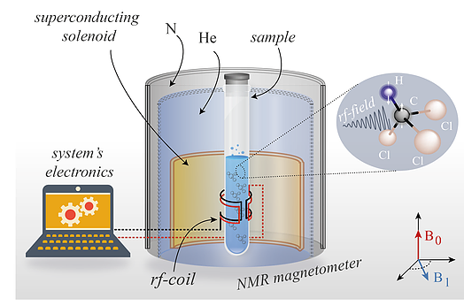
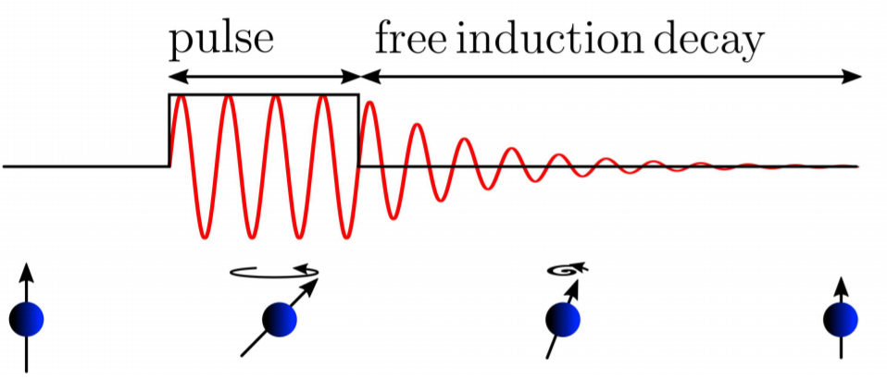
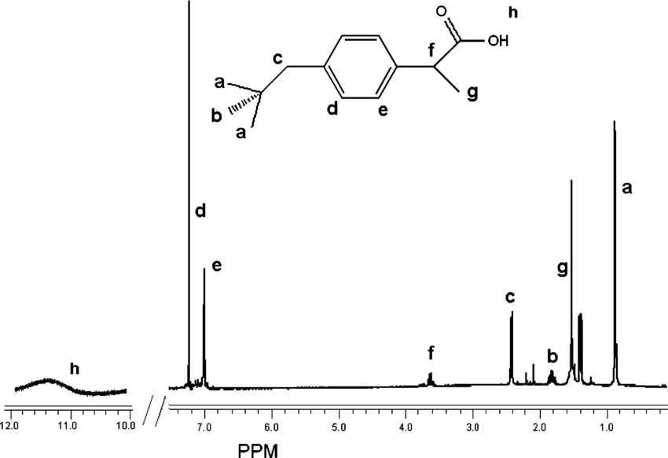
Nuclear magnetic resonance spectroscopy
external pulse free induction decay (FID)
Field in pick-up coil, i.e., signal
$$B_{0}$$
Sample magnetization vector
$$B_{1}\sin\left(ω_{0}t\right)$$
NMR H-spectrum
of ibuprofen (advil)
Typical $B_{0}$ fields: 1-20 T
Larmor frequencies: 100s MHz
Hz-level splittings due to spin-spin interactions
www.quantumufabc.org/labs
CASPEr is similar to NMR
Mizrahi, Boaz, and Abraham J. Domb. "Anhydride prodrug of ibuprofen and acrylic polymers." Aaps Pharmscitech 10.2 (2009): 453-458.
D. Budker et al., Phys. Rev. X 4, 021030 (2014)

Slide 5
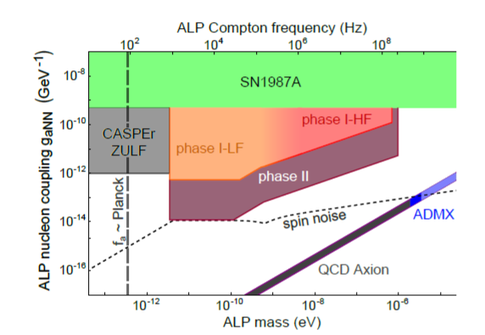
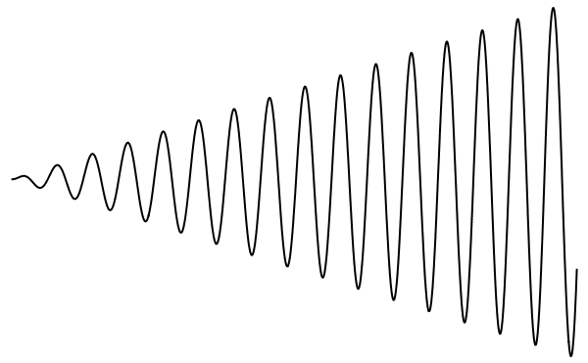
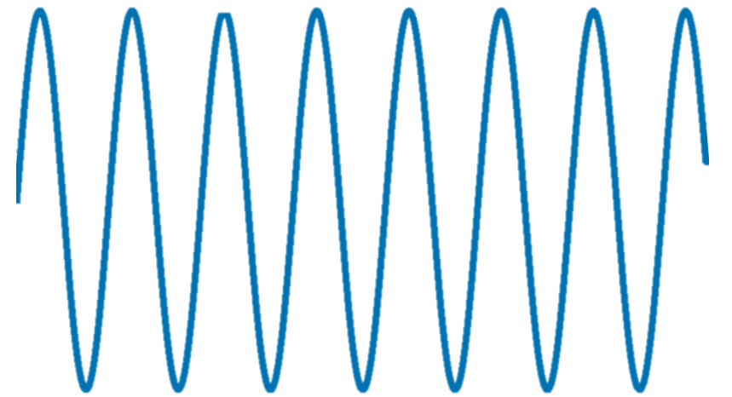
CASPEr-gradient principle and goals
Transverse magnetization
$$B_{0}$$
time
ALP field
If $ω_{a}=ω_{L}$
www.quantumufabc.org/labs
CASPEr is similar to NMR
wait
(make sure the apparatus is on)
D. F. Jackson Kimball et al., Overview of the Cosmic Axion Spin Precession Experiment (CASPEr), in Microwave Cavities and Detectors for Axion Research, edited by G. Carosi and G. Rybka (Springer International Publishing, Cham, 2020), pp. 105–121

Slide 6
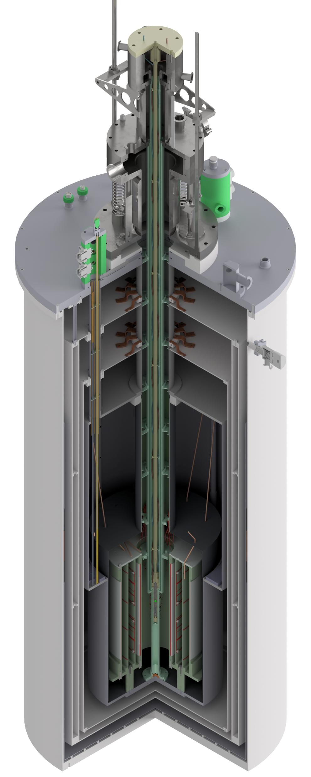
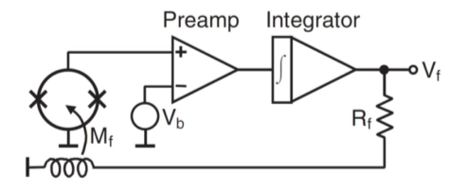
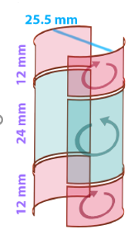
CASPEr-gradient low field setup, 1 kHz – 4 MHz
0.1 T (1 kG) superconducting B₀ coil
wet bore
actively shielded
superconducting shield
placed in Faraday room
SQUIDs
variable temperature insert
Flux-locked loop
gradiometer
Scheme of SQUID https://commons.wikimedia.org/wiki/File:SQUID_IV.jpg

Slide 7
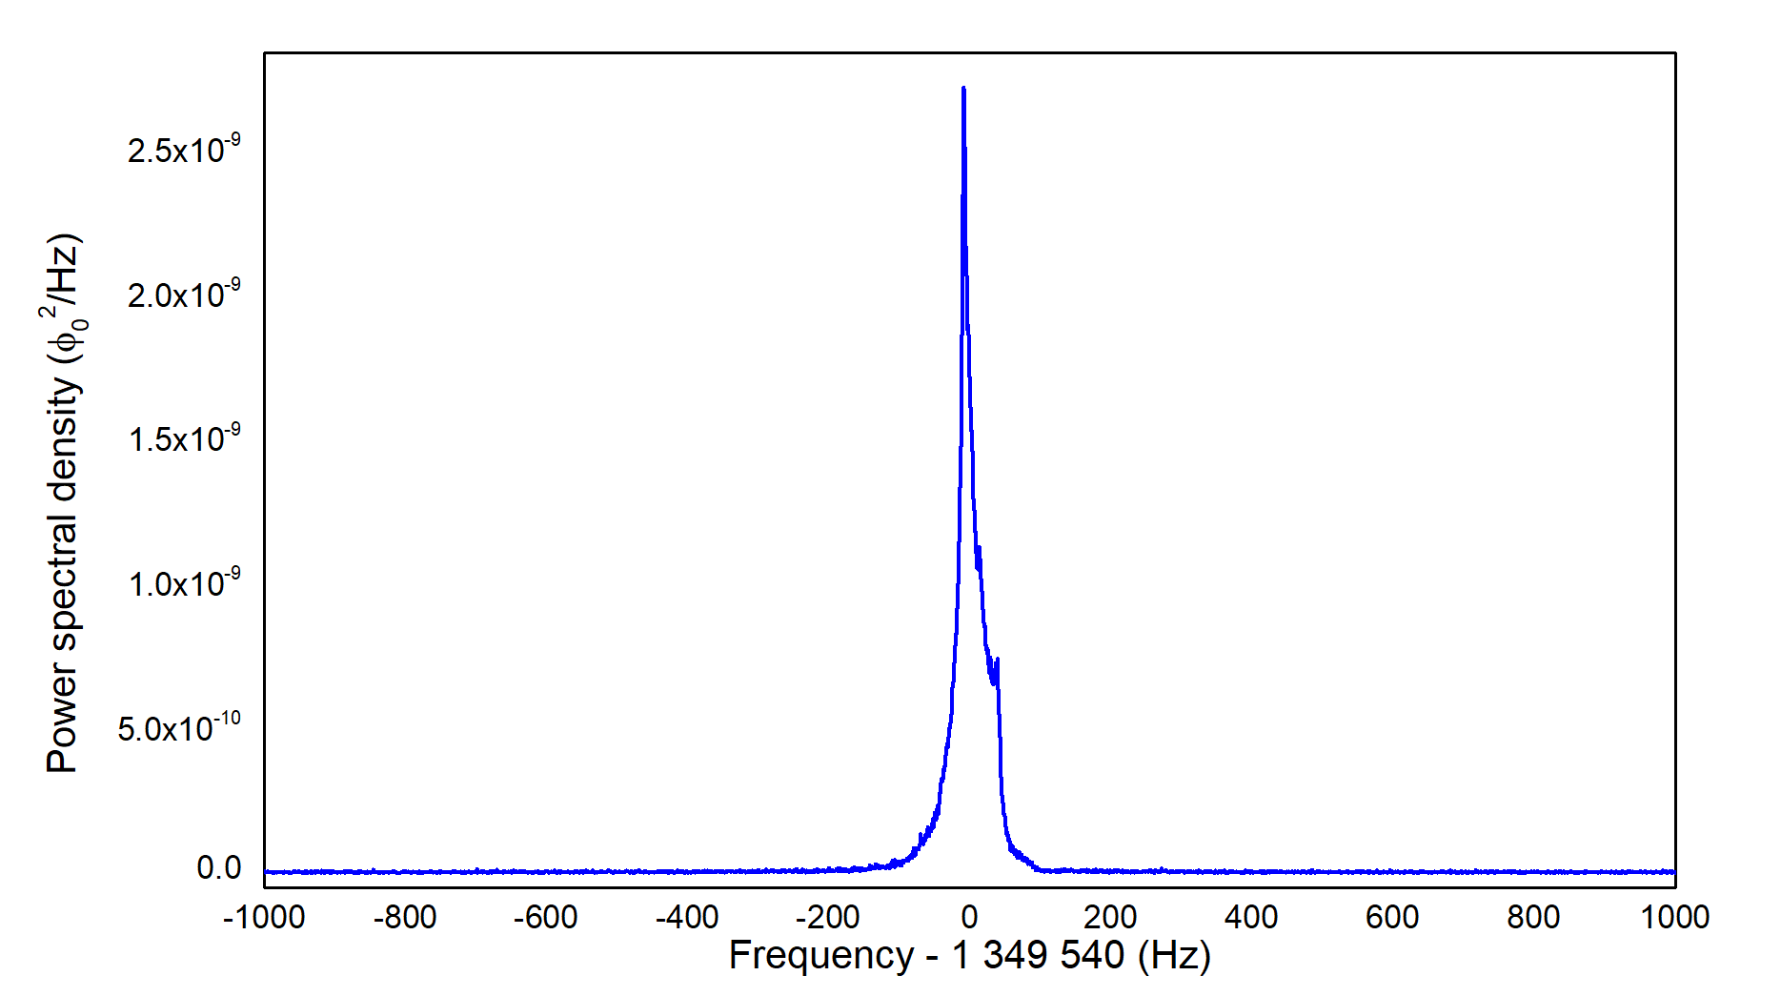
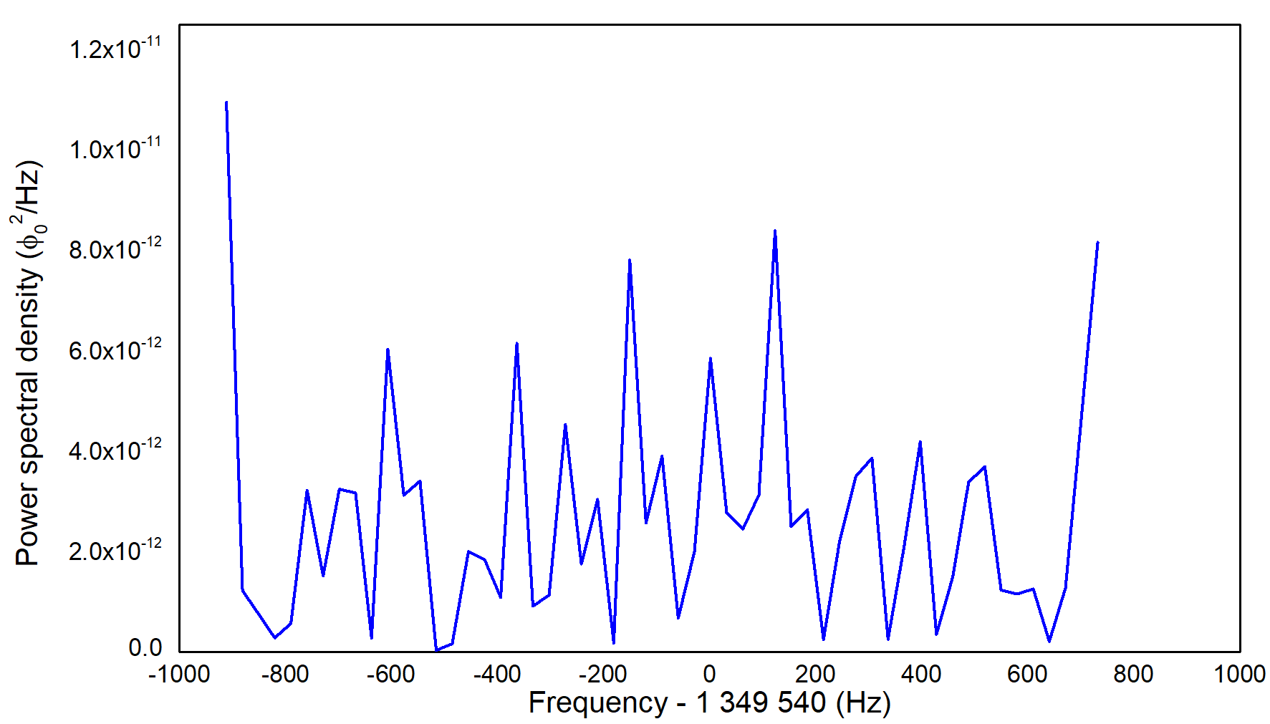
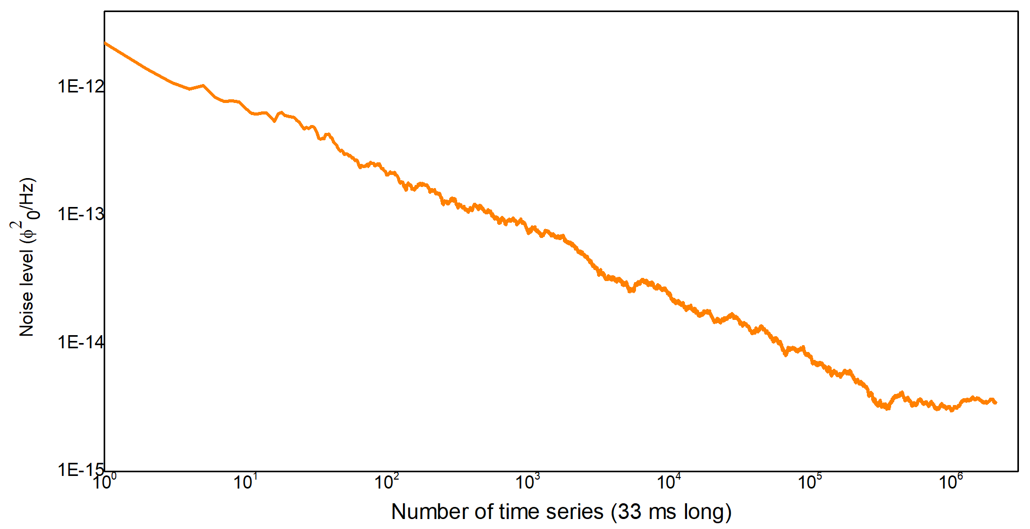
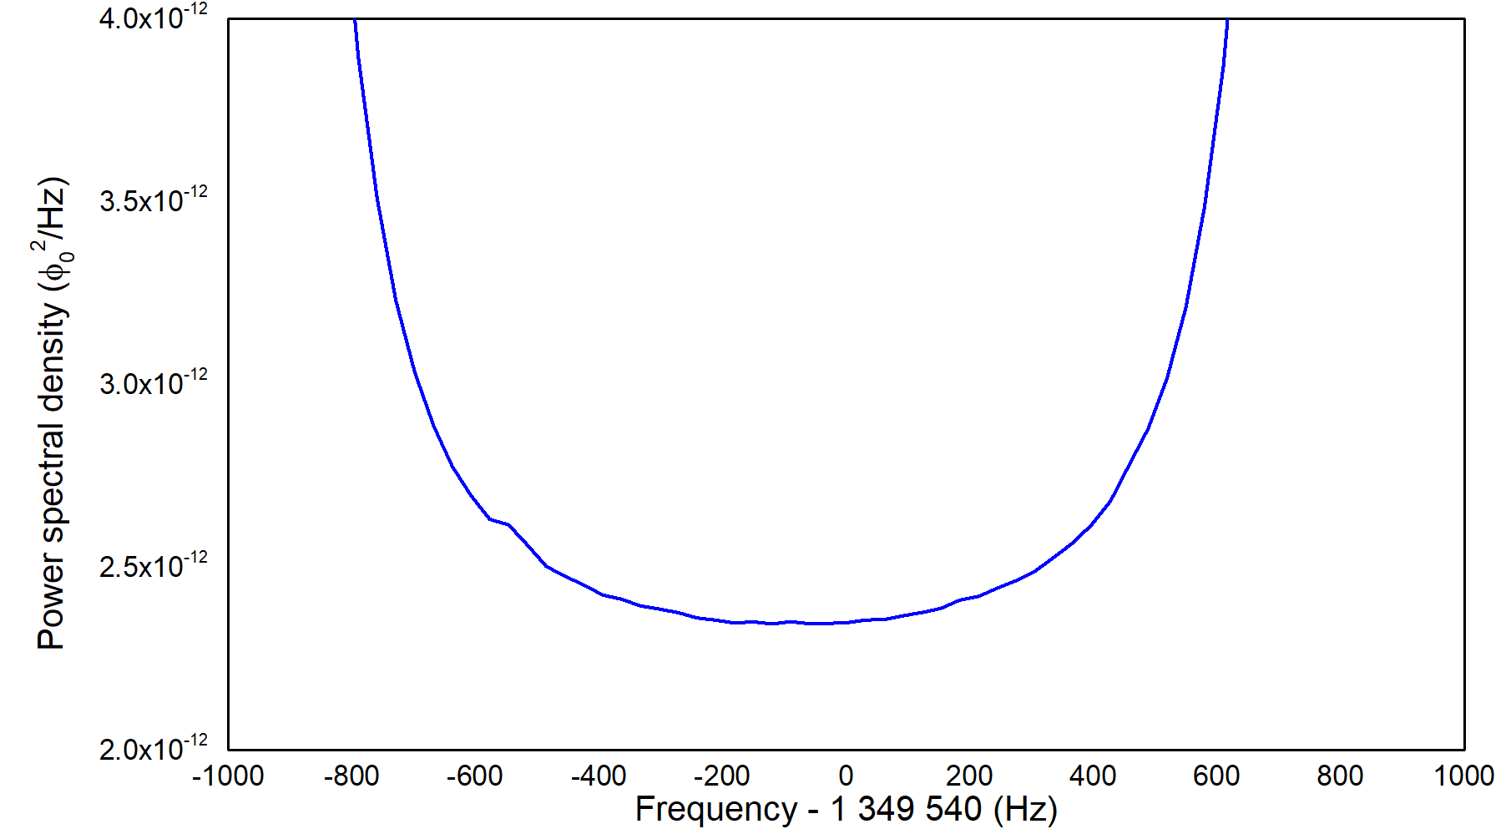
CASPEr-gradient low field setup, first preliminary results
NMR spectrum of 1.4 mL ($N ≈8⋅{10}^{22}$) of methanol
No transverse pulse applied
Known sample, calibrated SQUID
-> no ALP coupling at 10⁻³ GeV⁻¹ level
(further data analysis and measurements underway)
Line width ≈ 20 ppm
noise power $∝τ^{−1/2}$
ALP sensitivity $∝τ^{−1/4}$
filter roll off

Slide 8
Sample (hyper)polarization
Thermal polarization
$$P∝{T B}_{0}≈{10}^{−7}$$
Does not require sample preparation
Current work
Hyperpolarized xenon-129
$P ≈0.7$
Liquid at 160 K
Long relaxation time $T_{1}≈1000$s
$T_{1}>$ hours when frozen
Future
Sample polarization:
$$P=\frac{N_{+}−N_{−}}{N_{+}+N_{−}}$$
Hyperpolarized protons
$P ≈0.1$
Wide variety of molecules
Short relaxation time $T_{1}<1$ s
Future

Slide 9
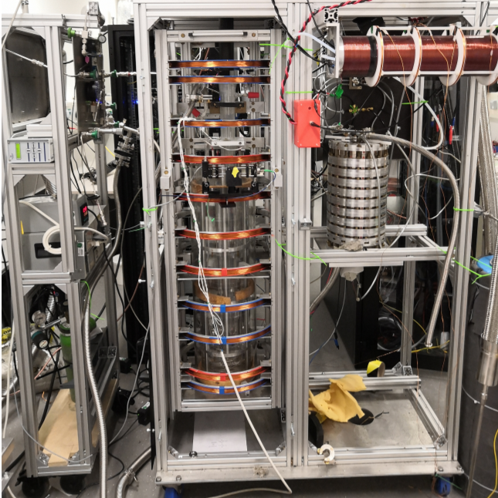
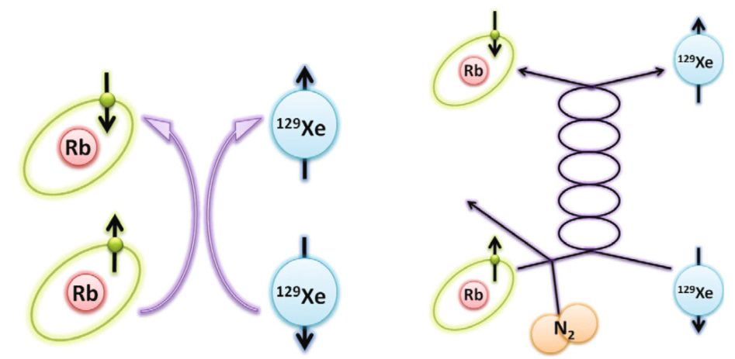
Hyperpolarization of xenon-129
Spin exchange optical pumping cell
Xe, N₂, and He mixed with Rb vapor
Control pressure and flow rate
Interaction region for 795 nm laser light at D1 line
Polarize Rb atoms
Spin exchange between Rb and ¹²⁹Xe
Transfer polarization to ¹²⁹Xe
Imai et al, “Continuous Flow Production of Concentrated Hyperpolarized Xenon Gas from a Dilute Xenon Gas Mixture by Buffer Gas Condensation.” Scientific Reports 7, no. 1 (2017): 7352
Kavtanyuk et al, “Production of Hyperpolarized ¹²⁹Xe Using Spin Exchange Optical Pumping.” Journal of the Korean Phys. Soc. 73, no. 10 (2018): 1458–65
Hersman et al, “Large Production System for Hyperpolarized 129Xe for Human Lung Imaging Studies.” Academic Radiology 15, no. 6 (2008): 683–92

Slide 10
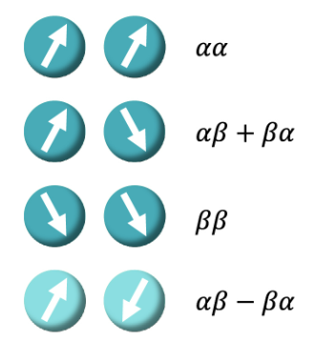
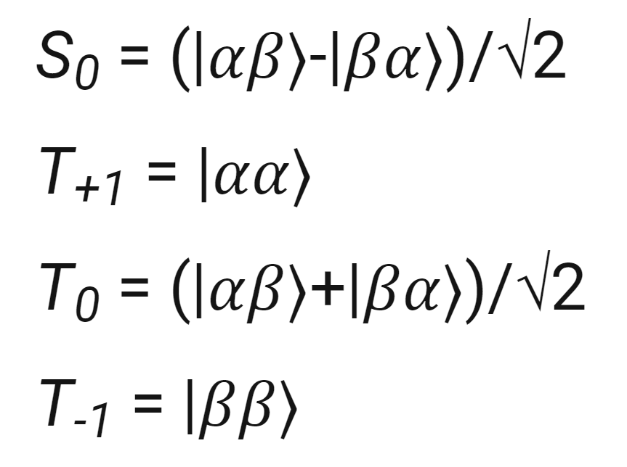
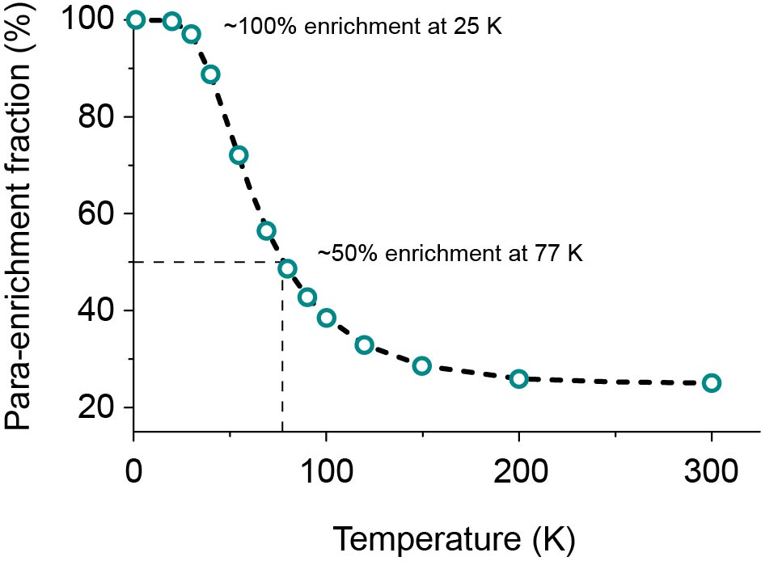
Hyperpolarization of protons
Parahydrogen induced polarization (PHIP)
Four spin states of molecular hydrogen:
Signal amplification by reversible exchange (SABRE)
Parahydrogen
NMR silent
Easy to produce
Long storage times (weeks)
In cooperation with
dr. Danila Barskiy at HIM
of spontaneous emission fame
https://blog.zulf.eu/BP5.php
https://www.sigmaaldrich.com/DE/de/technical-documents/technical-article/research-and-disease-areas/metabolism-research/phip-sabre

Slide 11
Maxwell-Boltzmann distributed
not clumped
$$B_{ALP}∝g_{aNN}v_{a} \sqrt{2ρ_{DM}}\sin\left(ω_{a}t\right)$$
Coherence limited to 10⁶ oscillations
directionality

Slide 12
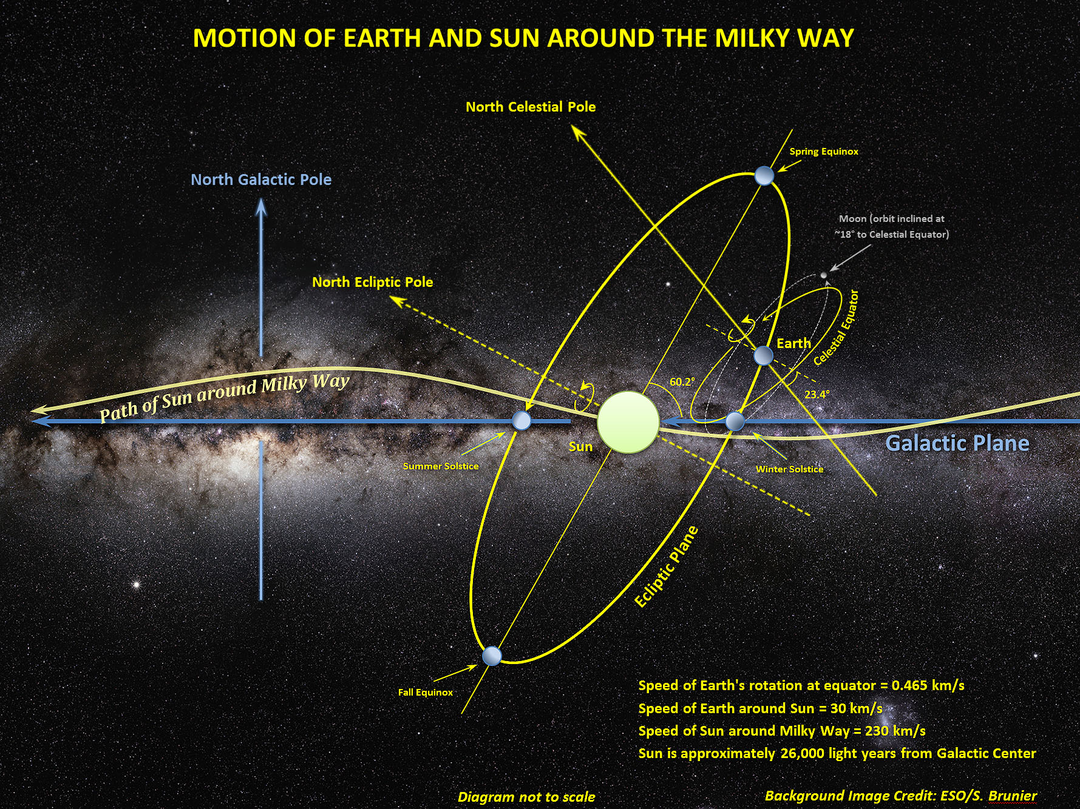
https://bigthink.com/starts-with-a-bang/earth-move-universe/

Slide 13
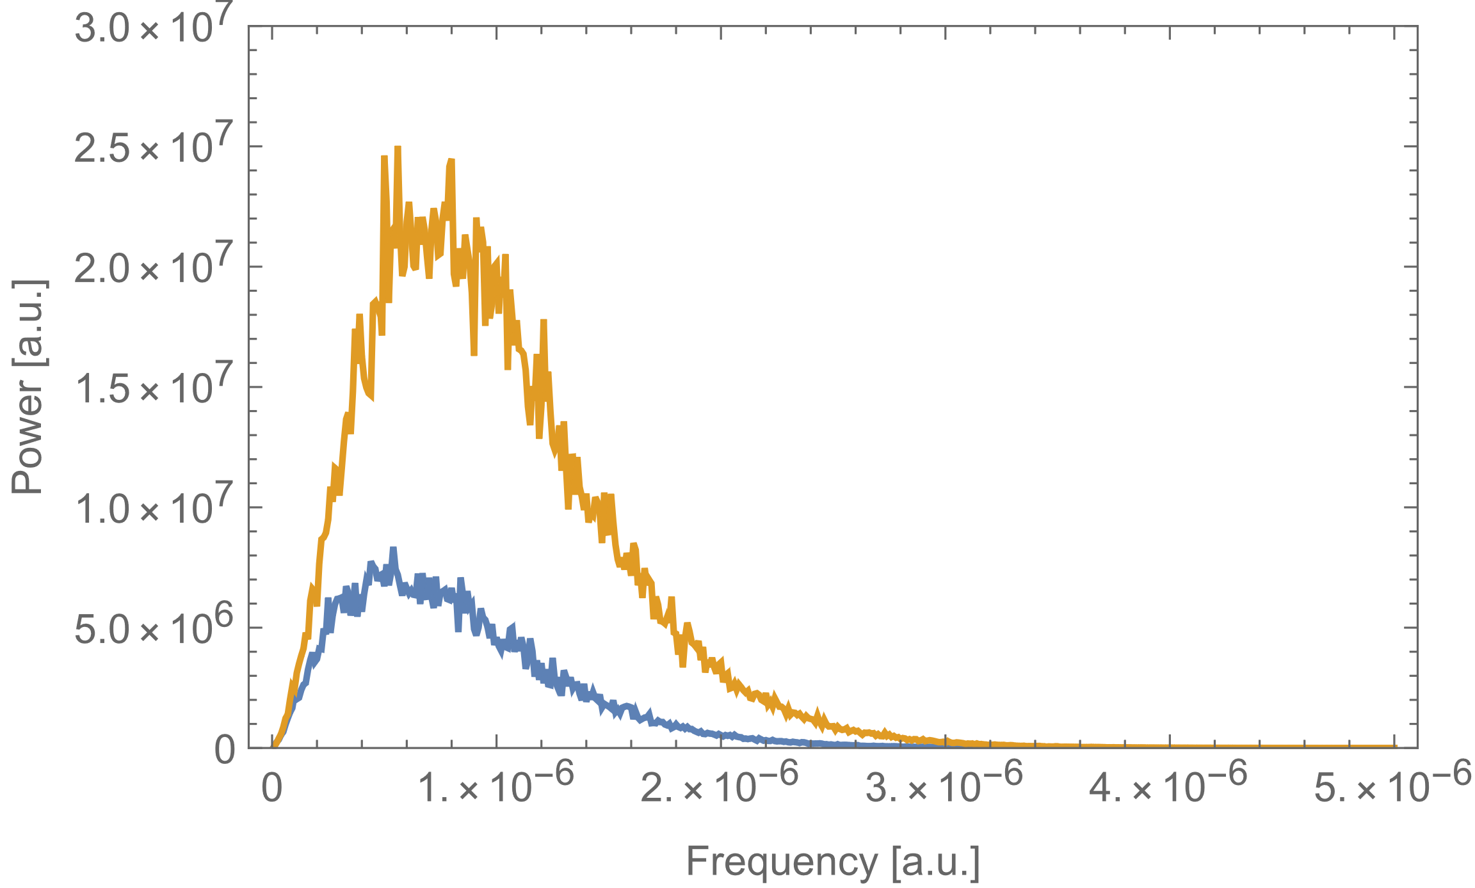
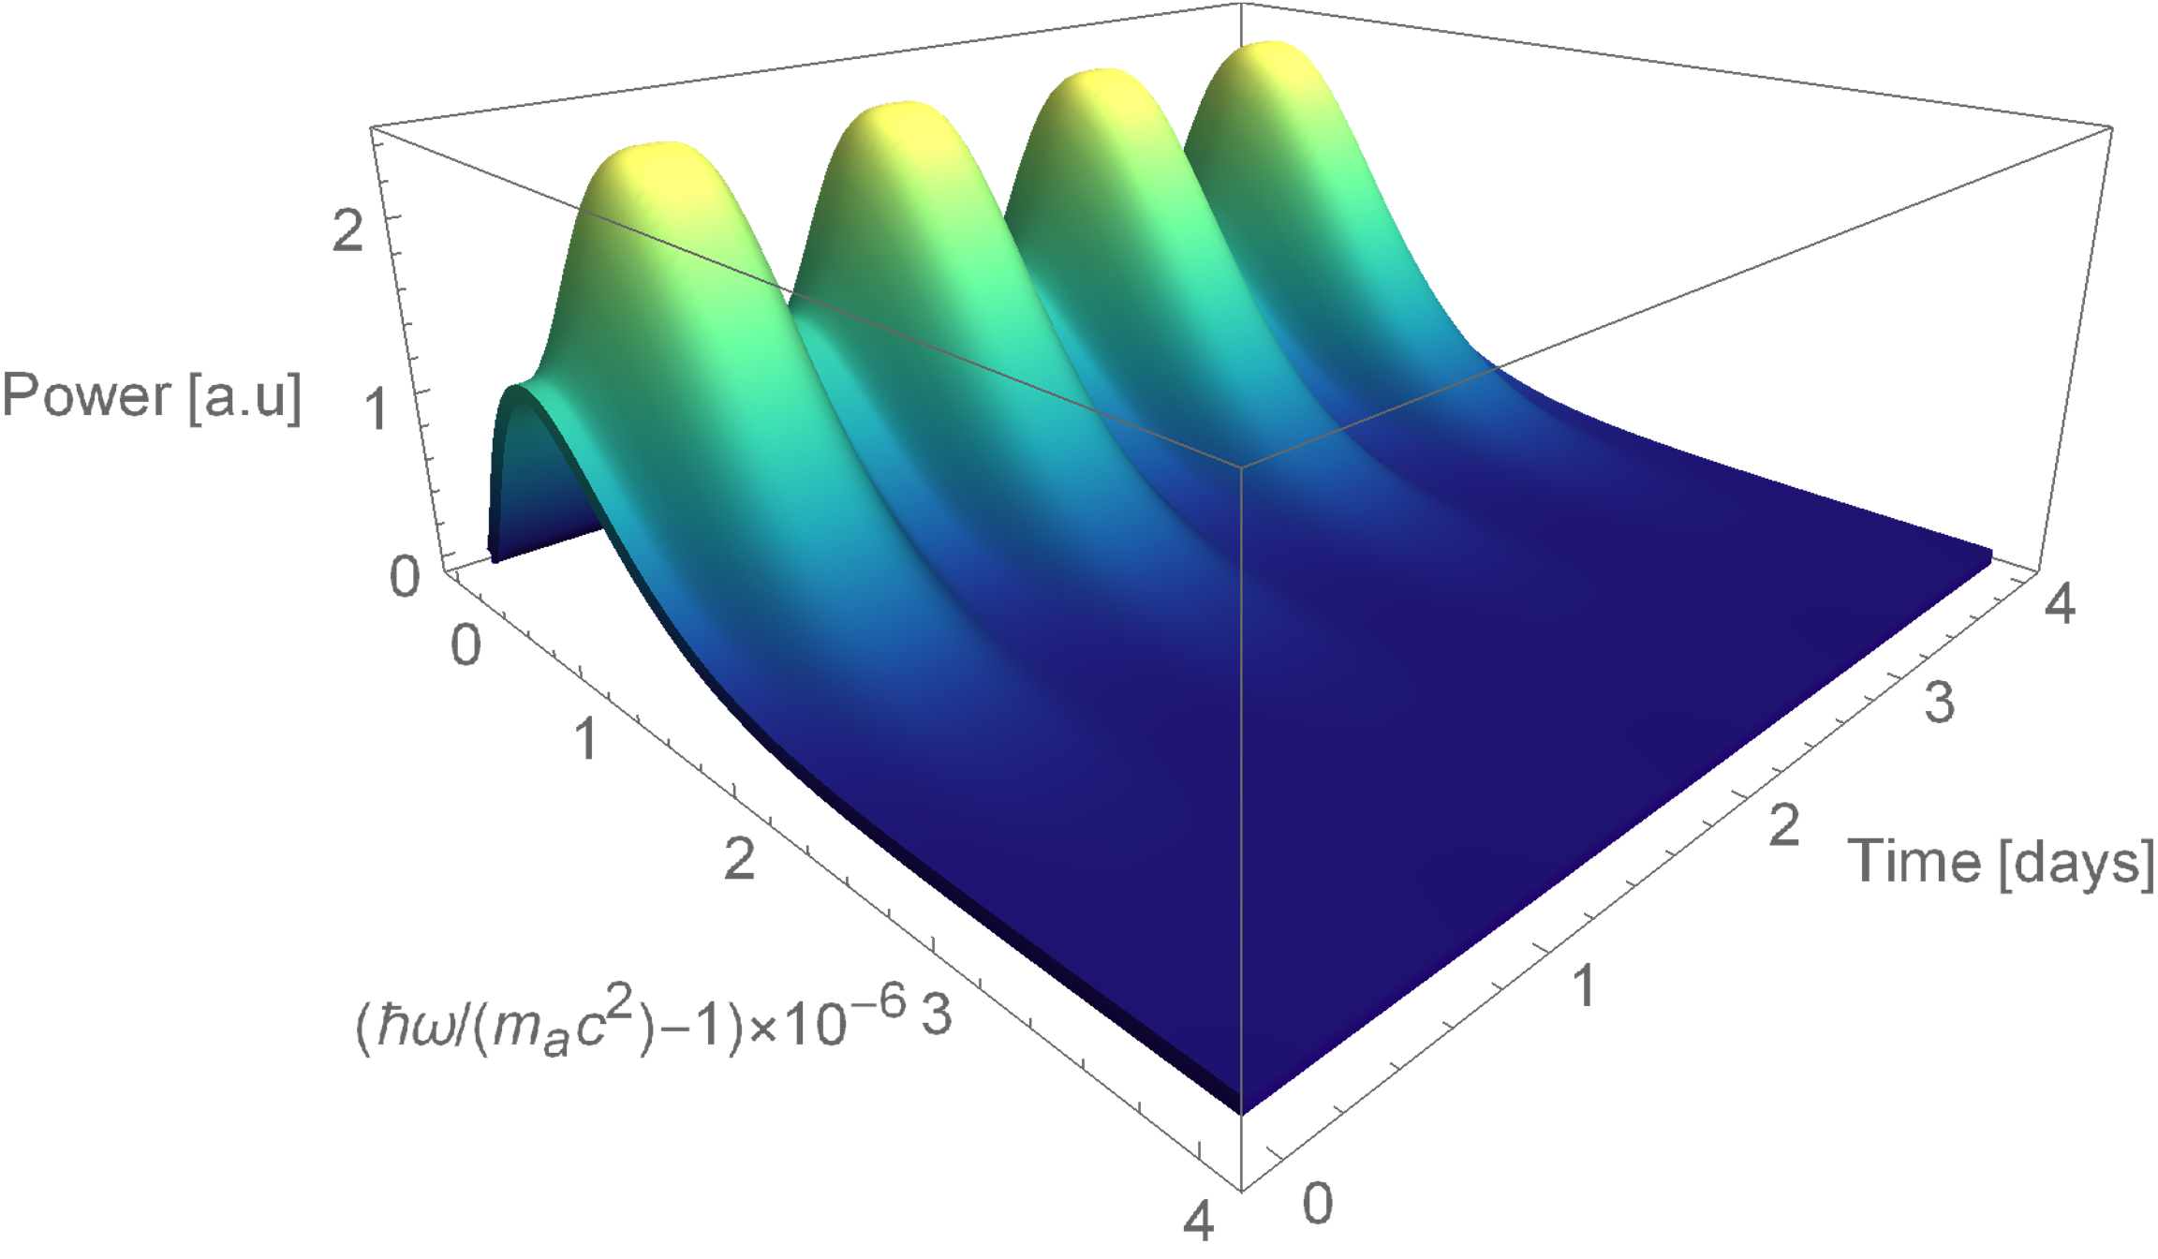
Line shape modulations due to Earth’s motion
Monte Carlo simulation and analytic solution in agreement
CASPEr Mainz B₀
Earth velocity
V. Gramolin et al., Spectral Signatures of Axionlike Dark Matter, Phys. Rev. D 105, 035029 (2022).

Slide 14
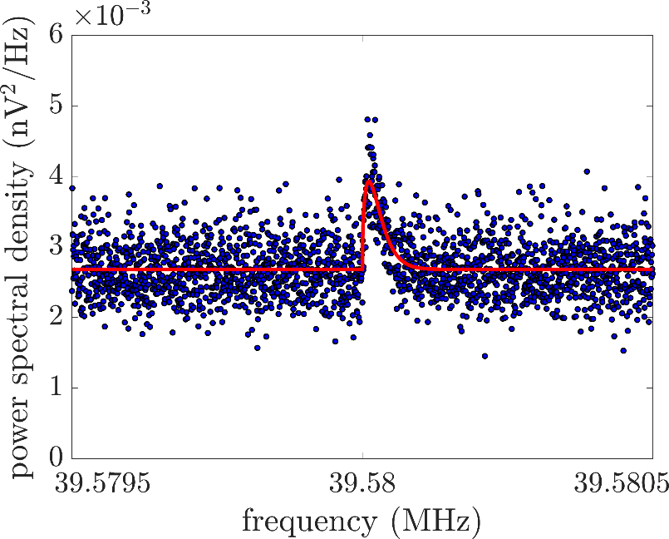
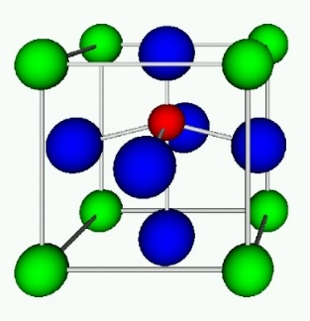
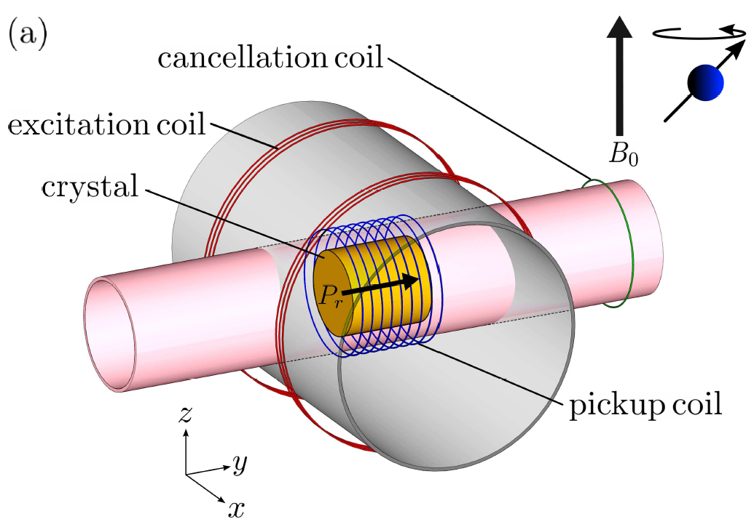
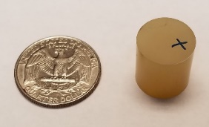
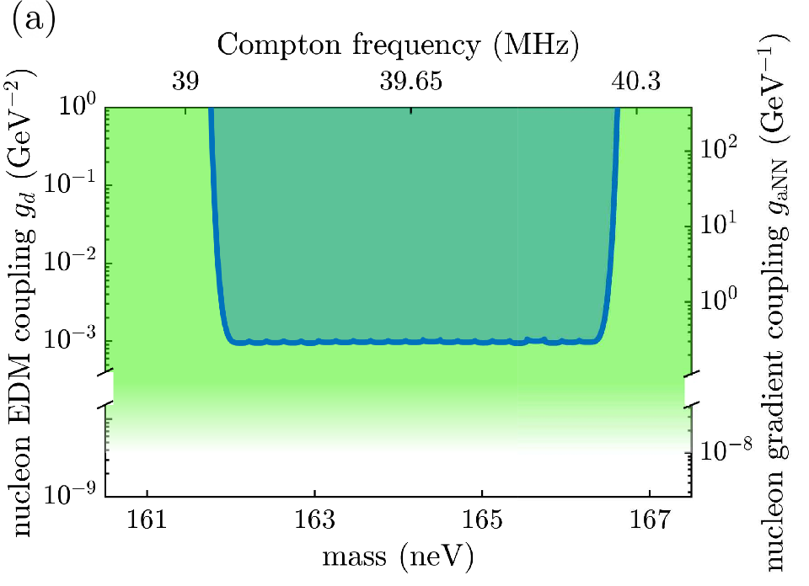
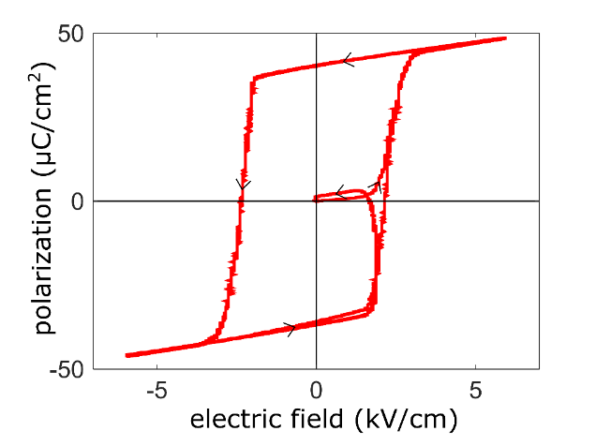
CASPEr-electric, probing gluon coupling using solid state NMR
injected ALP dark matter signal:
²⁰⁷Pb nuclear spins in ferroelectrically-polarized PMN-PT
D. Aybas et al., Phys. Rev. Lett. 126, 160505 (2021)

Slide 15
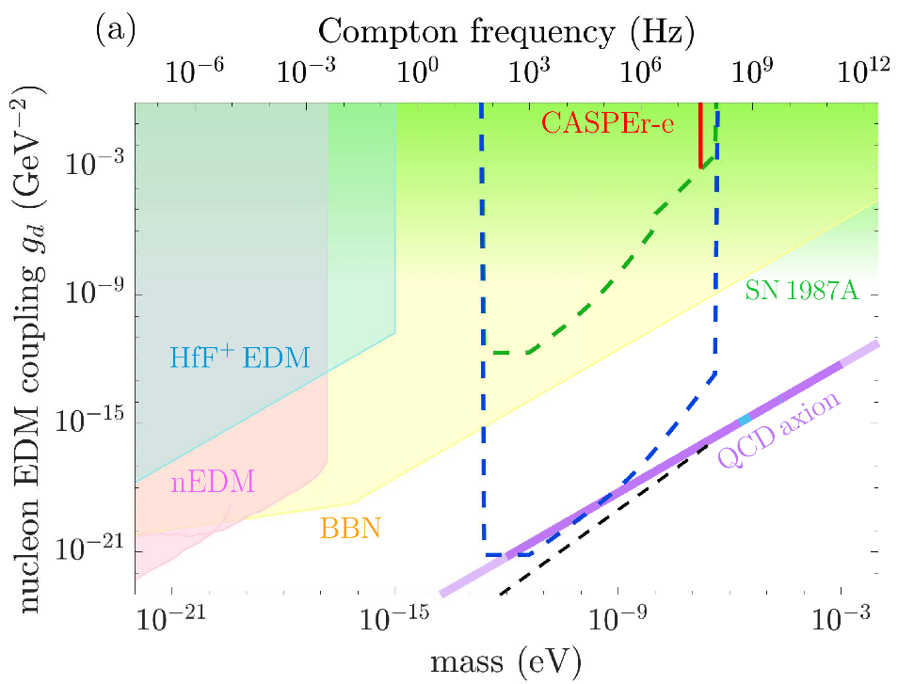
D. Aybas et al., Quant. Sci. Tech. 6, 034007 (2021)
CASPEr-electric, towards the QCD-axion
D. Aybas et al., Phys. Rev. Lett. 126, 160505 (2021)
our present limits
other experimental constraints
our sensitivity with current setup
QCD axion band
our sensitivity with upgraded setup: 80 cm sample, 100 mK
spin projection noise quantum sensitivity limit
ongoing work:
1) sweep the full frequency range → current results at 40 MHz, we are sweeping down to kHz
2) increase sample size → currently
3) improve material → currently ferroelectric PMN-PT
non-centrosymmetric ionic crystals
4) improve sensor → currently RF amp/SQUID
collaboration with SLAC to couple RQUs
5) increase spin polarization (quantum state control) → currently
optical control of spin thermalization
optical spin hyperpolarization

Slide 16
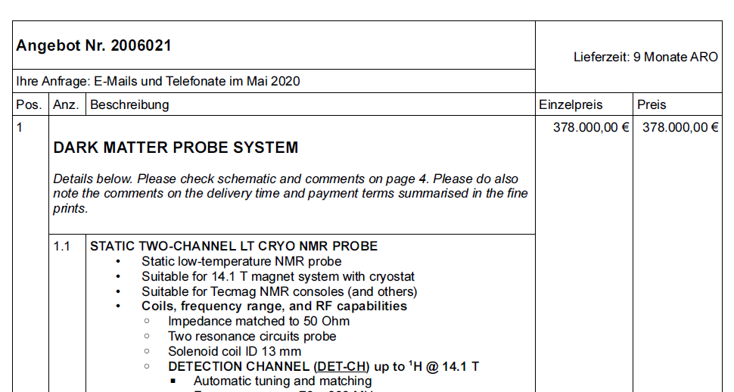
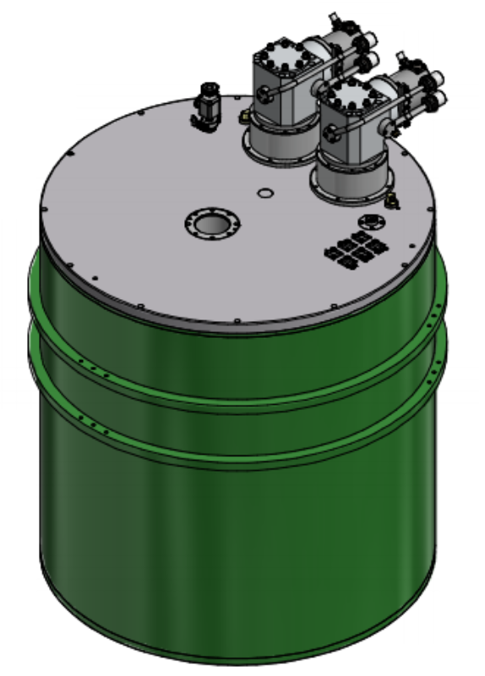
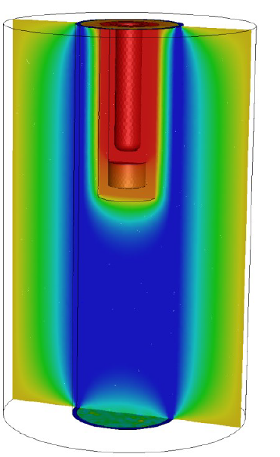
CASPEr-gradient high field, up to 600 MHz
14.1 T warm bore magnet
delivery Fall 2022
2 variable temperature inserts (VTIs)
design based on e.g. ANSYS simulations
sample at 160 to 300 K
pickup coil
tunable capacitors
amplifier at 20 K

Slide 17
Conclusions and outlook
First gradient measurements at 1.34954 MHz exclude ALP at $g_{ANN}≈{10}^{−3}$ GeV⁻¹ (preliminary)
First electric measurements at 39-40 MHz exclude ALP at $g_{d}=9.5⋅{10}^{−4}$ GeV⁻²
Sample polarization allows for orders of magnitude sensitivity gain
Gradient line shape fundamentally different to scalar one
High field apparatus under construction

