Slide 1



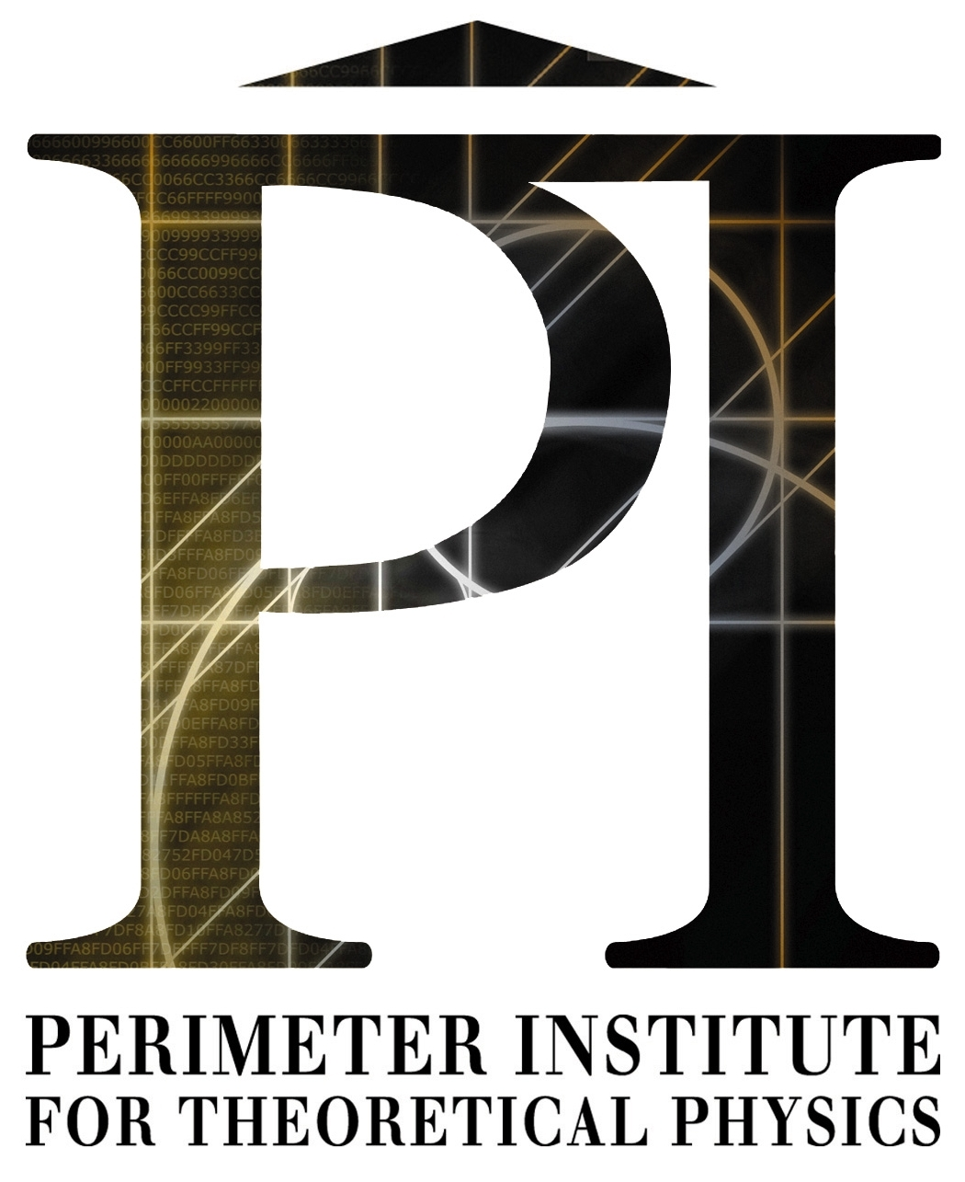


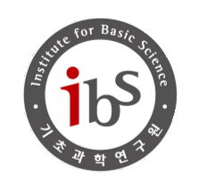
Axion Resonant InterAction DetectioN Experiment (ARIADNE)
Collaborators
Andrew Geraci, Chloe Lohmeyer, Nancy Aggarwal
Asimina Arvanitaki, Aharon Kapitulnik , Alan Fang
Josh Long, Chen‐Yu Liu, Mike Snow, Inbum Lee, Justin Shortino , Yannis Semertzidis, Yun Shin, Dongok Kim, Youngeun Kim, Yong‐Ho Lee, Lutz Trahms, Wolfgang Kilian, Allard Schnabel, Jens Voigt
Center for Fundamental Physics (CFP)
A. Geraci for the ARIADNE collaboration
PATRAS 2022, Mainz, Germany, Aug 8-12

Slide 2
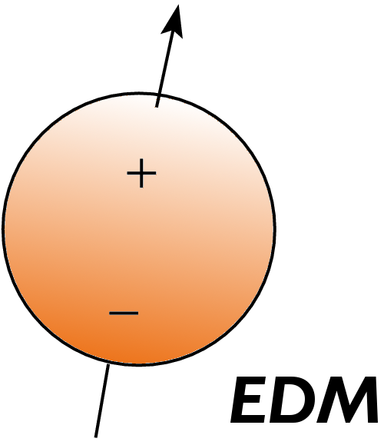
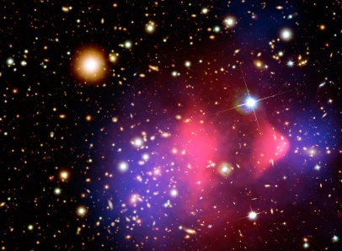
Axions
Light pseudoscalar particles in many theories Beyond Standard model
Peccei-Quinn Axion (QCD) solves strong CP problem
Dark matter candidate
Also mediates spin-dependent “fifth-forces”
at short range (down to 30 µm)
R. D. Peccei and H. R. Quinn, Phys. Rev. Lett. 38, 1440 (1977);
S. Weinberg, Phys. Rev. Lett. 40, 223 (1978);
F. Wilczek, Phys. Rev. Lett. 40, 279 (1978).
J. E. Moody and F. Wilczek, Phys. Rev. D 30, 130 (1984).
Can be sourced locally
No cosmological assumptions!

Slide 3
Axion and ALP Searches
Source
Coupling
 | Photons | Nucleons | Electrons
Dark Matter (Cosmic) axions | ADMX, HAYSTAC, CAPP, ORGAN, DM Radio, LC Circuit, MADMAX | CASPEr | QUAX
Solar axions | CAST IAXO
Lab-produced axions | Light-shining-thru- walls (ALPS, ALPS-II) | ARIADNE

Slide 4
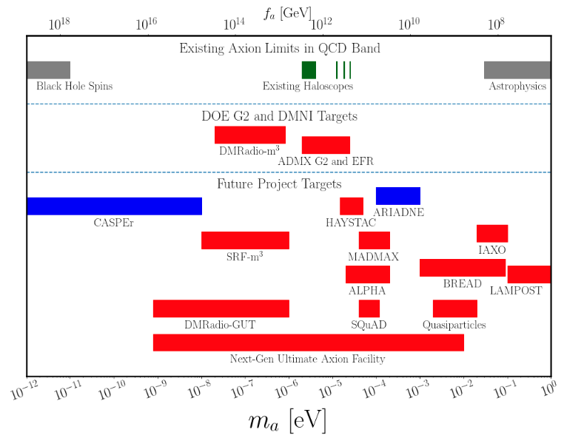
QCD axion parameter space
m_{a} ~ Λ_{QCD}² / f_{a}
Possible couplings: Gluons, photons, fermions

Slide 5

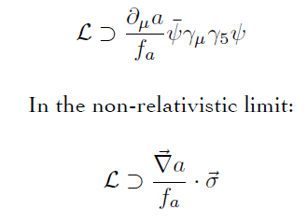
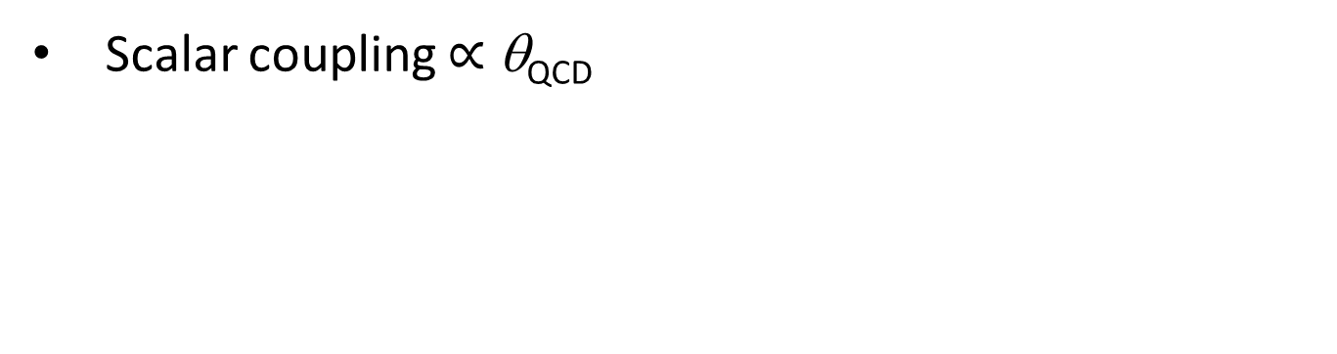
Axion-exchange between nucleons
Scalar coupling $∝$ θ_{QCD}
Pseudoscalar coupling
Axion acts a force mediator between nucleons
N
N
Monopole-monopole
Monopole-dipole
dipole-dipole
axion mass search range: 100 µeV < m_{a} < 10 meV

Slide 6
Spin-dependent forces
r
m_{f}
σ
Monopole-Dipole axion exchange
m_{a} < 6 meV
λ_{a} > 30 μm
Different than ordinary B field
Does not couple to angular momentum
Unaffected by magnetic shielding
Fictitious magnetic field

Slide 7
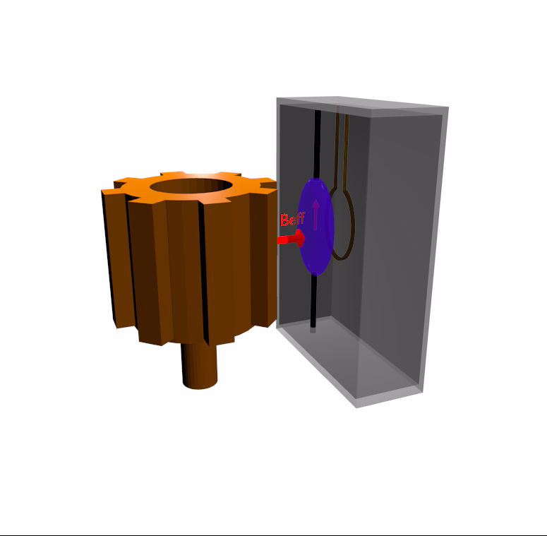
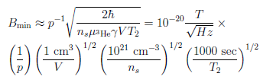
Concept for ARIADNE
Unpolarized (tungsten)
segmented cylinder sources B_{eff}
Applied Bias field B_{ext}
Laser Polarized ³He gas senses B_{eff} (Indiana U)
SQUID pickup loop measures resulting precessing nuclear magnetization (CAPP)
Limit: Transverse spin projection noise
Superconducting shielding to screen
magnetic backgrounds (Stanford)
Arvanitaki and A. Geraci., Phys. Rev. Lett. 113, 161801 (2014)
A. Geraci et.al, arxiv: 1710.05413 (2017),
Notes:
Similar techniques used in short-range gravity experiments

Slide 8
Projected Sensitivity
[4],[5],[6],[7],[8]
[3]
[3] G. Raffelt, Phys. Rev. D 86, 015001 (2012)] [4] G. Vasilakis, et. al, Phys. Rev. Lett. 103, 261801 (2009).
[5] K. Tullney,et. al. Phys. Rev. Lett. 111, 100801 (2013) [6] P.-H. Chu,et. al., Phys. Rev. D 87, 011105(R) (2013).
[7] M. Bulatowicz, et. al., Phys. Rev. Lett. 111, 102001 (2013), [8] Lee, et.al. Phys. Rev.Lett. 120, 161801 (2018).
A. Arvanitaki and AG., Phys. Rev. Lett. 113,161801 (2014).

Slide 9
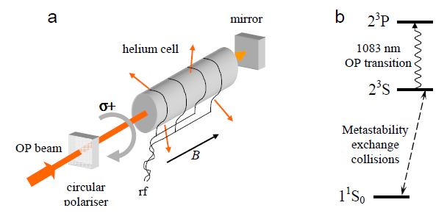
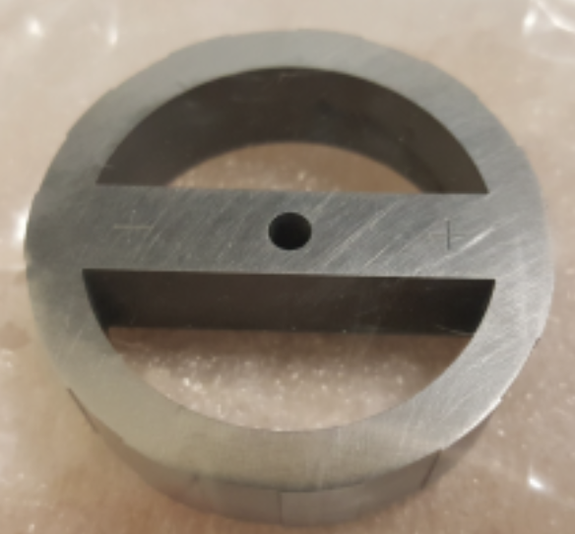

Experimental setup
Laser-polarized ³He sensor
Metastability exchange optical pumping
source mass
Tungsten source mass rotor
11 segments
100 Hz nuclear spin precession frequency
2 x 10²¹ / cc ³He density
3 mm x 3 mm x 150 µm volume
Separation ~200 µm
$\vec{B}$ field on
3.8 cm diameter

Slide 10
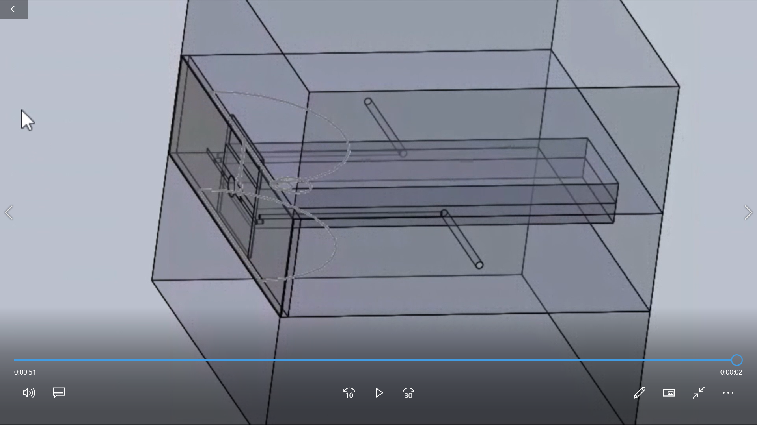
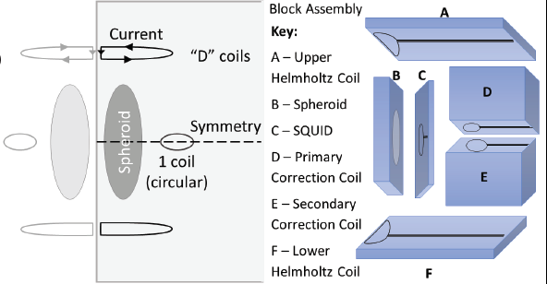
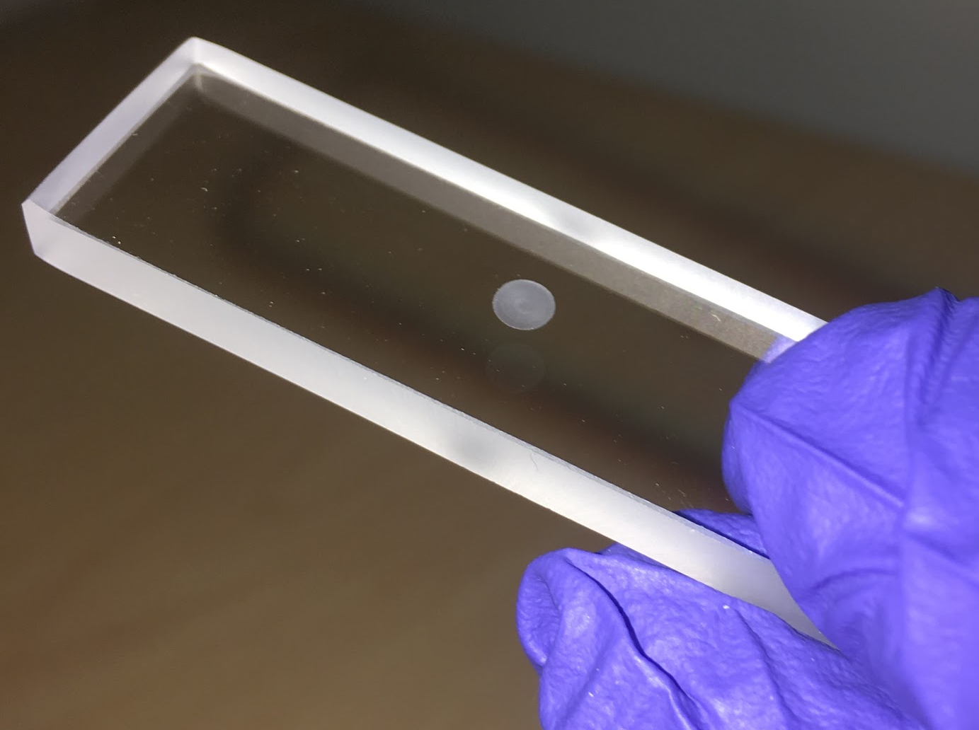
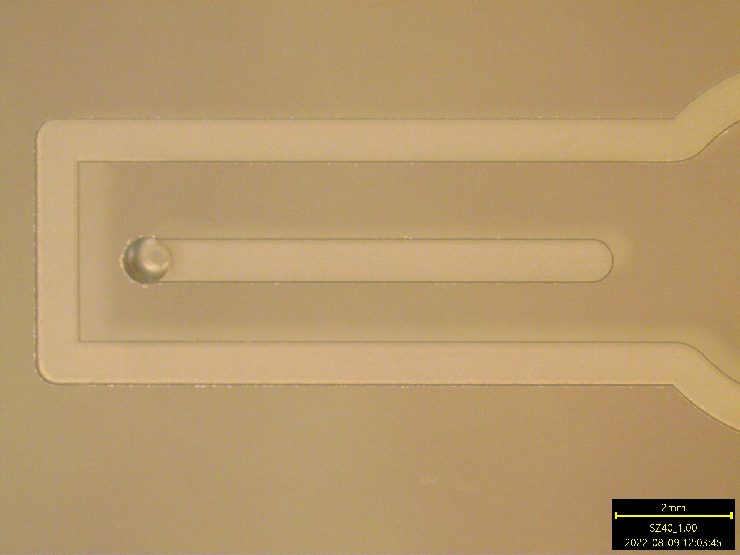
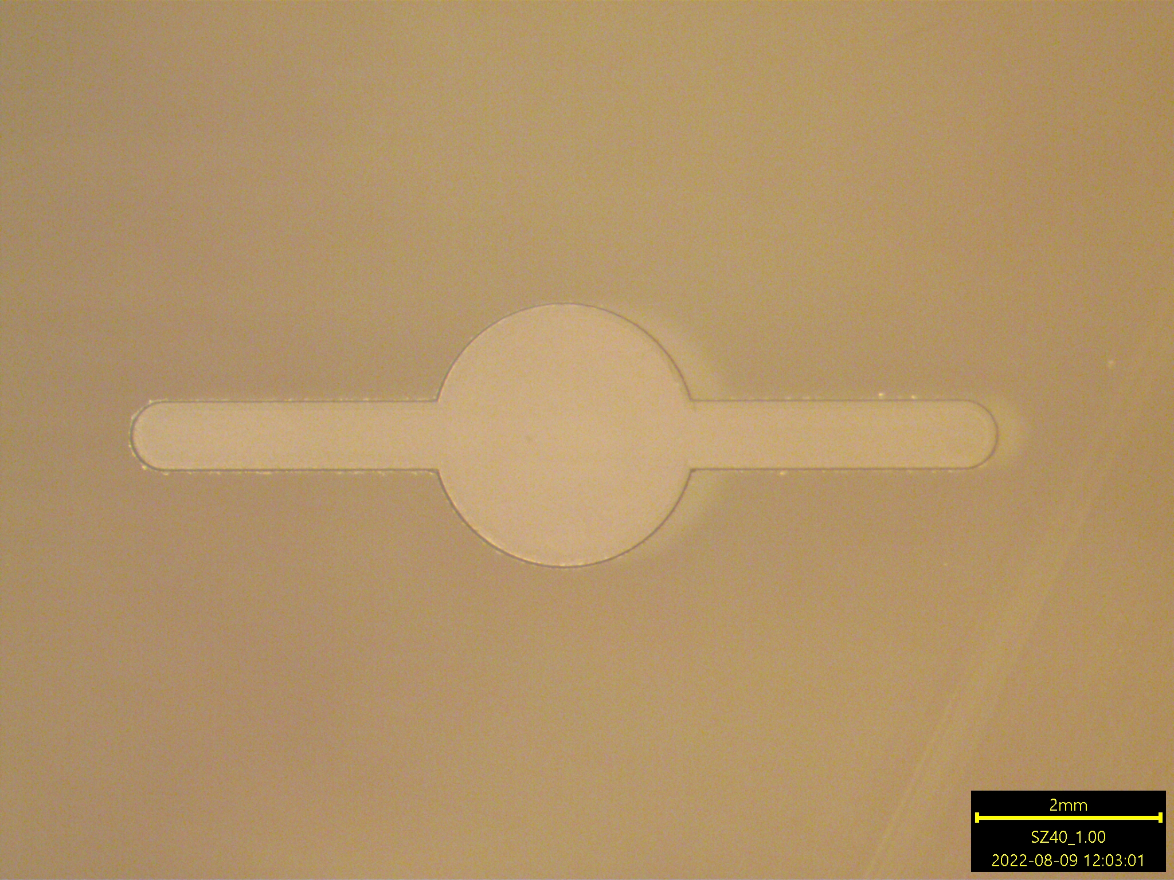
Quartz Sample
Block Assembly
Half-spheroid pocket
Assembly for 3He filling
Nb shield
Fabrication in process- Sierra optics, inc.

Slide 11
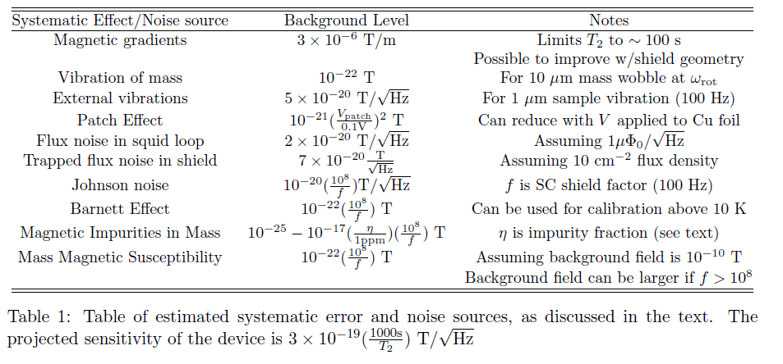

Experimental challenges
1/2
Spin-speed stability of rotary stage
Wobble/vibration of source mass (in progress)
Magnetic shielding factor tests for thin film Niobium
Tests for Magnetic impurities in Source mass
Trapped flux noise in Nb films, noise in squid loops (in progress)
Design/Simulation Work: Magnetic gradient reduction strategy
Testing completed
or in process:

Slide 12
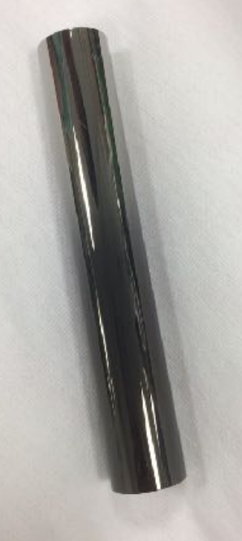
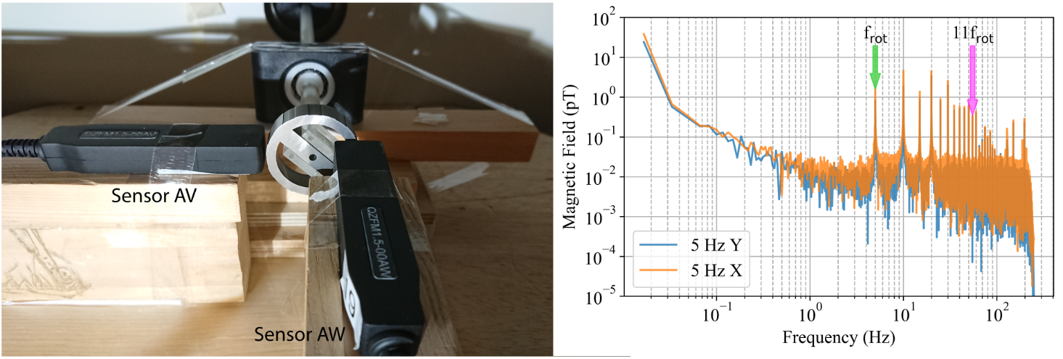
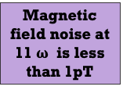
Backgrounds and noise tests
H. Fosbinder-Elkins, Y. Kim, J. Dargert et.al. Quantum Sci. Technol. 7 014002 (2022).
Superconducting shielding test
→Essential for eliminating magnetic backgrounds
(Johnson noise, magnetic susceptibility, impurities, Barnett effect)
~10⁸ achieved
Meets spec for design sensitivity
Testing: sputtered Nb on quartz tubes
w/supplemental Pb foils
Magnetic impurities test - tungsten source mass
Consistent with Johnson noise plus a few (3) isolated surface magnetic domains
Low-field, high-resolution optical magnetometry
Meets spec for design sensitivity
N. Aggarwal, et.al., Phys Rev Research (2021)

Slide 13
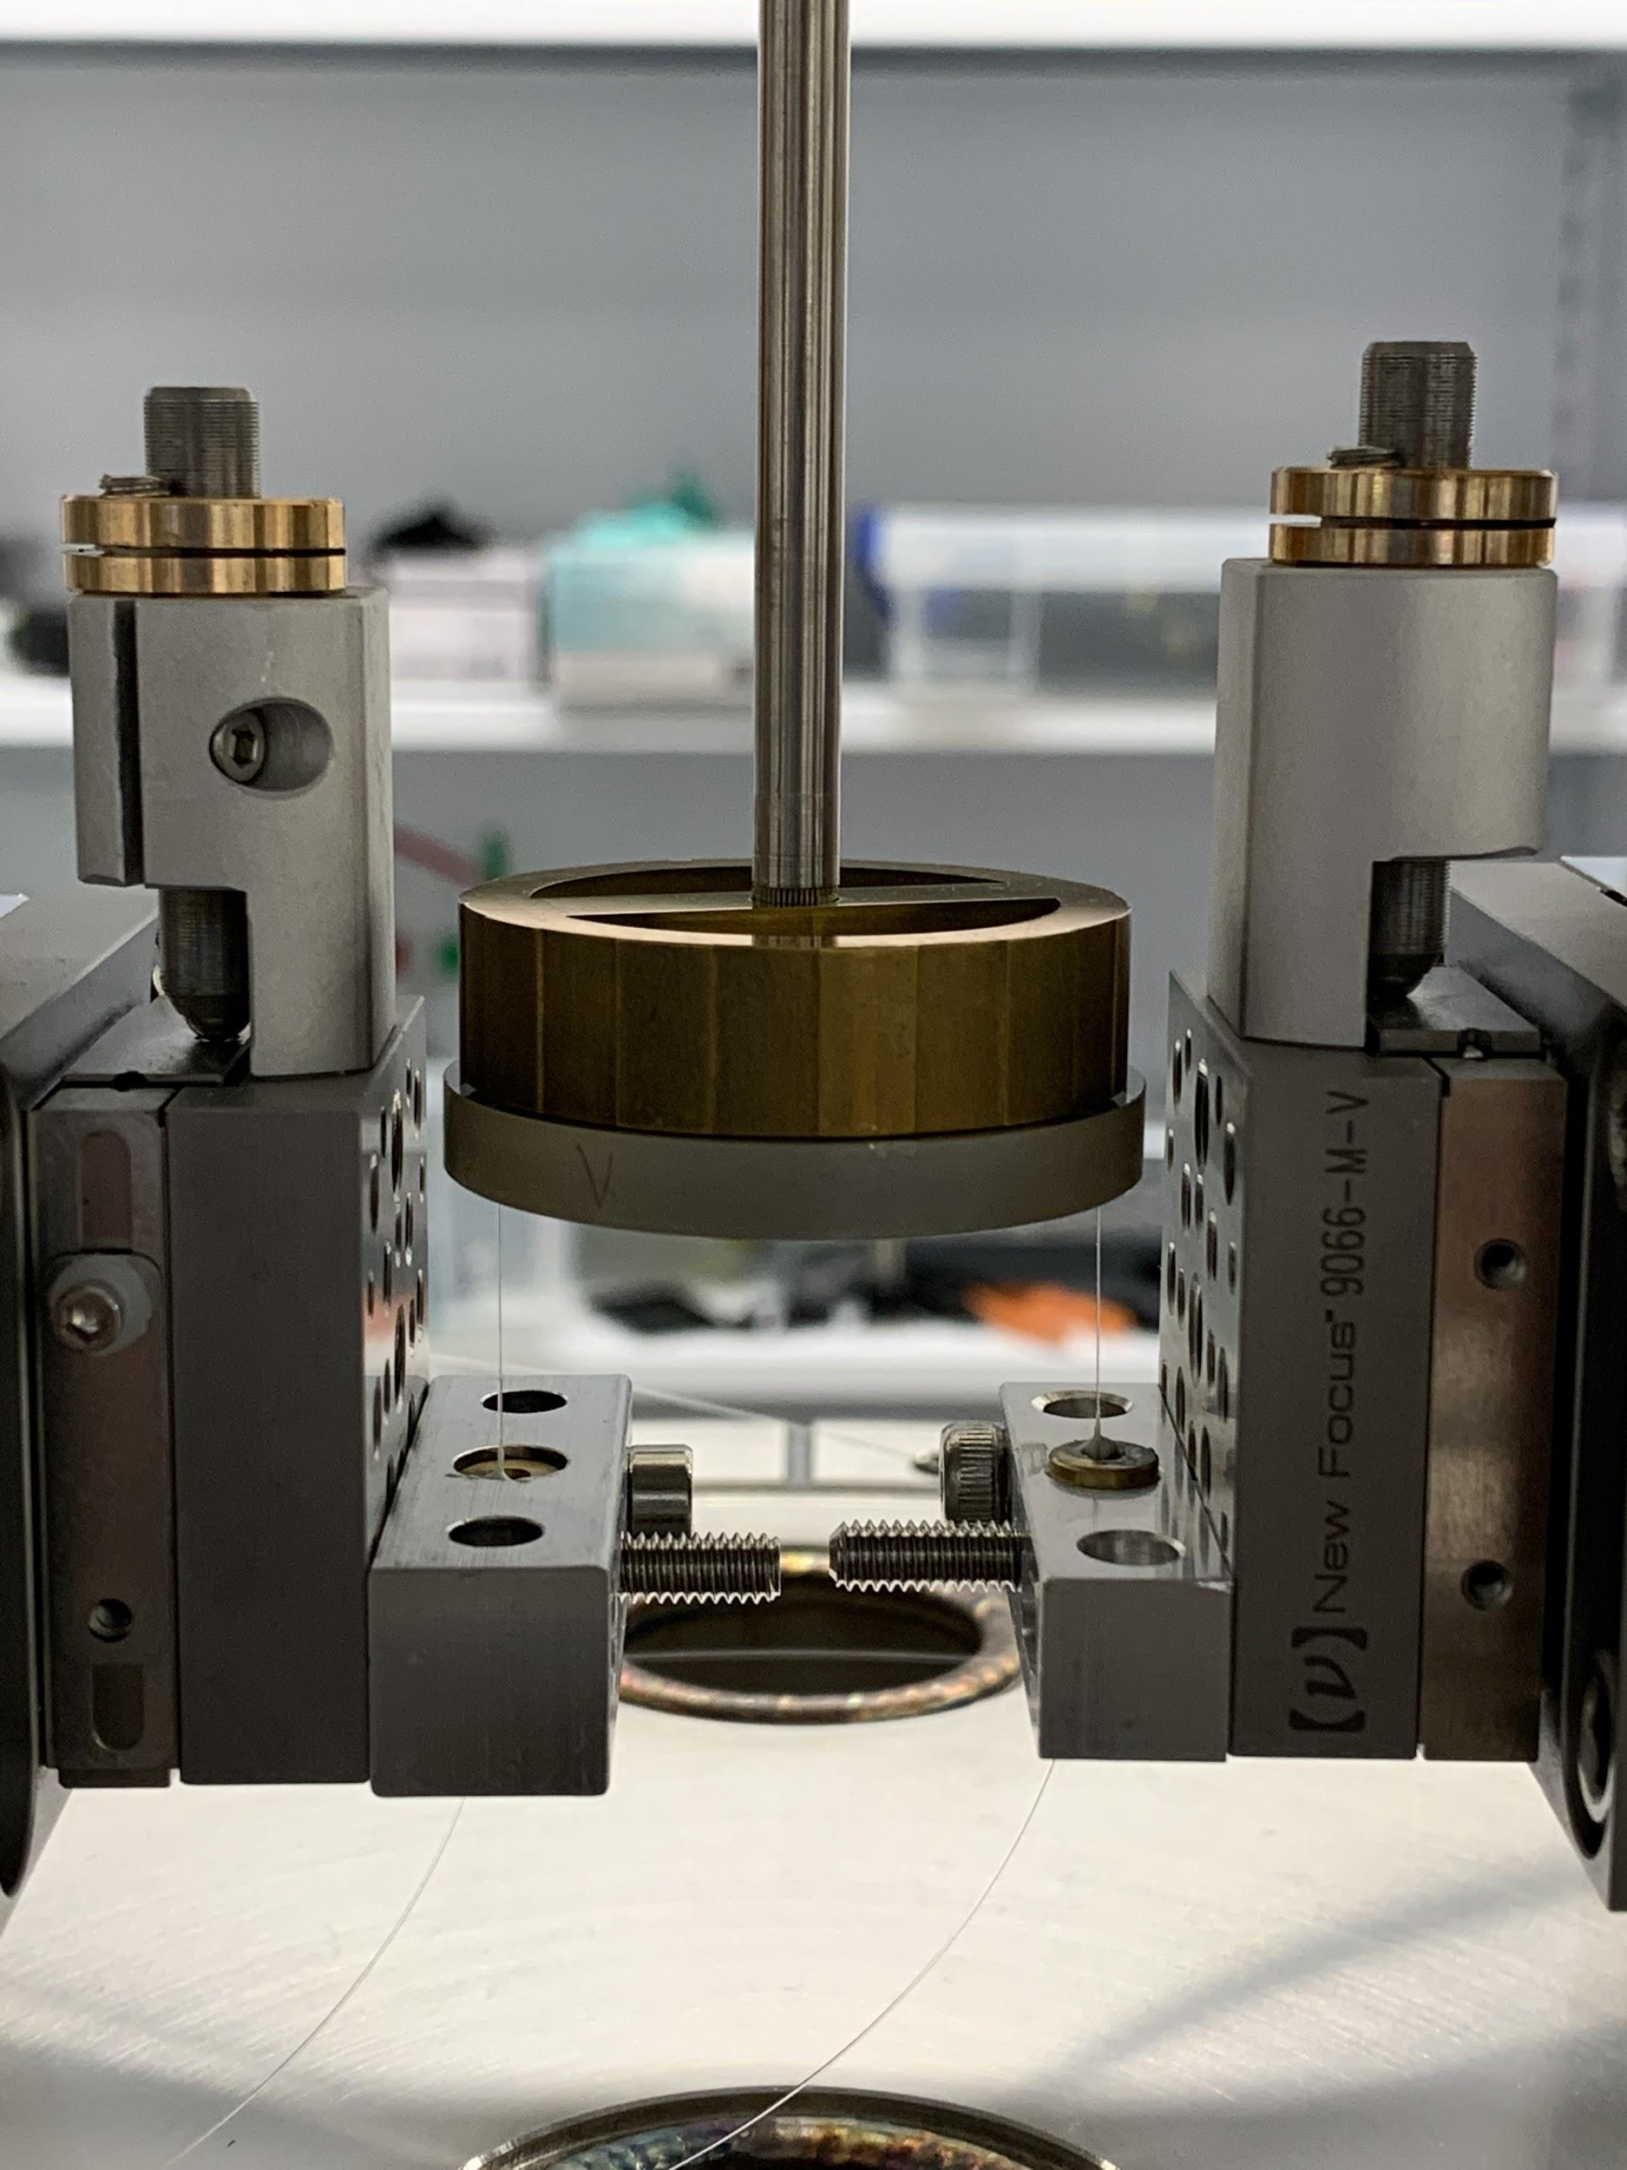
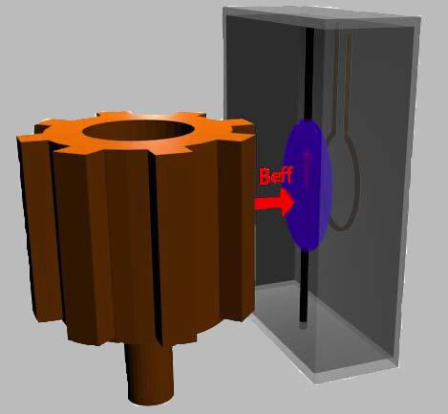
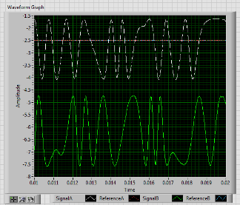
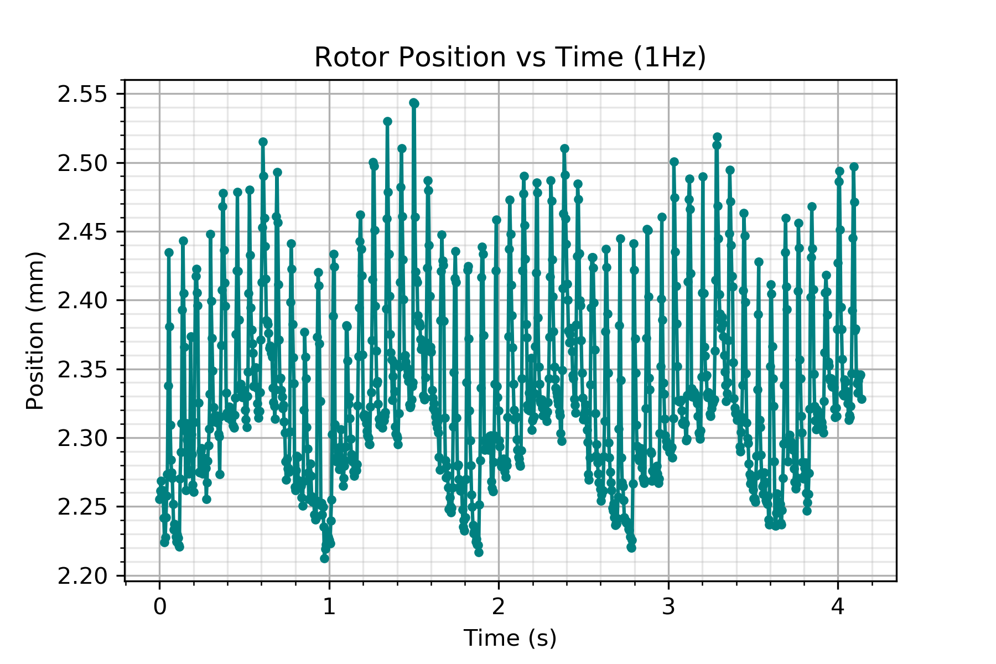
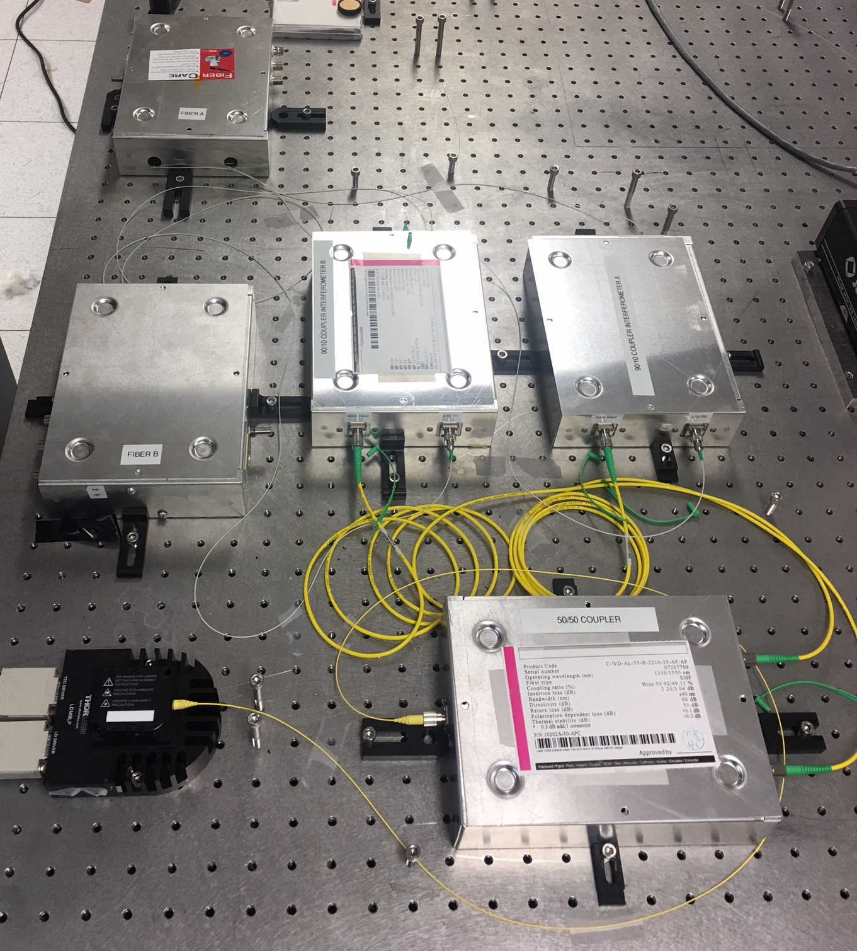
Backgrounds and noise tests
Rotary stage stability test
Rotation speed control
8.3 Hz ~ 1 part in 10000
RMS ~ 1 part in 3000
Allows utilization of T₂ > 100s
Preliminary benchtop optical test
wobble ~ +/- 40um
Within factor of 2 of spec for design sensitivity
Balancing/wobble improvements in process
Preliminary Benchtop optical test
wobble ~ +/- 40um
fibers
Interferometers
Design spec: rotation “wobble” < 50 um
Monitored in-situ with fiber optic interferometers

Slide 14
Conclusion
Estimated Timeline:
Cryostat completion: Fall 2022
Commissioning/
early data taking: 2023
ARIADNE experiment: Fifth-force NMR search for QCD axion
→ lab-sourced search sensitive to QCD axion in under-explored mass range
100 µeV < m_{a} < 10 meV
→ No need to scan mass, independent of local DM density
→ Complementary to neutron, proton EDM searches
→ Covers entire QCD axion parameter space when combined with haloscope and helioscope experiments

Slide 15


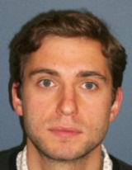
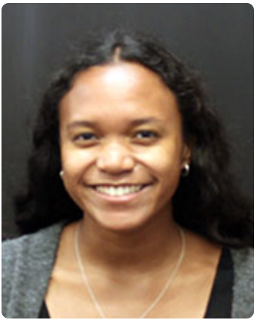
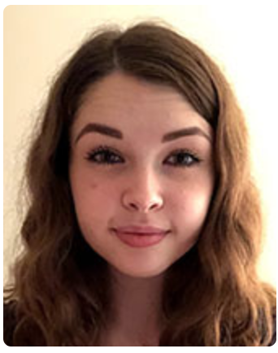
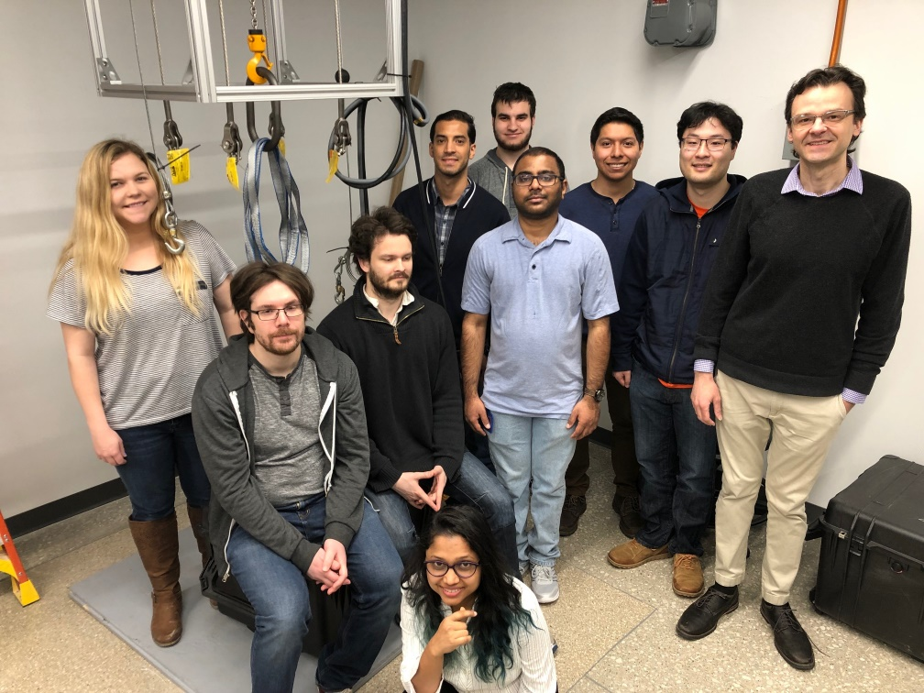

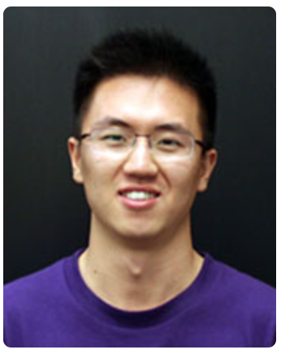
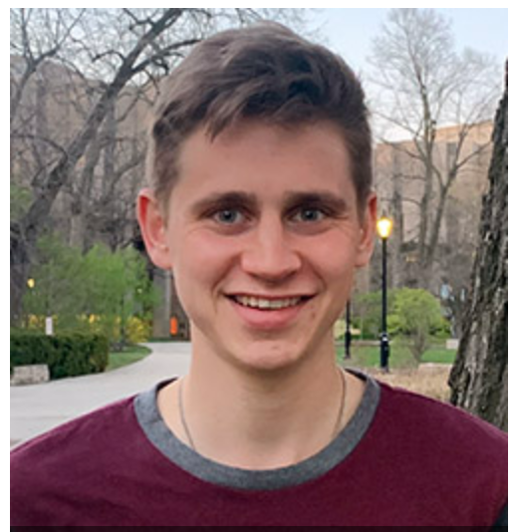
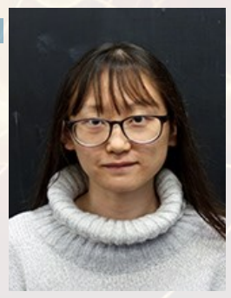




Acknowledgements
Geraci Lab 2017
Geraci Lab Summer 2018
Alexey Grinin (PD), Nia Burrell (G), Shelby Klomp (G), Aaron Wang (G), Andrew Laueger (UG), Huan Zhang (G)
Collaborators (GW):
Peter Barker (UCL)
Astro Theory:
Asimina Arvanitaki (Perimeter)
Masha Baryakhtar (Perimeter)
Mae Hwee Teo (Stanford)
Shane Larson (NU)
Vicky Kalogera (NU)
Group Members (left to right): Chloe Lohmeyer (G), Evan Weisman (PD), George Winstone (PD), Nancy Aggarwal (PD), Cris Montoya (PD), Daniel Grass (UG), Chethn Galla (G), Eduardo Allejandro (G), William Eom (G), Andy Geraci (PI)

