Slide 1
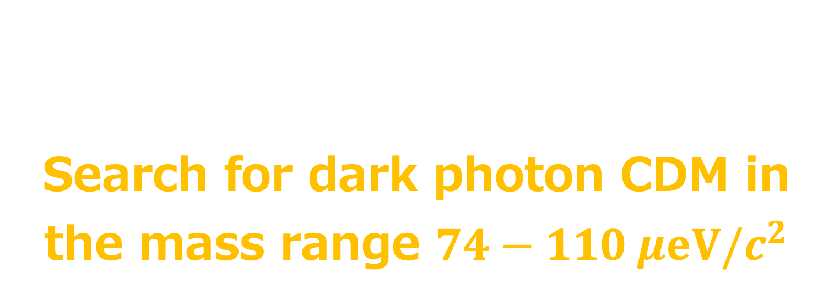
First Results of DOSUE-RR
Search for dark photon CDM in the mass range $74−110 μeV/c^{2}$
Osamu TAJIMA (Kyoto U.)
On behalf of the DOSUE-RR collaboration
https://arxiv.org/abs/2205.03679

Slide 2

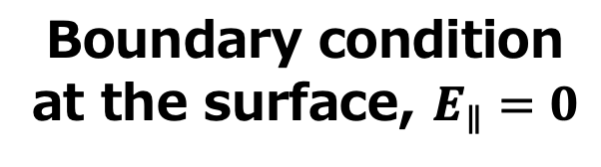
What’s DP-CDM?
Dark-photon
Cold Dark Matter
D. Horns et al. , JCAP 1304, 016 (2013)
EM-fields of DP-CDM appear via Kinetic mixing
$$E_{DP}={χ m}_{DP} X_{DP}$$
DP-CDM
Metal plate
(Boundary of EM field)
Boundary condition
at the surface, $E_{∥}=0$
Almost perpendicularly emitted from the boundary
“Conversion photon”

Slide 3
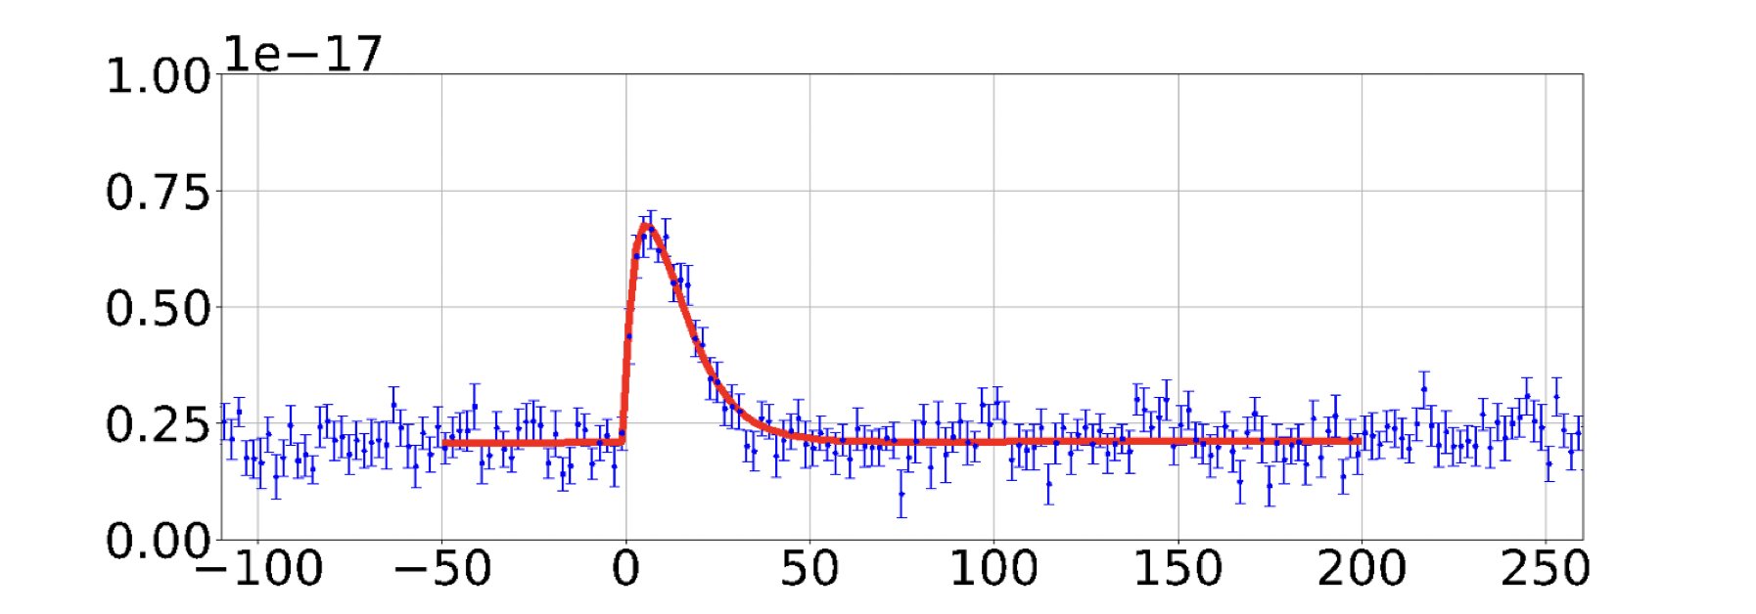
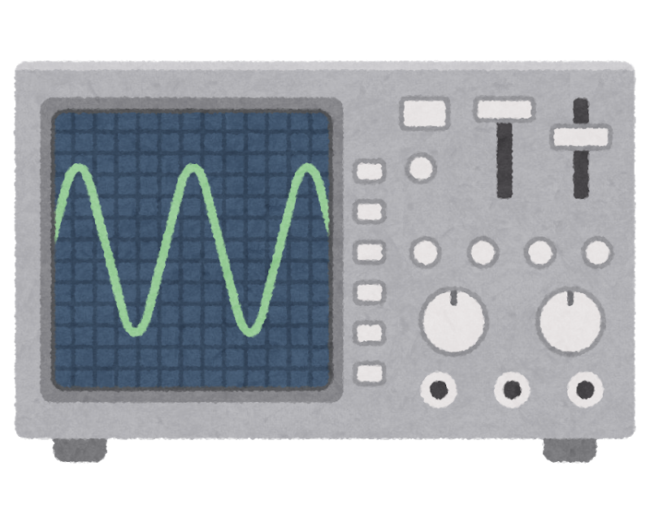


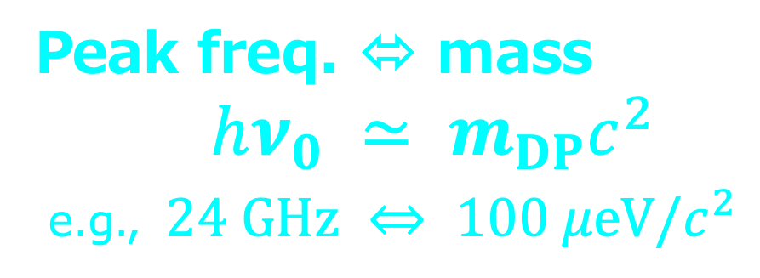


Detection principle of DP-CDM
$$P_{obs}∝χ^{2 }$$
N. Tomita, S. Oguri, et al. , JCAP 09, 012 (2020)
D. Horns et al. , JCAP 1304, 016 (2013)
DP-CDM
Peak height $∝χ^{2}$
converter
Metal plate
(boundary of EM)
Simulated spectrum of conversion photon
$Δν/ν_{0}$ ~ $β^{2}$ ~ $10^{−6}$
$$e.g., Δν\sim 20 kHz for ν_{0}=20 GHz$$
Conversion
photon
(perpendicular within 0.1˚)
Power (W)
Horn antenna
$$ν−ν_{0} (kHz)$$
millimeter-wave
Radio receiver
Peak freq. ⬄ mass
$hν_{0} ≃ m_{DP}c^{2}$
e.g., $24 GHz ⇔ 100 μeV/c^{2}$
Spectrometer

Slide 4
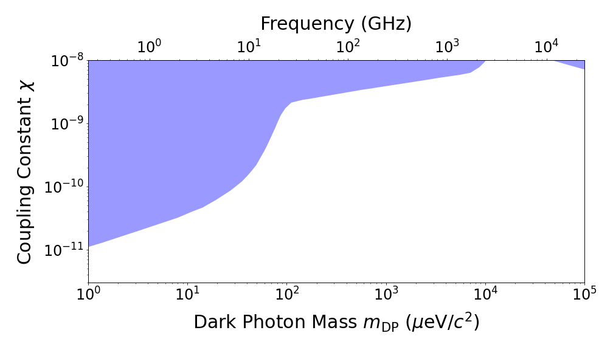
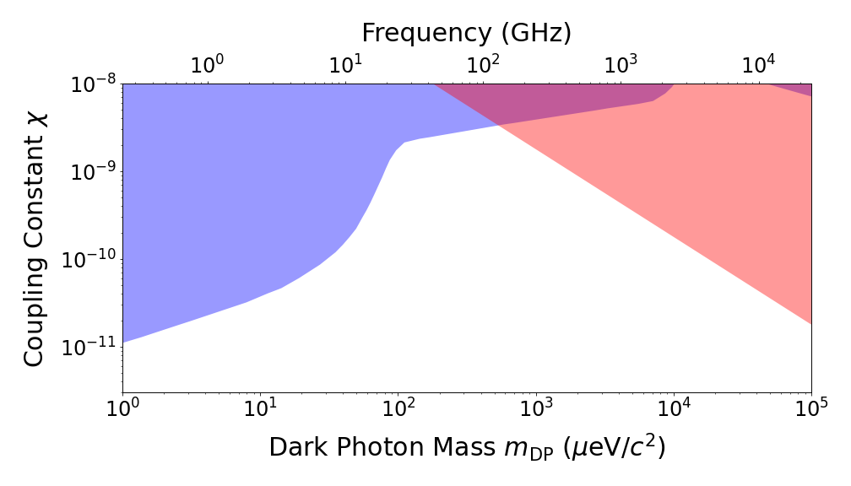
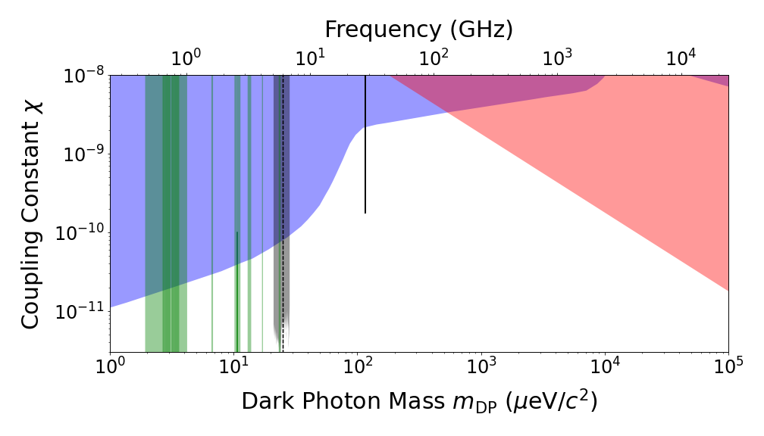
Constraints to date
CMB etc.
Tomita et al.
Solar lifetime
Dish antenna
Axion
Haloscope

Slide 5
Constraints to date
DOSUE-RR is series of experiments
to explore wide region!
CMB etc.
Tomita et al.
Solar lifetime
Dish antenna
No strong constraint here*
Axion
Haloscope
* Motivations from string theories and inflation models,
e.g., JCAP 1304, 016 (2013), Phys. Rev. D 93, 103520 (2016).

Slide 6

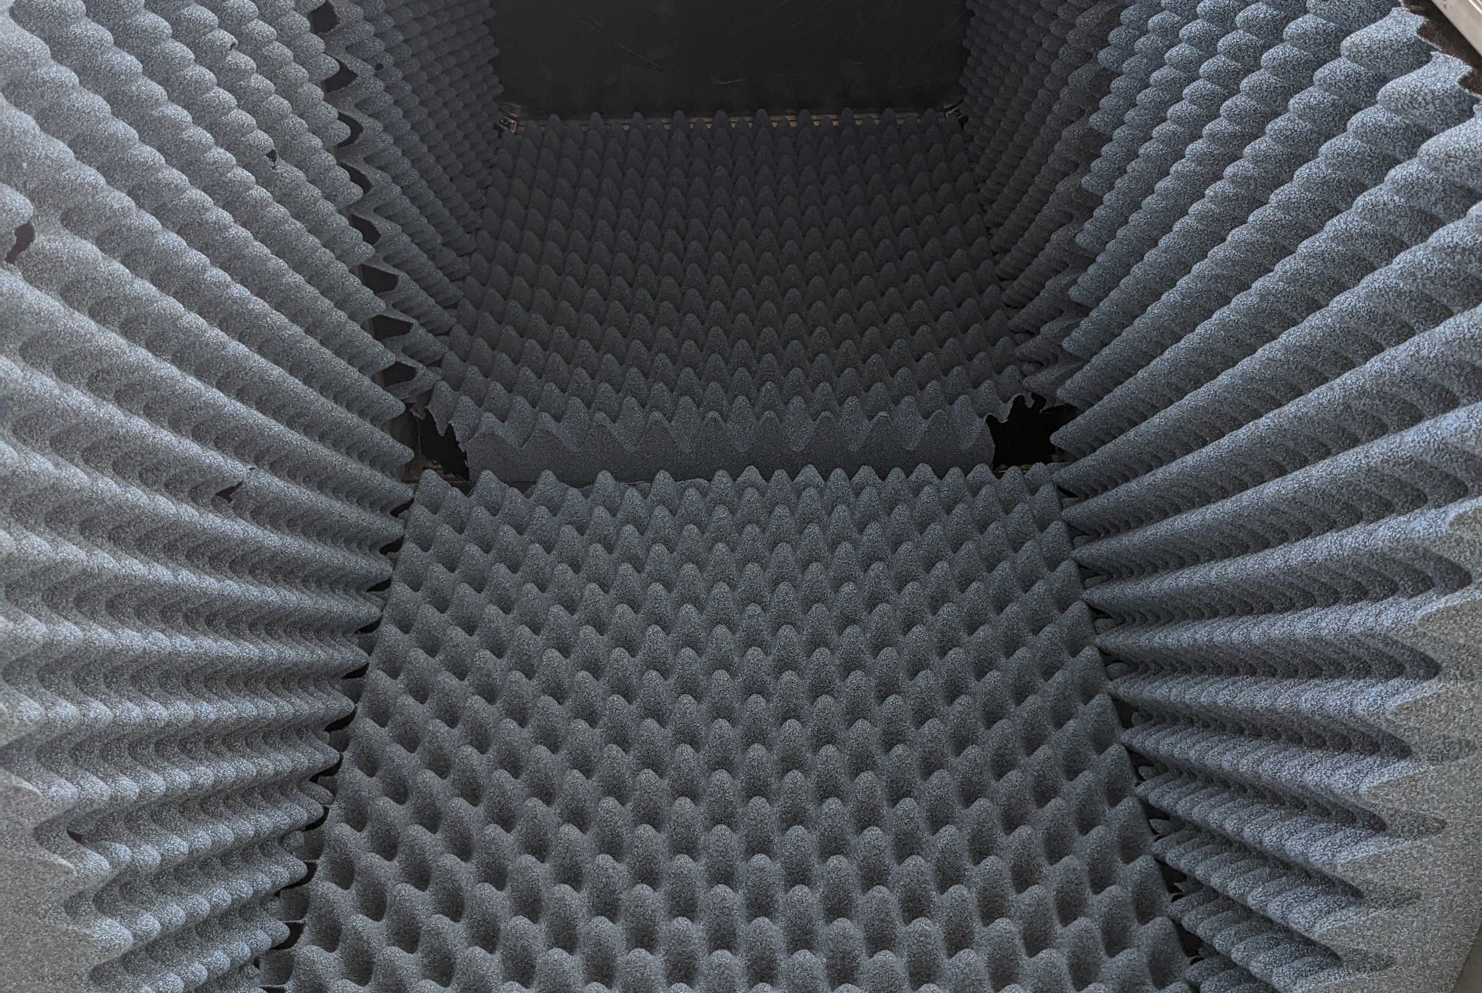
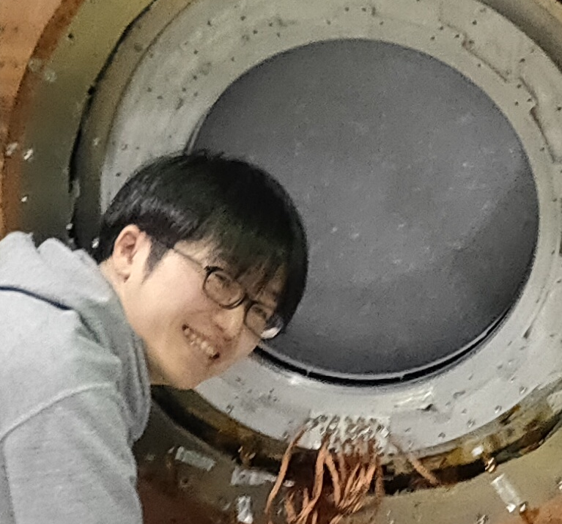

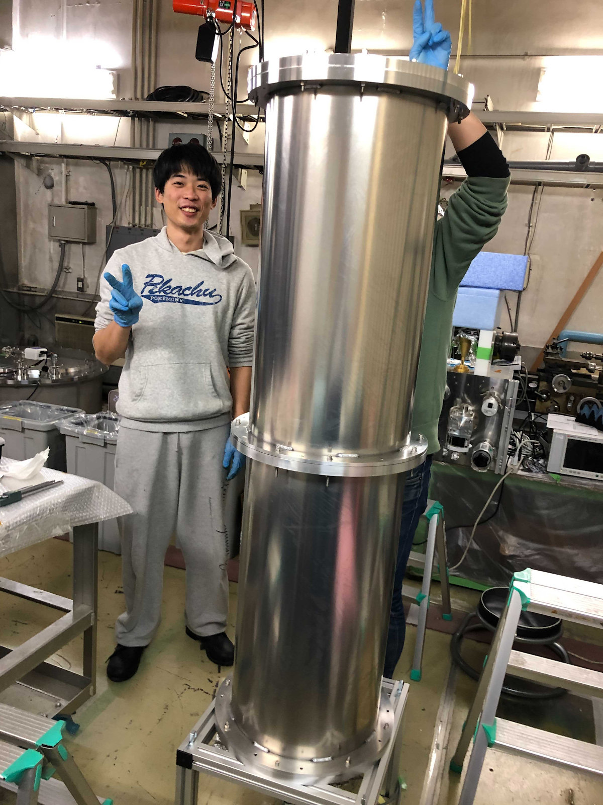
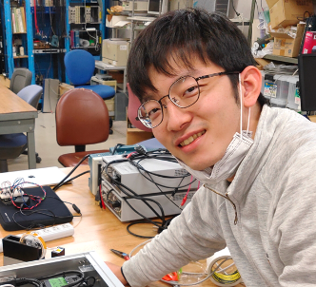
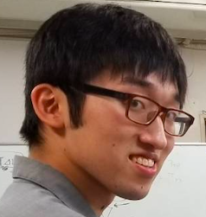

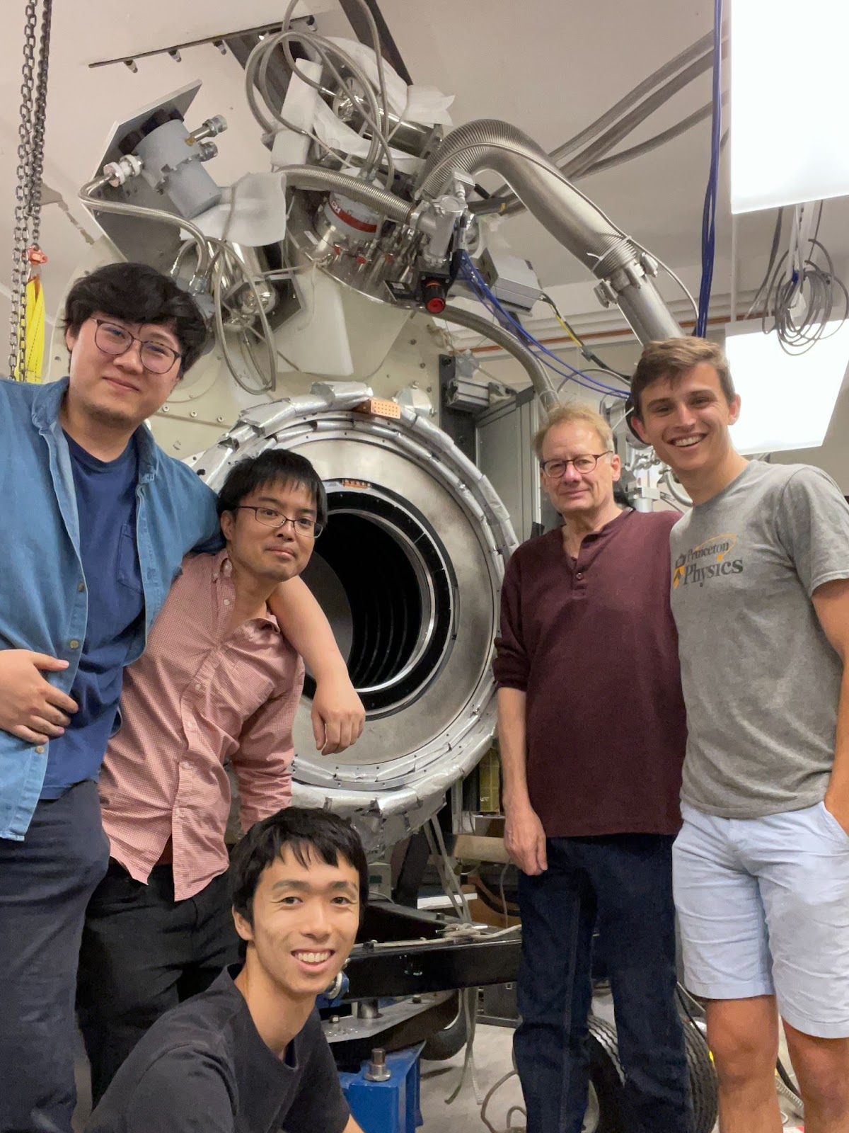
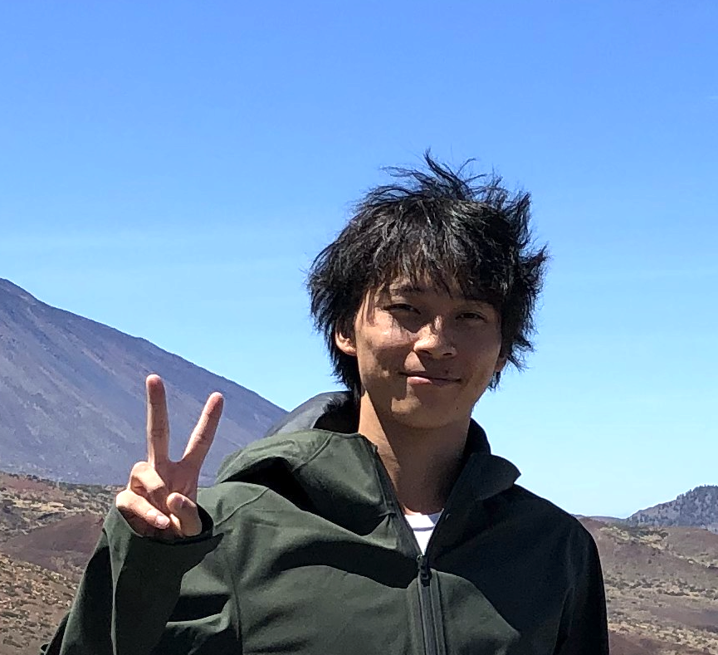
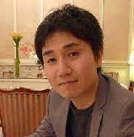

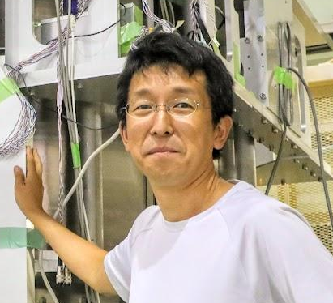

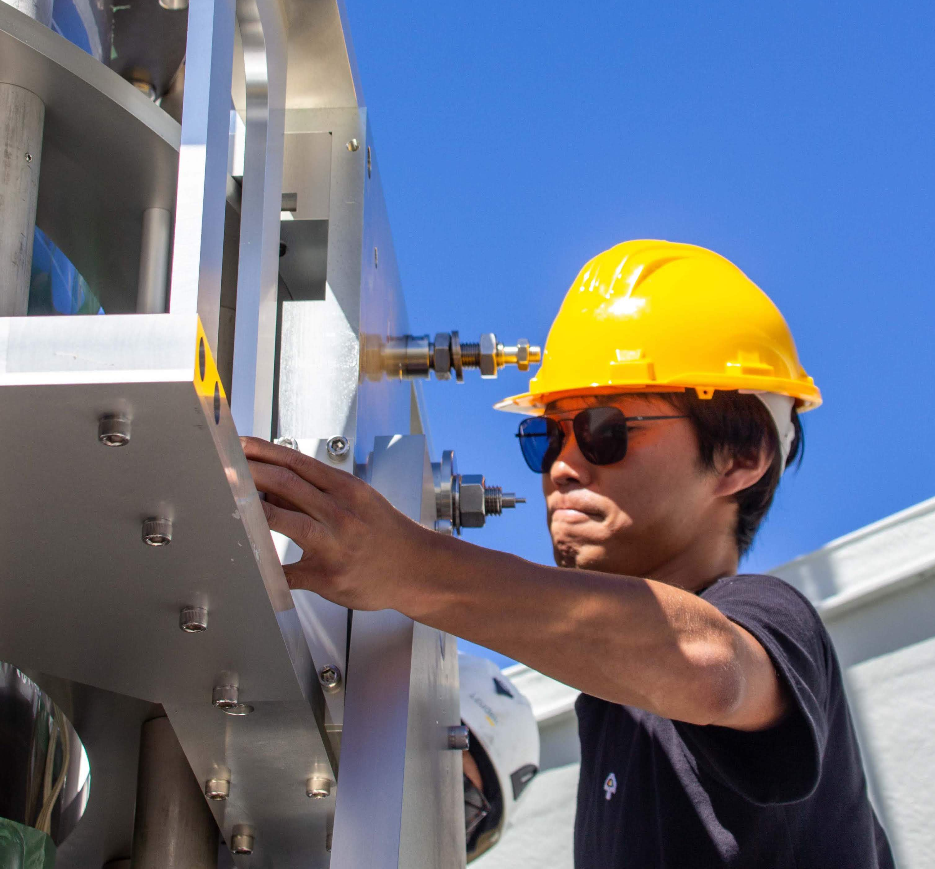
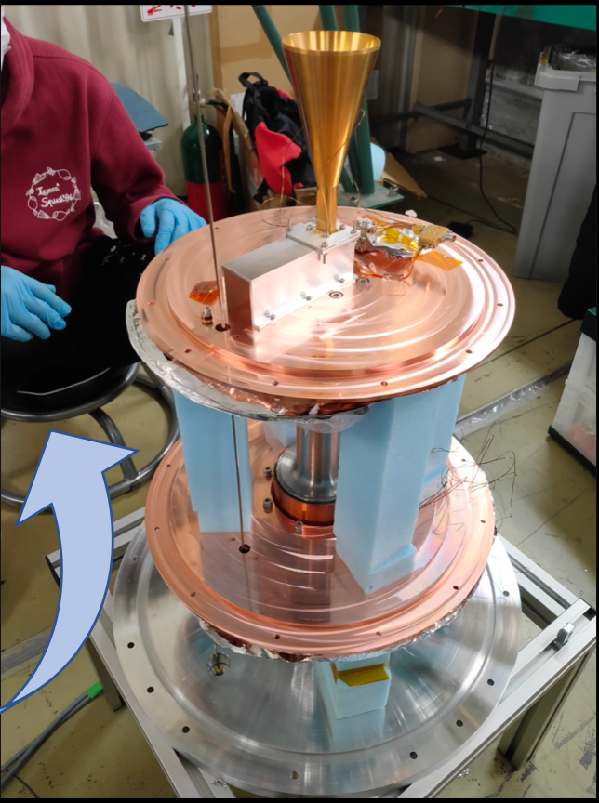
The DOSUE-RR Collaboration
Dark-photon/dark-matter Observing System for Un-Explored Radio-Range
Kyoto University
Shunsuke Adachi
Ryo Fujinaka
Shumpei Kotaka
Hironobu Nakata
Yudai Seino
Yoshinori Sueno
Toshi Sumida
Junya Suzuki
Osamu Tajima
Soichiro Takeichi
__ Do-Su-E.
(local phrase
in Kyoto)
University of Tsukuba
Shunsuke Honda
Recently moved from Instituto de Astrofisica de Canarias (IAC)

Slide 7
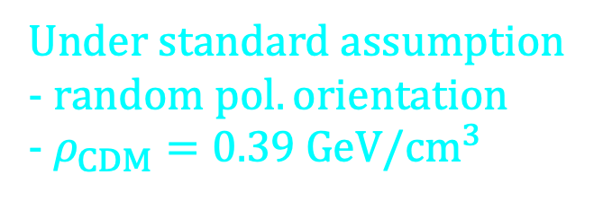
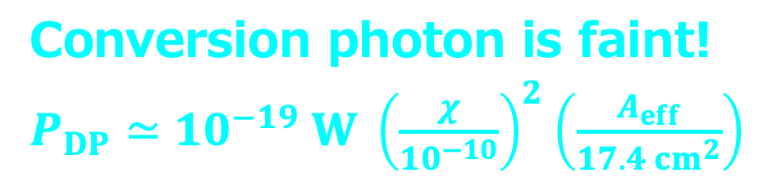
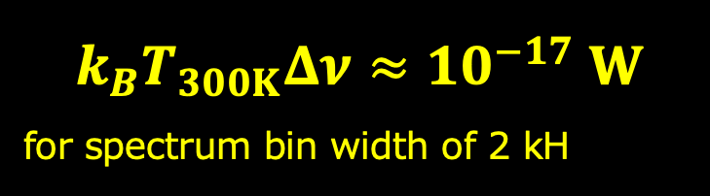
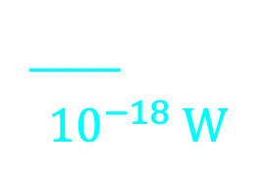
Major Noise?
_____
$${10}^{−18} W$$
DP-CDM
converter
Metal plate
(boundary of EM)
Thermal radiation from ambient is major noise
$$k_{B}T_{300K}Δν≈10^{−17} W$$
for spectrum bin width of 2 kH
Conversion
photon
(perpendicular within 0.1˚)
Horn antenna
Conversion photon is faint!
$P_{DP}≃10^{−19} W {\left(\frac{χ}{{10}^{−10}}\right)}^{2}\left(\frac{A_{eff}}{17.4 cm^{2}}\right)$
millimeter-wave
Radio receiver
Under standard assumption
- $random pol. orientation$
- $ρ_{CDM}=0.39 GeV/cm^{3}$
Spectrometer

Slide 8
Instrumental concepts
DP-CDM
converter
Metal plate
(boundary of EM)
Thermal radiation from ambient is major noise
Conversion
photon
(perpendicular within 0.1˚)
Suppression of thermal noise
(same strategy as recent CMB experiments)
Horn antenna
millimeter-wave
Radio receiver
Maintenance the system and optical path in the cryogenic shield at ~3 K
Spectrometer

Slide 9
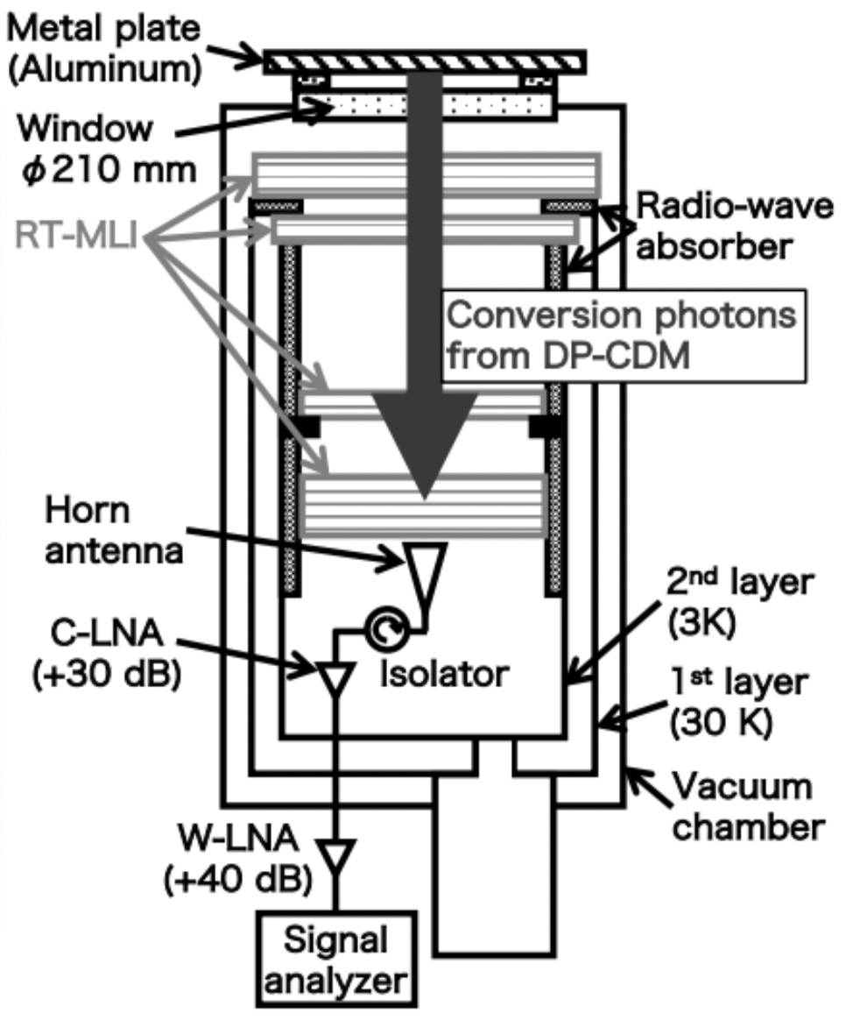

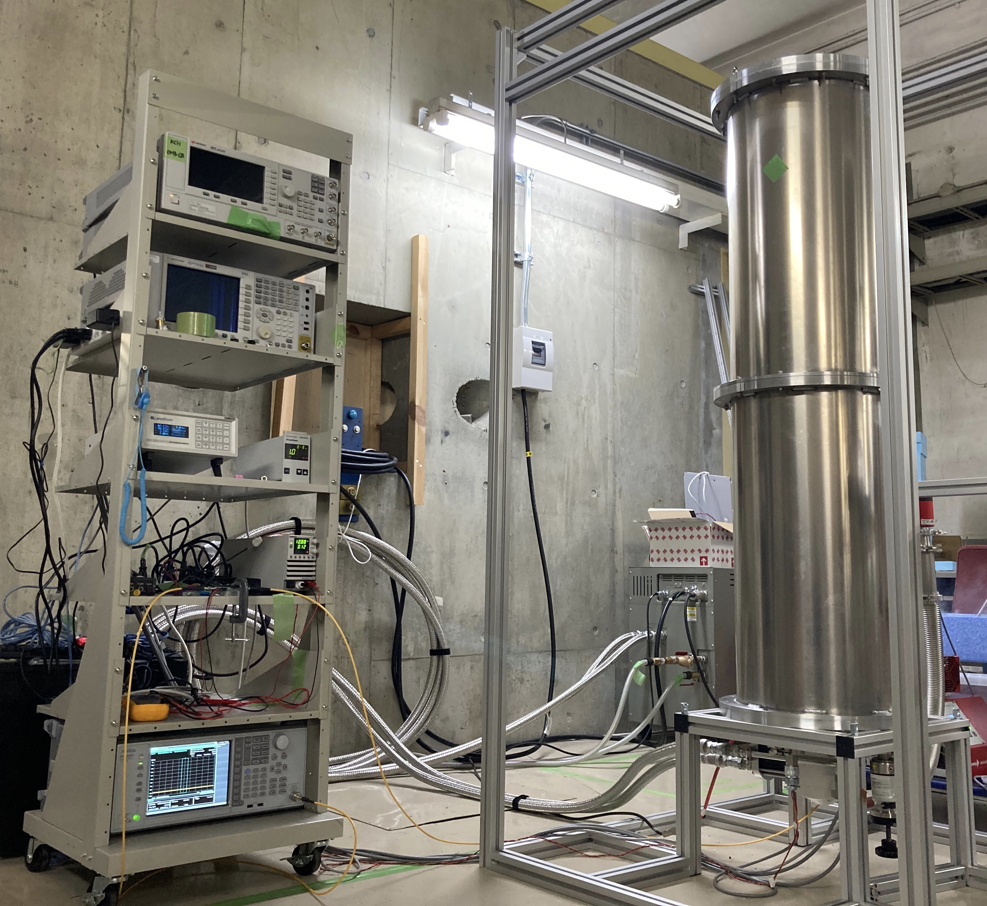
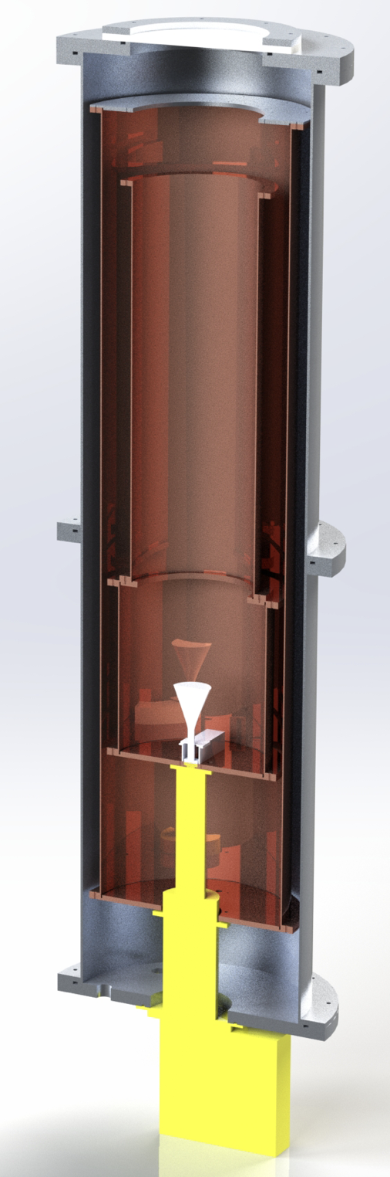
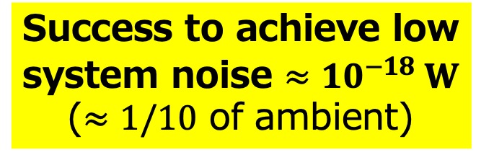
Instruments
Aluminum plate
0.4 m
Window
Success to achieve low system noise $≈{10}^{−18} W$ ($≈1/10$ of ambient)
Vacuum
chamber
Conversion photon
30 K shell
Thermometer monitor
Vacuum gauge monitor
1.7 m
3 K shell
Bias electronics
W-LNA (+40 dB)
Aldetec ALM-1826S210
Horn antenna
C-LNA (+30 dB)
LNF-LNC15-29B
set in cold box
GM refrigerator
Signal analyzer
ANRITSU MS2840A

Slide 10
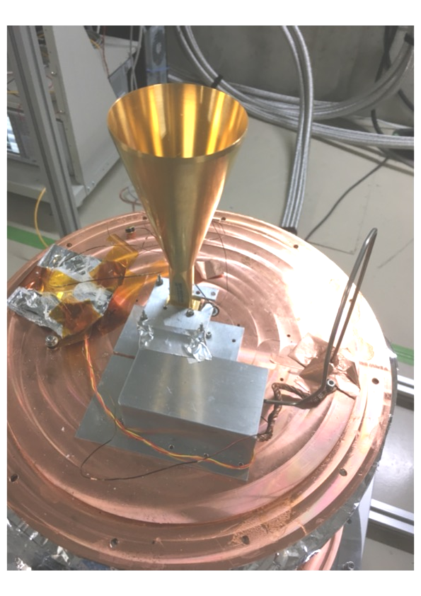
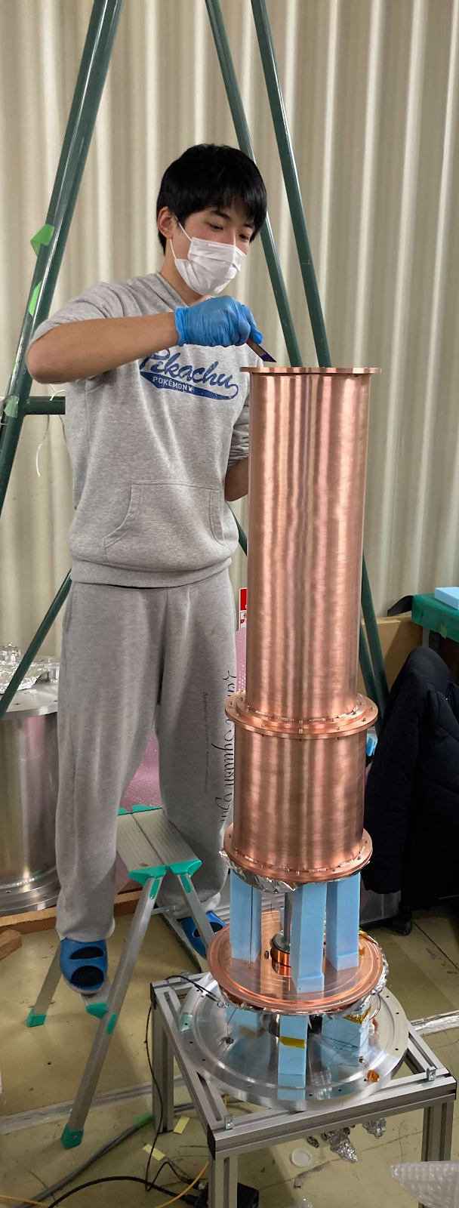
Instruments cont.
Aluminum plate
My master
thesis research!
Window
Vacuum
chamber
Conversion photon
30 K shell
3 K shell
Horn antenna
C-LNA (+30 dB)
LNF-LNC15-29B
set in cold box
GM refrigerator

Slide 11

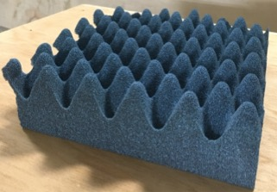





Calibration: gain
$P_{meas.}=G ×P_{in}+N_{rec.}$
Blackbody source
Radio aborber
(ECOSORB CV3)
@ 77K & 290K
Maintained in the cryogenic condition
$$P_{in}$$
Raw signal is amplified by LNAs
$P_{meas.}=G × P_{in}+N_{rec.}$
Horn antenna
$$×G$$
Typical gain
G = +62 dB
Typical time variation
< 1% in hour-scale
millimeter-wave
Radio receiver
$$+N_{rec.}$$
Spectrometer

Slide 12
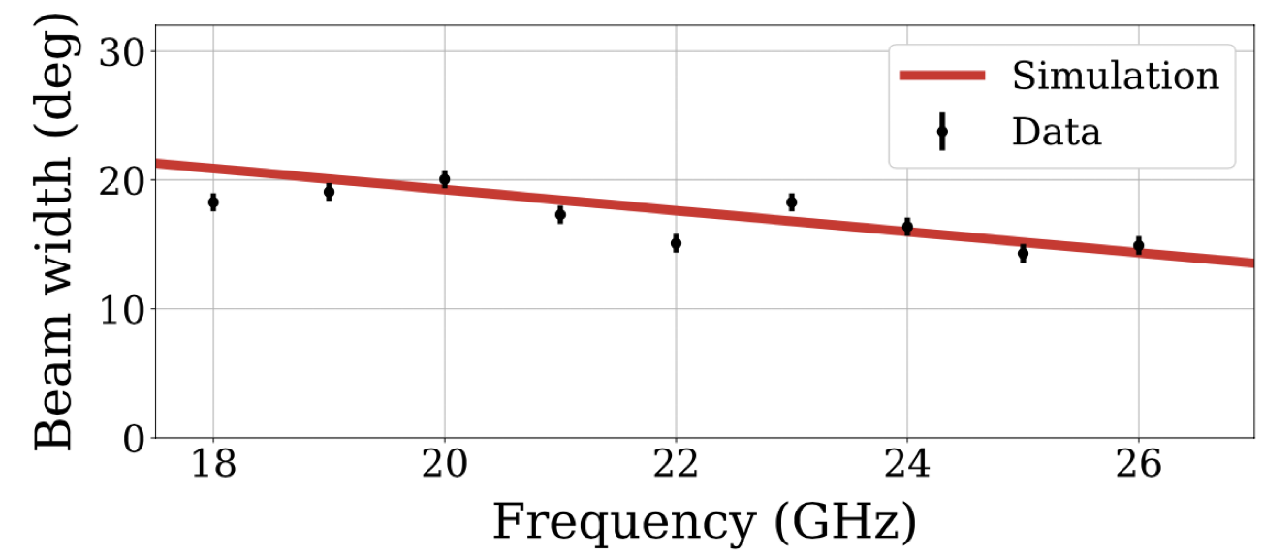
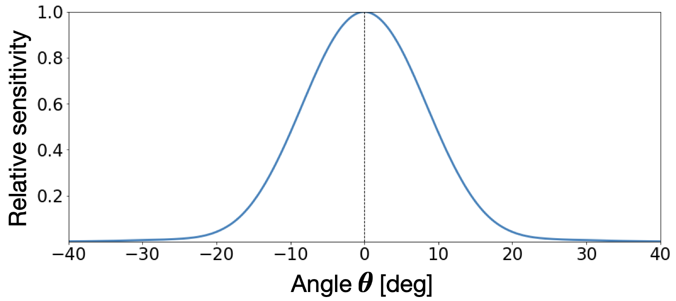


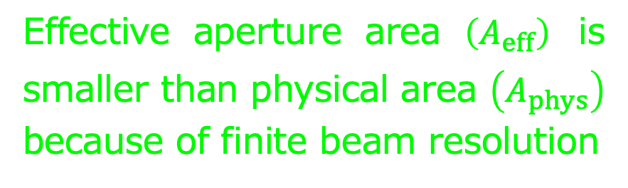
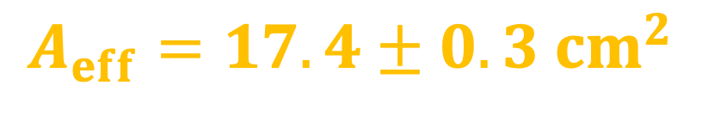
Calibration: A_{eff}
Effective aperture area $\left(A_{eff}\right)$ is smaller than physical area $\left(A_{phys}\right)$ because of finite beam resolution
$$A_{eff}$$
$$A_{eff}=17.4±0.3 cm^{2}$$
Simulation
at 20 GHz
$$A_{phys}$$
Beam width
Horn antenna

Slide 13

Data set for exploration
…
Swept power from 18 GHz – 26.5 GHz
  Freq. limit by waveguide cutoff, capability of SA
  FFT at RBW of 300 Hz (analysis bin width of 2 kHz)
  Bandwidth of single FFT scan is limited at 2.5 MHz
18.0
Frequency (GHz)
26.5
$$≈$$
…
…
Gain calibration
Every 100 MHz interval
(~40 min)
Took 12 days to explore whole range
Nov. 29 – Dec. 10, 2021

Slide 14
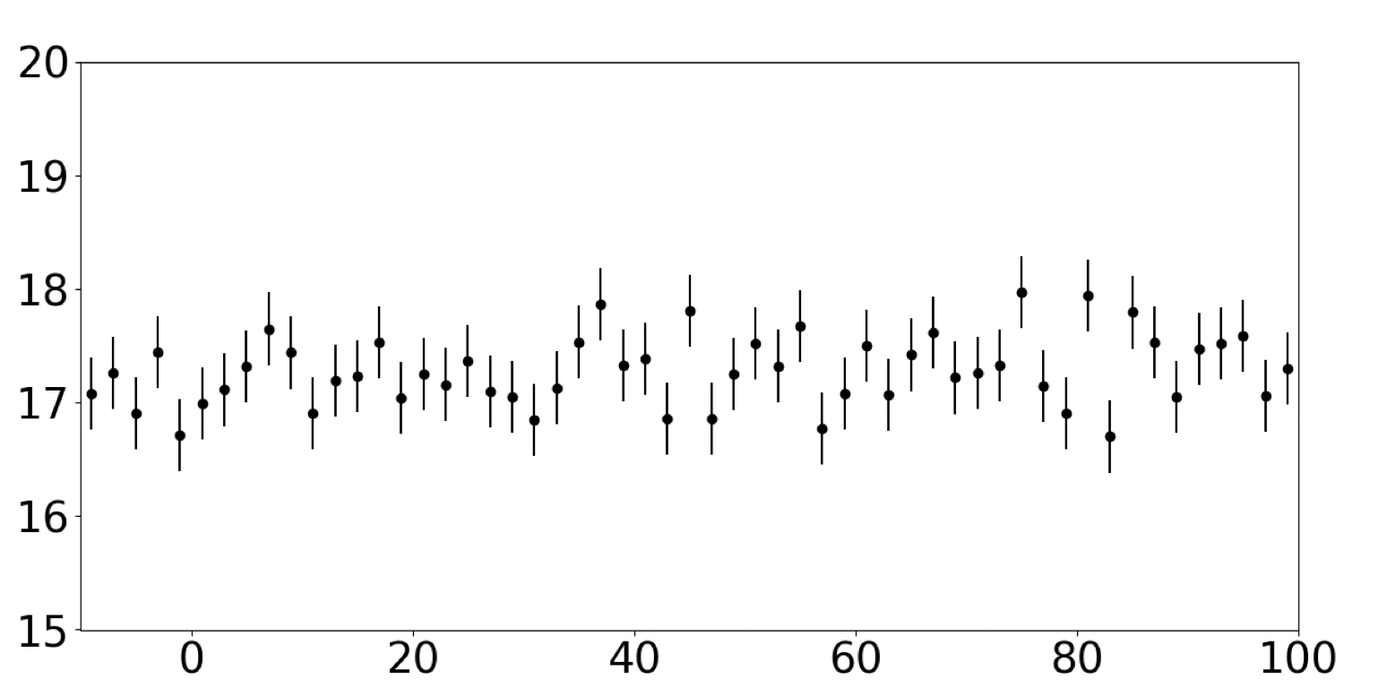


An example of spectrum data
stat. error $≲10^{−19} W$
Power (x10⁻¹⁹ W)
Frequency (kHz + 18 GHz)
Expected sensitivity we achieved: $χ≲{10}^{−10}$
$$⇔P_{DP}≃{10}^{−19} W @ χ={10}^{−10}$$

Slide 15



Methodology of Signal Extraction
Extract $P_{DP}$ for each $ν_{0}$ , i.e., sweeping fits
Isothermal perturbation
Fit function
The Maxwell-Boltzmann
$$f\left(ν\right)=P_{DP} × F\left(ν;ν_{0}\right) +\left[a(ν−ν_{0})+b\right]$$
Signal power $×$ shape
Baseline offset
Simulated spectrum of conversion photon
$Δν/ν_{0}$ ~ $β^{2}$ ~ $10^{−6}$
$$e.g., Δν\sim 20 kHz for ν_{0}=20 GHz$$
Power (W)
$$ν−ν_{0} (kHz)$$

Slide 16
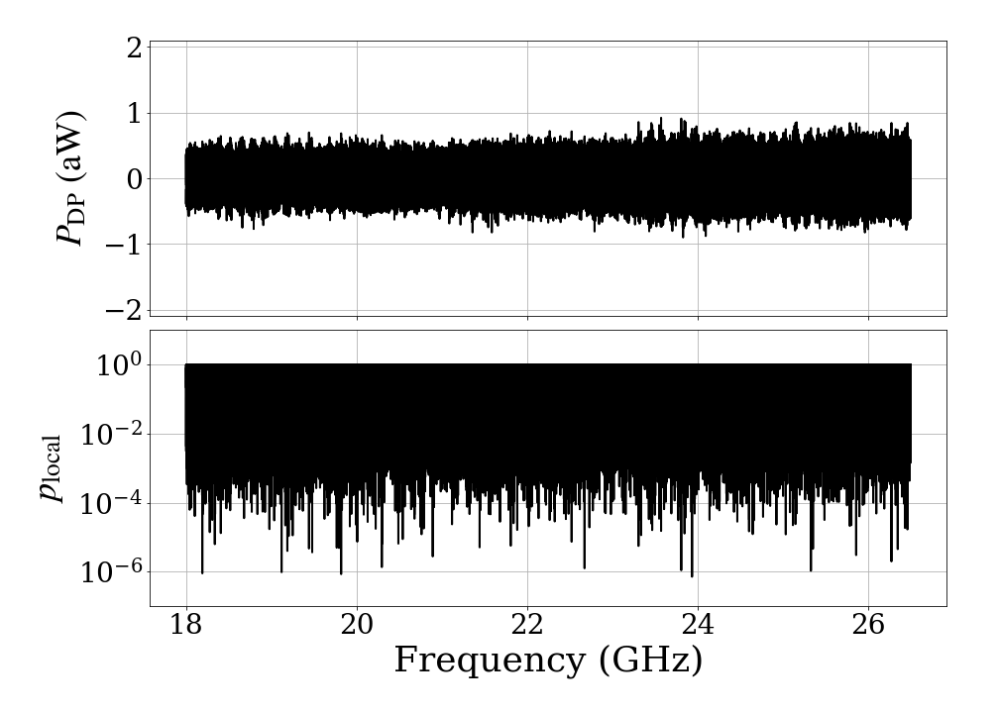

Results of Signal Extraction
$${↶10}^{−18}W$$
Found NO
significant
signal
No significant excess at specific freq.
Null signal hypothesis
Taking into account “look-else-where” among all 4,250,000 fit results
Global p-value under null hypothesis: 68%

Slide 17
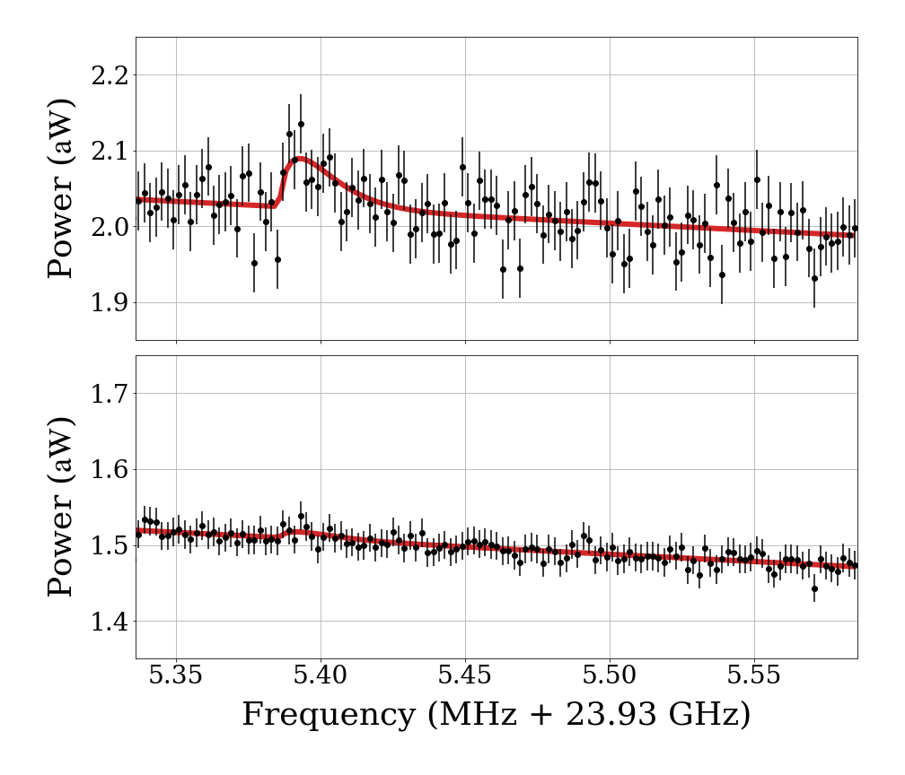
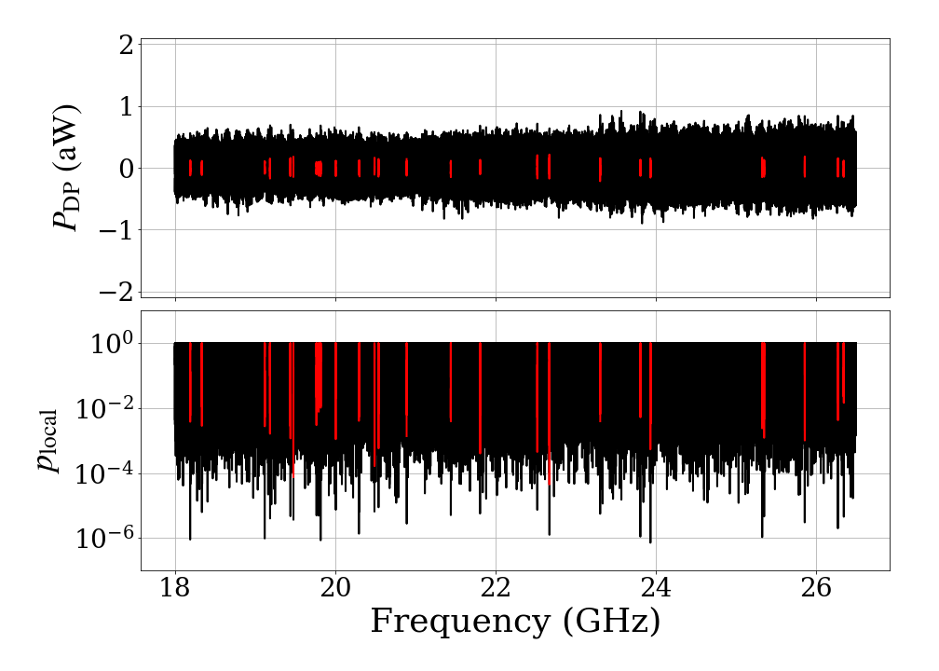


Further investigation with more statistics
No discovery??
Stat. $×11$
Additional data in Jan. 17, 2022
Confirmed NO signal
Even though $p_{global}=68\%⋯$,
we don’t wanna miss discovery
Confirmed zero-consistent results

Slide 18

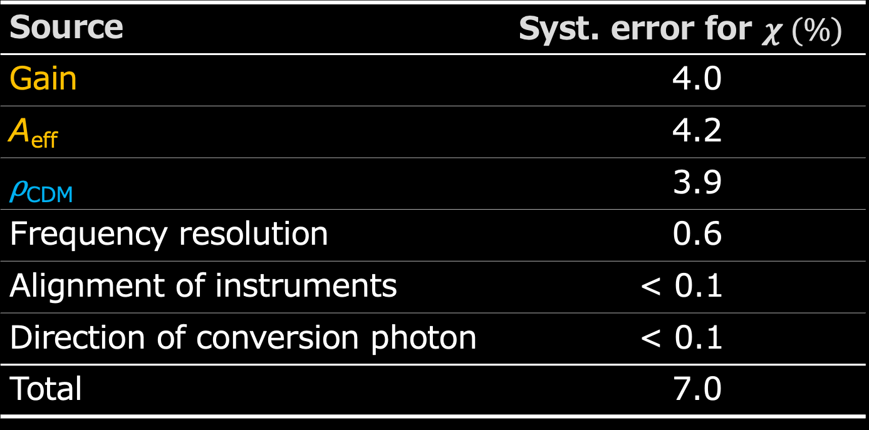
Systematic Errors
Source | Syst. error for $χ (\%)$
Gain | 4.0
A_{eff} | 4.2
⍴_{CDM} | 3.9
Frequency resolution | 0.6
Alignment of instruments | < 0.1
Direction of conversion photon | < 0.1
Total | 7.0
Uncertainty of calibration
Model uncertainty
$$χ=1.0 ×{10}^{−10} {\left( \frac{P_{DP}}{{10}^{−19} W} \frac{17.4 cm^{2}}{A_{eff}} \frac{0.39 GeV/cm^{3}}{ρ_{CDM}} \right)}^{1/2}$$

Slide 19
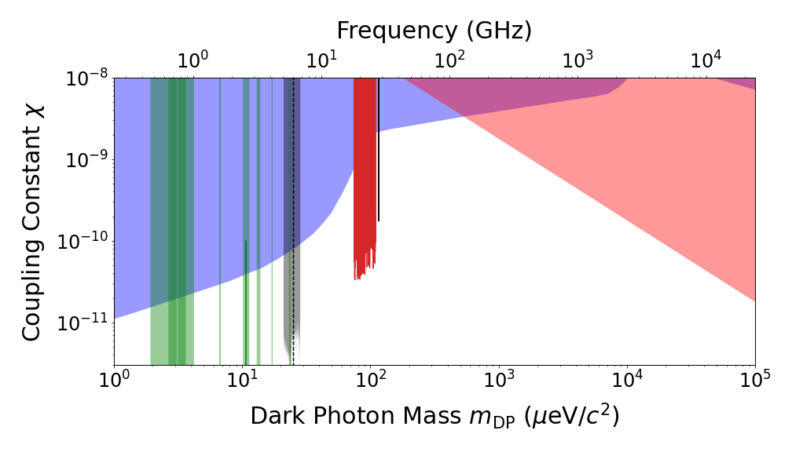
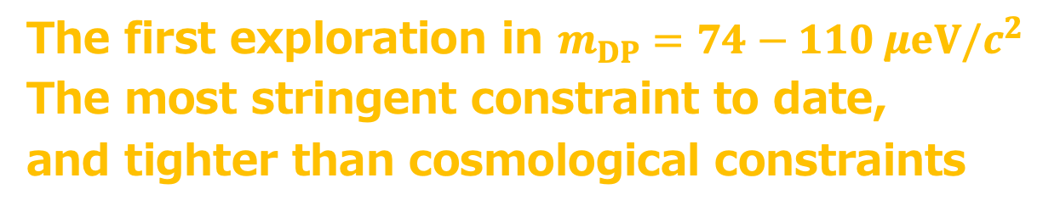

Upper limits at 95% C.L.
CMB etc.
Solar lifetime
Dish antenna
Axion
Haloscope
This work!
$$χ<\left(0.3−2.0\right)×10^{−10} @95\%CL$$
The first exploration in $m_{DP}=74−110 μeV/c^{2}$
The most stringent constraint to date,
and tighter than cosmological constraints

Slide 20
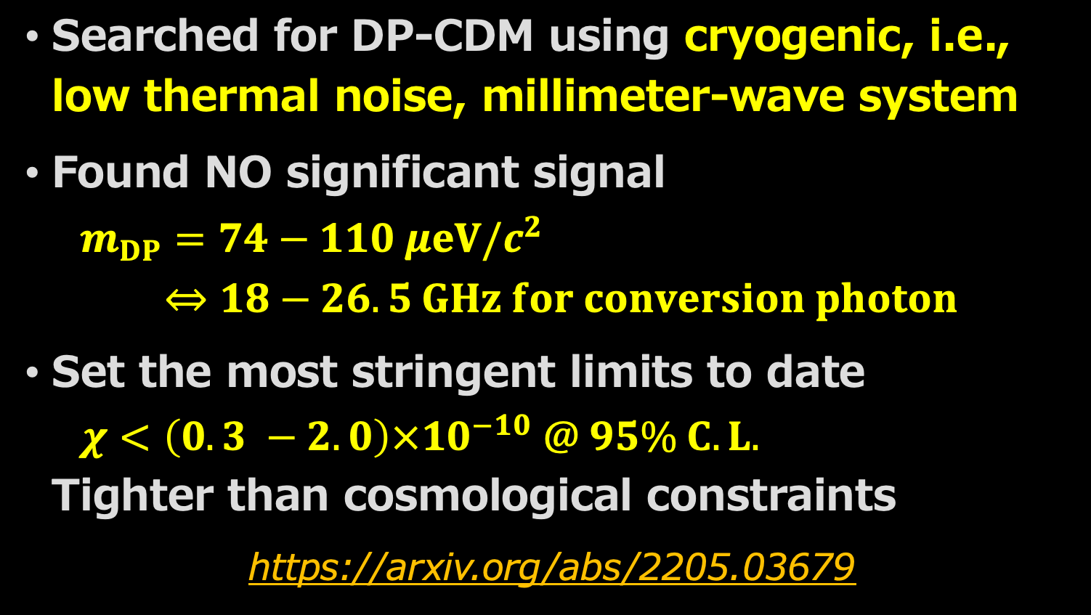
First Results of DOSUE-RR
Dark photon/dark matter Observing System for Un-Explored Radio Range
Summary
Searched for DP-CDM using cryogenic, i.e., low thermal noise, millimeter-wave system
Found NO significant signal
$m_{DP}=74−110 μeV/c^{2}$
$⇔18−26.5 GHz for conversion photon$
Set the most stringent limits to date
$χ<\left(0.3 −2.0\right)×{10}^{−10} @ 95\% C.L.$
Tighter than cosmological constraints
https://arxiv.org/abs/2205.03679

Slide 21
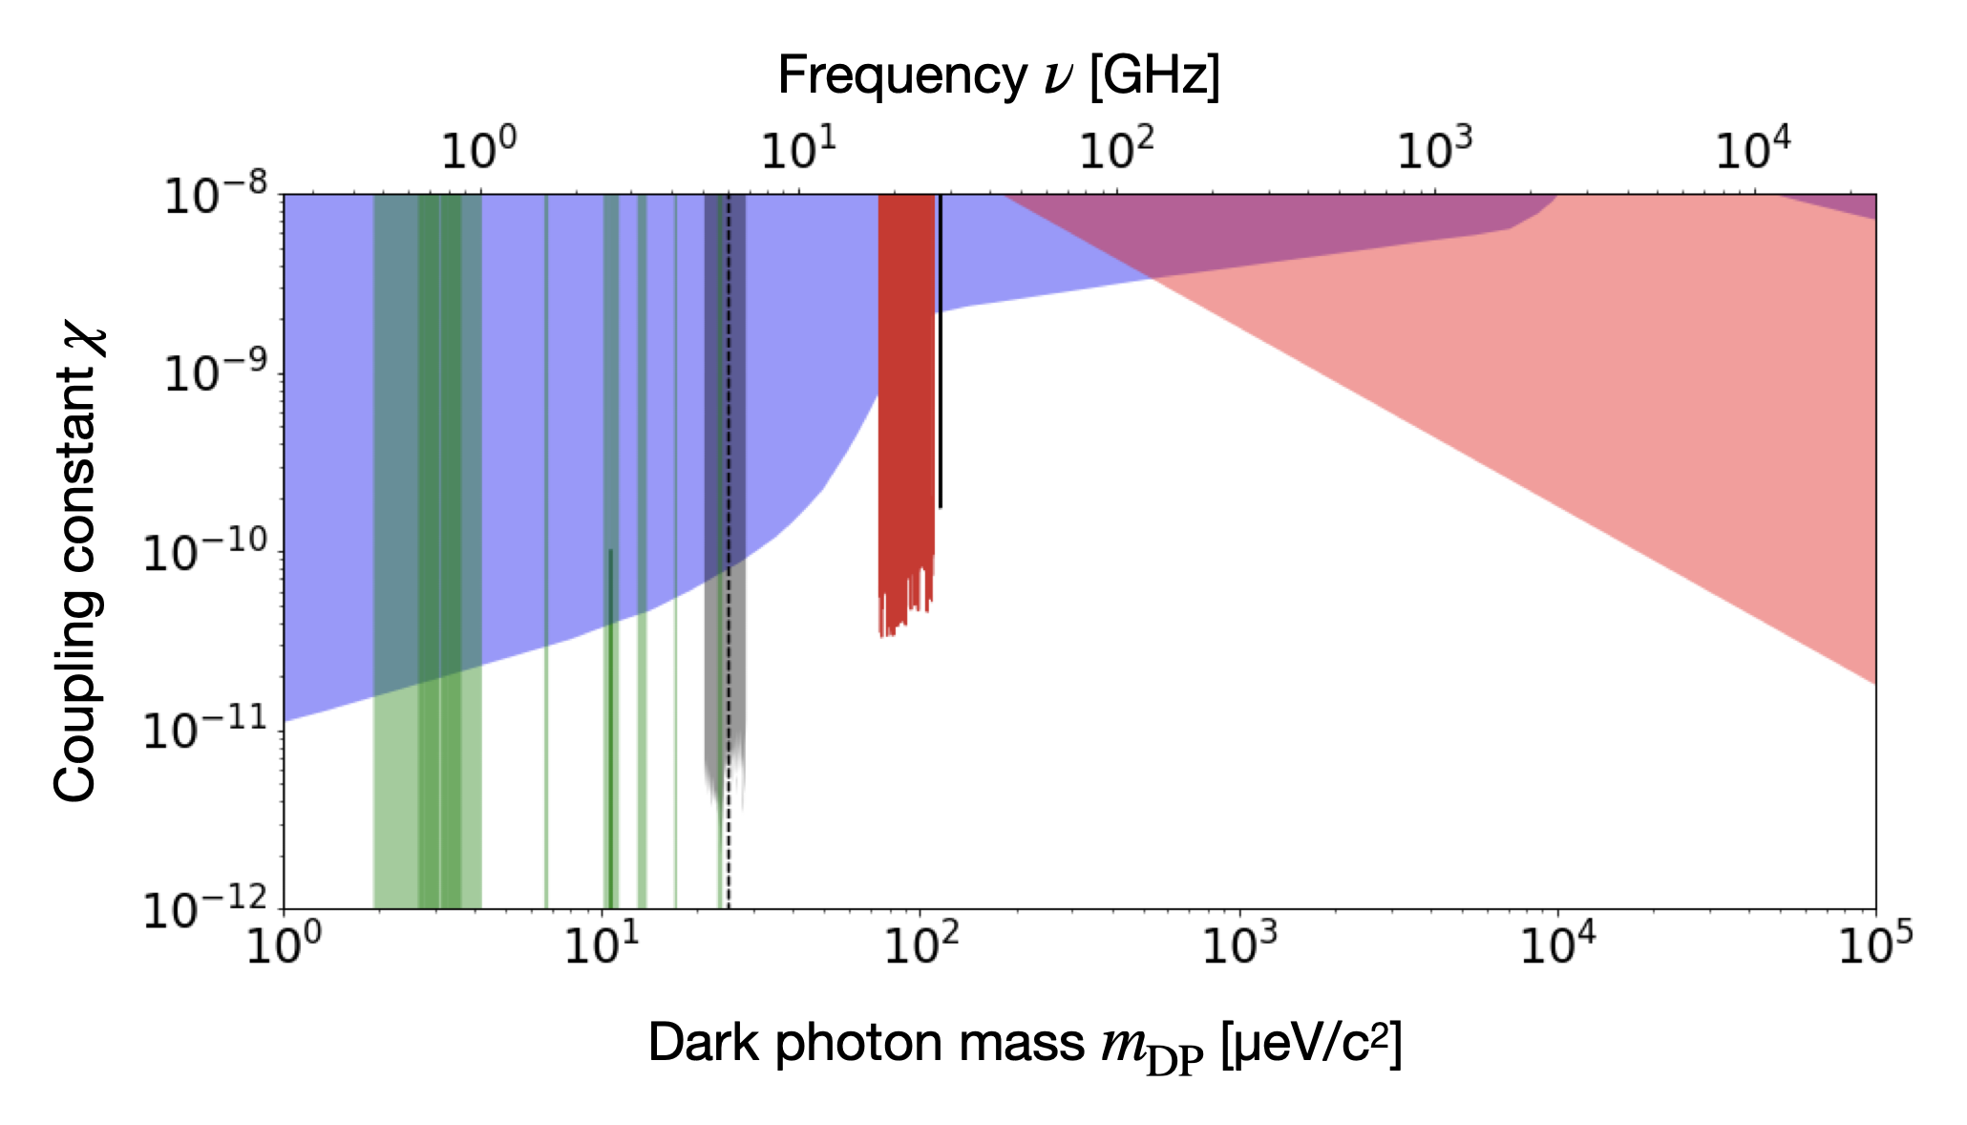
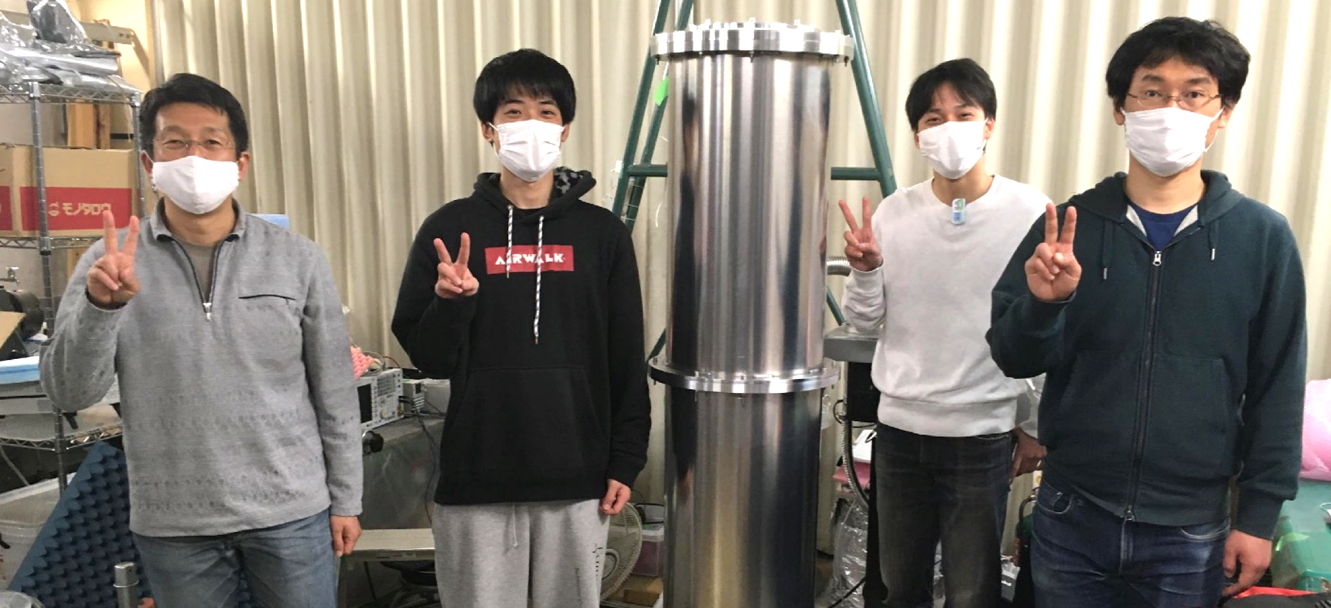
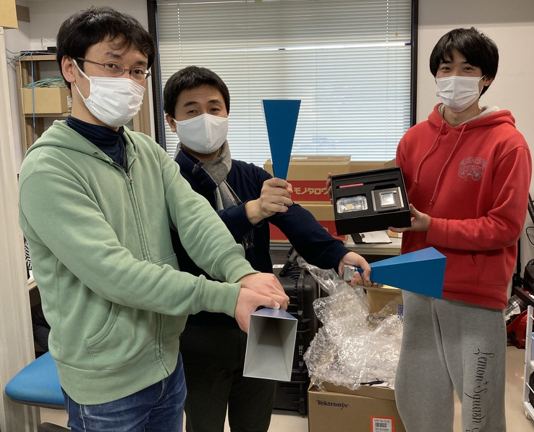
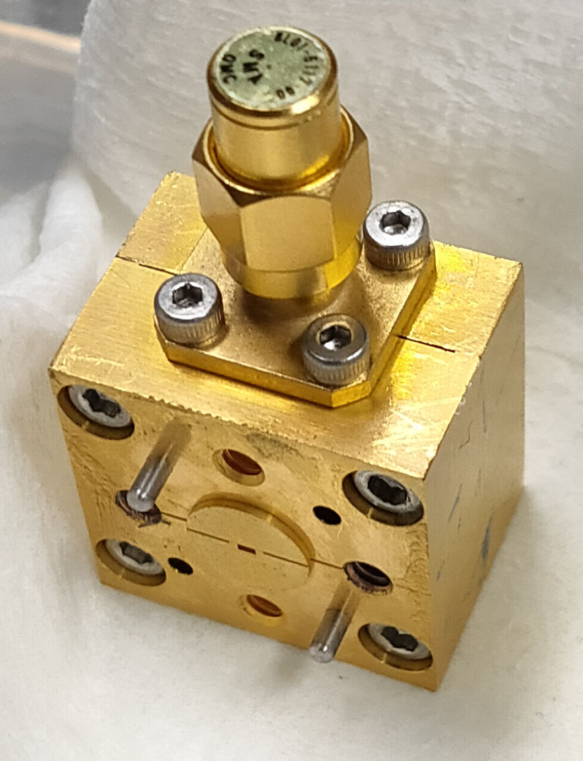
Stay Tuned!
This results
(K-band)
DOSUE-RR is
series of experiments
Systems for 8 – 18 GHz (J-band) & 170 – 260 GHz (Y-band) are in prep.

Slide 22
Extra Slides

Slide 23
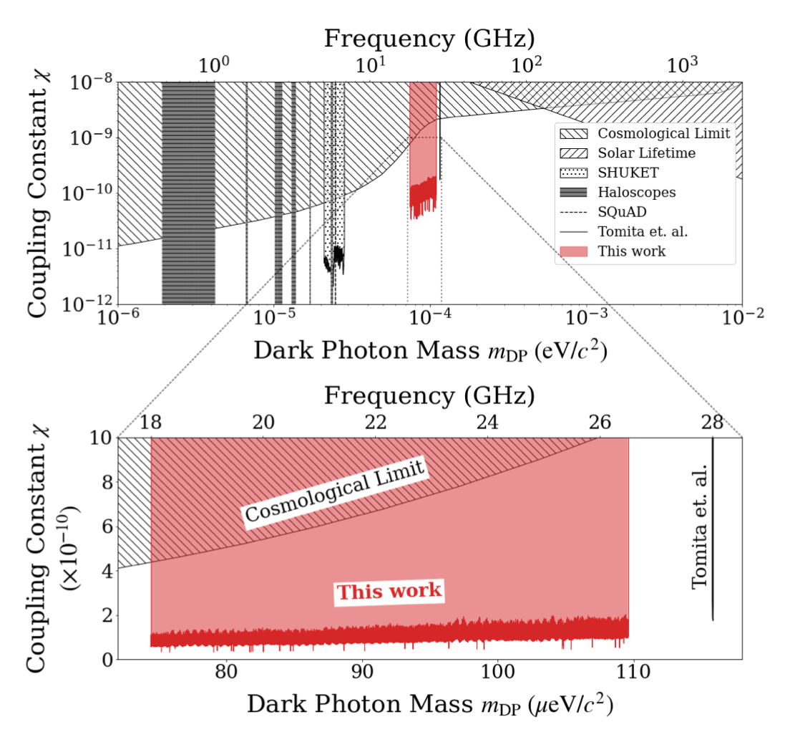

Slide 24
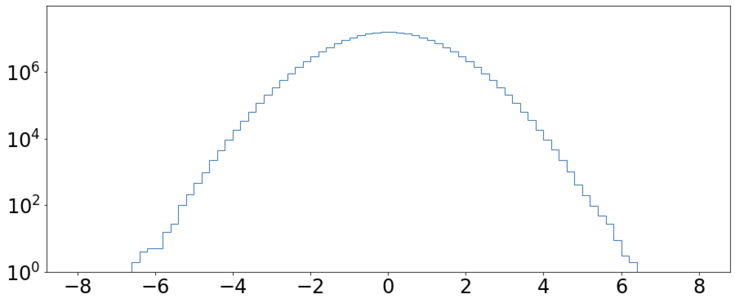

“Null Samples”
Signal + Noise
Signal + Noise’
Noise only
Data set A
Data set B
Null sample (A-B)
We have 12 data samples
462 combinations for making null samples
Checking potential systematics
Optimizing analysis
Calculation of statistical significance
Entries
$$P_{DP}/ΔP_{DP}$$

Slide 25
Freq. bin-width for analysis
Raw data (interval 76.3 Hz) has correlations among neighbor bins because of the window function (RBW 300 Hz) is not perfect top-hat shape. This makes a bias for error estimation in the fits for signal extraction
Taking wider bin (i.e., re-binning) mitigates the effect of the correlation in the raw data
Optimized bin-width using ”null samples”
Correlations
Data samples for signal extraction
Re-binning
RBW 300 Hz

Slide 26

Statistical analysis
The $p_{local}$ is obtained using the fit results for null samples
Given by the fraction above each fit result ($P_{DP}/ΔP_{DP}$)
Entries
$$P_{DP}/ΔP_{DP}$$

Slide 27

Statistical analysis
Consistency between the explored samples and null samples

Slide 28

“dSpec”, DAQ speed x1000
RFSoC based spectrometer is underdevelopment
Wideband width ~2 GHz
⬄ DAQ speed x1000 comparing to the commercial signal analyzer

Slide 29
What’s DP-CDM?
Dark-photon
Cold Dark Matter
D. Horns et al. , JCAP 1304, 016 (2013)
EM-fields of DP-CDM appear via Kinetic mixing
$$E_{DP}={χ m}_{DP} X_{DP}$$
DP-CDM
Metal plate
(Boundary of EM field)
Boundary condition
at the surface, $E_{∥}=0$
Almost perpendicularly emitted from the boundary
“Conversion photon”

