Slide 1
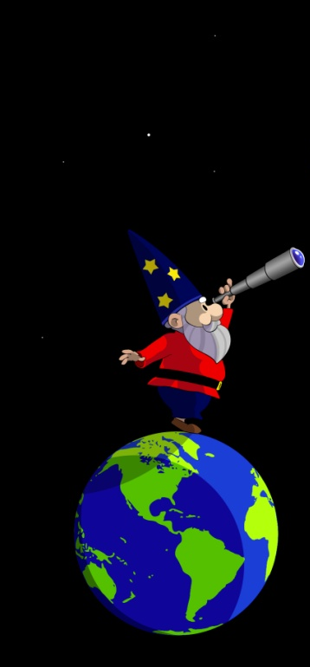
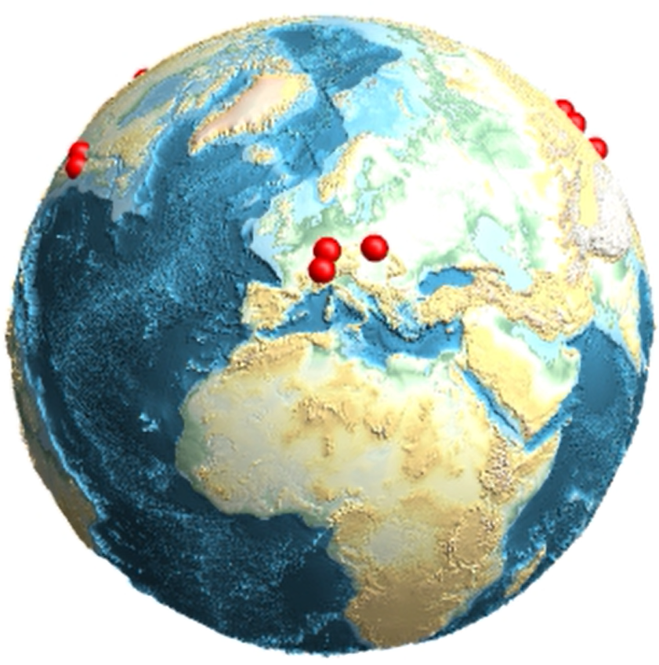

Intensity Interferometry for Ultralight Bosonic Dark Matter Detection
H. Masia Roig, N. Figueroa Leigh, A. Bordon, J. A. Smiga, Y. V. Stadnik, D. Budker, G. P. Centers, A. V. Gramolin, P. S. Hamilton, S. Khamis, C. A. Palm, S. Pustelny, A. Sushkov, A. Wickenbrock, D. J. Kimball
#54

Slide 2
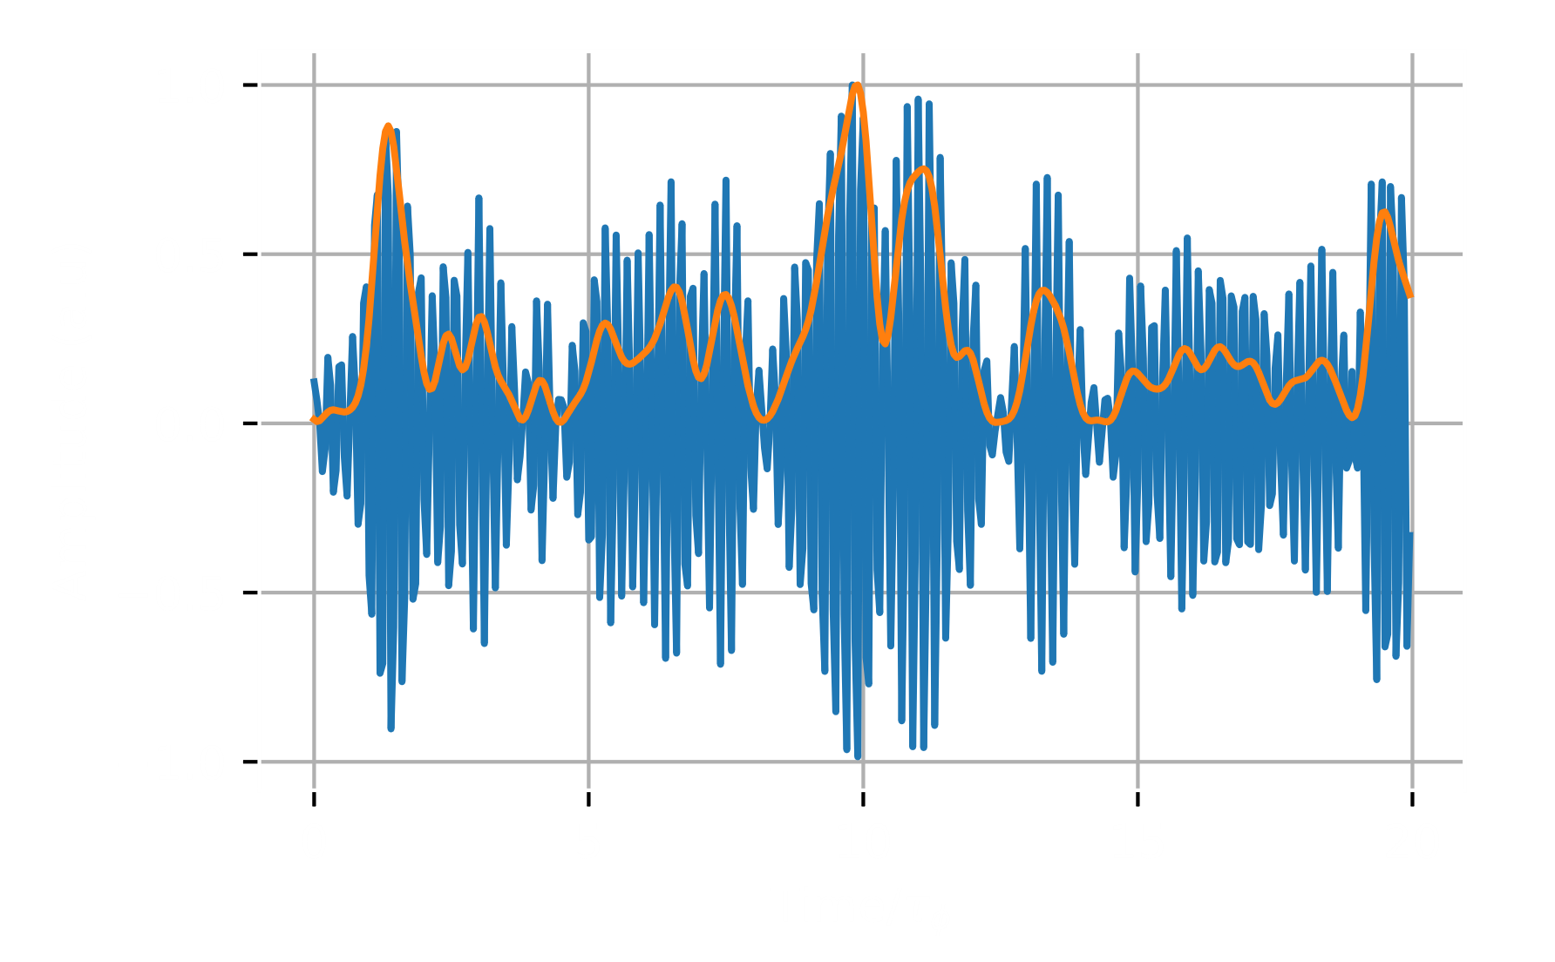
Ultra-Light Bosonic Dark Matter Field
Quadratic coupling
Near-zero frequency component
Interference
#54

Slide 3
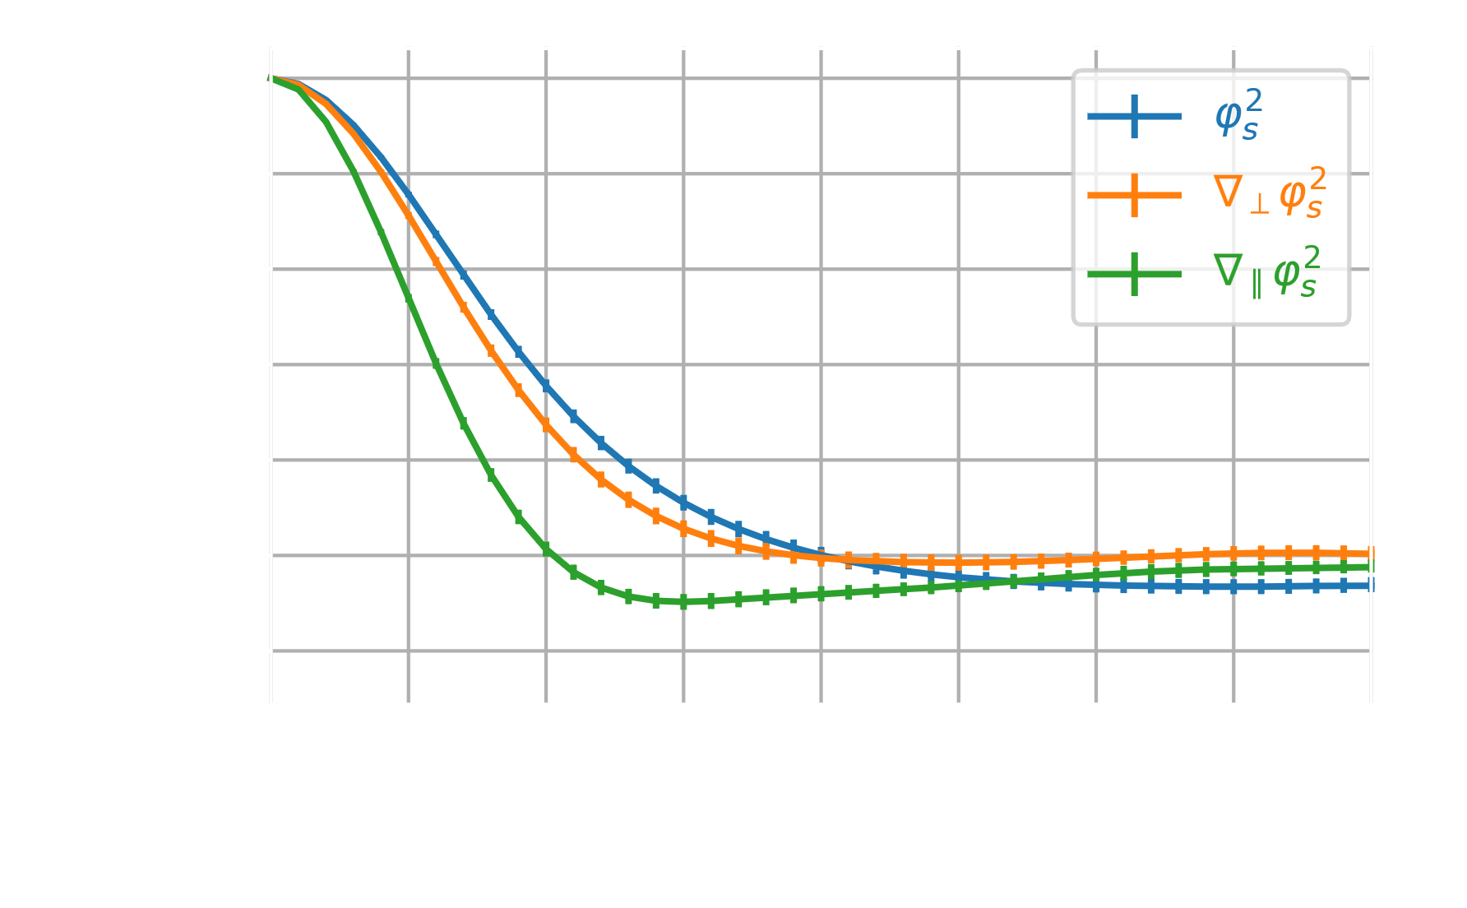
Global Network of Quantum Sensor
Signature stochastic dark matter background
Correlate sensors
Explore beyond cosmological constraints
#54

