Slide 1
New prospects for the axion dark-matter search brought by the advanced GNOME sensor M. Padniuk, E. Klinger, G. Łukasiewicz, E. Kukowka, Derek J. Kimball, A. Wickenbrock, D. Budker and S. Pustelny
(Global Network of Optical Magnetometers for Exotic physics search)
A universal tool for the search of
the transient exotic spin couplings

Slide 2
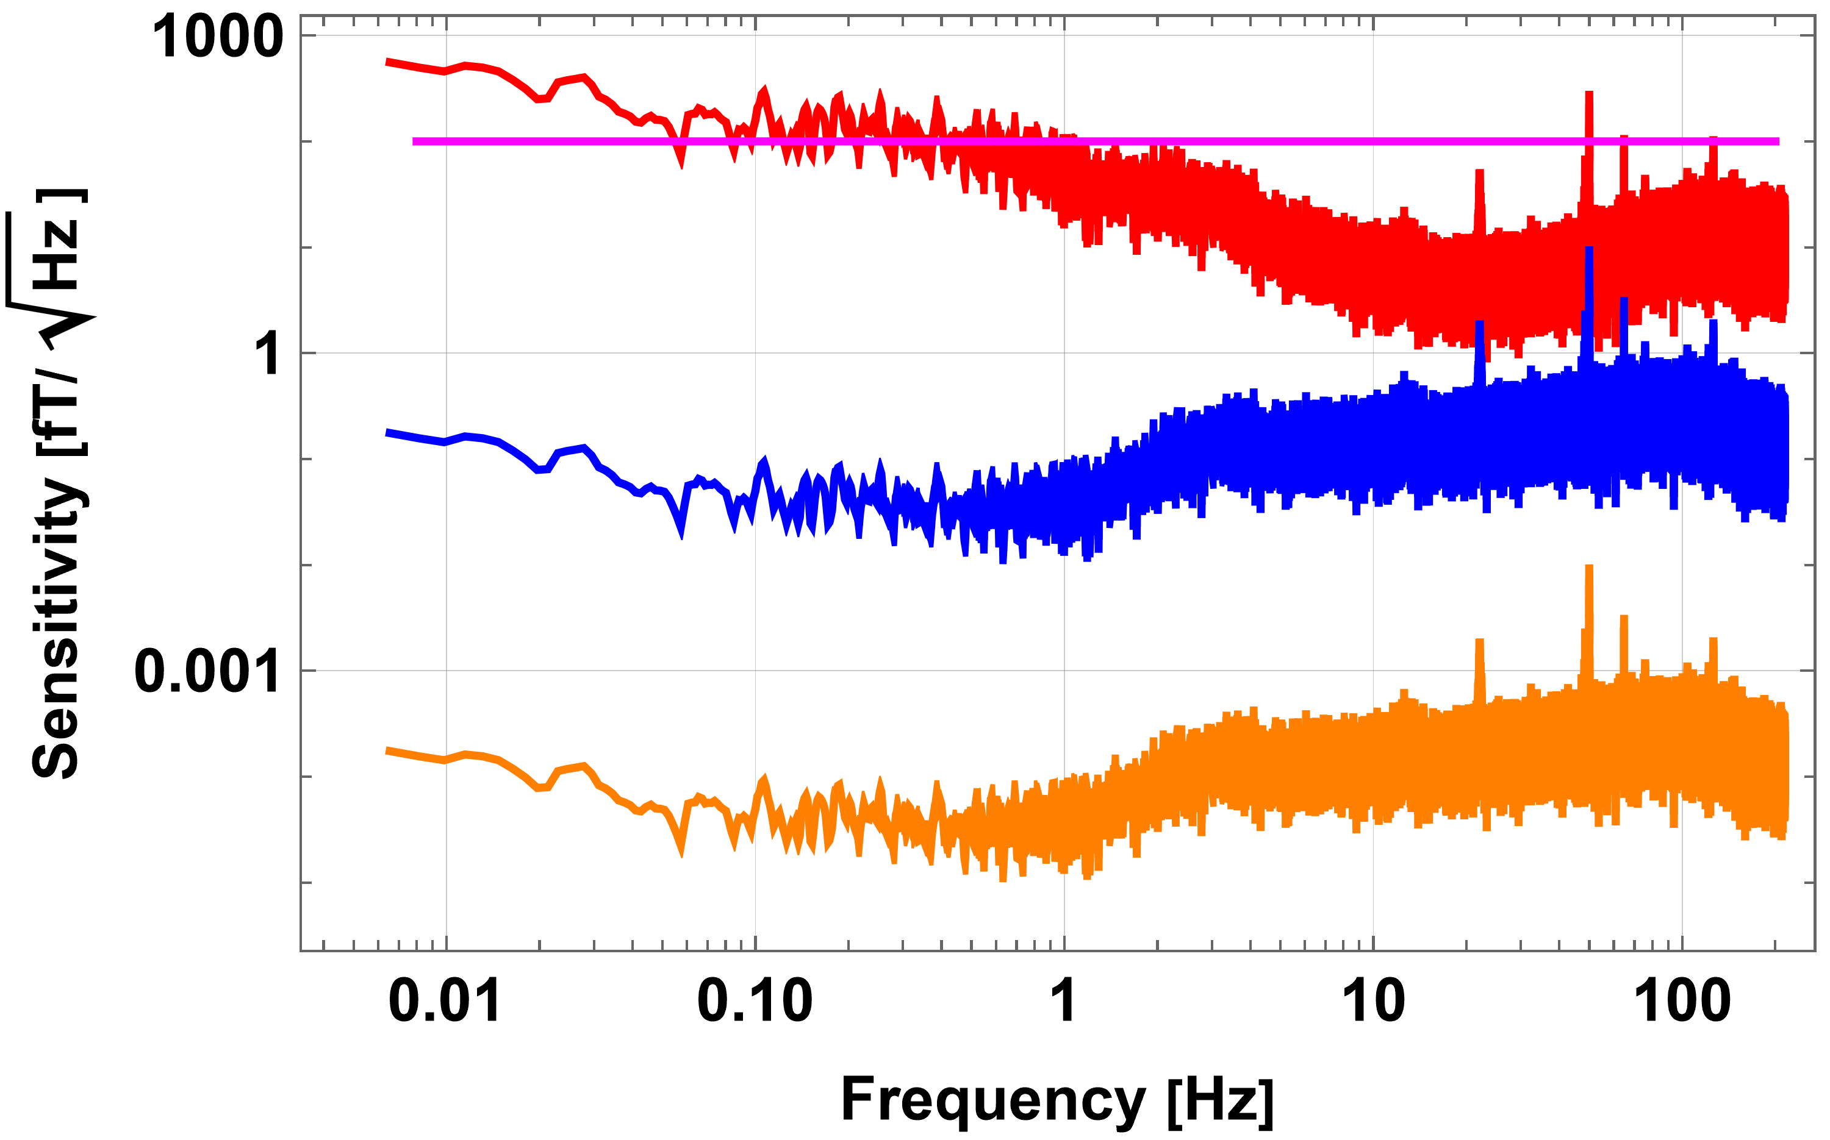
Mainz advanced GNOME station
A typical GNOME station
Magnetic
Proton
Neutron
POSTER #39

