Slide 1
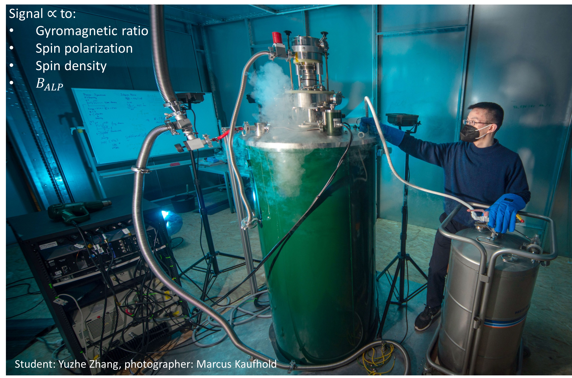
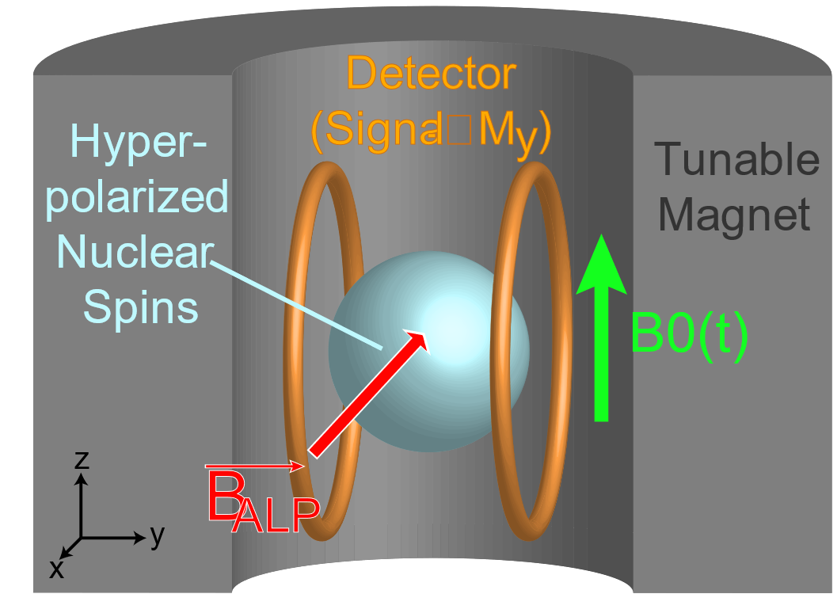
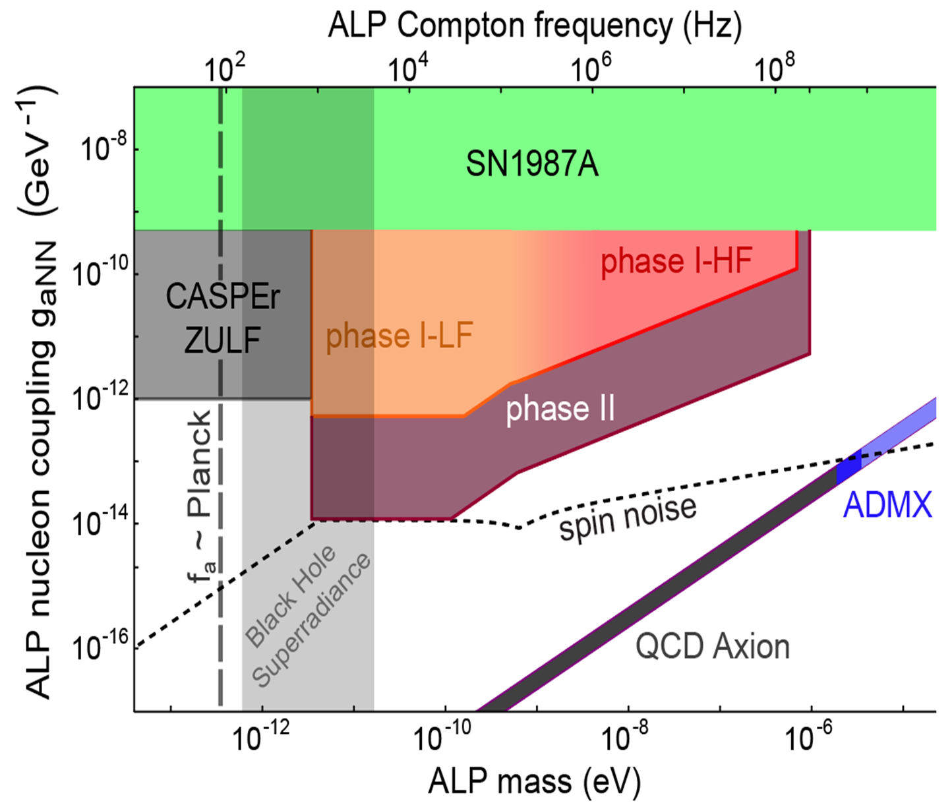
Interface Between the Xenon-129 polarizer and NMR Spectrometer in the CASPEr Dark Matter Experiment
Poster #24 – Ophir Ruimi (HUJI & JGU)
ophir.ruimi@mail.huji.ac.il
How to detect axions?
Hyperpolarization by SEOP
Xe transport and sample preparation
Achieved and projected results

